Slide 1
Seamless Combination of Object-Based Probabilistic Nowcasting and NWP Ensemble of Convective Cells from KONRAD3D
Lukas Josipović, Nora Strotjohann, Gregor Pante, Ulrich Blahak
PrePEP-Conference
March 19th, 2025

Slide 2
Motivation
Verification score for convective cells
1
…improved
Nowcasting
…combined products (seamless)
NWP
…improved
0
Lead time
t₀

Slide 3

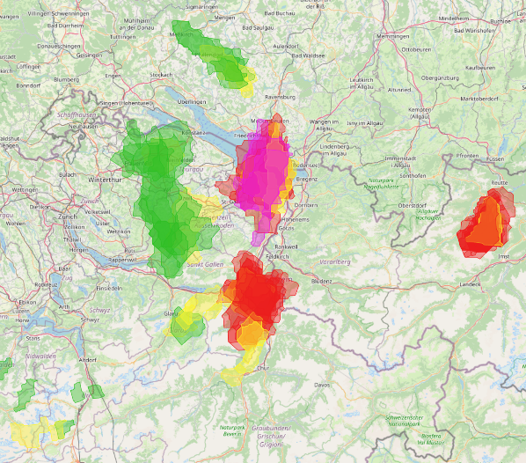
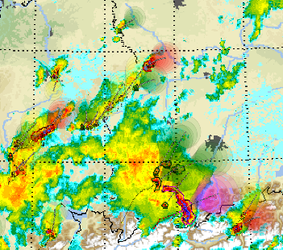
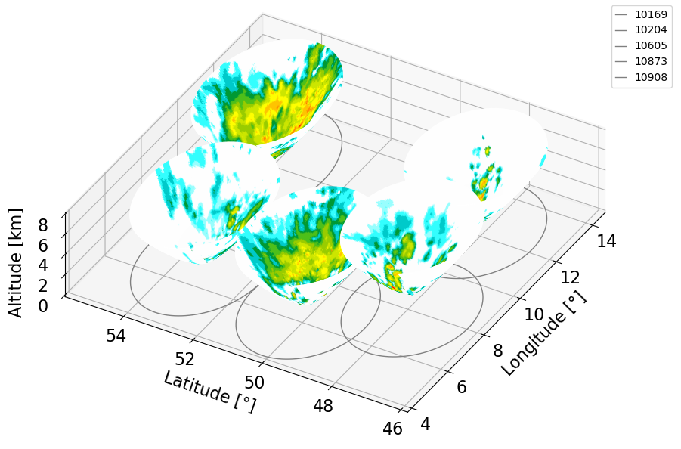
Available -Cells
  detection, tracking and forecasting of convective cells at DWD
Radar cells
  available every 5 min
Nowcasting cells
  KONRAD3D-EPS based on radar cells
  available every 5 min
  20 members
NWP cells
  ICON-D2-RUC + EMVORADO
  2-moment microphysics scheme
  available every hour with a 5-min forecast step
  forecast time of 14 h
  21 members
NWP cells
radar cells
EMVORADO
Notes:
SINFONY-RUC comprises the ICON-D2-EPS employing the two-moment microphysics scheme
EMVORADO = Efficient Modular VOlume scanning RADar Operator
3

Slide 4
KONRAD3D-SINFONY Overview
input data
algorithms
products
NWP cells
KONRAD3D-RUC
radar cells
KONRAD3D
NWC cells
KONRAD3D-EPS
1 init
21 members
20 members
seamless object combination
clustering
dbscan
selection
total interest
relocation
combination
object-based
clustering for all detections in a range of ±30 min around reference time
calculate TI for each cell of a cluster in reference to the assigned radar cell
correction of every NWP cell and their forecast by the according relocation vector
of relocated NWP cells and NWC cells
pixel-based

Slide 5
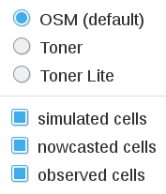
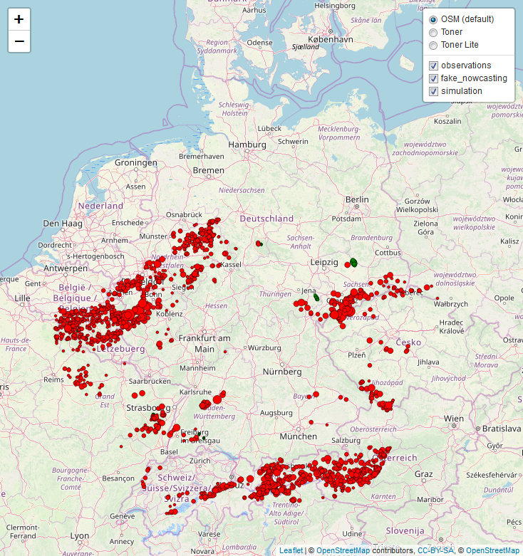
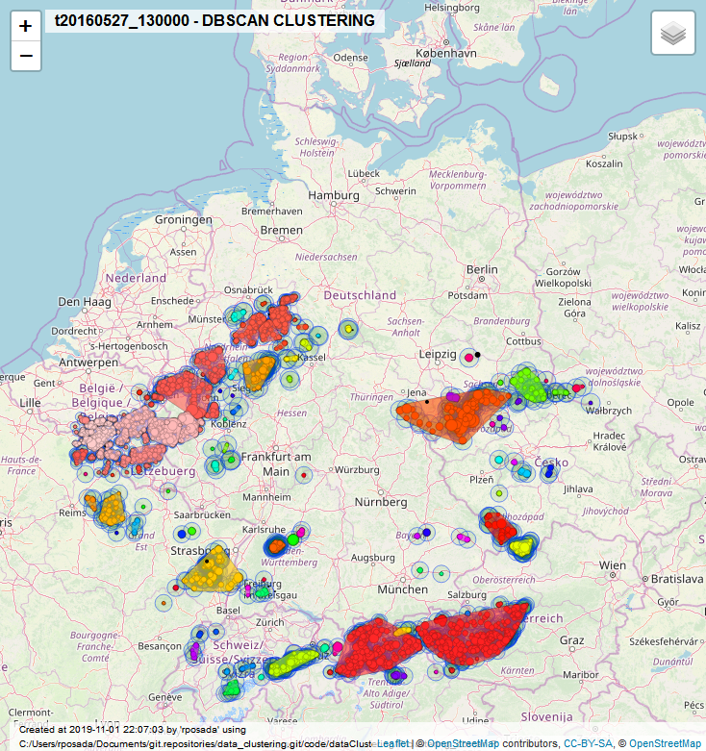
Clustering of NWP Cells
spatial clustering of cell centroids using dbscan
  neighborhood_distance = 30 km
any number of clusters are possible
  here 141
discard short-living and single cells
< 30 km
cluster #1

Slide 6
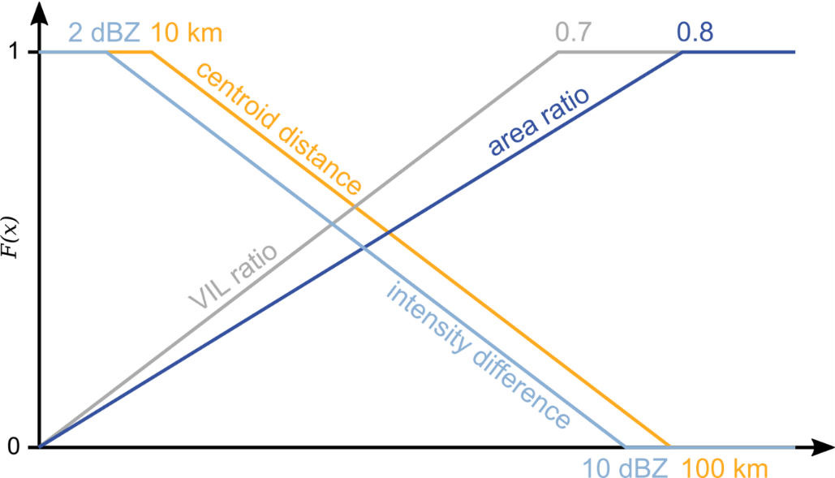


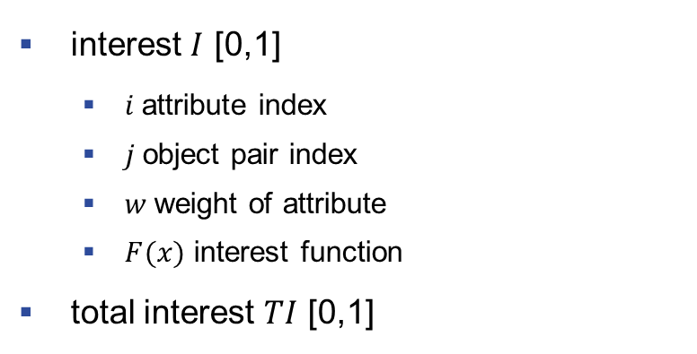
Selection and Relocation of Best NWP Cells
KONRAD3D cell properties
  centroid distance
  area
  VIL
  max. reflectivity (intensity)
only cells with a TI > 0.85 are selected
interest function
NWP cell
interest $I$ [0,1]
  $i$attribute index
  $j$object pair index
  $w$weight of attribute
  $F(x)$ interest function
total interest $TI$ [0,1]
$$I_{i,j}=w_{i}{ F}_{i,j}$$
$$TI_{j}= \frac{\sum_{i=1}^{M}{I_{i,j}}}{\sum_{i=1}^{M}{w_{i}}}$$
radar cell

Slide 7
Selection and Relocation of Best NWP Cells
KONRAD3D cell properties
  centroid distance
  area
  VIL
  max. reflectivity (intensity)
only cells with a TI > 0.85 are selected
radar cell
NWP cell
NWP cells
radar cell

Slide 8
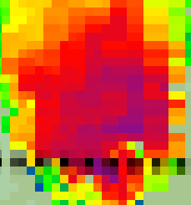
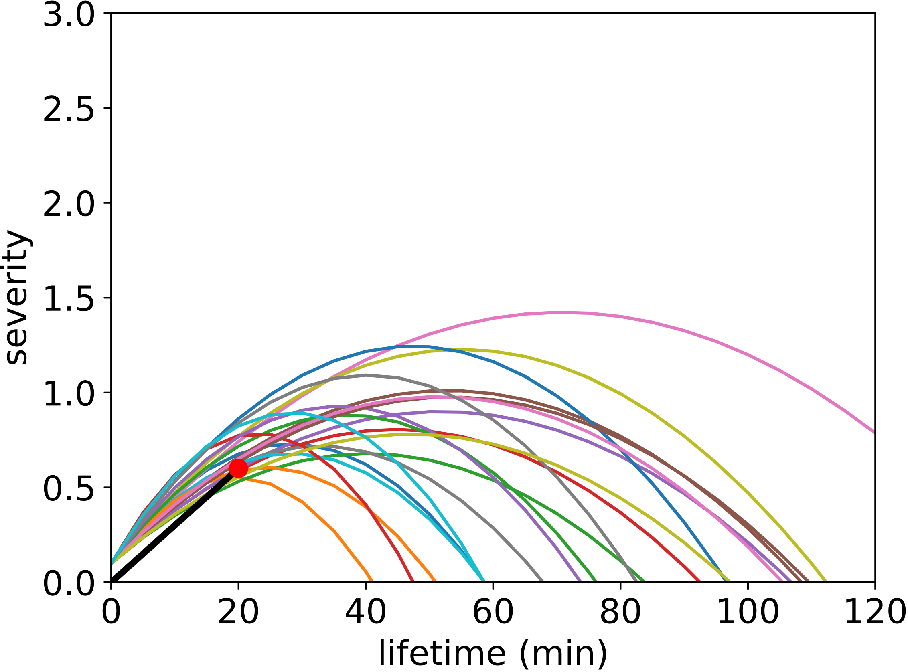
KONRAD3D-EPS overview
Objective
Ensemble prediction of cell life cycles with regard to nowcast uncertainties in position, motion, intensity, and lifetime
Ensemble Initialization
Cell position, motion, severity: KONRAD3D detected cells as mean + statistically tuned observation errors
Lifetime, maximum expected severity: drawing from theoretical PDFs that were fitted to the corresponding observed distributions
20 members per cell
Prediction
Constant cell speed and parabolic life cycle
Correction of the Nowcast of Redetected cells
Cell positions and speed: Ensemble-Kalman-Filter
(Maximum expected) severity and lifetime:
  fitting of cell parabolas to observed severity trend of last 15 min
maximum severity
Stochastic ensemble of cell positions of a detected K3D cell.
Empirical and theoretical PDF of maximum expected severity.
Cell lifetimes (min)
Mean temporal development of K3D cell severity from 04. to 09.2019.
Example of fitting parabolas to observed severity trend (black solid line.)

Slide 9
KONRAD3D: Cell Severity
Function of 5 reflectivity-based cell attributes
Piecewise linear function per predictand
Weighted averaging
Consolidation with warning flags for hail, heavy rain, gusts
Cell category as round(severity)
Piecewise linear function of VIL.
Severity | Meaning
0 | weak
1 | moderate
2 | severe
3 | extreme

Slide 10
Combination
Fusion of KONRAD3D-EPS cells and selected NWP cells at time of observation
Nowcasting cells die when their parabolic lifecycle is at the end
Convective initiation is predicted using future NWP cells (also clustered using dbscan)
  Seamless object-based forecast up to 12 h
radar cell
nowcasting cells
NWP cells
t = 0

Slide 11
Combination
Fusion of KONRAD3D-EPS cells and selected NWP cells at time of observation
Nowcasting cells die when their parabolic lifecycle is at the end
Convective initiation is predicted using future NWP cells (also clustered using dbscan)
  Seamless object-based forecast up to 12 h
nowcasting cells
NWP cells
t = 5

Slide 12
Combination
Fusion of KONRAD3D-EPS cells and selected NWP cells at time of observation
Nowcasting cells die when their parabolic lifecycle is at the end
Convective initiation is predicted using future NWP cells (also clustered using dbscan)
  Seamless object-based forecast up to 12 h
nowcasting cells
NWP cells
t = 10

Slide 13
Combination
Fusion of KONRAD3D-EPS cells and selected NWP cells at time of observation
Nowcasting cells die when their parabolic lifecycle is at the end
Convective initiation is predicted using future NWP cells (also clustered using dbscan)
  Seamless object-based forecast up to 12 h
nowcasting cells
NWP cells
t = 15

Slide 14
Combination
Fusion of KONRAD3D-EPS cells and selected NWP cells at time of observation
Nowcasting cells die when their parabolic lifecycle is at the end
Convective initiation is predicted using future NWP cells (also clustered using dbscan)
  Seamless object-based forecast up to 12 h
nowcasting cells †
NWP cells
t = 20

Slide 15
Combination
Fusion of KONRAD3D-EPS cells and selected NWP cells at time of observation
Nowcasting cells die when their parabolic lifecycle is at the end
Convective initiation is predicted using future NWP cells (also clustered using dbscan)
  Seamless object-based forecast up to 12 h
NWP cells
t = 25

Slide 16
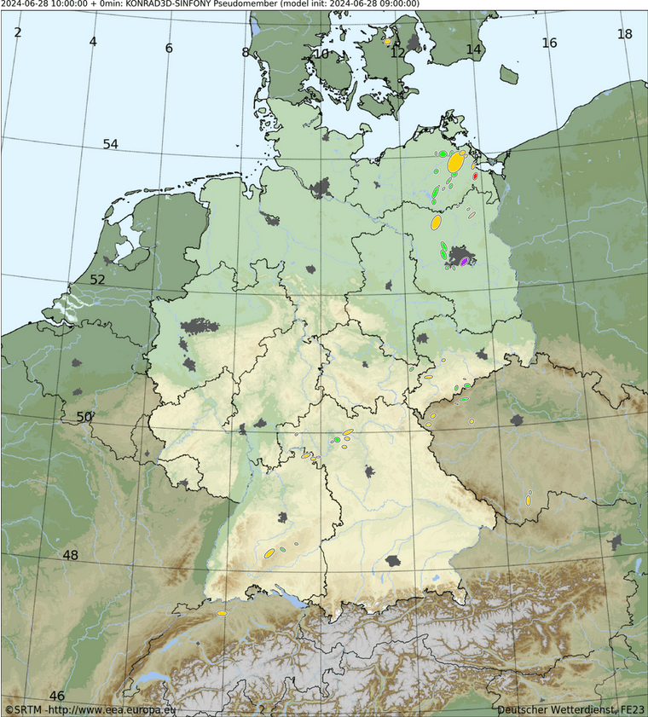
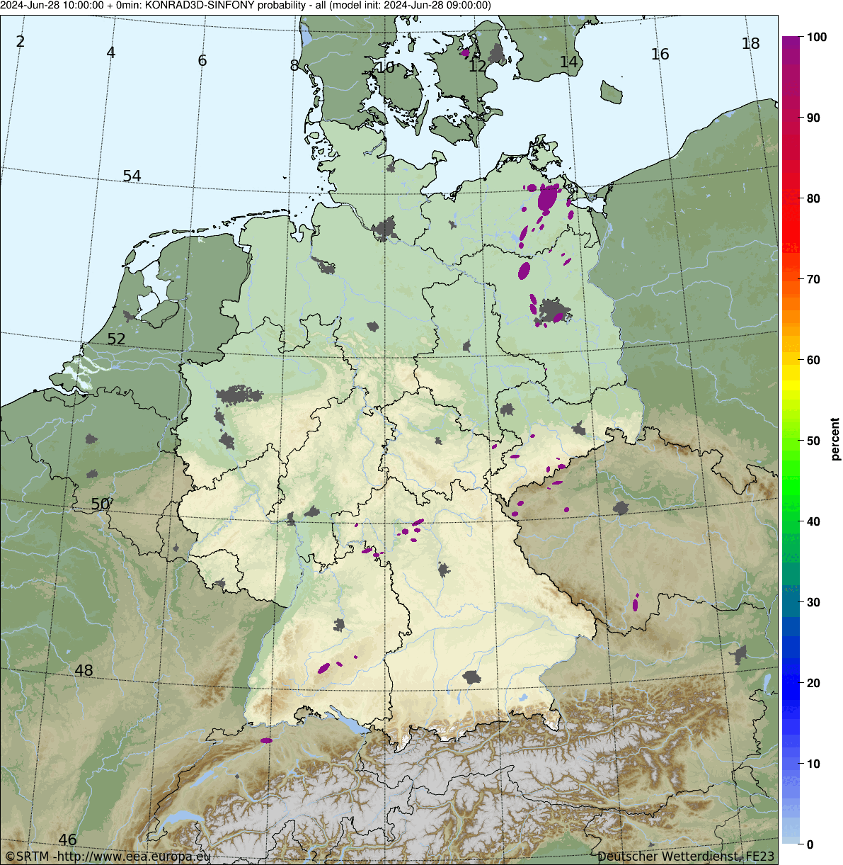
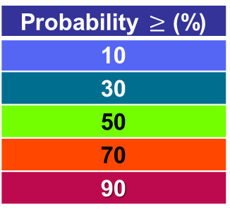
Ensemble Probabilities of Convective Cells
Probabilities derived by counting NO contributing members per pixel.
Here: probabilities for cells of all severities.
We provide exceedance probabilities for each severity category.
Probability $≥$ (%)
10
30
50
70
90
weak
moderate
severe
extreme
Observation
Forecast until +4h
Notes:
Work in progress! If You have ideas, feel free to tell us!

Slide 17

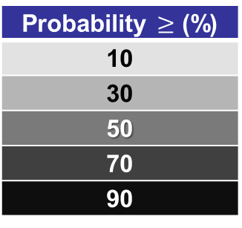
Calibrated Probabilities and Representative Cells
Work is still in progress!
Aim: get smoother visualization
By N. Strotjohann
Probability $≥$ (%)
10
30
50
70
90
weak
moderate
severe
extreme
Observation
Forecast until +4h
Notes:
Work in progress! If You have ideas, feel free to tell us!

Slide 18
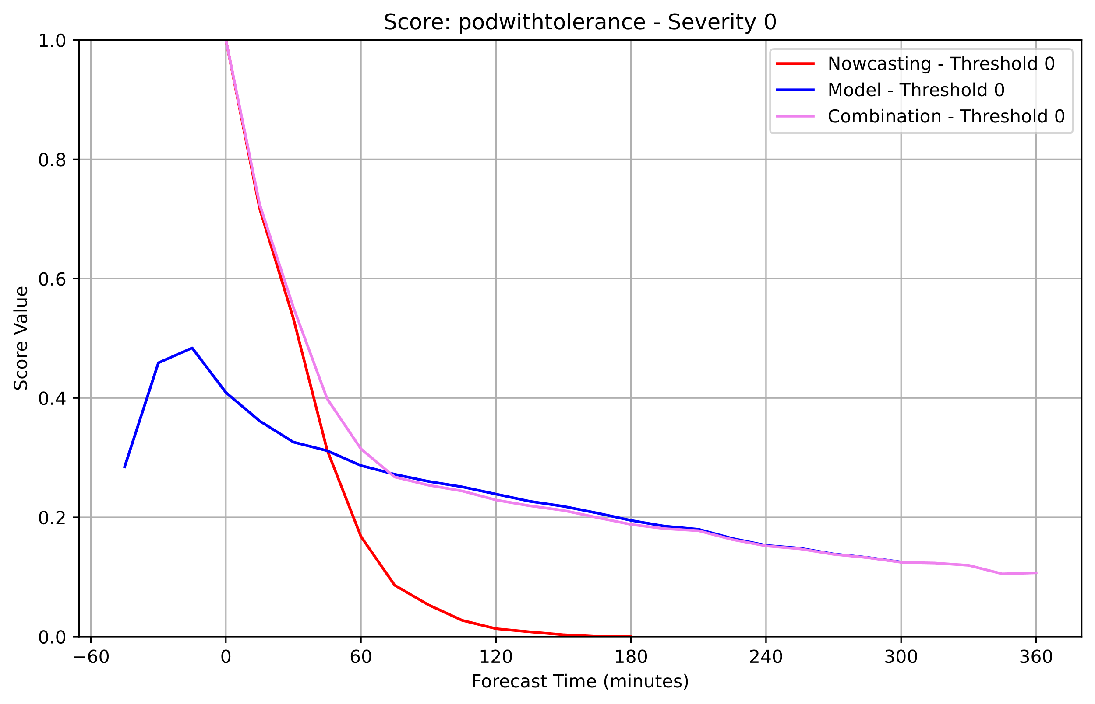
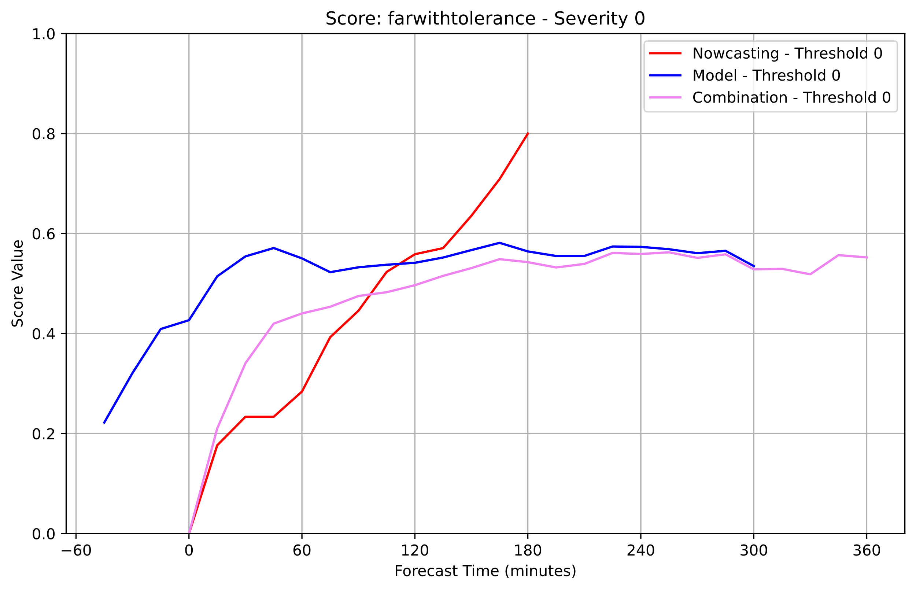
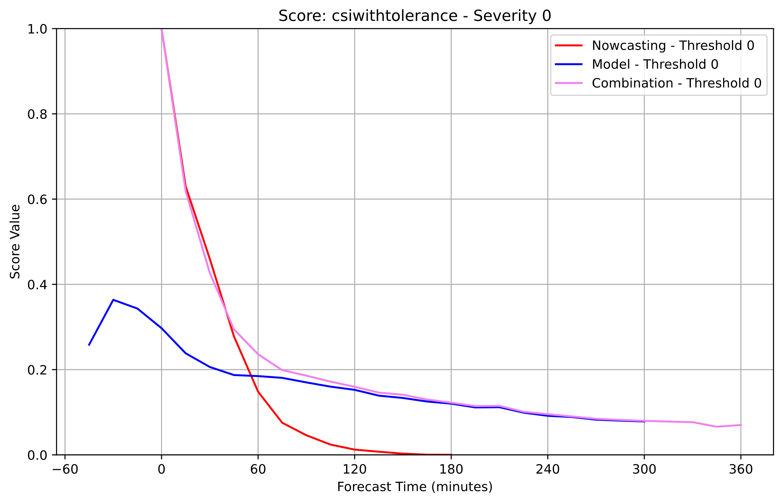
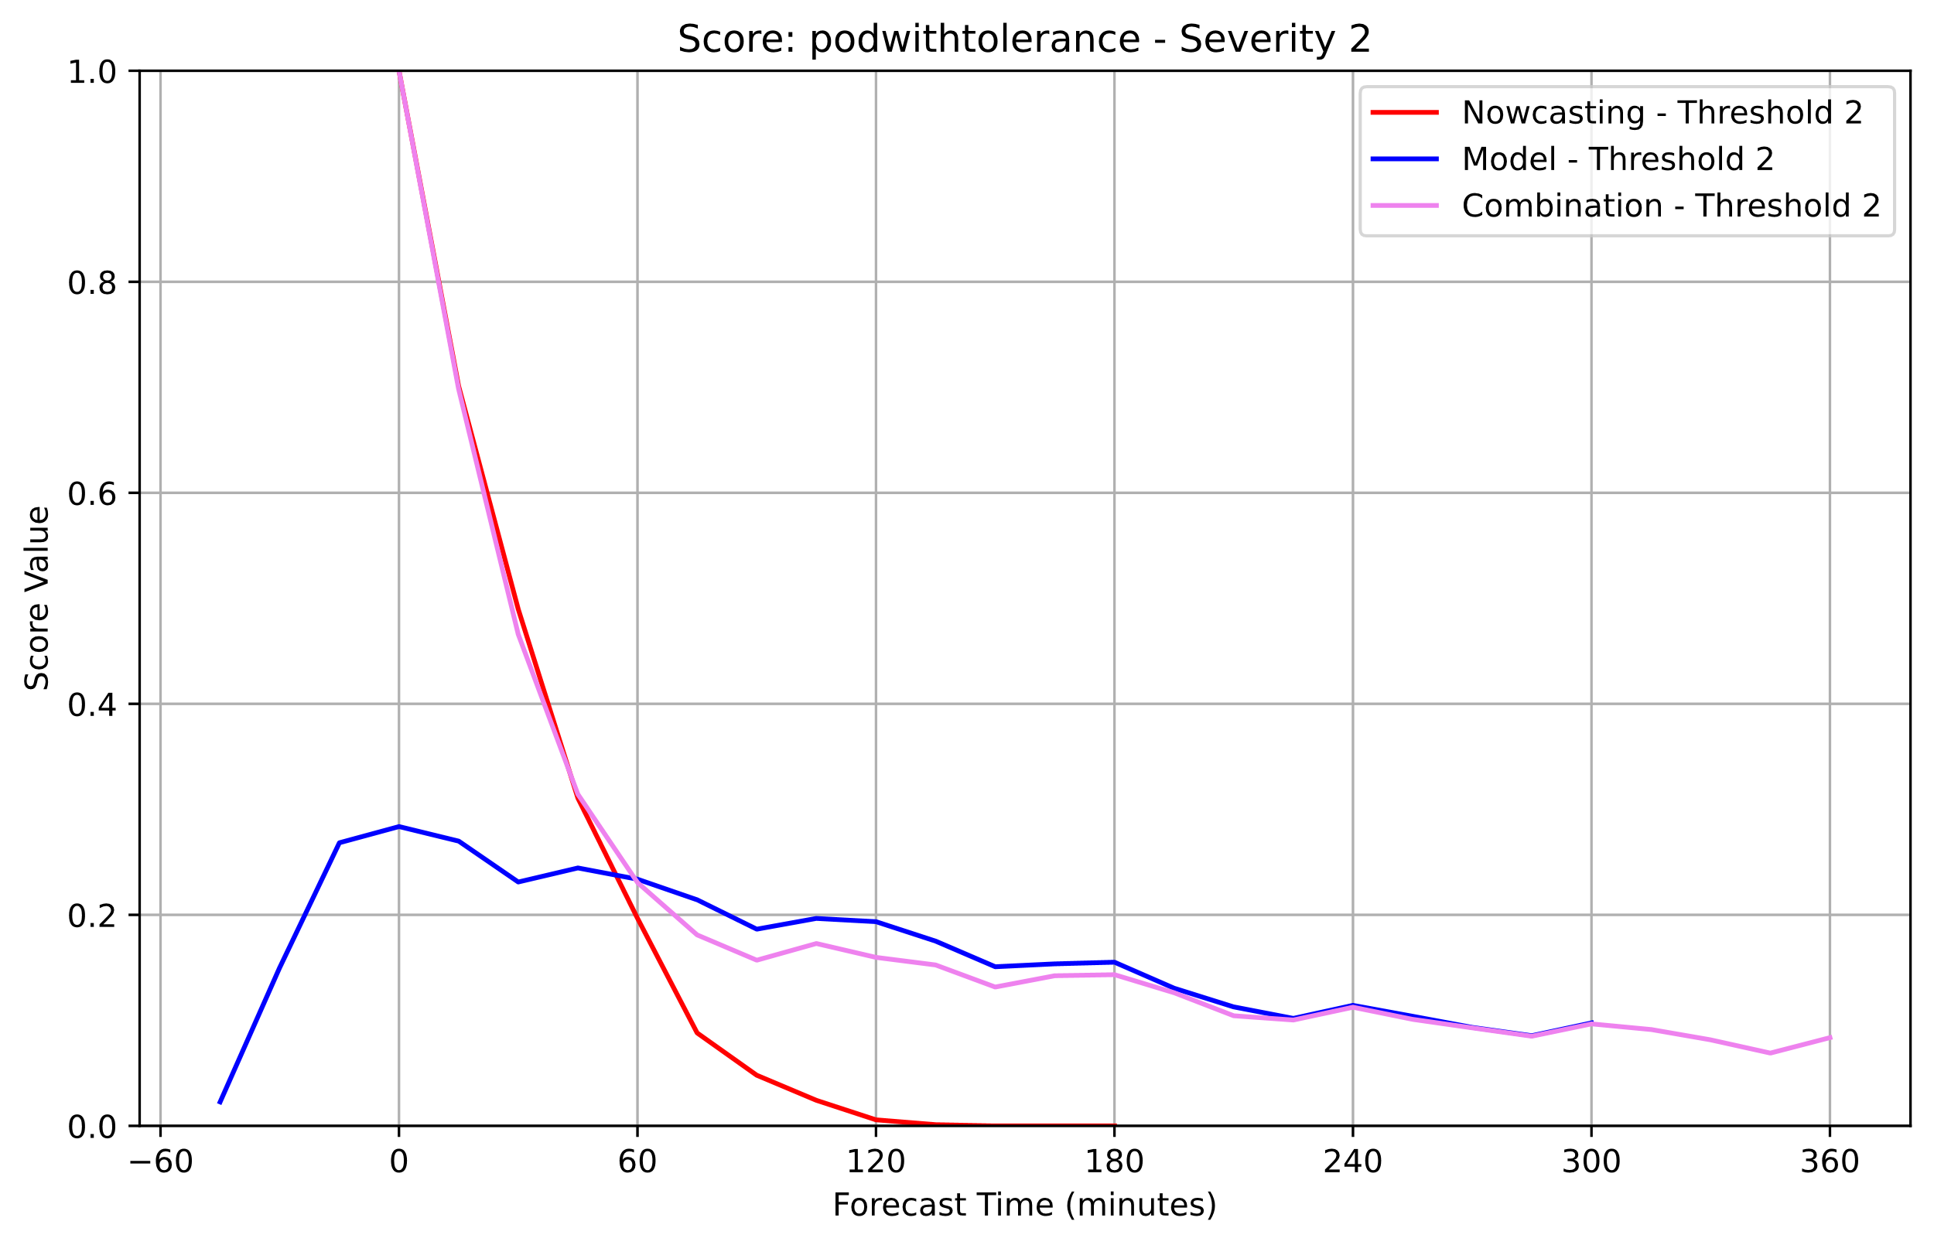
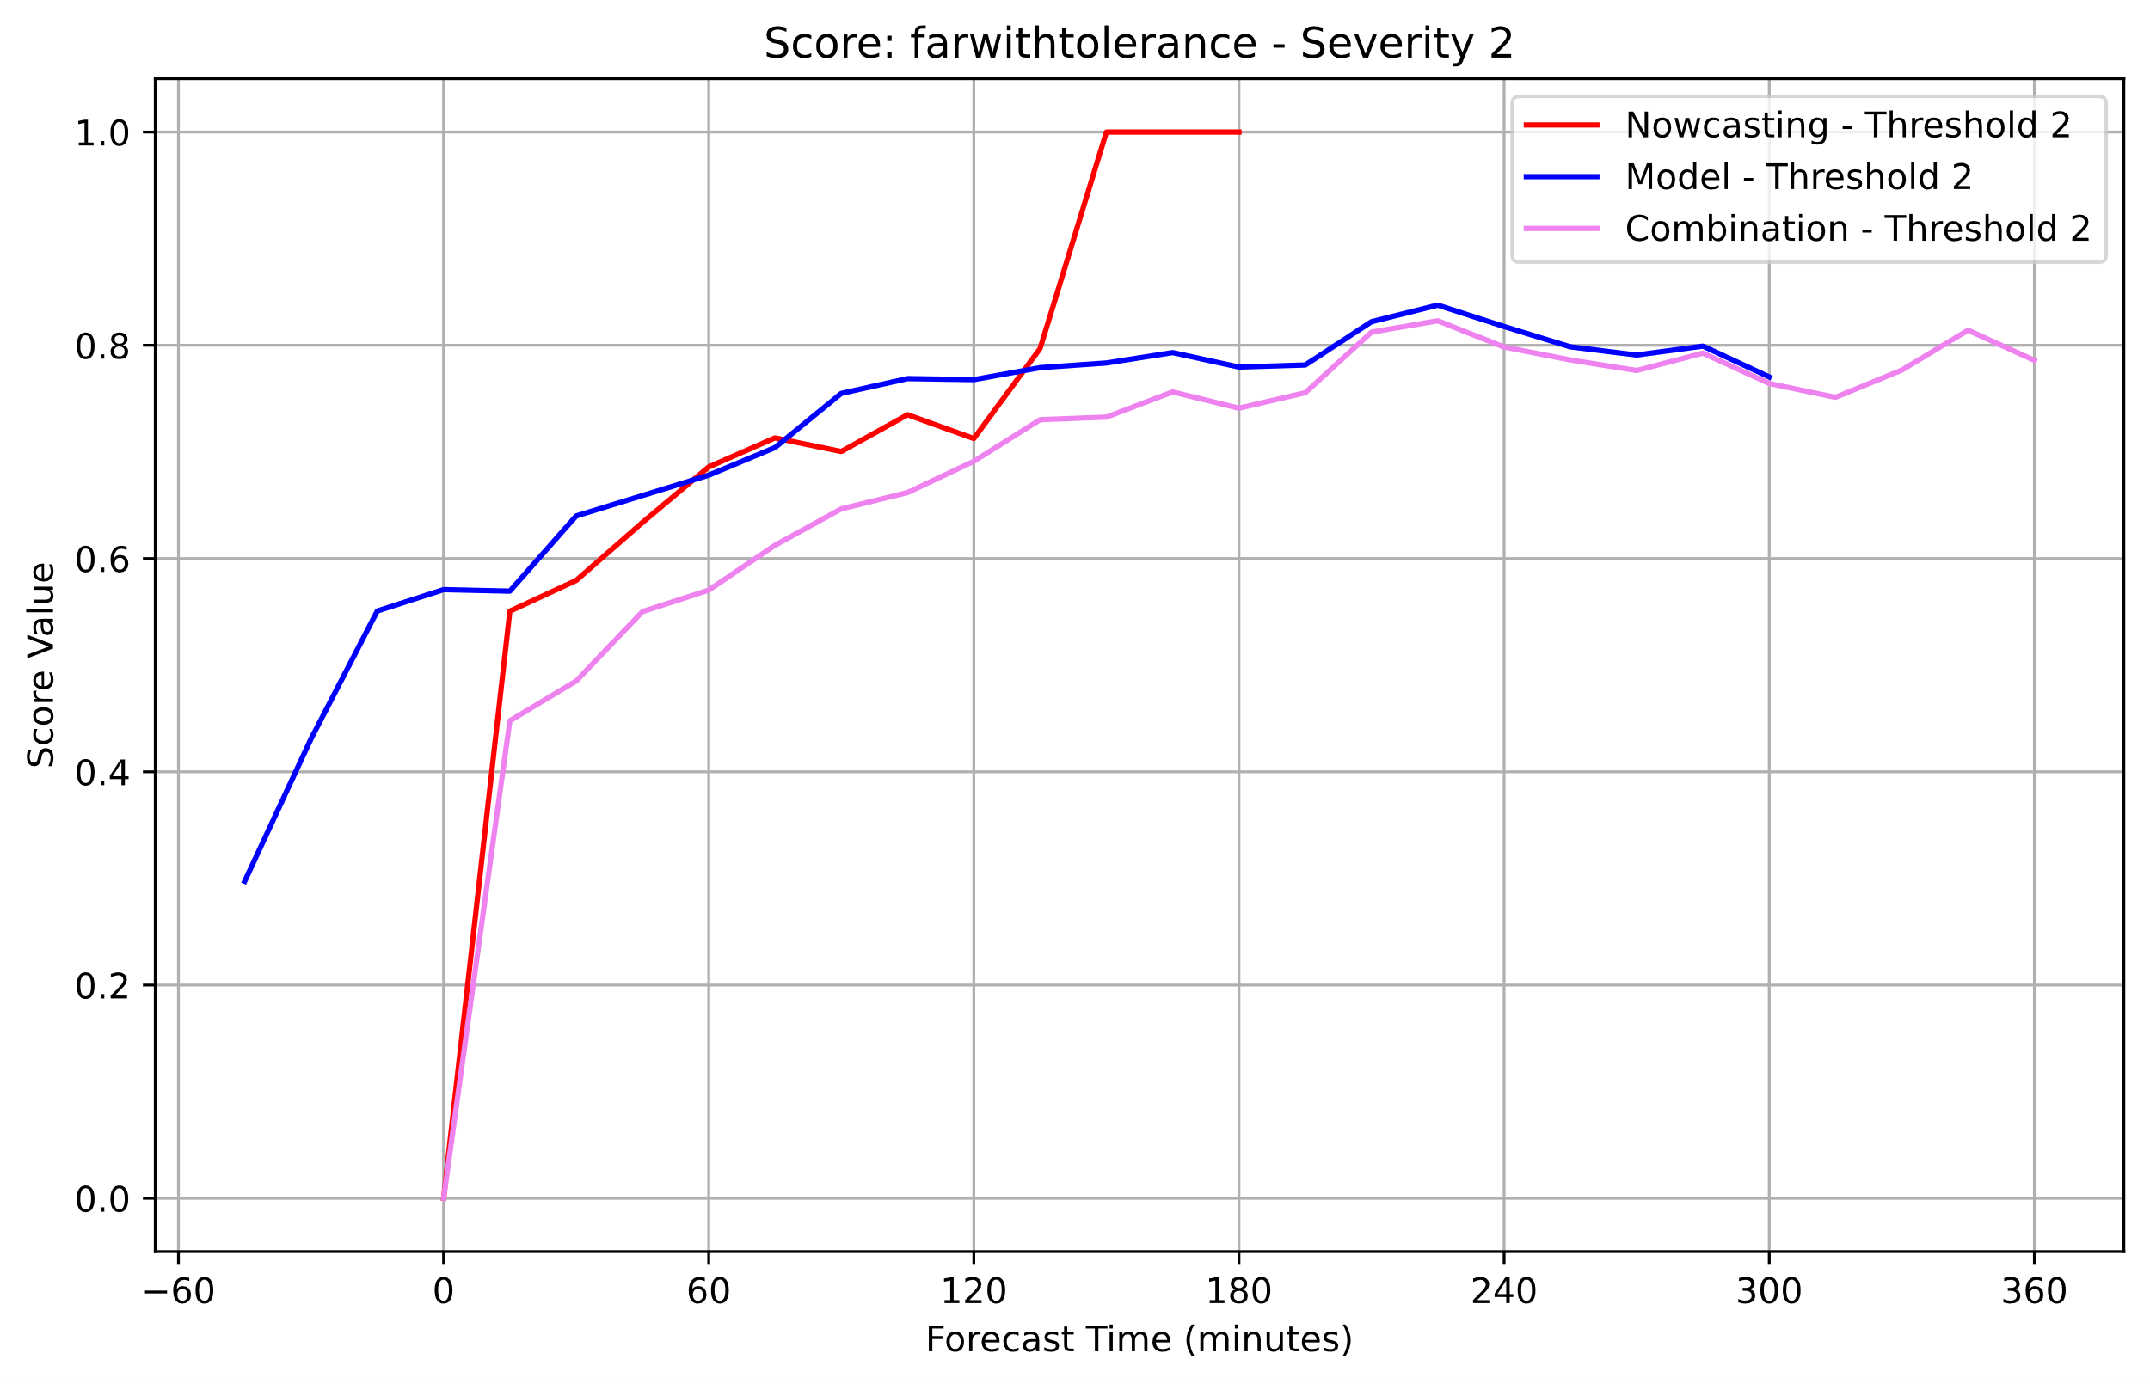
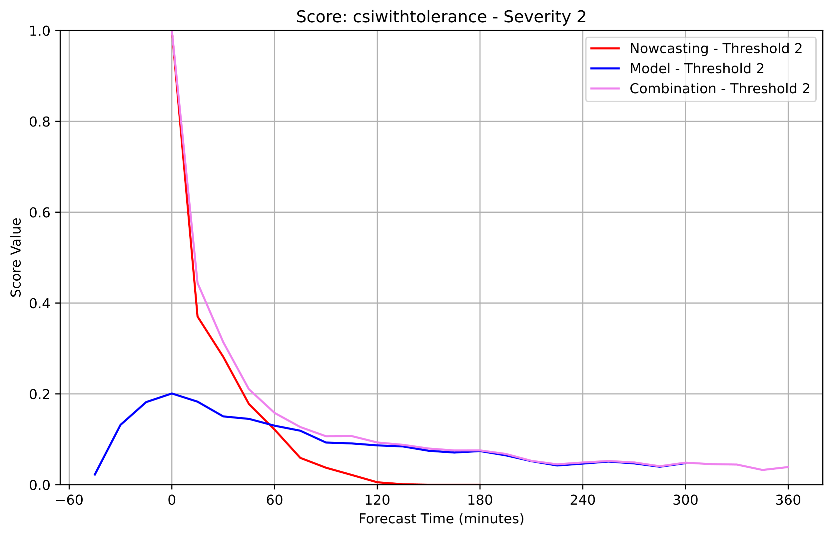
Verification of Period May 26th to June 29th, 2016 with 1-hourly inits
KONRAD3D-EPS nowcasting:
ICON-RUC:
KONRAD3D-SINFONY:
Box size: 31 km, probability threshold for a positive forecast: 25 %. Left: POD, center: FAR, right: CSI. Lead time: 6 h.

Slide 19
Current Status
Real-time operations for tests and evaluation
Derived ensemble products:
  Exceedance probability fields for four different cell severity levels
  Calibrated probabilities with representative cells
Evaluation at ESSL Testbeds 2023 and 2024
Maximum forecast time: currently 10 h, planned 12 h
Update rate: 5 min (1 h for ICON-RUC cells)

Slide 20
Outlook and Future Plans
Further tuning and verification
Improvement of cell detection in simulated reflectivities
Improvement of severity nowcast based on machine learning
Development of probabilistic warning flags for gusts and hail based on machine learning
Evaluation by DWD forecasters and at ESSL Testbed
Deployment into operational service for automatic issuance of thunderstorm warnings

Slide 21
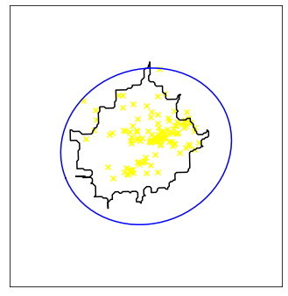
Contact:
Lukas Josipović, M.Sc.
Deutscher Wetterdienst
Frankfurter Straße 135
63067 Offenbach, Germany
E-Mail: Lukas.Josipovic@dwd.de
Tel.: +49 (0) 69 / 8062 - 3178
Supercell south from Offenbach, Germany,
August 18th, 2019.

Slide 22
References
Johnson, A., X. Wang, Y. Wang, A. Reinhart, A. J. Clark, I. L. Jirak, 2020: Neighborhood- and Object-Based Probabilistic Verification of the OU MAP Ensemble Forecasts during 2017 and 2018 Hazardous Weather Testbeds, Weather and Forecasting, 35, 169-191, doi: 10.1175/WAF-D-19-0060.1.

Slide 24
Backup

Slide 25
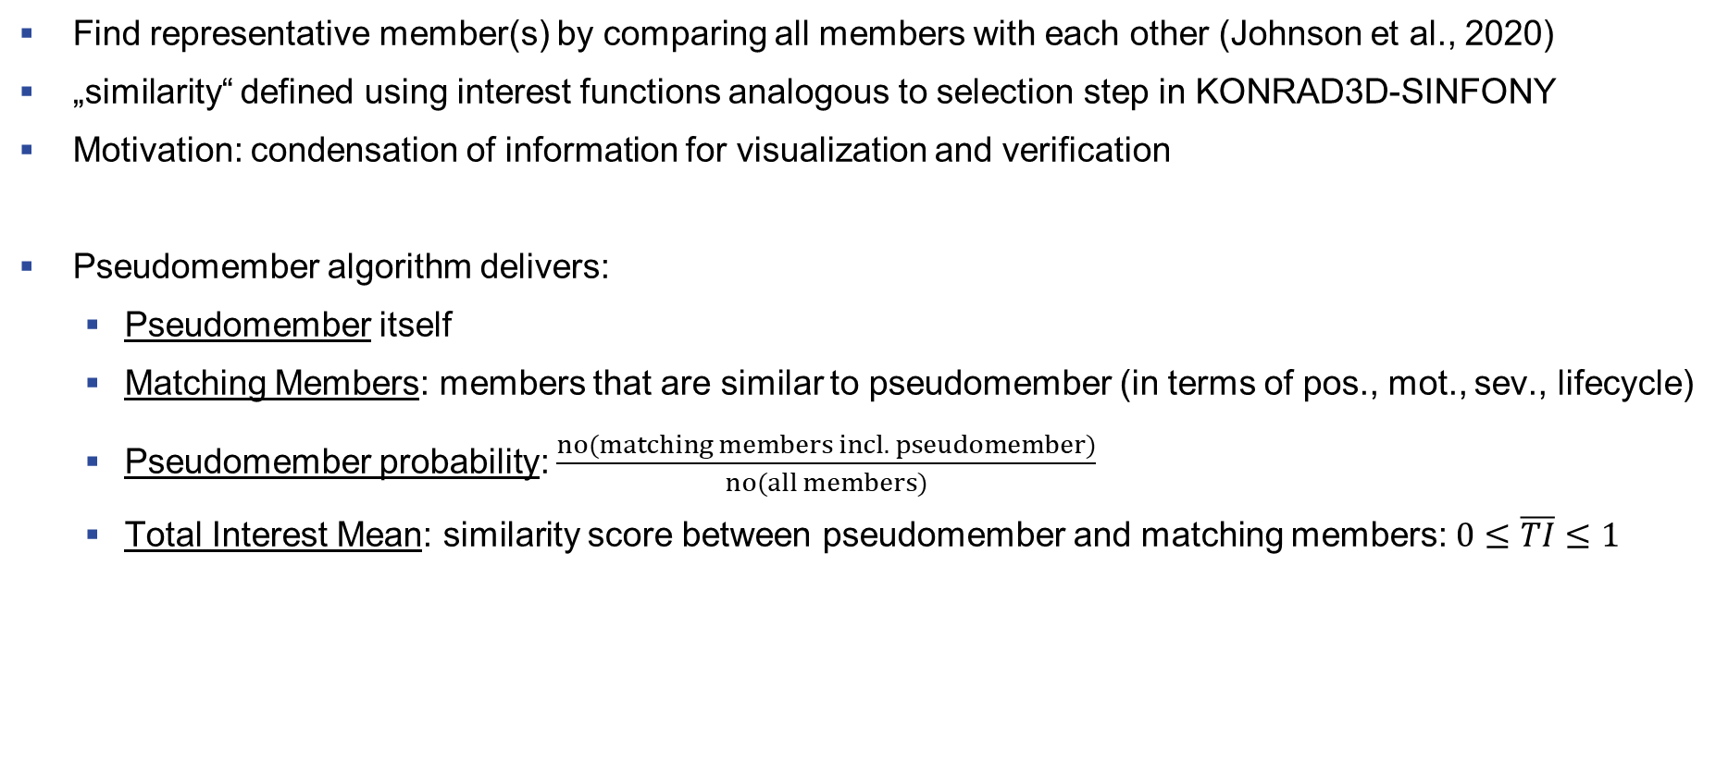
Postprocessing: Pseudomember
Find representative member(s) by comparing all members with each other (Johnson et al., 2020)
„similarity“ defined using interest functions analogous to selection step in KONRAD3D-SINFONY
Motivation: condensation of information for visualization and verification
Pseudomember algorithm delivers:
  Pseudomember itself
  Matching Members: members that are similar to pseudomember (in terms of pos., mot., sev., lifecycle)
  Pseudomember probability: $\frac{no(matching members incl. pseudomember)}{no(all members)}$
  Total Interest Mean: similarity score between pseudomember and matching members: $0≤\overline{TI}≤1$

Slide 26
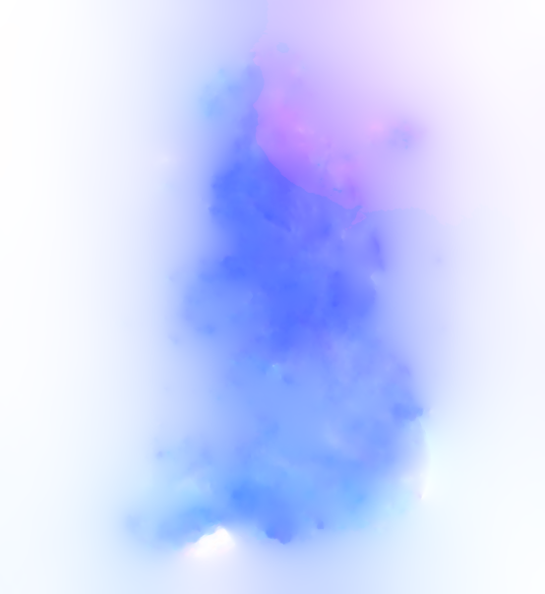

KONRAD3D: Cell Detection
Cell Detection
  Adaptive thresholding scheme in 2D radar sweeps
  Principle: Seek disjoint features around local maxima within regions of increased radar reflectivity (e.g. 35 dBZ)
  Formation of 3D features by spatial adjacency
  2D cell polygons w.r.t associated regular grid (250m x 250m)
Optical Flow: Via OPENCV library (Open Source Computer Vision)
Local Maximum
35dBZ
Adapted threshold

Slide 27
KONRAD3D: Cell Detection
Cell Detection
  Adaptive thresholding scheme in 2D radar sweeps
  Principle: Seek disjoint features around local maxima within regions of increased radar reflectivity (e.g. 35 dBZ)
  Formation of 3D features by spatial adjacency
  2D cell polygons w.r.t associated regular grid (250m x 250m)
Optical Flow: Via OPENCV library (Open Source Computer Vision)
Associated 2D regular grid
Color coded optical flow field

Slide 28
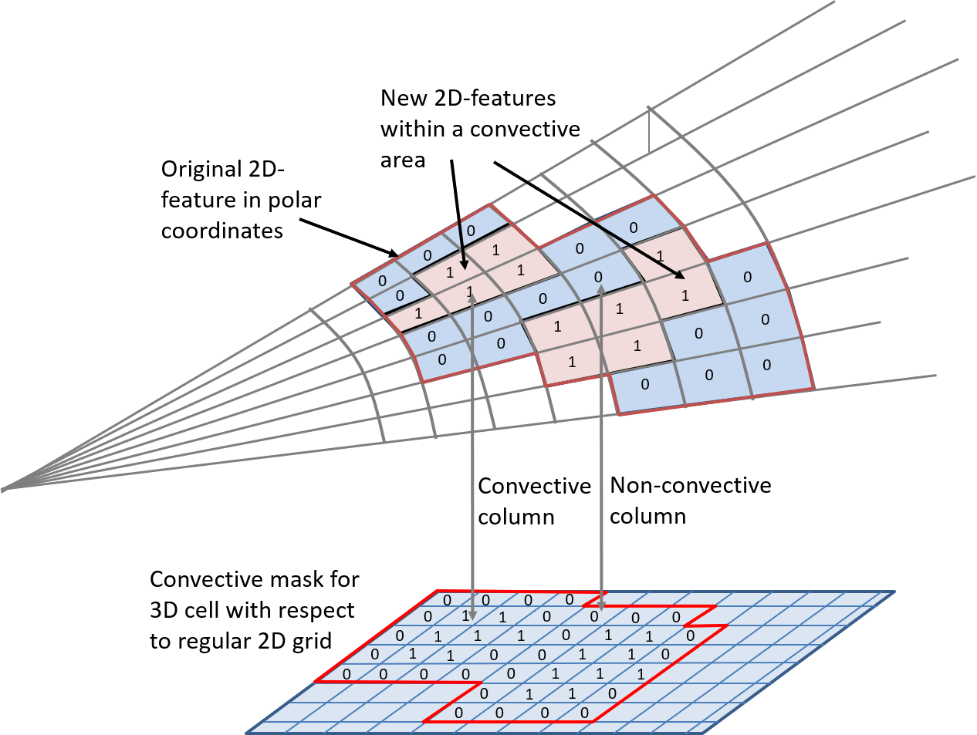
KONRAD3D: Convective Mask Principle
Figure 7: Imprinting “convective mask” from
Step 2.c to 2D-features. New 2D-features arise from which new 3D cells are formed in d.

Slide 29
KONRAD3D-EPS overview
Objective
Ensemble prediction of cell life cycles with regard to nowcast uncertainties in position, motion, intensity, and lifetime
Ensemble Initialization
Cell position, motion, severity: KONRAD3D detected cells as mean + statistically tuned observation errors
Lifetime, maximum expected severity: drawing from theoretical PDFs that were fitted to the corresponding observed distributions
20 members per cell
Prediction
Cells move with constant speed
Life cycle of cell intensity is a upside down parabola
Correction of the Nowcast of Redetected cells
Cell positions and speed: Ensemble-Kalman-Filter
(Maximum expected) severity and lifetime: fitting of cell parabolas to observed severity trend of last 15 min
Special treatment of long-living cells using lightning and mesocyclones
maximum severity
Stochastic ensemble of cell positions of a detected K3D cell.
Empirical and theoretical PDF of maximum expected severity.
Cell lifetimes (min)
Mean temporal development of K3D cell severity from 04. to 09.2019.
Example of fitting parabolas to observed severity trend (black solid line.)

Slide 30
KONRAD3D-EPS: Object-Based Nowcasting Ensemble
Objective
Capture nowcast uncertainties
Predict intensity changes
Concept
Generate an ensemble with 20 members by:
  KONRAD3D output as ensemble mean
  Statistically calibrated errors of the observations
  Statistical distributions of maximum severity and lifetime
Predict cell parameters
  Cell speed assumed to be constant
  Severity show a parabolic behavior
Apply an Ensemble Kalman filter to track cells
Ensemble of KONRAD3D cell centers

Slide 31
Observed maximum severities of KONRAD3D cells fitted to a Gumbel distribution.
Period: JJA 2021.
→ Used for initialization only!

Slide 32

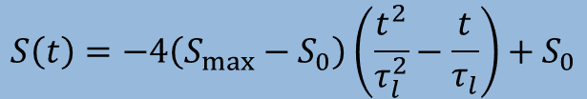
KONRAD3D-EPS: Severity Lifecycle Prediction
Severity lifecycle prediction is main objective of KONRAD3D-EPS
Severity $S$ is parameterized as a parabola function of lifetime $τ_{l}$ und maximum severity $S_{max}$
$$S\left(t\right)=−4\left(S_{max}−S_{0}\right)\left(\frac{t^{2}}{τ_{l}^{2}}−\frac{t}{τ_{l}}\right)+S_{0}$$
Cell lifetimes (min)
Severity | Meaning
0 | weak
1 | moderate
2 | severe
3 | extreme

Slide 33
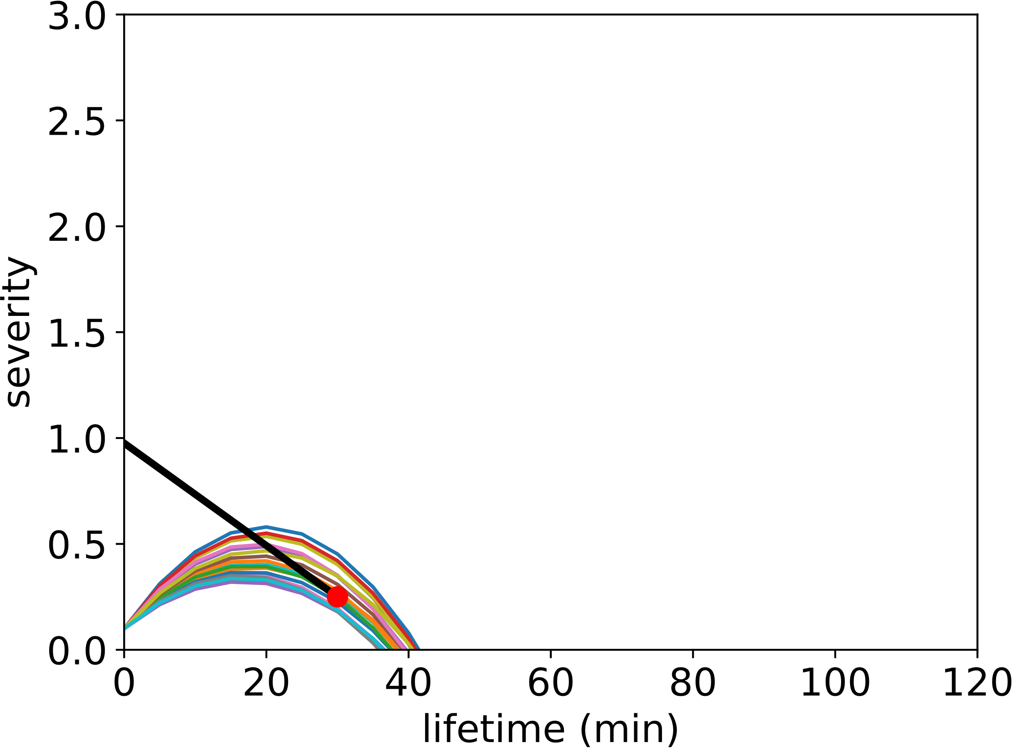
KONRAD3D-EPS: Correction
Cell Motion
Ensemble-Kalman filter
Application of covariance inflation if necessary
Cell Severity Parabolas
Fit parabolas to the observed severity trend of the last 15 (configurable) minutes
Error of fit determines parabola spread
(a)
(b)
Fitting severities to observed trends (black lines). Currently observed severity indicated by red dot. Examples for:
intensification.
weakening.

Slide 34
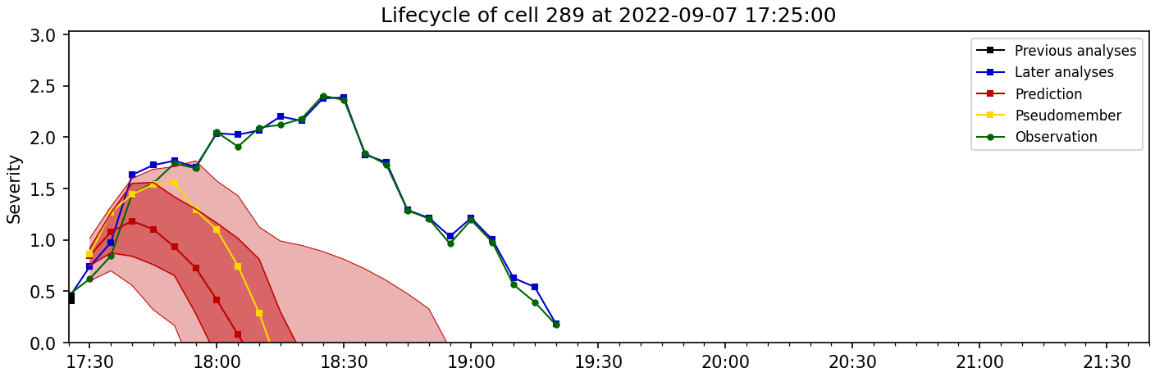
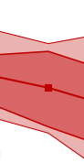
KONRAD3D-EPS: Lifecycle Visualization
90 %
75 %
Mean
25 %
10 %
Ensemble prediction of a cell lifecycle.
Severity | Meaning
0 | weak
1 | moderate
2 | severe
3 | extreme

Slide 35
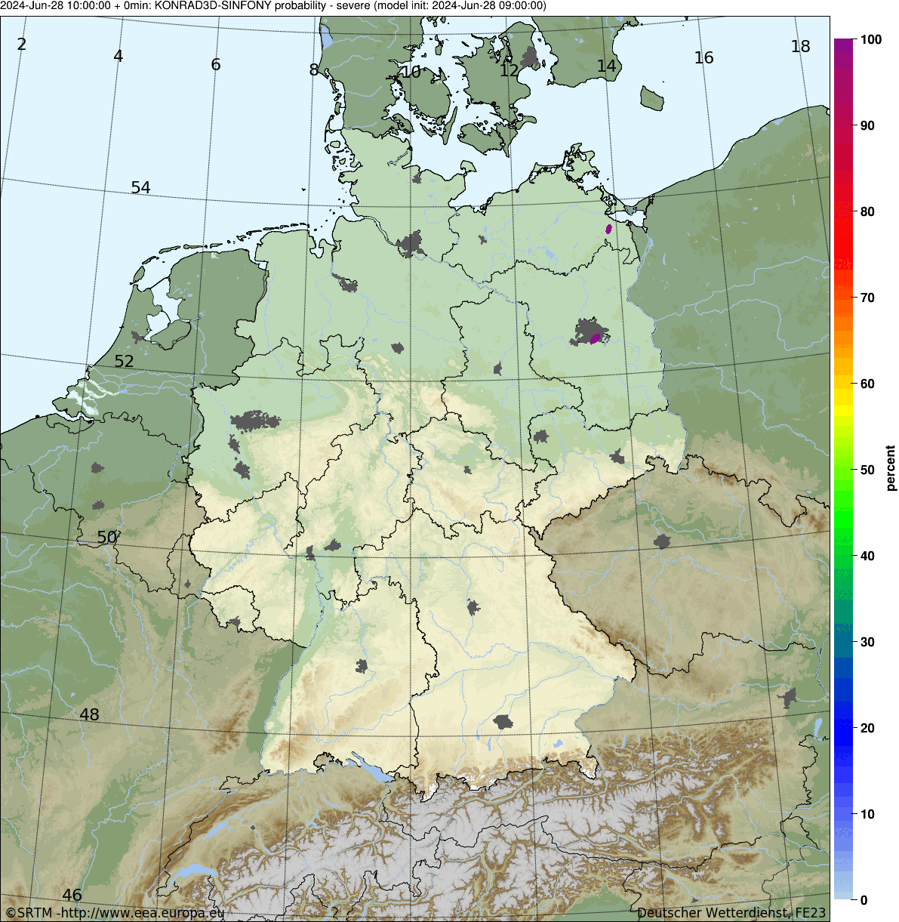
Ensemble Probabilities of Severe / Extreme Convective Cells
Probabilities derived by counting NO contributing members per pixel.
Here: probabilities for severe + extreme cells.
We provide exceedance probabilities for each severity category.
Probability $≥$ (%)
10
30
50
70
90
weak
moderate
severe
extreme
Observation
Forecast until +4h
Notes:
Work in progress! If You have ideas, feel free to tell us!

Slide 36
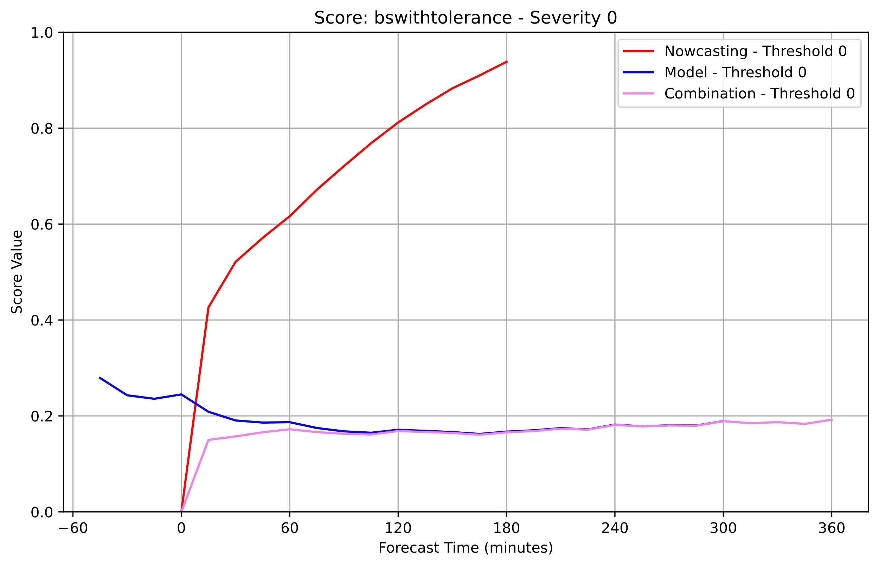
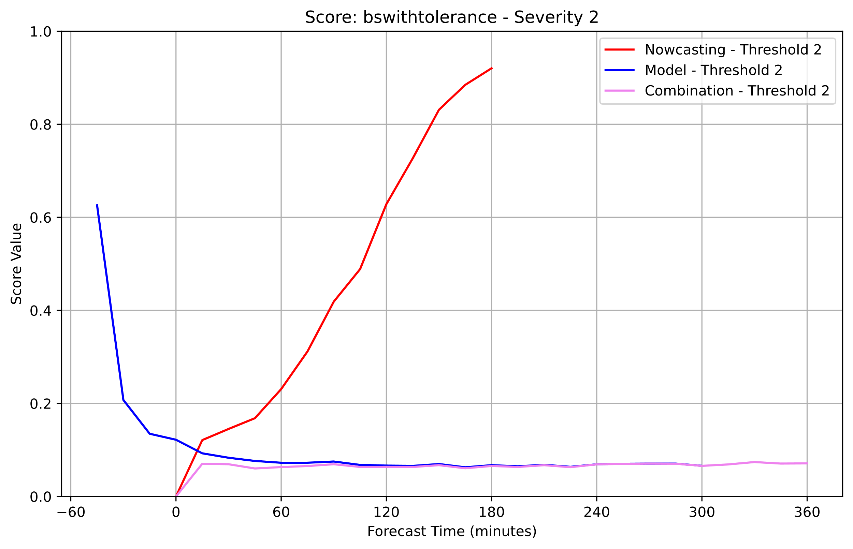
Verification: Brier Score

Slide 37
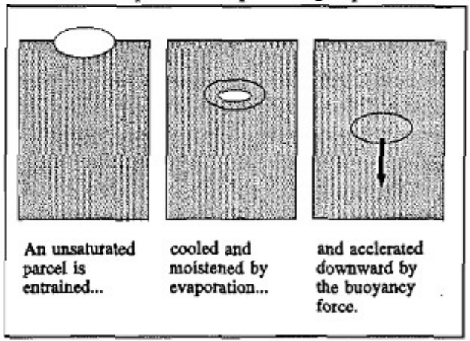
KONRAD3D: Gust Flag
General
Based on „Cloud Top Penetrative Downdraft Mechanism“
Aim: determine maximum expected gust category at the ground
Definition
Gust Flag | Wind Speed (km/h) | Beaufort
0 | 0 – 64 | 0-7
1 | 65 – 104 | 8-10
2 | 105 – 140 | 11-12
3 | > 140 | 12
Schematic of a dry air parcel (ellipse) that is mixed into a cloud (grey area) (Stewart, 1991).

Slide 38
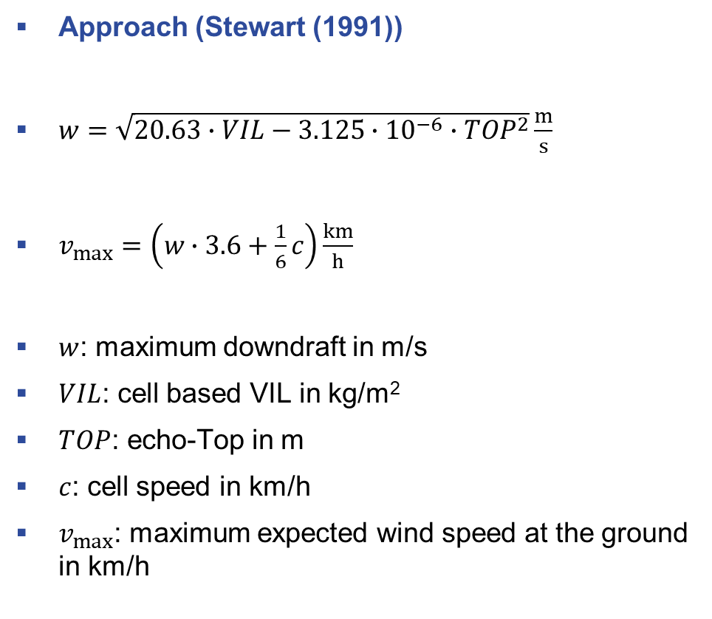
KONRAD3D: Gust Flag
General
Based on „Cloud Top Penetrative Downdraft Mechanism“
Aim: determine maximum expected gust category at the ground
Definition
Approach (Stewart (1991))
$w=\sqrt{20.63∙VIL−3.125∙{10}^{−6}∙{TOP}^{2}}\frac{m}{s}$
$v_{max}=\left(w∙3.6+\frac{1}{6}c\right)\frac{km}{h}$
$w$: maximum downdraft in m/s
$VIL$: cell based VIL in kg/m²
$TOP$: echo-Top in m
$c$: cell speed in km/h
$v_{max}$: maximum expected wind speed at the ground in km/h
Gust Flag | Wind Speed (km/h) | Beaufort
0 | 0 – 64 | 0-7
1 | 65 – 104 | 8-10
2 | 105 – 140 | 11-12
3 | > 140 | 12

Slide 39
KONRAD3D: Heavy Rain Flag / Potential
Suppose, the most intense part of the cell passes over you. How many rain do you have to expect?
Rain rate estimated by averaged reflectivities around cell core
Rain accumulation along the line through most intense point in cell polygon in direction of motion.
Current HRP = rain rate x accumulation time
Include HRP history to estimate final HRP estimated by
Maximum of vertical maxima
Accumulation time = Time the cell needs to travel from point A to point B
B
HR Flag | Rain accumulation (mm)
0 | 0 – 15
1 | 15 – 25
2 | 25 – 40
3 | > 40
A
Direction of motion
Integration path

Slide 40
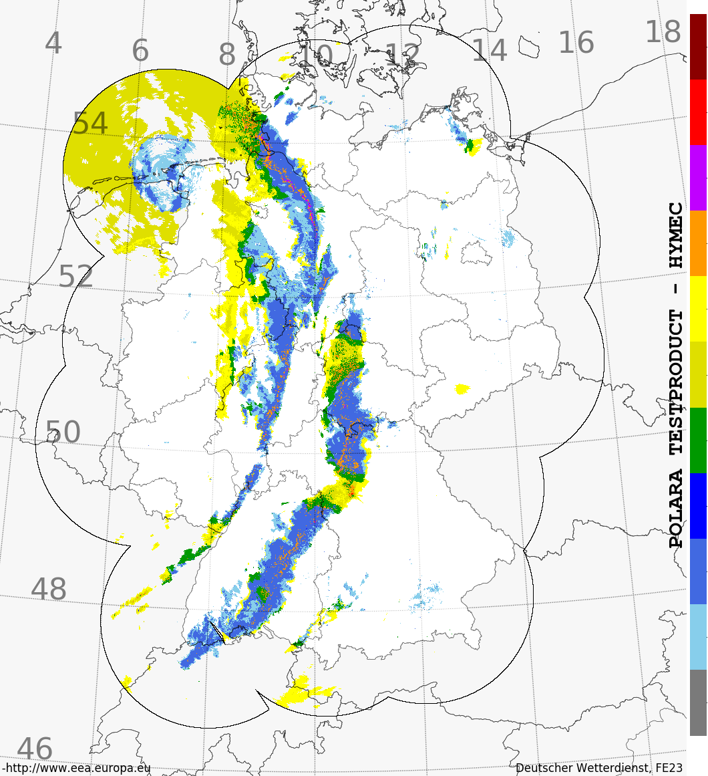
HYMEC
“HYdroMEteor Classification“
Algorithm developed by J. Steinert, M. Schultze
Based on 3D polarimetric radar data and ICON D2
Returns most likely hydrometeor class
Large hail
Hail
Wet hail
Graupel
Ice crystals
Snow
Rain/snow
Big drops
Rain
Drizzle
Not classified
HYMEC composite of Germany,
October 18th, 2019, 13:30 UTC.

Slide 41
KONRAD3D: Hail Flag
General
Based on HYdroMEClassification classes “hail” and “large hail”
Aim: determine whether a KONRAD3D cell currently contains near-surface hail
Definition
Determination
Compute echo bottoms (EB) hail and large hail
Compare those with total echo bottom
Hail Flag | HYMEC hail class | Meaning
0 | None | No hail
1 | Hail | Moderate hail
2 | Large hail | Severe / extreme hail
EB_{large hail} – EB_{total} < 2 km
yes
no
HF = 2
EB_{hail} – EB_{total} < 2 km
no
yes
HF = 0
HF = 1

Slide 42
KONRAD3D: overview of cell attributes
Geometry (horizontal + vertical extent, 3D centroid, topographic elevation at centroid, cells in neighborhood)
Intensity (severity, 3 warning flags, maximum reflectivity, cell areas and echo tops by reflectivity thresholds)
Hail (echo tops, bottoms, areas, and volumes of HYMEC’s hail classes)
Lightning (lightning rate, density, lightning jumps)
NWP (CAPE, SHR, PPW, SRH, etc. from ICON-EU for different parcel curves)
Mesocyclone (intensity, horizontal and vertical extent) → new!
Tracking (cell speed, predecessor(s), splits, merges)
Forecast (predicted cell positions for next hour)

