Slide 1
Exploring Total Column Water Vapor Retrievals from satellite-based NIR measurements in pre-convective environments
RealPEP
Cintia Carbajal Henken, Jan El Kassar & Rene Preusker
Freie Universität Berlin
PrePEP Conference, Bonn, Germany
20 March 2025
Notes:
Hi everyone, my name is Cintia Carbajal Henken from Freie Universität Berlin. I am a member of the RealPEP research group. Today, I‘ ll show you how high resolution satellite-based TCWV can support monitoring of pre-convective environment and thus convective nowcasting.

Slide 2
Why use TCWV to monitor pre-convective environments
Moisture is a key ingredient for deep convection and heavy precipitation
Low-level moisture variability drives convective initiation
Signal convective potential before onset of clouds and precipitation
Notes:
So, why shoud we use satellite-derived TCWV fields to monitor pre-convective environments?
We know that moisture is a key ingredient for deep convection and heavy precipitation, next to a unstable lapse rate and lifting mechanism (TBD check this Especially the low-level moisture, thus the water vapor amount in the boundary layer, plays a central role in convection. Small-scale increases in moisture can signal potential for convection before the onset of clouds and precipitation. That is where our work comes in. We investigate how we can leverage new satellite-based TCWV retrievals to improve characterization of pre-convective environments and enhance nowcasting methods.

Slide 3
Why use TCWV to monitor pre-convective environments
Moisture is a key ingredient for deep convection and heavy precipitation
Low-level moisture variability drives convective initiation
Signal convective potential before onset of clouds and precipitation
Satellite-based NIR TCWV (Preusker et al., 2021)
Vertically integrated water vapor in kg/m²
High sensitivity towards surface:
Notes:
The TCWV retrievals I am talking about here are all retrieved using measurements in the Near-Infrared part of the spectrum. Our groupt at FUB developed retrieval frameworks using NIR channels for several instruments in the past, like MERIS and MODIS, and more recently OLCI and currently working on FCI. Simply put, we relate the ratio of measured reflectances in the water vapour absorption band around 0.9 micron to a near-by window channel, so no absorption, to total column water vapor amounts. This is the vertically integrated water vapor in the atmosphere in units of kg/m2. The absorption is not too strong, meaning we can see the entire column, and sensitivity increases towards the surface.

Slide 4
Why use TCWV to monitor pre-convective environments
Moisture is a key ingredient for deep convection and heavy precipitation
Low-level moisture variability drives convective initiation
Signal convective potential before onset of clouds and precipitation
Satellite-based NIR TCWV (Preusker et al., 2021)
Vertically integrated water vapor in kg/m²
High sensitivity towards surface:
→ changes in TCWV are driven mostly by changes in low-level moisture
Notes:
This means that changes in TCWV are mostly driven by changes in water vapor amounts in the boundary layer, so low-level moisture.

Slide 5
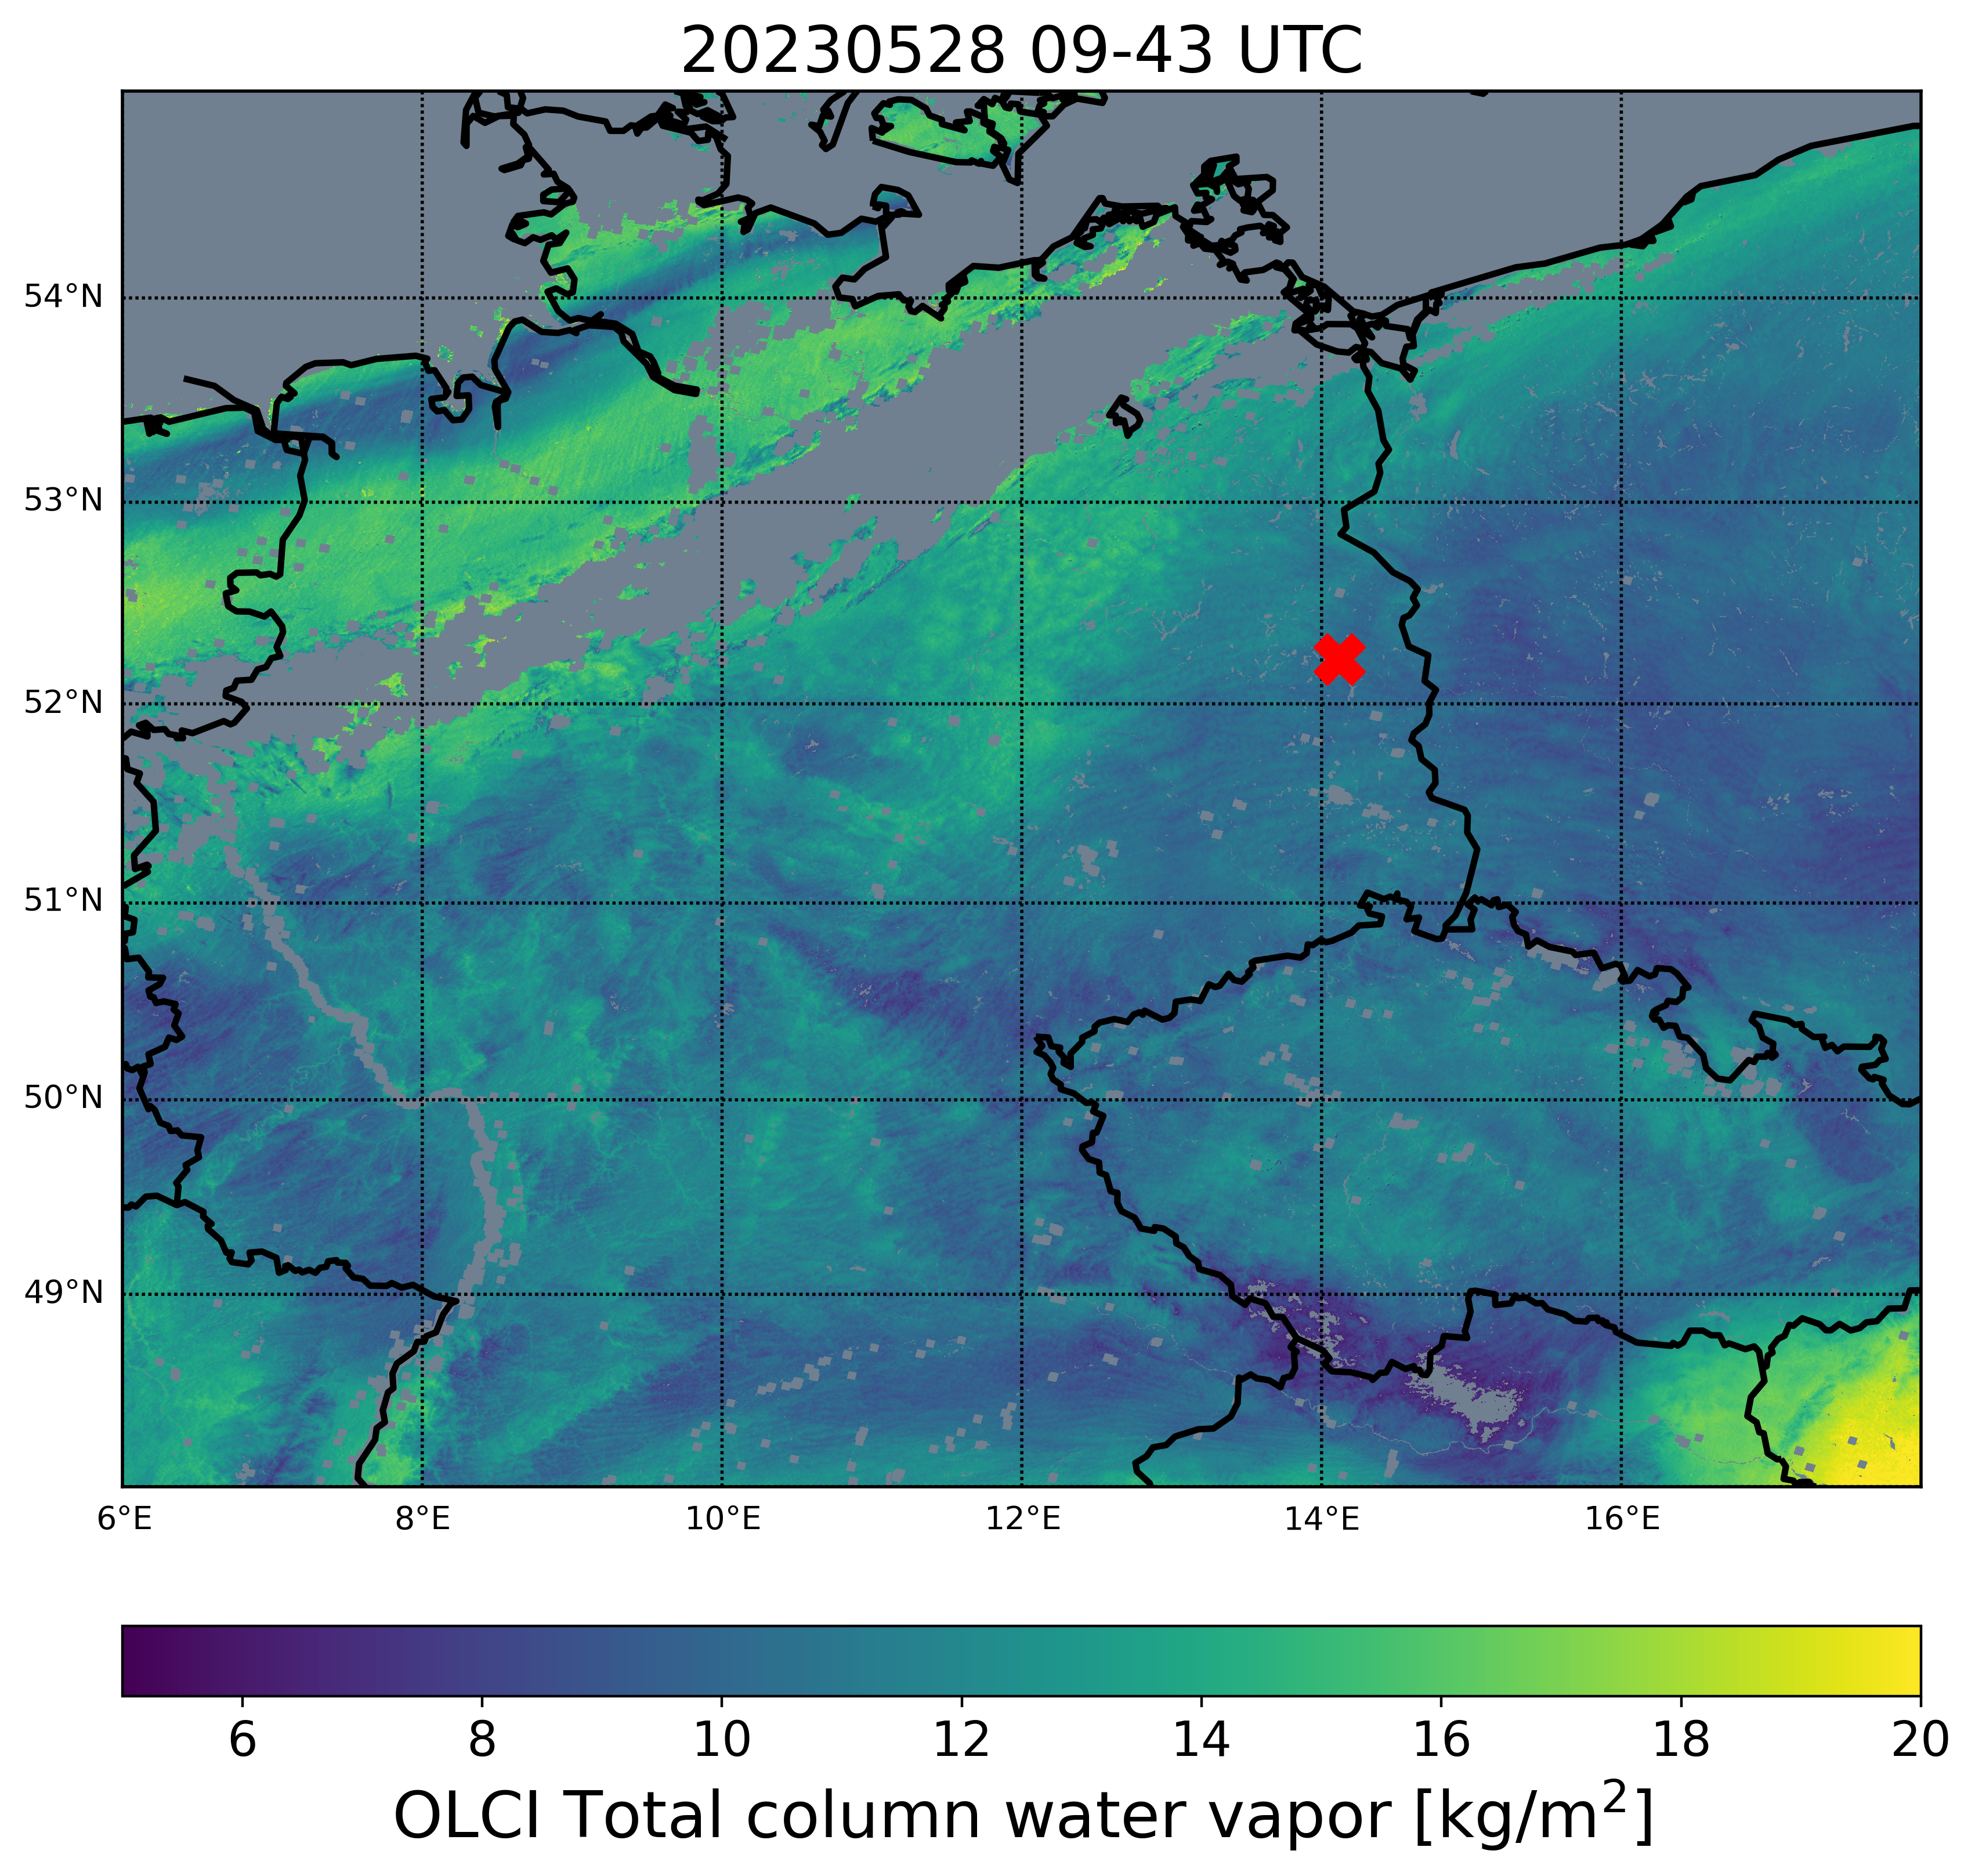
Why use TCWV to monitor pre-convective environments
Moisture is a key ingredient for deep convection and heavy precipitation
Low-level moisture variability drives convective initiation
Signal convective potential before onset of clouds and precipitation
Satellite-based NIR TCWV (Preusker et al., 2021)
Vertically integrated water vapor in kg/m²
High sensitivity towards surface:
→ changes in TCWV are driven mostly by changes in low-level moisture
Sentinel-3 OLCI
Notes:
Here I show an example of a TCWV field over Germany and surroundings from the OLCI instrument onboard the polar-orbiting Sentinel-3 satellites. It has a horizontal resolution of 300x300m2. We see large-scale and more regional structures with regions with higher and lower values, also influence of surface elevation.

Slide 6
Why use TCWV to monitor pre-convective environments
Moisture is a key ingredient for deep convection and heavy precipitation
Low-level moisture variability drives convective initiation
Signal convective potential before onset of clouds and precipitation
Satellite-based NIR TCWV (Preusker et al., 2021)
Vertically integrated water vapor in kg/m²
High sensitivity towards surface:
→ changes in TCWV are driven mostly by changes in low-level moisture
Sentinel-3 OLCI
Notes:
When we zoom in, we observe smaller features in the field, like here the bubbling pattern, but also the lines with alternating high and low values. This happens quite often and the lines with higher TCWV values often align with clouds streets. As you can see, we do not retrieve TCWV in cloudy areas and only during daytime.

Slide 7
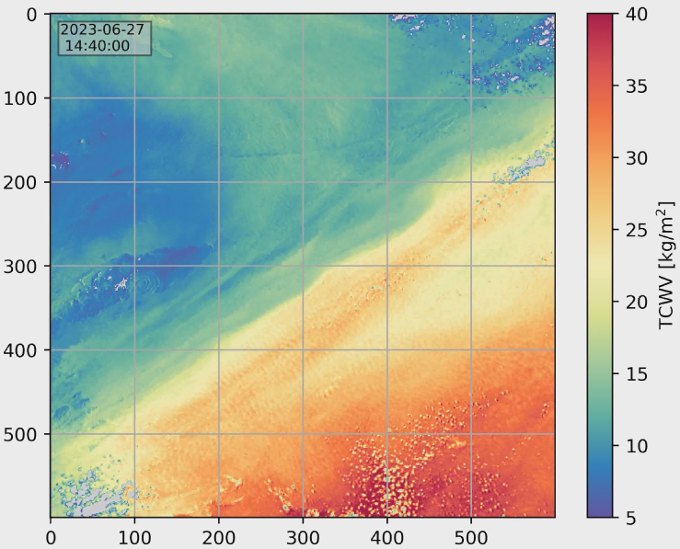
Why use TCWV to monitor pre-convective environments
Moisture is a key ingredient for deep convection and heavy precipitation
Low-level moisture variability drives convective initiation
Signal convective potential before onset of clouds and precipitation
Satellite-based NIR TCWV (Preusker et al., 2021)
Vertically integrated water vapor in kg/m²
High sensitivity towards surface:
→ changes in TCWV are driven mostly by changes in low-level moisture
MTG FCI
Sentinel-3 OLCI
MTG-FCI
Figure Credit: Jan El Kassar
Notes:
Currently, we are evaluating our TCWV retrieval framework for measurements from the Flexible Combined Imager, FCI, an instrument on the geostationary satellite MTG. It is the first geostationary instrument to have this NIR WV absorption band. The horizontal resolution is about 1km2. This is a scene in a desert area In Northern Africa, where we see a dry and moist airmass meeting, the boundary, and a small-scale bubble structure here. So also on the km scale we can see small-scale features in the boundary layer.

Slide 8
From moisture observations to convective potential
How to feed this clear-sky TCWV information into a parameter directly related to convective potential
Notes:
The key question, in the context of improving convective nowcasting, is: how do we translate this clear-sky TCWV information into a parameter that’s directly relevant for convection potential?

Slide 9
From moisture observations to convective potential
How to feed this clear-sky TCWV information into a parameter directly related to convective potential
CAPE: Convective Available Potential Energy
Strongly controlled by properties of the boundary layer
Notes:
We know that there are several atmospheric instability indices used in forecasting that incorporate moisture information to assess convective potential.
One of them is the very well-known CAPE.

Slide 10
From moisture observations to convective potential
How to feed this clear-sky TCWV information into a parameter directly related to convective potential
CAPE: Convective Available Potential Energy
Strongly controlled by properties of the boundary layer
CAPE:
Positive buoyancy
EL
Environmental profile
Parcel
profile
LFC
LFC
Notes:
CAPE measures how much energy is available for air to rise. High CAPE values means stronger storms. On a thermodiagram, CAPE is the area between the parcels´s temperature profile and the environmental temperature profile, where the parcel is warmer than the surroundings, thus having a positive buoyancy.. When we add more moisture, the parcel profile shifts towards the right, increasing the area and thus CAPE.

Slide 11
From moisture observations to convective potential
How to feed this clear-sky TCWV information into a parameter directly related to convective potential
CAPE: Convective Available Potential Energy
Strongly controlled by properties of the boundary layer
CIN: Convective inhibition
CAPE:
Positive buoyancy
CIN:
Negative buoyancy
EL
Environmental profile
Parcel
profile
LFC
Notes:
When looking at CAPE, one should also consider CIN, convective inhibition. CiN, is the negative buoyancy that has to be overcame to initiate convection.

Slide 12
CAPE/CIN Sharpening approach
For a fast and straightforward approach (Carbajal Henken et al, in prep), combine:
NWP forecast temperature/humidity fields
ΔTCWV = TCWV_{obs} - TCWV_{model}
12
Notes:
We propose a fast and straightforward approach to adjust CAPE and CIN estimates based on the satellite-derived TCWV.
We relate the change of CAPE per change of TCWV to the difference between model TCWV and satellite-observed TCWV.
We compute CAPE/CIN using temperature and humidity profiles from an NWP forecast fields.

Slide 13
CAPE/CIN Sharpening approach
For a fast and straightforward approach (Carbajal Henken et al, in prep), combine:
NWP forecast temperature/humidity fields
ΔTCWV = TCWV_{obs} - TCWV_{model}
model
13
Notes:
The sensitivities, so the change in CAPE per change in specific humidity, and the change in specific humidity per change in TCWV are computed within the model environment.

Slide 14
CAPE/CIN Sharpening approach
For a fast and straightforward approach (Carbajal Henken et al, in prep), combine:
NWP forecast temperature/humidity fields
ΔTCWV = TCWV_{obs} - TCWV_{model}
obs - model
model
14
Notes:
Then, we compute the difference between observed and modeled TCWV, what we call Delta TCWV.
We add the difference in CAPE to the model computed CAPE to get the sharpened CAPE. Same procedure for CIN.

Slide 15
CAPE/CIN Sharpening approach: Case study
Areas of interest:
Robust OLCI TCWV retrievals over Germany in spring/summer time
Dominant clear-sky conditions at satellite overpass times (~9 UTC, ~11 LT)
Within 3 hours after satellite overpass: isolated/scattered convective development on local to region scales
→ late morning/early afternoon convective cases
Some convective potential present (non-zero CAPE values, low CIN values)
15
Notes:
Now I will demonstrate the CAPE sharpening approach with case studies.
We focus on regions where we have reliable OLCI TCWV retrievals over Germany, for satellite overpasses this is in late morning under clear-sky conditions—around 9 UTC or 11h local time. Within three hours after satellite overpass, we observed isolated or scattered convective development. In areas with non-zero CAPE and not too negative CIN values.

Slide 16
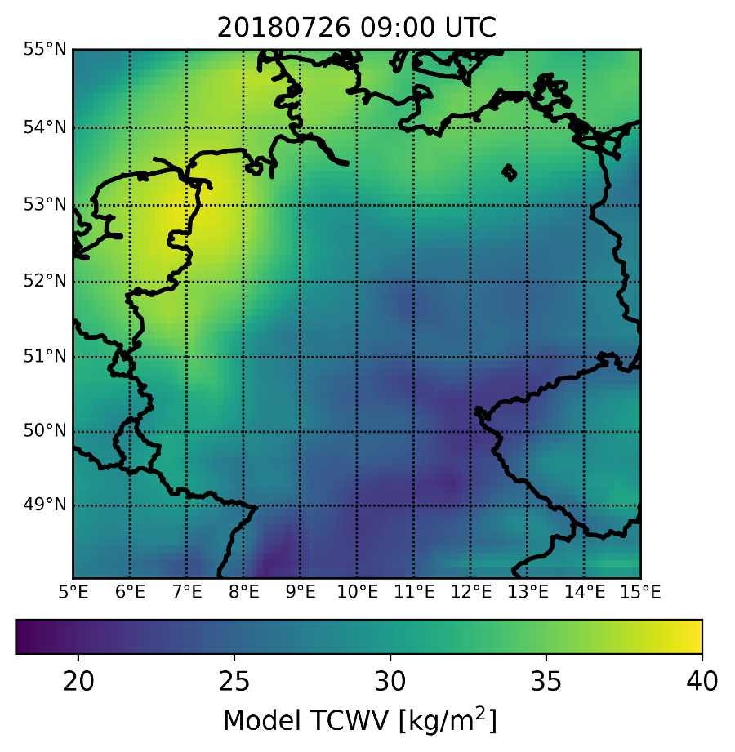
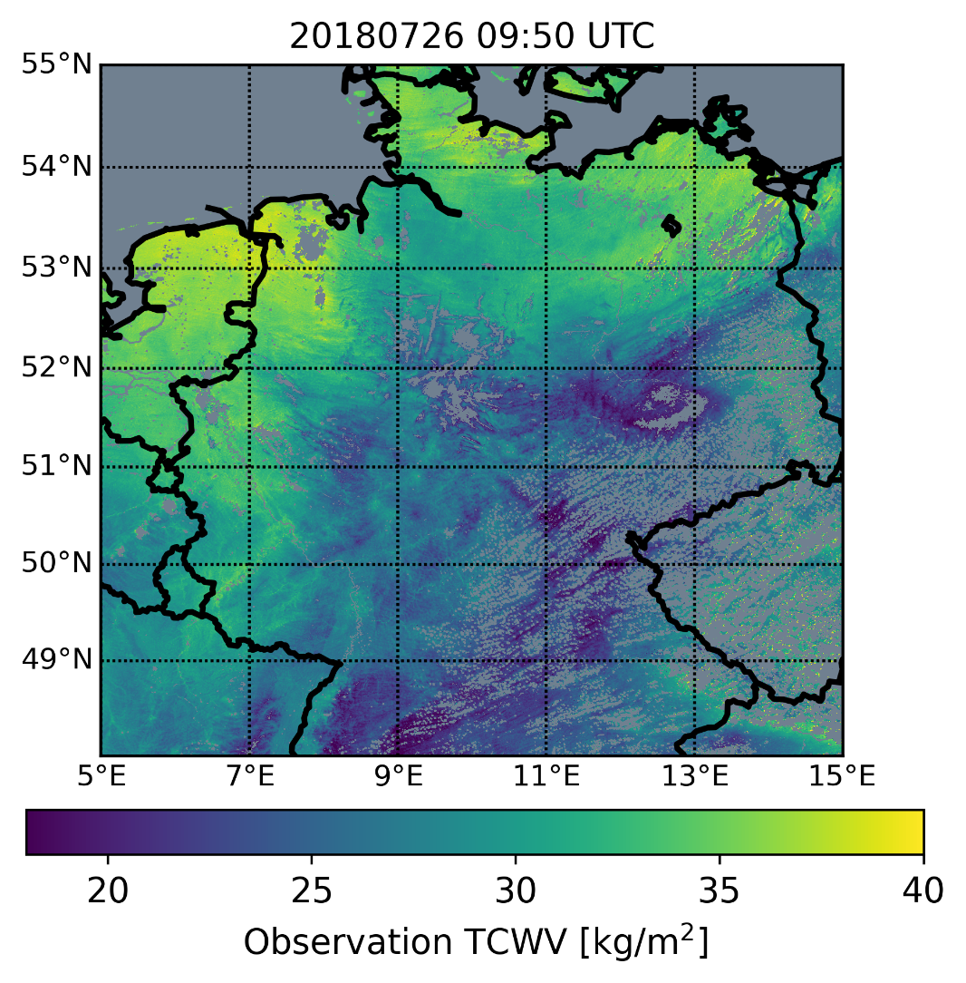
CAPE/CIN Sharpening approach: Case study
Areas of interest:
Robust OLCI TCWV retrievals over Germany in spring/summer time
Dominant clear-sky conditions at satellite overpass times (~9 UTC, ~11 LT)
Within 3 hours after satellite overpass: isolated/scattered convective development on local to region scales
→ late morning/early afternoon convective cases
Some convective potential present (non-zero CAPE values, low CIN values)
ERA5 reanalysis forecast fields
OLCI on Sentinel-3B
16
Notes:
and on the right, we have the OLCI TCWV field from about 50 minutes later. While the large-scale patterns are quite similar..

Slide 17
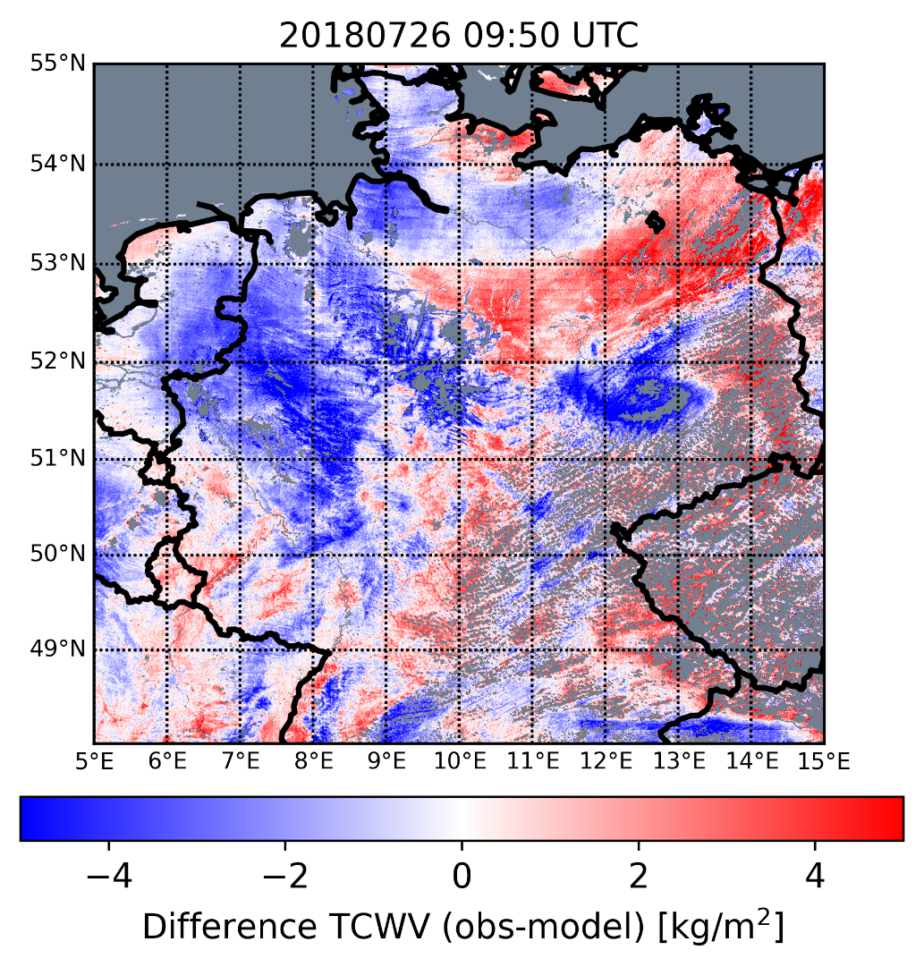
CAPE/CIN Sharpening approach: Case study
Areas of interest:
Robust OLCI TCWV retrievals over Germany in spring/summer time
Dominant clear-sky conditions at satellite overpass times (~9 UTC, ~11 LT)
Within 3 hours after satellite overpass: isolated/scattered convective development on local to region scales
→ late morning/early afternoon convective cases
Some convective potential present (non-zero CAPE values, low CIN values)
ERA5 reanalysis forecast fields
OLCI on Sentinel-3B
17
Notes:
, the difference field reveals significant regional differences

Slide 18
CAPE/CIN Sharpening approach: Case study
Areas of interest:
Robust OLCI TCWV retrievals over Germany in spring/summer time
Dominant clear-sky conditions at satellite overpass times (~9 UTC, ~11 LT)
Within 3 hours after satellite overpass: isolated/scattered convective development on local to region scales
→ late morning/early afternoon convective cases
Some convective potential present (non-zero CAPE values, low CIN values)
ERA5 reanalysis forecast fields
18
Notes:
Let’s zoom in on Northern Germany, where we have a locally forming convective storm.

Slide 19
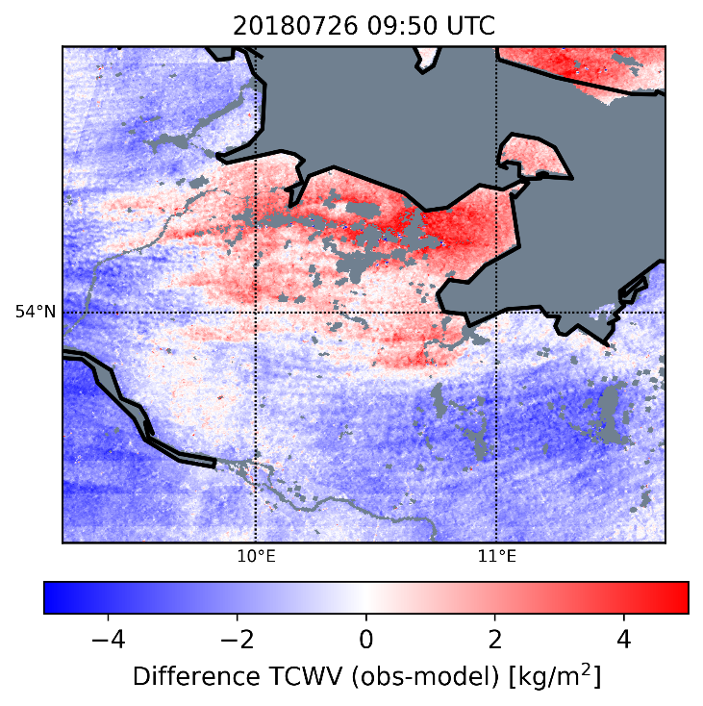
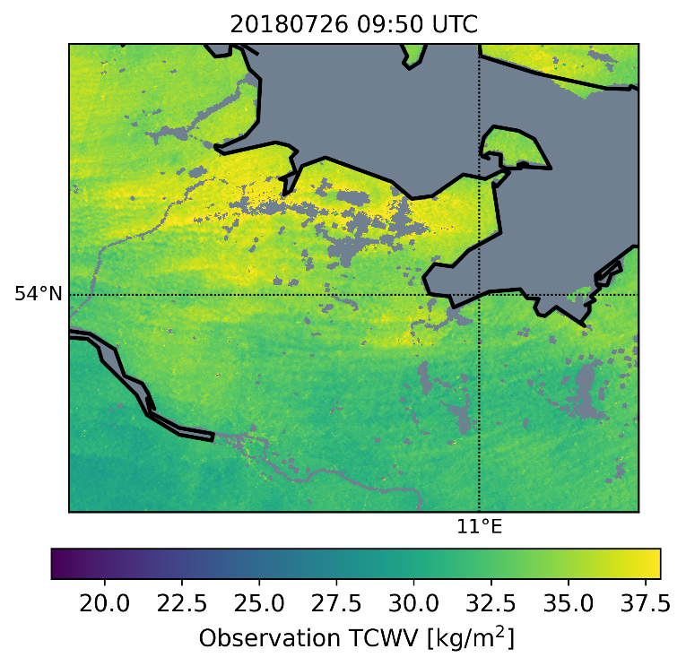
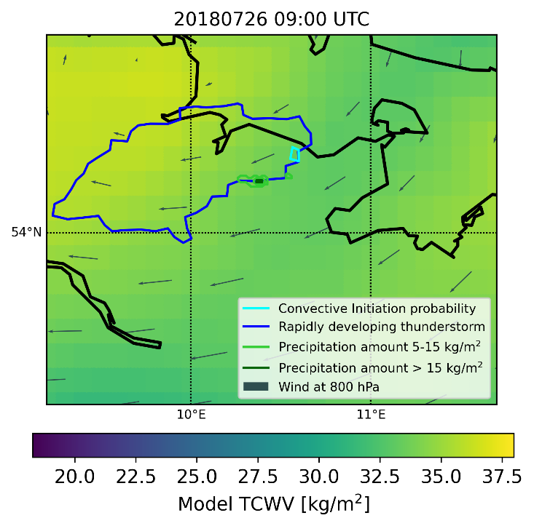
CAPE/CIN Sharpening approach: Case study
MODIS-TERRA at 10.04 UTC
MODIS-Aqua at 11.50 UTC
19
Notes:
In this zoomed region, within two to three hours after the OLCI overpass, a very localized convective storm developed—precisely where we see the largest positive differences in TCWV.
Cumulus cloud lines, the cloud streets, formed in areas where the alternating high and low TCWV structures were already apparent in the clear-sky TCWV fields.
We used SEVIRI data, ERA5 reanalysis, and NWCSAF software to generate convective cloud products. These give us information about location and time and classification of convective clouds. In light blue, you see convective initiation indicators—clouds showing early signs of deep convection. In dark blue, we localize the rapid development of deep convective clouds.
We also include localized precipitation accumulations from Radolan radar data, further confirming the convective activity.

Slide 20
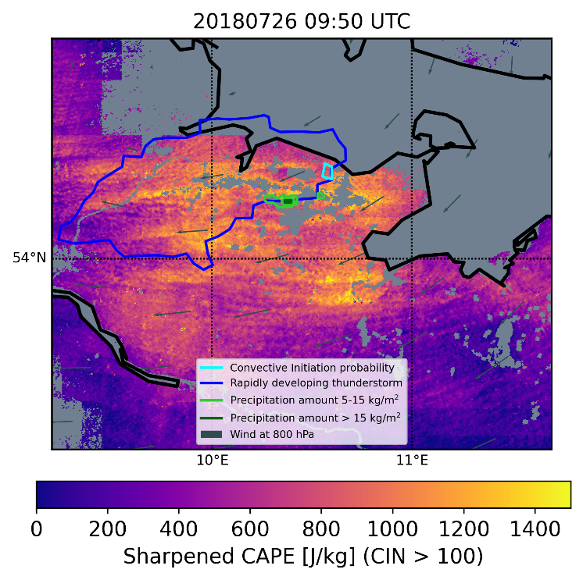
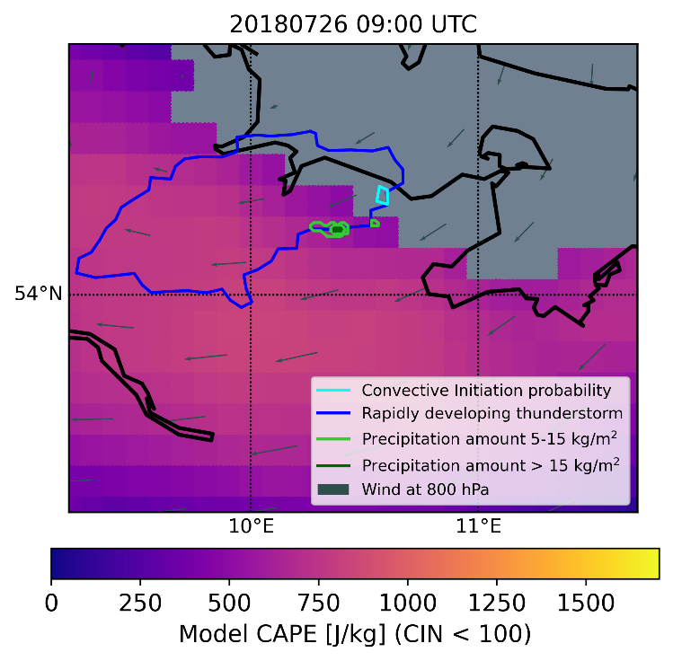
CAPE/CIN Sharpening approach: Case study
Contours:
NWCSAF Convective Initiation probability > 0
NWCSAF Rapid developing thunderstorm
RADOLAN Precipitation accumulation
20
Notes:
Here, we compare model CAPE with sharpened CAPE.
The model CAPE is generally smoother and has lower values, due to the coarser resolution of ERA5 fields. By contrast, the sharpened CAPE field highlights localized areas with elevated CAPE, aligning much better with where we observed convective initiation and further development.

Slide 21
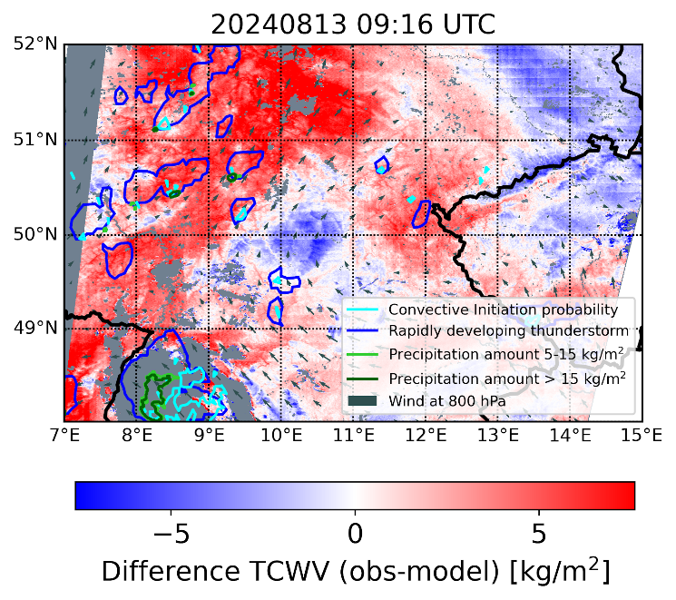
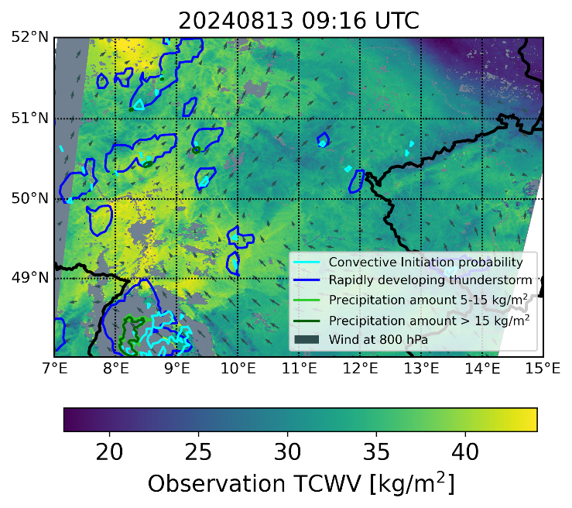
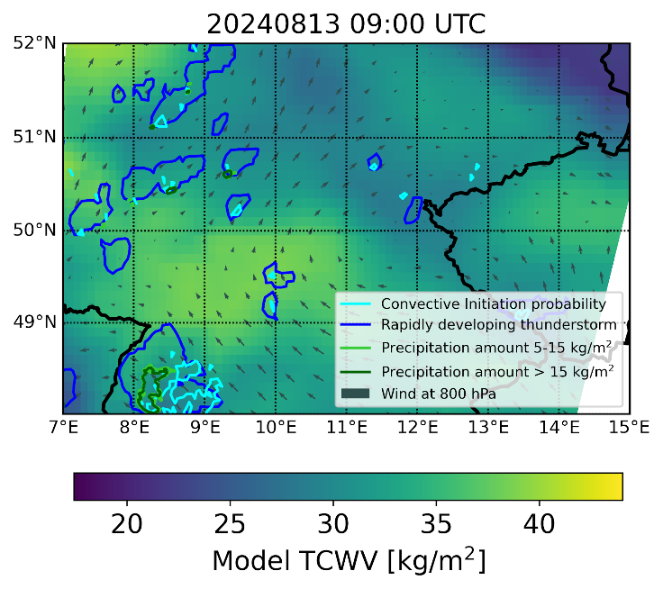
CAPE/CIN Sharpening approach: Case study
21
Notes:
This next example, from last summer, shows a broader area of elevated CAPE and subsequent scattered convection over central Germany.
Here, model and observed TCWV fields agree well on the large scale. However, the TCWV difference field shows high positive values in the west, where most convective systems develop.

Slide 22
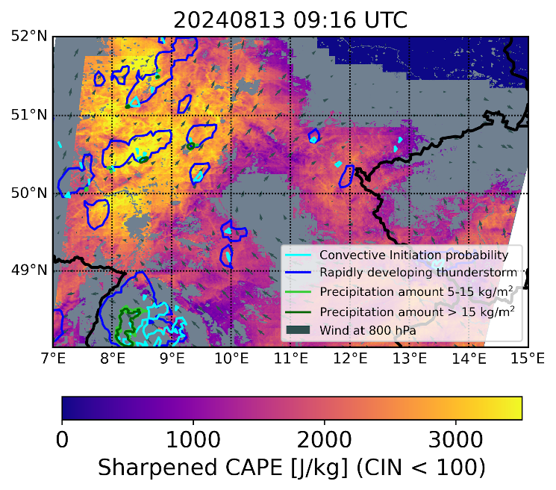
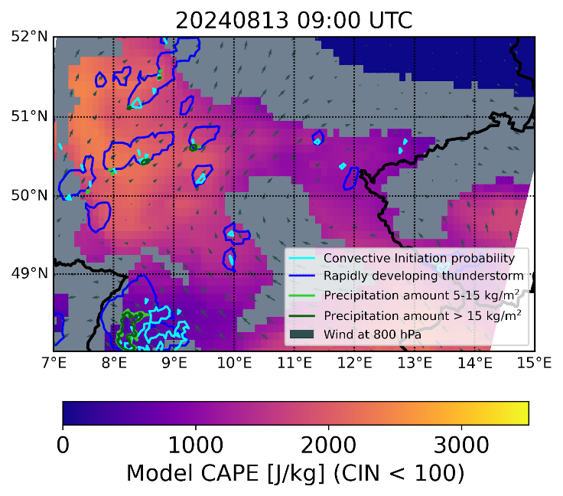
CAPE/CIN Sharpening approach: Case study
ICON-D2 forecast
22
Notes:
The sharpened CAPE field highlights regions with increased convective potential more clearly than the model alone, particularly in the western part and also in a smaller area in eastern Germany.
In this case, the ICON-D2 operational forecast model at 2.2 km grid spacing agrees better with the sharpened CAPE, though we still see regional differences—especially in the east.

Slide 23
CAPE/CIN Sharpening approach: Initial statistics
Initial statistical assessment on discriminatory power of CAPE to identify areas suscesptible to convection.
Aggregate data from 4 case study days with widespread non-zero CAPE values in Germany
To compare across days with different meteorological conditions
→ CAPE anomaly is pixel/grid cell deviation from regional mean value using a moving window with size ~ 100x100km²
23
Notes:
We also did an initial more quantitative assessment. Where we aggregated data from four case study days with clear-sky conditions and subsequent convective development within three hours. Taking the entire domain, which is Germany and some surroundings.
We divided regions into RDT (Rapidly Developing Thunderstorms) and non-RDT regions, based on NWCSAF convective cloud products.

Slide 24
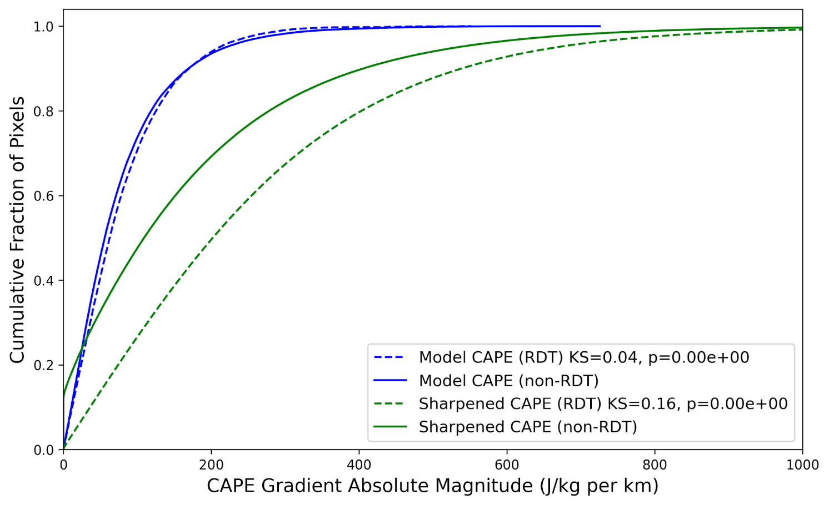
CAPE/CIN Sharpening approach: Initial statistics
Initial statistical assessment on discriminatory power of CAPE to identify areas suscesptible to convection.
Aggregate data from 4 case study days with widespread non-zero CAPE values in Germany
To compare across days with different meteorological conditions
→ CAPE anomaly is pixel/grid cell deviation from regional mean value using a moving window with size ~ 100x100km²
24
Notes:
Here, we show the cumulative distribution function of the CAPE anomaly—the pixel-based deviation from the regional mean, which is computed within a moving window of roughly 100 by 100 square kilometers to make a fair comparison across days with different meteorological conditions.
We see that for ERA5, the CDF rises steeply, with little distinction between RDT and non-RDT areas. In contrast, the sharpened CAPE shows a slower ascent, with an even slower increase in RDT regions, indicating improved discriminatory power for identifying areas susceptible to convection.
TBD should be better, look at paper.

Slide 25
Conclusions and Outlook
CAPE sharpening approach
Fast and straight forward method, with one additional piece of information
Works for subset of convective cases in Germany using ERA5 data
refines spatial
adds more variability in regions with convective development
better alignment with regions of convective development
Relies strongly on shape of model atmospheric profiles
if baseline CAPE is low, their might not be a meaningful update of CAPE using satellite TCWV information
OLCI TCWV
On polar-orbiting satellite,
high spatial resolution, capturing small-scale BL features that NWP models might struggle with
only one or two snapshots in the late morning time, no temporal evolution of moisture field
limits assessment of cases, e.g., no afternoon convective development
Notes:
Coming to the conclusions.
Our CAPE sharpening approach is fast and straightforward. The method refines the spatial scales of CAPE estimates and aligns better with regions of observed convective development.
However, the method’s effectiveness depends strongly on the shape of the model’s atmospheric profiles. If baseline CAPE values are low, the potential for meaningful CAPE sharpening using satellite TCWV information may be limited.
Regarding OLCI TCWV retrievals, they offer high spatial resolution and capture small-scale boundary layer features that NWP models may struggle to resolve. These features can highlight areas of interest for convection. The limitation is the temporal resolution—typically one or two snapshots per morning—restricting the analysis to cases with late morning or early afternoon convective development.

Slide 26
Conclusions and Outlook
Temporal evolution and vertical distributions of WV fields
MTG-FCI TCWV retrieval framework, also using this NIR 0.9 micron WV absorption band
Temporal resolution of 10 min, spatial resolution ~2 km for Germany (~50 OLCI pixels)
Towards low-level moisture estimates
synergy with FCI Thermal Infrared bands to constrain better the vertical distrubtion of WV
synergy with MTG Sounder for information on vertical profiles
Complement the more physically-based methods with AI-based methods
Figure credit: Jan El Kassar
First version of Retrieval Framework for MTG-FCI TCWV running on EWC (El Kassar et al., under review)
Notes:
Looking ahead:
We are working on the MTG-FCI TCWV retrieval framework, which will also use the near-infrared 0.9 micron absorption band. The great thing is, that FCI offers a temporal resolution of 10 minutes and spatial resolution of around 2 km for Germany. However, the effective resolution of NWP models is coarser.
We aim to move towards low-level moisture estimates combining our retrievals with FCI thermal infrared bands to better constrain the vertical distribution of water vapor.
Additionally, the synergy with the upcoming MTG Sounder instrument will provide vertical profile information.
Finally, we are exploring ways to complement physically-based retrievals with AI-based approaches.

Slide 27
MTG-FCI TCWV
Figure credit: Jan El Kassar
Notes:
And, finally, Do you remember the bubble structures I showed earlier? Now, in this time loop, we can observe their emergence and the subsequent formation of cumulus clouds. We also see wave-like structures and gravity waves moving outward from boundaries between regions of high and low TCWV (where the drier and moisture airmasses meet)

Slide 28
Thanks!
Notes:
Thank you very much for your attention! I’d be happy to take any questions.

Slide 29
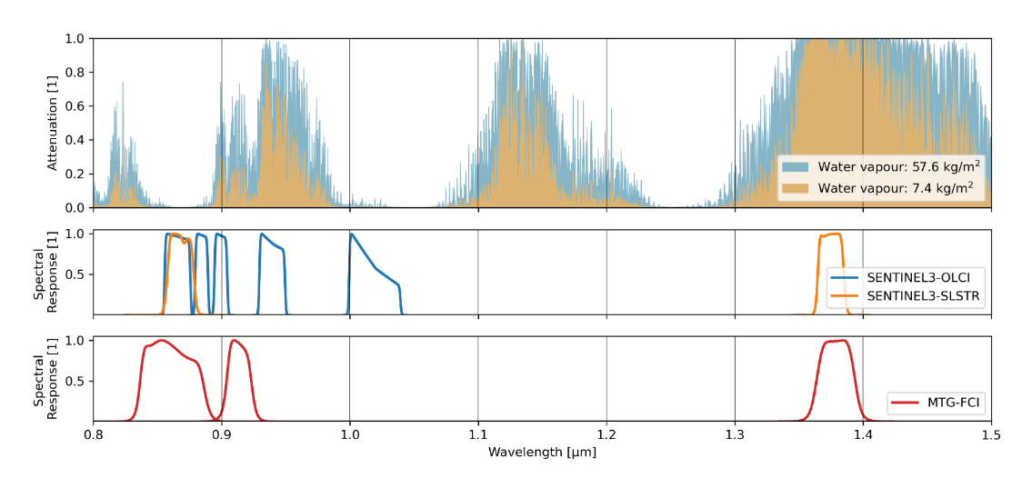
TCWV retrievals from NIR satellite measurements
Daytime, clear-sky, over land surfaces
Retrieval framework for instruments: MERIS, MODIS, OLCI, MTG-FCI (MetImage etc.)
Use ratio of absorption at 0.9 micron to a near-by window channel
Many validation exercises with well-established ground-based TCWV observations
more moisture
less moisture
From: El Kassar et al. 2025 in prep
Notes:
Our groupt at FUB developed retrieval frameworks using NIR channels for several instruments in the past, like MERIS and MODIS, and more recently OLCI and currently working on FCI. First instrument on a polar-orbiting satellite to carry this water vapor absorption band at 0.9 micron.
Etc.

Slide 30
CAPE/CIN Sharpening approach
EL
Increase TCWV
Increase CAPE
CAPE:
Positive buoyancy
CIN:
Negative buoyancy
Decrease |CIN|
Environmental profile
Parcel
profile
LFC
T-skew, log-p diagram (metpy)
Notes:
In this example, a 13% increase in TCWV results in an almost 50% increase in CAPE. You can clearly see how the parcel profile shifts, reducing CIN and expanding the CAPE area on the diagram.

Slide 31
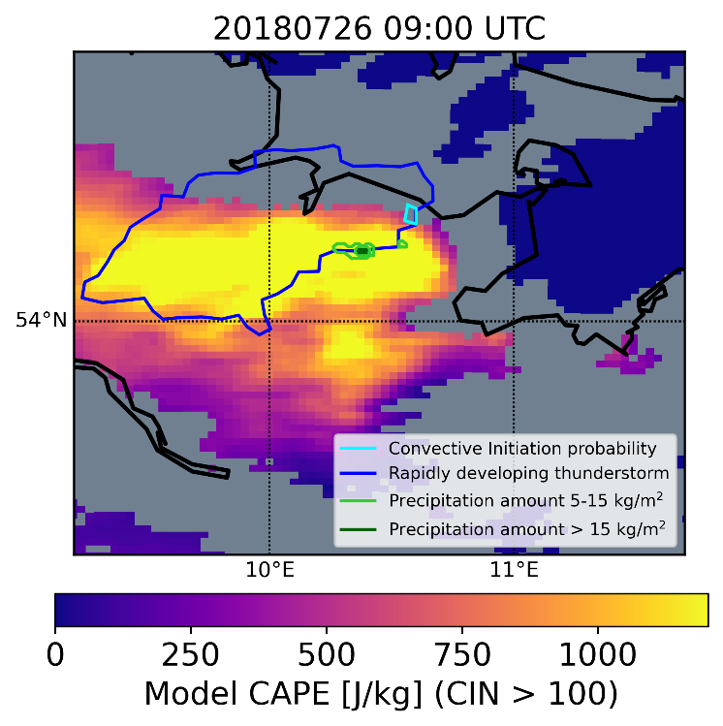
CAPE/CIN Sharpening approach: Case study
COSMO-D2 analysis
31
Notes:
For reference, we compare with COSMO-D2 reanalysis data from the Pamore database at the German Weather Service (DWD). COSMO-D2’s finer grid spacing captures more of the spatial variability, and its CAPE distribution agrees better with our sharpened CAPE fields.

Slide 32
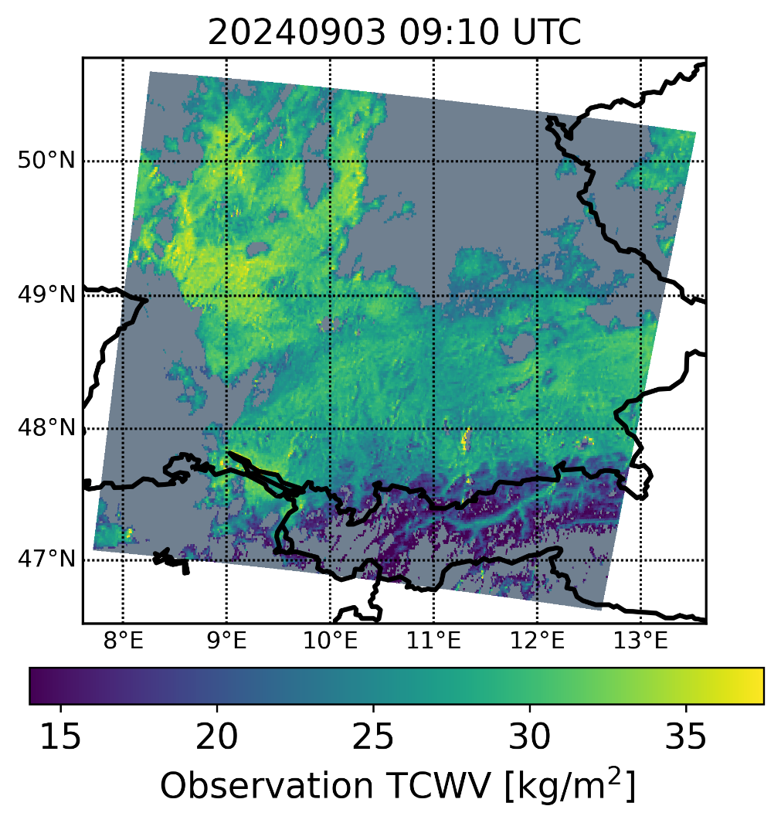
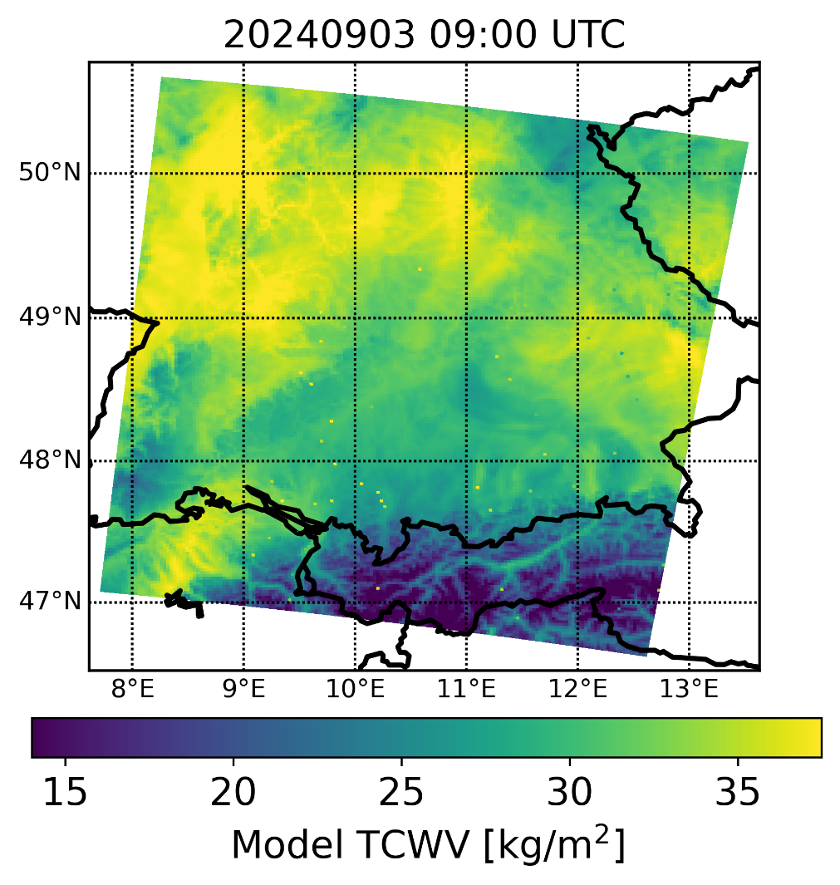
MTG-FCI TCWV observations vs model
ICON-D2
Δx ~ 2km
Effective spatial resolution?
Notes:
alleine starten lassen

Slide 33
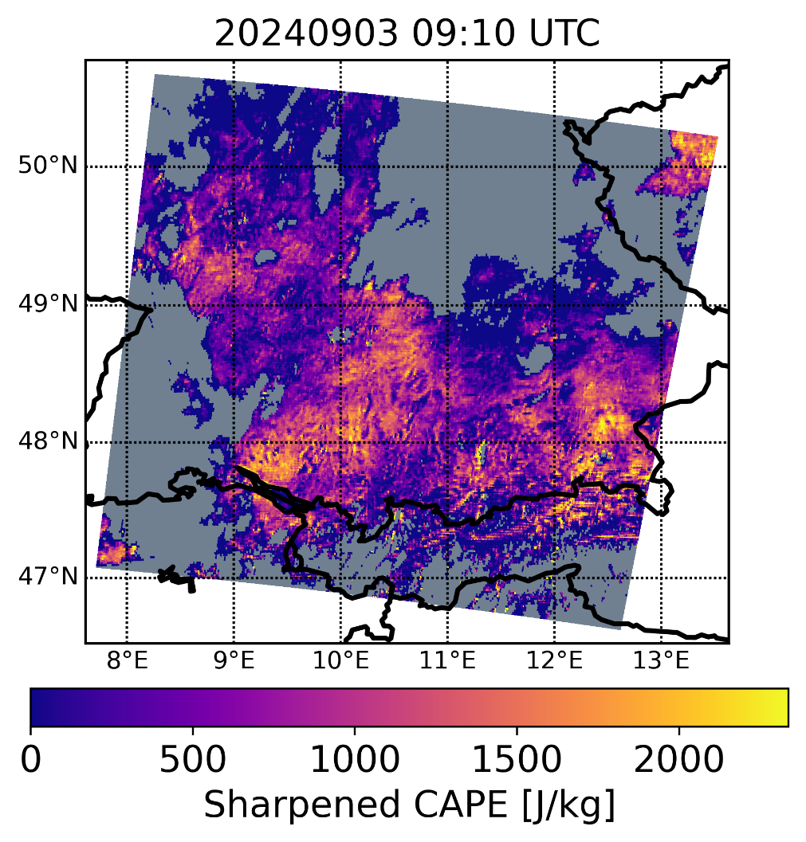
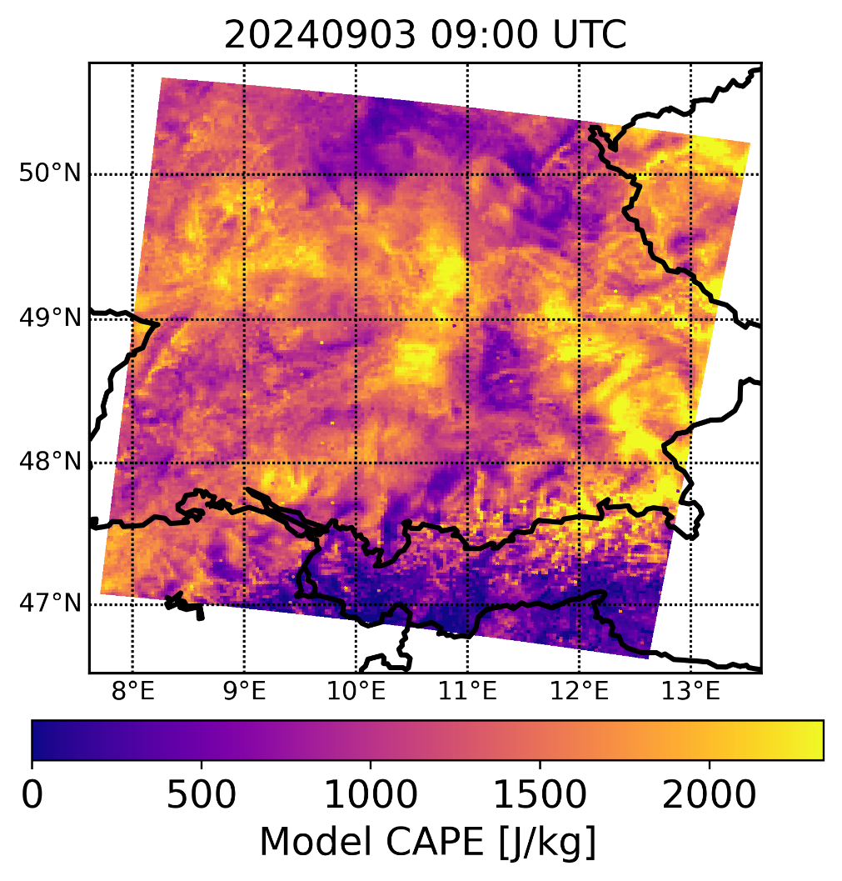
MTG-FCI TCWV in pre-convective environments
Observation
Model
ICON-D2
Δx ~ 2km
Effective spatial resolution?
Notes:
alleine starten lassen

