Slide 1
Analyse der Wiederkehrperiode der maximalen täglichen Niederschlags katastrophen im Zagros-Gebirge, Iran: März (2019)
Return Period Analysis of Maximum Daily Rainfall Disasters in the Zagros Mountains, Iran: March (2019)
E. Mobarak Hassan
E. Fattahi
J. Sepehri*

Slide 2
Introduction
Goals
In March 2019, maximum daily rainfall exceeded the long-term average, leading to significant flooding downstream in the Karkheh Basin.
Key contributing factors included heavy rainfall, the impacts of climate change, and alterations in land structures along riverbanks.
Heavy rainfall, made worse by climate change, increases the risk of floods, landslides, and damage to infrastructure, highlighting the need for better water management and disaster planning.
This paper aims to analyze the return period of heavy rainfall events in the Zagros Mountains of Iran, focusing on the March 2019 floods in the Karkheh River Basin. By evaluating the annual and monthly variations, statistical characteristics, and return periods of extreme rainfall, this study seeks to understand the frequency and intensity of hydrological extremes. It further explores the interplay of climate change and land surface alterations on flooding, offering insights to support climate resilience and flood mitigation strategies in vulnerable regions.

Slide 3
Summary of the objectives, focus, analyses, key findings, and implications of the study on the return period of heavy rainfall events in the Zagros Mountains, with emphasis on the March 2019 floods in the Karkheh River Basin
Aspect | Details
Objective | Analyze the return period of heavy rainfall events in the Zagros Mountains of Iran.
Focus | March 2019 floods in the Karkheh River Basin.
Key Analysis | - Annual and monthly variations of maximum daily rainfall.
 | - Statistical characteristics of extreme rainfall events.
 | - Return period estimation using statistical distributions (Gumbel, Inverse Gamma).
Key Findings | - Maximum daily rainfall shows an increasing trend, indicating more frequent heavy rainfall events.
 | - Gumbel distribution best fits long-term data; Inverse Gamma fits shorter data periods.
 | - Return periods for extreme events range from 50 to 300 years.
Significant Observation | - March 2019 rainfall exceeded long-term averages, leading to severe flooding downstream in the Karkheh basin.
 | - Alterations in land surface structure contributed to increased human and financial losses.
Implications | - Provides insights into hydrological extremes.
 | - Supports strategies for flood mitigation and climate resilience in vulnerable regions.
Notes:
This paper aims to analyze the return period of heavy rainfall events in the Zagros Mountains of Iran, with a focus on the March 2019 floods in the Karkheh River Basin. By evaluating the annual and monthly variations, statistical characteristics, and return periods of extreme rainfall, this study seeks to understand the frequency and intensity of hydrological extremes. It further explores the interplay of climate change and land surface alterations on flooding, offering insights to support climate resilience and flood mitigation strategies in vulnerable regions.

Slide 4
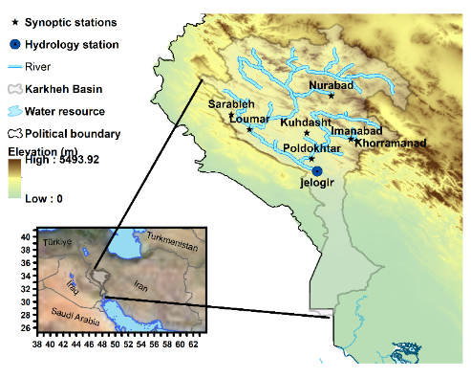
Study Area: Zagros Mountains
Karkheh Basin: Located in western Iran, the basin is characterized by rugged terrain and a diverse climate.
The March 2019 floods exposed vulnerabilities to extreme rainfall, with Pol-Dokhtar receiving 139 mm and Nurabad 101 mm of precipitation.
The topographical features of the Zagros Mountains significantly influence precipitation patterns, particularly during extreme weather events and heavy rainfall..
Station Name | Latitude | Longitude | Elevation (m) | Data Coverage (Years)
Khoramabad | 33.43 | 48.28 | 1147.8 | 72
Kusdasht | 33.52 | 47.65 | 1197.8 | 25
Poldokhtar | 33.15 | 47.72 | 713.5 | 24
Nurabad | 34.05 | 48.00 | 1859 | 22
Sarableh | 33.78 | 46.57 | 1045 | 16
Loumar | 33.57 | 46.83 | 850 | 15
Imanabad | 33.40 | 48.37 | 1500 | 14
100 km

Slide 5
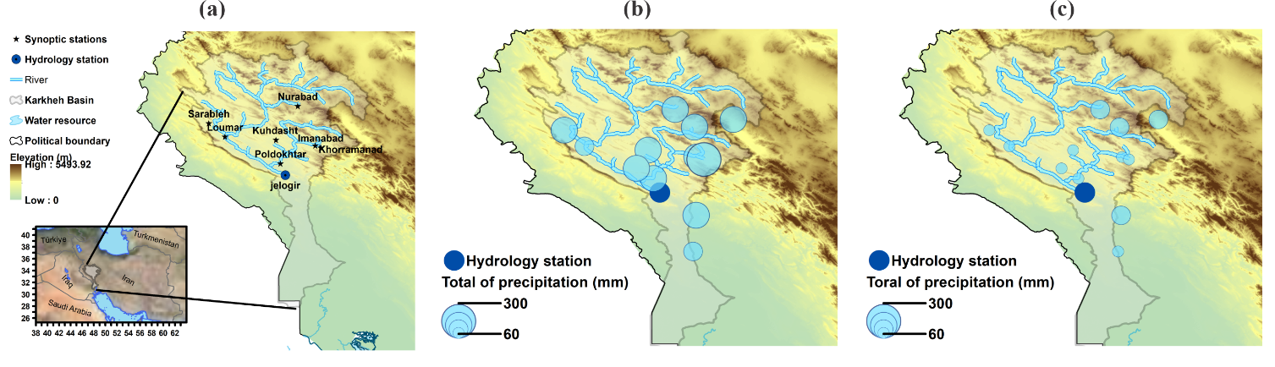
Total of Precipitation (March and April 2019)
(a) March 2019
(b) April 2019
Daily Maxima
Station Name | March2019 (mm) | April2019 (mm)
Khoramabad | 66 | 85.4
Kusdasht | 63 | 21
Poldokhtar | 139.4 | 17
Nurabad | 79.2 | 101
Sarableh | 41.7 | 38
Loumar | 66 | 9
Imanabad | 117 | 31
100 km
Graph a) demonstrates the amount of heavy rain in March 2019
Graph b) shows the amount of regular rain in April 2019.
The table shows the total precipitation in March and April 2019. The maximum amount is demonstrated by red.

Slide 6
Methodologies and Analyses for Rainfall and Return Period Assessment
Slide 6 and elsewhere. Give some information on Probable Maximum Precipitation. I assume daily totals and Rain + Snow? Recent papers (https://doi.org/10.5194/egusphere-2024-2594) point out some of the problems with the WMO definition.
Aspect | Details
Station Data | Initial analysis of 7 stations with descriptive statistics (mean, median, mode, etc.). Selected 4 stations with >20 years of data for further study.
Trend Analysis | Trends in total annual and maximum 24-hour precipitation analyzed. Mann-Kendall method used for trend detection.
PMP Estimation Methods | Hershfield Method: Used with K_{m} factors of 15 and 6. Modified Desa Method: Excludes max precipitation to calculate K_{m}.
PMP Calculation | Equation: X_{PMP} = X_{n} + S_{n} * K. Desa method adjusts K_{m} and uses max value across stations.
Return Period Analysis | Evaluated empirical and mathematical return periods using historical data. Software: HyfranPlus for probability distribution fitting.
Probability Distributions | Distributions Used: GEV, Log-Normal, Log-Normal3, Pearson Type III, Gumbel, Inverse Gamma. Parameters estimated via Maximum Likelihood Estimation (MLE).
Goodness-of-Fit Tests | Applied Akaike Information Criterion (AIC) and Bayesian Information Criterion (BIC). Evaluated model performance and reliability.
Purpose | To understand extreme rainfall patterns, estimate return periods, and assess risks for the Zagros Mountains region.

Slide 7
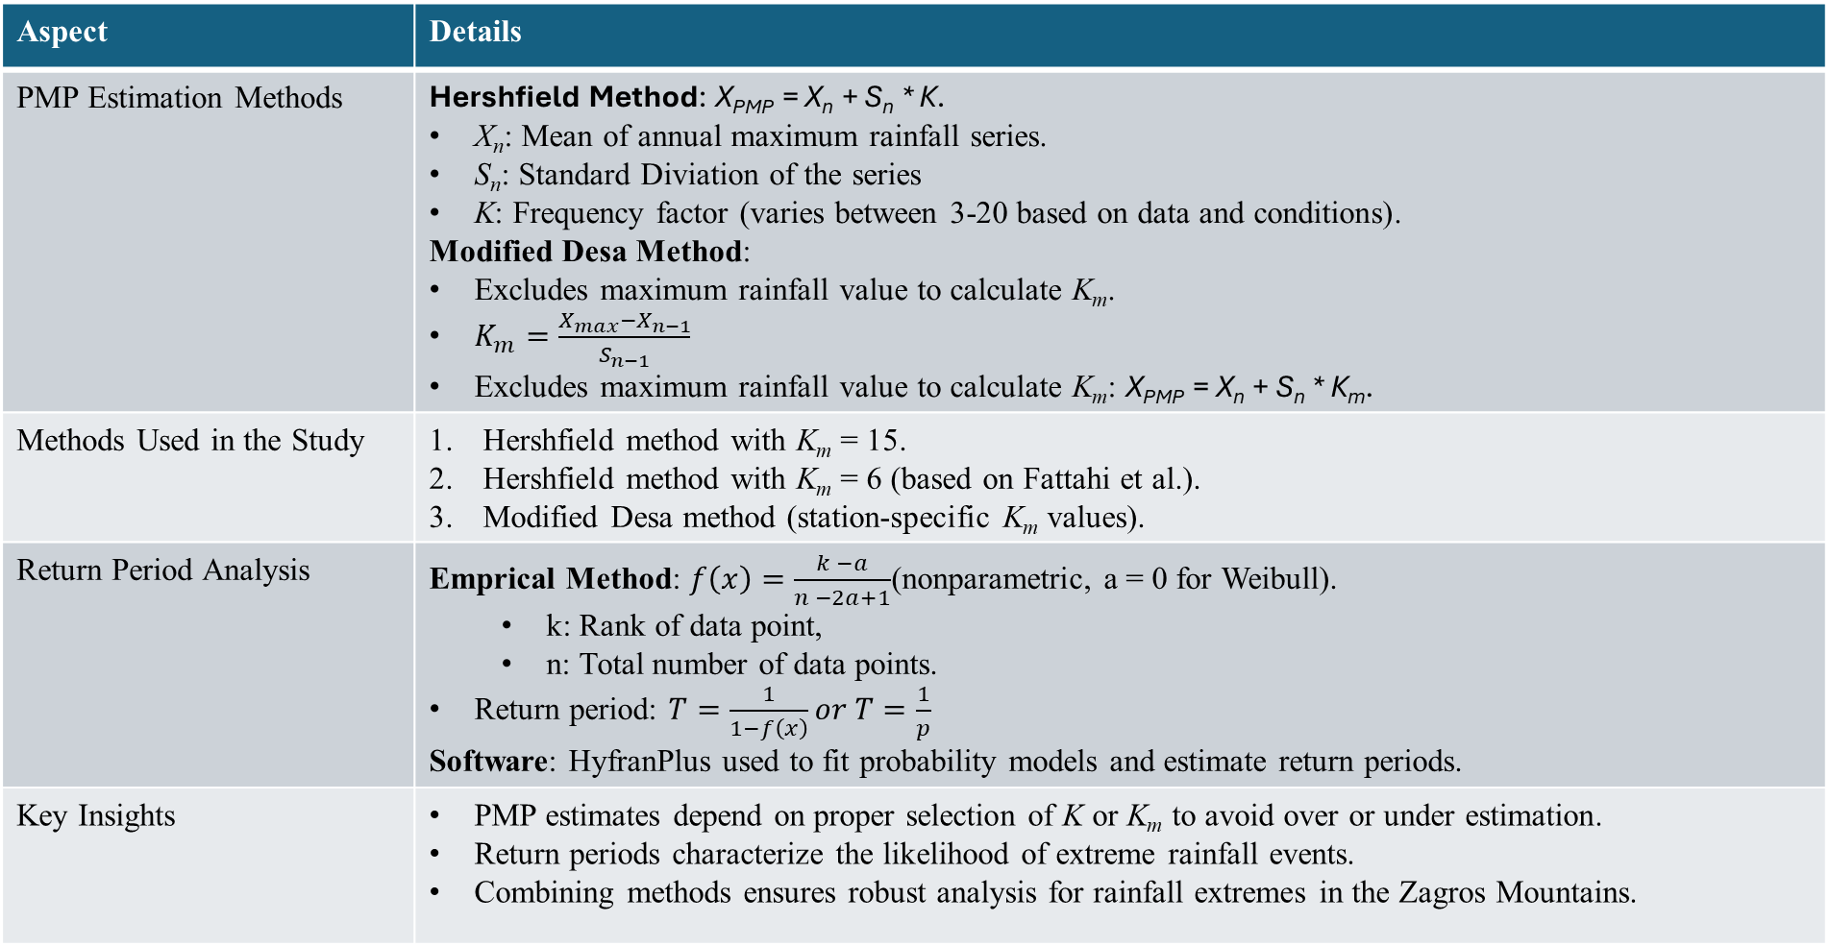
PMP (Probability Maximum Precipitation) Analysis and Return Period Estimation
Aspect | Details
PMP Estimation Methods | Hershfield Method: X_{PMP} = X_{n} + S_{n} * K. X_{n}: Mean of annual maximum rainfall series. S_{n}: Standard Diviation of the series K: Frequency factor (varies between 3-20 based on data and conditions). Modified Desa Method: Excludes maximum rainfall value to calculate K_{m}. $K_{m}=\frac{X_{max}−X_{n−1}}{S_{n−1}}$ Excludes maximum rainfall value to calculate K_{m}: X_{PMP} = X_{n} + S_{n} * K_{m}.
Methods Used in the Study | Hershfield method with K_{m} = 15. Hershfield method with K_{m} = 6 (based on Fattahi et al.). Modified Desa method (station-specific K_{m} values).
Return Period Analysis | Emprical Method: $f\left(x\right)=\frac{k −a}{n −2a+1}$(nonparametric, a = 0 for Weibull). k: Rank of data point, n: Total number of data points. Return period: $T=\frac{1}{1−f\left(x\right)}or T=\frac{1}{p}$ Software: HyfranPlus used to fit probability models and estimate return periods.
Key Insights | PMP estimates depend on proper selection of K or K_{m} to avoid over or under estimation. Return periods characterize the likelihood of extreme rainfall events. Combining methods ensures robust analysis for rainfall extremes in the Zagros Mountains.

Slide 8
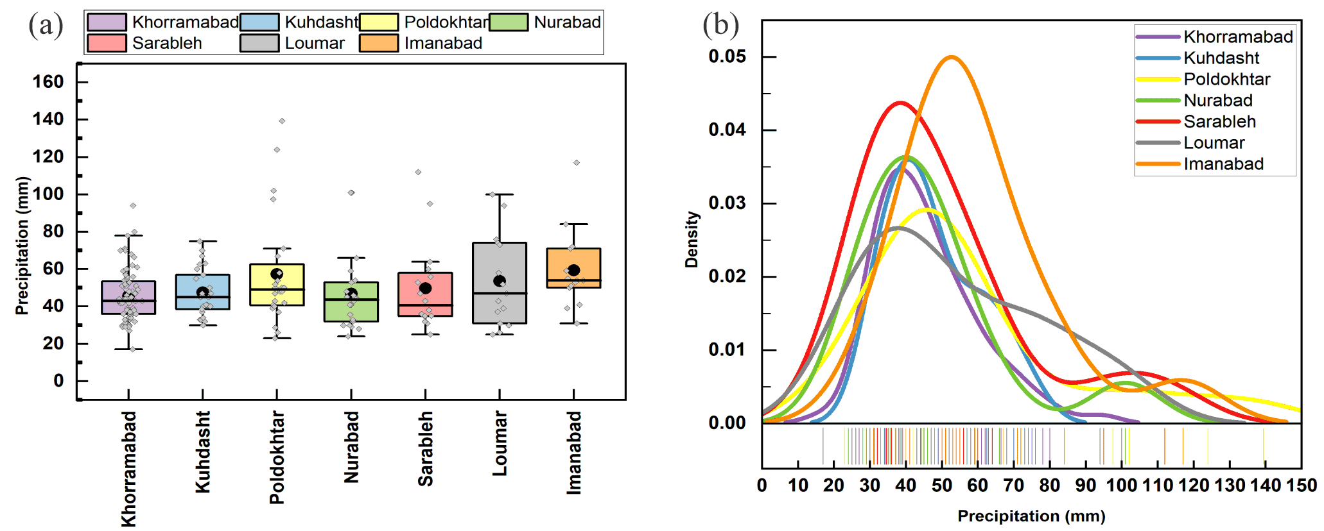
(a) Box plot of Maximum daily precipitation, (In the Study Period)
Long-term maximum daily precipitation in Karkheh
Annual total rainfall showed no significant trend.
Maximum daily rainfall displayed an increasing trend, indicating a rise in heavy rainfall events.
Positive skewness was observed at all stations, reflecting a tendency toward extreme values
(b) Distribution of Maximum daily precipitation in Karkheh stations (In the Study Period)

Slide 9
Aspect | Key Finding
Long-term Maximum Daily Precipitation | - Highest recorded rainfall: 139.4 mm (Poldokhtar), 117 mm (Imanabad). - Bimodal distribution: Observed at Sarableh, Nurabad, and Imanabad. - Positive skewness: Extreme values dominate.
Statistical Summary | - Mean precipitation: Highest at Imanabad (59.4 mm). - Skewness: Highest at Nurabad (1.73). - Kurtosis: Highest at Imanabad (3.15). - Flat distributions: Kuhdasht and Loumar.
Annual Trends | - No significant trend in total annual precipitation. - Significant increase in maximum daily precipitation at Poldokhtar (p = 0.009) and gradual increase at Khorramabad (p = 0.038).
March 2019 Rainfall Anomalies | - March 2019: Exceptionally high rainfall at Poldokhtar and Nurabad. - Historical peaks far exceeded, particularly at upstream stations, contributing to flooding risks.
Monthly Variability | - March-April 2019: Extreme rainfall at Nurabad and Poldokhtar. - Khorramabad: Rainfall lower than historical daily maximums. - Significant monthly variability across all stations.
Statistical Summary including mean, minimum, maximum, mode, median, standard deviation, skewness and kurtosis of Maximum Daily Precipitation (mm) Data
 | N | Mean | Minimum | Maximum | Mode | Median | Standard Deviation | Coefficient of Variation(%) | Skewness | Kurtosis
Khorramabad | 72 | 45.6 | 17 | 94 | 36 | 43 | 14.2 | 31.14 | 0.97 | 1.12
Kuhdasht | 25 | 47.6 | 30 | 75 | 33 | 45 | 12.9 | 27.10 | 0.60 | -0.65
Poldokhtar | 24 | 57.4 | 23 | 139.4 | 50 | 49 | 29.7 | 51.74 | 1.58 | 2.02
Nurabad | 22 | 46.8 | 24 | 101 | 30 | 43.7 | 20.5 | 43.80 | 1.73 | 2.99
Sarableh | 16 | 49.8 | 25 | 112 | 35 | 40.5 | 24.0 | 48.19 | 1.64 | 2.35
Loumar | 15 | 53.7 | 25 | 100 | -- | 47 | 24.5 | 45.62 | 0.63 | -0.77
Imanabad | 14 | 59.4 | 31 | 117 | 54 | 54 | 21.6 | 36.36 | 1.52 | 3.15

Slide 10
Statistical Analysis
Gumbel distribution is effective for long-term data (72 years) at Khorramabad.
Inverse Gamma distribution is best for shorter datasets.
Return periods for extreme events range from 50 to 300 years
Discussion of Uncertainties
Lack of long-term data (>30 years) for many stations.
Limited synoptic data (<20 years) restricts return period analysis.
Reliance on historical data introduces uncertainties due to climate change.

Slide 11
PMP (mm) calculation with different methods
PMP Method | Khoramabad (72) | Kuhdasht (25) | Pol-Dokhtar (24) | Nurabad (22)
Hershfile (K_{m} = 15) | 268.8 | 240.4 | 502.8 | 355.0
PMP (24)/P24 | 2.86 | 3.21 | 3.61 | 3.52
Modified (K_{m} = 6) | 135.40 | 124.71 | 235.58 | 170.08
PMP 24/P24 | 1.44 | 1.66 | 1.69 | 1.68
Desa et al (2001) | 98.3 | 92.6 | 161.0 | 118.8
K_{m} | 3.50 | 2.43 | 3.34 | 3.48
PMP (24)/P24 | 1.05 | 1.23 | 1.16 | 1.18
Highest PMP (24-h): Pol-Dokhtar (139 mm) and Nurabad (101 mm).
PMP24/P24 ratio was lowest in the third estimation method
  (Desa et al., 2001).
Highlights critical zones for flood mitigation.
  PMP estimation highest for Pol-Dokhtar using Hershfield method (502.8 mm).

Slide 12
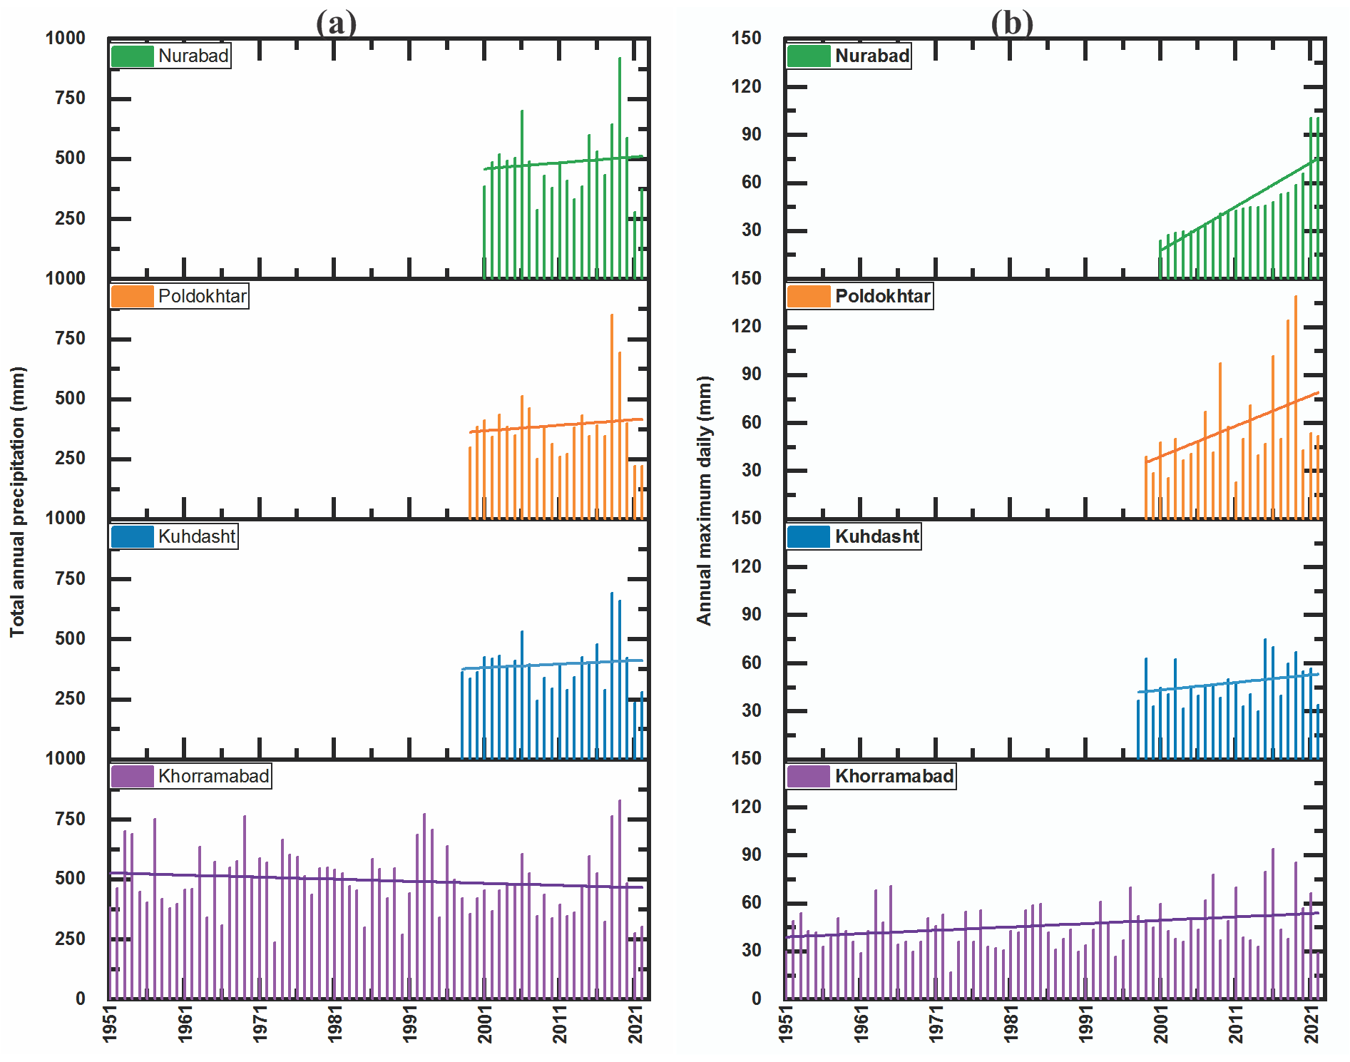
Time-series plots comparing precipitation levels during March 2019 with historical data.
Annual Rainfall Trends
Annual total rainfall showed no significant trend.
Maximum daily rainfall increased, indicating a rise in heavy rainfall events.
Positive skewness observed in all stations, reflecting a tendency toward extreme values.

Slide 13
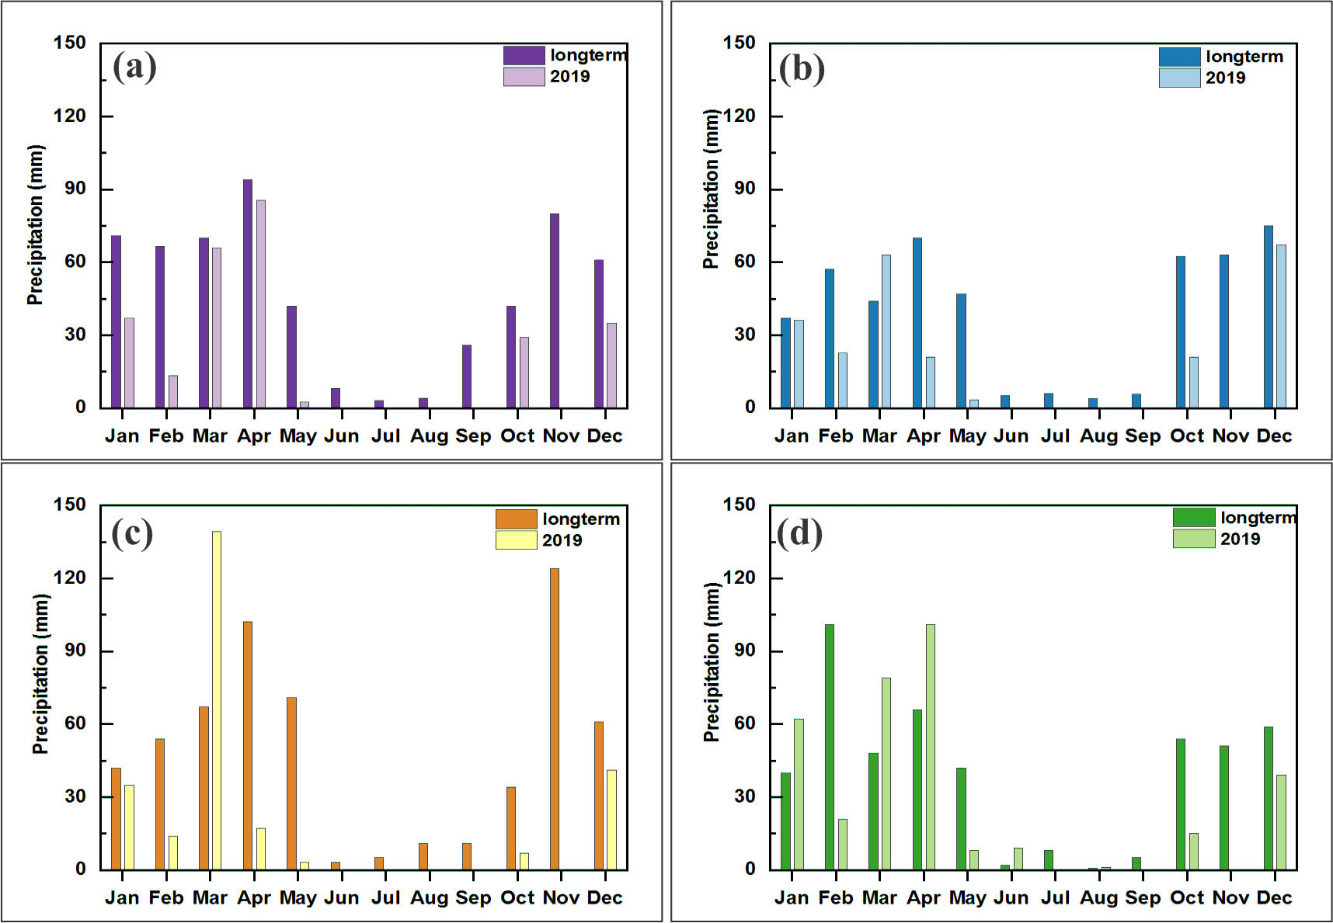
Monthly maximum daily precipitation
Khorramabad
Kuhdasht
Poldokhtar
Nurabad

Slide 14
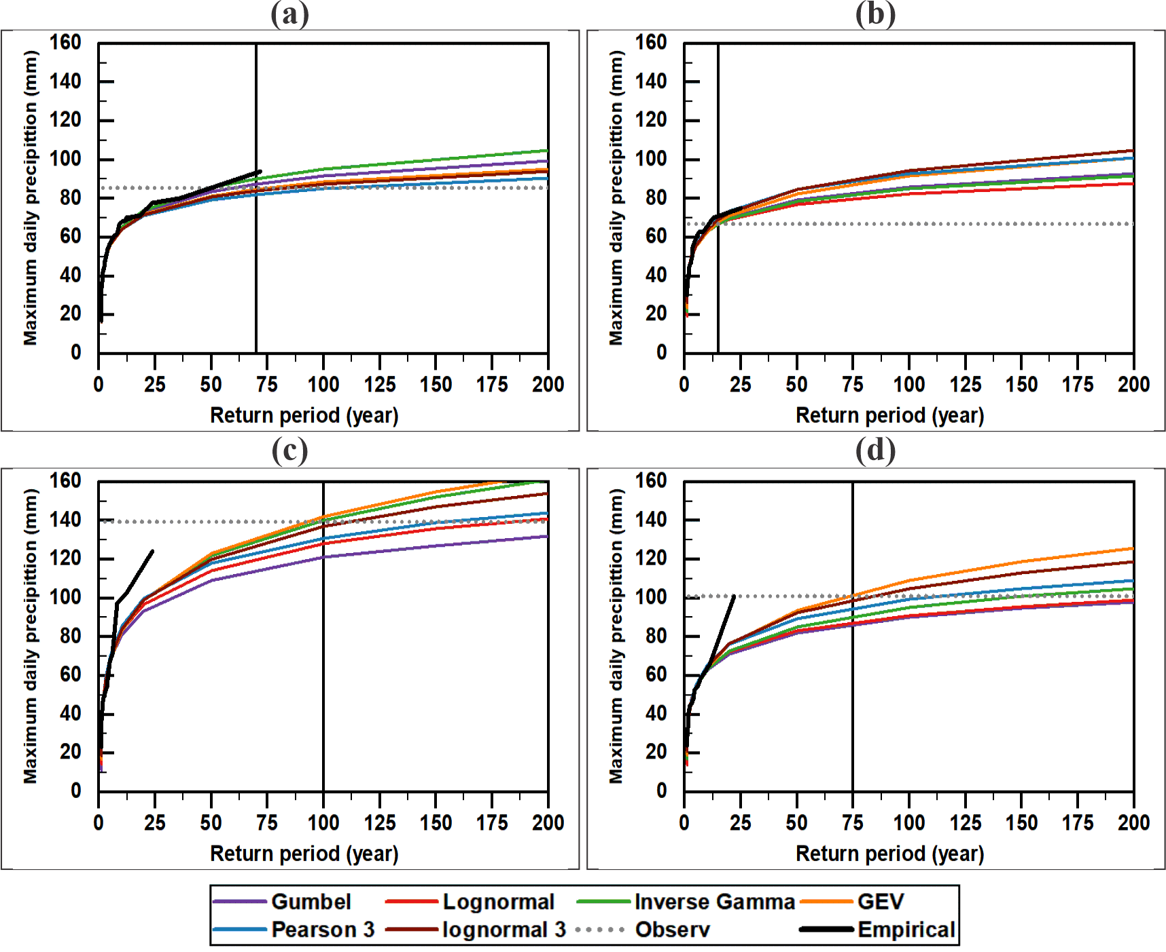
Annual Maximum Precipitation vs. Return Period
Return period
Aspect | Key Findings
Return Period Analysis | - Khorramabad: Empirical return period for 85 mm is 54 years; mathematical models range from 50–70 years (except Pearson III). - Kuhdasht: Empirical return period for 67 mm is 10 years; mathematical models range 15–20 years.
Performance of Statistical Distributions | - Best fit (overall): Inverse Gamma. - Khorramabad: Gumbel performed best. - Weaker fits: Pearson Type III and GEV (especially for Poldokhtar and Nurabad).
March 2019 Events | - Poldokhtar: 139 mm rainfall linked to a return period of 70–300 years. - Nurabad: 101 mm rainfall return period ranges from 70–200 years. - Differences in empirical vs. mathematical distributions were significant.
Climate Variability Insights | - Trends in extreme precipitation during March and April 2019 reflect potential shifts in rainfall patterns. - Variability in model fits indicates the need for careful evaluation and validation.
Implications for Flood Risk | - A clear relationship between precipitation magnitude and return periods highlights flood risks. - Data assists in flood management and policy planning.
Khorramabad
Kuhdasht
Poldokhtar
Nurabad

Slide 15
Distribution Type | Khoramabad (72) |  | Kuhdasht (25) |  | Pol-Dokhtar (24) |  | Nurabad (22)
 | BIC | AIC | BIC | AIC | BIC | AIC | BIC | AIC
Inverse Gamma | 3 | 3 | 1 | 2 | 1 | 1 | 1 | 1
Gumble | 1 | 1 | 2 | 3 | 3 | 3 | 2 | 2
Lognormal | 2 | 2 | 3 | 4 | 2 | 2 | 3 | 4
Pearson3 | 6 | 6 | 4 | 1 | 6 | 6 | 4 | 3
_{GEV} | 4 | 4 | 6 | 6 | 4 | 4 | 5 | 6
Lognormal3 | 5 | 5 | 5 | 5 | 5 | 5 | 6 | 5
Performance scores of statistical distributions (BIC and AIC) for analyzing maximum precipitation at selected stations. This table lists the distribution types with their corresponding scores for the Bayesian Information Criterion (BIC) and Akaike Information Criterion (AIC). Lower scores indicate a better fit.

Slide 16
Conclusion:
Section | Summary
Event Overview | March 2019 saw maximum daily rainfall exceeding the long-term average, causing flooding downstream in the Karkheh basin. Contributing factors included heavy rainfall and altered land structures along riverbanks.
Rainfall Trends | Annual total rainfall showed no significant trend, but maximum daily rainfall displayed an increasing trend, signaling more frequent heavy rainfall events. Rainfall data exhibited positive skewness toward extreme values.
PMP Analysis | Pol-Dokhtar and Nurabad had the highest PMP (24-h) estimates. The PMP24/P24 ratio was highest in Pol-Dokhtar and Nurabad, with the lowest ratio observed in the third PMP estimation method by Desa et al. (2001).
Statistical Distributions | Gumbel distribution was most effective for the 72-year record at Khorramabad, while the Inverse Gamma distribution was best for shorter records, estimating return periods of 50-300 years for extreme events at various stations.
Key Stations | Maximum daily rainfall: 139 mm (Pol-Dokhtar) and 101 mm (Nurabad) in March 2019. Return periods for these values ranged from 70 to 300 years. The highest long-term daily rainfall did not occur in March or April.
Insights and Implications | The study enhances understanding of hydrological extremes in the Zagros Mountains, informing flood mitigation strategies and supporting climate resilience in vulnerable regions.
Uncertainties and Limitations | Lack of long-term data (over 30 years) for many stations, especially those recording the highest rainfall. Limited synoptic data (under 20 years) restricts return period analysis. Historical data introduces climate change-related uncertainties.

