Slide 1


Developing early warning systems for Greek Prefectures and Municipalities
Bonn, 18/03/2025

Slide 2

Early warning systems-Why we need them?
Severe weather events are among the great risks for modern societies.
Climate change is increasing their severity and frequency.
In addition, forest fires are a major environmental problem for the Mediterranean countries

Slide 3
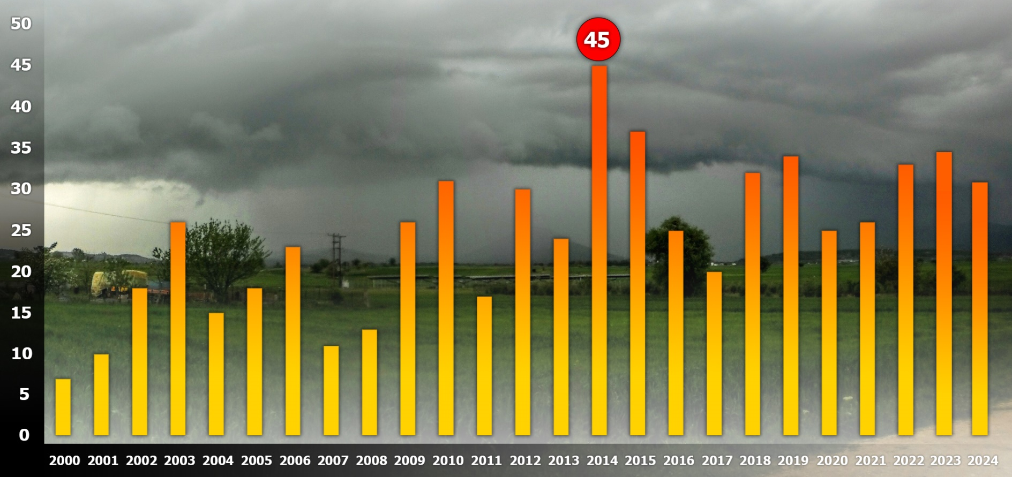
Severe weather events in Greece (2000-2024)
NUMBER OF THE MOST SEVERE EVENTS
2000-2009: 60 events
2010-2019: 90 events
2000-2009: 167 weather events
2010-2019: 295 weather events

Slide 4
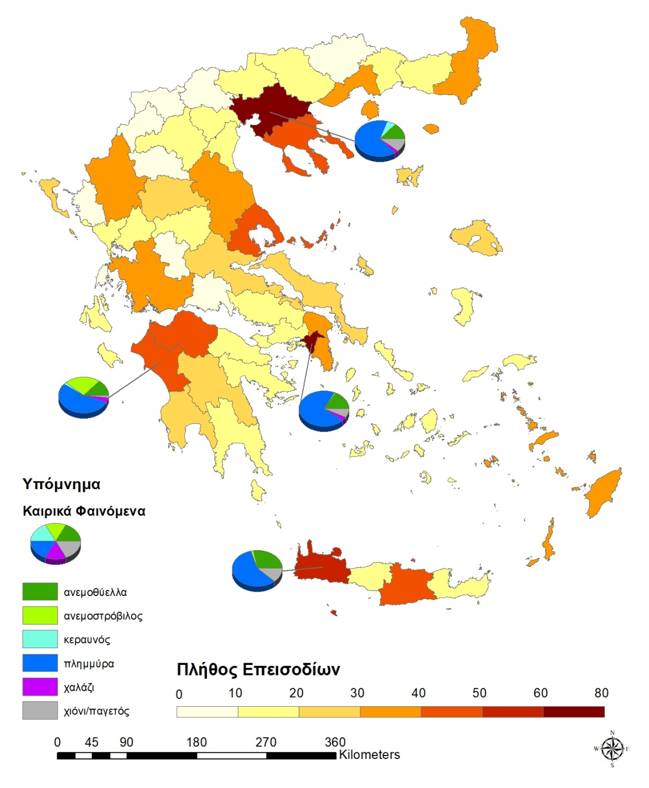
Geographical distribution of weather events

Slide 5
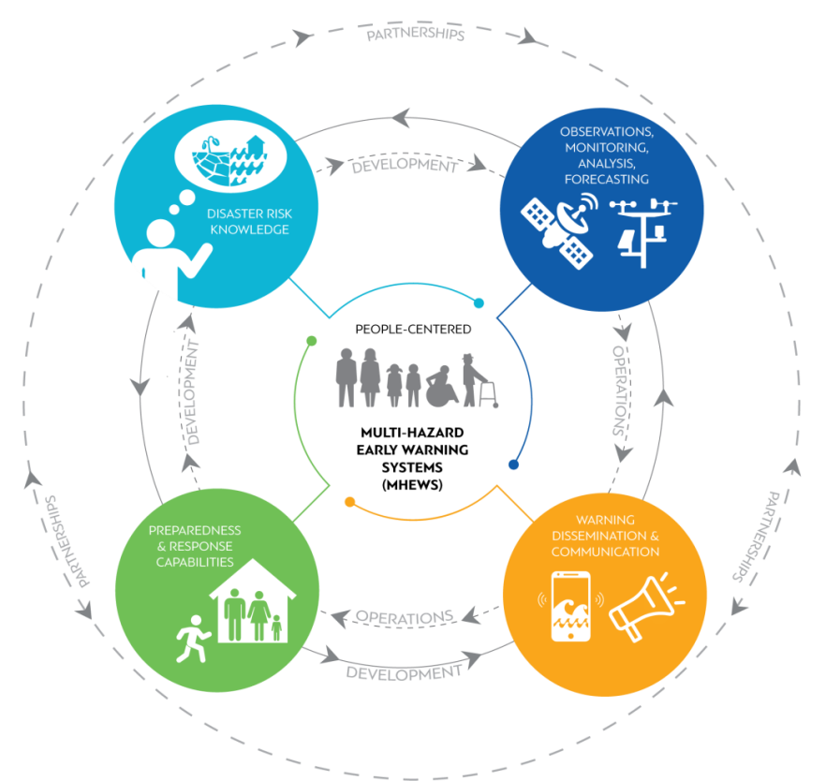
Early warning systems-4 pillars
Observations, monitoring,
analysis, forecasting
.
Disaster risk knowledge
Preparedness and response capabilities
Warning dissemination and communication

Slide 6
Steps to build an Early Warning System
1 | Identify the disaster risk factors of the area
2 | Develop/expand observing platforms and forecasting services, tailored to the local needs
3 | Build and operate the Early Warning System-collaboration with the local authorities
4 | Training local authorities and volunteer’s associations

Slide 7
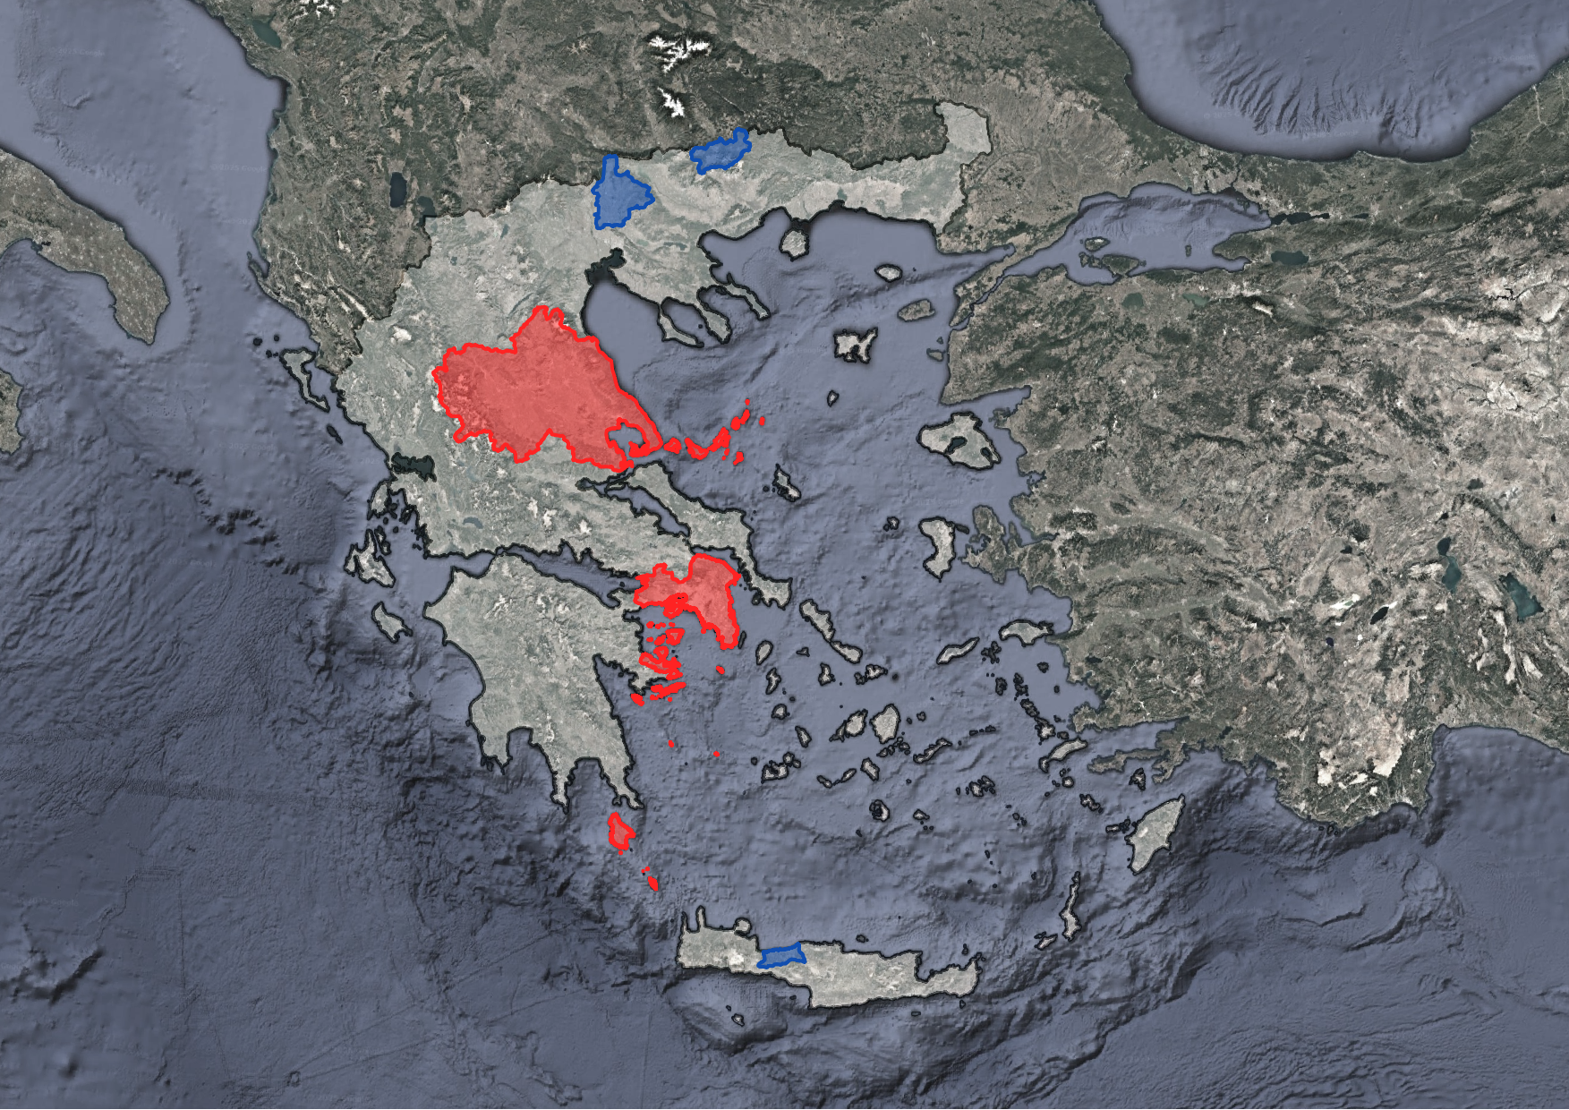
Early warning systems in operation

Slide 8
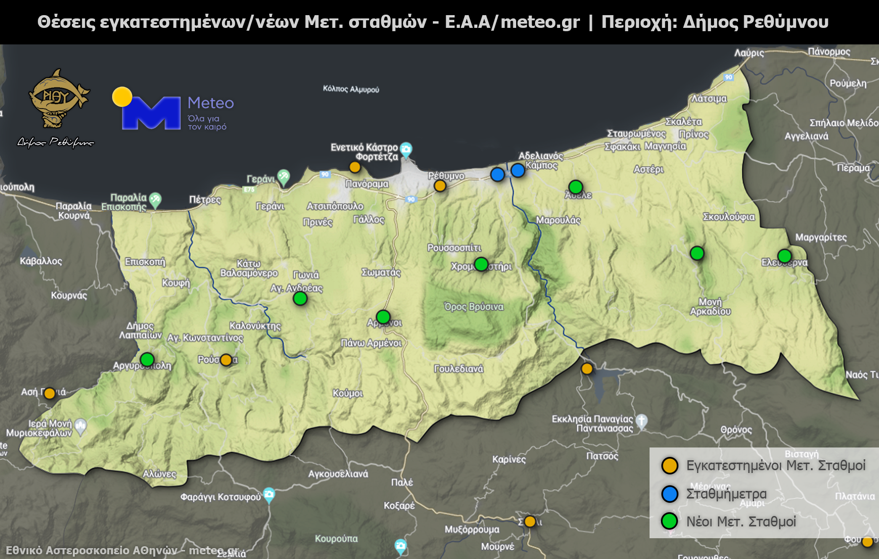

Example: Building an EWS for Rethymno
Existing weather stations (yellow dots)
7 new weather stations (green dots)
2 level meters (blue dots)
2 air-quality sensors

Slide 9
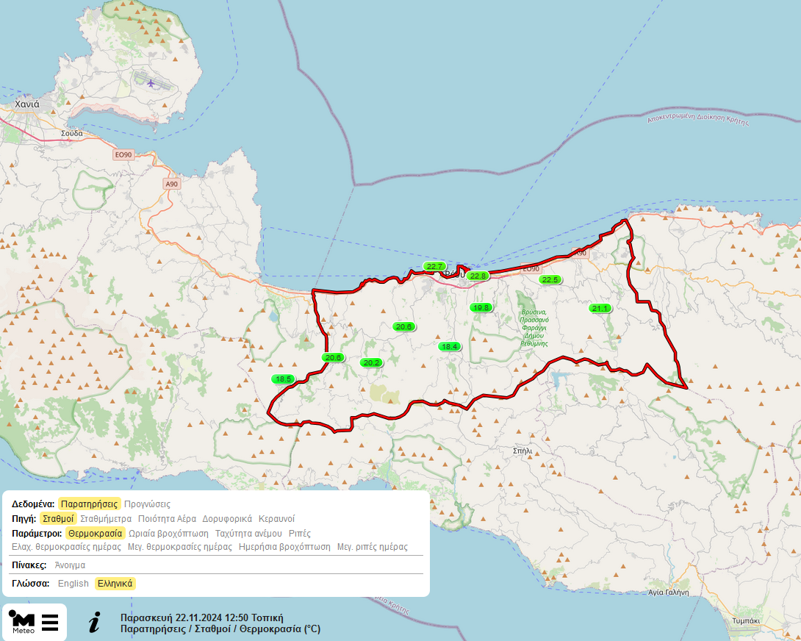
EWS-Main page
www.meteo.gr/rethymno

Slide 10
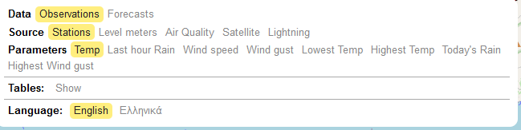
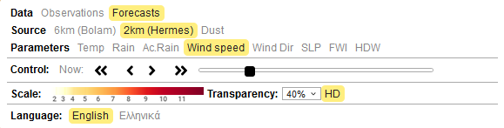
EWS-Main menu

Slide 11
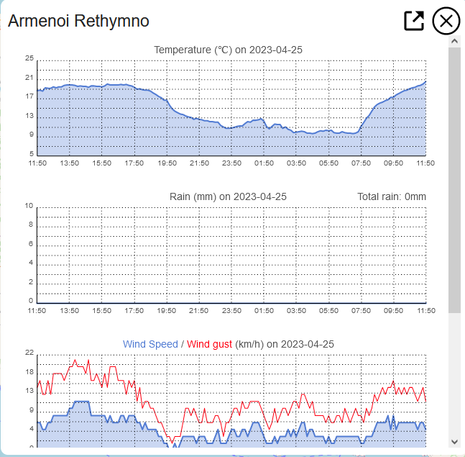
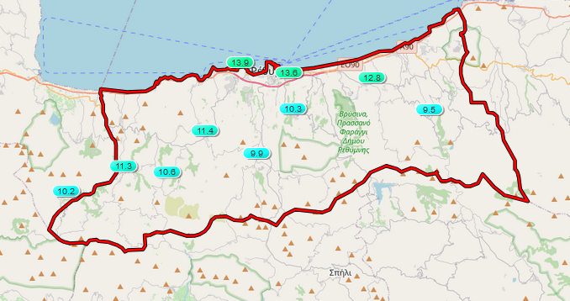
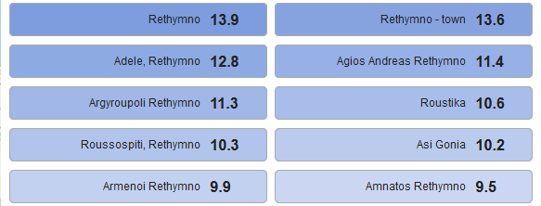
Station Observations

Slide 12
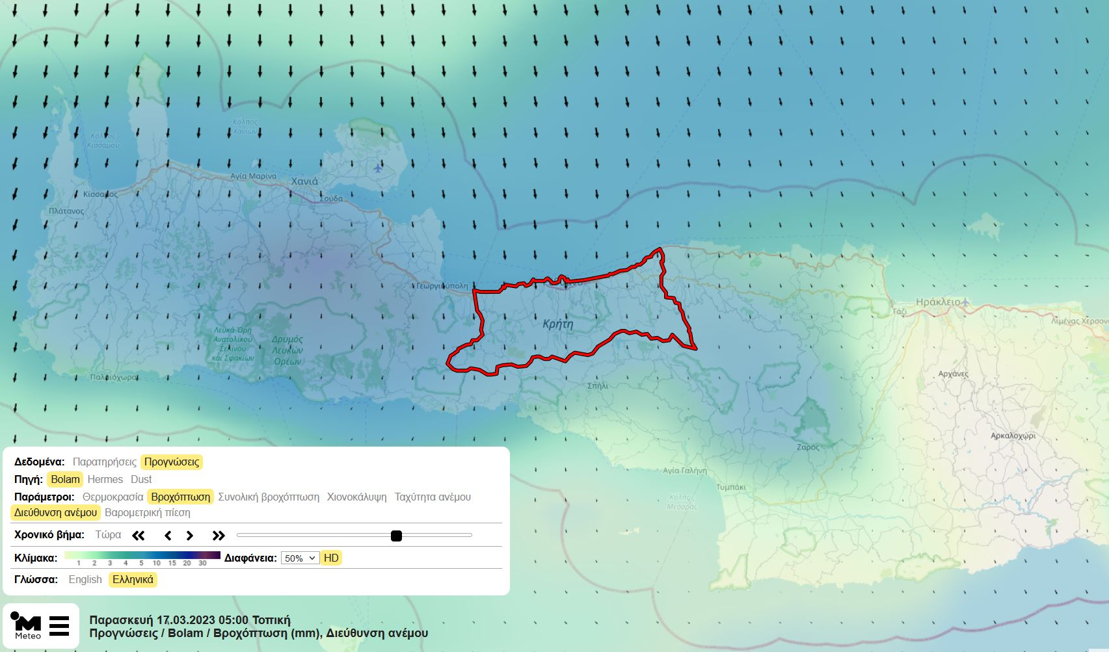
Wind and rainfall forecasts

Slide 13
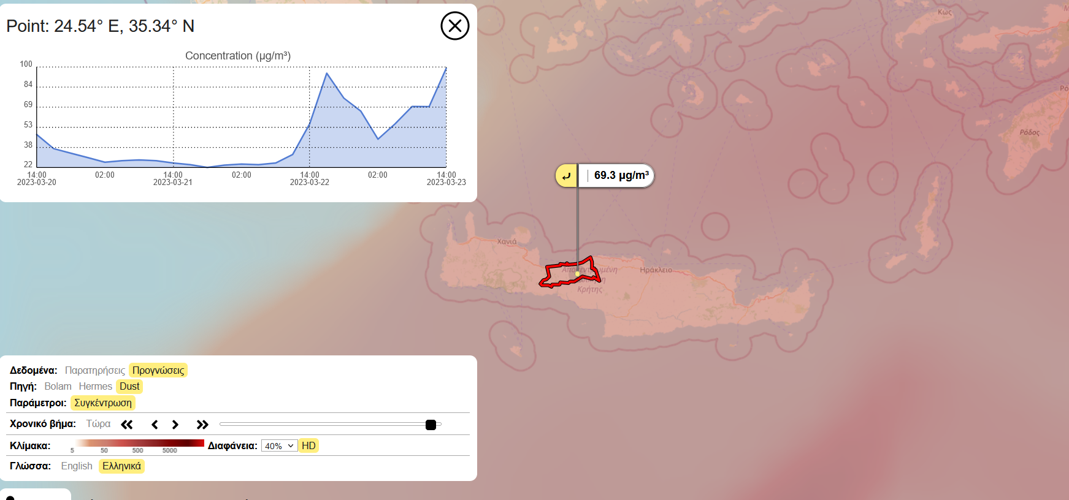
Dust forecasts

Slide 14
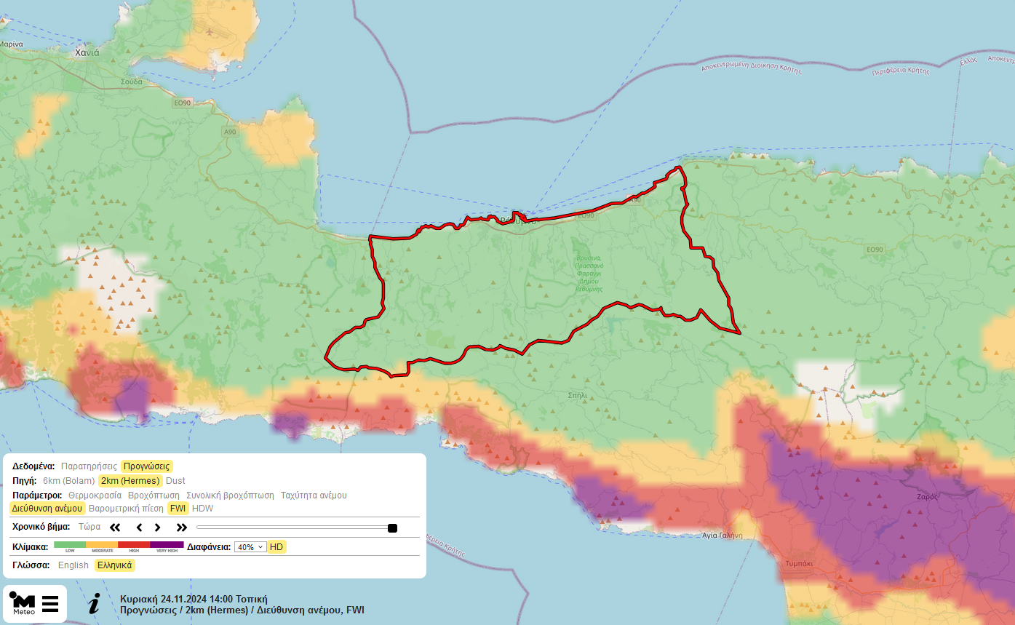
Fire danger index

Slide 15
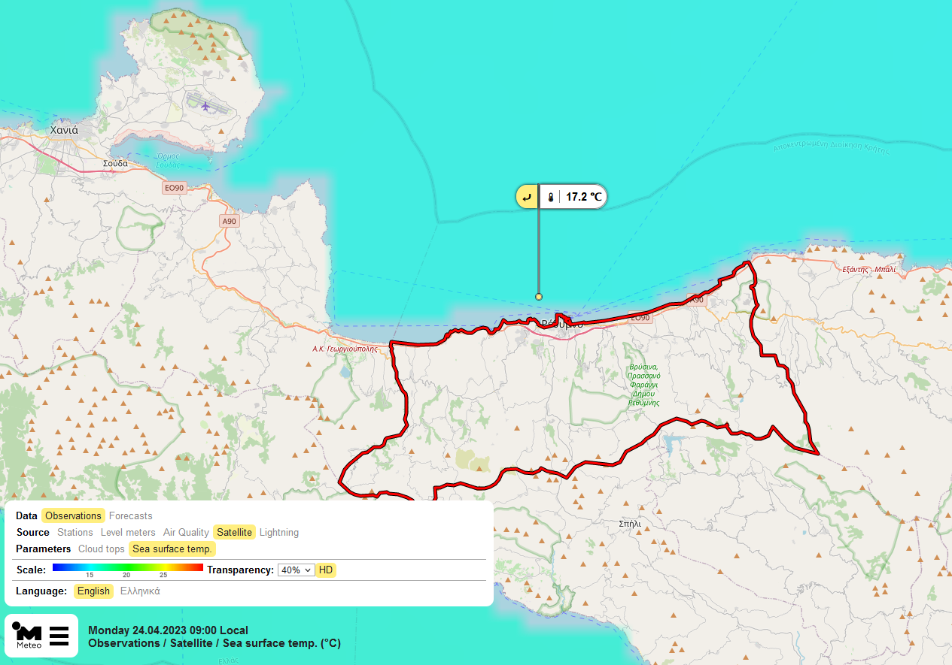
Sea Surface Temperature

Slide 16
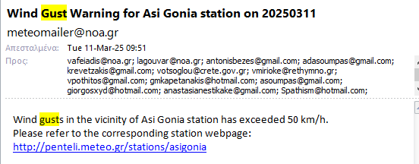
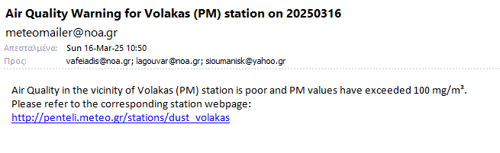
Automated Messaging
Wind Gusts-Crete-Southern Greece
Air quality-Northern Greece

Slide 17
Early warning systems in operation

Slide 18
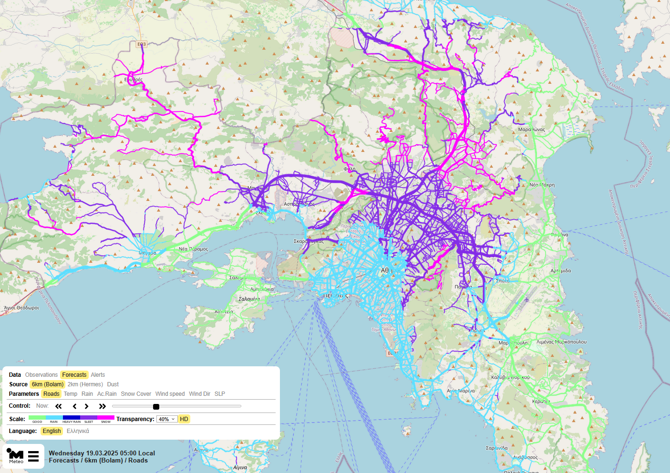
Region of Athens-Road conditions

Slide 19
Strengths and weaknesses
Strengths
Unique way to combine all source of information in one platform
Life Protection
Infrastructure Protection
Improved Disaster Preparedness
Weaknesses
False Alarms & Misses
Implementation Costs-sustainability of the infrastructure
Authorities/Public Response Variability-Lack of integration in decision-making

Slide 20
Further improvements
Apply an ensemble forecasting approach
Apply hydrological models at basin scale
Further develop impact-based forecasts
Expand the observational networks (radars needed!)
Invest in staff training with clear operational protocols.
Improve public communication through multi-channel warnings (SMS, social media, etc.).
Enhance coordination between meteorological service providers, first responders, local authorities and volunteers.
Secure consistent funding for system upgrades.

Slide 21
THANK YOY

