Slide 1
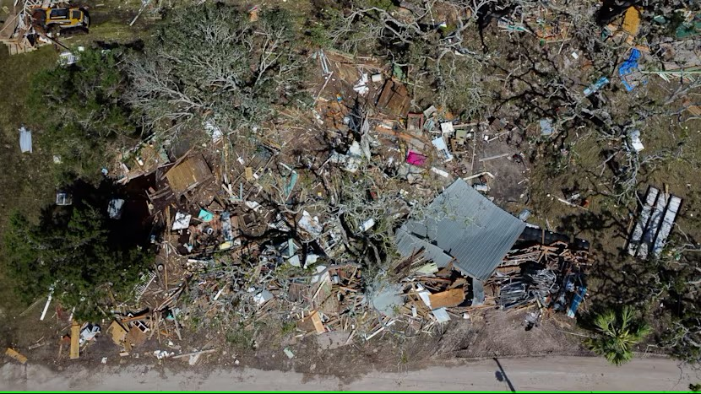
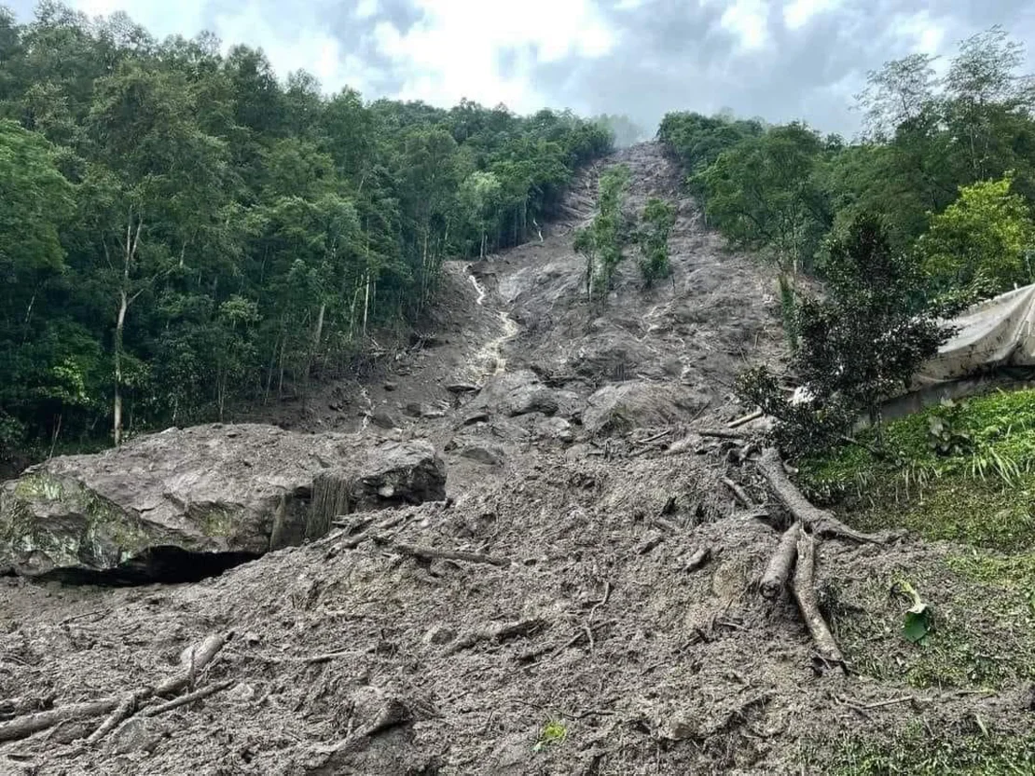
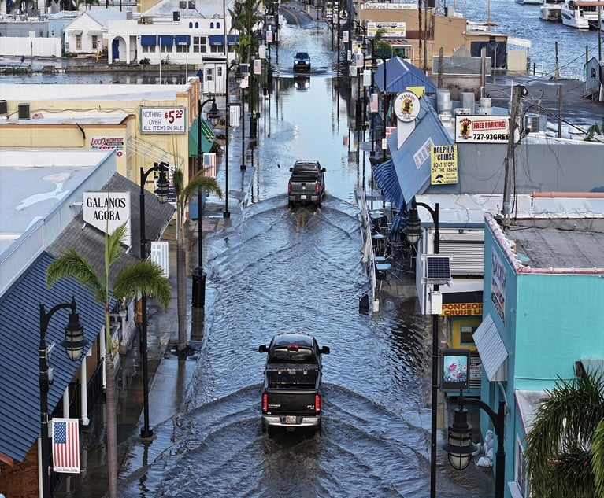
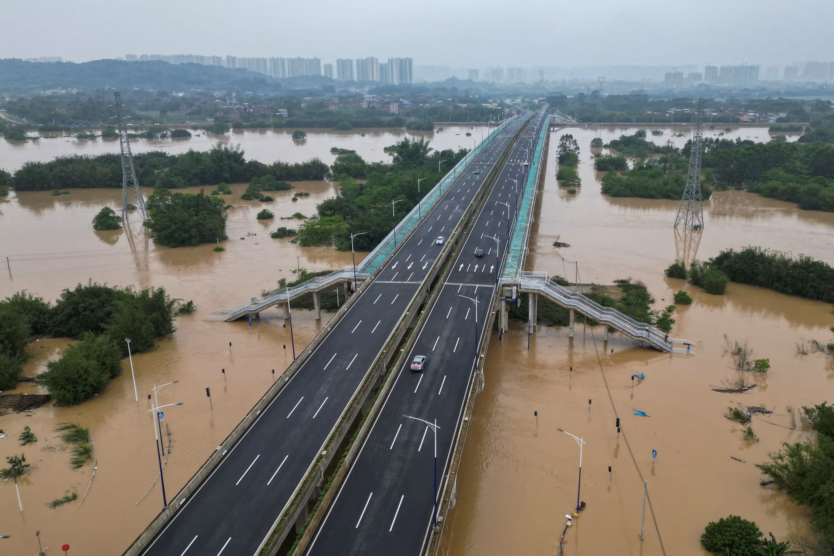
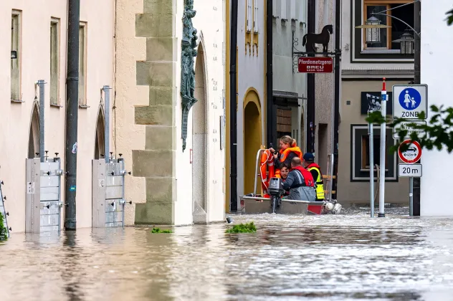
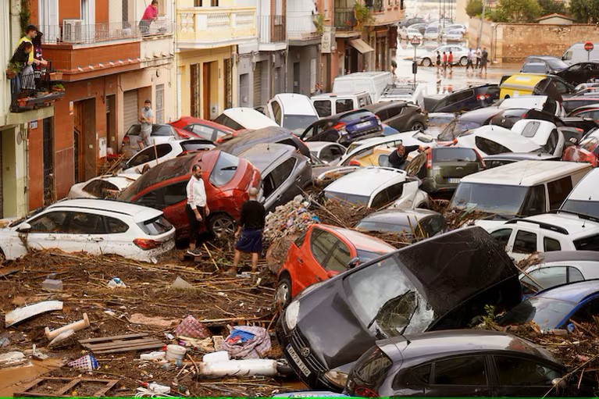
A Global Sub-Daily Rainfall dataset
Amy C. Green¹
Hayley Fowler¹, Matt Fry², Stephen Blenkinsop¹, Elizabeth Lewis³, Selma Guerreiro¹
¹ School of Engineering, Newcastle University
² UK Centre for Ecology and Hydrology
³ School of Engineering, Manchester University
amy.green3@newcastle .ac.uk
GSDR
Notes:
Hi everyone, I’m Amy Green.
I’m a research associate at Newcastle University in England, and I work primarily on extreme rainfall at the moment, which is what I am going to talk to you about today.
Background is simulating rainfall for understanding radar rainfall estimation errors.
This work is a collaboration between a lot of people.

Slide 2
Extreme rainfall in 2024…
Source: Christian Aid Report – Counting the cost
 |  | Fatalities | Economic Cost (USD)
Jan-Dec | US storms | 88 | 60+ bn
Oct | Hurricane Milton | 25 | 60 bn
Sep | Hurricane Helene | 232 | 55 bn
Jun-Jul | China floods | 315 | 15.6 bn
Sep | Typhoon Yagi | 829+ | 12.6 bn
Jul | Hurricane Beryl | 70 | 6.7 bn
Sep | Storm Boris | 26 | 5.2 bn
Apr-May | Rio Grande do Sul floods | 183 | 5 bn
Jun | Bavaria floods | 6 | 4.45 bn
Oct | Valencia floods | 226 | 4.22 bn
Notes:
Extreme rainfall has devastating impacts across the globe.
From hurricanes in the US, to droughts followed by flooding in Brazil, cyclones impacting monsoons and heavy storms such as Boris in Europe
2024 was one of the wettest years on record.
Consequently, flooding was the weather event which had the highest cost in terms of both fatalities and economic damage.
Extreme rainfall resulted in several cascading impacts such as flooding, landslides and storms hitting before recovery from previous events.

Slide 3
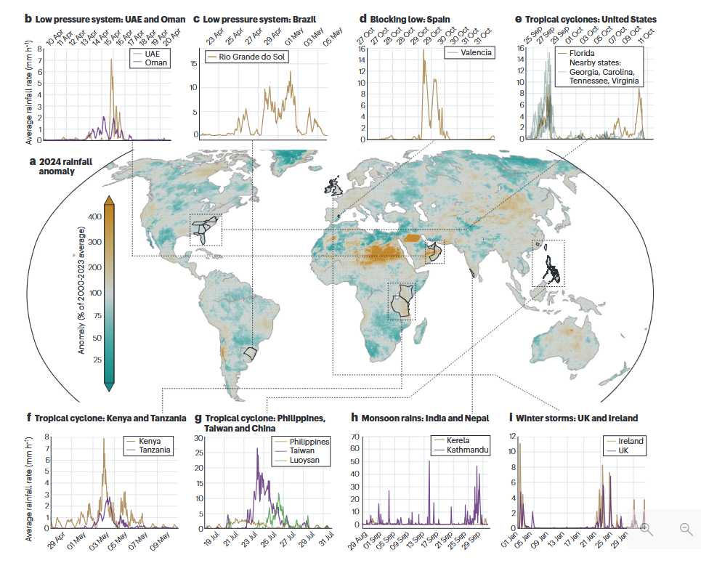
Extreme rainfall in 2024…
Notes:
These are just some of the biggest extreme rainfall events in 2024, extracted from satellite data, and the annual rainfall anomaly for 2024 as a percentage of the previous X years.
The impacts of extreme rainfall are clear, and the intensity and frequency are changing due to climate change.
Often record-breaking precipitation events have been increasing globally, largely in line with thermodynamic forcing.
For adaption, mitigation, design and warning we need accurate, timely estimation and prediction of events, and how they may change in the future.
Climate models project ongoing rainfall intensification (with regional variability governed by local warming rates, local scale storm dynamics and large-scale circulation variability.
There is lot still unknown, and so there is no getting around it, even with all the tools and knowledge we already have, we need high quality rainfall observations to enable us to understand extreme rainfall.
I’m sure everyone here knows that, given we are at a rainfall conferences so I will move quickly on through the motivation and introduction of this talk so we can get to the more interesting stuff more quickly.

Slide 4





Rainfall estimation
Rain gauges
Weather radar
Satellite
Citizen science
Microwave links
Notes:
There are a few different ways of estimating rainfall – both direct and indirect – each with their own merits and associated problems.

Slide 5
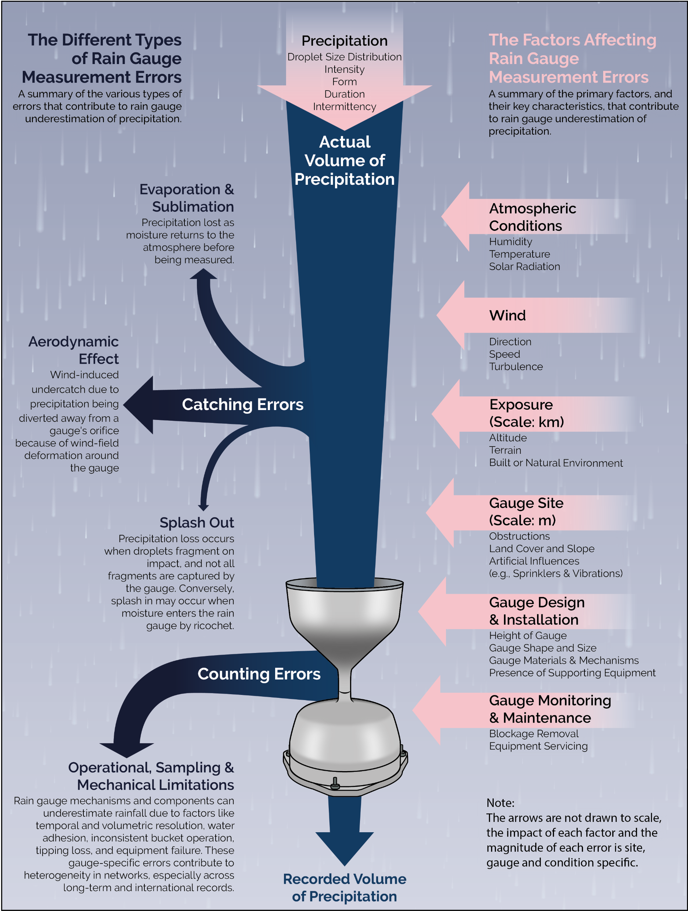
Rainfall estimation
Rain gauges
Weather radar
Satellite
Higher accuracy
Longer records
Low spatial information
Citizen science
Microwave links
Image source: Ruth Dunn
Notes:
Historically, rain gauges were used, which provide fairly accurate estimates of rainfall rates at a good temporal resolution but these only provide information about a small area, even with dense gauge networks.

Slide 6
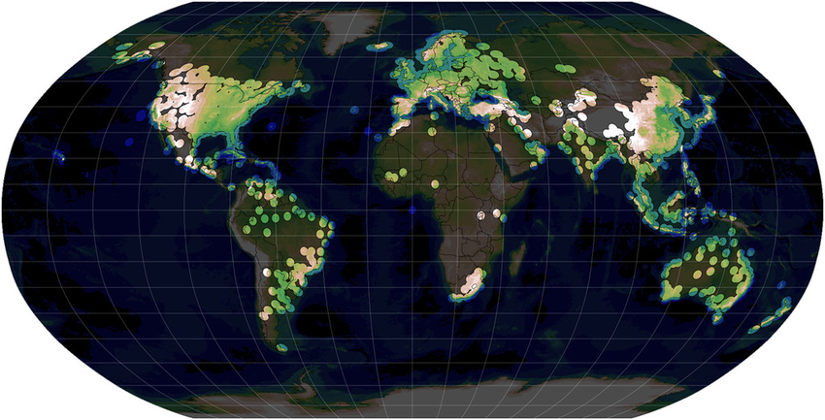
Rainfall estimation
Rain gauges
Weather radar
Satellite
Indirect measurements
Shorter records
High spatial information
Citizen science
Microwave links
Image source:
Doyle, A. J. (2022) Use of operational weather radars for understanding Indian monsoon convection and evaluating convection-permitting models. PhD thesis, University of Reading
Notes:
Over recent decades, spatial rainfall data has become more prevalent, with the improvements in radar rainfall estimation, particularly with dual polar observations.
GPM satellite data has a very good global coverage, but this has a lower spatial resolution.
Depending on the use of the rainfall data, a different dataset will be more desirable, but typically studies on extreme rainfall require fairly long records and so favour rain gauge data.
Either way, it is generally good practice to use rainfall from multiple sources, and so rain gauge data are often used for quality checking, correcting and ground truthing other rainfall datasets.
Ideally a sub-daily resolution is needed to capture extreme intense events.

Slide 7
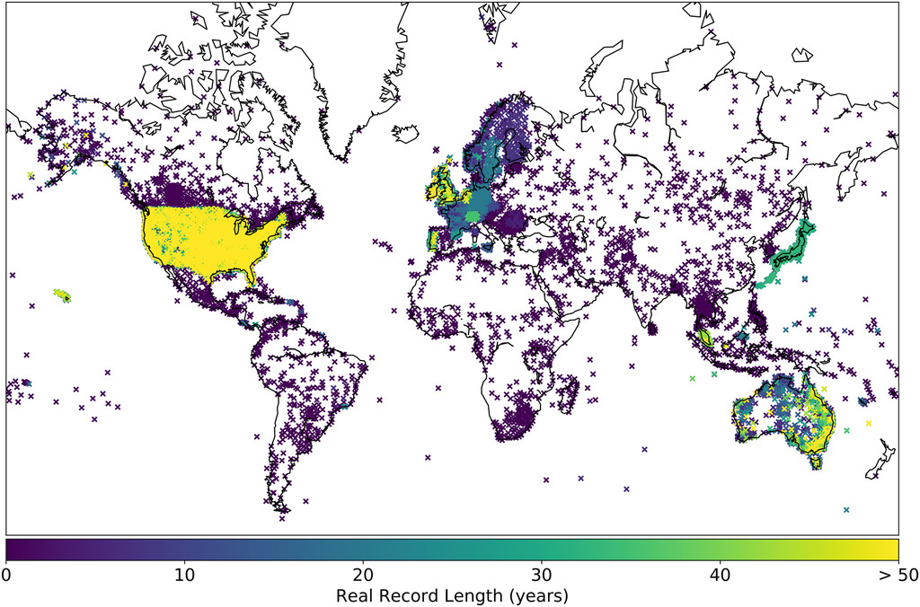
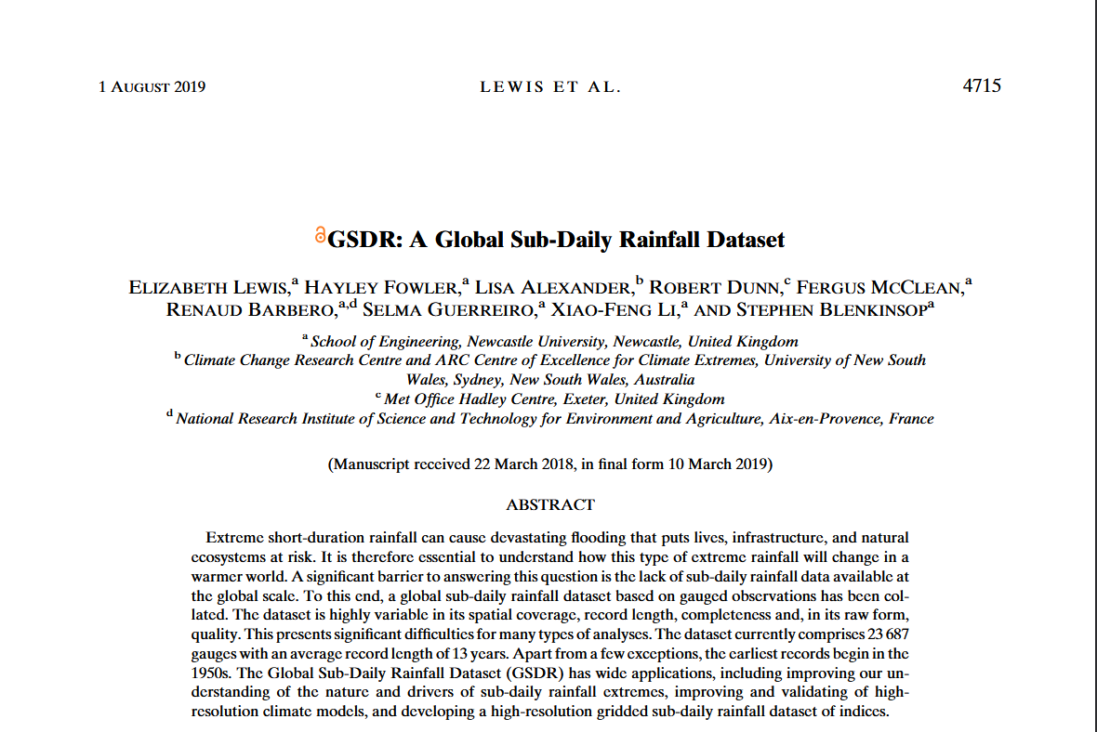

What is the GSDR?
Image source:
Lewis et al (2019) GSDR: A Global Sub-Daily Rainfall Dataset, DOI: 10.1175/JCLI-D-18-0143.1
INTENSE project
Global dataset of hourly quality controlled rain gauge observations
Manual collection
23,687 rain gauges
Notes:
To this end, as part of the INTENSE project, a global dataset of sub-daily rainfall was collected.
This dataset contains over 20 thousand rain gauges, accumulated to an hourly resolution.
The collection of the data was mostly done manually, with the help of international meteorological agency and colleagues across the globe (and took a lot of time).

Slide 8
What is the GSDR?
Image source:
Lewis et al (2019) GSDR: A Global Sub-Daily Rainfall Dataset, DOI: 10.1175/JCLI-D-18-0143.1
Quality controlled
  25 quality checks and 11 rules
  excludes suspicious values, improves correspondence with manually quality-controlled GPCC data
  Flexible level of removal depending on data use
Variable spatial coverage, record length, completeness, average record length 13 years, earliest records in 1950s.
Notes:
Data was quality controlled using rule-based checks, with 20 flags, including suspicious gauge checks, high value checks using extreme daily indices and neighbourhood checks, with the option of relaxing flags depending on the data usage (followed by manual checks).
The resulting dataset has variable spatial coverage, record length and completeness.
The average record length 13 years, with the earliest records in 1950s.

Slide 9
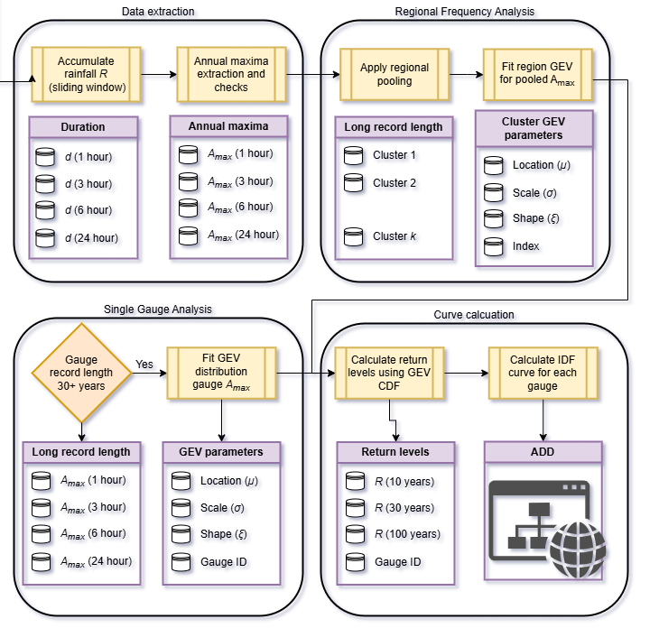
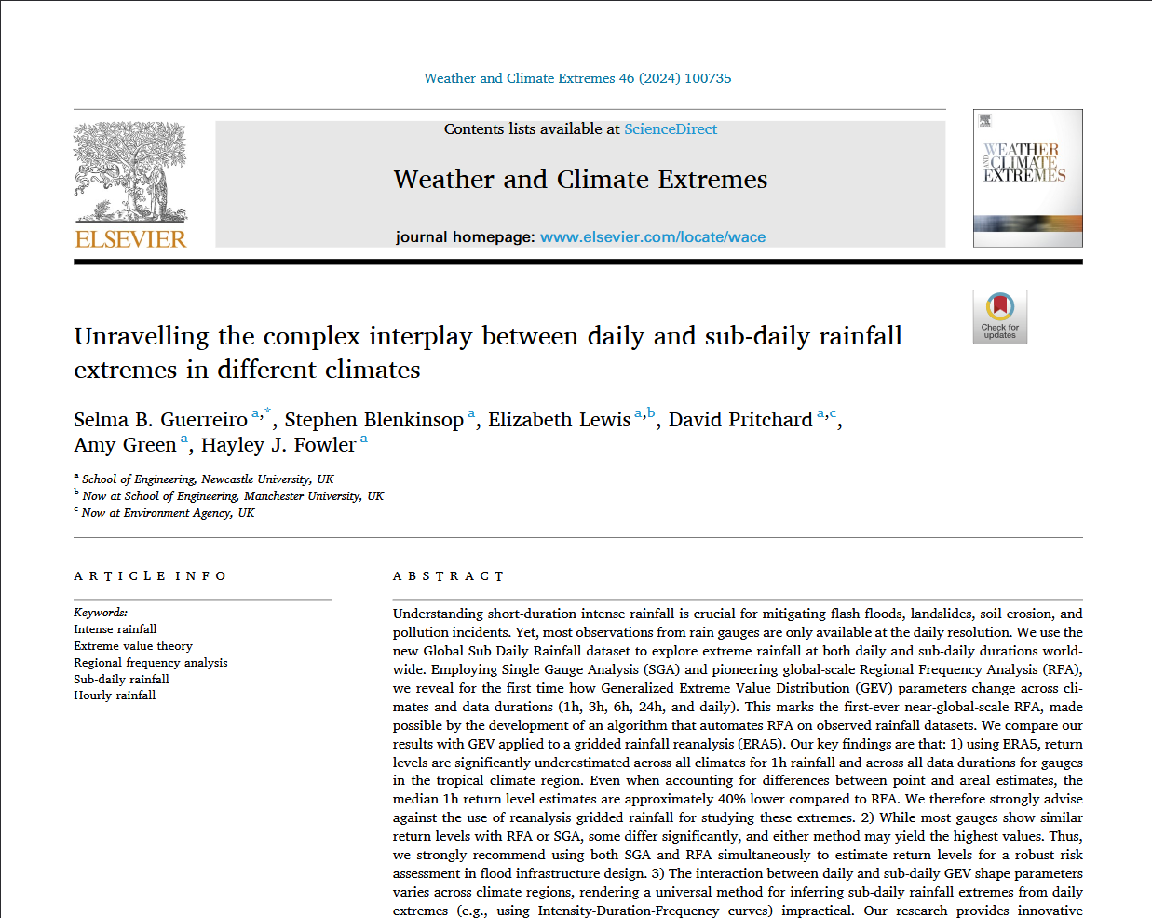
Extreme rainfall workflow
Extreme value analysis
Duration 1-24hr
Regional pooling
Compared to ERA5 with area reduction factor
Notes:
This dataset has been used to consider the behaviour of extreme precipitation for different climatologies across the globe.
The data was accumulated up to different durations, 1, 3, … 24 hours and annual maxima were extracted.
The quality controlled rainfall data was used for an extreme value analysis, taking the longer gauge records first, to fit a single gauge generalised extreme value distribution.
For all gauge records (>15years), for each duration regional frequency analysis was applied first, by applying regional pooling to the gauge records, and then ther regional GEV paramters were converted back to single gauge GEV parameters.
This was compared to results obtained from ERA5 reanalysis data (regularly used for climatological studies for this application).

Slide 10
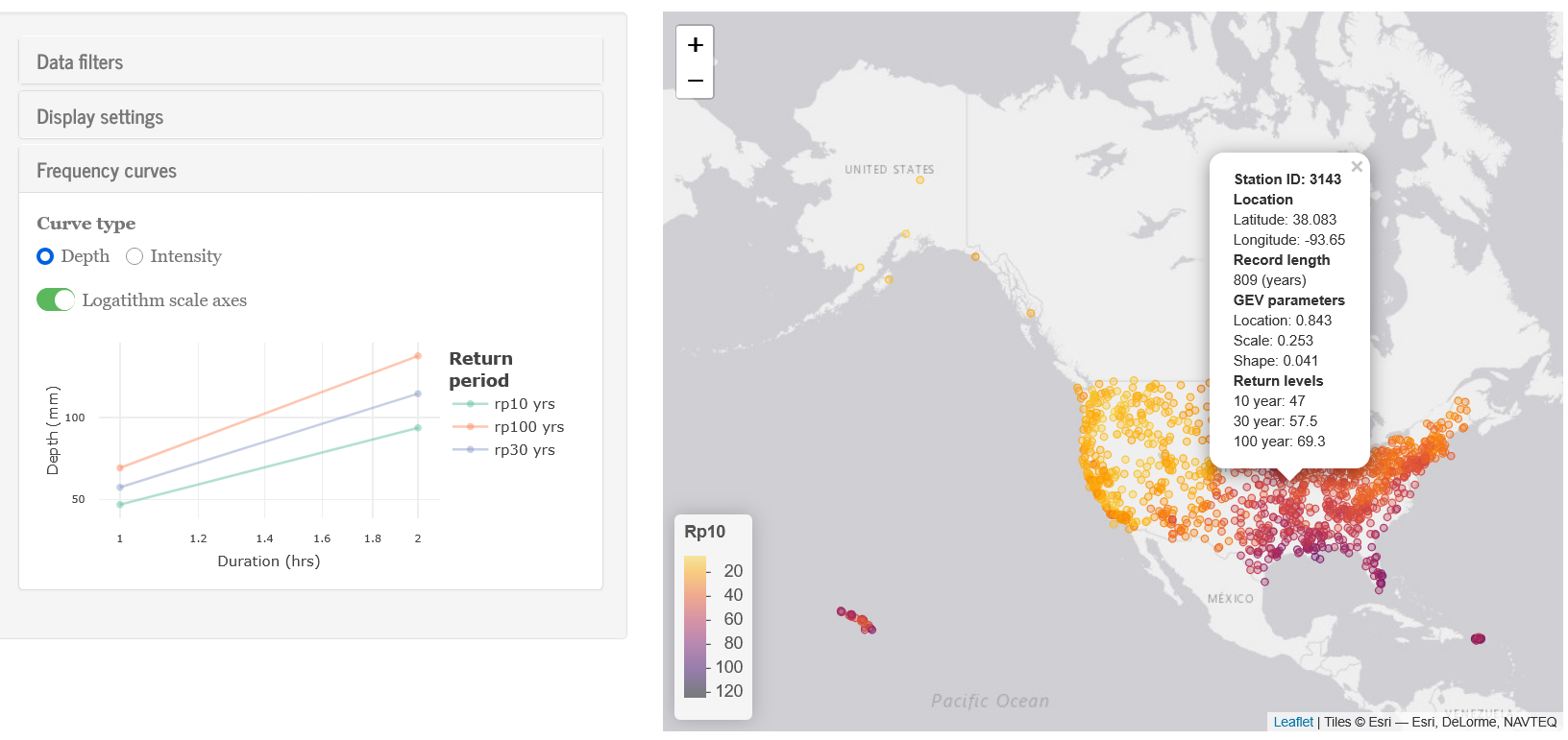
Climatology
Intensity-duration-frequency curves

Slide 11
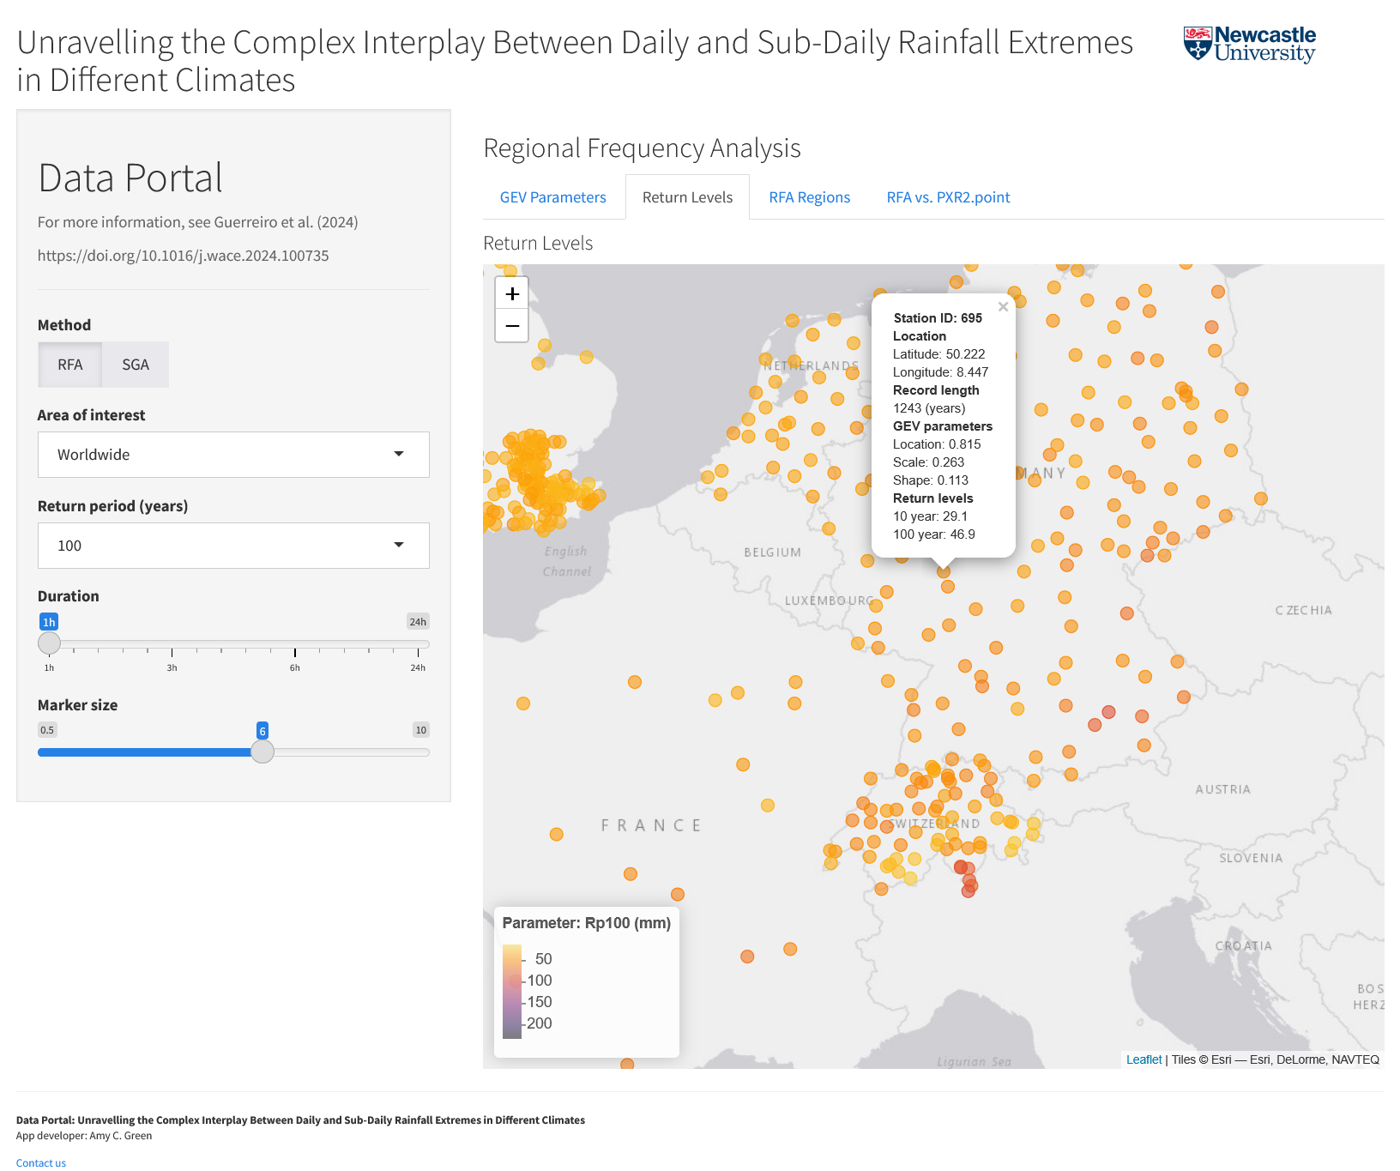
Extreme rainfall analysis
ERA5 significantly underestimates return levels (40% lower) across all climates (1hr), and all durations (tropical regions), even with areal reduction factor
Advise against using gridded reanalysis rainfall data for extreme studies
Notes:
- We found that whilst gridded reanalysis rainfall data is often used for extreme studies, they significantly underestimate return levels across all climates at a 1hr resolution, and at all durations for tropical regions.

Slide 12
Extreme rainfall analysis
Mostly similar return levels for regional/single-gauge, some differ significantly (no bias either way)
Apply single-gauge and regional frequency for return levels, for a robust risk assessment for flood design infrastructure
Notes:
Although for many of the gauges, the return levels were similar for regional frequency analysis and single gauge analyses, they differed quite a lot for some gauges, with both methods equally as likely to give higher return levels
For a robust risk assessment (for example for flood risk design infrastructure) it is recommended that both methods are used simultaneously where possible.

Slide 13
Extreme rainfall workflow
Daily and sub-daily interactions for GEV shape parameter varies across climate regions
Universal method for inferring sub-daily from daily (e.g. IDF curves) impractical
Crucial validation tool for the rising no. of convection-permitting climate models worldwide.
Notes:
When considering the interaction between daily and sub-daily parameter estimates, results show that GEV shape paramters vary across climate regions.
Using IDF curves and a universal method for inferring sub-daily extremes from daily is impractical.
This is a crucial validation tool for the rising number of convection-permitting climate models worldwide.

Slide 14
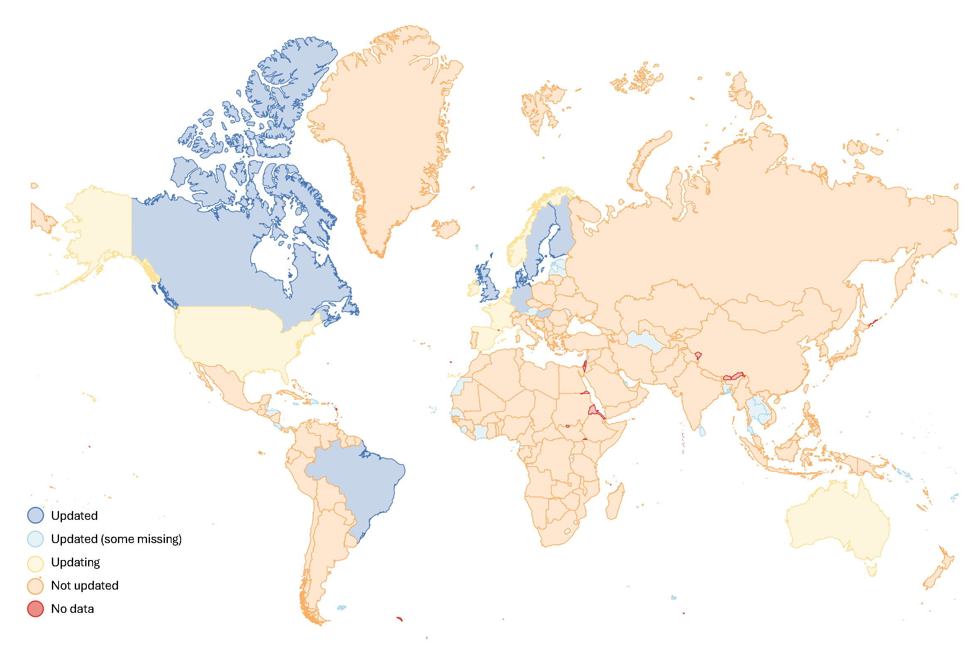
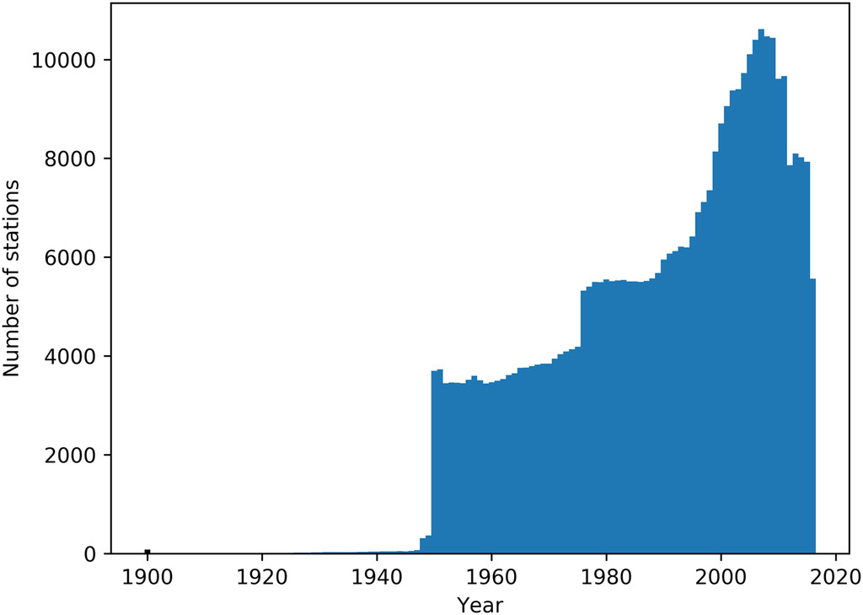
GSDR updates
Global
Notes:
Information previously given was based on the original GSDR dataset, so the average record length of 13 years was for the initial dataset with the most recent observations from 2018. Most records stopped in around 2016, and as the data was manually collected, not all of the data is easy to update, or share.
Although 2016 feels relatively recent, this was nearly a decade ago, and so with the hopes (and optimism of a fresh postdoc) of doubling the average record length, I have been updating the dataset.
Although I have contacted (manually), a LOT of colleagues and meteorological services (if anyone here has hourly rain gauge data they can share please do send me an email), with rapidly changing technology and a much needed move to open-access data, there are a lot more APIs and open observations for rainfall, not as many as there should be, but we are getting there as a community, with the challenge of climate change giving us a small nudge.
The updated GSDR dataset, which should be available in the coming months, is mostly open and a majority of the data is accessed using Python, and the process is much more automated, and open.
This is a (already out of date as I received Isreal data last week) plot of the data we have already collected, again a shout out to anyone that has used, seen and has to share any datasets that may be missing.

Slide 15
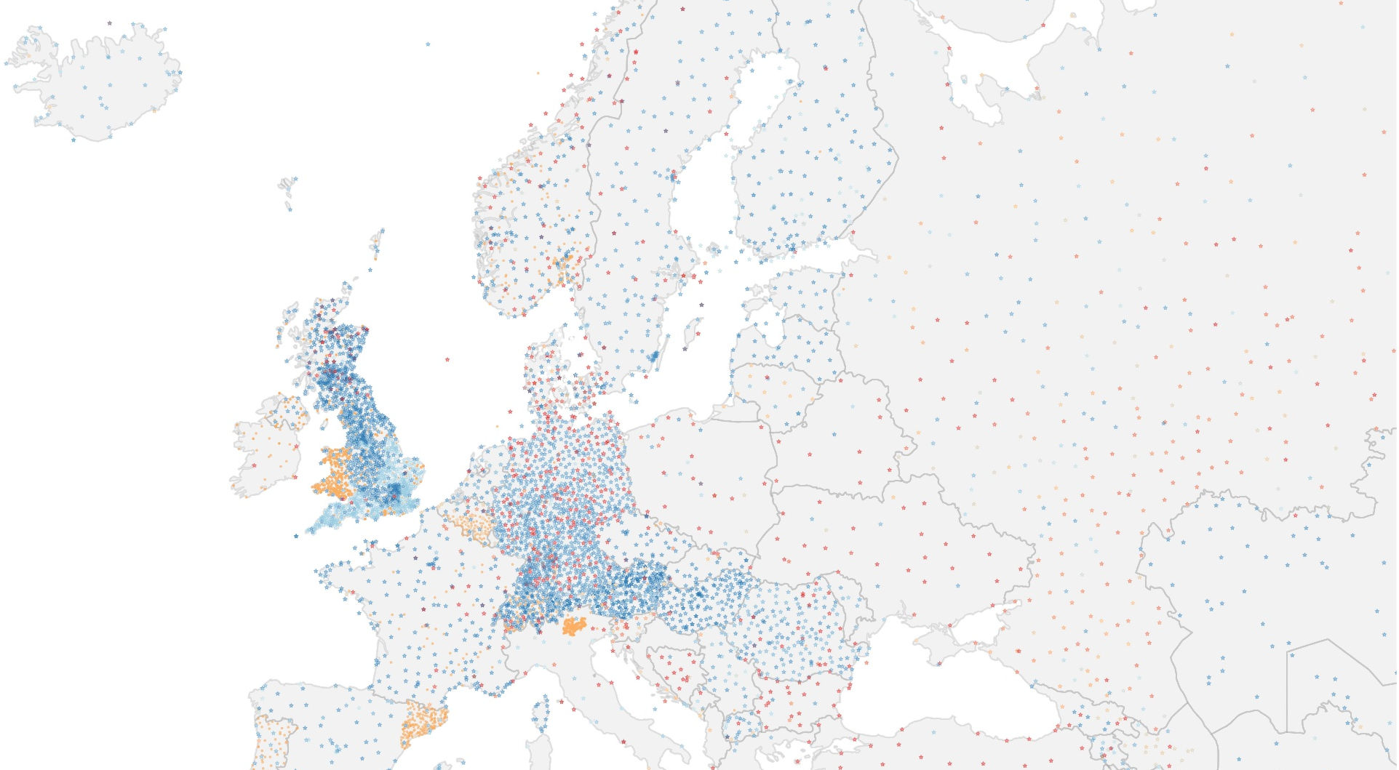
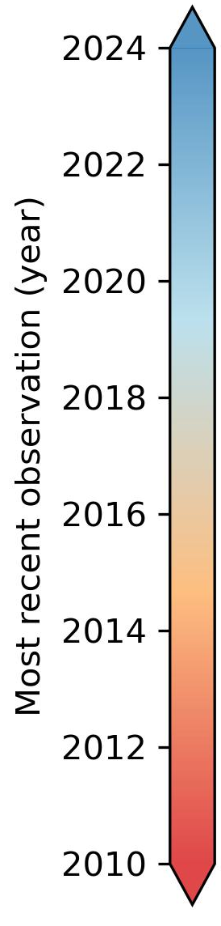
GSDR updates
Europe
Notes:
This is the length of the records for the data in Europe, which shows that a large portion has been updated, although there are some countries which still haven’t been updated.
The data is currently being quality controlled, and the UK has been used as a test case for quality checks.
This was then included as part of a gridded radar gauge rainfall estimates dataset for GB dataset from 2006-2023, which involved additional checks (corresponding radar pixel checks, what other ones), newer data (2018 onwards) much higher agreement with radars etc.

Slide 16
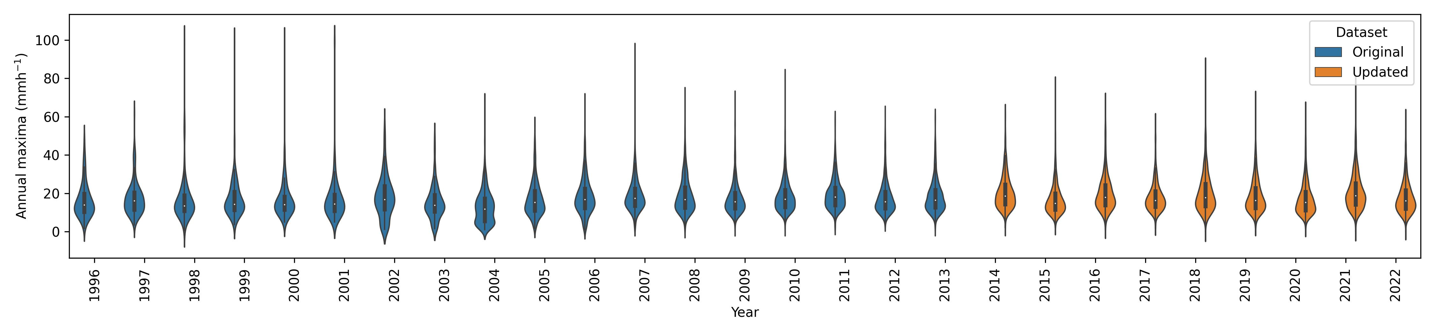
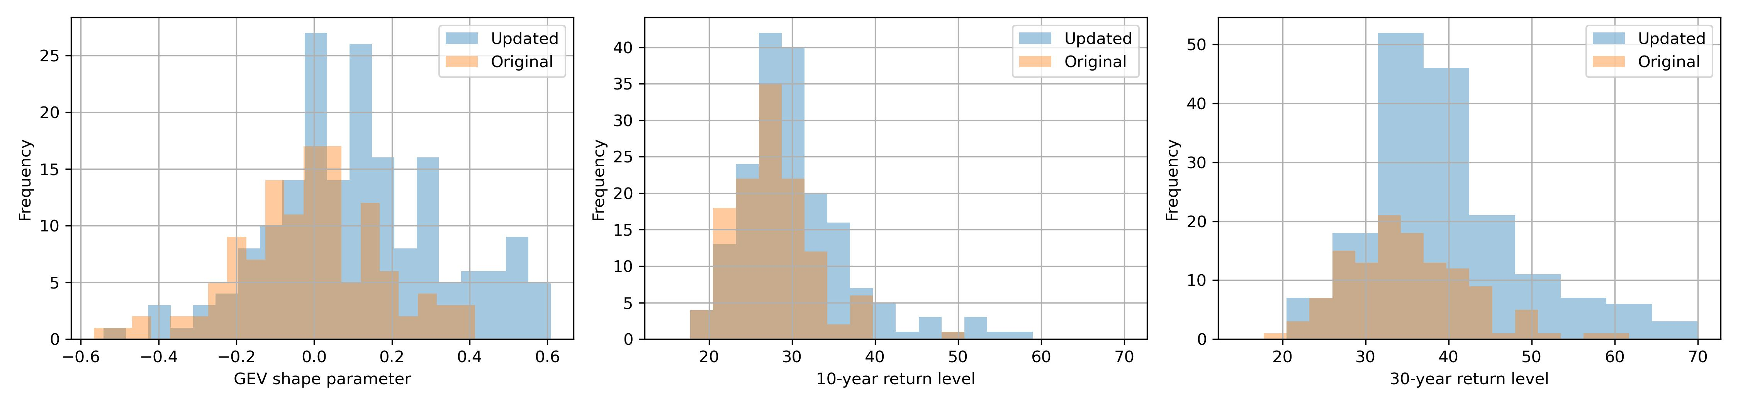
GSDR updates
Germany
Notes:
If we take Germany for example (as we are here), these are just some preliminary results to highlight the differences between the new and old data – we ca see that we have a lot more data, impacting our parameter estimates and return periods, with a lot more estimates available due to longer records.

Slide 17

Moving forward
Additional quality control checks where available (e.g. nearest radar pixels), machine learning.
GSDR-I: Precipitation indices
Better understanding how extreme precipitation will change in the future
  Compare with climate projections and other observations (e.g. satellite) – Indices for EUROCORDEX/Convection permitting as part of IMPETUS4CHANGE
  Verification of reference periods
  Assessment of performance
  Adjustment factors for better understand
Better connectivity between GSDR datasets
GSDR-I
GSDR-IDF
GSDR
GSDR-QC
Notes:
In terms of the next steps, making the dataset available for use is the plan for the next few months, for both the updated GSDR and the intensity-duration-frequency curves.
In future we plan to provide regular updates/version controlled GSDR, with a move towards automating the process to provide a regularly updated hourly quality controlled rainfall dataset.
Additional quality control checks will be considered where available (e.g. nearest radar pixels) and machine learning methods.
More coherence and easy access to parts of the GSDR and subsequent products, with GSDR, GSDR-QC, GSDR-I and GSDR-IDF more integrated.
Extreme precipitation indices based on GSDR, summarises ADD. Frequency and intensity of sub-daily rainfall extremes.
Climate precipitation indices, also calculated for climate projections, comparison between precipitation indices from observations (e.g. gauge, satellite etc), and climate model reference periods for both validation and adjustments.

Slide 18
GSDR: A Global Sub-Daily Rainfall dataset
What it is and why we need it
Applications for extreme rainfall
  Crucial validation tool for convective permitting models
Additional datasets within the GSDR
  Extreme indices
  Quality control
  Updated dataset
Future plans
Image sources
https://mediacentre.christianaid.org.uk/new-study-top-10-climate-disasters-cost-the-world-billions-in-2024/
https://edition.cnn.com/2024/06/14/india/india-sikkim-landslide-deaths-tourists-stranded-intl-hnk/indehttps://www.theguardian.com/world/2024/apr/23/china-floods-death-toll-guangdong-province-pearl-river-deltax.html
https://www.opb.org/article/2024/10/30/spain-flooding-photos-show-the-devastation-in-valencia/
GSDR-I
GSDR-IDF
GSDR
GSDR-QC

Slide 19
A Global Sub-Daily Rainfall dataset
Amy C. Green¹
Hayley Fowler¹, Matt Fry², Stephen Blenkinsop¹, Elizabeth Lewis³, Selma Guerreiro¹
¹ School of Engineering, Newcastle University
² UK Centre for Ecology and Hydrology
³ School of Engineering, Manchester University
amy.green3@newcastle .ac.uk
GSDR
Notes:
Thank you for listening, does anyone have any questions?

