Slide 1
Hybrid modelling for real-time urban pluvial flood mapping
Daan Buekenhout
Prof. Patrick Willems
Prof. Ricardo Reinoso-Rondinel
PrePEP Conference – Bonn, Germany – 17 March 2025

Slide 2
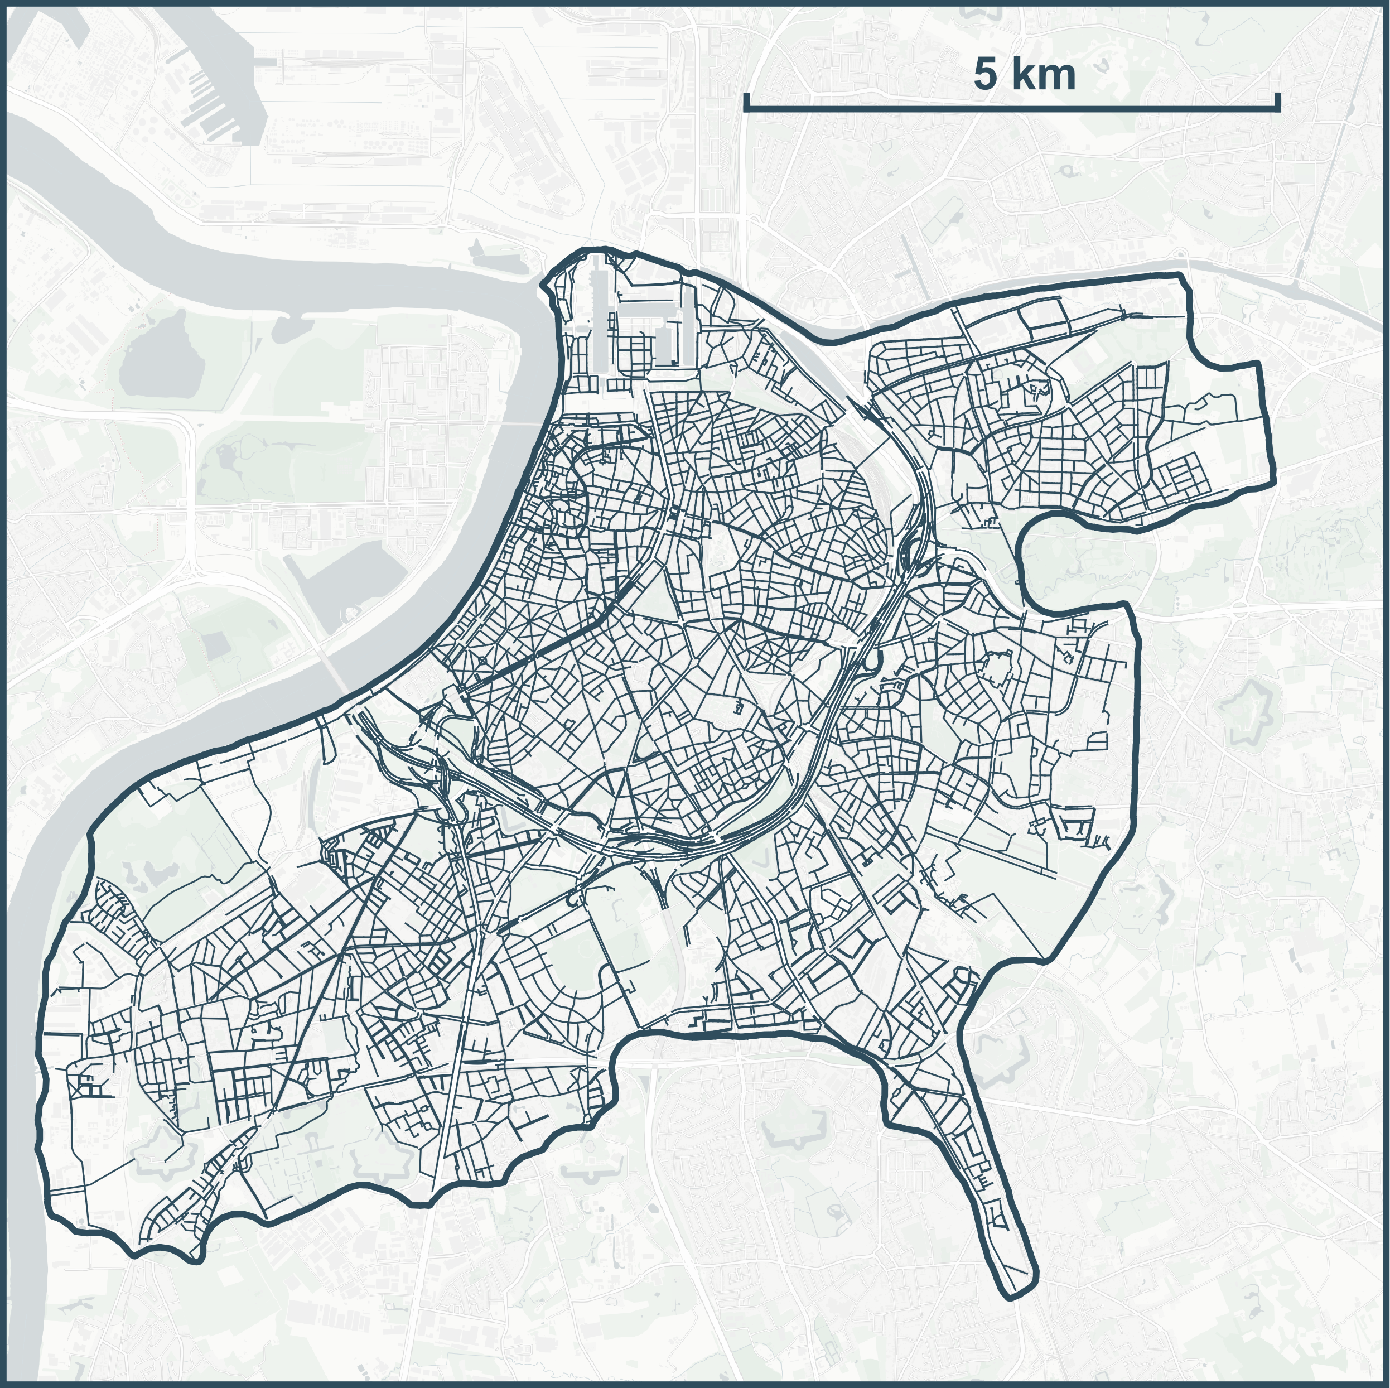
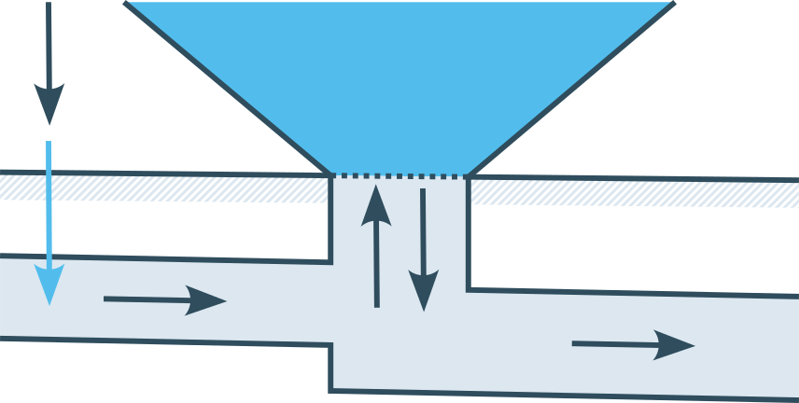
Flood models
Saint-Venant equations (1D)
0D
Flood volume
Rainfall
Surface runoff
1D
Sub-surface flow

Slide 3
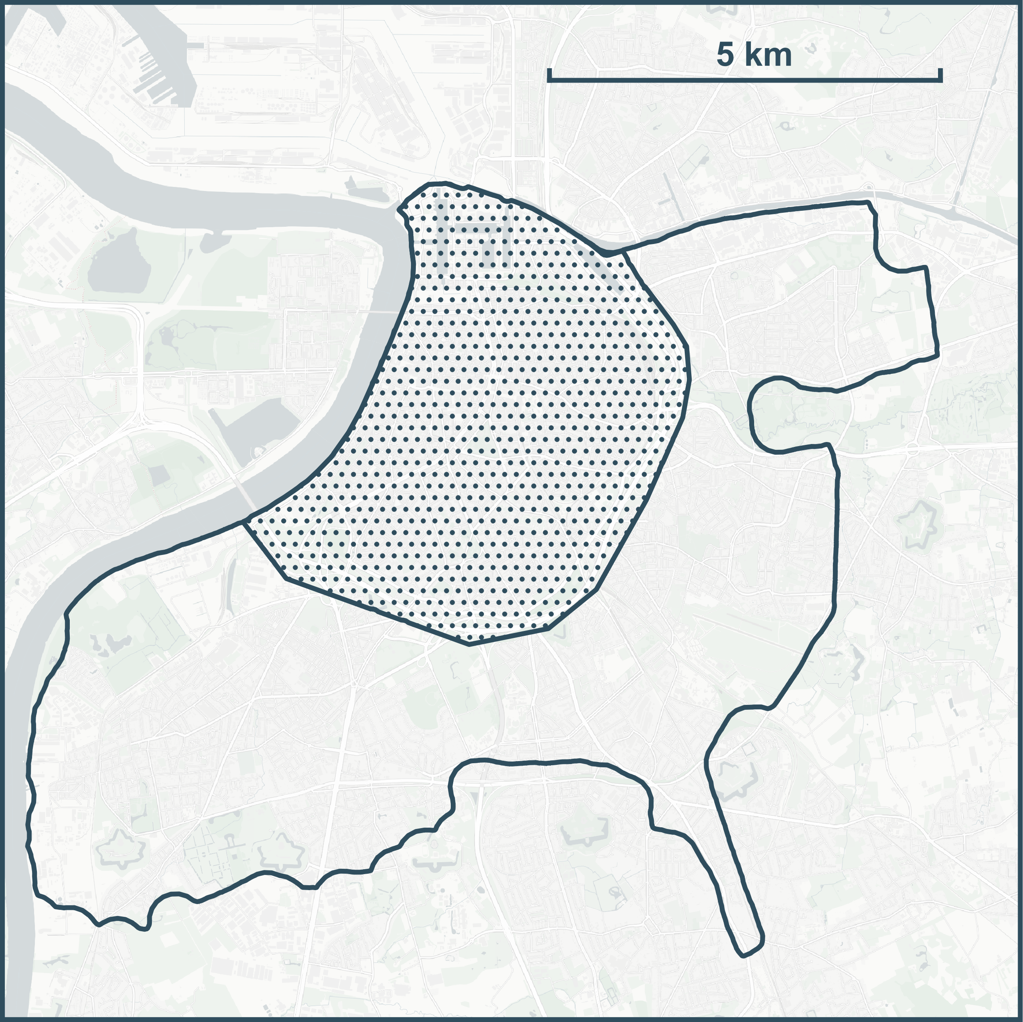
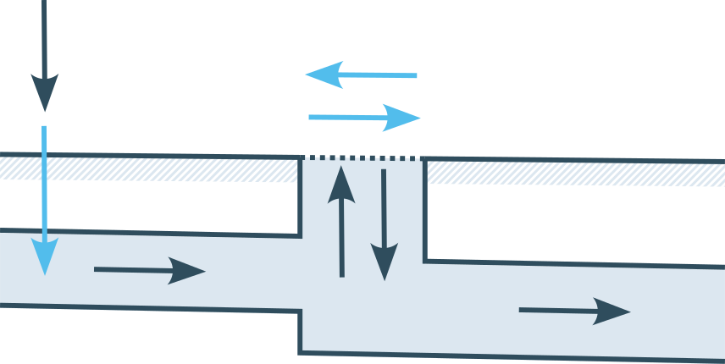
Flood models
Saint-Venant equations (1D)
Shallow-water equations (2D)
2D
Rainfall
Surface flow
Surface runoff
1D
Sub-surface flow

Slide 4
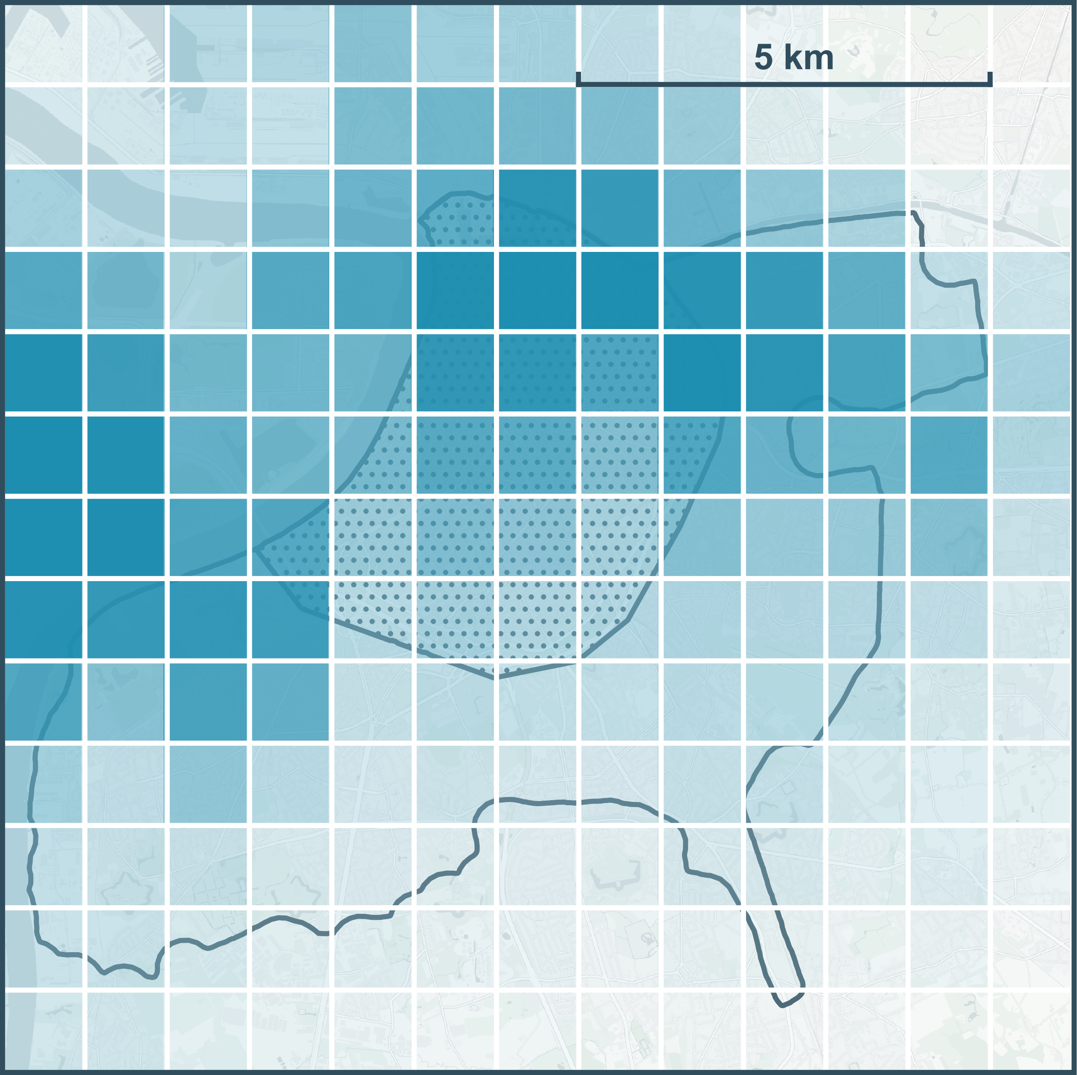
Flood forecast
Radar precipitation estimation
Precipitation nowcast
► Computational constraint

Slide 5
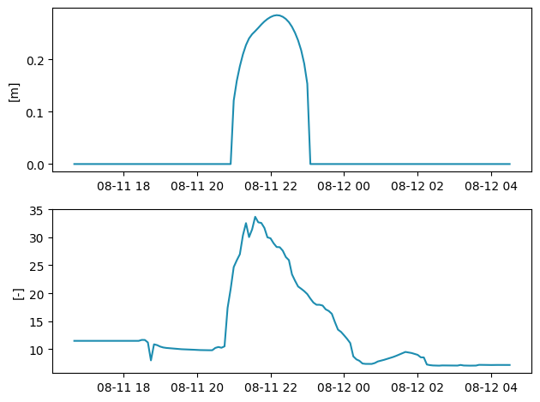
Fast flood model hybrid model
Flood depth
Data-driven model
Gaussian Process
Dimensionality reduction
EOF / PCA
EC / PC

Slide 6


Slide 7


Slide 8
Fast flood model hybrid model
Flood depth
Data-driven model
Gaussian Process
Dimensionality reduction
EOF / PCA
Simplified flood model
Physically-based
EC / PC

Slide 9
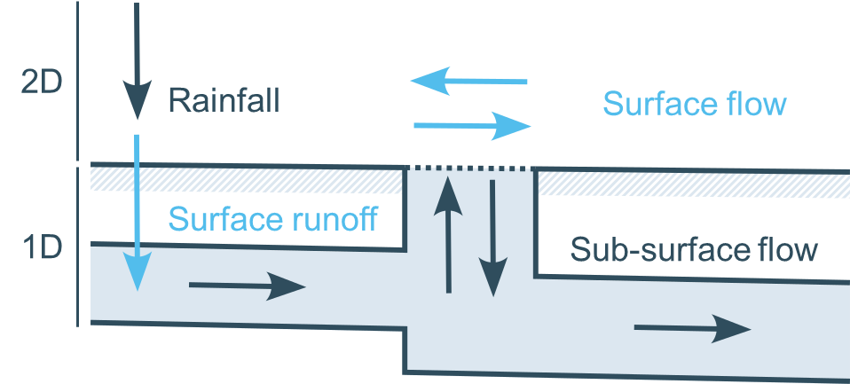
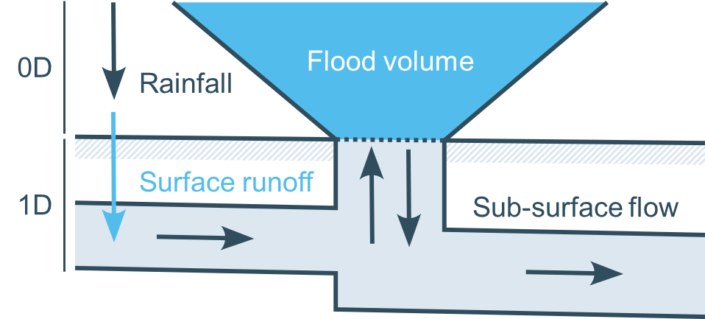
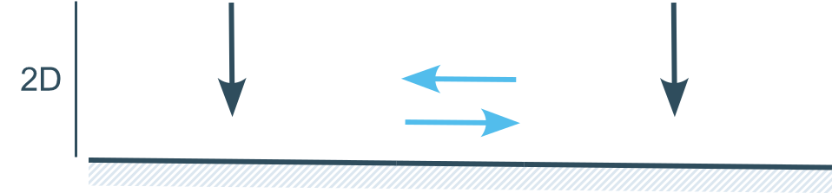
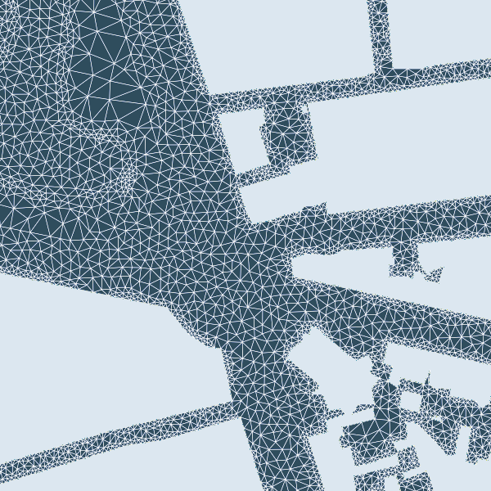
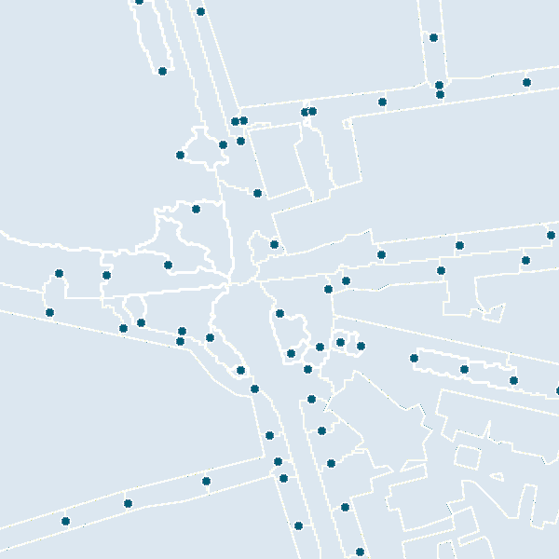

Original (1D2D)
Simplified (1D0D)
Simplified (2D)

Slide 10
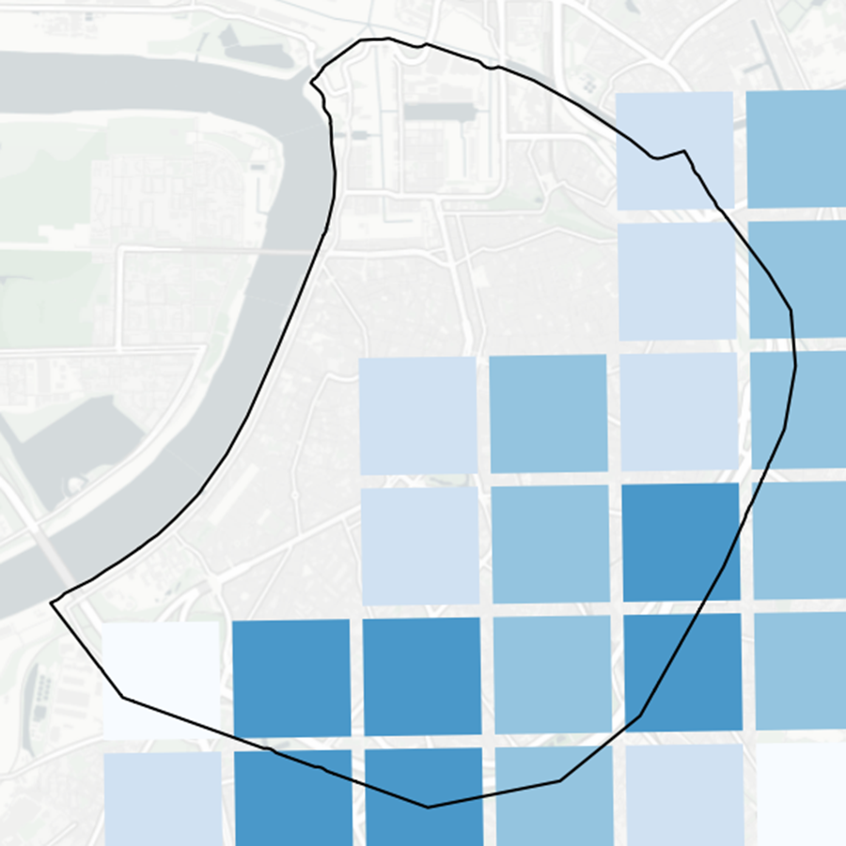
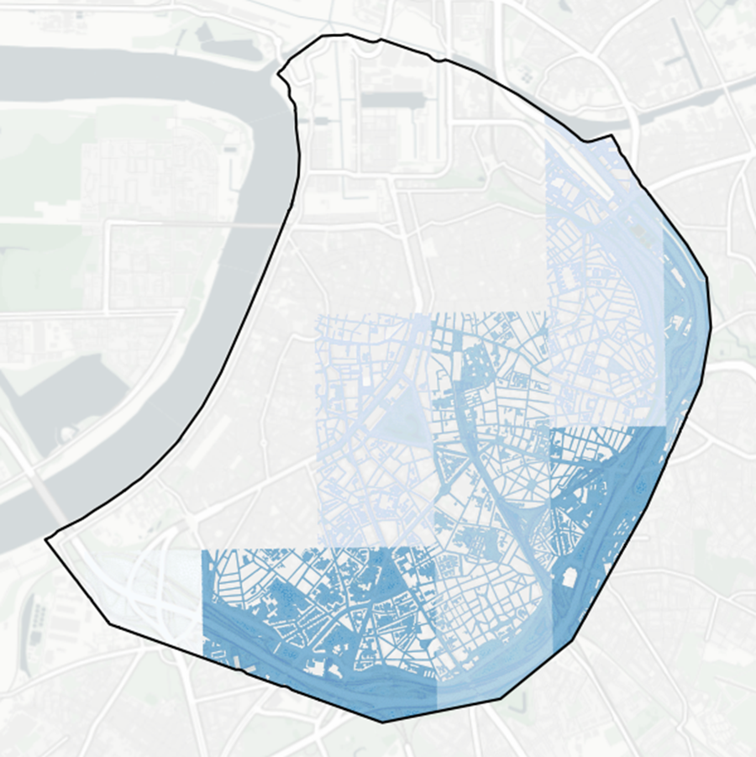
Rainfall no flood model
►►►
Accumulated rainfall
Original mesh

Slide 11
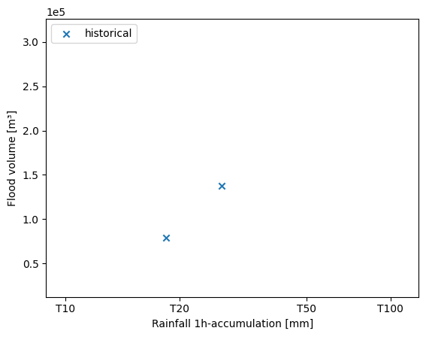
Dataset
QPE (2017-2023)
A
B

Slide 12
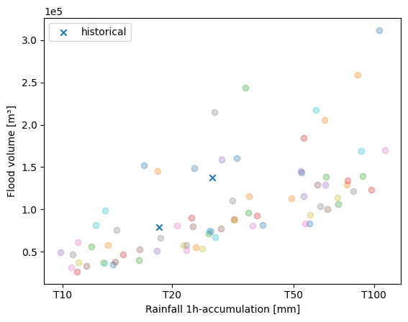
Dataset
QPE (2017-2023)
Training data
Spatial transposition
Cross-validation
Stratified sampling
Rainfall over 2D zone
A
B

Slide 13
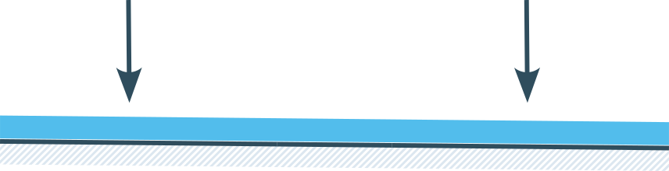
Results cross validation
Original
Hybrid
Hybrid
Hybrid
μ_{CV} (σ_{CV}) | 1D2D | 1D0D | 2D | Rainfall
Dimensions [#] | 877k | 23k | 5.7k | 86
Time / h_{sim} [s] | 188.8 (10.9) | 11.7 (0.2) | 2.5 (0.1) | 0
CSI [-] | - | 0.69 (0.03) | 0.62 (0.05) | 0.32 (0.08)
R²_{peak} [m] | - | 0.81 (0.06) | 0.87 (0.06) | 0.53 (0.14)
Δ_{peak} [m] | - | 0.01 (0.01) | 0.03 (0.01) | 0.07 (0.01)
RMSE [m] | - | 0.09 (0.01) | 0.07 (0.01) | 0.14 (0.01)

Slide 14
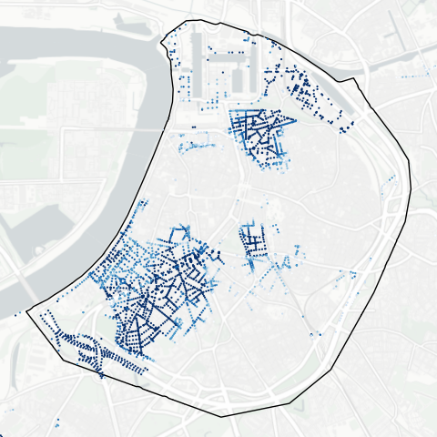
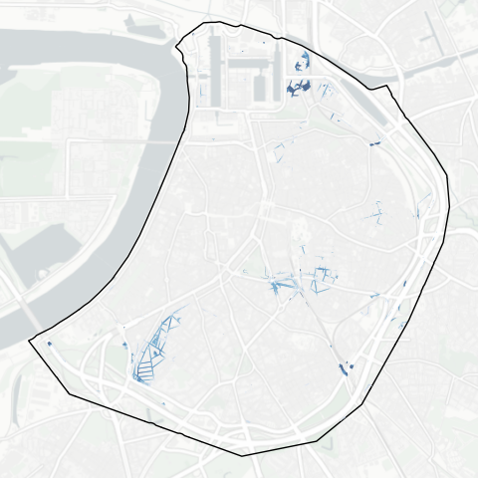
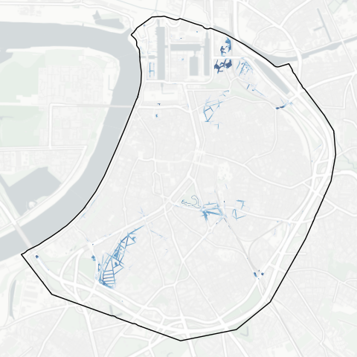
Results storm A
CSI [-] | 0.57
RMSE [m] | 0.14
R²_{peak} [m] | 0.78
Δ_{peak} [m] | 0.029
Simplified (1D0D)
Hybrid model (1D0D)
Original (1D2D)

Slide 15
Results storm A
CSI [-] | 0.57
RMSE [m] | 0.14
R²_{peak} [m] | 0.78
Δ_{peak} [m] | 0.029
▼
Simplified (1D0D)
Hybrid model (1D0D)
Original (1D2D)

Slide 16
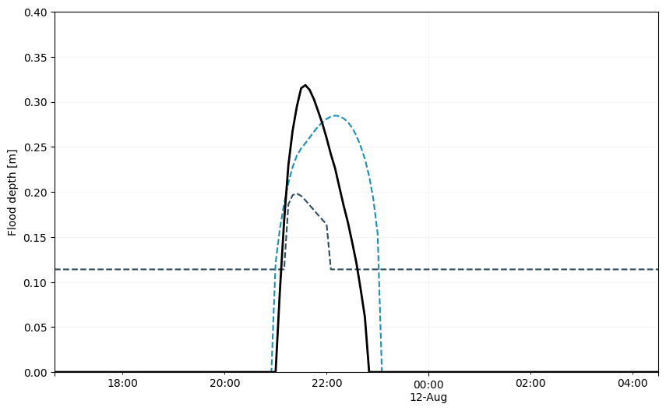
Results storm A
1D0D
2D

Slide 17
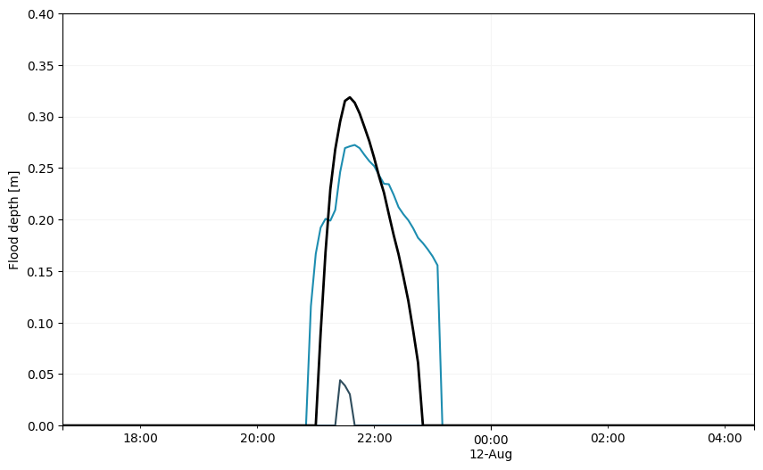
Results storm A
Hybrid (1D0D)
Hybrid (2D)

Slide 18
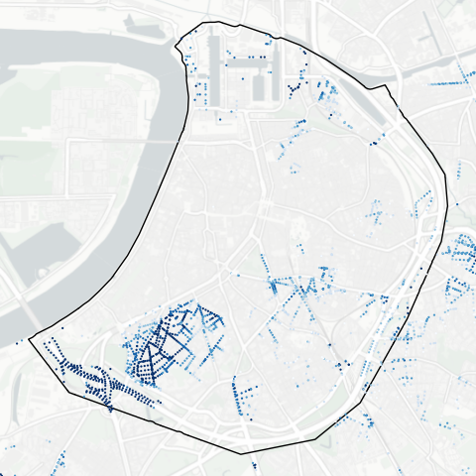
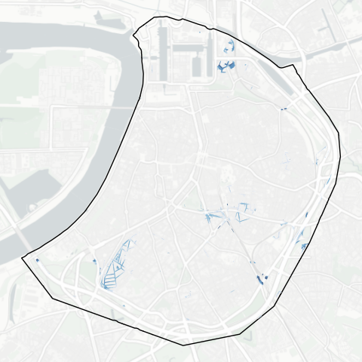
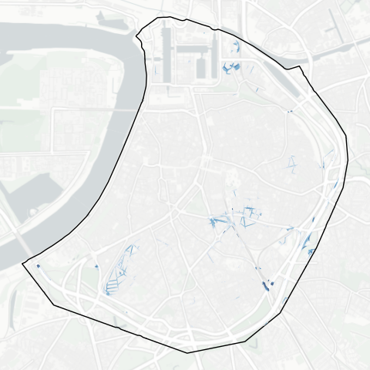
Results storm B
CSI [-] | 0.70
RMSE [m] | 0.05
R²_{peak} [m] | 0.87
Δ_{peak} [m] | -0.002
Simplified (1D0D)
Hybrid (1D0D)
Original (1D2D)

Slide 19
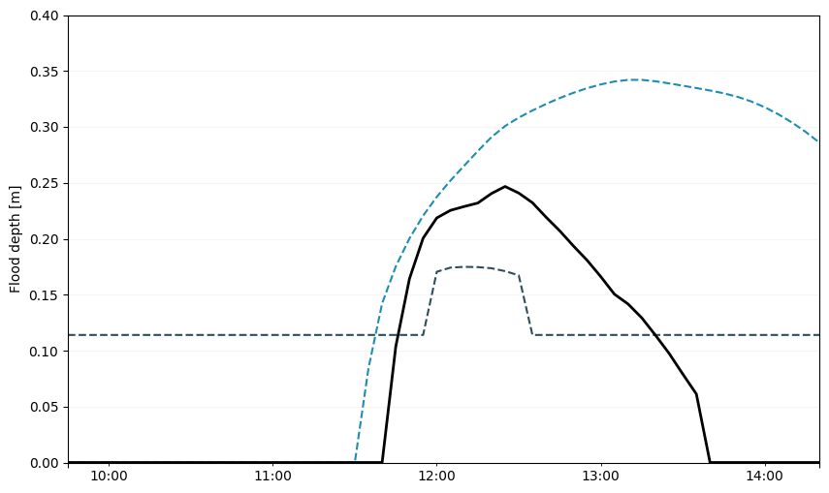
Results storm B
1D0D
2D

Slide 20
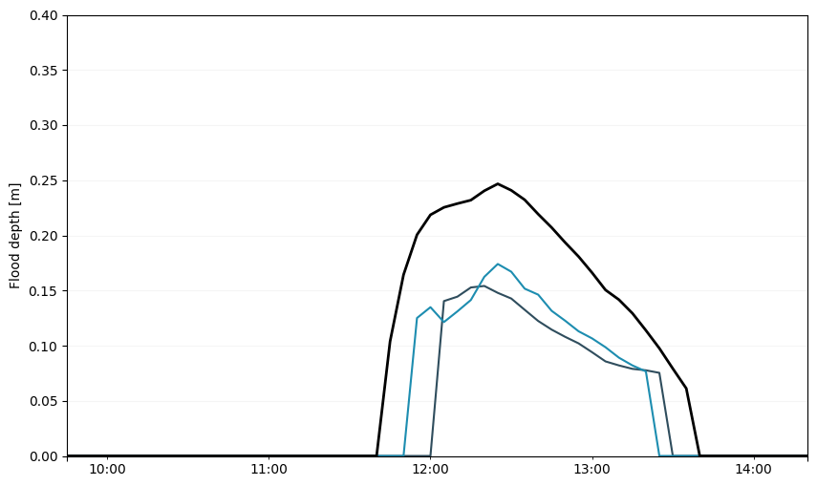
Results storm B
Hybrid (1D0D)
Hybrid (2D)

Slide 21

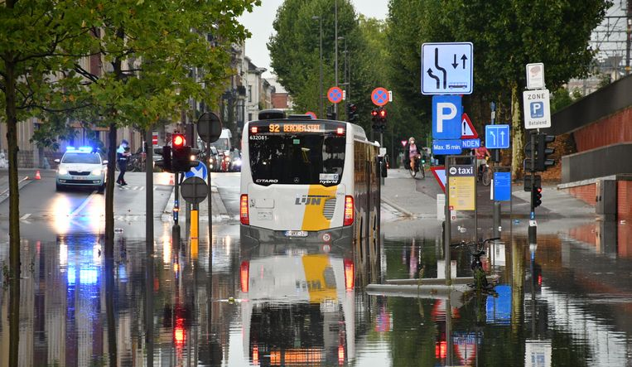
Urban pluvial flood
Hybrid model
Dimensionality reduction
Data-driven model
Simplified model
► Informative warnings
©Marc De Roeck
daan.buekenhout@kuleuven.be

