Slide 1

- the Combination of Nowcasting and NWP on the Convective Scale at DWD
* Seamless INtegrated FOrecastiNg sYstem
*
Ulrich Blahak, on behalf of Team SINFONY & Friends
Deutscher Wetterdienst (DWD)
Team SINFONY & Friends: Roland Potthast, Kathleen Helmert, Julia Keller, Manuel Werner, Alberto De Lozar, Axel Seifert, Klaus Stephan, Elisabeth Bauernschubert, Christian Welzbacher, Thomas Hanisch, Helmut Frank, Matthias Zacharuk, Robert Feger, Lilo Bach,
Michael Hoff, Martin Rempel, Lisa Neef, Kathrin Feige, Markus Schultze, Sven Ulbrich, Kobra Khosravian, Vera Maurer, Jana Mendrok, Mareike Burba, Leonhard Scheck, Annika Schomburg, Klaus Vobig, Christian Berndt, Gregor Pante, Sabrina Wahl, Maike Ahlgrimm, Thorsten Steinert, Hendrik Reich, Ulrich Friedrich, Arne Spitzer, Lukas Josipovic, Thomas Deppisch, Matthias Gottschalk,
Tobias Bergmann, Cornelius Hald, Isabel Schnoor, Nora Strotjohann, Malte Schmid, Jan Bondy, Andreas Brechtel,
Michael Debertshäuser, Sophie Löbel, Nikolaos Antonoglu, Michael Denhard, Marcus Paulat, Vanessa Fundel, Felix Fundel, Peter Sohn,
Andreas Höfer, Friedemann Ebach, Markus Zeindl, Alexander Hartmann, Eleonora Lipovezki, Marcus Werner, Christoph Schraff,
Tim Böhme, Björn Breitenbach, Marcus Beyer, Christian Herold, Christina Speicher, Helge Tuschy, Tanja Winterrath, Ewelina Walawender, Armin Rauthe-Schöch, Katharina Lengfeld, Kathrin Wapler, Stefanie Hollborn, Linda Schlemmer, Jan Keller, Julia Frank

Slide 2
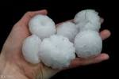
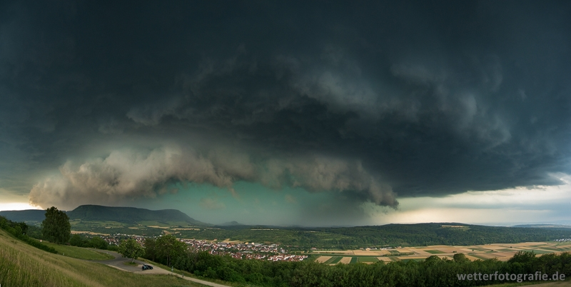
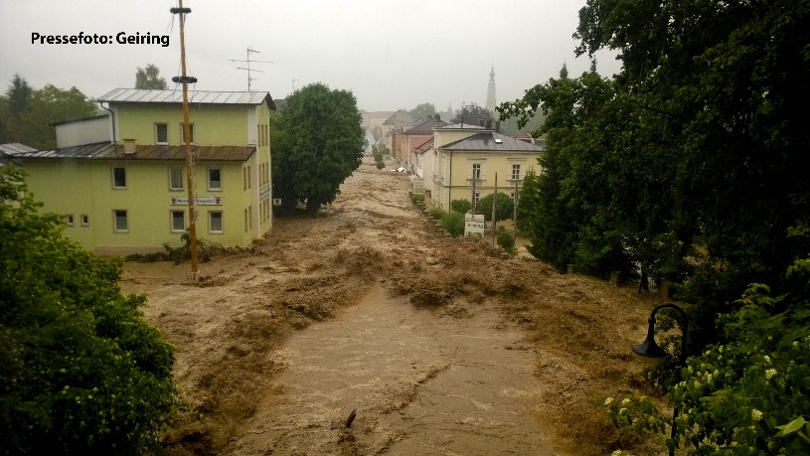
Challenges of very-short-range high impact weather forecasting and warning
How to transfer the very detailed high-resolution / high-frequent observations (radar, sat, lighting, etc.) into seamless useful forecasts for small-scale high-impact events?
Timely and as accurate as possible!
With uncertainty estimates!
Useful and usable down the warning chain!
  Our goal to that end: Achieve better convective forecasts
  from now to the the next 12 h!
    Develop a seamless probabilistic forecasting system on the convective scale from 0 – 12 h lead time
    Establish vivid exchange and a co-design approach with users
    (DWD forecasters, flood forecasting centres)

Slide 3
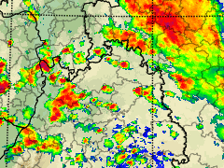
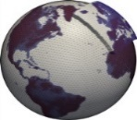
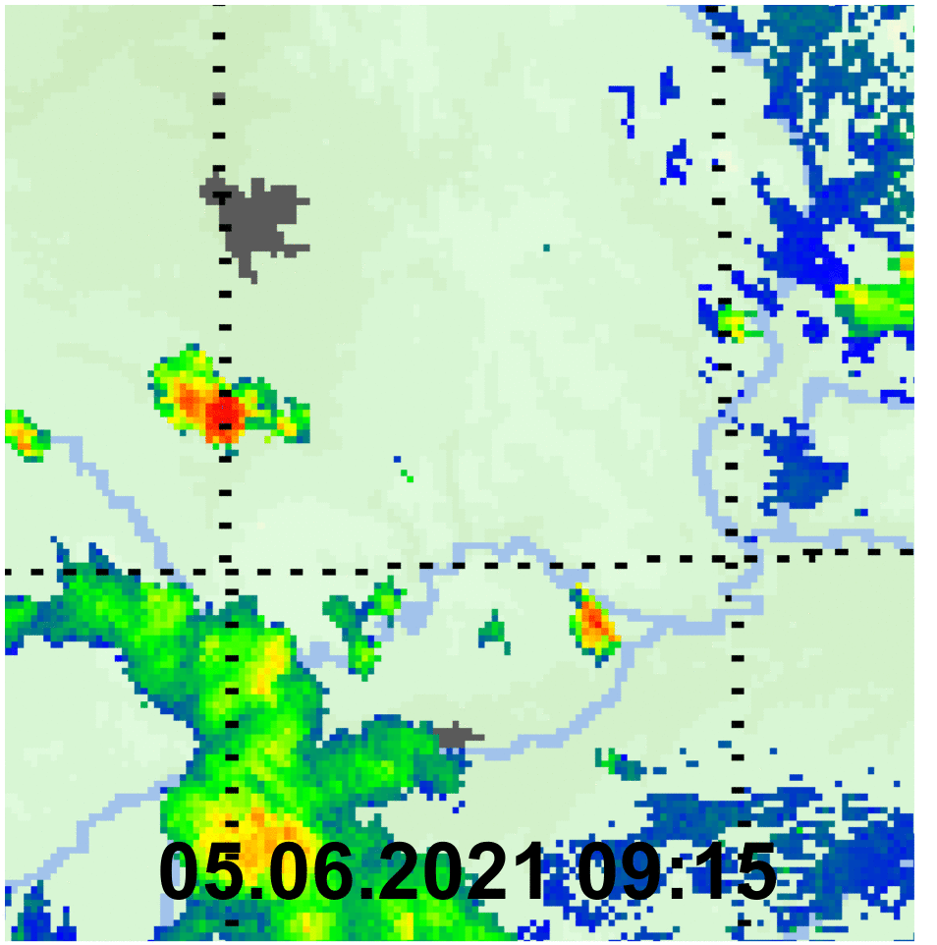

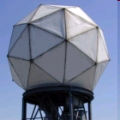
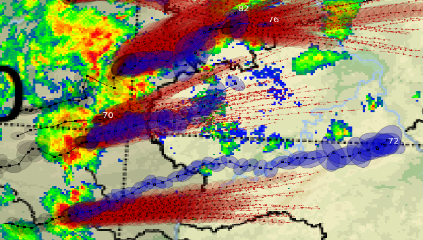
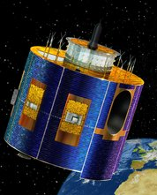

The SINFONY as in current transition to operations
STEPS-DWD
Some verification score for convective events
Combined / blended products:
Threshold-based probabilities (mm/h, dBZ)
Combined areal ensemble (mm/h, dBZ)
Combined cell objects
Hourly new ENS forecasts up to
+ 14 h (RUC)
Daily real time runs
Under evaluation
Daily real time runs
Under evaluation
1
ICON-LAM
Δx = 2 km
adapted model physics
… improved
Radar based precipitation Nowcasting
  Gridded fields
  (mm/h, dBZ)
  Cell objects
… combined products
Operational since 11 July 24
Available ~35 min
after the actual date
Nowcasting
NWP
Assimilation of new data* in KENDA-LETKF:
  Radar volume scans
  v_{r}, dBZ, cell objects
  METEOSAT VIS / IR
  Lightning
… improved
Operational
0
Daily real time runs
Under evaluation
t₀
Current crossover at 1 – 1,5 h!
Lead time
EPS
*) In addition to the „conventional“ data, such as SYNOP, TEMP, profiler, MODE-S

Slide 4
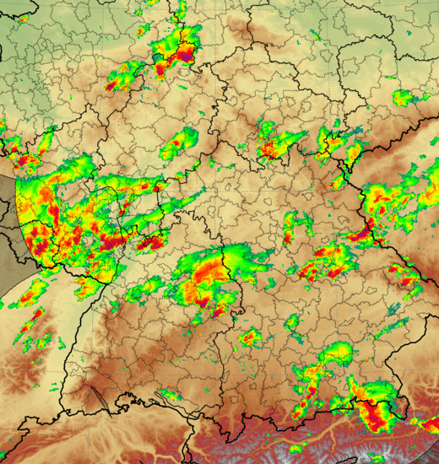
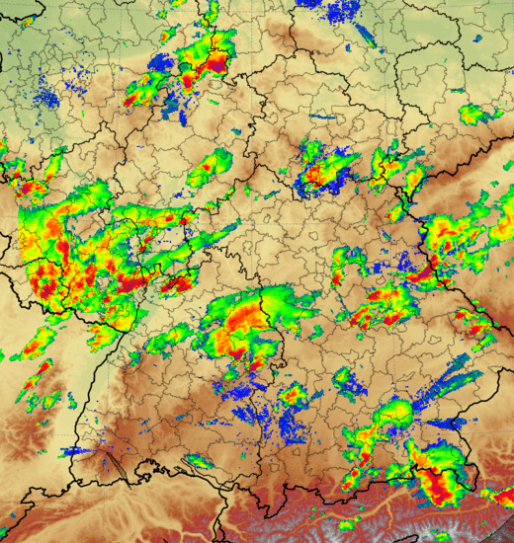
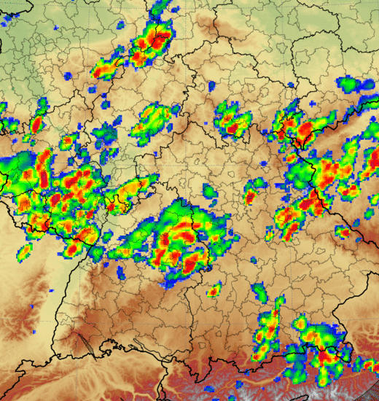

Poster 85
Martin Rempel
Talk Wed
Christian Berndt
One of our combinded products:
INTENSE – Blending by DA cycle
Nowcasting STEPS-DWD
INTENSE (1 of 20 members)
NWP ICON-RUC-EPS
Plan: technically operational in Q1/2026
Nowcasting-ENS (5‘ updates)
Combined ENS
Nerini et al. 2019
Gives us 20 scenarios
precip and reflectivity
- Combined products
„Best of both worlds“
NWP-ENS (hourly updates)
t₀
Fcst lead time
4

Slide 5
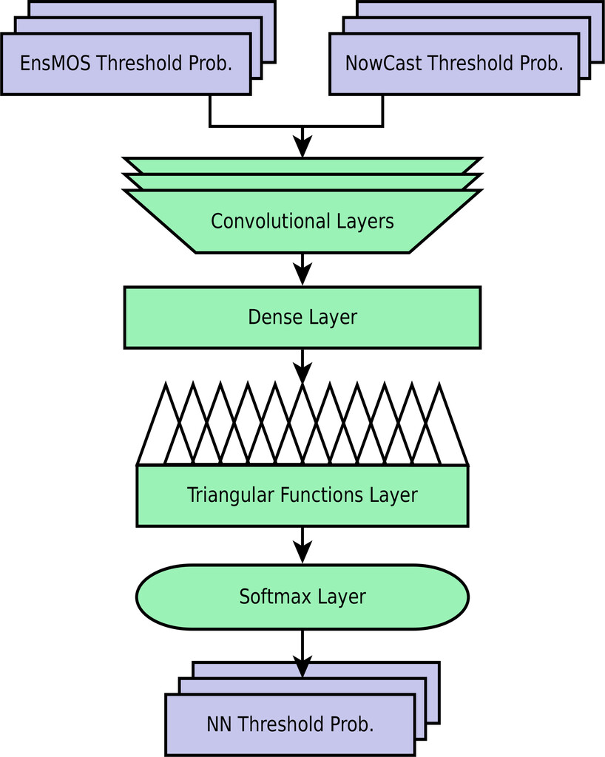
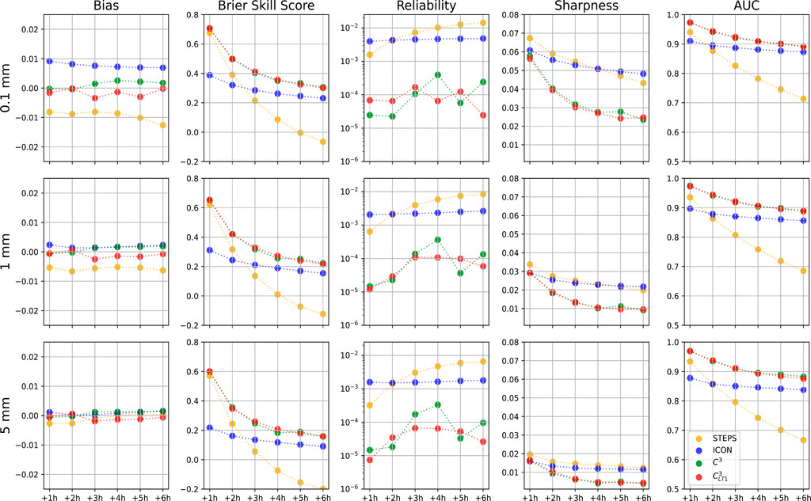
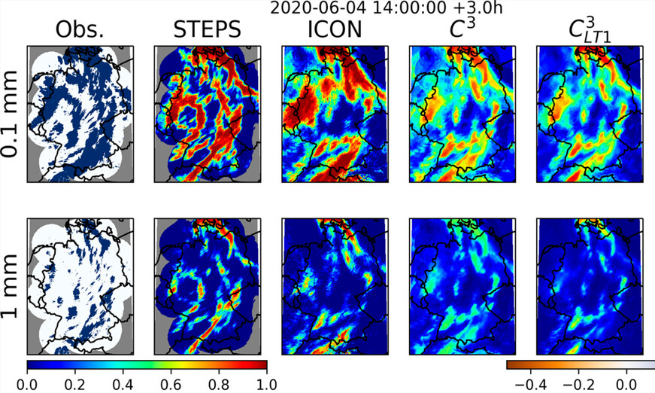
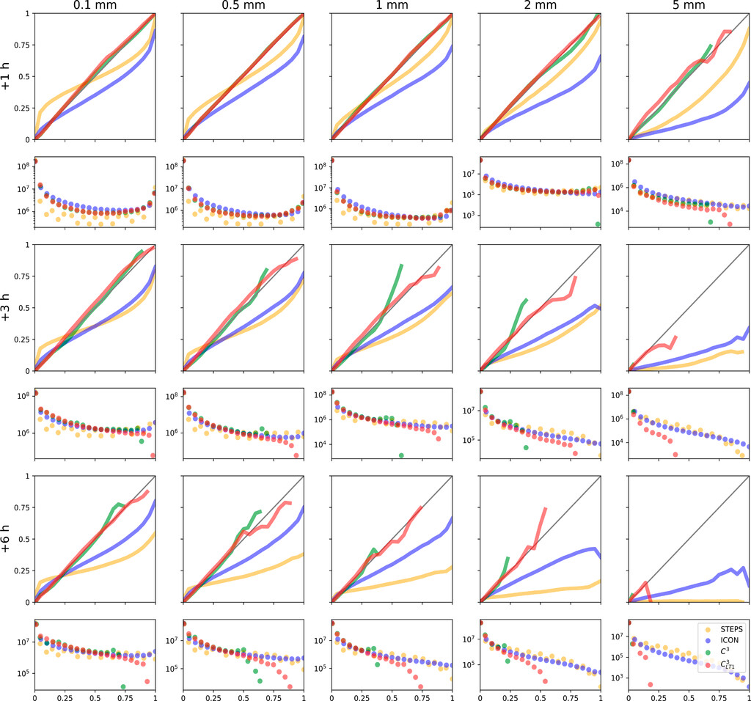
Other ens. combination methods than INTENSE in SINFONY
Martin Rempel et al. (2022), Artif. Intell. Earth Syst., doi:10.1175/AIES-D-22-0020.1
  Prototype for NN-approach Consistent Calibrated Combination („C3“)
  Blended CDF (multiple thresholds simultaneously and consistently) at each location (co-op. with Institute of Stochastics, University Ulm)
RUC
STEPS
Reliability for threshold 1 mm in 1 h at +3h
Exceedance probability

Slide 6
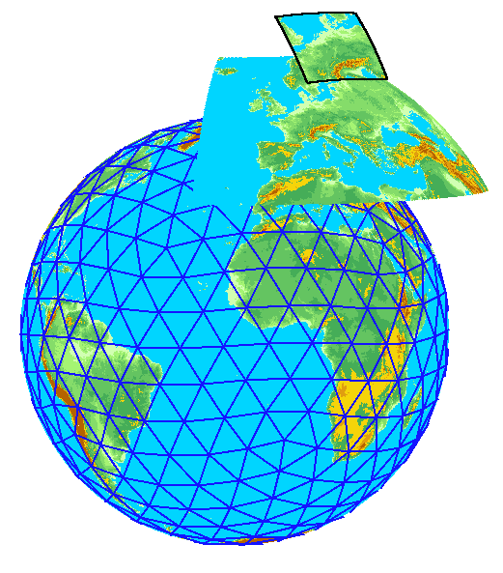


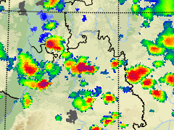
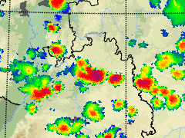
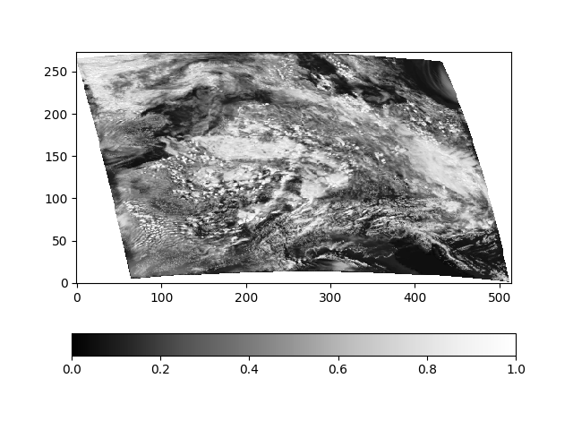
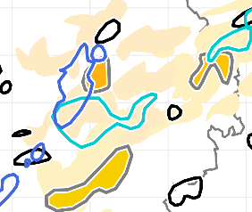
More details on the ICON-RUC
ICON-D2
DET / ENS : 2 km (+48h)
  ➔ Advanced forward operators:
  Radar volumes and composites
  Cell objects (KONRAD3D)
  VIS / IR sat data
Seamless Nowcasting-NWP-products
Verification
Data assimilation via LETKF together with classical Latent Heat Nudging
Neu: ICON-RUC
DET / ENS: 2 km (+14h)
Part of the
Hourly new forecasts
Advanced 2-moment cloud microphysics with hail
Optimized for < 12 h and at same time godd reflectivity, clouds and precipitation
Quickly available after 35‘
More frequent output
EMVORADO
ICON-EU Nest
DET / ENS : 6.5 / 13 km
MFASIS / RTTOV
KONRAD3D detect + track
ICON global
DET / ENS : 13 / 26 km
Talk Tue L. Neef
Assimilation of lightning and refl. texture fraction
Talk Tue
Kobra Khosravian (SPP-PROM)
Towards ZDR column DA
= Boundary conditions

Slide 7
Advanced 2-moment cloud microphysics scheme in ICON-RUC/-EPS
Significant investment in 2-moment cloud microphysics ( +50 % runtime compared to ICON-D2)
  Additional prognostic number concentrations as 2nd moment, additional prognostic hail.
  Quasi-prognostic hydrometeor size
Justified because it is beneficial for the SINFONY:
  Bias reduction in DA of radar and sat
  Combined products in radar observation space
Talk Thu
Sophie Löbel
DSD comparison with distrometers
Talk Fri
Alberto de Lozar
Comparison and tuning based on radar and sat obs

Slide 8
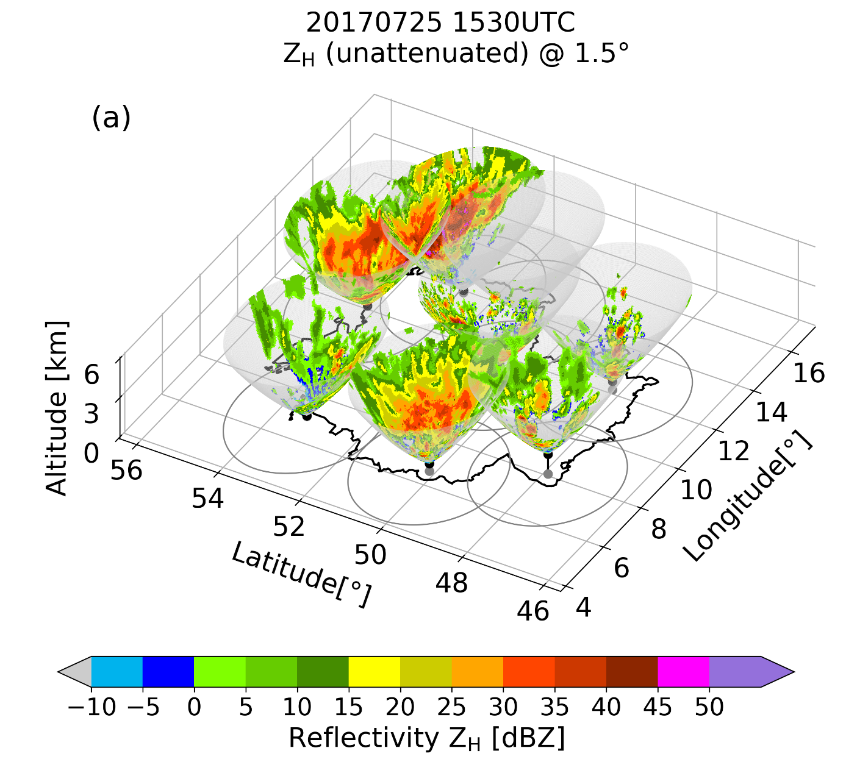
Talk Fri
Suomi Dutta (SPP-PROM)
Realistic snow flake shapes for polar. moments
Radar forward operator EMVORADO for volume scans
Simulated radar moments along all the rays of synthetic volume scans every 5‘:
Radar reflectivity Z_{h} Mie / T-matrix spheroids
Radial wind V_{r}
Under devel: polarisation parameters Z_{v}, ZDR, KDP, PHIDP, RHOHV, LDR, A_{h}, A_{v}
Radars: DWD + other Europ. radars from OPERA
Talk Fri
Julian Steinheuer (SPP-PROM)
Evaluation of ICON-2mom by polarimetric radar data
Zeng et al., 2016: An efficient volume-scanning radar forward operator for NWP models: description and coupling to the COSMO model, QJRMS, 142, 3234-3256, doi:10.1002/qj.2904

Slide 9
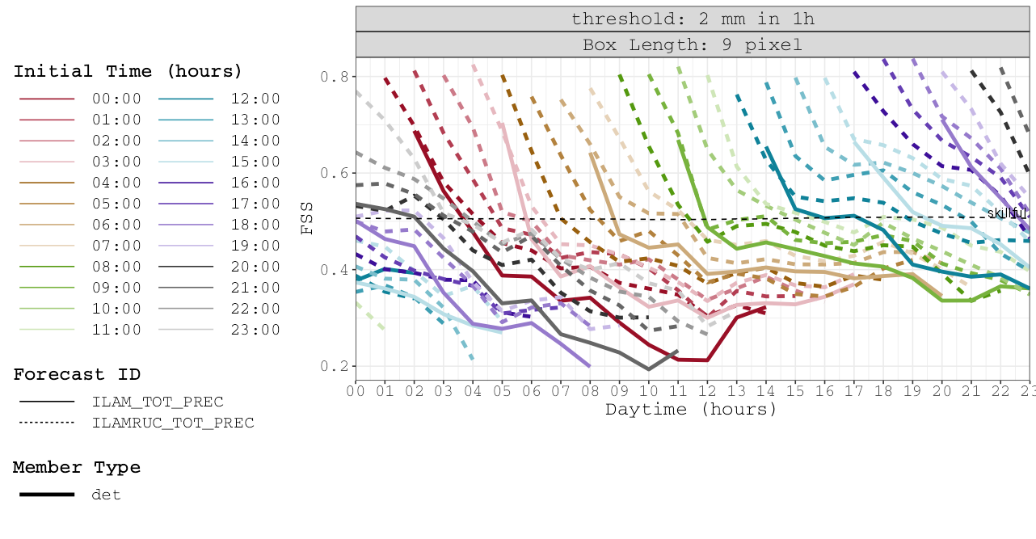
From user perspective: 1h rain sum ICON-RUC and ICON-D2 verified against gauge-adjusted QPE (Radolan RW), 08/2024
ICON-D2 3-hourly inits
ICON-RUC 1-hourly inits
„good“
20 km
ICON-RUC 14 UTC run
ICON-D2 12 UTC run
Now let‘s call this a „user init time“ ...
„poor“

Slide 10
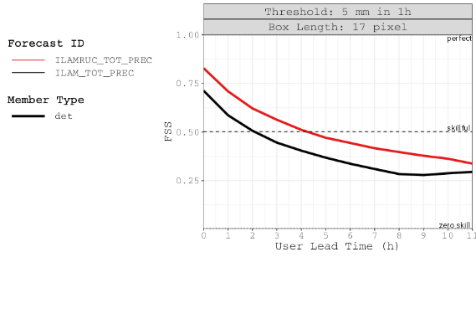
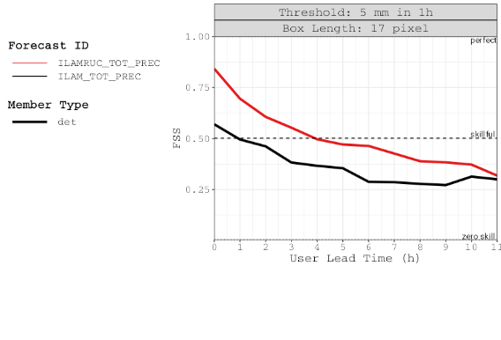
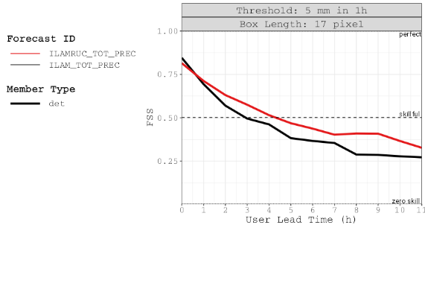
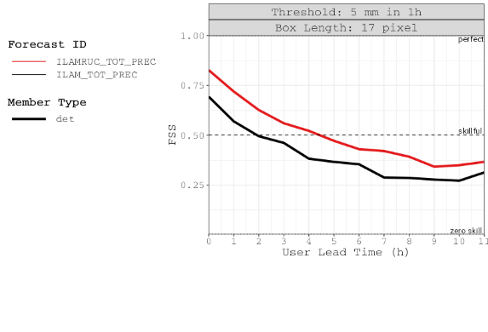
From user perspective: 1h rain sum ICON-RUC and ICON-D2 verified against gauge-adjusted QPE (Radolan RW), 08/2024
... and then we aggregate scores over different user init times (full hours) of the day.
„User lead time“ is along the remaining forecast time that lies in the future for the user.
Shows the average forecast quality for a user which always looks at the most recent model run.
ICON-D2 = 3-h-updates, RUC = 1-h-updates → corresponding advantage of RUC has 3-h rhythm:
20 km
20 km
20 km
20 km
Newest RUC is 2 h „younger“ than ICON-D2
Newest RUC has same init as ICON-D2
Newest RUC is 1 h „younger“ than ICON-D2
All user init times
00, 03, ..., 21 UTC
01, 04, ..., 22 UTC
02, 05, ..., 23 UTC

Slide 11
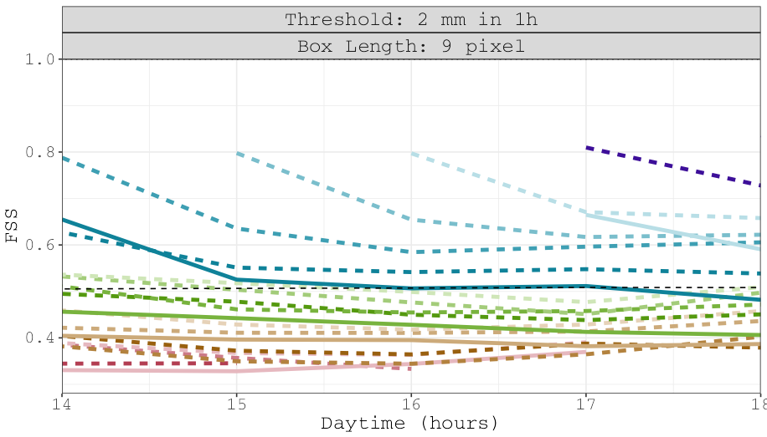
… and now we blend in the Nowcasting in the framework of a combined product:
… and so on

Slide 12
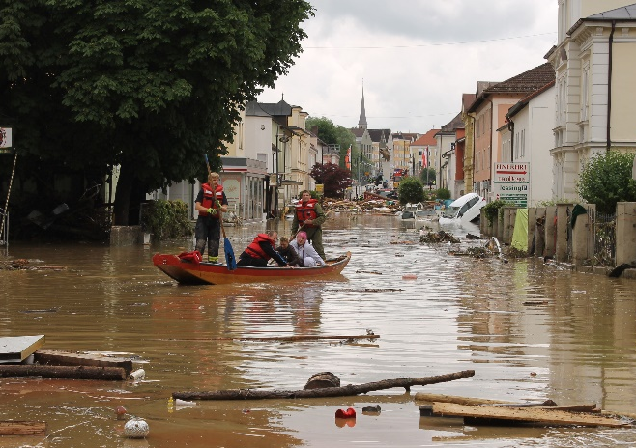
Achievements by SINFONY developments since 2017?
Heavy convective period May / June 2016 was important motivation for creating the SINFONY
Flash flood events in Braunsbach (29.5.2016) and Simbach am Inn (1.6.2016)
Re-forecast of the period 26.5. – 29.6.2016 with all components of today‘s SINFONY system and comparison with the original operational COSMO-DE/-EPS forecasts from that time

Slide 13
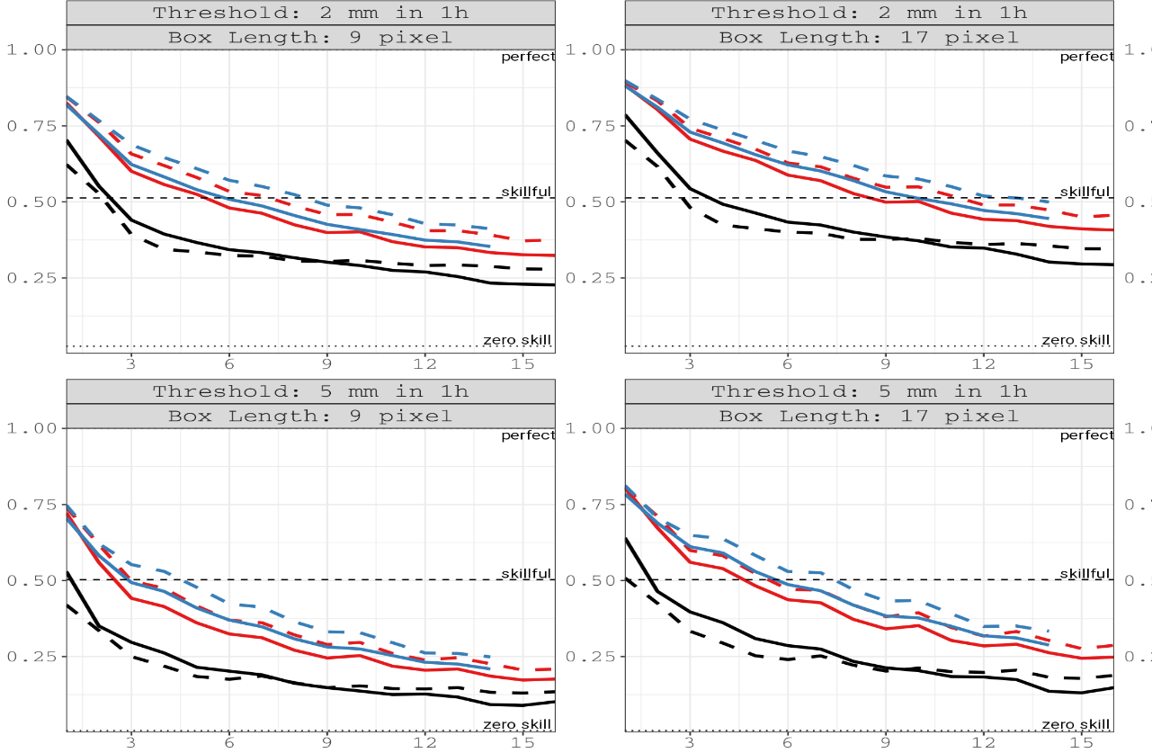
Achievements in NWP: FSS precipitation 26.5. – 30.6.2016
COSMO-DE
ICON-D2
ICON-D2-RUC
Deterministic
Neighborhood ENS
probability (NEP)
6 years progress in NWP
Common result of many general ICON developments and of the SINFONY developments
Forecast lead time

Slide 14
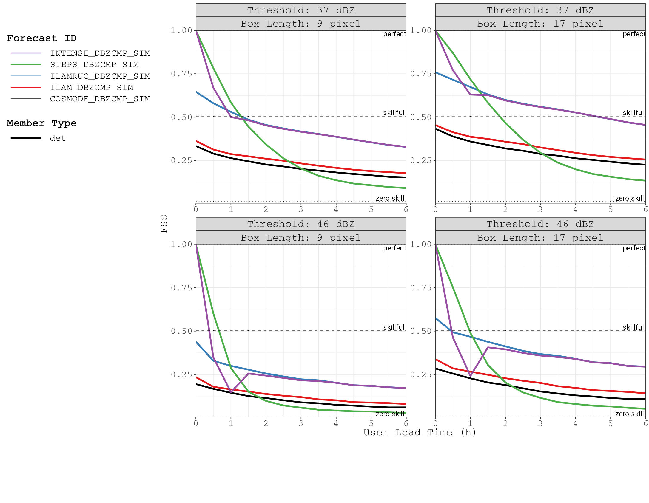
Achievements in NWP and combined products:
FSS Radar Reflectivity 26.5. – 30.6.2016
User perspective, aggregated over all user init times
COSMO-DE
ICON-D2
ICON-D2-RUC
STEPS-DWD Nowcasting
INTENSE Combination

Slide 15
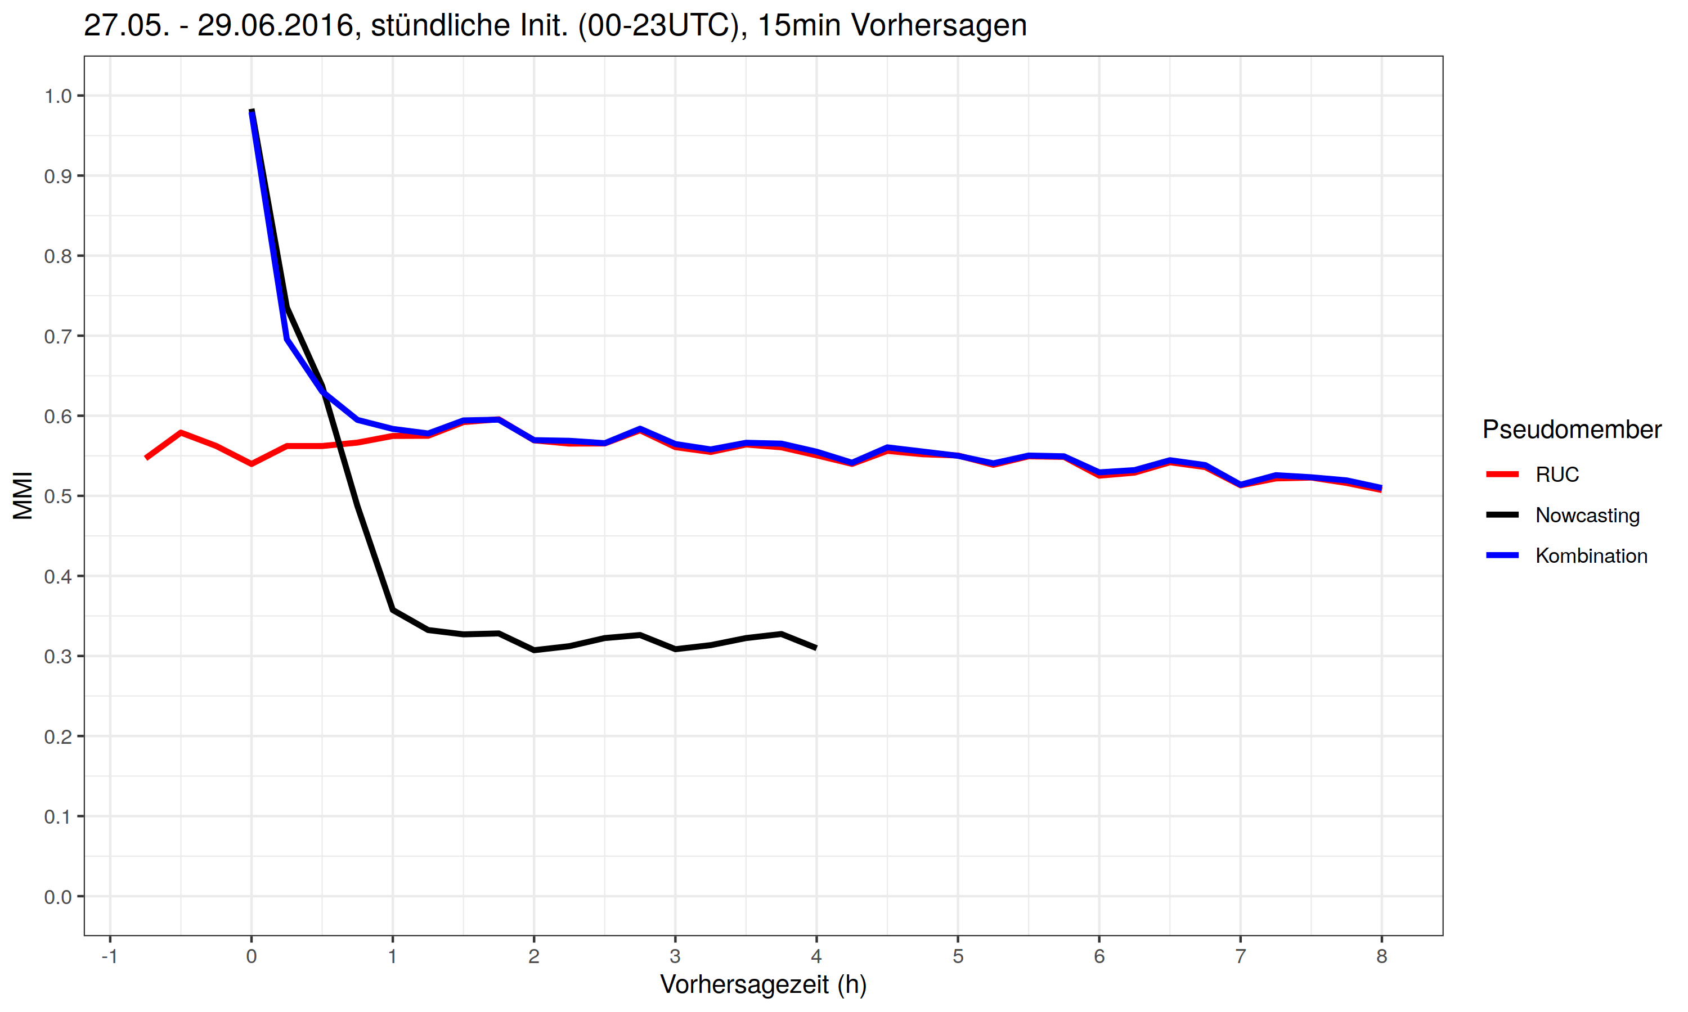
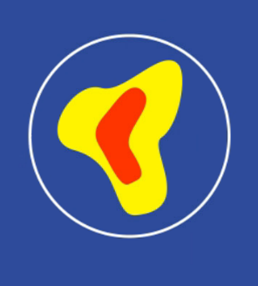

Achievements in NWP and combined products:
Cell objects verification by MMI-Score 27.5. – 29.6.2016
Core areas from all elevations =
3D cell object
MODE (Davies, 2009)
MMI = Median of Maximum Interest
Composite score
Cell properties considered in the MMI:
  Cell centroid distance to observed cell
  Cell area ratio
  Cell severity
Talk Wed
L. Josipovic
KONRAD3D-SINFONY
Poster 87
N. L. Strotjohann
KONRAD3D-SINFONY

Slide 16
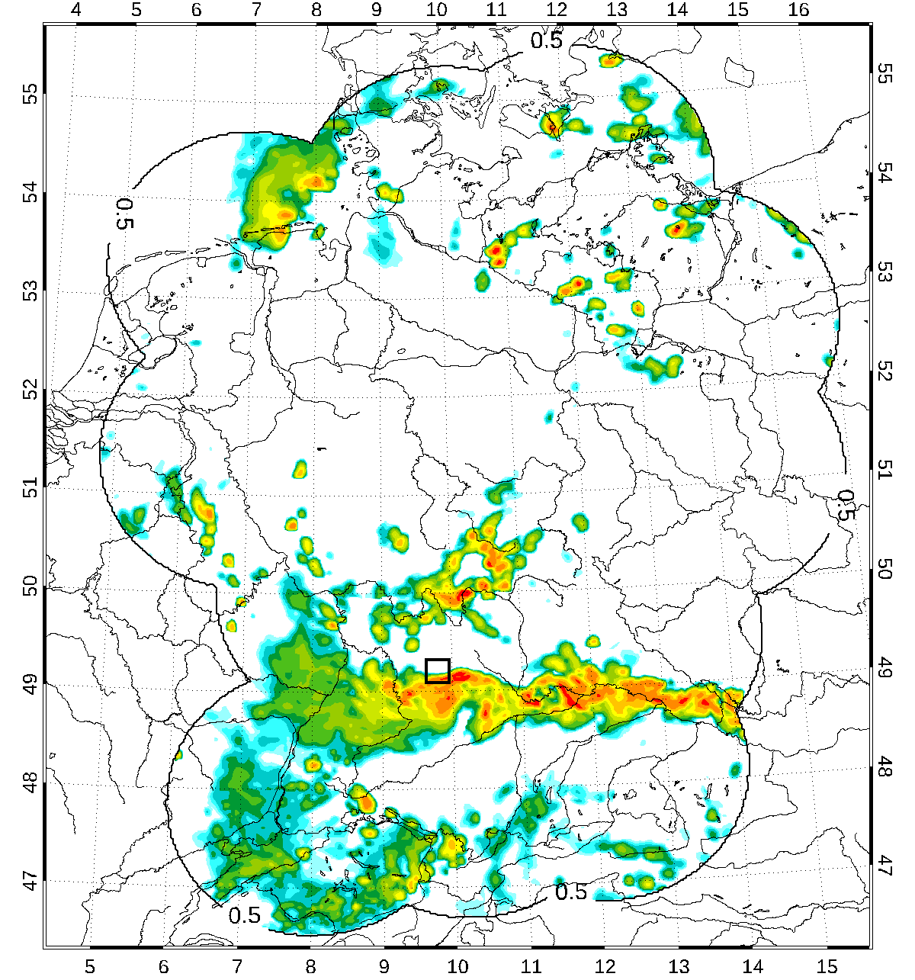
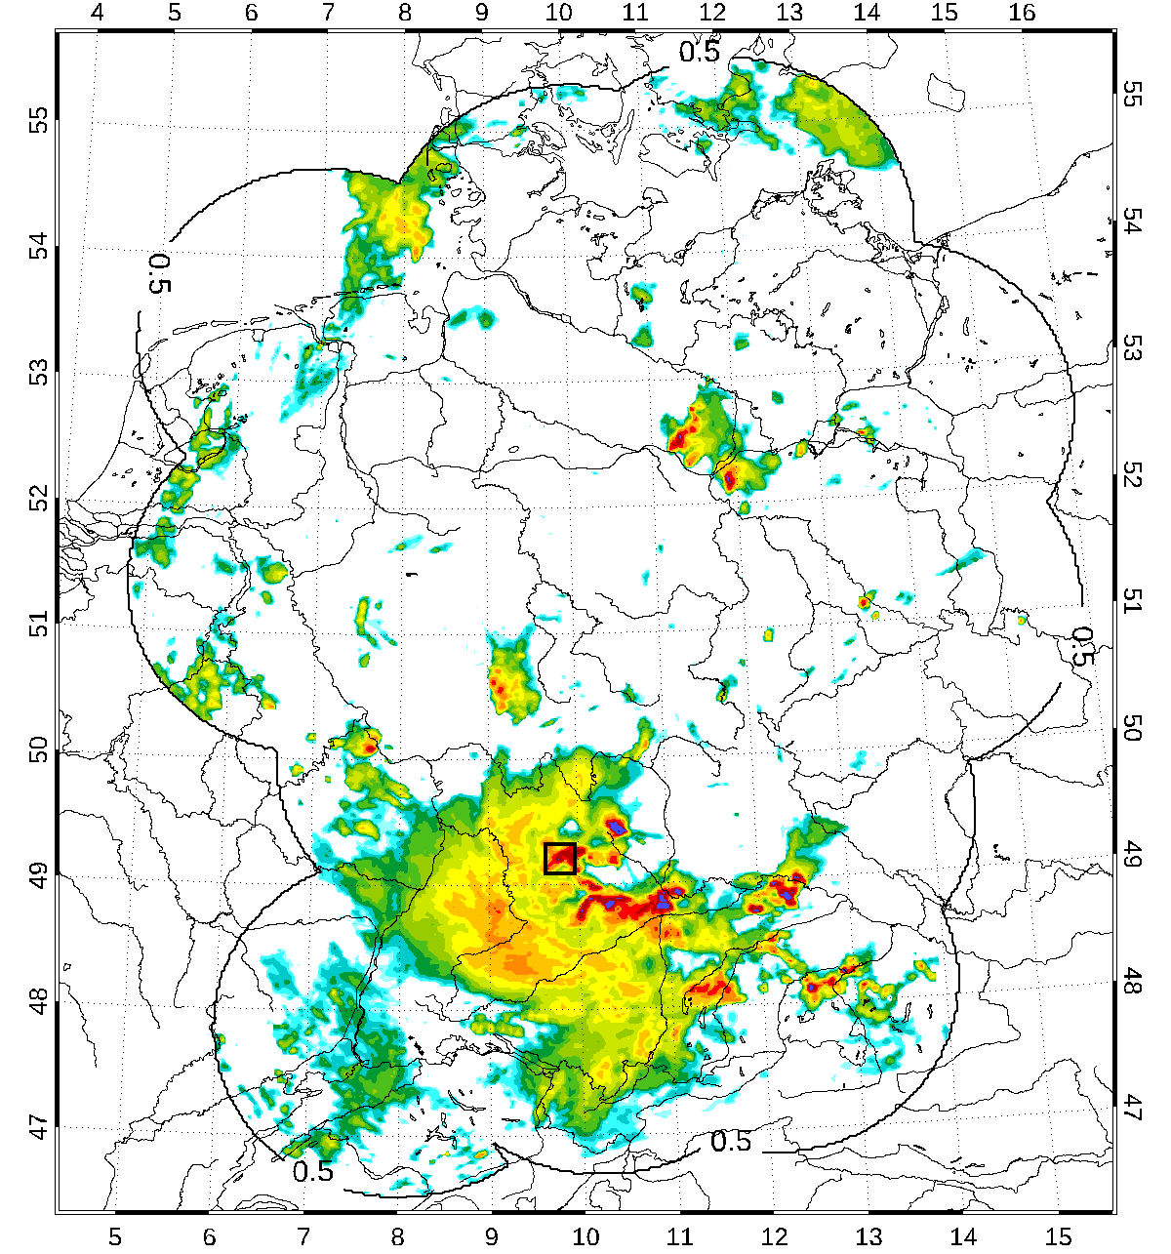
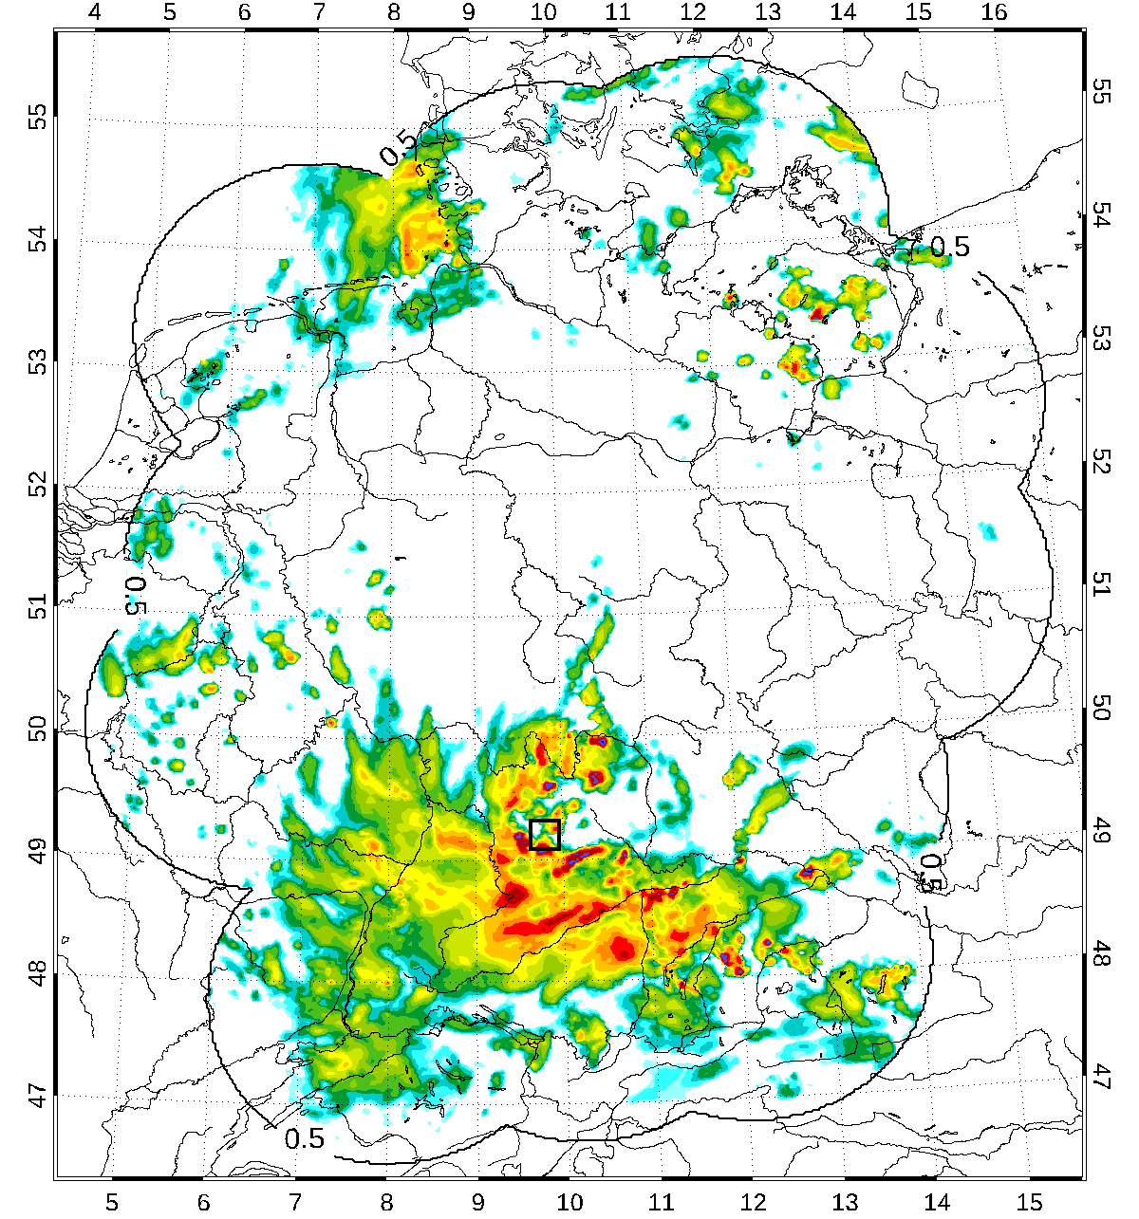
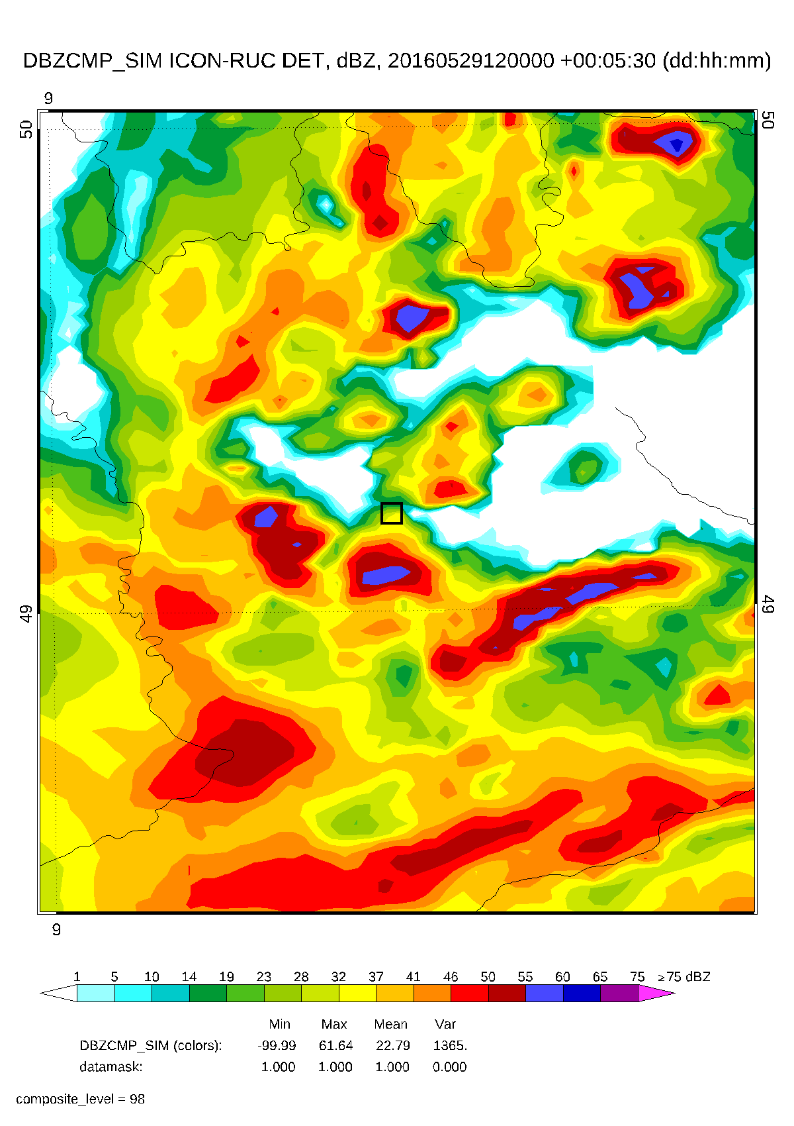
Achievements in NWP for Braunsbach case
Radar reflectivity, Braunsbach flash flood case, 29.5.2016
Reflectivity composites of EMVORADO at 17:30, init 12 UTC
Old COSMO-DE-like det. exp. from 2019 OBS ICON-RUC det. re-forecast

Slide 17
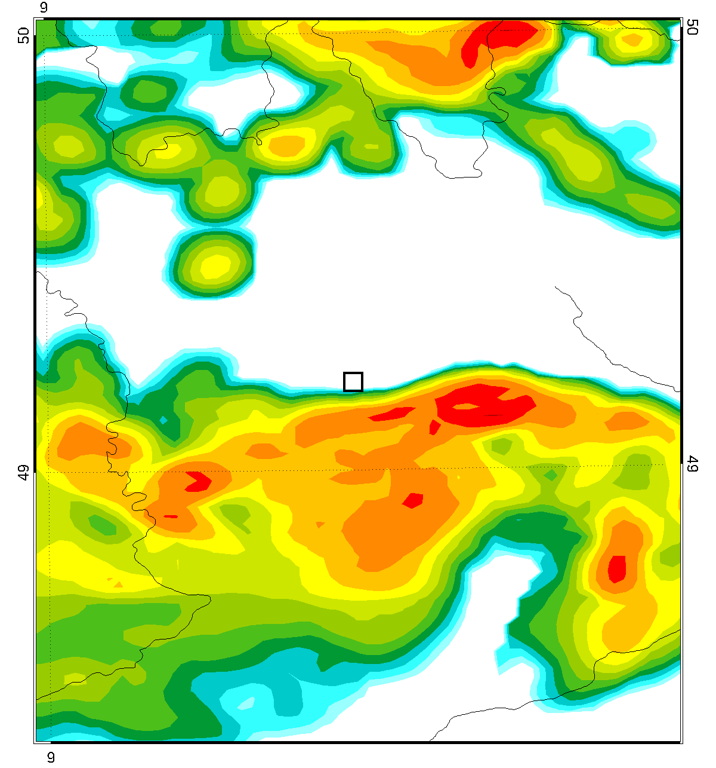
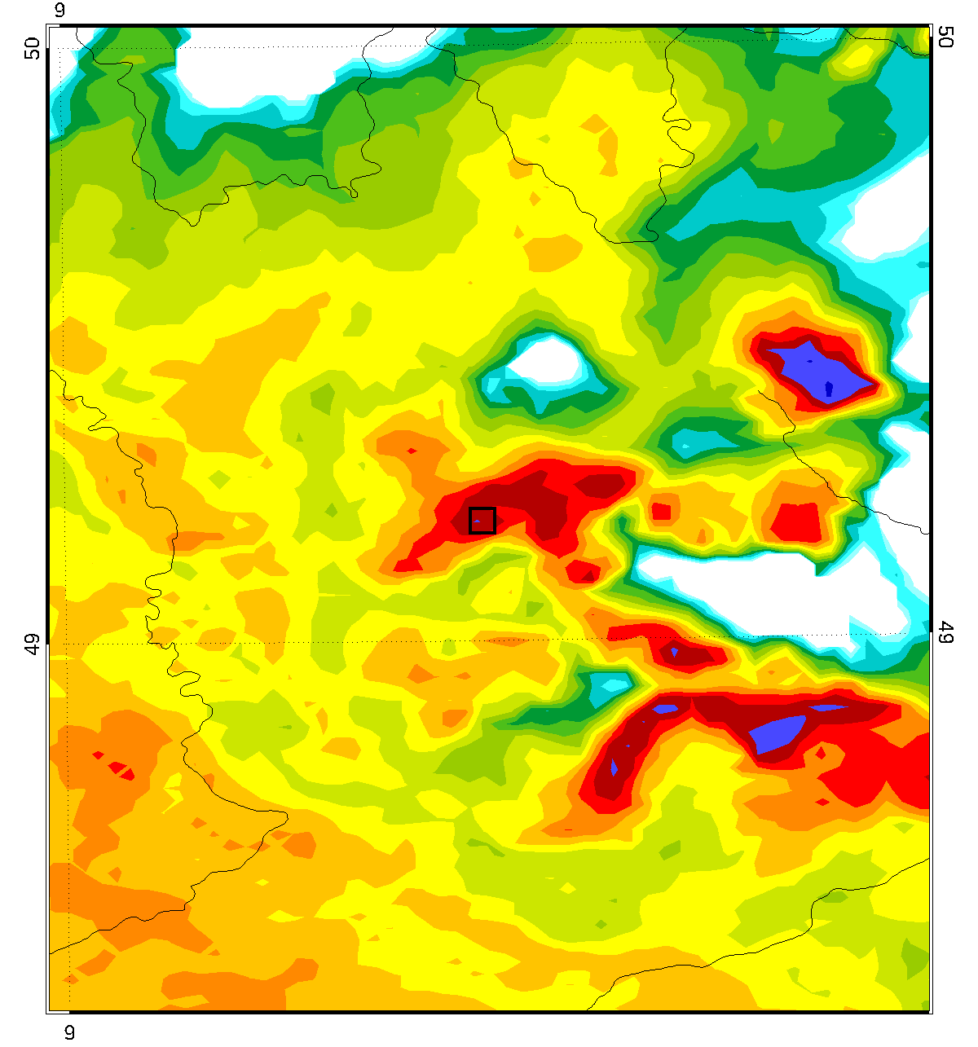
Achievements in NWP for Braunsbach case
Radar reflectivity, Braunsbach flash flood case, 29.5.2016
Reflectivity composites of EMVORADO at 17:30, init 12 UTC
Old COSMO-DE-like det. exp. from 2019 OBS ICON-RUC det. re-forecast

Slide 18
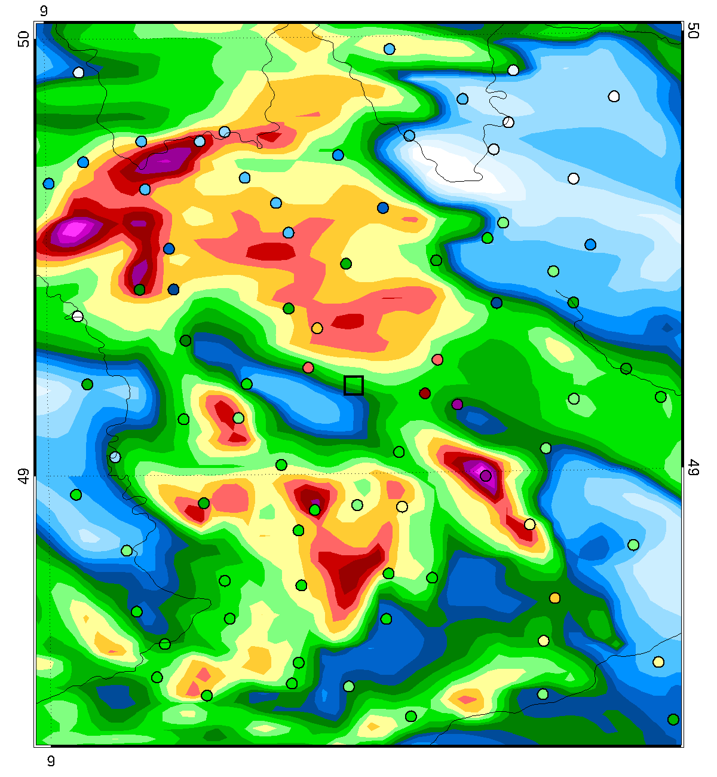
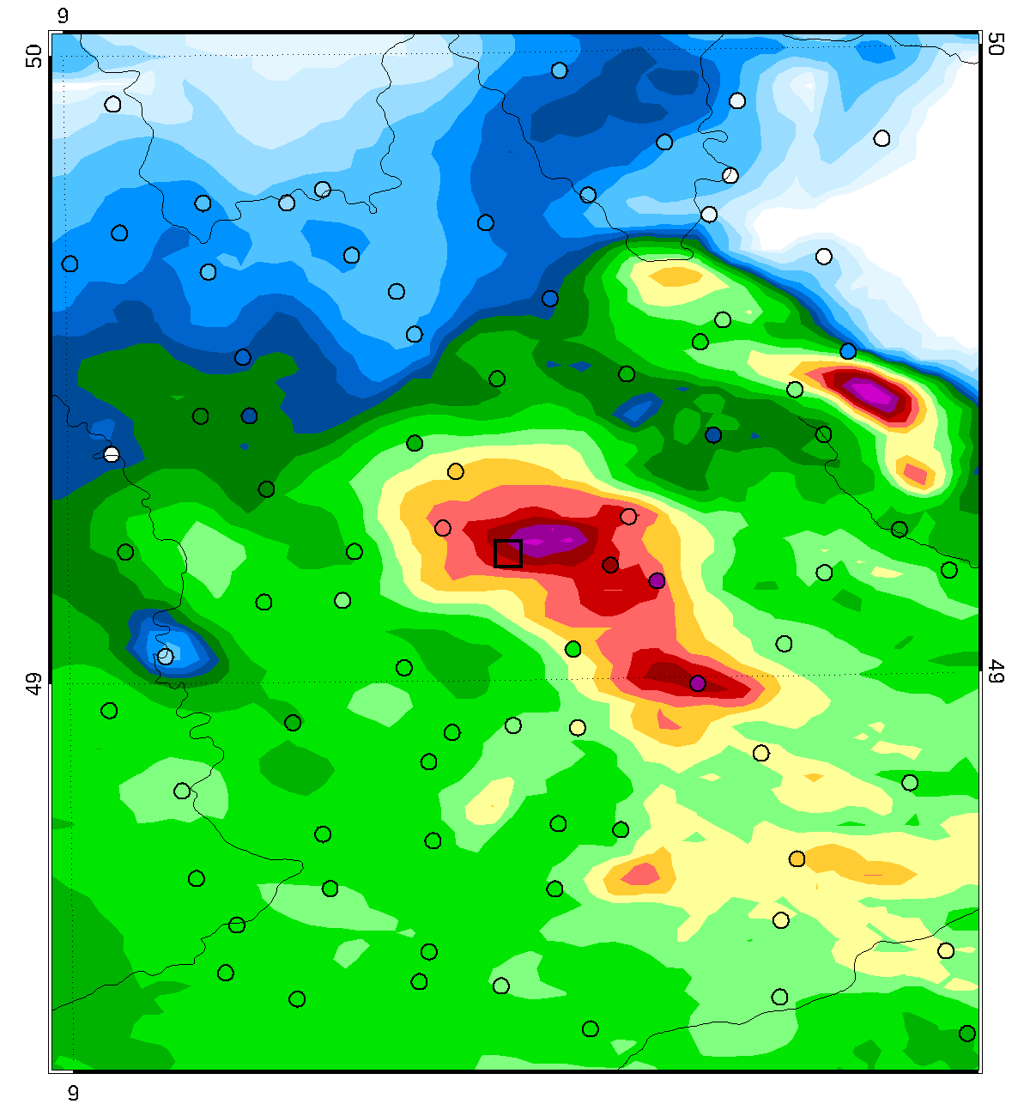
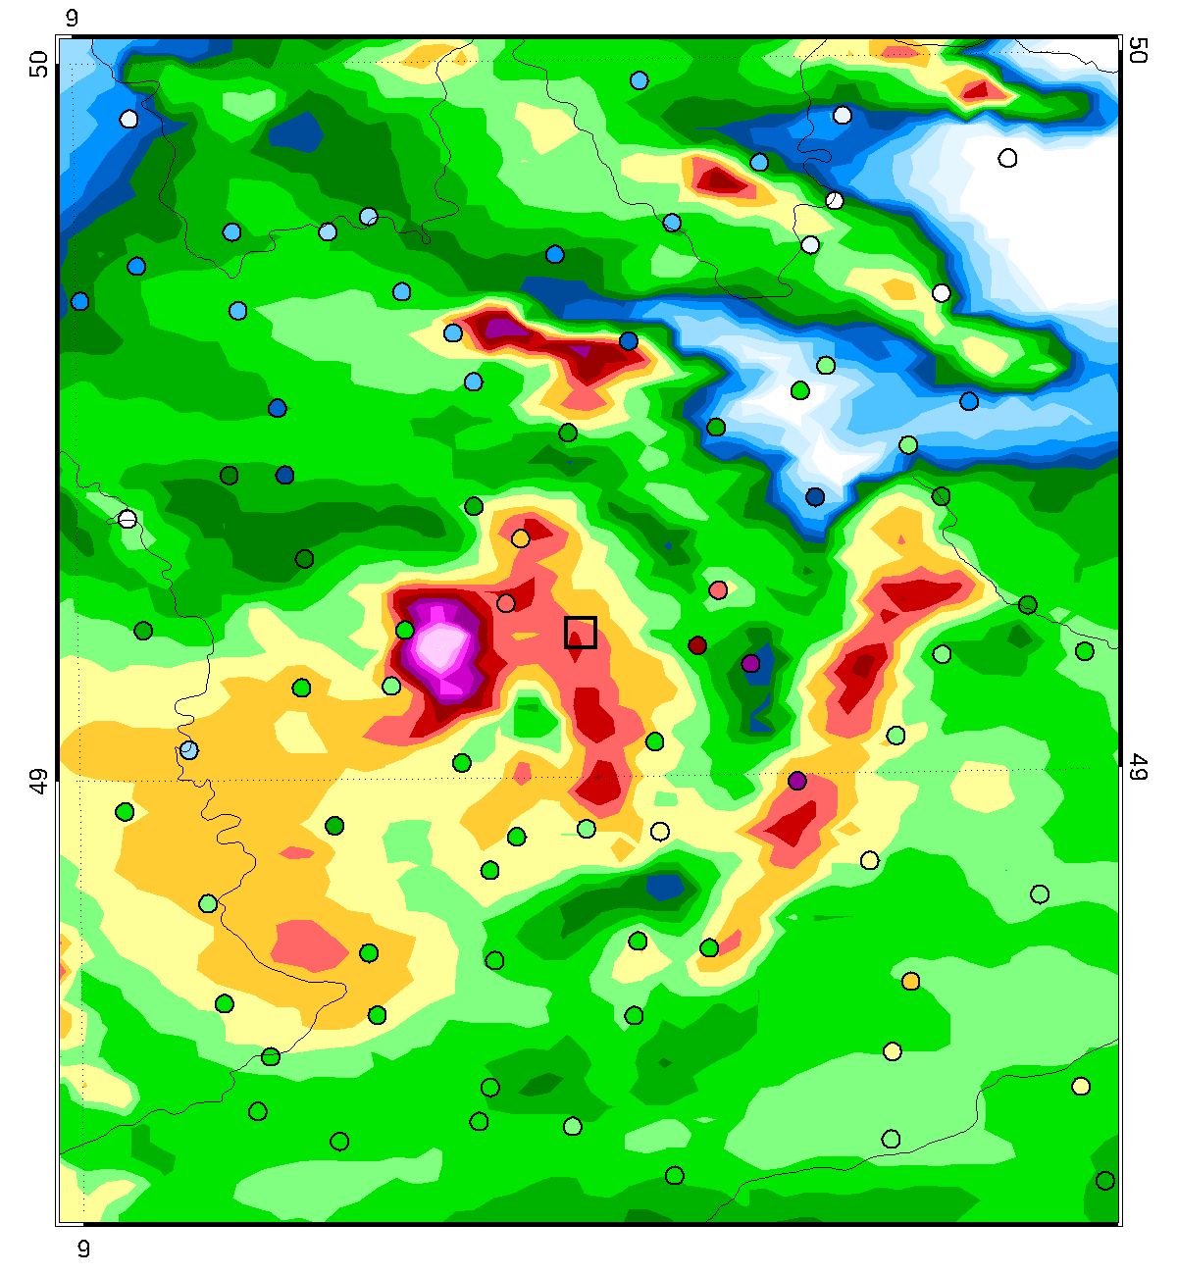
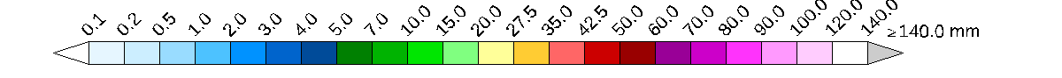
Achievements in NWP for Braunsbach case
Precipitation, Braunsbach flash flood case, 29.5.2016
Accumulated precipitation from 17 – 19 UTC
Old COSMO-DE det. init 12 UTC OBS ICON-RUC det. re-forecast init 12 UTC

Slide 19
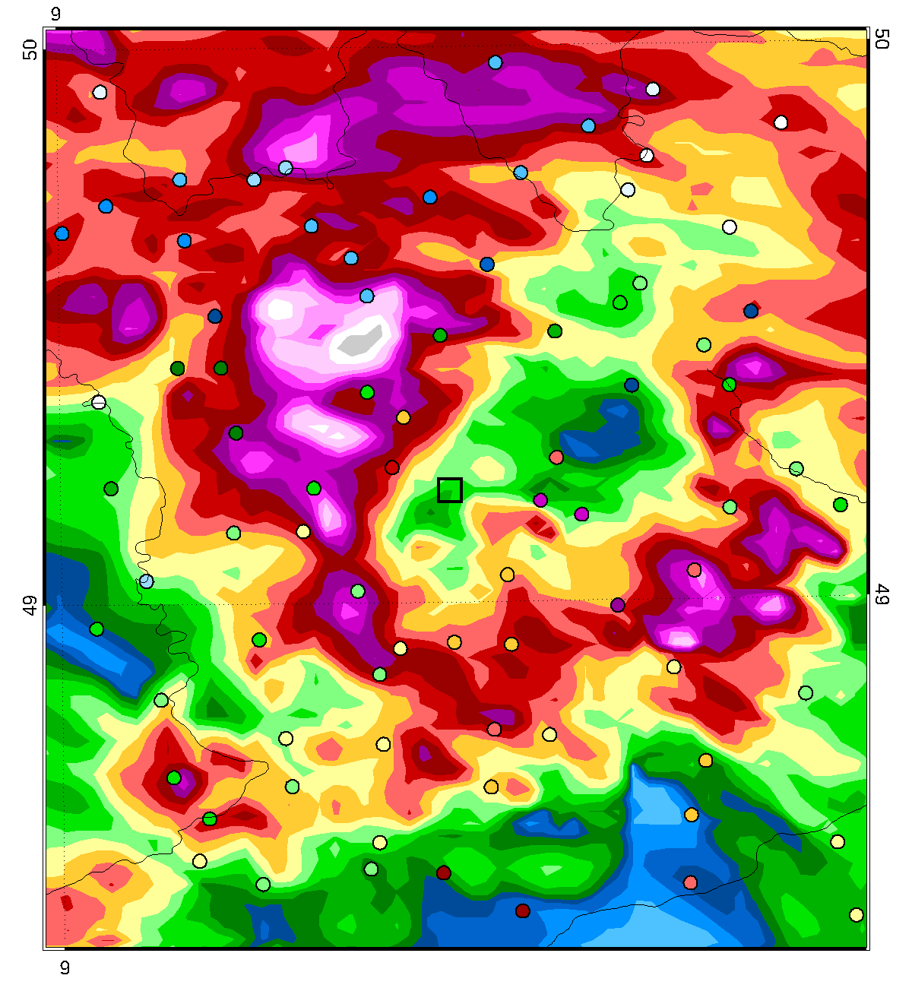
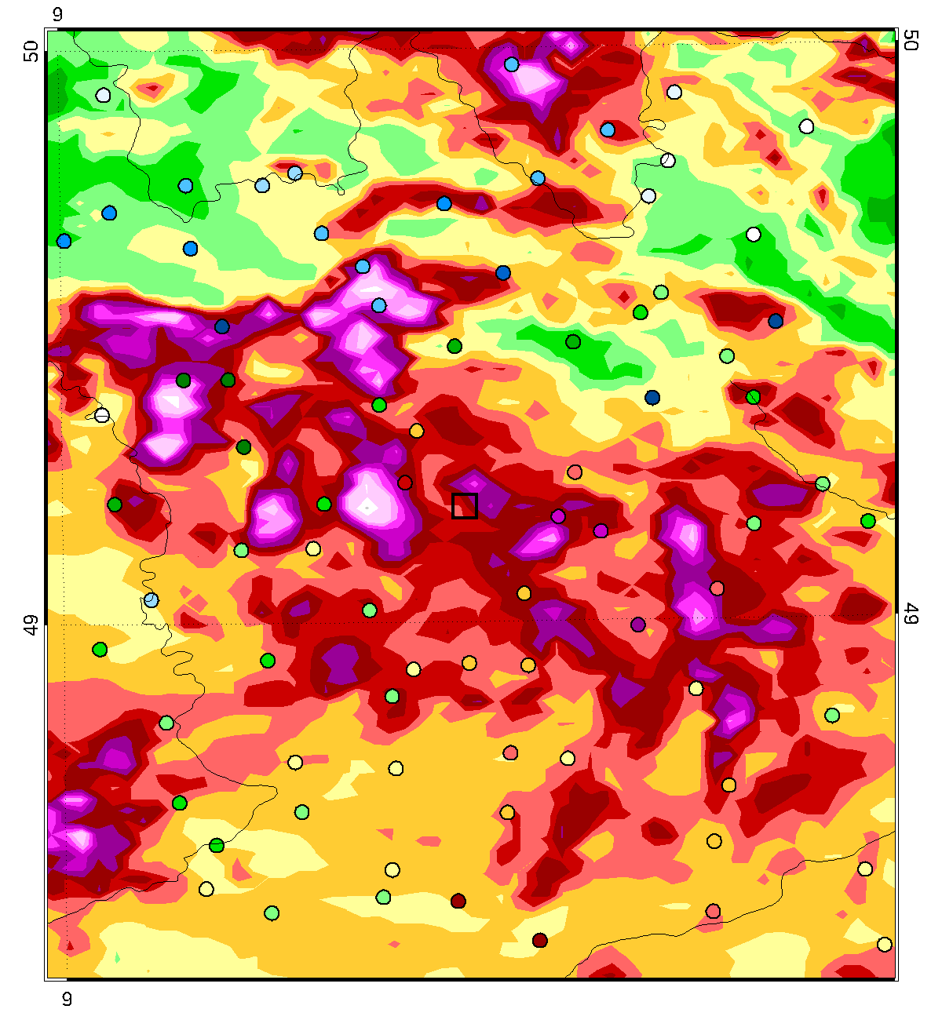
Achievements in NWP for Braunsbach case
Precipitation, Braunsbach flash flood case, 29.5.2016
Accumulated precipitation from 17 – 19 UTC
Old COSMO-DE ensmax init 12 UTC OBS ICON-RUC ensmax re-forecast init 12 UTC

Slide 20
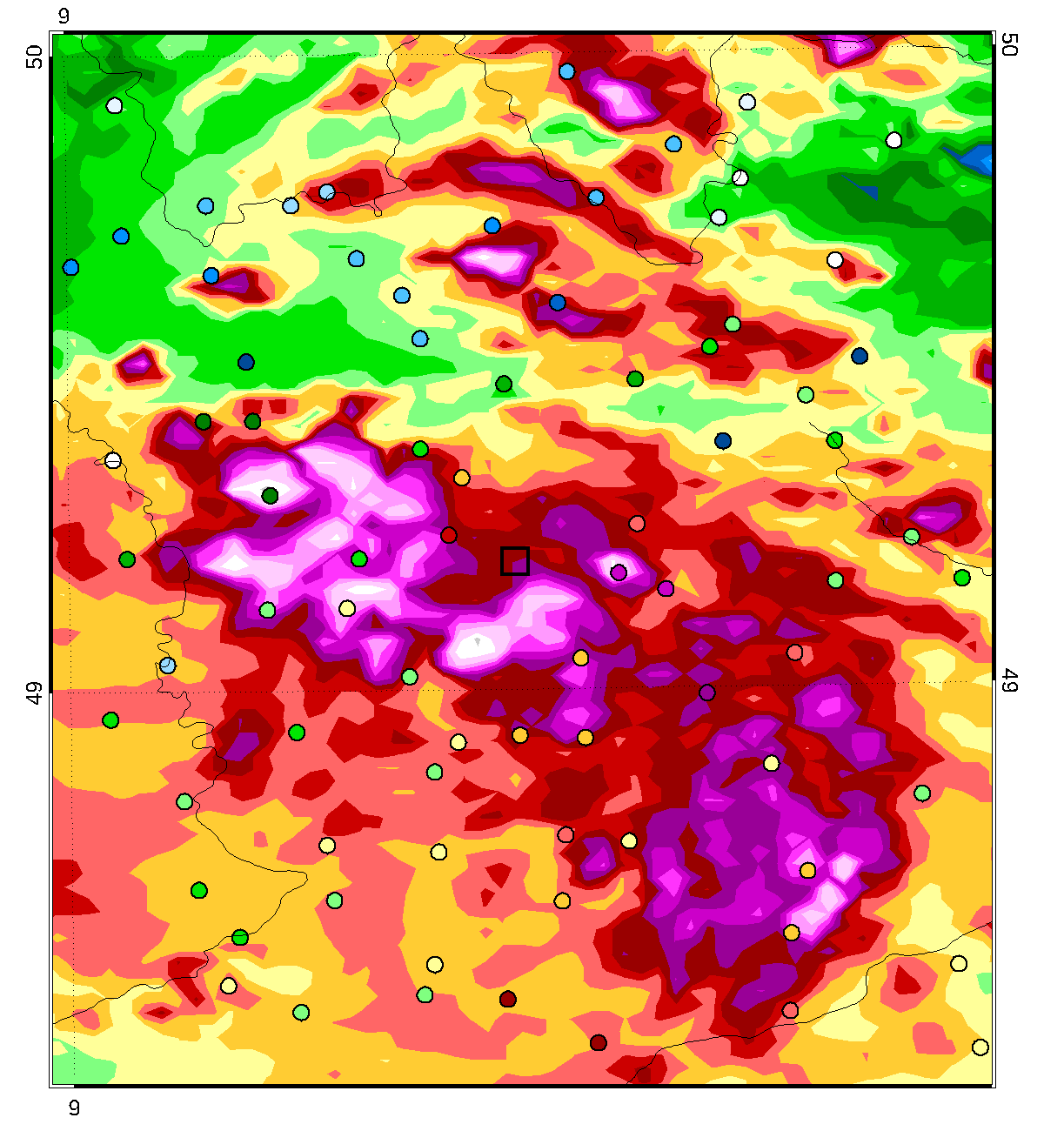
Achievements in NWP for Braunsbach case
Precipitation, Braunsbach flash flood case, 29.5.2016
Accumulated precipitation from 17 – 19 UTC
Old COSMO-DE ensmax init 12 UTC OBS ICON-RUC ensmax re-forecast init 14 UTC

Slide 21
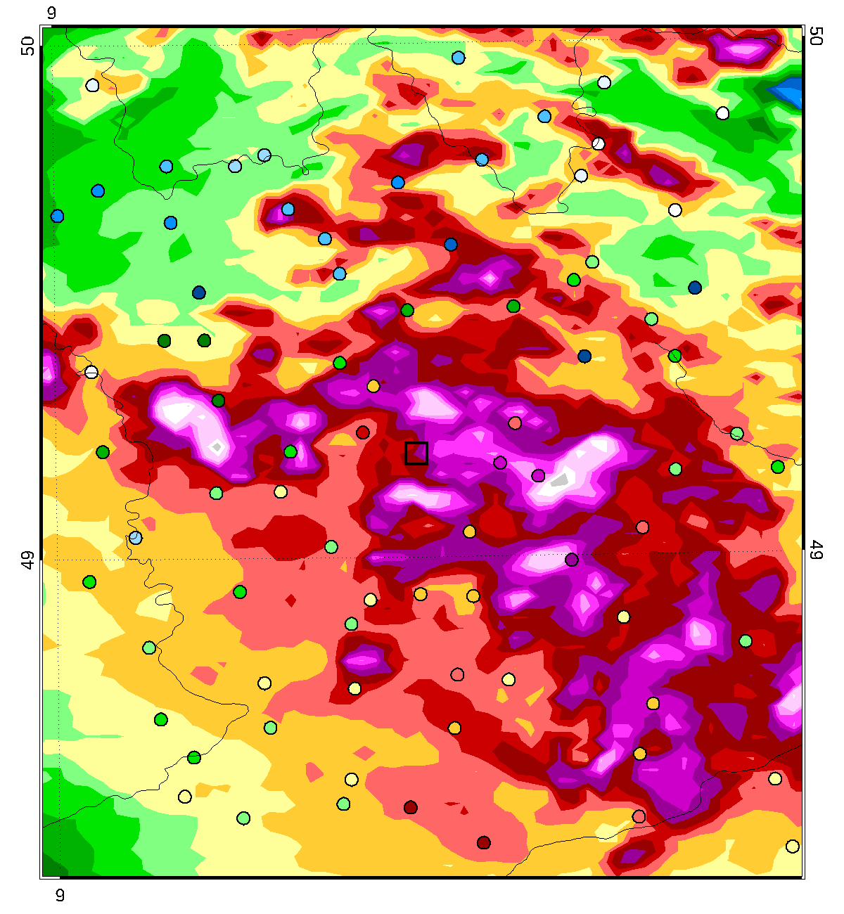
Achievements in NWP for Braunsbach case
Precipitation, Braunsbach flash flood case, 29.5.2016
Accumulated precipitation from 17 – 19 UTC
Old COSMO-DE ensmax init 12 UTC OBS ICON-RUC ensmax re-forecast init 14 UTC

Slide 22
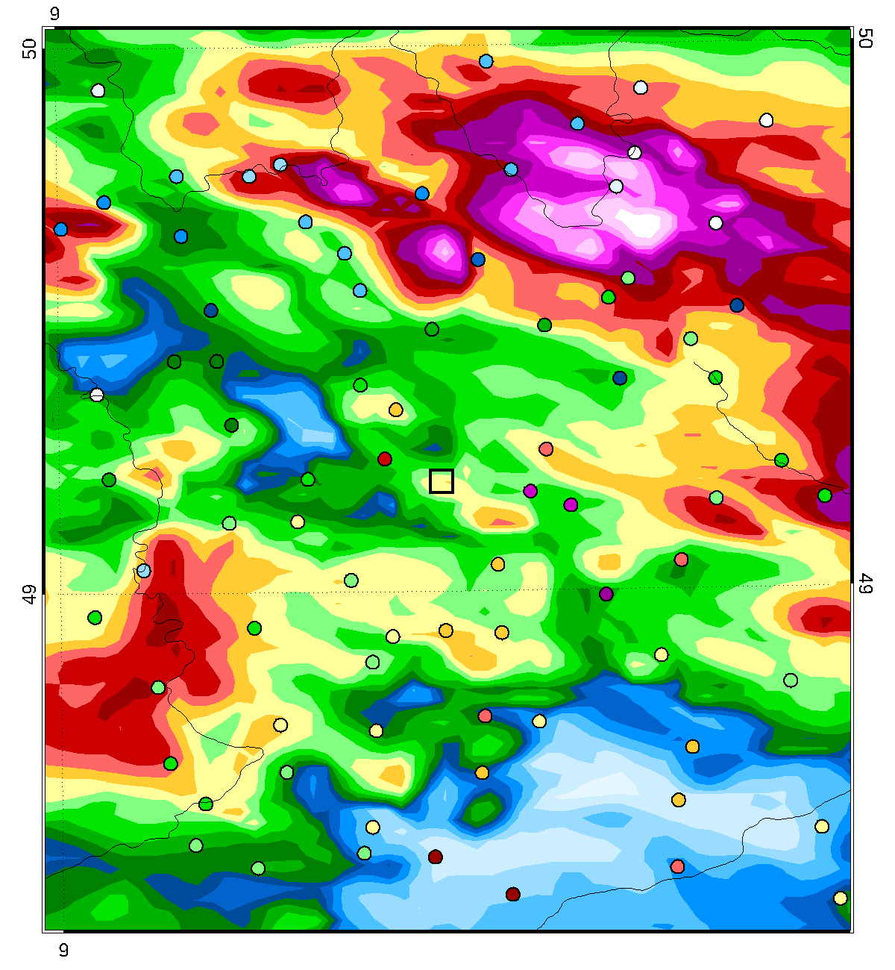
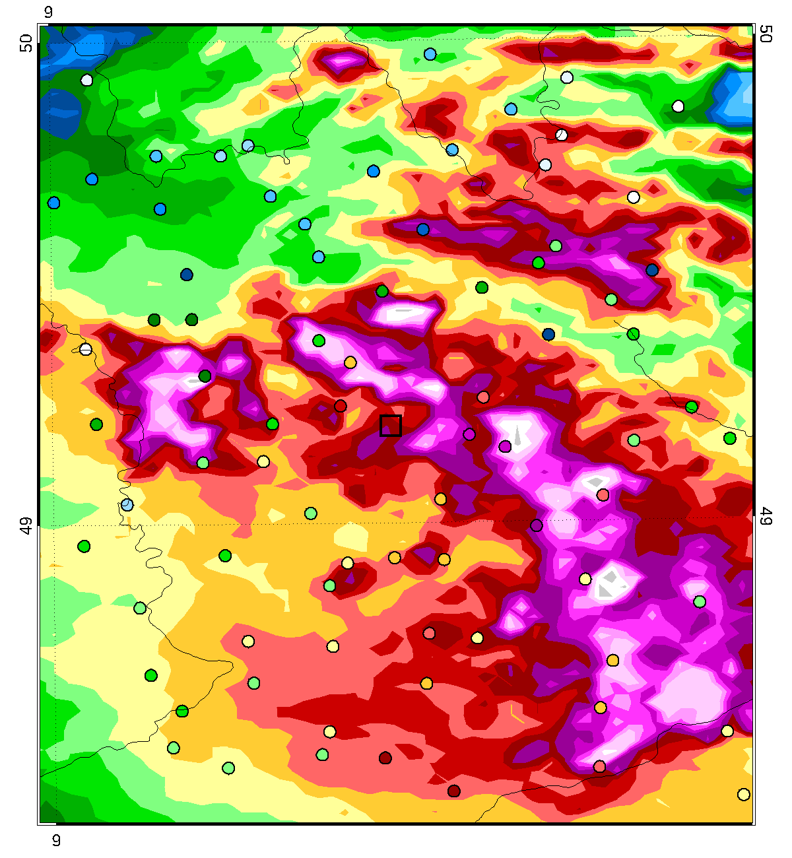
Achievements in NWP for Braunsbach case
Precipitation, Braunsbach flash flood case, 29.5.2016
Accumulated precipitation from 17 – 19 UTC
Old COSMO-DE ensmax init 15 UTC OBS ICON-RUC ensmax re-forecast init 15 UTC

Slide 23
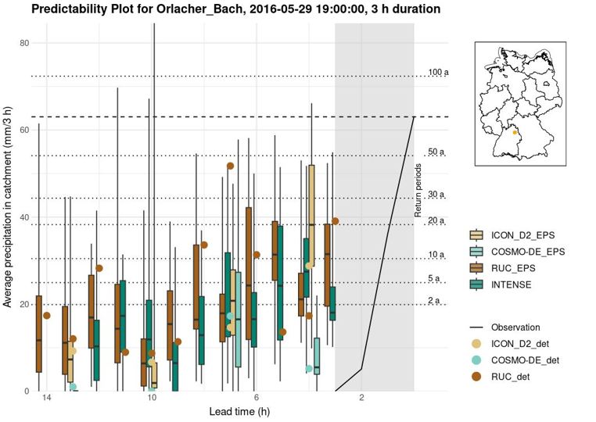
Predictability of catchment precipitation for
Braunsbach case
Poster 139
Ina Blumenstein-Weingartz
Predictability Plots
Catchment very small
(< 10 km²)
Quasistationary cell was very small
Very hard to predict, small spatial shifts have large negative impact
Nearly none of the ensembles got it within its bounds
However, ICON-D2 and RUC considerably closer than the old COSMO-DE
Note: INTENSE appears shifted by 1 h, because involves 1-h old RUC

Slide 24

Co-Design in hydro-meteorological partnership
Poster 39
Olga Kiseleva
Eval of SINFONY precip products in LARSIM runoff forecasting model
Talk Tue
Julia Keller
Tailoring precip products for flood forecasting by co-design
Augmenting the hydrometeorological value chain
through co-design
User-specific, catchment based evaluation of DWD’s precipitation forecasts
Adaptation of DWD’s new warning system to needs of flood forecast
Evaluation of DWD data and products within operational flood forecasting applications
Improving communication of
forecasts and warnings*
Decision makers,
civil protection,
emergency management
Observations (Precipitation,…)
Operational NWP
& Nowcasting
Observations (Discharge,…)
Flood forecasting
models
Flood
Forecasting
Centres
Deutscher
Wetterdienst
Flood
predictions
Weather Predictions
Climatologies
Flood inundation maps
Global-to-regional ICON Digital Twin (GLORI)
* Sub-project, co-financed by the
Landesamt für Umwelt Rhineland-Palatinate

Slide 25


Aggregation of INTENSE over catchment area (AREA)
Poster 95
Jan Bondy
AREA
Simbach case, 7 UTC INTENSE, EPS max
6 h rain sum [mm] in catchment upstream of each pixel Return period [years]
Quickly identify small river catchments (< 500 km²) with high precipitation input at short lead times → flash flood potential
Development together with German flood forecasting centers
(Jan Bondy and Christian Berndt)

Slide 26
Summary and outlook SINFONY
Promising prototypes developed, now phase of consolidation, step-by-step operational introduction in the next years, longterm operations & maintenance
ICON-RUC(-ENS) already operational and available on opendata.dwd.de
SINFONY components work good for convective season. But need to work
on winter and other phenomena!
Therefore, further research activities 2025 – 2028 in project SINFONY 3.0:
  Extend focus to other types of weather (e.g., stratiform, winter, fog)
  and other customers like aviation, energy sector
  Seamless beyond 12 h and for other parameters (wind, temperature, clouds)
  Integrate satellite Nowcasting
  Improve QPE
  AI-methods more and more used in all of these projects
We try co-design with users / customers: test data, evaluations, common projects (e.g., in the framework of our Co-Design projects)
Poster 74
N. Antonoglou
Radar and Rain DSD‘s
www.dwd.de/sinfony sinfony@dwd.de

Slide 27



Thank you for your attention!
SINFONY Tutorials / E-Learning:
www.dwd.de/sinfony → E-learning
(in German language)
(SINFONY Retreat, April 2024, Kloster Höchst i. Odw.)
www.dwd.de/sinfony sinfony@dwd.de

Slide 28









Our external partners
Cooperate with other projects and external partners:
  HErZ, Extramural research
  MeteoSwiss
  Waves2Weather
  IMK@KIT
  University Ulm
  University Tübingen
  DFG research group RealPeP
  DFG priority program PROM
  European Severe Storms Laboratory (ESSL) Testbed

Slide 29





The SINFONY as in current transition to operations
New in SINFONY:
ICON-RUC ensemble-forecast up to +14 h
hourly inits
(Rapid Update Cycle)
Adapted physics
New data in DA:
  Radar Vol dBZ, v_{r}
  SAT VIS / IR
Seamless combined forecast products
Data Assimilation
Obs → Nowcasting → NWP
INTENSE ensemble for fields
C3 exceedance probabilities
KONRAD3D-SINFONY ensemble for cell objects
Scenarios
Exceedance probabilities
  for thresholds
  for presence of conv. cells
Best estimate of expected precipitation
Numerical
Weather Prediction
(convection allowing)
Super
Computer
ICON
Model
(optimized)
Superimpose uncertainties
New in SINFONY:
STEPS-DWD precipitation fields ensemble-nowcast
KONRAD3D(-EPS)
convective cell objects
Probabilistic
Full ensemble
Nowcasting
Track and extra- polate motion of structures / cells
Take life-cycle into account

Slide 30
Some more details on the ICON-RUC
Other differences to ICON-D2:
Focus on good precipitation
and clouds / synthetic cloudy
obs at the same time
2-moment cloud microphysics with explicit hail
For the first time hourly NWP update at DWD
Available after 35’!
Operational since July 2024
Now on opendata.dwd.de
New: ICON-RUC
DET / ENS: 2 km
1-hourly fcst +14 h
20 mem (40 in ass)
Part of the
ICON-D2
DET / ENS : 2 km
20 mem (40 in ass)
3-hourly fcst +48 h
ICON-EU Nest
DET / ENS : 6.5 / 13 km
ICON global
DET / ENS : 13 / 26 km
= Boundary data

Slide 31



NWP results in observation space
(dBZ, cell objects, Sat IR / VIS channels)
Talk Tue 09:20
Nora Strotjohann
KONRAD3D-SINFONY
Advanced forward operators for:
Radar volumes/composites EMVORADO (Vr, Refl, pol. par.)
Cell objects EMVORADO + KONRAD3D (cell tracking in each RUC member)
VIS / IR sat images MFASIS / RTTOV
Seamless combined Nowcasting-NWP-products (5‘ update, 5‘ time resolution)
Verification / model development
Assimilation by our LETKF together with
conventional data and Latent Heat Nudging (LHN)
MFASIS / RTTOV
KONRAD3D detect + track
EMVORADO
2-mom
Obs
1-mom
Poster No. 52 Mon
Jana Mendrok
Polar. eval ICON-RUC
Notes:
Neue Folie, kurze Umschreibung der Herausforderung bei der Darstellung von Modelldaten im Beobachtungsraum, als Ergänzung zur Darstellung der simulierten Volumen-Scans auf der nächsten Folie.

Slide 32

Verification reflectivity STEPS-Nowcasting and RUC vs. Radar in 07/2023 (det + ens)
Time period: 01.07. – 31.07.2023
Forecast runs: 12, 13, 14, … ,18 UTC
(deterministic)
Parameter: Radar reflectivity (dBZ)
Score: fraction skill score (FSS)
STEPS-DWD Nowcasting (det)
ICON-D2-RUC det, 2 km, LHN + 3D-rad
Neighbourhood ENS Prob. (NEP)
„Good“
2 km
25 dBZ
Added value of ensemble
Mainly visible on very small spatial scales
FSS
Progress by NWC = Added Value at the very small scales by introducing ensembles!
„Bad“
Lead time [h]

Slide 33










Performance of ICON-RUC in forecasting a supercell near Berchtesgaden at 20.6.2024
RUC
09 UTC +06 h
RUC
10 UTC +05 h
Eucom
Obs 15UTC
ICON-D2 09 UTC +06 h
RUC
11 UTC +04 h
RUC
12 UTC +03 h
RUC
13 UTC +02 h
ICON-D2 12 UTC +03 h

Slide 34



Added value of the ensemble, e.g., for hail forecasting
Comparison with ESWD and DWD crowd reports
ICON-RUC deterministic
ICON-RUC ensemble maximum
Hail amount 15 – 16 UTC
Init 12 UTC
Hail amount 15 – 16 UTC
Init 12 UTC
  Direkt output for hail amount and mean size at the ground
  Currently work on max size estimate and gaining some experience

Slide 35

Achievements in NWP for Braunsbach case
Precipitation, Braunsbach flash flood case, 29.5.2016
Accumulated precipitation from 17 – 19 UTC
Old COSMO-DE det. init 12 UTC OBS ICON-RUC det. re-forecast init 13 UTC

Slide 36

Achievements in NWP for Braunsbach case
Precipitation, Braunsbach flash flood case, 29.5.2016
Accumulated precipitation from 17 – 19 UTC
Old COSMO-DE det. init 12 UTC OBS ICON-RUC det. re-forecast init 14 UTC

Slide 37


Achievements in NWP for Braunsbach case
Precipitation, Braunsbach flash flood case, 29.5.2016
Accumulated precipitation from 17 – 19 UTC
Old COSMO-DE det. init 15 UTC OBS ICON-RUC det. re-forecast init 15 UTC

Slide 38

Achievements in NWP for Braunsbach case
Precipitation, Braunsbach flash flood case, 29.5.2016
Accumulated precipitation from 17 – 19 UTC
Old COSMO-DE det. init 15 UTC OBS ICON-RUC det. re-forecast init 16 UTC

Slide 39



Achievements in NWP for Simbach case
Precipitation, Simbach flash flood case, 1.6.2016
Accumulated precipitation from 9 – 13 UTC
Old COSMO-DE det. init 03 UTC OBS ICON-RUC det. re-forecast init 03 UTC

Slide 40

Achievements in NWP for Simbach case
Precipitation, Simbach flash flood case, 1.6.2016
Accumulated precipitation from 9 – 13 UTC
Old COSMO-DE det. init 03 UTC OBS ICON-RUC det. re-forecast init 04 UTC

Slide 41

Achievements in NWP for Simbach case
Precipitation, Simbach flash flood case, 1.6.2016
Accumulated precipitation from 9 – 13 UTC
Old COSMO-DE det. init 03 UTC OBS ICON-RUC det. re-forecast init 05 UTC

Slide 42


Achievements in NWP for Simbach case
Precipitation, Simbach flash flood case, 1.6.2016
Accumulated precipitation from 9 – 13 UTC
Old COSMO-DE det. init 06 UTC OBS ICON-RUC det. re-forecast init 06 UTC

Slide 43

Achievements in NWP for Simbach case
Precipitation, Simbach flash flood case, 1.6.2016
Accumulated precipitation from 9 – 13 UTC
Old COSMO-DE det. init 06 UTC OBS ICON-RUC det. re-forecast init 07 UTC

Slide 44


Achievements in NWP for Simbach case
Precipitation, Simbach flash flood case, 1.6.2016
Accumulated precipitation from 9 – 13 UTC
Old COSMO-DE ensmax init 03 UTC OBS ICON-RUC ensmax re-forecast init 03 UTC

Slide 45


Achievements in NWP for Simbach case
Precipitation, Simbach flash flood case, 1.6.2016
Accumulated precipitation from 9 – 13 UTC
Old COSMO-DE ensmax init 06 UTC OBS ICON-RUC ensmax re-forecast init 06 UTC

Slide 46

Predictability of catchment precipitation for Simbach case
Catchment very small
(~ 15 km²)
Quasistationary cell was very small
Very hard to predict, small spatial shifts have large negative impact
None of the ensembles got it within its bounds
However, RUC and ICON-D2 showed at least some signal, while for COSMO-DE only the det. run had some signal
Note: INTENSE appears shifted by 1 h
(Ina Blumenstein-Weingartz Co-Design project)

Slide 47


Aggregation of INTENSE over catchment area (AREA)
Simbach case, 7 UTC INTENSE, EPS 90 % percentile
6 h rain sum [mm] in catchment upstream of each pixel Return period [years]
Quickly identify small river catchments (< 500 km²) with high precipitation input at short lead times → flash flood potential
Development together with German flood forecasting centers
(Jan Bondy and Christian Berndt)

