Slide 1






Project IMA
Seamless predictions at the Royal Meteorological Institute of Belgium
Lesley De Cruz^{1,2}, Michiel Van Ginderachter¹, Maarten Reyniers¹, Alex Deckmyn¹, Simon De Kock^{1,2}, Idir Dehmous¹, Wout Dewettinck³, Felix Erdmann¹, Ruben Imhoff⁴, Arthur Moraux^{1,2}, Ricardo Reinoso-Rondinel^{1,5}, Mats Veldhuizen⁶, Joseph James Casey¹, Loic Faleu Kemajou¹, Anshul Kumar¹, Viktor Van Nieuwenhuize¹
1 Royal Meteorological Institute, Brussels, Belgium
2 Electronics and Informatics (ETRO), Vrije Universiteit Brussel, Brussels, Belgium
3 Physics and Astronomy, Ghent University, Ghent, Belgium
4 Operational Water Management & Early Warning, Deltares, Delft, The Netherlands
5 Civil Engineering, Hydraulics & Geotechnics, KU Leuven, Leuven, Belgium
6 Royal Netherlands Meteorological Institute (KNMI), De Bilt, the Netherlands

Slide 2
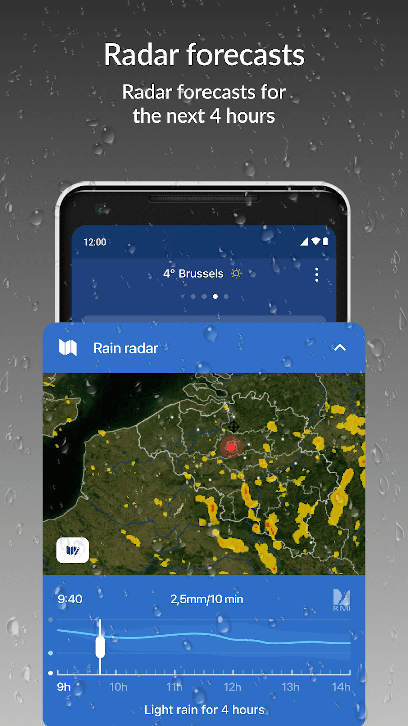
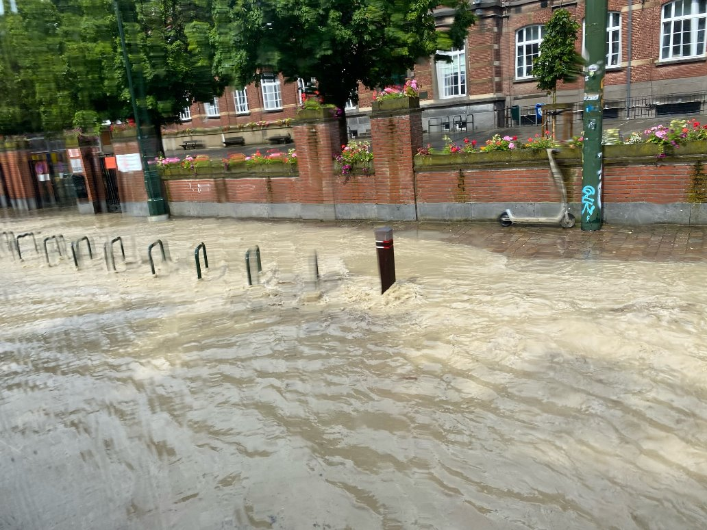
Seamless Prediction Programme: Rationale
Need for rapidly updating forecasts which
integrate the latest high-resolution observations
cover timescales from minutes to days ahead
optimize forecast skill over this range
combine nowcasting and high-resolution NWP
target users in (urban) hydrology, the renewable energy sector, and the general public.
Other European systems: DWD’s SINFONY; FMI’s ULJAS, MetOfﬁce’s IMPROVER, ...
RMI Weather app on the Google Play Store

Slide 3
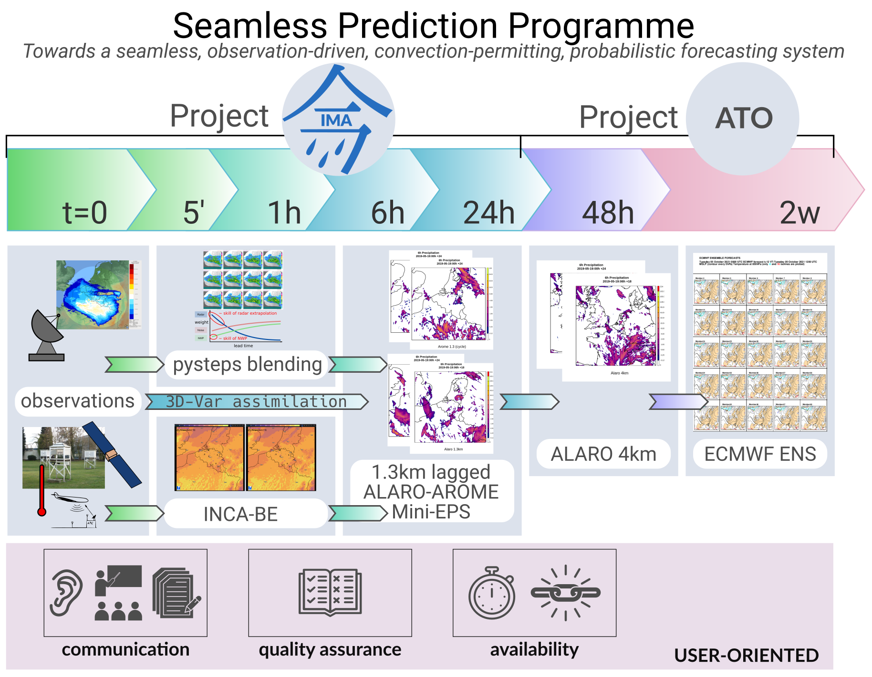
AI precipitation blending (Simon De Kock et al.)
AI multimodal
(Arthur Moraux et al.)
AIFS?

Slide 4
Seamless precipitation ensemble nowcasting part of Project IMA:
based on pysteps

Slide 5
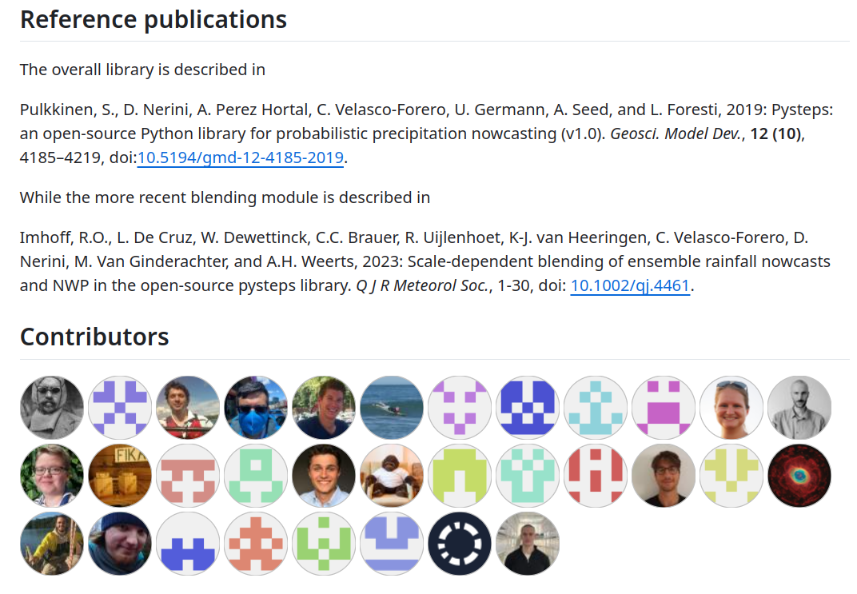
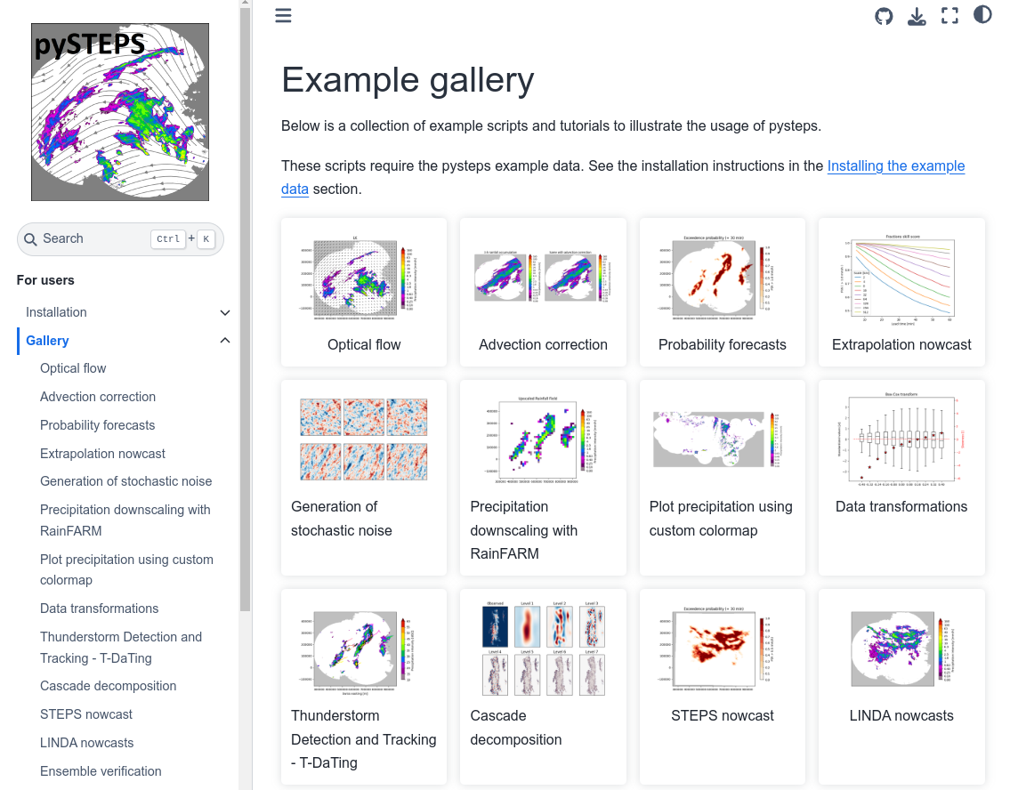
Bigger picture: the pysteps initiative
Community-driven free and open-source framework for precipitation nowcasting
Deterministic and probabilistic nowcasting, validation, visualization, …
Friendly and welcoming community at https://github.com/pysteps/pysteps

Slide 6
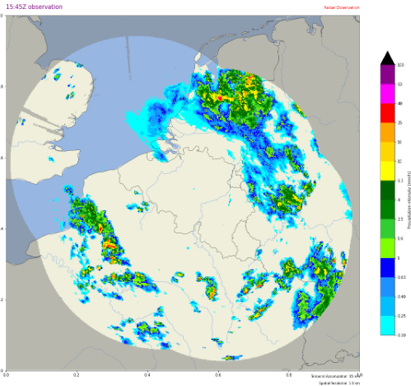
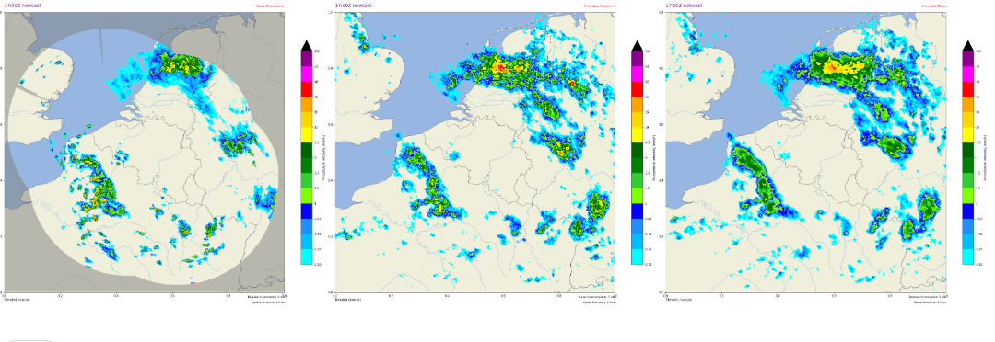

Seamless ensemble precipitation nowcasts: "pysteps-be"
Input:
Observations: RADQPE Belgian radar rainfall composite, 1km resolution, 5’ frequency. Rain gauge correction through mean field bias and external drift kriging. (Goudenhoofdt & Delobbe 2016; Journée et al. 2023)
NWP: ALARO/AROME (lagged) mini-EPS at 1.3km, 45" aggregated to 5’ (Termonia et al., 2018)
Output:
48 24-member ensemble
goal: run every 5'
timestep of 5’
up to +6 hours lead time
using scale-dependent stochastic perturbations (STEPS)
with a skill- and scale-dependent blending (Imhoff et al. 2023)
Running in a docker container
+ NWP
observation, random member, mean

Slide 7
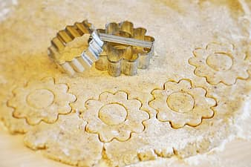
Evolving open-source nowcasting for the future
pysteps keep improving, e.g. in the blending:
Performance and maintainability improvements
Better representation of extremes (probability matching)
Spatial blending at the edge of the radar domain
Interoperability between AI-based and "classical" nowcasting
How to avoid reinventing the wheel?
Conversation started in EUMETNET's E-AI WG6: nowcasting
Integration of new AI methods in pysteps, through plugins
Welcome to integrate/interface your methods as plugins, check out:
https://github.com/pySTEPS/cookiecutter-pysteps-plugin
(initiated by Andres Perez Hortal and extended by our colleagues)
LDCast
prtype
DGMR

Slide 8
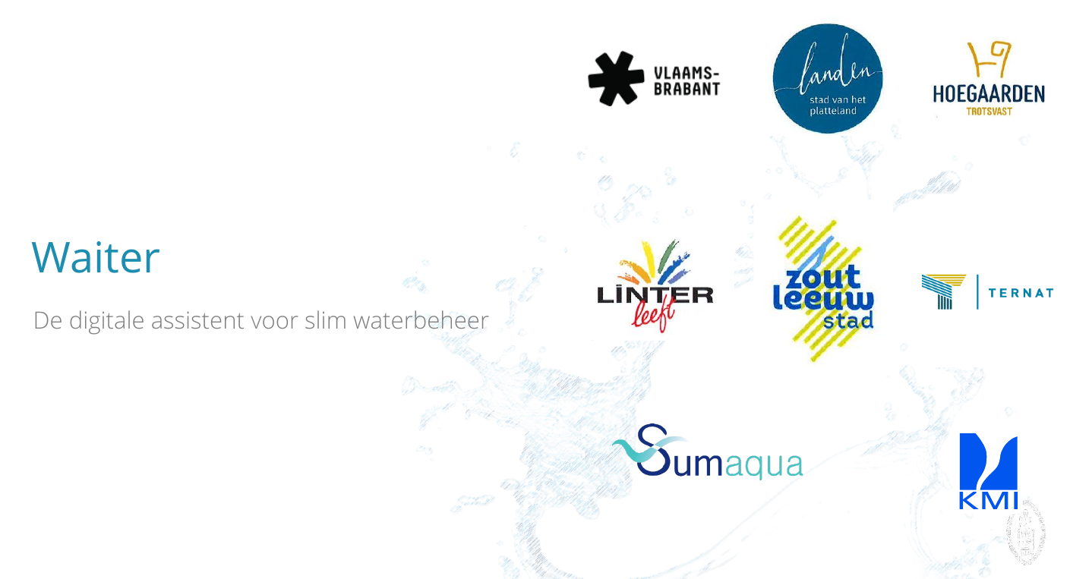
Applications (I): Waiter

Slide 9
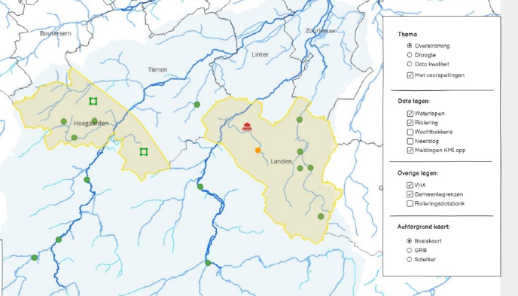
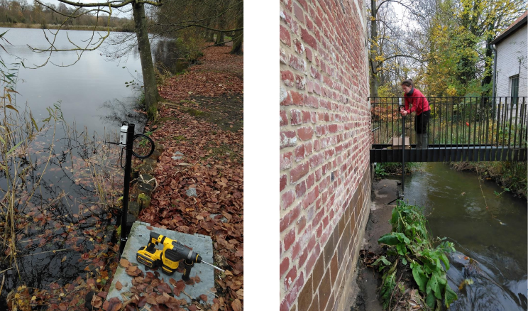
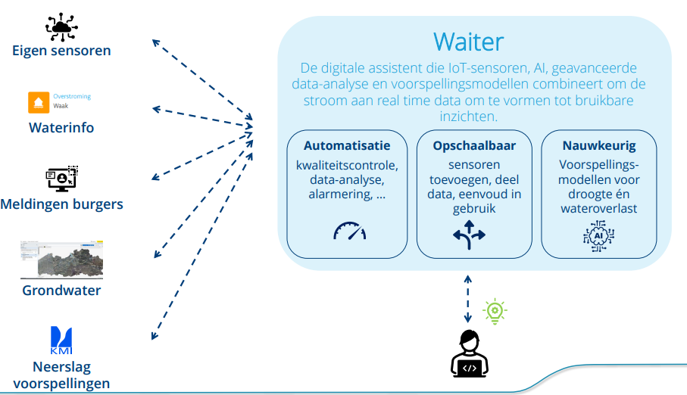
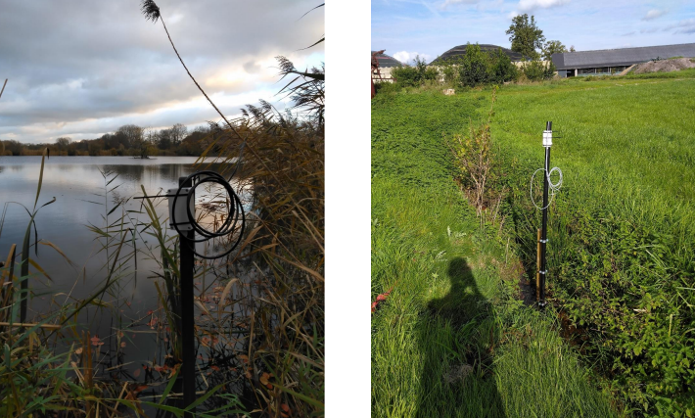
Tim Franken & colleagues, Sumaqua

Slide 10
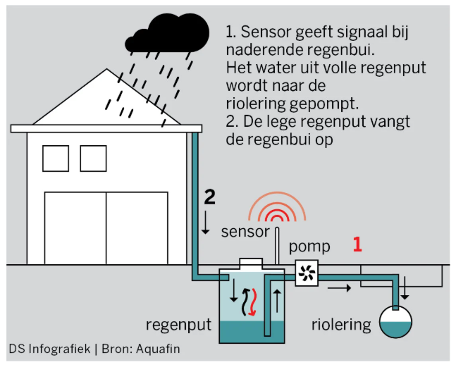
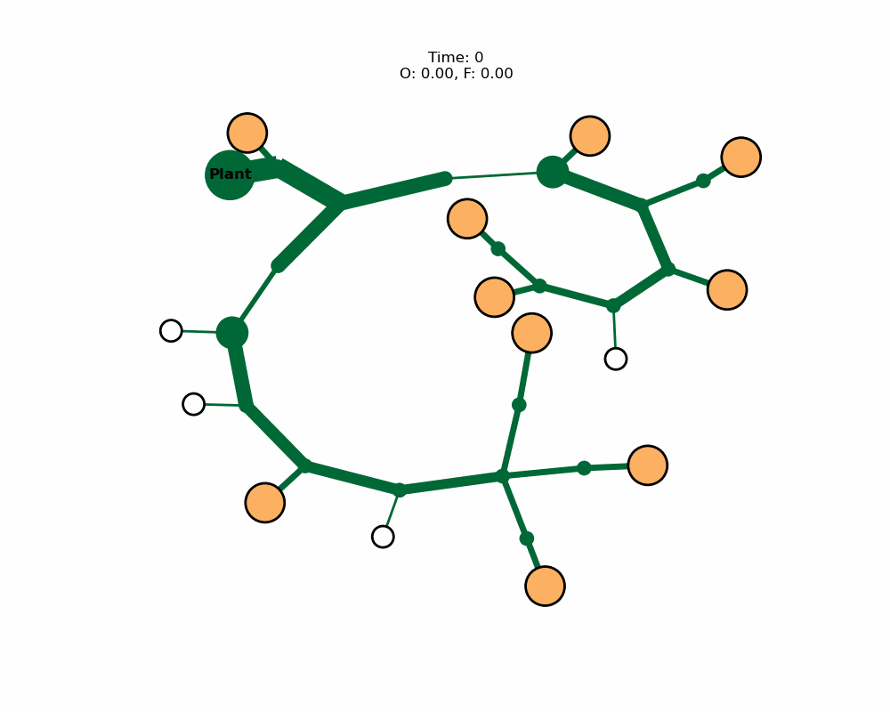
Applications (II): Aqtiput
Entire street (controlled)
Entire street (uncontrolled)
"Optimal coordinated control of private rainwater wells using ensemble rainfall forecast data" – final presentation
Mathematics for Industry study week challenge by Aquafin and RMI, 19-23 September 2023
https://be-maths-in.be/mfi23/wp-content/uploads/sites/27/2024/01/team_Aquafin_RMI-v2.pdf
Credits: Arne Bouillon, Guillaume Derval, Sheetal Jain, Thomas Lessinnes, Christian Mugisho Zagabe and Pieter Vanmechelen - supervisors: Geert Dirckx, Stefan Kroll & Lesley De Cruz

Slide 11
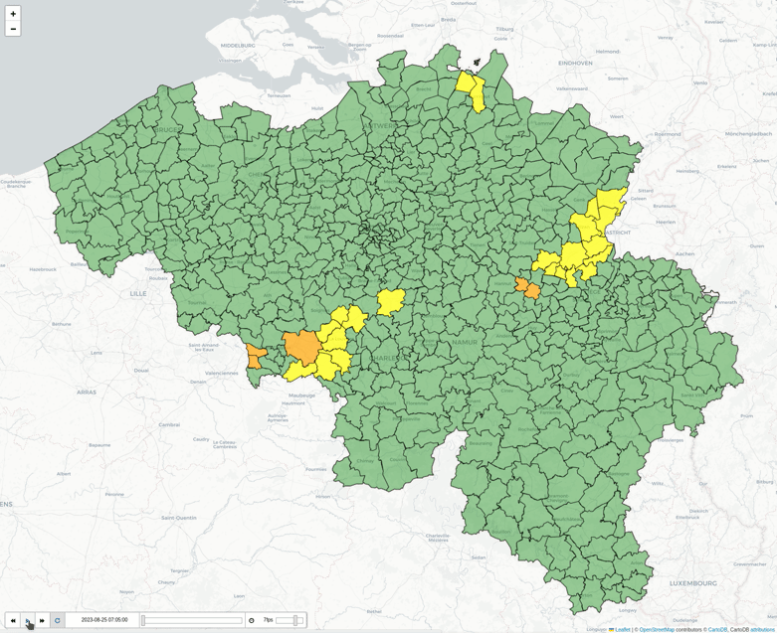
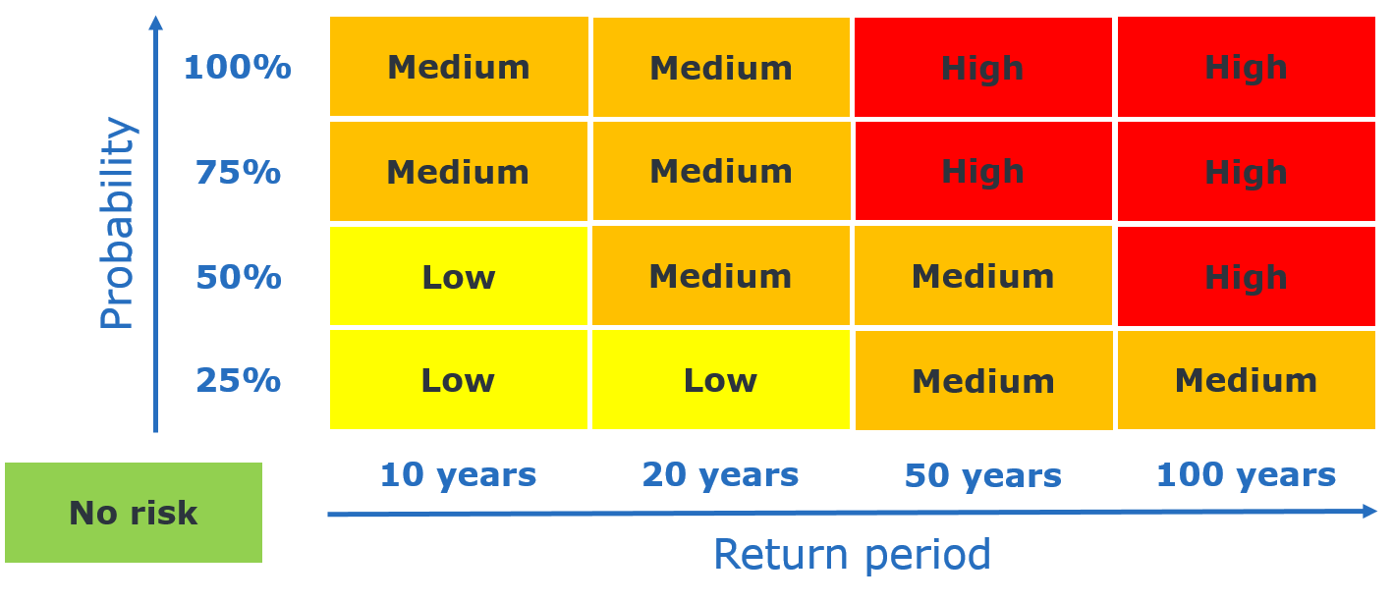
Applications (III): Rainfall warnings based on return level exceedance probabilities (PyRainWarn)
Credits: Felix Erdmann

Slide 12

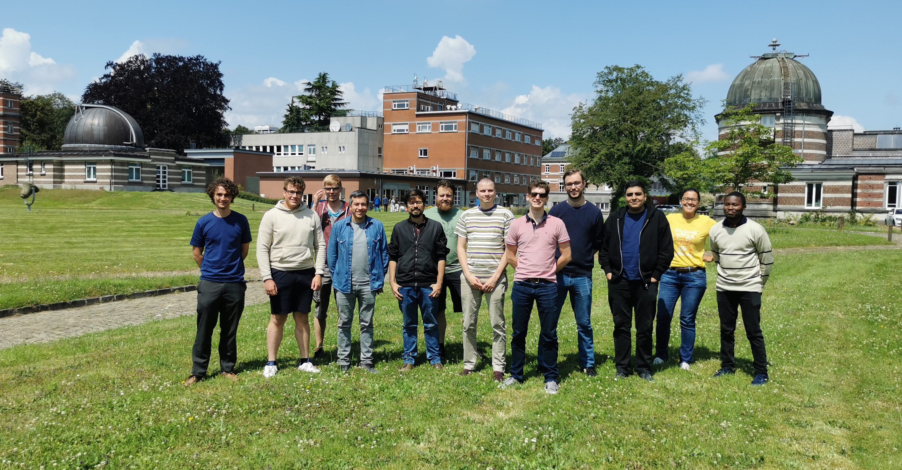
Pysteps hackathon 2025
Are you interested in joining the next pysteps hackathon in the Belgian Ardennes region?
Mon 8 - Fri 12 September 2025
https://forms.microsoft.com/e/Dm8veYEq9b
Pysteps hackathon at RMI, 2024

