Slide 1

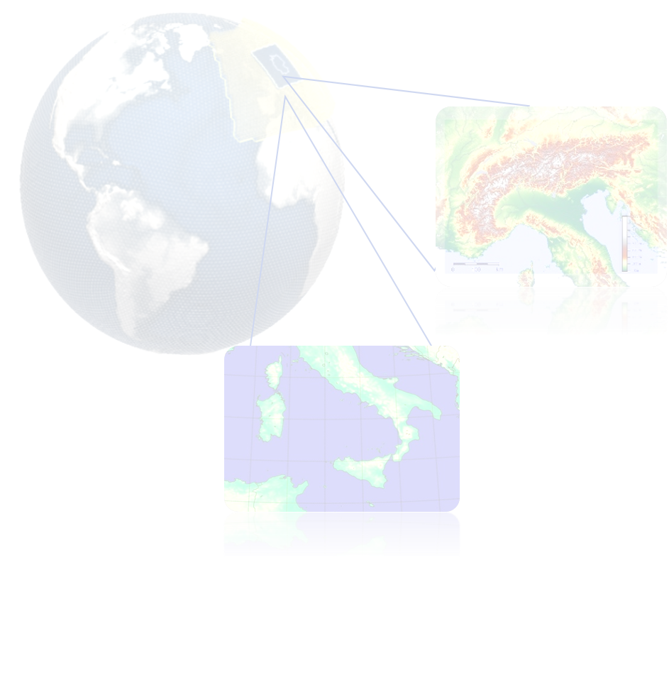
Zahra Parsakhoo
Chiara Marsigli, Christoph Gebhardt, Axel Seifert, Jan Keller
Studies of Convection-Permitting Ensemble Forecasting for ICON-D2 with a 1km Nest over the Alps
PrePEP Conference | University of Bonn | 18 March 2025

Slide 2
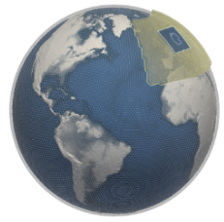
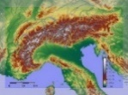
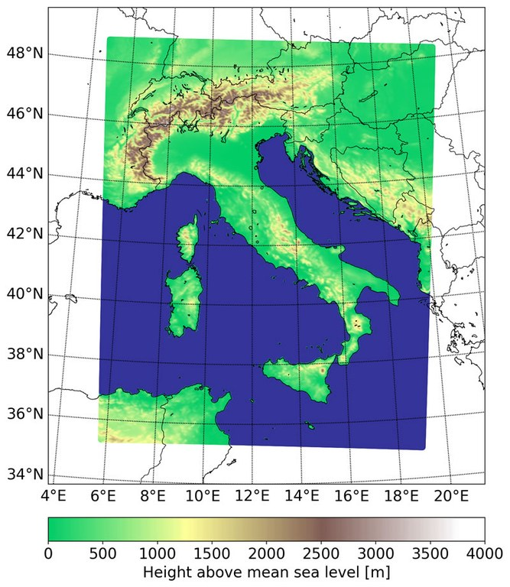

Global storm-resolving (~3km) regional sub-km scale (500 m)
Uncertainty estimation with ensembles
Configurable and on-demand
500m

Slide 3
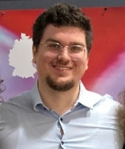
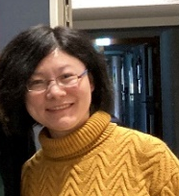


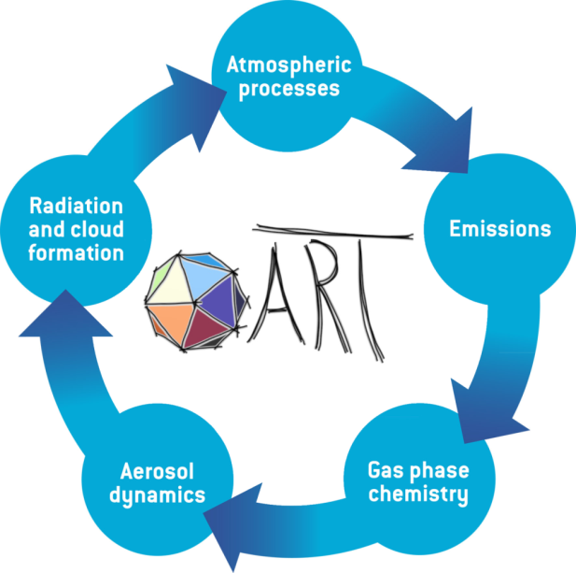


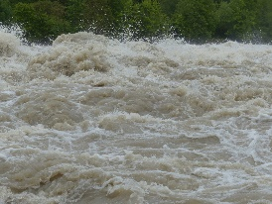
GPU
capability
(Michael Krayer)
system implementation
and data assimilation
(Xu Xu)
model physics for high-resolution
(Daniela Littmann)
Project leader:
Chiara Marsigli
500m
aerosol
(Katerina Kusakova)
ensembles
for high-resolution
floods
Co-Design
Project

Slide 4
Test and development of the model perturbation
ensembles
for high-resolution
Classical parameter perturbation
(CPP)
Operational at DWD
Stochastically perturbed parameterization (SPP)
Notes:
Test model perturbation Test and development of the model perturbation

Slide 5
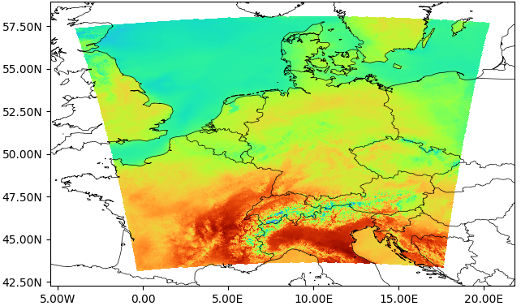
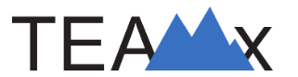
EXPERIMENTs SETUP
Two-way nesting
Horizontal grid resolution | 2km (ICON-D2), 1km (*TEAMx)
Upper boundary | 22km
Vertical levels | 65
LAT-BC | Forecasts (ICON-EU)
Perturbed initial conditions | KENDA (ICON-D2-EPS)
Forecast duration | 24h starting on 2022062100
Forecast restart | 6h
Ensemble members | 20
Microphysics | 1mom or 2mom
Turbulence | TURBDIFF
Land | TERRA
Standard operational model perturbations
Parent domain: ICON-D2
Nest domain
1km horizontal resolution
*TEAMx: https://www.teamx-programme.org/
Notes:
1km → high resolution compared to operational forecast

Slide 6
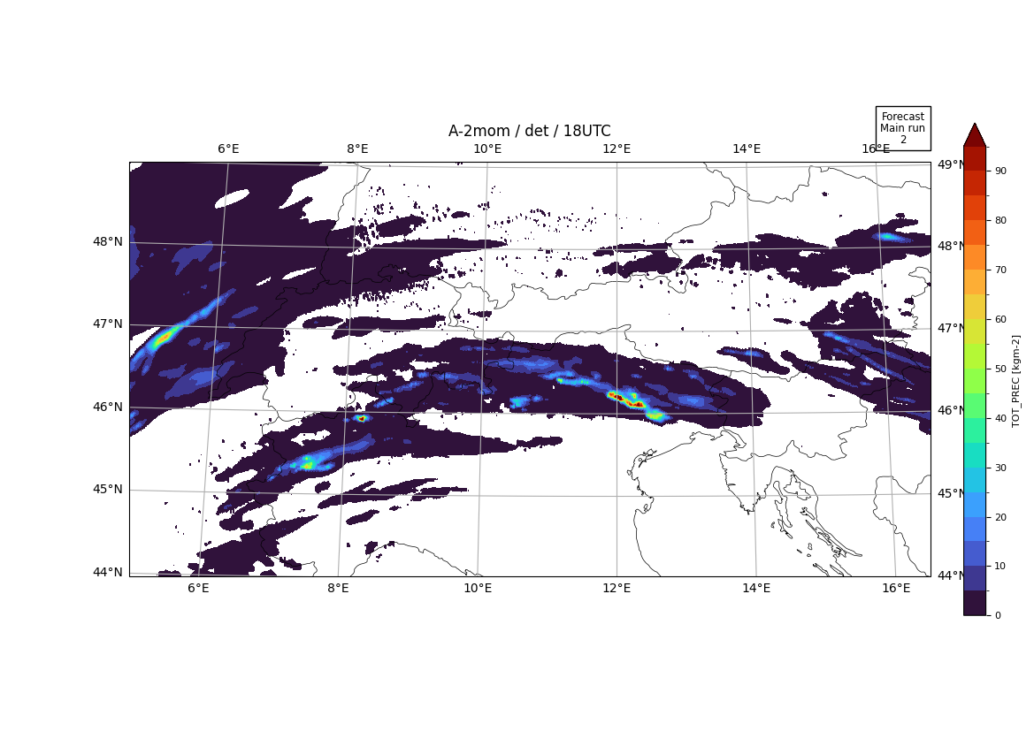
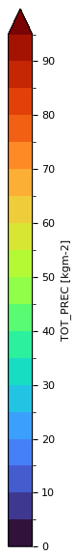
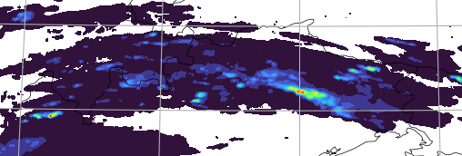
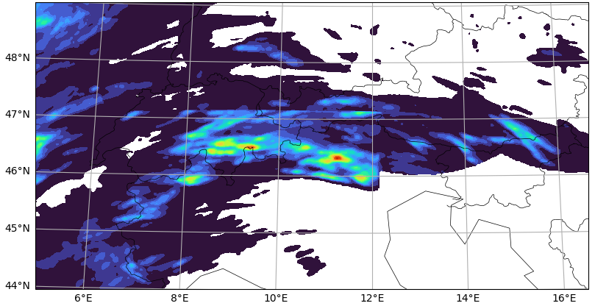
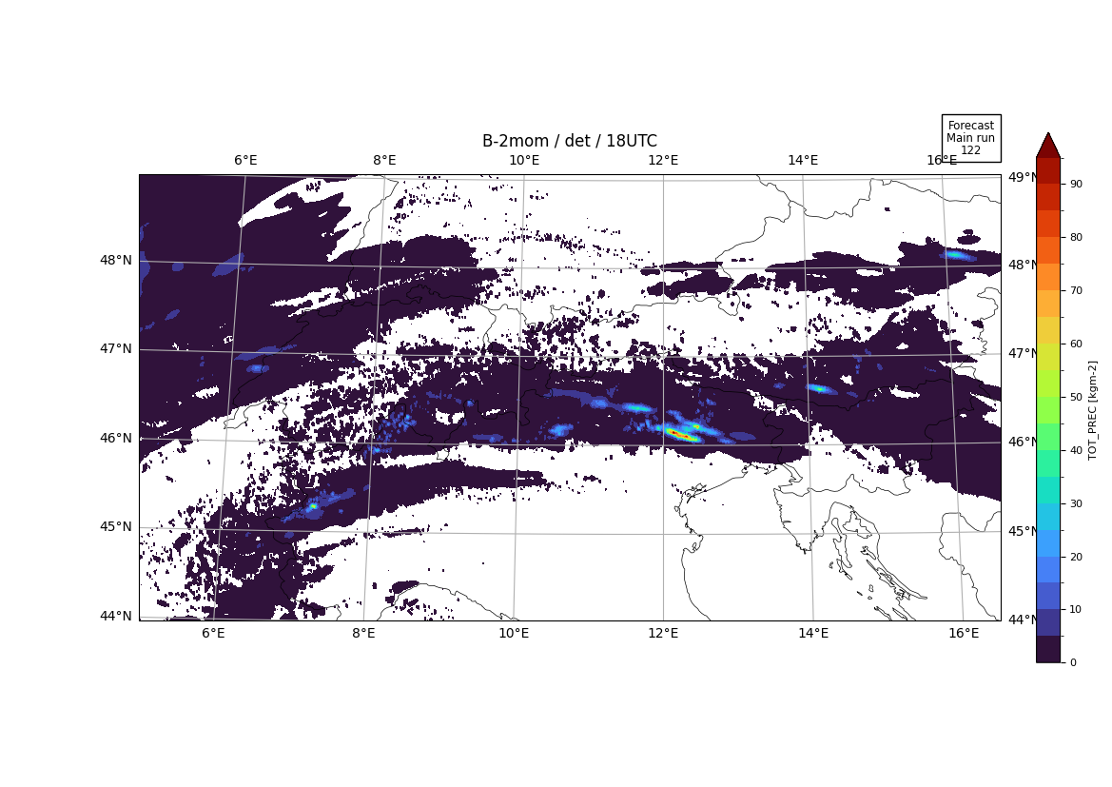
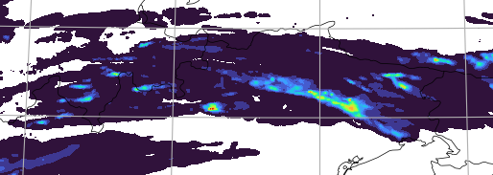
Testing the impact of convection schemes
1km
shallow convection only
deep convection parameterization (gray-zone-tuning version)
Precipitation estimate from radar
6
Notes:
Both experiments forecast less rain than observation.
Shallow-conv-only (exp A2) forecasts relatively more rain than grayTuning (exp B2)
Max. rain location forecast is shifted w.r.t. obs.

Slide 7

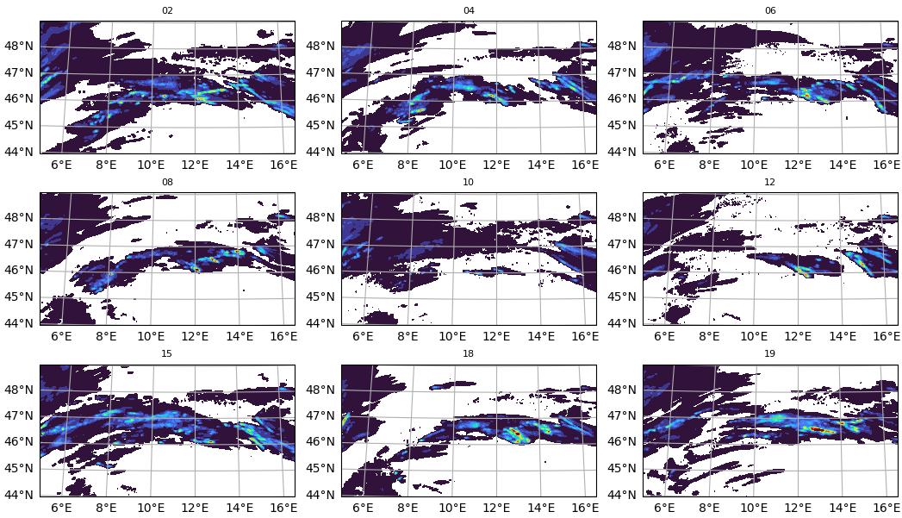
Behaviour of the ensemble members
Radar
Some members with misplaced rain
Some members with too little rain
Shallow
convection
only
7

Slide 8
Summary of first part
Shallow-conv-only experiment forecast is slightly better in generating rain,
Experiments with 2mom microphysics produce more realistic clouds than 1mom,
In this case, there is no significant difference in precipitation between 1km and 2km in the south of Germany
→ Motivation of second part: SPP
Notes:
We wanted to introduce a more effective model perturbation for higher resolution → thats why we started SPP to allow more sophisticated perturbation in order to catch convection at higher resolution

Slide 9
Static parameter perturbation (Operational at DWD)
Stochastically perturbed parameterization (SPP)
Each uncertain parameter is set to its default or to one of the limits of its perturbation range
This is done randomly at forecast start for each member independently
On average each uncertain parameter is perturbed in 50% of the members per forecast run
The value is kept fix during the run
Alternatively, an uncertain parameter is perturbed with a specific temporally evolving stochastic pattern for each member
Perturbation fields should have both spatial and temporal correlations
All ensemble members have the same climatology, although their bias can be different from unpertubed forecast
The value changes stochastically based on certain constraints related to the stochastic patterns properties, i.e., spatial/temporal correlation, variance

Slide 10
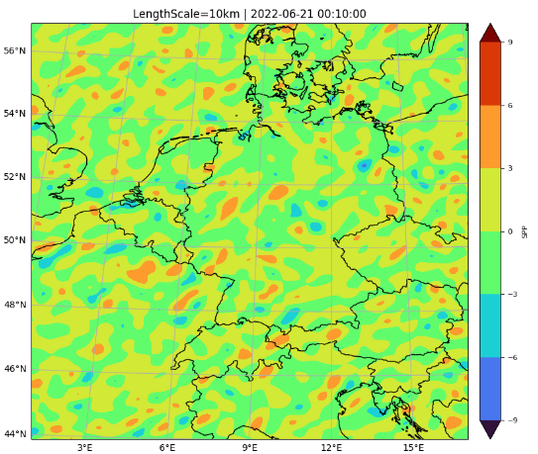
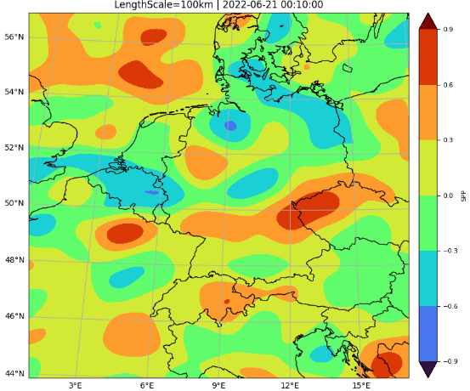
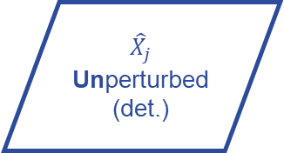
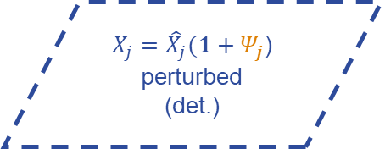
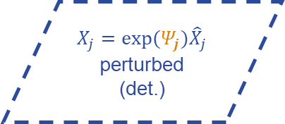
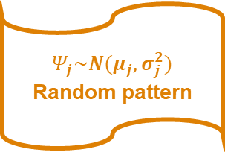
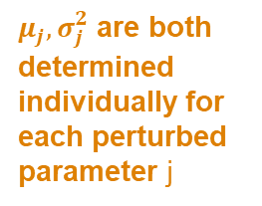
$$X_{j}=exp⁡(Ψ_{j}){\hat{X}}_{j}$$
perturbed
(det.)
$${\hat{X}}_{j}$$
Unperturbed
(det.)
$$Ψ_{j}\sim N(μ_{j},σ_{j}^{2})$$
Random pattern
$X_{j}={\hat{X}}_{j}(1+Ψ_{j}$)
perturbed
(det.)
$μ_{j},σ_{j}^{2}$ are both determined individually for each perturbed parameter j
Pattern properties:
Length scale
Time scale
Modes
Variance
Ref: Ollinaho et. al. 2016, Frogner et al. 2021, and Tsiringakis et. al. 2024
Notes:
Option a implies that the mean of the distribution of the perturbed parameter is equal to the unperturbed value while option b implies that the median of the distribution is equal to unperturbed value

Slide 11
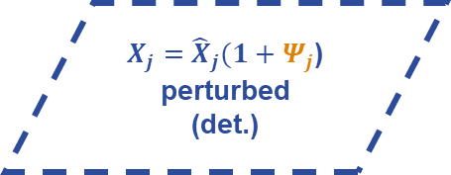
$$X_{j}=exp⁡(Ψ_{j}){\hat{X}}_{j}$$
perturbed
(det.)
$${\hat{X}}_{j}$$
Unperturbed
(det.)
$$Ψ_{j}\sim N(μ_{j},σ_{j}^{2})$$
Random pattern
$X_{j}={\hat{X}}_{j}(1+Ψ_{j}$)
perturbed
(det.)
$μ_{j},σ_{j}^{2}$ are both determined individually for each perturbed parameter j
Pattern properties:
Length scale
Time scale
Modes
Variance
Ref: Ollinaho et. al. 2016, Frogner et al. 2021, and Tsiringakis et. al. 2024
Notes:
Option a implies that the mean of the distribution of the perturbed parameter is equal to the unperturbed value while option b implies that the median of the distribution is equal to unperturbed value

Slide 12
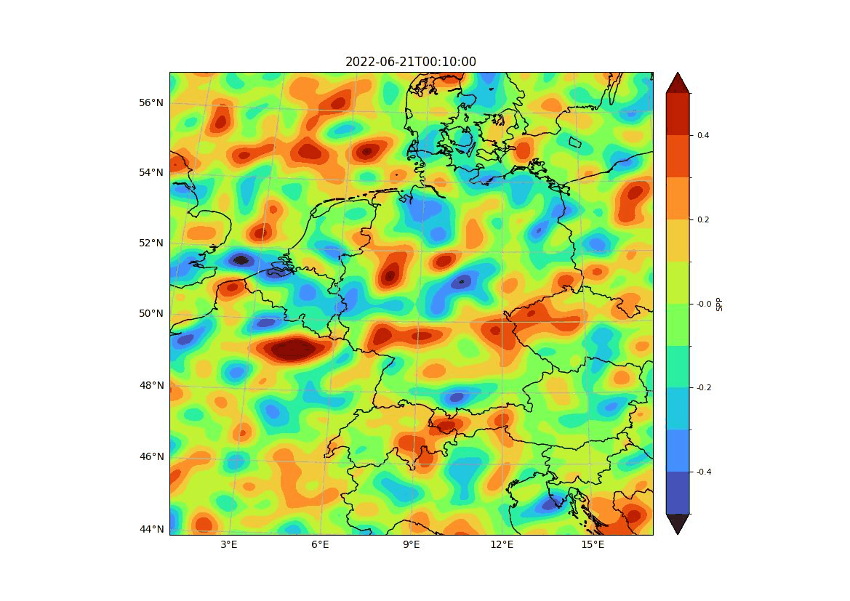
SPG in ICON implemented by Axel Seifert and Maleen Hanst
SPG properties:
Fourier Series vs. Lagandre Polynomial
Pattern length scale = 50km
Pattern time scale = 1 hour
Pattern modes = 50
Pattern variance = 0.1
Sensitivity tests for SPG variance
The model shows numerical instability with higher values of SPP variance:
SPP variance = 1.0 : Model crashed
SPP variance = 0.5 : Model crashed
SPP variance = < 0.4 : Model ran successfully

Slide 13
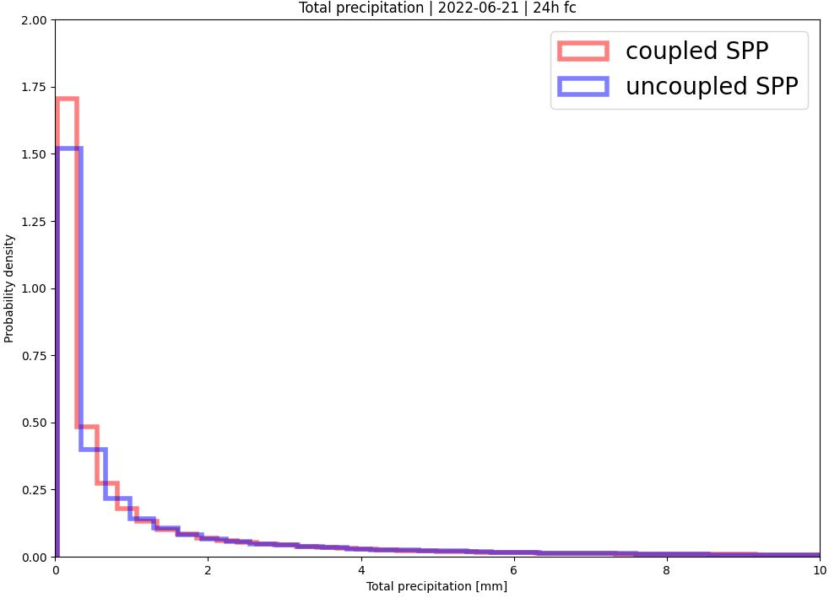
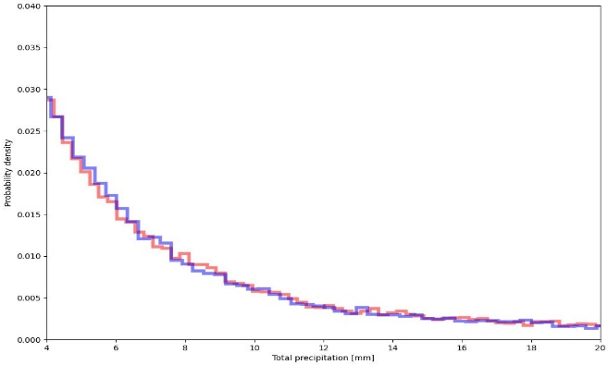
Deterministic forecast
Test on a real case
Test: Coupled SPP with 2mom microphysics scheme
For perturbing the sedimentation velocity of graupel
24h run
ICON-LAM: D2 domain
21st of June 2022

Slide 14
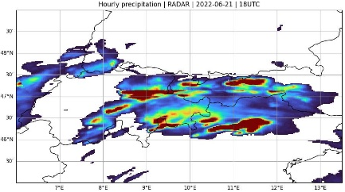
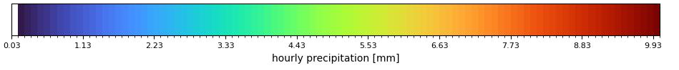
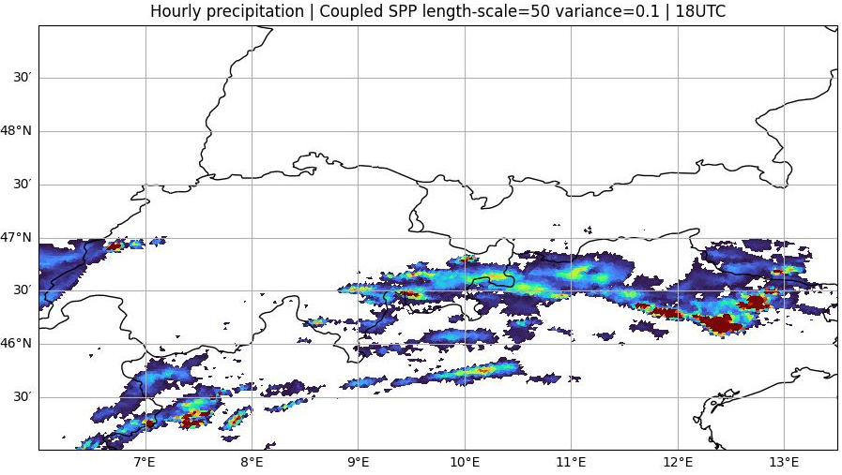
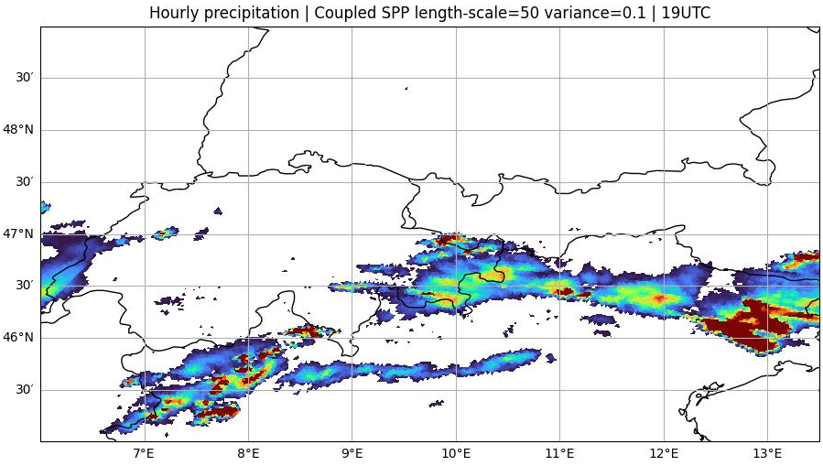
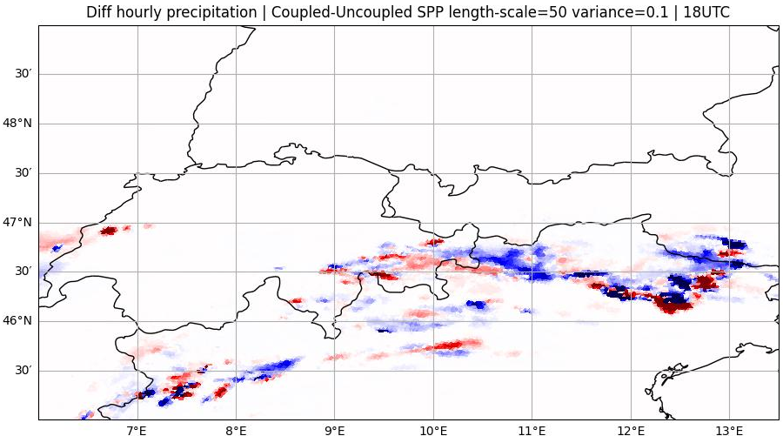
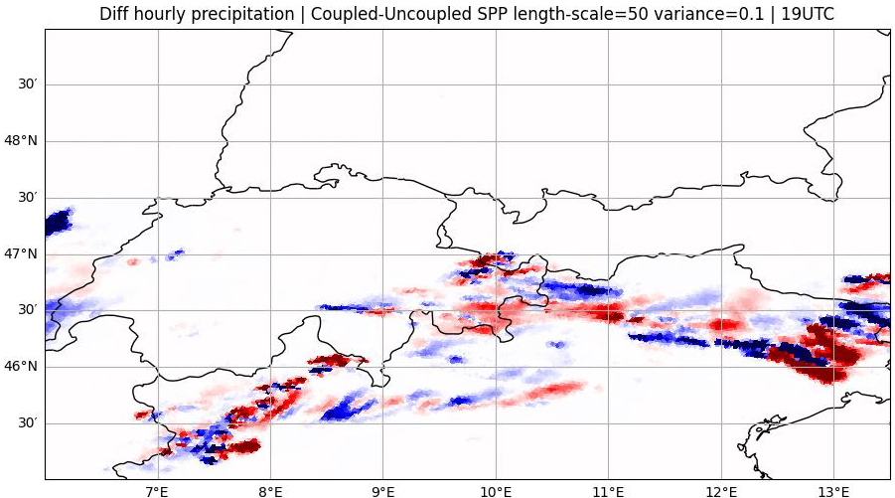
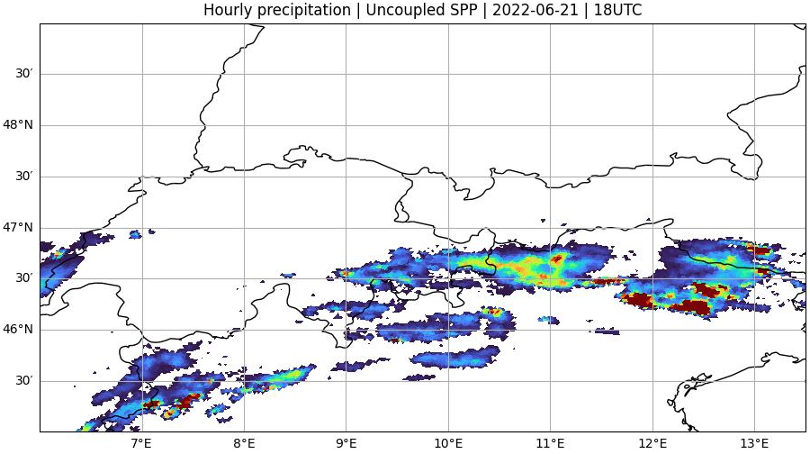
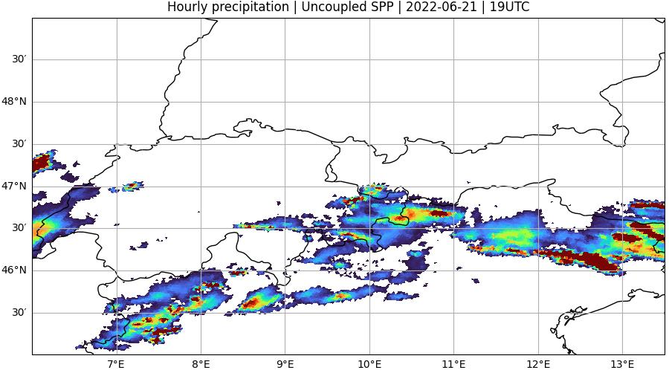
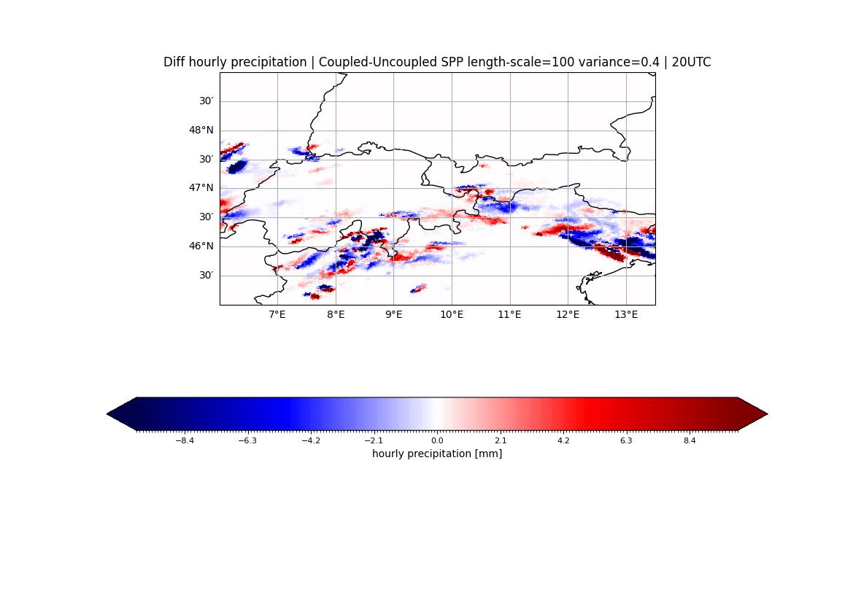
Hourly precipitation
18UTC
19UTC
coupled SPP
uncoupled SPP
Notes:
SPP perturbation of this parameter on precipitation show reasonable behaviour. We don‘t have strange behaviour! There is no systematic differences in this case and this parameter and deterministic → this was already a sanity check

Slide 15
Ensemble forecast
Test on a real case
Test: Coupled SPP with 2mom microphysics scheme
Implementation of SPP
ICON-D2-EPS
✓
For perturbing the sedimentation velocity of graupel
Test
24h run
ICON-LAM-EPS: D2 domain
21st of June 2022

Slide 16
Test Setup
LAT-BC → Forecasts from ICON-EU
Pertrubed Initial Conditions → KENDA (ICON-D2-EPS) with 20 members
CPP
REF
SPP
~18 physical parameter perturbation fixed during forecast run time
Operational perturbation
No model perturbation
  No SPP
  No operational perturbation
SPP activated for perturbing sedimentation velocity of graupel
No operational perturbation

Slide 17
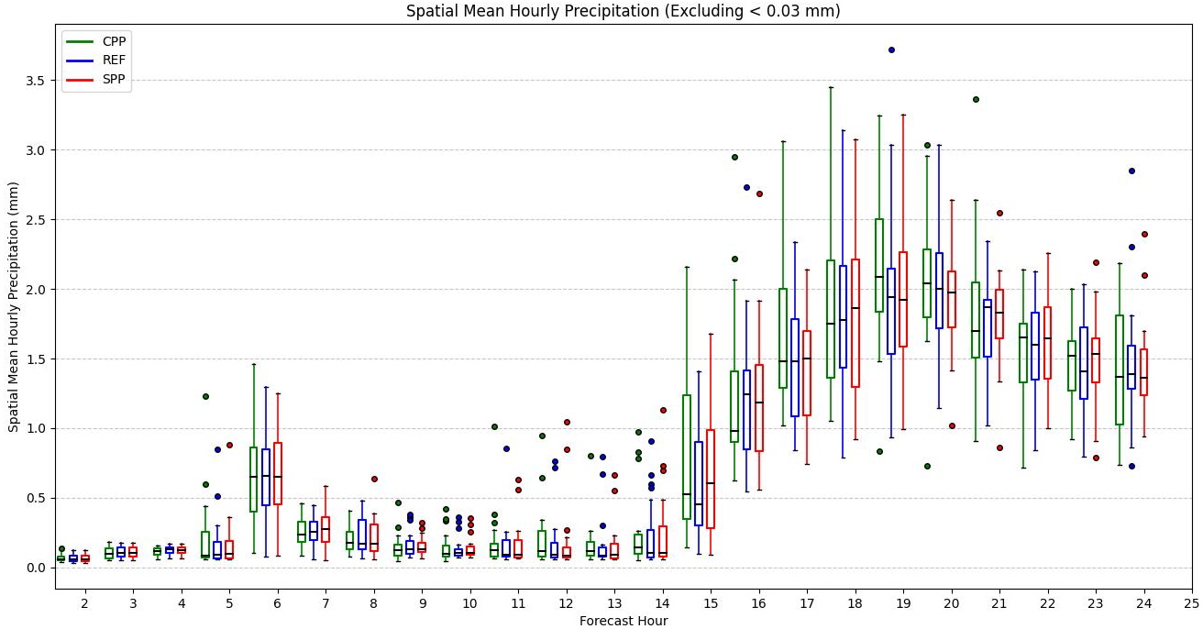
Statistical Analysis
Box-Whisker plot:
The larger distribution (wider min-max range) observed in CPP indicates a higher level of perturbations.
The medians across the different experiments are very similar, showing consistency.

Slide 18
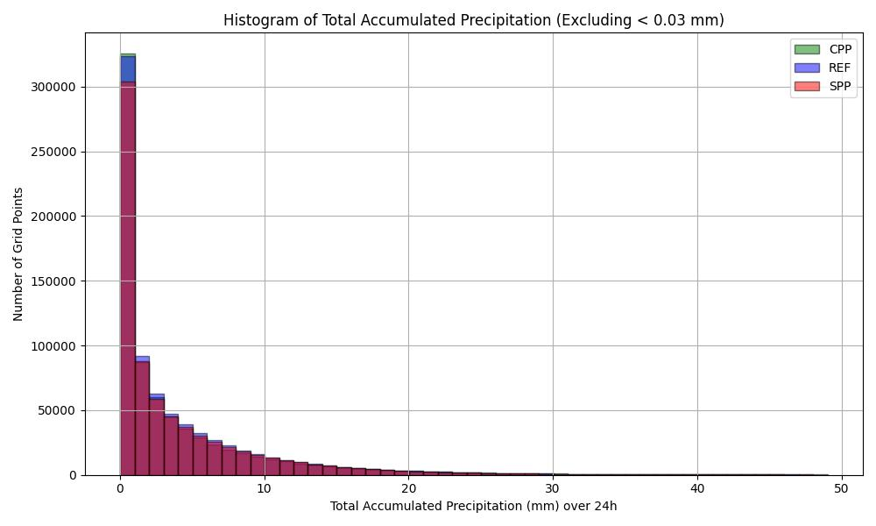
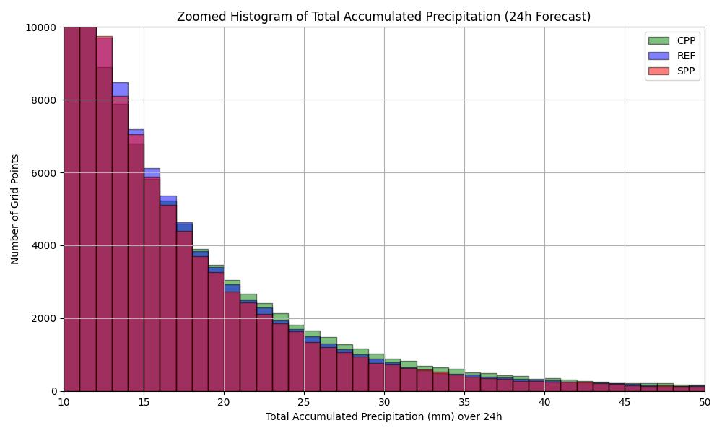
Statistical Analysis
Histogram plot:
For the smallest and largest rain bins, the CPP experiment shows higher precipitation, suggesting that more perturbations generate more rain in these extremes
The differences among the experiments are not statistically significant

Slide 19
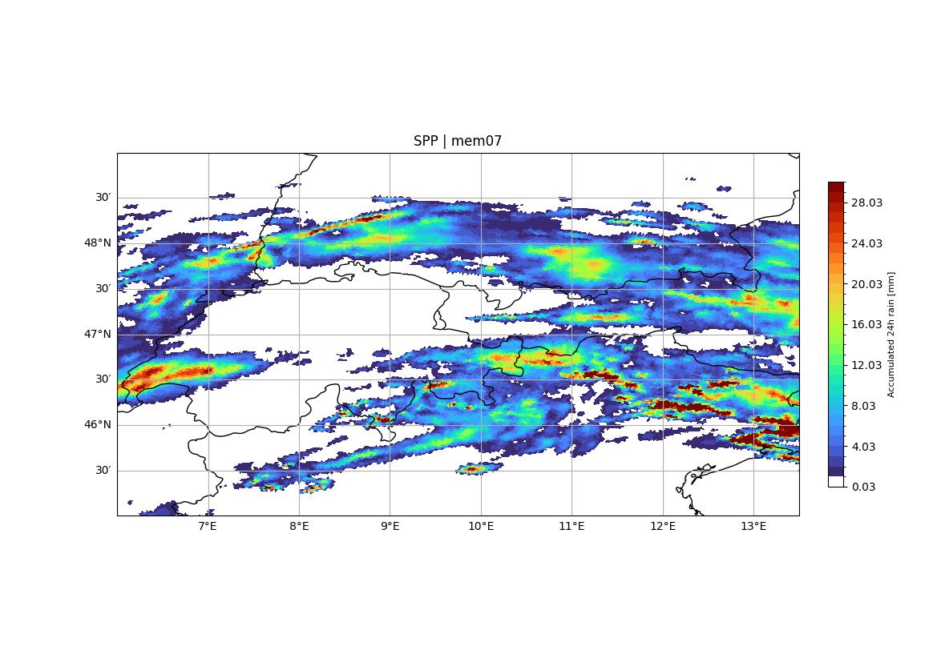
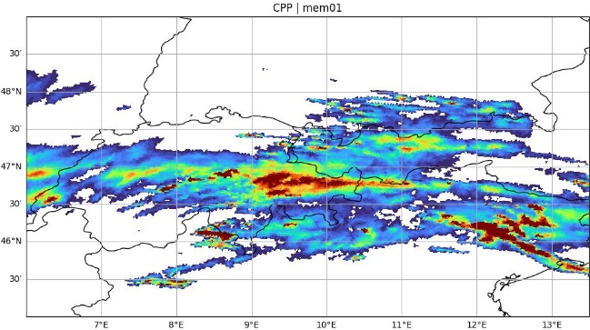
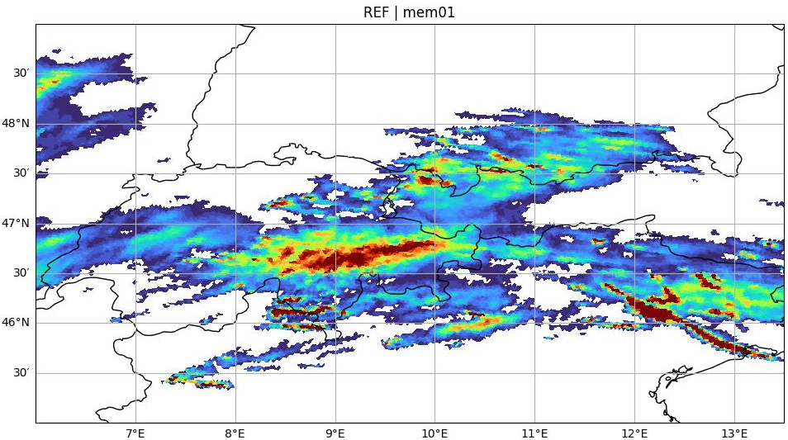
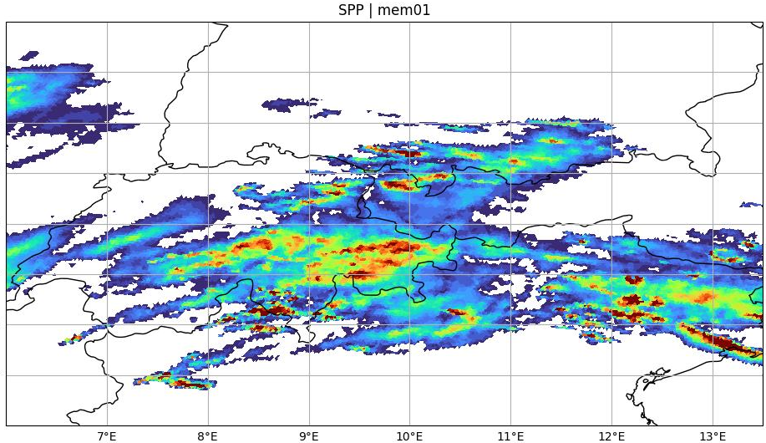
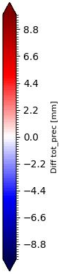
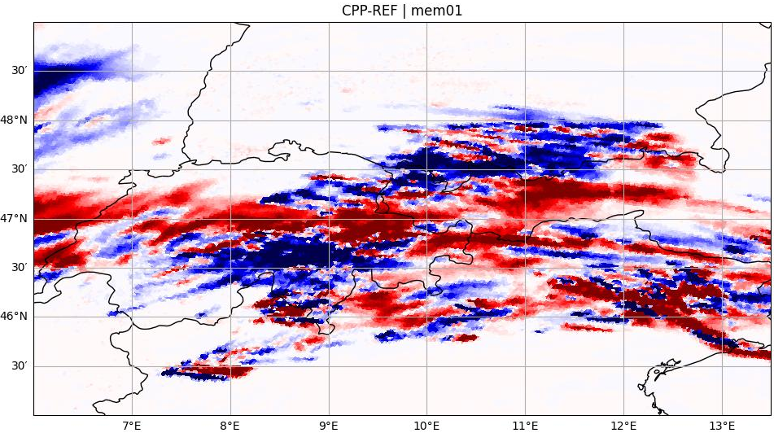
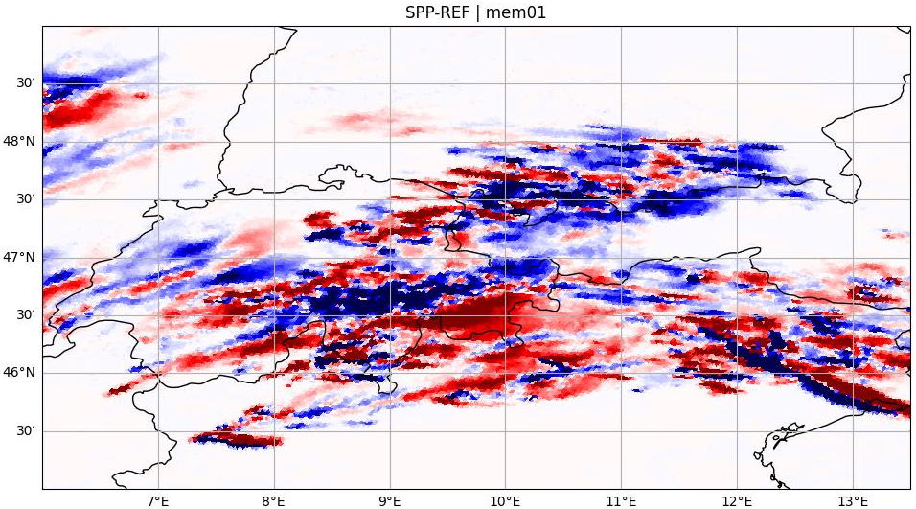
Maps of accumulated 24h rain | member 01

Slide 20
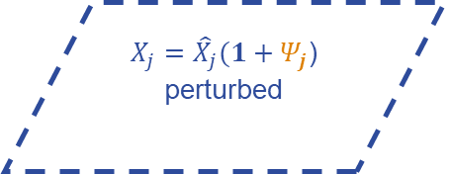
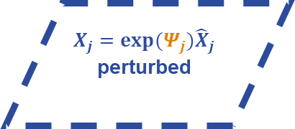
$$X_{j}=exp⁡(Ψ_{j}){\hat{X}}_{j}$$
perturbed
$${\hat{X}}_{j}$$
Unperturbed
(det.)
$$Ψ_{j}\sim N(μ_{j},σ_{j}^{2})$$
Random pattern
$X_{j}={\hat{X}}_{j}(1+Ψ_{j}$)
perturbed
Next Parameter
rdepths
(Maximum allowed shallow convection depth)
in convection parameterization
Ref: Ollinaho et. al. 2016, Frogner et al. 2021, and Tsiringakis et. al. 2024
Notes:
Maximum allowed shallow convection depth

Slide 21
Outlook
The impact of SPP on the sedimentation velocity of graupel shows reasonable behavior in this first case → No systematic differences observed in precipitation.
A longer statistical study period is needed to confirm results
Local analyses based on observation
Next Steps:
Implementation of SPP in ICON:
  Couple SPP with physics schemes for selected parameters
  Nest: First test uncoupled at 500 m resolution, then fully coupled with SPP
Benchmarking
  Tuning SPP in ICON-LAM-D2: Optimize values for SPP parameters
  Refining SPP for Higher Resolution: Focus on 1 km resolution for the GLORI Alpine region.

Slide 22
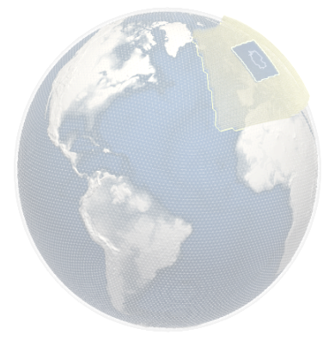




Thank you for your attention with a picture of my ous colleagues 😉
Notes:
I want to thank you for listening—with a picture of my Glorious colleagues! 😉

Slide 23



Maps of accumulated 24h rain | member 06
SPP | mem06
?
Model crashed after 7h forecast →Numerical instability
(Divided by zero)

Slide 24



Contour levels: 0.03 , 7.5, 15, 22.6 , 30.1
0.03 < ensemble mean < 30 mm

Slide 25


Slide 26


