Slide 1
analyzing & Interpreting cloud radar Doppler spectrum peaks
The PEAKO-peakTree toolkit:
Teresa Vogl, Martin Radenz, Moritz Lochmann, Heike Kalesse-Los

Slide 2
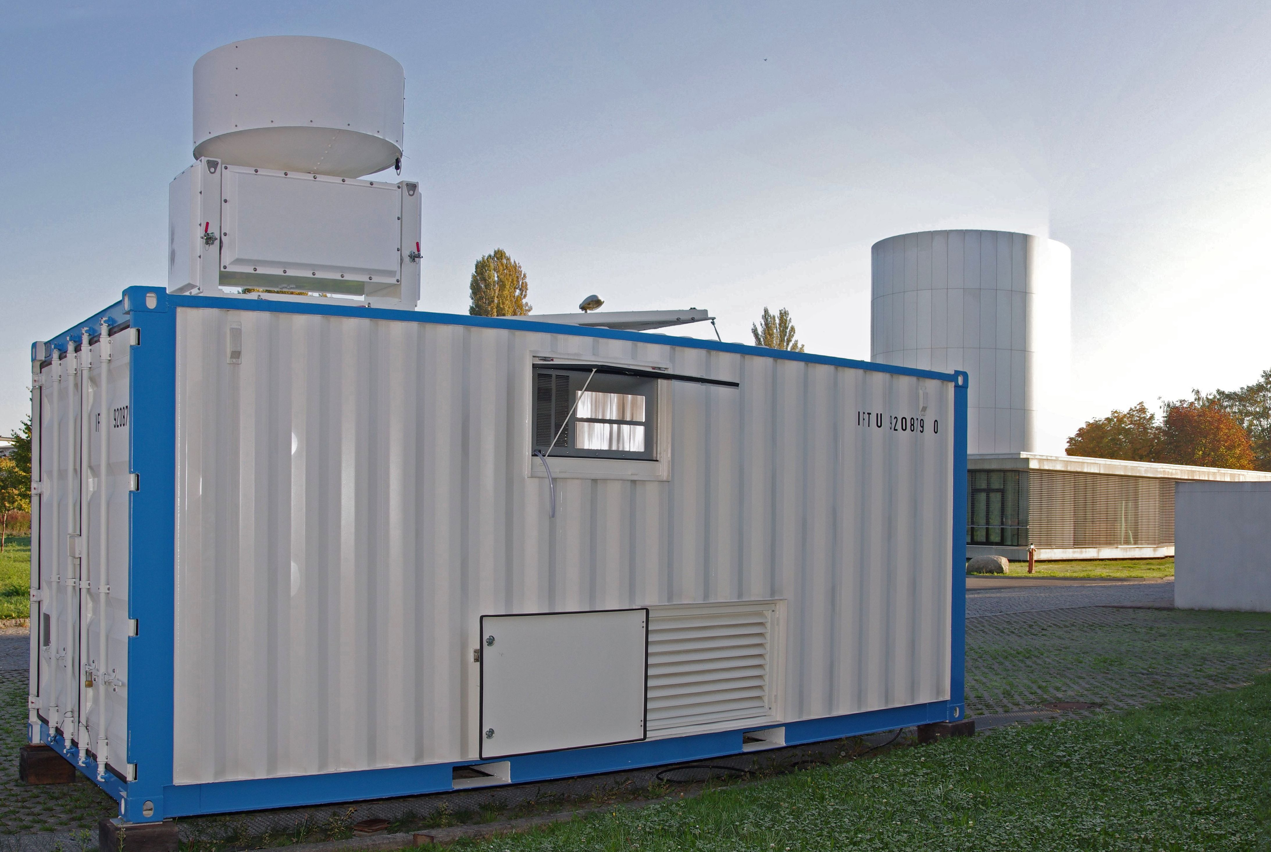
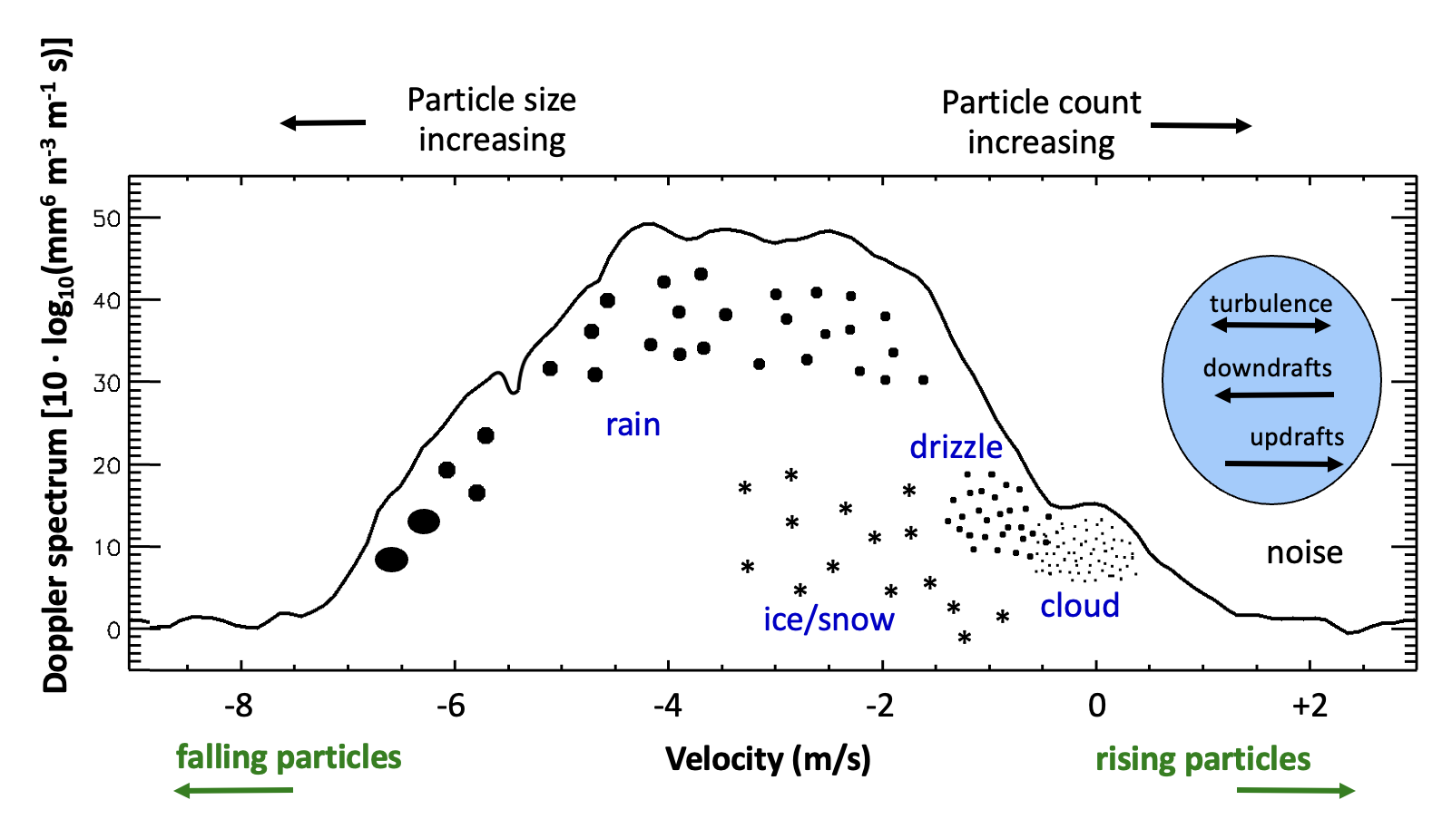
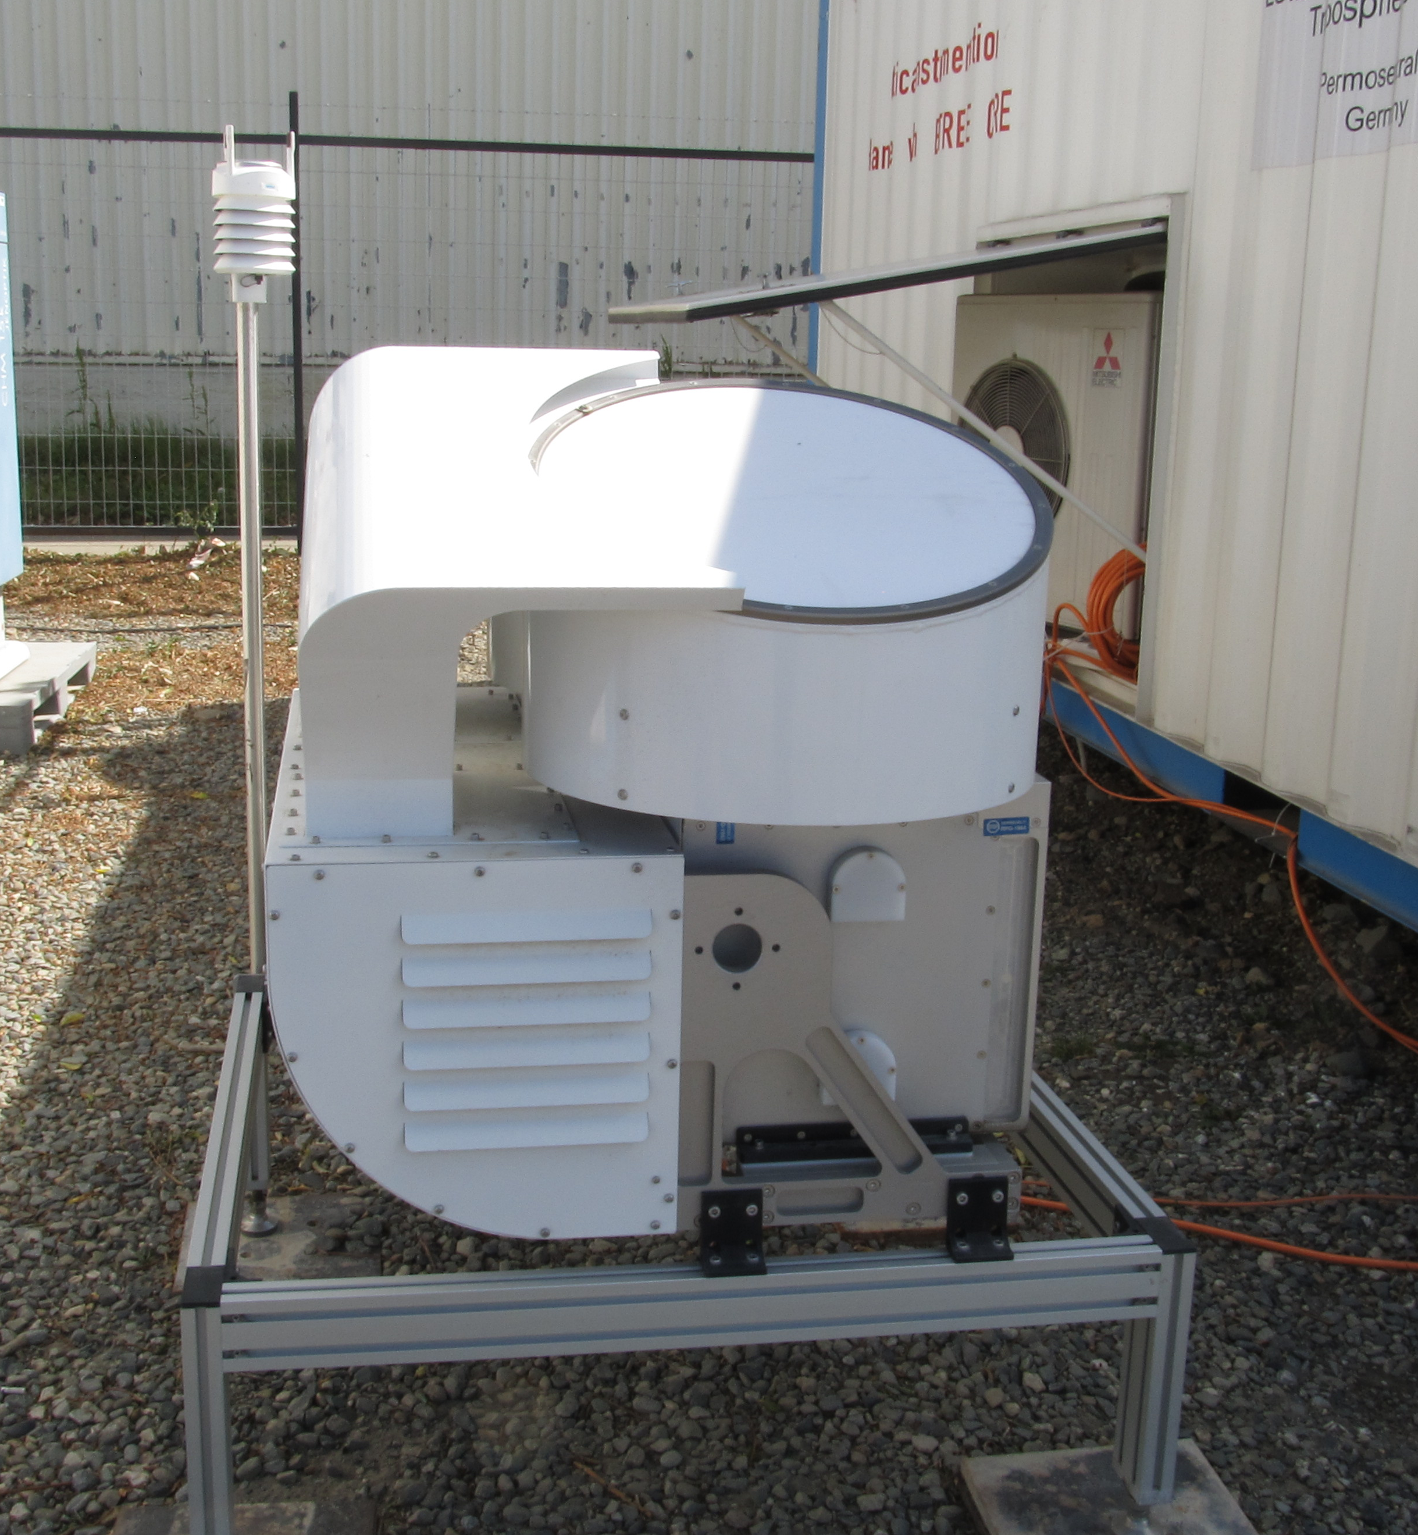
Cloud radar doppler spectra
METEK 35.5 GHz cloud radar (MIRA-35)
RPG 94 GHz Cloud Radar (LIMRAD94)
2

Slide 3
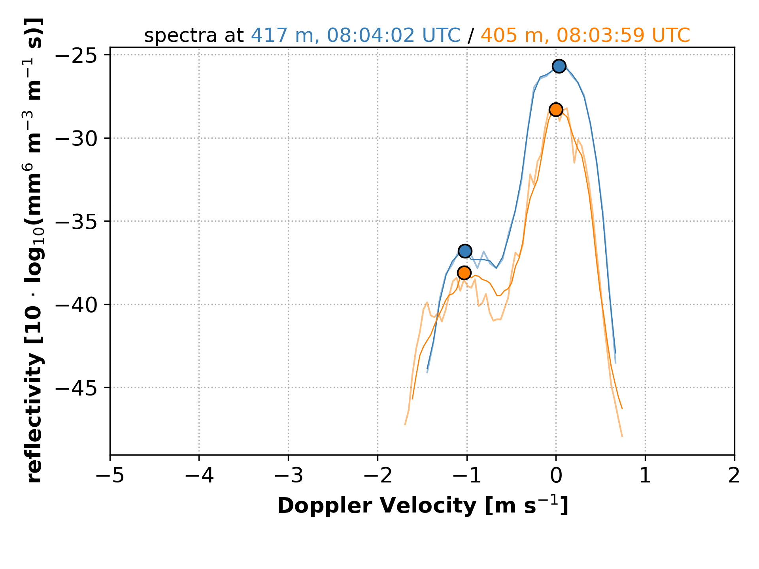
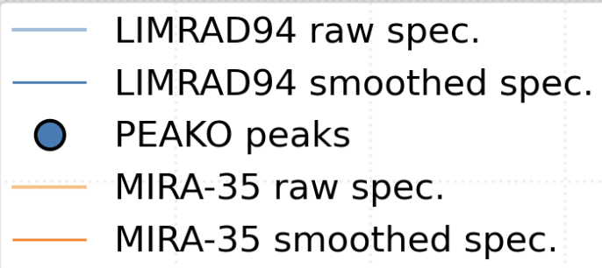
PEAKO overview
PEAKO is a supervised radar Doppler spectrum peak finding algorithm. It finds the optimal parameters for detecting peaks in cloud radar Doppler spectra based on user-generated training data.
PEAKO is used to:
create labeled data (peaks marked by a user in cloud radar Doppler spectra), which are used for training and testing the learned function
train the algorithm using the labeled data to obtain the optimal parameter combination for peak detection
detect peaks in cloud radar Doppler spectra using the learned function for new data sets
input to peakTree

Slide 4
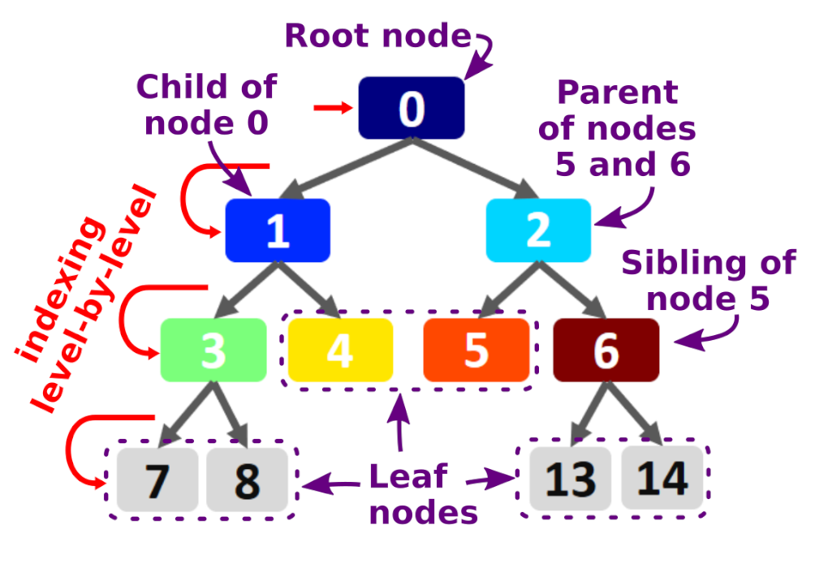
peakTree: Peak structuring with binary trees

Slide 5
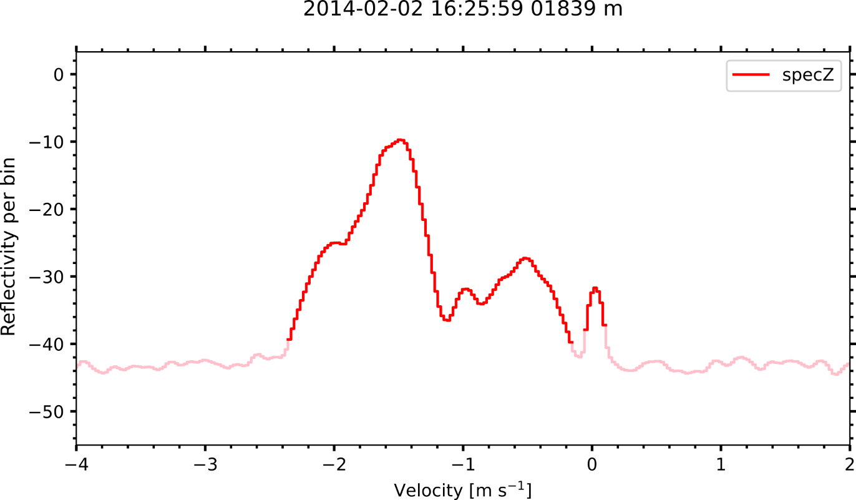
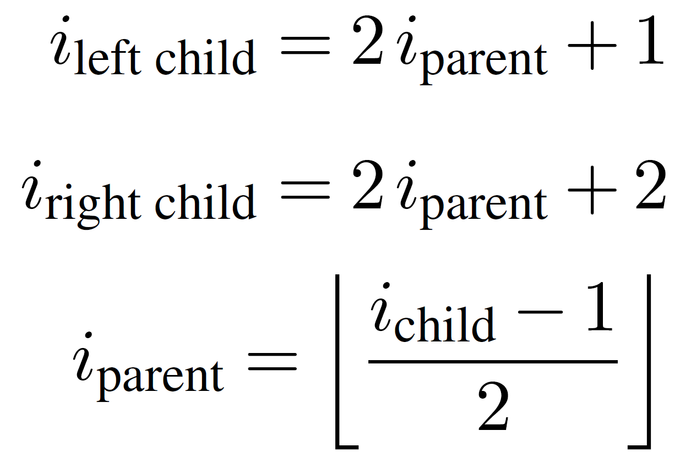
Represent (sub-)peaks as nodes in a binary tree
node 0 is equal to ‘traditional’ moments
0
0
1
1
2
prominence
2
3
3
4
5
6
4
threshold
7
8
9
10
11
12
9
10
id (bounds) Z v σ 𝛾 thres. prom.
0 (157, 260) | 0.98, -1.52, 0.22, 2.54, -40.0, 30.3
+- 1 (157, 249) | 0.96, -1.52, 0.20, 2.09, -40.0, 30.3
| +- 3 (157, 209) | 0.85, -1.55, 0.14, -1.41, -36.5, 26.8
| `- 4 (209, 249) | -14.97, -0.61, 0.21, -0.57, -36.5, 9.2
| +- 9 (209, 220) | -22.54, -0.95, 0.06, 0.18, -34.1, 2.2
| `-10 (220, 249) | -15.74, -0.55, 0.14, -0.22, -34.1, 6.8
`- 2 (254, 260) | -25.26, 0.03, 0.04, -0.02, -40.0, 8.3
node 0
node 1
node 2
node 3
node 4
9
10

Slide 6
application examples
hydrometeor classification → statistics for long data sets
deriving insect concentrations

Slide 7
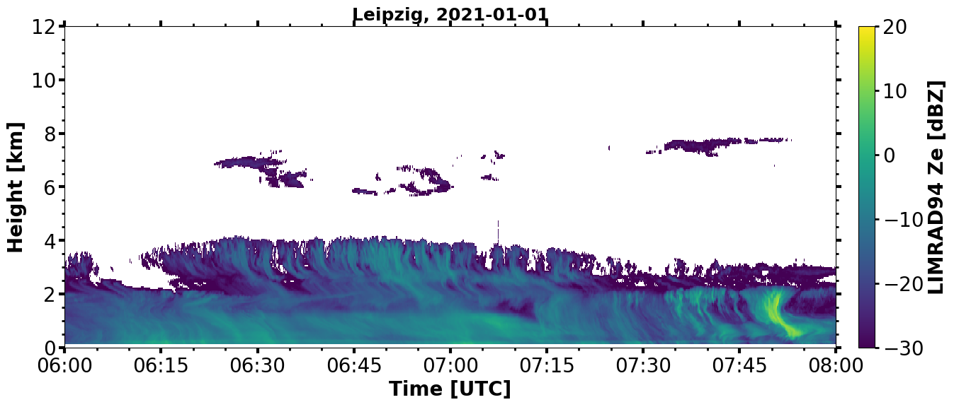
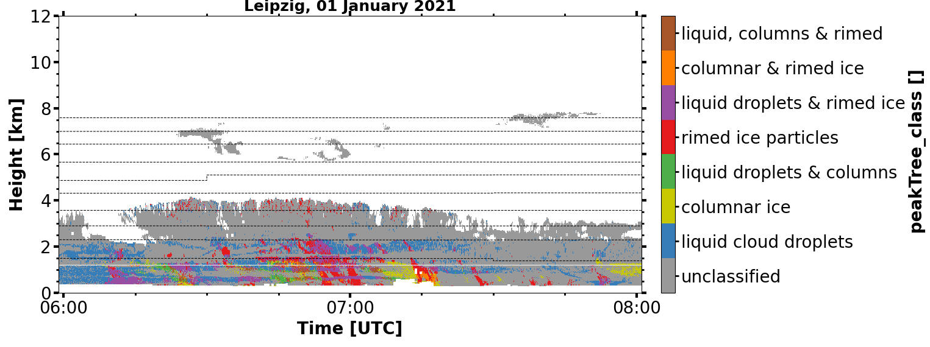
peak-based hydrometeor classification
assigning hydrometeor types based on peak properties
liquid: low MDV, low Ze, low LDR
columnar ice: low Ze, high LDR
rimed particles: falling more than 1.5 m/s faster than another slower-falling peak
Ze
[dBZ]
rimed particles
liquid droplets
-3
-2
-1
0
1
2
MDV
[m/s]

Slide 8
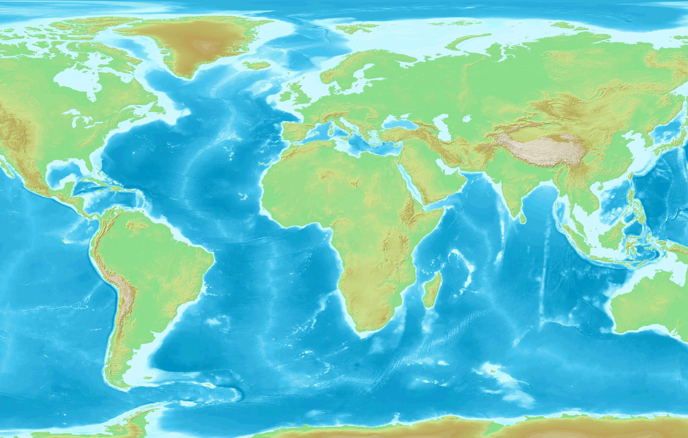
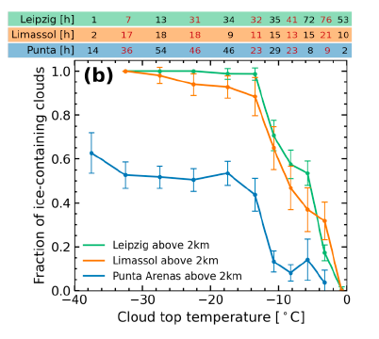
Observed Contrast in Cloud phase
Central Europe vs. Southern Chile: stark contrast in ice formation efficiency in thin stratiform clouds likely due to INP availability (Radenz et al., 2021)
contrasts in riming occurrence in thick cloud systems?
Leipzig
Limassol
Punta Arenas
Radenz, 2021
8
Notes:
Considering the cloud phase, let‘s have a look at this study
aerosol effect
ice growth processes at the different sites!

Slide 9
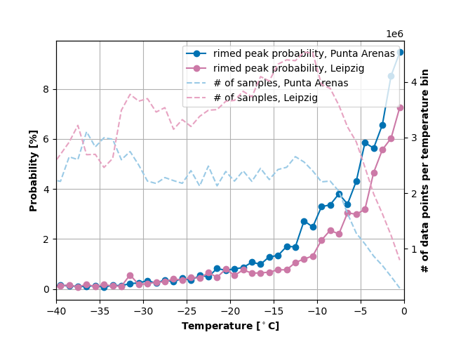
Observed Contrast in riming
probability of rimed peak [%]
fraction of ice-containing clouds
cloud top temperature [$℃$]
temperature [$℃$]
! preliminary !

Slide 10
Detecting insects with PEAKO/peakTree
insects have a characteristic signature in Doppler spectra (sharp, narrow peaks)
for sufficiently narrow peaks, it can be assumed that one peak = one insect (Wood et al., 2009)
→number of peaks = number of insects
preprint
Notes:
Doppler spectra from Leipzig LIM data set
Wood et al., 2009: https://onlinelibrary.wiley.com/doi/abs/10.1002/met.146

Slide 11
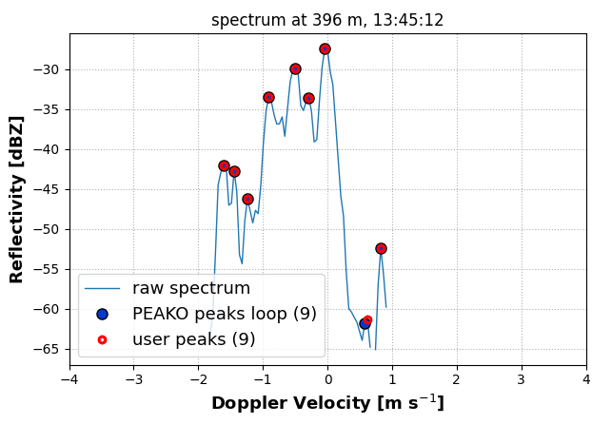
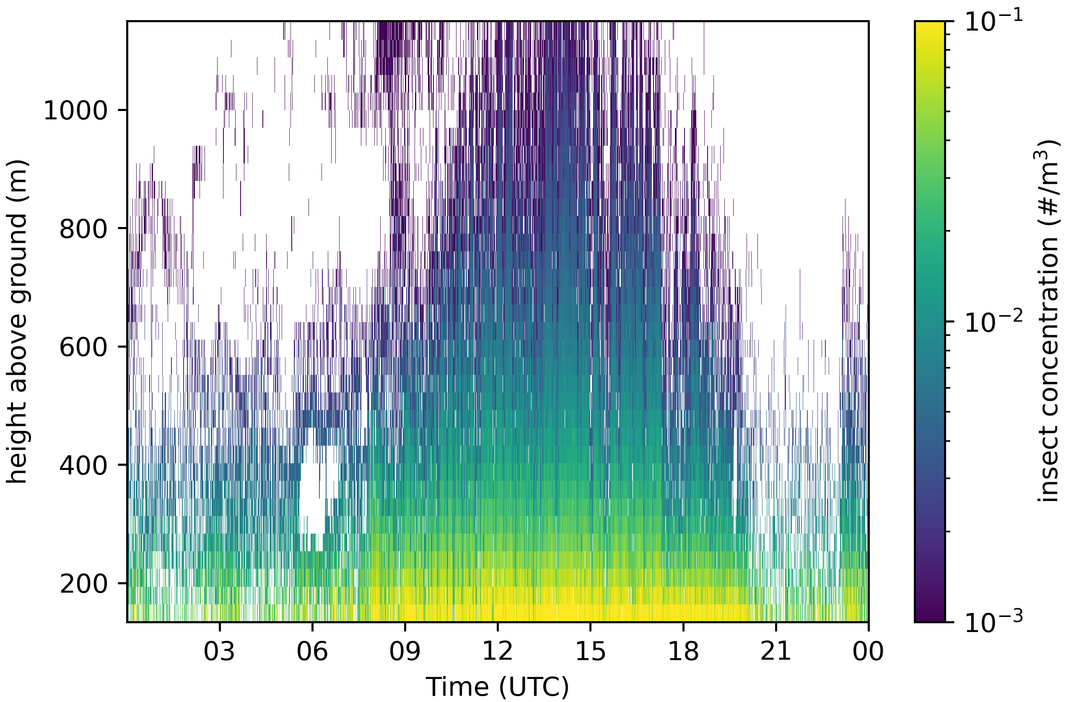
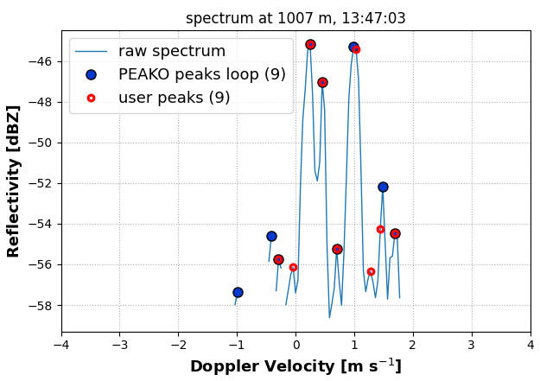
Detecting insects with PEAKO/peakTree
PEAKO for finding peak-finding parameters:
peakTree to analyze individual peaks, e.g. to filter peaks for their spectral width, signal to noise ratio or reflectivity
“finished” aerial insect concentration product

Slide 12
Thanks for your attention!

Slide 13
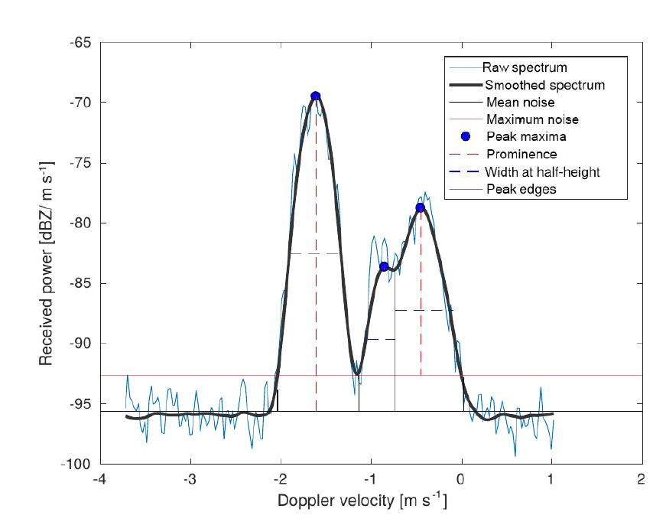
PEAKO: peak finding function
1) average neighboring spectra in time and range
2) smooth the averaged spectrum using a smoothing span [m s⁻¹] and a polynomial of a certain degree (Savitzky-Golay smoothing method)
3) find peaks (maxima in the resulting spectrum), using scipy.signal.find_peaks
4) keep only those peaks having a minimum peak width at half-height [m s⁻¹] and above a minimum prominence threshold [dB]
Reflectivity [dBZ]
Doppler velocity [m s⁻¹]

Slide 14
Represent (sub-)peaks as nodes in a binary tree
and if this would be a distinct subpeak?
node 0 is equal to ‘traditional’ moments
0
0
1
1
2
prominence
2
3
3
4
5
6
4
threshold
7
8
9
10
11
12
9
10
id (bounds) Z v σ 𝛾 thres. prom.
0 (157, 260) | 0.98, -1.52, 0.22, 2.54, -40.0, 30.3
+- 1 (157, 249) | 0.96, -1.52, 0.20, 2.09, -40.0, 30.3
| +- 3 (157, 209) | 0.85, -1.55, 0.14, -1.41, -36.5, 26.8
| `- 4 (209, 249) | -14.97, -0.61, 0.21, -0.57, -36.5, 9.2
| +- 9 (209, 220) | -22.54, -0.95, 0.06, 0.18, -34.1, 2.2
| `-10 (220, 249) | -15.74, -0.55, 0.14, -0.22, -34.1, 6.8
`- 2 (254, 260) | -25.26, 0.03, 0.04, -0.02, -40.0, 8.3
node 0
node 1
node 2
node 3
node 4
9
10

