Slide 1
Tailoring forecasts and other DWD products to flood forecasting applications following a co-design approach
Julia H. Keller¹, Jan Bondy¹, Vanessa Fundel¹, Ina Blumenstein-Weingartz¹, Olga Kiseleva¹, Maja Rüth¹, Stefan Wolff¹, Thomas Deutschländer¹, Kathrin Feige¹, Felix Fundel¹, Stefanie Hollborn¹ Andreas Lambert¹, Armin Rauthe-Schöch¹, Ute Badde², Manfred Bremicker², Norbert Demuth³, Natalie Stahl-van Rooijen⁴, Joachim Stoermer⁴
¹ Deutscher Wetterdienst, ² Landesanstalt für Umwelt, Baden-Württemberg, ³ Landesamt für Umwelt, Rhineland-Palatinate, ⁴ Landesamt für Umwelt, Bavaria
Notes:
Many different colleages that contributed to this presentation and the work presented here

Slide 2
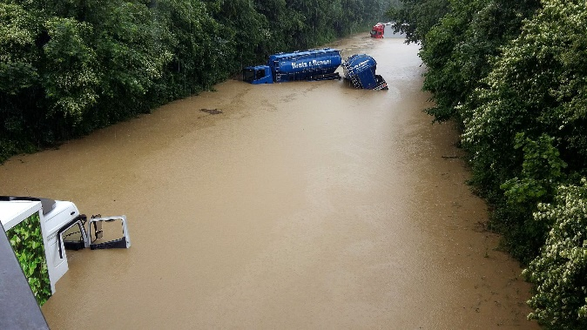
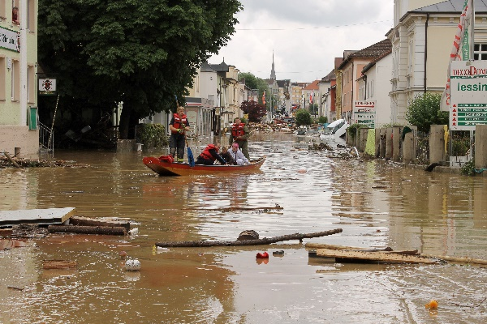
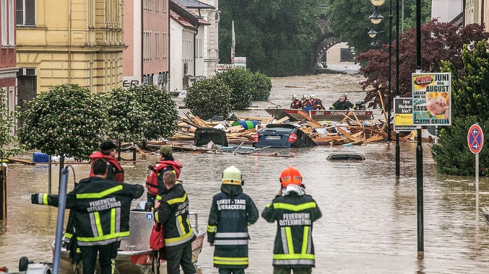
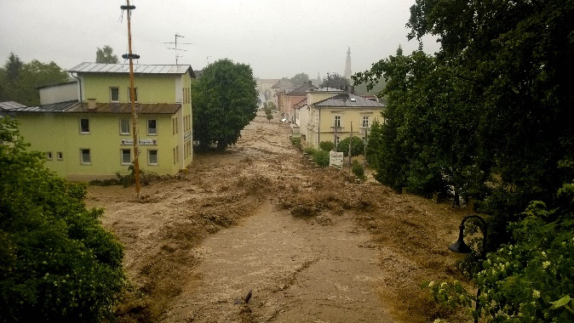
What is driving us all…
Protection of life and limb
Prevention of damage and harm
Provide early warnings in effective communication formats
1
2
3
4
Bildnachweise: Mit freundlicher Genehmigung
1,2 Marianna Madl, Simbacher Anzeiger (2016)
3 Daniel Scharinger, dpa (2016)
4 Walter Geiring, Pressefoto (2016)

Slide 3
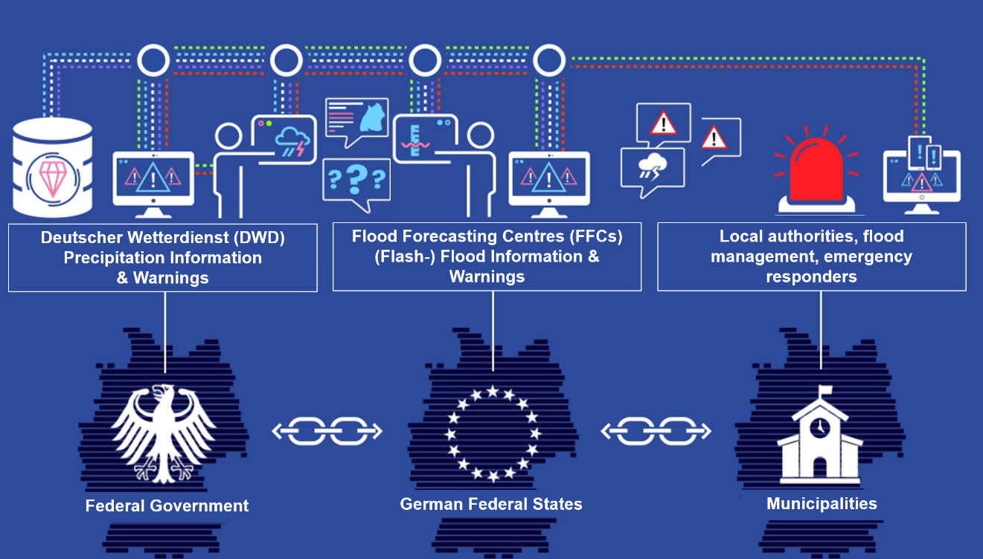
Flood forecasting and alerting chain in Germany
Graphic by Peter Sohn, DWD

Slide 4
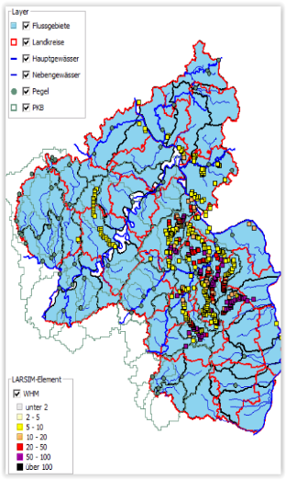
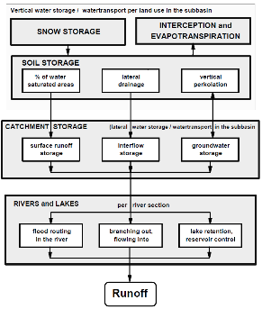
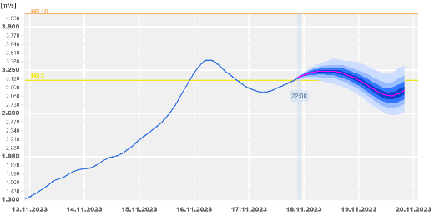
Flood forecasting steps
Radar observations, rain and discharge gauges, snow analyses
Large Area Runoff Simulation model
https://www.larsim.info/en/
Return period
Warning map
NWP-EPS
Hydromet. input data
waterbalance model
Discharge forecast
Water level at gauging station

Slide 5
Join forces to address challenges
After flood disaster 2021:
Strengthened collaboration between DWD and flood forecasting centres (FFCs)
Joint workshop on co-design of research and development
Improve common understanding of challenges
Intensify exchange
Outcome: Idea to initiate joint research and development project along the hydrometeorological value chain

Slide 6
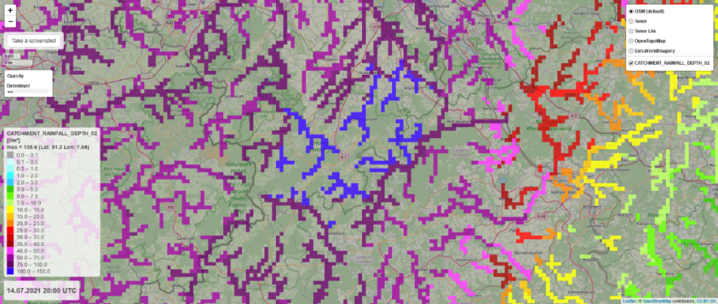
Aggregation over catchment areas (AREA)
Starting point: New forecast product
Jan Bondy, Christian Berndt, ID 95, Session 5A
Post-processing of precipitation observations and forecasts for river catchments (10 ≤ A ≤ 500 km²), based on mean areal precipitation
Fast detection of precipitation-based flood risks (flash flood potential)
Support operational workflow of FFCs in highly dynamic situations (e.g. summer convective events)
Developed in exchange with FFCs

Slide 7
Project: Co-Design in hydro-meteorological partnership
Augmenting the hydrometeorological value chain
through co-design
Part of
Italia – Deutschland science-4-services network in weather and climate (IDEA-S4S)
New joint research network for improving seamless weather and climate forecasts for floods and droughts
User-specific, catchment based evaluation of DWD’s precipitation forecasts
Adaptation of DWD’s new warning system to needs of flood forecast
Evaluation of DWD data and products within operational flood forecasting applications
Improving communication of forecasts and warnings*
Decision makers,
civil protection,
emergency management
Observations (Precipitation,…)
Operational NWP
& Nowcasting
Observations (Discharge,…)
Flood forecasting
models
Flood
Forecasting
Centres
Deutscher
Wetterdienst
Flood
predictions
Weather Predictions
Climatologies
Flood inundation maps
Global-to-regional ICON Digital Twin (GLORI)
* Sub-project, co-financed by the
Landesamt für Umwelt Rhineland-Palatinate

Slide 8
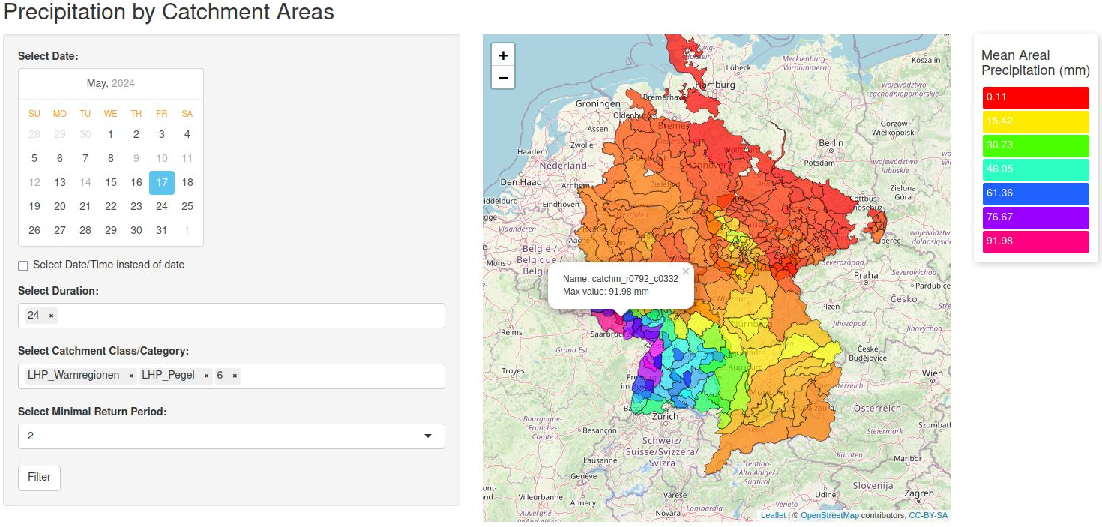
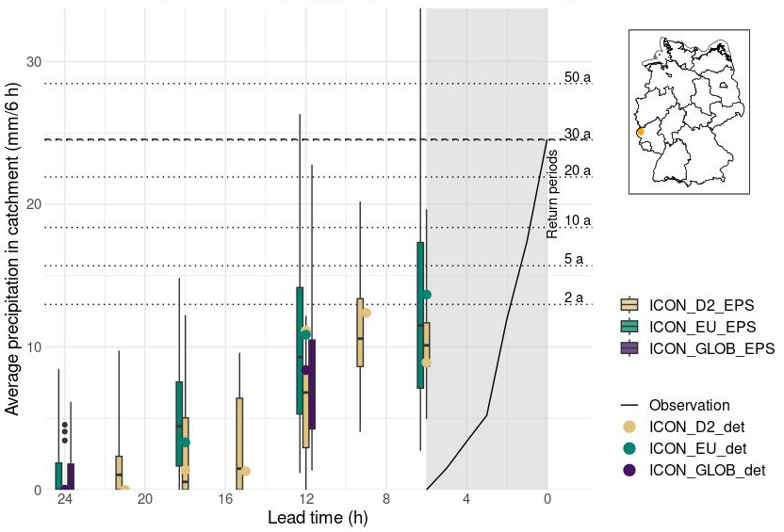
User-specific, catchment based evaluation
Development of an analytical tool for flood forecasting to retrospectively analyse precipitation in river catchment areas
Ina Blumenstein-Weingartz ID 139, Session 5B
Uses river catchment areas and extreme values for precipitation heights for several return periods from SINFONY project
Conduct catchment area-related verification and develop event catalogue
Supervised by DWD

Slide 9
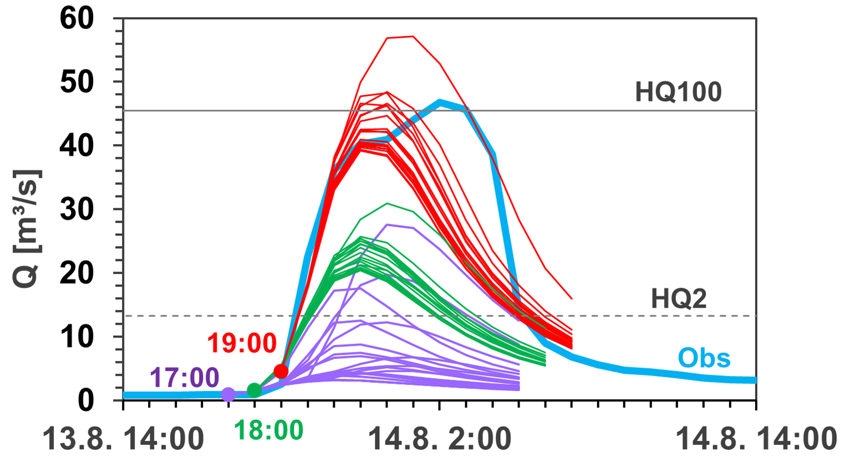
Evaluation of DWD data in operational flood forecasting applications
Olga Kiseleva ID 39, Session 5B
Standardized verification of hydrological forecasts of flood forecasting centres
Comparisons of discharge simulation, e.g. using the water balance model LARSIM, with different meteorological input data (ICON-D2, ICON-RUC, INTENSE)
Develop tools for operational analysis, creation and maintenance of an event catalogue
LARSIM discharge simulations for SINFONY-INTENSE
Supervised by FFC Baden-Württemberg and DWD

Slide 10
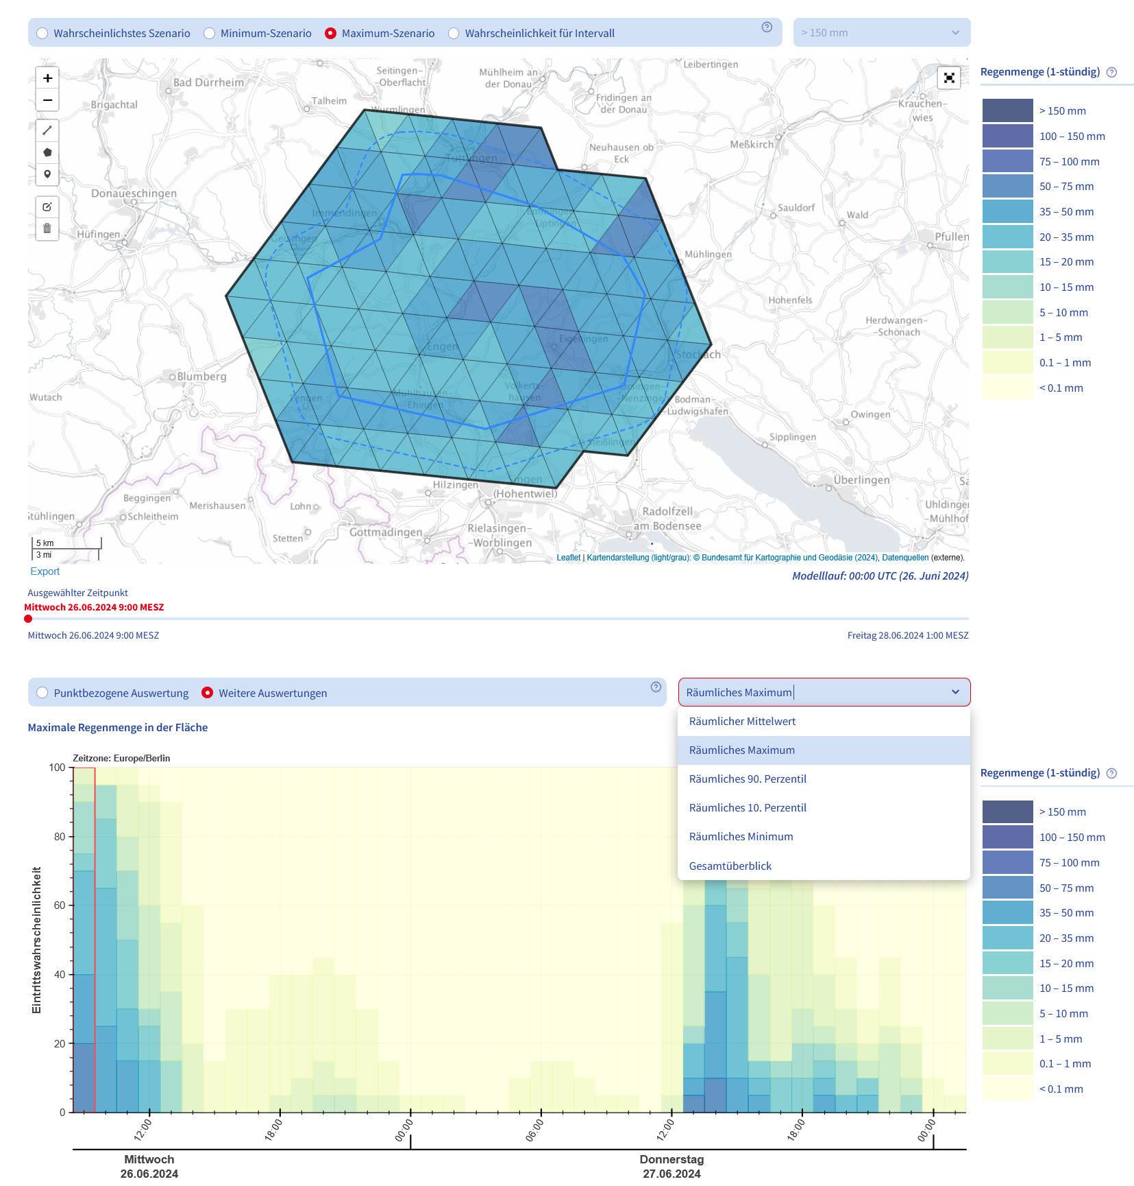
Adaptation of DWD’s new warning system to needs of flood forecasting centres
New features in the warning portal for Flood Forecasting Centres:
Area-based evaluation
Probability of occurrence for values aggregated over the area of interest
Aggregation measures: Mean, Maximum, Minimum, Percentile
Possible use case: Estimate for area-representative rainfall in river catchment →Purely rainfall-based signal for flood risks
Maja Rüth
ID 96, Session 5A
RainBoW
Supervised by DWD

Slide 11
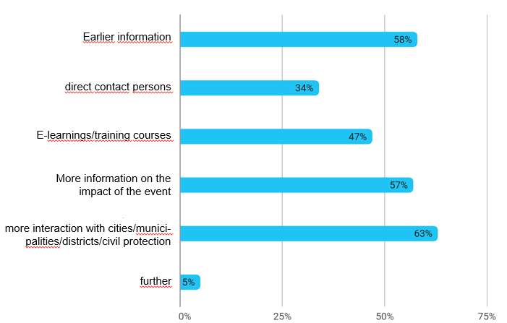
Improving communication of forecasts and warnings
Joint survey (June-Aug 2024) by DWD & FFCs to civil protection, authorities and flood victims
Analysis of product use
Feedback on dealing with uncertainties
Evaluation of interest in workshops and serious games
Development of a serious game
assessing potential damage in the event of flooding and training of possible decision paths
No poster
Get in touch with stefan.wolff@dwd.de or the team ☺
Question: What additional knowledge would help you to cope better with extreme weather events (floods/heavy rain)?
Supervised by FFC Rhineland-Palatinate DWD

Slide 12
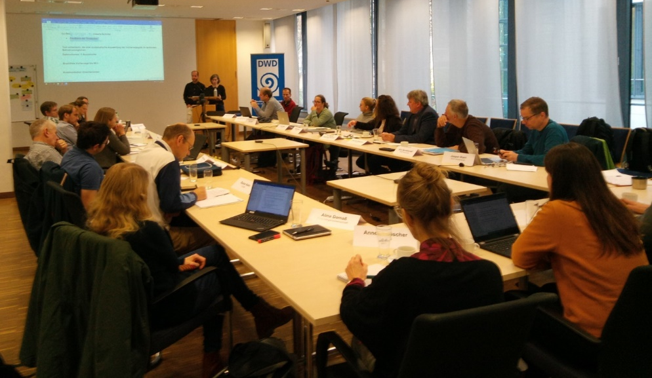
Fostering the collaboration
Projects jointly supervised by the DWD and the three participating flood forecasting centres
Involvement of all German flood forecasting authorities through already existing working groups
Annual Co-Design workshops to jointly work on goals of the project

Slide 13
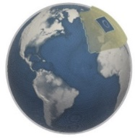
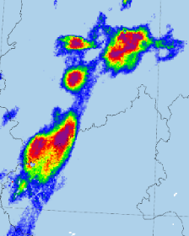
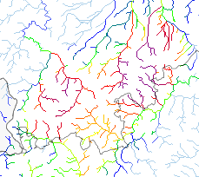
Link to other activities
Identification of requirements and potential for improvements
ICON-Development
Co-Design
Project
Development, test and evaluation of applications in flood forecasting
Seamless Precipitation Forecasts from 0-12
Development of Procedures and Products
Development of warning portal
Data, Procedures, Products

Slide 14
Summary
Flood forecasting in Germany faces several different challenges concerning hydro-meteorological and communication aspects
Improvement is most effective and promising in a co-design format
There are many different aspects along the forecasting chain and a lot of action is underway and encouraging
Feedback and advice based on experiences is very welcome

