Slide 1
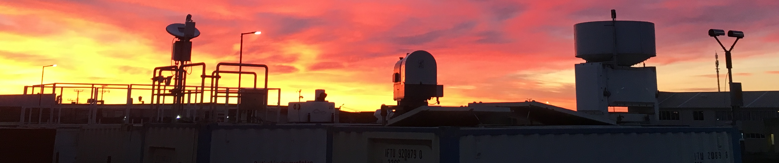





Investigation of aerosol effects on precipitation initiation processes in the alternately clean and aerosol-laden environment
of New Zealand Aotearoa
Patric Seifert¹, Heike Kalesse-Los², Martin Radenz¹, Tom Gaudek¹, Albert Ansmann¹, Andreas Macke¹, Adrian McDonald³, Guy Coulson⁴
1: Leibniz Institute for Tropospheric Research (TROPOS), Leipzig, Germany
2: Leipzig Institute for Meteorology, University of Leipzig, Germany
3: University of Canterbury, Christchurch, NZ
4: The Air Quality Collective, Auckland, NZ
presented at PrePEP conference, Bonn, Germany, 21 March 2025
©Martin Radenz

Slide 2
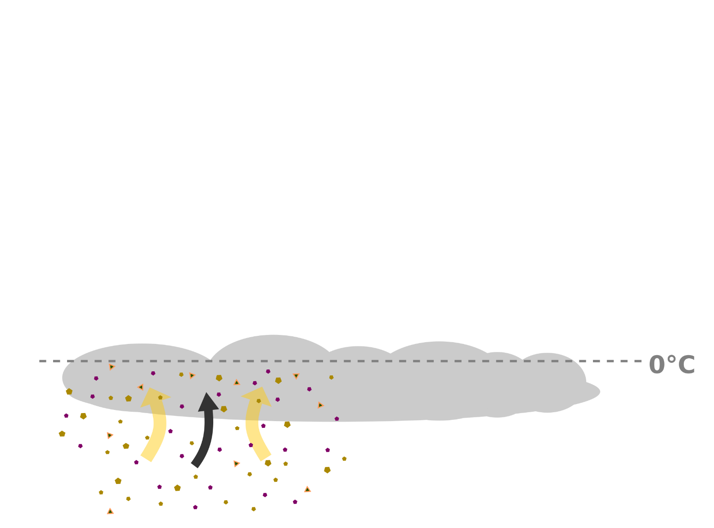
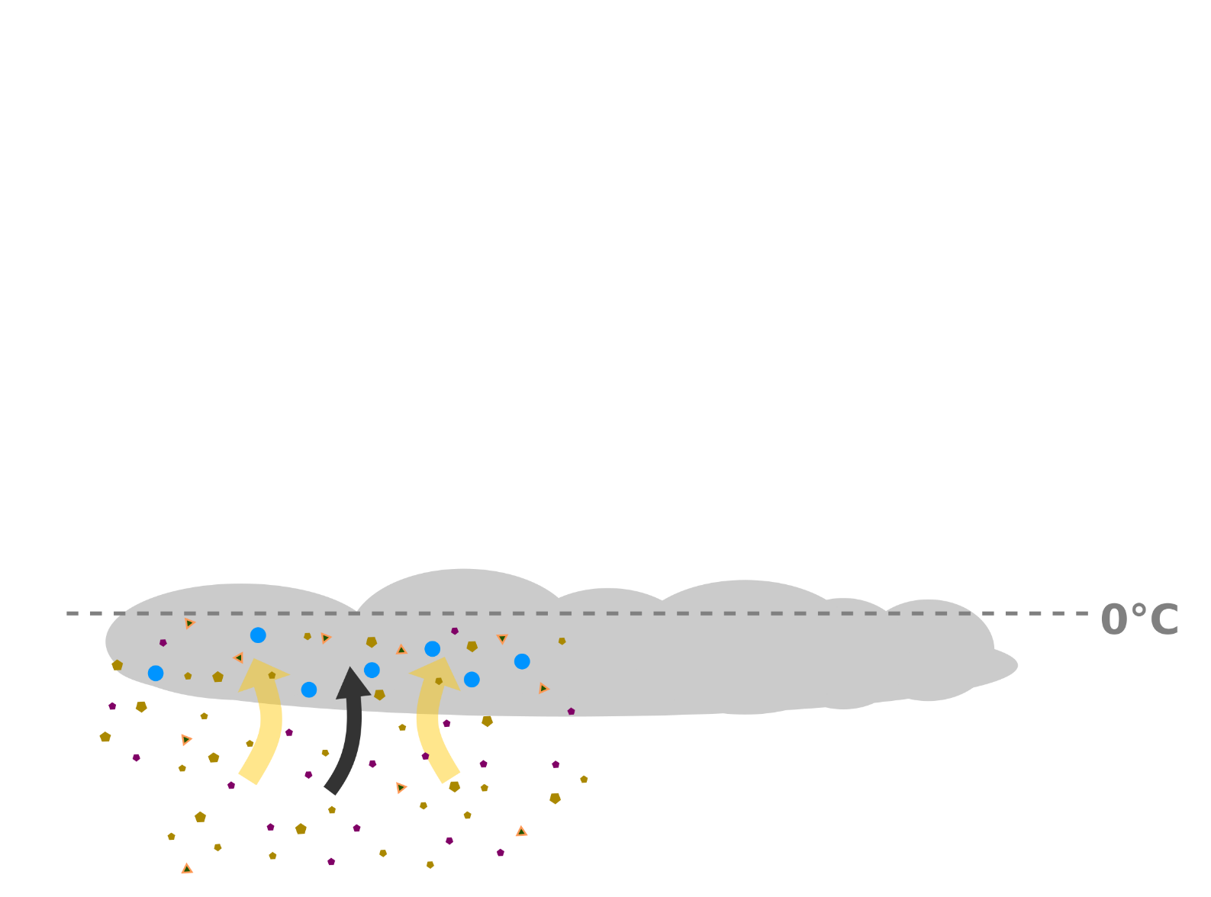
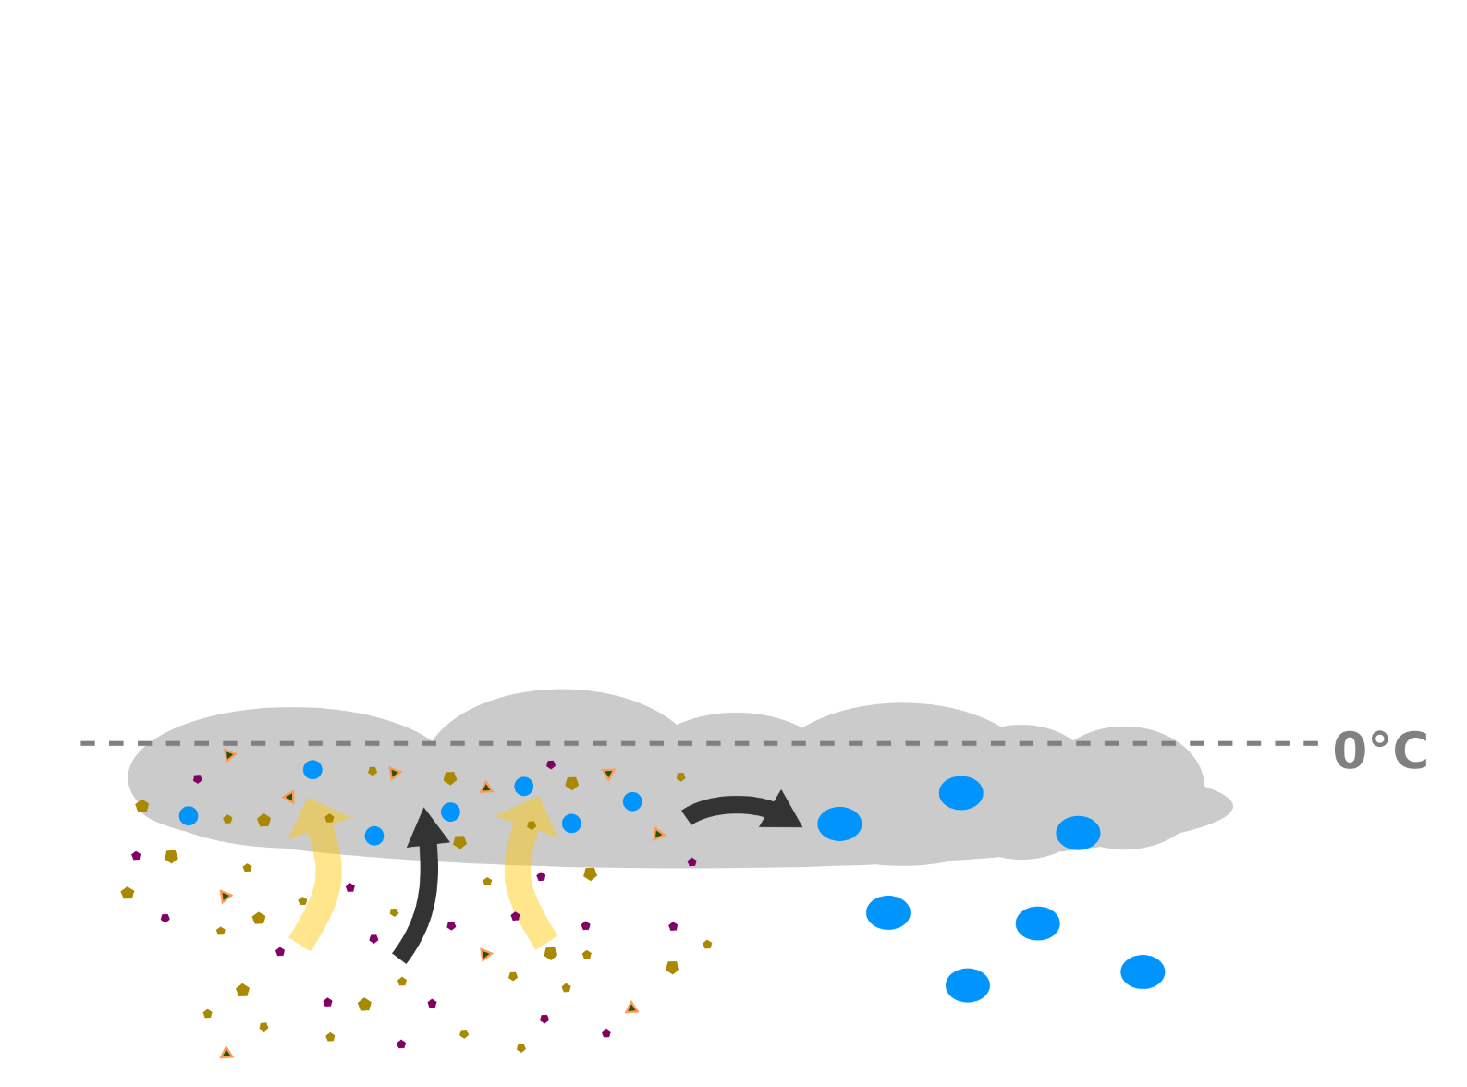
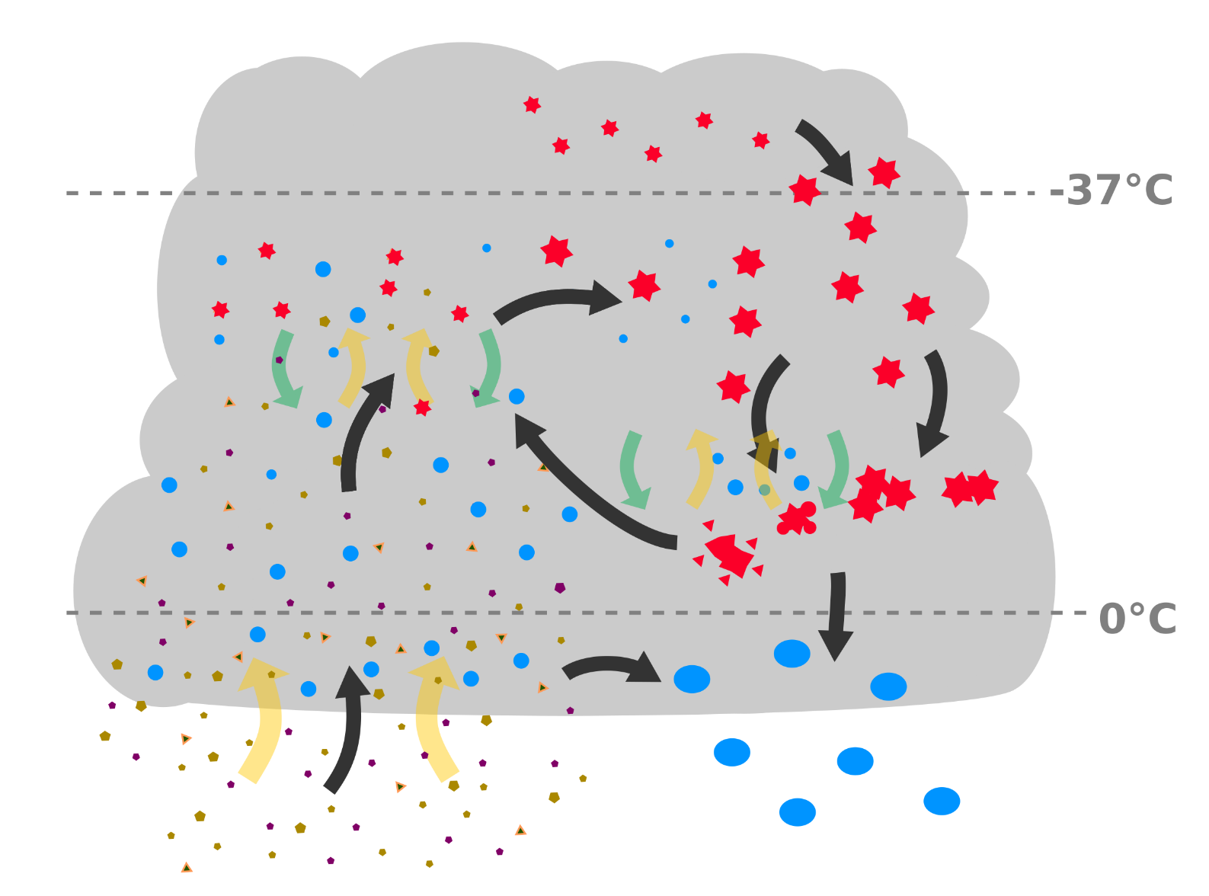

Motivation 1 – the masked relevance of aerosol in cloud processes:
Complex entanglement of aerosol, cloud dynamics and the formation of hydrometeors and precipitation
Role of aerosol by far not clarified
But also other (thermodynamic) contributions
still not well constrained
+ homogeneous ice formation
heterogeneous ice formation
What is the role of aerosol and turbulence in the evolution of cloud systems?
riming
aggregation
aerosol particles
cloud droplets
ice particles
cold rain
warm
rain
large ice particles
rain
©M. Radenz
Patric Seifert (seifert@tropos.de), ACI over New Zealand, 21 March 2025, PrePEP Bonn
Notes:
we are dealing here with aerosol cloud interactions
conceptual view on cloud microphysics
aerosols -> updraft -> cloud droplets if enough moisture is available ->
collision coalescence effective -> droplets grow-> warm rain
slightly colder temperatures, still liquid water, but some aerosol particles might act as ice nucleating particles and form ice
for very low temperatures ice also form homogeneously.
In the mixed phase situation the ice particles grow efficiently on the expense of water droplets and will start to sediment.
At this stage tow more processes might happen: rimining (incl splintering) and aggreagation.
cold rain (majority of rain in the mid-latitudes)
But we will focus on the heterogeneous ice formation here.
→ cut out only that part of the cloud

Slide 3
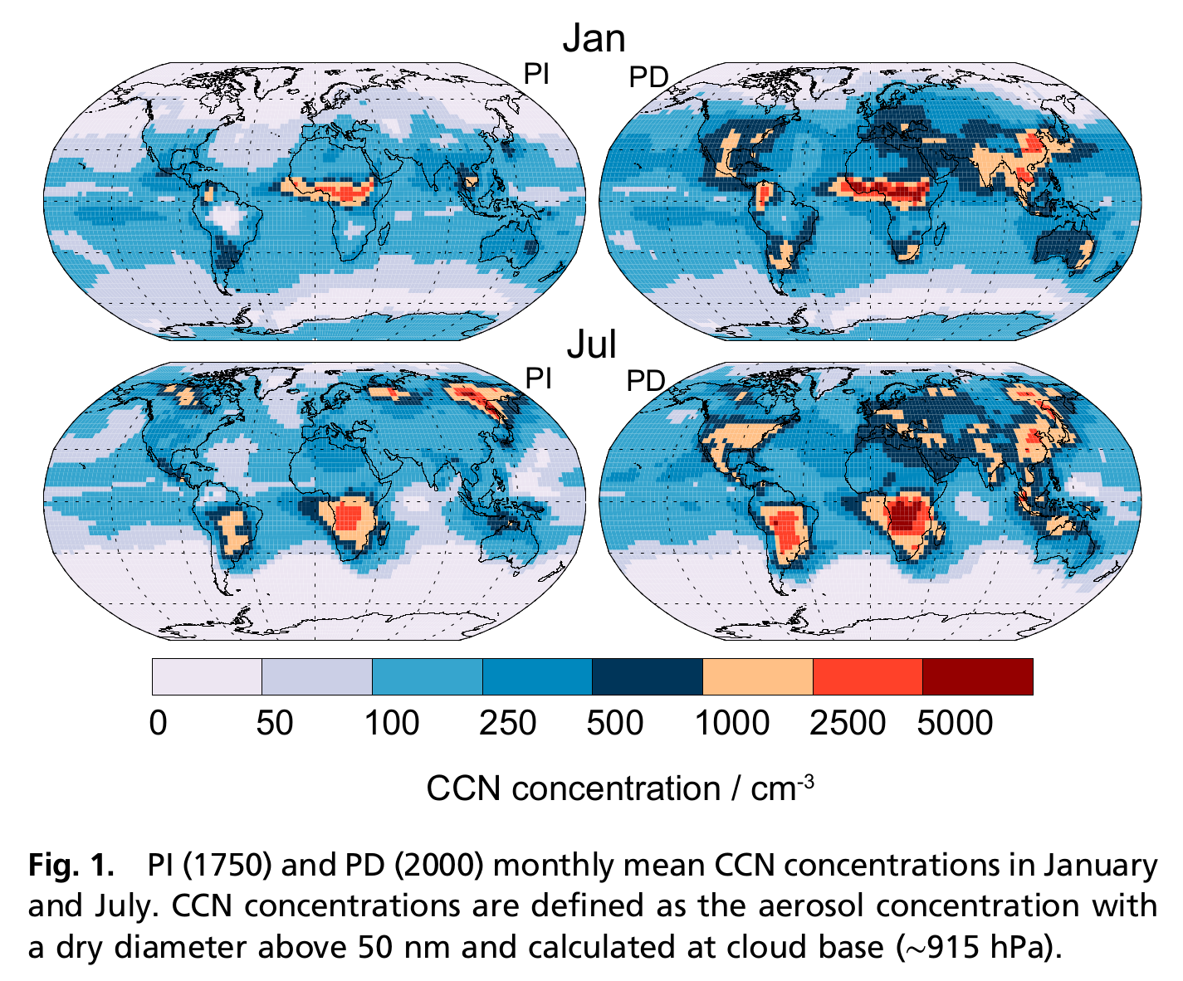
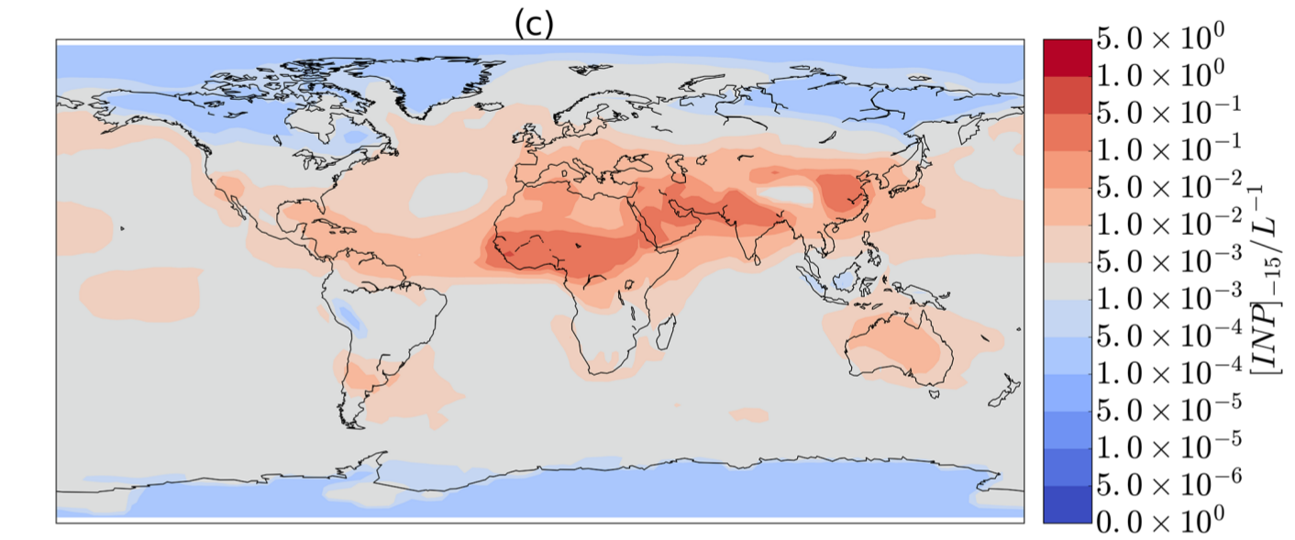
Locations with long-term ground-based remote sensing by TROPOS Remote Sensing Department (RSD)
Gobal maps of (near-surface) cloud condensation nuclei (CCN) and ice nucleating particle (INP) concentrations
[Hamilton 2014 PNAS]
present day
~1000 cm⁻³
Mean concentration of INP at ground
for -15°C (dust and marine biogenic)
Arctic/MOSAiC
~100 cm⁻³
~ 100 m⁻³
Leipzig
Limassol, CY
~1000 cm⁻³
Cape Verde
Punta Arenas, CL
< 50 cm⁻³
< 5 m⁻³
New Zealand
Neumayer 3
[Vergara-Temprado 2017 ACP]
Patric Seifert (seifert@tropos.de), ACI over New Zealand, 21 March 2025, PrePEP Bonn
Notes:
- CCN availability over the Southern Oceans in the summer (Jan) is low, on the order of 100 cm-3, in the winter (Jul) even lower (<50 cm-3)
- This is in strong contrast to e.g. Central Europe or the Eastern Mediterranean (red star) where 1000 cm-3 are typical.
Hamilton 2014, PNAS:
- GCM study
PD = present day
Uncertainties: -Over marine regions, modeled uncertainty in CCN concentrations is typically 20–40% between ±60° latitude,
up to about 70–90% at higher latitudes and over 100% near Antarctica and high latitude Arctic regions. In some continental regions, uncertainties exceed 100% of the mean
in regions dominated by fires.
- we identify the southern Pacific Ocean (approximately 20°S–60°S, 90°W –180°W) as a large region close to pristine, especially during SH summer
when monthly mean PD CCN concentrations in this region are in the range of 53–285 cm−3
- In NH midlatitude regions, there are no pristine days at any time of the year
Yum and Hudson, 2014, JGR:
Tasmania, winter-summer contrasts of CCN based on aircraft obs.
Winter: mean CCN 30 cm-3;
(dry diameter above 50 nm and calculated at cloud base (∼915 hPa) → of what? Which paper?)
Vergara-Temprado, 2017 ACP:
- Global model of INP based on lab + field meas. of K-feldspar (active component) and marine organics
Annual mean distributions of ice-nucleating particles concentrations, for an activation temperature of -15 C based on
feldspar (a) and marine organics (b). Panel (c) shows the total INP concentration obtained by summing the INP concentrations from Kfeldspar
and marine organics. We show [INP]T for a T of -15 C because this is a temperature used by many instruments. The number
of INP that activate to ice crystals ([INP]ambient) at the surface will be zero over much of the globe, because these particles will
only become important at high altitudes. Surface concentrations are shown because this is where most observations of atmospheric INP
concentrations are made.

Slide 4
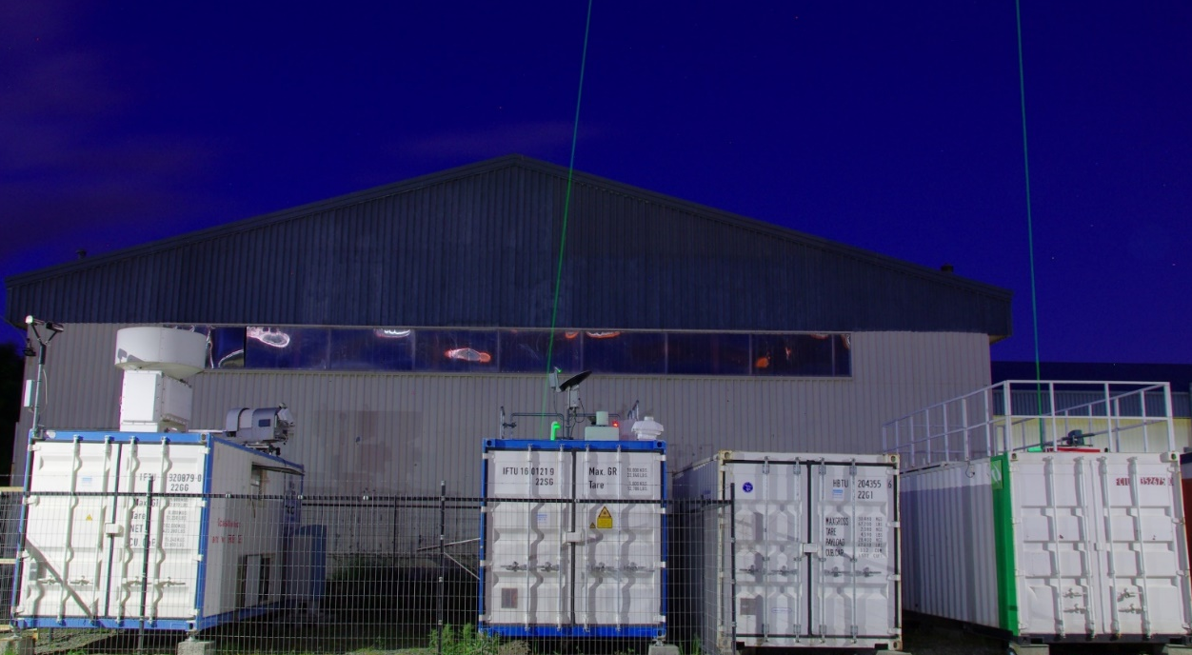
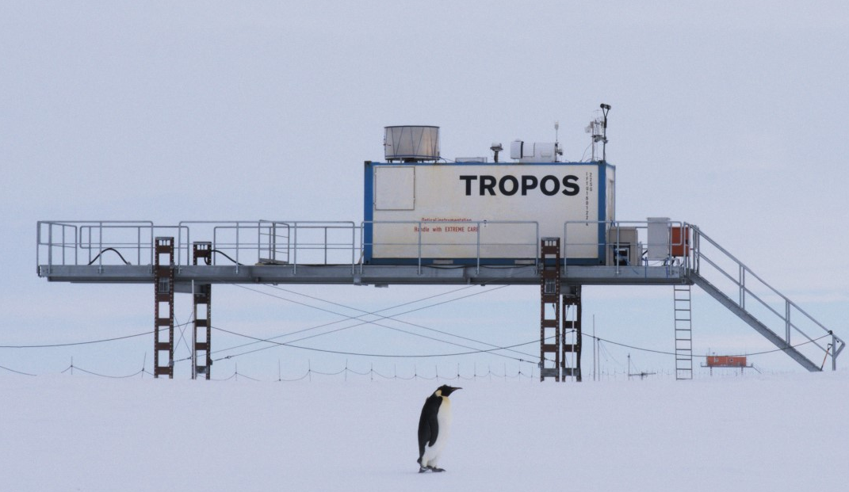

Profiling observations: Study aerosol-cloud-dynamics interaction with synergistic remote-sensing methods
(Mixed-phase) Clouds
LACROS at Punta Arenas, Chile
(2018-2021)
Aerosol
Dynamics
Oceanet-Atmosphere exploratory platform at Neumayer-3 Station,
Antarctica
(2023-2024)
Precipitation
Polly^{XT}
Lidar
Doppler Lidar
Disdro-
meter
Cloud
Radar
Radiation
PollyNet
4
Patric Seifert (seifert@tropos.de), ACI over New Zealand, 21 March 2025, PrePEP Bonn

Slide 5
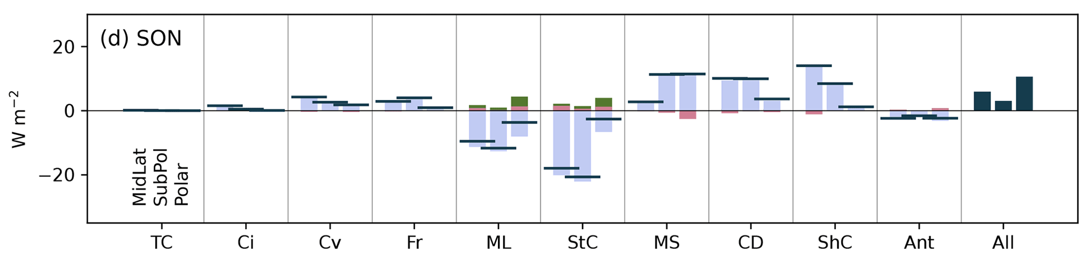
Motivation 2 - Why New Zealand? → The Southern-Ocean cloud bias
Models don‘t manage to accurately simulate the solar radiation budget at the surface of the southern hemisphere mid- and high latitudes!
Wrong amount of sunlight is predicted to reach the surface!
Reasons:
  Wrong representation of macrophysical and microphysical cloud properties
  Distributions of cloud fraction and thermodynamic phase simulated much worse compared to their northern-hemisphere counterparts
What is the role of lack of aerosol???
Shortwave cloud radiative feedback at top of atmosphere of the southern hemisphere
Too reflective
Too absorptive
Cloud types:
[Fiddes et al., 2022, ACP]
Patric Seifert (seifert@tropos.de), ACI over New Zealand, 21 March 2025, PrePEP Bonn

Slide 6
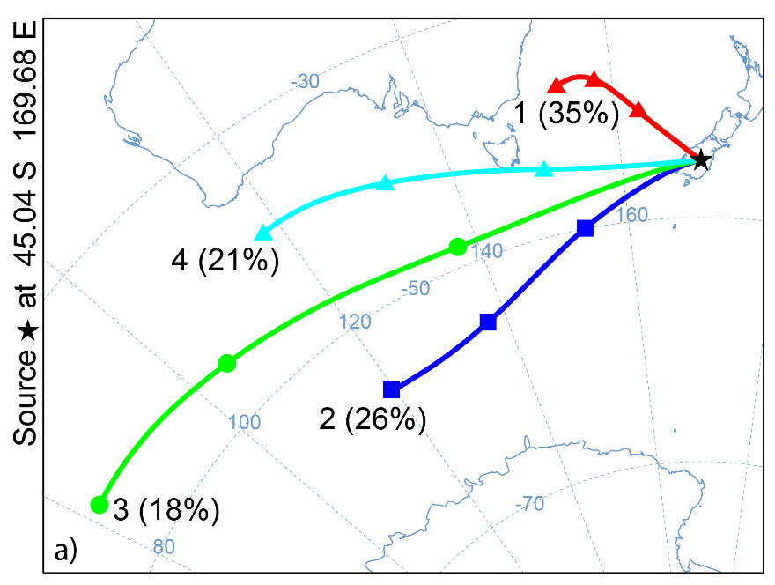
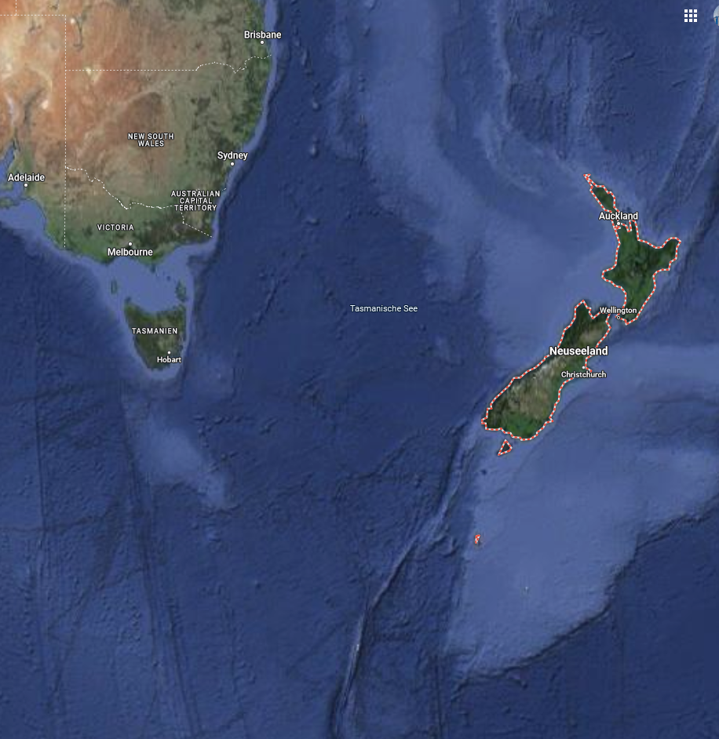
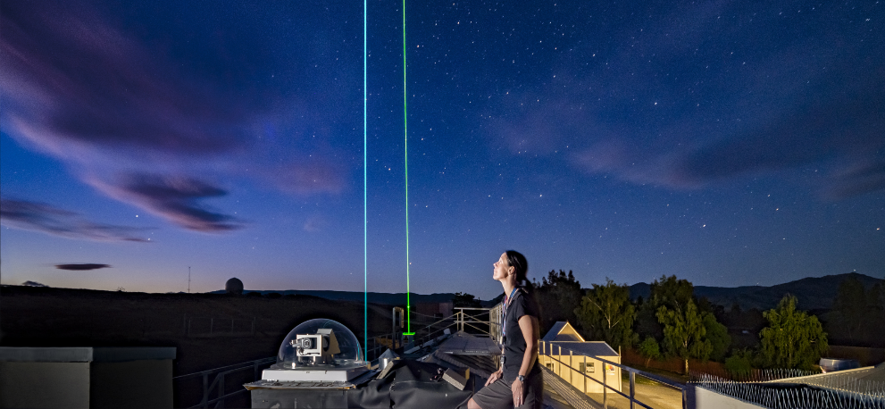
Motivation 3 – New Zealand is great to study contrasting aerosol environments!
Alternating periods of clean air and polluted air above New Zealand
Clouds and aerosol conditions for both scenarios can be observed at one location.
First feasability study (TROPOS + NIWA Lauder):
  Hofer et al., 2024, ACP, https://doi.org/10.5194/acp-24-1265-2024
One back-trajectory for each observed cloud layer
~35% air from Australia
→ „polluted“
~40% air from Southern Ocean
→ „clean“
Polluted Airmasses
Lidar beams at the NIWA Lauder atmospheric observatory
Clean Airmasses
Patric Seifert (seifert@tropos.de), ACI over New Zealand, 21 March 2025, PrePEP Bonn

Slide 7
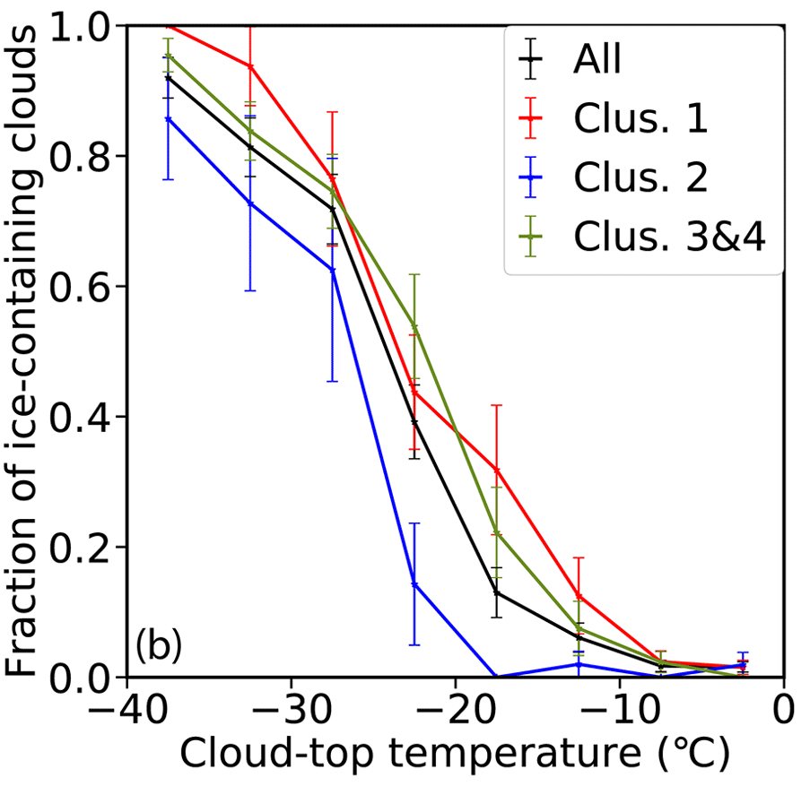
Motivation 3 – New Zealand is great to study contrasting aerosol environments!
Alternating periods of clean air and polluted air above New Zealand
Clouds and aerosol conditions for both scenarios can be observed at one location.
First feasability study (TROPOS + NIWA Lauder):
  Hofer et al., 2024, ACP, https://doi.org/10.5194/acp-24-1265-2024
One back-trajectory for each observed cloud layer
~35% air from Australia
→ „polluted“
~40% air from Southern Ocean
→ „clean“
Low aerosol load
Reduced efficiency of ice formation
Increased reflectivity of clouds for solar radiation

Slide 8
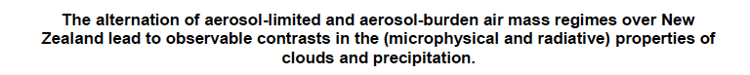
Investigating Aerosol-Cloud-rADiation-interactioN over Aotearoa (ACADIA) as part of the goSouth-2 umbrella project
Hypothesis:
6 scientific goals

Slide 9
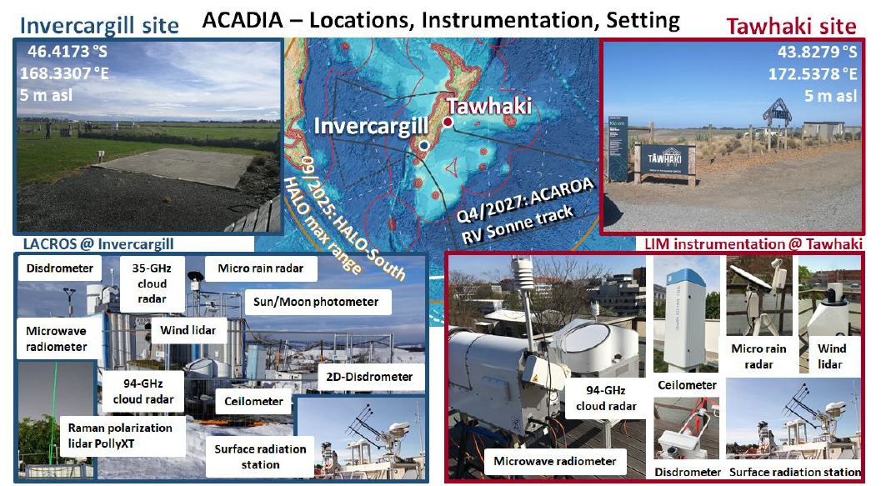
GOAL 1: long-term ground-based observations
1yr obs (Sep 2025 – Aug 2026)
Timing in-sync with goSouth2 campaign series, including HALO-SOUTH campaign (Sep – Oct, 2025)
Deployment of LACROS instrumentation at INV financed by TROPOS
Deployment of LIM instrumentation (Uni Leipzig) at TAWHAKI applied for
2 PhDs (3 yrs) applied for
©Tom Gaudek
Plus auxilliary in-situ instrumentation at Invercargill for:
  Aerosol size distribution from 5 nm to 32µm;
  Cloud Condensation Nuclei Counter (CCNC) and Ice Nucleating Particle (INP) analysis

Slide 10
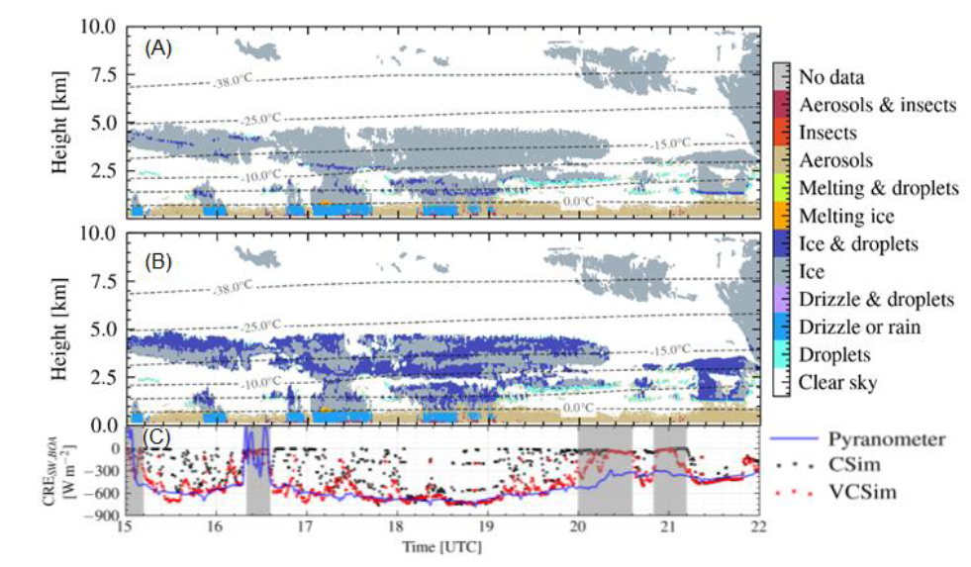
Science GOAL 2:
Fill data gap of long-term aerosol, cloud and precipitation observations over ANZ to create data base of Southern Ocean cloud properties
Best estimates of cloud thermodyn. profiles
Standard Cloudnet Target Classification
VOODOO enhanced Target Classification
(Schimmel et al., 2022)

Slide 11
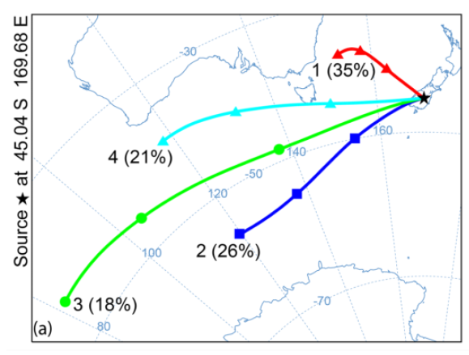
Science GOAL 3:
Fill data gap of long-term aerosol, cloud and precipitation observations over ANZ to create data base of Southern Ocean cloud properties
Best estimates of cloud thermodyn. Profiles
Conduct contrast studies for clouds and aerosols for different air mass regimes over Invercargill and Tawhaki
Cluster analysis of back-trajectories for altitudes of stratiform
mixed-phase cloud tops (Hofer et al., 2024)

Slide 12
Science GOAL 4:
Fill data gap of long-term aerosol, cloud and precipitation observations over ANZ to create data base of Southern Ocean cloud properties
Best estimates of cloud thermodyn. Profiles
Conduct contrast studies for clouds and aerosols for different air mass regimes over Invercargill and Tawhaki
Perform radiative closure studies
Standard Cloudnet Target Classification
VOODOO enhanced Target Classification
Cloud Radiative Effect (T-CARS)
(Schimmel et al., 2023)

Slide 13
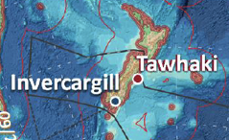
Science GOAL 5:
Fill data gap of long-term aerosol, cloud and precipitation observations over ANZ to create data base of Southern Ocean cloud properties
Best estimates of cloud thermodyn. Profiles
Conduct contrast studies for clouds and aerosols for different air mass regimes over Invercargill and Tawhaki
Perform radiative closure studies
Identify regimes when INV and TAW were subsequently passed by same air mass to assess transformation of aerosols and clouds over South Island of ANZ
Air mass transformation along 450 km path over South Island of ANZ?

Slide 14
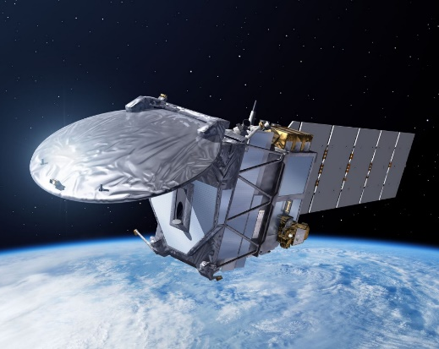
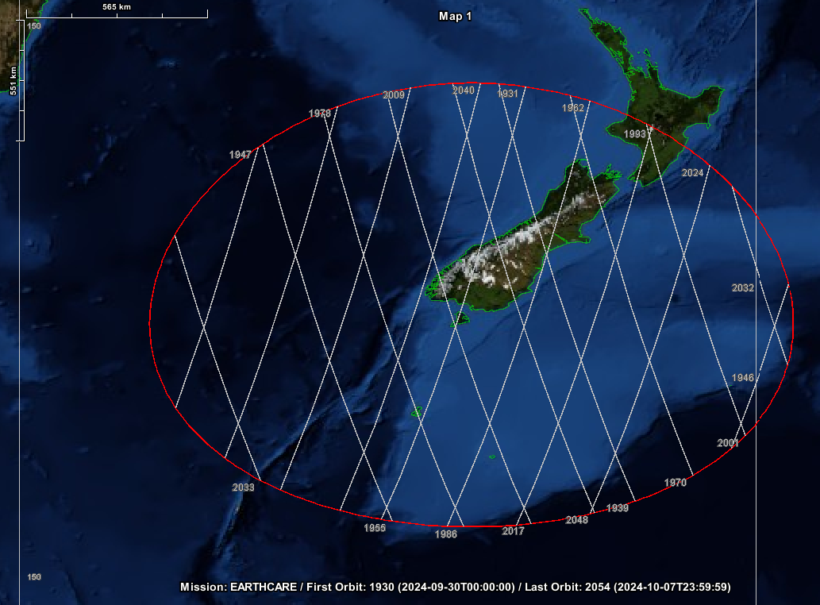

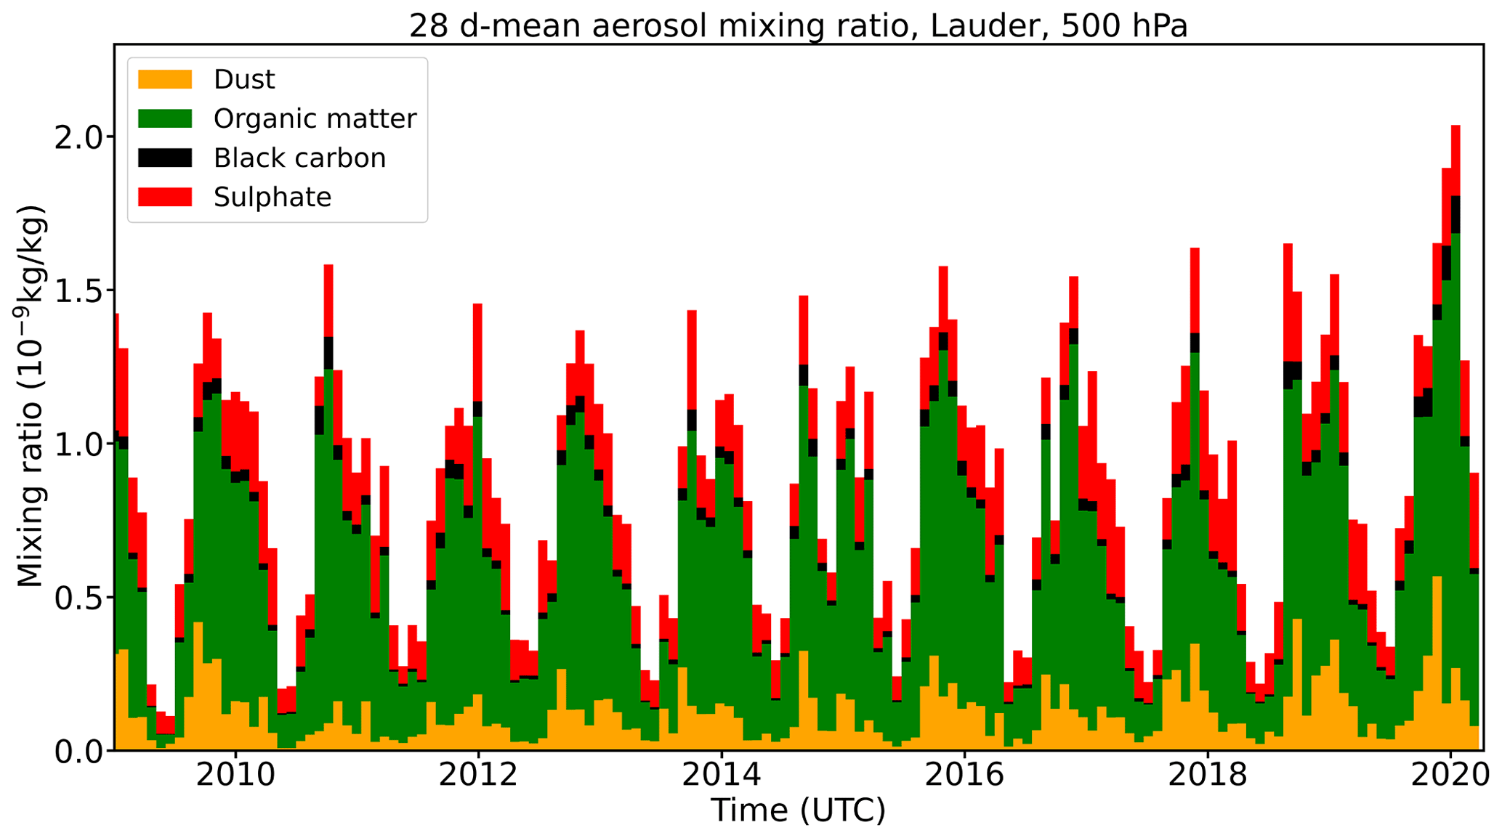
Science GOAL 6:
Fill data gap of long-term aerosol, cloud and precipitation observations over ANZ to create data base of Southern Ocean cloud properties
Best estimates of cloud thermodyn. Profiles
Conduct contrast studies for clouds and aerosols for different air mass regimes over Invercargill and Tawhaki
Perform radiative closure studies
Identify regimes when INV and TAW were subsequently passed by same air mass to assess transformation of aerosols and clouds over South Island of ANZ
Contextualize observations with HALO-South Obs./EarthCARE obs. and model simulations (e.g., CAMS and hopefully more)
EarthCARE
CAMS @ Lauder
  Hofer et al., 2024, ACP, https://doi.org/10.5194/acp-24-1265-2024

Slide 15
Summary
Problem:
  Persistent false model representation of cloud properties in the mid- and high latitudes of the southern hemisphere
Possible reason:
  Lack of cloud-relevant aerosol (CCN, INP) not accurately represented in the simulation setups
Approach:
  goSouth-2 & ACADIA
  Characterization of aerosol and cloud properties during long-term deployment of ground-based remote sensing instrumentation to New Zealand
  Aerosol-Cloud-Interaction contrast studies
  Unprecedented characterization of cloud microphysical structure for improved radiative transfer simulations
Polluted Airmasses
Clean Airmasses

Slide 16
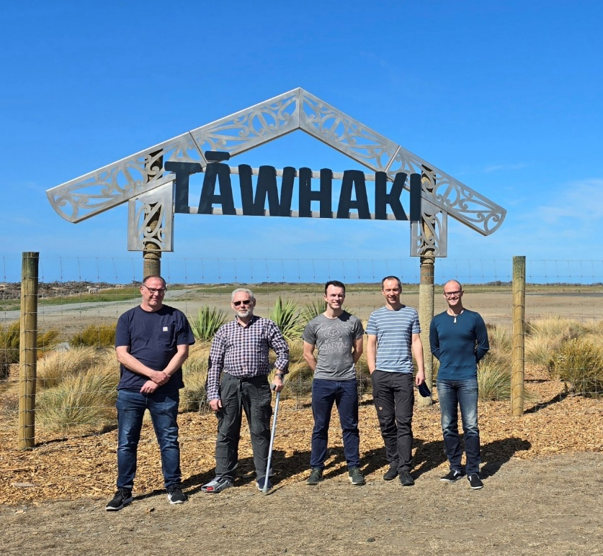
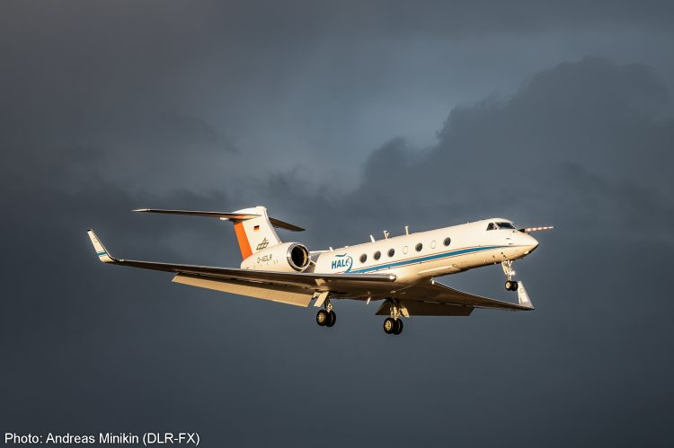

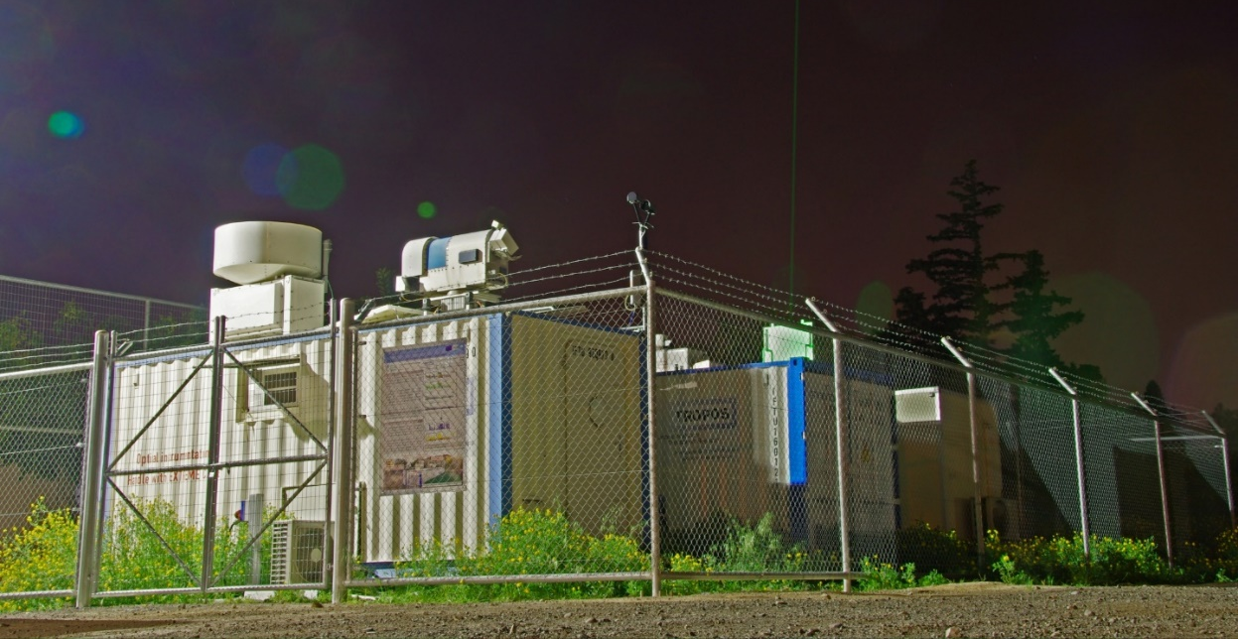
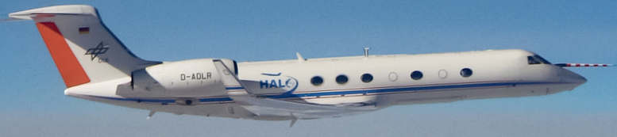
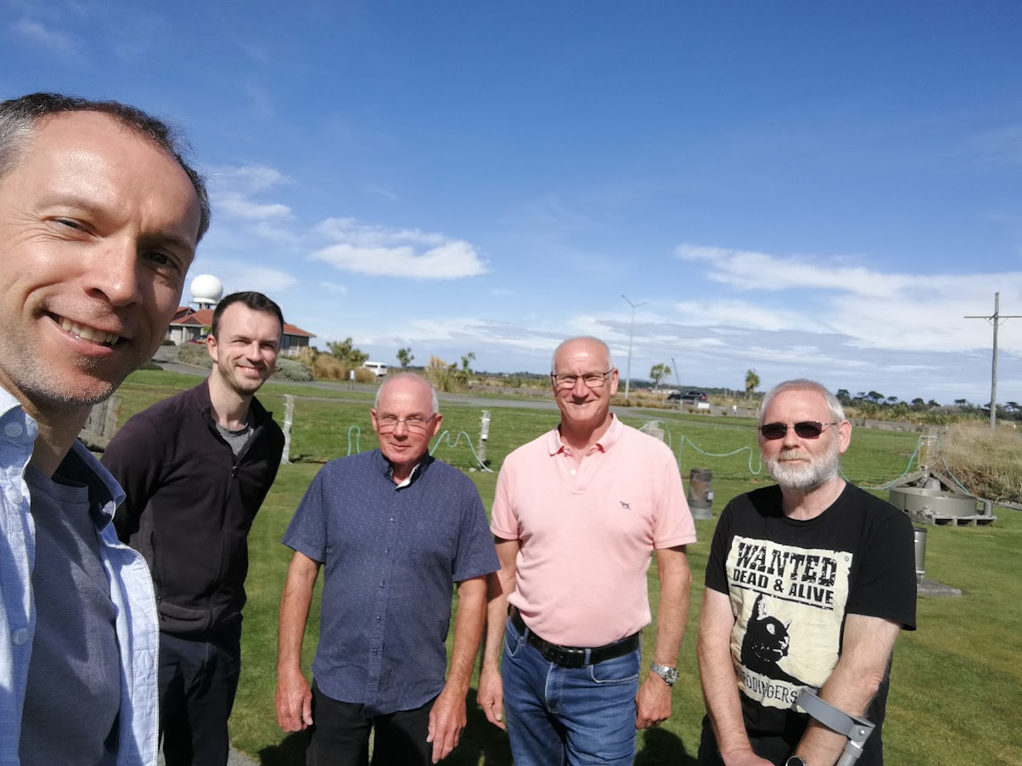
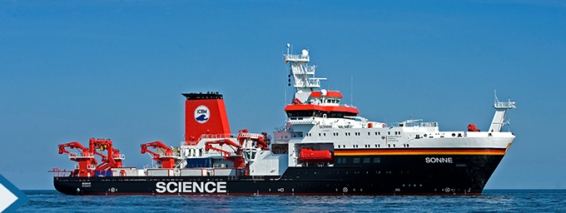

Thank You
HALO Aircraft (HALO-South 09/2025)
Limassol, Cyprus
(2016-2018)
Tawhaki Aerospace Center
+ RV Sonne (ACAROA, Q1/2028)
MetService, Invercargill

Slide 17
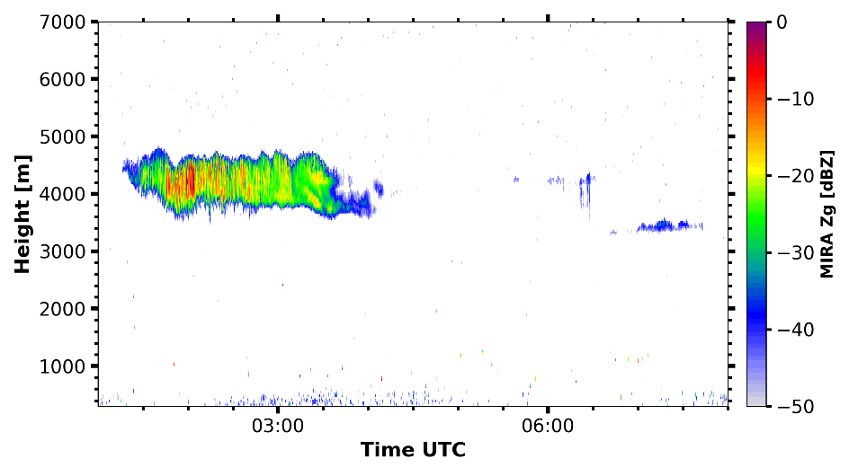
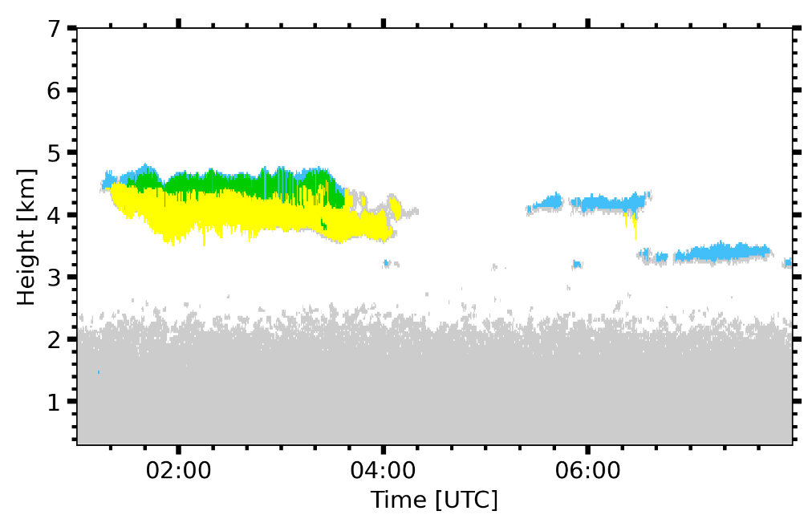
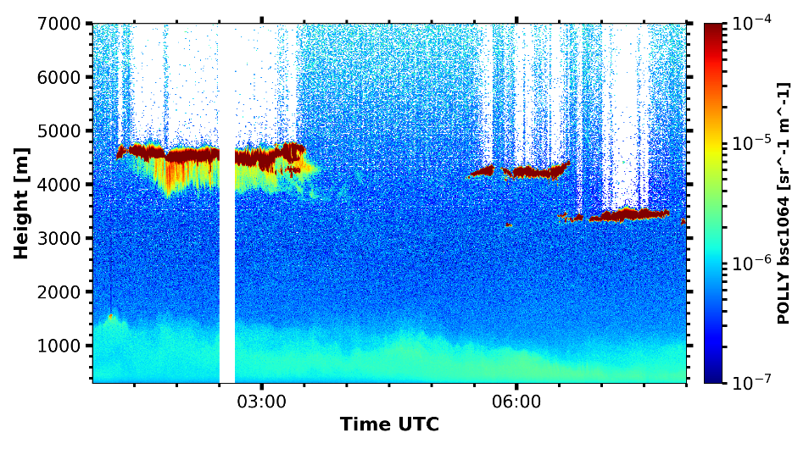
One approach to identify ACI: Picking target scenarios from long-term observations
E.g:
  stratiform supercooled liquid clouds
  Defined turbulence
Radar reflectivity
-15°C
CLOUDNET target categorization
ice and liquid
liquid
ice
aerosol
# stratiform clouds
Leipzig 1063
Limassol 352
Punta Arenas 1267
Lidar backscatter
[Radenz et al., 2021, ACP;
He et al., 2025, in review for JGR]
Punta Arenas 28 Nov 2018

Slide 18
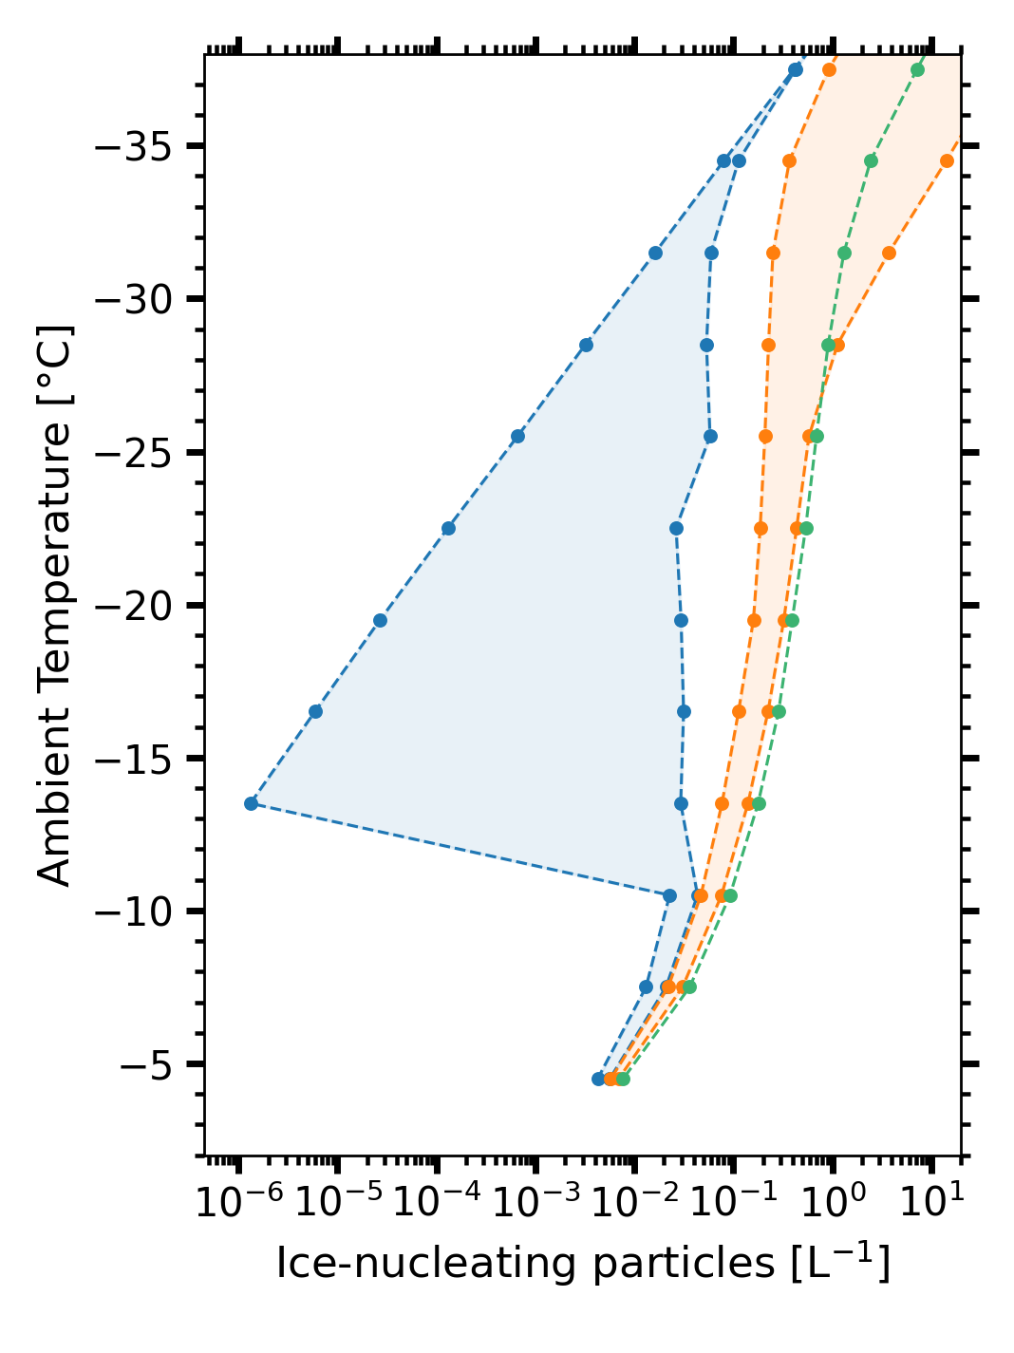
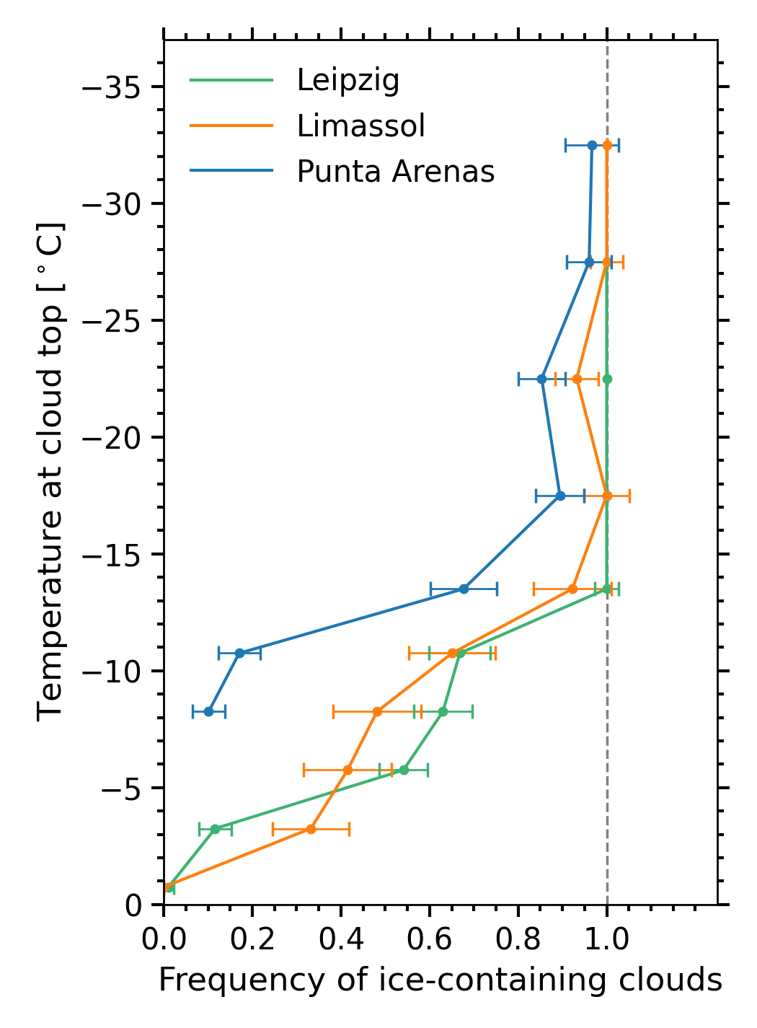
Occurrence of heterogeneously formed ice vs. INP concentrations
Estimate of average INP concentrations
Limassol
Lidar optical
profiles
Punta
Arenas
free-tropospheric
+ non-wave
clouds
Less frequent ice formation at temperatures, where INPs are at least a factor 10 less common
air mass source
pure marine
1% continental
Punta
Arenas
INP
parame-terization
Leipzig
Leipzig
Limassol
[Radenz et al., ACP, 2021]
Notes:
Finally, after considering both aspects the fraction of ice-containing clouds for free-tropospheric and non-wave conditions can be estimated.
The remaining difference in ice formation frequency can then be attributed to differences in aerosol properties. At Punta Arenas, ice formation is less frequent at temperatures, where ice-nucleating particles are at least a factor 10 less common.
Additionally we could show, that the ice virga over Punta Arenas contained less ice mass and had a lower ice to liquid content ratio.

Slide 19
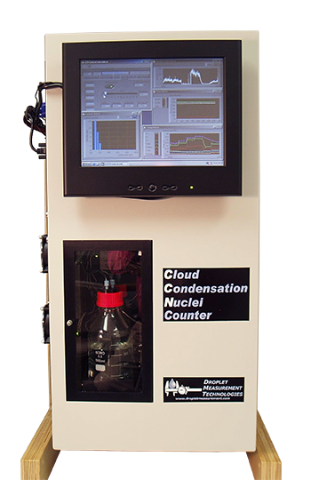
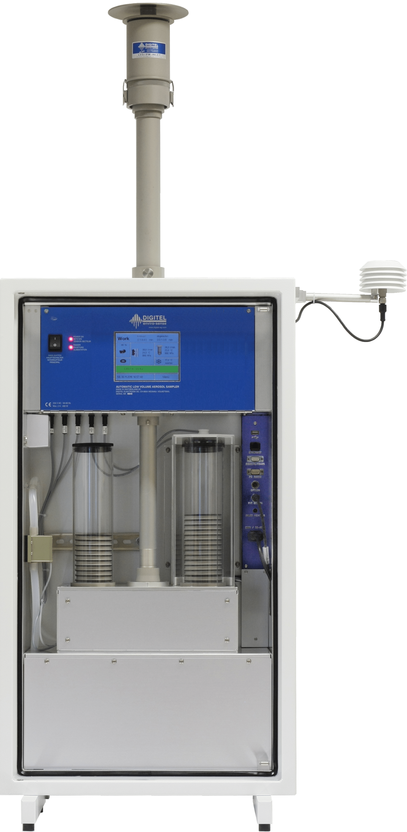
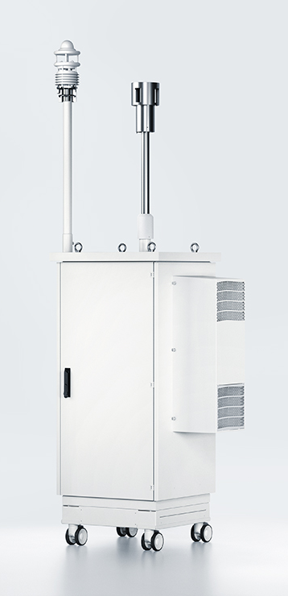
Auxilliary in-situ instrumentation at Invercargill
Aerosol size distribution from 5 nm to 32µm
Cloud Condensation Nuclei Counter (CCNC)
Ice Nucleating Particle (INP) analysis
SMPS DURAG EDM 665 WRAS
Cloud Condensation Nuclei Counter
Low-Volume Filter sampler

