Slide 1



Quantifying Riming by Combining the Video In Situ Snowfall Sensor with Cloud Radar Observations
Maximilian Maahn, Nina Maherndl, Nils Pfeifer, Sabine Hörnig
Notes:
highlight your vision on this position, in relation to research, education, acquisition of funds and added value to society

Slide 2
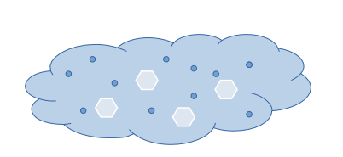
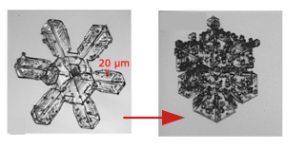
Why are we interested in riming?
In mixed-phase clouds, cloud ice and water droplets coexist
Riming describes how droplets freeze onto ice crystals
Riming one of most efficient precipitation formation processes
Difficult to quantify from observations
Process not sufficiently understood for weather & climate models
Research question:
How can we quantify riming from observations?
Adapted from Waitz et al. (2022)

Slide 3
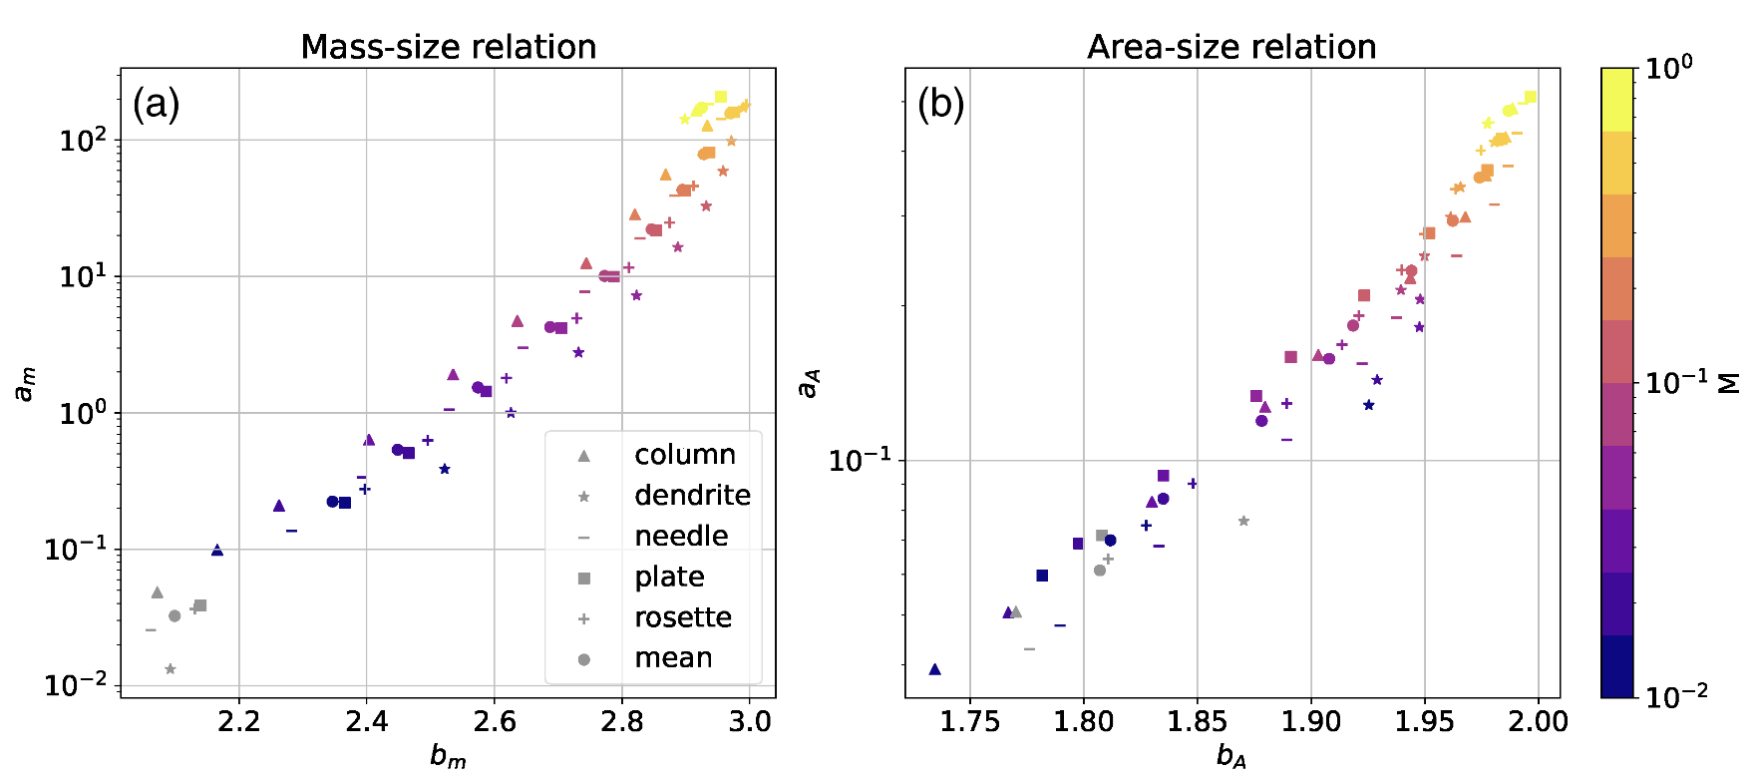
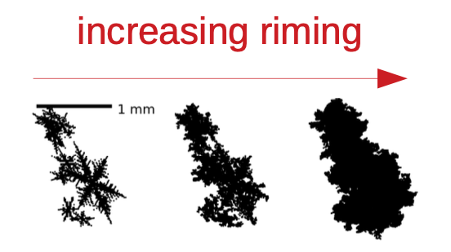


Combined Riming retrieval
Use aggregation and riming model to estimate scattering properties and mass-size relations of rimed aggregates
Graupel
No riming
$$m\left(D\right)=a_{m}D_{max}^{b_{m}}$$
Maherndl et al. (2023)

Slide 4



Combined Riming retrieval
Use aggregation and riming model to estimate scattering properties and mass-size relations of rimed aggregates
Retrieve normalized rime mass M by combining collocated radar and in situ observations
Cloud radar
reflectivity
in situ
particle size distribution
Maherndl et al. (2024a)
Notes:
Originally for aircraft

Slide 5
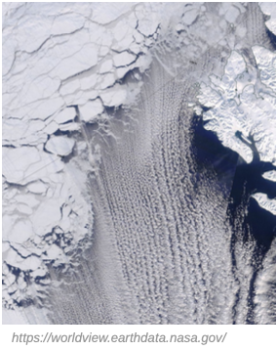
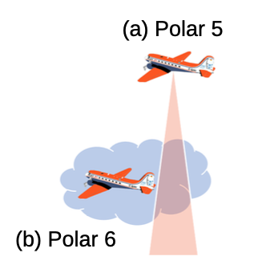
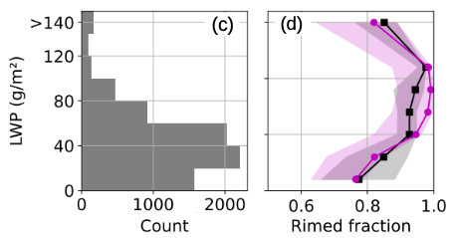
Riming in clouds with low liquid water paths
Apply retrieval to airborne data from HALO-(AC)³
Collocated radar and in situ observations
~80% of clouds LWP < 40 g/m² are rimed
Does turbulence extent the contact time between ice and liquid?
Maherndl et al (2024a)

Slide 6
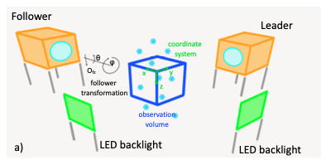
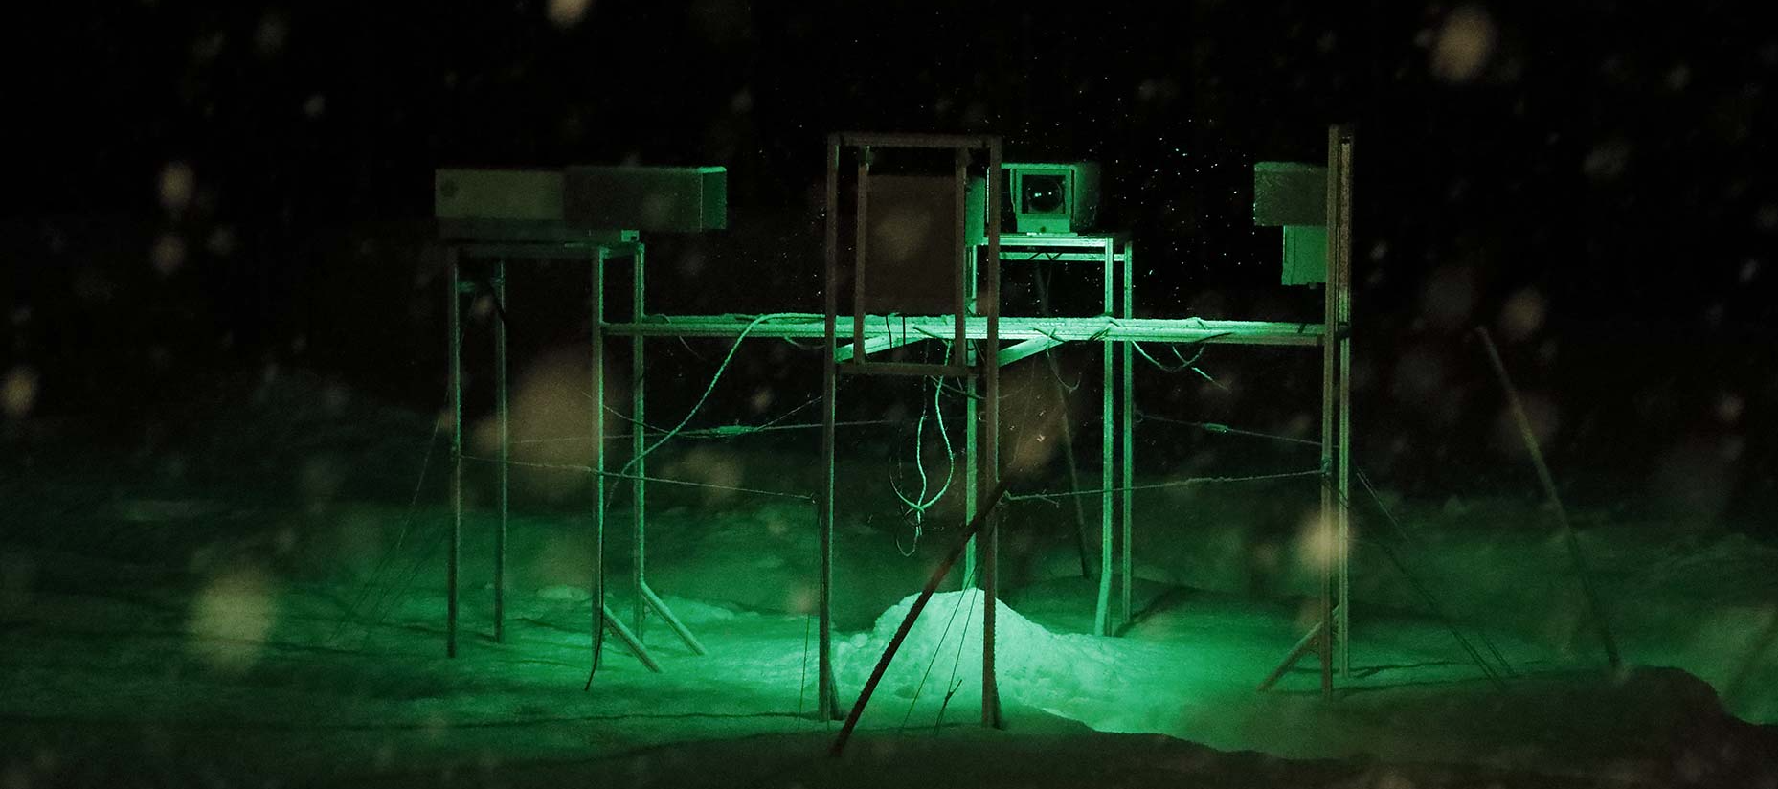
Video In Situ Snowfall sensor (VISSS)
use two cameras to observe from two angles and constrain observation volume
combine high resolution images (42 to 59 μm) and large sampling volume (up to 75 x 75 x 61 mm)
high framerate (150 - 270 Hz) allows for tracking of particles
minimize wind disturbance
open source hardware & software
Why develop your own instrument?
Maahn et al., 2024

Slide 7
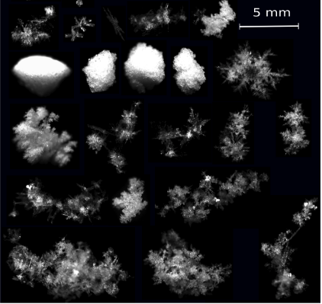
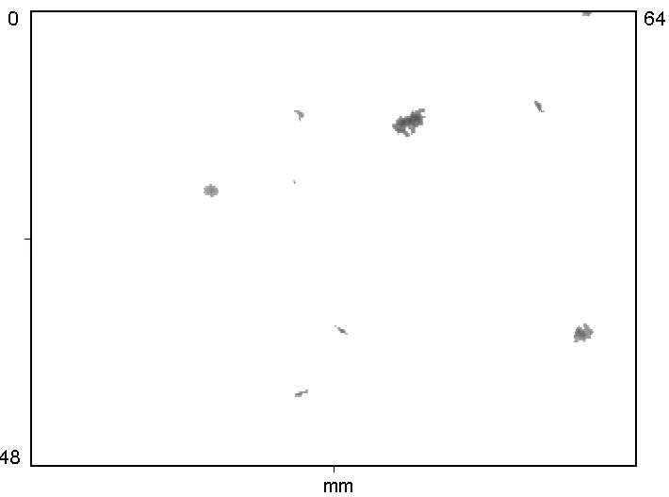
Established in situ sensors
Garrett et al. 2012
NASA
OR
Few high-quality particle observations
Many low-quality particle observations

Slide 8
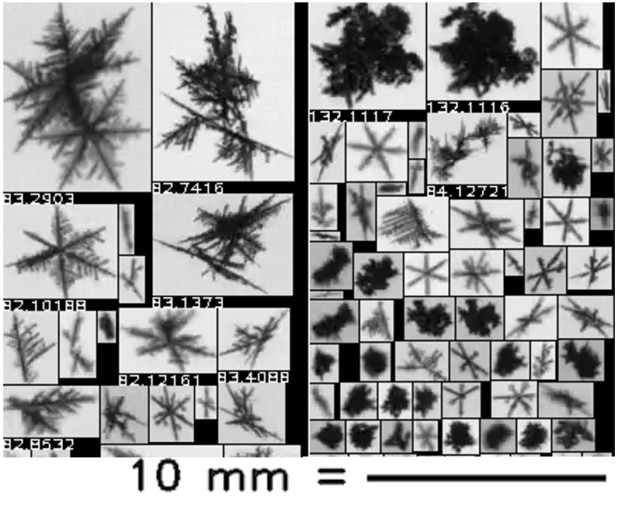
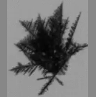
Video In Situ Snowfall sensor (VISSS)
Many high-quality observations for
Identifying dominant growth process
  Aggregation
  Riming
Quantifying precipitation properties
  Particle shape
  Particle type
  Particle number concentration
  Particle fall velocity
Constraining remote sensing observations
Maahn et al., 2024

Slide 9
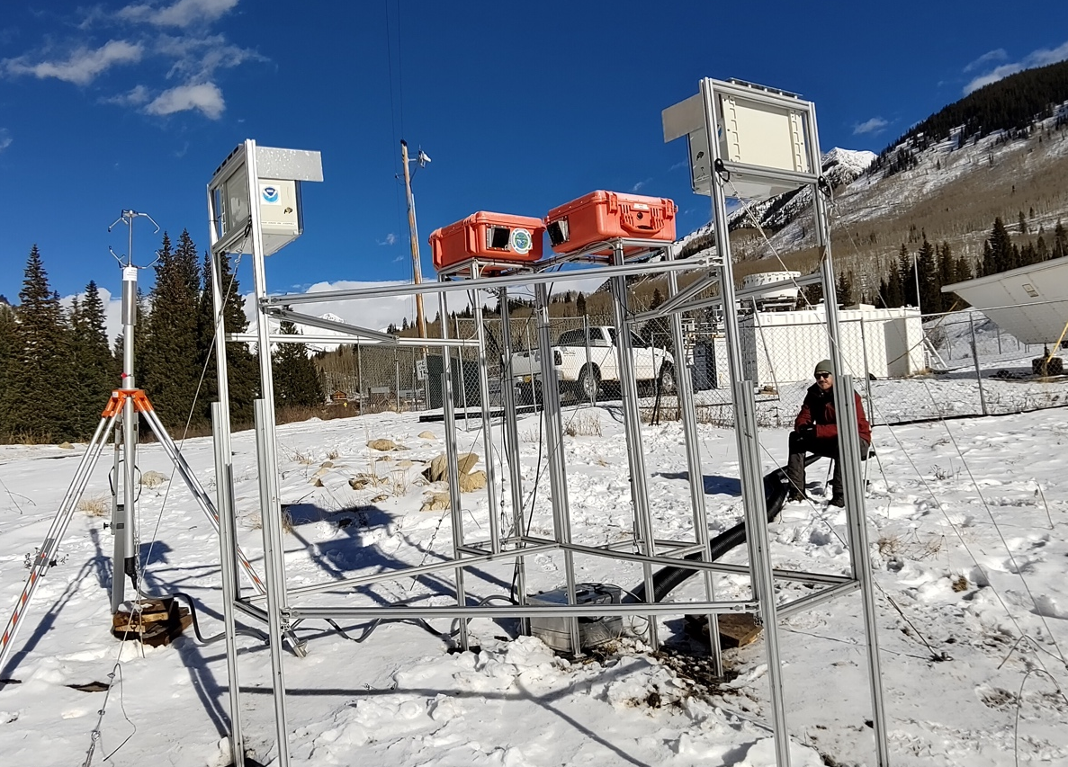
Apply combined retrieval to VISSS data
ARM SAIL campaign in 2022/23 in Colorado
Almost 10 m snowfall
Use collocated RPG 94 GHz radar measuring at 40° elevation
Use 1st generation VISSS
What is the sensitivity of the Z-IWC relation to riming?
Maherndl et al (2025)

Slide 10
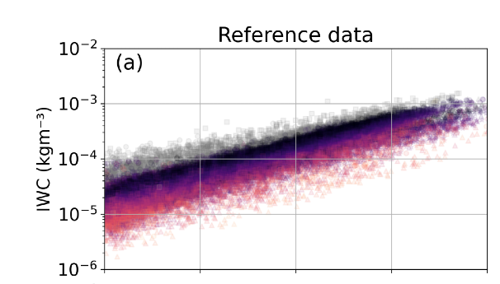


Sensitivity of the reflectivity (Z) – ice water content (IWC) relation to riming
Retrievals of ice water content based on radar reflectivity are inaccurate
Riming explains large parts of this variability
IWC from the VISSS & radar
Z from the radar
Retrievals of ice water content based on radar reflectivity are inaccurate
Riming explains large part of Z-IWC (and Z-S) relation variability!
No riming
Graupel
Maherndl et al (2025)

Slide 11
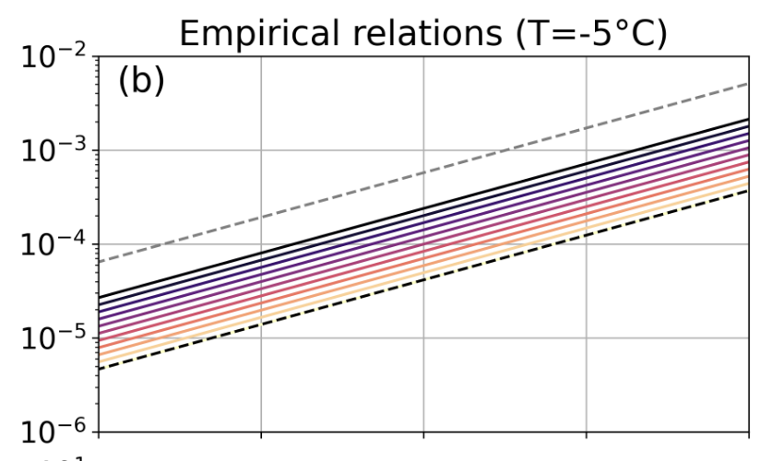
Sensitivity of the reflectivity (Z) – ice water content (IWC) relation to riming
How can we measure riming without in situ information?
IWC from the VISSS & radar
Z from the radar
Retrievals of ice water content based on radar reflectivity are inaccurate
Riming explains large part of Z-IWC (and Z-S) relation variability!
We can derive Z-IWC (and Z-S) relations as a function of riming
No riming
Graupel
Maherndl et al (2025)

Slide 12
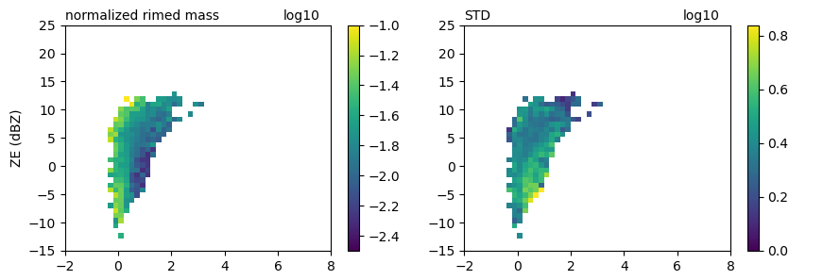
Quantify riming with polarimetric radar
Mean normalized rime mass
Standard deviation norm. rime mass
Understand impact of riming on polarimetric variable based on observations
Potential for riming retrieval based on polarimetric cloud radar observations?
Normalized rime mass M
KDP at 40º elevation (º/km)
KDP at 40º elevation (º/km)
Hörnig et al (in preparation)

Slide 13
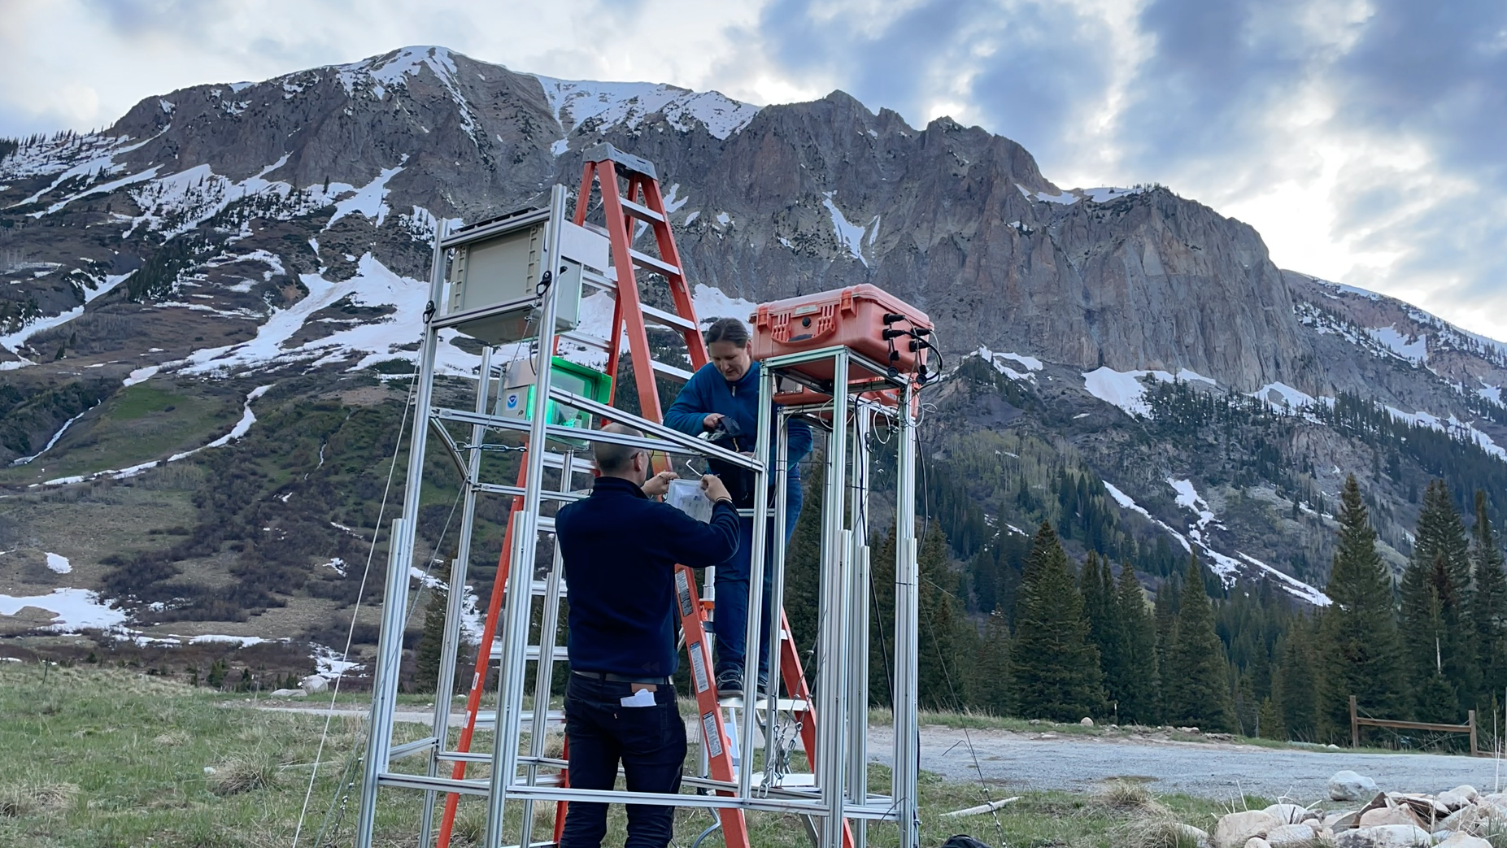
Summary
Major progress with quantifying riming from in situ and remote sensing observations
Can be used to study riming process
Can improve radar-based IWC (and snowfall rate) retrievals

Slide 14
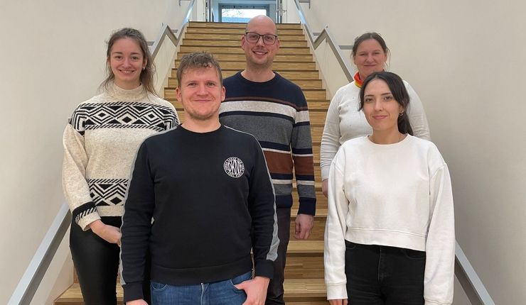
Summary
Thanks to my team!
Combine in situ and remote sensing observations
insights into microphysical cloud and precipitation processes
  Riming
  Droplet fragmentation

Slide 15
[1] Maherndl et al.: A riming-dependent parameterization of scattering by snowflakes using the self-similar Rayleigh–Gans approximation. Q. J. R. Meteorol. Soc., 2023
Riming retrieval
[2] Maherndl et al.: Quantifying riming from airborne data during HALO-(AC)³. AMT, 2024
In situ snowfall observations: VISSS
Particle size distributions
Radar forward
simulator
(PAMTRA)
riming-dependent parameterization [1]
for ice particle properties
Z = function(M)
Ground-based cloud radar
Measured radar reflectivity Z
at lowest range gate
Find M
such that
=
Simulated Z
at ground
► combined method [2]

Slide 16
Thanks to my team!

Slide 17
Comparison with PIP and Parsivel at Hyytiälä
Good agreement of mass weighted mean diameter
VISSS (and Parsivel) N₀ larger than PIP N₀, likely due to better sensitivity to small particles (D< 1mm)
VISSS observes up to 100.000 particles per minute
For drizzle spectra, excellent agreement with Parsivel for D>0.5 mm
Maahn et al., 2024

Slide 18
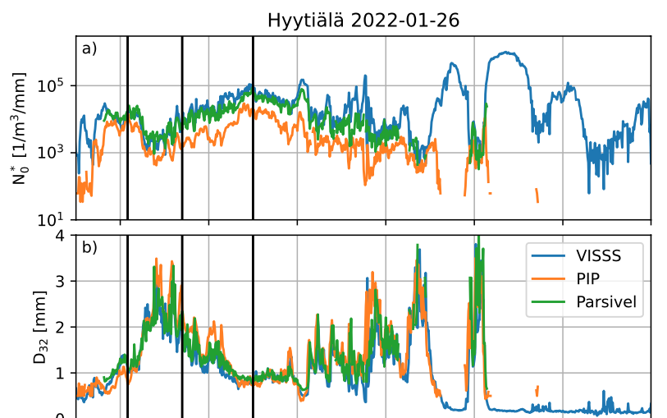

Comparison with PIP and Parsivel at Hyytiälä
Good agreement of mass weighted mean diameter
VISSS (and Parsivel) N₀ larger than PIP N₀, likely due to better sensitivity to small particles (D< 1mm)
VISSS observes easily 10.000 particles per minute
Maahn et al., 2024

Slide 19
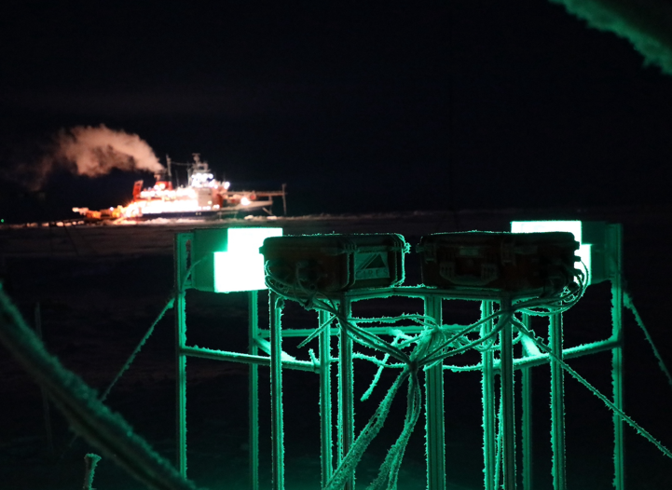
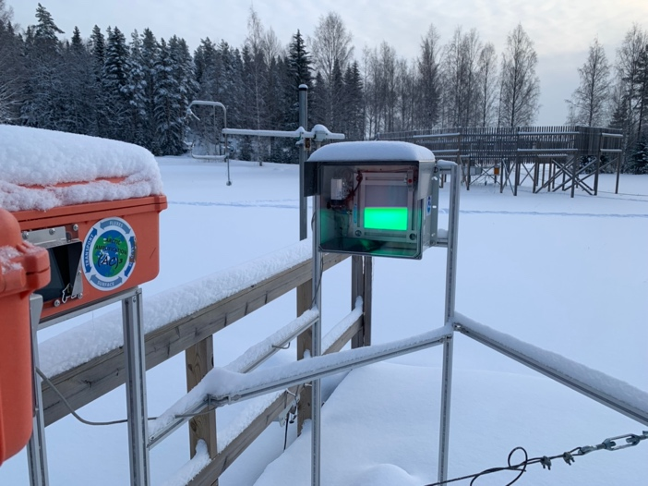
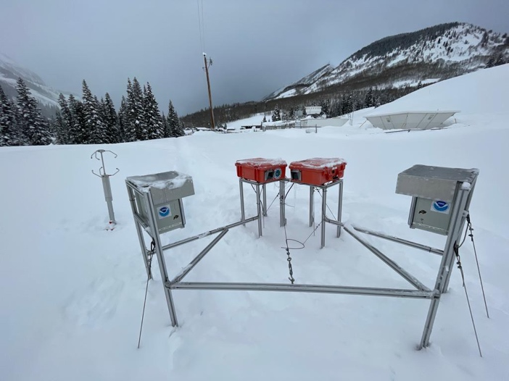
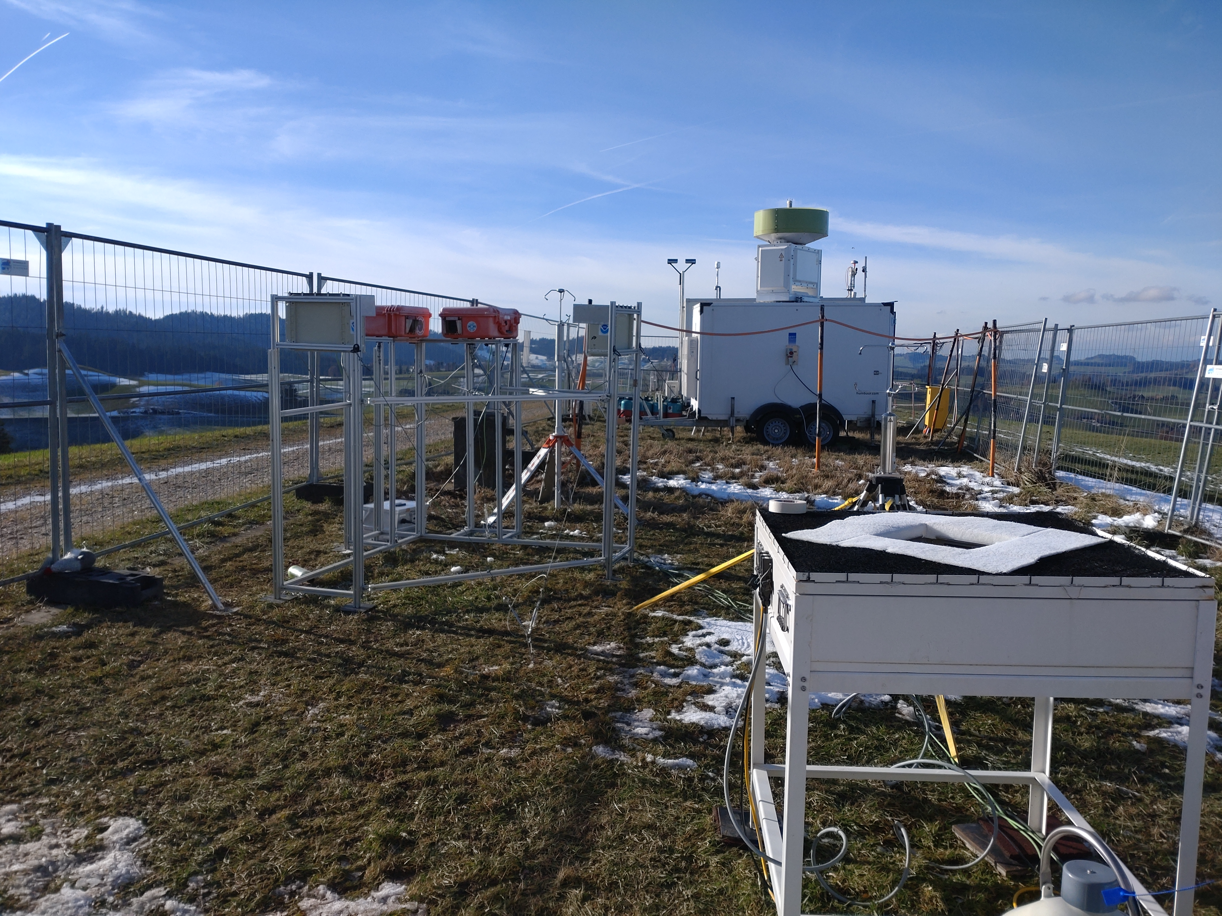
Deployments
MOSAiC, 2019/20
Hyytiälä, Finland 2021/22 & since 2023
Ny-Ålesund, Svalbard since 2021
SAIL, Colorado 2022/23
Eriswil, Switzerland 2023/24
> 2600 days observations, 1.000.000.000.000 snow particles
Maahn et al., 2024

Slide 20


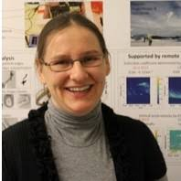
Studying the Riming process
Research Example II
EE 11 cand. mission WIVERN
SPP PROM
Nina Maherndl
Sabine Hörnig
Veronika Ettrichrätz
TR 172 (AC)³

