Slide 1
RealPEP
A probabilistic AI-based merging of Commercial Microwave Link and Radar QPE
Julius Polz¹, Luca Glawion¹, Maximilian Graf³, Mahfuja Akter⁴, Nico Blettner¹, Silke Trömel⁴, Harald Kunstmann^{1,2}, Christian Chwala¹
1 Institute of Meteorology and Climate Research, Karlsruhe Institute of Technology
2 Institute of Geography, University of Augsburg, Augsburg, Germany
3 Deutscher Wetterdienst (DWD), Offenbach, Germany
4 University of Bonn, Institute for Geosciences - Section Meteorology
Source: Flickr

Slide 2
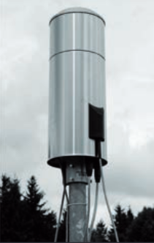
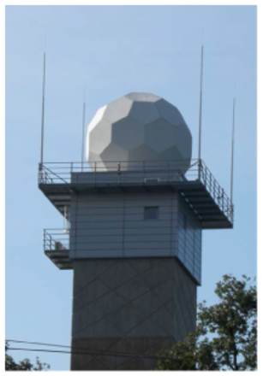
Rainfall sensors in Germany
Rain Gauge
Weather radar (C-band)
Source: DWD
Source: DWD

Slide 3
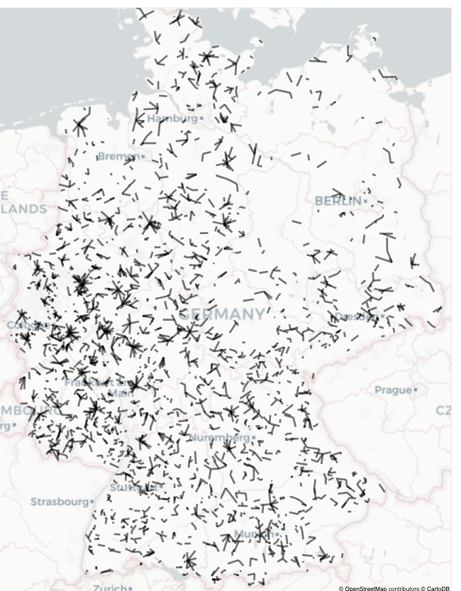
Rainfall sensors in Germany
Rain Gauge
Commercial microwave link (CML)
Weather radar (C-band)
Source: DWD
Source: C. Ruf, KIT
Source: DWD

Slide 4
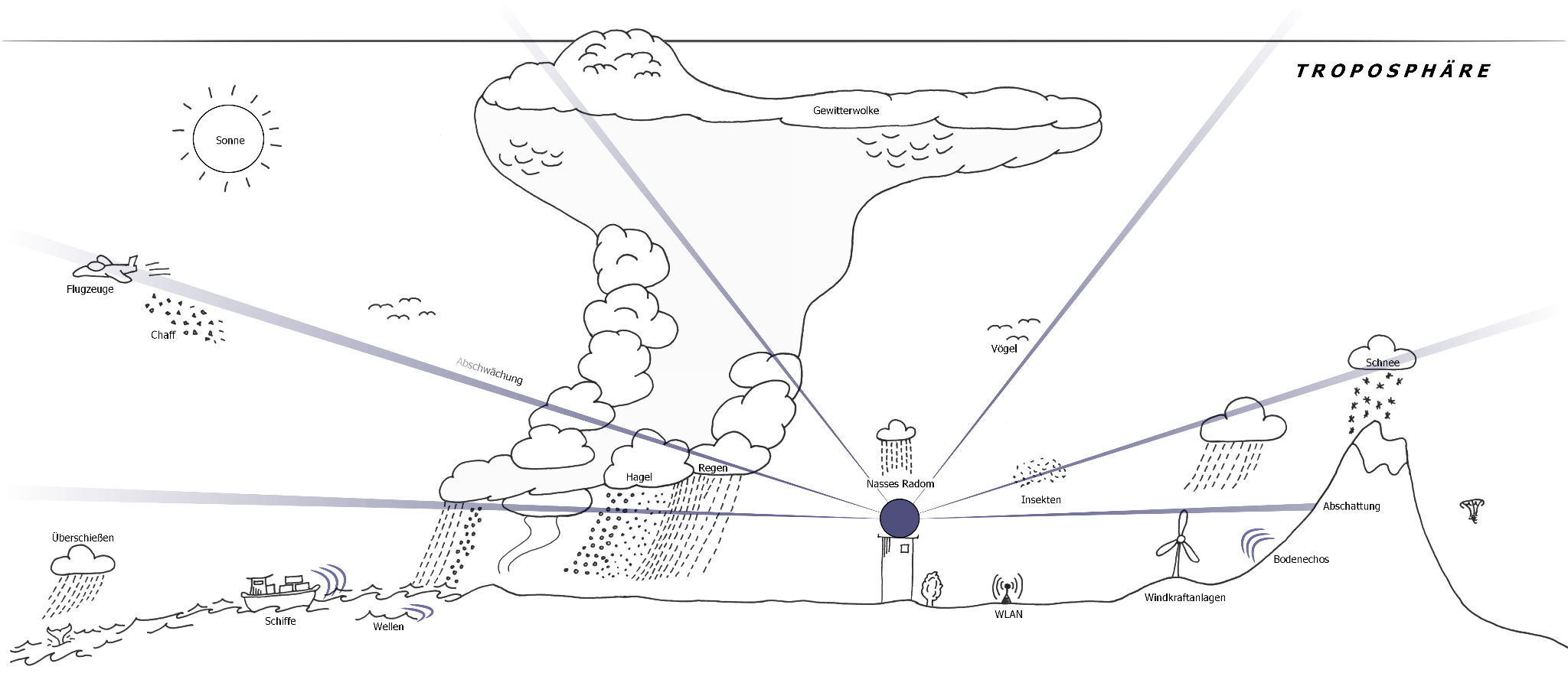
Systematic measurement errors
Sun
Airplanes
Attenuation
Birds
Snow
Hail
Rain
wet radome
Insects
Beam blockage
Overshooting
Echoes
Wi-Fi
Windfarms
Ships
Waves
Source: DWD
‹#›

Slide 5
Systematic measurement errors
3-hour aggregation
Sun
5-minute measurement interval
Airplanes
Attenuation
Birds
Snow
wet radome
Insects
Beam blockage
Overshooting
Echoes
Sampling related error
Wi-Fi
Windfarms
Ships
Waves
Source: DWD
‹#›

Slide 6
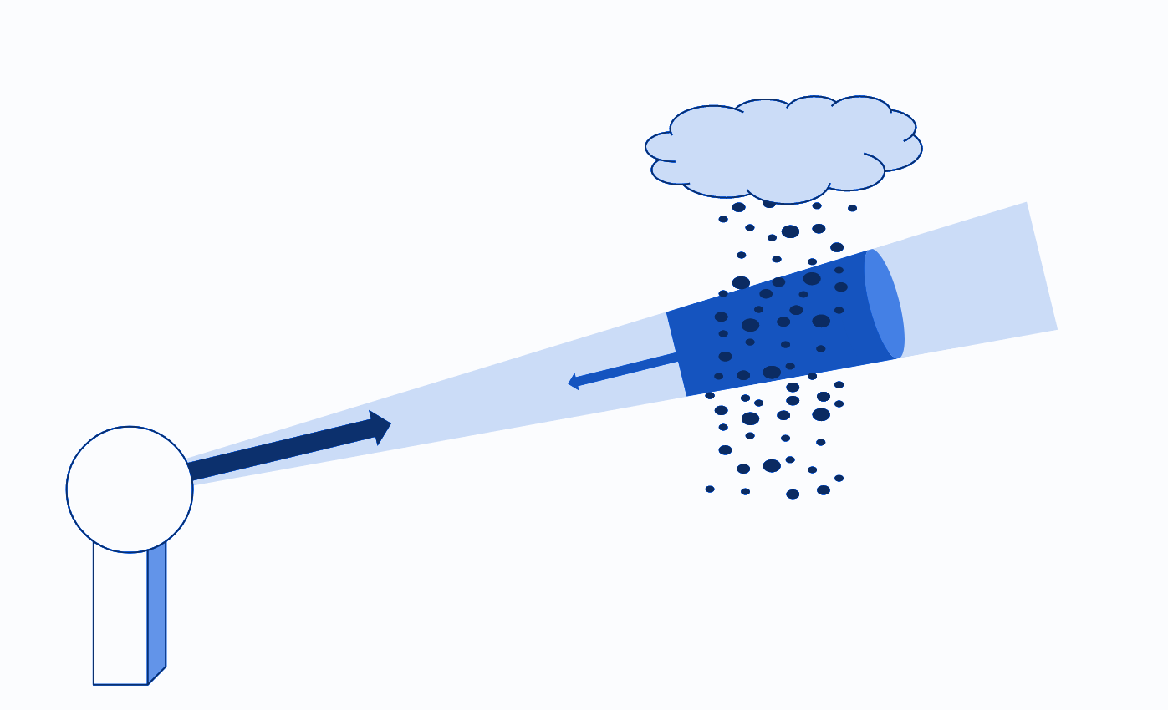
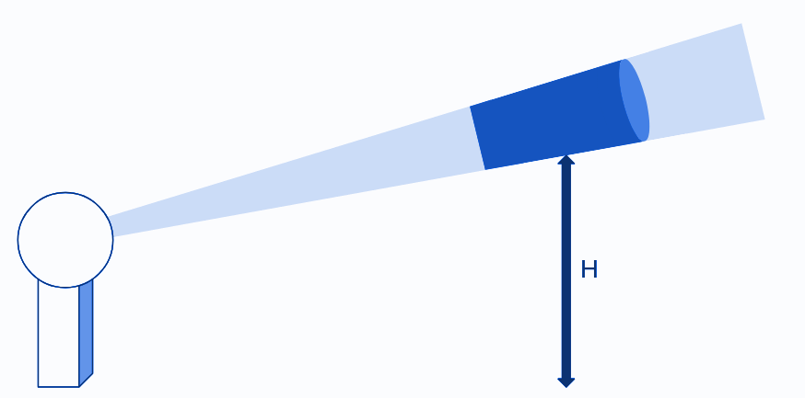
Problem formulation
Input:
Radar QPE (RADOLAN-RY)
5 min res.
Target:
Rain gauge QPE
1 min res.
Prediction via deep learning approach
Radar Measurement height
‹#›

Slide 7
Problem formulation
Input:
Radar QPE (RADOLAN-RY)
5 min res.
Target:
Rain gauge QPE
1 min res.
Radar Measurement height
Objectives:
Short-term prediction of five 1-min time-steps
Reduce biases compared to rain gauges
Spatiotemporal consistency of rainfall maps
‹#›

Slide 8
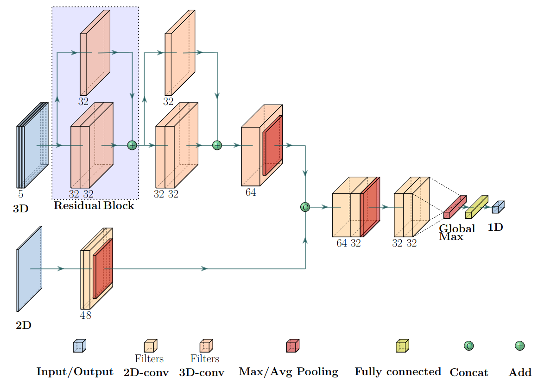
ResRadNet Residual neural network using 3D convolutions
11km x 11km x 5*5min
5*1min
11km x 11km
Polz et al. 2024
TGRS
‹#›

Slide 9
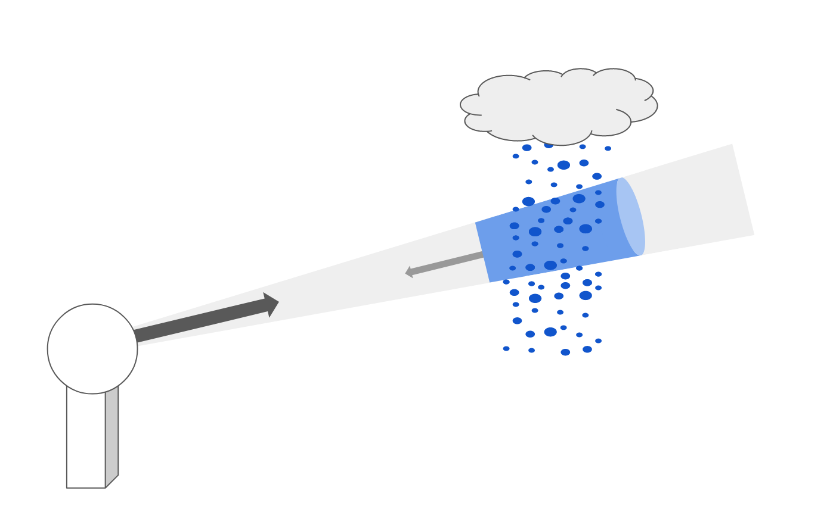
ResRadNet Residual neural network using 3D convolutions
Intuition:
“Model perturbation of input rather than absolute state”
11km x 11km x 5*5min
5*1min
11km x 11km
Polz et al. 2024
TGRS
‹#›

Slide 10
Training data
Pearson correlation coefficient
Normalized root mean squared error
Polz et al. 2024
TGRS
‹#›

Slide 11
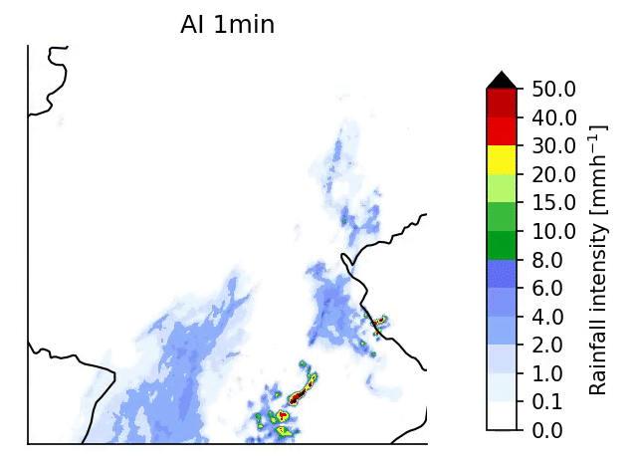
Raw radar
Gauge adjusted radar
ResRadNet
5 min
5 min
1 min
Animation: July 6 2021
‹#›

Slide 12
Raw radar
Gauge adjusted radar
ResRadNet
5 min
5 min
5 min
Animation: July 6 2021
Less Blue and Red!
‹#›

Slide 13
Advection correction
Raw radar
ResRadNet
Maps of rainfall sum between 16:00 and 19:00 on 6 July 2021
‹#›

Slide 14
5 minute resolution
1 minute resolution
Rain gauge [mm]
ResRadNet [mm]
ResRadNet [mm]
Missing extremes due to uncertainty and double penalty effect
→behaves like an ensemble mean prediction
‹#›

Slide 15
Disclaimer:
The following results are much less validated
The presented ideas are valid though ;)

Slide 16
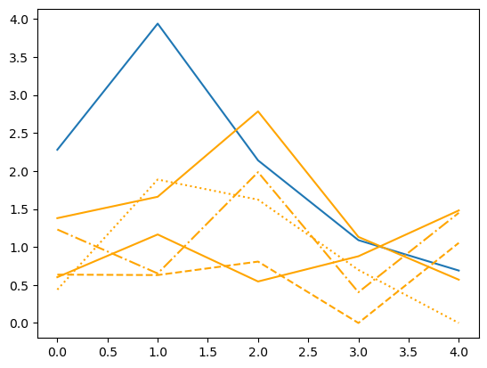
Observation
Prediction Ensemble
Monte Carlo Dropout¹
R [mm]
Timestep [Minutes]
¹Gal & Ghahramani, 2016. Dropout as a bayesian approximation: Representing model uncertainty in deep learning. ICML

Slide 17
Observation
Prediction Ensemble
Monte Carlo Dropout
R [mm]
Timestep [Minutes]
Observation
Continuous Ranked
Probability Score (CRPS)
Prediction CDF

Slide 18
Observation
Train: June 2020
Test: July 2020
Continuous Ranked
Probability Score (CRPS)
Prediction CDF
Ensemble 1
Ensemble 2
Ensemble 3
Ensemble 4
Ensemble 5
Observation [mm/5min]
Count [ ]
Prediction [mm/5min]

Slide 19
Variability? 😊
Extremes? 😕
→ explore alternative randomisation

Slide 20
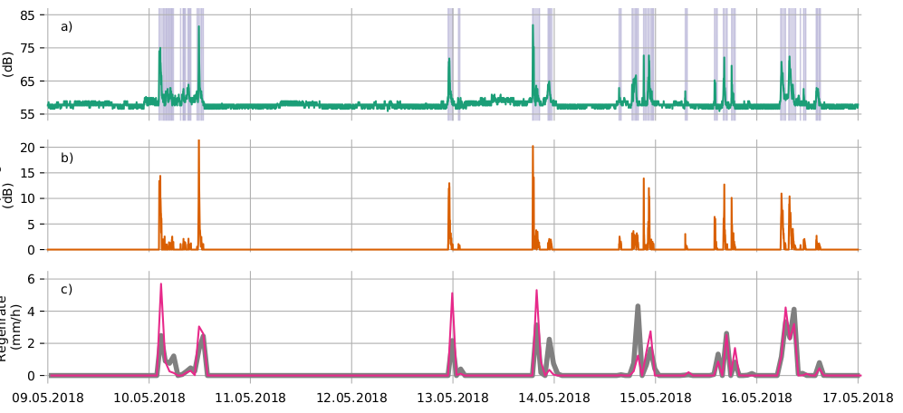
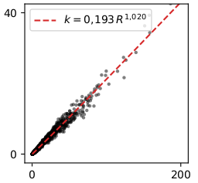
QPE with commercial microwave links
Power law regression
Attenuation
specific attenuation
k [dB/km]
Rainfall
30GHz
rain rate
R [mm/h]
Graf, Polz and Chwala; PiuZ 2021

Slide 21
Commercial microwave links (CML)
3904 CMLs
instantaneous measurement of transmitted and received signal level
1-minute resolution

Slide 22
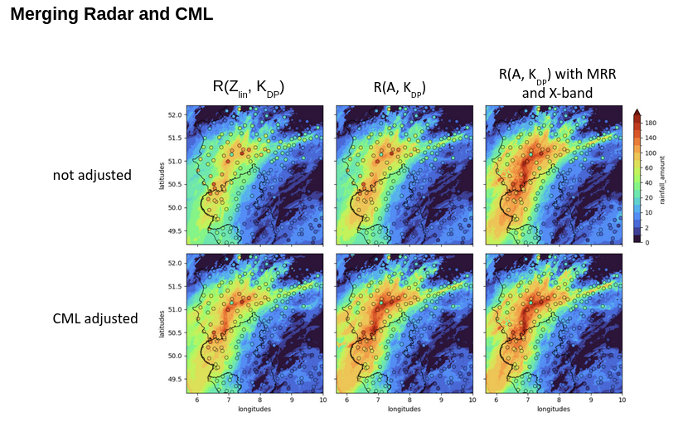

Slide 23
ResRadNet Residual neural network using 3D convolutions
11km x 11km x 5*5min
5*1min
‹#›

Slide 24
up to 25 CMLs
11
11
25 1-minute time steps

Slide 26
Model not trained on winter data

Slide 27
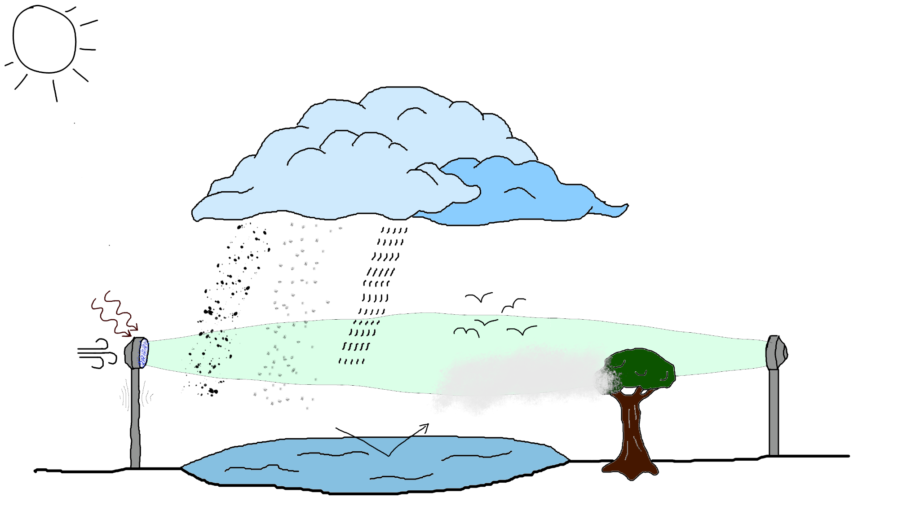
Systematic measurement errors - CML
Hail
Snow
Rain
Radiation
Birds/Insects
Temperature
Beam bending
Wind
Wet antenna
Fog/Water vapor
Reflection
Obstacles
‹#›

Slide 28
Systematic measurement errors - CML
Time to scale training data
Hail
Snow
Rain
Radiation
Birds/Insects
Temperature
Beam bending
Wind
Wet antenna
Fog/Water vapor
Reflection
Obstacles
‹#›

Slide 29
Conclusion:
ResNet approach for radar adjustment works
CRPS loss + dropout
creates reasonable variability
does not solve missing extremes
CMLs provide valuable information, especially at 1-minute resolution

Slide 30
Thank you!

Slide 31
Data splitting
Train
60% of stations, 2020
Test
20% of stations, 2021
Validation
20% of stations, 2013-2021
Daily validation
>1000 independent stations, 2013-2021
Important: spatio-temporally independent validation!
?
!
!!
Polz et al. 2024
TGRS
‹#›

Slide 32
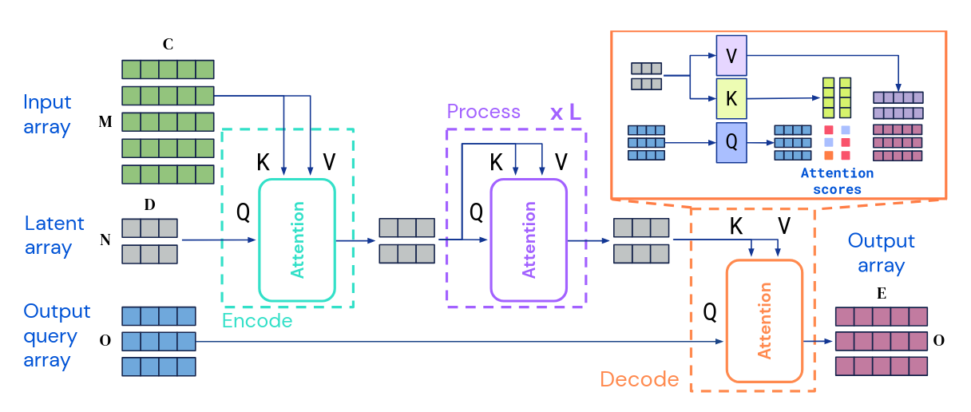
Apart from the obvious scaling and calibration than needs to be done,
we require a more flexible approach to digest the CML data
Jaegle, A., Borgeaud, S., Alayrac, J. B., Doersch, C., Ionescu, C., Ding, D., ... & Carreira, J. (2021). Perceiver io: A general architecture for structured inputs & outputs. arXiv preprint arXiv:2107.14795.

Slide 33
Sampling error
Advection corrected
(pySTEPS)
Advection corrected
gauge adjusted
Raw radar
Maps of rainfall sum between 16:00 and 19:00 on 6 July 2021
Polz et al. 2024
TGRS
‹#›

Slide 34
Sampling error
Advection corrected
(pySTEPS)
Advection corrected
gauge adjusted
Raw radar
Maps of rainfall sum between 16:00 and 19:00 on 6 July 2021
ResRadNet
Polz et al. 2024
TGRS
‹#›

Slide 35
Sampling error
Advection corrected
(pySTEPS)
Advection corrected
gauge adjusted
Raw radar
Maps of rainfall sum between 16:00 and 19:00 on 6 July 2021
ResRadNet
Polz et al. 2024
TGRS
‹#›

Slide 36
Sampling error
Advection corrected
(pySTEPS)
Advection corrected
gauge adjusted
Raw radar
Maps of rainfall sum between 16:00 and 19:00 on 6 July 2021
ResRadNet
Polz et al. 2024
TGRS
‹#›

