Slide 1
Achievements of the
COST Action on
Opportunistic Precipitation Sensing (OpenSense)
2025-03-17
PrePEP conference – University of Bonn

Slide 2
Achievements of the
COST Action on
Opportunistic Precipitation Sensing (OpenSense)
Christian Chwala (KIT), Vojtěch Bareš (Czech Technical University in Prague), Hagit Messer (Tel Aviv University), Roberto Nebuloni (Consiglio Nazionale delle Ricerche (CNR)), Martin Fencl (Czech Technical University in Prague), Aart Overeem (Royal Netherlands Meteorological Institute), Maximilian Graf (Deutscher Wetterdienst), Remco van de Beek (SMHI, Sweden), Jonas Olsson (SMHI, Sweden), Laura Varga (Budapest University of Technology and Economics), Cristina Deida (Vrije Universiteit Brussel), Jonatan Ostrometzky (Tel Aviv University), Luis Angel Espinosa (Association of Instituto Superior Técnico for Research and Development, Lisbon), Natalia Hanna (TU Wien), Remko Uijlenhoet (Delft University of Technology)
2025-03-17
PrePEP conference – University of Bonn

Slide 3
What is OpenSense?
What are the main achievements of OpenSense?
What can we expect in addition, also beyond the duration of OpenSense?

Slide 4
What is OpenSense?
What are the main achievements of OpenSense?
What can we expect in addition, also beyond the duration of OpenSense?

Slide 5
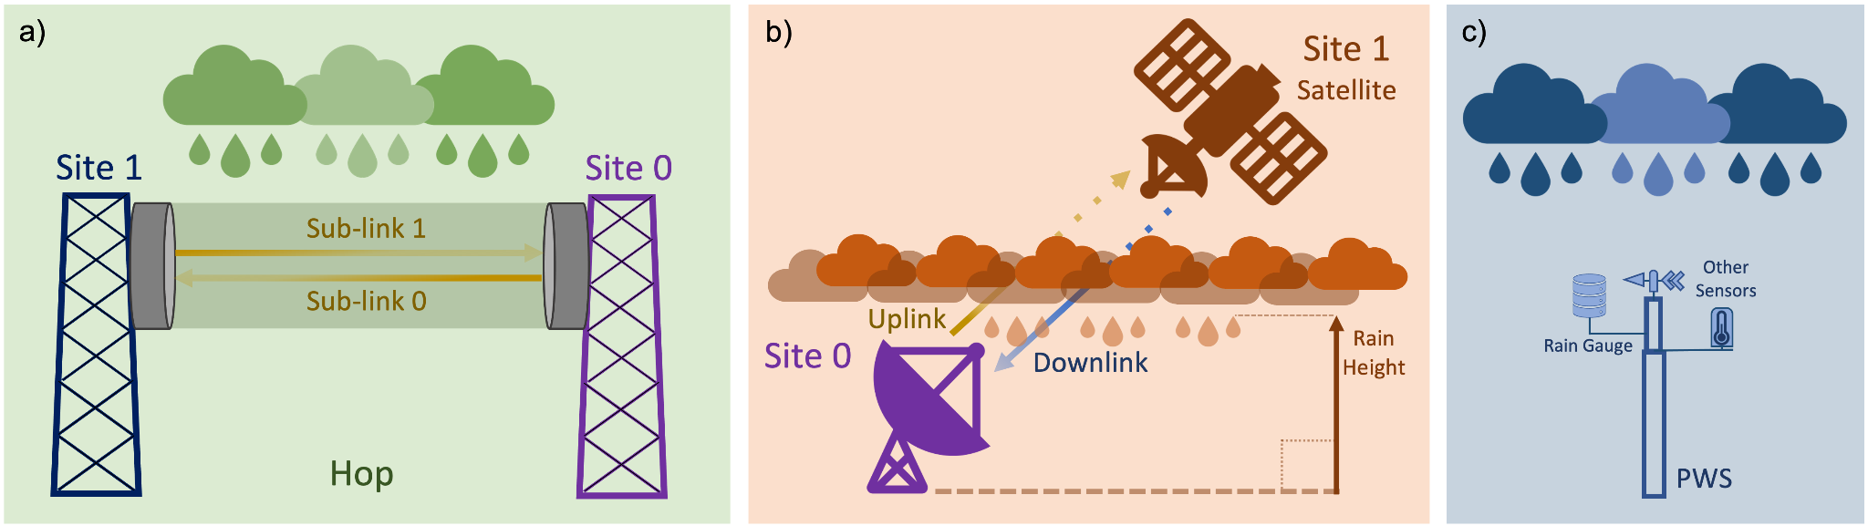
What is „Opportunistic Precipitation Sensing“?
To opportunistically (in a positive sense) use data from devices that were not meant to measure rainfall or which where not meant to provide high-quality rainfall data.
CML
Commercial microwave link
SML
Satellite microwave link
PWS
Personal
weather station

Slide 6
What are the goals of OpenSense?
Improve access to OS observations
Improve reliability of OS observations
Use OS in operational setting

Slide 7
What are the goals of OpenSense?
Connect stakeholders
Hydrology & meteorology
Improve access to OS observations
Radio-wave propagation
Connect experts
Data owners
Researchers
End users
Improve reliability of OS observations
Signal processing
Use OS in operational setting
Telecommunication

Slide 8
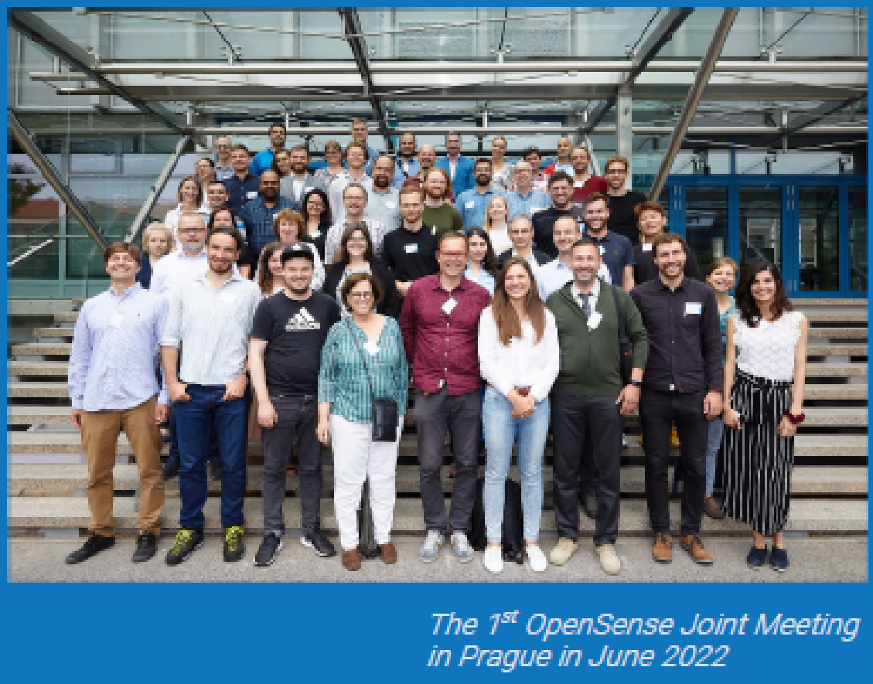
Who we are
140 members from 33 countries
Researchers from academia
EUMETNET + 8 European Met Services
Telecommunication companies + GSMA
Consultancy companies

Slide 9
The OpenSense working groups
WG 1
data
WG 4
involves stakeholders
WG 2
methods
WG 3
application
WG 5
capacity building

Slide 10
The OpenSense working groups
WG 1
data
WG 4
involves stakeholders
WG 2
methods
WG 3
application
WG 5
capacity building

Slide 11
What is OpenSense?
What are the main achievements of OpenSense?
What can we expect in addition, also beyond the duration of OpenSense?

Slide 12
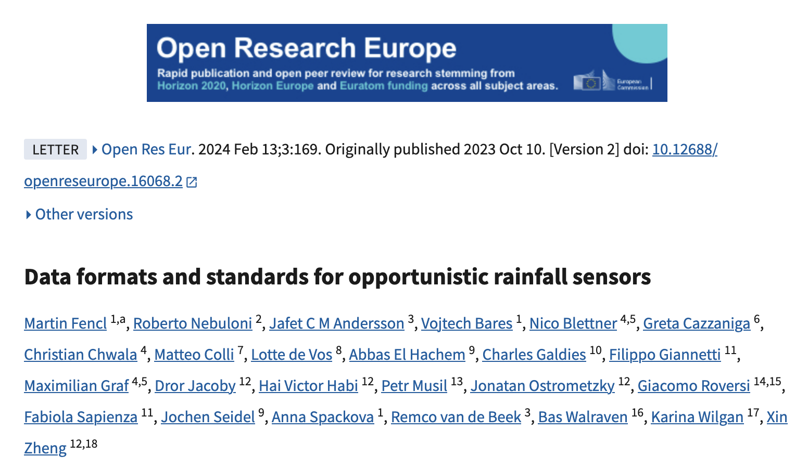
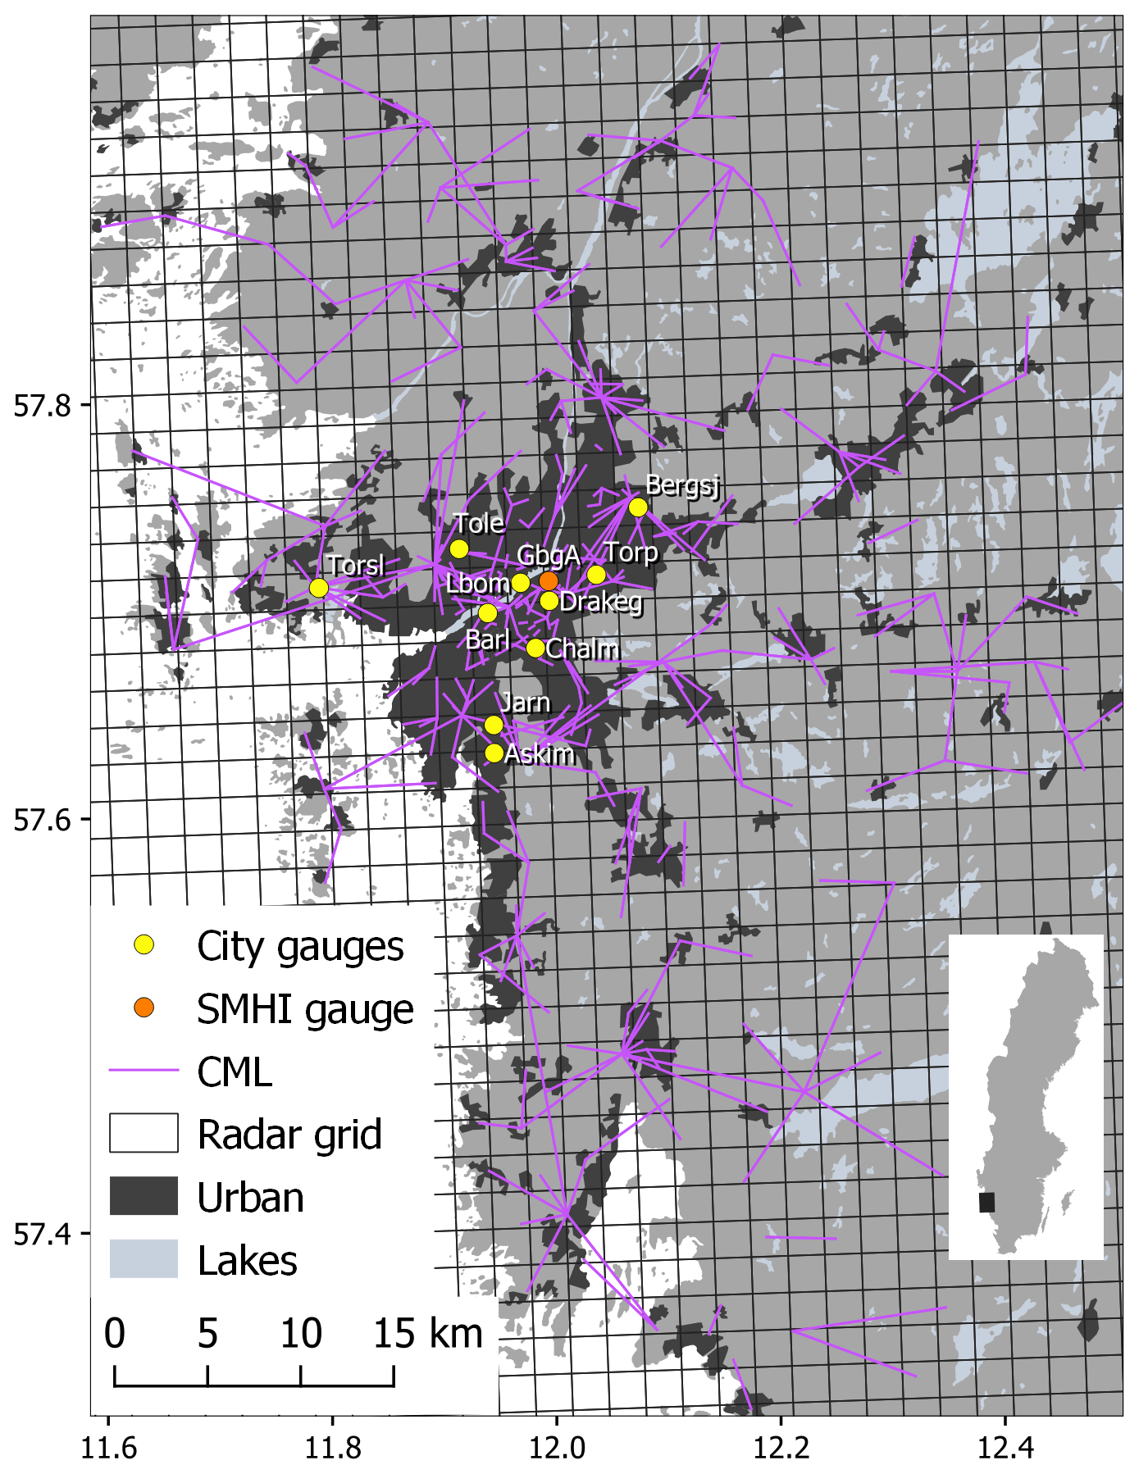
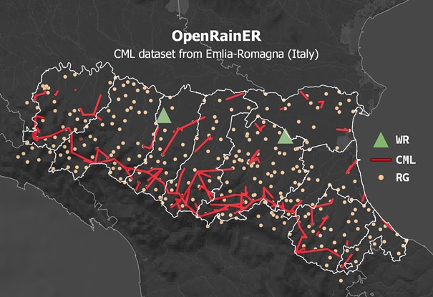
Working group “Data”
Defined a standard for data storage and naming conventions
Supported the publication of two open datasets with CML, gauge and radar data
  OpenMRG (city of Gothenburg, Sweden) Andersson et al. (2022) https://doi.org/10.5194/essd-14-5411-2022
  OpenRainER (Emilia-Romagna, Italy)
  Covi and Roversi (2024) https://doi.org/10.5281/zenodo.10593848

Slide 13
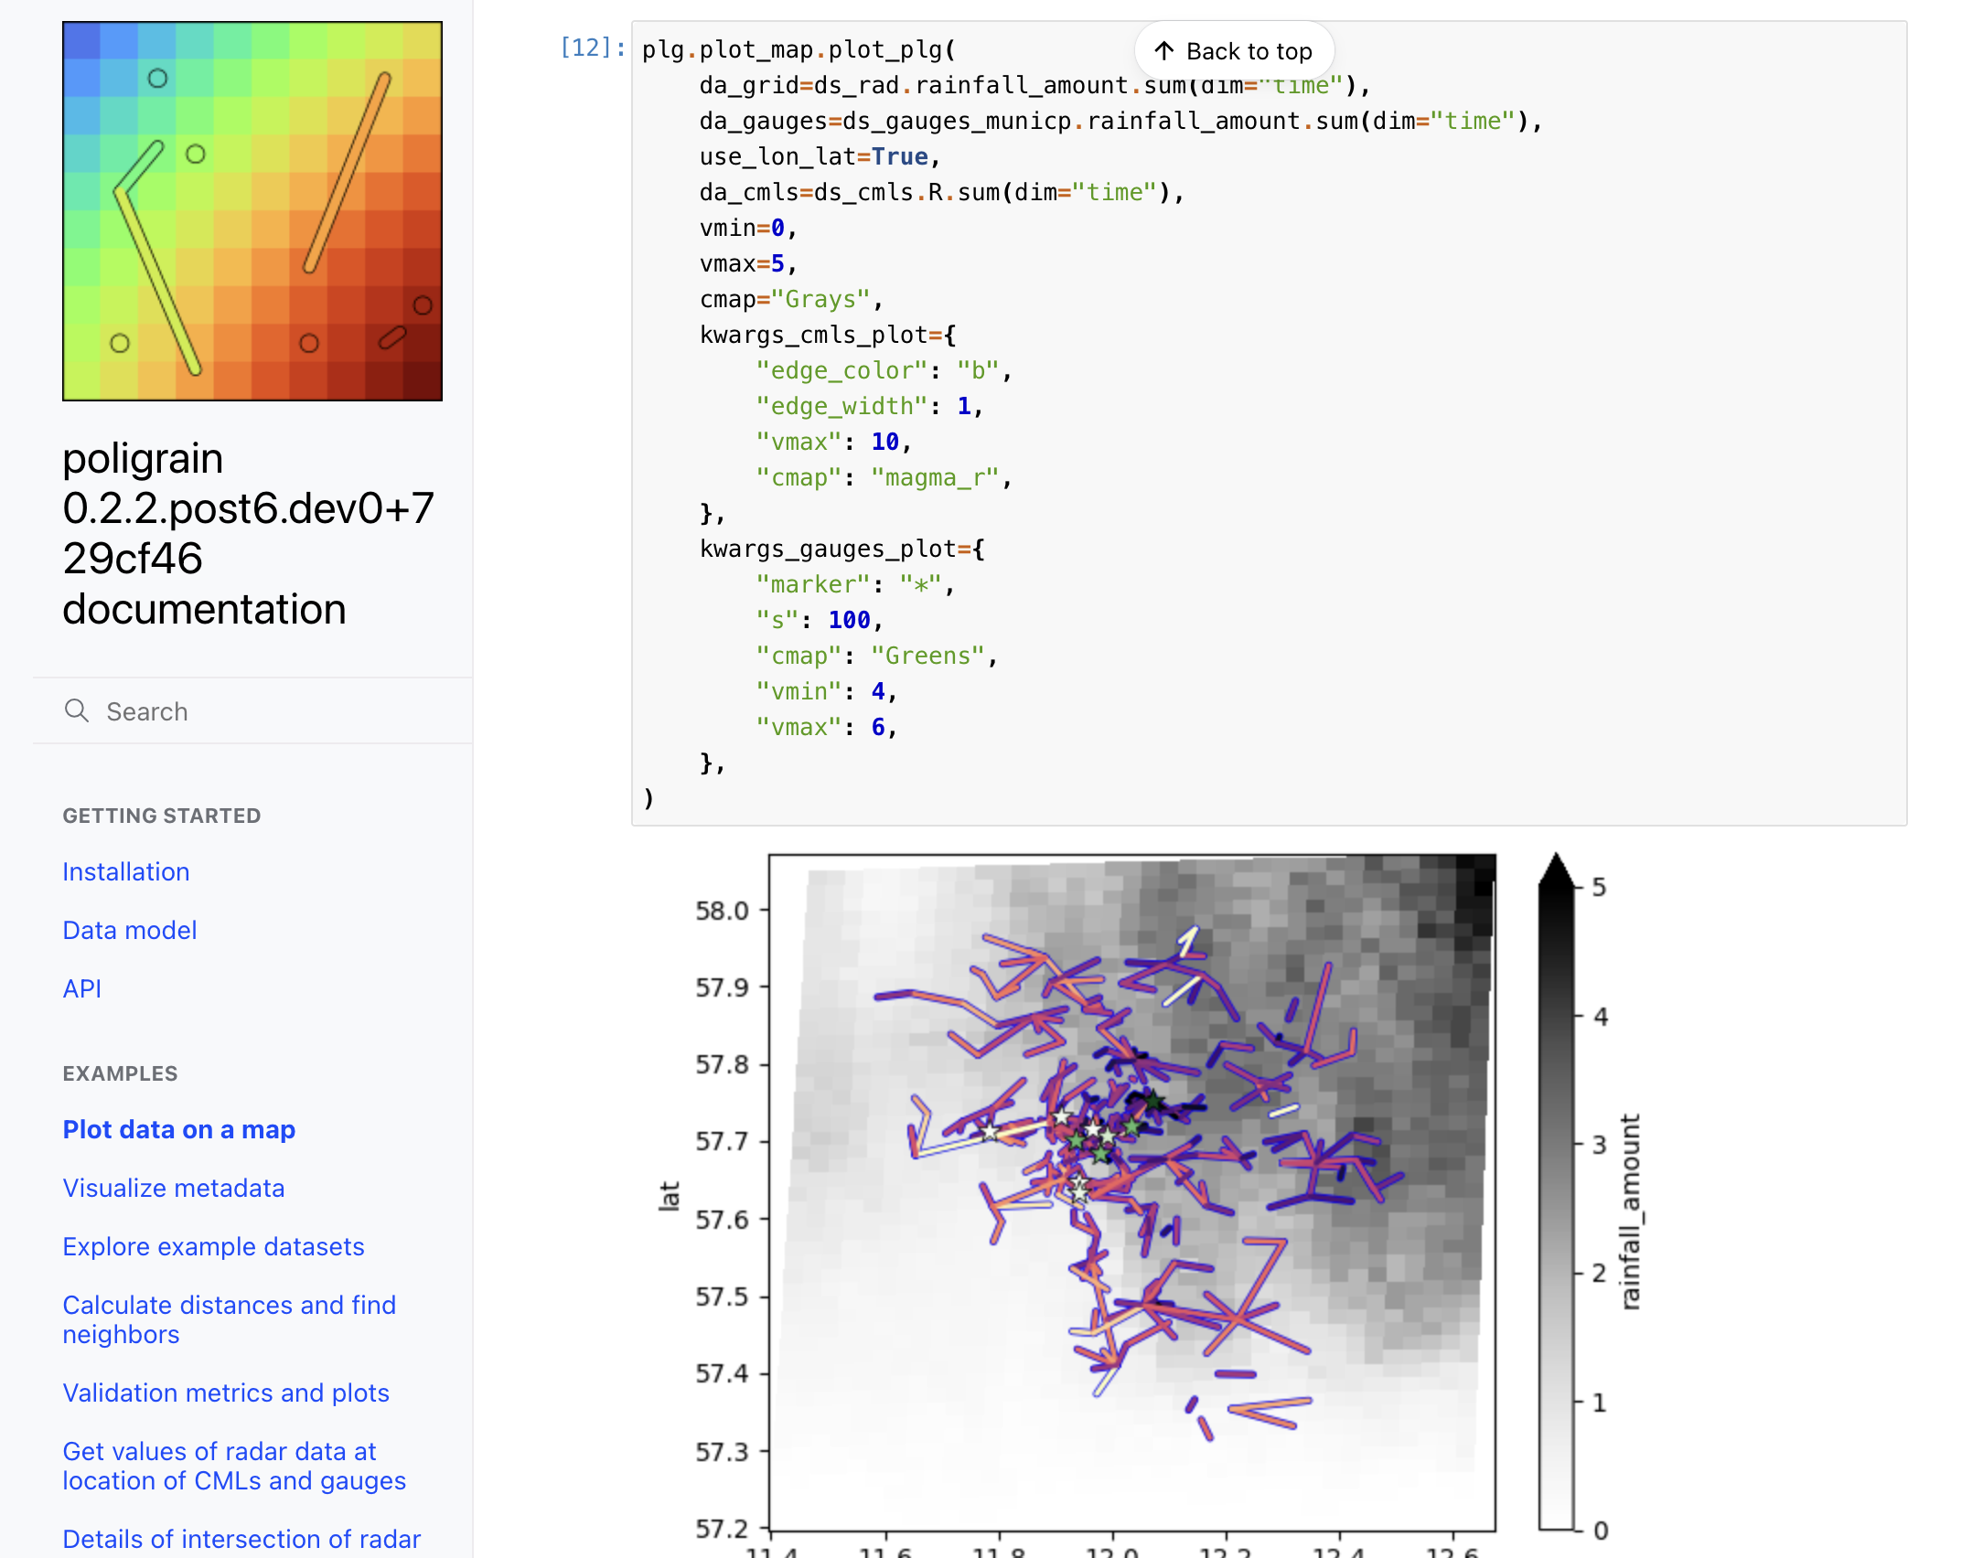
Working group “Software & Methods”
Review of existing implementations
Joint development of:
  poligrain
    Simplify common tasks for working with point, line and gridded rainfall sensor data
    https://github.com/OpenSenseAction/poligrain
  pycomlink
    Processing methods for CML rainfall estimation
    https://github.com/pycomlink/pycomlink
  pypwsqc
    Quality control methods for PWS data
    https://github.com/OpenSenseAction/pypwsqc

Slide 14
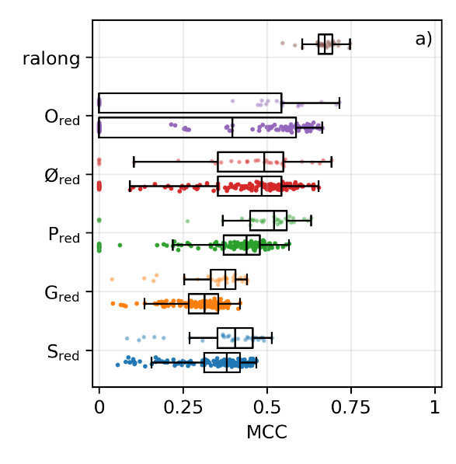
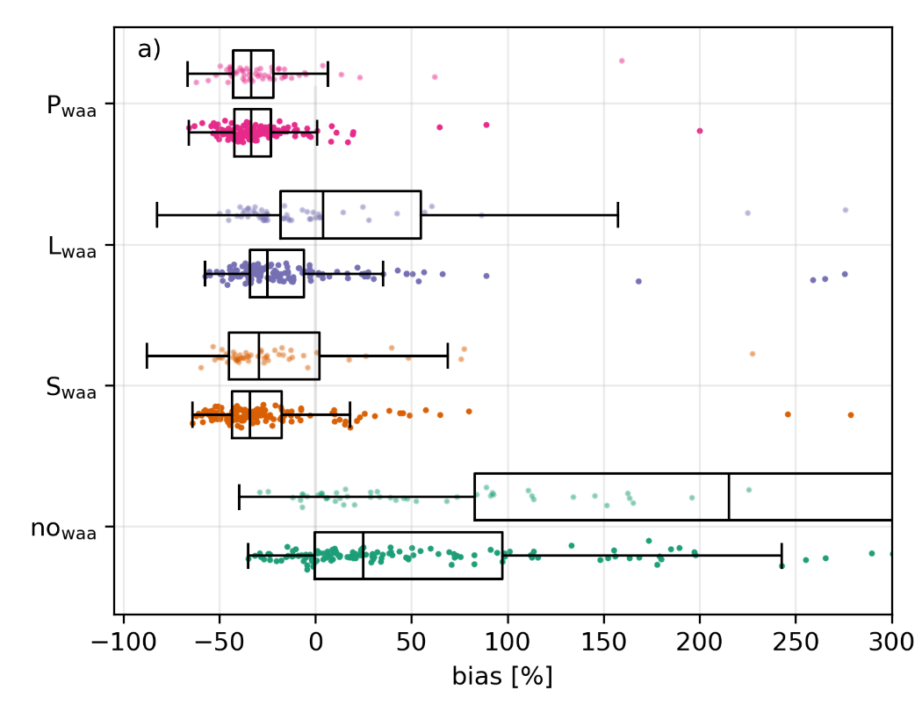
Working group “Software & Methods”
Intercomparison of CML processing methods
  Comparison of rain event detection and wet antenna estimation methods
  Using OpenMRG and OpenRainER dataset
  Graf et al. (in preparation)
Performance of different rain event detection methods
Bias depending on wet antenna correction methods

Slide 15
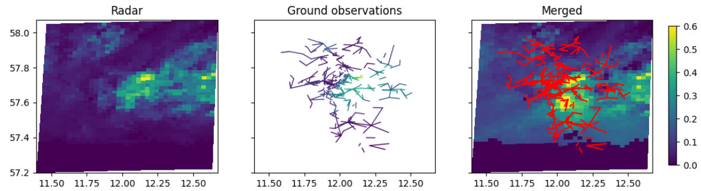
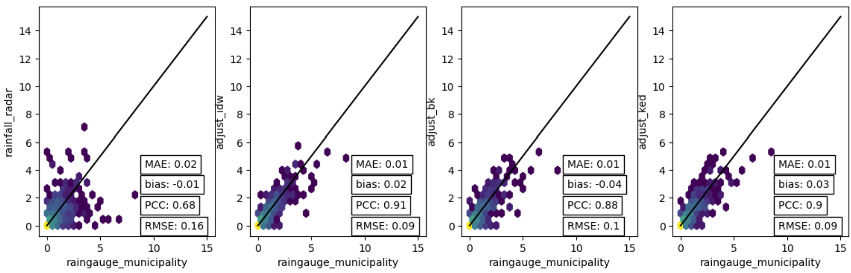
Working group “Merging and application”
Method intercomparison for radar-CML merging
  Using two large open datasets
  Fully reproducible
  Comparing different methods:
    Additive-IDW
    Multiplicative-IDW
    Block Kriging
    KED
Unadjusted radar
Additive IDW
Block Kriging
KED

Slide 16
What is OpenSense?
What are the main achievements of OpenSense?
What can we expect in addition, also beyond the duration of OpenSense?

Slide 17
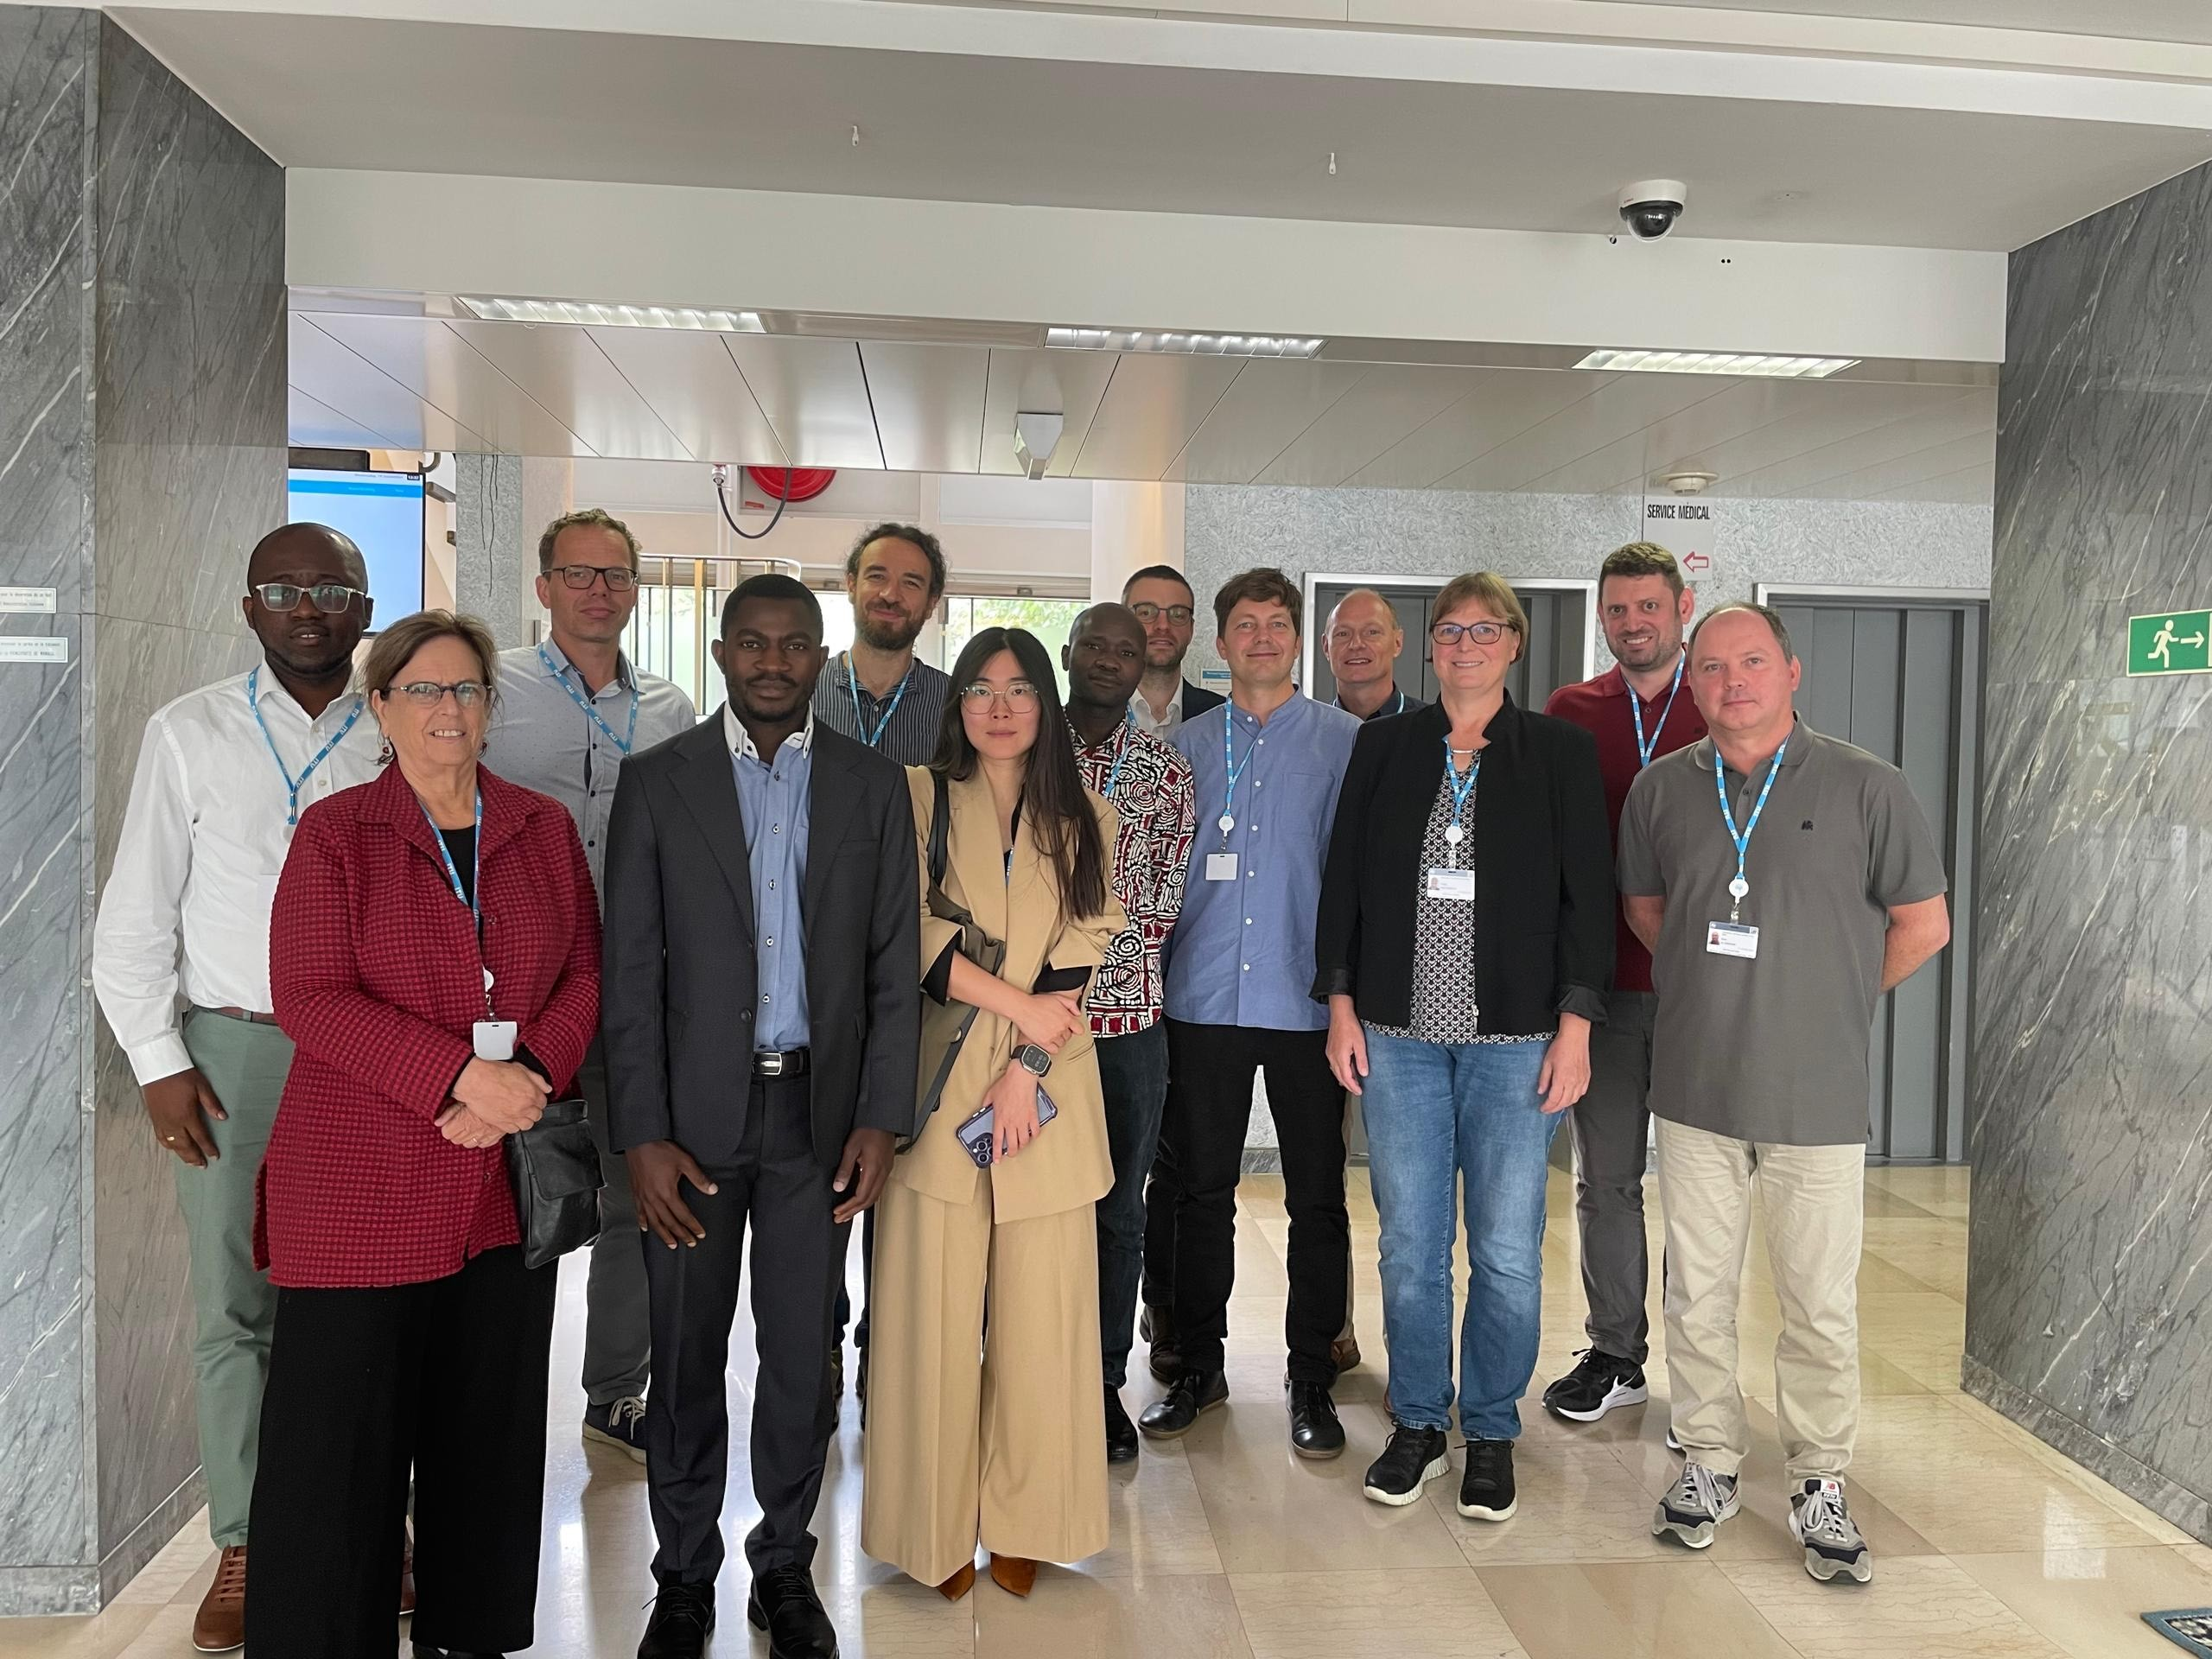



Outlook
Refine software packages
  Integrate more station QC methods
  Integrate SML processing methods
  Grow the community of contributors
Finalize intercomparison studies for merging and PWS QC
Solve CML data accessibility issue via the
“Global Microwave Link Data Collection Initiative” (GMDI)

Slide 18
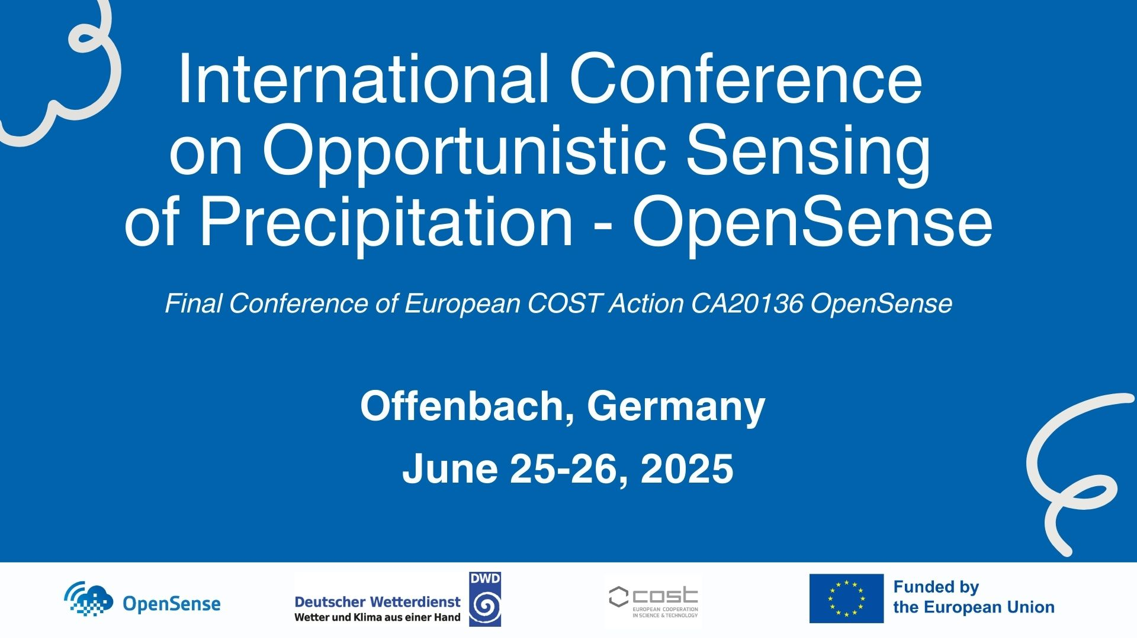

Save-the-Date
https://indico.scc.kit.edu/e/opensense_conference_2025

Slide 19
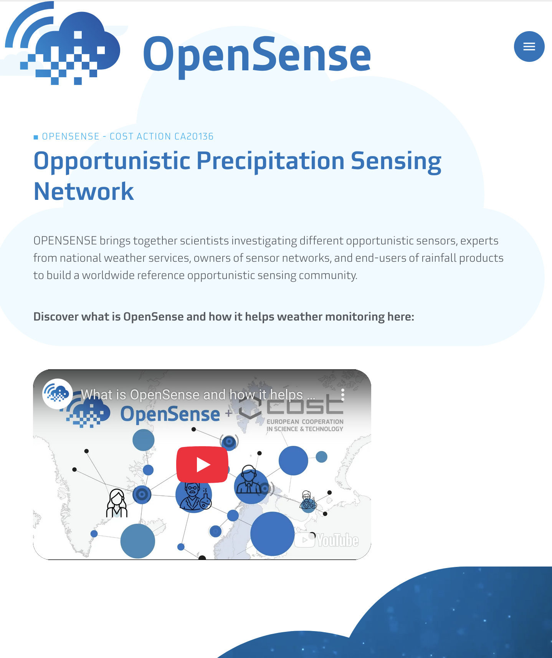

https://opensenseaction.eu/

