Slide 1


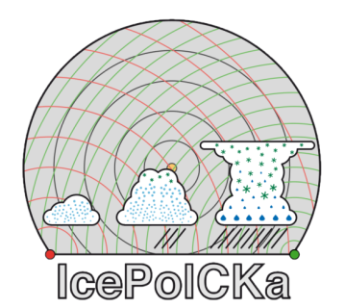

A statistical evaluation of convective cloud microphysics in a numerical weather prediction model with polarimetric radar observations
Gregor Köcher¹, Tobias Zinner¹, Florian Ewald², Christian Heske²
1: Meteorologisches Institut, Ludwig-Maximilians-Universität, Munich, Germany (LMU)
2: Deutsches Zentrum für Luft- und Raumfahrt, Oberpfaffenhofen, Germany (DLR)
Email: gregor.koecher@physik.uni-muenchen.de

Slide 2
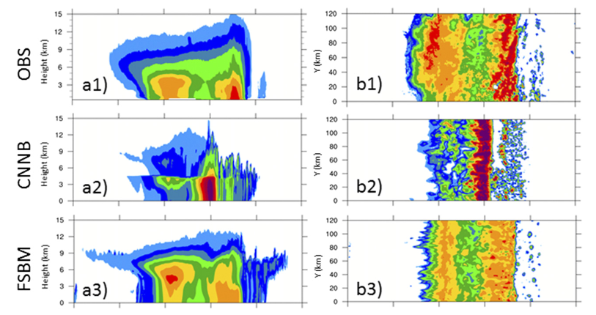
Introduction
Problem: NWP struggles to correctly simulate spatial distribution and intensity of convective and stratiform parts in convective systems
Vertical cross-section
Horizontal cross-section
Microphysics
Convection
Can vary strongly from case to case
Hard to observe on high level of detail
Determines transport from convective updraft into stratiform precipitation parts
Influences structure and development of convection
Controls sedimentation speed through ice density
Requires statistics over large data set
Xue et al. (2017), AMS

Slide 3
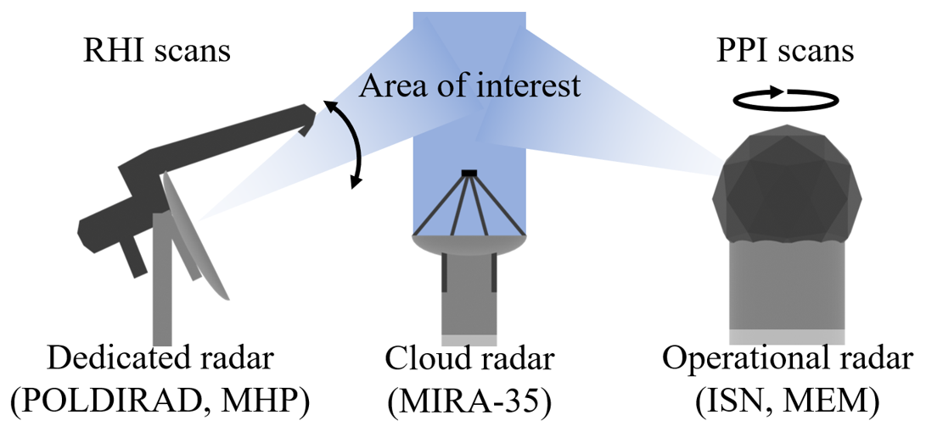
Introduction
Approach: Statistical comparison of simulated and observed polarimetric radar signals to evaluate microphysics during spatio-temporal development of thunderstorms
Substantial variability in thunderstorm
development
Statistical approach over large data set
Microphysics hard to observe on high level of detail
Polarimetric / Multifrequency radar:
Sensitive to particle shape, size, phase…
Combining radar network data with vertical pointing cloud radar (Christian Heske, DLR)
Comparison in observation space

Slide 4
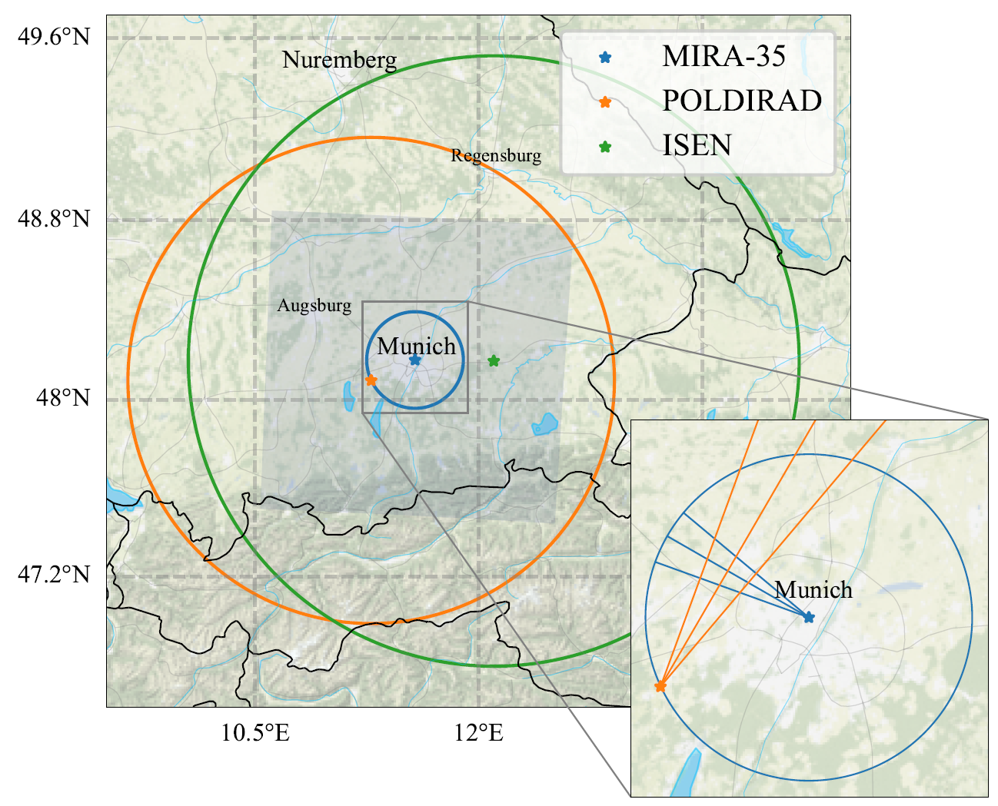
Radar quantities
Dual-wavelength ratio (DWR)
Strongly sensitive to particle size
Reflectivity (Z)
Differential reflectivity (ZDR)
Strongly sensitive to particle shape
Sensitive to particle number, size, phase, and density
Z_{DR}$=10⋅log⁡(\frac{Z_{H}}{Z_{V}})$
Z_{DR} =10⋅log⁡(𝑍_𝐻/𝑍_𝑉 )
DWR = dBZ_{C} – dBZ_{Ka}
Other quantities
Specific differential phase (KDP)
Linear Depolarization Ratio (LDR)
Copolar correlation coefficient (RHOhv)
Doppler Velocity (Vel)
Köcher et al. (2022), AMT

Slide 5
Radar quantities
Dual-wavelength ratio (DWR)
Strongly sensitive to particle size
Reflectivity (Z)
Differential reflectivity (ZDR)
Strongly sensitive to particle shape
Sensitive to particle number, size, phase, and density
Z_{DR}$=10⋅log⁡(\frac{Z_{H}}{Z_{V}})$
Z_{DR} =10⋅log⁡(𝑍_𝐻/𝑍_𝑉 )
DWR = dBZ_{C} – dBZ_{Ka}
Other quantities
Specific differential phase (KDP)
Linear Depolarization Ratio (LDR)
Copolar correlation coefficient (RHOhv)
Doppler Velocity (Vel)
Köcher et al. (2022), AMT
30 convection days
> 1000 convective cells

Slide 6
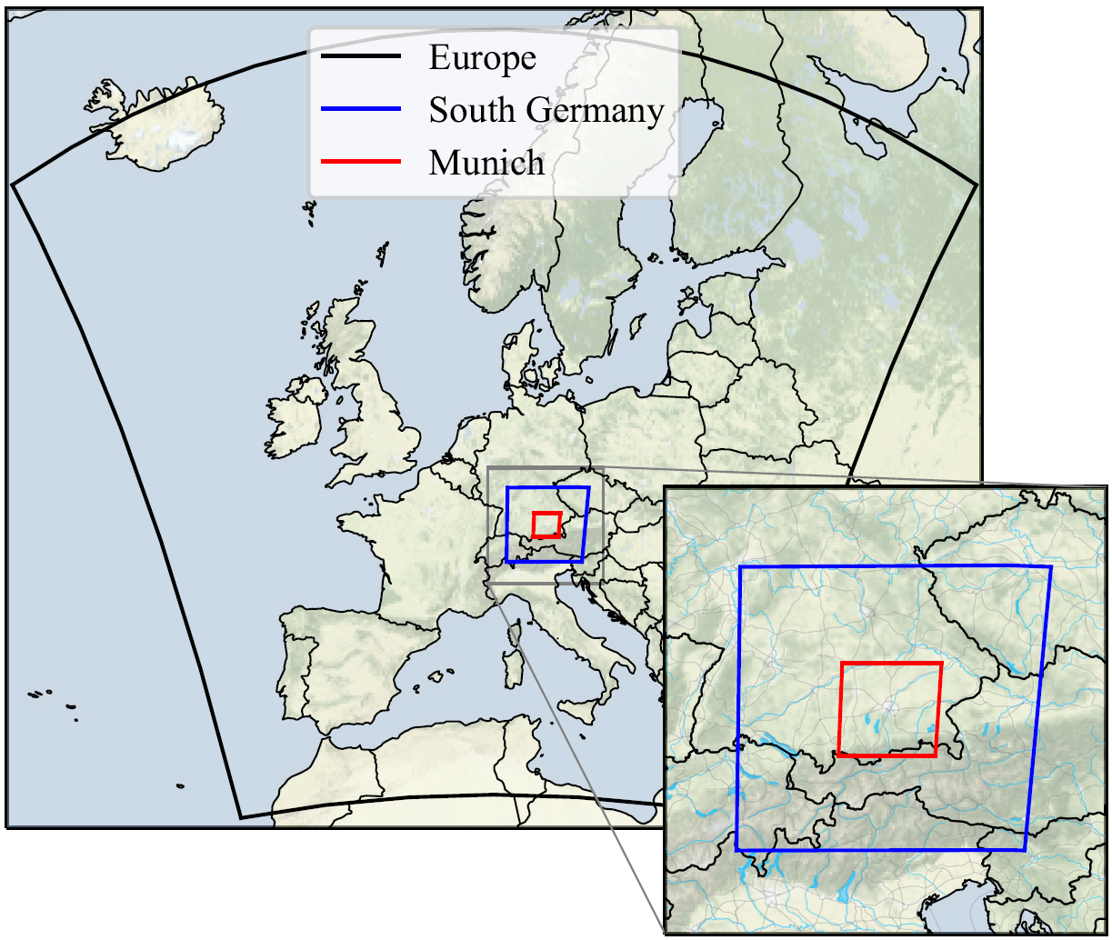
Model Setup
The model
WRF: Weather Research and Forecasting Model (Skamarock et al., 2019)
Regional numerical weather prediction model (NWP)
Köcher, Gregor (2023). Dissertation, LMU Munich
Munich Domain with a grid spacing of 400 m

Slide 7
Model Setup
The model
The microphysics
WRF: Weather Research and Forecasting Model (Skamarock et al., 2019)
Regional numerical weather prediction model (NWP)
Bulk (Thompson 2-mom, Morrison 2-mom, Thompson 2-mom aerosol aware)
Spectral Bin (Shpund 2019)
P3 (Morrison and Milbrand 2015)
Köcher, Gregor (2023). Dissertation, LMU Munich
Munich Domain with a grid spacing of 400 m

Slide 8
Model Setup
The model
The microphysics
WRF: Weather Research and Forecasting Model (Skamarock et al., 2019)
Regional numerical weather prediction model (NWP)
Bulk (Thompson 2-mom, Morrison 2-mom, Thompson 2-mom aerosol aware)
Spectral Bin (Shpund 2019)
P3 (Morrison and Milbrand 2015)
Comparison to observations
With polarimetric radar forward operator
CR-SIM: Cloud Resolving Model Radar Simulator (Oue et al., 2020)
Köcher, Gregor (2023). Dissertation, LMU Munich
Munich Domain with a grid spacing of 400 m

Slide 9
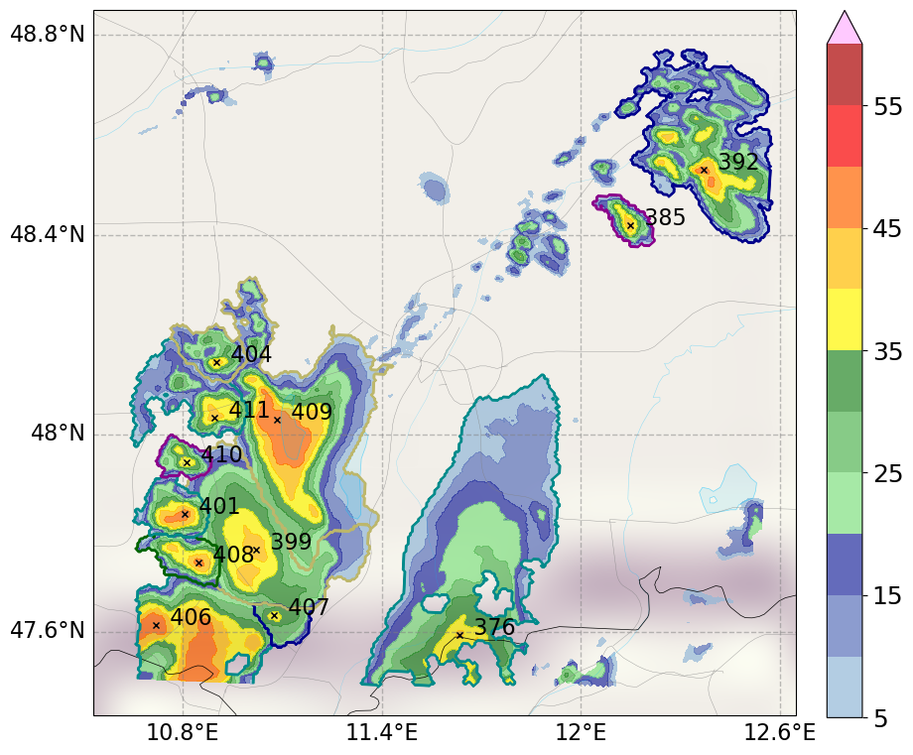
Automatic Cell Tracking
Problem: Tracking of convective cells with their associated stratiform precipitation
Solution: Tobac (Tracking and Object-Based Analysis of Clouds, Heikenfeld et al., 2019)
Z (dBZ)
Tobac
Feature identification based on reflectivity
Assigns stratiform precipitation based on watershedding technique
Links features to tracks with trackpy

Slide 10
Automatic Cell Tracking
Problem: Tracking of convective cells with their associated stratiform precipitation
Solution: Tobac (Tracking and Object-Based Analysis of Clouds, Heikenfeld et al., 2019)
Z (dBZ)
Tobac
Feature identification based on reflectivity
Assigns stratiform precipitation based on watershedding technique
Links features to tracks with trackpy
Works for simulation and observation alike

Slide 11
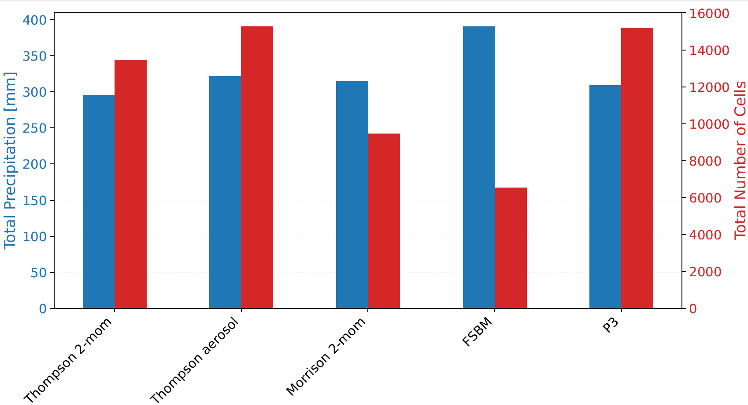
Spatial distribution: microphysics
Dataset
In blue: Total surface precipitation
In red: Total number of identified convective cells
What do you see
30 days of convection
5 microphysics schemes

Slide 12
Spatial distribution: microphysics
Dataset
In blue: Total surface precipitation
In red: Total number of identified convective cells
What do you see
30 days of convection
5 microphysics schemes
Total surface precipitation:
Similar

Slide 13
Spatial distribution: microphysics
Dataset
In blue: Total surface precipitation
In red: Total number of identified convective cells
What do you see
30 days of convection
5 microphysics schemes
Total surface precipitation:
Similar
Number of convective cells: Different

Slide 14
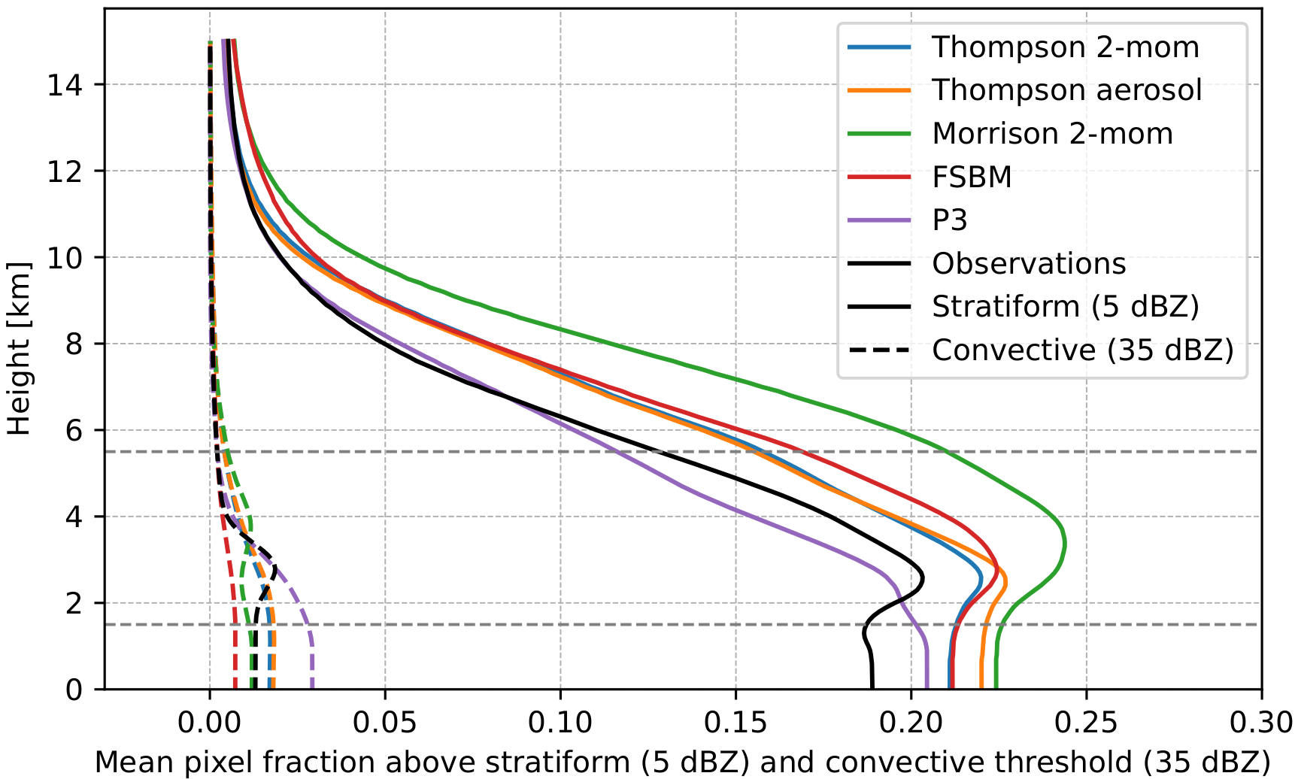
Spatial distribution: Vertical
What do you see?
Fraction of pixels above 5 and 35 dBZ with height
Proxy for precipitation coverage
Radar observations in black, simulations in color

Slide 15
Spatial distribution: Vertical
What do you see?
Morrison: Too high stratiform (5 dBZ) coverage
P3: Close to observations at upper heights
Microphysics
Fraction of pixels above 5 and 35 dBZ with height
Proxy for precipitation coverage
P3: Unrealistic strong increase of convective coverage below 3 km
Radar observations in black, simulations in color

Slide 16
Spatial distribution: Vertical
What do you see?
Morrison: Too high stratiform (5 dBZ) coverage
P3: Close to observations at upper heights
Microphysics
Fraction of pixels above 5 and 35 dBZ with height
Proxy for precipitation coverage
P3: Unrealistic strong increase of convective coverage below 3 km
Radar observations in black, simulations in color
Low Morrison precipitation intensity

Slide 17
Spatial distribution: Vertical
What do you see?
Morrison: Too high stratiform (5 dBZ) coverage
P3: Close to observations at upper heights
Microphysics
Fraction of pixels above 5 and 35 dBZ with height
Proxy for precipitation coverage
P3: Unrealistic strong increase of convective coverage below 3 km
Radar observations in black, simulations in color
Low Morrison precipitation intensity
What is happening for P3?

Slide 18
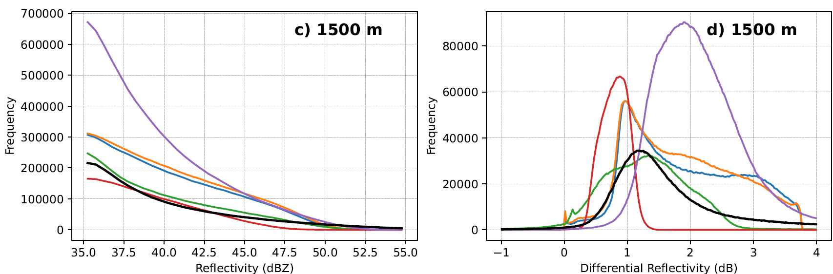
Radar signals: Convective Core
Histograms of simulated and observed (differential) reflectivity

Slide 19
Radar signals: Convective Core
Histograms of simulated and observed (differential) reflectivity
  Too high ZDR in P3
  Too high Z in P3

Slide 20
Radar signals: Convective Core
Histograms of simulated and observed (differential) reflectivity
  Too high ZDR in P3
  Too high Z in P3
P3 rain drops too large!

Slide 21
Radar signals: Convective Core
Histograms of simulated and observed (differential) reflectivity
  Too high (low) ZDR in P3 (FSBM)
  Too high (low) Z in P3 (FSBM)
P3 rain drops too large!
FSBM rain drops too small!

Slide 22



Summary
Polarimetric radar observations
Sensitive to particle properties (shape, size, density, …)
Useful tool for evaluation of model microphysics
Spatial distribution of precipitation
Too much convective coverage in P3 below 3 km
Particle size distributions
In convective core: P3 produces too large rain drops
Morrison: Too much stratiform coverage at all heights
In stratiform region: Morrison and FSBM too small rain drops
On objective based convective cell basis
Using an automated cell-tracking algorithm (Tobac)
Statistical evaluation
Köcher, G., Zinner, T., Knote, C., Tetoni, E., Ewald, F., and Hagen, M. (2022): Evaluation of convective cloud microphysics in numerical weather prediction models with dual-wavelength polarimetric radar observations: methods and examples, Atmos. Meas. Tech., 15, 1033–1054, https://doi.org/10.5194/amt-15-1033-2022
Köcher, G., Zinner, T., and Knote, C. (2023): Influence of cloud microphysics schemes on weather model predictions of heavy precipitation, Atmos. Chem. Phys., 23, 6255–6269, https://doi.org/10.5194/acp-23-6255-2023
Köcher, Gregor (2023): Convective cloud microphysical parameterizations in a numerical weather prediction model: an evaluation with polarimetric radar observations. Dissertation, LMU München: Faculty of Physics, https://doi.org/10.5282/edoc.32170
Email: gregor.koecher@physik.uni-muenchen.de

Slide 23
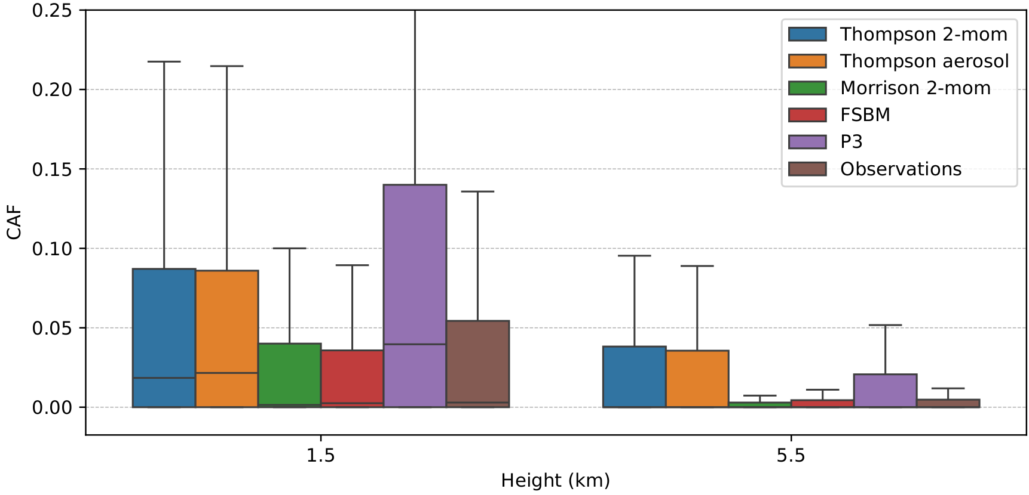
Spatial distribution: Horizontal
CAF (Convective Area Fraction)
What do you see?
Boxplots of CAF at 1.5 and 5.5 km height
Observations in brown, simulations in color

Slide 24
Spatial distribution: Horizontal
CAF (Convective Area Fraction)
What do you see?
Microphysics
Boxplots of CAF at 1.5 and 5.5 km height
Two groups: Smaller and larger median CAFs
Smaller CAFs: Morrison 2-mom, FSBM, radar observations
Larger CAFs: Thompson 2-mom, Thompson aerosol, P3
Observations in brown, simulations in color

Slide 25
Spatial distribution: Horizontal
CAF (Convective Area Fraction)
What do you see?
Microphysics
Boxplots of CAF at 1.5 and 5.5 km height
Two groups: Smaller and larger median CAFs
Smaller CAFs: Morrison 2-mom, FSBM, radar observations
Larger CAFs: Thompson 2-mom, Thompson aerosol, P3
Observations in brown, simulations in color
P3 much too high CAF at 1.5 km!

Slide 26
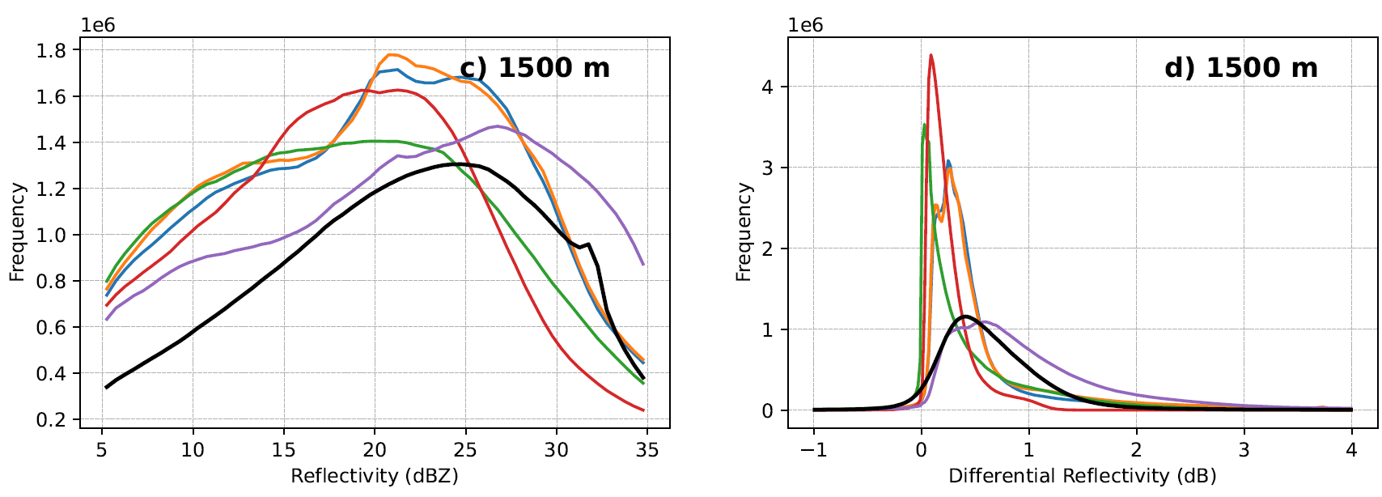
Radar signals: Stratiform
Histograms of simulated and observed (differential) reflectivity
  P3 ZDR fits much better compared to convective cores
  All other schemes too low ZDR
  FSBM and Morrison low Z bias

Slide 27
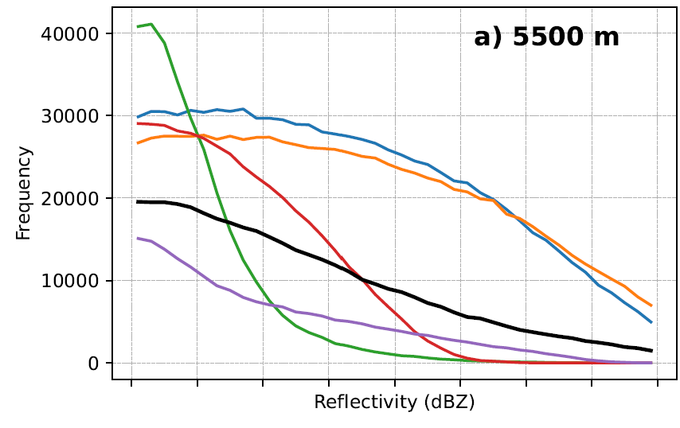
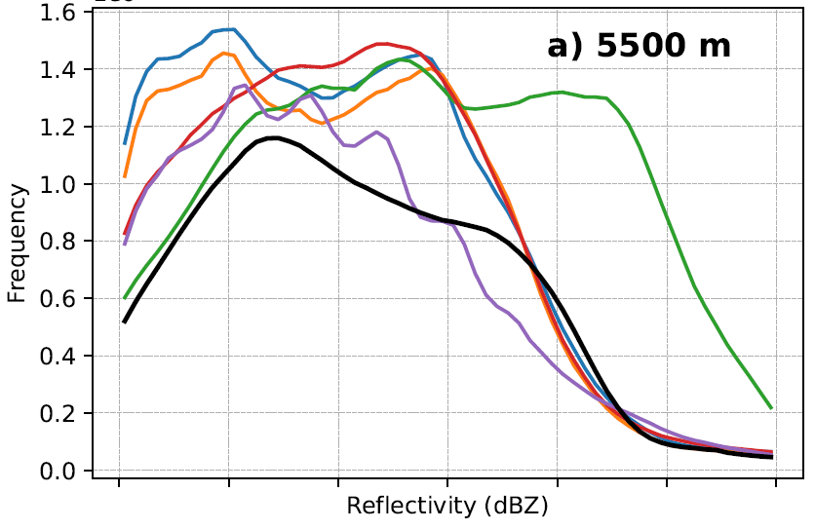
Radar signals: ICE
Convective Core
Stratiform
  Low bias in P3 → Opposite to 1.5 km
  High bias in Thompson 2-mom and Thompson aerosol → Same as in 1.5 km
  High bias in Morrison reflectivity
    → Opposite to 1.5 km stratiform region

Slide 28
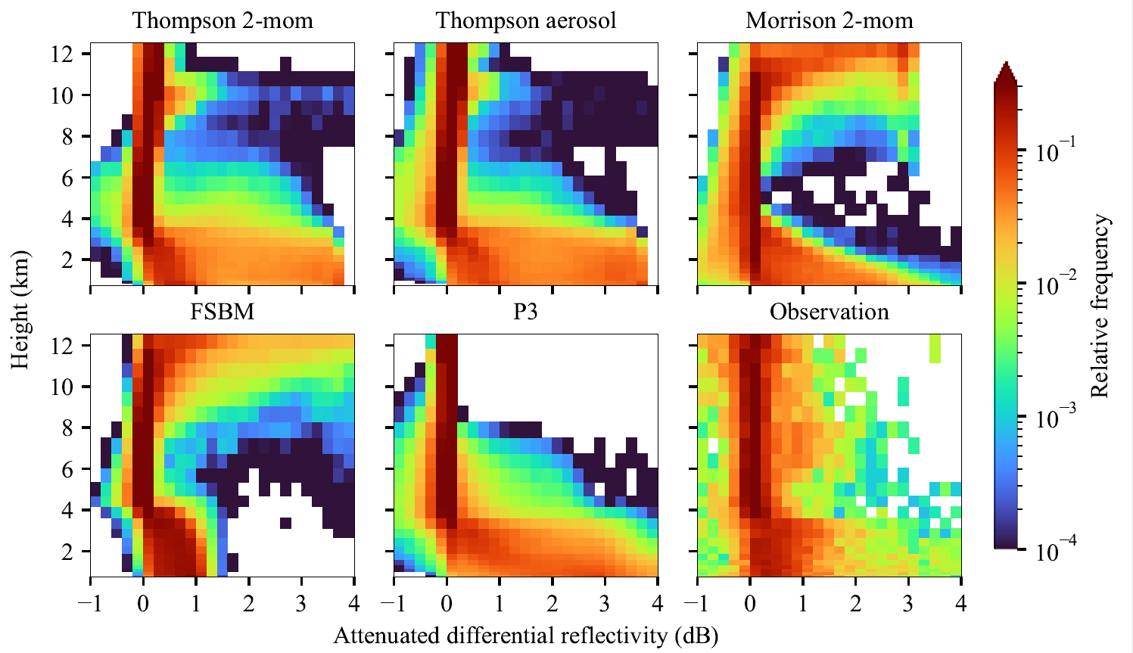
Statistical comparison of radar signals
Differential reflectivity (ZDR)
Have too large ZDR spread
Too many large drops
FSBM
Better captures high density at low ZDR
Does not show any high ZDR
Most models
Sensitive to particle shape
Proxy for size of rain
ZDR (dB)
Köcher et al. (2022), AMT

Slide 29
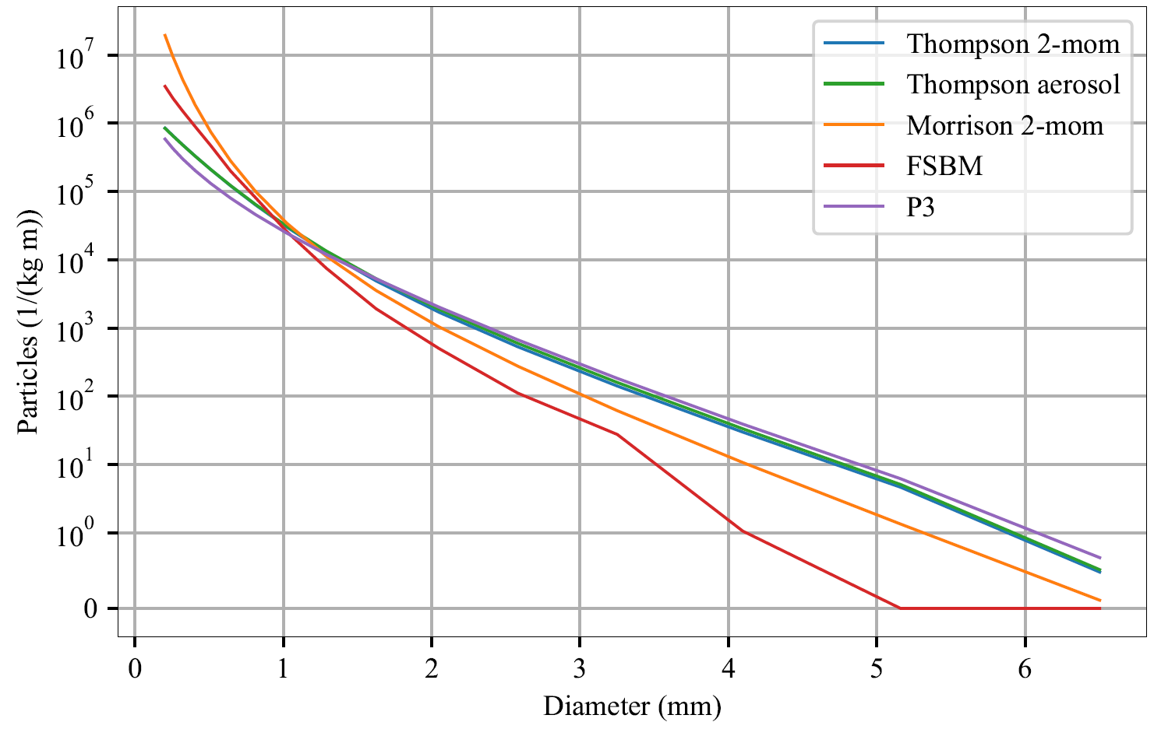
Statistical comparison of radar signals
Köcher et al. (2023), ACP
Köcher et al. (2022), AMT
Too few large rain drops!
In FSBM (and Morrison)

Slide 30
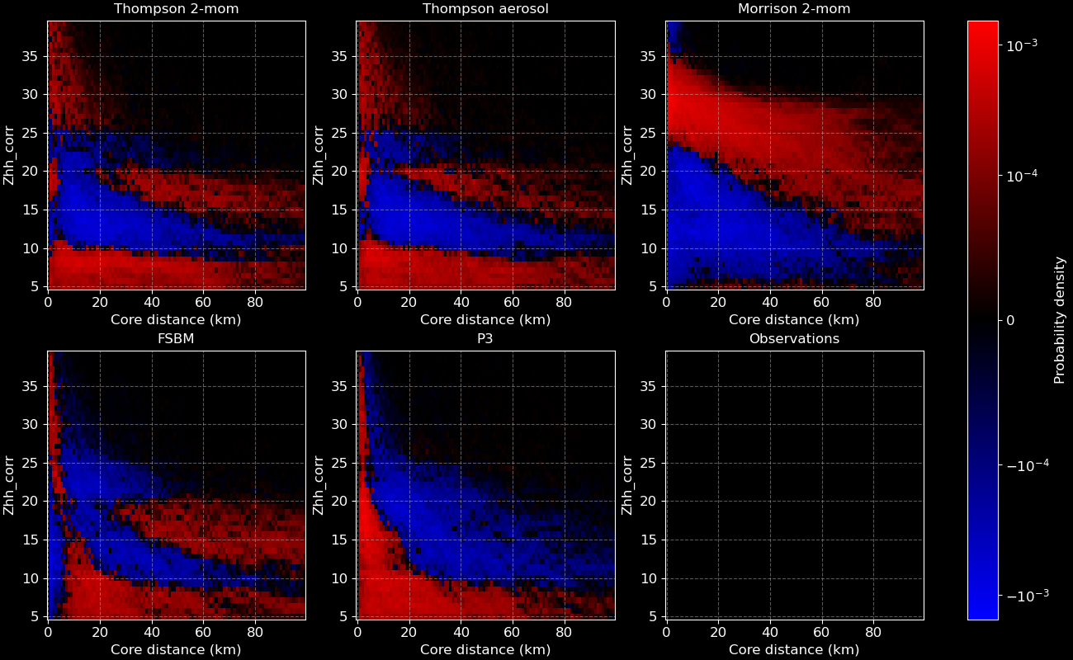
Towards spatio-temporal development
Height:
5.5 km
Variable:
Reflectivity
What do you see?
2D histogram of radar / model differences
Red: Too frequently simulated
Blue: Too rarely simulated
Radar reflectivity (dBZ)
„Error“ depends on distance to cell core and on MP-scheme
Distance to cell core (km)

