Slide 1
PrePEP - Conference:
Application of a predictive recurrent neural network for quantitative precipitation nowcasting (QPN)
18.03.2025
Mst. Mahfuja Akter
Silke Trömel
Institute for Geosciences, University of Bonn

Slide 2
Objectives
To use Deep Learning Methodology on polarimetric rainfall retrievals for nowcasting.
Evaluate and Compare the model with existing state-of-the-art(SOTA) nowcast algorithm Spectral Prognosis, Sprog-LOC.

Slide 3
Nowcast algorithm SPROG, SPROG-LOC
The spectral prognosis nowcasting algorithm (SPROG, Seed 2003) exploits the scale-dependent movements of precipitation.
The method decomposes the field into a multiplicative cascade of decreasing spatial scales, an autoregressive (AR) model is used to predict the temporal evolution of each cascade level.
SPROG tends to smooth nowcasting fields in small but convective precipitation areas at longer lead-times.
Reinoso-Rondinel et al. (2022) introduced SPROG-LOC, which performs better for more intense precipitation.
SPROG-LOC estimates spatially localized AR coefficients from the spatial variability of the precipitation by convoluting a scale-dependent kernel with its corresponding cascade level.

Slide 4
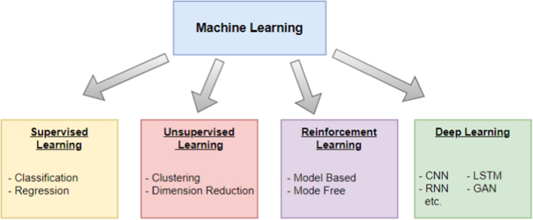
Deep Learning Methodology
A part of Machine learning that leverages artificial neural network
Mimics how human brain works through the combination of input data
Deep learning learns sequential time series data to predict future sequences.
https://journalofbigdata.springeropen.com/articles/10.1186/s40537-023-00852-y
Predictive Deep learning has become a very effective tool in radar meteorology for precipitation nowcasting.

Slide 5
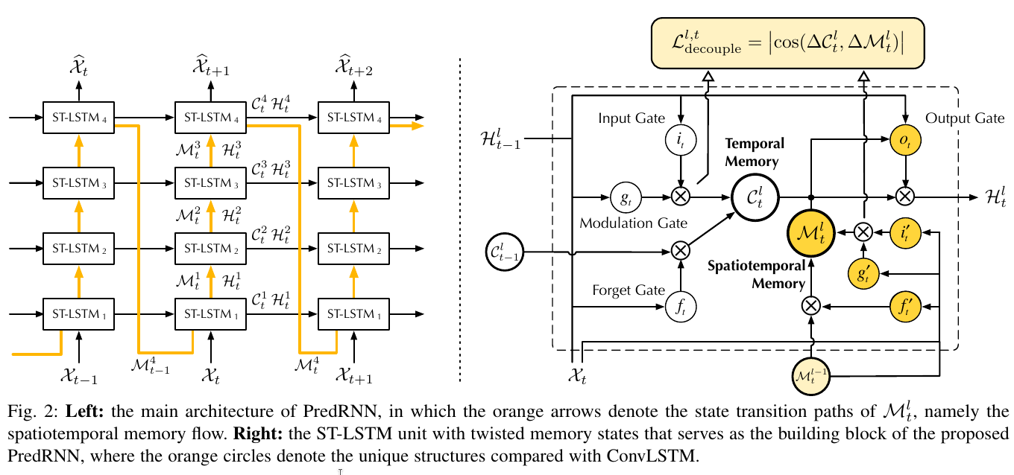
PredRNN: A Recurrent Neural Network for Spatiotemporal Predictive Learning
[Wang, et. al. 2021]
A PredRNN model has been implemented with spatiotemporal long and short-term memory (ST-LSTM) units.
Additional connections between time steps force memory states to flow throughout the network.
The model introduced a decoupling and reverse sampling mechanism to learn long and short-term dynamics, to model the shape deformation more efficiently.
We used this framework to predict nowcasting of quantitative rain field.

Slide 6
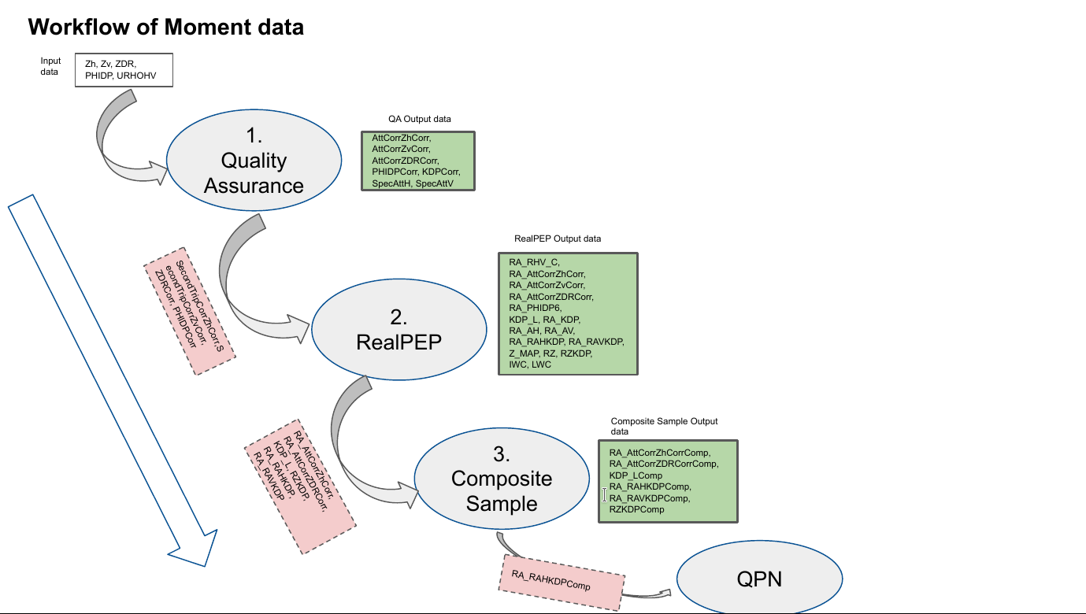
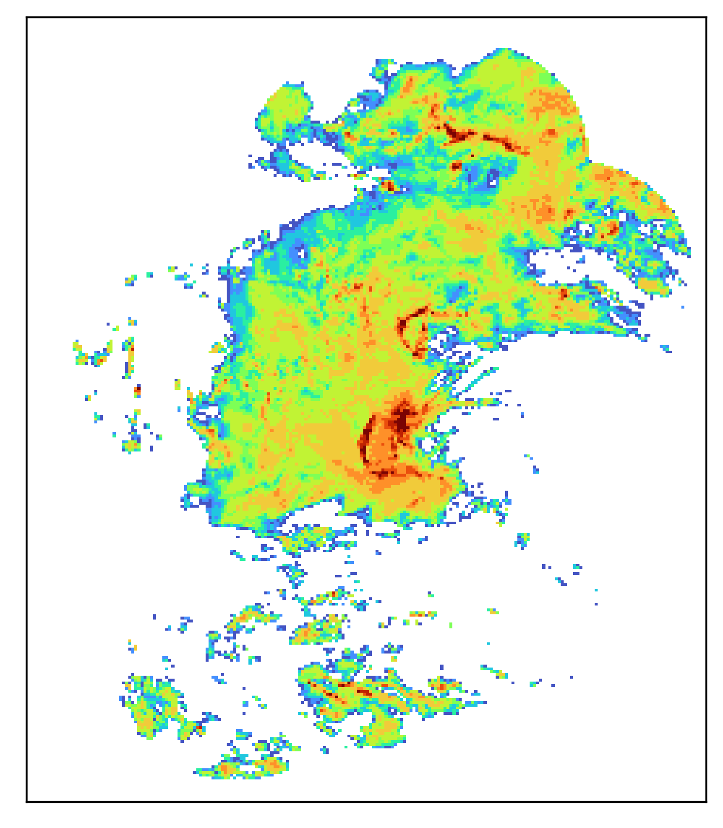
Polarimetric Rainfall Data Processing
C-Band radar Data
05.2019
06.2020
07.2021
QPE
R(Ah,KDP)
R(Av,KDP)
R(Z,KDP)
QPE
Zh, URHOHV, TempU, TempL
R(Ah,KDP)
Polarimetric rainfall retrievals R(Ah, KDP) based on QPE algorithms [Chen et. al. 2021], [Chen et. al. 2023] by using the Polara C++ platform from the Deutscher Wetterdienst (DWD).
The generated rainfall covers the whole Germany.

Slide 7
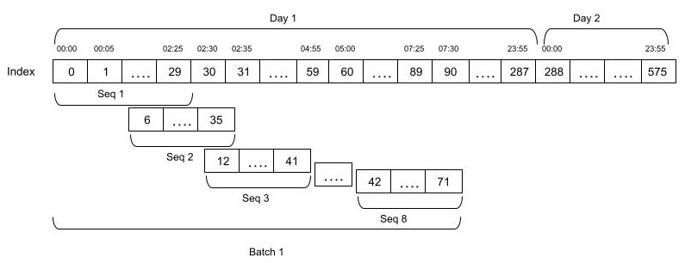
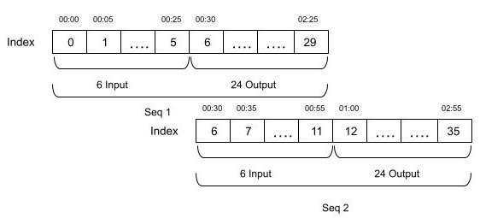
Polarimetric Rainfall Data Processing
Polarimetric rainfall retrievals R(Ah,KDP) composite data is in 1200x1100 form of each 5-minute temporal resolution.
Crop and resize(taking mean of 4x4 into 1) the data into 280x220 and prepare the data into 30 long sequences.
Total 1452 sequences made from 33 days are used to train PredRNN model.
Total 304 sequences from 7 days are tested both in PredRNN and nowcast model SPROG-LOC.
Each sequences are splitted into 6 frames as input that predicts 24 future frames as output.

Slide 8
PredRNN Model Configuration:
4x ST-LSTM
2x Conv2D
6
5 x 5
24
280x220
280x220
Four ST-LSTM layers with 128 number of channels and the convolutional kernels of 5 × 5 inside the ST-LSTM unit.
ADAM optimizer is used with a batch of 8 sequences.
The Loss function MSE (L2 loss) and decoupling loss is combinedly used.
The learning rate is set to 10⁻⁴ with maximum of 10,000 iterations.
Model is implemented in Pytorch

Slide 9
SPROG-LOC Model Configuration:
Cascade levels are set to 6 and time steps to 24 as input and output frames respectively.
The velocity vector is computed with DARTS optical flow.
Autoregressive (AR) model of order 1 is adopted.
Nowcasted fields are matched with mean probability matching method.
Correction factor I is set to 10%
Model is implemented with pysteps library.

Slide 10
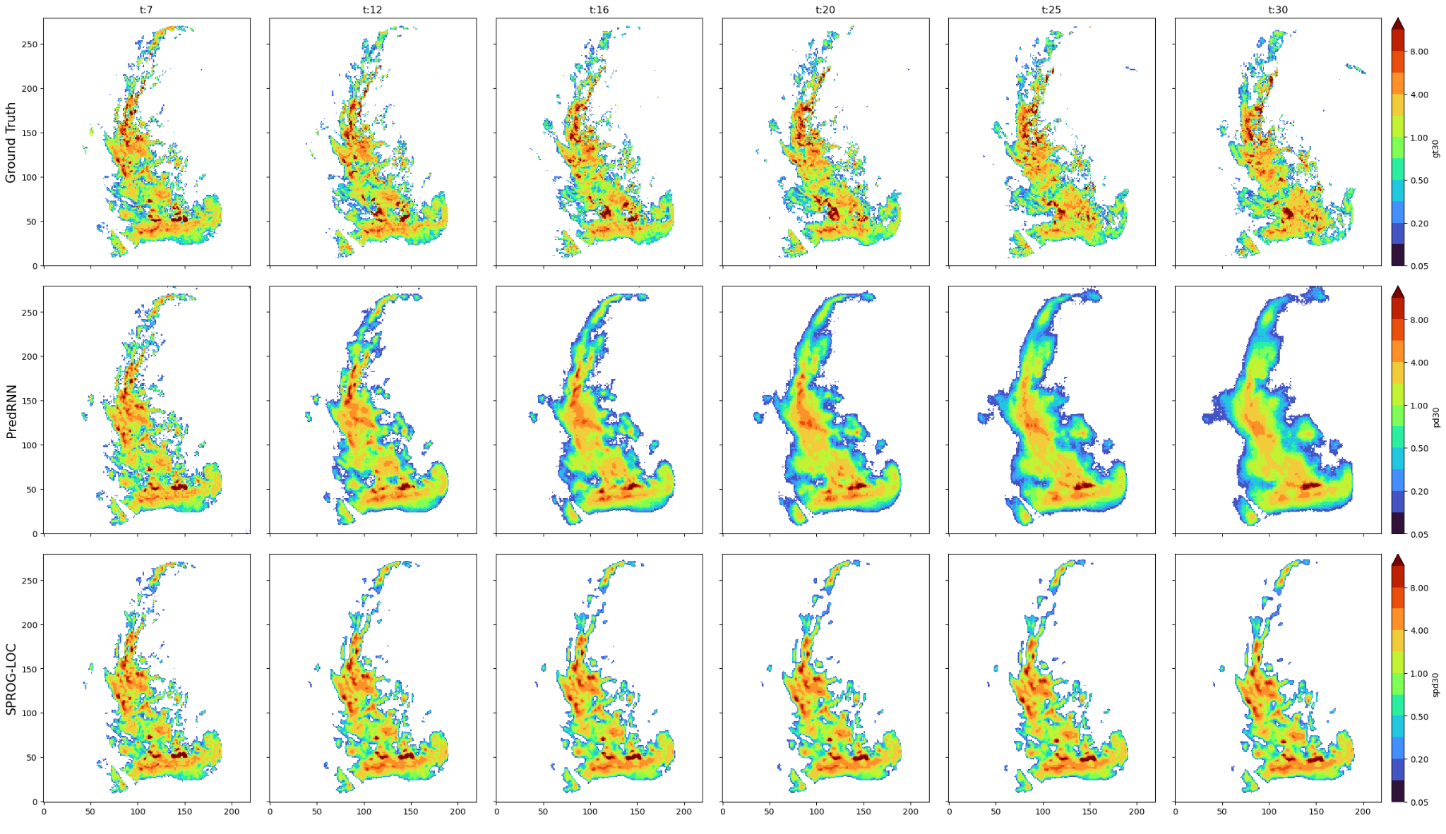
Nowcast Prediction: Example 1
Input rain data
GroundTruth data
Predicted Rain data

Slide 11
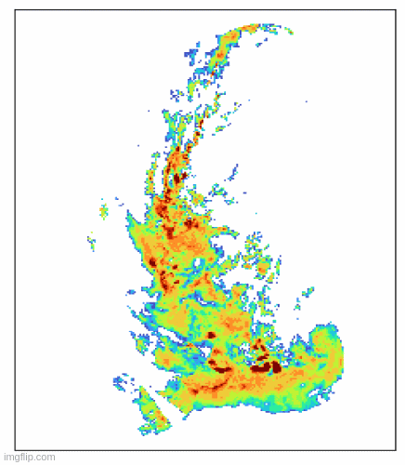
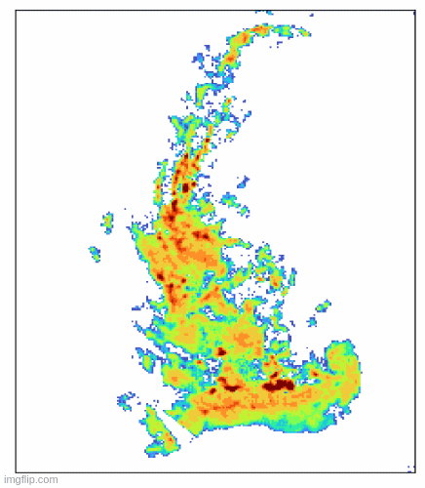
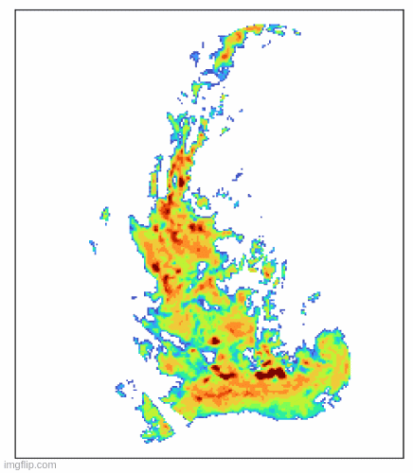
Nowcast Prediction: Example 1
GroundTruth
PredRNN
SPROG-LOC

Slide 12
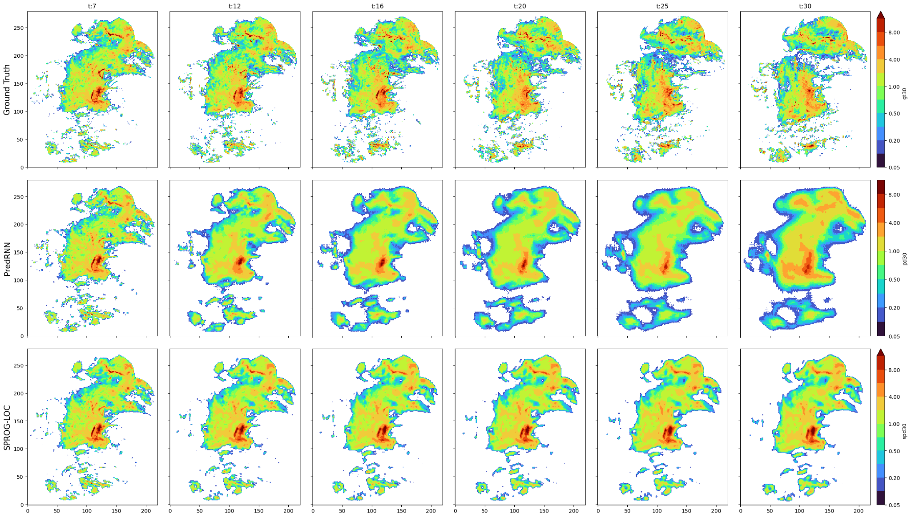
Nowcast Prediction: Example 2
Input rain data
GroundTruth data
Predicted Rain data

Slide 13
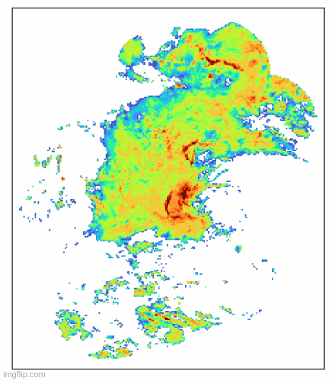
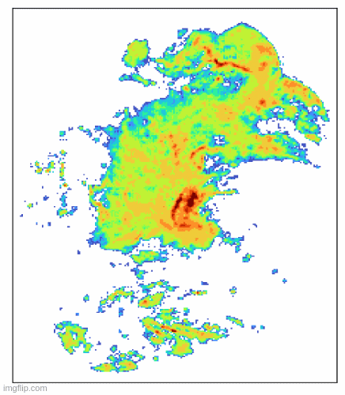
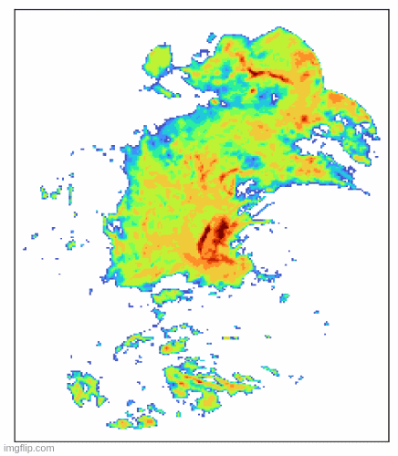
Nowcast Prediction: Example 2
GroundTruth
PredRNN
SPROG-LOC

Slide 14
Evaluation: PredRNN Vs Sprog-LOC
Evaluation measures are calculated on total 304 sequences (7 days) and take the average of predicted data of respective lead times.
Nowcast rainfall data are limited into 0~40 mm, then normalised into 0~1. Which is later multiplied by 255 for image data.
RMSE: Root Mean Squared Error | POD: Probability of Detection
SSIM: Structural Similarity Index | CSI: Critical Success Index
LPIPS: Learned Perceptual Image Patch Similarity | FAR: False Alarm Ratio
7 Days Evaluation:
20170725, 20190508, 20190521 Stratiform Cases
20200620 Convective, and
20200604, 20210708, 20210711 Mixed Cases

Slide 15
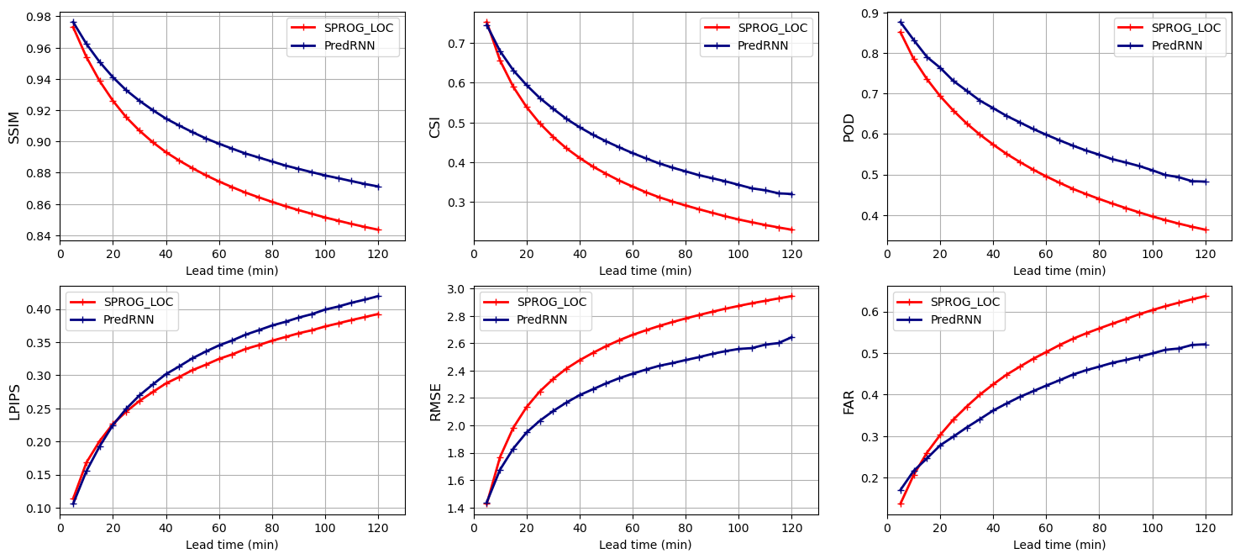
Evaluation: PredRNN Vs Sprog-LOC
Rainfall threshold Rth = 5.0 mm/h is used to calculate CSI, FAR, FSS, where image data range is 0~255.
SSIM calculate differences based on pixel values, when LPIPS leverages deep learning to better align with human visualization. LPIPS is more sensitive to perceptual human judgments.

Slide 16
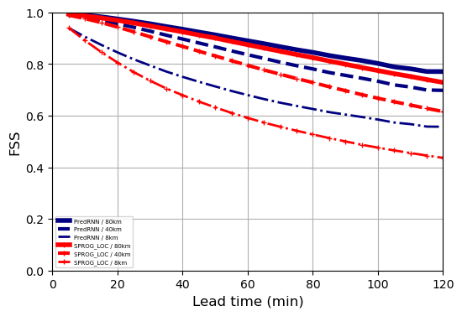
Evaluation: PredRNN Vs Sprog-LOC
Fraction Skill Score shows that PredRNN increasingly outperform when distance scale reduces from 80 km ~ 8 km throughout the entire nowcast.

Slide 17
Summary
We compare Deep Learning Method, PredRNN with existing Nowcasting algorithm Spectral Prognosis, Sprog-LOC.
PredRNN clearly outperforms in each evaluation criteria except LPIPS (visualization).
Training more epochs leads the model to learn better to closer nowcast but worsen over time.
Exploit the PredRNN model to combine satellite-based information with radar measurements to further increase the lead time.
Try other Deep learning Methodology (e.g. Generative Adversarial Network ( GAN) if it improves Nowcast prediction better.
mahfuja.akter@uni-bonn.de

