Slide 1
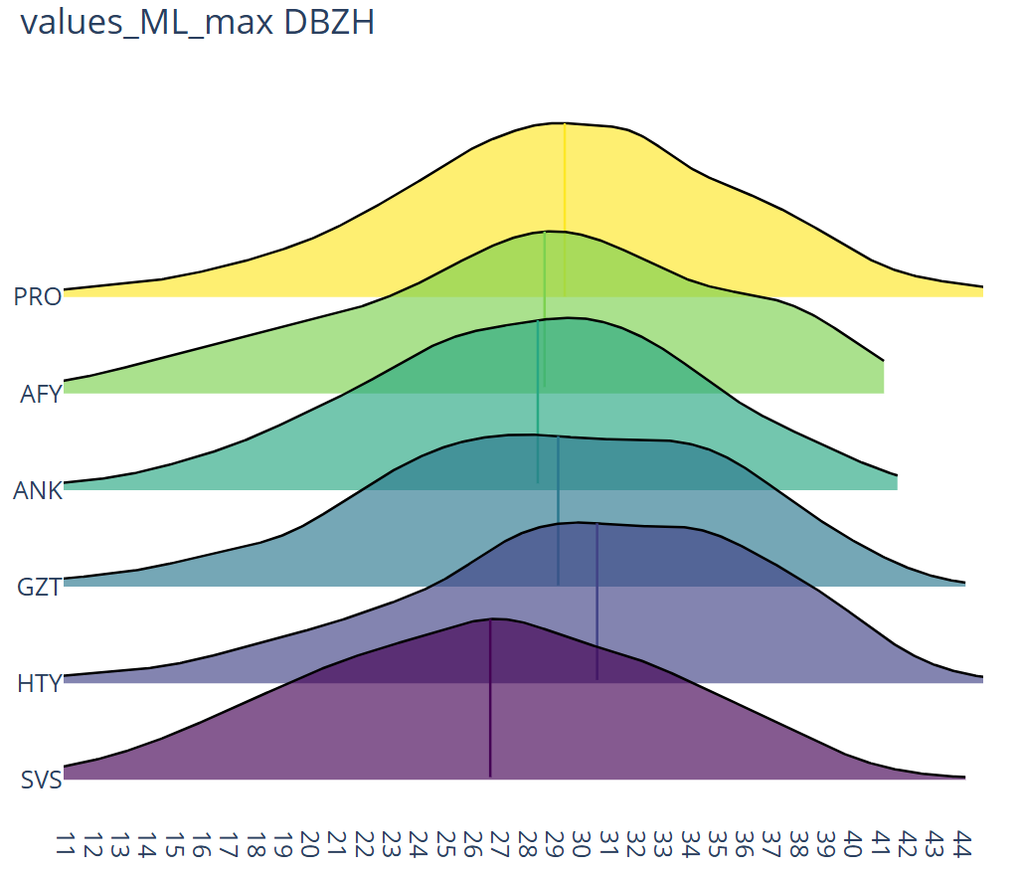
From Cloud Tops to Surface: Statistical Insights into Stratiform Microphysics over Germany and Türkiye
PrePEP - Conference
CRC1502 DETECT
https://sfb1502.de/
Julian Alberto Giles¹, Armin Blanke¹, Raquel Evaristo¹, Silke Trömel¹²
¹ Institute of Geosciences, Meteorology Section, University of Bonn, Germany
² Laboratory for Clouds and Precipitation Exploration, Geoverbund ABC/J, Bonn, Germany
21 March 2025

Slide 2
Motivation
Statistical analyses of polarimetric radar data are important for:
Improving the understanding of precipitation-generating processes and their regional and seasonal differences.
Model evaluation and improvement, particularly in terms of microphysical parameterizations.

Slide 3
Motivation
Statistical analyses of polarimetric radar data are important for:
Improving the understanding of precipitation-generating processes and their regional and seasonal differences.
Model evaluation and improvement, particularly in terms of microphysical parameterizations.
Most studies are based on a limited selection of a cases

Slide 4
Motivation
Statistical analyses of polarimetric radar data are important for:
Improving the understanding of precipitation-generating processes and their regional and seasonal differences.
Model evaluation and improvement, particularly in terms of microphysical parameterizations.
Most studies are based on a limited selection of a cases
We aim to analyze a large radar database

Slide 5
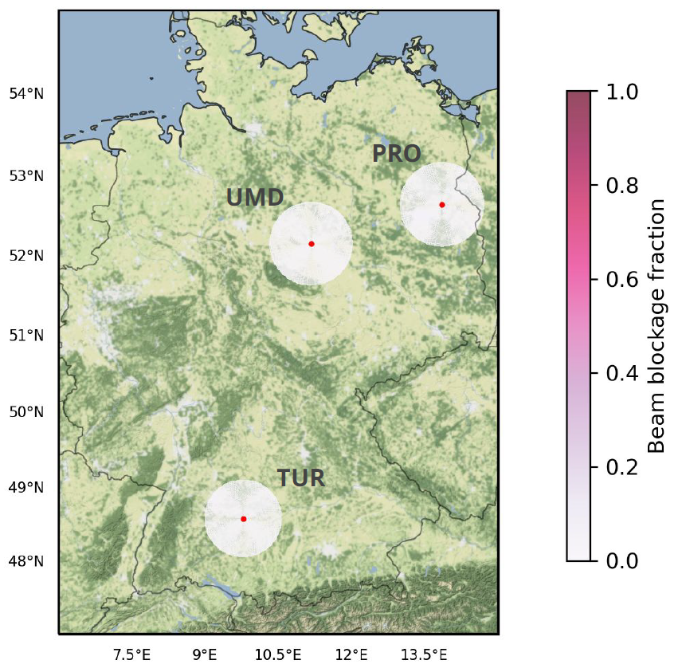
Data
From operational C-band polarimetric radars: 3 in Germany and 5 in Türkiye
Period: 2015-2020
PRO
UMD
ANK
AFY
SVS
GZT
TUR
HTY
10° or 12° elevation angle beam blockage

Slide 6
Data
From operational C-band polarimetric radars: 3 in Germany and 5 in Türkiye
Period: 2015-2020
PRO
UMD
ANK
AFY
SVS
GZT
TUR
HTY
10° or 12° elevation angle beam blockage
From ERA5: 3D temperature

Slide 7
Processing chain
RHOHV noise correction.
ZDR offset correction.
PHIDP offset correction and smoothing. KDP calculation.
Melting layer detection.
Microphysical retrievals calculation.
Stratiform classification.
QVP generation.
Riming detection.

Slide 8
Processing chain
RHOHV noise correction.
ZDR offset correction.
PHIDP offset correction and smoothing. KDP calculation.
Melting layer detection.
Microphysical retrievals calculation.
Stratiform classification.
QVP generation.
Riming detection.
Only data points classified as stratiform from QVPs with melting layer detected are included in the statistics

Slide 9
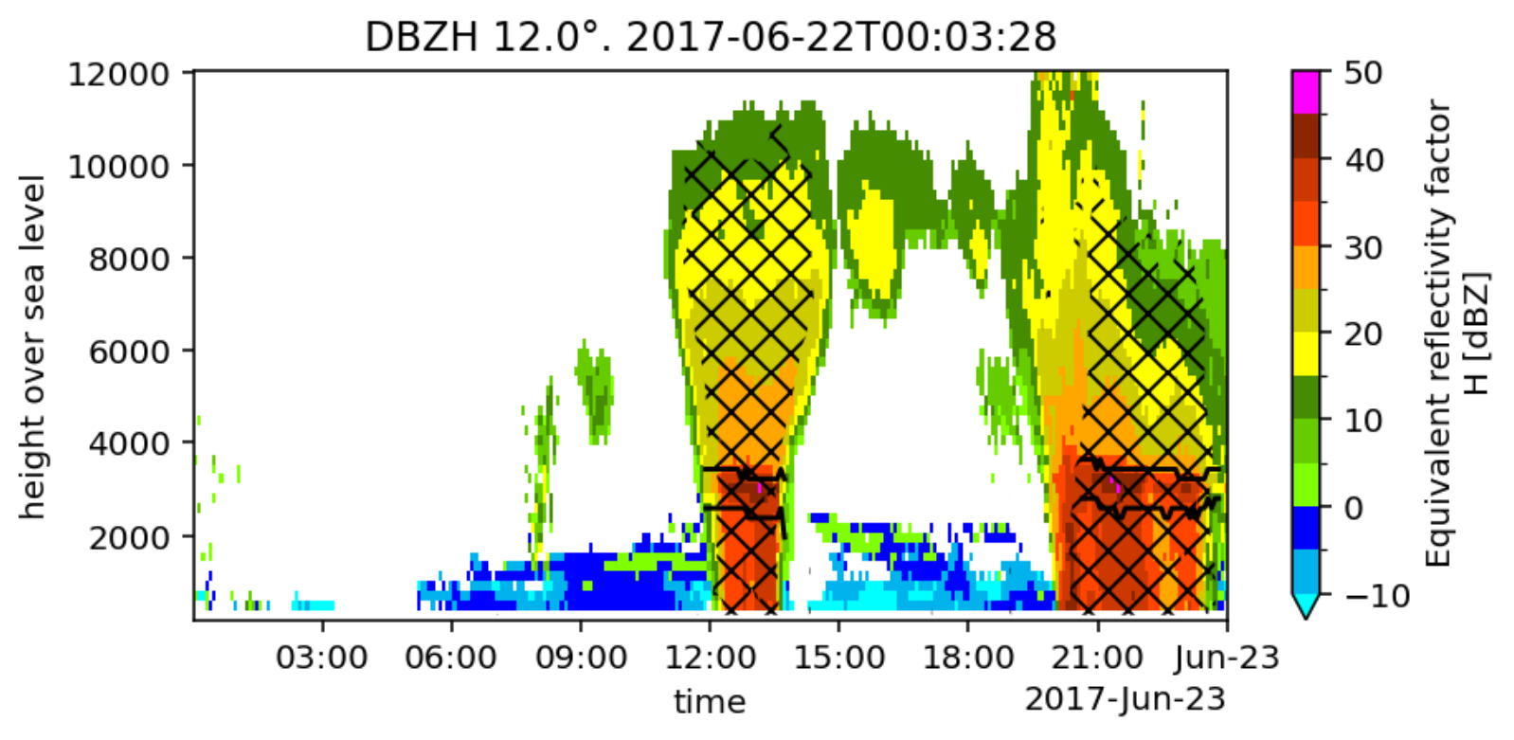
Results: what can we extract?
Frequency diagram of DBZH vs temperature
Example QVPs: PRO 2017-06-22
DBZH
Hatches: stratiform according to information entropy method (developed by Tobias Scharbach)

Slide 10
Results: what can we extract?
Cloud top height and temperature
Frequency diagram of DBZH vs temperature
Example QVPs: PRO 2017-06-22
DBZH
Min, max, mean
Gradients
Hatches: stratiform
ML thickness

Slide 11
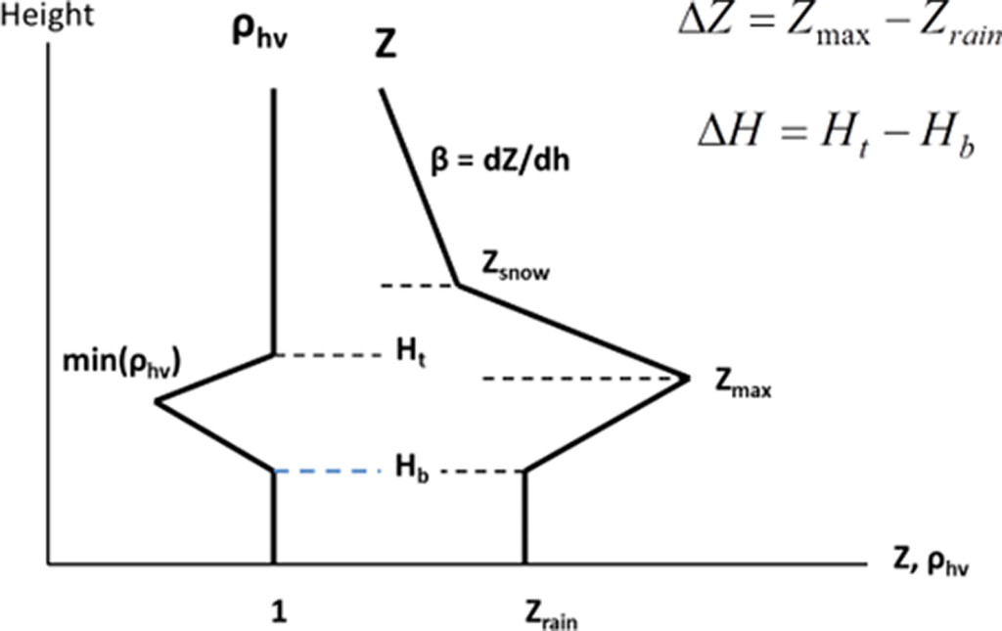
Results: implications for QPE
The value of 𝛽 has large impact in the modeling of the vertical profiles of reflectivity for QPE correction.
Talk by Raquel Evaristo on Monday
Reference 𝛽 in the USA: -4 dB/km
Modeled vertical profiles according to Ryzhkov and Krause (2022)

Slide 12
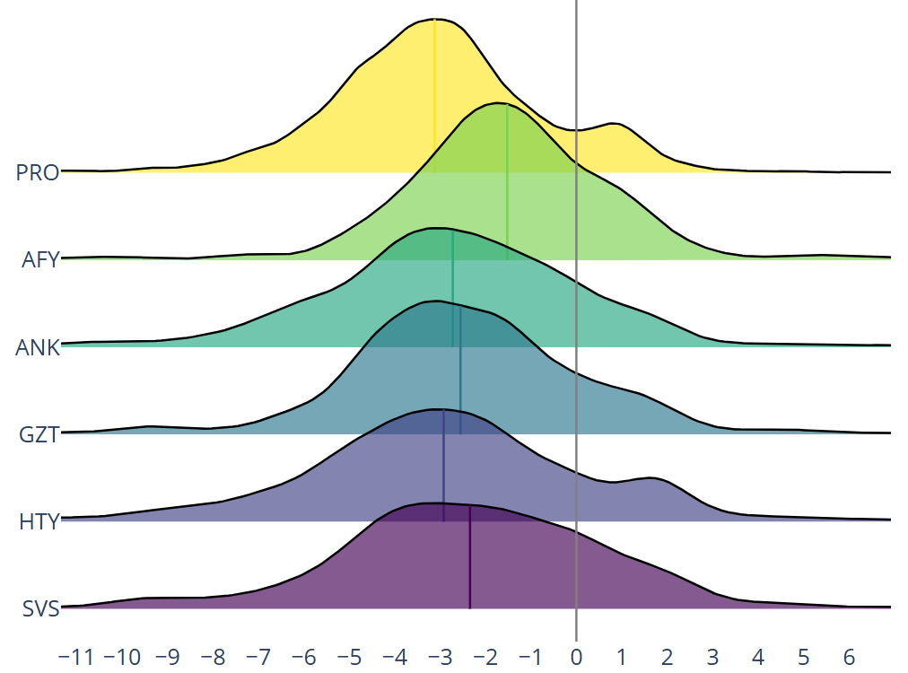
Results: implications for QPE
Gradient of reflectivity above the melting layer
𝛽 [dBZ/km]
USA reference

Slide 13
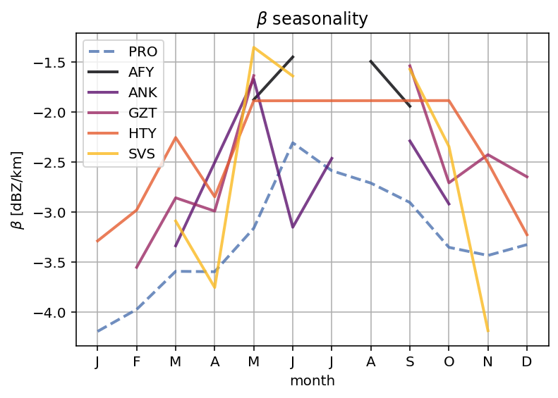
Results: implications for QPE
Gradient of reflectivity above the melting layer
𝛽 [dBZ/km]
Seasonality of 𝛽 [dBZ/km]
USA reference

Slide 14
Results: implications for QPE
Gradient of reflectivity above the melting layer
𝛽 [dBZ/km]
Seasonality of 𝛽 [dBZ/km]
Choosing an appropriate value according to our climatology improves the QPE results (Talk by Raquel Evaristo on Monday)
USA reference

Slide 15
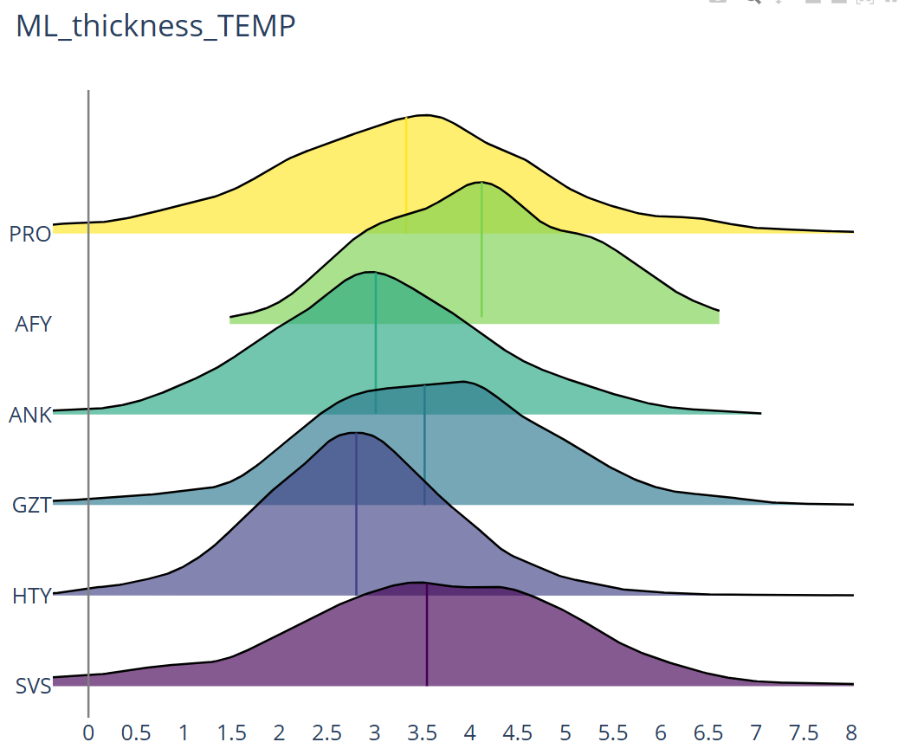
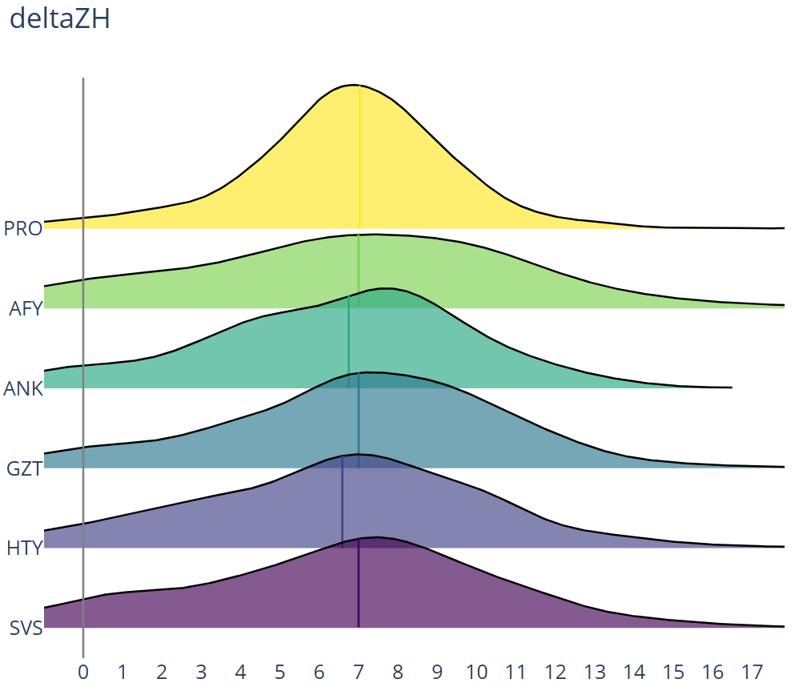
Results: melting layer regional differences and similarities
Melting layer temperature-thickness [°C]
ΔZH = ZH_{ML}^{max} - ZH_{rain}
ZH_{ML}^{max}
USA reference

Slide 16
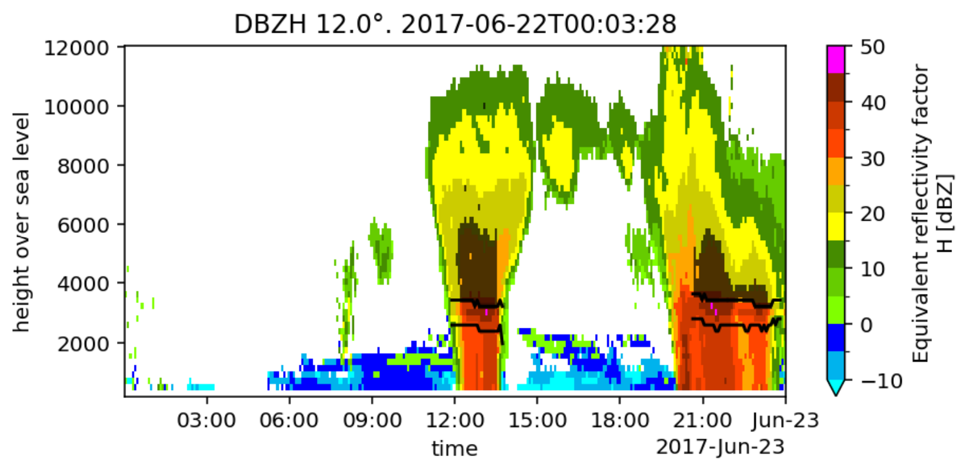
Results: riming characterization
Example QVPs: PRO 2017-06-22
DBZH
Machine learning method for riming/no riming classification (Blanke et al. 2024)
Talk by Armin Blanke on Wednesday
Riming

Slide 17
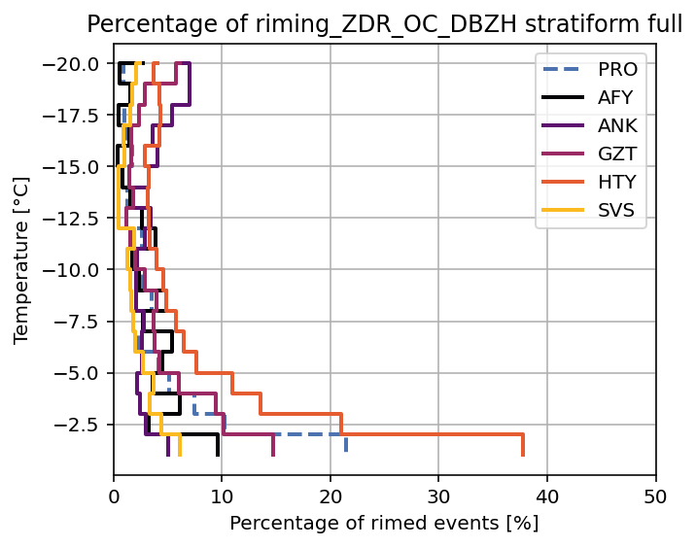
Results: riming characterization
Percentage of data points with riming per temperature level

Slide 18
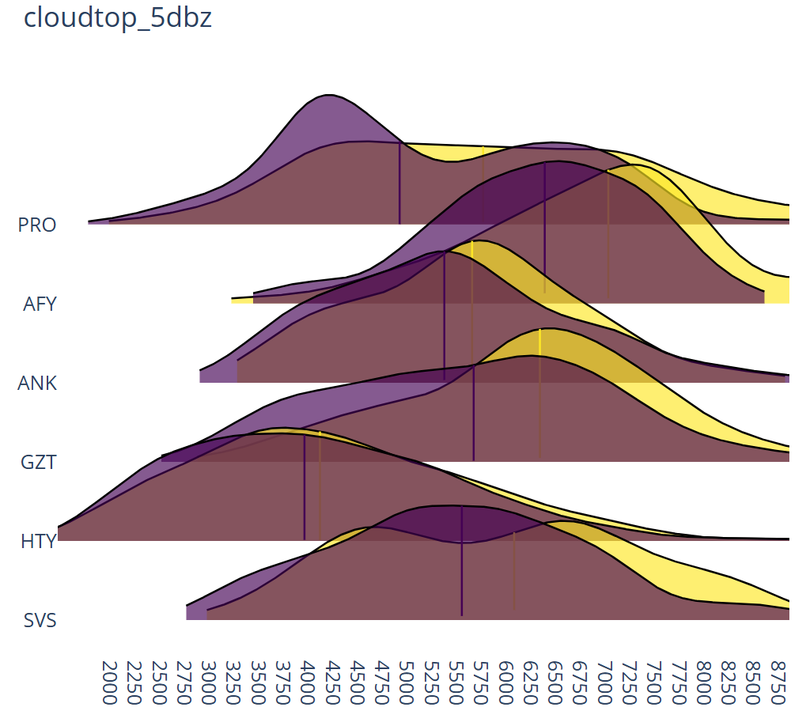
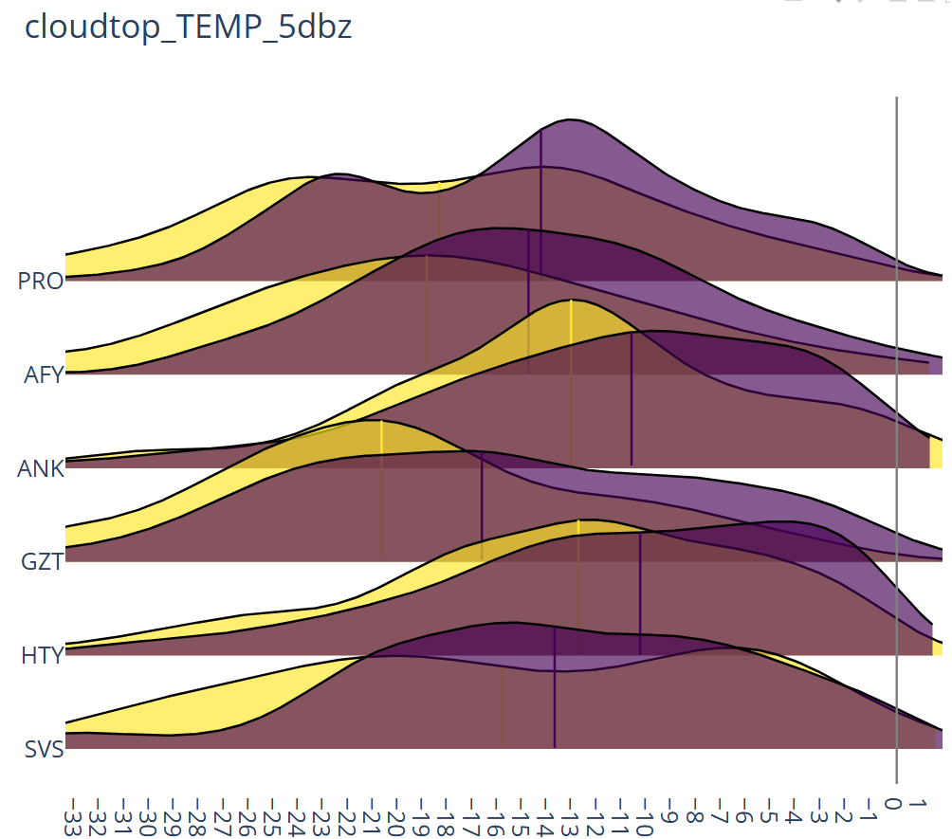
Results: riming characterization
Cloud-top height [m]
Cloud-top temperature [°C]
Yellow: QVPs with riming
Purple: QVPs without riming

Slide 19
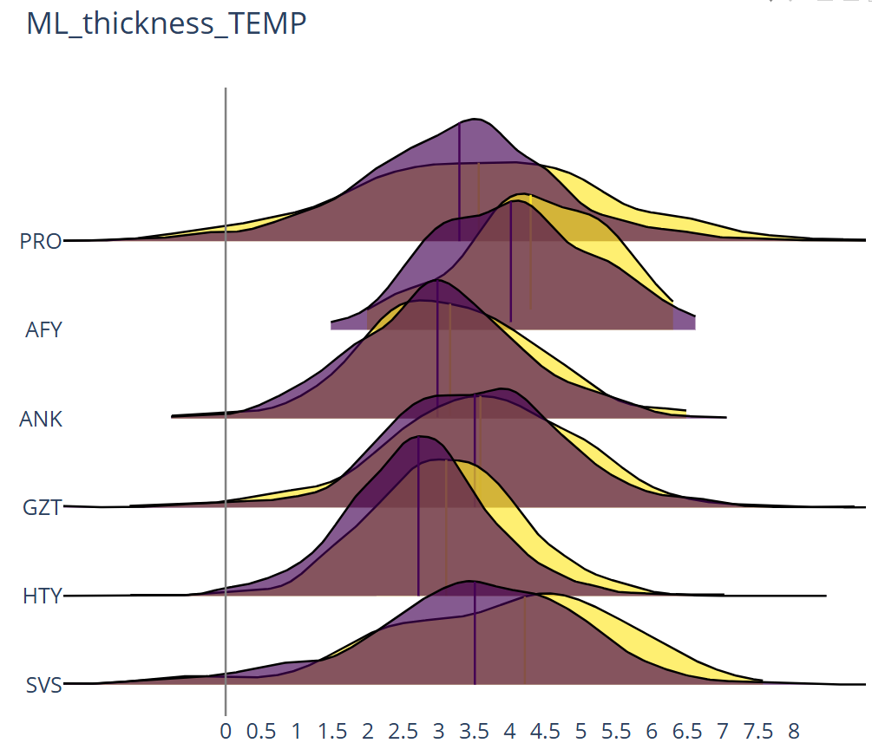
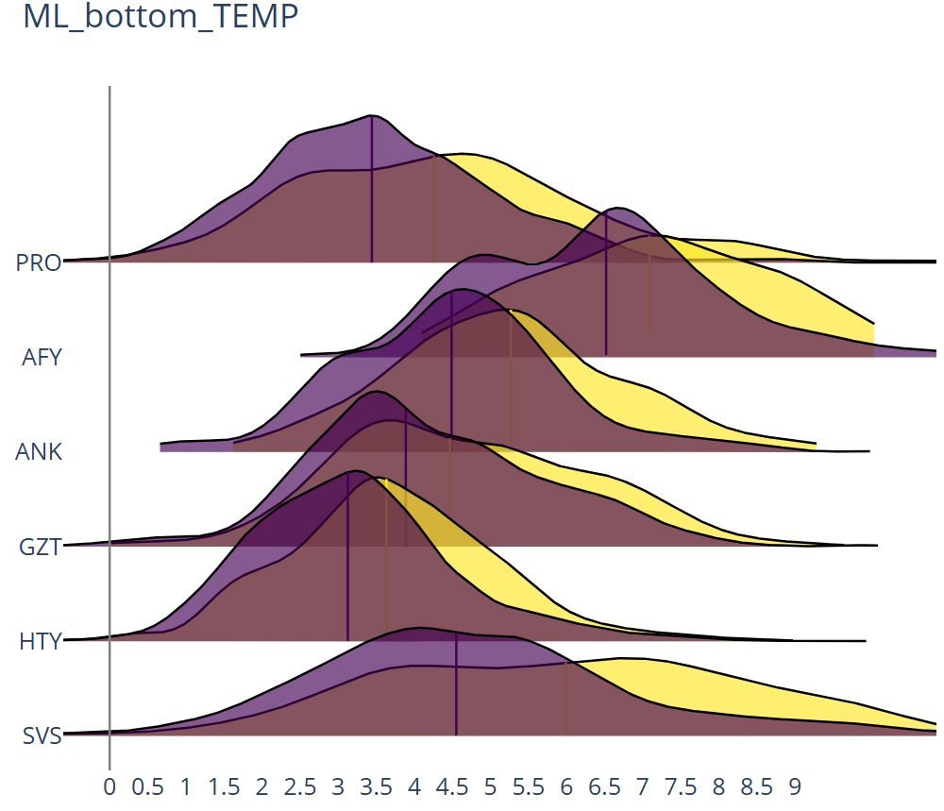
Results: riming characterization
Melting layer temperature-thickness [°C]
Melting layer bottom temperature [°C]
Yellow: QVPs with riming
Purple: QVPs without riming

Slide 20
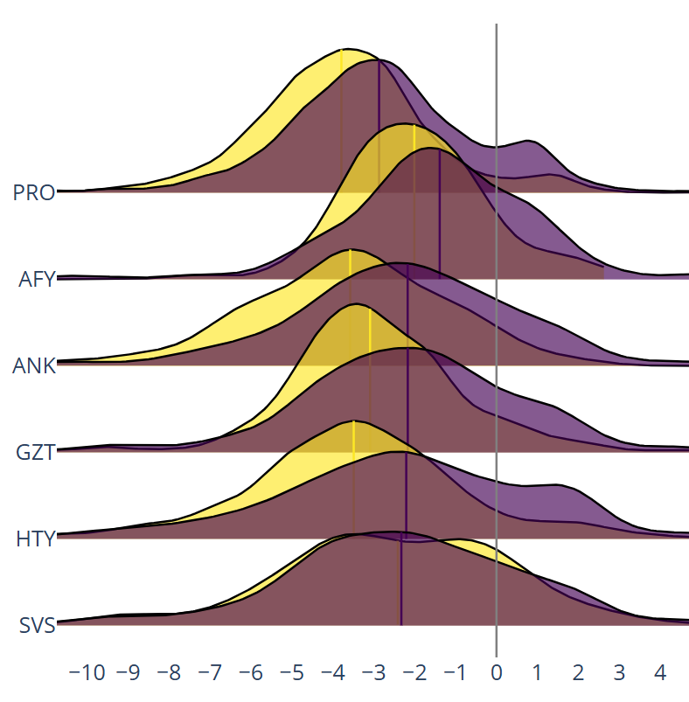
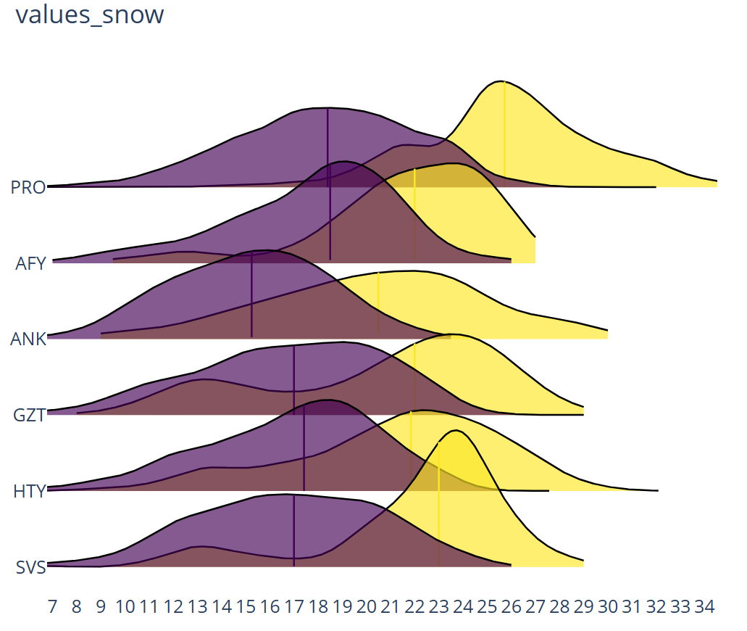
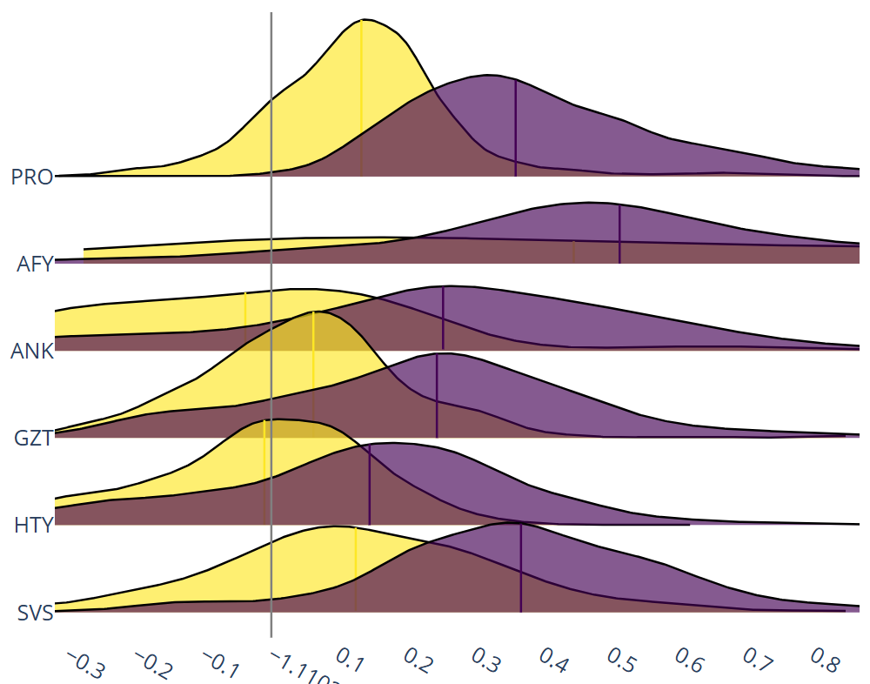
Results: riming characterization
𝛽 [dBZ/km]
DBZH above the melting layer
ZDR above the melting layer
Yellow: QVPs with riming
Purple: QVPs without riming

Slide 21
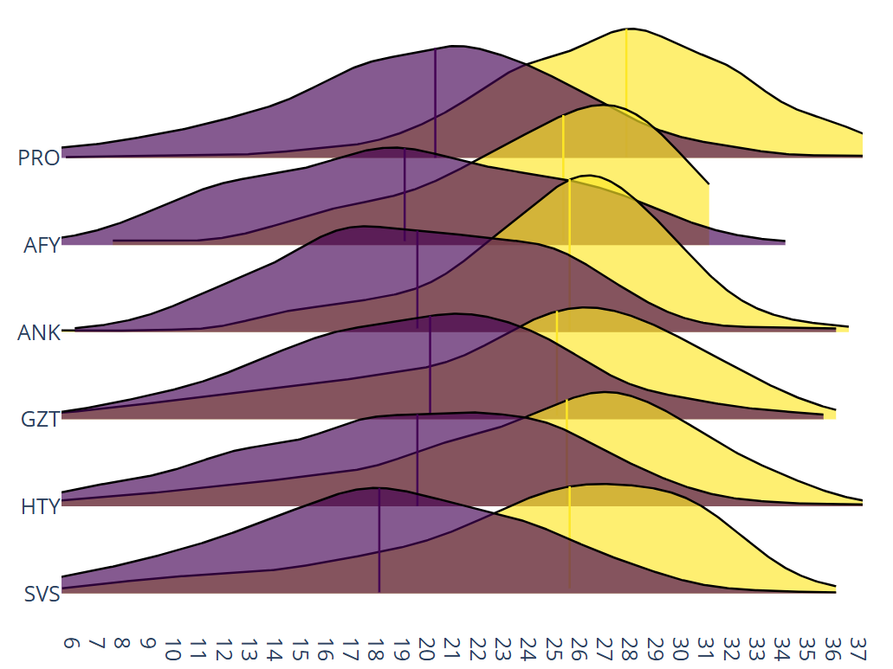
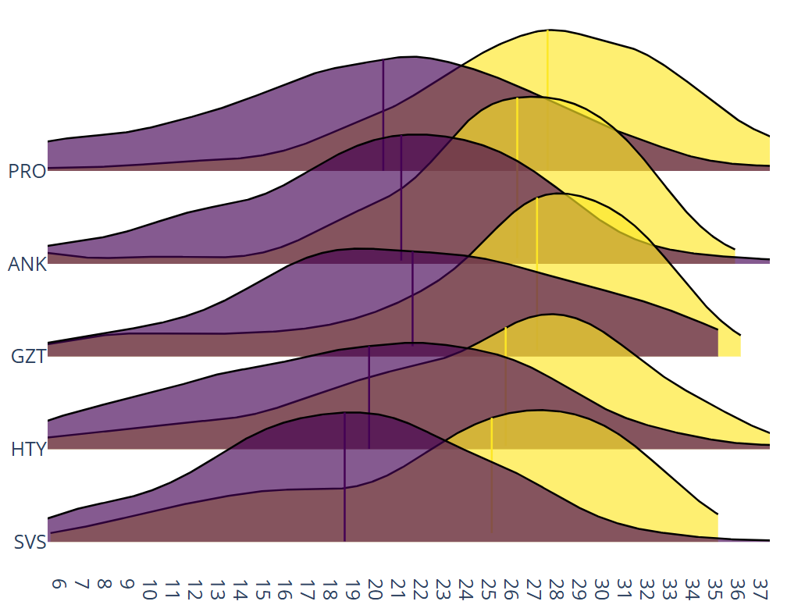
Results: riming characterization
DBZH below the melting layer
DBZH at surface
Yellow: QVPs with riming
Purple: QVPs without riming

Slide 22
Conclusions
A large radar database allows us to characterize stratiform precipitation
Identify regional and seasonal differences.
Analyze different precipitation-generating processes.

Slide 23
Conclusions
A large radar database allows us to characterize stratiform precipitation
Identify regional and seasonal differences.
Analyze different precipitation-generating processes.
Future plans: validate model runs (ICON+EMVORADO)
Are the microphysical processes well represented?
Does the model reproduce the seasonal and regional differences?

Slide 24
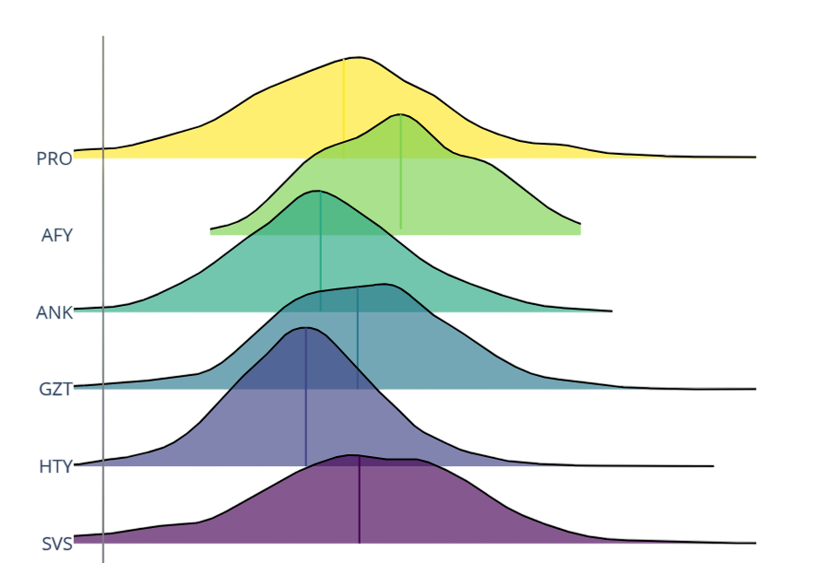
Thank you for your attention!
CRC1502 DETECT
https://sfb1502.de/
Contact:
jgiles@uni-bonn.de

Slide 25
References
Ryzhkov, A., and J. Krause, 2022: New Polarimetric Radar Algorithm for Melting-Layer Detection and Determination of Its Height. J. Atmos. Oceanic Technol., 39, 529–543, https://doi.org/10.1175/JTECH-D-21-0130.1
Blanke, A., Gergely, M., and Trömel, S.: A new aggregation and riming discrimination algorithm based on polarimetric weather radars, EGUsphere [preprint], https://doi.org/10.5194/egusphere-2024-3336, 2024.

