Slide 1
Which ice microphysical processes might explain the typical radar signatures in the Dendritic Growth Layer?
Leonie von Terzi, Stefan Kneifel (LMU Munich)
Christoph Siewert, Axel Seifert, Fabian Jakub (DWD)
Davide Ori (Uni of Cologne)

Slide 2
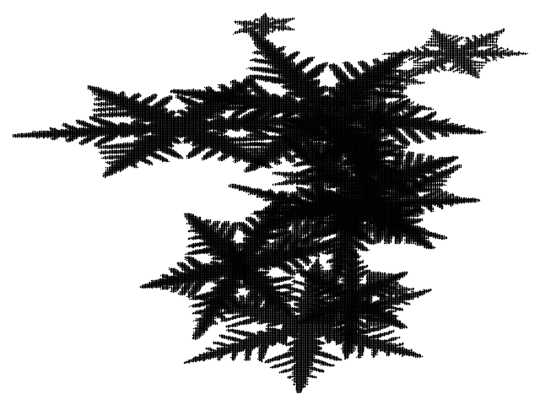
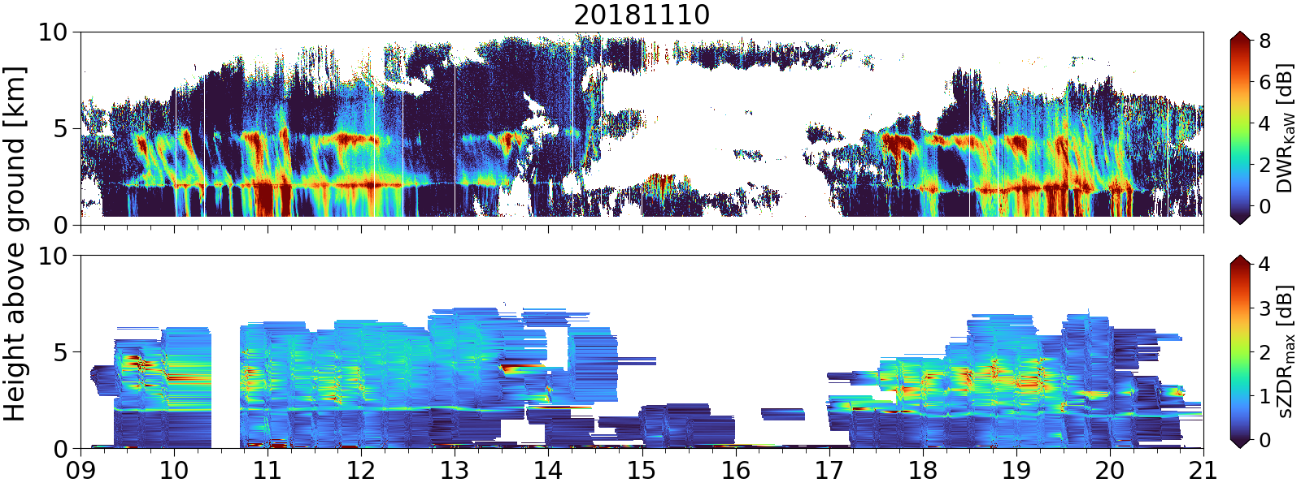
The Dendritic Growth Layer (DGL)
Temperature
-20°C
What is the DGL? Why is it important?
What does the radar see?
-10°C
0°C

Slide 3
The Dendritic Growth Layer (DGL) – a typical case study:
Ka-Band, 90° elv
W-Band, 30° elv
W-Band, 30° elv
W-Band, 30° elv
Increase in DWR
2nd mode in Doppler spectrum
Increase in KDP
Increase in sZDR_{max}
→ aggregation
→ New ice particles?
→ Ice concentration or size increases?
→ Plate-like ice crystals are growing
How are the new ice particles generated?
Shouldn‘t aggregation reduce concentration? How can KDP increase then?

Slide 4
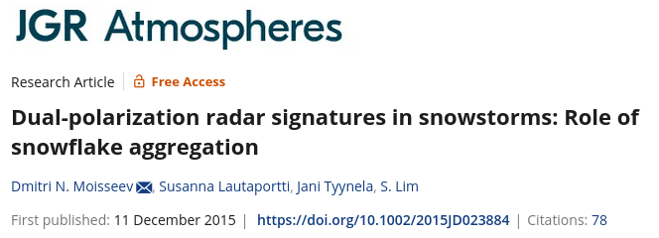
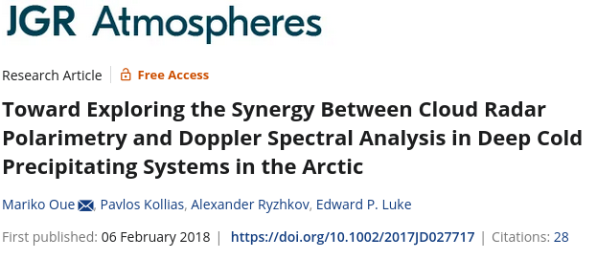
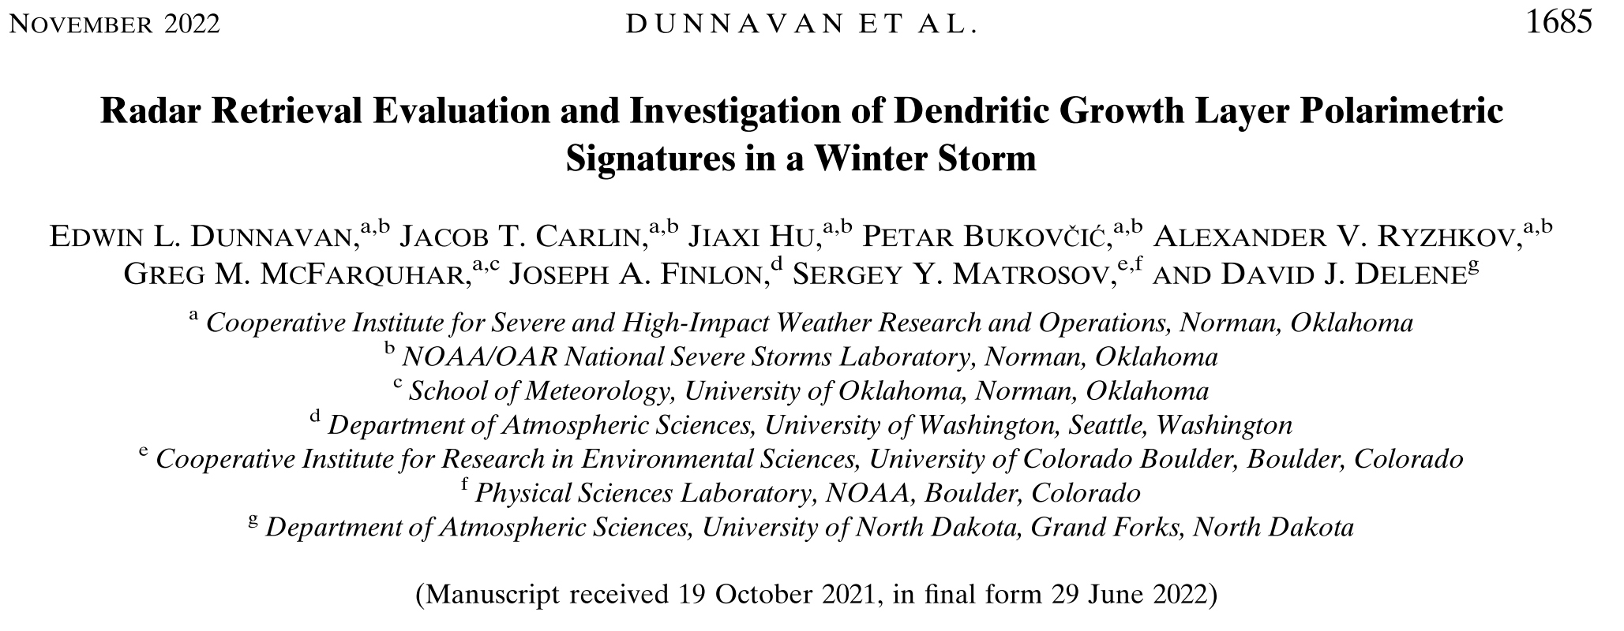

Slide 5
The Dendritic Growth Layer (DGL)
Hypotheses:
Small ice crystals sedimenting from above which grow plate-like rapidly in DGL
Primary nucleation in DGL produces plate-like particles which grow rapidly in DGL
Secondary ice production (collisional fragmentation) in DGL produces fragments of ice particles
Radar only sees effect of ice microphysical processes (IMP) on the observed particle distribution, not the IMP themselves!

Slide 6
The 1D Lagrangian Monte-Carlo particle model
Let‘s combine observations with a model in which current knowledge of IMP can be implemented (Brdar and Seifert, JAMES, 2017)
1D:
„shaft“ model, no turbulence, no convection,…
Lagrangian Particle Model:
predict motion and evolution of individual particles
Monte-Carlo approach:
group particles with similar microphysical properties into super-particles
McSnow predicts evolution of super-particles due to
Deposition → habit prediction (Welss et al., JAMES, 2024)
Aggregation
Riming
Secondary ice production
i.e. fragmentation

Slide 7
Forward simulations: DDA LUTs
„Problem“: McSnow has freely evolving particle properties:
We want to consistently forward simulate into Radar Space!
Solution: DDA LUTs of a large variety of ice particles (approx. 3100 particles)
Dendritic ice crystals
Columnar ice crystals
Aggregates with varying monomer habits and riming degree

Slide 8
Hypotheses
Small ice crystals sedimenting from above grow plate-like
Secondary ice production (Fragmentation) in DGL produces fragments of ice particles

Slide 9
McSnow simulation setup
Small ice crystals sedimenting from above
Assumption:
Average ${RH}_{i}=5\%$ (from Radiosonde data)
Ice nucleation at $−20°C <T<−50°C$, concentration increasing from $1L^{−1}$at $−20°C$ to $20L^{−1}$ $−50°C$
Ice nucleation: initialisation of ice particles with $D=10μ$m, aspect ratio $=1$, ice density
After nucleation: particles can evolve freely due to depositional growth, aggregation,…

Slide 10
3. Only ice nucleation at $T<−20°C$
Ka-Band, 90° elv
W-Band, 30° elv
W-Band, 30° elv
W-Band, 30° elv
Observation
If particles sediment into DGL, they are already to big to grow into extreme shapes such as plates. Therefore the polarimetric signatures are not observed.
Simulation
Without ice nucleation (primary or secondary) we do not have a second spectral mode, and also no polarimetric signatures in DGL!

Slide 11
Hypotheses
Small ice crystals sedimenting from above grow plate-like
Secondary ice production (collisional fragmentation) in DGL produces fragments of ice particles
Same setup as in first hypothesis
New fragmentation scheme based on Grzegorczyk et al. 2023 (see talk by Miklós Szakall, Thu 16:15, Session 2 A) and Takahashi 1995

Slide 12
2. Secondary ice production – collisional fragmentation
Ka-Band, 90° elv
W-Band, 30° elv
W-Band, 30° elv
W-Band, 30° elv
Obs
Sim
Second mode
KDP is similar
sZDRmax is there

Slide 13
Which ice microphysical properties might explain the typical radar signatures in the dendritic growth layer?
Ice particles sedimenting into the DGL do not grow plate-like
We need a production mechanism close to -15°C for enhanced ZDR and KDP in the DGL!
Fragmentation is a promising candidate
Combining „research“ models, laboratory studies and radar observations can help to close current knowledge gaps!

Slide 14
Anhang

Slide 15
Take Home messages:
The second mode in the Doppler spectrum as well as the increase in sZDRmax appear to be a direct result of new production of ice particles within the DGL (primary and secondary ice production).
Fragmentation is needed in order to produce the large increase in KDP.
Ice crystals sedimenting into the dendritic growth layer do not explain the main DGL features.

Slide 16
1. Primary nucleation in DGL produces plate-like particles
Ka-Band, 90° elv
W-Band, 30° elv
W-Band, 30° elv
W-Band, 30° elv
Obs
Sim
McSnow is able to reproduce (most of) the important radar variables!
What are the differences? Why are they there?

Slide 17
Forward simulations: DDA LUTs
„Problem“: McSnow has very detailed information about particle properties:
We want to consistently forward simulate into Radar Space!
Solution: DDA LUTs of a large variety (approx. 1500) of particles
Dendritic ice crystals
Columnar ice crystals
Aggregates with varying monomer habits and riming degree

Slide 18
1. Primary nucleation in DGL produces plate-like particles
Ka-Band, 90° elv
W-Band, 30° elv
W-Band, 30° elv
W-Band, 30° elv
Obs
Sim
Strength of DWR in DGL is similar
DWR peak:
at wrong temperature
too strong
Is sublimation at correct height?
Strength of KDP is massively underestimated
Concentration (and size) of particles underestimated?
Strength of sZDRmax is overestimated
no wobbling of particles assumed
Peak of sZDRmax is too wide
Aggregation is not fast enough?
Does turbulence play a role?

Slide 19
McSnow simulation setup
Secondary ice production (collisional fragmentation) in DGL produces fragments of ice particles
Same simulation setup as in 1st hypothesis
In addition: new fragmentation scheme based on Grzegorczyk et al. 2023 (see talk by Miklos Szakall) and Takahashi 1995:
Fragmentation happens during collision if ambient temperature between -12 and -18°C
Number of fragments is temperature dependent with maximum at -15°C
Maximum number of fragments per fragmentation event: 20
Size of fragments follows exponential PSD according to Grzegorczyk with mode of PSD $@70μ$m

Slide 20
Outlook
Orientational averaging of ice particles is currently running (see talk of Davide and Soumi?)
This could decrease the polarimetric variables (which is needed in case of sZDRmax)
We need more laboratory experiments in order to constrain
Temporal dependence of fragmentation
Shape of fragments
…
→ Talk by Sudha

Slide 21
Multi-month spectral polarimetric multi-frequency radar dataset
von Terzi, ACP 2022
The dendritic growth layer is know for:
Increase in DWR
→ aggregation
Increase in sZDRmax
Increase in KDP

Slide 22
Summary – which hypothesis is most likely?
 | DWR | 2nd mode in Doppler spectrum | KDP | sZDRmax
Primary nucleation @ ${RH}_{ice}>100\%$
Primary nucleation + fragmentation
Primary nucleation @ $T<−20°C$

Slide 23
Multi-month spectral polarimetric multi-frequency radar dataset
von Terzi, ACP 2022
Hypotheses:
Primary nucleation in DGL produces plate-like particles which grow rapidly in DGL
Secondary ice production (Fragmentation) in DGL produces fragments of ice particles
Small ice crystals sedimenting from above which grow plate-like rapidly in DGL

Slide 24
Obs
Primary nucleation @ ${RH}_{ice}>100\%$
Primary nucleation + Fragmentation
Primary nucleation @ $T<−20°C$

Slide 25
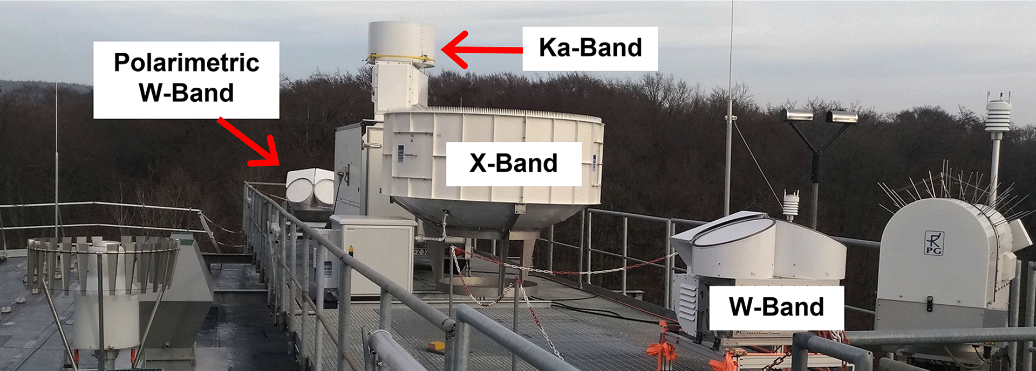
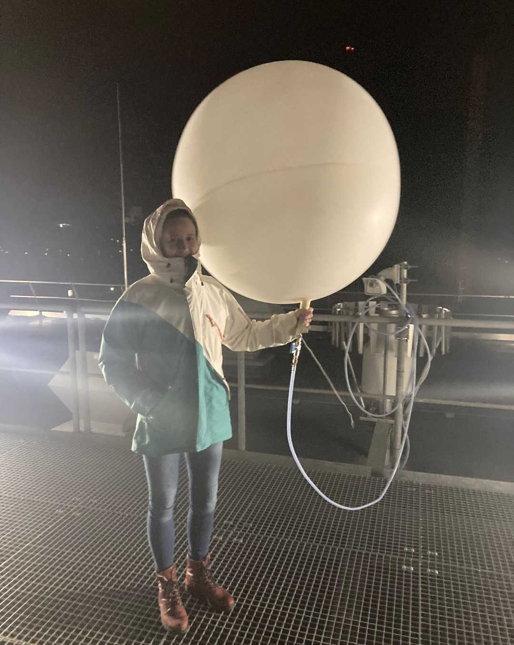
Two radar campaigns:
Jülich – Germany
Tripex-pol
Nov 2018 – Jan 2019
Zenith X, Ka, W-Band
Scans pol. W-Band
15 Radiosondes
Tripex-pol-scan
Dec 2021 – Feb 2022
Zenith X-Band
Scans with pol. W-Band and Ka-Band
50 Radiosondes

Slide 26
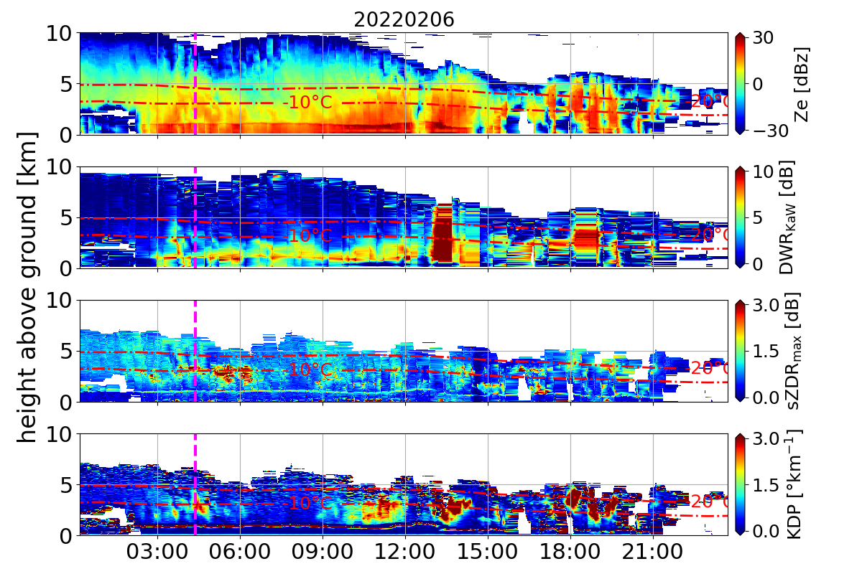
The Dendritic Growth Layer – a case study:

Slide 27
Why Fragmentation?
Status of SIP research: (as in talk from Korolev at ICCP 2021)
Description | Mechanism | # Lab works | Lab studies quantification | # years | simulations
 | Droplet fragmentation during freezing | 35 | Work-in-progess (ongoing) | 69 | Early stage
 | Splintering during riming (HM process) | 22 | Work-in-progess (ongoing) | 61 | Yes physical mechanism under debate
 | Fragmentation during ice-ice collision | 2 | Work-in-progess (deeply hybernated) | 49 | Early stage
 | Fragmentation during sublimation | 9 | Work-in-progress (deeply hibernated) | 47 | Early stage
 | Activation of INPs in transient supersaturation | 5 | Not attempted | 49 | no

Slide 28
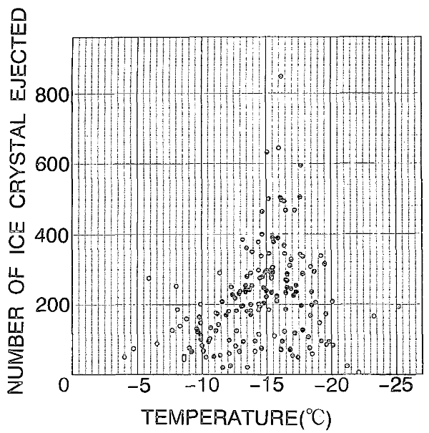
Why Fragmentation?
Fragmentation:
Fragile dendritic arms growing on ice particles and aggregates
Arms break off during collisions
Potential to be active over wide parameter range (not like other SIP)
Problem:
Very little understanding
Grzegorczyk, ACP 2023
Takahashi 1995

Slide 29
Outlook McSnow simulations
Fragmentation produces 2. Mode with reasonable sZDR
KDP is too small – can we produce more fragments?
Which conditions are most favourable for fragmentation?
Are there other explanations for 2. Mode?
Local enhancement of relative humidity → INP get activated and new ice crystals are formed
Both hypothesis are currently investigated in more detailed with a statistical approach!

Slide 30
Conclusions
Observations show an increase in number concentration in DGL alongside second mode and enhanced sZDR
Simulations indicate that second mode might be more likely related to fragmentation than new INP activation
… of course more simulations are needed to investigate in a more objective way…
… more information on fragmentation is needed to constrain fragmentation scheme in McSnow …

Slide 31
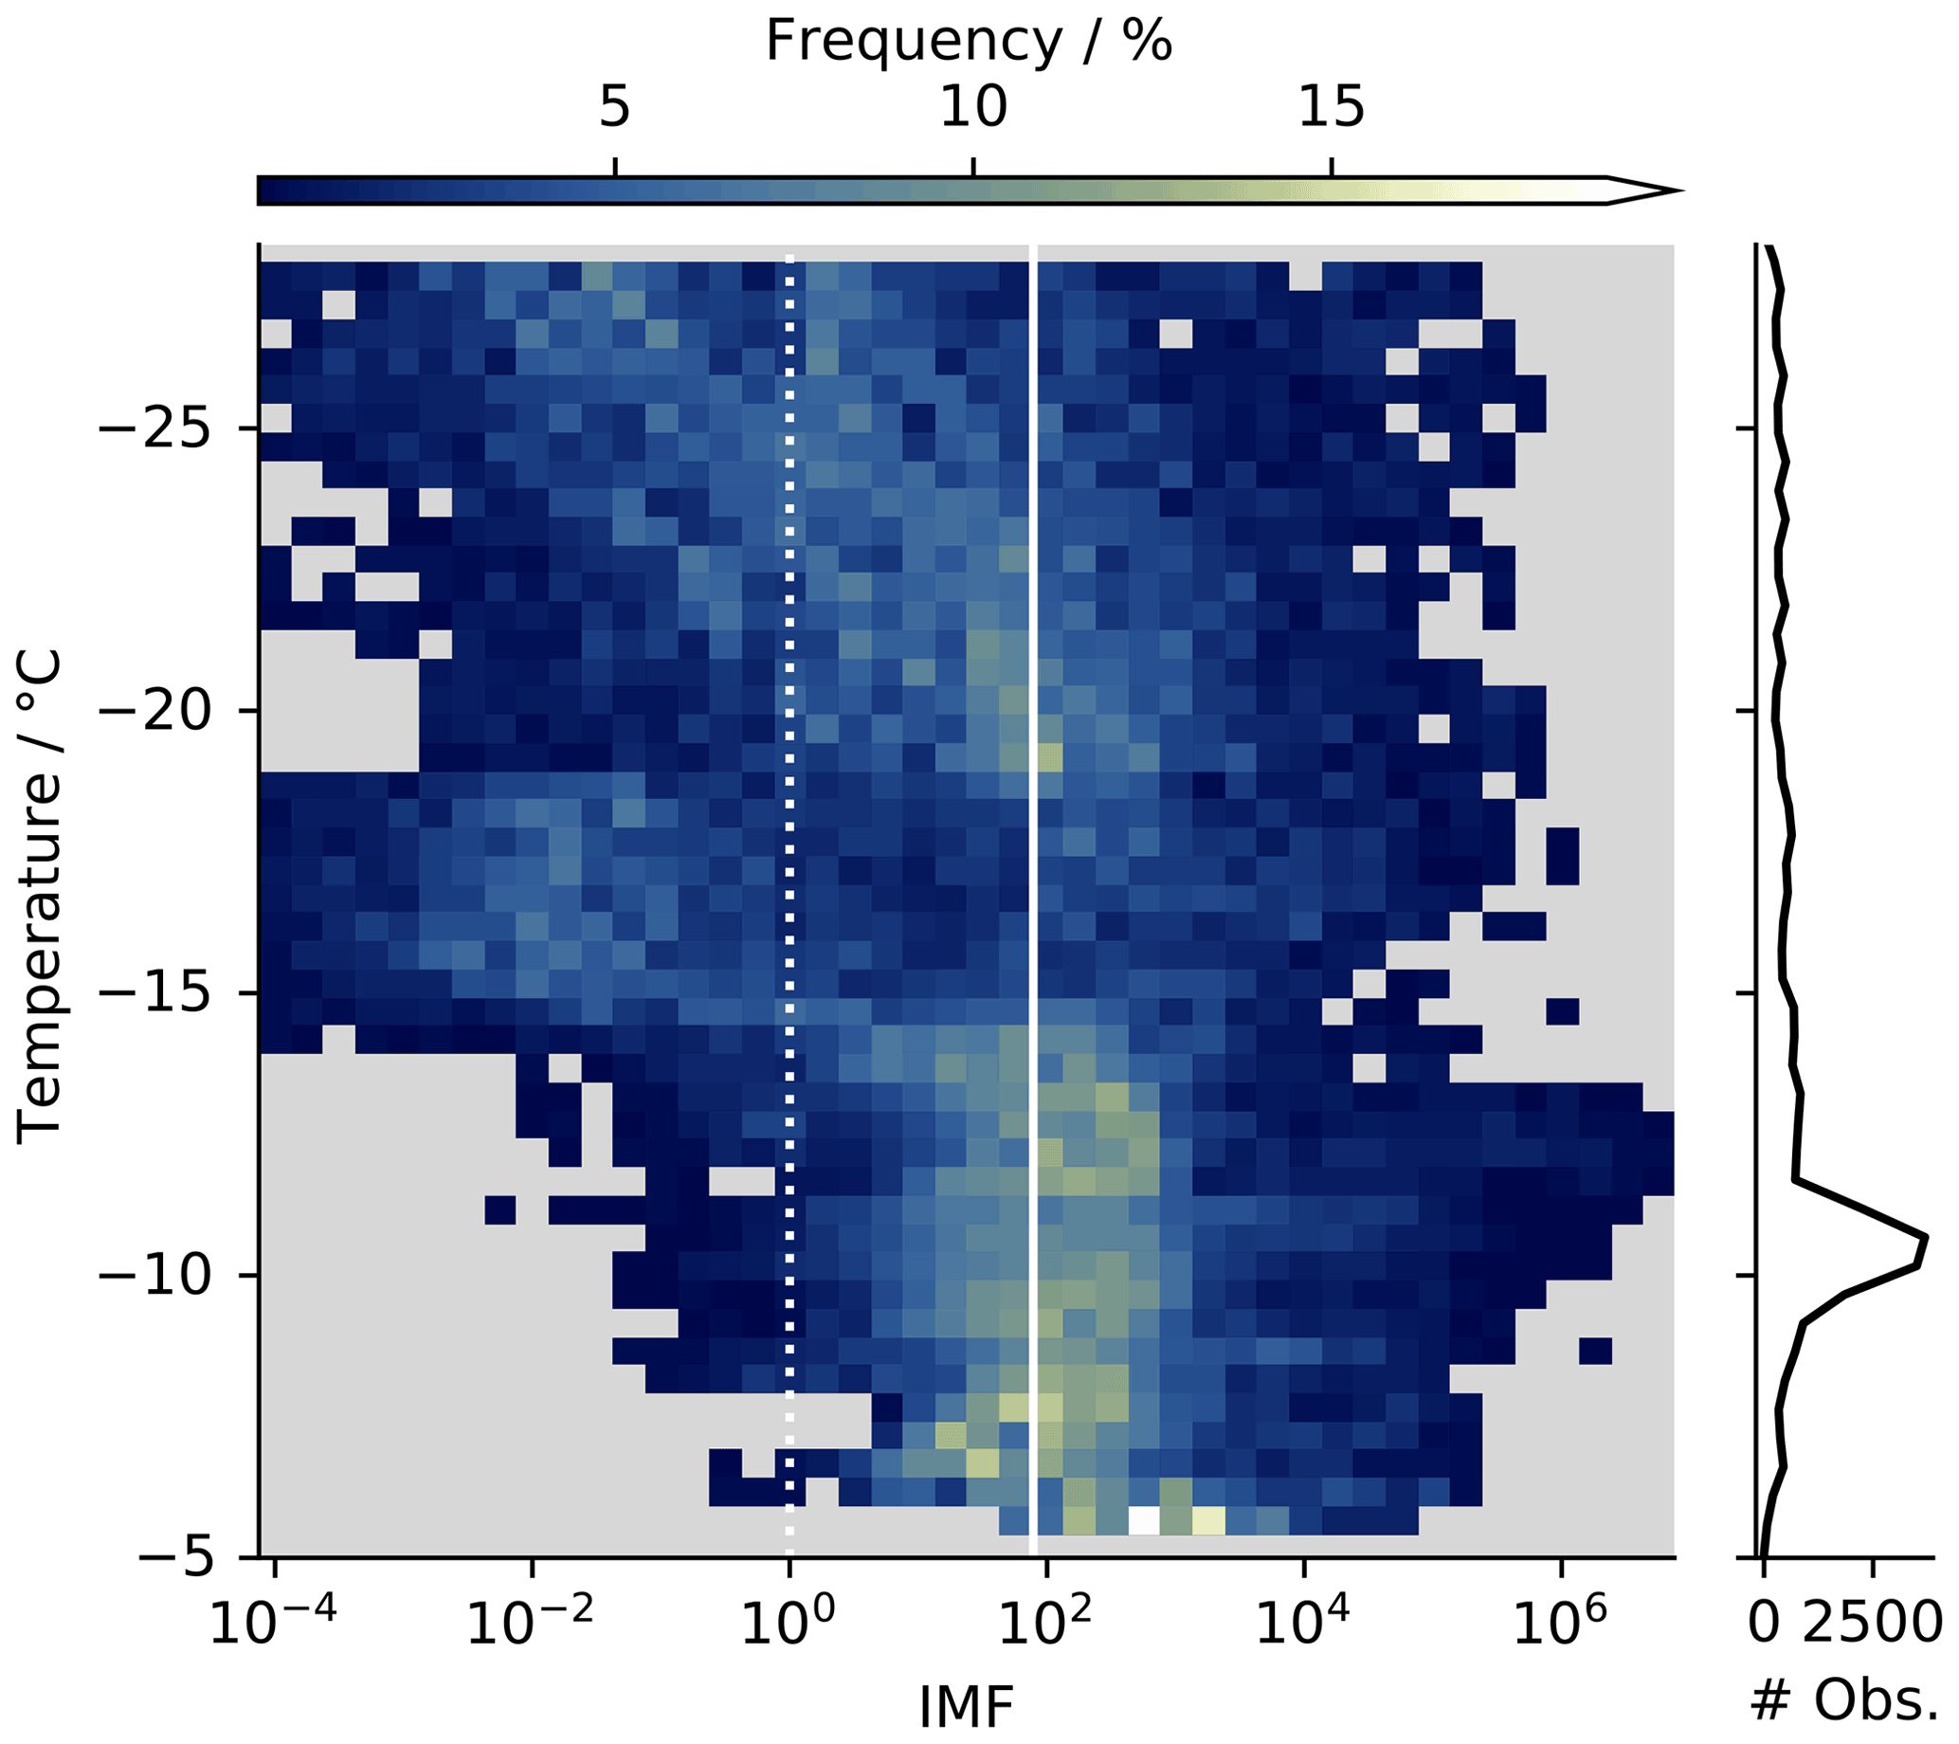
Why Fragmentation?
factor 10 to 100 more ice particles (IP) observed than ice nucleating particles (INP) measured
E.g. ice multiplication factor $IMF=\frac{N(IP)}{N(INP)}$
Secondary ice production (SIP)
???
Hallett-Mossop ??
Wieder et al. ACP, 2022

Slide 32
Multi-month spectral polarimetric multi-frequency radar dataset
Radars only observe the effect of microphysical processes, not the processes themselves!!
→ Model where current knowledge of microphysical processes is implemented and hytpothesis can be tested
von Terzi, ACP 2022
Do ice – ice collisions in the DGL cause fragmentation?
Ice nucleating particles (INP) get activated and produce new primary ice

Slide 33
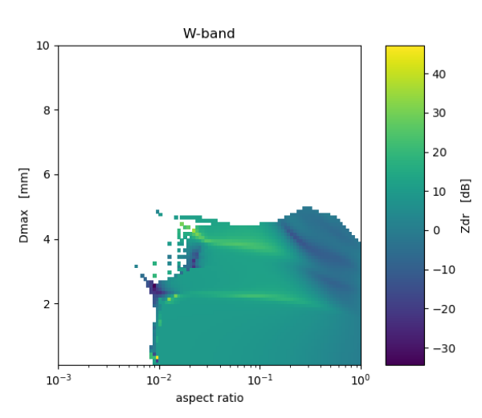
Forward simulations: from T-matrix to DDA
Tmatrix has a convergence problem!
Courtesy of Davide Ori

Slide 34
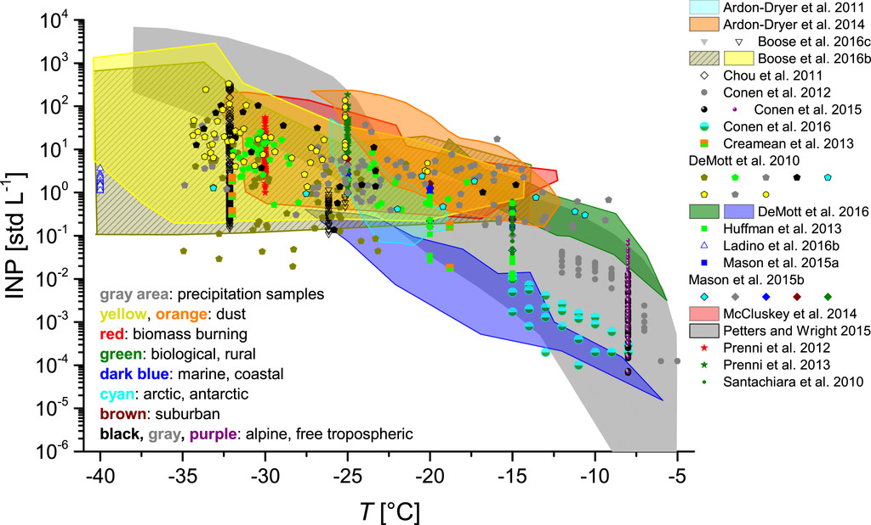
Are new INP activated in DGL?
Mode of aggregates from above
Second nucleation layer in DGL
Nucleation rate was adapted to have 2-3 $L^{−1}$ ice crystals in the second mode
McSnow mit habit prediction (Welss, JAMES 2023)
Atmosphere setup:
Temp: const. Lapse rate
Rhi: 105% (median of radiosonde observations)

Slide 35
Are new INP activated in DGL?
Simulation
KDP too small → not enough particles?
Particles not asymmetric enough?
sZe too small → particle concentration or size too small
sZDR too small → aspect ratios too large
Observation

Slide 36
The Lagrangian Monte-Carlo particle model
Radar only sees effect of ice microphysical processes (IMP) on the observed particle distribution, not the IMP themselves!
→ Let‘s combine observations with a model in which current knowledge of IMP can be implemented
Lagrangian Particle Models:
predict motion and evolution of individual particles
Monte-Carlo approach:
group particles with similar microphysical properties into super-particles
McSnow predicts evolution of super-particles due to
Deposition → habit prediction (Welss et al. 2024)
Aggregation
Riming
Secondary ice production
i.e. fragmentation

Slide 37
Our radar setup:
Jülich – Germany
Tripex-pol
Nov 2018 – Jan 2019
Zenith X, Ka, W-Band
Scans pol. W-Band
15 Radiosondes
Tripex-pol-scan
Dec 2021 – Feb 2022
Zenith X-Band
Scans with pol. W-Band and Ka-Band
50 Radiosondes

