Slide 1
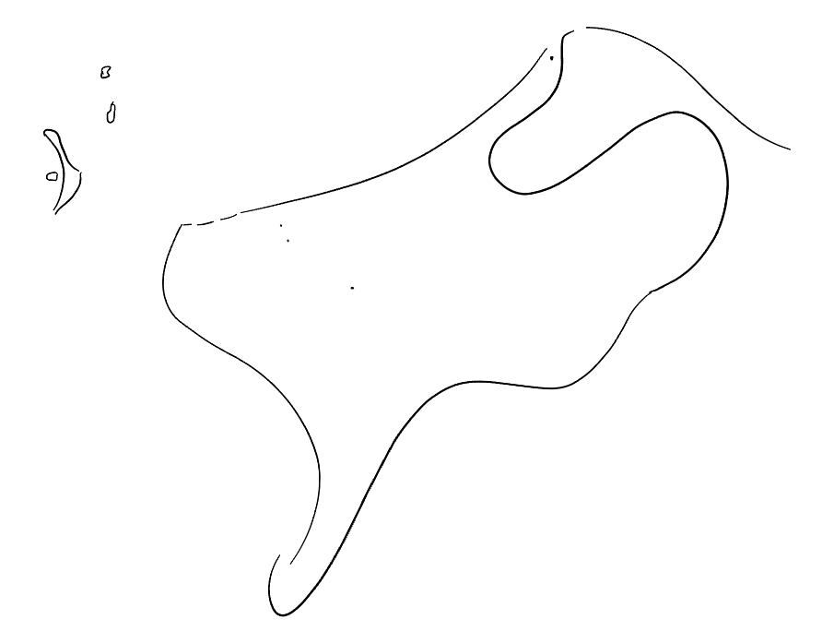

Towards smarter weather radar
PrePEP // 20-03-2025
Shafi Sardar // Marc Schleiss
Dept. of Geoscience and Remote sensing
Faculty of Civil Engineering and Geoscience
A simulation study on adaptive scanning strategies for improved precipitation monitoring and forecasting
Notes:
25 sec
What is the best possible way to measure the observed precipitation.
Measuring fast-changing weather events. -- > increased observations of extreme weather events.

Slide 2
Context of this research
Weather radar networks are growing in number, size and variety
Unrealised potential
Radars operate using independent scanning techniques
Larger focus on better radar data processing rather than improved data collection strategies.
Notes:
25 sec
We have so many weather radars now, more radars = better…
More countries are investing in national weather radar networks.
There is unrealised potential… With this research we want to work towards tapping into potential synergies between weather radar networks.

Slide 3
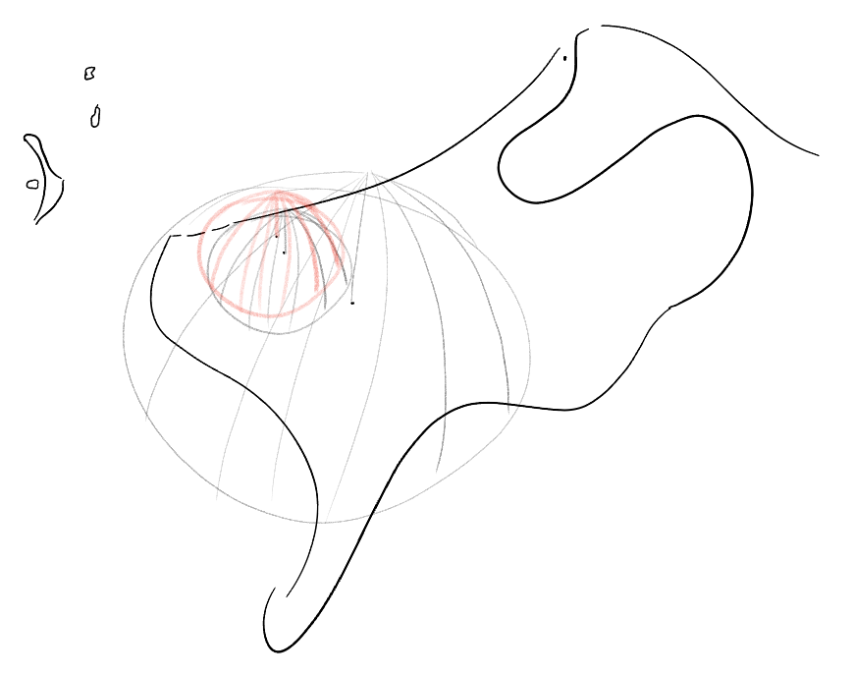
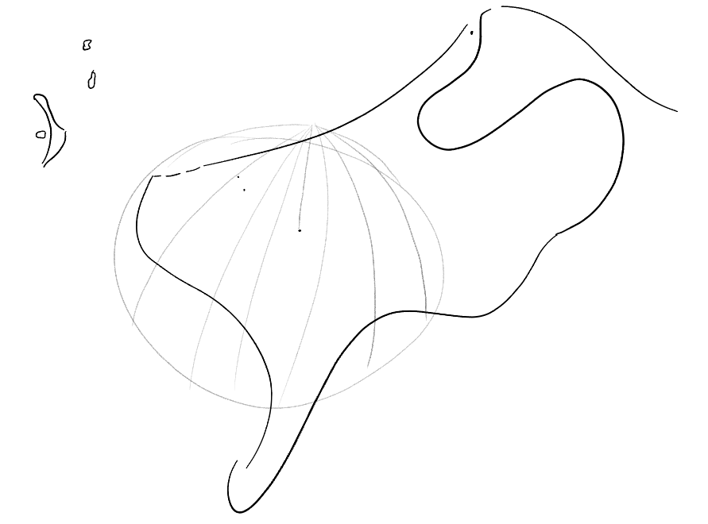
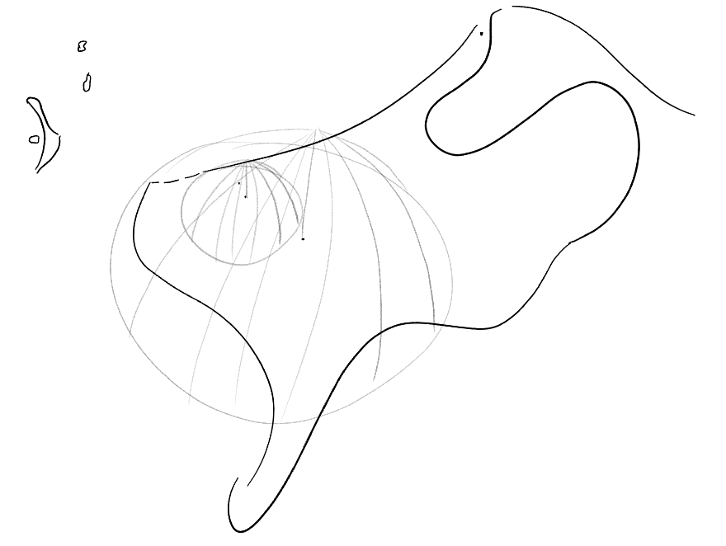
Problem statement
Weather radar network in the Netherlands
  KNMI C-band radar // Herwijnen – Fixed scanning
  X-band radar // Rotterdam – Fixed scanning
  MESEWI X-band radar // Delft – Adaptive scanning
How can we best exploit adaptive
scanning capabilities?
Notes:
30 sec
The network we work with and we will eventually study is one in the Netherlands.
Explain the network,
national C-band radar, fixed scanning pattern, regional X-band radar, fixed scanning pattern, regional X-band radar, we can play with this radar (we have our own radar).
The question is, how can we best use our own adaptive weather radar to compliment/collaborate with the other radars?
Well ok… what can we adapt for a single radar, and how does this change the quality of the information it produces?

Slide 4
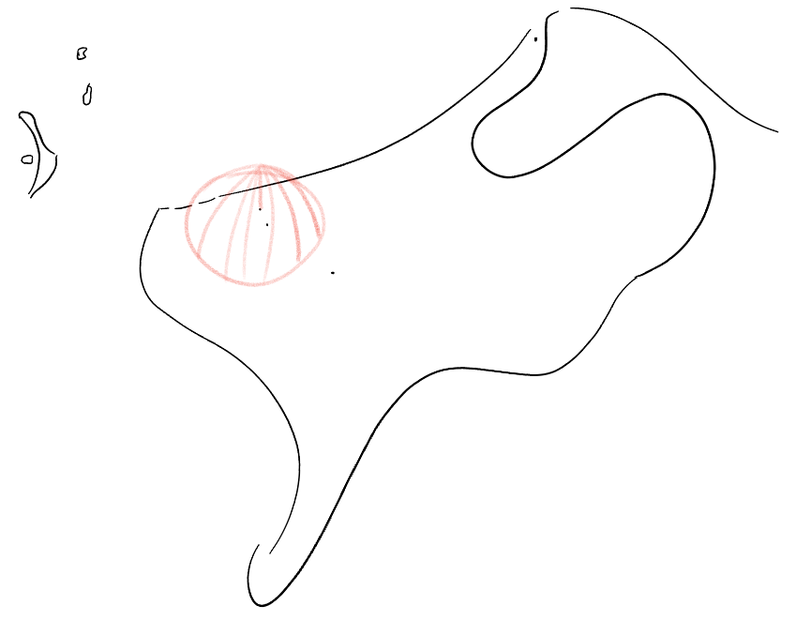
Examples of adaptive scanning
Changing where a radar looks:
  Radial measurements (plan position indicators)?
  Only scanning certain sectors?
  Elevation scans?
Changing how a radar looks:
  Sensitivity of the radar?
  Sampling frequency?
  Rotation speed?
Notes:
20 sec.
For a single radar, we can change where a radar looks [explain], or how a radar looks… [explain]
FOR a simple case study, we explore the rotation speed in radial measurements… (planned position indicators. ) as an adaptiation

Slide 5
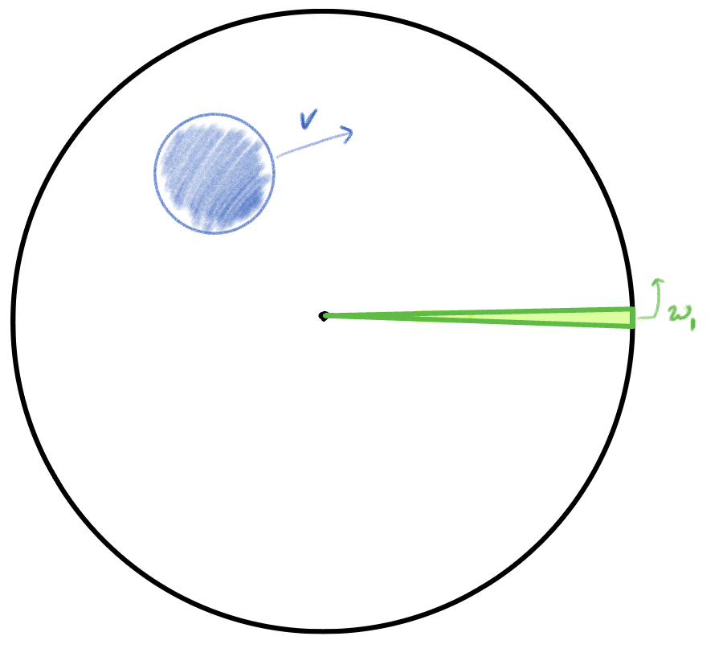
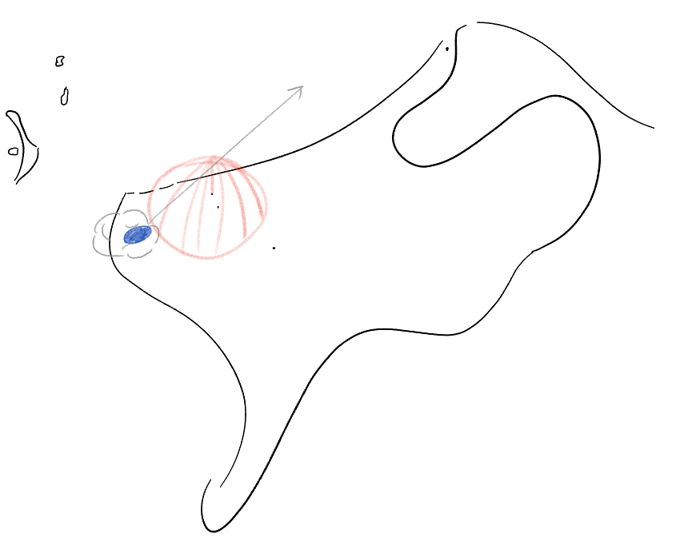
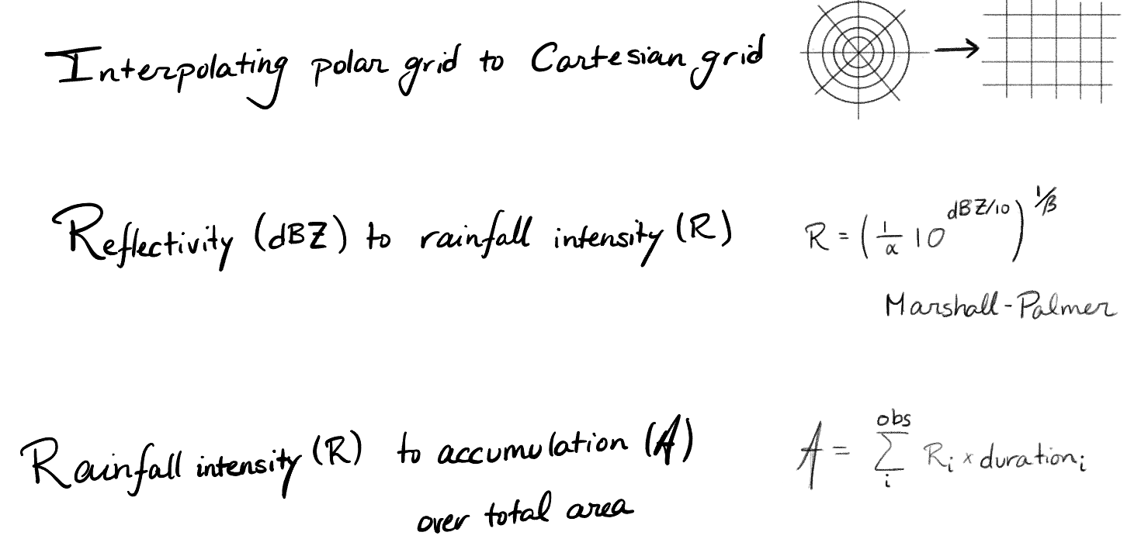
How does rotation speed influence measurements?
A simple situation – 1 raincell
A simple radar model – plan position indicator
A simple processing chain – reflectivity
Notes:
45 sec
We need to test!
We start with a simple situation,
We have a simple radar model
We have a simple processing chain.

Slide 6
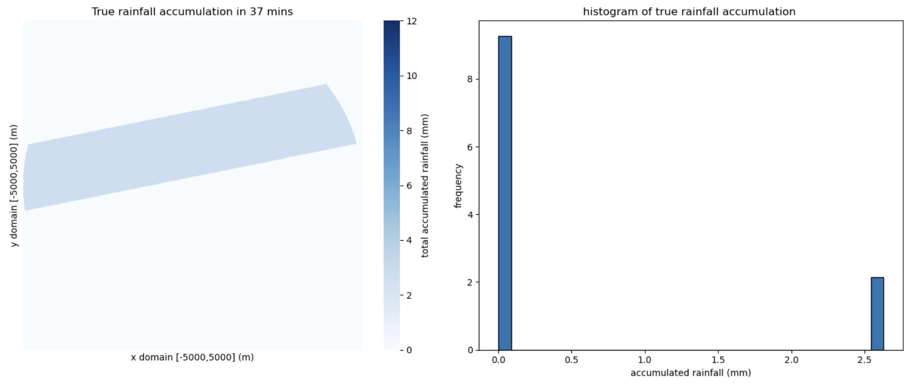
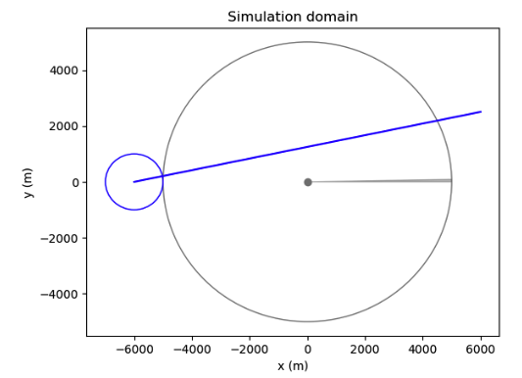
Simulation setup
path of the rain cell
radar
radar beam
rain cell
Notes:
1 min
Just so we have numbers…
Weather radar:
-- range resolution of 50m,
-- max range of 5000 m
angular resolution of 1 degree
Anuglar speeds from 1/6 to 6 RPM.
Rain cell core:
-- constant speed (5m/s), intensity (45 dBZ), radius (1km),
-- path is linear...
important notes...
Attenuation free measurements,
no non-meteorological returns. i.e. what we see is rain.
The true rainfall accumulation map then is…. Note we have PERFECT INFORMATION (no measurement noise, no discrete observation times.)
We have perfect info (slide 6) and radars give only imperfect measurements.

Slide 7
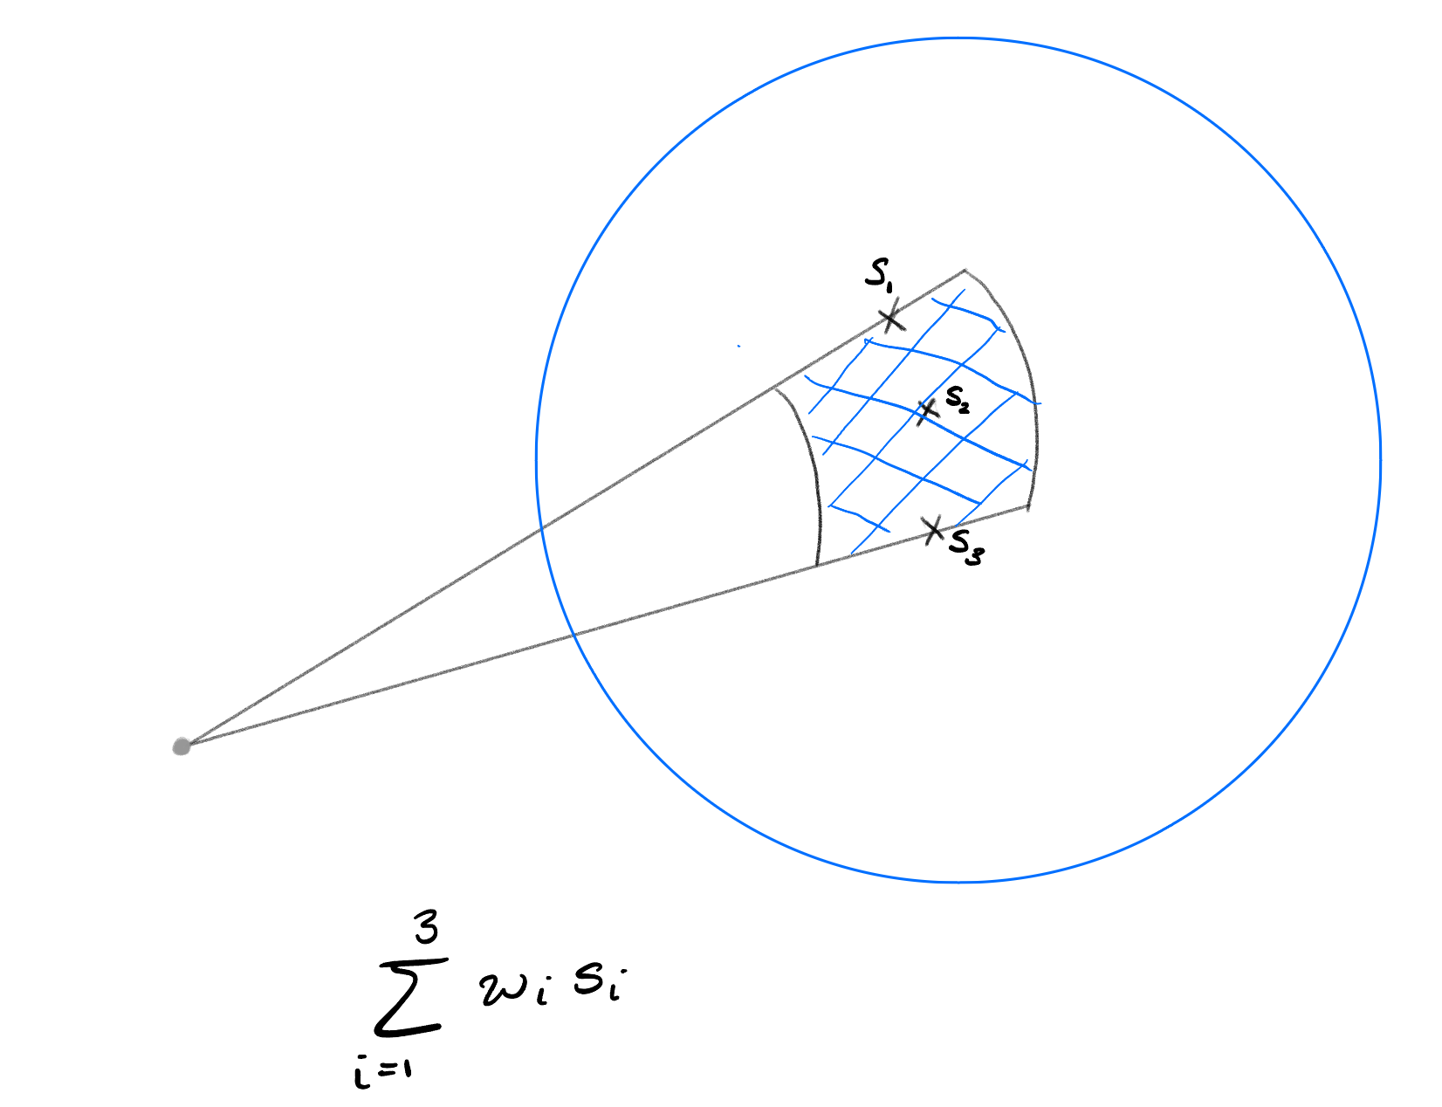
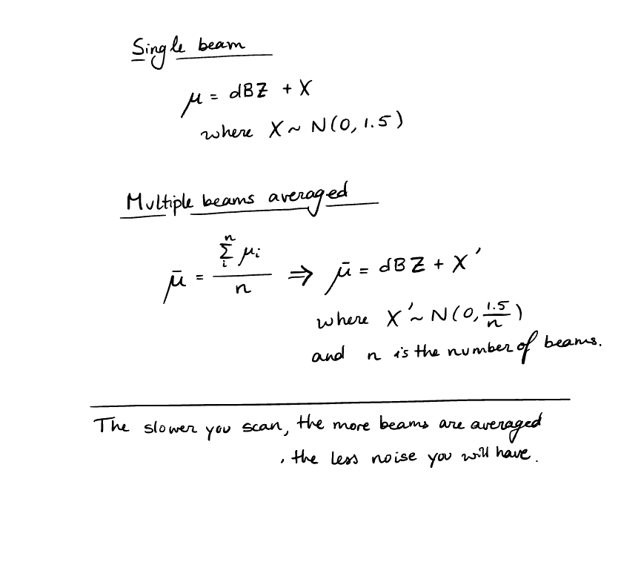
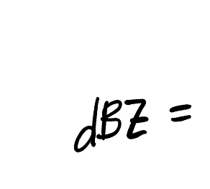
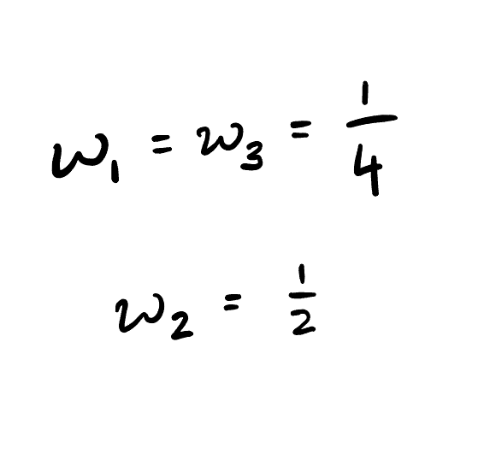
Sampling method and noise model
radar beam
radar
rain cell
Notes:
We add two imperfections, one is partial observations with sampling in the beam. The other is measurement noise. Measurement noise scales with speed.
1 min
We start with the sampling method. For realism, we sample at three points within the range gate… with the largest weight given to the sampled point in the centre.
To go to the noise model:
ADDITIVE noise! For a single beam.
We implemented slower scanning by integrating over more beams…
The noise get averaged out.
Two imperfections in the measurements… see what the effect is…

Slide 8
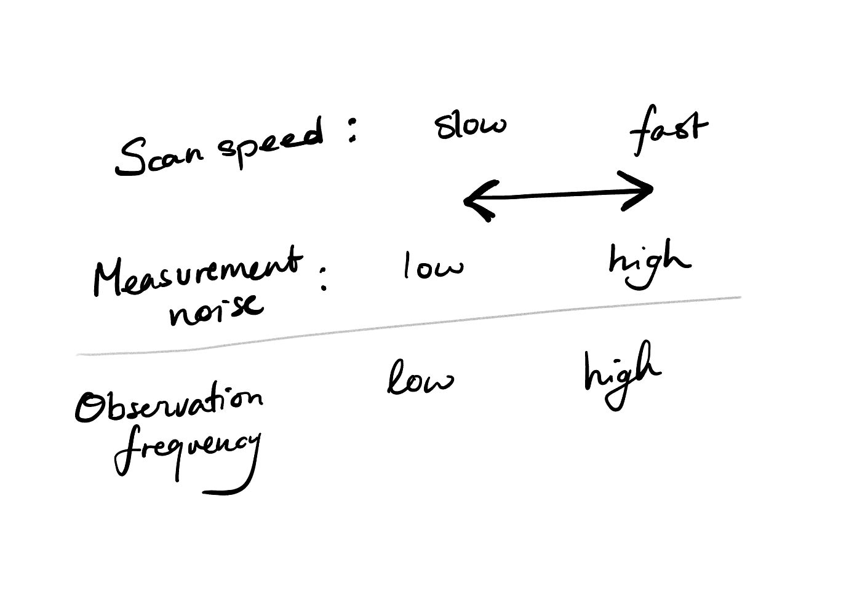
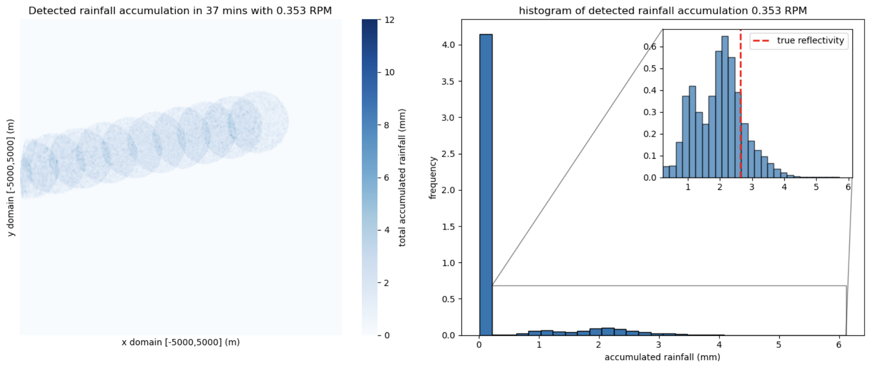
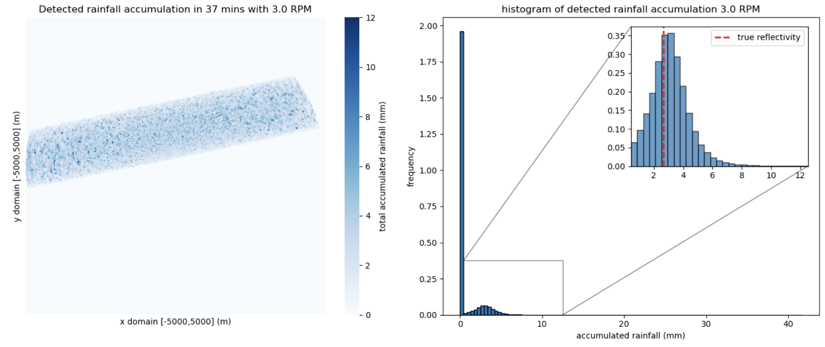
Measurement noise & rotation speed
Notes:
1 min
We have the true rainfall accumulation?
What happens when we have imperfect information?
Two outputs of scanning at two different speeds… slow and fast…
*click*
-- measurement noise, and observation frequency.
The slower you scan, the better your measurement noise (noise model), but the less frequently you see the rain cell…
The faster you scan, the worse your measurmenet noise, but the more frequently you see the rain cell.

Slide 9
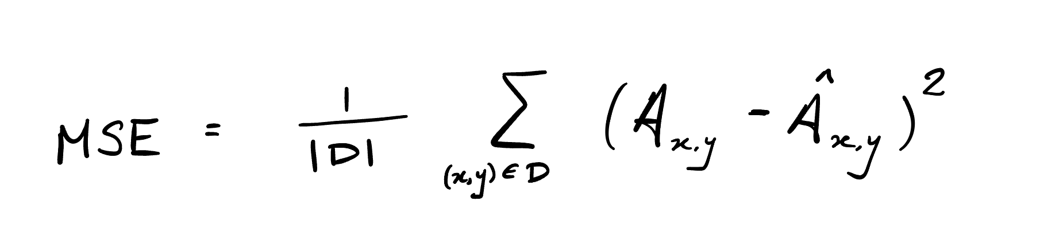
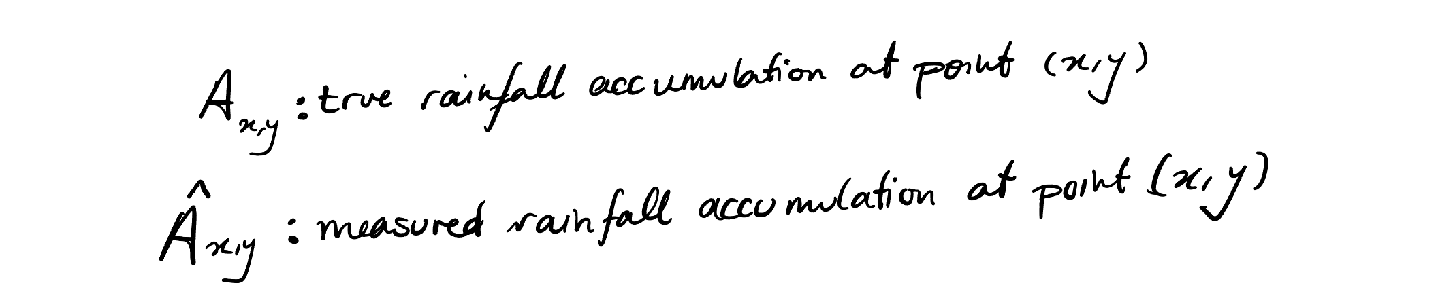
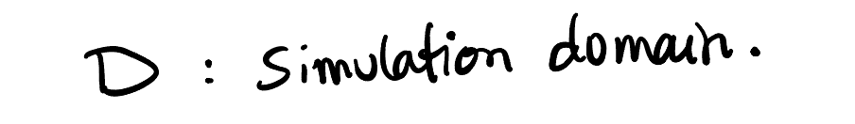
What do we compare?
Mean squared error
Is no rain measured as no rain?
Is present rain measured correctly?
Notes:
Well… what do we compare?
We compare the true rainfall accumulation to the measured/observed rainfall accumulation…
Mean squared difference.
Good for checking zeros (true negatives)
Good for checking non-zeros (true positives…)
Combines everything in one number… but fine, it’s a standard choice of metric.

Slide 10
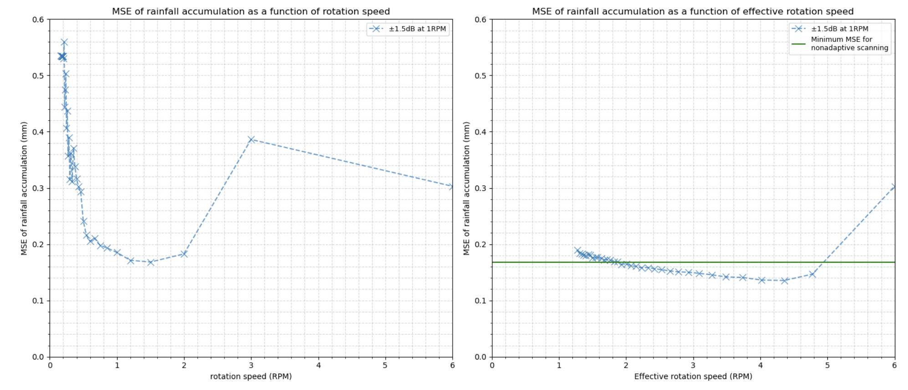
Simulation result
Balance between the measurement noise
  and the observation frequency
Notes:
3 min
What are we looking at?
The mean squared error between the observed and the true rainfall accumulation at a given rotation speed.
We have the interplay between measurement noise and observation frequency…
There is a balance between number of observations (given no temporal interpolation) and the measurement noise!!
Is there an optimal rotation speed balancing these? YES!!
Is there a way where our observation is high and our measurement noise is low? Can we look to adaptive scanning?
Welllll we can test it using simulations!
Yes!!

Slide 11
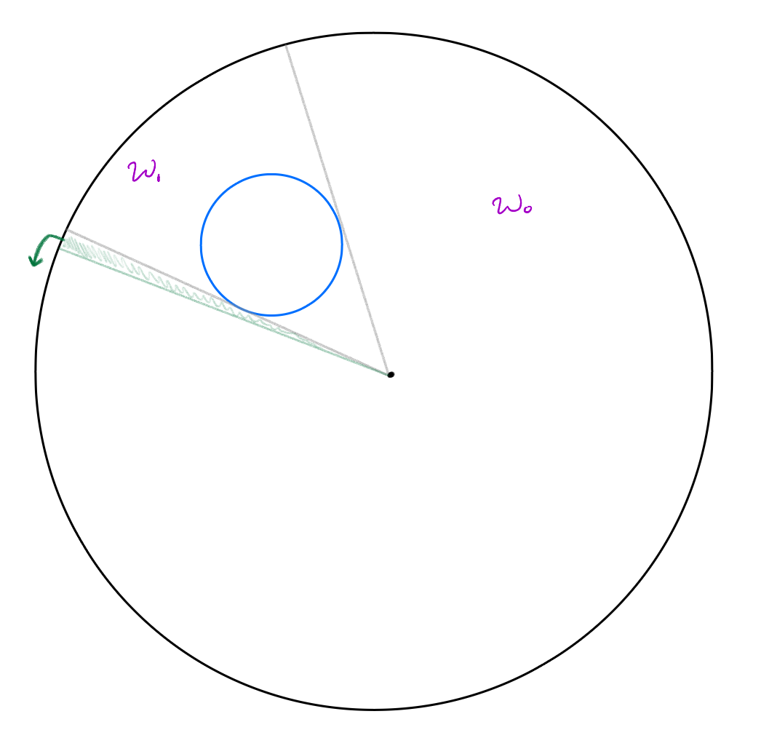
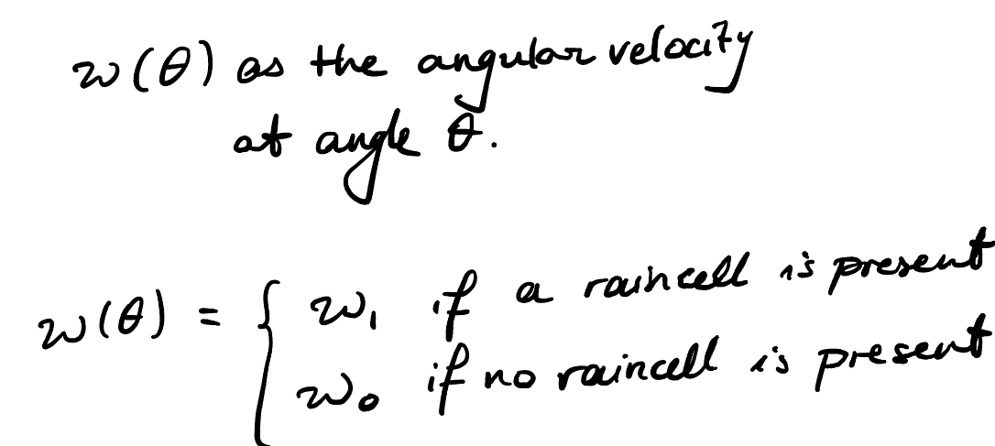
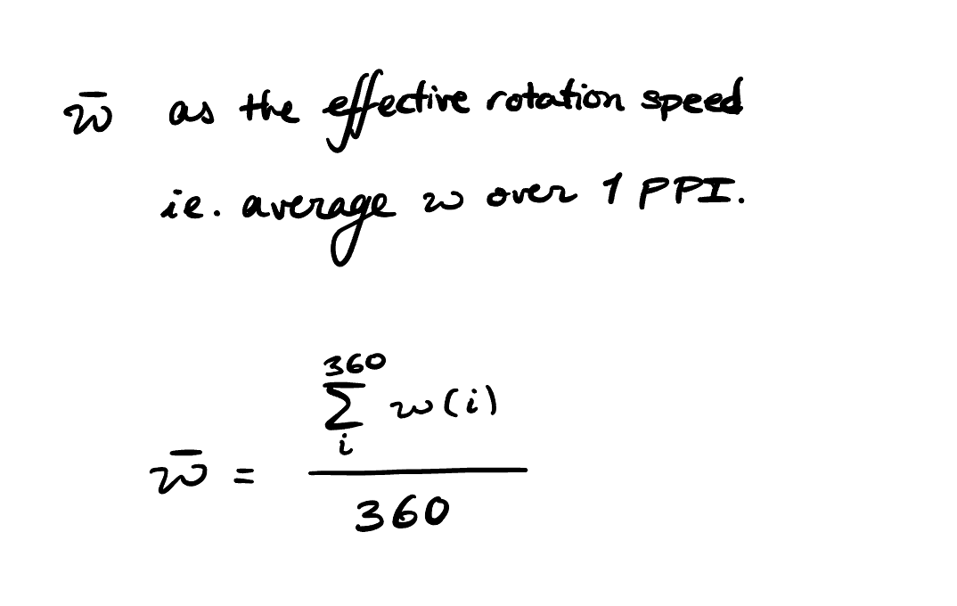
Variable rotation speed
Go slow if you see rain, go fast if you do not
Notes:
Ok so how should we scan?
e.z. go slow if you see rain, go fast if you don’t.
If there is no rain, noisy measurements make no difference.
Just to formulate it explicitly:
There is now a slight nuance…. Instantanious rotation speed no longer equals the overall rotation speed.
We have to start looking at an effective rotation speed…
i.e. the average rotation speed over 1 PPI.

Slide 12
Variable rotation speed
Go slow if you see rain, go fast if you do not
Notes:
So if we compare the mean squared error between the true and observed rainfall using adaptive scanning, we se the following.
The green line is the minimum of a constant rotation speed. And only sometimes does the variable rotation speed outperform the constant rotation speed.
There are bad adaptations, there are good adaptations… limits om instruments might exclude other configurations…
Now we can analyse scanning techniques given a model of the whole pipeline: of a situation, the radar scanning and the processing chain.
My point is not that this simple rain-cell, radar model, processing chain combination is the best.
My point is that, once we have these graphs, we can connect the dots… we can quantify whether the stress on the engine is with the extra mm accuracy in the forecast. This was with MSE, can do with another performance metric. Can make it as crazy as you would like… only looking at extremens.

Slide 13






Conclusions
Even a simple case shows us the delicate balance between measurement noise and observation frequency
More quantitative tests on scanning strategies are required
A lot of possible improvements:
  Multiple radars
  Variable rainfall intensity
  The vertical dimension
NWO OTP grant SMARTER – 19959
S. Sardar // M. Schleiss // A. Pappas // F. Fioranelli
Notes:
Toy model: Even this simple case shows us the delicate balance between measurement noise and observation frequency, with more testing the effect of rain-cell size, speed, and path can all be tested.
Quantitative testing gives more objective metrics on scanning strategies… easier comparison and decision making on what strategy is best to use.
Model can still be improved... Of course.
Variable intensities…
Multiple raincells….
Going into the third dimension…!
We focus on multiple radars in a network, and variable intensities of rain-cells.
Before I move to questions I want to thank our partners, and the other members in our team.

Slide 14
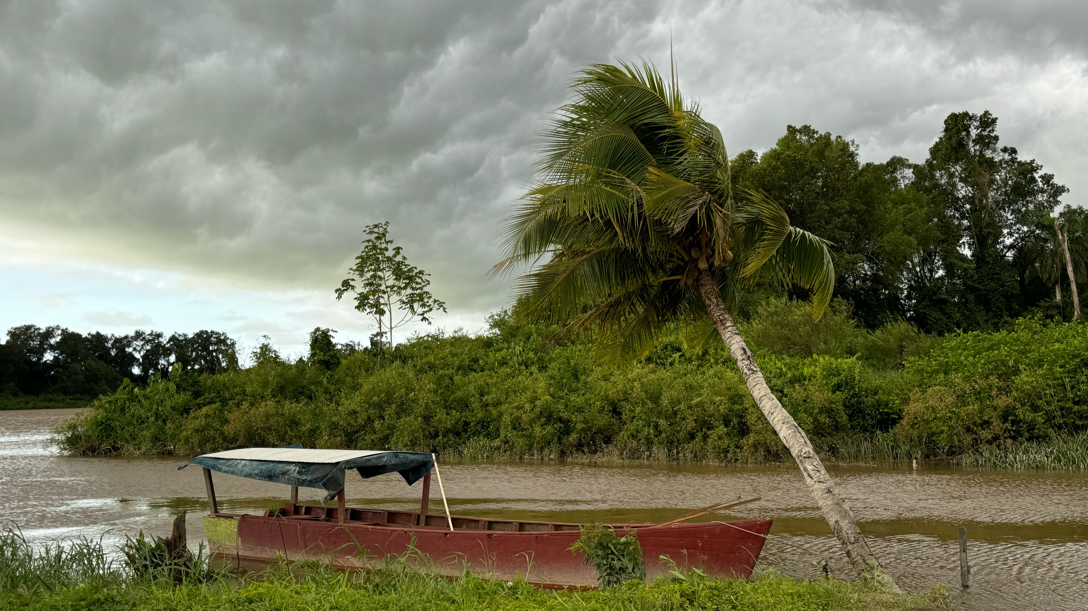
Notes:
I am now ready to open the floor for questions.

Slide 15
Simulation result
Notes:
3 min
What are we looking at?
The mean squared error between the observed and the true rainfall accumulation at a given rotation speed.
There is a minimum!! There is a balance between number of observations (given no temporal interpolation) and the measurement noise!!
Is there an optimal rotation speed balancing these?
Can we design a new scanning strategy having the best of both worlds?
Yes!!
There are bad adaptations, there are good adaptations… limits om instruments might exclude other configurations…
Now we can do policy analysis of scanning techniques given a model of the whole pipeline.
My point is not that this simple rain-cell, radar model, processing chain combination is the best good.
My point is that, once we have these graphs, we can connect the dots… we can quantify whether the stress on the engine is with the extra mm accuracy in the forecast. This was with MSE, can do with another performance metric. Can make it as crazy as you would like… only looking at extremens.
What other information does this simulation quantify?
is the breadth of the minimum in the adaptive scanning robust... does it stay the same?
changes relative to rain size.....
function of range....
how the beam propagates... getting to the systematic effect.
one for rotation speed one for measurement noise.

Slide 16
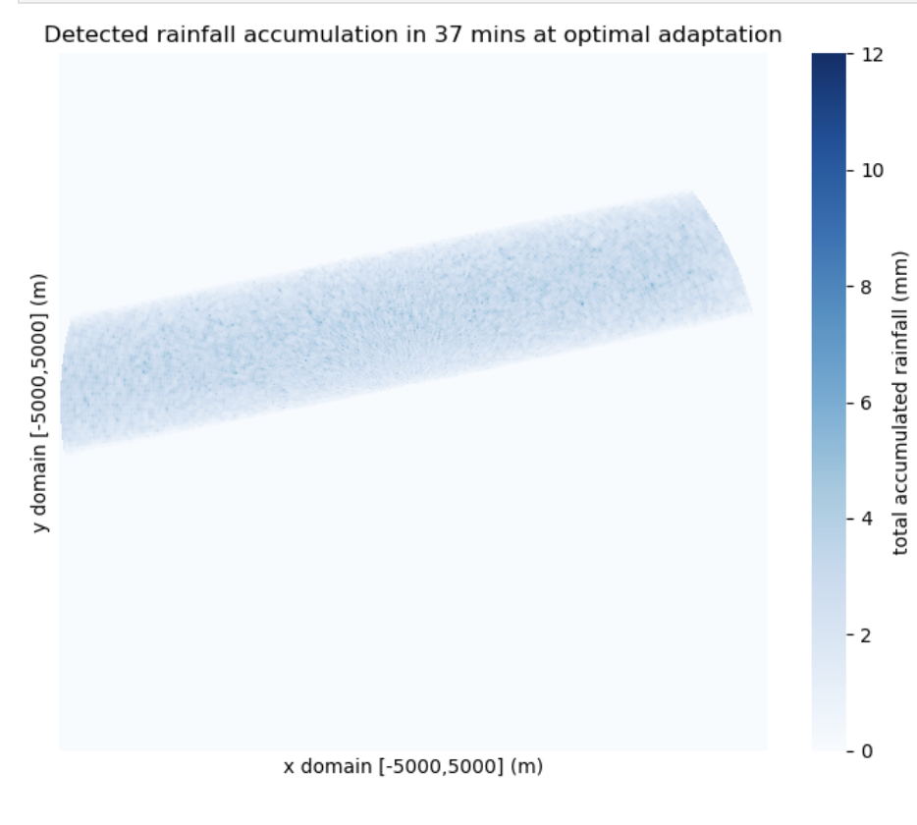
Sanity check
Notes:
Just to make sure our results are physical….
Yeah this seems ok. It seems like it’s the best of both worlds….
Now lets look at another way of looking at the same information… the frequency of values.

Slide 17
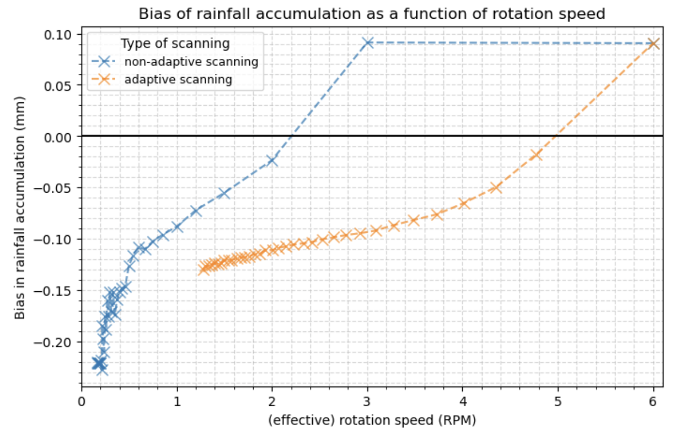
Bias?

