Slide 1
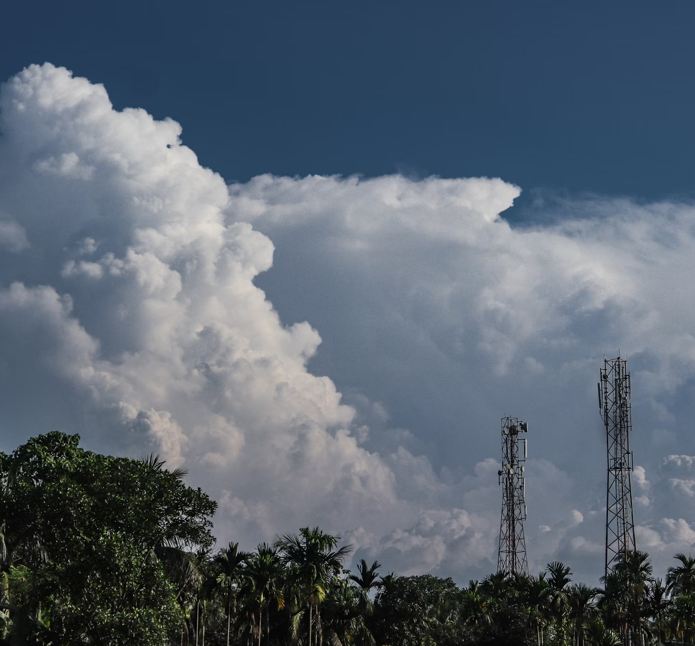
Tropical rainfall nowcasting with Commercial Microwave Links
Bas Walraven¹, Ruben Imhoff² , Aart Overeem³, Miriam Coenders¹, Rolf Hut¹, Luuk van der Valk¹ & Remko Uijlenhoet¹
¹ Delft University of Technology, Delft, The Netherlands ² Deltares, Delft, The Netherlands ³ Royal Netherlands Meteorological Institute (KNMI), De Bilt, The Netherlands
Source: Unsplash

Slide 2
Rainfall retrieval from CMLs
Path averaged rainfall intensities derived from signal attenuation along the path
Attenuation of the microwave signal through scattering and absorption by raindrops
R = ak^{b}
Mobile network operators typically log received signal levels (RSL) for quality control purposes
Minimum and maximum RSL every 15 minutes
Path-averaged rainfall intensity (mm h⁻¹), R
specific attenuation (dB km⁻¹), k
a, b; coefficients dependent on frequency and DSD
Source: Unsplash

Slide 3
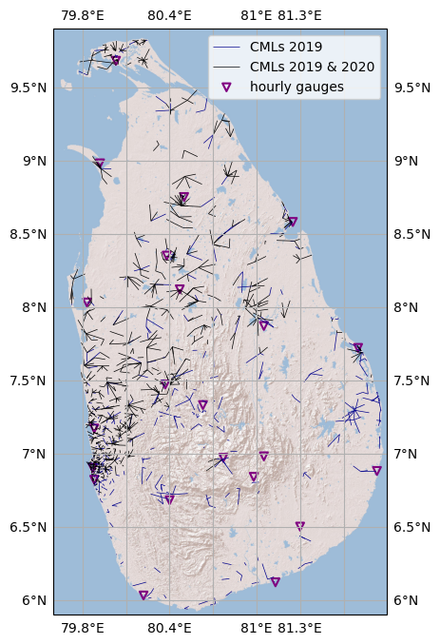
Tropical CML data set
Sri Lanka
CML data from one of the mobile network operators in Sri Lanka
Minimum and maximum RSL levels every 15 minutes
From 2570 sub-links across 1328 unique link paths
21 hourly reference rain gauges
Overeem et al. (ERL, 2021) & Walraven et al. (JHM, 2024)

Slide 4
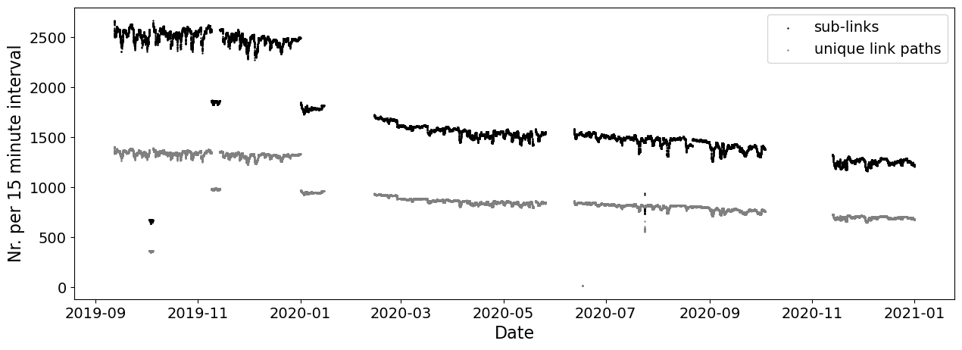
Tropical CML data set
CML data from one of the mobile network operators in Sri Lanka
Minimum and maximum RSL levels every 15 minutes
From 2570 sub-links across 1328 unique link paths
For 15 months (Sept. 2019 – Dec. 2020)

Slide 5
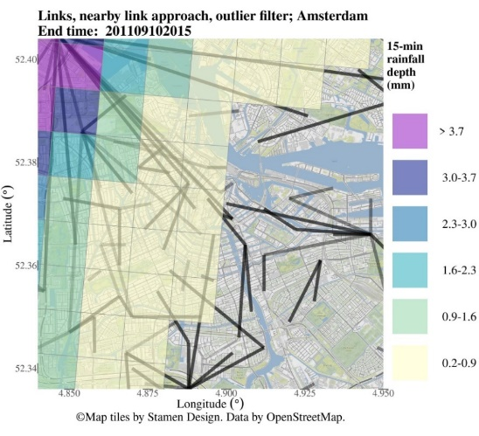
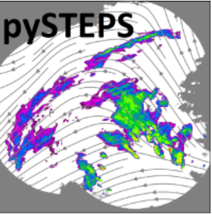
Methods: Estimating QPE and QPF
Open-source R-package “RAINLINK”
15-minute min/max RSL
2D rainfall field
From dB to mm hr⁻¹
2x2km grid
https://github.com/overeem11/RAINLINK
Overeem et al. (AMT, 2016)
From observation to forecast
Nowcast: lead time up to 3 hours
2D rainfall field
t+15
t+30
…
t+180
20 ensembles
Lucas Kanade optical flow
Semi-Langrangian advection

Slide 6
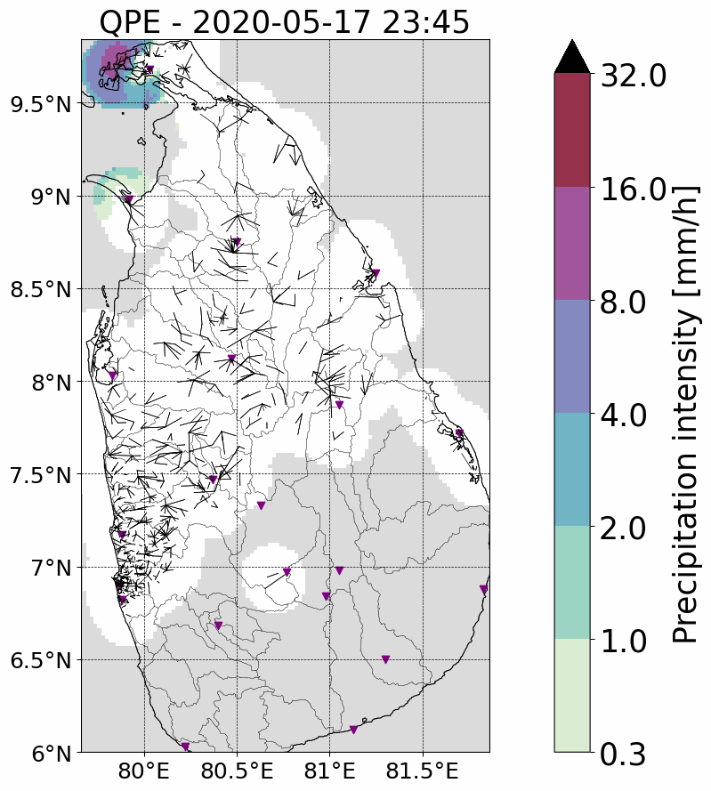
Quantitative precipitation estimates (QPE)
QPE from interpolated CML rainfall maps
Areas more than 18 km from a link are masked
Case study 1h event: 18 May 2020 02:30 – 03:30 (and the three preceding hours)

Slide 7
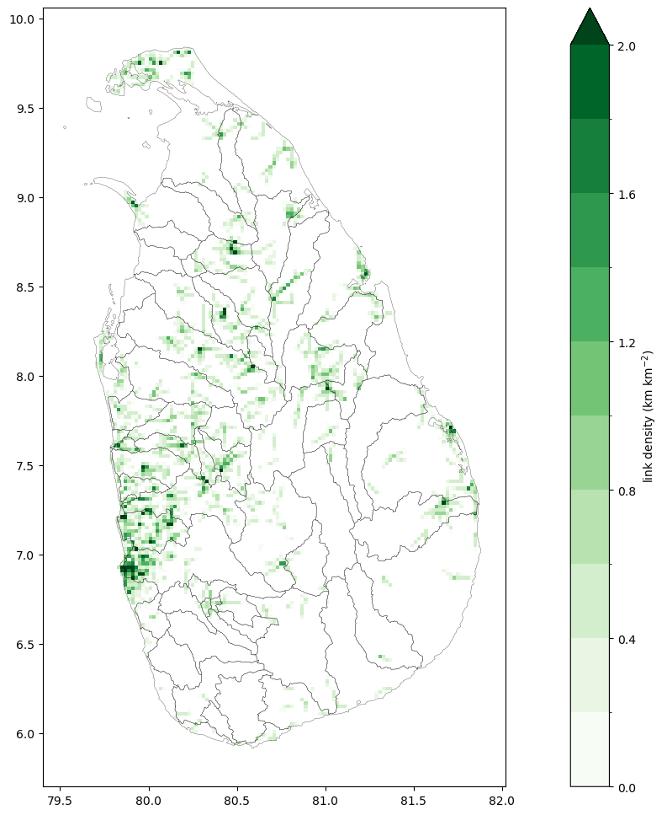
What influences skillfulness?
Link density per pixel (2x2 km)
Link density per catchment
Total number of links per catchment
Catchment size
Catchment location w.r.t. dominant wind direction
Catchment location w.r.t. to land/sea borders
Notes:
If we compare the QPE to QPF we see there are definitely some similarities In this animiation, by the time ‘our’ 1h event occurs this nowcast has a lead time of 90 minutes.
But we also clearly see some discrepancies.
First of all the nowcast doesn’t always see the event coming, storm cells appear in the QPE that are not picked up or picked up too late by the QPF, especially at the edges of the domain.
Secondly, the nowcast has difficulty following the storm cells, especially at longer lead times we see the cells disappear the rain is more ‘smeered’ out.

Slide 8
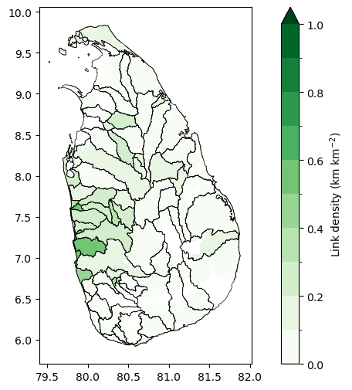
What influences skillfulness?
Avg. link density per catchment
Link density per catchment
Total number of links per catchment
Catchment size
Catchment location w.r.t. dominant wind direction
Catchment location w.r.t. to land/sea borders
From a “hydrological perspective”:
what factors influence the forecast skill?
Notes:
If we compare the QPE to QPF we see there are definitely some similarities In this animiation, by the time ‘our’ 1h event occurs this nowcast has a lead time of 90 minutes.
But we also clearly see some discrepancies.
First of all the nowcast doesn’t always see the event coming, storm cells appear in the QPE that are not picked up or picked up too late by the QPF, especially at the edges of the domain.
Secondly, the nowcast has difficulty following the storm cells, especially at longer lead times we see the cells disappear the rain is more ‘smeered’ out.

Slide 9
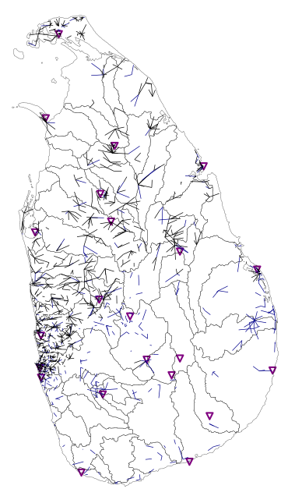
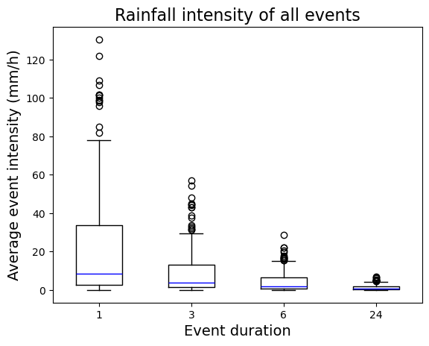
Selecting events to nowcast
SIM
NEM
FIM
SWM
Sept. 2019
Sept. 2020
68 catchments
4 seasons
4 durations (1, 3, 6, and 24 hrs)
2 events per duration
Notes:
As a result of the shift of the ITCZ, Sri Lanka also has distinct seasons, that bring moisture at different times of the year, depending on the dominant wind direction.

Slide 10
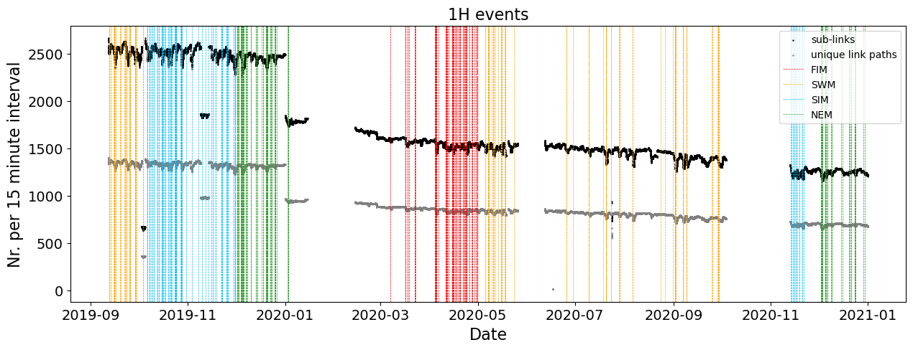
Selecting events to nowcast
SIM
NEM
FIM
SWM
Sept. 2019
Sept. 2020
68 catchments
4 seasons
4 durations (1, 3, 6, and 24 hrs)
2 events per duration
Notes:
As a result of the shift of the ITCZ, Sri Lanka also has distinct seasons, that bring moisture at different times of the year, depending on the dominant wind direction.

Slide 11
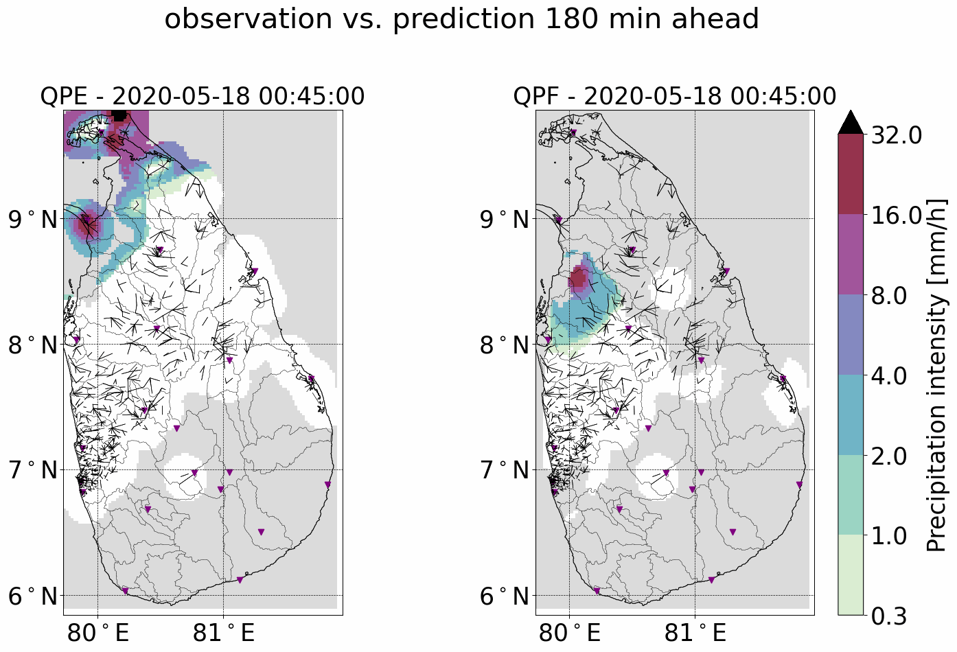
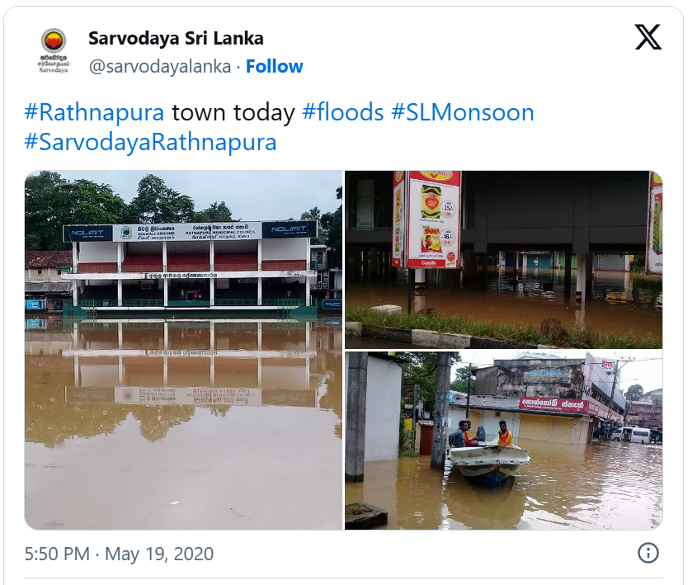
The “early-warning perspective”
How long before the event takes place
can we already predict it?
Notes:
If we compare the QPE to QPF we see there are definitely some similarities In this animiation, by the time ‘our’ 1h event occurs this nowcast has a lead time of 90 minutes.
But we also clearly see some discrepancies.
First of all the nowcast doesn’t always see the event coming, storm cells appear in the QPE that are not picked up or picked up too late by the QPF, especially at the edges of the domain.
Secondly, the nowcast has difficulty following the storm cells, especially at longer lead times we see the cells disappear the rain is more ‘smeered’ out.

Slide 12
Correlation coefficient
Correlation based on a pixel by pixel comparison within the catchments
Skillful from 45 minutes before the event and onwards
No large differences across the seasons
Skillful lead time seems fairly insensitive to event duration (i.e. average intensity)
Notes:
So is it only challenges?
Well not only. If we look at the 1h event we consider.
The animation shows the QPE, based on CMLs, which actually underestimate the event. But this is a big event, up to 60mm in an hour!
Since these high intensity cells tend to appear almost out of nowhere, you see that in the hour the event takes place the prediction from 60 minutes ago is actually quite for off because it has as input the entire hour before. This is also the reason we see a large overestimation in the succeeding hour.
However, in almost all cases the spread in the ensembles given by the error bars is able to capture the QPE pretty well, for low and high intensity events.
And of course we’ve focused mostly on the uncertainties related to the QPF, there are uncertainties associated with the QPE too, but it’s not always trivial to completely separate the two.
Now to put this whole story in perspective of this session a little bit, we will looked a precipitation dataset based on CMLs, used it an application, specifically nowcasting, and discussed some of the uncertainties that are associated with applying this dataset.
But if I could leave you with one thought it would be that:
Though there is still room for improvement, considering the lack of rainfall data sets in areas that would benefit most from such applications, it’s also just time to start using the data that we do have.

Slide 13
STEPS (probabilistic) vs. Eulerian persistence
Correlation based on a pixel by pixel comparison within the catchments
STEPS slightly more skillful and precise than Eulerian persistence
Notes:
So is it only challenges?
Well not only. If we look at the 1h event we consider.
The animation shows the QPE, based on CMLs, which actually underestimate the event. But this is a big event, up to 60mm in an hour!
Since these high intensity cells tend to appear almost out of nowhere, you see that in the hour the event takes place the prediction from 60 minutes ago is actually quite for off because it has as input the entire hour before. This is also the reason we see a large overestimation in the succeeding hour.
However, in almost all cases the spread in the ensembles given by the error bars is able to capture the QPE pretty well, for low and high intensity events.
And of course we’ve focused mostly on the uncertainties related to the QPF, there are uncertainties associated with the QPE too, but it’s not always trivial to completely separate the two.
Now to put this whole story in perspective of this session a little bit, we will looked a precipitation dataset based on CMLs, used it an application, specifically nowcasting, and discussed some of the uncertainties that are associated with applying this dataset.
But if I could leave you with one thought it would be that:
Though there is still room for improvement, considering the lack of rainfall data sets in areas that would benefit most from such applications, it’s also just time to start using the data that we do have.

Slide 14
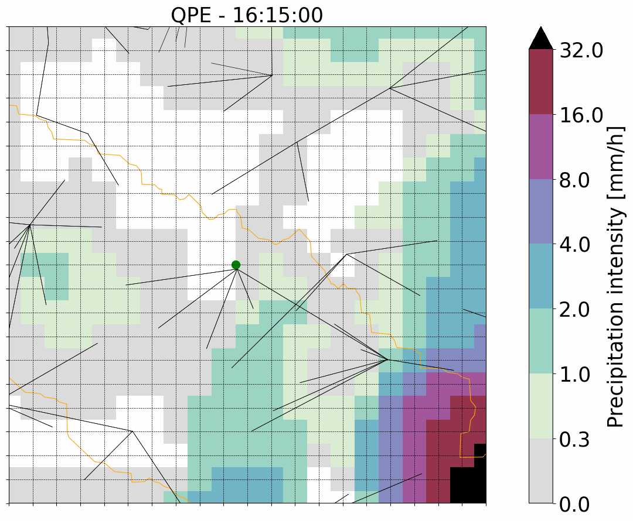
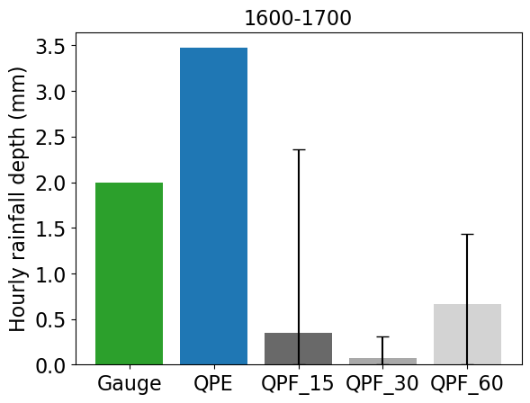
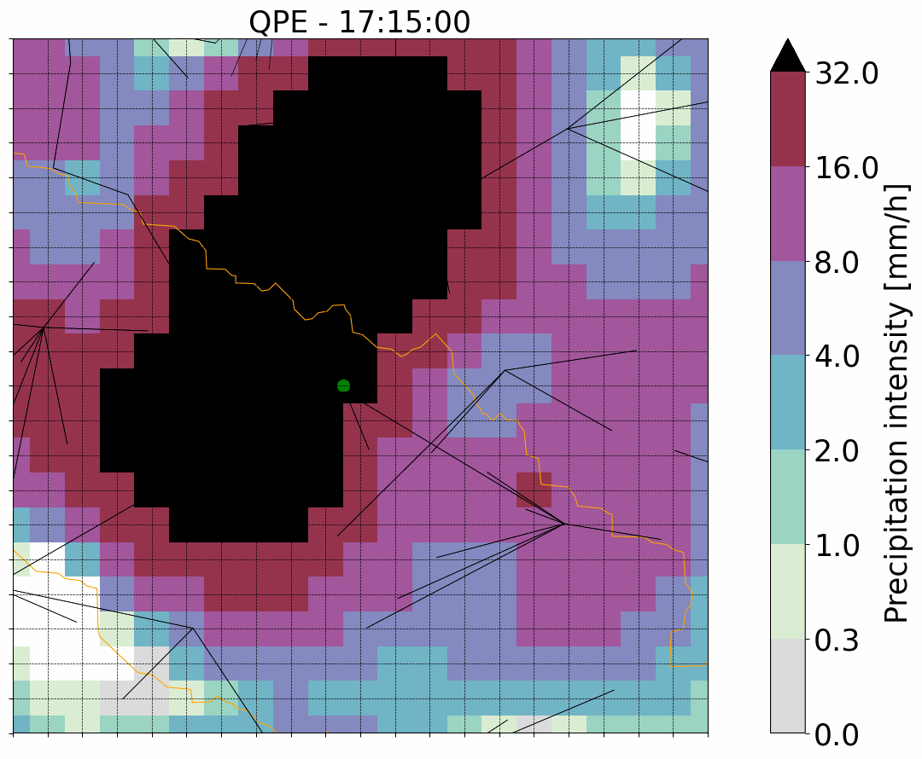
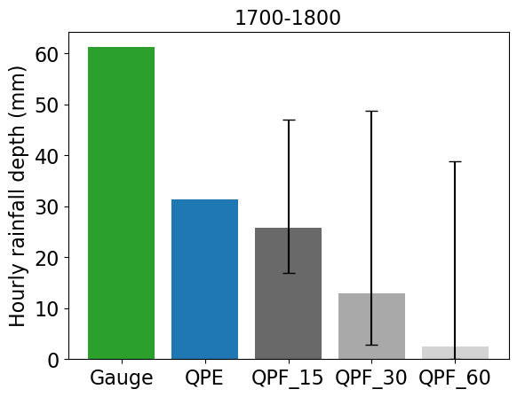
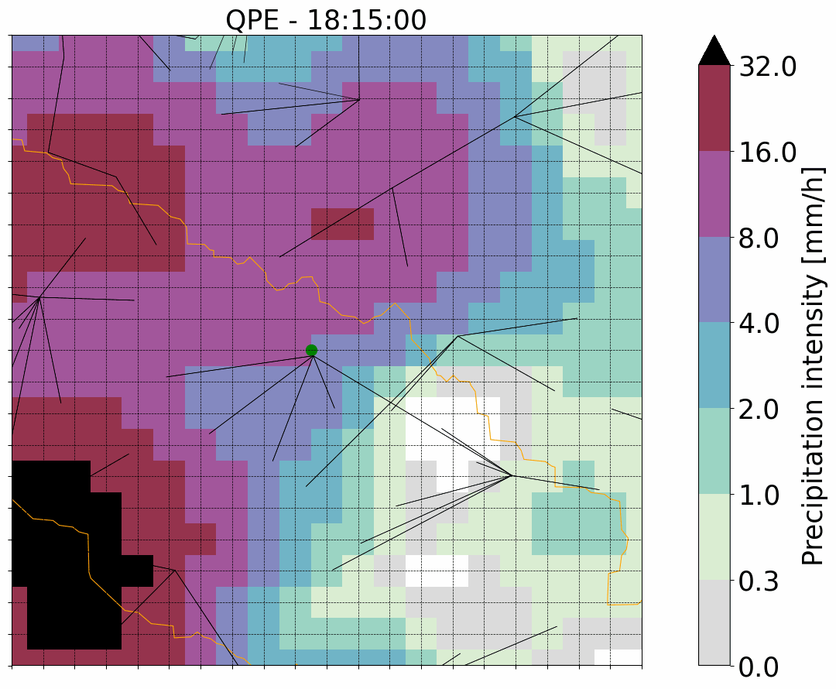
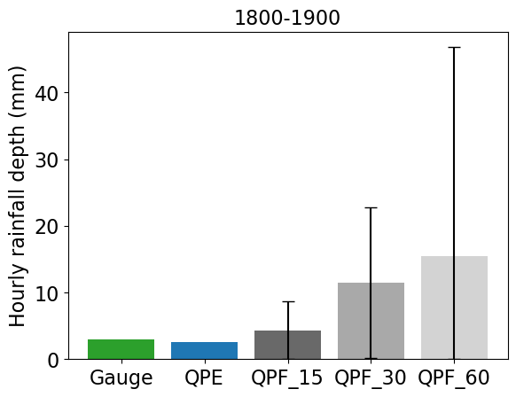
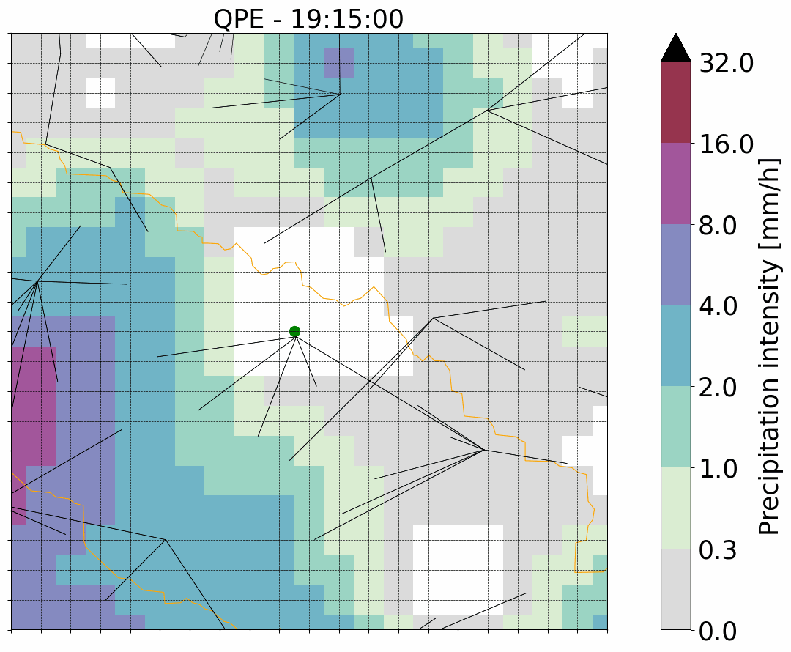
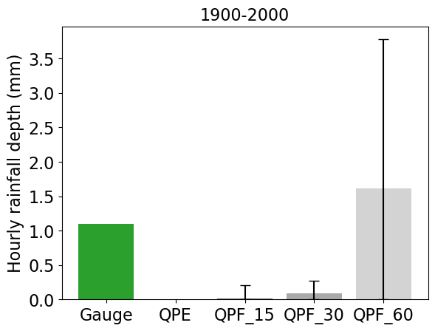
QPF vs. point reference
16h00 -17h00
Rain gauge
17-18h:
61.2 mm
Event from 17h00 – 18h00:
QPF15: input from 16h45 – 17h45
QPF30: input from 16h30 – 17h30
QPF60: input from 16h00 – 17h00
Error bars indicate the spread in the ensembles
event
18h00 -19h00
19h00 -20h00

Slide 15
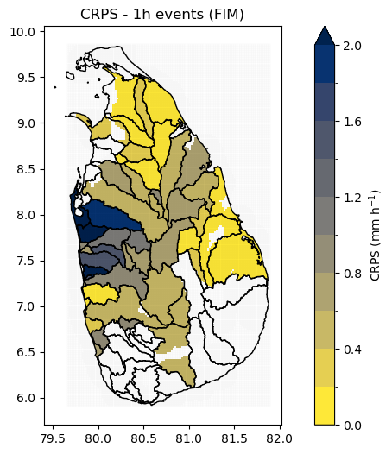
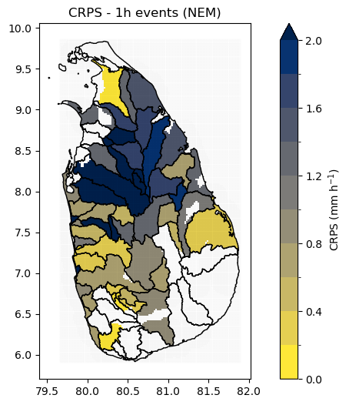
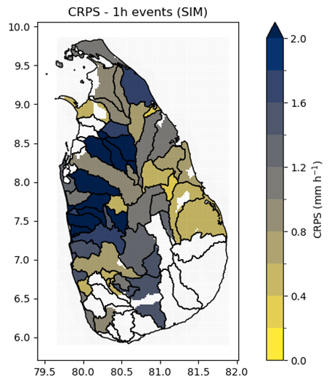
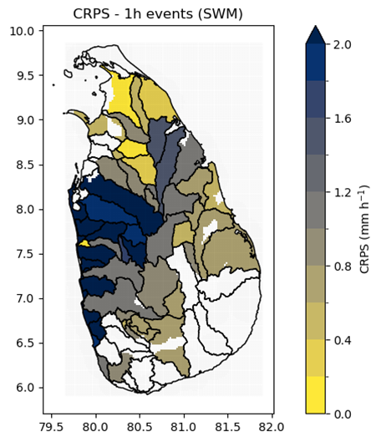
Continuous Ranked Probability Score
CRPS based on a pixel by pixel comparison within the catchments
The error in monsoon seasons is (of course..) higher
Though this coincides with location of landfall of the dominant wind direction
Notes:
So is it only challenges?
Well not only. If we look at the 1h event we consider.
The animation shows the QPE, based on CMLs, which actually underestimate the event. But this is a big event, up to 60mm in an hour!
Since these high intensity cells tend to appear almost out of nowhere, you see that in the hour the event takes place the prediction from 60 minutes ago is actually quite for off because it has as input the entire hour before. This is also the reason we see a large overestimation in the succeeding hour.
However, in almost all cases the spread in the ensembles given by the error bars is able to capture the QPE pretty well, for low and high intensity events.
And of course we’ve focused mostly on the uncertainties related to the QPF, there are uncertainties associated with the QPE too, but it’s not always trivial to completely separate the two.
Now to put this whole story in perspective of this session a little bit, we will looked a precipitation dataset based on CMLs, used it an application, specifically nowcasting, and discussed some of the uncertainties that are associated with applying this dataset.
But if I could leave you with one thought it would be that:
Though there is still room for improvement, considering the lack of rainfall data sets in areas that would benefit most from such applications, it’s also just time to start using the data that we do have.

Slide 16
Take home messages
Predictions can be skillful almost an hour before an event takes place
This can improve further if we approach this from a more hydrological / catchment perspective
Higher CML coverage can increase skill by eliminating ‘blind spots’
Your QPF will only be as good as your QPE
It’s time to start applying the data we do have!
Source: Unsplash

Slide 17
Thank you for your attention.
b.walraven@tudelft.nl
Source: Unsplash

