Slide 1
What can radars tell us about snowfall microphysics?
Insights from a MCMC approach
Anne-Claire Billault-Roux^{1,2} and Alexis Berne¹
¹ Environmental remote sensing lab, EPFL, Lausanne, Switzerland
²Now at MeteoSwiss, Payerne, Switzerland
1st PrePEP conference, March 2025

Slide 2
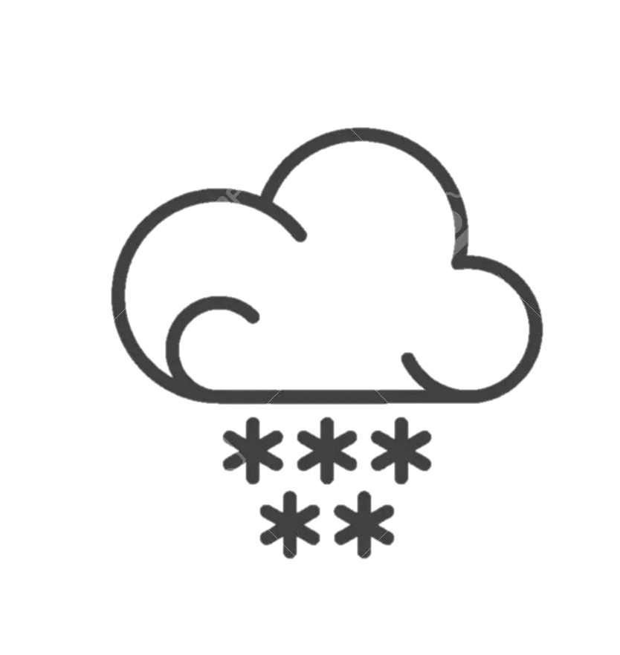
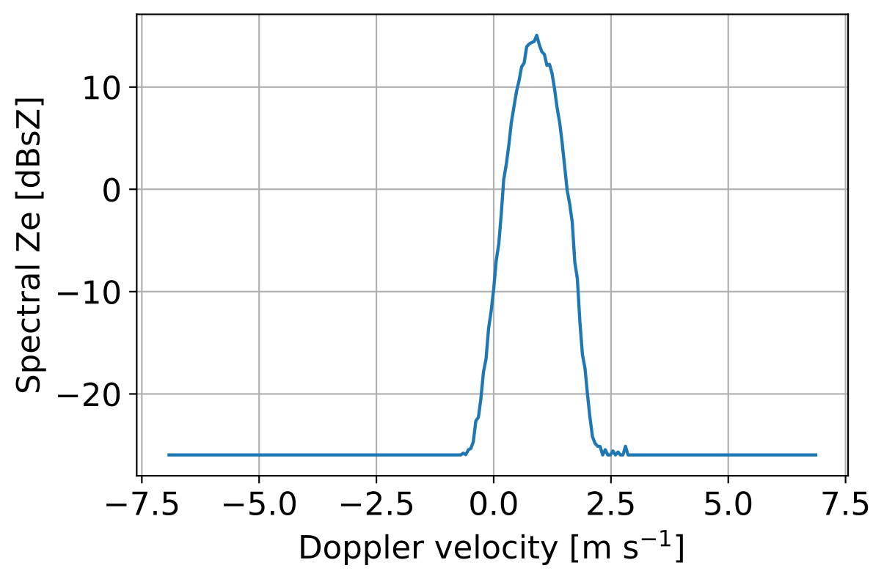
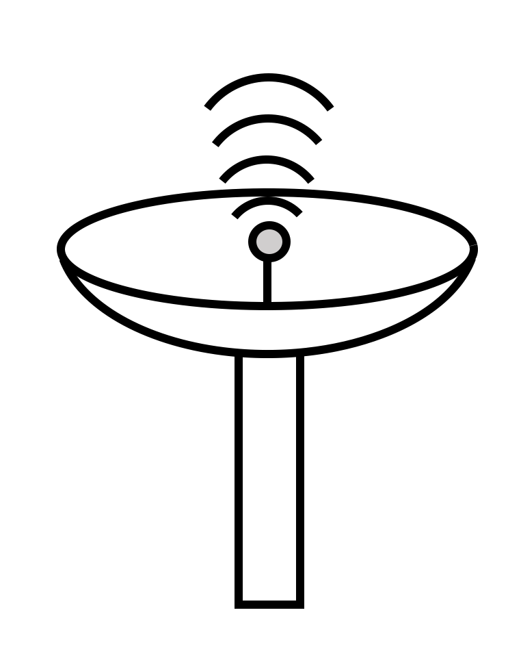
The radar Doppler spectrum
Doppler spectrum: radar reflectivity as a function of Doppler velocity
At a given time & height
Microphysical properties
￫ scattering, aerodynamics…
Radar properties
￫ wavelength, beam width…
Atm. dynamic processes
￫ turbulence, wind…
Vertically-pointing radar
Faster-falling particles
1

Slide 3
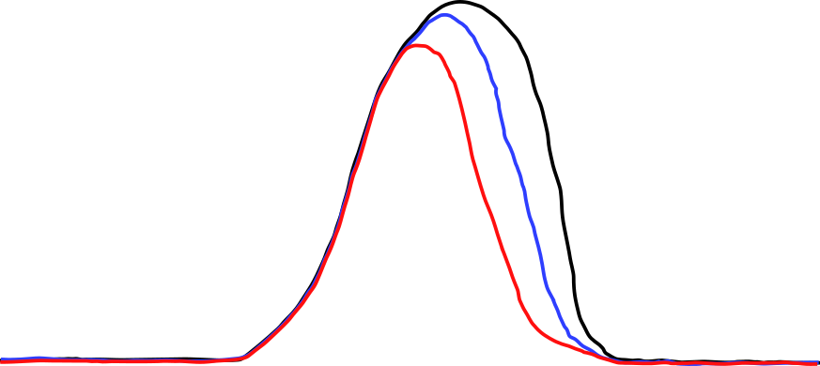
Multi-frequency Doppler spectra
Rayleigh/non-Rayleigh scattering regimes: more info on PSD
‘Small’ particles: sZe_{X} ≈ sZe_{Ka} ≈ sZe_{W}
‘Large’ particles: sZe_{X} > sZe_{Ka} > sZe_{W}
X
Ka
Spectral Ze [dBsZ]
W
Doppler velocity [m s⁻¹]
Faster-falling particles
2

Slide 4
Question: how much microphysical info is contained in these data?
full PSD?
PSD parameters?
density?
mass-size relation?
orientation?
geometry?
aspect ratio?
area-size relation?
…
X
Ka
Spectral Ze [dBsZ]
W
Doppler velocity [m s⁻¹]
Faster-falling particles
3

Slide 5
Approach: retrieve posterior distributions using MCMC
Given a set of triple-freq. Doppler spectra, what is the underlying distribution of microphysical descriptors that can explain the observations (posterior distribution)?
Uncertainty quantification
Sensitivity tests (e.g., impact of atmospheric broadening, of modelling choices…)
Assess reasonable assumptions for operational retrievals
4

Slide 6
Approach: retrieve posterior distributions using MCMC
Given a set of triple-freq. Doppler spectra, what is the underlying distribution of microphysical descriptors that can explain the observations (posterior distribution)?
Uncertainty quantification
Sensitivity tests (e.g., impact of atmospheric broadening, of modelling choices…)
Assess reasonable assumptions for operational retrievals
Markov chain Monte Carlo (MCMC): Bayesian retrieval framework
Few mathematical assumptions on retrieval problem / error distributions
Retrieval of full posterior distributions
Too slow for use on large datasets
4

Slide 7
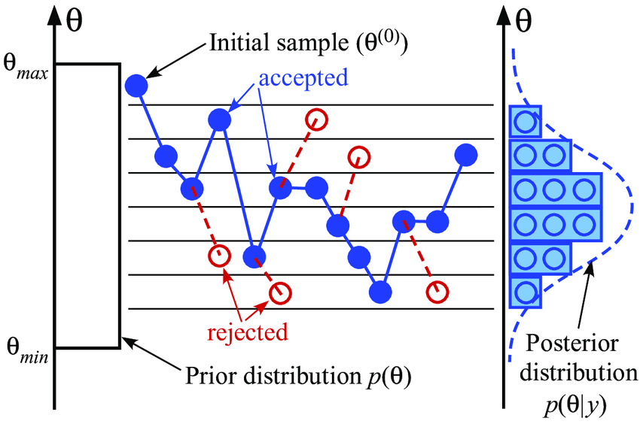
Framework
MCMC, Metropolis-Hastings: iterative algorithm, based on a chain of accept/reject decisions; leading to sample full posterior distribution.
Specific choices:
Adaptive proposal
Parallel tempering needed in some settings
Prior: uniform (bounds from literature)
Illustration: Tomic et al. 2019
5

Slide 8
Framework
Simulations of radar spectra using PAMTRA (Mech et al, 2020)
Frequencies: X + Ka + W bands
Scattering: Self-similar Rayleigh-Gans approximation (SSRGA, Hogan and Westbrook 2014)
Velocity-size: Heymsfield 2010
Microphysical descriptors retrieved:
PSD shape: Gamma (prescribed through $D_{eff}$, µ, $N_{T}$)
Mass-size relation: $a_{m}$, $b_{m}$ (correlated in prior)
Area-size relation: $α_{a}$, $β_{a}$ (correlated in prior)
Turbulent broadening and radial wind shift: EDR, v_{r} (ON/OFF)
Analysis conducted on 10 simulated examples of triple-freq. spectra (representative)
6

Slide 9
Baseline retrieval: first outcomes
$D_{eff}+bmass$: narrow + ‘differentiated’ posterior
$N_{T}$: same (but log…)
µ: wide / ‘flat’ posterior
$β$: ‘non-specific’ posterior
7

Slide 10
Sensitivity to retrieval parameters
Atmospheric effects (turbulence + radial wind): wider and biased posterior
Number of frequencies: single freq = uncertainty ++; dual-freq = worse if X+Ka only
Using ‘wrong’ SSRG coefficients: minor impact
Using ‘wrong’ mass/size relation: biased posterior
Using ‘wrong’ PSD shape (µ): wider and biased posterior
8

Slide 11
Sensitivity tests: mass-size relation
Knowing true $a_{m}$, $b_{m}$ reduces posterior width
e.g., - 40% IQR0.1-0.9 in $log(N_{T})$
Assuming wrong $a_{m}$, $b_{m}$ (e.g., Brown and Francis 1995) leads to biased posterior
e.g., +20% mean in $log(N_{T})$, -100% mean in µ
sometimes quasi-disjoint distributions
Ex S9
9

Slide 12
The case of bimodal Doppler spectra
Bi-(multi-)modal spectra measured when different hydrometeor populations co-exist in radar volume
Using MCMC framework: retrieval of 2 ice populations and compare to baseline
Impact of bimodal “separation” on retrieval quality?
10

Slide 13
The case of bimodal Doppler spectra
Jensen-Shannon distance w.r.t. baseline
In some cases, distributions retrieved with similar accuracy than baseline
Peak separation plays a great role in retrieval ability
11

Slide 14
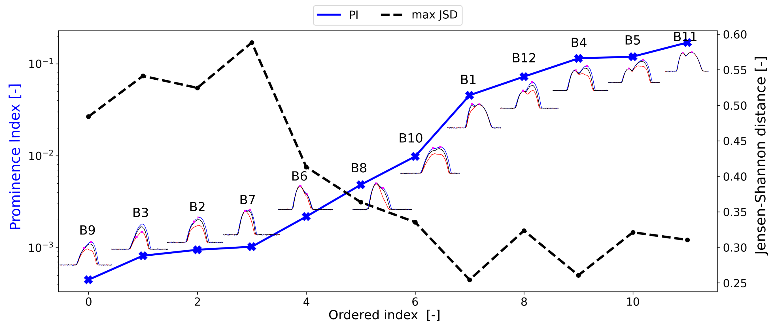
The case of bimodal Doppler spectra
Peak separation: quantified with prominence index (mean ratio of peak prominence) <-> related with mean JSD
=> shows information content accessible in multi-peaked spectrum
12

Slide 15
Conclusion
MCMC framework on examples of simulated multi-frequency radar Doppler spectra
Few mathematical assumptions
Retrieval of full posterior distributions
Too slow for operational use
13

Slide 16
Conclusion
MCMC framework on examples of simulated multi-frequency radar Doppler spectra
Few mathematical assumptions
Retrieval of full posterior distributions
Too slow for operational use
Insights gained
Information content: different level of confidence depending on variable ($D_{eff}$ ≠ µ)
Sensitivity tests: certain common assumptions can be misleading (e.g., a/b, PSD shape)
Bimodal spectra: prominence index indicates possibility for accurate retrieval
13

Slide 17
Conclusion
MCMC framework on examples of simulated multi-frequency radar Doppler spectra
Few mathematical assumptions
Retrieval of full posterior distributions
Too slow for operational use
Insights gained
Information content: different level of confidence depending on variable ($D_{eff}$ ≠ µ)
Sensitivity tests: certain common assumptions can be misleading (e.g., a/b, PSD shape)
Bimodal spectra: prominence index indicates possibility for accurate retrieval
Perspectives
Sheds light on intrinsic uncertainties
Using statistical emulators in view of applications on larger datasets
13

Slide 18
Thank you!

Slide 19
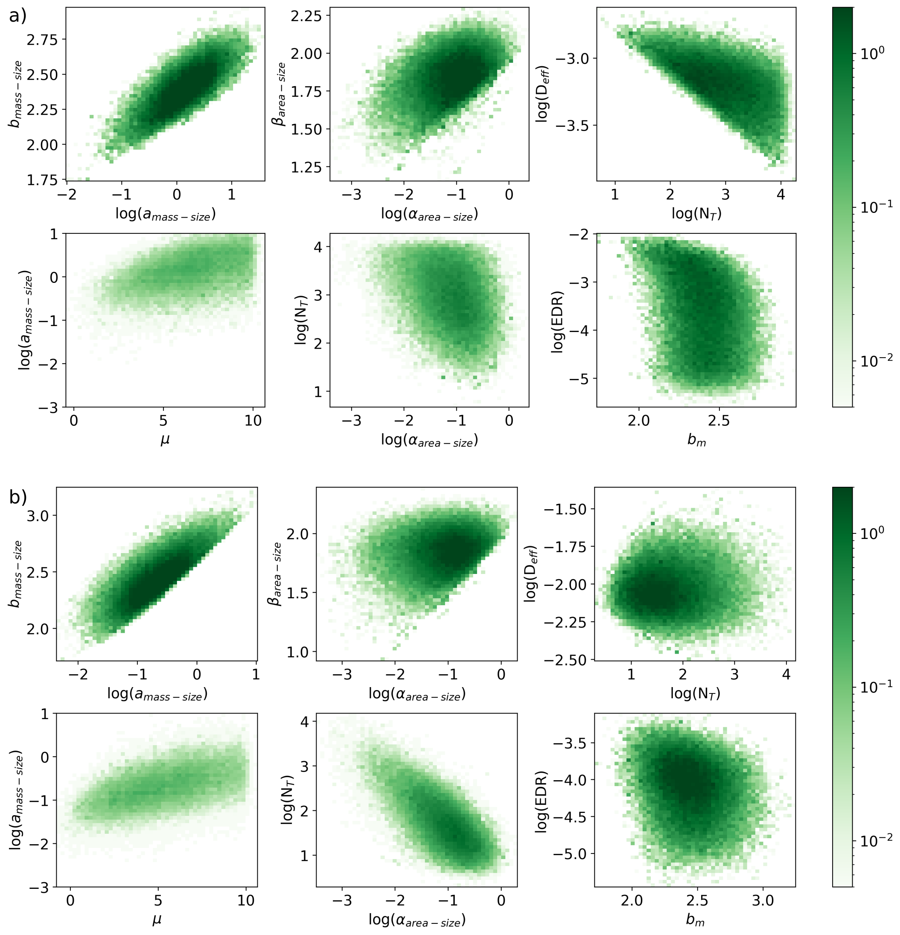
Baseline retrieval: bivariate analyses
Certain correlations come from prior (a/b, $α$/$β$)
$N_{T}$/$D_{eff}$: expected
Others to be explored

Slide 20
Sensitivity tests: SSRG example
Assuming a set of SSRG coefficients different than the true one (i.e., used for original simulation): only minor impact on retrieved posterior
Depending on SSRG coefs, bias in $N_{T}$ and $b_{m}$
Ex S6

Slide 21
Sensitivity tests: PSD shape
Knowing true µ reduces posterior width (but not drastically)
Assuming wrong µ (e.g., exp. PSD) leads to wider and biased posterior
e.g., +80% IQR0.1-0.9 $D_{eff}$ , -10% mean $b_{m}$, on average
sometimes quasi-disjoint distributions
Ex S10

Slide 22
Sensitivity tests: atmospheric effects
Turbulent broadening: leads to wider posterior and bias
e.g. +30% in IQR0.1-0.9 for $b_{m}$ on average
But if turbulence is known: no impact on posterior (no intrinsic loss of information in spectra)
Turb unknown
Turb known
Turb unknown
Turb known
Turb unknown
Turb known
Turb unknown
Turb known
Turb unknown
Turb known
Ex S3

Slide 23
Sensitivity tests: atmospheric effects
Radial wind: leads to wider posterior and bias
e.g. +40% in IQR0.1-0.9 for $log(N_{T})$ on average
Similar effect if uniform vertical wind (same for 3 radars) or radar misalignment (differential radial wind)
Ex S1

