Slide 1
Comparing raindrop size distributions from the two-moment microphysics scheme of the ICON-RUC model with disdrometer observations
PrePEP 2025
Precipitation Processes –
Estimation and Prediction
20th March 2025
Sophie Löbel, Nikolaos Antonoglou, Ulrich Blahak, Alberto de Lozar, Axel Seifert and the Sinfony Team

Slide 2
Motivation
extreme rain rates in the ICON-D2 are often too high
  one moment scheme
extreme rain rates in the RUC sometimes too low
  2 moment scheme ⟶ more detailed ⟶ but still not perfect
DWD has a large measuring network with different instruments
  more that 150 stations with a disdrometer additional to the conventional precipitation instruments
  provide information about size and fall speed ⟶ stored but not used at the moment within DWD
  this information can help to improve the microphysical parameterisation (we start with rain)

Slide 3
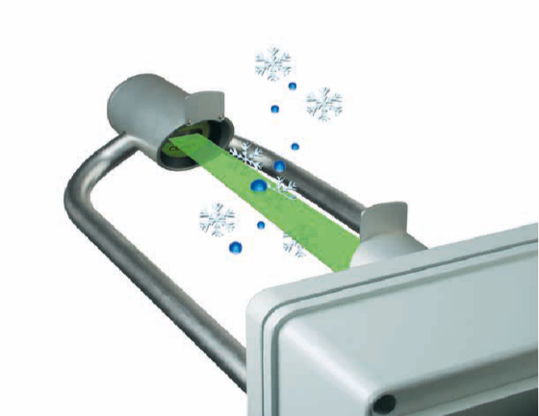
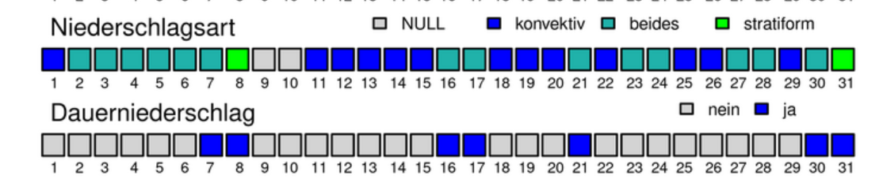
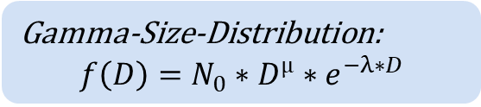
Disdrometer
measuring device that determines the size, falling speed and number of drops by means of a laser
measurements output in 1-minute intervals; 0.16mm ⟶ 8mm
precipitation type can be determined
28 days selected from 2024 (only rain):
  May – September ⟶ summer period
  days marked as days with permanent precipitation
  includes stratiform, convective and mixed precipitation types
Preparation of the observations
averaged data over 10 minutes to minimize measurement errors
dominant precipitation type: rain
50’000 measurements to evaluate
Precipitation type
Continuous rain
Gamma-Size-Distribution:
$$f\left(D\right)=N_{0}∗D^{µ}∗e^{−λ∗D}$$

Slide 4
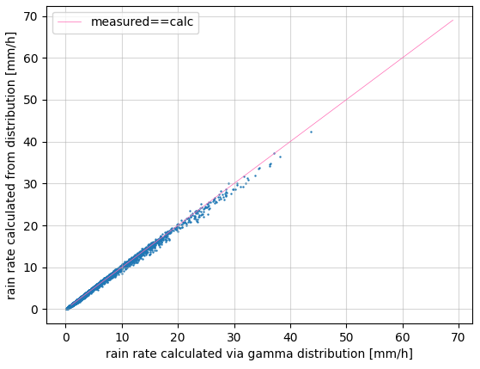
Plausibility check of the Gamma-size-distribution
rain rate determined from the measured distribution (particles per size and velocity bin) and from the calculated gamma-size-distribution match
Gamma-size-distribution correct assumption for observations
⟶ can be used further

Slide 5
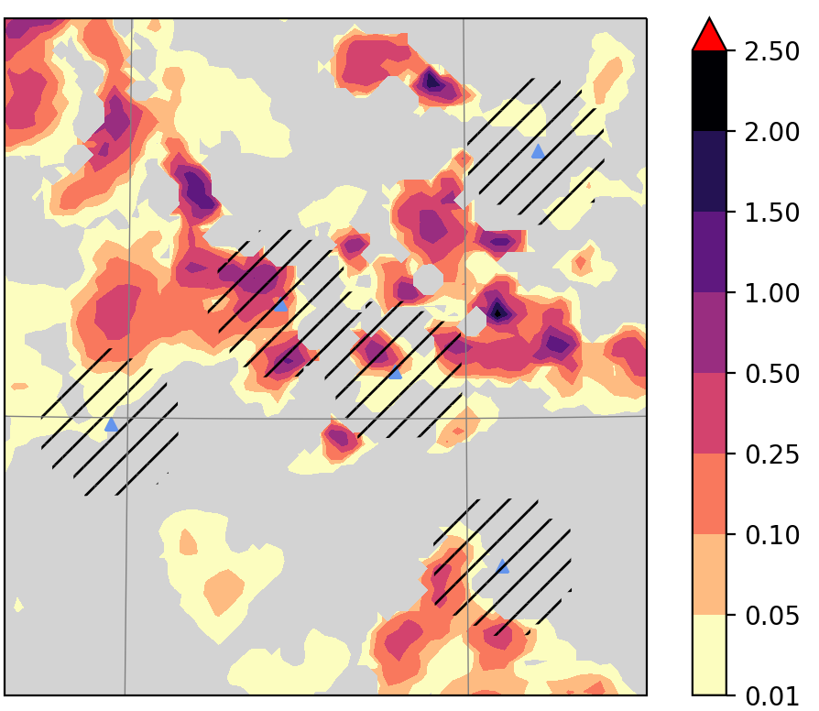
ICON – RUC
Rapid Update Cycle (RUC) produces short term forecast with focus on convective (severe) storms
produces every hour a new forecast with 14h lead time
contains a 2-moment-microphysics scheme ⟶ includes information about mass and number of particles
⟶ follows a gamma size distribution ⟶ same assumption as in disdrometer measurements
first guess data from assimilation cycle taken as model equivalent (+1h forecast)⟶ temporal resolution 1h
  6UTC ⟶ 21 UTC
Comparison:
measurements assigned in time
⟶ e.g. obs from 8:30 – 9:20 UTC ⟶ 9UTC model data
stations with measurements collected ⟶ each station only scored once ⟶ no directly comparison possible ⟶ distortion of the model statistics
average and maximum specific mass of the rain determined within a radius of 15 km around the station
calculated from this distribution specific parameters, rain rate and mass weighted diameter ⟶ 13700 model equivalents

Slide 6
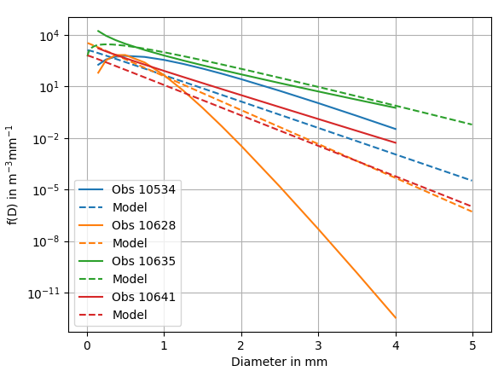
Rain-drop-size-distribution
By means of the mass and number concentration from the model particle size and gamma-size-distribution can be specified for each grid point
Model size distributions show different distributions compared to observations, but similar rain rates
observed size distributions with different rain rates (solid lines)
  Station 10534: 7,4mm/h
  Station 10628: 0,43mm/h
  Station 10635: 17,7mm/h
  Station 10641: 1,0 mm/h
individual comparison of each measurement not useful; maybe for single specific cases
statistical evaluation for different parameters

Slide 7
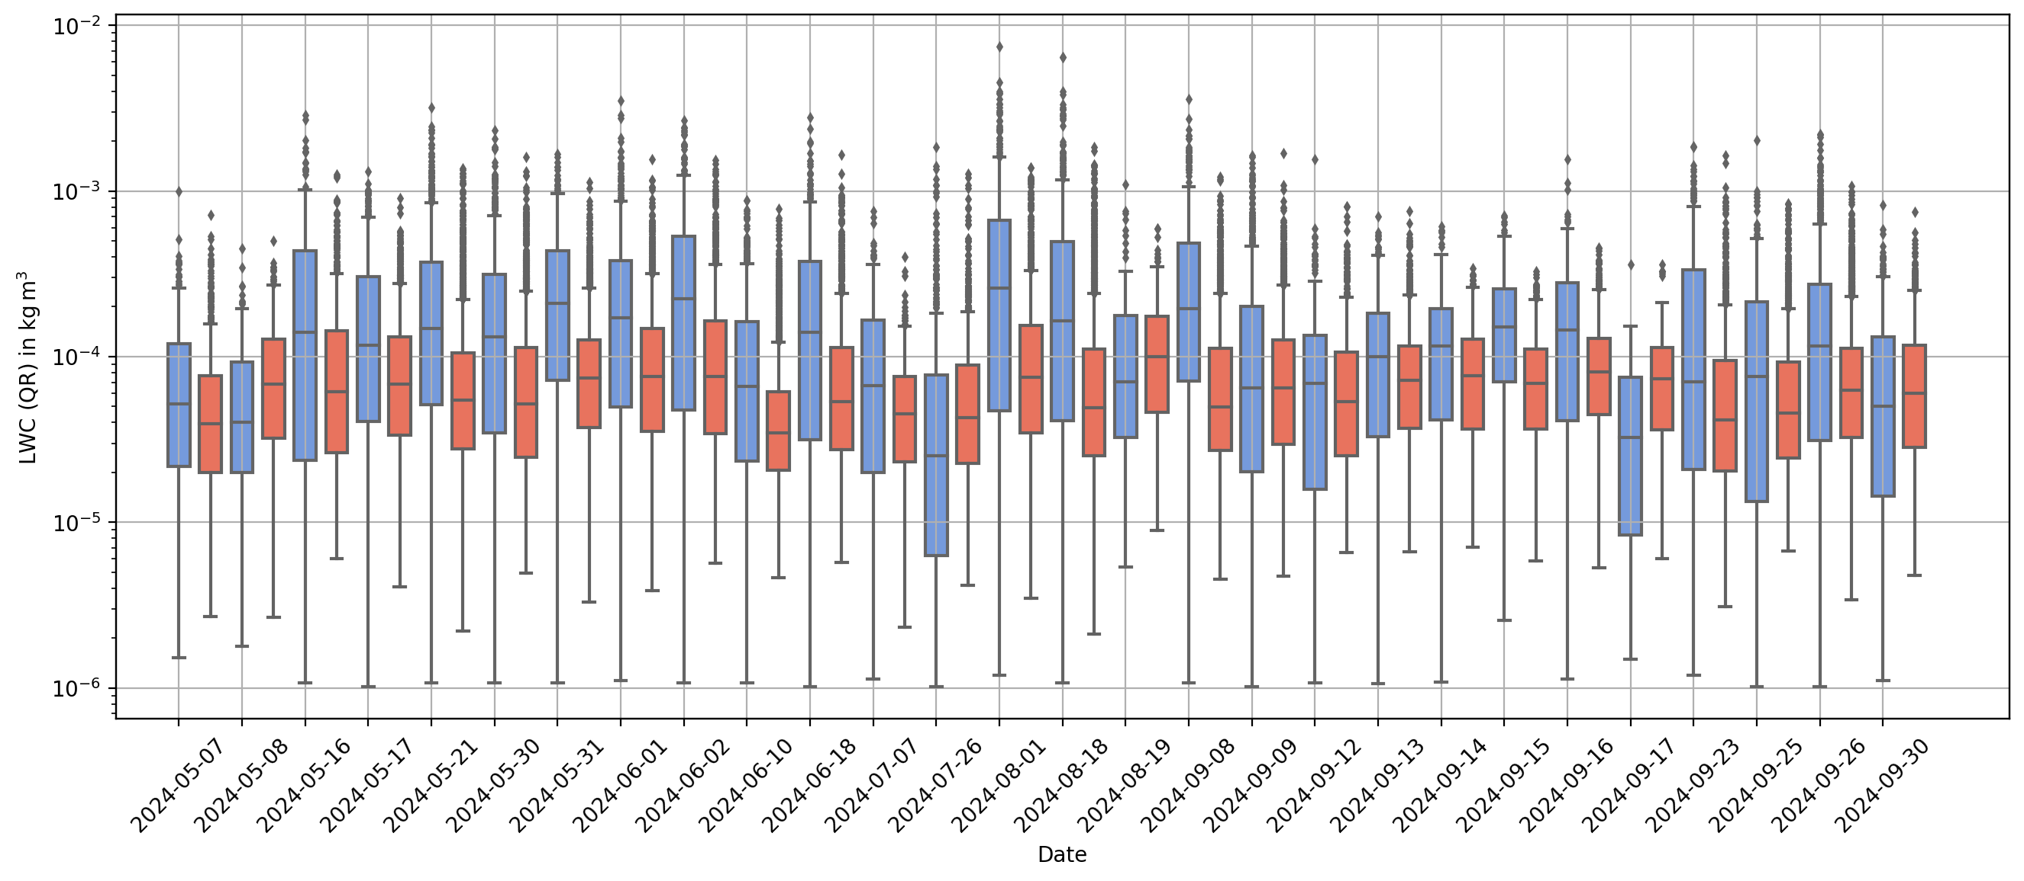
Specific rain content (maximum of qr)
Model, Obs
model values higher ⟶ maximum of a precipitation area does not always pass the station
more fluctuation in the model

Slide 8
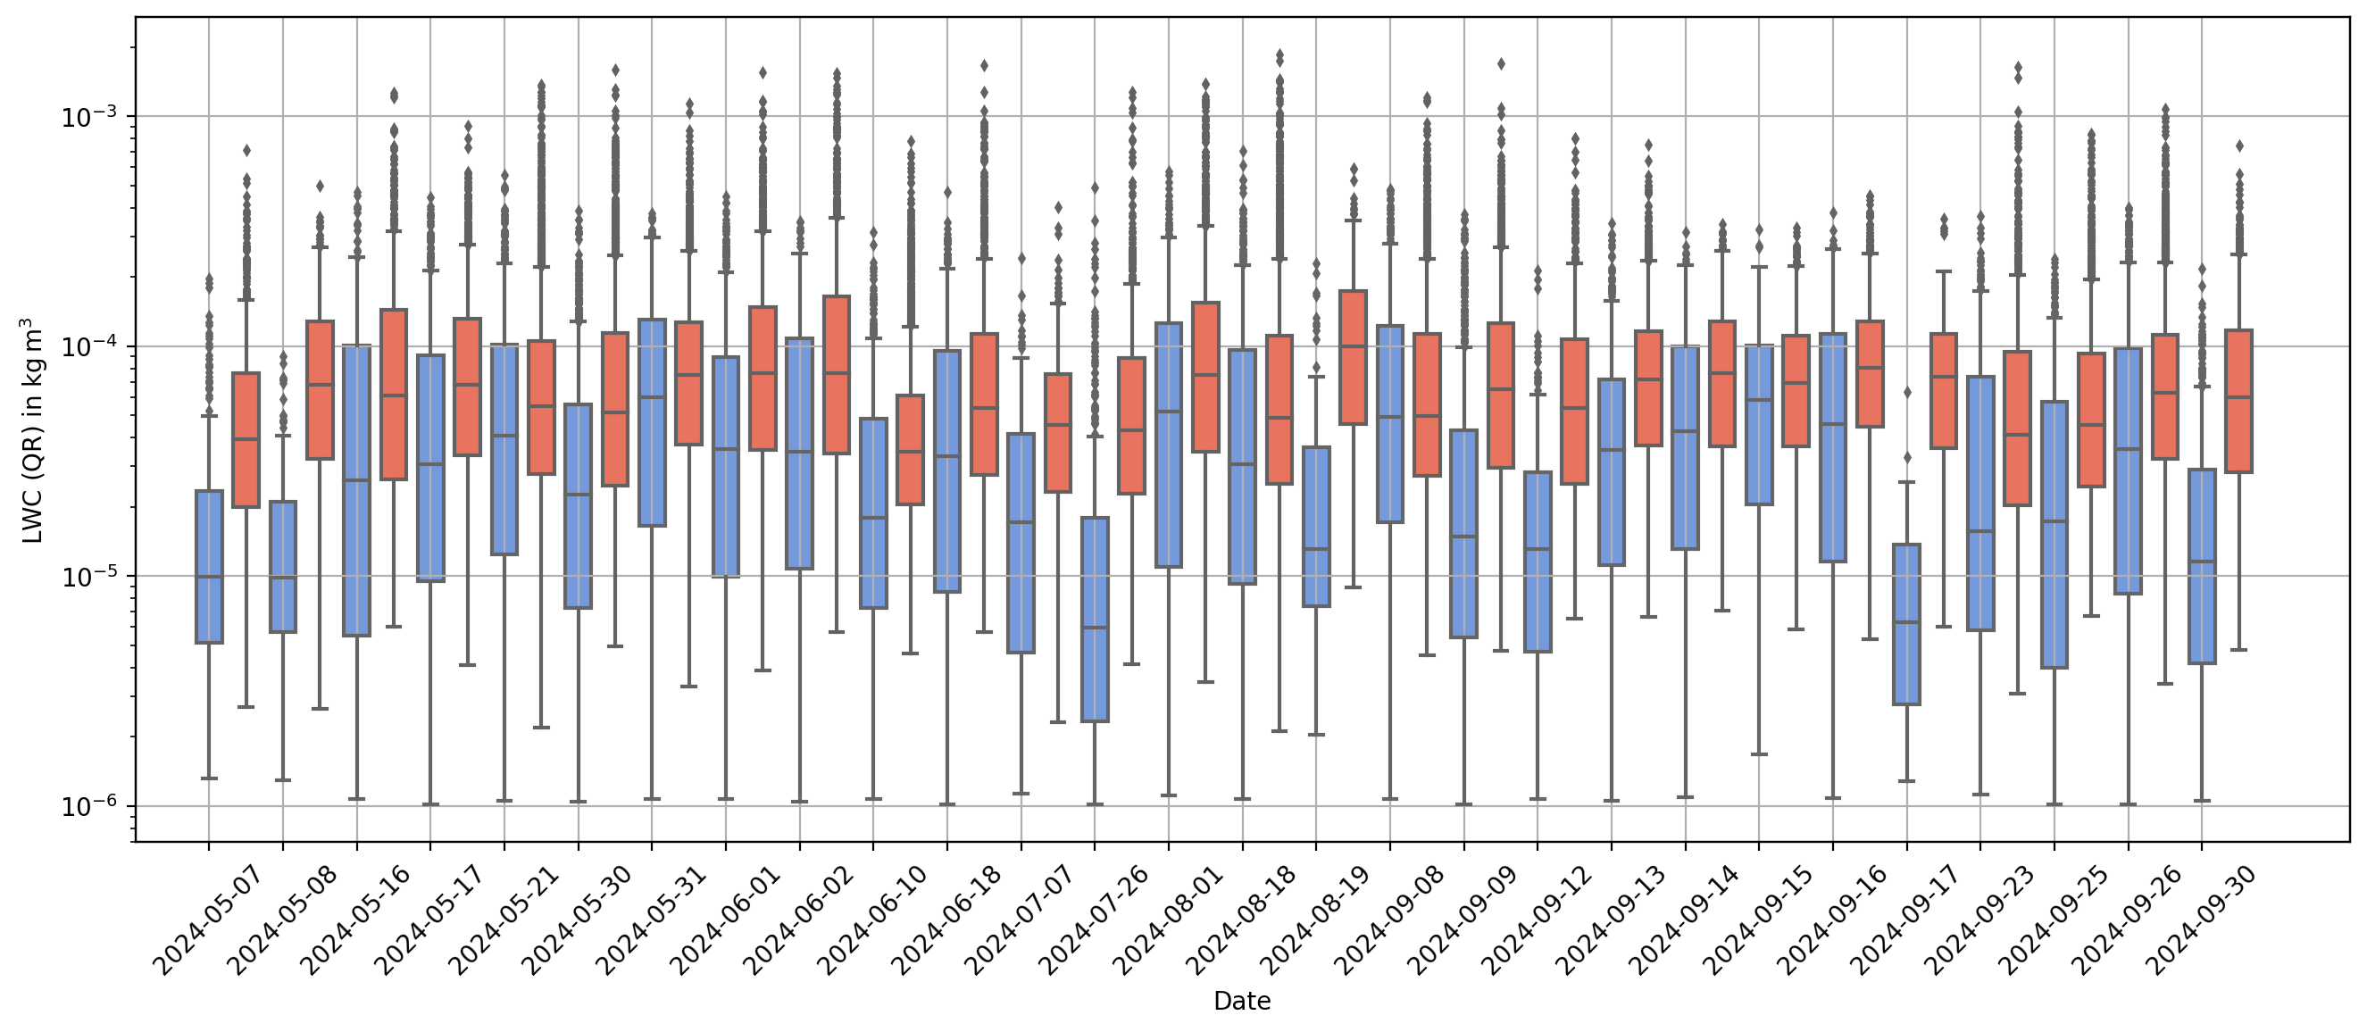
Specific rain content (mean qr)
Model, Obs
Less rain water content around the station ⟶ area dryer or water included in other precipitation type
spread in the model values still higher

Slide 9
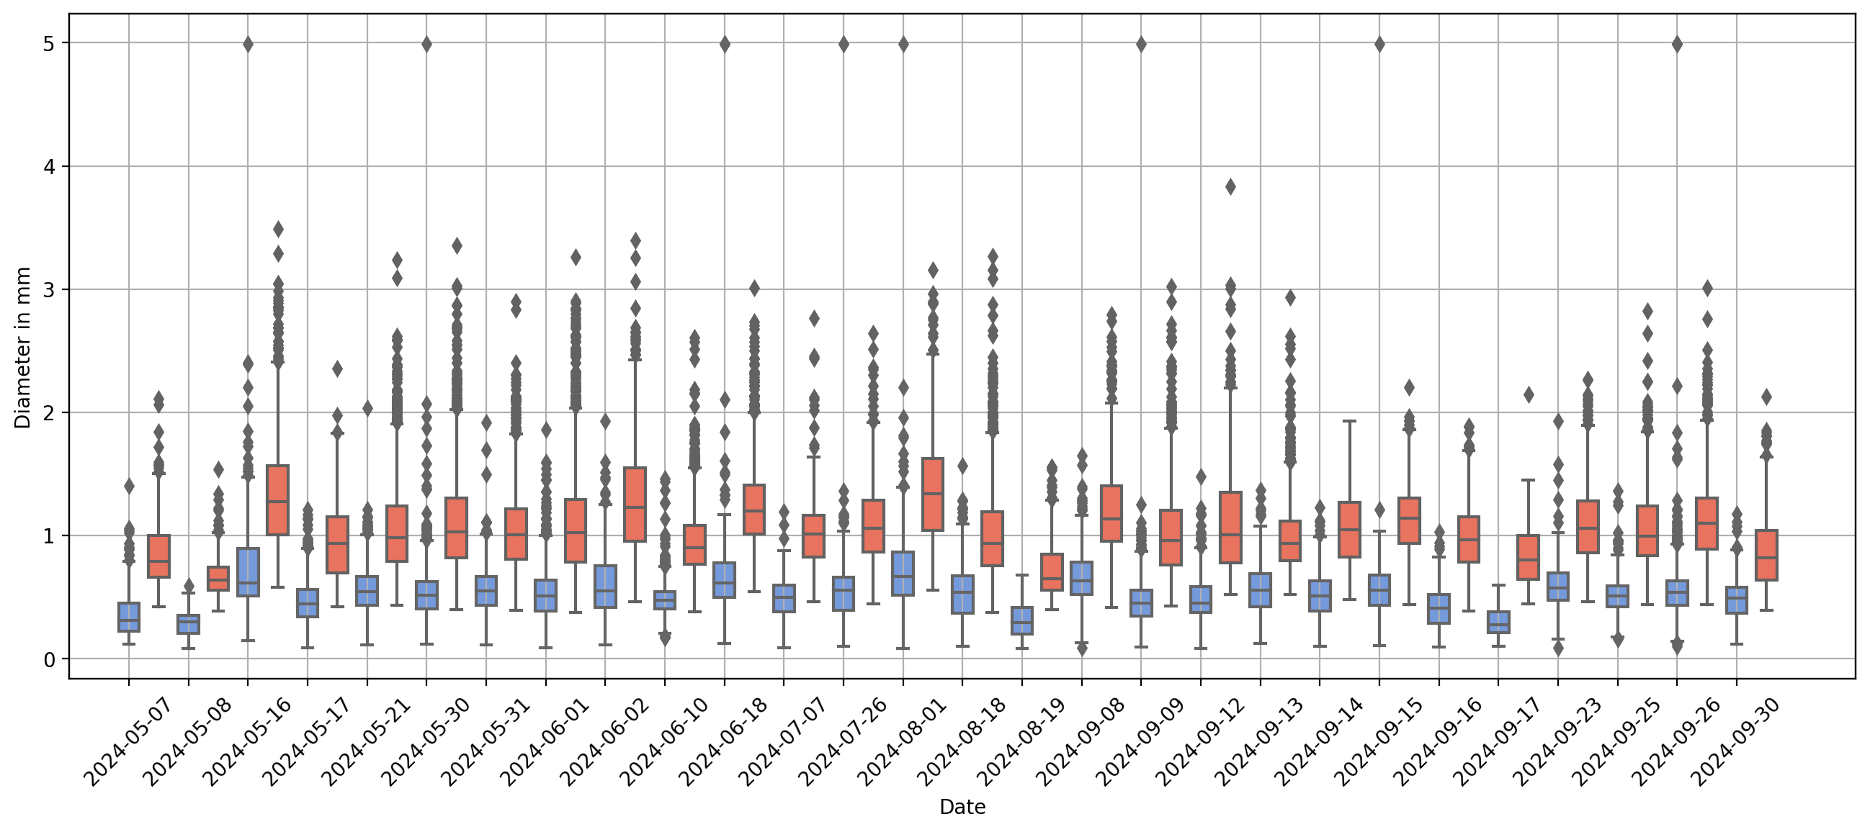
Mass weighted mean diameter at max(qr)
Model, Obs
Droplets too small in the model for all cases.

Slide 10
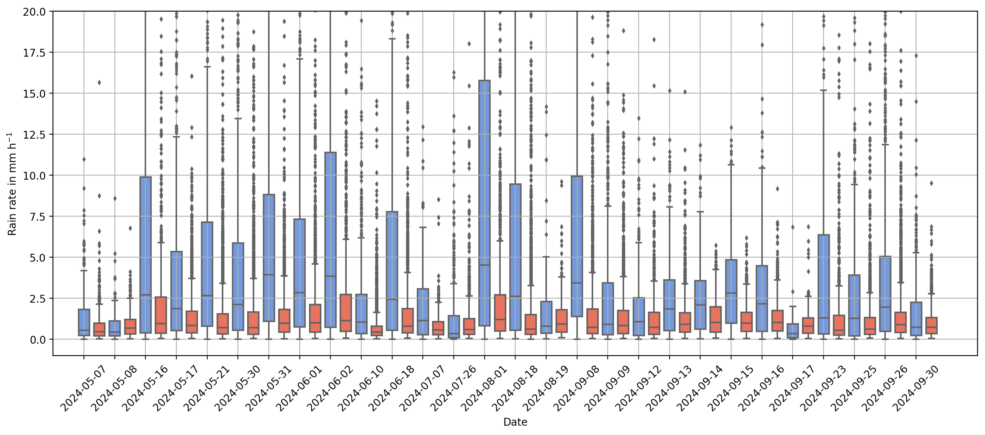
Rain rate estimate from drop size distribution at max(qr)
Model, Obs
Model rain rate significantly higher ⟶ would totally over estimate the rain rate ⟶ unequal to model output!
single measurements equal to model

Slide 11
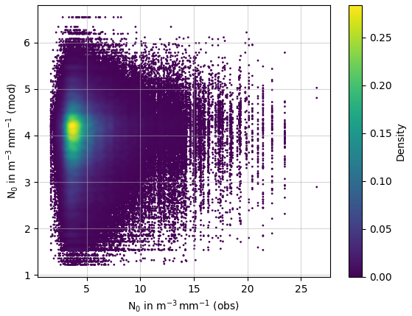
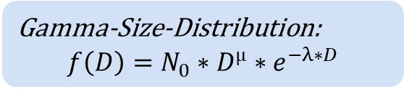
Comparison of the intercept parameter N0
Gamma-Size-Distribution:
$$f\left(D\right)=N_{0}∗D^{µ}∗e^{−λ∗D}$$
most of the data around 10^4 particles per volume air and droplet size in both datasets
model values between 10^3 and 10^5 particles
observation between 10^3 and 10^7 particles
in reality more very small rain drops, but model close enough

Slide 12
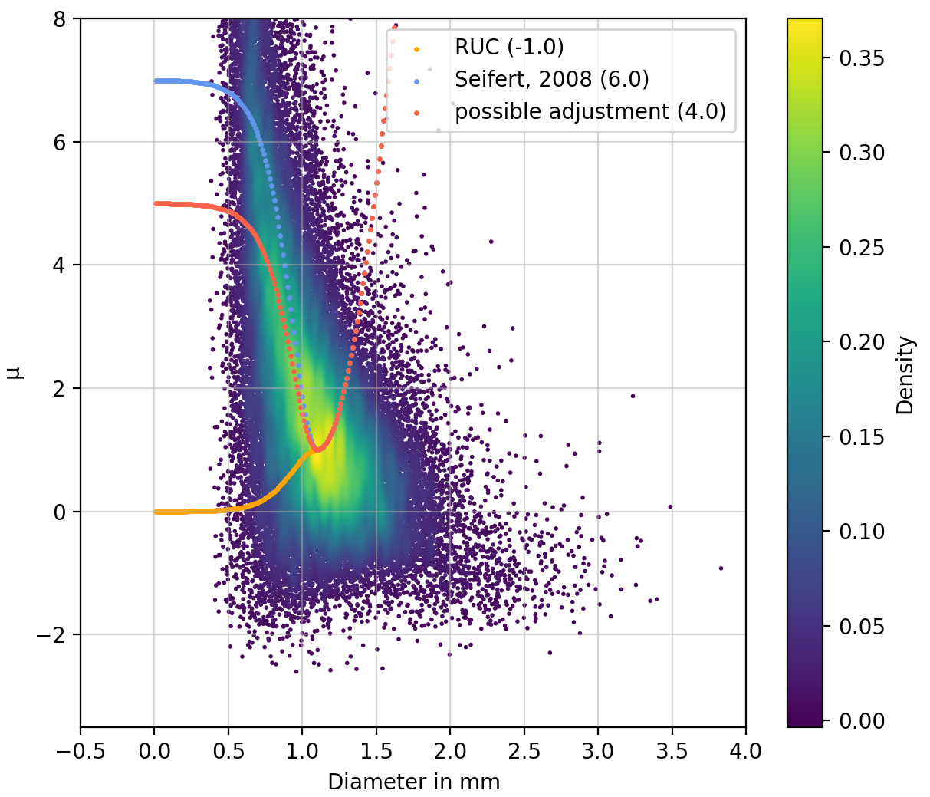
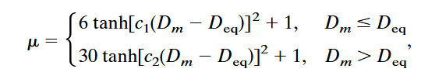

Connection between µ and mean diameter
Gamma-Size-Distribution:
$$f\left(D\right)=N_{0}∗D^{µ}∗e^{−λ∗D}$$
Calculation of µ (shape parameter) in the model depends on the mean diameter
$$D_{eq}=1.1mm$$
for larger droplets the distribution should shift to a exponential size distribution
value for very small particles set to 7 in the default setting
at the beginning RUC had produced too-little drizzle ⟶ changed to 0
forecasting of drizzle in the RUC has improved ⟶ could be set to a higher value or back to the original

Slide 13
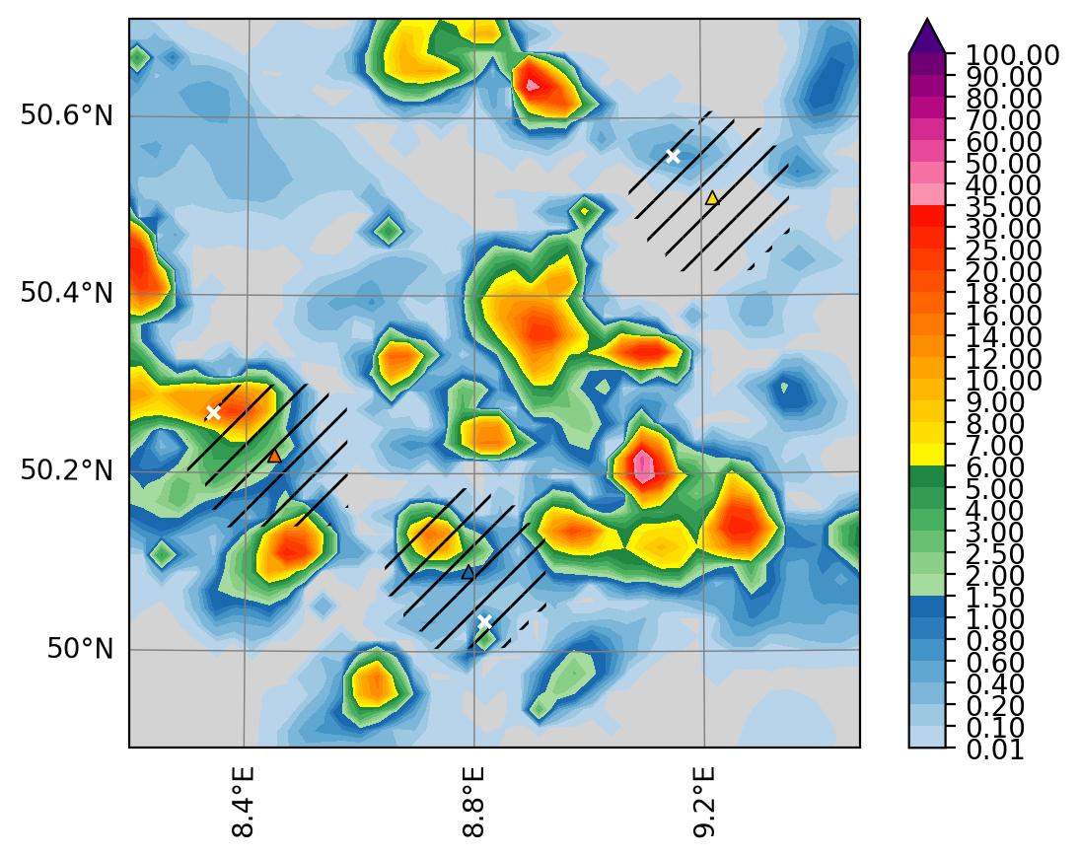
Conclusion and further work
mass weighted mean diameter is significantly underestimated ⟶ median = maximum of the distribution ⟶ distribution has to be shifted to higher particle sizes
adjust the connection of the µ and particle mean diameter in the model
find a new fitting for µ - λ – dependence ⟶ try it in the model
include parameters in the area of the observations statistically
⟶ not just the maximum value
recalculate the forecasts for he case days:
  direct temporal comparisons possible, temporal
  aspect can be examined (are we too early/too late/just right)
  comparison of rain rate possible

Slide 14
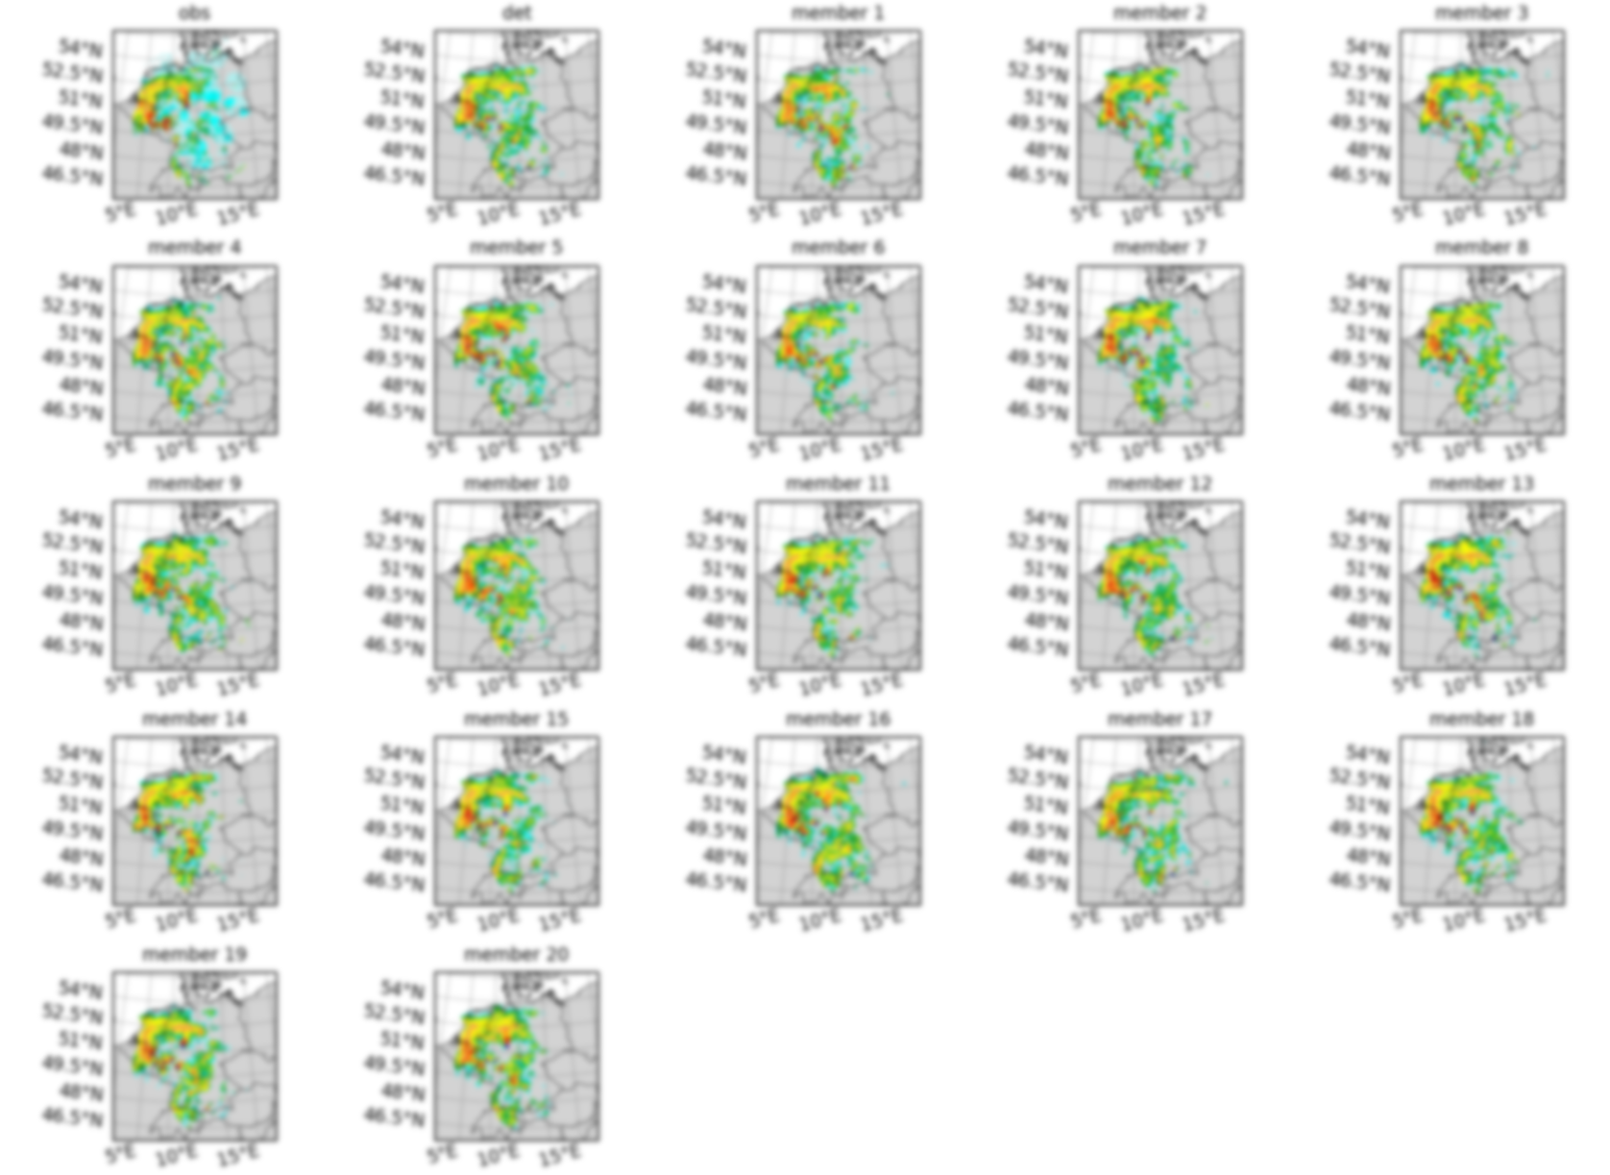
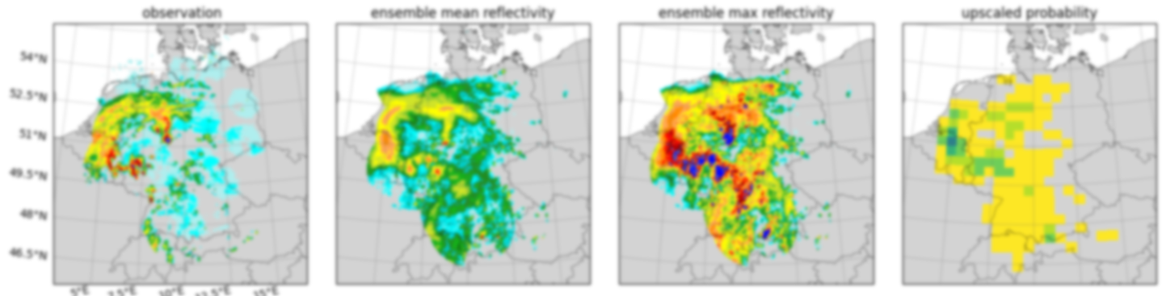
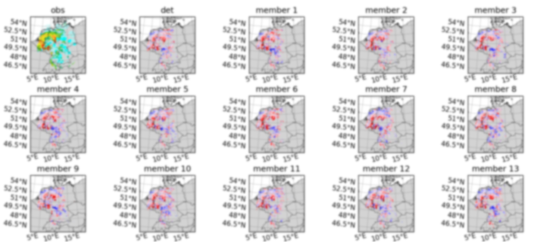
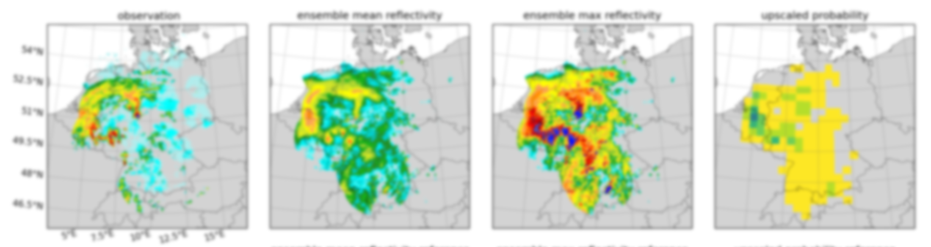
Thanks for listening!

Slide 15
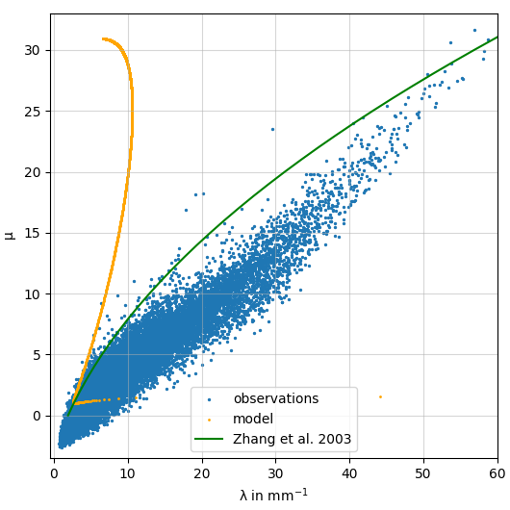
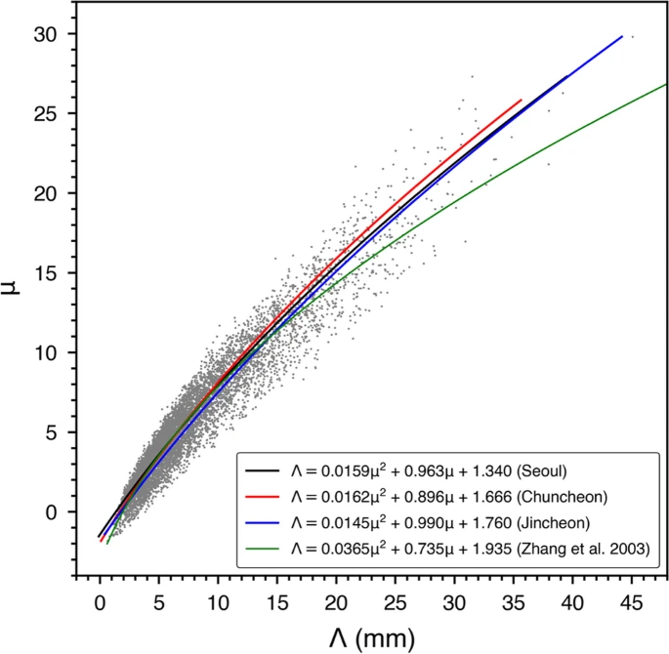
Connection between µ and λ
Comparison with literature:
from J.Lee et al., 2022
Completely different shape of the model curve
µ increases faster that λ
should be the other way round
also different from findings in the literature
µ is the shape parameter ⟶ width of the distribution
λ describes the slopes
at DWD mainly used to determine rainfall rates from radar measurements

