Slide 1



PolarCAP: Remote sensing and modelling of cloud microphysical processes in thermodynamically and aerosol-constrained super-cooled stratus clouds
Kevin Ohneiser, Patric Seifert, Willi Schimmel, Fabian Senf, Jan Henneberger, Fabiola Ramelli, Robert Spirig, Huiying Zhang, Anna Miller, Nadja Omanovic, Christopher Fuchs, Anja Hardt, Heike Wex, Markus Hartmann, Veronika Ettrichrätz, Anton Kötsche, Heike Kalesse Los, Maximilian Maahn, and Ulrike Lohmann
20 March 2025, Bonn, PrePEP conference

Slide 2
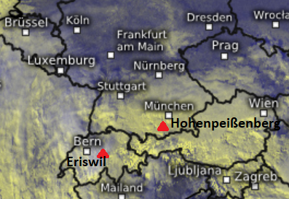
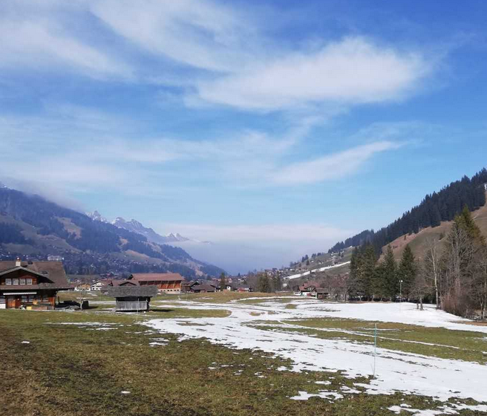
Motivation
Improve the understanding of the formation, persistence and environmental impact of the long-lasting supercooled liquid stratus layer in Bise situations
Approaches: Combination of remote-sensing, in situ, INP (ice-nucleating particles) sampling to:
  Evaluate availabilty (lack!) and spatial distribution of ice nucleating particles (INP) → See poster #25
  Characterize the role of the supercooled stratus layer for precipitation formation via natural seeder-feeder processes → 8 Jan 2024, this presentation
Above Bise clouds
~1300 m ü. NN
Wind

Slide 3
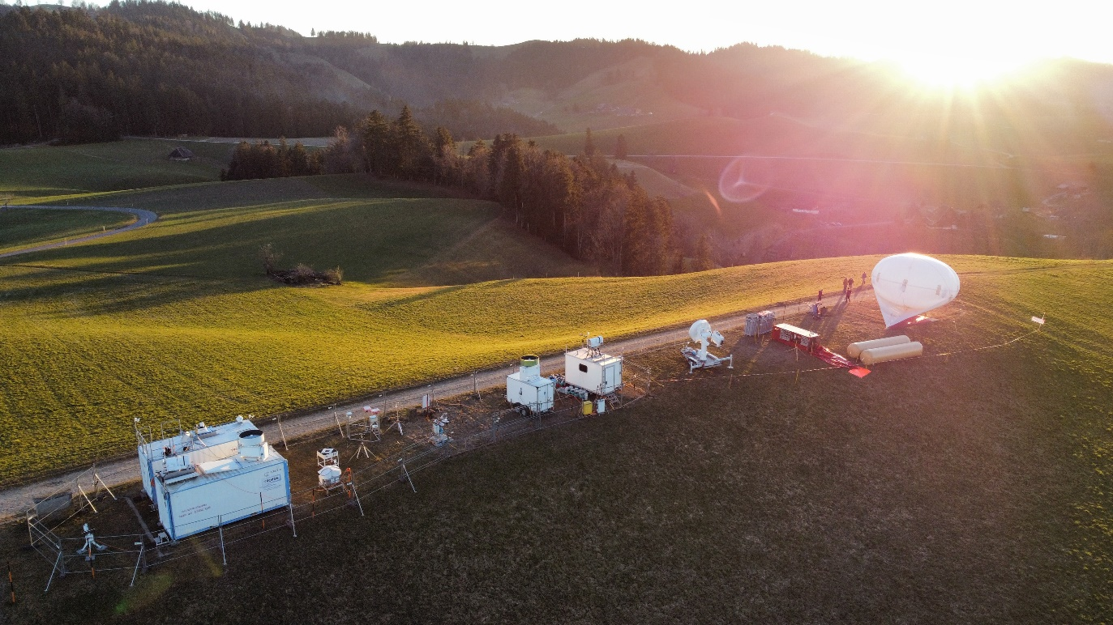
MASC Multi-Angle Snowflake Camera
Holimo - HOLographic Imager
for Microscopic Objects with the helium-filled balloon „Bob“
About CLOUDLAB/PolarCAP:
Henneberger et al., BAMS, 2023
CE318-T Solar lunar photometer
Streamline Pro
1.5-µm Doppler lidar
Mira35 STSR
35-GHz Cloud radar
PollyXT Raman polarization lidar
RPG94 FMCW-DP
94-GHz cloud radar
CHM-15kx
Ceilometer
CHM-15kx
Ceilometer
HATPRO G5 Micro-wave radiometer
HATPRO G5 Micro-wave radiometer
Parsivel 1d-Disdrometer
12 GHz Cloud radar
INP sampler
MRR-Pro 24-GHz micro rain radar
Mira35 STSR
35-GHz Cloud radar
RPG94 FMCW-DP
94-GHz cloud radar
2DVD - 2-dimensional
video disdrometer
VISSS Video In Situ Snowfall Sensor
Photo: Jan
Henneberger

Slide 4
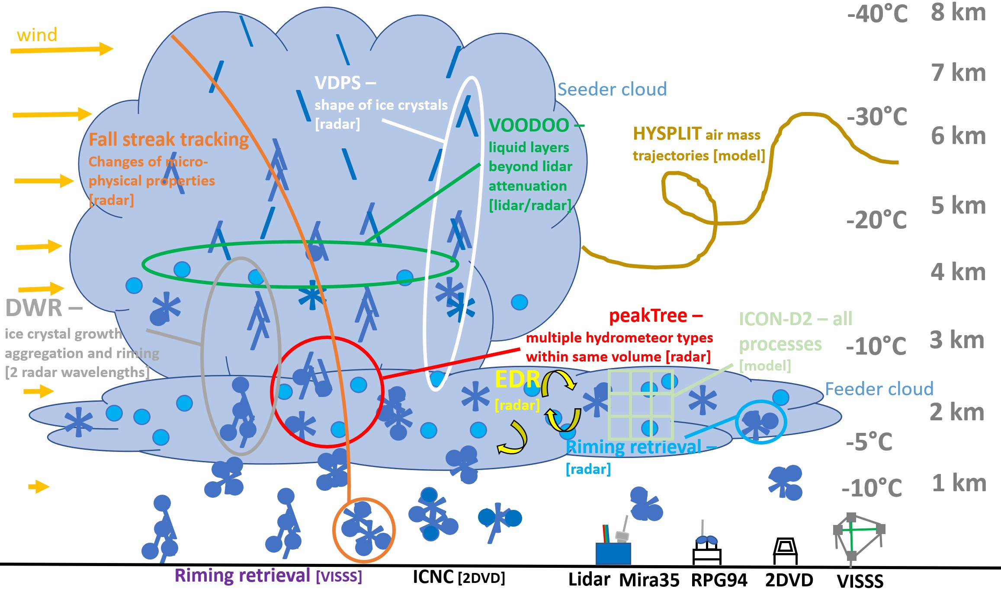
Apply big set of retrievals to the big dataset

Slide 5
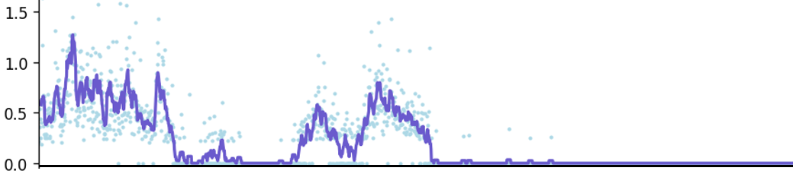
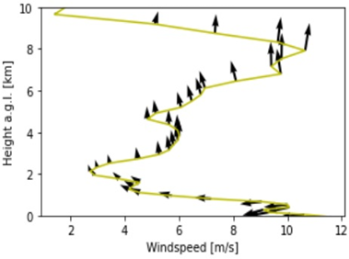
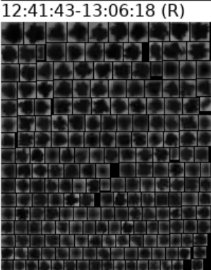
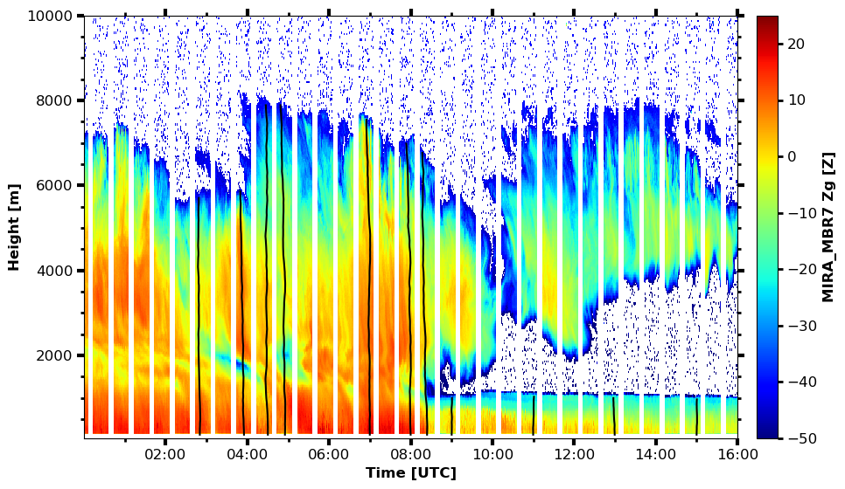
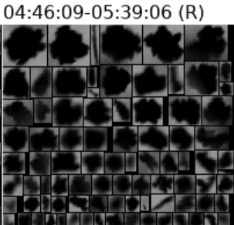
Natural seeding event of ice crystals into low-level supercooled cloud
Precipitation [mm/h]
Warmfront
S wind
Bise: NE wind
Precipitation enhancement due to seeder-feeder interaction
Seeder cloud
8 Jan 2024
Eriswil, Switzerland
-10°C
Bise cloud

Slide 6
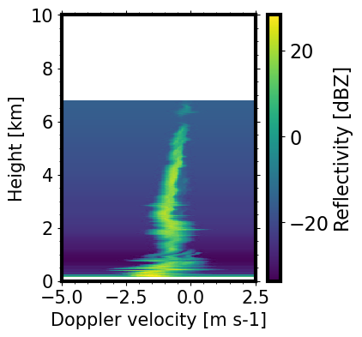
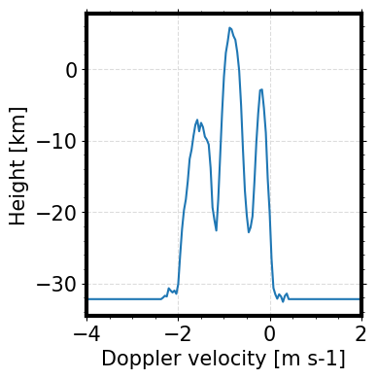
Doppler spectrogramm / Doppler spectrum
New peak small ice crystals
due to seeder-feeder interaction
or 3d-effect?
08:20 UTC
weak seeding
Seeding large ice crystals?
Bise liquid water?
Multipeak signatures caused by seeding
Doppler spectrum at 1km, 8:20 UTC

Slide 7
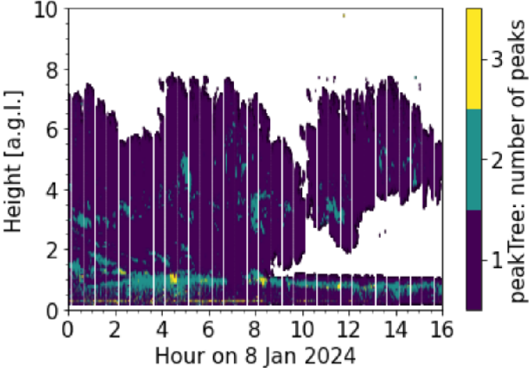
PeakTree – automatic Doppler peak identification
When seeding ice crystals reached
the Bise cloud – number of particle
modes increased
Water and ice coexists and riming
can take place
Widespread multi-peak Doppler spectra at interface layer of seeder and feeder cloud
About PeakTree: Radenz et al, AMT, 2019
Vogl et al., EGUsphere 2024

Slide 8
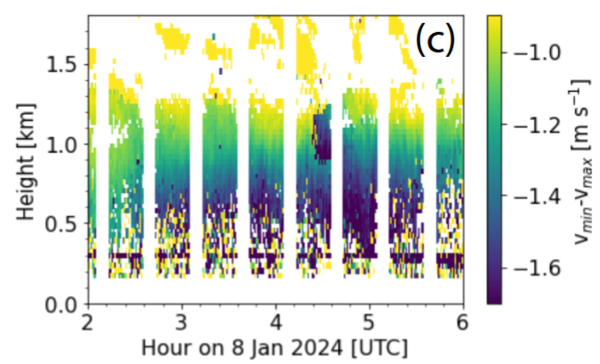
Signal of riming also in peakTree
Estimate riming probability by evaluating the difference between min and max Doppler velocity
Particles fall with 0.8m/s at Bise cloud top (these are aggregates from seeder cloud, for more information see poster of Audrey Teisseire)
but with more than 1.7m/s at cloud base,
Transition from aggregates to graupel
Bise cloud

Slide 9
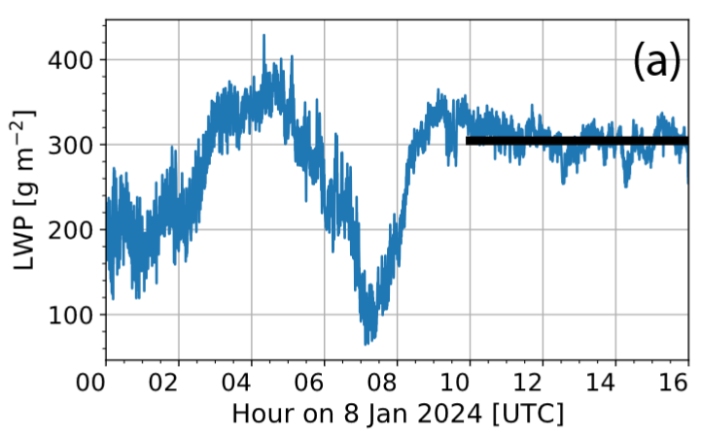
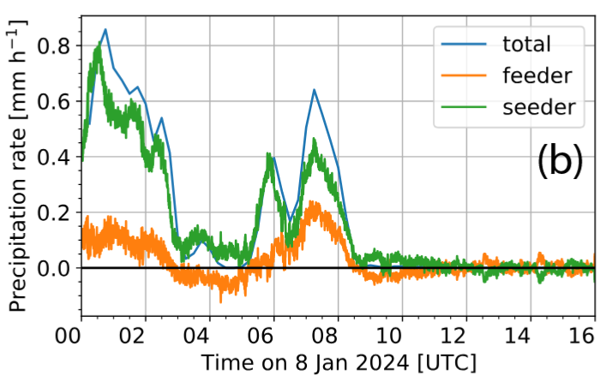
Quantification of precipitation enhancement of seeder-feeder interaction via LWP measurements
Higher precipitation during times with lower LWP
Approx. 10-30% of the total precipitation is provided by the Bise cloud → consistent with literature (modeling studies and observations)
Work in progress

Slide 10
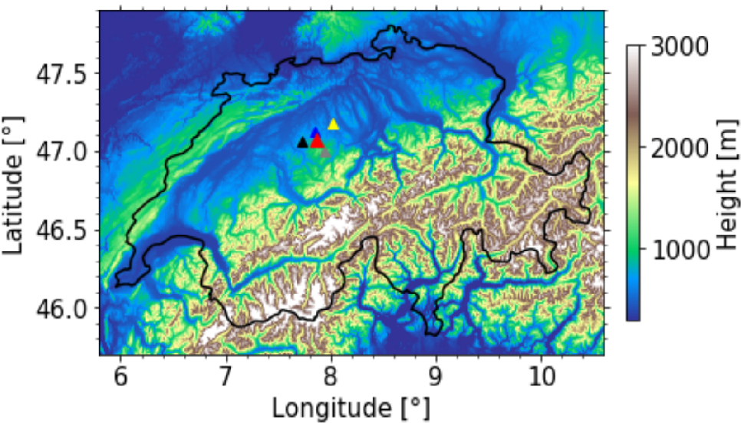
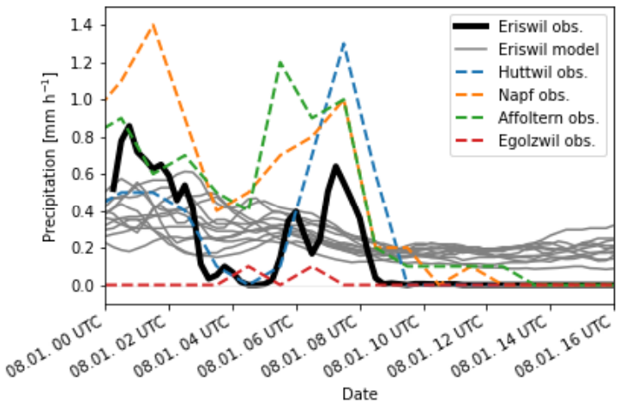
Precipitation: Spatial representativeness & model intercomparison
Precipitation underestimated
by model during seeding
Precipitation overestimated by model
during Bise cloud – lack of INP?
ICON D2
Eriswil Disdrometer observations
Hourly precipitation
Eriswil ICON-D2
simulation
Eriswil, Huttwil, Napf, Affoltern, Egolzwil
ICON D2 underestimates seeder-feeder effect but overestimates ice precipitation from stratus layer

Slide 11
Summary
Case study from 8 Jan 2024 with natural seeding effect was shown
  1) Seeder-Feeder process increases precipitation by about 10-30%
  No precipitation formation in stand-alone supercooled stratus layer
  Water and ice coexisted, interacted and formed graupel on the way through the cloud
Weather model (ICON D2) was found to:
  1) underestimate the seeder-feeder effect
    wrong representation of seeder-feeder process within the model?
  2) overestimate precipitation from the stratus (Bise-cloud) layer
    impact of low ice nucleating particle (INP) concentrations? See Poster #25
This study Ohneiser et al., 2025 will be submitted to ACP soon

