Slide 1
Assimilation of Lightning and Reflectivity Texture
Fraction in ICON-LAM
Lisa Neef
Ulrich Blahak, Klaus Stephan, Christian Welzbacher (+ many others)

Slide 2
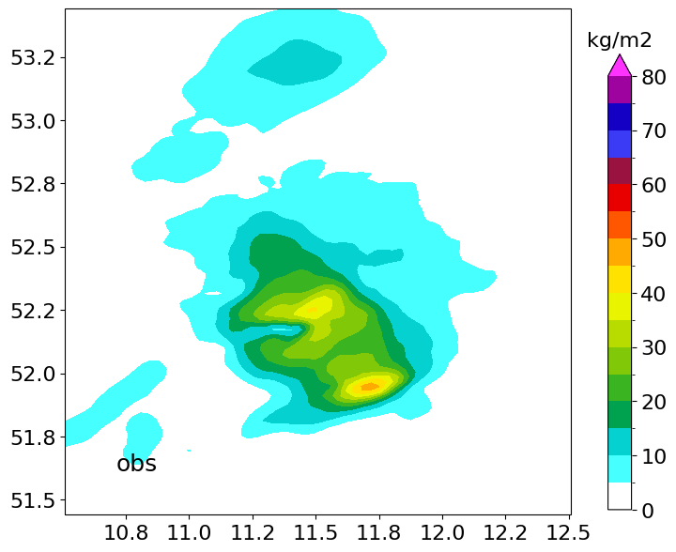
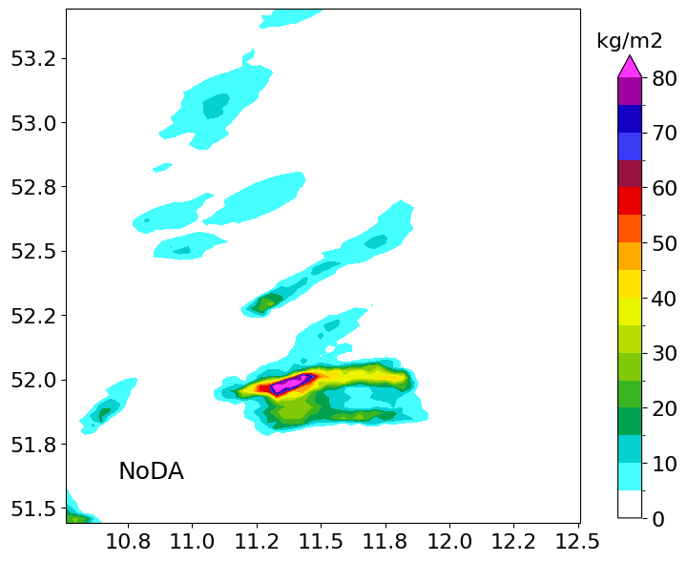
Convective-scale Data Assimilation
example: 2023062218 cell 897
18:00 (FG)
18:20
18:40
19:00
1h TOT_PREC
obs
first guess
let’s update T, QV, U, V, P, and hydrometeors here in order to
improve the evolution of cells
improve the conditions that lead to more convection
correct the convective cells we have
Notes:
this is cell 802

Slide 3
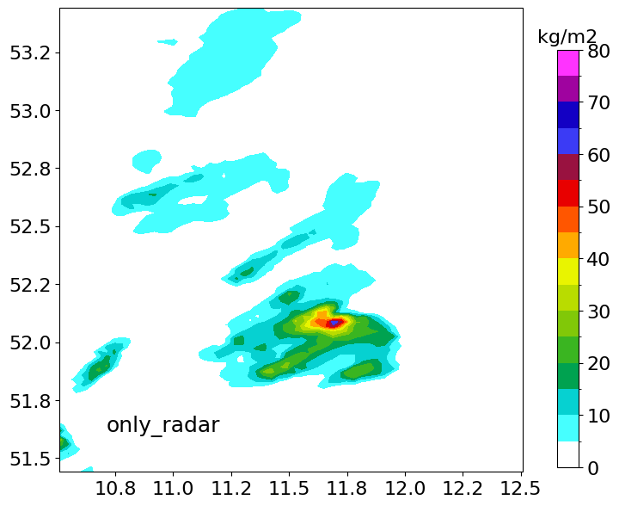
Convective-scale Data Assimilation
example: 2023062218 cell 897
18:00 (FG)
18:20
18:40
19:00
1h TOT_PREC
obs
first guess
DA of 3D radar
Notes:
this is cell 802

Slide 4
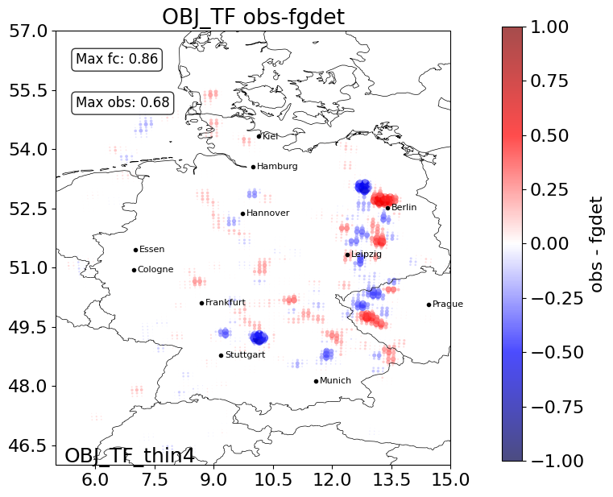
Fractions Skill Score
Now what if we assimilate the FSS?
set a threshold
(e.g. in dBZ) & neighborhood on gridboxes
What fraction of points in the box exceed a threshold?
Take diff between obs and model

Slide 5
Observation
Model Equivalent

Slide 6
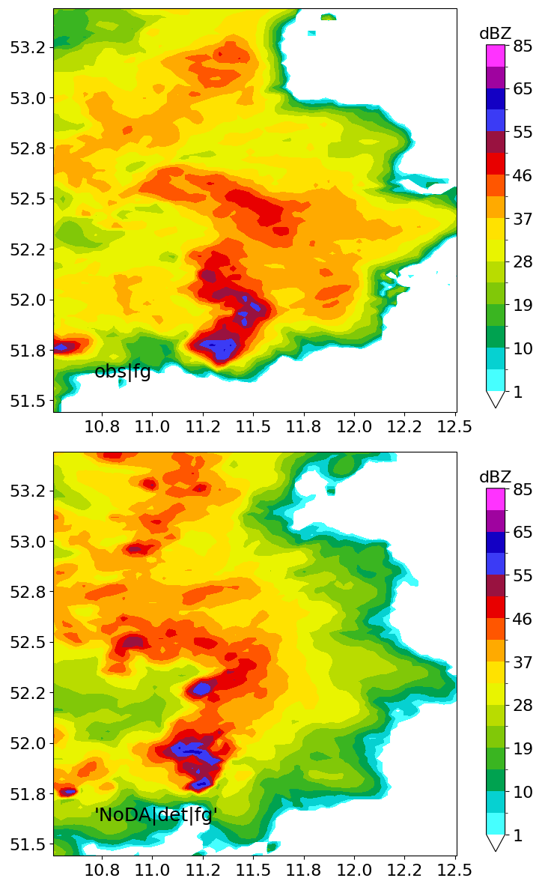
Reflectivity Texture Fraction
RTF thresh 25dBZ
RTF thresh 37dBZ
RTF thresh 46dBZ
RTF thresh 27dBZ, larger box
obs
model

Slide 7
Reflectivity Texture Fraction DA
obs-model diffs
RTF thresh 25dBZ
RTF thresh 37dBZ
RTF thresh 46dBZ
RTF thresh 37dBZ, larger box
temp increments

Slide 8
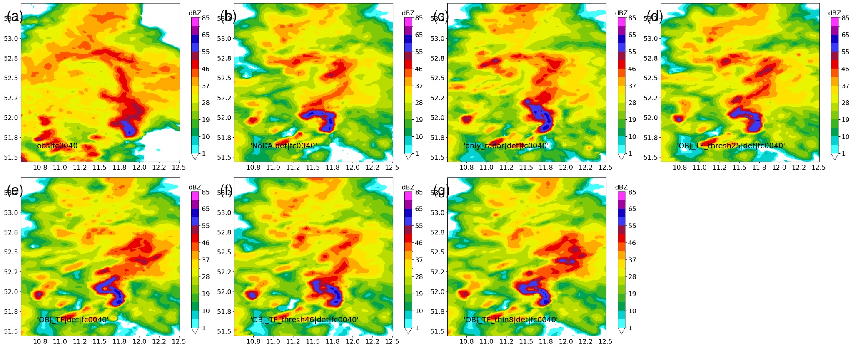
Reflectivity Texture Fraction DA
obs
NoDA
3D Radar
RTF thresh 25dBZ
RTF thresh 37dBZ
RTF thresh 46dBZ
RTF thresh 37dBZ, box2
dBZ 40 min after update

Slide 9
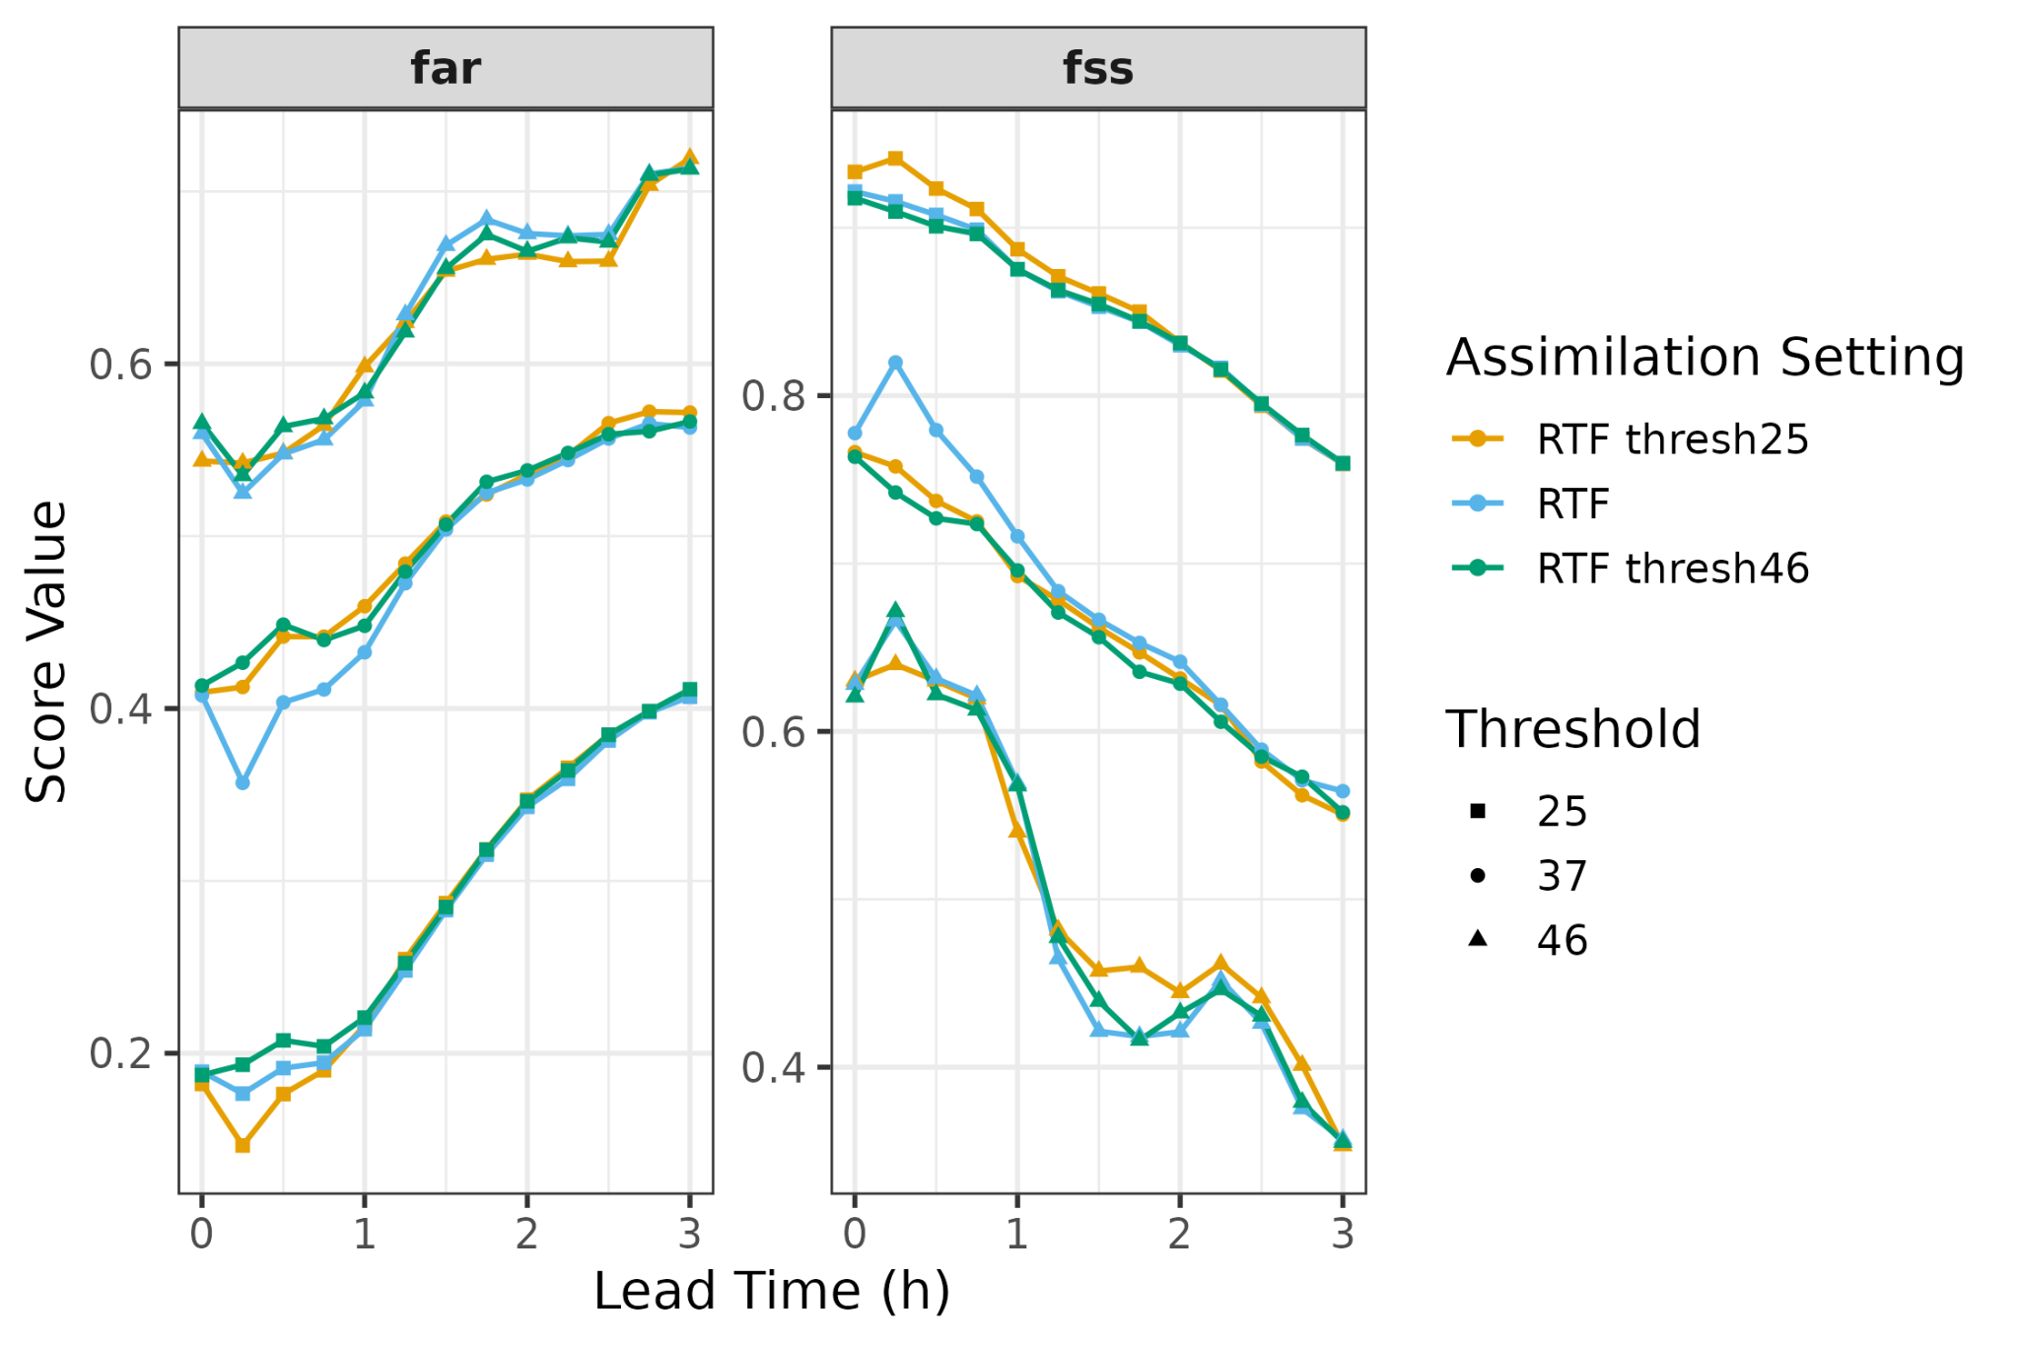
Texture Fraction DA in multiple cases
False alarms go down (and FSS goes up) at the scales where we define the texture fraction.

Slide 10
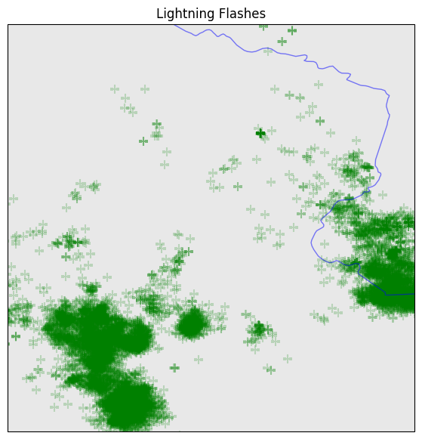
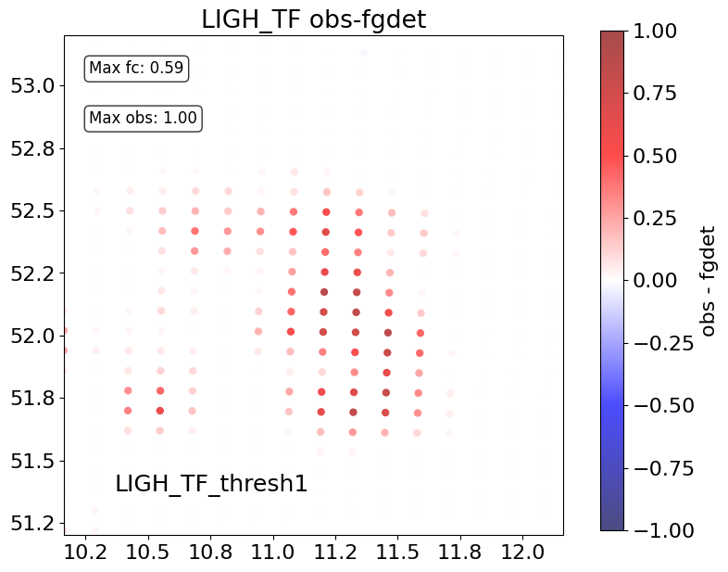
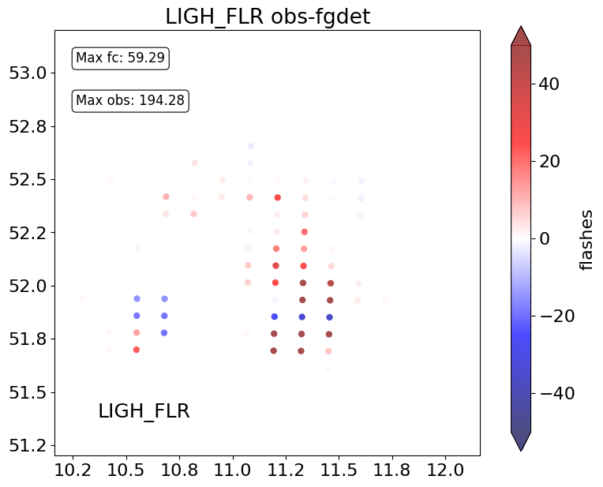
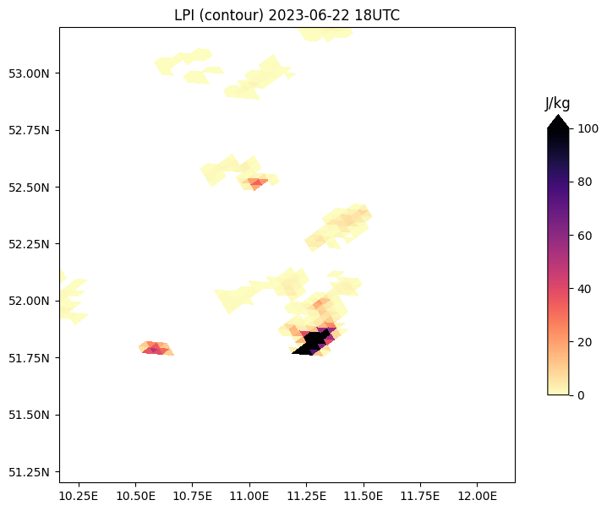
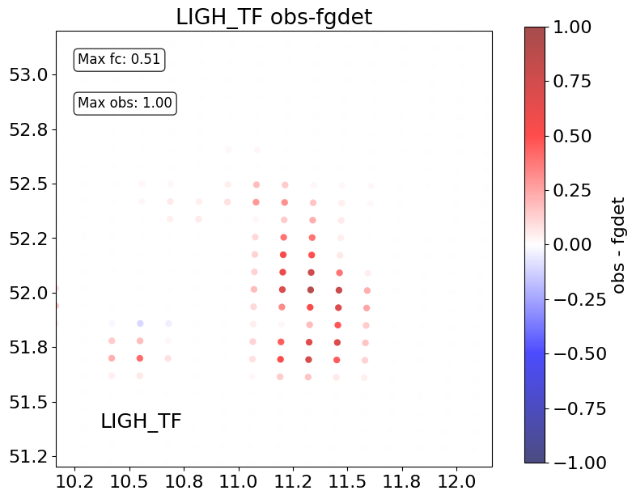
Lightning Texture Fraction
example: 2023062218 cell 270
LTF threshold 1 flash
flashrate
LTF threshold 45 fl
Notes:
something is fucked in this example – is it close to the edge of the model grid? is flashrate sorted wrong or is the superobbing wrong?

Slide 11
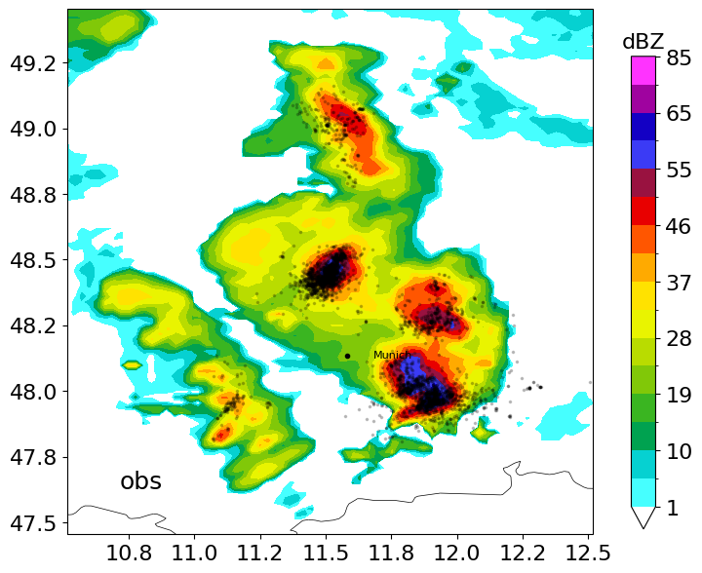
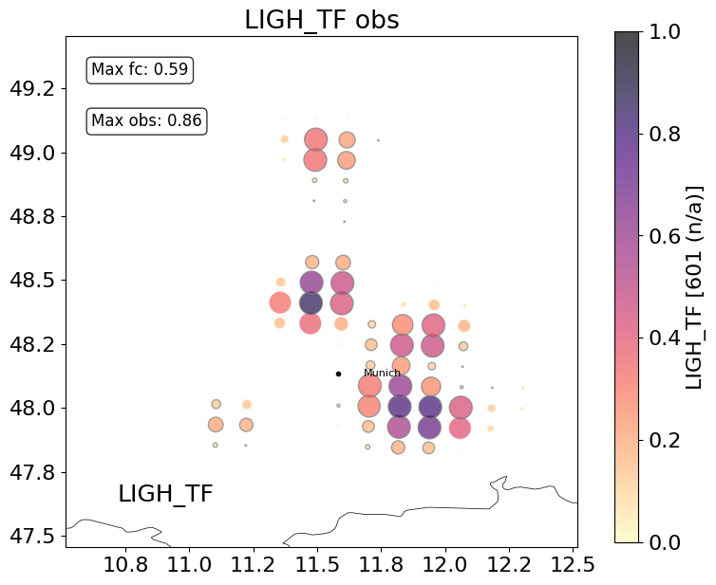
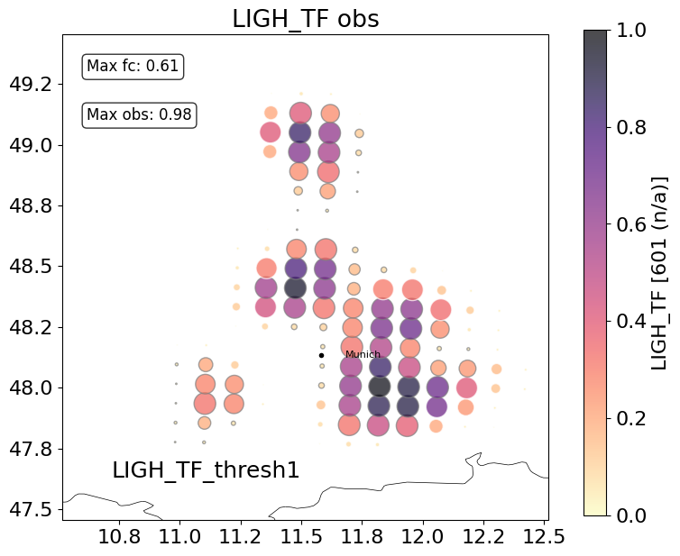
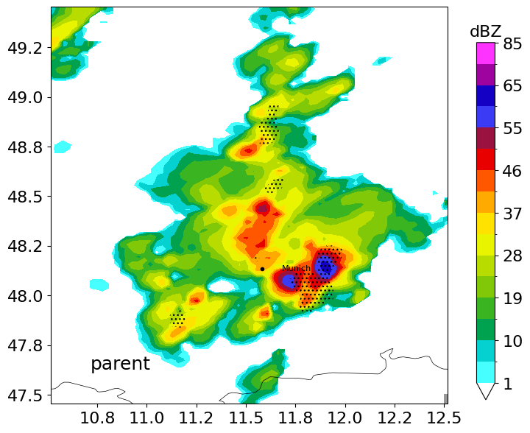
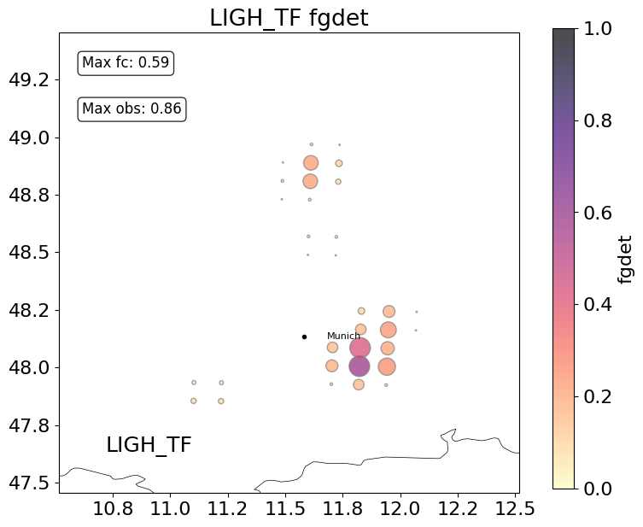
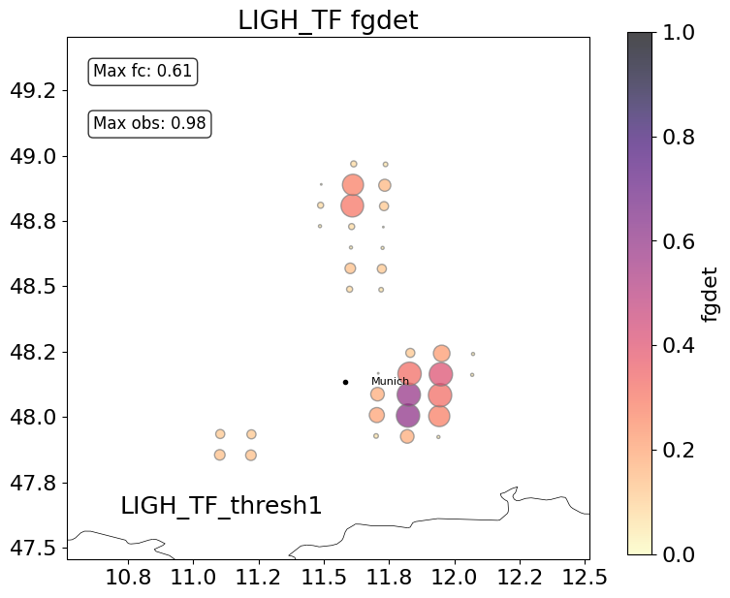
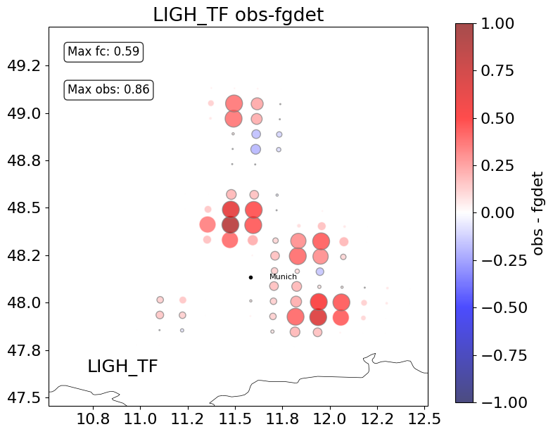
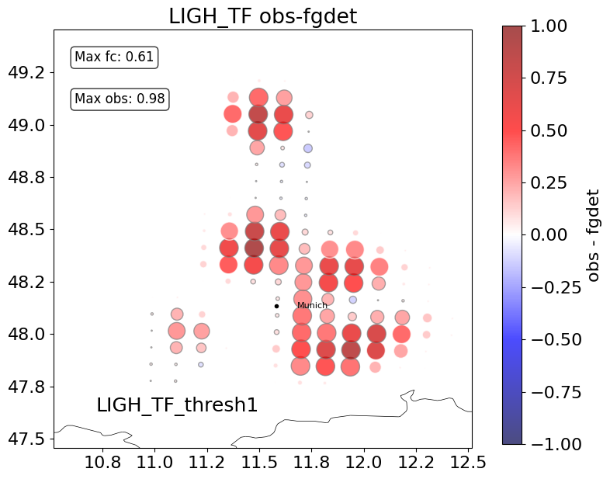
Lightning Texture Fraction
LTF thresh 15 flashes
LTF thresh 1 flash
obs
model

Slide 12
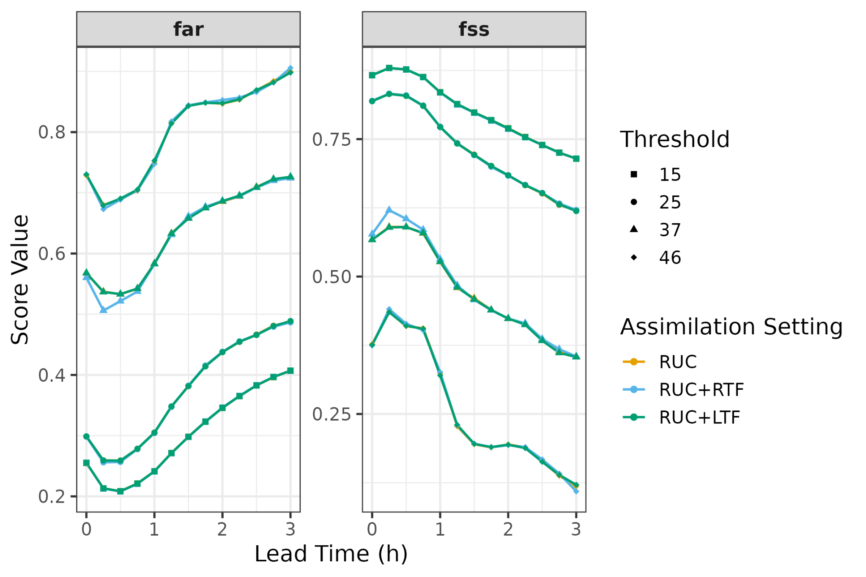
Texture Fraction DA in the SINFONY-RUC
In the full Rapid Update Cycle, adding RTF improves scores for the first 40-60 min.
LTF not so much…

Slide 13
Convective-scale Data Assimilation
We are trying to correct convective processes over the next few hours by doing an instantaneous adjustment of the environment in which convection takes place.
Zero-spread where no model equivalent
Limited to the space spanned by the ensemble
Nonlinear observation operators
Zero-spread where no model equivalent

Slide 14
Summary
We are trying to correct convective processes over the next few hours by doing an instantaneous adjustment of the environment in which convection takes place.
Casting precipitation-related observations as texture fraction can give the DA an extra push that targets the thresholds and scales that we want.
But:
v difficult to get impact beyond 30 min
non-linearity of obs operator is a problem
payoff questionable in system that is already highly constrained

Slide 15
More Qs? Contact me!
Lisa Neef
E-Mail: lisa.neef@dwd.de
Tel.: +49 69 8062 3143

Slide 16
extras

Slide 17
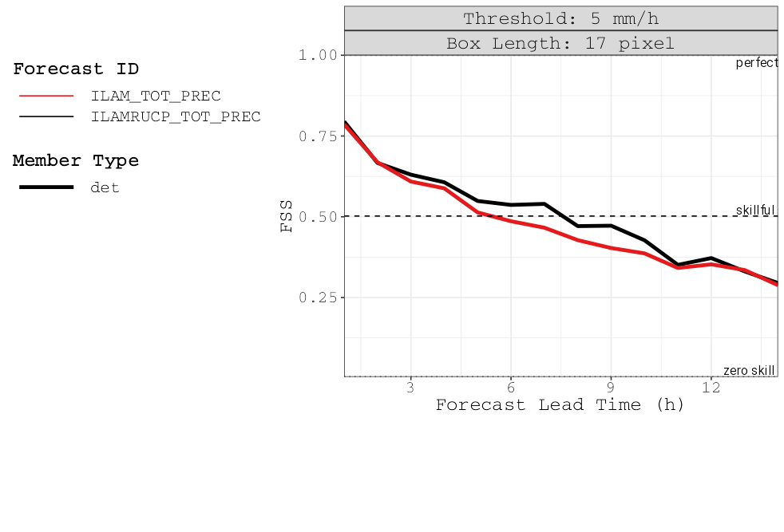
Texture Fraction DA in the SINFONY-RUC
The DWD Rapid Update Cycle
ICON-LAM D2
hourly assimilation with LETKF
conventional obs
radar scans
SEVIRI visual and IR
2-moment microphysics
hydrometeor updates
hourly 14-h forecasts
ICON-LAM Routine
RUC

