Slide 1



Investigating KDP signatures inside and below the dendritic growth layer with W-band doppler radar and in situ snowfall camera
Anton Kötsche¹, Alexander Myagkov², Maximilian Maahn¹, Veronika Ettrichrätz¹, Teresa Vogl¹, Alexander Ryzhkov^{3,6}, Petar Bukovcic^{3,6}, Leonie von Terzi⁴ , Davide Ori⁵ ,Heike Kalesse-Los¹
¹ Leipzig Institute for Meteorology, University of Leipzig, Germany
² RPG Radiometer Physics GmbH, Germany (alexander.myagkov@radiometer-physics.de)
³ NOAA National Severe Storms Laboratory, Norman, Oklahoma, USA
⁴ Meteorological Institute, Ludwig-Maximilians-Universität in Munich, Munich, Germany
⁵ Institute of Geophysics and Meteorology, University of Cologne, Cologne, Germany
⁶ Cooperative Institute for Severe and High-Impact Weather Research and Operations, University of Oklahoma, Norman, Oklahoma, USA

Slide 2
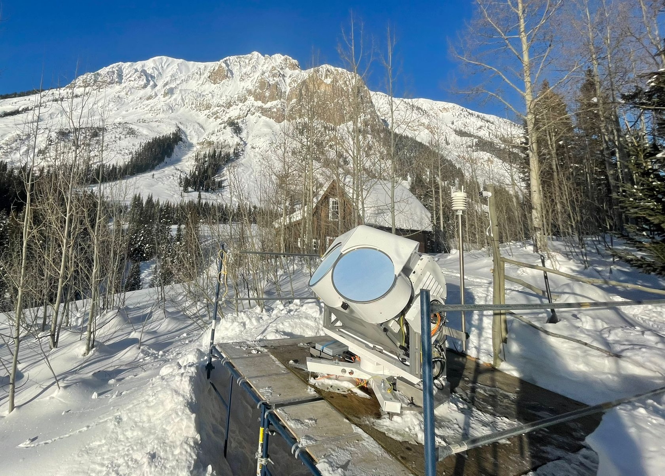
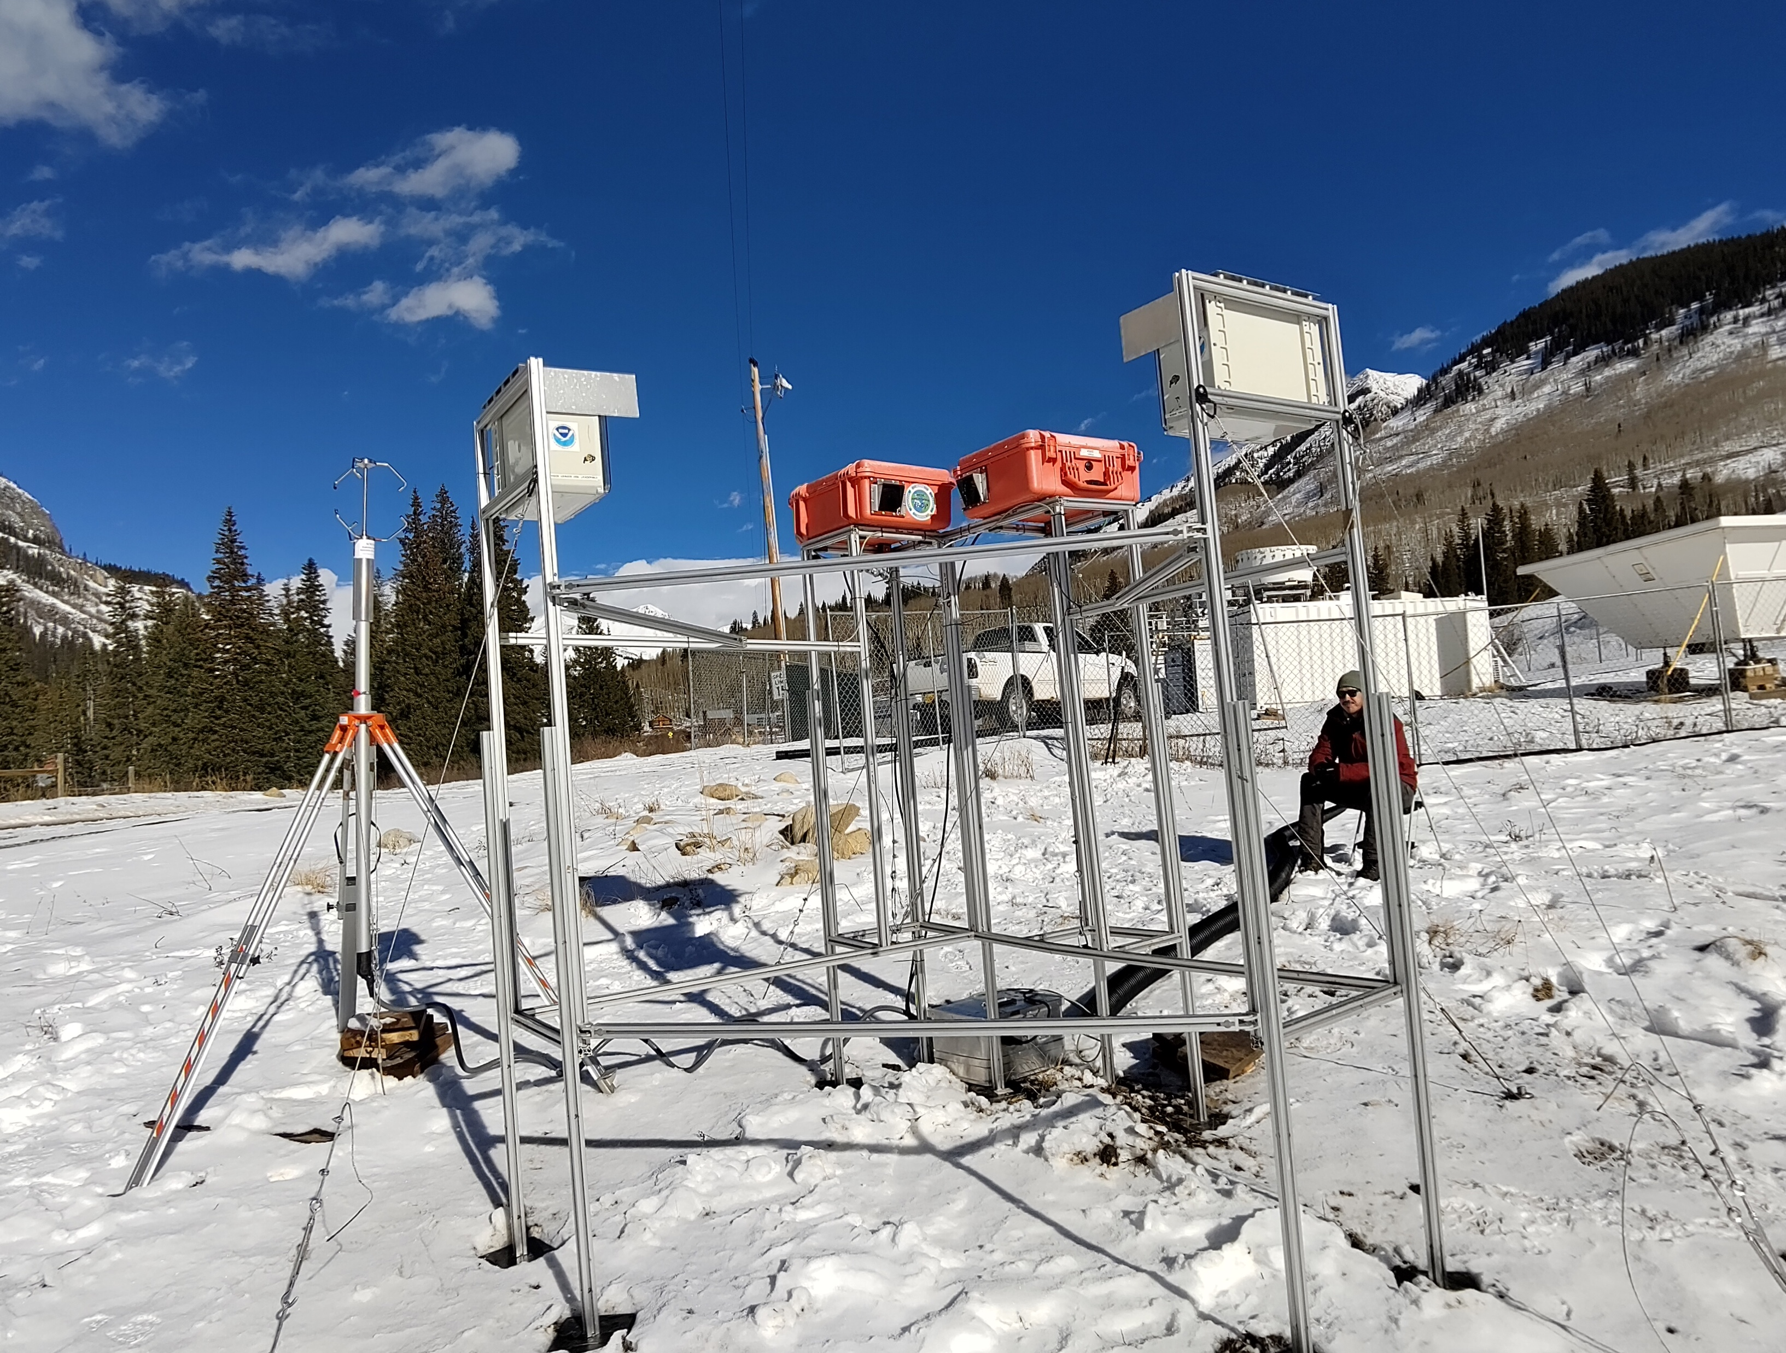
Dataset | Investigating the origin of W-Band radar KDP signatures
THE corsipp Campaign joined SAIL & SPLASH in the Rocky Mountains (Nov 15, 2022 – June 6, 2023)
94 GHz W-Band Cloud Radar LIMRAD94
In-Situ Snowfall Camera VISSS
Source: Ben Schmatz
Source: Isabelle Steinke
Leipzig University team: Heike Kalesse-Los (PI), Maximilian Maahn (PI), Veronika Ettrichrätz (Postdoc), Anton Kötsche (PhD Student)
Notes:
- CORSIPP Project took place in the second winter of the ARM SAIL/NOAAA SPLASH campaign in the Colorado Rocky Mountains
- 94 GHz Dual-Pol Cloud Radar and In-Situ Snowfall Camera deployed at Gothic (CO) 3000m AMSL

Slide 3
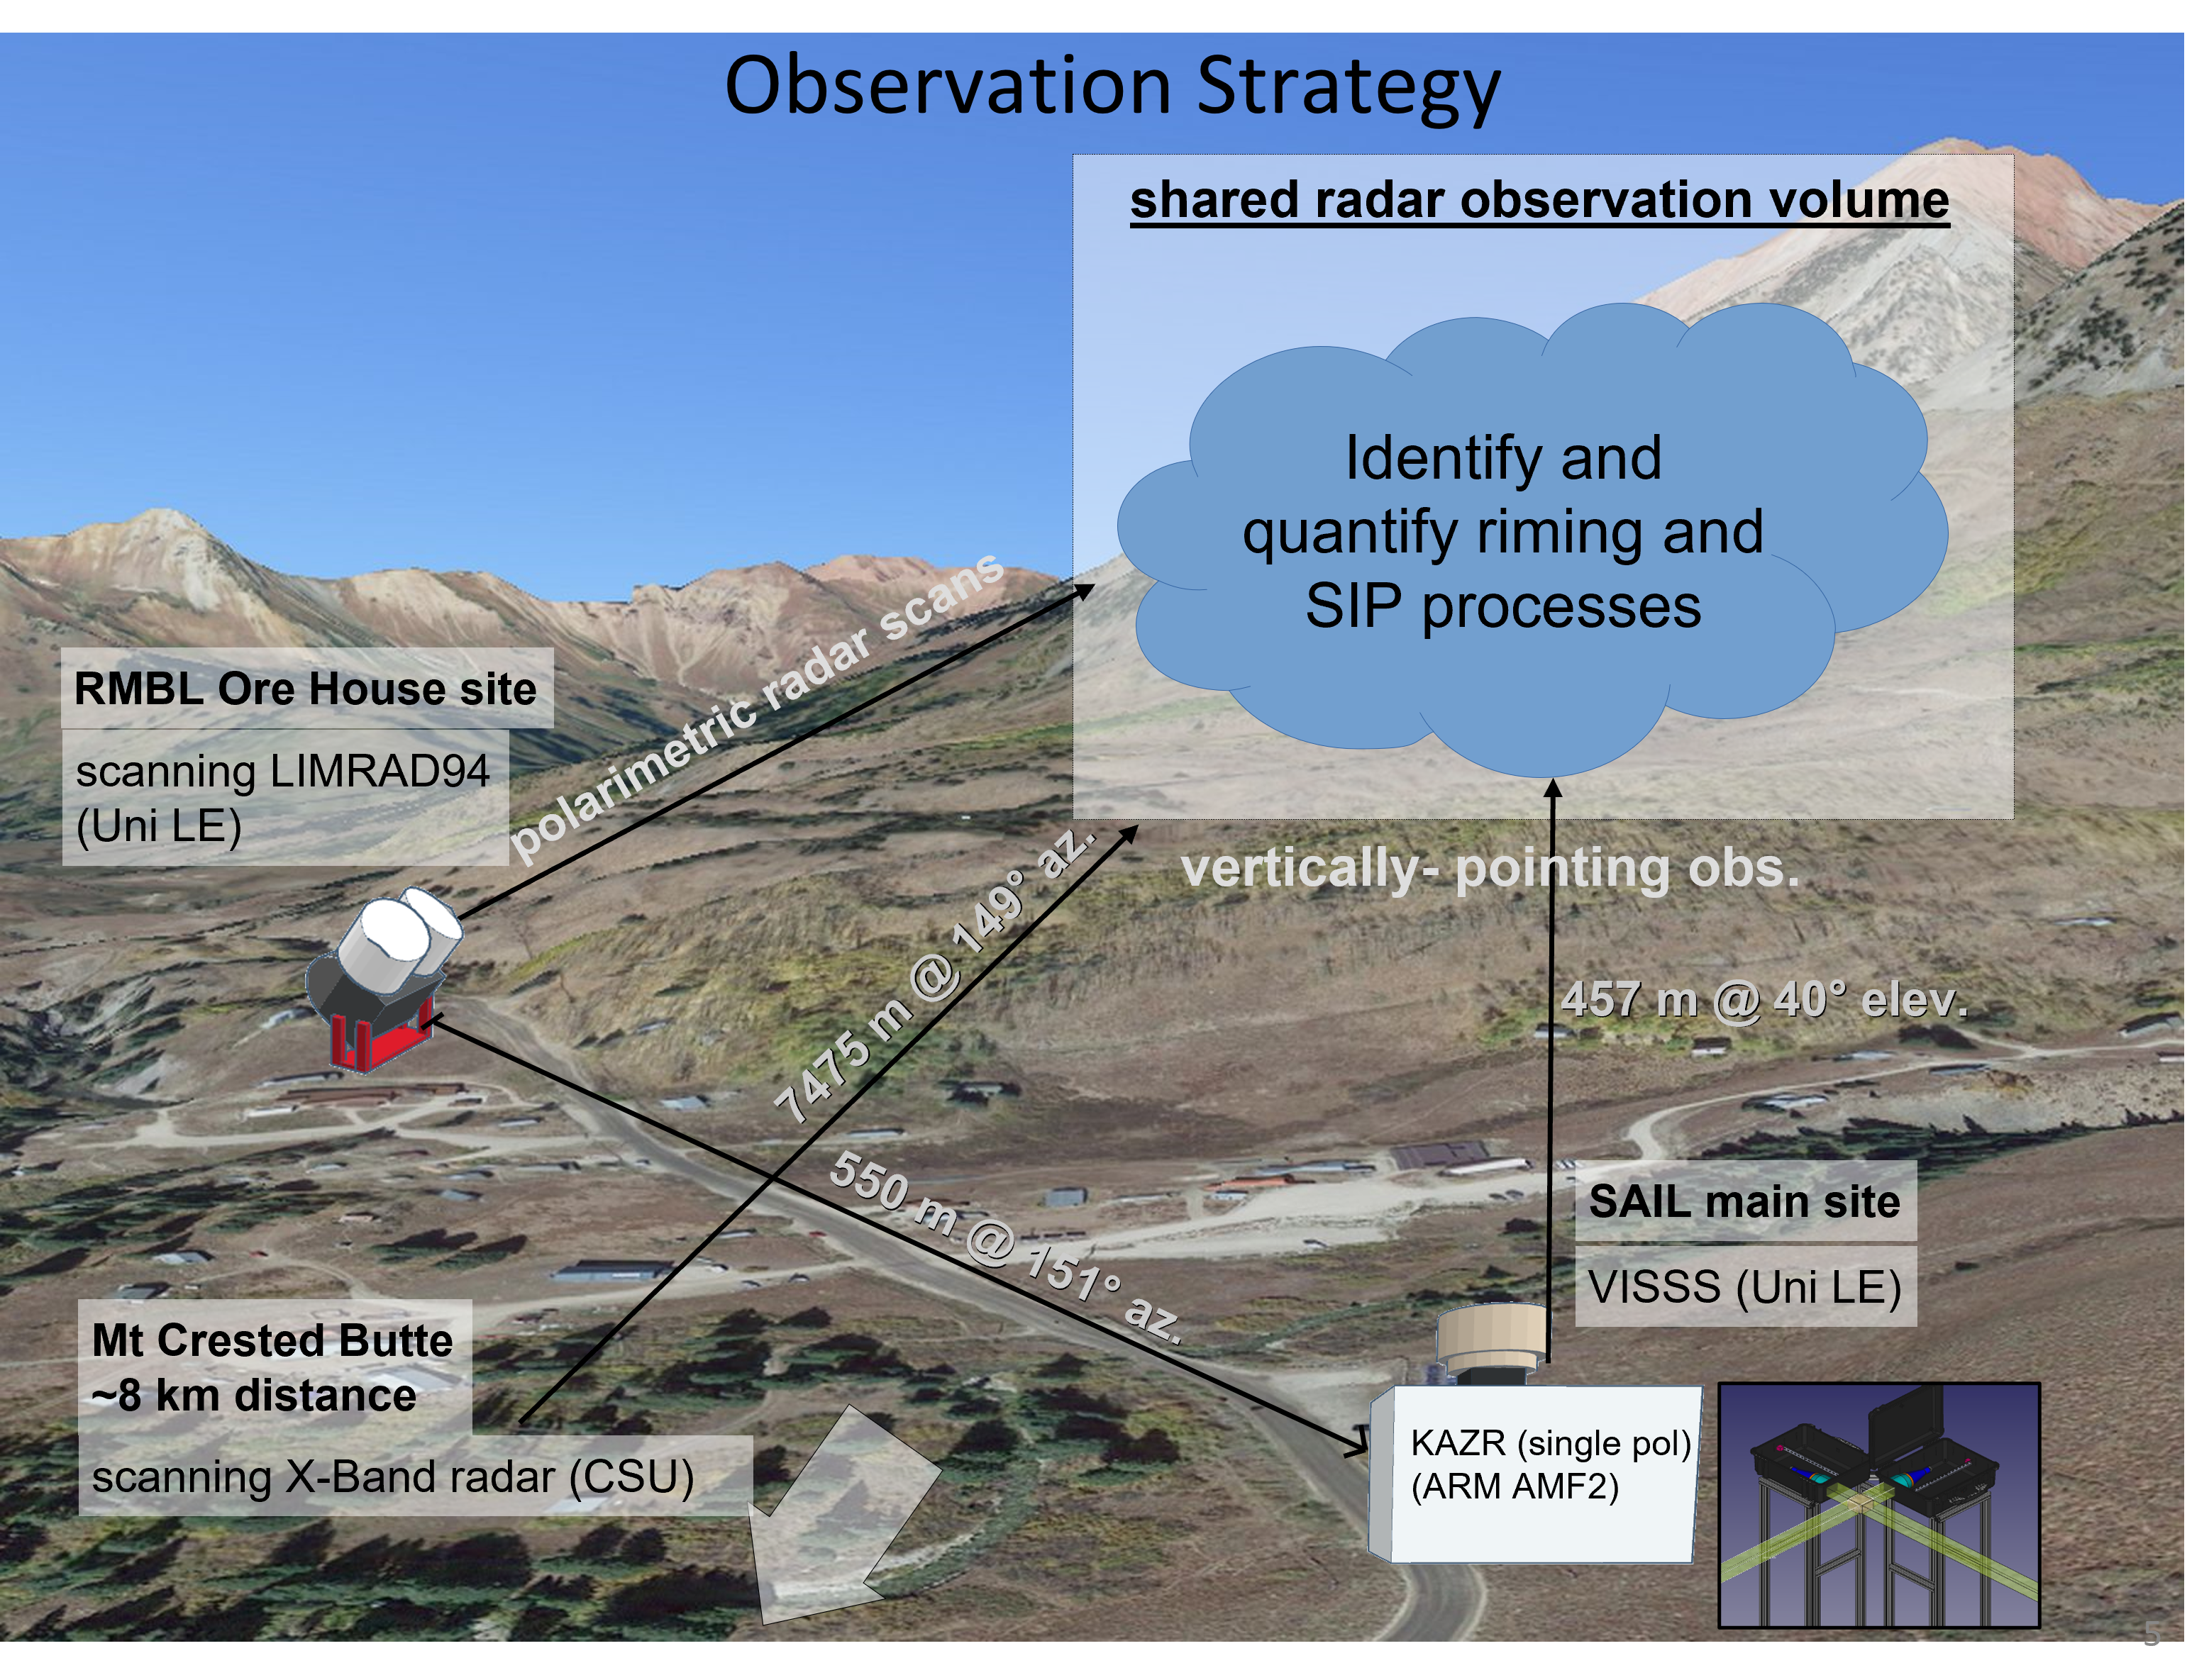
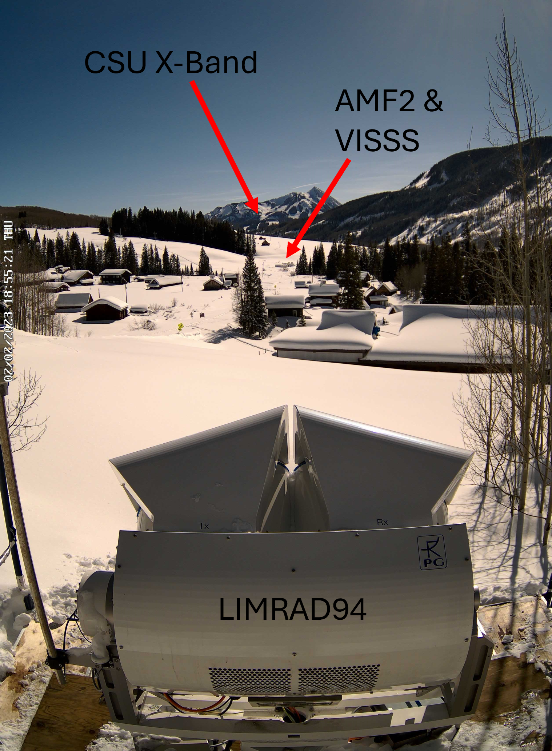
Instruments | Investigating the origin of W-Band radar KDP signatures
AMF2 and CSU X-Band deployed during ARM SAIL / NOAA SPLASH campaign
35 GHz
Notes:
- Multiple instruments and radars on site
- Shared observational volume between LIMRAD94, ARM KAZR and CSU X-Band to observe snowfall microphysics.
- VISSS next to KAZR observing snow images and PSDs in situ

Slide 4
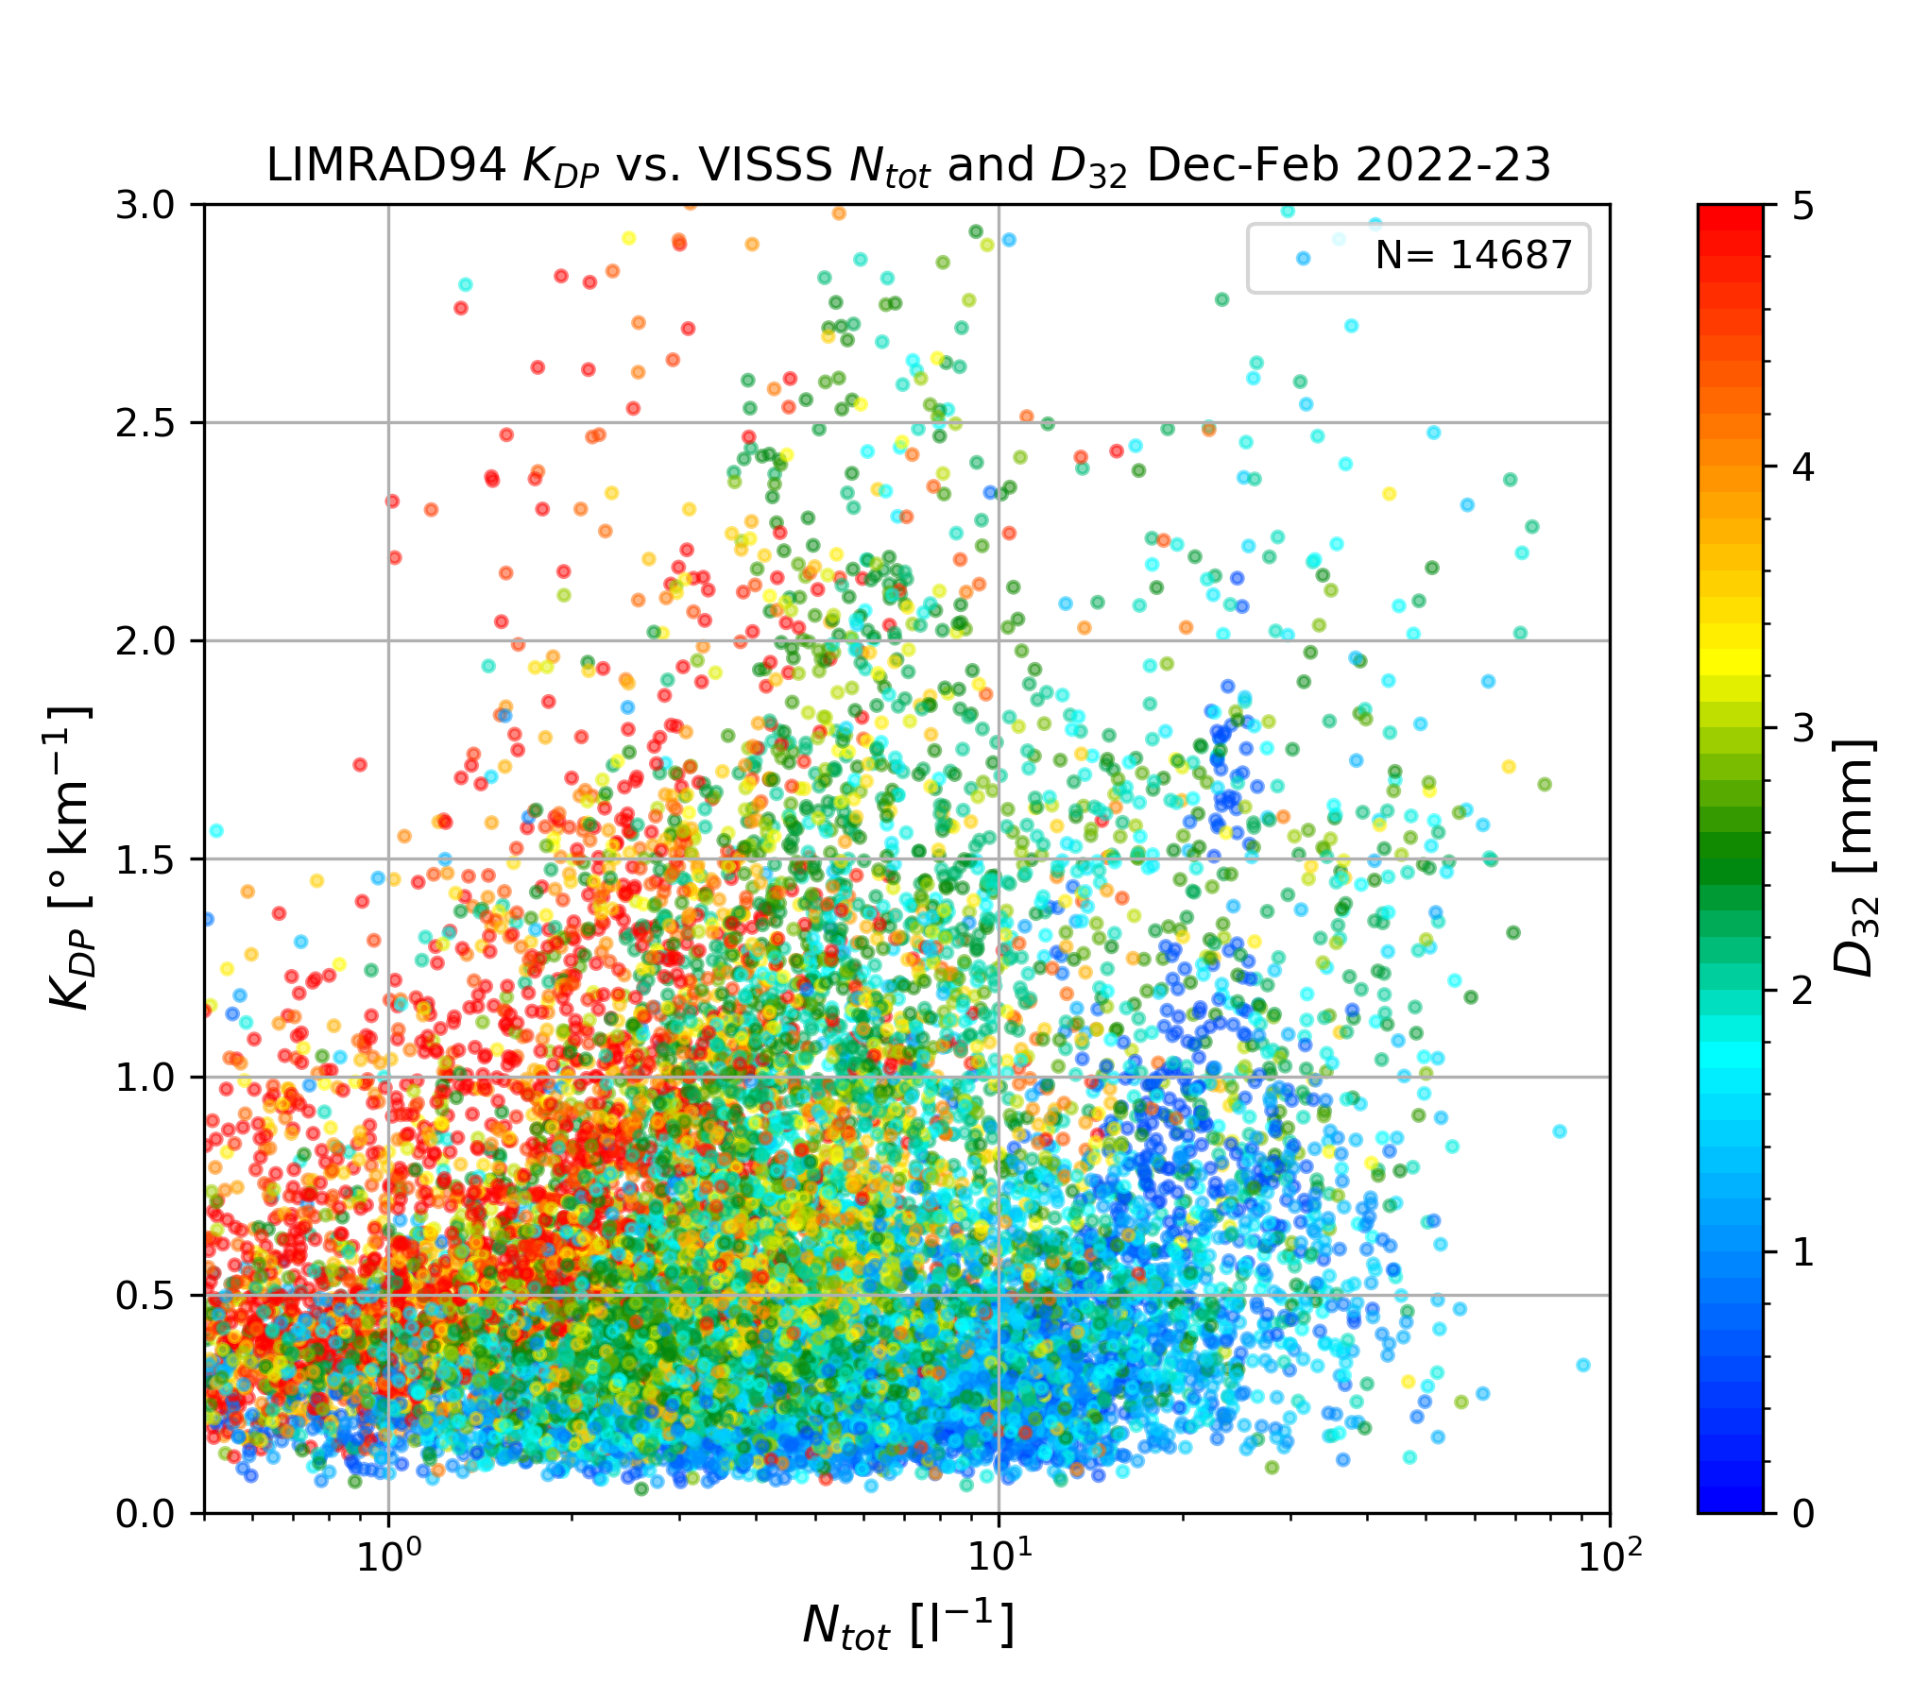
WHICH PARTICLE SIZES ARE RELATED TO KDP SIGNATURES?
Results | Investigating the origin of W-Band radar KDP signatures
LIMRAD94 KDP spatially averaged (median) between 100 and 500 m AGL (52 range gates)
LIMRAD94 KDP temporally averaged (median) to fit the VISSS time resolution of one minute.
Colors are “effective” diameter (D32) = ratio between 3rd and 2nd moment of PSD
Different Ntot and D32 at ground related to similar KDP
4
Notes:
clear connection between higher KDP and Ntot
particle populations with D32 of> 4 mm (red) have Ntot below 10 → still KDP values larger than 2 ◦ km−1
Q: Are larger aggregates are the main contributors to the observed W-band KDP ? Or is it the small ice particles?

Slide 5
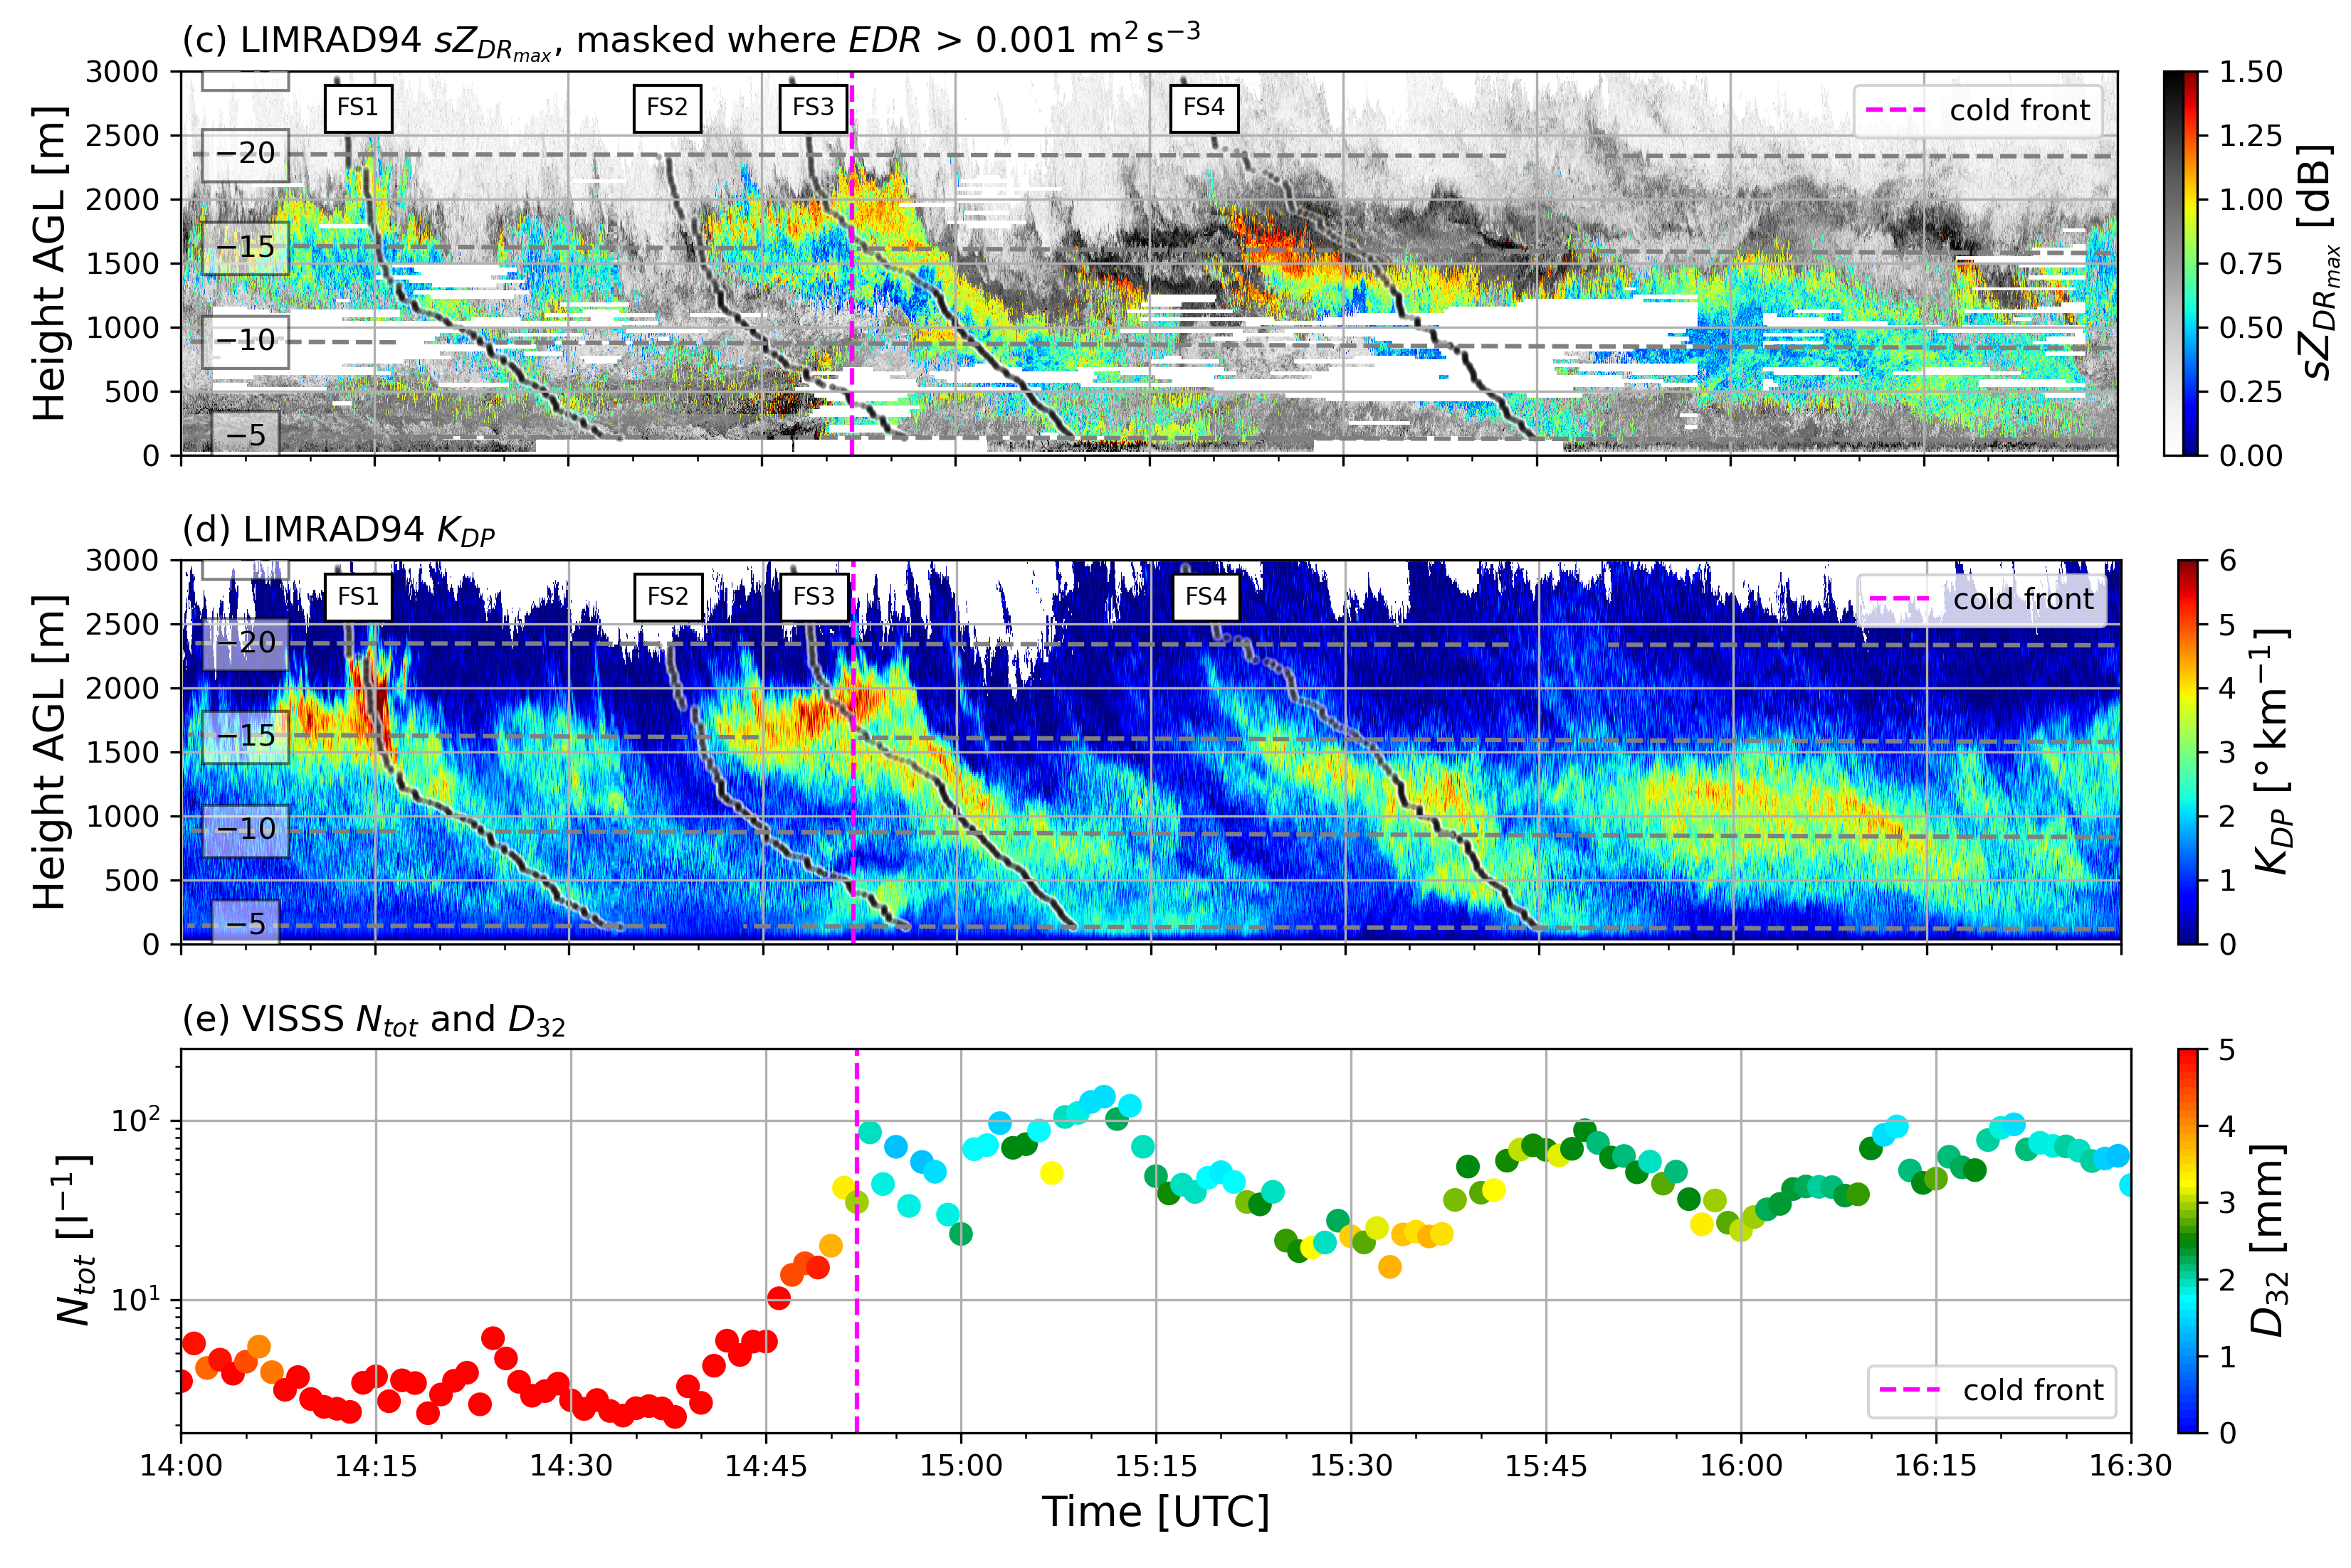
Case Study Dec 6, 2022
Results | Investigating the origin of W-Band radar KDP signatures
Coldfront
Complex synoptic situation with coldfront passage at 14:55 UTC
Turbulence along shear layer due to orographic blocking
Multiple fallstreaks with similar KDP values but very different microphysical processes
Strong changes in particle number concentrations and particle sizes before and after the coldfront
Notes:
We chose this case study because we find multiple KDP fall streaks with very different particle population properties

Slide 6
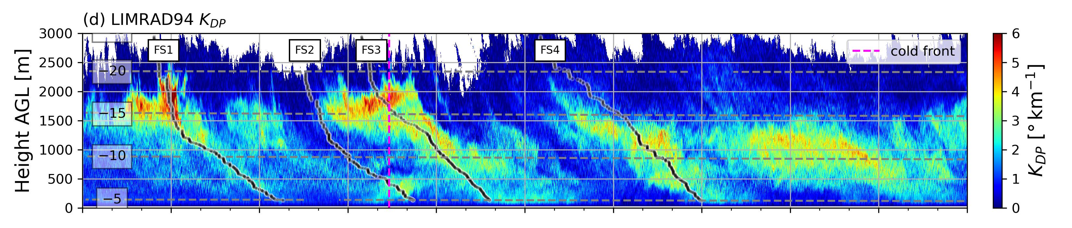
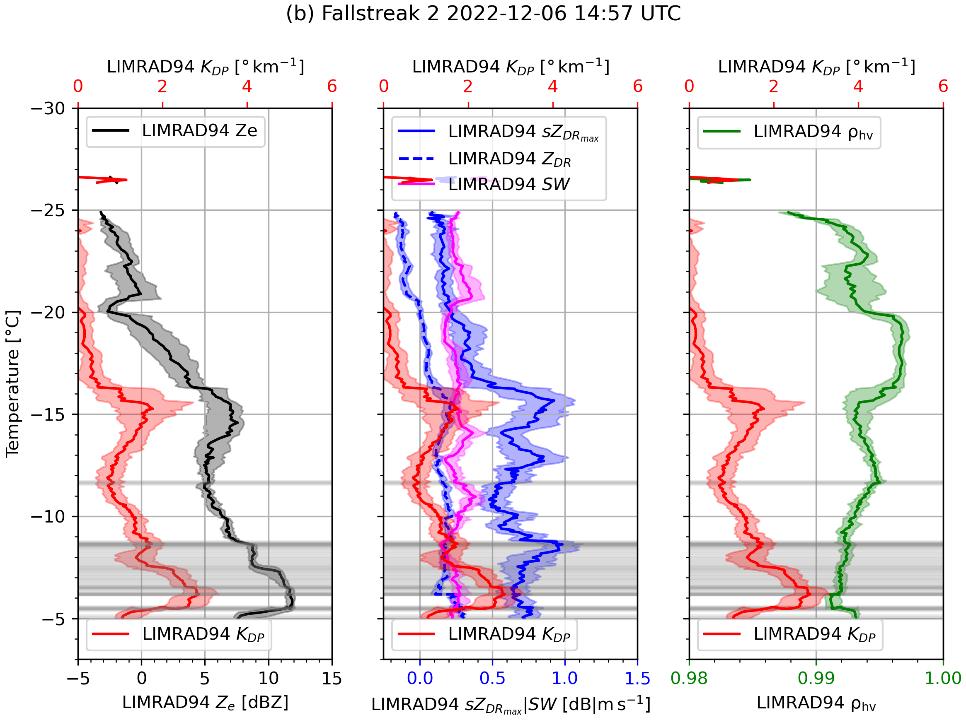
Results | Investigating the origin of W-Band radar KDP signatures
Fallstreak during coldfront
KDP - Specific diff. Phase (deg/km)
SW
RHV
ZE
sZDRmax
sZDRmax – max ZDR in spectra (dB)
RHV – Correlation coefficient
SW – Spectral Width
KDP
Grey areas: strong turbulence
Notes:
Main Point: KDP close to ground likely caused by blowing snow

Slide 7
Results | Investigating the origin of W-Band radar KDP signatures
Fallstreak during coldfront
Weak dendritic growth aloft, KDP around 1 deg/km
Turbulent layer close to surface caused by incoming cold air → strong wind increase
Increased KDP and ZE very close to surface → likely caused by blowing snow
SW
RHV
ZE
sZDRmax
KDP
Notes:
Main Point: KDP close to ground likely caused by blowing snow

Slide 8
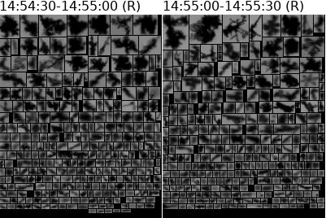

Results | Investigating the origin of W-Band radar KDP signatures
Fallstreak during coldfront
VISSS images
SW
RHV
ZE
sZDRmax
KDP

Slide 9
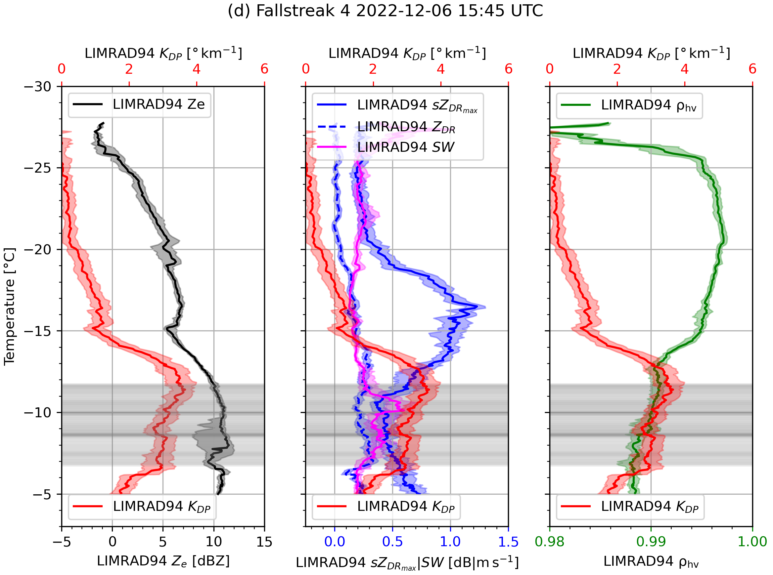
Results | Investigating the origin of W-Band radar KDP signatures
Fallstreak after coldfront
Strong sZDR enhancement without KDP enhancement → larger anisotropic particles with low number concentration (plates/dendrites)?
Peak in KDP below sZDRmax peak, sZDRmax already decreasing → Aggregates of large anisotropic particles producing KDP?
sZDRmax decreases in turbulent layer → broadening of spectra and random orientation
KDP constant in turbulent layer → breakup of aggregates? SIP by ice-ice collision?
Dendrite branches observed by VISSS
ZE
SW
RHV
KDP
sZDRmax
Notes:
Main point: KDP constant in turbulent layer despite enhanced width of canting angle distribution → SIP likely

Slide 10
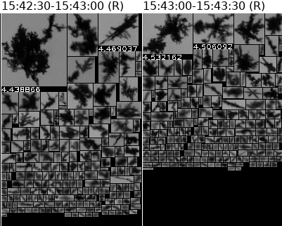
Results | Investigating the origin of W-Band radar KDP signatures
Fallstreak after coldfront
ZE
SW
RHV
KDP
sZDRmax

Slide 11
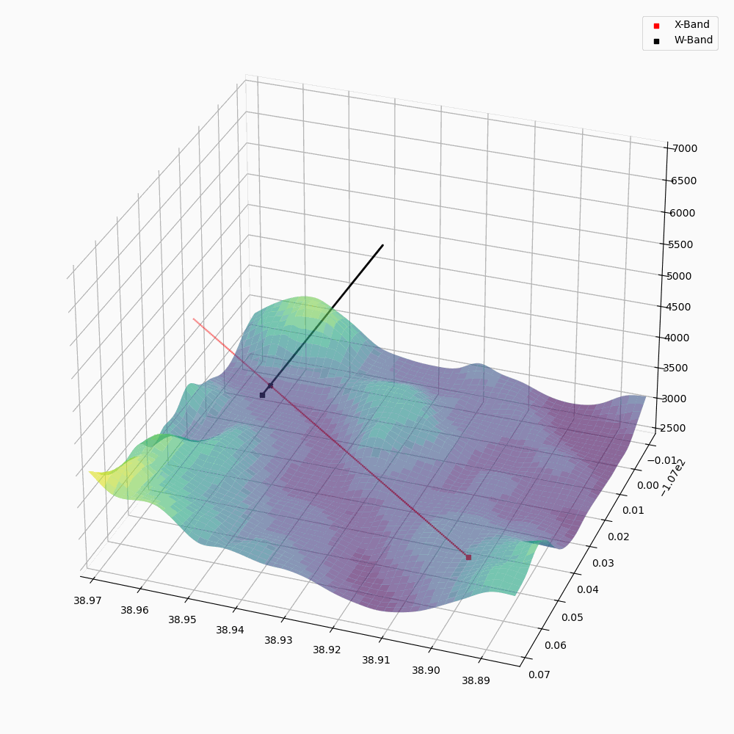
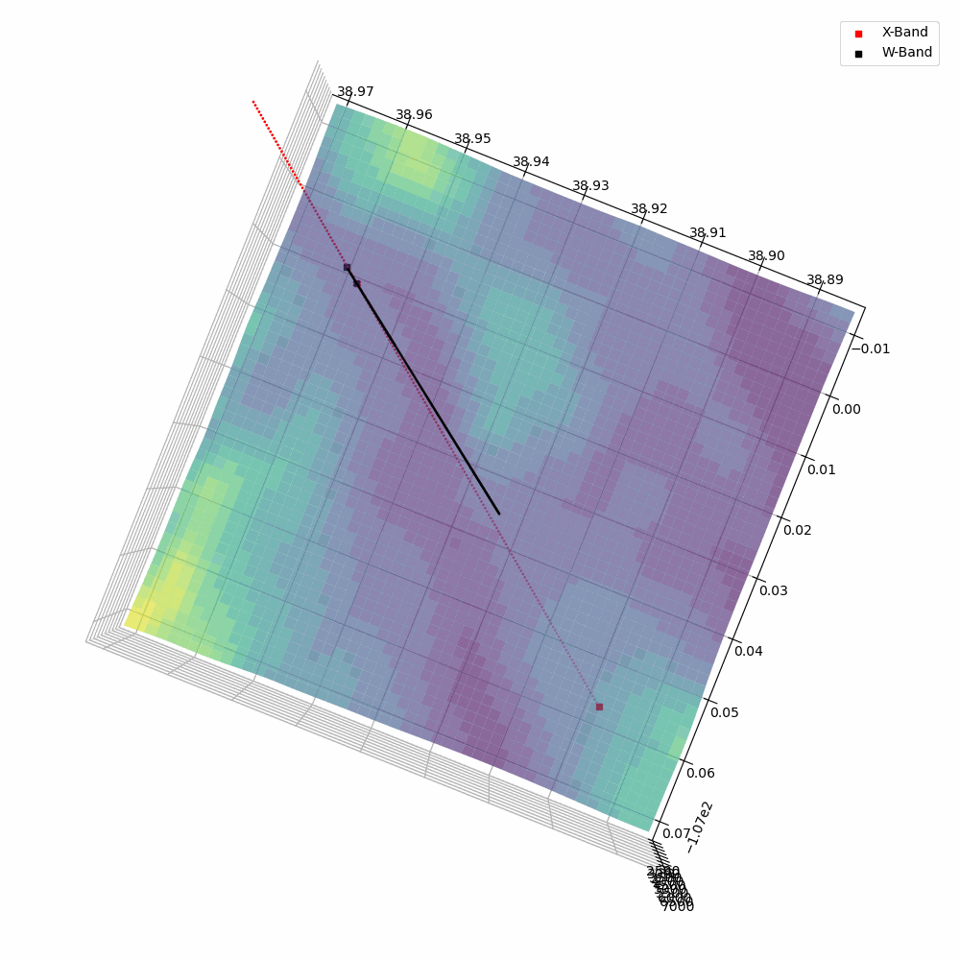
Instruments | Investigating the origin of W-Band radar KDP signatures
Using additional data from CSU X-band radar
LIMRAD94
Height
CSU X-band
Lon
Lat
Notes:
We try to use the collocated X-band data to get further information about the particle populations

Slide 12
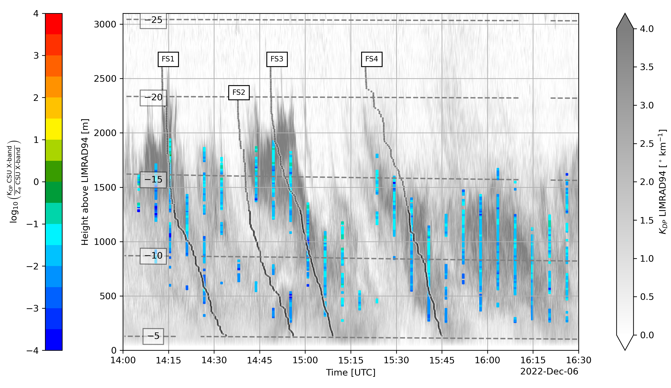
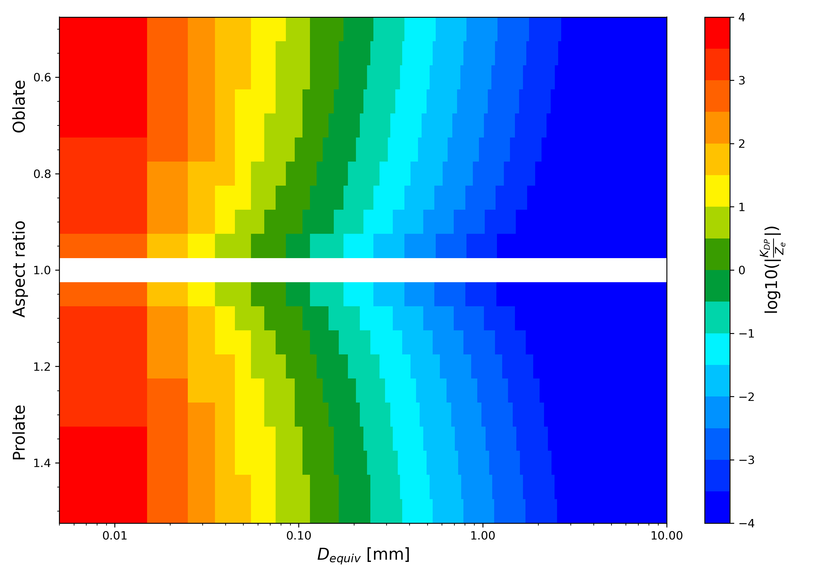
Ratio of X-Band Ze and KDP to estimate size of particles producing KDP
Measured KDP/Ze ratio X-band
Simulated KDP/Ze ratio X-band
Simulation by Alexander Myagkov
In DGL KDP/Ze ratio between -1 and -2 → Diameter of particles < ~0.8mm
Notes:
X-band is analyzed, as its Ze is not affected by non-Rayleigh scattering
Simulations with T-Matrix, using spheroidal approach
Colorbar of both plots is the same → -1 to -2 is light blue
→ Particles in DGL producing KDP likely <0.8mm

Slide 13
Ratio of X-Band Ze and KDP to estimate size of particles producing KDP
Measured KDP/Ze ratio X-band
Simulated KDP/Ze ratio X-band
Simulation by Alexander Myagkov
In DGL KDP/Ze ratio between -1 and -2 → Diameter of particles < ~0.8mm
Below DGL KDP/Ze ratio between -2 and -2.5 → Diameter of particles < ~1.2mm
Notes:
-2 to -2.5 is light darker blue
→ Particles below DGL producing KDP likely <1.2mm → particle size towards surface increased by aggregation

Slide 14
Ratio of X-Band Ze and KDP to estimate size of particles producing KDP
Measured KDP/Ze ratio X-band
Simulated KDP/Ze ratio X-band
Simulation by Alexander Myagkov
In DGL KDP/Ze ratio between -1 and -2 → Diameter of particles < ~0.8mm
Below DGL KDP/Ze ratio between -2 and -2.5 → Diameter of particles < ~1.2mm
But: spheroidal approximation, might not correctly estimate contribution of aggregates
Notes:
-2 to -2.5 is light darker blue
→ Particles below DGL producing KDP likely <1.2mm → particle size towards surface increased by aggregation

Slide 15
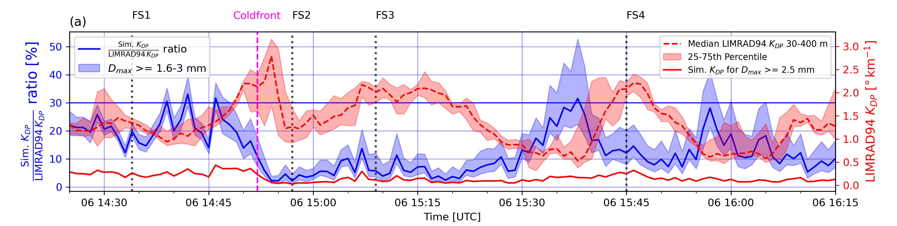

Results | Investigating the origin of W-Band radar KDP signatures
KDP from larger aggregates? LIMRAD94 and VISSS observations
KDP observations near surface
Simulated KDP
Ratio Simulated / Observed KDP
Simulation by Leonie von Terzi
Modeling KDP based on VISSS PSD data using DDA
Only particles larger than 2.5mm included
Dendrite aggregates used as particles for simulation
Contribution to KDP of 10-15 % can be attributed to aggregates with a maximum diameter>= 2.5 mm.
When the PSD contains a large number of aggregates → contribution of up to 20 %
Notes:
Sims using DDA for better representation of aggregates
Highest contribution of aggregates to KDP during FS1 and FS1 and FS4.
Full Plot in Backup slides in case there are questions on Ze or VISSS Ntot for this case

Slide 16
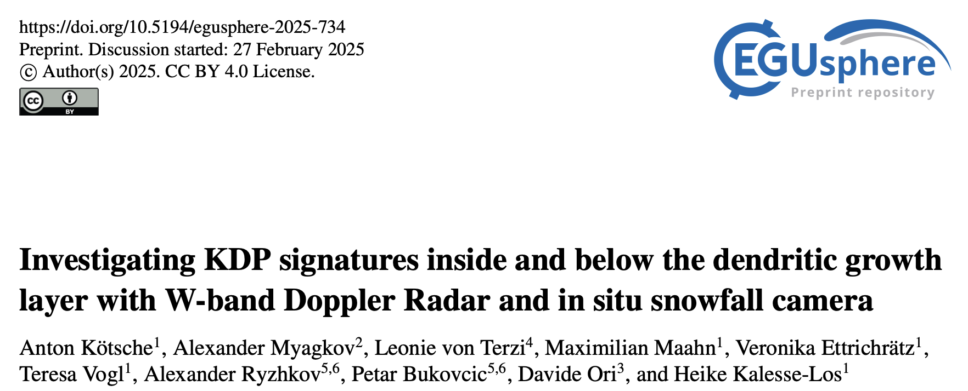

Conclusion/Outlook | Investigating the origin of W-Band radar KDP signatures
Similar W-band KDP values can be produced by strongly variable particle number concentrations.
Small ice particles (<1.2mm) are the main contributors to the observed W-band KDP
Up to 20% of the observed KDP can be attributed to large dendrite aggregates
Blowing snow likely caused W-band KDP of up to 3 deg/km
Despite the dampening effect of turbulence mentioned above, we observed an increase in KDP inside a strong turbulent layer → might be due to SIP
Conclusion:

Slide 17
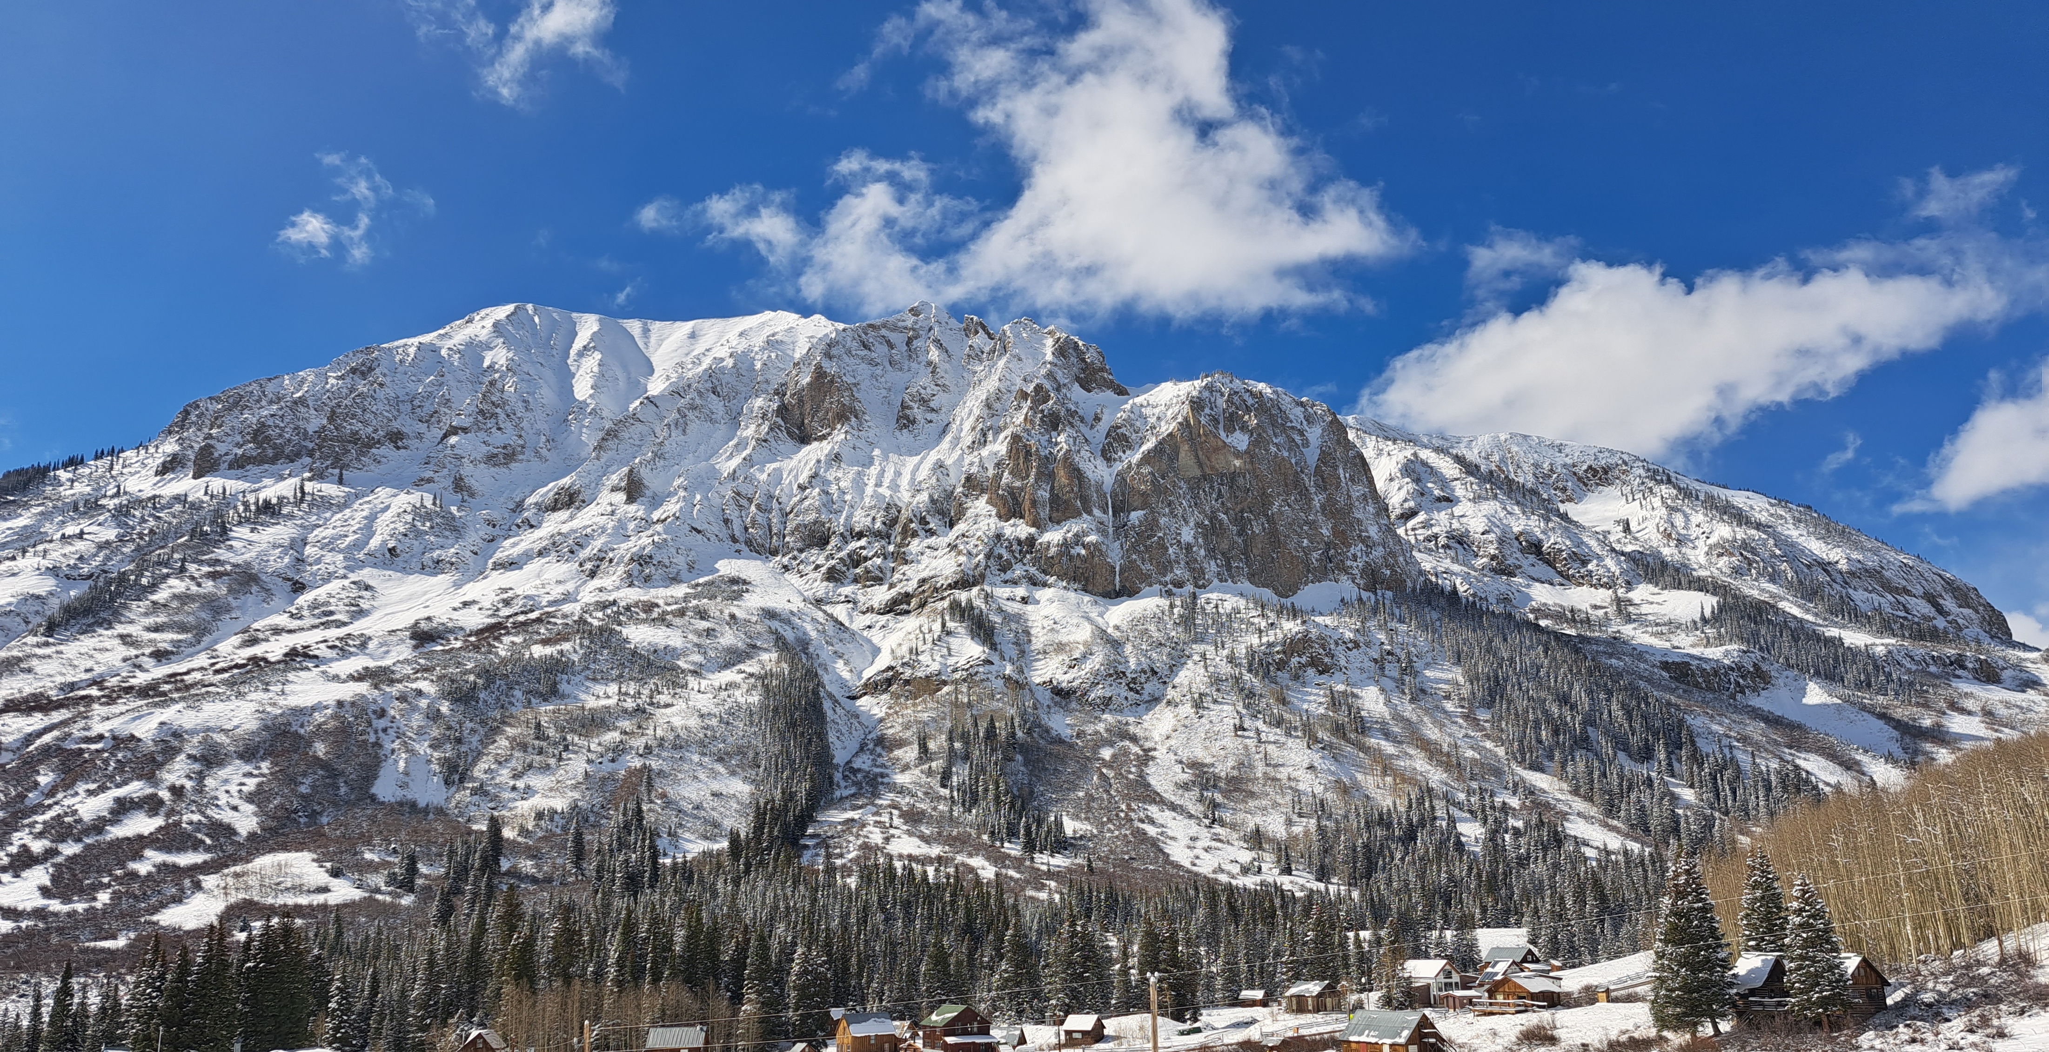
Thank you for your attention!

Slide 18
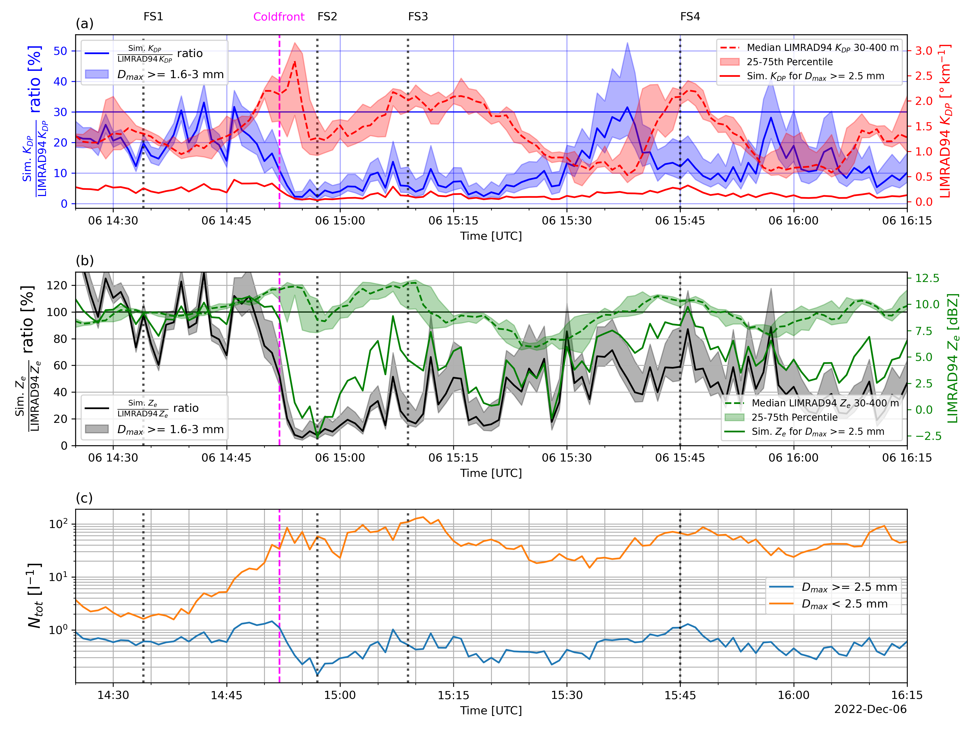
KDP Panel
Ze Panel
VISSS Panel

