Slide 1
Hydrometeor partitioning ratios for polarimetric ground-based and dual-frequency space-borne radar observations
Velibor Pejcic, Kamil Mroz, Kai Mühlbauer and Silke Trömel

Slide 2
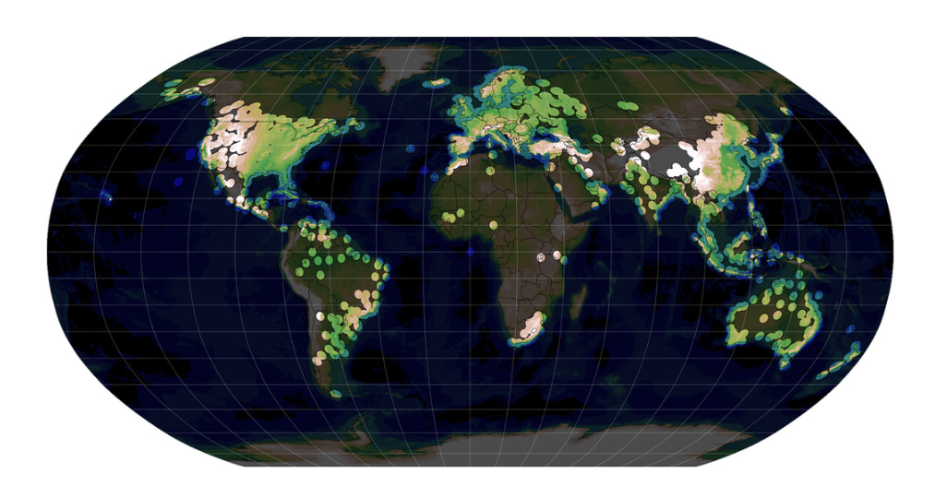
Objectives/Motivation
Solid
Mixed
Liquid
SR (DF)
Derivation and validation of hydrometeor partitioning ratios (HPR) estimated with hydrometeor classifications (HMC-P) based on dual-frequency (DF) or dual polarization (DP) measurements by combining ground-based (GR) and space borne radar (SR) observations.
DF
Rain?
Graupel?
Hail
?
HMC
?
GR (DP)
?
?
DP
Saltikoff et al. (2019)
Notes:
Typically, HMC provide information about the dominant hydrometeor class in the resolved radar volume and do not provide information about the coexisting recessive/secondary hydrometeor classes.
SR-based HMCs (3D), like the one of GPM’s DPR, are reduced to a separation into liquid, mixed and solid by melting layer detection (besides a few 2D flags).
HPR estimates are an excellent tool for evaluating NWP models. Especially in extreme weather regions without GR measurements (like Hurricane Alley) SR-based HPR can make such evaluation possible.

Slide 3
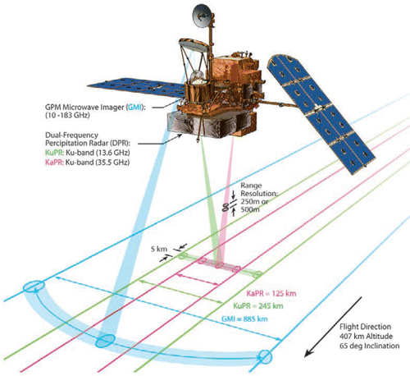
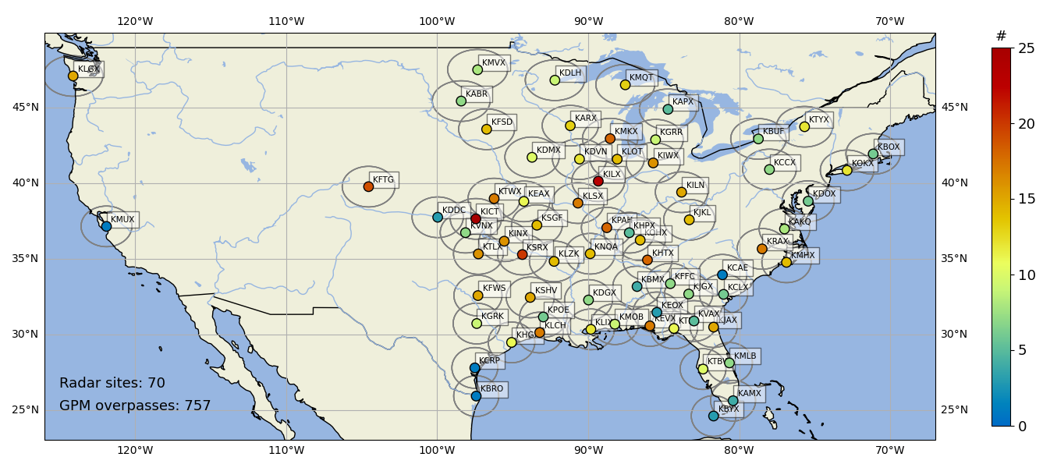
Data
SR
GR
Global Precipitation Mission Core Satellite (GPM)
NEXRAD
Scan angle = ±17°
Scan angle = ±8.5°
125m
5km
S-band (~3GHz) DP weather radar data
Resolution: Δr: 250m, Δϕ: 1°, Δθ: 0.5°-19°
757 volume scans between 2014 and 2023 with GPM overpass are used.
Ku-band : 13.6 GHz
Ka-band : 35.5 GHz
JAXA/NASA
Furukawa et al. 2013

Slide 4
Comparison of SR and GR Observations
Quasi HPRs (qHPRs) as „Ground Truth“
HMC-P
SR (DF)
SR (DF)
Samples X_{i}, i>10⁶
Train size: 80%
Test size: 20%
N
z
W
E
DP
qHPR
DF
x
S
GR (DP)
H₃
H₃
H₂
H₁
H₁
H₂
H₃
H₃
H₁
H₃
H₃
GR (DP)
H₂
H₃
H₃
H₂
H₁
H₁
H₂
H₃
H₃
HMC-P
Notes:
Let's look at the idea and strategy. On the left side we see GR measurements in the horizontal plane and on the right side as a cross section.
With state of the art HMC we can identify a dominant hydrometeor type for each GR bin.
Let's take a look how the SR measurements look in the horizontal and vertical planes.
As you can see, we have to merge the SR and GR observations in order to consider scan volumes of the same size.
The first step is to average the DP measurements of all GR bins within an SR footprint.
Then all DF measurements from all SR bins within the GR beamwidth are averaged.
The resulting measurement volumes contain several hundred GR volumes which allow the determination of quasi HPRs per matched volume based on the dominant hydrometeor types classified with GR.
We call such resulting measurement volumes sampels S and we have more than a billion of them.
Our HMC is first trained with the 80% of the dataset and the remaining 20% are used to estimate HPR with HMC-P based on DF only.
We do the same with the DP measurement samples.
In a perfect world, our estimates would then be equivalent to the qHPRs.

Slide 5
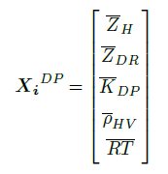
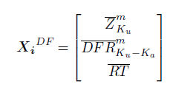
Estimation of HPR with HMC-P
Samples X_{i}, i>10⁶
Light Rain (HPR_{LR})
Moderate Rain (HPR_{MR})
Heavy Rain (HPR_{HR})
Big Drops (HPR_{BD})
Covariance Matrix C_{k}(qHPR_{k})
Centroids μ_{k}(qHPR_{k})
Weights W_{k}(T)
Multivariat Normaldistribution (MVND):
Refined approach of Besic et al. (2018)
HPR_{HR}=10%
HPR_{BD}=40%
HPR_{MR}=40%
HPR_{LR}=10%
Hydrometeor Partitioning Ratio (HPR):
Notes:
Let's move on to the derivation of the HPR. What you see on the right is exactly what the audience doesn't want to see in the last talk at 18:30. That's why we're cutting it short.
The whole assumption here is based on the work of Besic et al. 2018 with additional refinements.
The Sampels S are used to create a multivariate normal distribution (MVND) for each hydrometeor class.
To visualise everything, let's take a look at a small example on the left. It is important to note that in DP-space our measurements are vectorised and include the information of ZH, ZDR, KDP, RHOHV, T and RT. If we now display the distributions of the hydrometeor classes LR, MR, HR and BD only in the two dimensional ZH-ZV plane, a measurement at this point would lead to an HPR for Moderate Rain of ~100%, a measurement here to ~100% HPR of Big Drops. A measurement exactly between the two distributions would therefore result in a 50%-50% mixture considering only these two hydrometeor types.
If we transfer everything to the DF-space, then the distributions will look like this, only the vector components change and Ku-band reflectivity and DFR are now used in addition to RT. You can already see that the information content of the DF-space is somewhat smaller compared to the DP-space.

Slide 6
Validation of HPRs^{DP/DF}
SR (DF)
SR (DF)
Samples X_{i}, i>10⁶
Train size: 80%
Test size: 20%
N
z
W
E
DP
qHPR
DF
x
S
GR (DP)
H₃
H₃
H₂
Validation
H₁
H₁
H₂
H₃
H₃
H₁
H₃
H₃
GR (DP)
H₂
H₃
H₃
$${HPR}_{k}^{DP}$$
$${HPR}_{k}^{DF}$$
H₂
H₁
H₁
H₂
H₃
H₃
HMC-P
Notes:
Let's look at the idea and strategy. On the left side we see GR measurements in the horizontal plane and on the right side as a cross section.
With state of the art HMC we can identify a dominant hydrometeor type for each GR bin.
Let's take a look how the SR measurements look in the horizontal and vertical planes.
As you can see, we have to merge the SR and GR observations in order to consider scan volumes of the same size.
The first step is to average the DP measurements of all GR bins within an SR footprint.
Then all DF measurements from all SR bins within the GR beamwidth are averaged.
The resulting measurement volumes contain several hundred GR volumes which allow the determination of quasi HPRs per matched volume based on the dominant hydrometeor types classified with GR.
We call such resulting measurement volumes sampels S and we have more than a billion of them.
Our HMC is first trained with the 80% of the dataset and the remaining 20% are used to estimate HPR with HMC-P based on DF only.
We do the same with the DP measurement samples.
In a perfect world, our estimates would then be equivalent to the qHPRs.

Slide 7
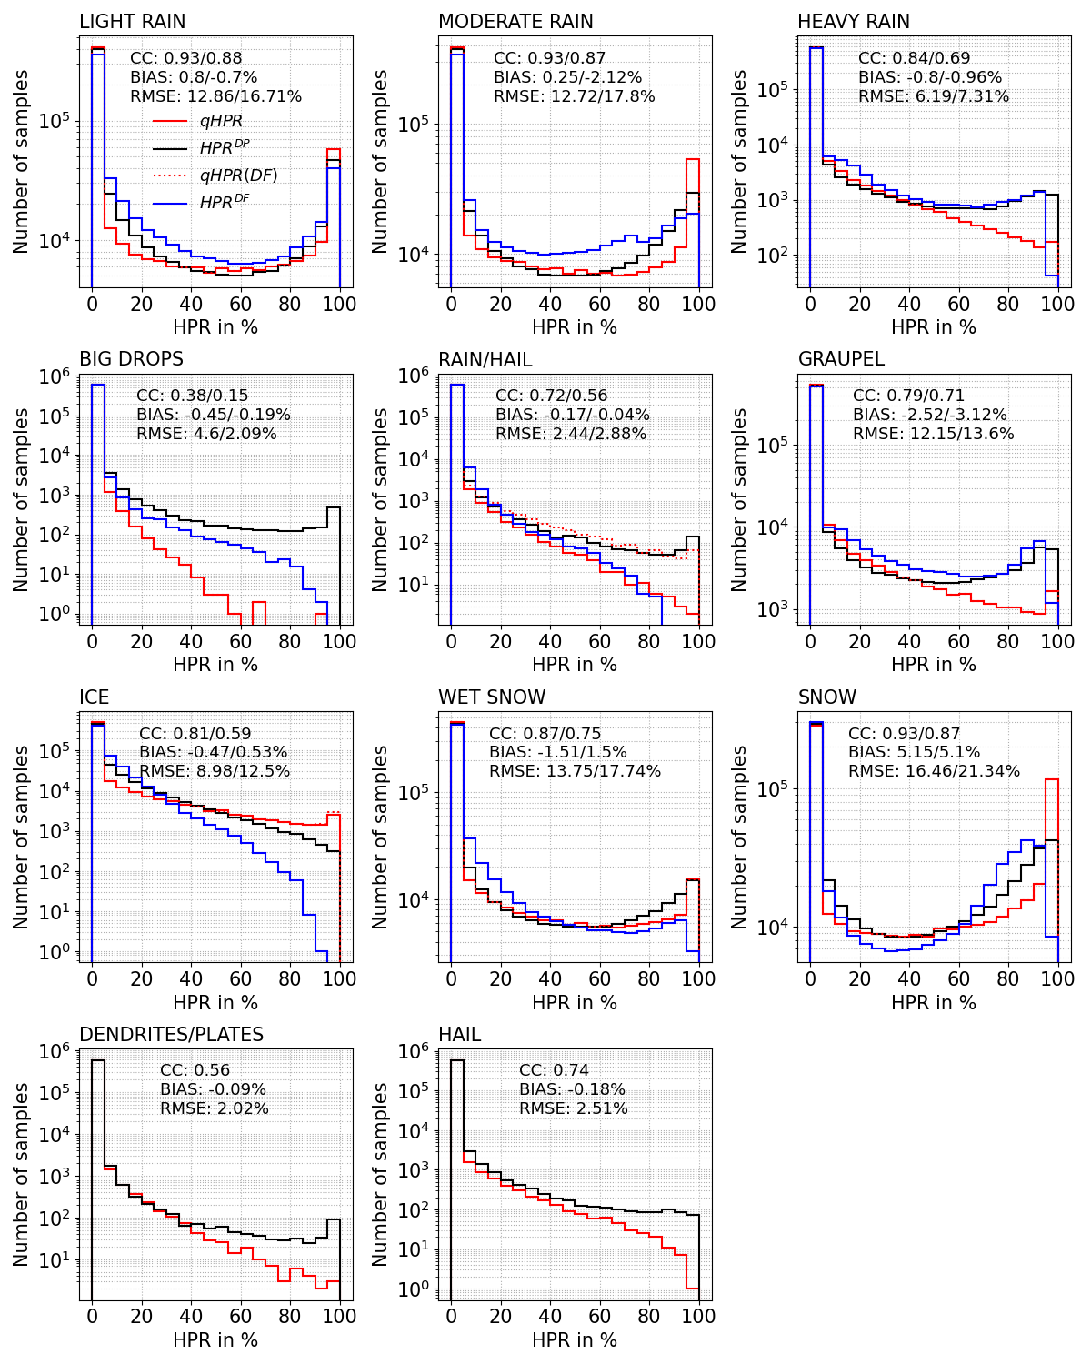
Validation of HPR^{DP/DF}
Test size: 20%
Overestimation
Underestimation
Performance: DP > DF
Notes:
To validate the estimates of HMC-P, HPR based on DP and HPR based on DF are derived from the DP and DF measurements of the test dataset and compared with the qHPRs also of the test dataset.
For example, the distributions for Light Rain show a good agreement here.
We have of course validated all hydrometeor classes. (Aufzählen!). In general, we can say that the HPR estimated with HMC-P corresponds to a high degree with the qHPR.
However, we also see overestimates for high HPRs for HR, BD, RH, GR, DP... but also underestimates for SN, IC and MR
Please note that due to very similar DF signals for IC and PD and RH and HA in DF-space, these groups have been merged.

Slide 8
Comparison between GPM and NEXRAD
2018-06-25 05:11UTC
GPM
NEXRAD
Notes:
We also checked the Consistency between DF and DP Results more qualitativly

Slide 9
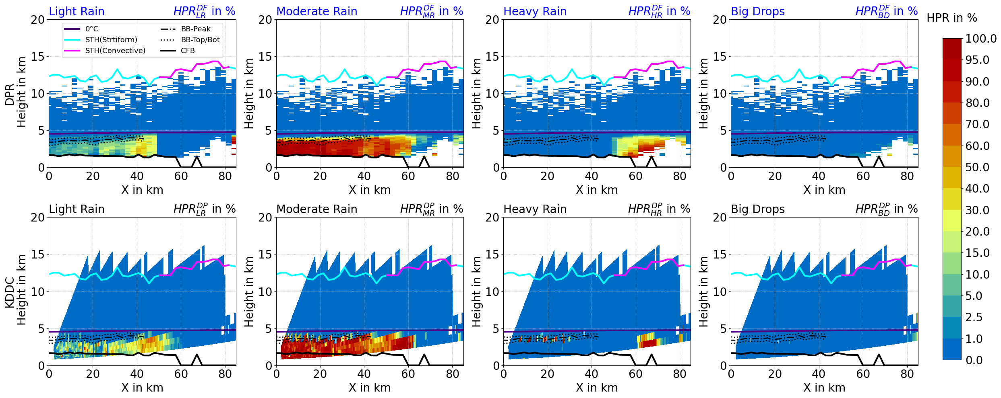
HPR^{DF/DP}-Estimates for liquid hydrometeors
NEXRAD GPM

Slide 10
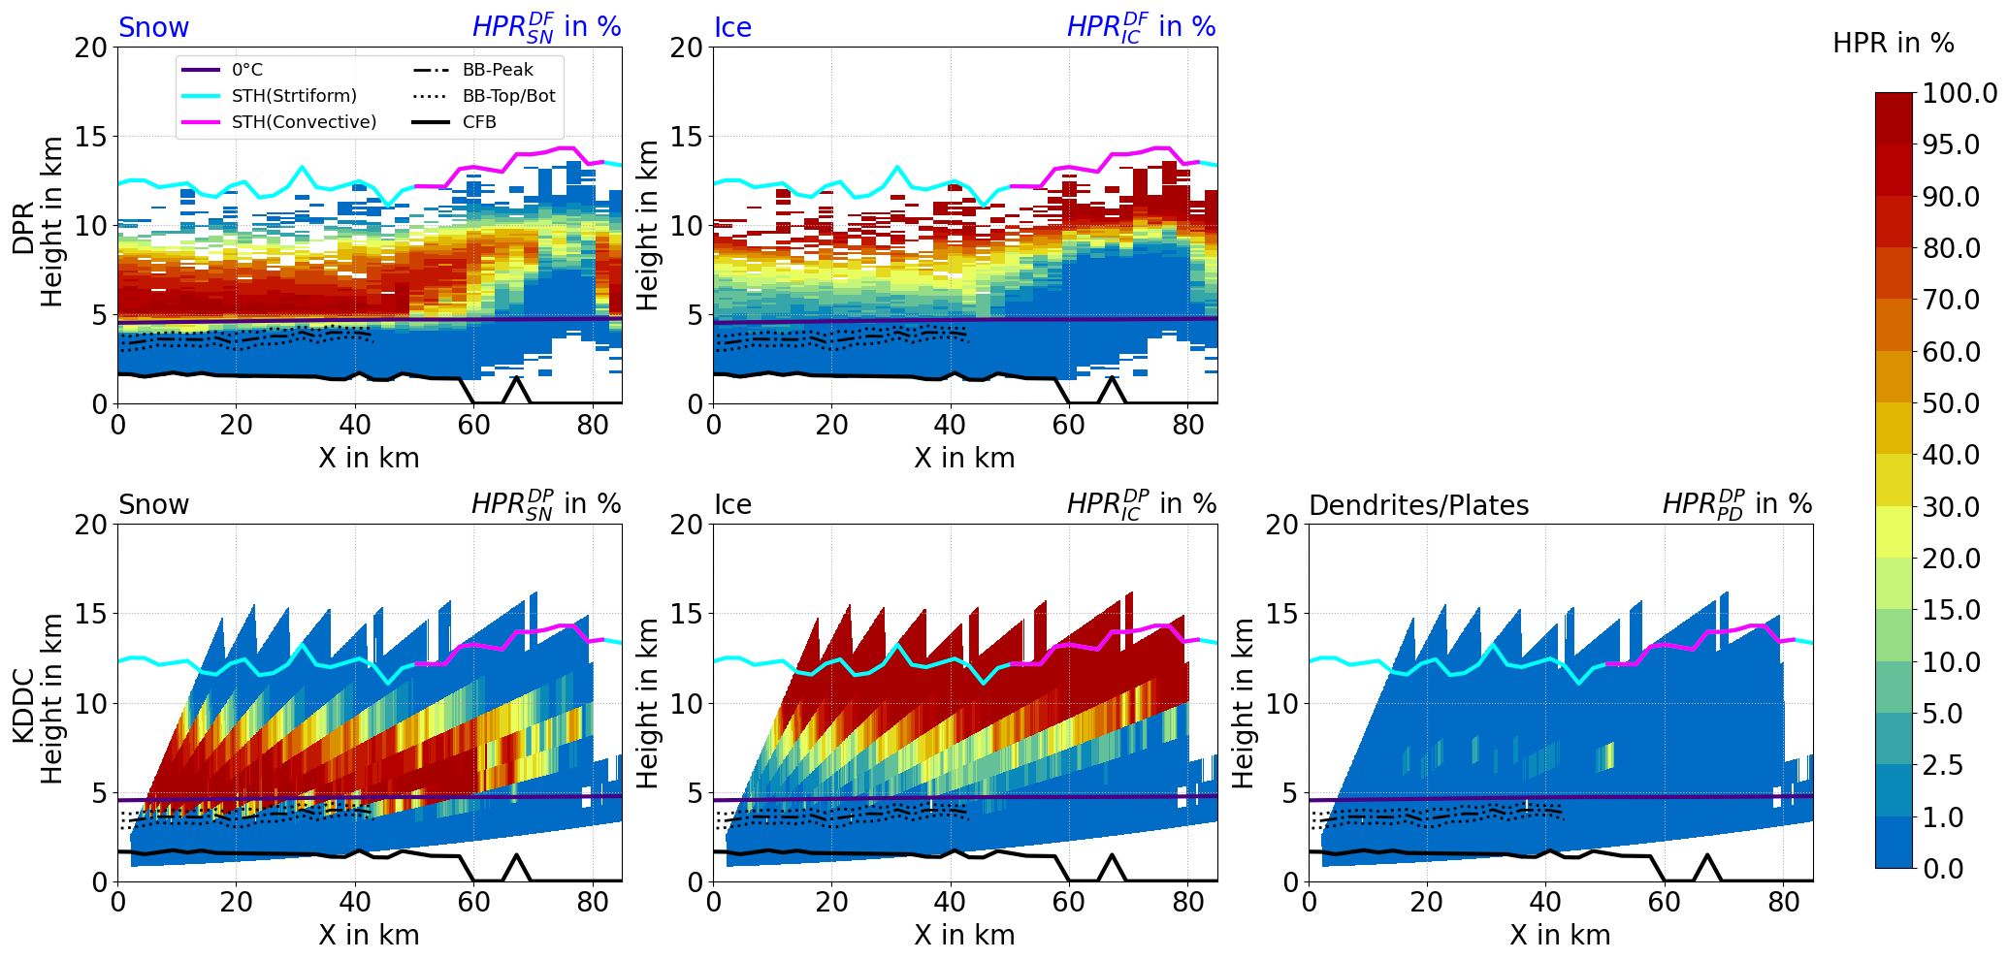
HPR^{DF/DP}-Estimates for solid hydrometeors
-15°C
NEXRAD GPM
-15°C

Slide 11
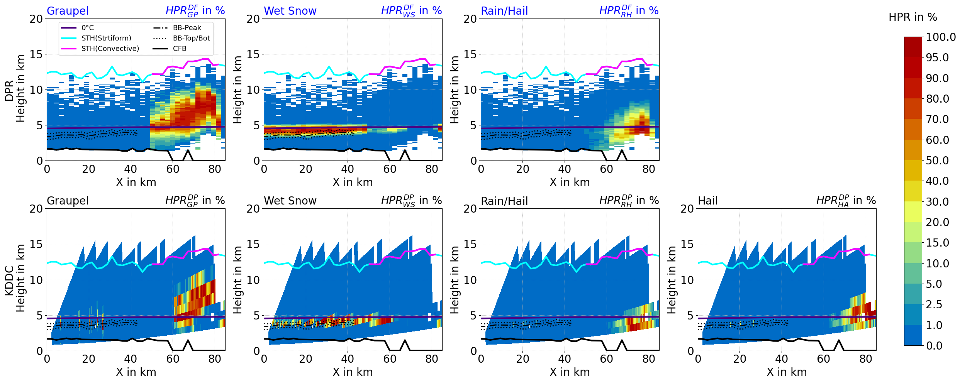
HPR^{DF/DP}-Estimates for mixed hydrometeors
0°C
NEXRAD GPM
0°C

Slide 12
Summary
We derived HPR based only on DF or DP observations.
HMC-P reproduces the qHPR ("ground truth“) to a high degree.
Direct comparisons of HPR^{DF} and HPR^{DP} show consistent results.
Performance: DP > DF
Overestimation of higher HPRs values for hail, graupel, big drops, heavy rain and dendrites/plates and underestimation of moderate rain, ice and snow.
GR
velibor@uni-bonn.de
SR

Slide 13
APPENDIX

Slide 14
DPR – Attenuation Correction

Slide 15
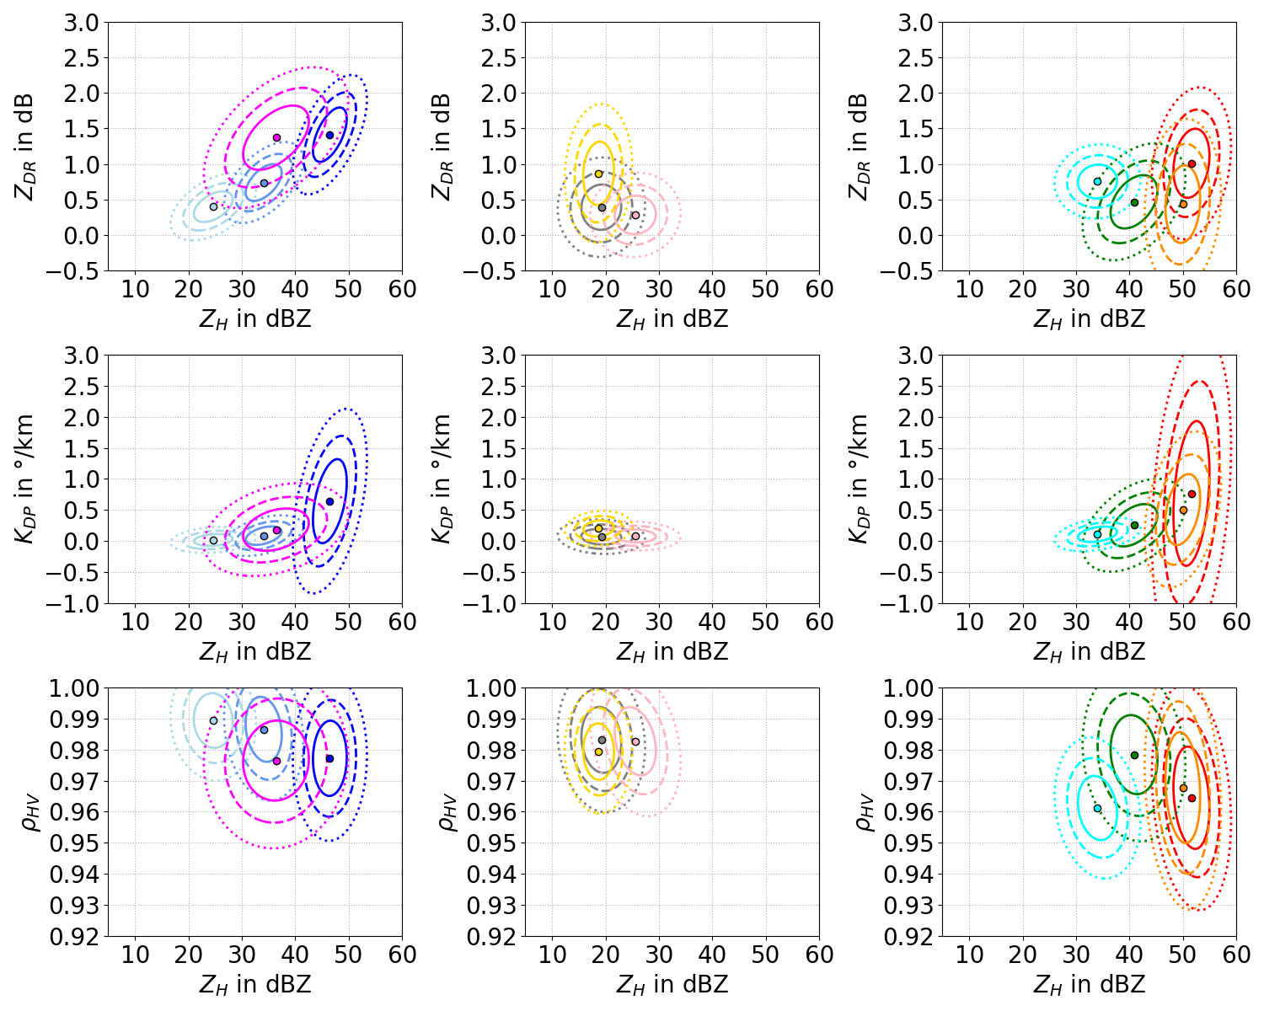
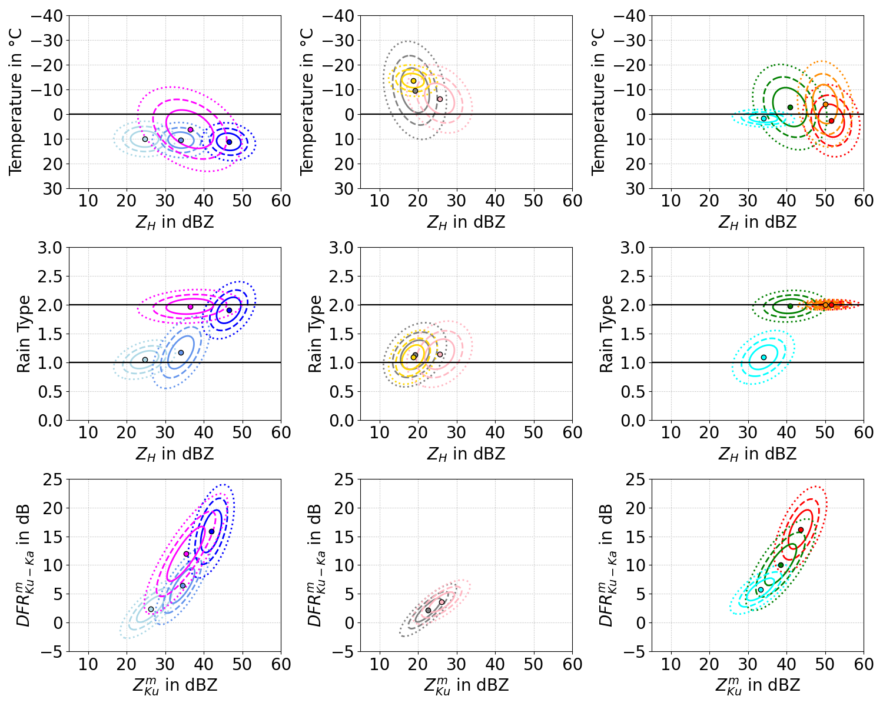
MVND for DP and DF
DP
Liquid
Solid
Mixed
Liquid
Solid
Mixed
DF
IC+PD
RH+HA

Slide 16
DP-MVND
Strong overlapping DF-MVND for RH and HA and IC and PD!
RH + HA
IC + PD!

Slide 17
Comparison of SR and GR Observations
Quasi HPRs (qHPRs) as „Ground Truth“
HMC and Validation
SR (DF)
SR (DF)
Samples X_{i}, i>10⁶
Train size: 80%
Test size: 20%
N
z
W
E
DP
qHPR
DF
x
S
GR (DP)
H₃
H₃
H₂
Validation
H₁
H₁
H₂
H₃
H₃
H₁
H₃
H₃
GR (DP)
H₂
H₃
H₃
$${HPR}_{k}^{DP}$$
$${HPR}_{k}^{DF}$$
H₂
H₁
H₁
H₂
H₃
H₃
HMC-P
Notes:
Let's look at the idea and strategy. On the left side we see GR measurements in the horizontal plane and on the right side as a cross section.
With state of the art HMC we can identify a dominant hydrometeor type for each GR bin.
Let's take a look how the SR measurements look in the horizontal and vertical planes.
As you can see, we have to merge the SR and GR observations in order to consider scan volumes of the same size.
The first step is to average the DP measurements of all GR bins within an SR footprint.
Then all DF measurements from all SR bins within the GR beamwidth are averaged.
The resulting measurement volumes contain several hundred GR volumes which allow the determination of quasi HPRs per matched volume based on the dominant hydrometeor types classified with GR.
We call such resulting measurement volumes sampels S and we have more than a billion of them.
Our HMC is first trained with the 80% of the dataset and the remaining 20% are used to estimate HPR with HMC-P based on DF only.
We do the same with the DP measurement samples.
In a perfect world, our estimates would then be equivalent to the qHPRs.

