Slide 1
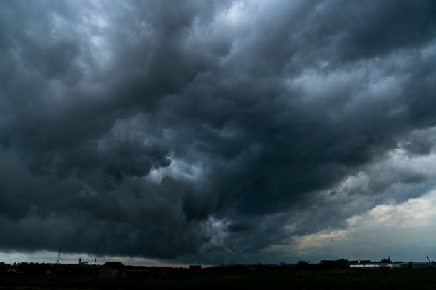





Intra-event return period co-occurrences in short-duration intense precipitation events
Tabea Cache, Emanuele Bevacqua, Jakob Zscheischler, Hannes Müller-Thomy and Nadav Peleg
PrePEP 2025
Session 5A
20 March 2025
Credits: Viktor Ketal

Slide 2
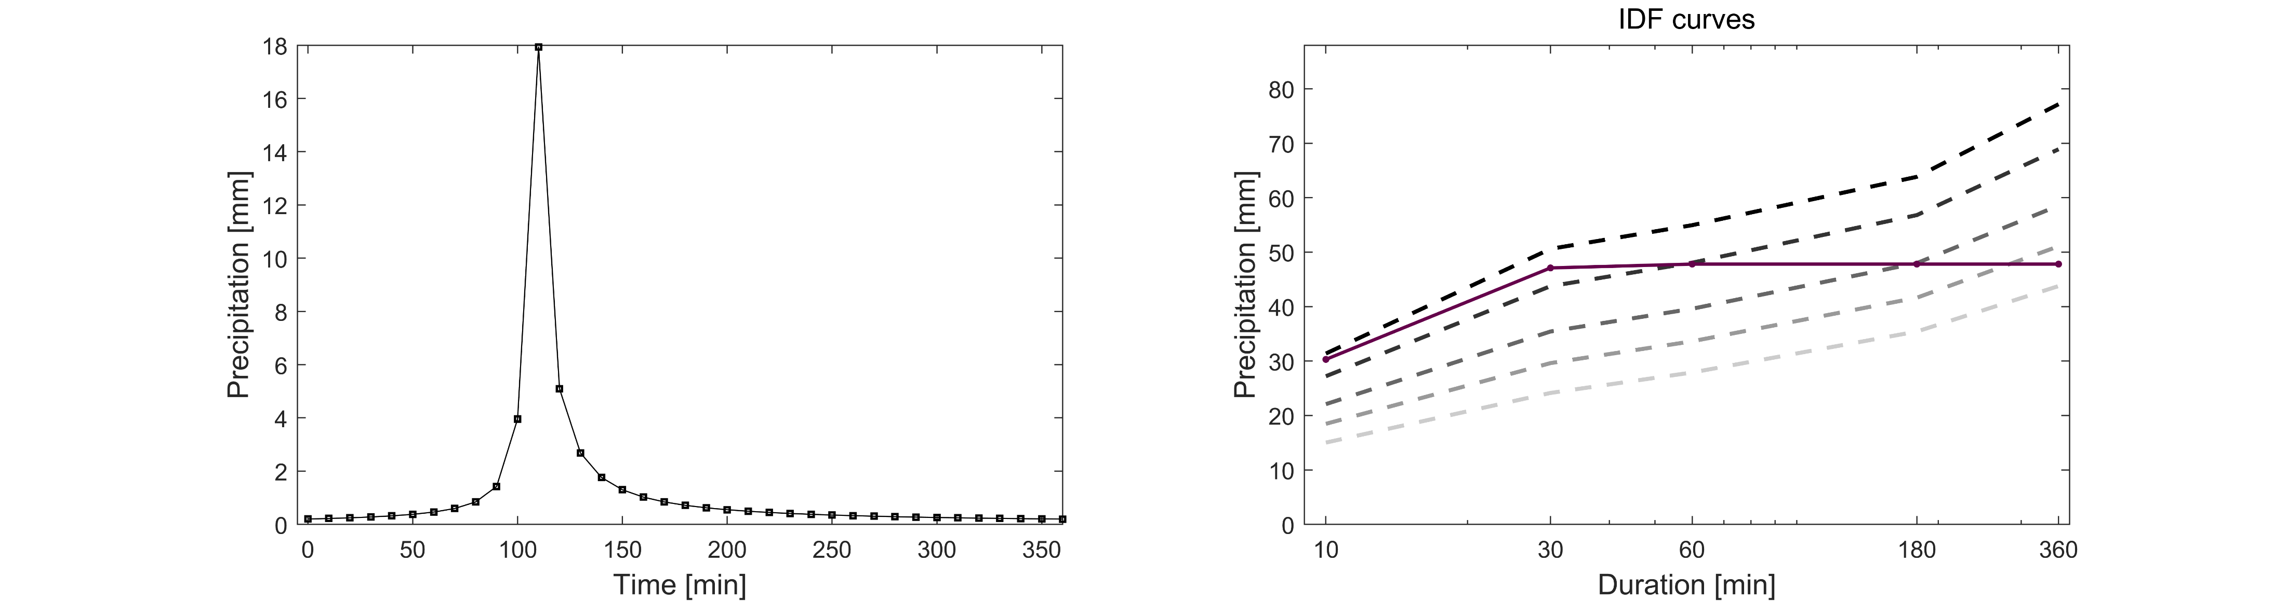
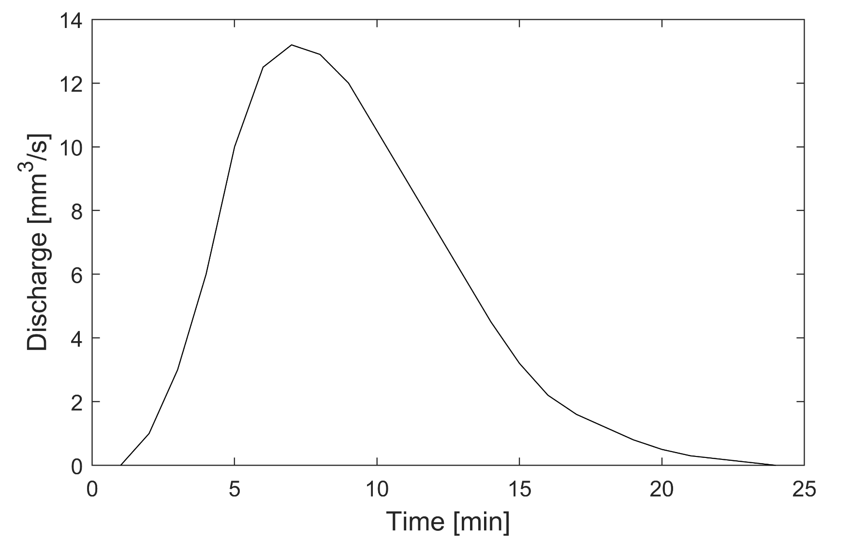
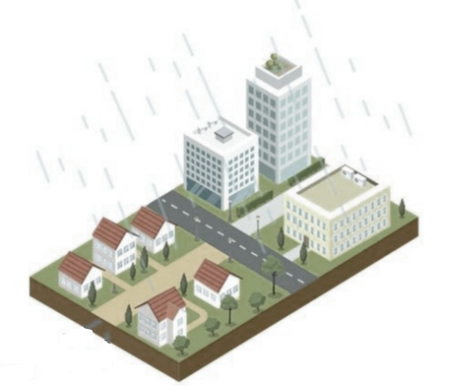
DESIGN STORMS
1
Develop a design storm hyetograph
3
Estimate and manage runoff
Flood warning
2
Route through a hydrodynamic model
PrePEP 2025: Joint return periods
1

Slide 3
DESIGN STORMS
1
Develop a design storm hyetograph
3
Estimate and manage runoff
Flood warning
2
Route through a hydrodynamic model
PrePEP 2025: Joint return periods
1

Slide 4

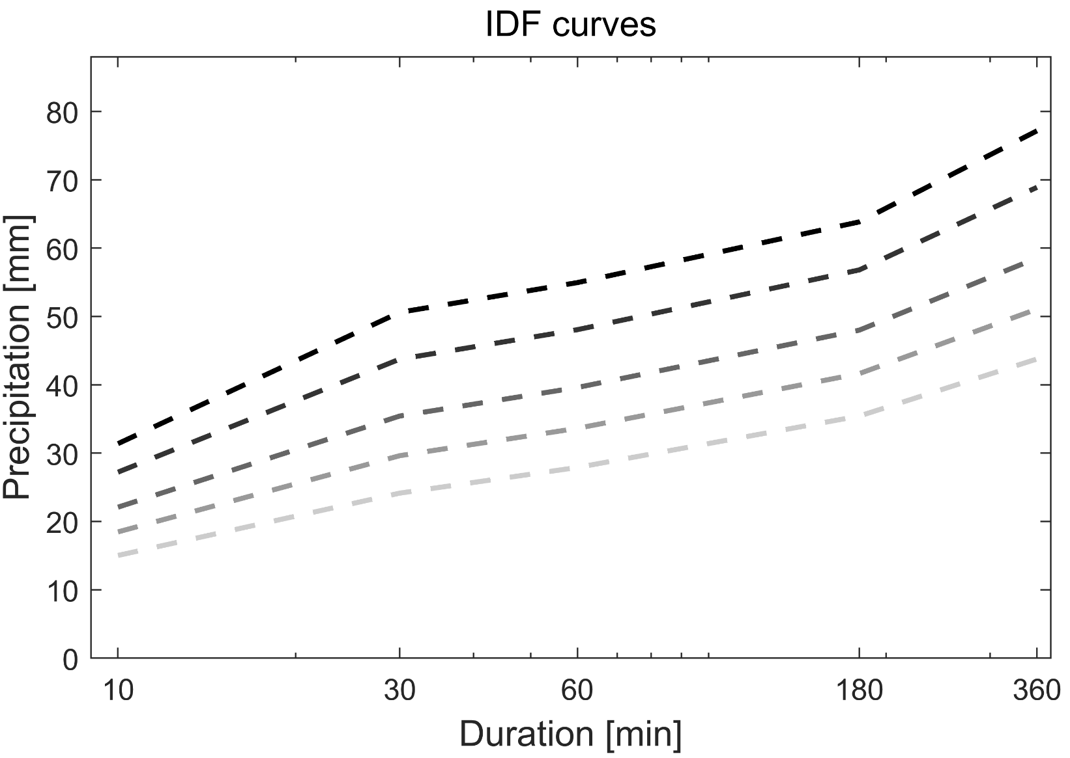
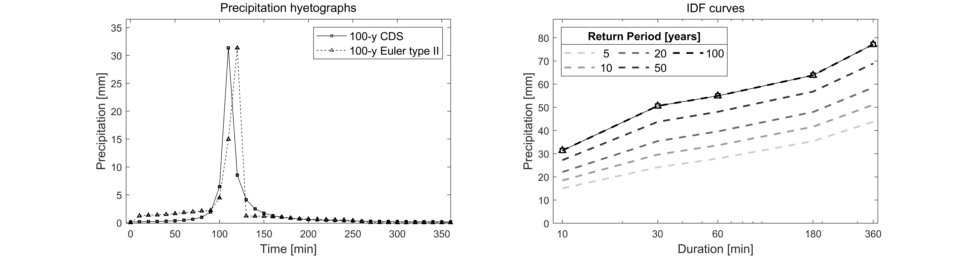
DESIGN STORMS
100 y
100 y
50 y
50 y
20 y
20 y
10 y
10 y
5 y
Design storm
Synthetic rainfall event which intensity over a duration is expected to occur with a certain return interval
5 y
Sampling methods
Entire IDF curve
PrePEP 2025: Joint return periods
2

Slide 5
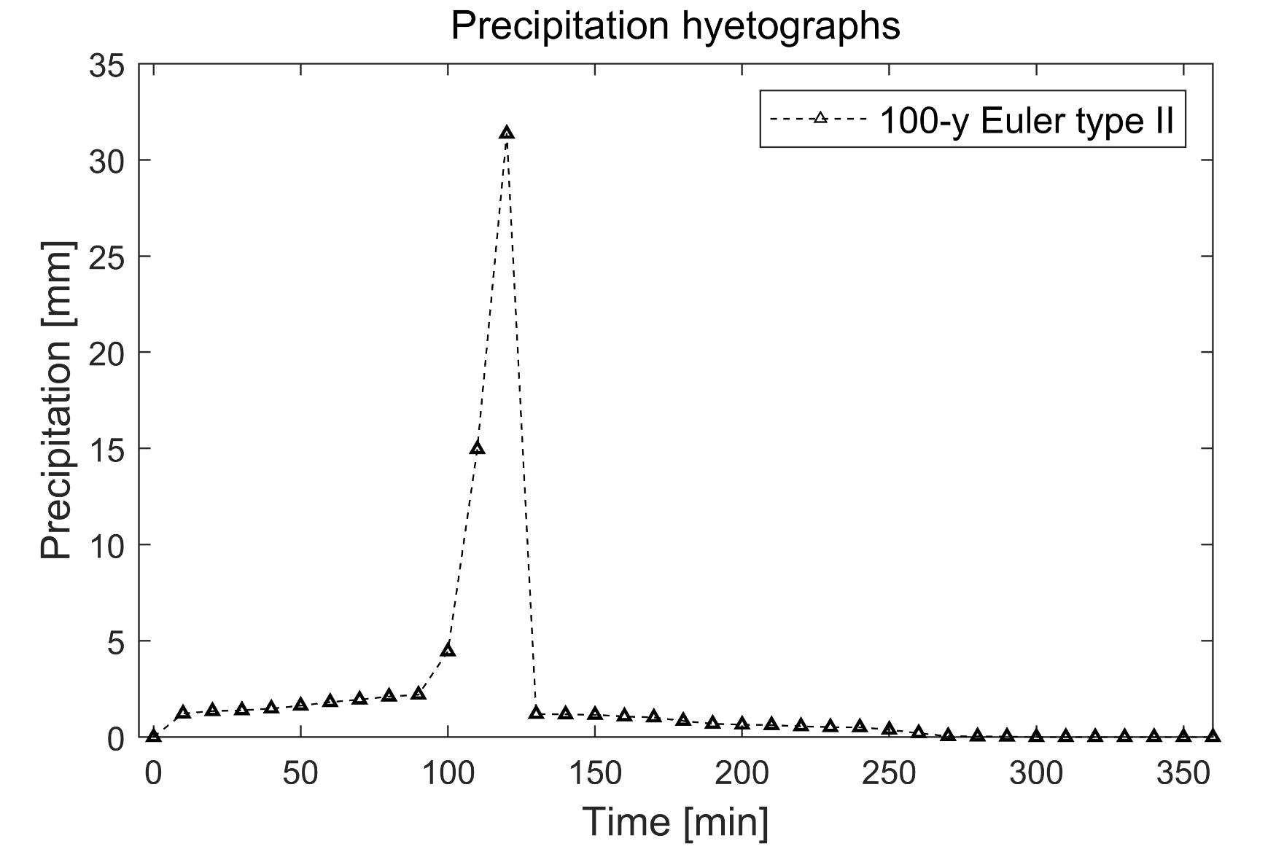
DESIGN STORMS
100 y
50 y
20 y
10 y
Design storm
Synthetic rainfall event which intensity over a duration is expected to occur with a certain return interval
5 y
Sampling methods
Entire IDF curve
PrePEP 2025: Joint return periods
2

Slide 6
DESIGN STORMS
100 y
50 y
20 y
10 y
Design storm
Synthetic rainfall event which intensity over a duration is expected to occur with a certain return interval
5 y
Sampling methods
Entire IDF curve
PrePEP 2025: Joint return periods
3

Slide 7
DESIGN STORMS
100 y
50 y
20 y
10 y
Design storm
Synthetic rainfall event which intensity over a duration is expected to occur with a certain return interval
5 y
Sampling methods
Entire IDF curve
Single point of the IDF curve
Simulation from stochastic models
PrePEP 2025: Joint return periods
4

Slide 8
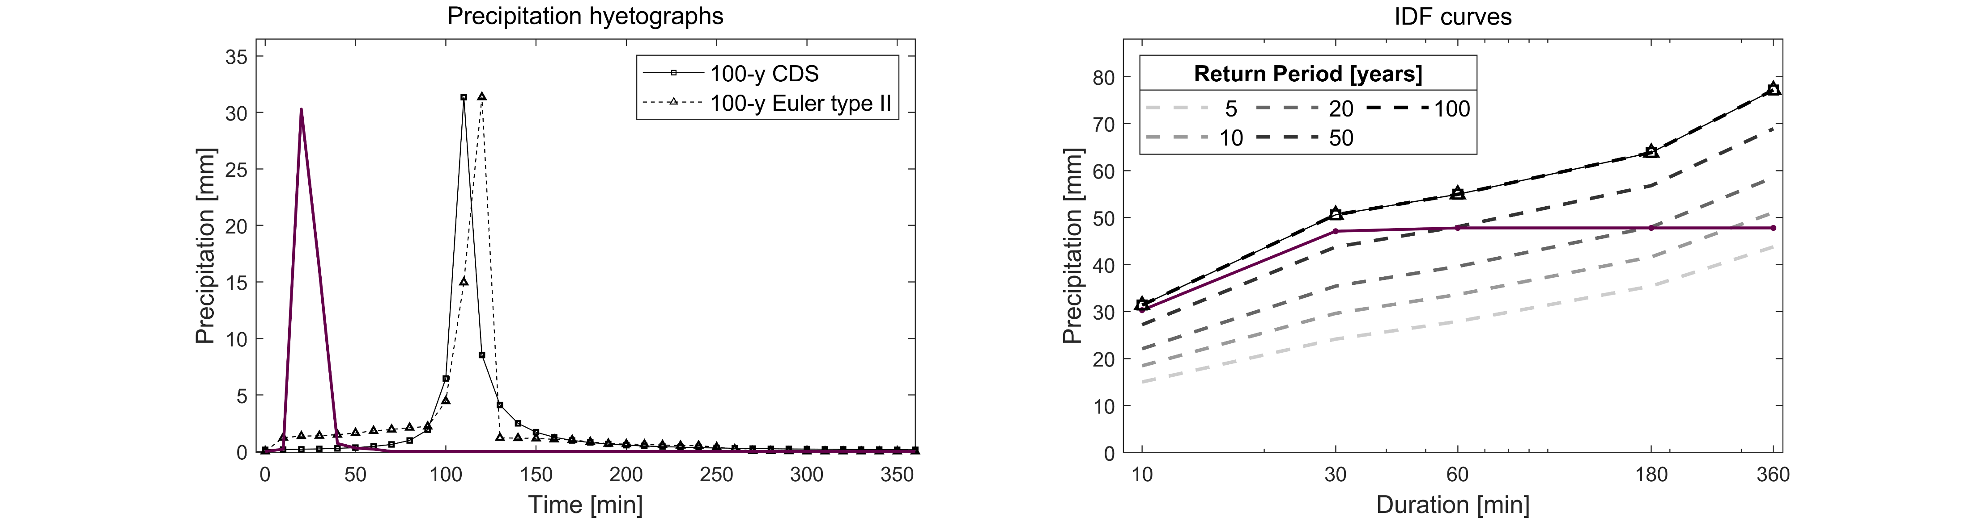
DESIGN STORMS
Observed event
100 y
50 y
20 y
10 y
Design storm
Synthetic rainfall event which intensity over a duration is expected to occur with a certain return interval
5 y
Sampling methods
Entire IDF curve
Single point of the IDF curve
Simulation from stochastic models
Observed event
Maximum moving window operations
PrePEP 2025: Joint return periods
5

Slide 9
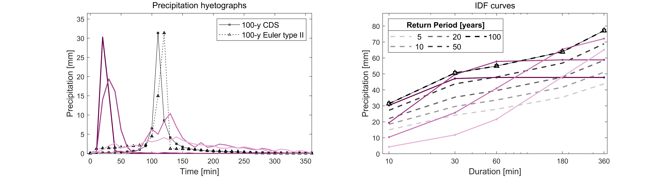
DESIGN STORMS
Observed events
100 y
50 y
20 y
10 y
Design storm
Synthetic rainfall event which intensity over a duration is expected to occur with a certain return interval
5 y
Sampling methods
Entire IDF curve
Single point of the IDF curve
Simulation from stochastic models
Observed events
Maximum moving window operations
PrePEP 2025: Joint return periods
How are intensities across the different duration intervals correlated?
5

Slide 10
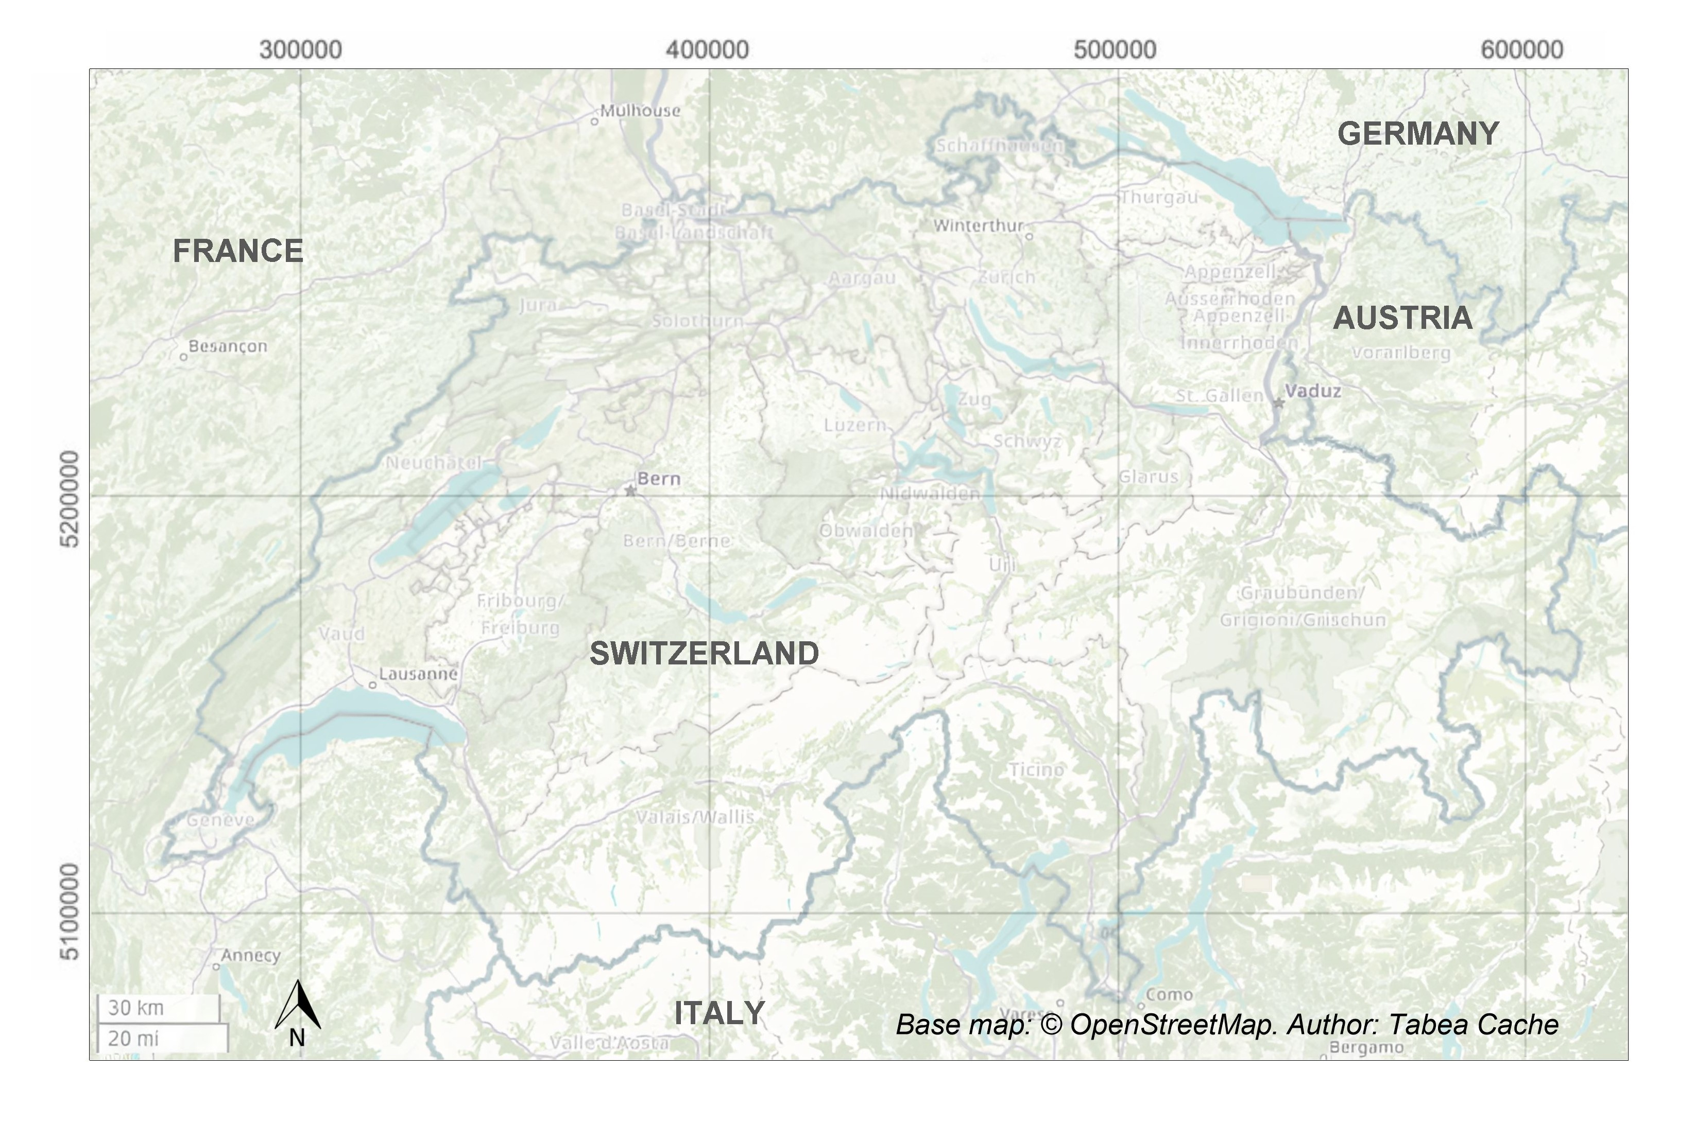
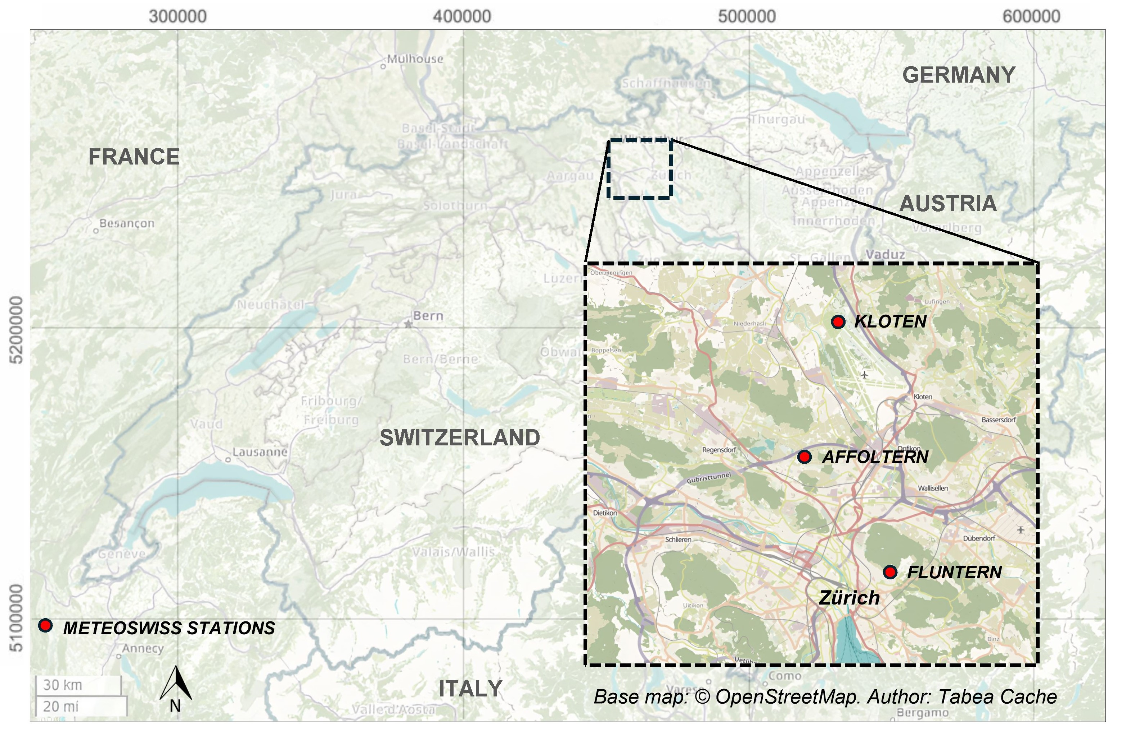
CASE STUDY: ZURICH
126 years at 10-min resolution
  Pooling 42 years of data from 3 stations
Short-duration intense precipitation events
360-min window maximum
Return period > 1.1 year
537 events (3.5% of all events)
PrePEP 2025: Joint return periods
6

Slide 11
DURATION-FREQUENCY DEPENDENCIES
How are intensities across the different duration intervals correlated?
Dependence structure between maximum accumulated precipitation volumes over different duration intervals:
100 y
10-min
30-min
60-min
180-min
360-min
50 y
PrePEP 2025: Joint return periods
20 y
10 y
5 y
1
1
2
2
…
3
3
4
4
7

Slide 12
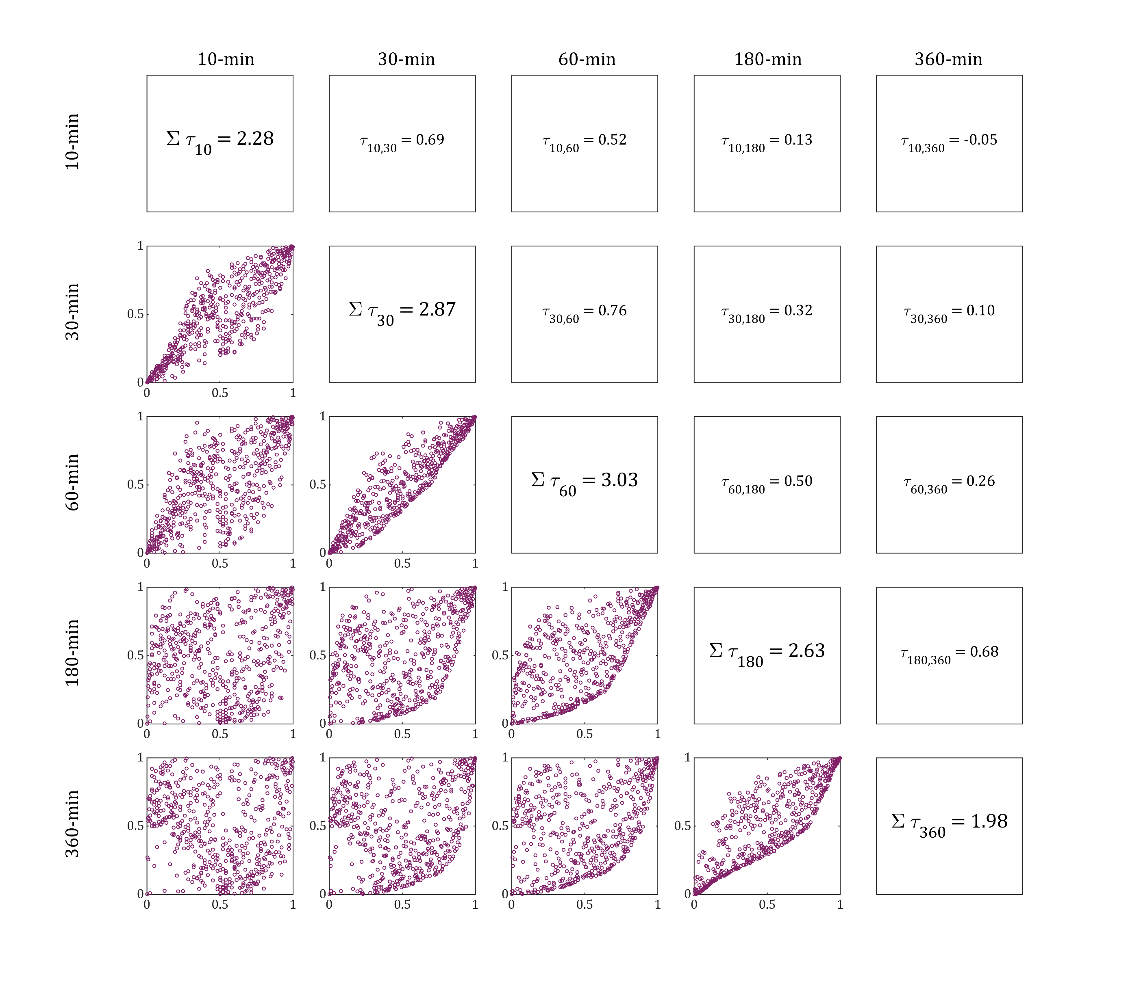
DURATION-FREQUENCY DEPENDENCIES
Kendall’s τ rank correlation coefficient*
How are intensities across the different duration intervals correlated?
Ranked V_{30-min}
Dependence structure between maximum accumulated precipitation volumes over different duration intervals:
10-min
30-min
60-min
180-min
360-min
Ranked V_{60-min}
PrePEP 2025: Joint return periods
Normalised ranks of accumulated precipitation volumes
8
* | τ| = 1 ⇒ perfect correlation, | τ| = 0 ⇒ absence of correlation

Slide 13
DURATION-FREQUENCY DEPENDENCIES
V_{10-min}
Kendall’s τ rank correlation coefficient*
V_{30-min}
V_{60-min}
V_{180-min}
V_{360-min}
V_{10-min}
How are intensities across the different duration intervals correlated?
V_{30-min}
Ranked V_{30-min}
Dependence structure between maximum accumulated precipitation volumes over different duration intervals:
V_{60-min}
10-min
30-min
60-min
180-min
360-min
Ranked V_{60-min}
PrePEP 2025: Joint return periods
V_{180-min}
Normalised ranks of accumulated precipitation volumes
V_{360-min}
9
* | τ| = 1 ⇒ perfect correlation, | τ| = 0 ⇒ absence of correlation

Slide 14
DURATION-FREQUENCY DEPENDENCIES
V_{10-min}
V_{30-min}
V_{60-min}
V_{180-min}
V_{360-min}
V_{10-min}
How are intensities across the different duration intervals correlated?
V_{30-min}
Dependence structure between maximum accumulated precipitation volumes over different duration intervals:
V_{60-min}
10-min
30-min
60-min
180-min
360-min
PrePEP 2025: Joint return periods
Highest correlation
V_{180-min}
V_{360-min}
10

Slide 15
DURATION-FREQUENCY DEPENDENCIES
V_{10-min}
V_{30-min}
V_{60-min}
V_{180-min}
V_{360-min}
V_{10-min}
How are intensities across the different duration intervals correlated?
V_{30-min}
Dependence structure between maximum accumulated precipitation volumes over different duration intervals:
V_{60-min}
Boundary
10-min
30-min
60-min
180-min
360-min
PrePEP 2025: Joint return periods
Highest correlation
V_{180-min}
Lowest correlation
V_{360-min}
11

Slide 16
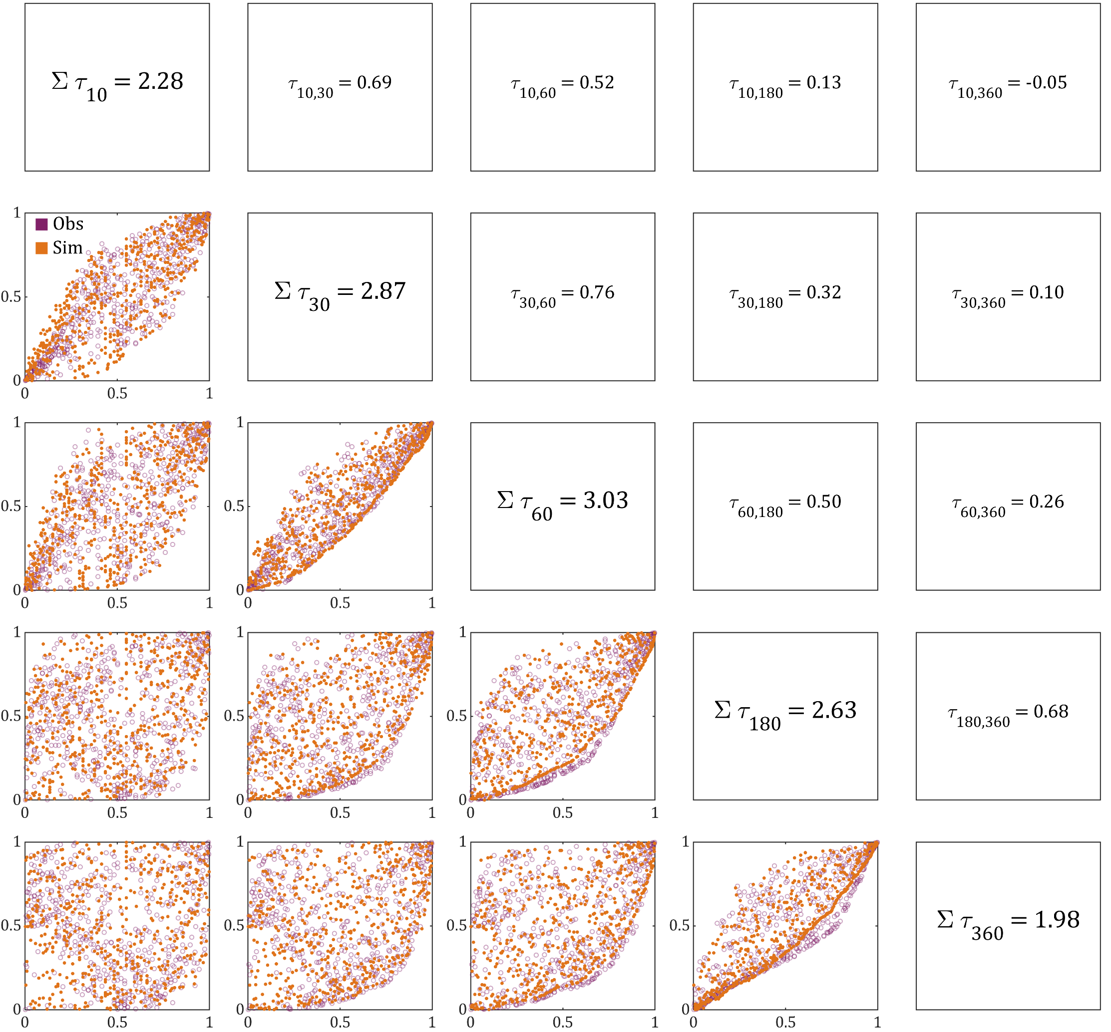
DURATION-FREQUENCY DEPENDENCIES
V_{10-min}
V_{30-min}
V_{60-min}
V_{180-min}
V_{360-min}
V_{10-min}
How are intensities across the different duration intervals correlated?
V_{30-min}
Dependence structure between maximum accumulated precipitation volumes over different duration intervals:
  Modelled with copula
V_{60-min}
PrePEP 2025: Joint return periods
V_{180-min}
V_{360-min}
12

Slide 17
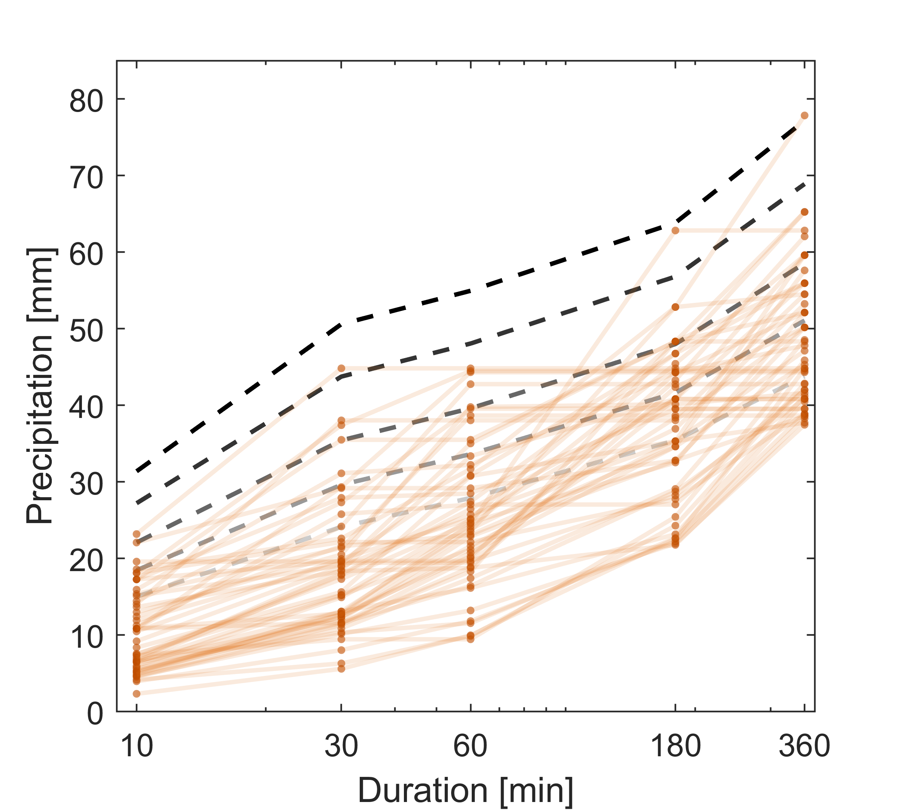
SIMULATING DURATION-FREQUENCY SAMPLES
Example: IDF profiles for 100 random events
Can we simulate precipitation samples that satisfy the observed duration-frequency dependencies?
100 y
50 y
20 y
Multivariate joint distribution of precipitation volumes over different durations
Dependence structure between different durations (modelled by copula)
AND
Univariate distribution
10 y
5 y
PrePEP 2025: Joint return periods
13

Slide 18
SIMULATING DURATION-FREQUENCY SAMPLES
Example: IDF profiles for 100 random events
Can we simulate precipitation samples that satisfy the observed duration-frequency dependencies?
100 y
50 y
20 y
Multivariate joint distribution of precipitation volumes over different durations
Dependence structure between different durations (modelled by copula)
AND
Univariate distribution
10 y
5 y
PrePEP 2025: Joint return periods
13

Slide 19
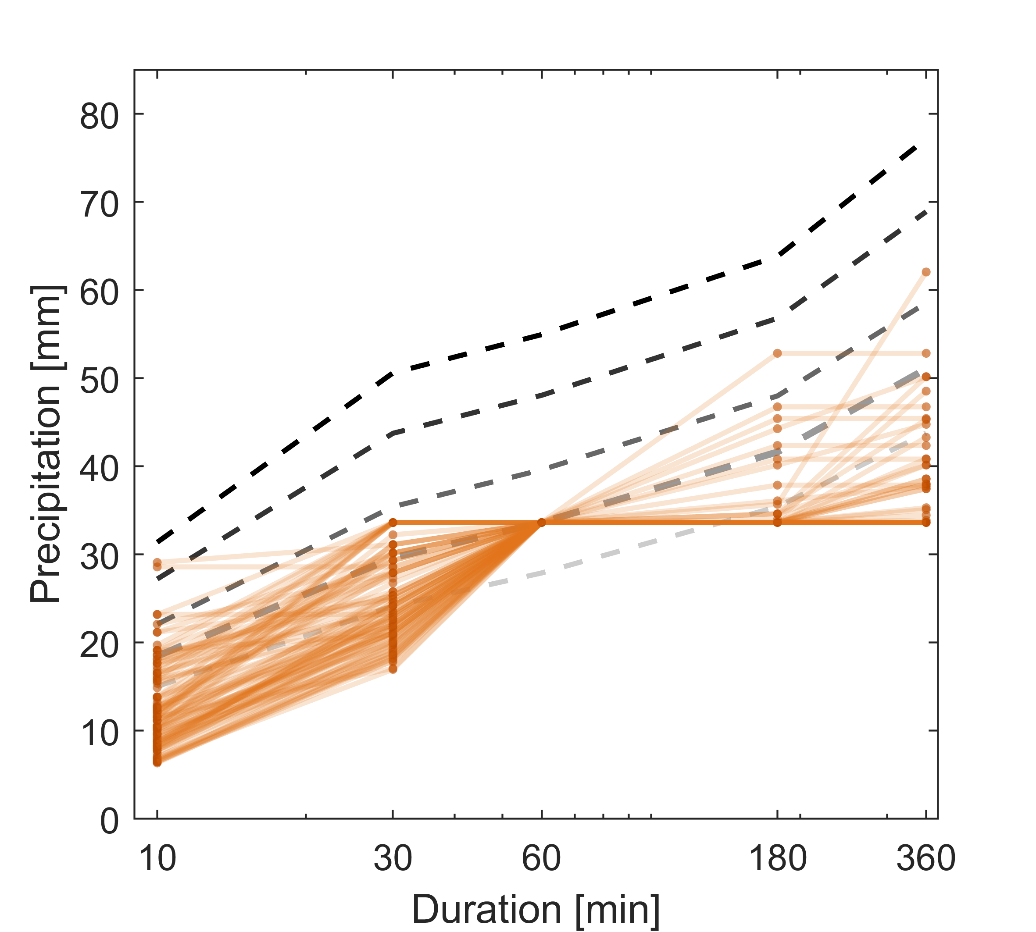
SIMULATING DURATION-FREQUENCY SAMPLES
Example: IDF profiles for 100 events with 10-y return period on the 60-min duration interval
Can we simulate precipitation samples that satisfy the observed duration-frequency dependencies?
100 y
50 y
20 y
Multivariate joint distribution
Dependence structure between variables (modelled by copula)
AND
Univariate distribution
10 y
5 y
PrePEP 2025: Joint return periods
Conditional sampling
‘Pivot point’
14

Slide 20

SIMULATING DURATION-FREQUENCY SAMPLES
Example: IDF profiles for 100 events with 10-y return period on the 60-min duration interval
How does the standard method compare with design storms that reproduce the observed duration-frequency dependencies?
100 y
50 y
20 y
Relative difference in the total storm volume
Average: +30%
Ranging from +34% to -22%
10 y
5 y
$$μ_{tot}=30\%$$
PrePEP 2025: Joint return periods
Total storm volume
15

Slide 21

SIMULATING DURATION-FREQUENCY SAMPLES
Example: IDF profiles for 100 events with 10-y return period on the 60-min duration interval
How does the standard method compare with design storms that reproduce the observed duration-frequency dependencies?
100 y
50 y
20 y
Relative difference in the total storm volume
Average: +30%
Ranging from +34% to -22%
10 y
5 y
$$μ_{tot}=30\%$$
PrePEP 2025: Joint return periods
$$μ_{peak}=35\%$$
Relative difference in the peak rainfall volume
Average: +35%
Ranging from +66% to -43%
Peak rainfall volume
Total storm volume
15

Slide 22
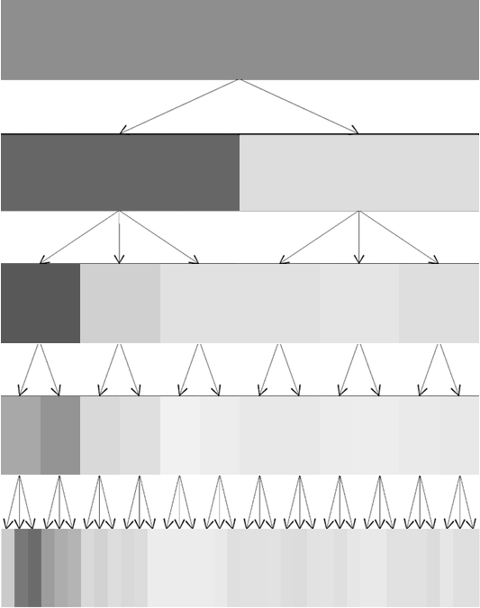
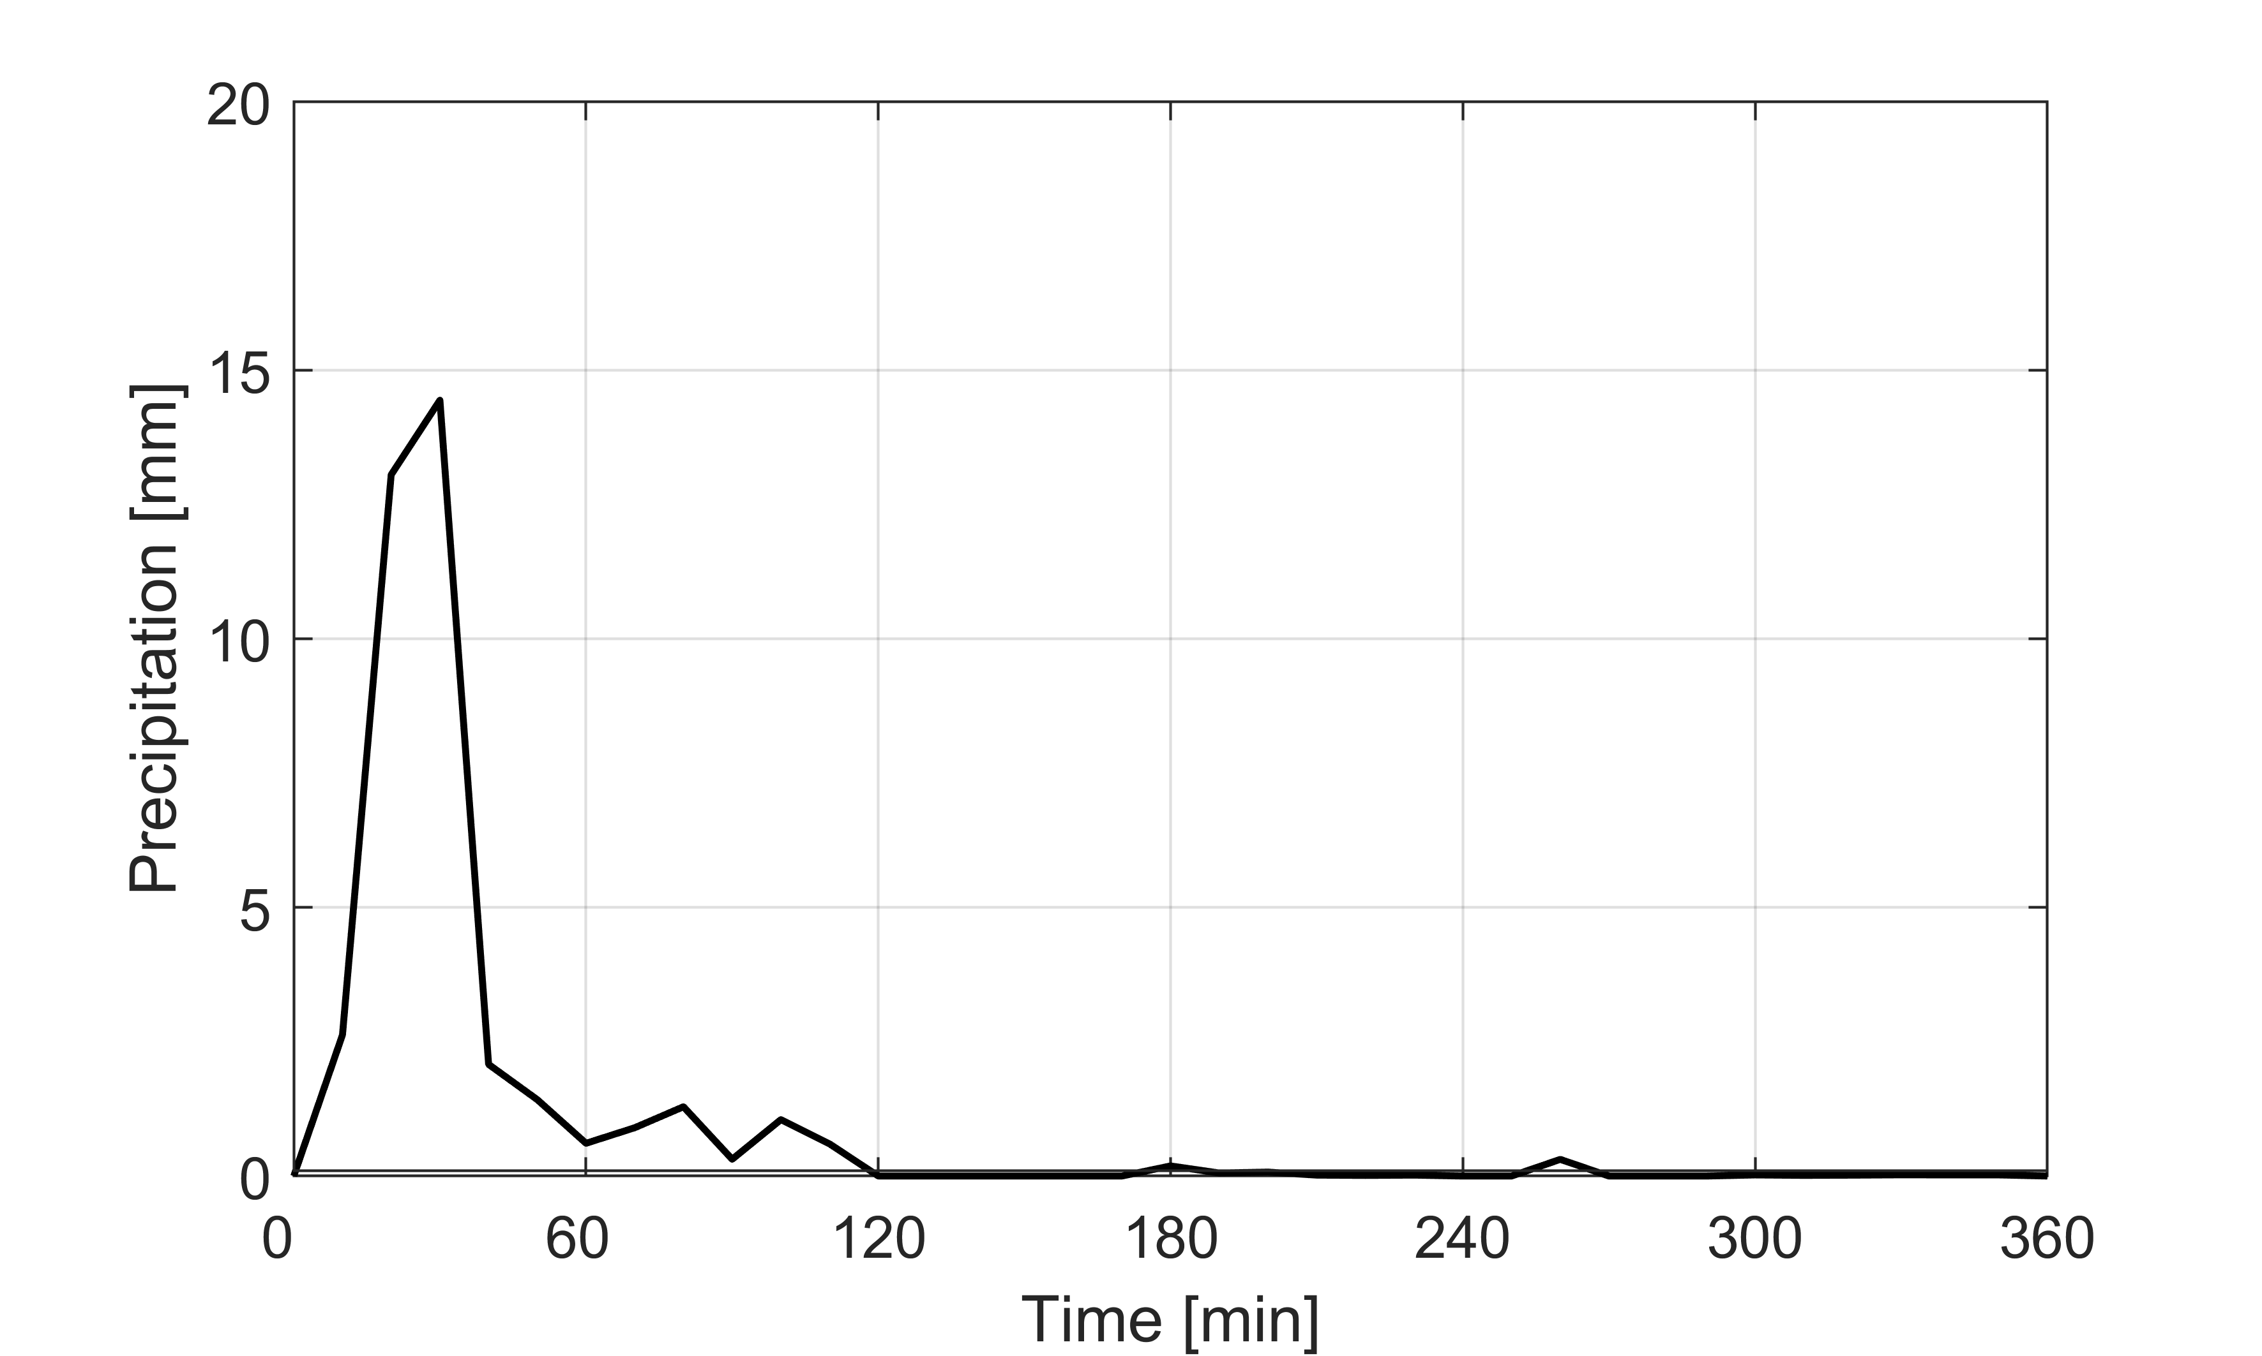
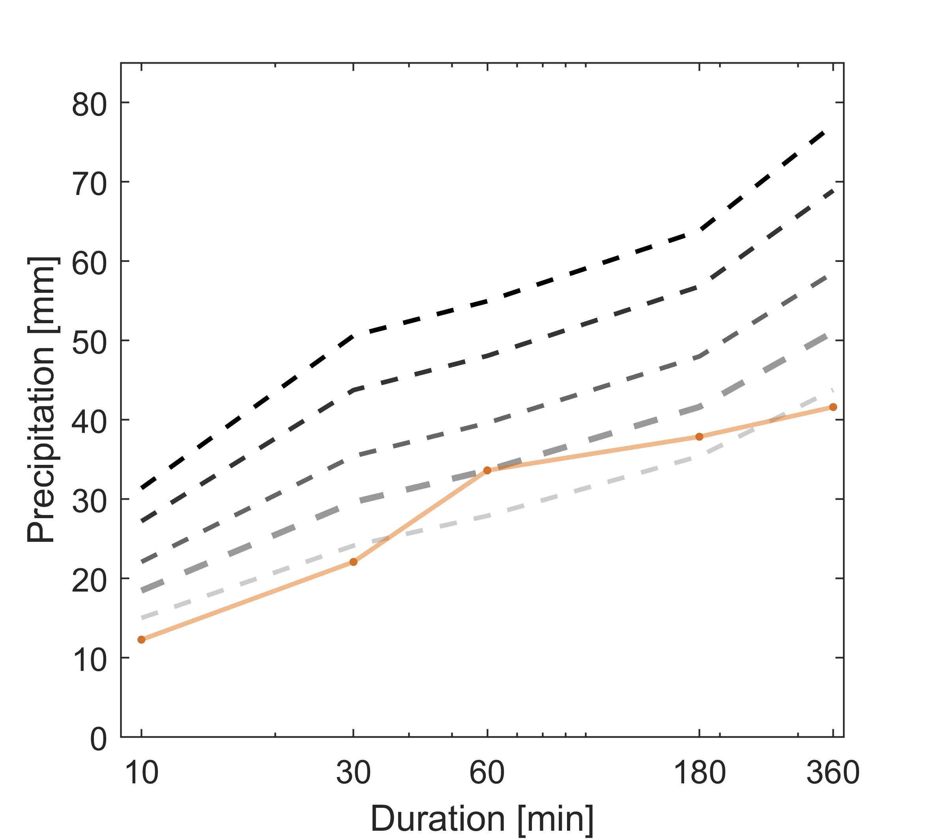
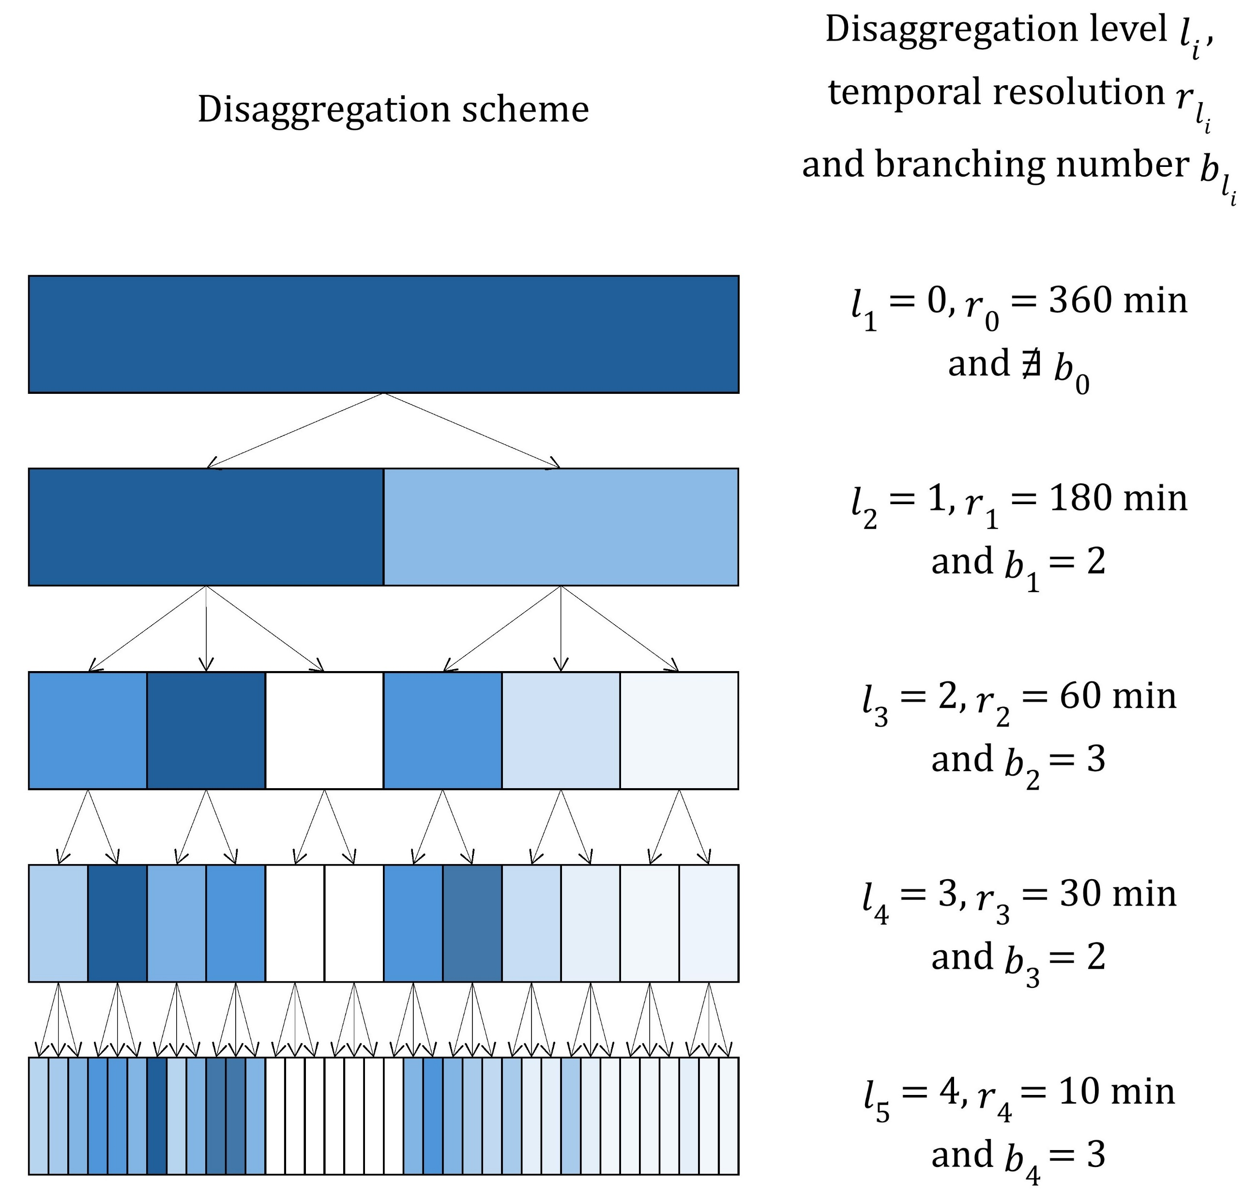
SIMULATING DESIGN STORMS
1
Copula-based approach for IDF profile sampling
Temporal disaggregation of rainfall
3
Realistic design storm
2
Constrained micro-canonical cascade model
360 min
100 y
50 y
180 min
20 y
10 y
5 y
60 min
PrePEP 2025: Joint return periods
30 min
10 min
Müller-Thomy, 2020
16

Slide 23
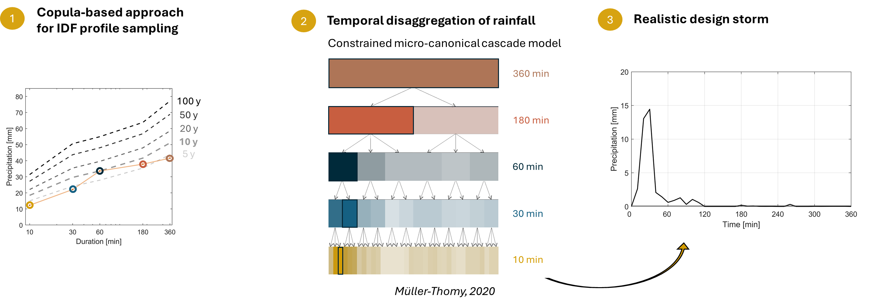
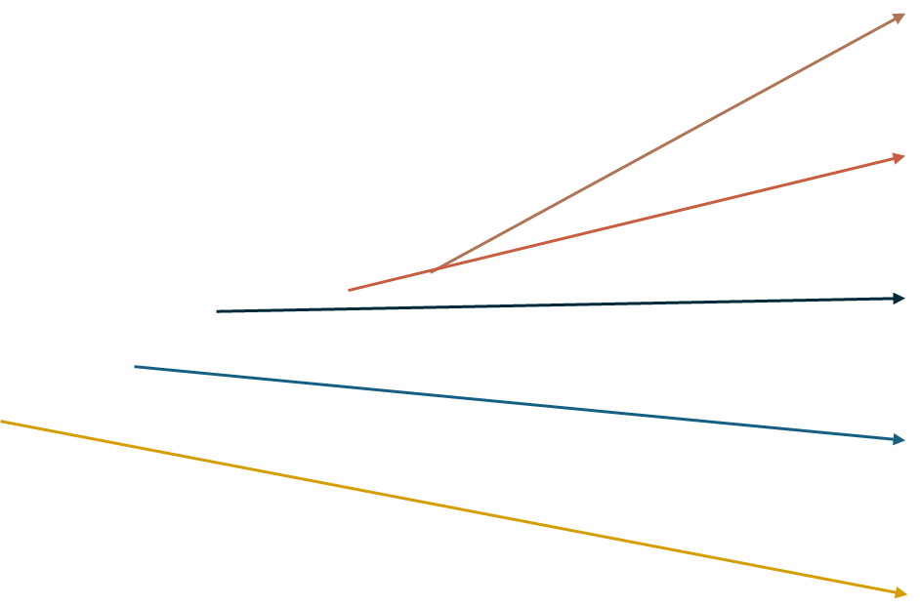
SIMULATING DESIGN STORMS
PrePEP 2025: Joint return periods
17

Slide 24
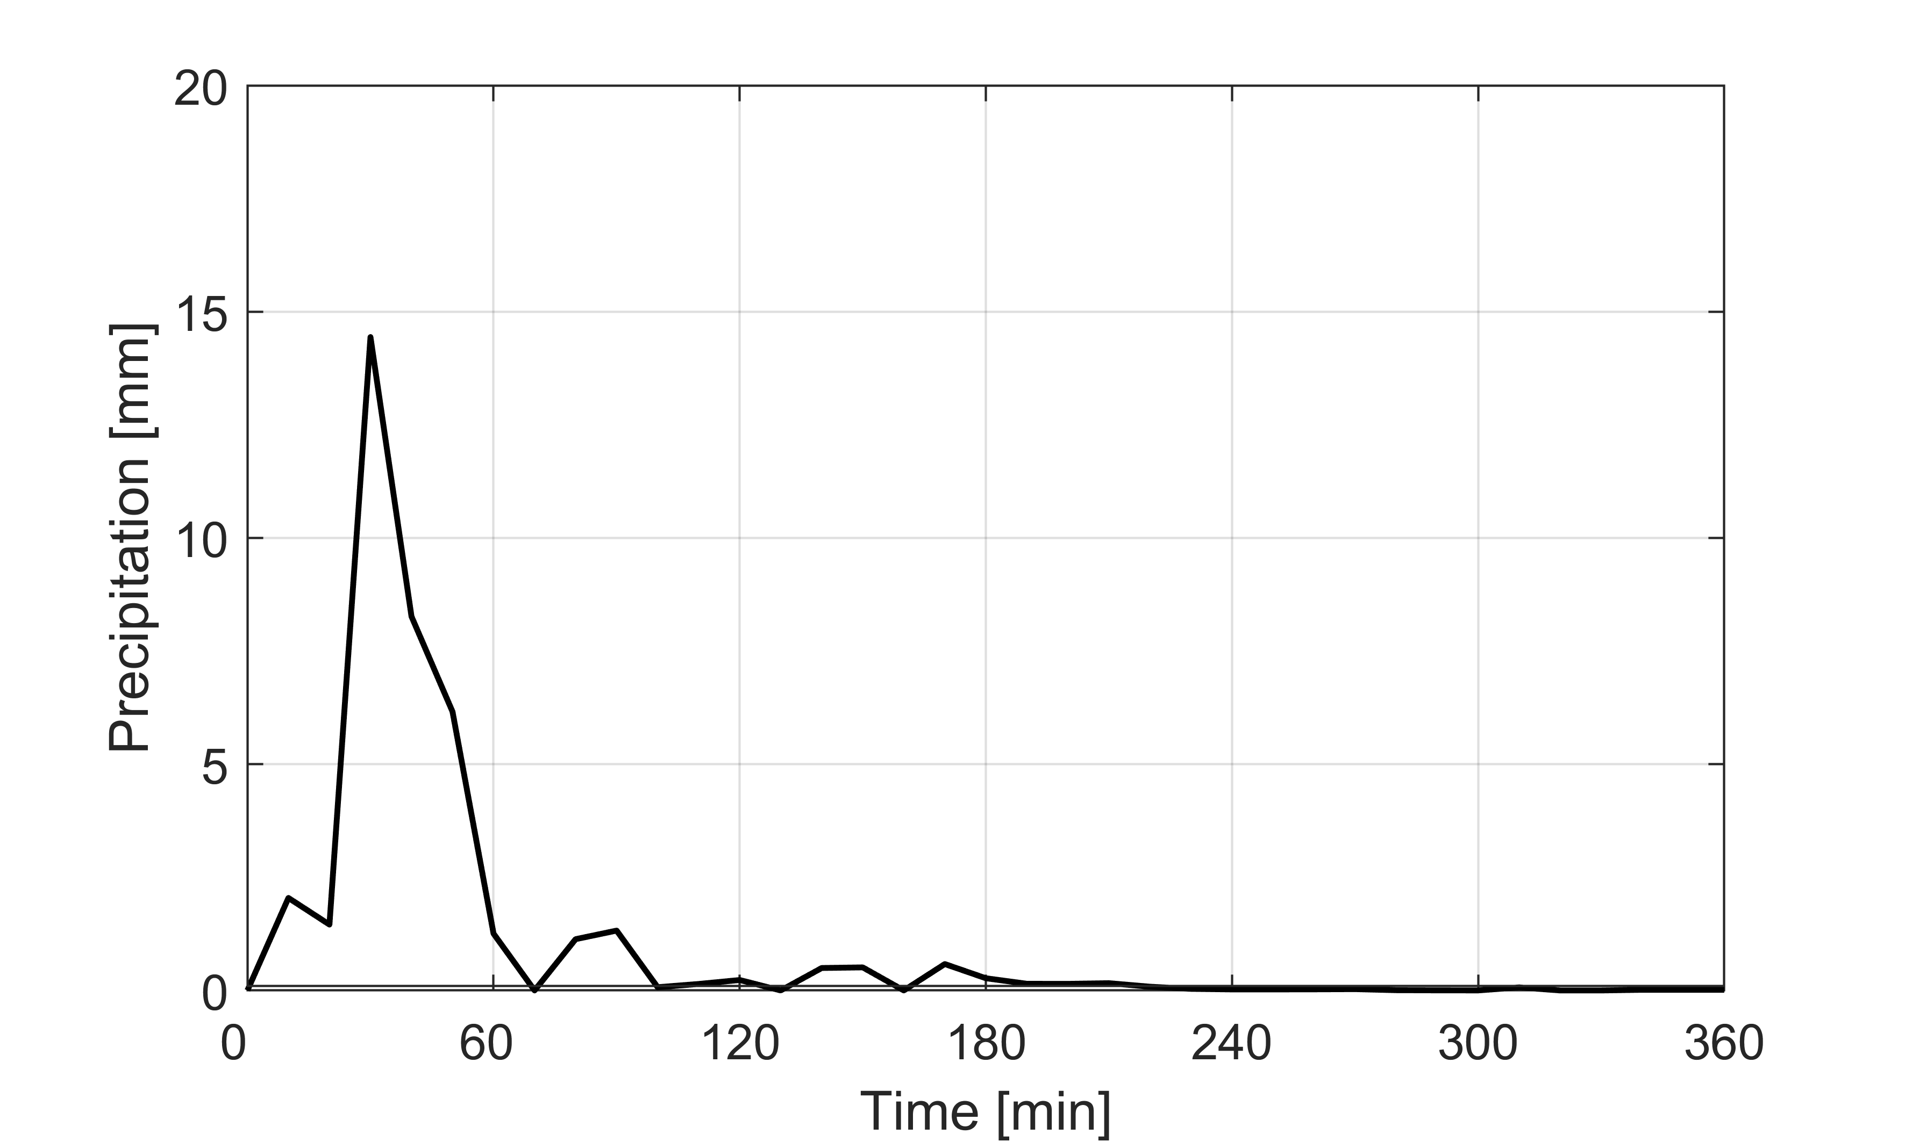
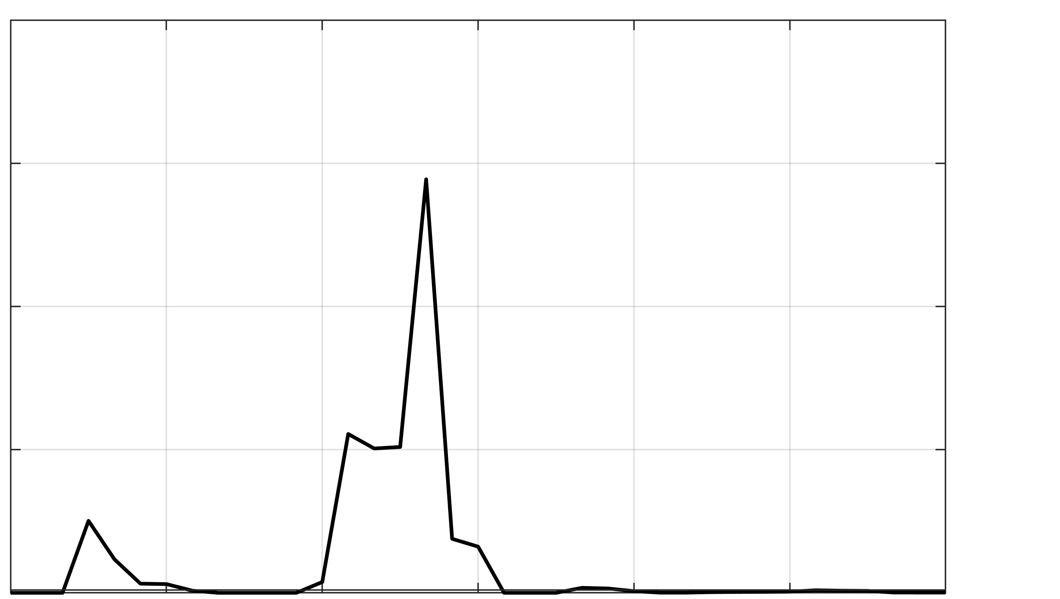
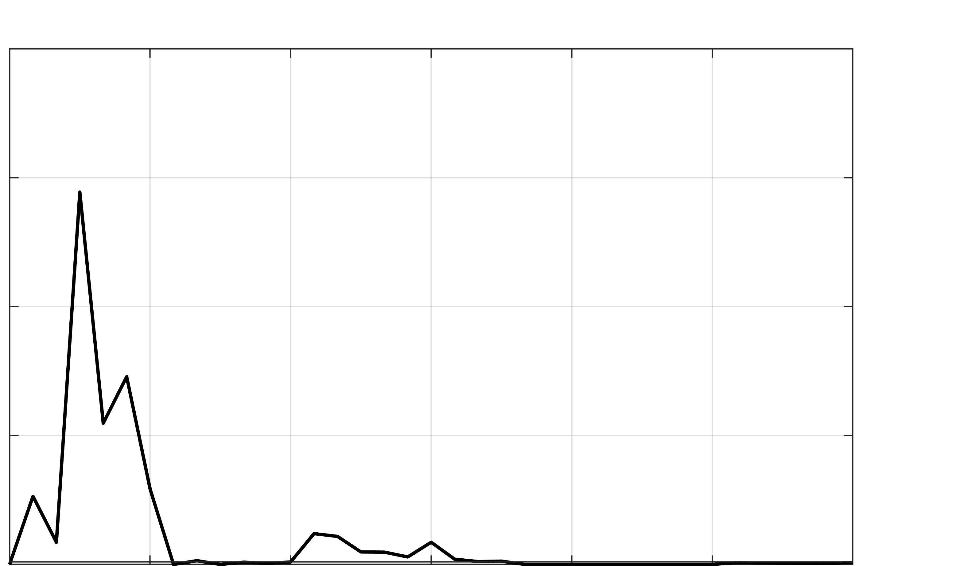
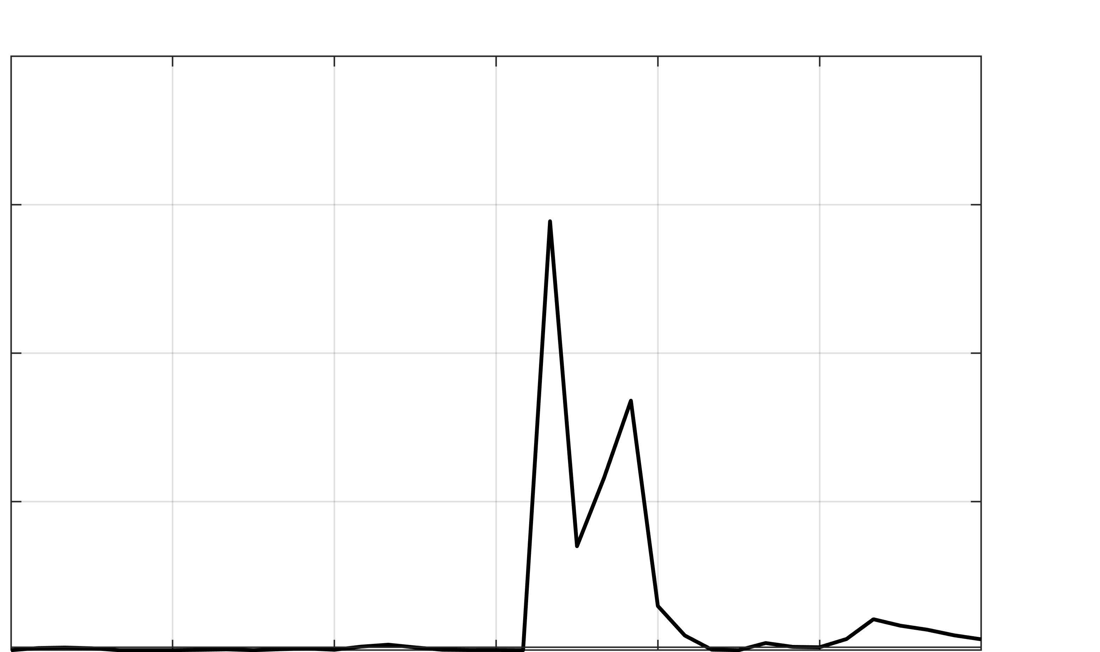
SIMULATING DESIGN STORMS
Ensemble of realistic design storms
PrePEP 2025: Joint return periods
18

Slide 25

Summary
Model generates storms that account for the joint return periods over different durations
High variability in possible duration-frequency profiles
Model highlights the overestimation of total precipitation volumes by the common design storm sampling methods
Thank you!
Credits: Viktor Ketal
tabea.cache@unil.ch

Slide 26
Supplementary material
PrePEP 2025: Joint return periods
S0

Slide 27
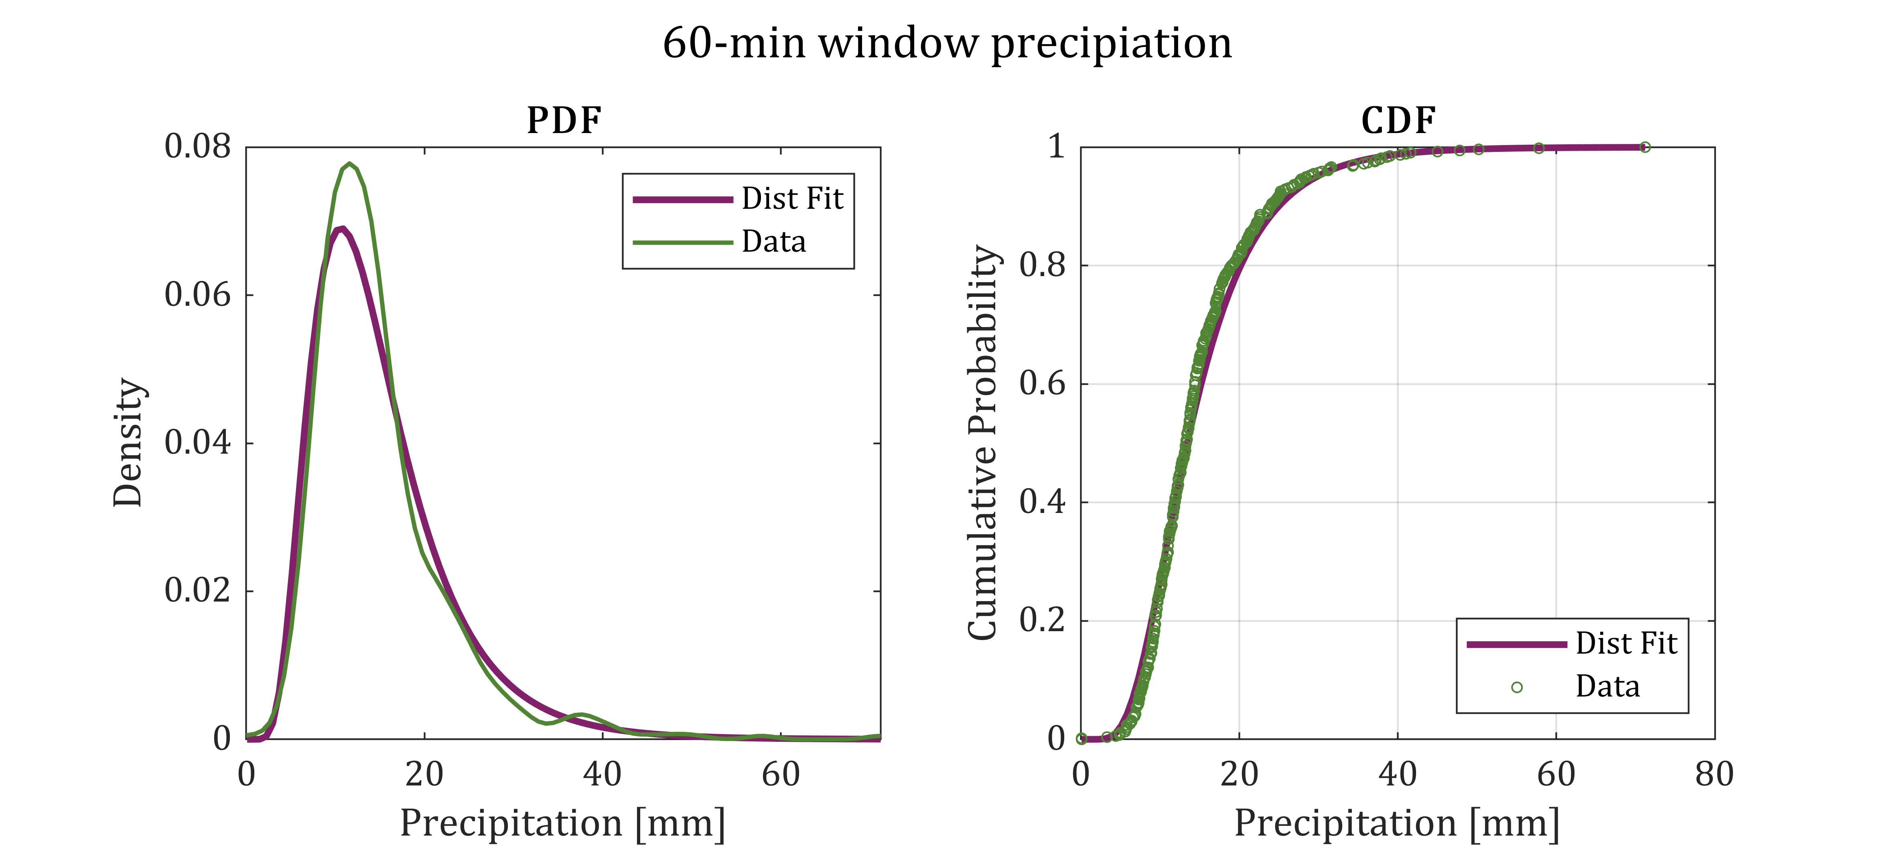
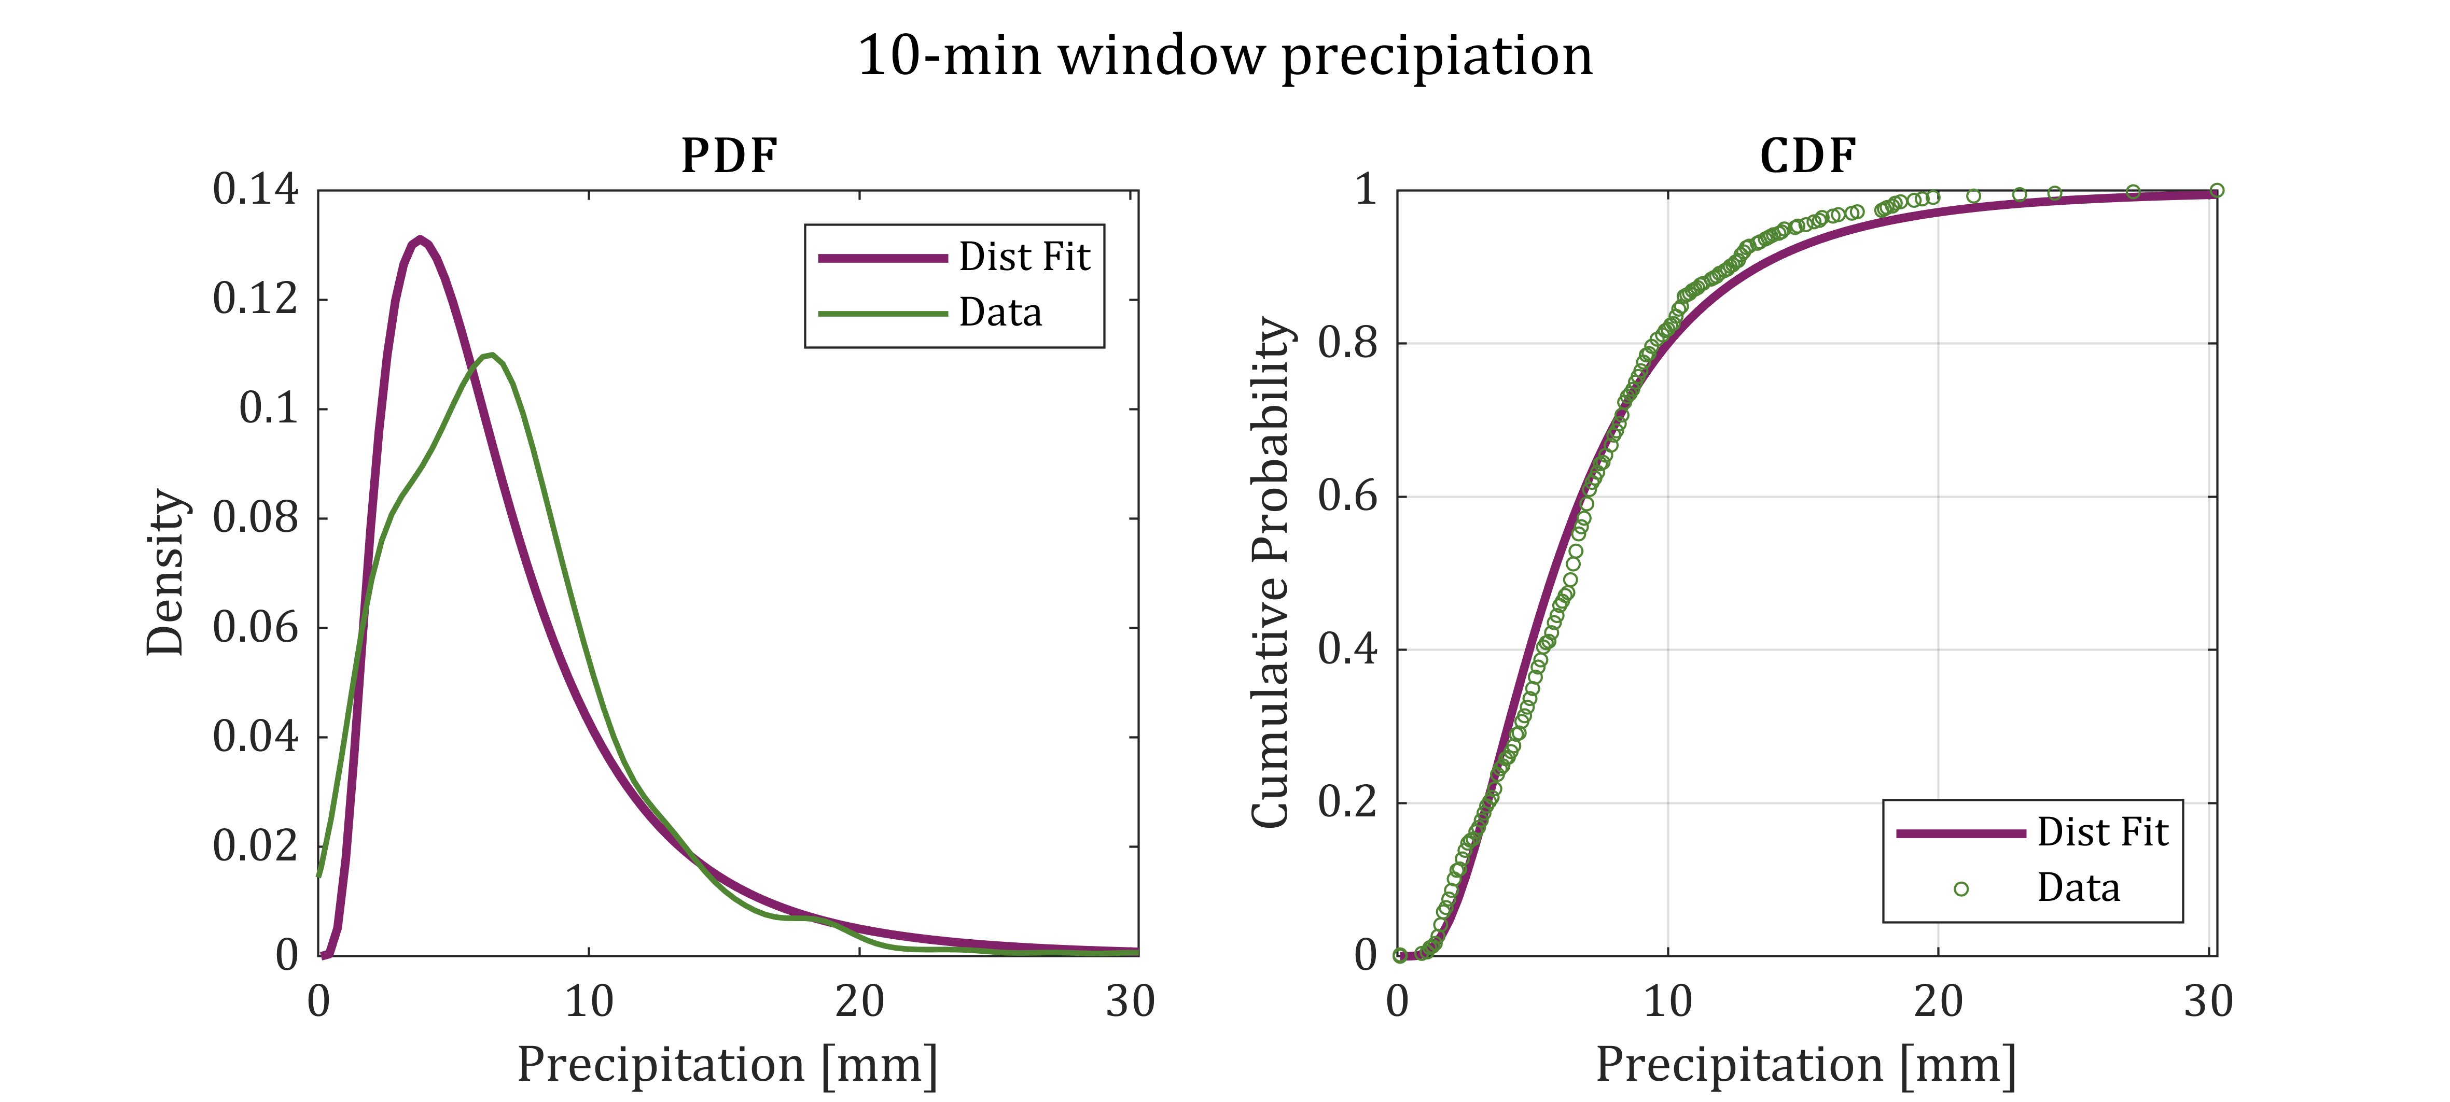
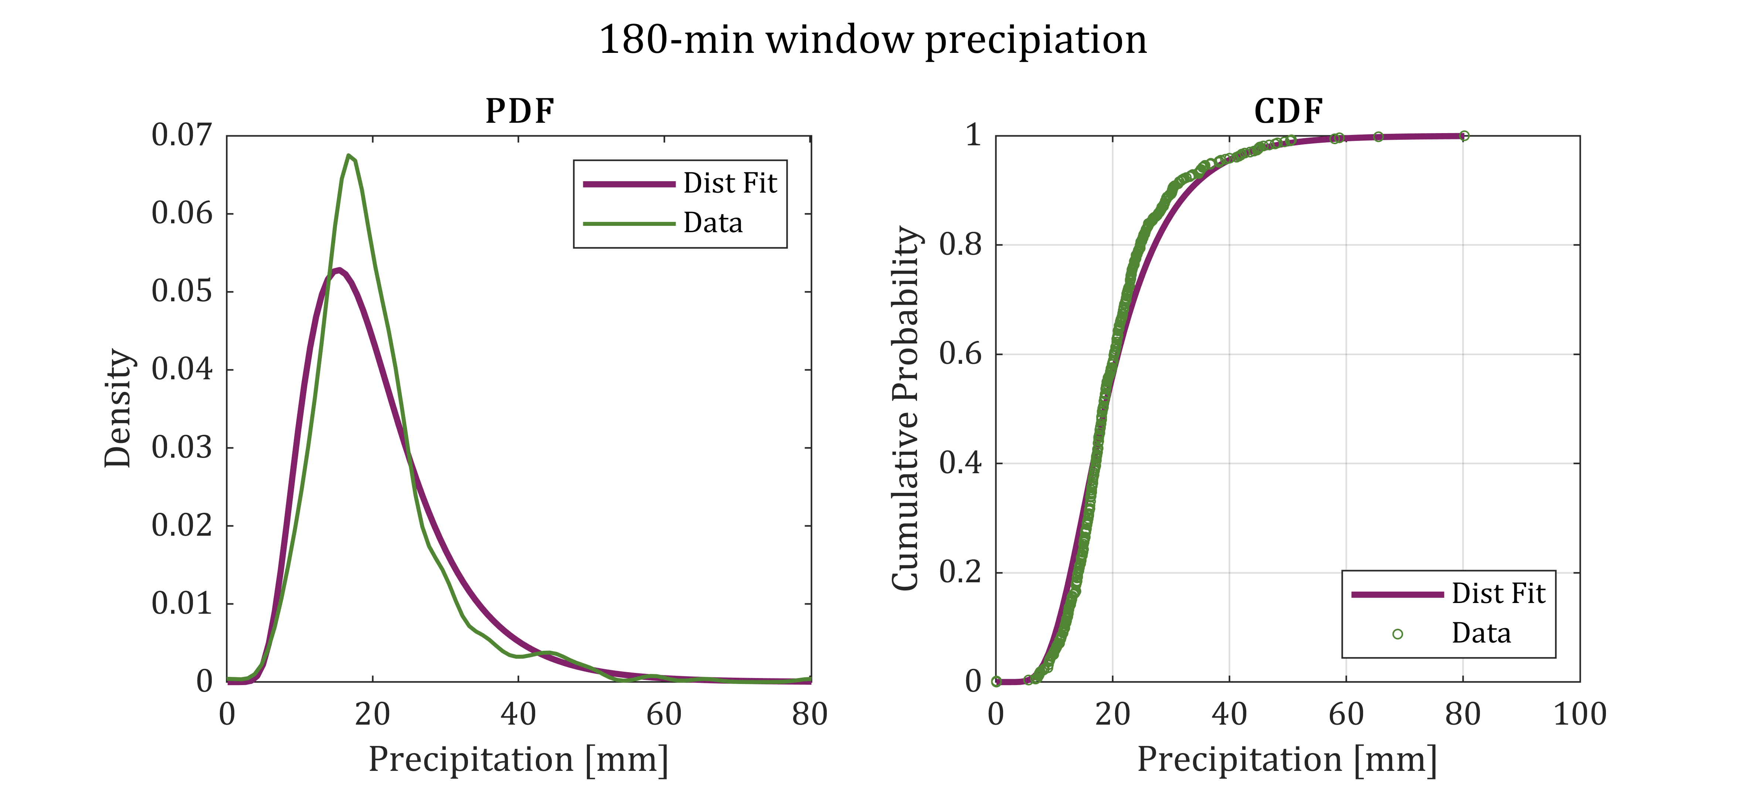
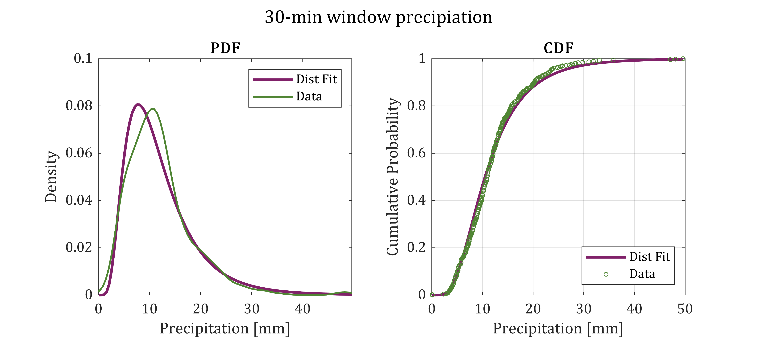
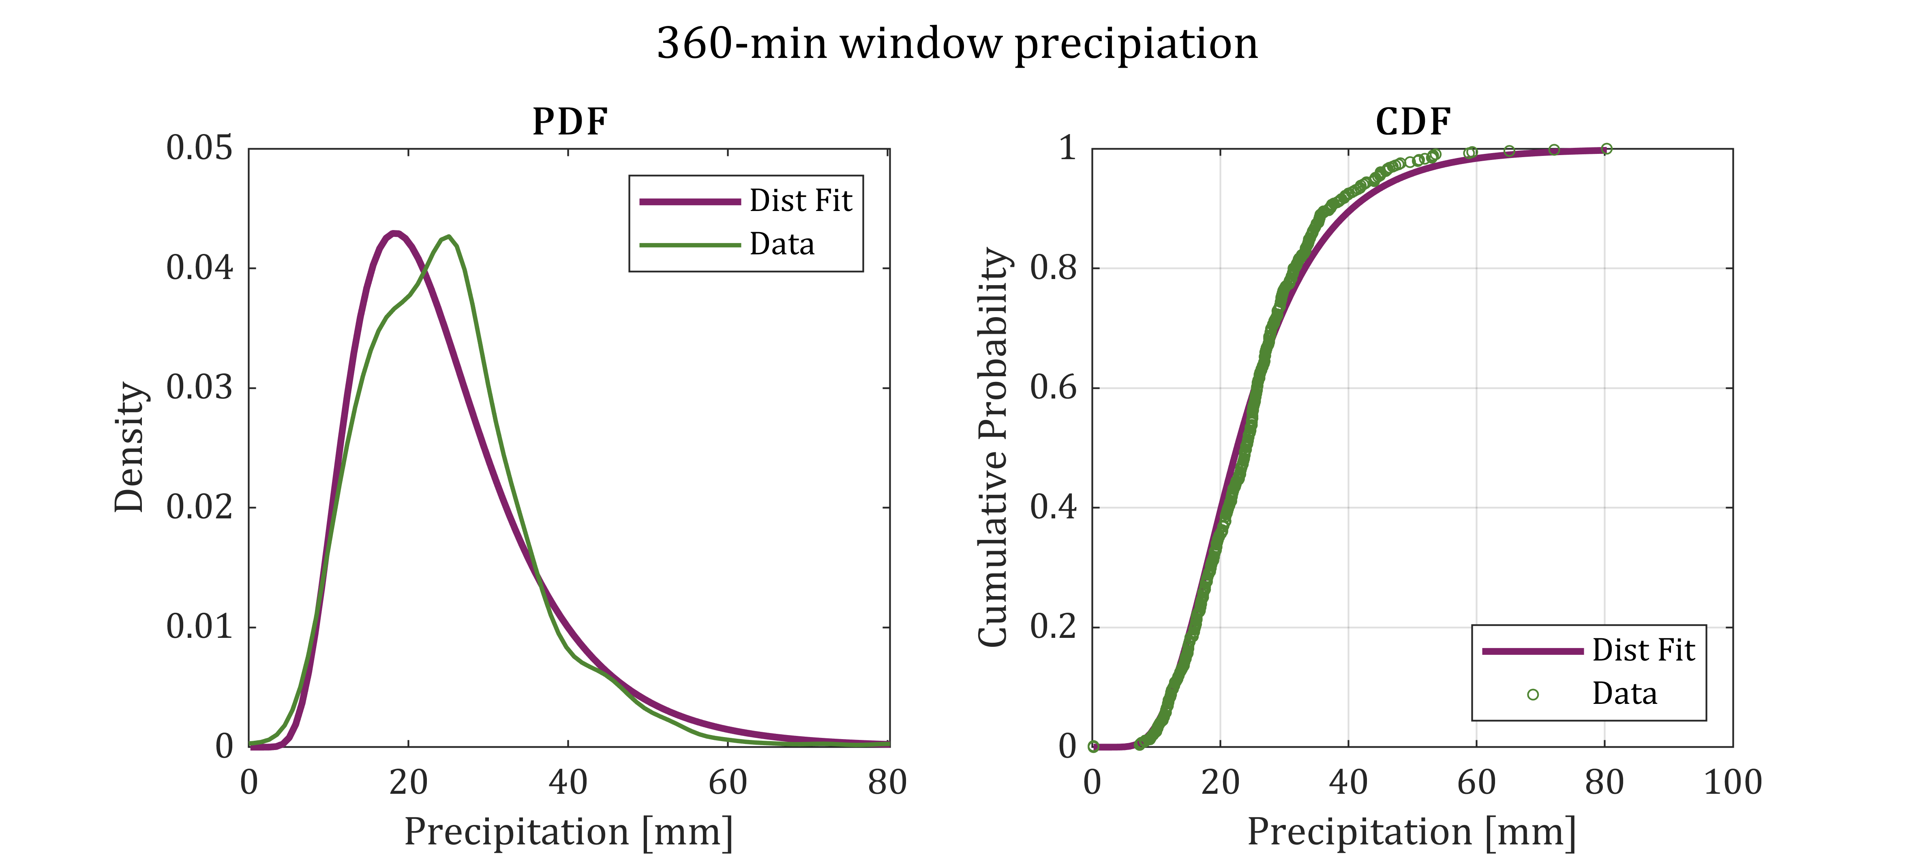
Marginal distributions
PrePEP 2025: Joint return periods
S1

Slide 28
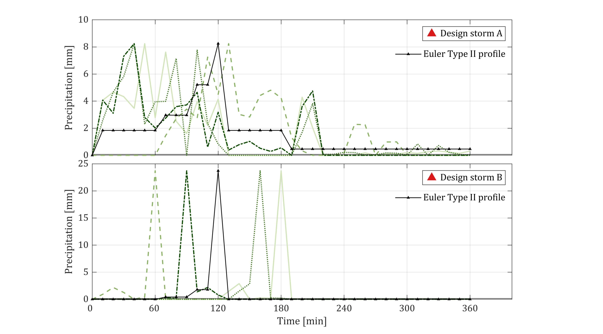
Euler Type II
PrePEP 2025: Joint return periods
S2

Slide 29
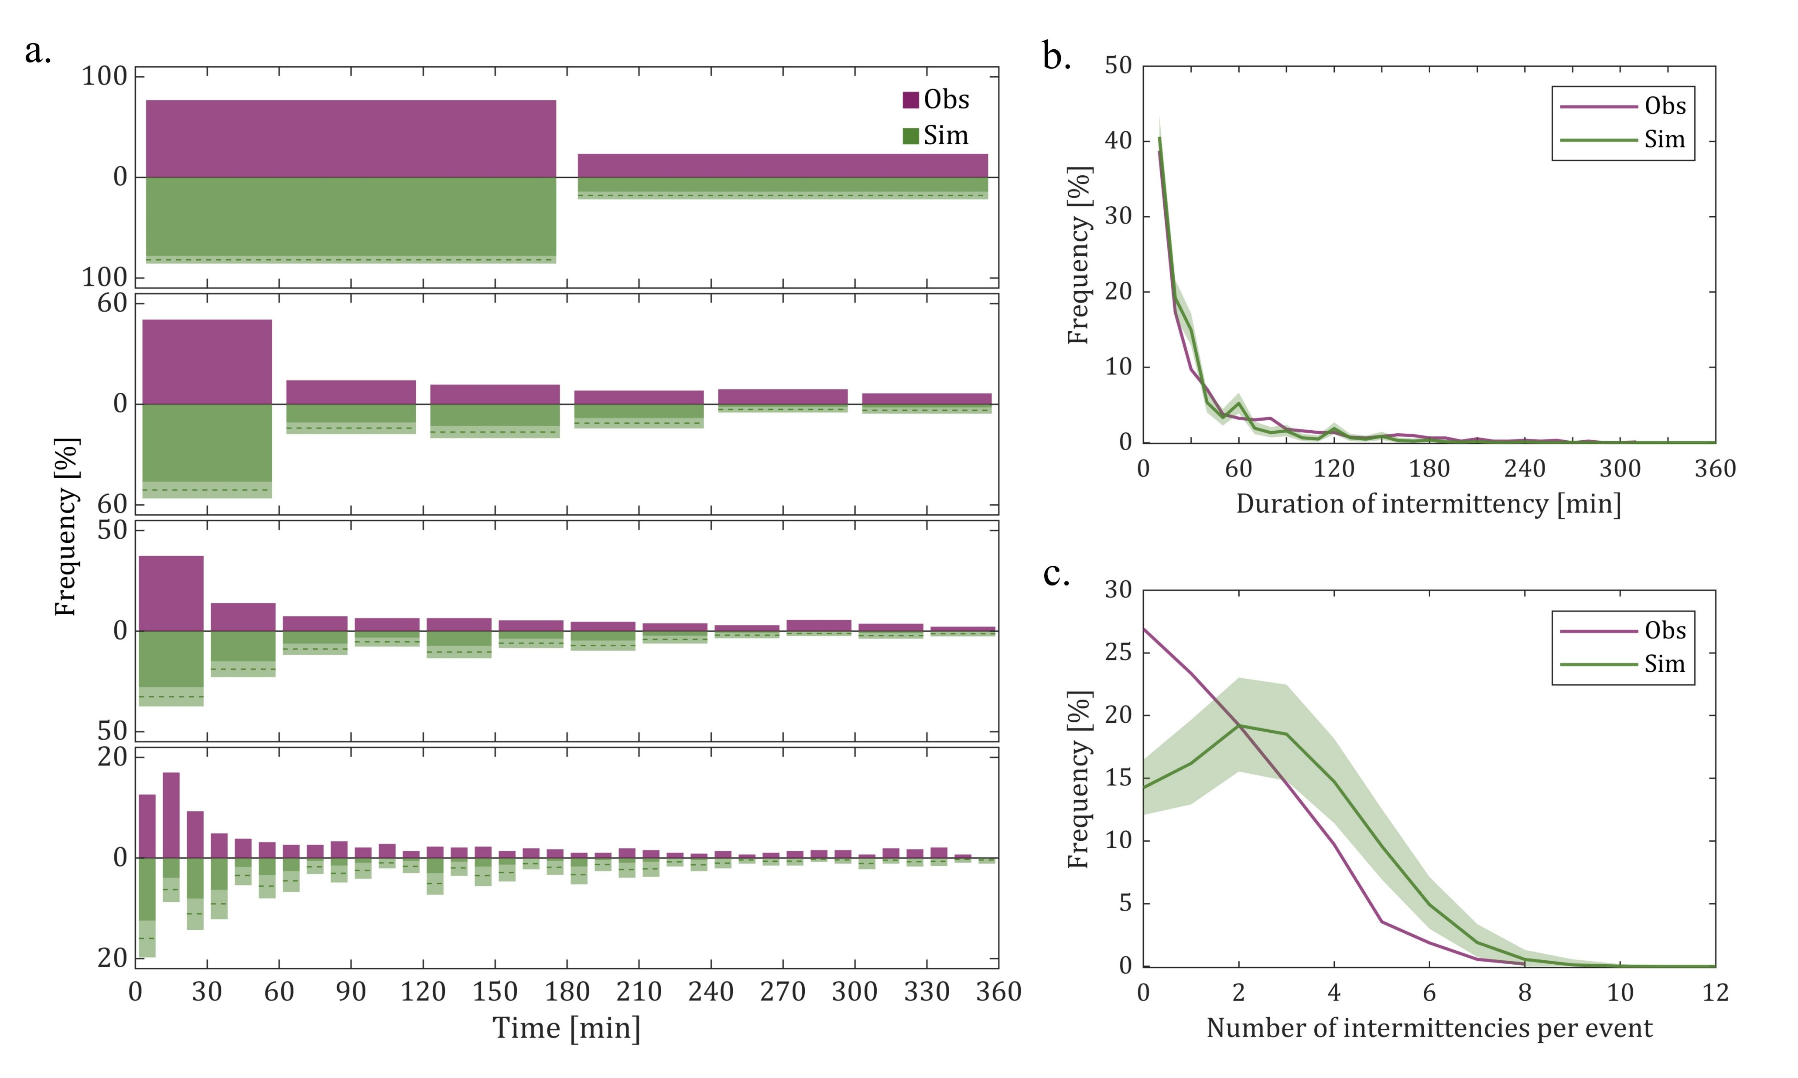
Model validation
PrePEP 2025: Joint return periods
S3

Slide 30
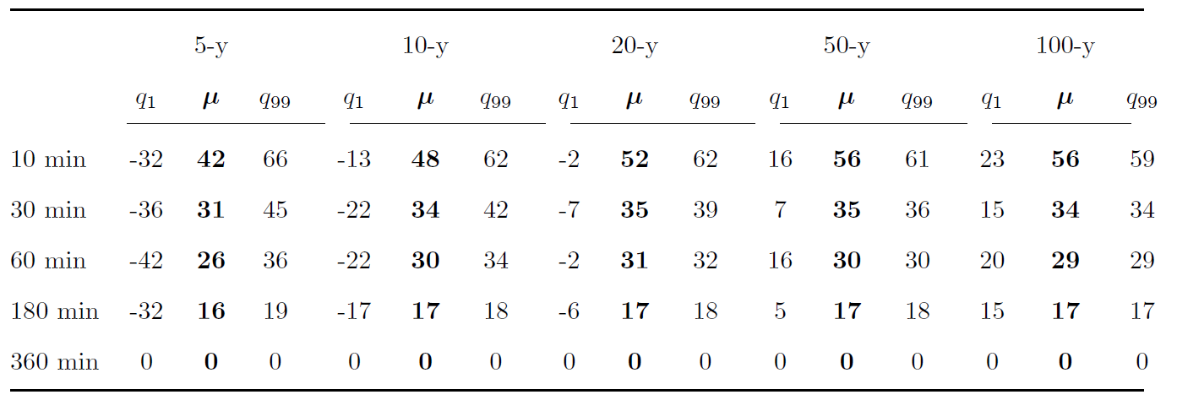
Relative difference of the total storm volume
PrePEP 2025: Joint return periods
S4

