Slide 1
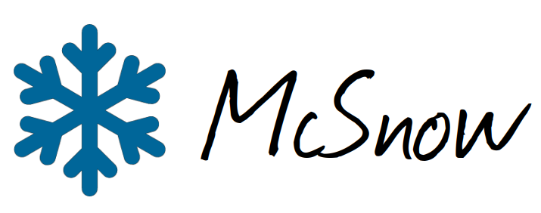



On the geometry and growth of aggregate snowflakes
Fabian Jakub¹, Axel Seifert¹, Christoph Siewert¹ and Leonie von Terzi²
(1) Deutscher Wetterdienst, Offenbach
(2) Meteorological Institute, Ludwig-Maximilians-Universität, Munich
PrePEP conference, Bonn, March 2025

Slide 2
DFG-funded project FRAGILE as part of SPP PROM
FRAGILE investigates the fragmentation of snowflakes using polarimetric cloud radars, Lagrangian particle modeling and laboratory experiments.
Here we report on a work package on the aggregation of snowflakes.
Understanding aggregate snowflakes, their geometry and growth is a
prerequisite for studying their fragmentation due to ice-ice collisions.
The geometry of aggregate snowflakes is important to understand radar measurements and QPE.
A better description of snowflakes may also improve numerical weather prediction models and QPF.

Slide 3
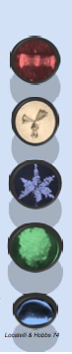
The super-particle microphysics model McSnow
McSnow is an open source Lagrangian particle model based on the Monte-Carlo algorithm of Shima at al. (2009).
McSnow had 8+1 prognostic variables for each super-particle
  ice mass m_{i}, ice volume V_{i} and aspect ratio ϕ
  number of monomers of aggregates N_{m}
  rime mass m_{r} and rime volume V_{r}
  liquid mass m_{l} and frozen mass m_{f}
  Monte-Carlo multiplicity ξ
McSnow includes all relevant ice microphysical processes like depositional growth, aggregation, riming, and melting.
In the following, we use McSnow in a simple 1d setup (rainshaft model).
For more details and references see https://gitlab.dkrz.de/mcsnow/mcsnow
For aggregates McSnow currently predicts their mass, the number of monomers and the aspect ratio of monomers.

Slide 4
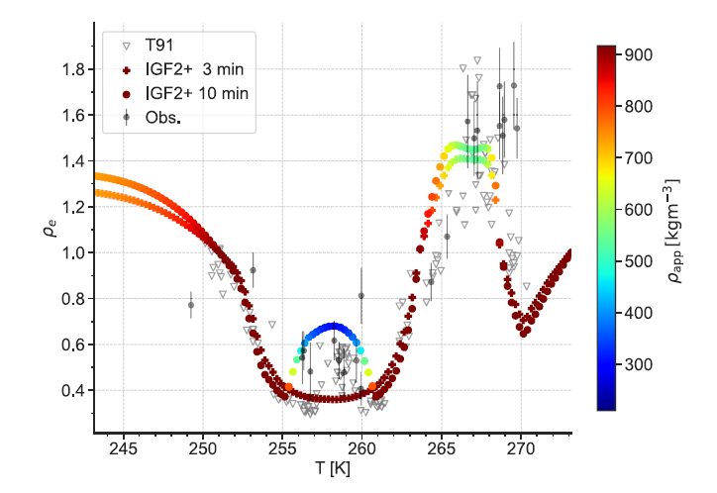
Habit prediction in McSnow
polarizability ratio
In the first phase of SPP PROM we have implemented a habit prediction for primary crystals in McSnow (Welss et al. 2024, JAMES)
Now we can propagate this habit information to the aggregate snowflakes: For this we store not only the number of monomers for each aggregate but also whether they are oblate (plate-like) or prolate (needle-like).
Hence, for each aggregate we have a monomer ratio MR, which is zero for pure needle aggregates and one for pure plate aggregates.
Figure 14 of Welss et al. (2024) showing polarizability ratios for ice crystals grown in the free‐fall chamber (open gray triangles), radar observations near cloud tops (gray bullets, error bars represent ±1 standard deviation), and McSnow simulations (color‐coded with particle's apparent density).

Slide 5
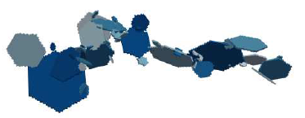
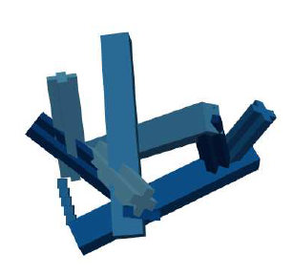
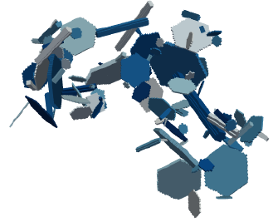
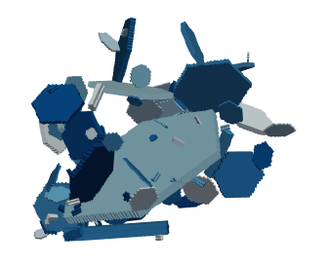
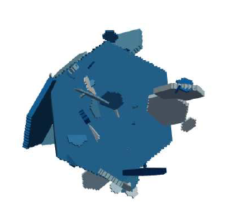
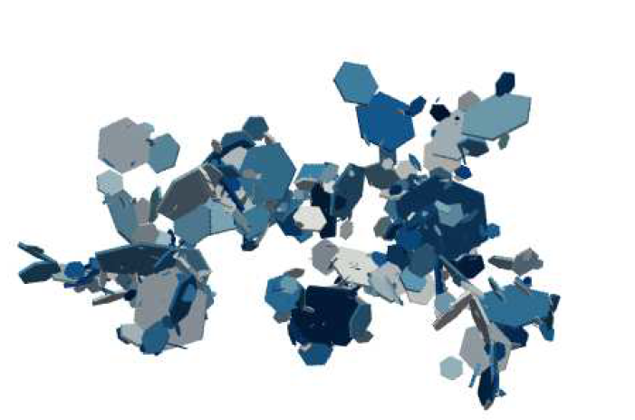
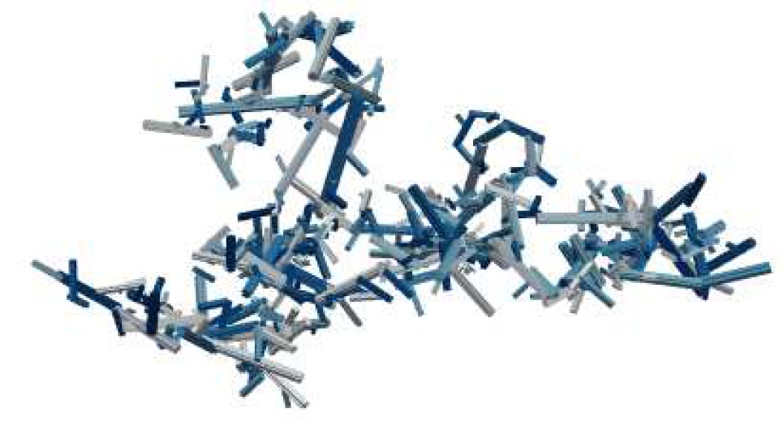
Artificial aggregate snowflakes
To generate the aggregate snowflakes we use the aggregation model of Leinonen and Moisseev (2014).
Aggregate snowflakes are clusters of polydisperse primary crystals or monomers. The monomers can be plates, needles, or dendrites.
Aggregates can even be mixtures of plates, needles and dendrites.
Each aggregate is unique due to different monomer number, monomer sizes, monomer shapes, and their collision angles.
Examples of artificial aggregate snowflakes with needle, plates and a mixture of both.

Slide 6
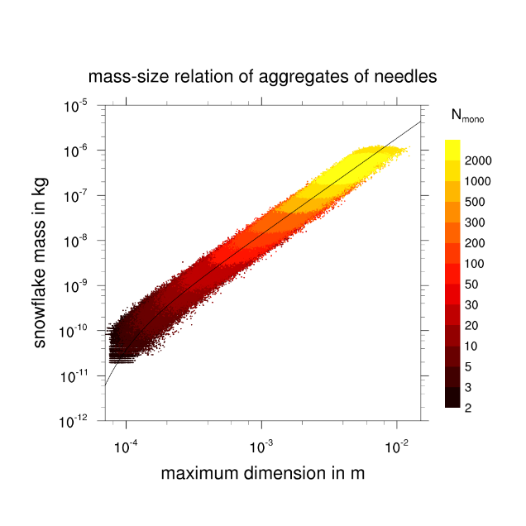
Fractal scaling and mass-size relation of aggregates
Aggregate snowflakes show universal scaling behaviour (Westbrook et al. 2004, GRL).
Therefore the average mass-size relation is a power law with an fractal exponent close to 2.
Mitchell (1996, JAS) gives a value of 2.1 for observed mixture aggregate.
The aggregation model produces snowflakes with an exponent of 2.15 for needles, 2.23 for plates and 2.21 for the 50/50 mixture of plates and needles.
But what about the scatter around the mean?

Slide 7
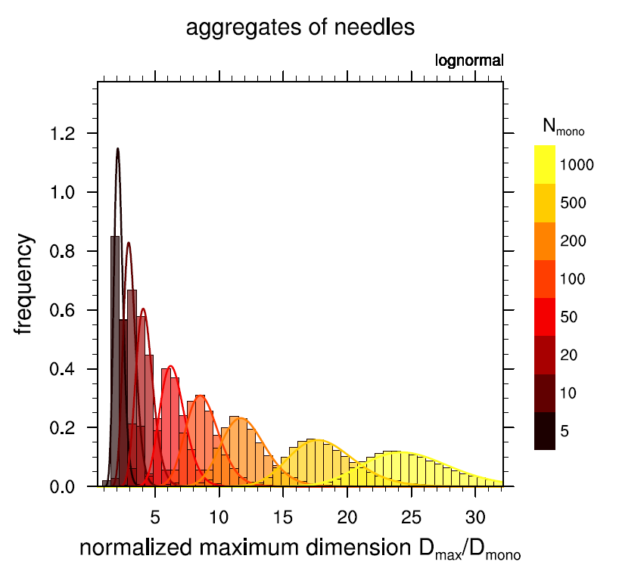
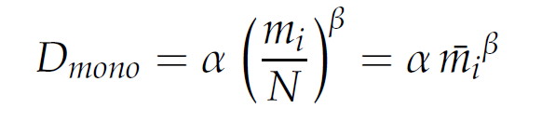
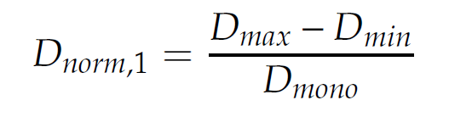
Maximum dimension of aggregate snowflakes
We normalize the maximum dimension of the aggregates with the mean size of their monomers:
The normalized maximum dimension
collapses the data to a lognormal distribution for any given monomer number N.
The finite size correction D_{min} is necessary because the aggregation model has a minimum monomer size.

Slide 8
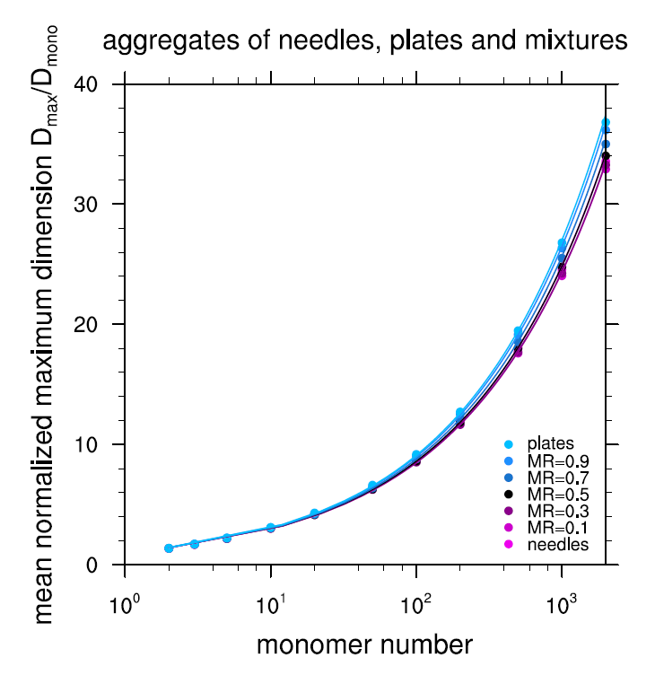
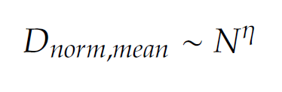
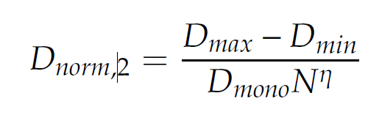
Maximum dimension of aggregate snowflakes
The scaling law is now written as a power law for the mean normalized diameter as function of monomer number:
For the normalized maximum dimension
This replaces the usual mass-size relation in McSnow.
The exponent shows a weak dependency on
particle shape.

Slide 9
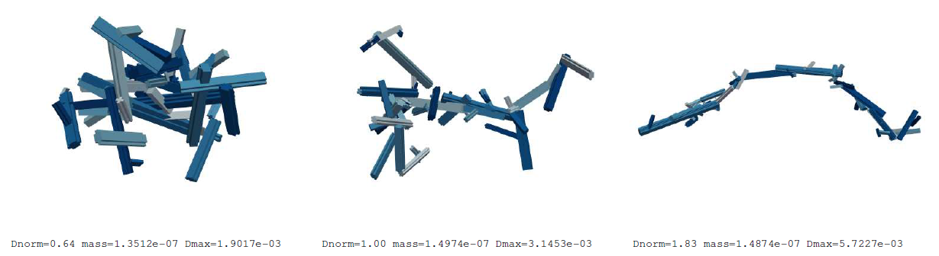
Examples of aggregates of needles with N=50
From the lognormal distribution, we know the probability of D_{norm} given N and m_{i} and therefore the geometry of the aggregate snowflake.

Slide 10
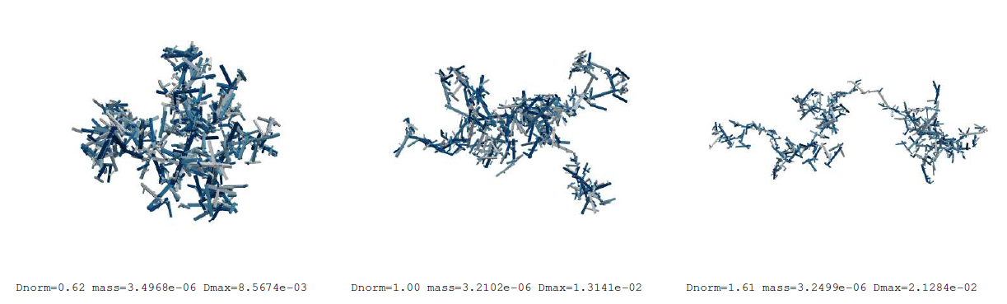
Examples of aggregates of needles with N=1000
From the lognormal distribution, we know the probability of D_{norm} given N and m_{i} and therefore the geometry of the aggregate snowflake.

Slide 11
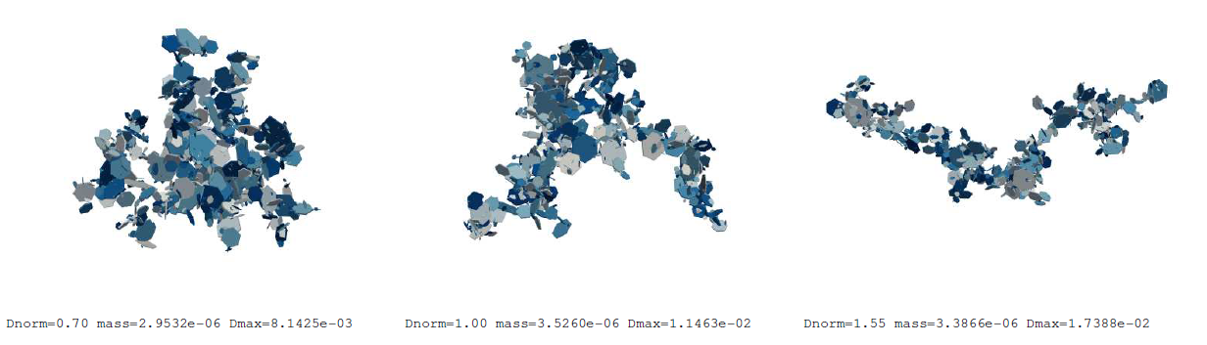
Examples of aggregates of plates with N=1000
From the lognormal distribution, we know the probability of D_{norm} given N and m_{i} and sample the geometry of the aggregate snowflake.

Slide 12
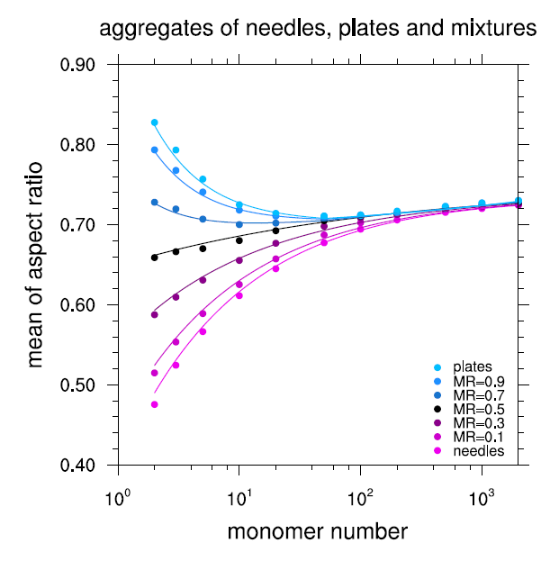

Aspect ratio of aggregate snowflakes
The aspect ratio is important for fall speed and polarimetry.
Aspect ratio of vertical projection:
Aspect ratio approaches 0.72 for large N for all monomer shapes consistent with Westbrook et al. (2004, GRL).
Aggregates of needles start with small aspect ratio, aggregates of plates with large aspect ratio.

Slide 13
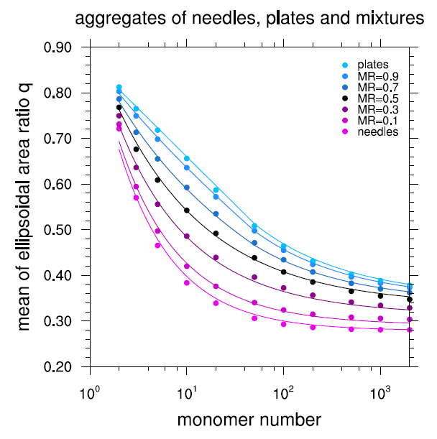
Cross sectional area of aggregate snowflakes
The cross section is important for fall speed and the collision kernel.
Here we use Böhm‘s ellipsiodal area ratio.
The area ratio decreases for large N but does not converge to a single value that is independent from monomer shape.
Aggregates of plates have a larger area ratio than aggregates of needles, and will therefore have lower terminal fall velocity.

Slide 14
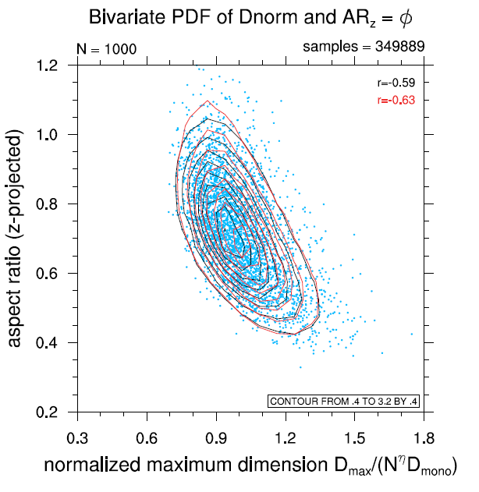
Correlation of aspect ratio and maximum dimension
The aspect ratio is correlated with D_{norm}
This correlation has to be parameterized in McSnow.
A combination of the lognormal distribution in D_{norm} with a normal distribution in ϕ is sufficient.
The plot shows a good agreement of the data (black lines) and the parameterization (red lines) for N=1000.

Slide 15
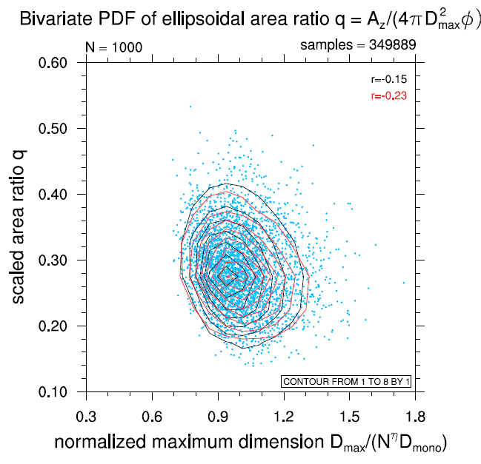
Correlation of area ratio and maximum dimension
The area ratio is very weakly correlated with D_{norm}
This shows that Böhm‘s ellipsoidal area ratio q is a good choice.
Again, we use a combination of the lognormal distribution in D_{norm} with a normal distribution in area ratio q.
The plot shows a good agreement of the data (black lines) and the parameterization (red lines) for N=1000.

Slide 16
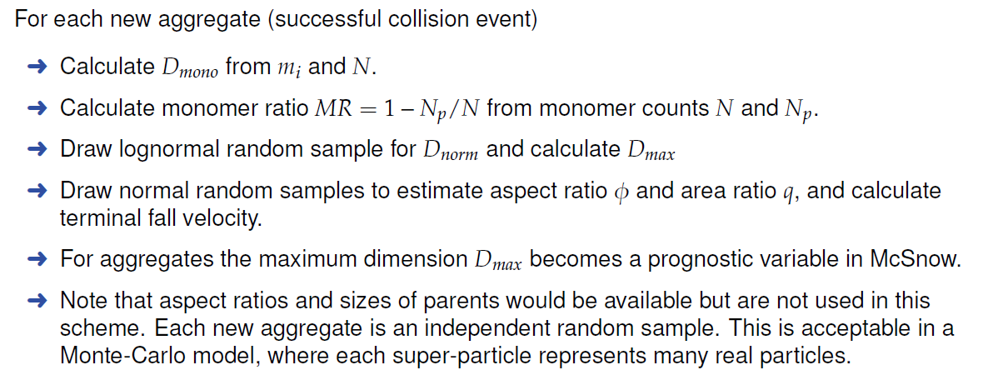
Implementation in McSnow

Slide 17
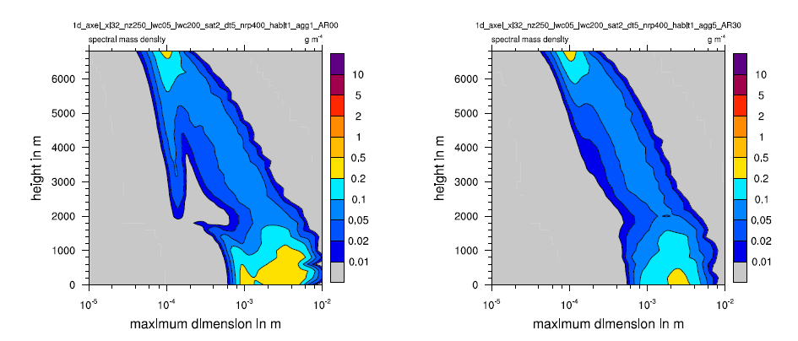
Idealized 1d simulations with McSnow
a) Mitchell (1996) mass-size relation b) stochastic aggregate snowflakes
Primary crystals are depleted more quickly with new stochastic aggregates.

Slide 18
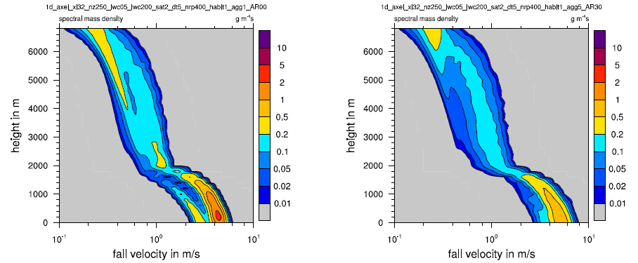
Idealized 1d simulations with McSnow
a) Mitchell (1996) mass-size relation b) stochastic aggregate snowflakes
Broader Doppler spectra with new stochastic aggregates.

Slide 19
Summary and Outlook
A new stochastic parameterization of aggregate snowflakes for Lagrangian super-particles models has been developed.
The new scheme can represent the variability of particle properties of aggregate snowflakes.
McSnow can now predict the maximum dimension, the aspect ratio, the cross-sectional area and the monomer habits of aggregates.
Discrete dipole approximation calculations of scattering properties are currently being performed to estimate polarimetric radar quantities.

Slide 20
additional slides

Slide 21
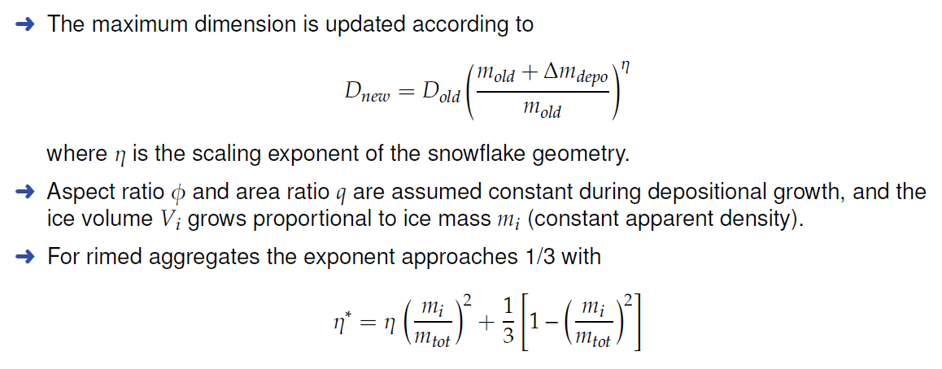
Implementation in McSnow: Depositional growth

