Slide 1
Study on Microphysics of Stratiform Precipitation Based on Dual-Polarization Radar and Airborne Observations
Hao Huang , Kun Zhao, Xiangfeng Hu, Guifu Zhang, and Yinghui Lu
a. School of Atmospheric Sciences, Nanjing University
b. Key Laboratory of Radar Meteorology, China Meteorological Administration
March, 2025
https://radar.nju.edu.cn
Notes:
Thank you chair. Good afternoon, everyone. I’m Hao Huang from Nanjing University. It’s a great pleasure here to present our study on the Microphysics of Stratiform Precipitation based on Dual-Polarization Radar and Airborne Observations. I would like to extend my thanks to all of my collaborators for their strong support in this research.

Slide 2
Outline
1. Introduction
2. Optimized microphysical retrieval
3. Microphysics of Stratiform Precipitation
4. Conclusion and discussion
Notes:
My presentation has four parts. I’ll first introduce the background and motivation.

Slide 3
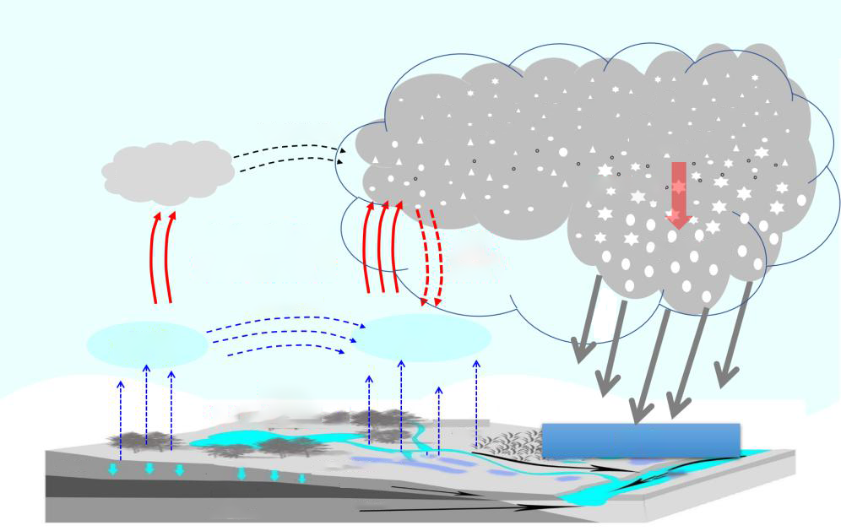
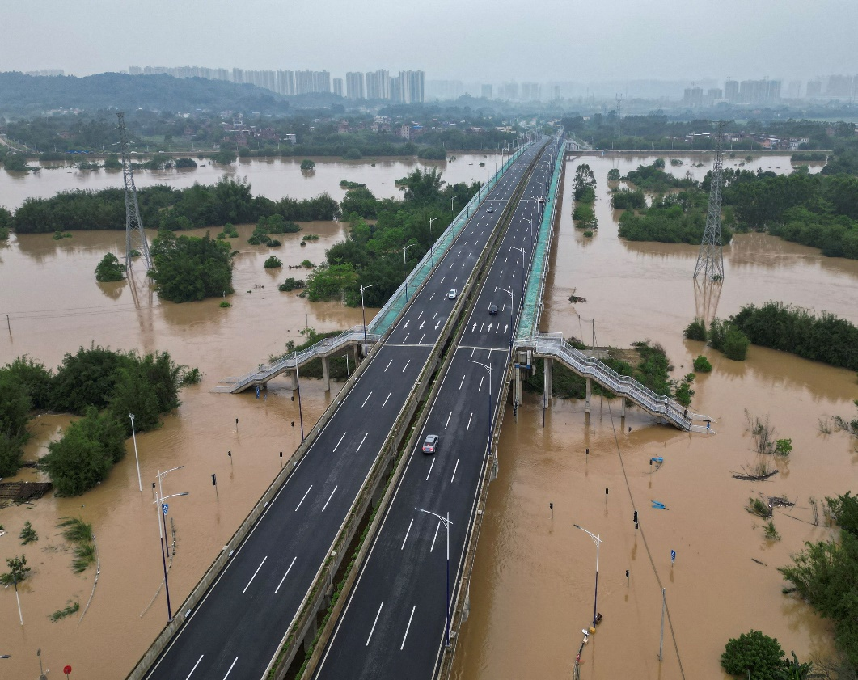
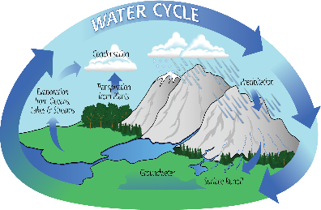
Cloud microphysics
Precipitation and cloud microphysics are crucial in research areas of meteorology and weather modification
Water Resources
Rainfall and Flooding
hydrometeors
hydrometeors
microphysical
processes
condense
rain
evaporate
vapor
vapor
precipitation
Credit: CAMS
Notes:
As widely recognized, rainfall plays a critical role in the water cycle and serves as one of the main water sources for daily life. However, it can also lead to destroying floods under certain conditions. Cloud microphysical processes are key in determining precipitation efficiency and intensity. Therefore, a deeper understanding of cloud microphysics is not only of great interest to the meteorological community but also crucial for disaster prevention.

Slide 4
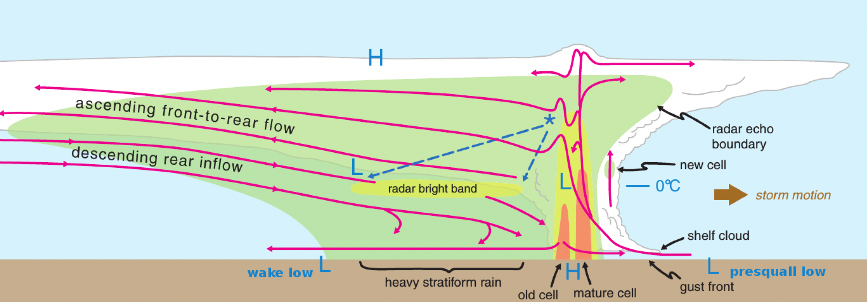
Importance of stratiform precipitation
Stratiform precipitation occurs more frequent than convection, affecting
1) atmospheric latent heat profile, and 2) storm development environment
Stratiform fraction underestimated in numerical models
Stratiform
TZ
Conv.
Forward Anvil
Notes:
This is a schematic diagram of a classic mesoscale convective system. As we know, stratiform precipitation occurs more frequently than convection and also accounts for a larger portion of the system. As we know, the heating and microphysical profiles in the stratiform regions are quite different from those in the convective regions. The latent heat profile in the stratiform area significantly affects the large-scale environment and storm development. However, in numerical weather models, stratiform precipitation is often underestimated, which can be partly attributed to uncertainties in the microphysical parameterization. As the latent heat profile is also related to microphysical processes. We should have a further investigation.

Slide 5
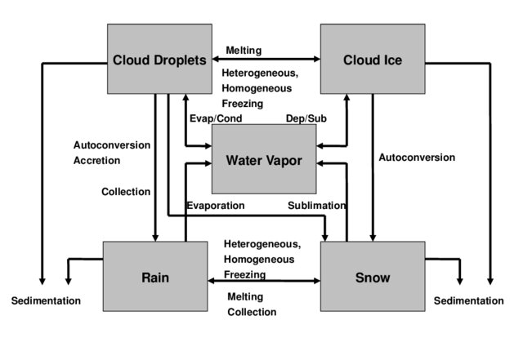
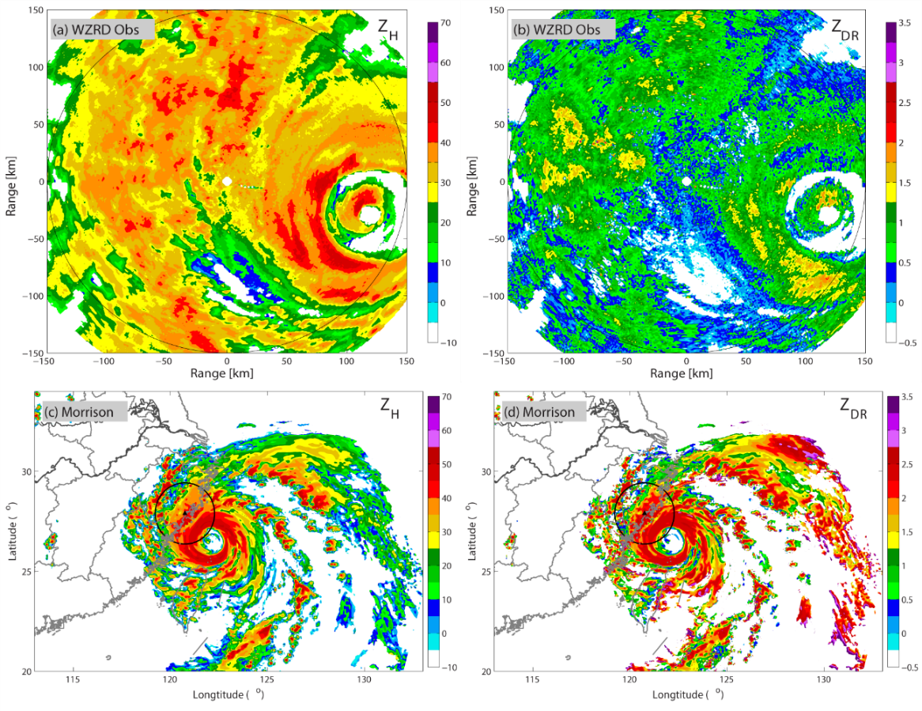
Uncertainty in stratiform parameterization
Large uncertainty in stratiform forecast from microphysical perspective
Considering instantaneous melting effect but no explicit representation of melting particles
Stratiform simulation in Lekima 2019
Processes in the Morrison and Gettelman (2008)
Obs. Z_{H}
Obs. Z_{DR}
model Z_{H}
model Z_{DR}
instantaneous effect but no melting particles
Salzmann et al.
Notes:
Though the structure of stratiform precipitation is much simpler than that of convection, there is still considerable uncertainty in its prediction. For example, the left panels show our simulation of Typhoon Lekima in 2019. When comparing the model results in the bottom panels with the observations in the top panels, we can see that the ZDR, which reflects the mean raindrop diameters, is generally overestimated in stratiform precipitation. One major source of parameterization uncertainty is the melting process. Most schemes only account for the effects of melting on the DSD and latent heat, but these processes assume that particles instantaneously transit from snow to rain, without explicitly representing melting particles, which may cause the missing of ML signature as also highlighted by Dr. ting-yu cha yesterday. This indicates a gap in our understanding of stratiform precipitation processes.

Slide 6
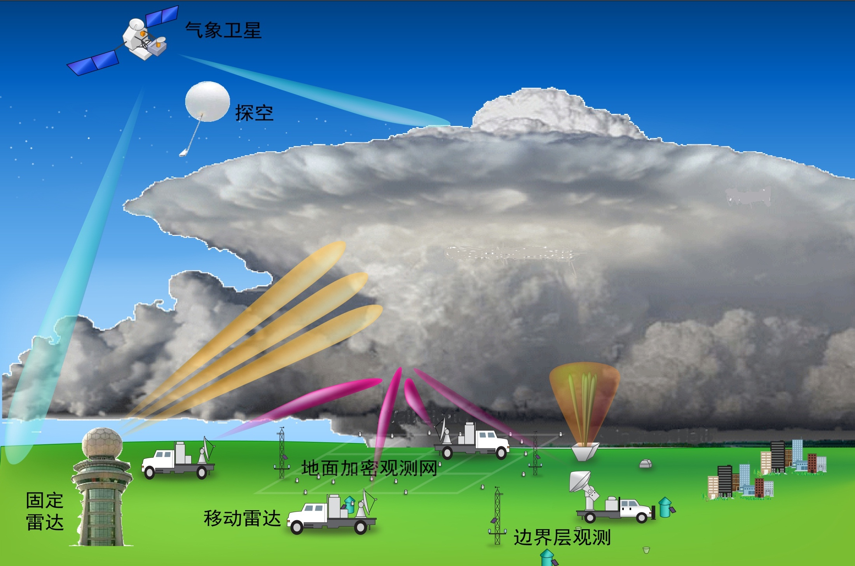
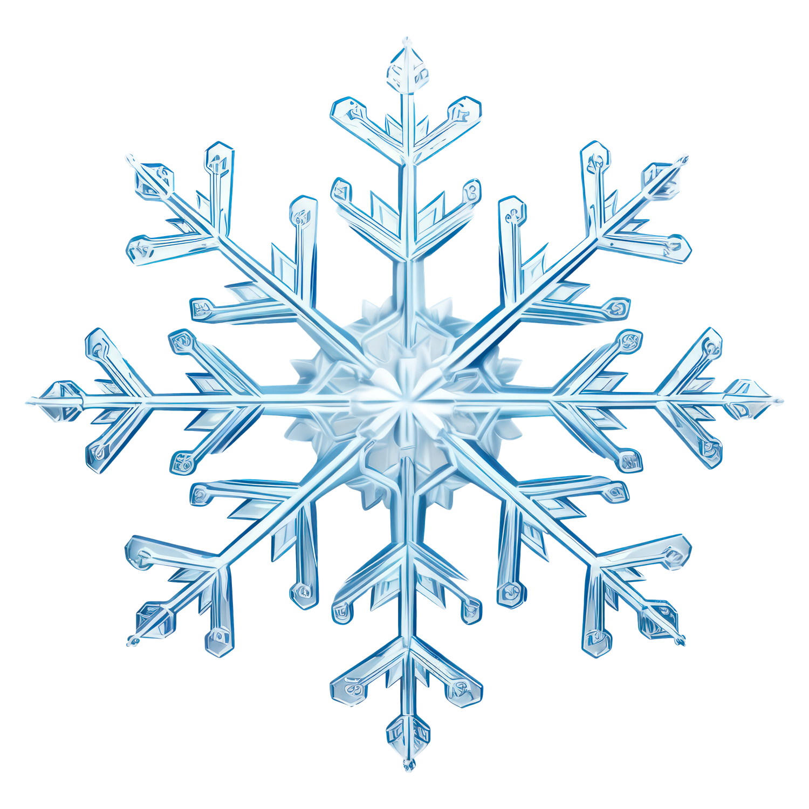
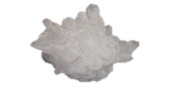
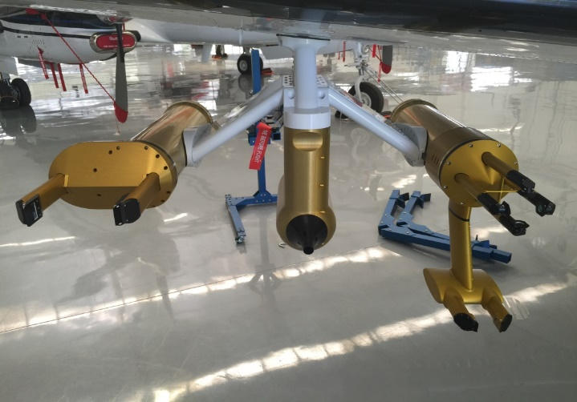
Microphysics observations
Incomplete information and errors in both airborne and radar remote sensing observations
—radar retrieval and multi-platform collaboration
Polarimetric radar observation
snow
hail
Airborne observation
rain
3D structure
Radar
10µm*128
2DS
HVPS
150µm*128
CPI
Polarimetric radar
2.4µm*1024
FCDP
Notes:
The most straightforward way to understand microphysical characteristics is through observation. Currently, there are two main observation methods. The first is the well-known dual-polarization radar, which captures the scattering properties of non-spherical particles to obtain high-resolution 3D precipitation characteristics. The second method is in-situ imaging, such as 2d-video disdrometer on the ground. Or airborne PIP from AMT and the HVPS from SPEC. However, in both in-situ and radar remote sensing observations, the microphysical information is often incomplete, and measurement errors are inevitable. In this study, we will present our efforts to improve the understanding of microphysics using these instruments and through their collaboration.

Slide 7
Outline
1. Introduction
2. Optimized microphysical retrieval
3. Microphysics of Stratiform Precipitation
4. Conclusion and discussion
Notes:
Then, I’ll introduce our progress in optimized retrieval of microphysical parameters from polarimetric radar.

Slide 8
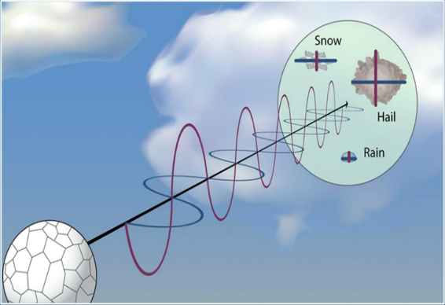
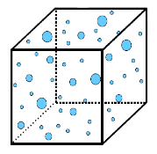
Key problem in microphysical retrieval
Two independent observations from radars, three unknown parameters in raindrop size distribution model, with more uncertainty by attenuation
Three-parameter Gamma DSD
N(D)
D
insufficient
Precipitation attenuation
Radar measurements
Z and Z_{DR}
2 independent observations (Z and Z_{DR})
power decrease in propagation
3+1 unknowns (N₀, 𝜇, $Λ$, and A)
Notes:
As we know, the essential of microphysical retrieval is to solve the equations representing the mapping relationship between microphysical parameters and radar observations. For polarimetric radars, only two independent observations are available, that is the reflectivity factor and differential reflectivity. However the most common DSD model is the gamma model, which has three unknowns. In addition, for X-band and C-band, the signal power is attenuated in propagation. So, it is insufficient to use two independent observations to solve three unknowns in gamma model and attenuation. So, we need more constraints and a better framework to solve the problem.

Slide 9
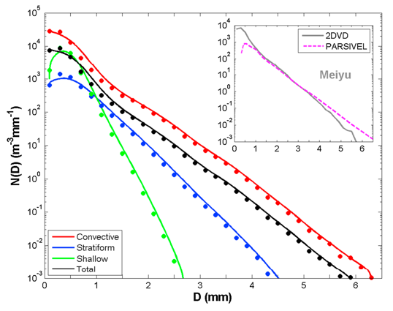
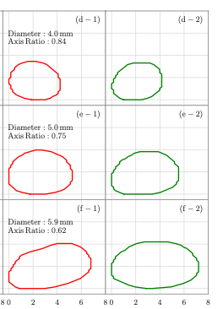
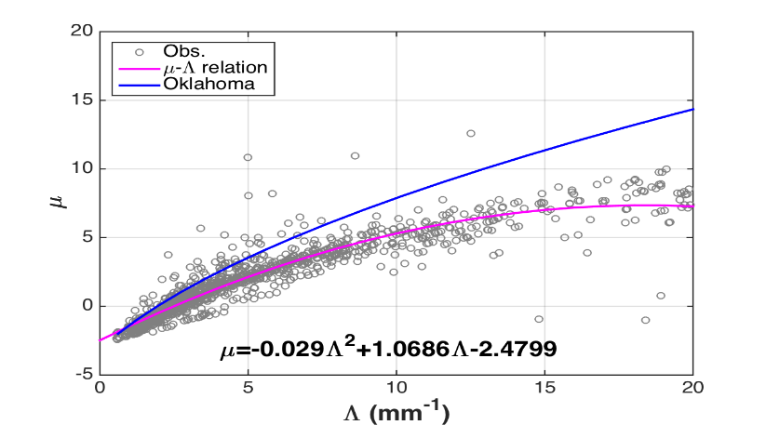
Improvement in physical constraints
With long-term DSD observations, constrained DSD models updated and relationships between DSD parameters and radar parameters built, which help decrease the uncertainty in retrieval model, and increase the retrieval reliability
2-D video disdrometer observations in field experiments
µ-Λ relationship for monsoon
Radar relationships
shape
USA
USA
China Monsoon
DSD
observations
Attenuation
Huang et al. 2017, 2021, Wen et al. 2018
Notes:
So, we first use the long-term 2DVD observations more than five year, to construct some constraints between the DSD parameters and radar parameters for different types of precipitation . For example, the middle panel shows the µ-Λ relationship for monsoon precipitation in east-China , which is quite different from that proposed for Oklahoma in USA. The right panel shows the relationship between specific attenuation and specific differential phase KDP for C-band, which is also different from that in the USA. So, such constraints may help decrease the uncertainty in retrieval model, and increase the retrieval reliability.

Slide 10
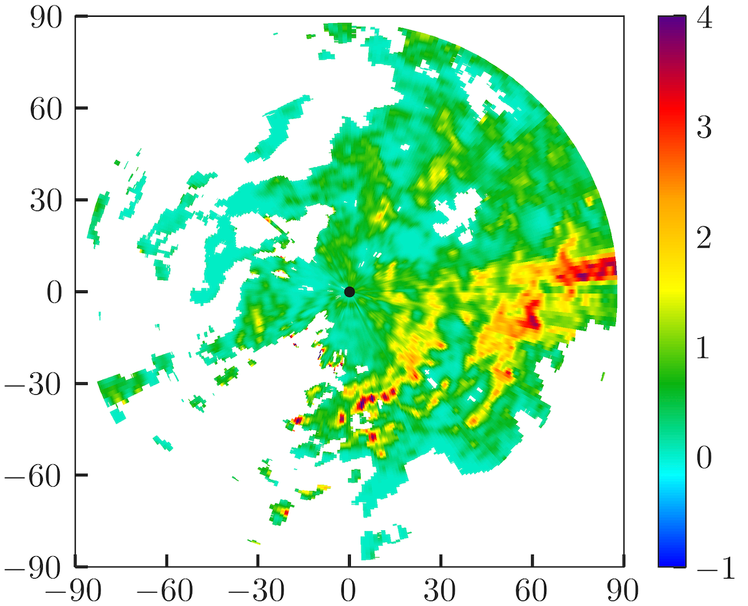
Variation retrieval of microphysics
The integrated variational optimization method for simultaneous retrieval of microphysical parameters and attenuation improves the physical consistency between parameters
Cost function example
Variational
optimization
$$J={\left[Z_{DR}\left[N_{0},Λ,f_{μ}\left(Λ\right)\right]−A_{DP}\left[N_{0},Λ,f_{μ}\left(Λ\right)\right]−Z_{DR}^{m}\right]}^{2}$$
$μ$-$Λ$ constraint
attention relation
obs.
dB
dB
Z_{DR}
Conv.
Z_{DR}
Var.
VS.
Discontinuity
Not well corrected
Continuous
Attenuation corrected
Huang et al., 2019@JTECH; Huang et al., 2020a@JH; Huang et al., 2020b@JHM
Notes:
To solve the microphysical retrieval equations under the constraints, we construct a variational optimization framework. For example, we first build a cost function describing the difference between the the observations and the radar variables calculated from the microphysical parameters using a forward operator. In the forward operator, we can add the constraints in a very straightforward way. Then the cost function is optimized with a gradient descending method. In such a way, we can get the optimized microphysical parameters, and also the corresponding optimized radar variables with the attenuation simultaneously corrected. Such as the optimized ZDR in the right panel, we have more continuous results, and the biases behind severe rainfall regions are clearly corrected.

Slide 11
Variation retrieval of microphysics
The integrated variational optimization method for simultaneous retrieval of microphysical parameters and attenuation improves the physical consistency between parameters
Radar-derived
Ground validation using disdrometer
2.0
D_{m}
1.5
D_{m} (mm)
1.0
D_{m} (mm)
0.5
6
DSD obs.
4
lg[N_{t} (m⁻³)]
2
N_{t}
0
lg[N_{t} (m⁻³)]
160
Rainfall rate
Accuracy improved 15%
Var.
Conv.
80
RR(mm h⁻¹)
0
23
01
03
05
07
Time (UTC)
Huang et al., 2019@JTECH; Huang et al., 2020a@JH; Huang et al., 2020b@JHM
Notes:
Using this framework, we can optimize the parameters of the gamma distribution at each radar point and then calculate the corresponding microphysical parameters, such as the mass-weighted mean diameter and total number concentration. We have quantitatively validated the retrieved parameters using ground-based 2DVD observations and found an average improvement of over 15%. I want to emphasize that, with this unified retrieval framework, all microphysical parameters are based on the same DSD at one point, ensuring high consistency across the parameters.

Slide 12
Outline
1. Introduction
2. Optimized microphysical retrieval
3. Microphysics of Stratiform Precipitation
4. Conclusion and discussion
Notes:
Then, I want to show our analysis about the microphysics in a stratiform case in north China.

Slide 13
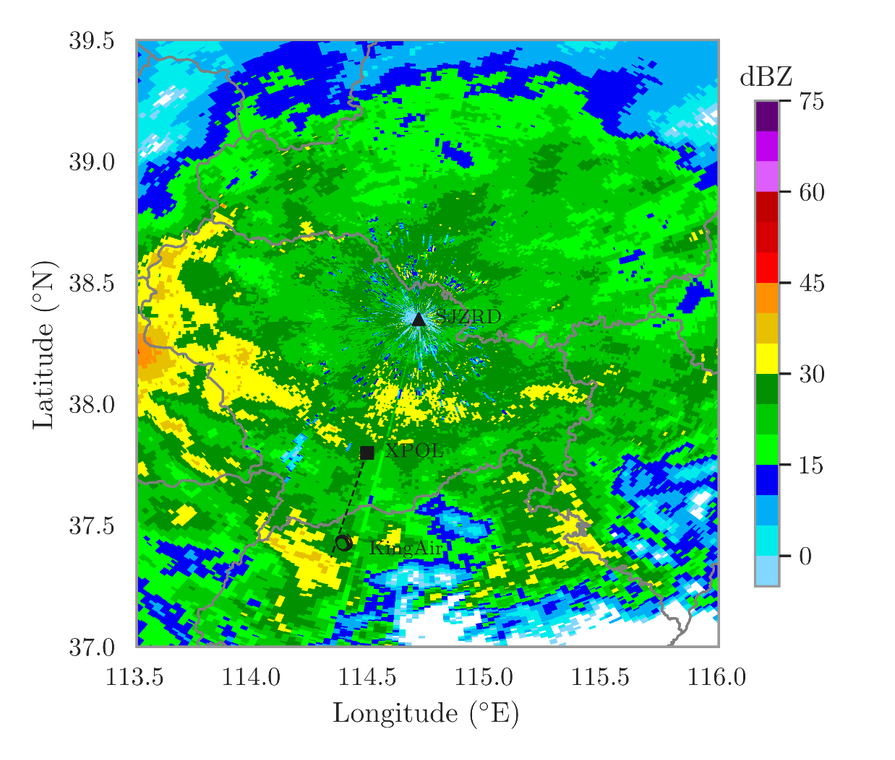
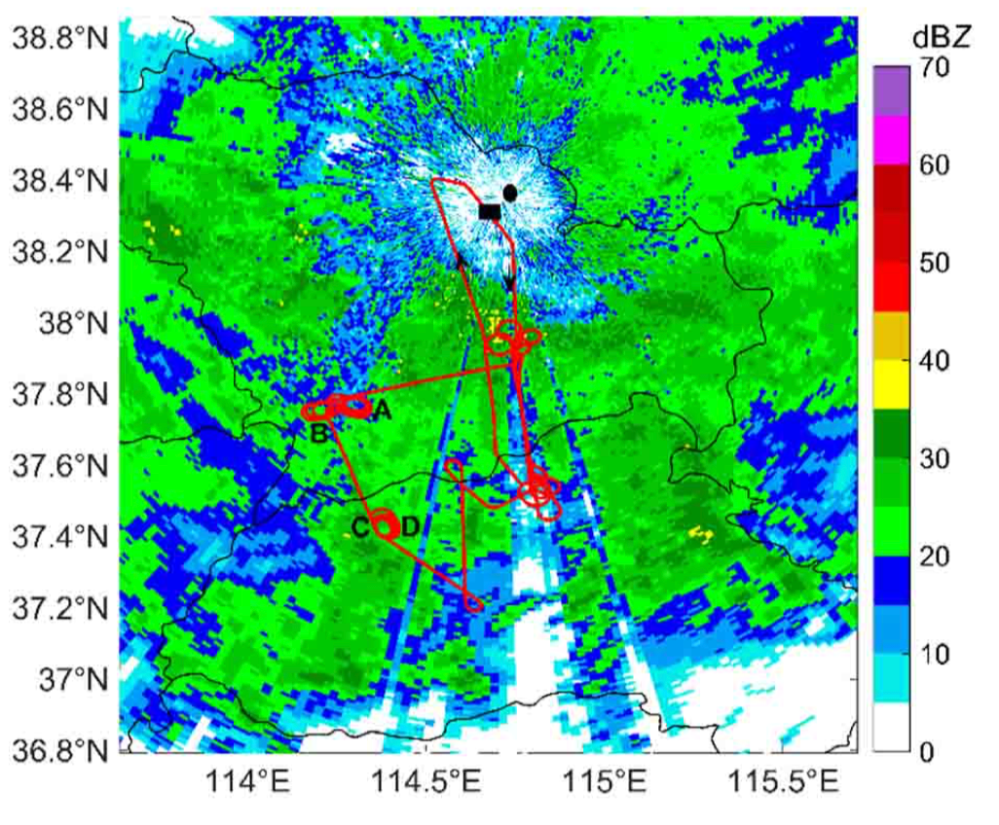
Radar observations and flight paths
2018 May 21 North China S-band radar
(flight path overlaid)
Location of XPOL and flight track
Data source:
X-band polarimetric radar data for general structure
Airborne (King-Air Plane) 2DS, CPI, and HVPS for particles
Notes:
This case happens in north China, to the east side of Taihang mountain. On May 21, in 2018. there is a wide spread stratiform precipitation system over the regions. And in the case, we have sent a King-Air Plane for the observations, with some imagers for different size ranges of particles, such as 2DS, CPI, and HVPS. The red curves show the flight path, and we have done some vertical spiral in these regions. We also have an XPOL scanning in a RHI mode towards one of these spirals. This gives us some useful data for the examination of the structures of the stratiform precipitation.

Slide 14
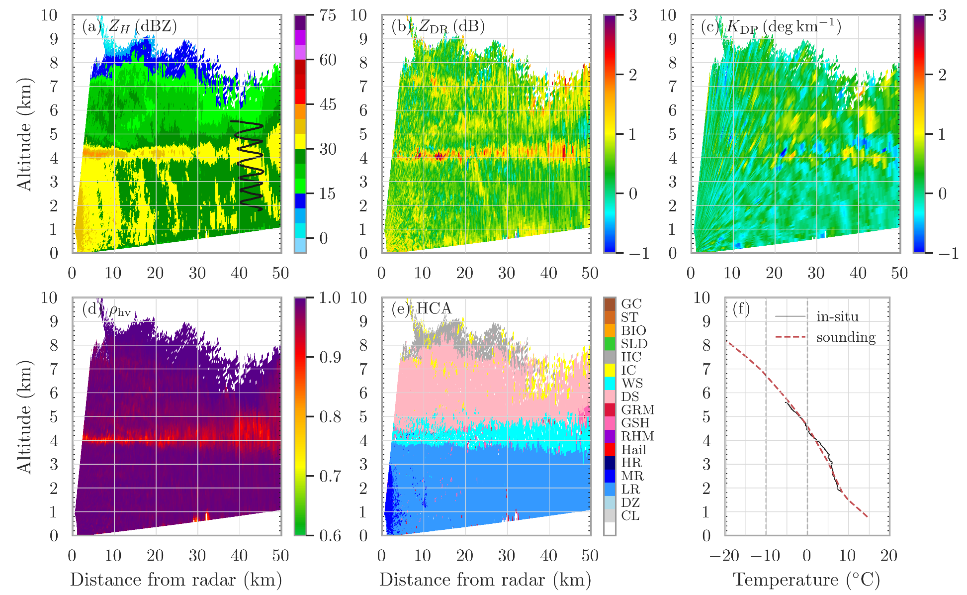
Stratiform structure from radar observations
1313 UTC RHI observations from Shijiazhuang X-POL
ice
snow
melting layer (ML)
rain (liquid)
Notes:
Here is the RHI scan of reflectivity factor, differential reflectivity, KDP, rhohv, and the hydrometeor classification results. The detectable top of the system is about 8 km. And due to the flight capability of King air, the vertical spiral is mainly between 2 and 6 km altitudes, as shown by the black track. From the observations, we can see very classic stratiform structure with a bright band near 4 km, and the reflectivity factor and differential reflectivity are enhanced, rhohv decreased, with the hydrometeors are mainly identified as wet snow. Above the ML is the ice region, with some hydrometeors identified as ice crystals on the top and dry snow slightly lower. Below the melting layer, light rain is identified.

Slide 15
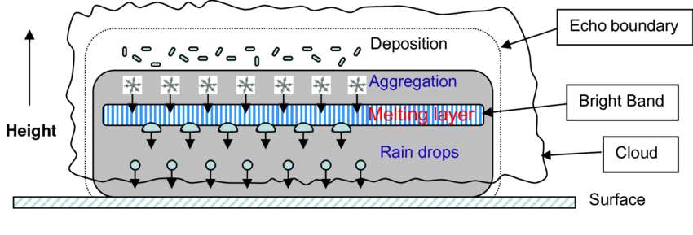
Stratiform structure from radar observations
1313 UTC RHI observations from Shijiazhuang X-POL
ice
snow
melting layer (ML)
rain (liquid)
Notes:
The structure is similar to that of classic radar observations of stratiform clouds. It is generally understood that ice crystals primarily form through deposition, followed by aggregation to form dry snow. In the melting layer (ML), the outer shell of snow particles melts first, increasing their dielectric constant and scattering ability, resulting in the formation of the bright band. As the particles collapse and become smaller, rainfall is formed, and the reflectivity factor decreases.

Slide 16
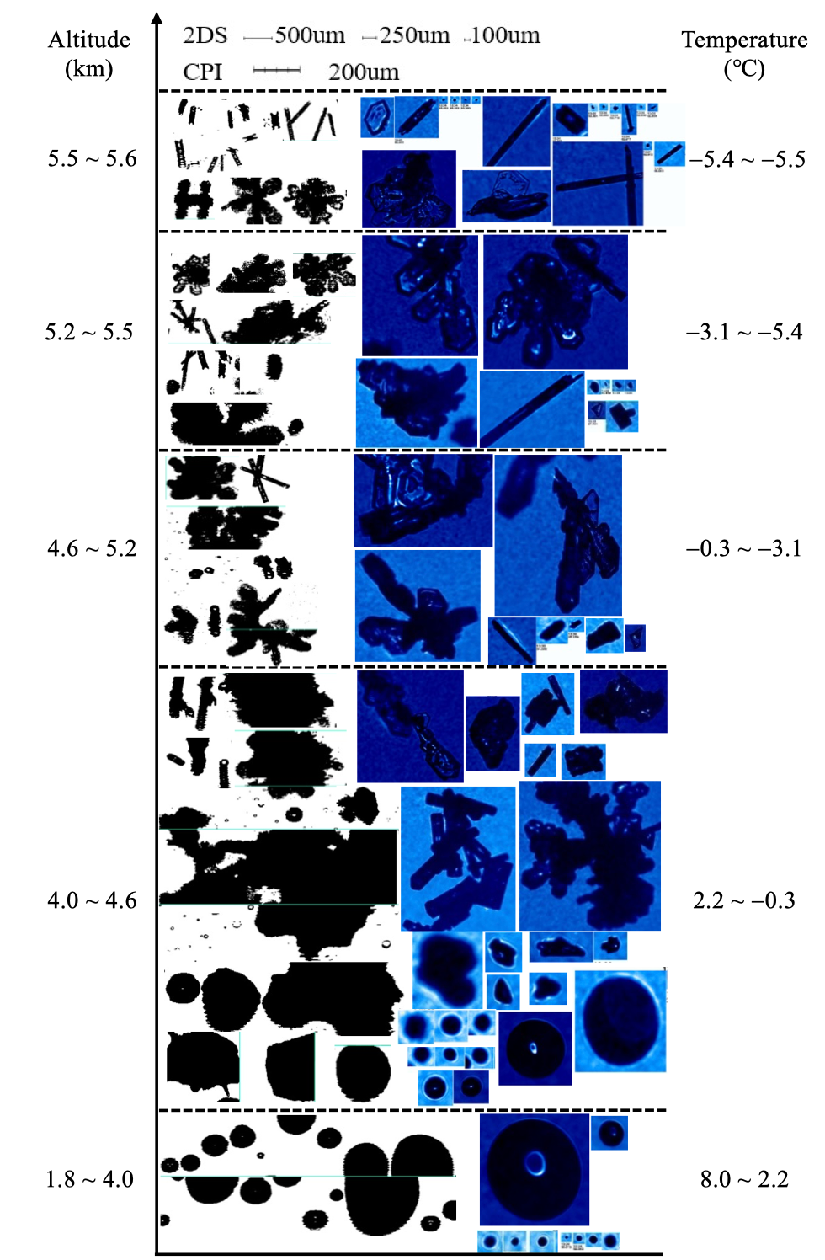
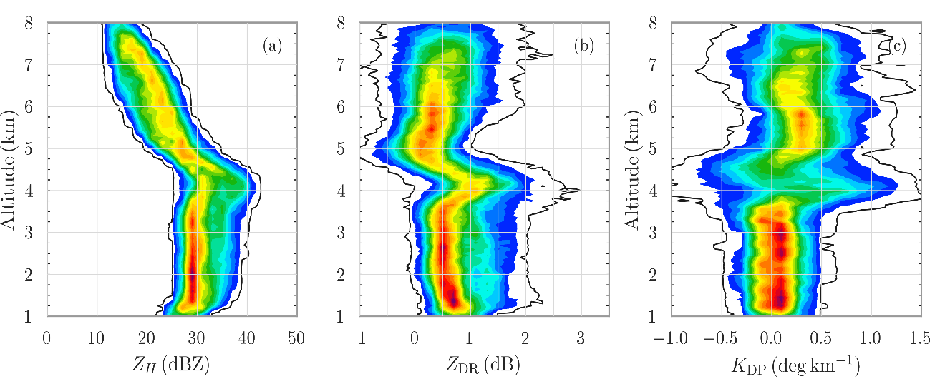
Ice habit and polarimetric signature
Ice layer:
Above −5℃, needle/column crystals, Z_{DR} increases
When altitude decreases, aggregation and riming dominate, Z_{H} increases, Z_{DR} decreases, K_{DP} increases
ML:
Ice particles gradually melt forming a bright band, Z_{H} increases, Z_{DR} increases, and K_{DP} increases
Rain layer:
Radar variables remain essentially unchanged across different altitudes
Notes:
Let’s examine more details with in-situ measurements from CPI, that is the cloud particle imager, as well as the polarimetric variables. First, in the ice layer, we can see some enhanced ZDR above the −5 degree, on the top. This implies the existence of needle/column crystals. Then, when altitude decreases, there are some increases in the reflectivity factor, decreases in ZDR, and some increases in KDP, implying the dominance of the aggregation and riming processes. The ML is between the altitudes of 4 and 4.6 km. In the melting layer, we can see classic increase in the reflectivity factor, ZDR, and KDP. And from the images we can see the gradual melting processes starting from the out shells. And the collapse process, and see ice kernels in the nearly-melted particles with quite different shapes. Below the melting layer is the rain layer, we can see nearly round small raindrops inside, and Radar variables remain essentially unchanged across different altitudes.
The ML is mainly between the altitudes of 4 and 4.6 km. In the melting layer, we can see classic increase in the reflectivity factor, ZDR, and KDP. And from the images we can see the gradual melting processes starting from the out shells. And the collapse process, and see ice kernels in the nearly-melted particles with quite different shapes.
Below the melting layer is the rain layer, we can see nearly round small raindrops inside, and Radar variables remain essentially unchanged across different altitudes.

Slide 17
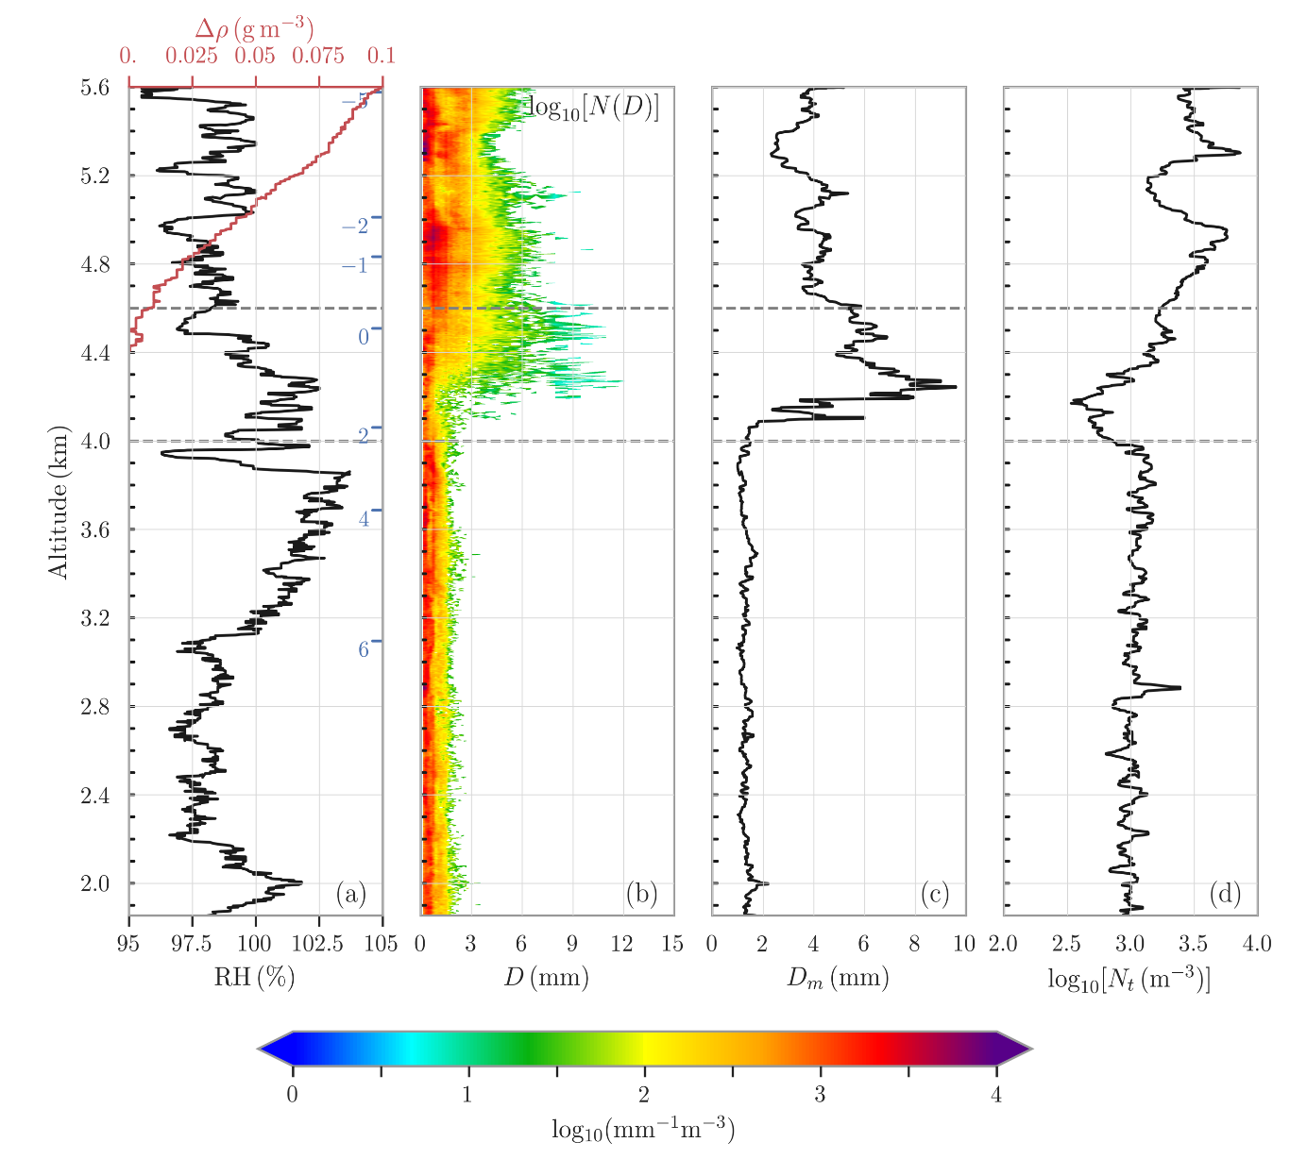
Profiles of microphysical parameters
HVPS (High Volume Precipitation Spectrometer)
RH
PSD
D_{m}
N_{t}
Ice crystals in high altitudes: small size and relatively high concentration
With decreasing altitudes: increase in size and decrease in concentration—aggregation and some riming
Particles in the melting layer: D_{m} increases and then decreases
Increases due to aggregation of sticky melting particles
Decrease, melting or breakup?
—breakup due to increasing N_{t}
Notes:
Let’s take a closer look at the particle size distributions, median diameter, and total number concentration from the High Volume Precipitation Spectrometer observations. At higher altitudes, ice crystals have smaller mean sizes and relatively high concentrations. As altitude decreases, we observe increases in particle size and a decrease in concentration, suggesting that aggregation and some riming processes are taking place. However, in the melting layer, there are two distinct stages. First, the particle size increase, mainly due to active aggregation, These happens, because particles tend to stick together more easily after partial melting. These larger particles also contribute to the bright band signature, in addition to the increase of scattering ability during melting. In the lower part of the melting layer, the median diameter decreases, which can partly be attributed to melting and particle collapse. The melting process itself may increase terminal velocity, leading to a decrease in total number concentration (Nt) due to flux conservation. However, in this region, we see a rapid increase in total number concentration, suggesting active breakup processes.

Slide 18
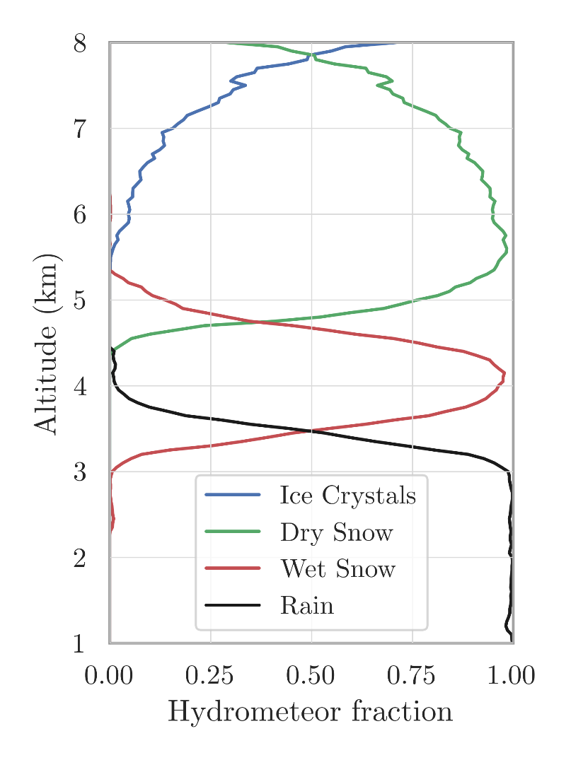
Profiles of microphysical parameters
HVPS (High Volume Precipitation Spectrometer)
RH
PSD
D_{m}
N_{t}
Notes:
The right panel shows the hydrometeor classification types from the radar, which are generally consistent with the results observed using the HVPS.

Slide 19
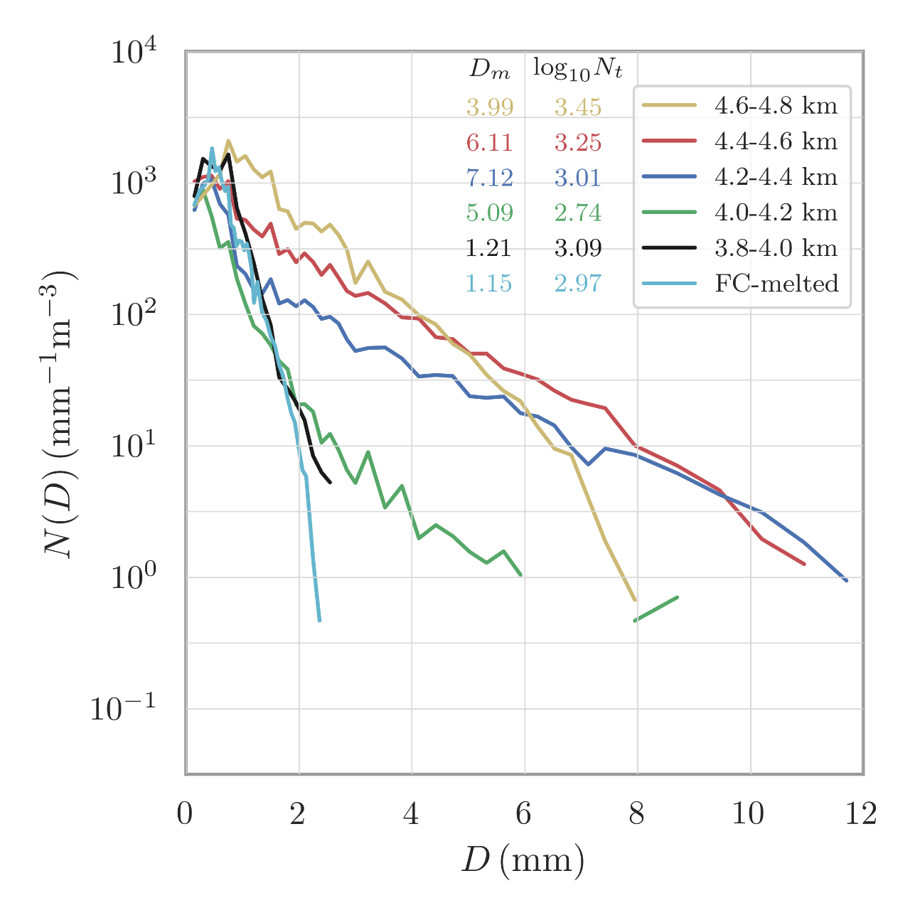
Melting layer microphysics and flux conservation
ML subsections (depth: 1/3 ML)
Above, Top, Median, Bottom, Below, FC
Decrease in medium-size concentration :
melting + aggregation
Flux conservation (commonly used in models) correct in the case?
N(D) underestimated < 1 or > 1.8 mm
finally, $D_{m}^{FC}<D_{m}^{obs}$ and $N_{t}^{FC}<N_{t}^{obs}$
Notes:
This slide provides a detailed look at the particle size distributions in different subsections of the melting layer (ML). The yellow line represents observations above the ML, while the red, blue, and green lines represent results within the ML, and the black line shows observations below the ML. Comparing the yellow line with the red and blue lines, we see a sharp decrease in medium-sized particle concentration, alongside an increase in larger particle concentration, due to the combined effects of the melting and aggregation processes. In the later stage of the ML, as larger particles begin to melt and breakup, there is a rapid increase in the concentration of smaller particles. Next, we examine the flux conservation assumption used in numerical models across the ML. The cyan line is calculated from the yellow line above the ML and compared with the black line observed below the ML. We observe an underestimation of larger particles with diameters greater than 1.8 mm, primarily because the flux conservation assumption fails to account for aggregation in the upper part of the ML. Additionally, there is an underestimation of small particles with diameters less than 1 mm, likely due to the model’s failure to capture the active breakup processes in the final stages of melting.

Slide 20
Outline
1. Introduction
2. Optimized microphysical retrieval
3. Microphysics of Stratiform Precipitation
4. Conclusion and discussion
Notes:
Here is the summary.

Slide 21
Conclusion and discussion
A variational method for the retrieval of DSD parameters has been developed , simultaneously achieving optimized estimation of attenuation (short-wavelength radar) and DSD parameters
Joint analysis of dual-polarization radar and aircraft observations reveals:
Ice crystal aggregation and riming above the melting layer, forming snowflakes
Contribution of coalescence and breakup of particles to radar bright bands
Particle concentration and diameter underestimated with flux conservation assumption
Outlook: The flight levels are relatively low, and understanding of the ice crystal formation process remains incomplete. More observations are needed!
Notes:
First, we developed a variational method for retrieving DSD parameters, which provides optimized estimation of both attenuation (for short-wavelength radar) and DSD parameters simultaneously. Next, using polarimetric radar and aircraft observations, we analyzed the microphysical structures and processes in a stratiform case over northern China. One key finding in the melting layer is that both coalescence and breakup processes occur, contributing to the bright-band signature. However, the flux conservation assumption commonly used in models may underestimate particle concentration and diameter in this case. We have also realized that the flight levels in this case were too low, limiting our understanding of ice crystal formation in higher altitudes. More comprehensive observations are needed to address this gap.

Slide 22
Thank you very much!
Email: huanghao@nju.edu.cn
https://radar.nju.edu.cn
Huang, H., Zhao, K., Zhang, G., Hu, D., & Yang, Z. (2020). Optimized raindrop size distribution retrieval and quantitative rainfall estimation from polarimetric radar. Journal of Hydrology, 580, 124248.
Huang, H., Zhao, K., Chen, H., Hu, D., Fu, P., Lin, Q., & Yang, Z. (2020). Improved Attenuation-based Radar Precipitation Estimation Considering the Azimuthal Variabilities of Microphysical Properties. Journal of Hydrometeorology, 21(7), 1605-1620.
Hu, X., Huang, H., Xiao, H., Cui, Y., Lv, F., Zhao, L., & Ji, X. (2022). Microphysical Characteristics of Precipitating Stratiform Clouds in North China Revealed by Joint Observations of an Aircraft and a Polarimetric Radar. Journal of the Atmospheric Sciences, 79(11), 2799-2811.
Hu, X., Huang, H., Hou, S., Zhao, K., Zhao C., et al., 2024: Airborne Investigation of Riming Process: Cloud and Precipitation Microphysics Within a Weak Convective System in North China. Advances in Atmospheric Sciences.
Notes:
I’ll stop here. Thank you for listening.

