Slide 1
Linking Ice-Phase Microphysics to Raindrop Characteristics, and Extreme Rainfall in Two Deep Convection Events in China
PrePEP - Conference: Precipitation Processes - Estimation and Prediction
Kun Zhao Gang Chen Yinghui Lu Zhe-Min Tan
Hao Huang Xin Xu
School of Atmospheric Sciences, Nanjing University
^{Mar.21, 2025 Bonn}

Slide 2
Outline
Background
Data and Method
Microphysical Characteristics
Conclusion and Discussion

Slide 3
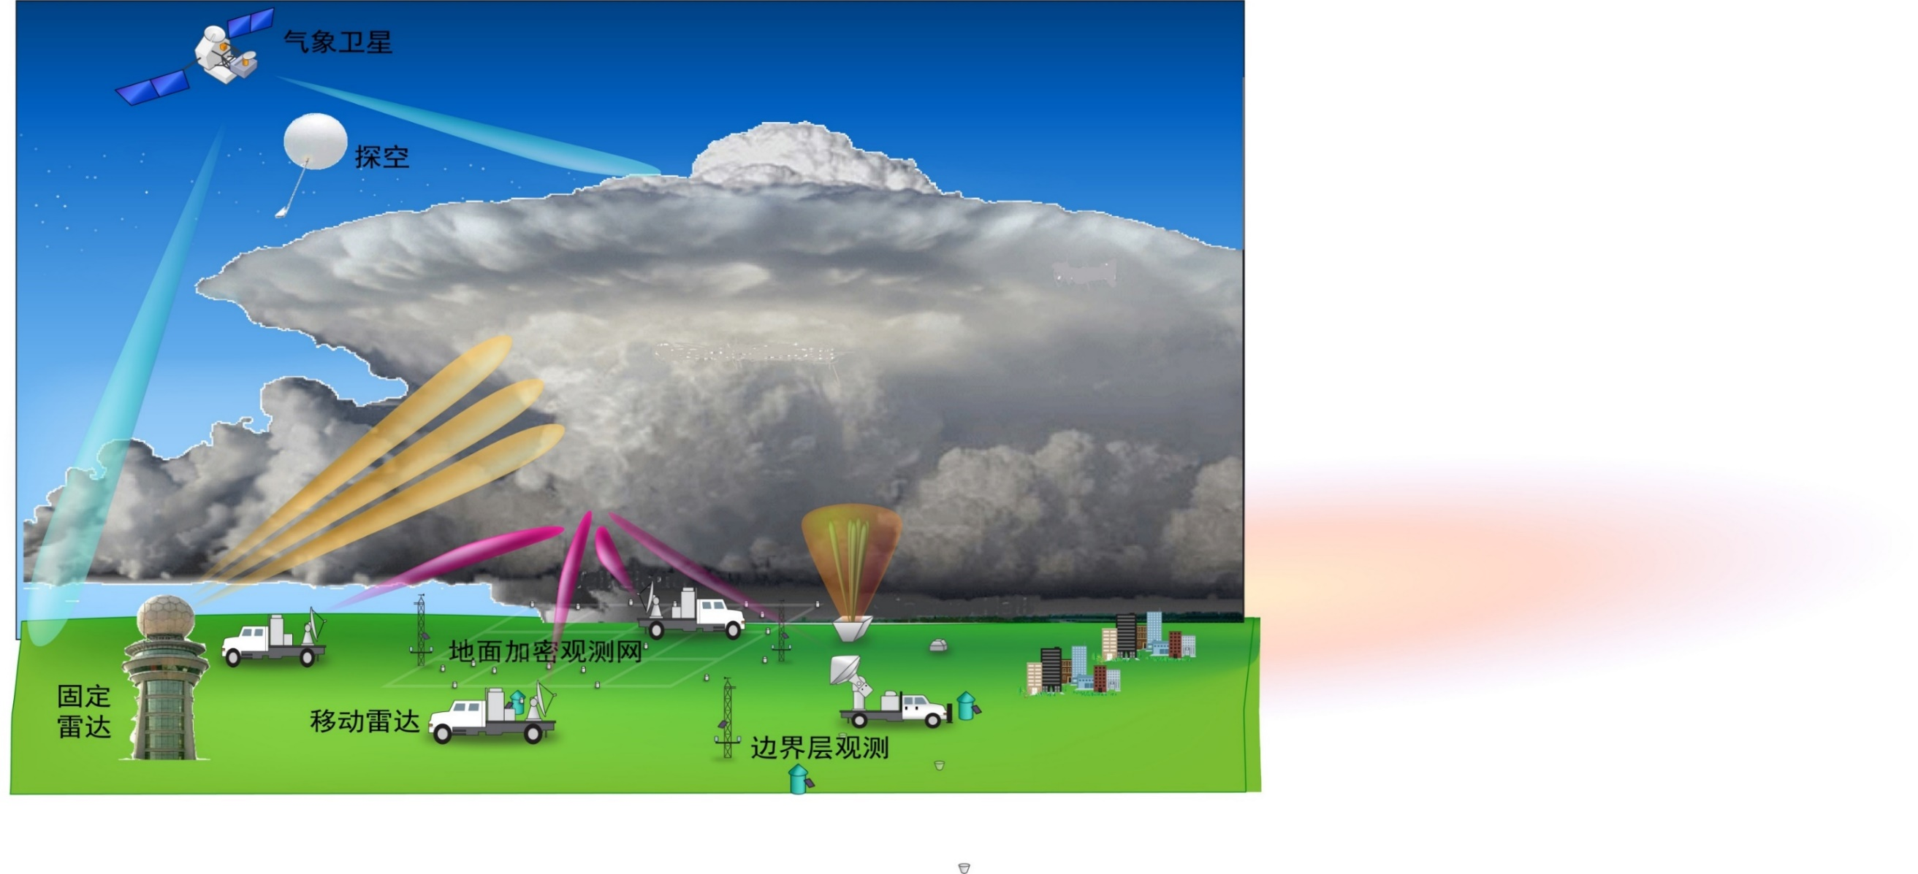
Background
Distribution of extremely hour rainfall (0.1%)
Radar: three-dimensional structure
Satellite
Sounding
Weather Station
Radar
Radar
Notes:
Eastern China are deeply influenced by the East Asian Summer monsoon. After the summer monsoon sets in, the warm and moist air are transported from the ocean, and met with the dry and cold air from the north, and occasionally, typhoons making landfall from the Northwest Pacific can contribute to frequent extreme rainfall events.
In terms of statistics, the extremely hour rainfall in this region basically exceeds 50mm/h

Slide 4
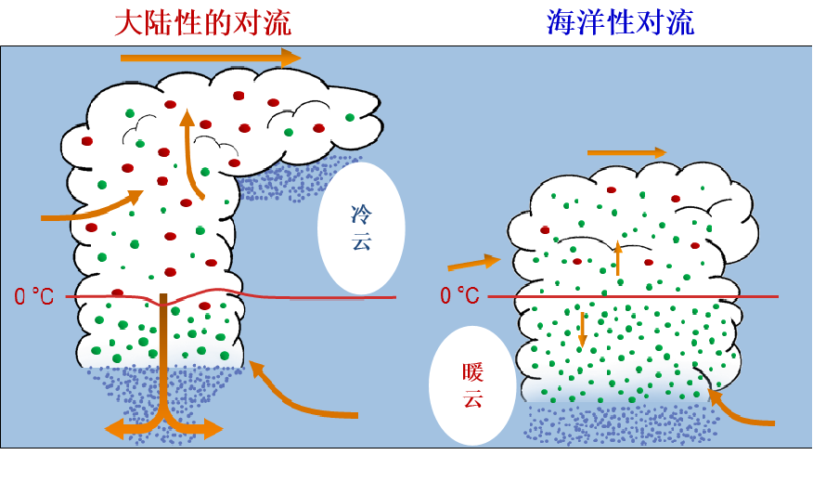
Convection Depth and Extreme Rainfall
Extreme rainfall convection
Deep and extreme rainfall convection
Continental convection (deep)
Maritime convection
Extreme rainfall
Extremely deep
Ice
Warm
Rain
Large mean size in continental convection
High number concentration in maritime convection
Extreme rainfall contributed by extreme deep convection on land is less than 30%
Bringi et al.,2003, JAS; Ryu et al., 2021, GRL
Hamada et al., 2015, NC; Xu et al.,2022, GRL
Notes:
However, previous studies have also found that the depth and intensity of convection seem to have a weak linkage with rainfall extremes. Extreme rainfall convection can be deep convection with active ice phase processes or relatively shallow convection with active warm rain processes.
Global statistics show that the overlap between extremely deep convection and extreme rainfall convection is less than 30%.

Slide 5
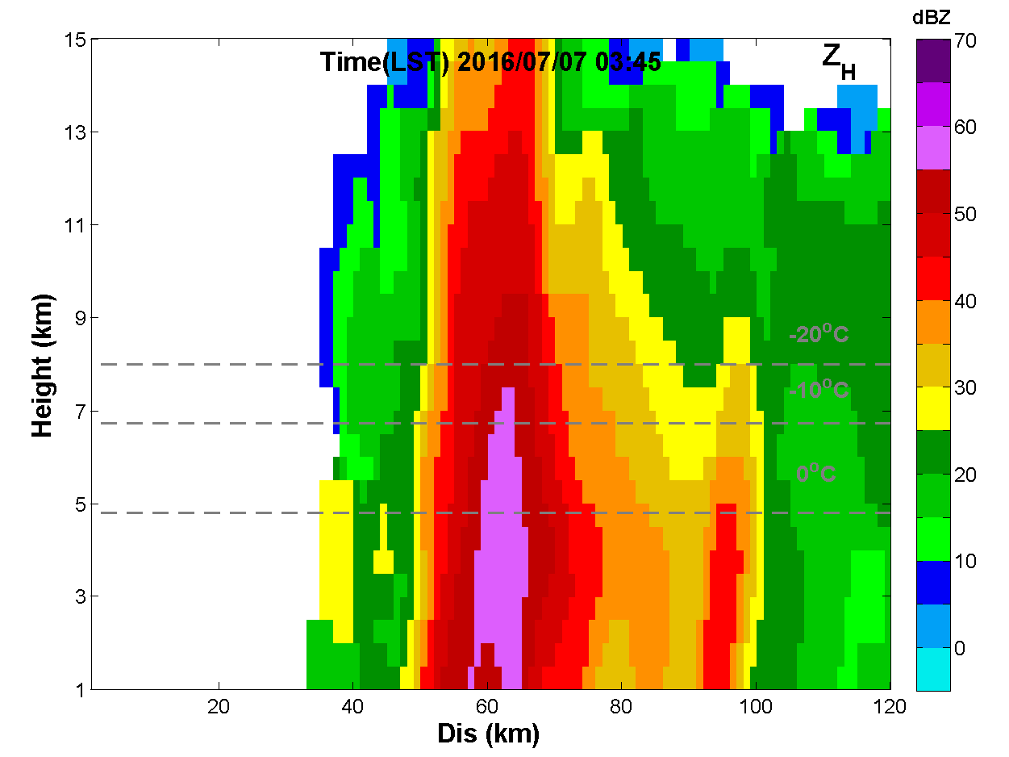
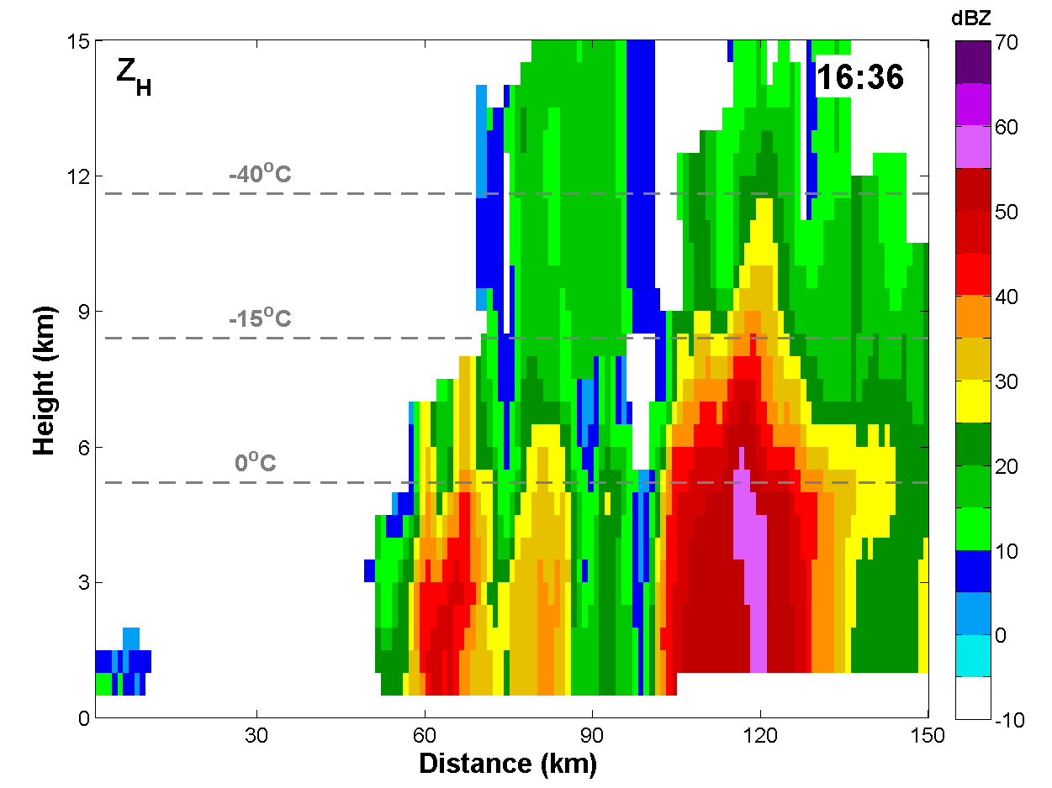
Two Extremely Deep Convection Events
Extreme rainfall in Henan, July 19-21, 2021
2016南京7·7特大暴雨
2021年21·7河南特大暴雨
Extreme rainfall in Nanjing, July 7, 2016
What are the specific role of ice-phase and warm-rain processes in deep convection causing extremely hour rainfall?
753.9mm
258mm
Record-breaking rainfall 201.9 mm/h
Extremely rainfall 129.2mm/h
Zhao et al., 2023, RS Chen et al. 2022, ESS
Notes:
The '217' Henan extremely heavy rainfall event occurred on 20 July 2021 in North China, producing a record-breaking hourly rainfall of 201.9 mm. The '7.7' Nanjing heavy rainfall event occurred on 7 July 2016 in East China, producing an extremely hour rainfall of 129.2 mm. The 20-dBZ echoes in both events exceeded 12 km, indicating obvious deep convection.
So, what are the specific roles of ice-phase and warm-rain processes in the deep convection causing such extremely hour rainfall?

Slide 6
Data and method
Precipitation Microphysics
Polarimetric Radar Fingerprints of Precipitation Microphysics
Warm
Rain
Ice
Polarimetric Radar
Disdrometer
Changes in the variables indicate specific microphysical process
Morrison et al., 2020, JAMES
Kumjian et al., 2012,ERAD; 2022,RS
Notes:
Microphysical processes generally include ice phase processes and warm rain processes. Ice phase processes include deposition, aggregation, riming and melting of ice particles. Warm rain processes include condensation, coalescence，breakup, evaporation.
Polarimetric radar can infer specific microphysical processes through vertical gradients in radar observations. For example, within the warm cloud layer, if ZH​, ZDR and KDP increase while ρhv decreases, it can be inferred that coalescence is dominant.
these so-called “fingerprints” of precipitation processes are observed
as vertical gradients in radar observables

Slide 7
Data and method
Polarimetric radar variables from ZZRD、LYRD and NJ CPOL (Z_{H} –Intensity of convection, Z_{DR} –Mean raindrop size, K_{DP} –Liquid water content)
50 OTT PARSIVEL disdrometers in Henan and a 2DVD in JN station (DSD, D_{m}, N_{w} , R).
Retrieval of DSD parameters and rain rate using polarimetric radar (Huang et al.,2020; Chen et al.,2017)
Retrieval of liquid and ice water content (Carey and Rutledge., 2000; Ryzhkov et al., 2018)
Hydrometeor identification algorithm (HID, Dolan et al., 2013) to identify the dominant hydrometeor type in each radar sample volume
K-means clustering algorithm (Anderberg 2014) to objectively classify the OTT-observed DSD datasets into separate groups
The four-dimensional Variational Doppler Radar Analysis System (VDRAS, Chen et al., 2016) to provide three-dimensional wind and thermodynamic fields.
Drizzle | Raindrop | Wet snow | aggregates | Ice crystals | Vertical aligned ice | Low-density graupel | High-density graupel | Hail | Big drops
Melting
Aggregation
Deposition
Riming
Notes:
Datasets from two S-Pol polarimetric radars and 1 CPOL radar, 50 OTT disdrometers and 2DVD were used in our study.
Surface DSDs are observed from the OTT and 2DVD disdrometers. Retrieved DSDs and rain rate aloft come from polarimetric radars.
The dominant hydrometeor type in each radar sample volume was identified from the wide used Hydrometeor identification algorithm, ten hydrometeor species characterized different microphysical processes are obtained.
The K-means clustering algorithm was also applied to objectively classify the OTT-observed DSD datasets into separate groups.
To obtain high-resolution three-dimensional wind and thermodynamic fields, the VDRAS was used.

Slide 8
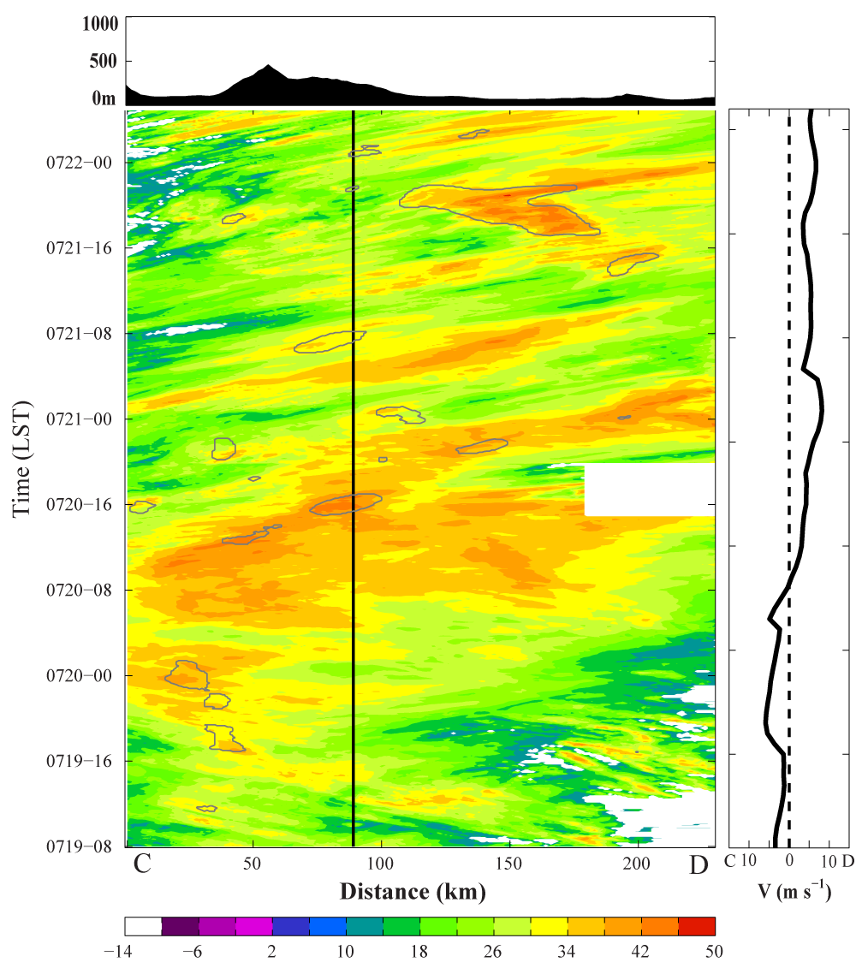
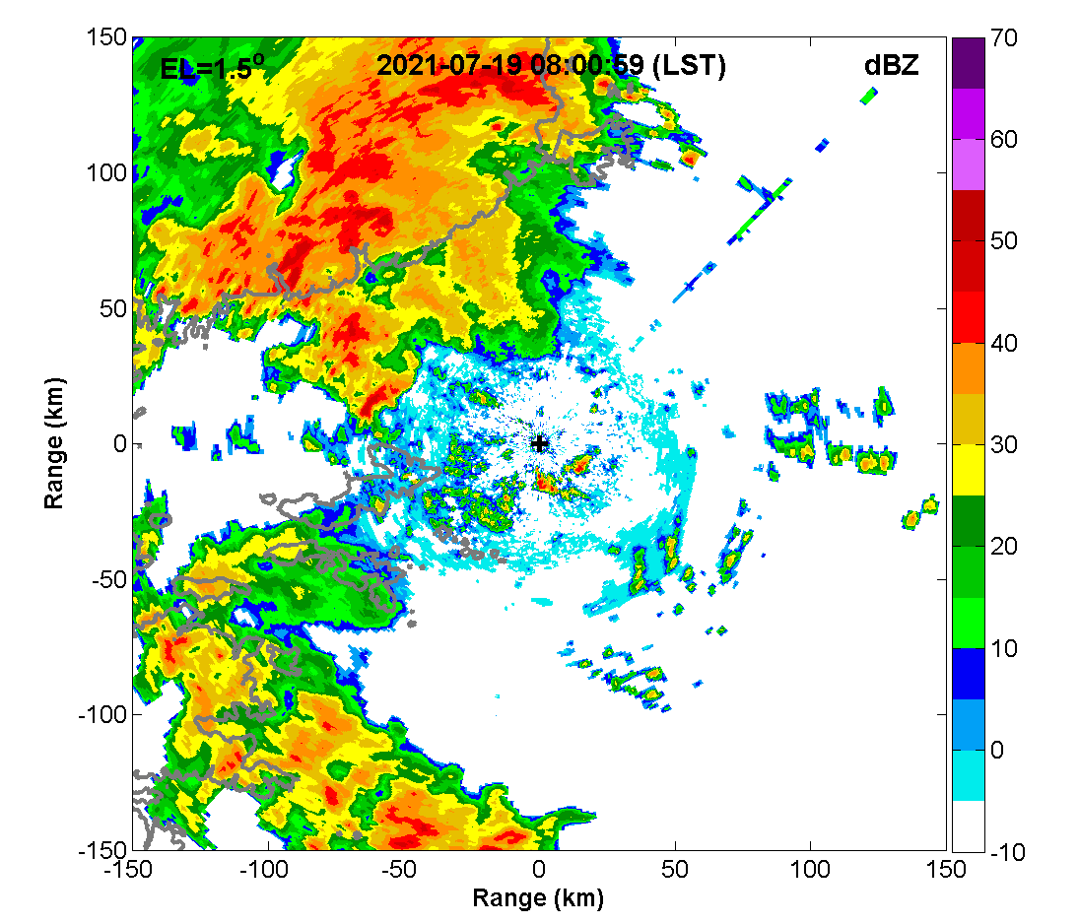
Case 1: Extremely Heavy Rainfall Event in Henan
Evolution of the convective systems
Mountain Plain
Stage III
Stage II
Stage I
Notes:
Radar observations revealed several rainfall episodes over the 3-day period. Wide areas of reflectivity exceeding 34 dBZ existed along direction from 04:00 to 20:00 LST July 20, corresponding to the precipitation systems causing extreme rainfall over Henan Province. Precipitation systems persistently develop and move from the plain regions (B) to the orographic side (A) from early morning to 2:00pm. and appeared to be quasistationary between 14:00 and 20:00 around the ZZ station (the black line). Deep convection was also observed and maintained over Zhengzhou, bringing the record-breaking rainfall up to 201.9 mm h−1

Slide 9
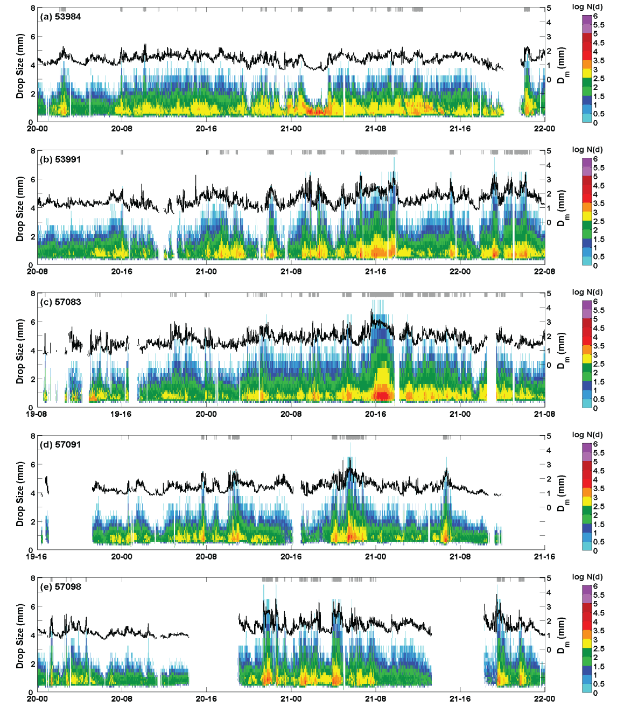
Extremely Heavy Rainfall Event in Henan
Time series of D-N_{D} from typical stations
No large raindrops，small Dm
没有大雨滴，平均粒径小
53991
53984
57083
57091
ZZ Station
201.9 mm/h
郑州站
57098
Large raindrops
有大雨滴，平均粒径大
The spatial and temporal variability of DSD characteristics
Notes:
We selected 5 typical OTT sites and time series of the raindrop N(D) are shown in the Figure.
Obvious variability of DSDs are shown for these sites, persistent rainfall was observed at the mountain site 53984, but almost no raindrop with a size larger than 4 mm. Dm is less than 2 mm. As for the other four OTTs, obvious precipitation episodes are observed during the passage of convective systems. A certain number of large raindrops were recorded and high number concentration of small raindrops were observed for each episodes.
Extremely high number concentrations of small rain-drops were recorded, and the maximum raindrop sizes exceeded 6 mm

Slide 10
DSD Characteristics
Based on the DSD characteristics, all heavy rainfall samples (11418) are clustered into five groups using the K-means algorithm
Group1
High concentration for all raindrop bins
Group1
Large mean size
High concentration
Group3
Small mean size
High concentration
Group3
Few large raindrops
Group2
Large mean size
Low concentration
Group1: large mean size high number concentration, maritime and continental convection
Group2: large mean size low number concentration, typical continental convection
Group3: small mean size high number concentration, typical maritime convection
Notes:
Based on the DSD characteristics, we have clustered all heavy rainfall samples into five groups using the K-means algorithm.
Group1 is characterized with large mean size high number concentration, maritime and continental convection
Group2 is characterized with large mean size low number concentration, typical continental convection
Group3 is characterized with small mean size high number concentration, typical maritime convection

Slide 11
DSD Characteristics
Boxplots of rain rate
Contribution to total rainfall from selected diameter intervals
Group3
The largest contribution of rainfall for small raindrops
Group1
Extreme rainfall
Large raindrops contribute over 10% rainfall
Group1: mean rain rate exceeds 100 mmh⁻¹, over 60% rainfall is contributed by raindrops with diameter >2 mm
Group3: rain rates basically lower than 50 mmh⁻¹, over 60% rainfall is contributed by raindrops with diameter <2 mm
Notes:
Distinct mean rain rates and relative rainfall number contributions from different raindrop diameter intervals were also observed.
Mean rain rate basically exceeds 100 mmh-1 in Group1, over 60% rainfall is contributed by raindrops with diameter >2 mm
Rain rates lower than 50 mmh-1 in Group3, over 60% rainfall is contributed by raindrops with diameter <2 mm

Slide 12
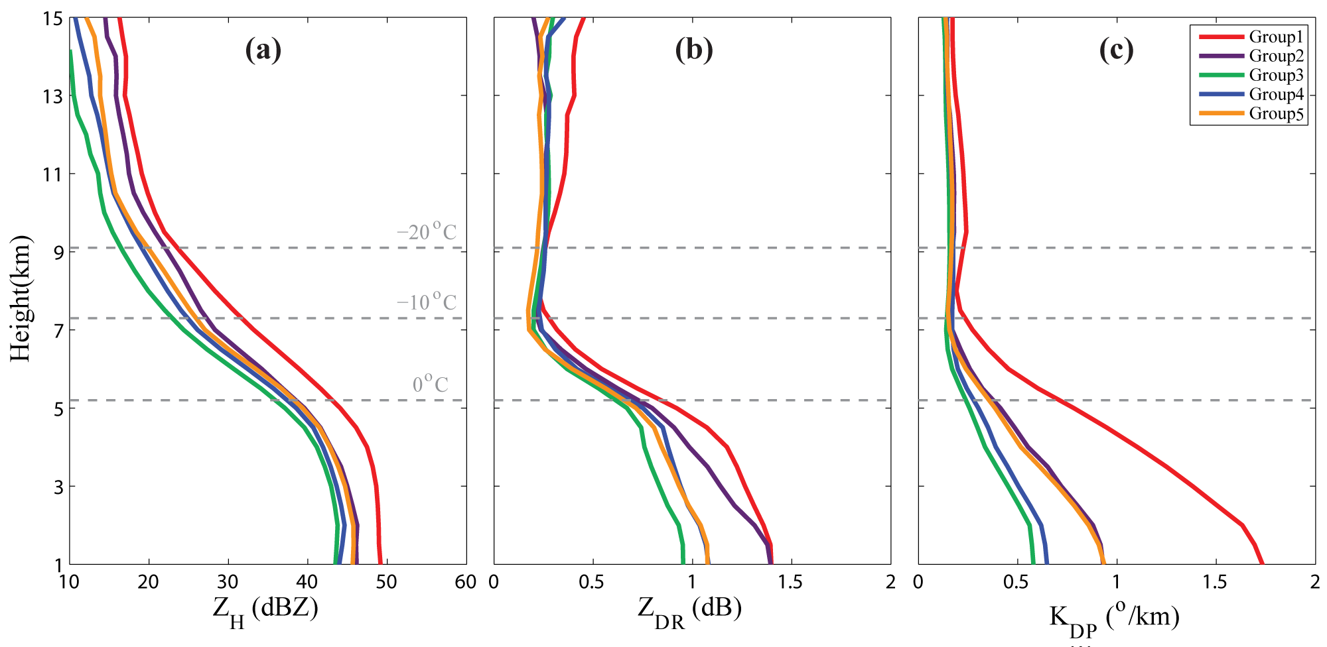
Microphysical Structure
The average profiles of polarimetric radar variables
Z_{H}: convection intensity
Z_{DR}: mean raindrop size
KDP: liquid water content
Growth of ice particles
Group1
Deep convection
Graupel (Riming）
Supercooled raindrops
Group3
Shallow convection
Group 1 and 2
Large raindrops
Rapid increase of LWC
Group1
High LWC
Group3
Small raindrops
Group1: the deepest convection, both active ice-phase and warm-rain coalescence processes
Group3: shallow convection, active warm-rain coalescence processes
Notes:
We have further compared the average $Z_{H}$, $Z_{DR}$, and $K_{DP}$ profiles of the five DSD groups, to analyze microphysical structures of the convection.
Significantly distinct signatures are identified in group1 (red) compared with the
other four groups from the profiles. The largest mean ZH values are found throughout all latitudes in group1, and the mean height of 30-dBZ echo reaches 8 km and is higher than the −10°C level, suggesting deep convection with intense
updrafts (DeMott and Rutledge, 1998).
Value of KDP grows rapidly from the freezing level to surface, indicating both active ice-phase and warm-rain coalescence processes.
Shallow convection is observed in Group3, the liquid water is basically produced by the active warm-rain coalescence processes

Slide 13
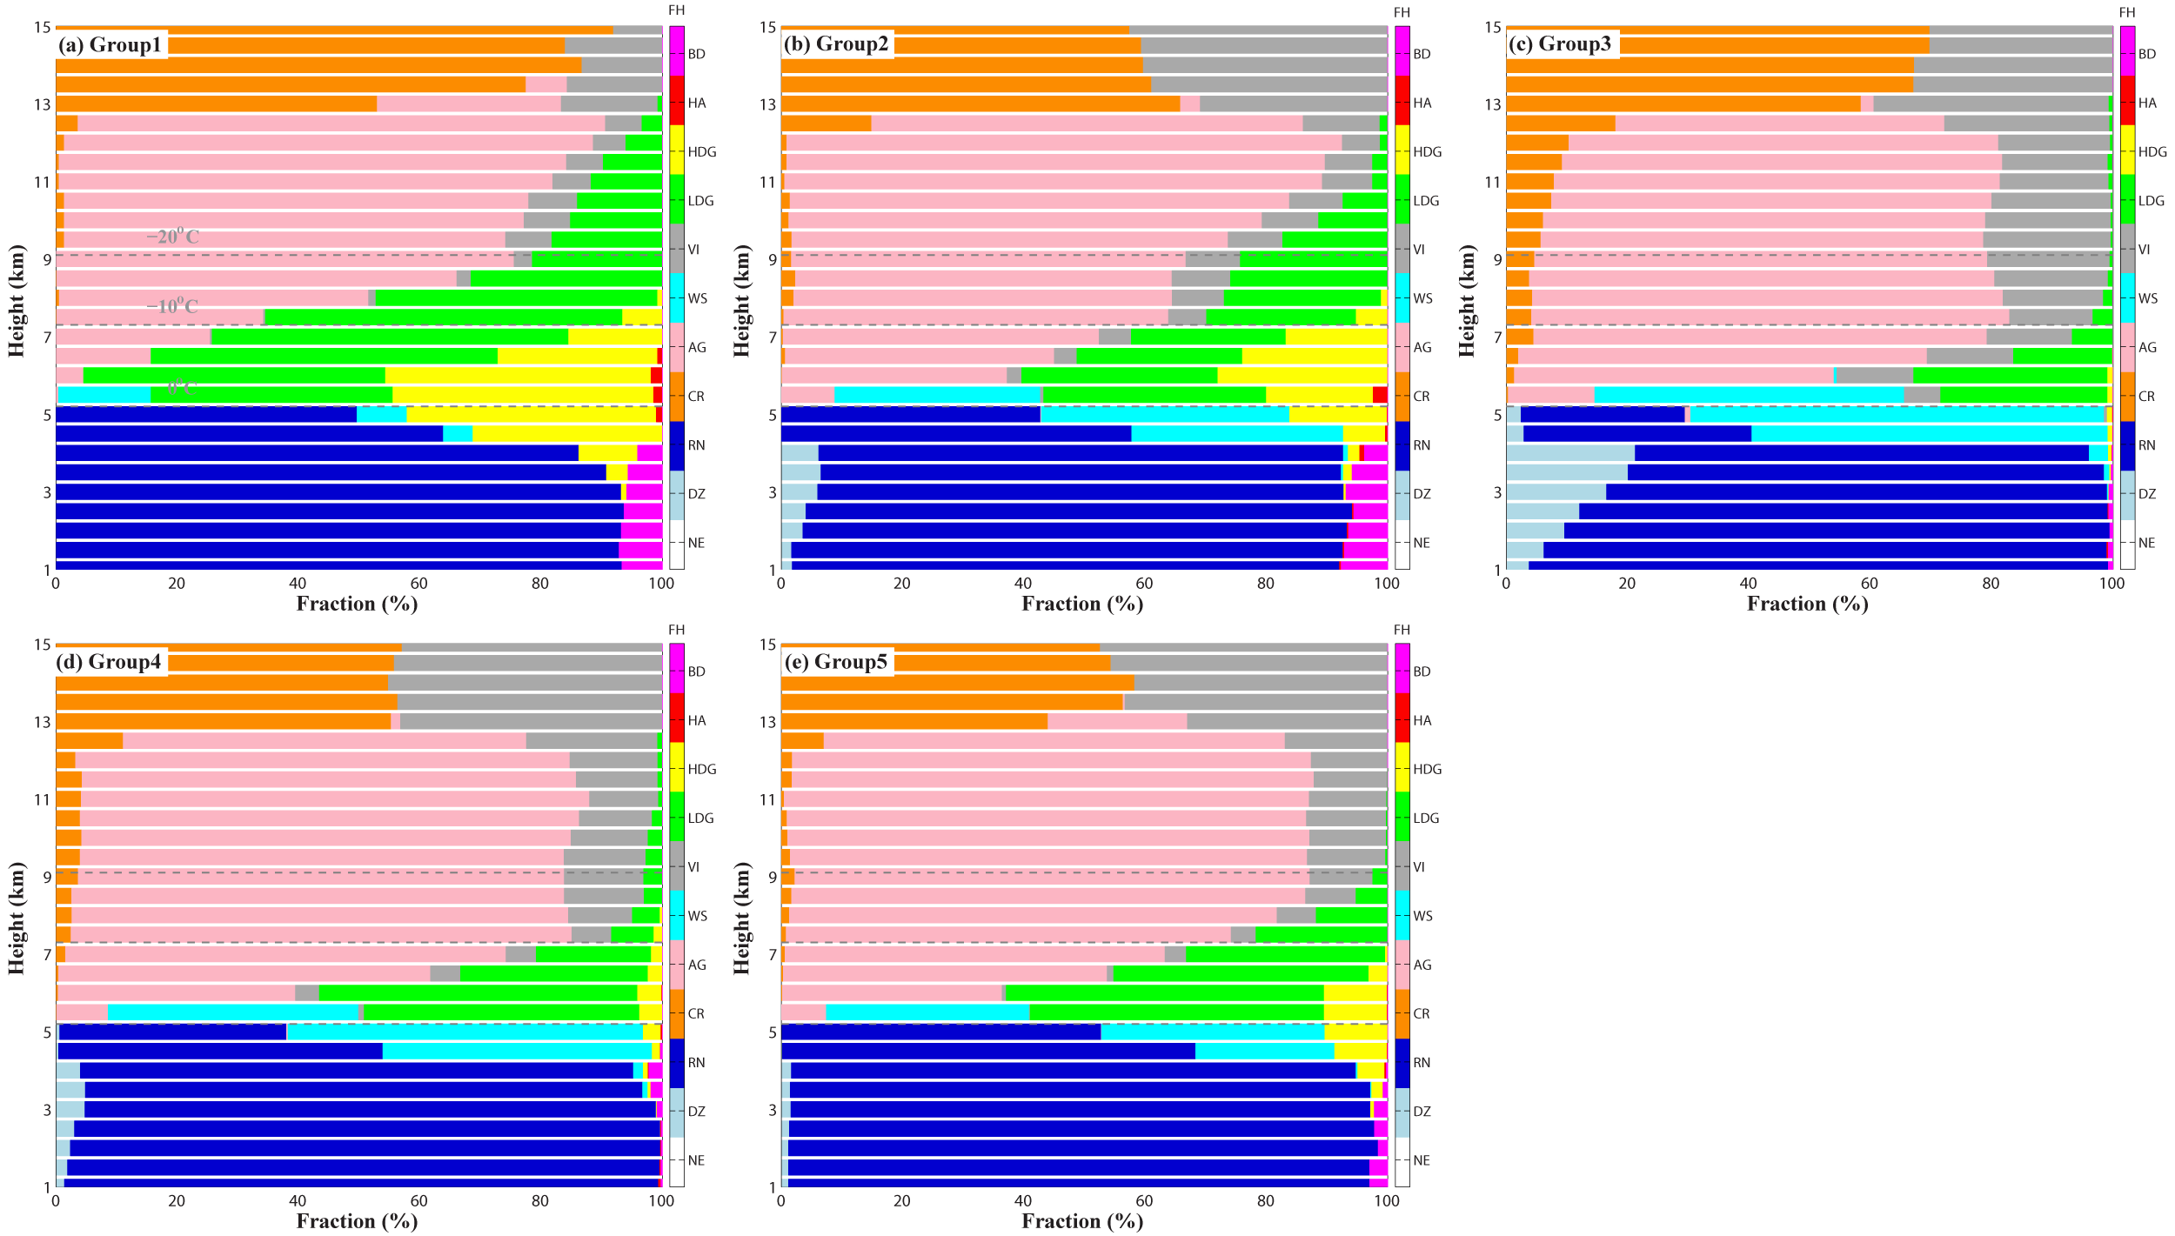
Microphysical Structure
Occurrence fractions of identified hydrometeors in vertical layers
Group1
High graupel fractions
Active riming process
Group3
Few low-density graupels
Group 1 and 2
Large raindrops
Spatial Distribution
Group1: the highest graupel fraction, active ice-phase processes
Group3: the lowest graupel fraction, suppressed ice-phase processes
Notes:
Occurrence fractions of identified hydrometeors in vertical layers are also compared.
Obviously, group1 possesses the highest graupel fraction, indicating active ice-phase processes. Certain large raindrops are identified in the low levels.
Group3 possesses the lowest graupel fraction, suggesting suppressed ice-phase processes.

Slide 14
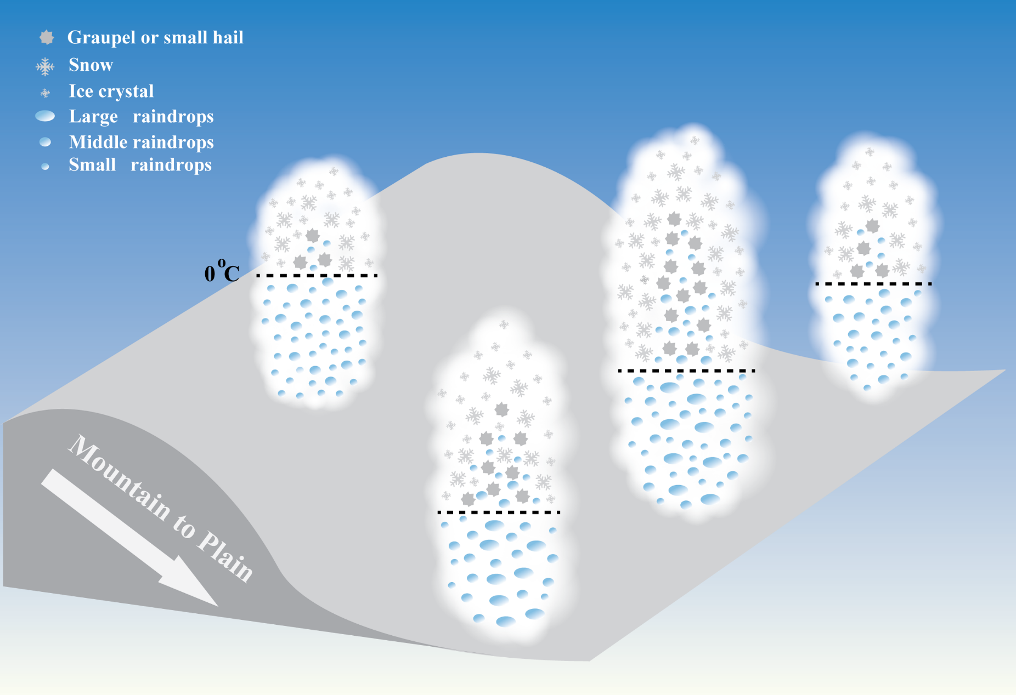
Conceptual Model
Significant microphysical variability is revealed, shallow (deep) convection with active warm-rain (ice-phase) processes is generated near mountain (plain) area.
Extreme rainfall is produced by convection possessing both active ice-phase and efficient warm-rain coalescence processes, raindrops are characterized by high number concentration and large mean sizes.
Chen and Zhao et al.,2022, SCES
Notes:
In summary, significant microphysical variability is revealed in the “21.7” Henan EHR event, shallow (deep) convection with active warm-rain (ice-phase) processes is generated near mountain (plain) area. Extreme rainfall is produced by convection possessing both active ice-phase and efficient warm-rain coalescence processes, raindrops are characterized by high number concentration and large mean sizes.
This work has been published in SCES.

Slide 15
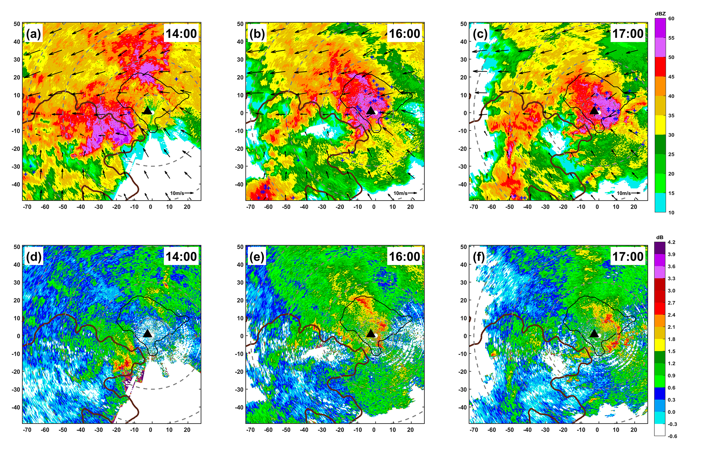
Typical group1 convection
Convection causing the record breaking hourly rainfall (201.9mm/h) in the plain (Zhengzhou city)
Z_{H}: intense radar echo
frequent lightning records
：Zhengzhou Station +:Lightning records Brown contours: terrain height
Notes:
To further compare the convection in different area, we have also investigated the typical convective systems.
The convective cell causing the record-breaking hourly rainfall is chosen for the plain.
Intense radar echo and frequent lightning records are observed in the cell. Large ZDR values are also found, indicating raindrop mean sizes.

Slide 16
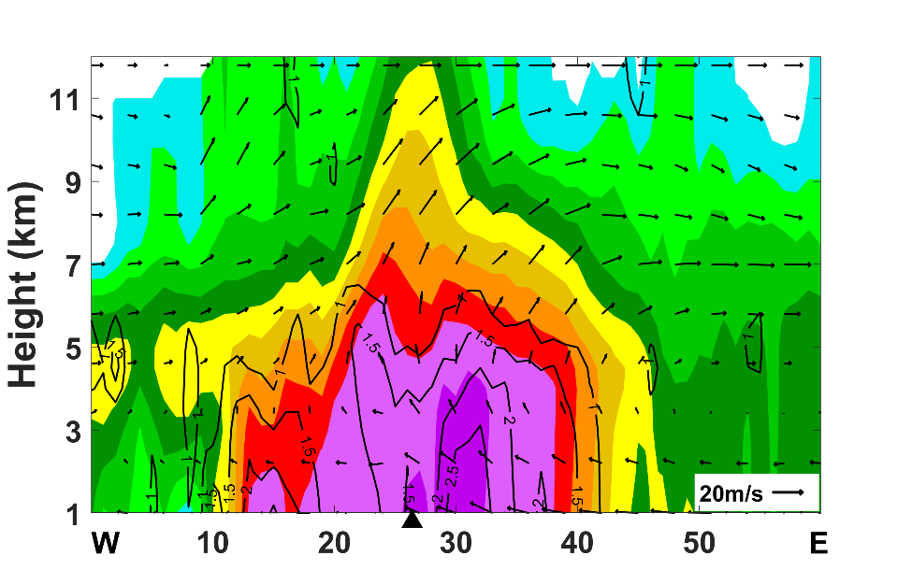
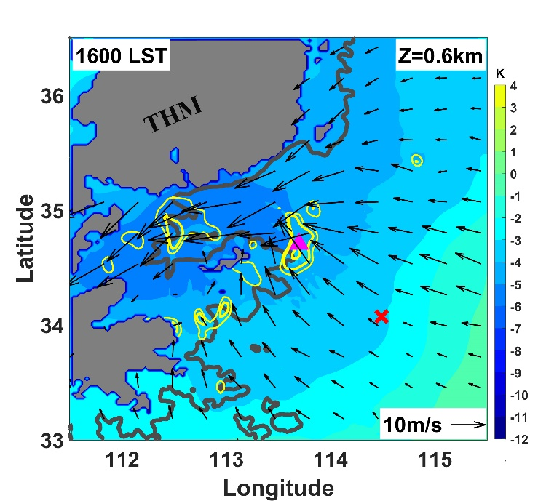
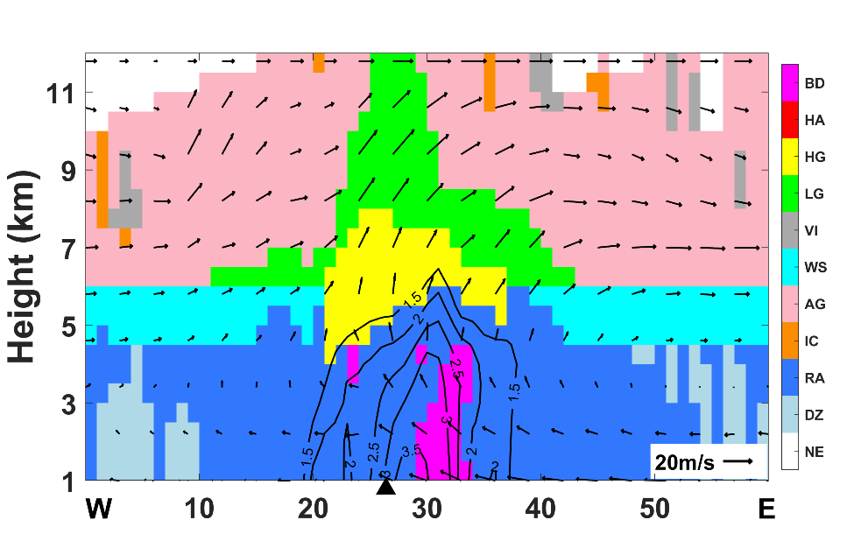
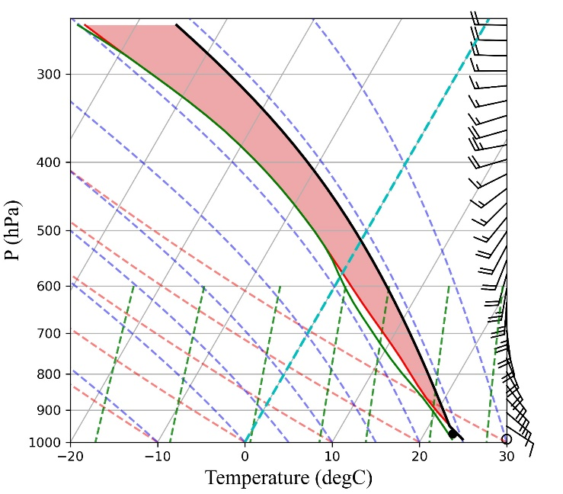
Typical group1 convection
Cross section of the convection
Synoptic conditions
Barrier Jet
Deep convection
Southeast wind
Southerly flow
Widespread
Graupels
CAPE=2670 Jkg⁻¹
Notes:
Deep convection is also identified from the cross section, widespred graupels distribute in the strong updraft area.
obvious convergence of the horizontal winds is found, and high CAPE exists.

Slide 17
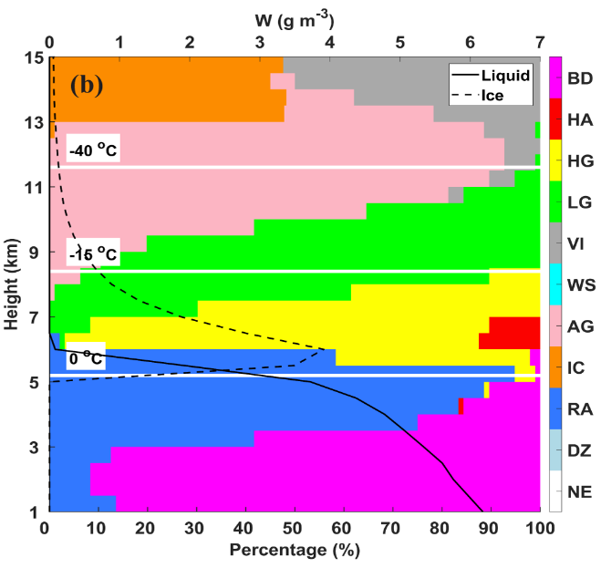
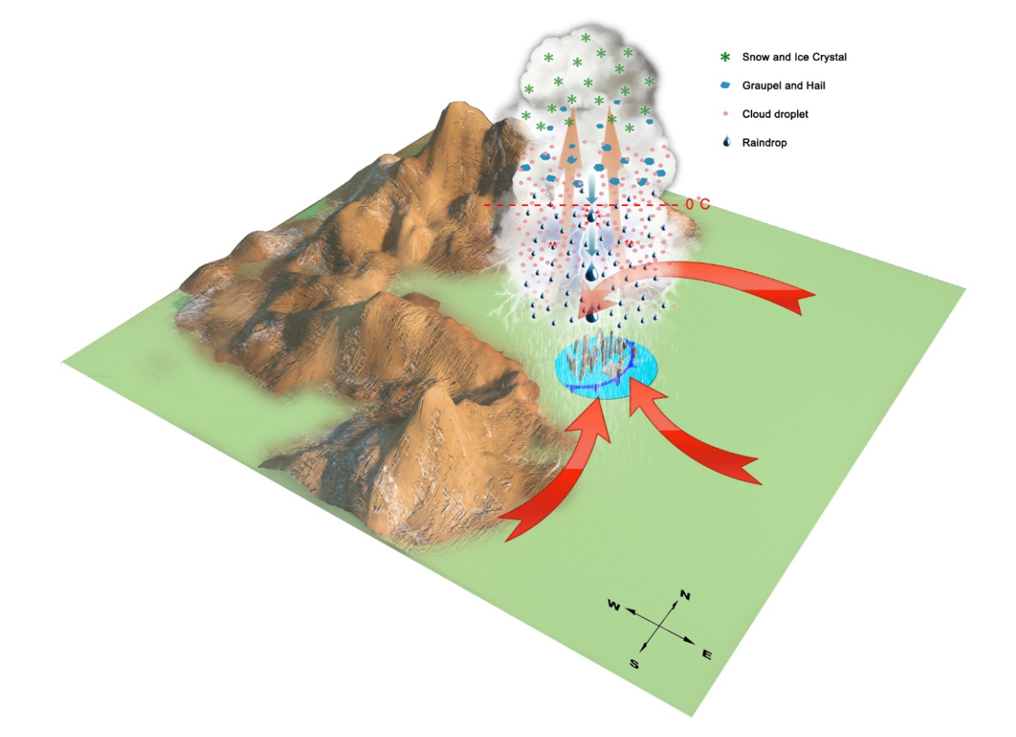
Conceptual model of the record-breaking hour rainfall
对流垂直结构
中尺度环境场
The combined active ice-phase and warm-rain processes
in deep convection cause the extremely hour rainfall
Zhao et al., 2023, RS
Notes:
Deep convection is also identified from the cross section, widespred graupels distribute in the strong updraft area.
obvious convergence of the horizontal winds is found, and high CAPE exists.

Slide 18
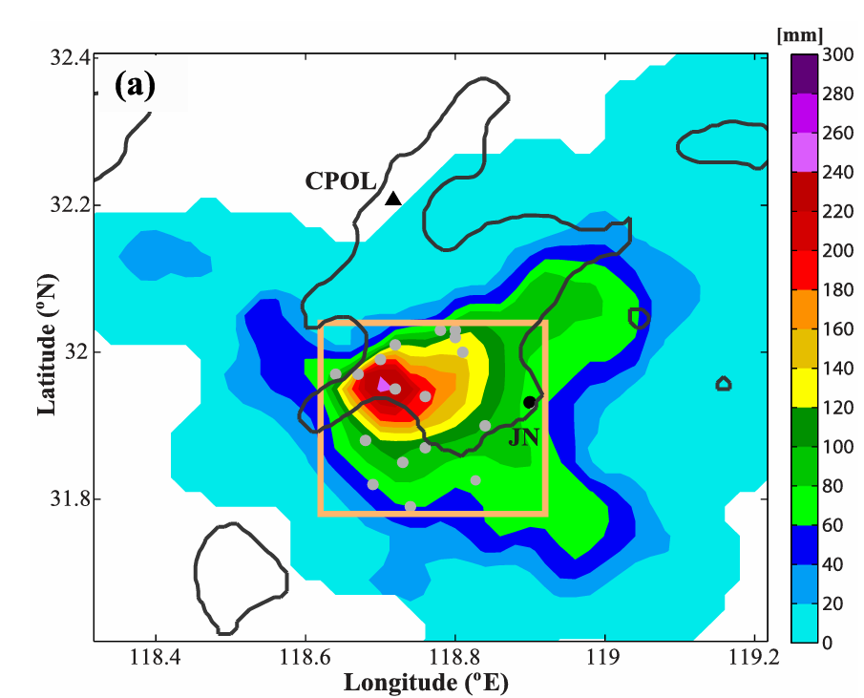
Case 2: Extreme Rainfall Event in Nanjing
The maximum 6-h rainfall (00-06): 258 mm
The maximum hour rainfall (02-03): 129.2 mm
Vertical structure of mature convection
Notes:
The Nanjing extremely heavy rainfall event resulted in a maximum 6-hour rainfall of over 258 mm, with the highest hourly rainfall reaching 129.2 mm, causing severe urban flooding in Nanjing. The convective cells initiated and organized in the midnight of July 7, reaching in mature stage between 2-3 AM, and generating a large number of lightning strikes. After 3 AM, the convection moved southeastward, leaving the urban area of Nanjing.

Slide 19
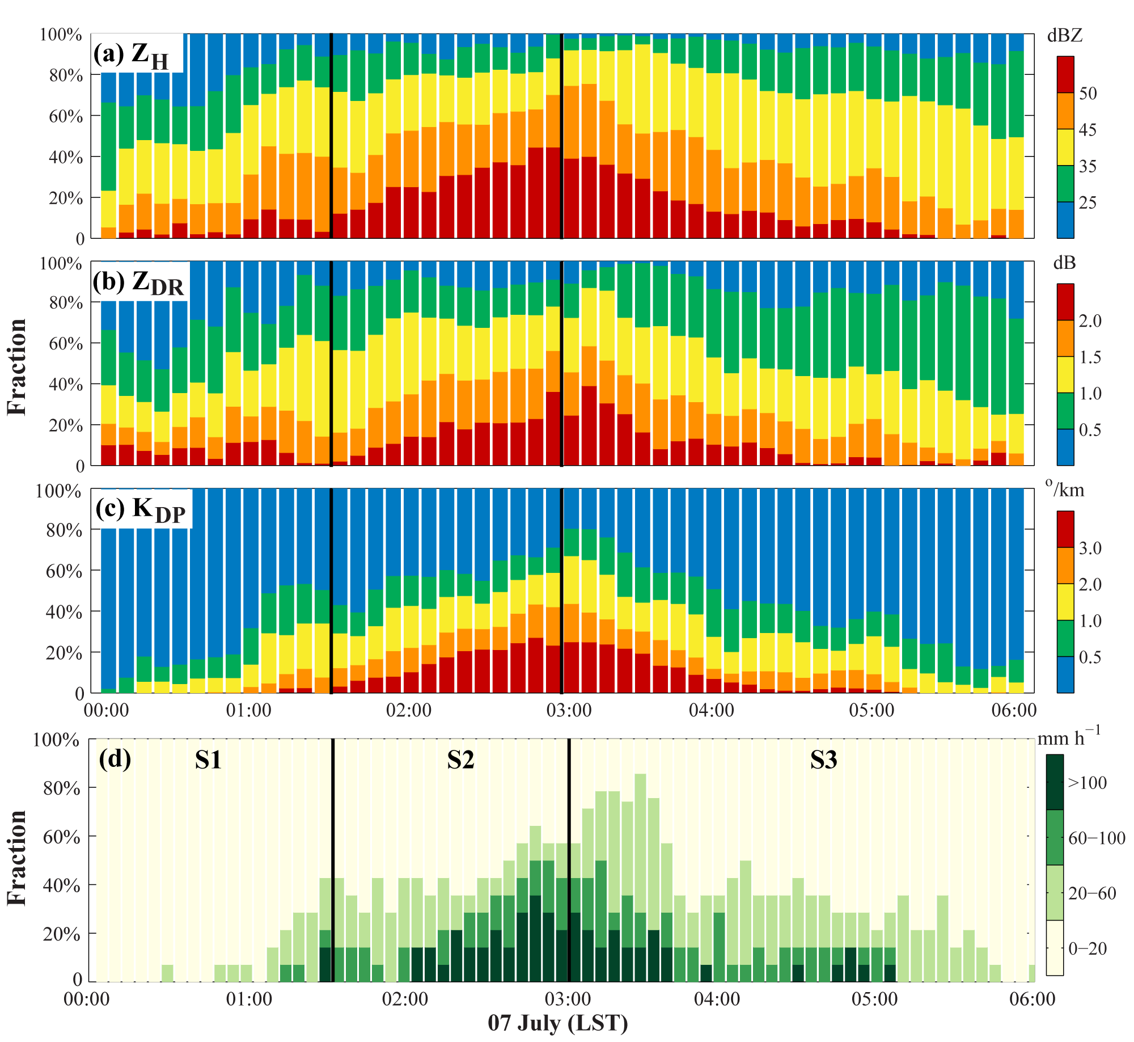
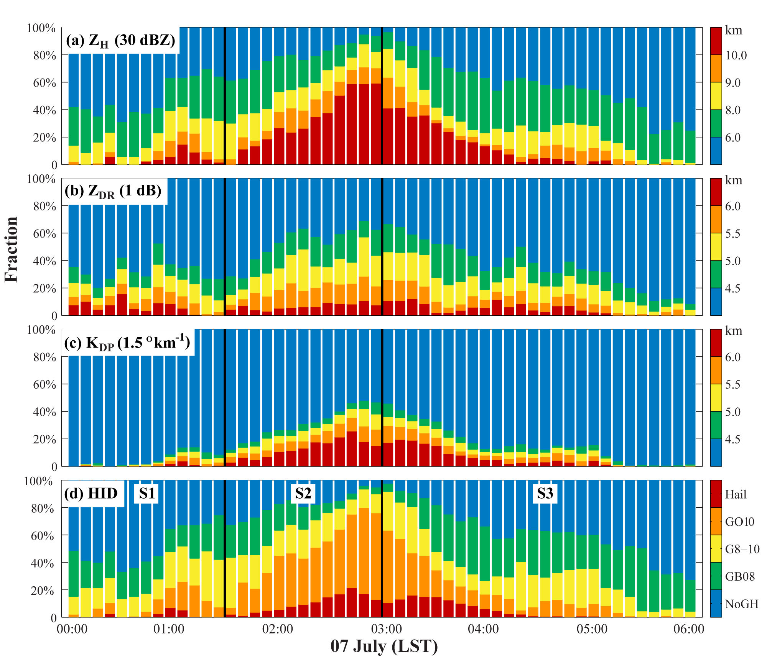
Evolution of Ice-phase Processes and DSD Characteristics
Polarimetric radar features at 1 km AGL
Ice-phase microphysics
Initiation
Mature
Dissipation
Deep convection in the mature stage, obvious K_{DP} column, maximum graupel exceeding 10 km AGL, heavy rainfall at surface
Notes:
The evolutions of polarimetric radar features are shown. Deep convection in the mature stage, obvious KDP column, maximum graupel exceeding 10 km AGL, heavy rainfall at surface.

Slide 20
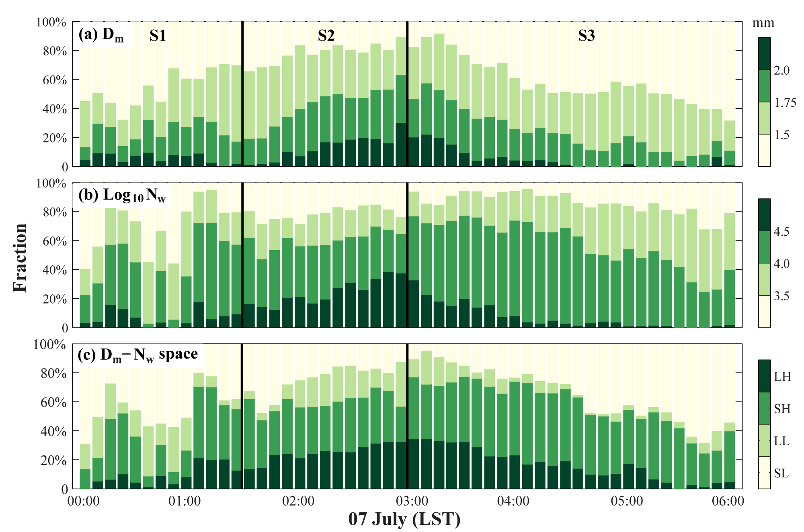
Evolution of DSD Characteristics
Retrieved DSD characteristics at 1 km AGL
2DVD observation at JN station
DSD quadrants | Description
LH | Large size & High concentration
SH | Small size & High concentration
LL | Large size & Low concentration
SL | Small size & Low concentration
DSD quadrant
The maximum fraction of LH samples in the mature stage
Notes:
Both radar retrievals and 2DVD observations have found that during the initial stage of convection, small mean size and low concentration raindrops dominate, while during the mature stage, large mean size and high concentration raindrops dominate, leading to extreme rainfall. After convection dissipation, the mean size of raindrops decreases significantly.

Slide 21
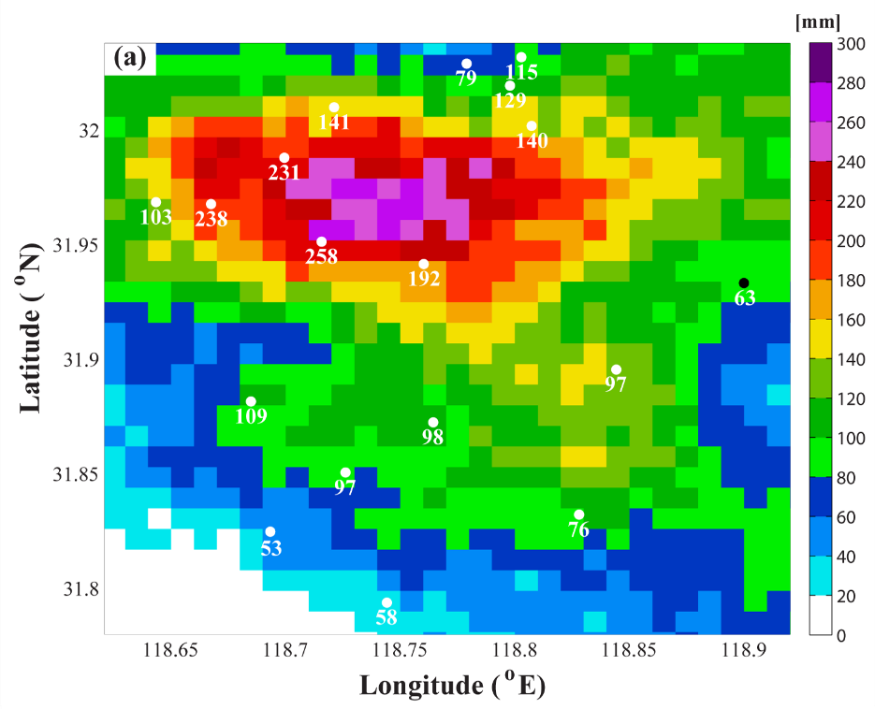
Link between GH Distributions and DSD Characteristics
Accumulated rainfall from radar QPE
Fraction of GH conditions in different RR ranges
Type | Identification
Hail | With hail identified aloft
GO10 | No hail, but with the maximum height of graupel over 10 km AGL
G8-10 | No hail, but with the maximum height of graupel between 8 and 10 km AGL
GB08 | No hail, but with the maximum height of graupel below 8 km AGL
NoGH | No hail or graupel identified aloft
High consistency between QPE and gauge
Positive correlation between RR & GH height
Notes:
Because of the consistency between the radar quantitative precipitation estimation results and the gauge observations, the radar QPEs are considered as true rainfall intensity at surface.
Statistics show that as the rainfall intensity increases, the proportion of vertical layer hair increases accordingly for the convective samples.

Slide 22
Link between GH Distributions and DSD Characteristics
Mean profiles of ice/rainfall water content
Growth of RWC-Dm within the warm-cloud layer
High IWC
Deeper convection, lower contribution from warm-rain processes
Growth of RWC
RWC is mainly contributed by ice-phase (warm-rain) processes in deep (shallow) convection
Notes:
Mean ice water and rainfall water profiles indicate that when hail is present in vertical layers, the ice water content is extremely high, and the contribution of warm rain processes to rainfall intensity is minimal.
Conversely, when the vertical heights of graupel and hail are lower, the contribution of warm rain processes to rainfall intensity is higher.

Slide 23
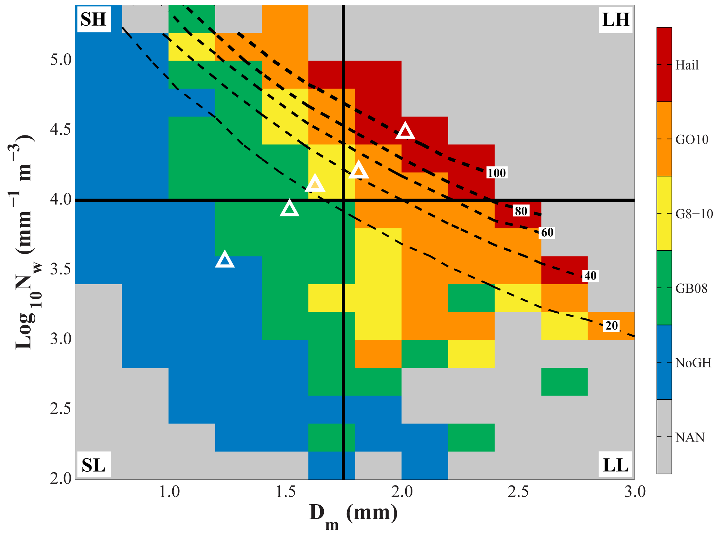
Link between GH Distributions and DSD Characteristics
The quantitative link between GH height and 1-km AGL DSD
Chen and Zhao et al.,2023, ESS
Notes:
Finally, we summarized the quantitative link between the vertical distribution of graupel and hail and the low-level DSD characteristics. We found that in this warm, moist environment with high CAPE, as the height of graupel and hail increased, the mean size of raindrops became larger, and the number concentration of raindrops also increased, leading to more extreme rainfall.

Slide 24
Conclusion and Discussion
Microphysical structure of deep convection causing extreme rainfall
Hydrometeor type and DSD retrieved from polarimetric radar
DSD observed by Disdrometer
Obs
NJ
Event
HN
Event
Deep convection
Large mean size &
High number concentration
（continental + maritime convection）
Both active in ice-phase and warm-rain processes(>200mm/h）
Extremely deep convection
Low-level DSDs are indicated by GH distribution height
Extreme RR (>100 mm/h) is mainly caused by convection with hail identified aloft
Active ice-phase processes

Slide 25
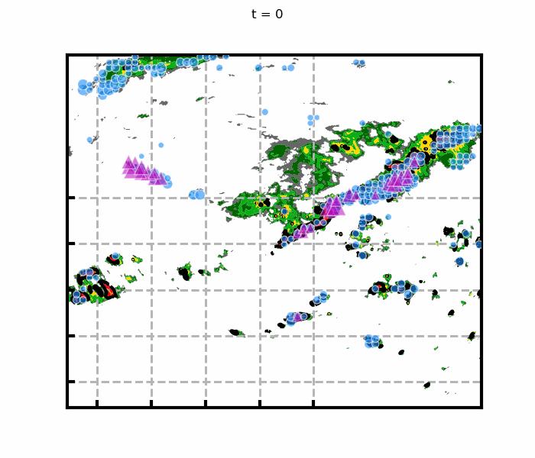
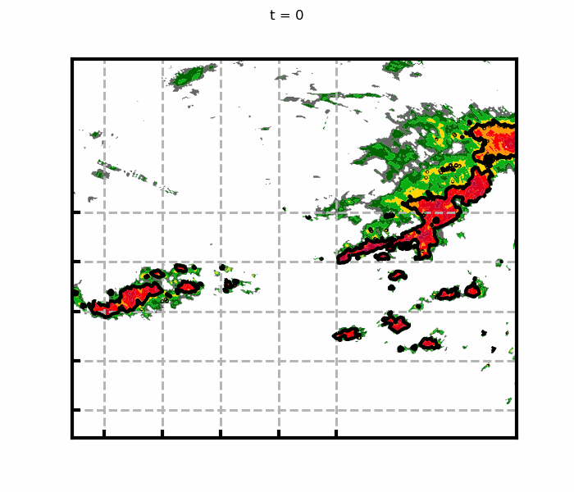
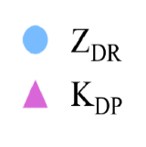
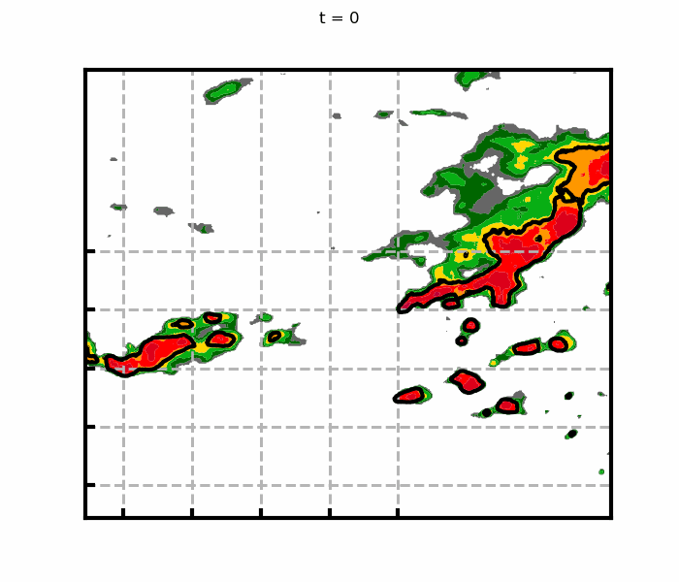
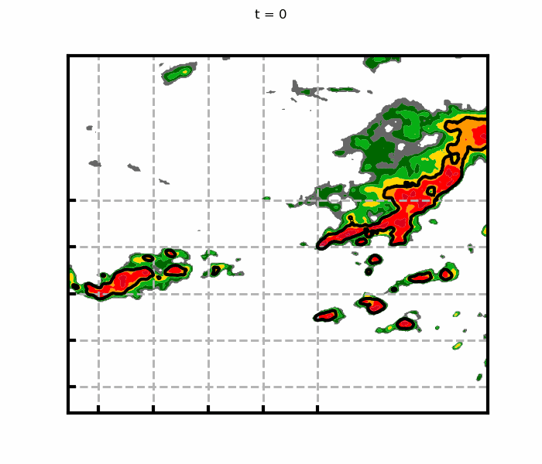
Ongoing Work
AI-Based Nowcasting Model with Polarimetric Radar Variables
Observation
C1
3-D Pol Variables
Convective Strutural Information
C2
C3
C1
Forecast
C1
Recurrent Structure
Longer Lead-time Forecasts
C2
C3
C2
C3
Pan and Zhao, GRL, 2021，2025 (In Preparation)

Slide 26
Related papers
Chen Gang, Zhao Kun(*), Wen Long., et al, 2023, Linking Ice-Phase Microphysics to Raindrop Characteristics in Deep Convection: A Warm-Sector Extreme Rainfall Case Study in Eastern China, Earth and Space Science, 10(2).
Chen Gang, Zhao Kun(*), Lu Yinghui., et al, 2022, Variability of microphysical characteristics in the “21.7” Henan extremely heavy rainfall event, Science China Earth Sciences, 65(10) , 1861–1878
Wei Peng, Xu Xin(*), Xue Ming., et al, 2023, On the Key Dynamical Processes Supporting the 21.7 Zhengzhou Record-breaking Hourly Rainfall in China , Advances in Atmospheric Sciences , 40, 337-349
Wen Long, Zhao Kun(*), Yang Zhonglin., et al, 2020, Microphysics of Stratiform and Convective Precipitation during Meiyu Season in Eastern China, Journal of Geophysical Research: Atmospheres, 125
Huang Hao, Zhao Kun(*), Chan Johnny C.L., et al, 2022, Microphysical characteristics of extreme-rainfall convection over the Pearl River Delta region, South China from polarimetric radar data during the pre-summer rainy season, Advances in Atmospheric Sciences , 39, 1-13.
Yang Zhonglin, Zhao Kun (*), Xu Kun., et al, 2019, Microphysical characteristics of extreme convective precipitation over the Yangtze-Huaihe river basin during the Meiyu season based on polarimetric radar data. Acta Meteorologica Sinica. 77(1): 58-72
Notes:
Related papers are listed here

Slide 27
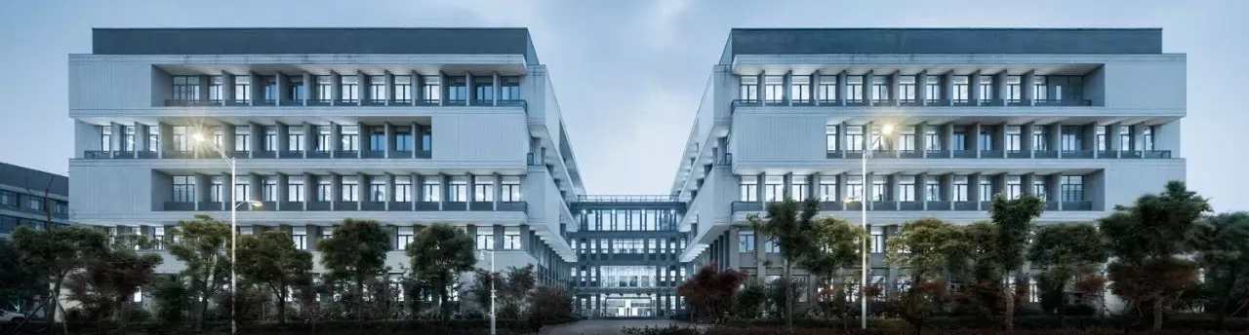
Thank you!
Any questions?

