Slide 1
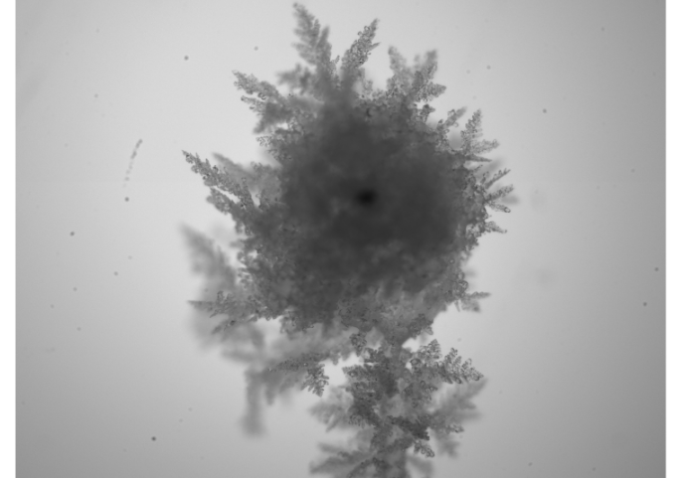
Laboratory studies into the fragmentation of ice particles due to collision
Miklós Szakáll
Vertical wind tunnel laboratory, University of Mainz, Germany
Pierre Grzegorczyk, Subir K. Mitra, Alexander Theis, Sudha Yadav

Slide 2
Laboratory studies into the fragmentation of ice particles due to collision
SECONDARY ICE PRODUCTION (SIP) /
ICE MULTIPLICATION
Miklós Szakáll
Vertical wind tunnel laboratory, University of Mainz, Germany
Pierre Grzegorczyk, Subir K. Mitra, Alexander Theis, Sudha Yadav

Slide 3
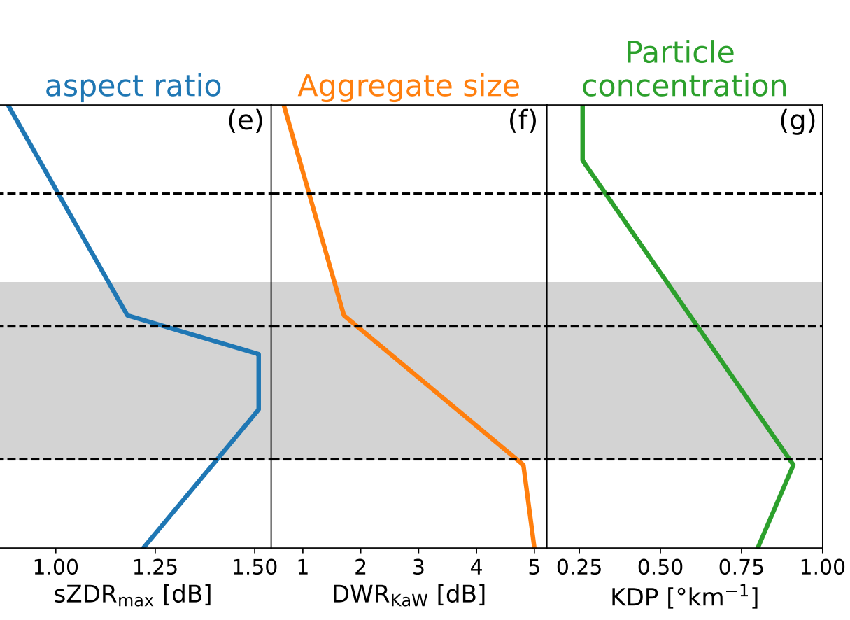
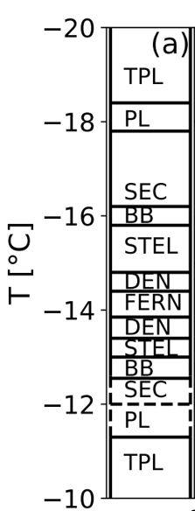
Motivation
Fragmentation due to collisions of particles with dendritic crystals
Takahashi, GRL, 1993
In general: Fragmentation due to collision of graupel
Our goal: Earn basic understanding on the collision process
Korolev and Leisner, ACP, 2020
von Terzi et al., ACP, 2022

Slide 4
theoretical framework
Collision kinetic energy (CKE, K₀)
Number of new fragments per collision
𝛼 - equivalent spherical area of the smaller particle
A - number density of breakable asperities
C - asperity-fragility coefficient
γ - shape function
$$K_{0}=\frac{1}{2}\frac{m_{1}m_{2}}{m_{1}{+m}_{2}}{\left(v_{2}−v_{1}\right)}^{2}$$
$$N=α∙A\left[1−exp\left(−{\left[\frac{C∙K_{0}}{α∙A}\right]}^{γ}\right)\right]$$
Phillips et al., JAS, 2017

Slide 5
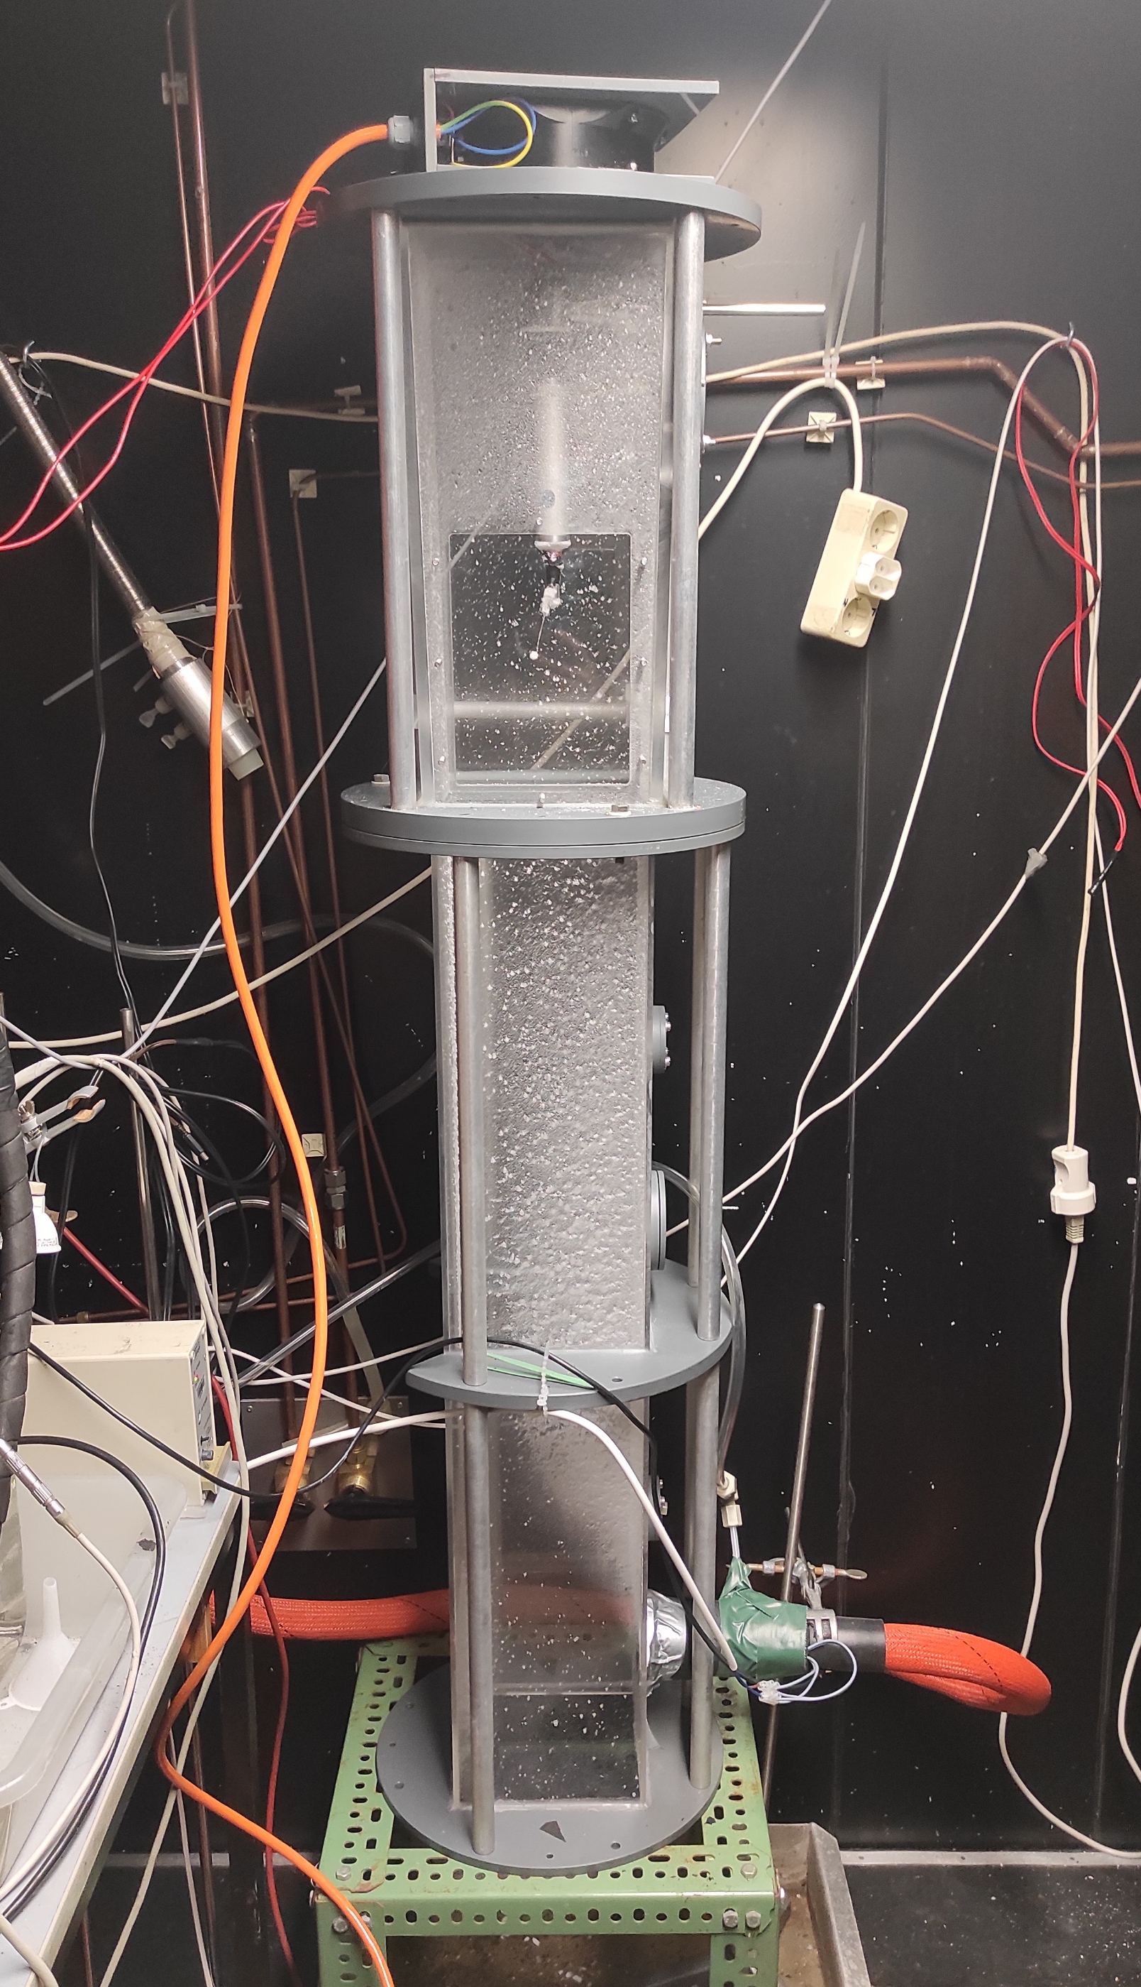
investigated particles
Graupel generator
GRAUPEL W/
DENDRITES
BARE GRAUPEL
ICE PELLETS
2.12 mm
0.21 g/cm³
-15 °C
2.5 mm
0.334 g/cm³
-15 °C
2.45 mm
0.558 g/cm³
-7 °C
5.0 mm
0.89 g/cm³
-15 °C; -5°C
Temperture: -7°C to -15 °C
Air speed: 2.8 m/s

Slide 6
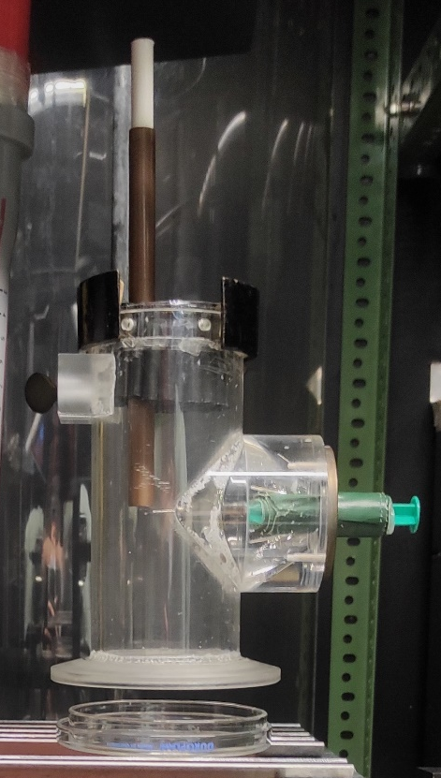
graupel-graupel collision
Fall tube
Stagnant particle
Petri dish

Slide 7
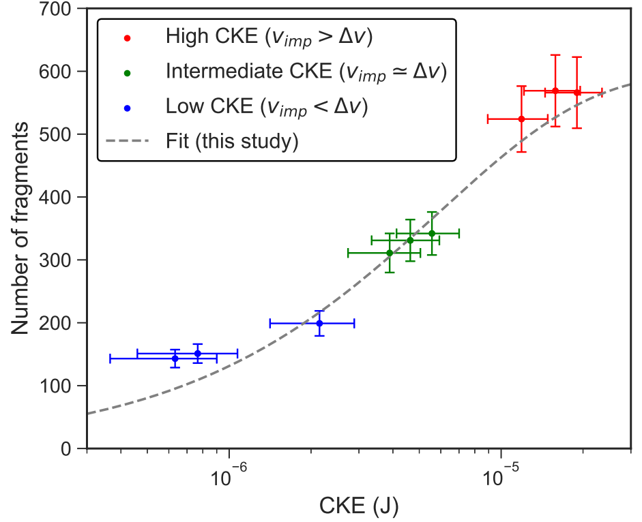
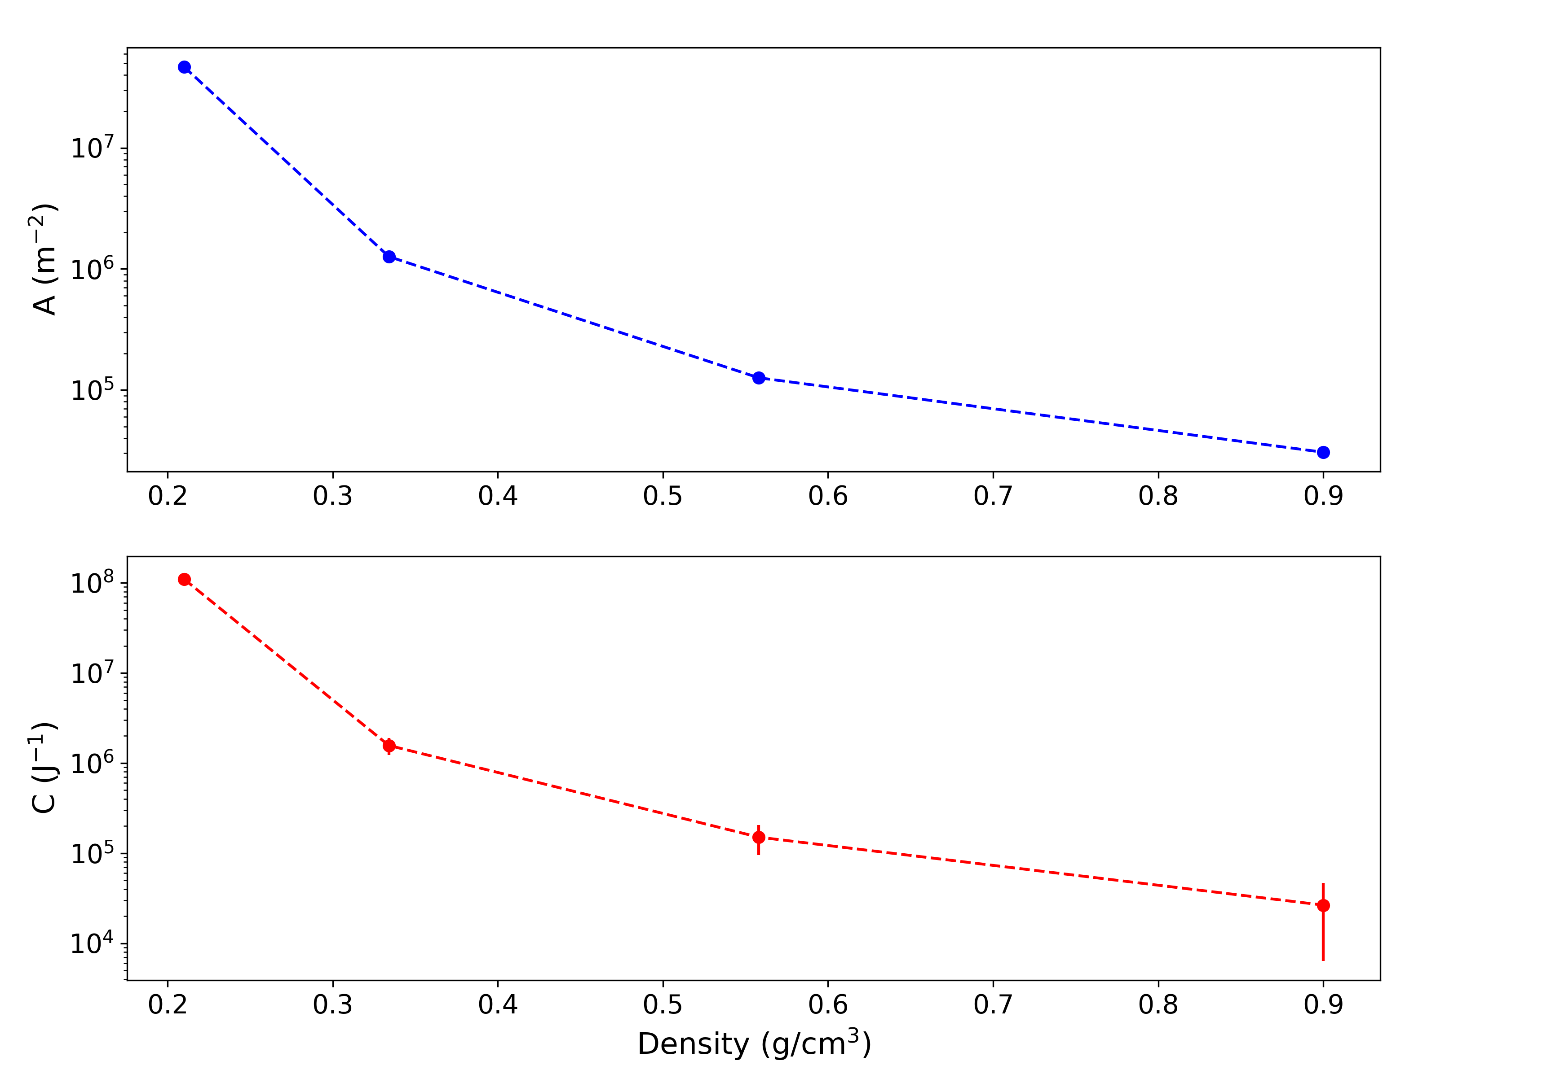
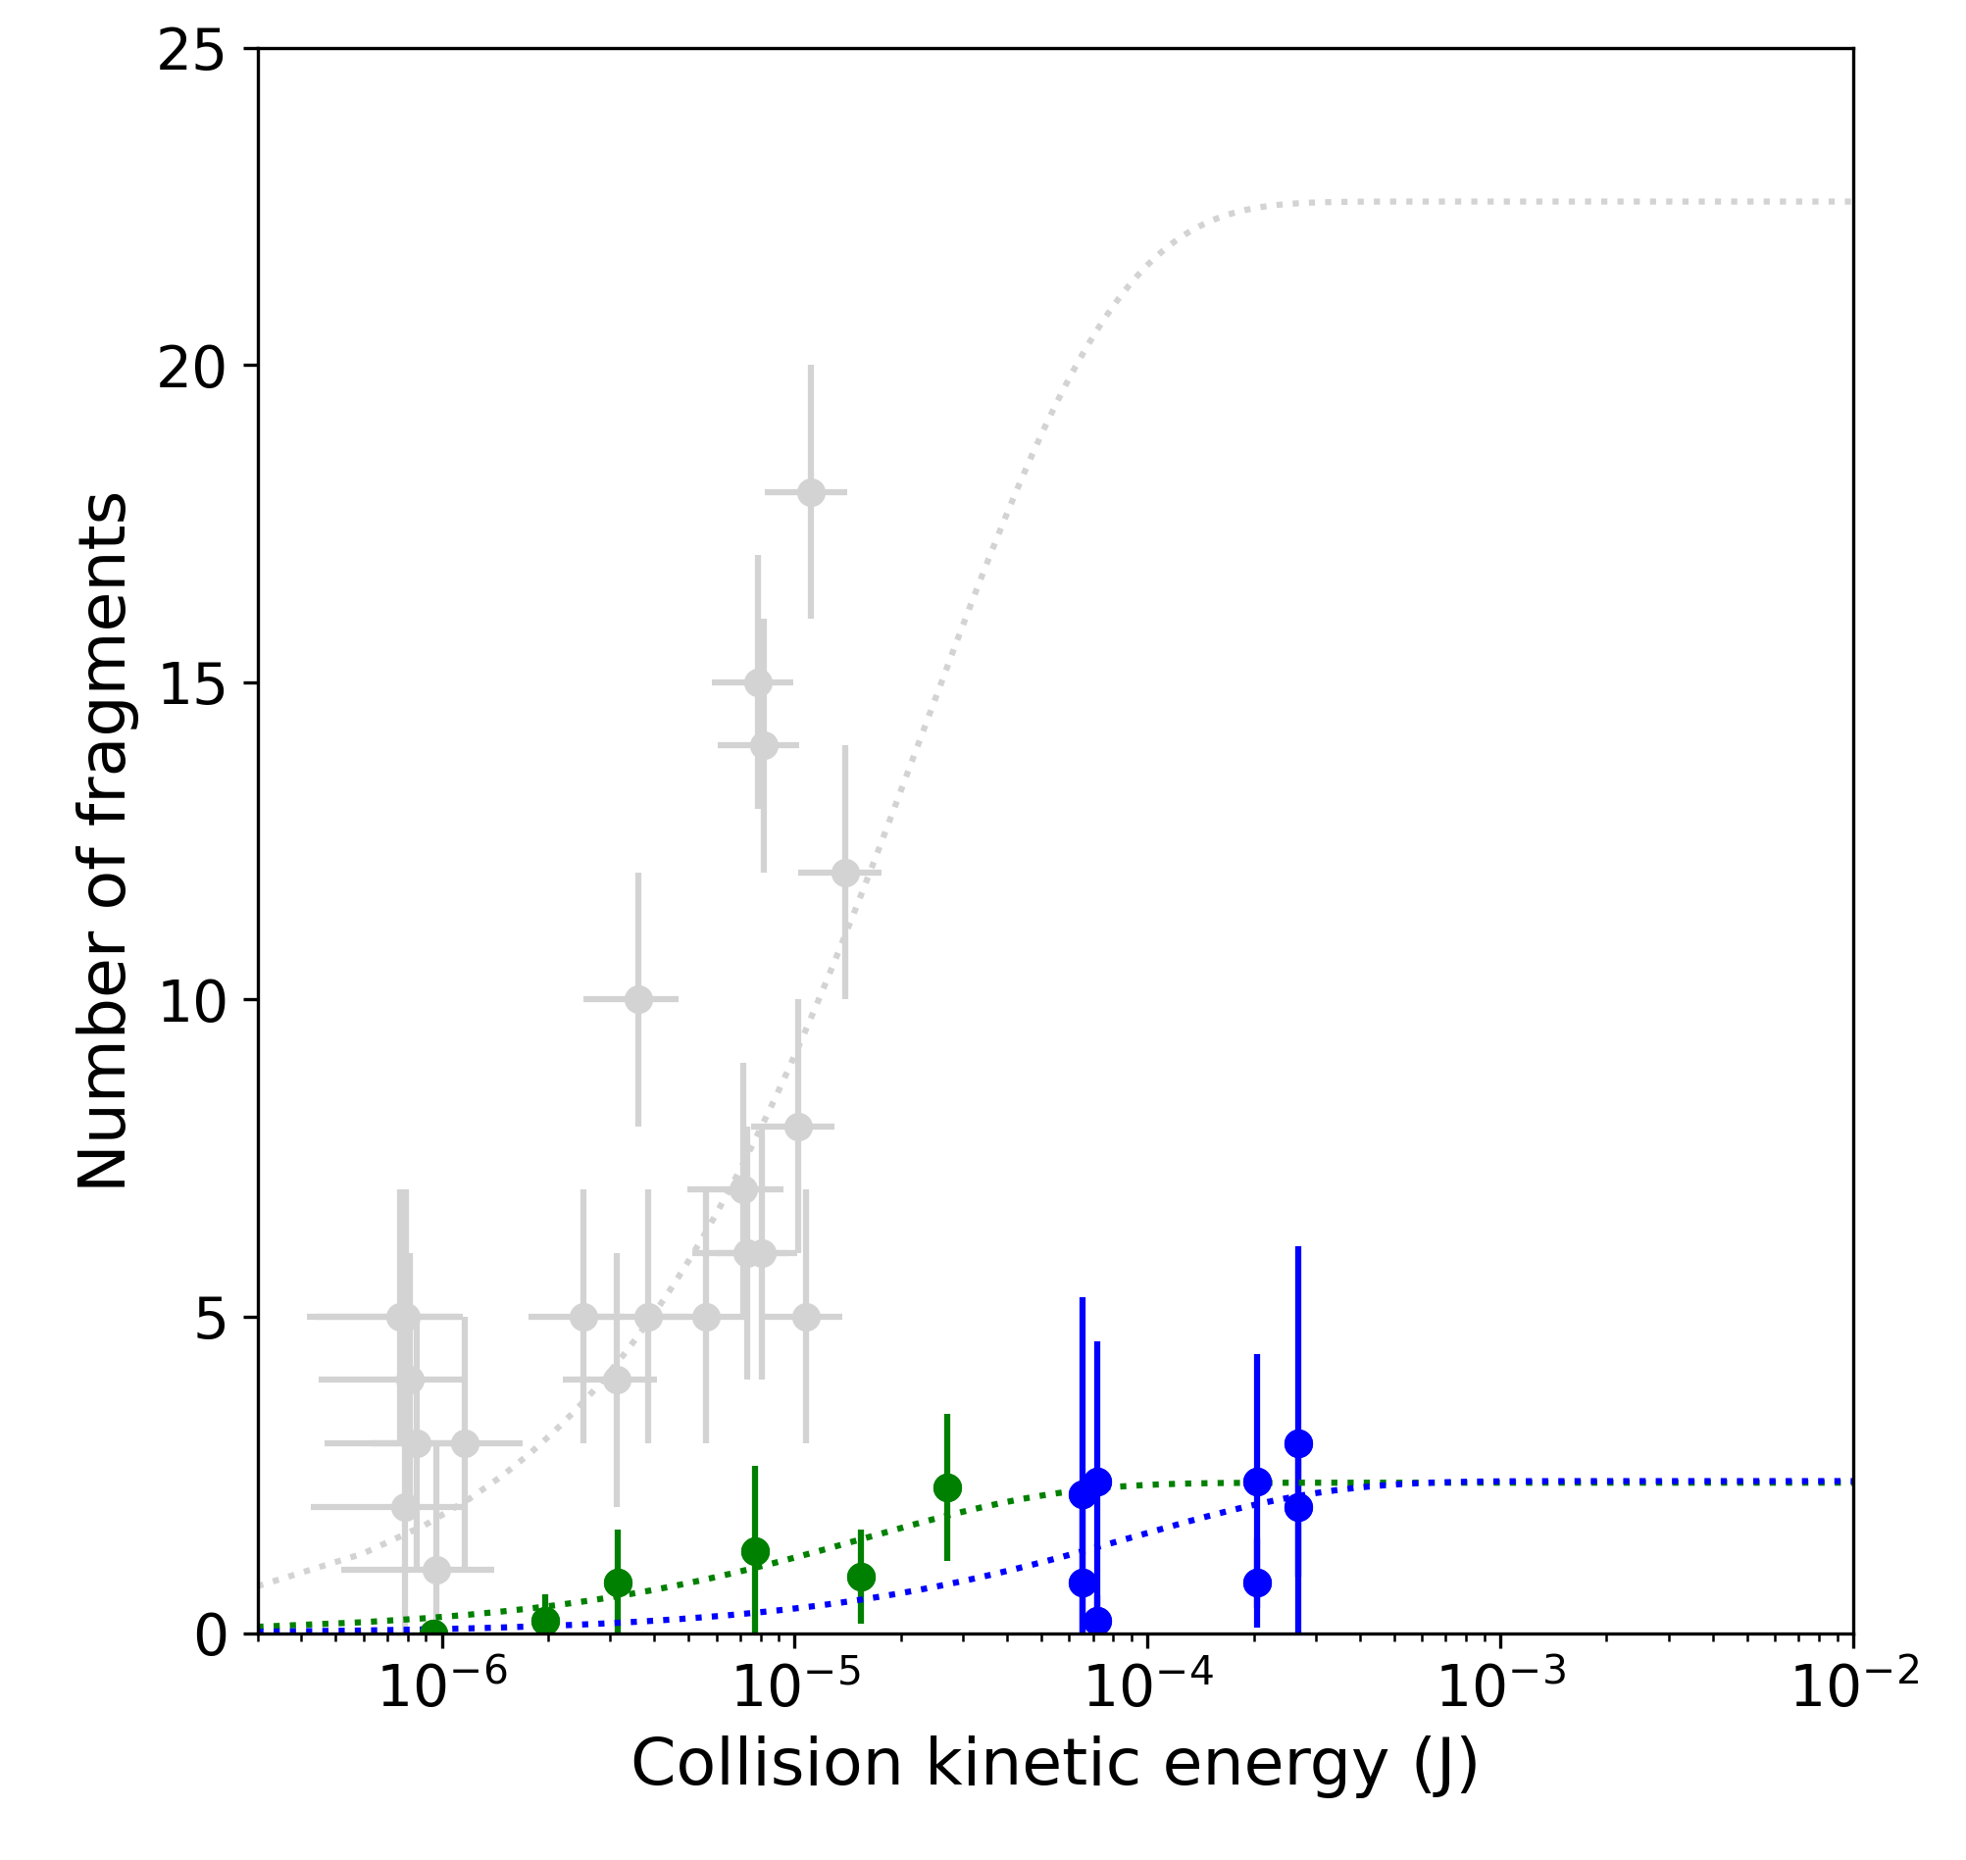
graupel – graupel collision results
$$N=α∙A\left[1−exp\left(−{\left[\frac{C∙K_{0}}{α∙A}\right]}^{γ}\right)\right]$$
A - number density of breakable asperities
^{GRAUPEL W/}
^{DENDRITES}
BARE GRAUPEL
0.334 g/cm³
0.558 g/cm³
0.89 g/cm³
C - asperity-fragility coefficient

Slide 8
graupel-graupel collision results (Dendritic)
Same distribution shape
Maximum at 75 µm
Similar to Takahashi (1993) observation of 60/100 µm crystals
Distribution shape is independent of CKE
Distribution peak depends on CKE
Mean area depends on CKE
Same distribution shape
Note: detection limit is 25 to 30 µm
Mean distributions of fragments area

Slide 9
graupel-snowflake collisions
Central collision
Side collision

Slide 10
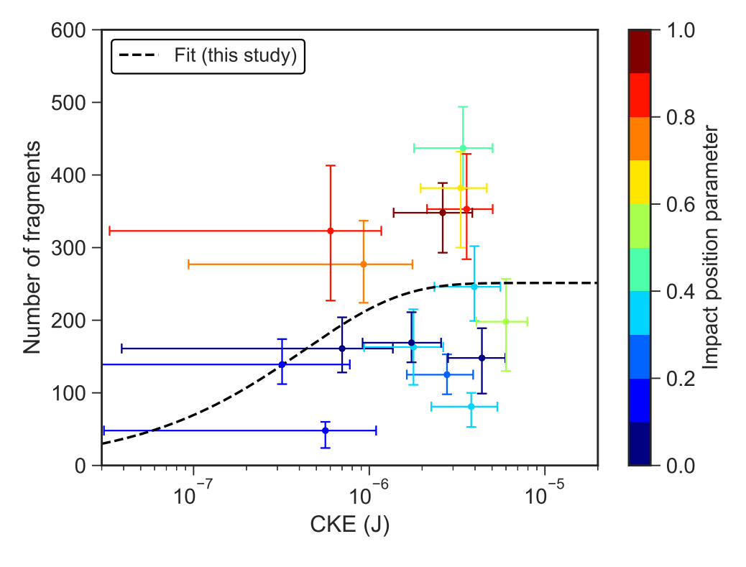
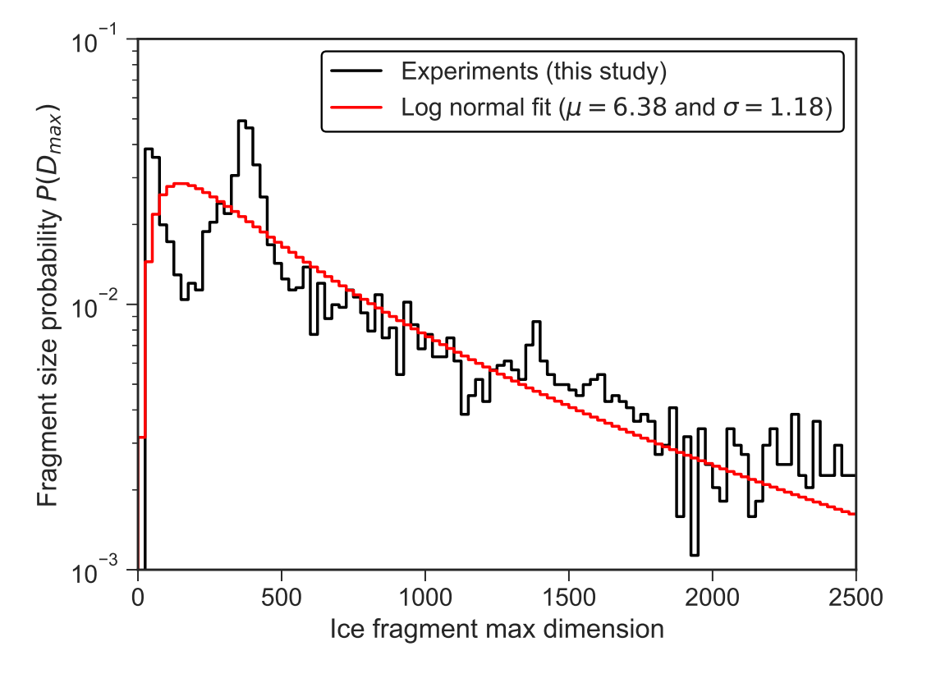
graupel-snowflake collisions - results
Number of fragments depends on
CKE
Impact position
Variability likely due to manual production
Sum of 16 distributions

Slide 11
summary and outlook
Density, i.e. structural dependence of the number of fragments generated in graupel-graupel/ice pellet collisions
We could derive size distributions for the fragments for low-density graupels with dendritic crystals on their surface and for snowflakes
…still to be answered/done
Is there any difference if a graupel has other crystal type on its surface?
Is there a temperature dependency on the number of fragments generated?
Snowflake-snowflake collisions
Results published in: Grzegorczyk et al., ACP, 23, 13505-13521, 2023;
Yadav et al., EGUsphere-2024-3222

Slide 12
thank you for your attention!
SIP HAPPENS!
(A. Korolev)
Results published in: Grzegorczyk et al., ACP, 23, 13505-13521, 2023;
Yadav et al., EGUsphere-2024-3222

Slide 13
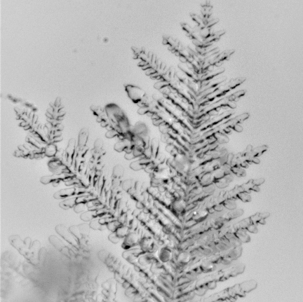
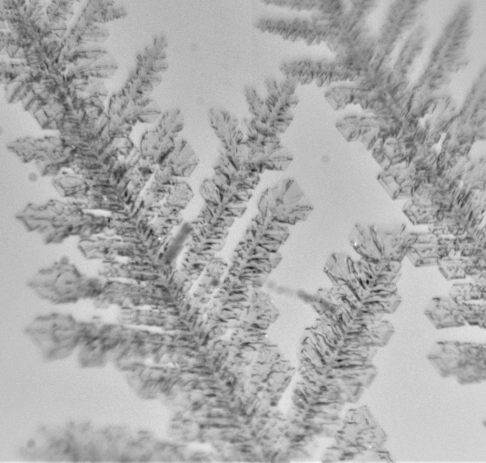
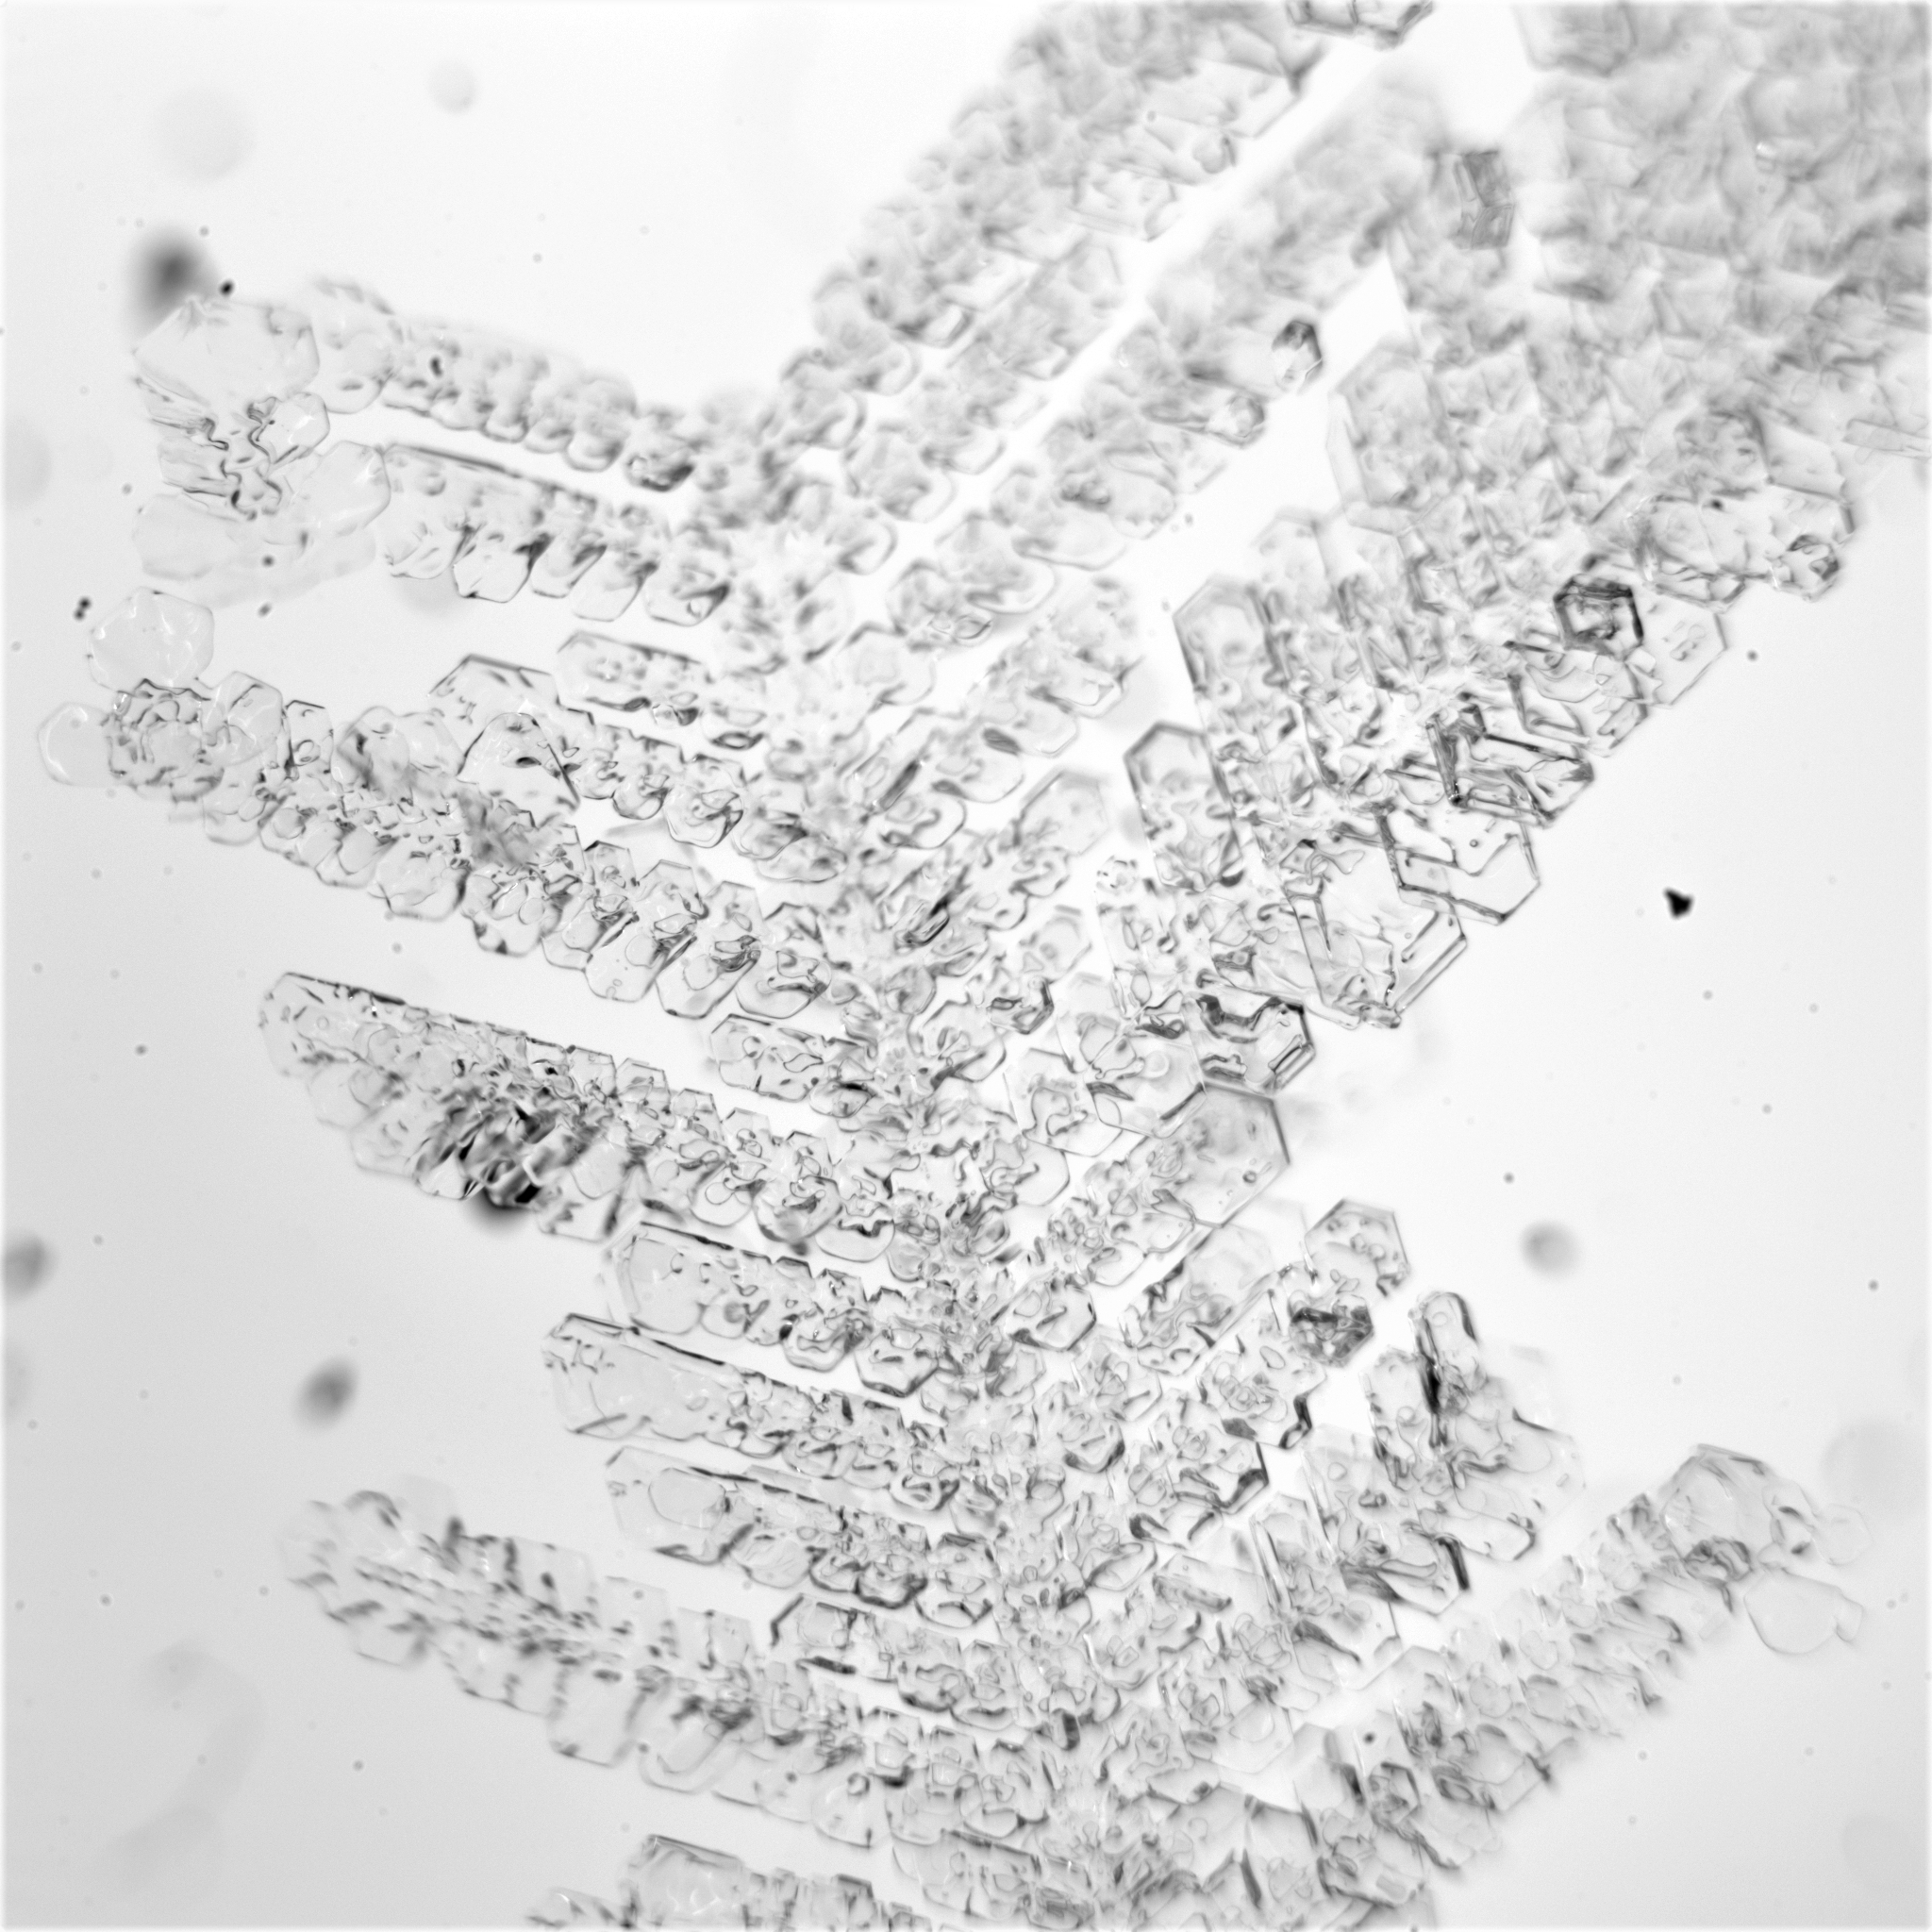
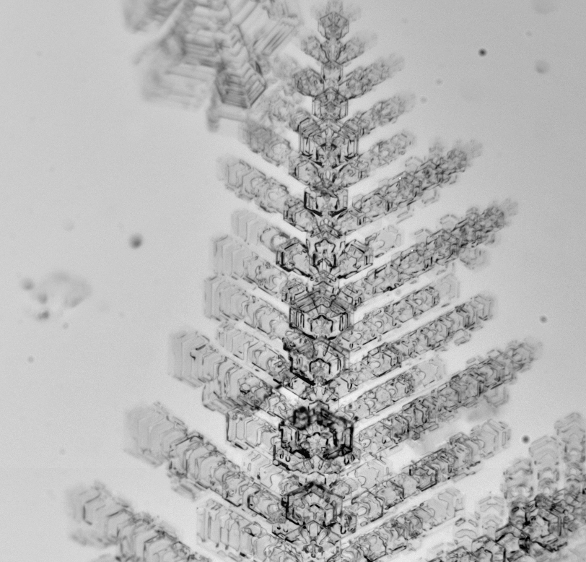
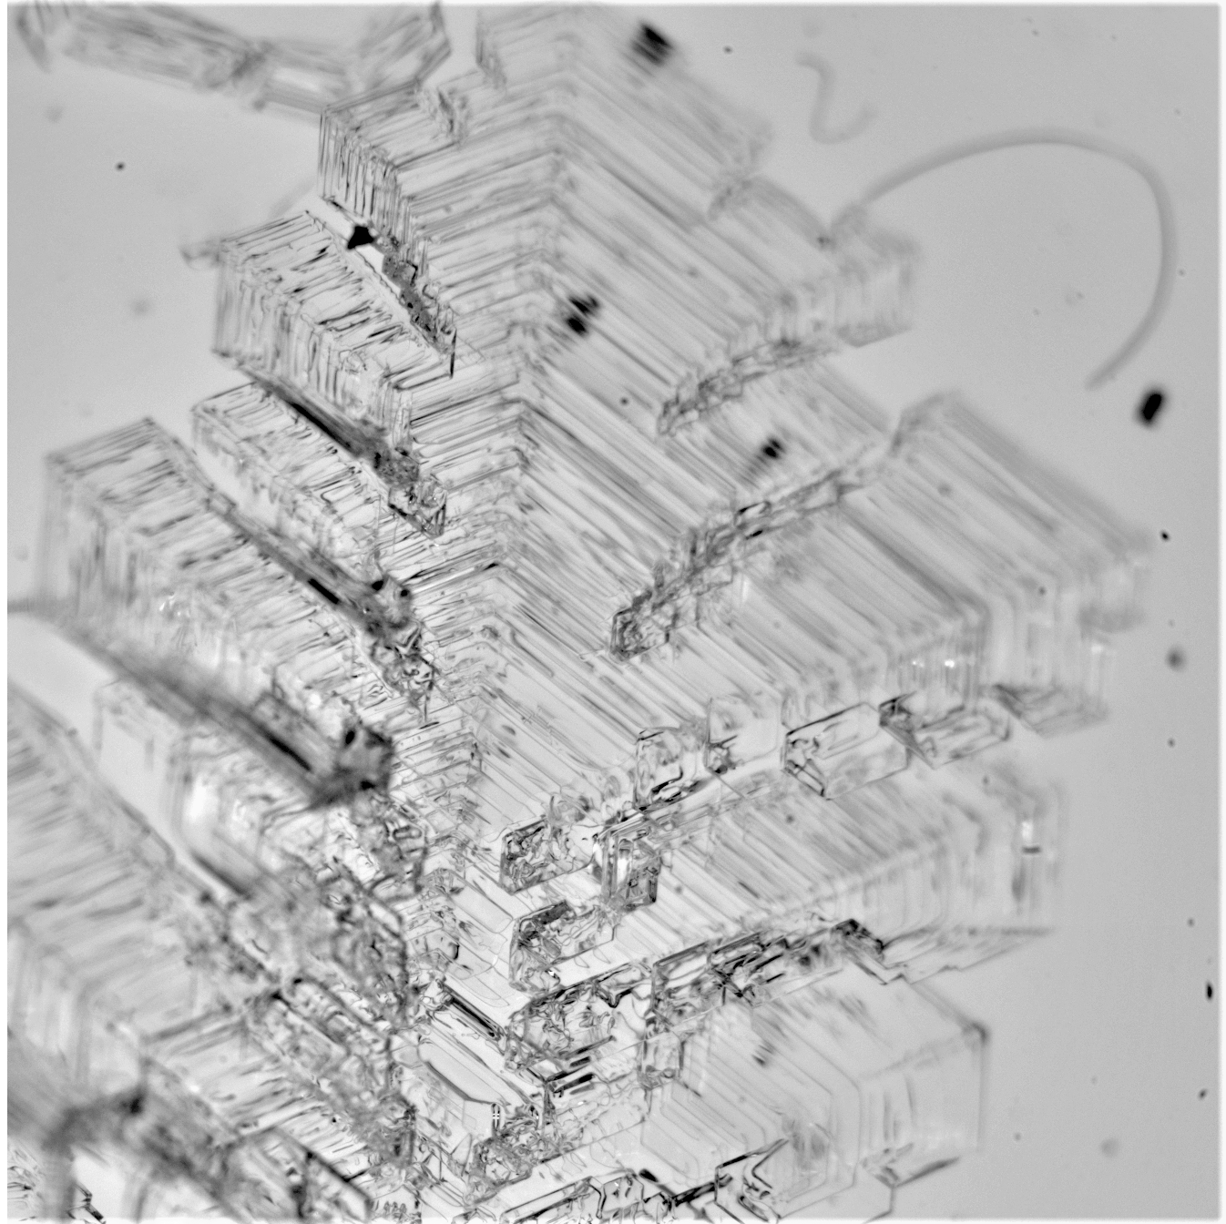
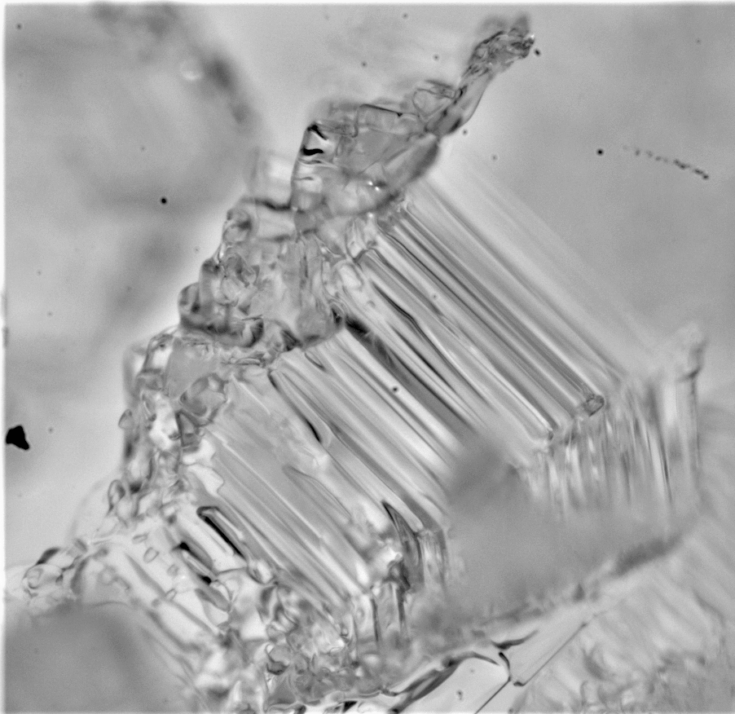
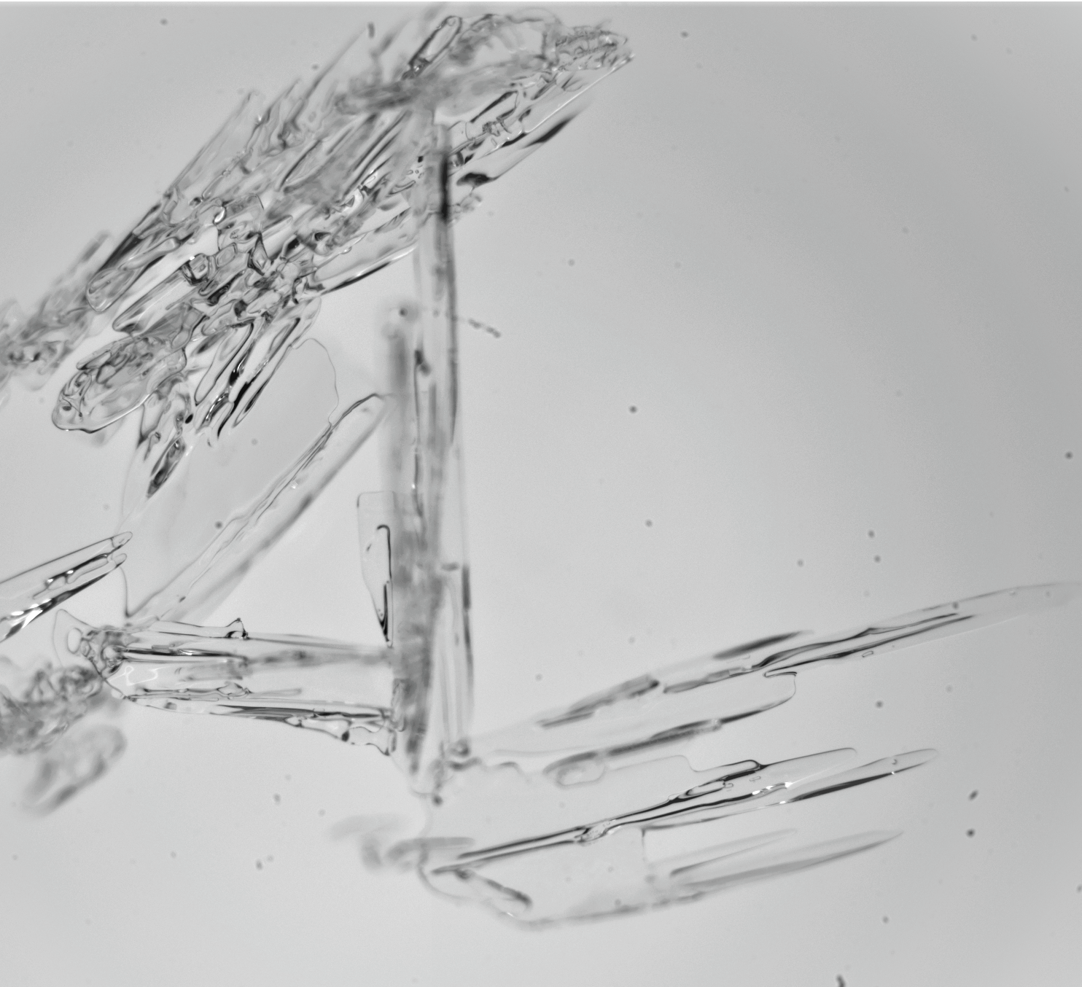
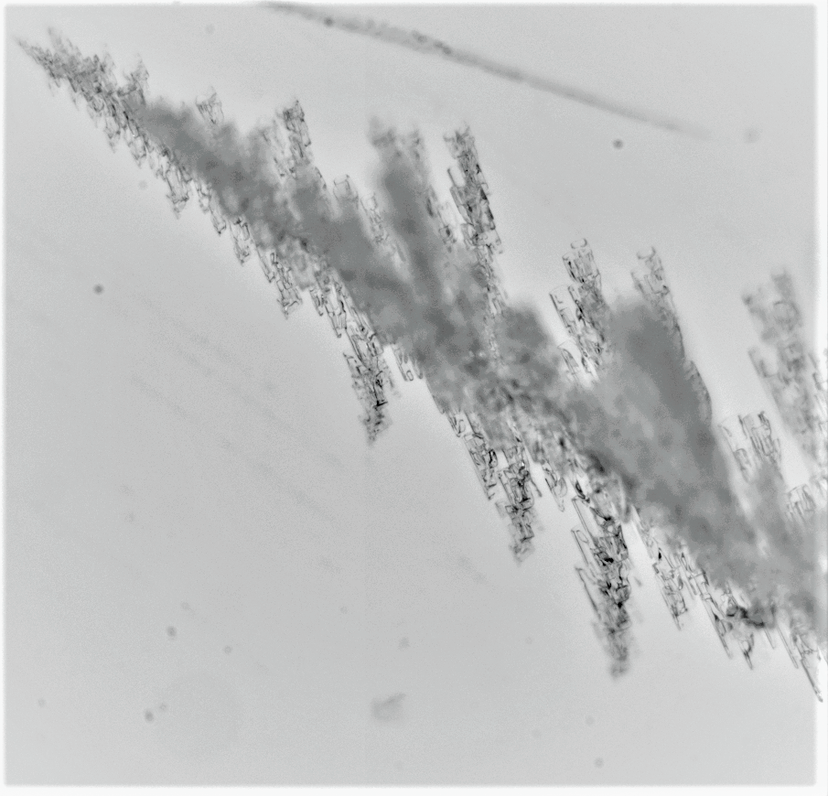
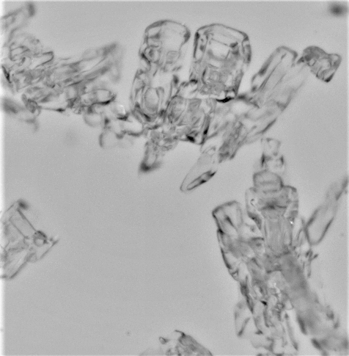
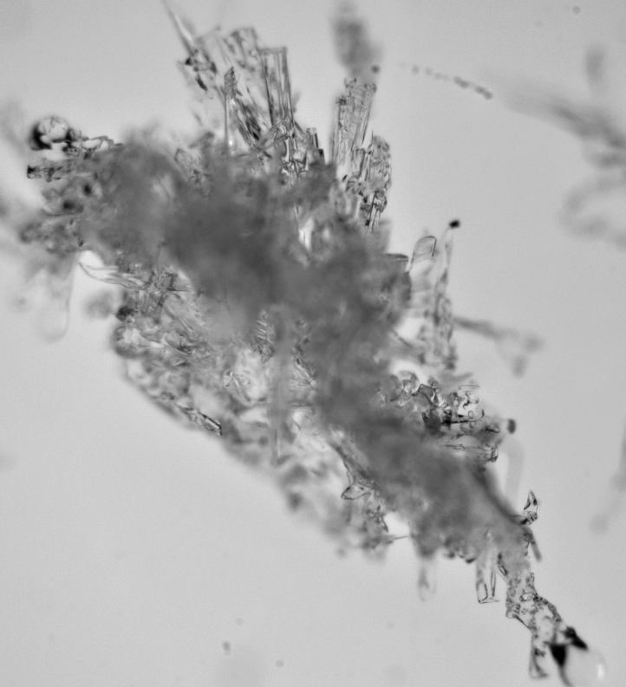
thank you for your attention
Dendrite
Dendrite with sectors
Dendrite with plates
Plates with dendrites
Assemblage of crossed plates
Skeletal plate
Needles
Dendrite with columns
Skeletal column with scrolls
Bundle of sheaths

Slide 14
Honestly… (constrains of the experiments)
artificial graupel and snowflakes
whether dendritic crystals on the surface represent natural conditions, is debatable
one fixed temperature (-15 °C) and one fixed relative humidity (120% wrt ice)
large snowflakes (~ 1 cm)
relatively low number of experiments

Slide 15
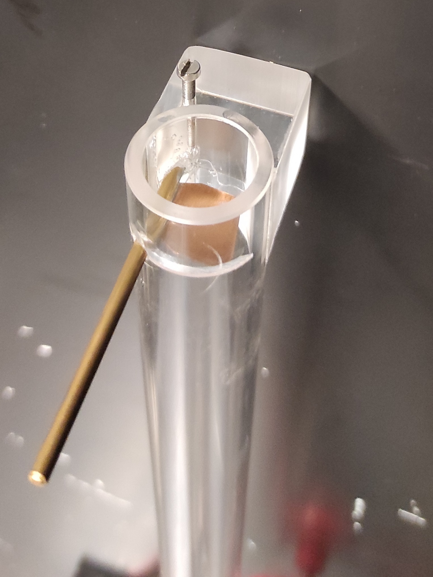
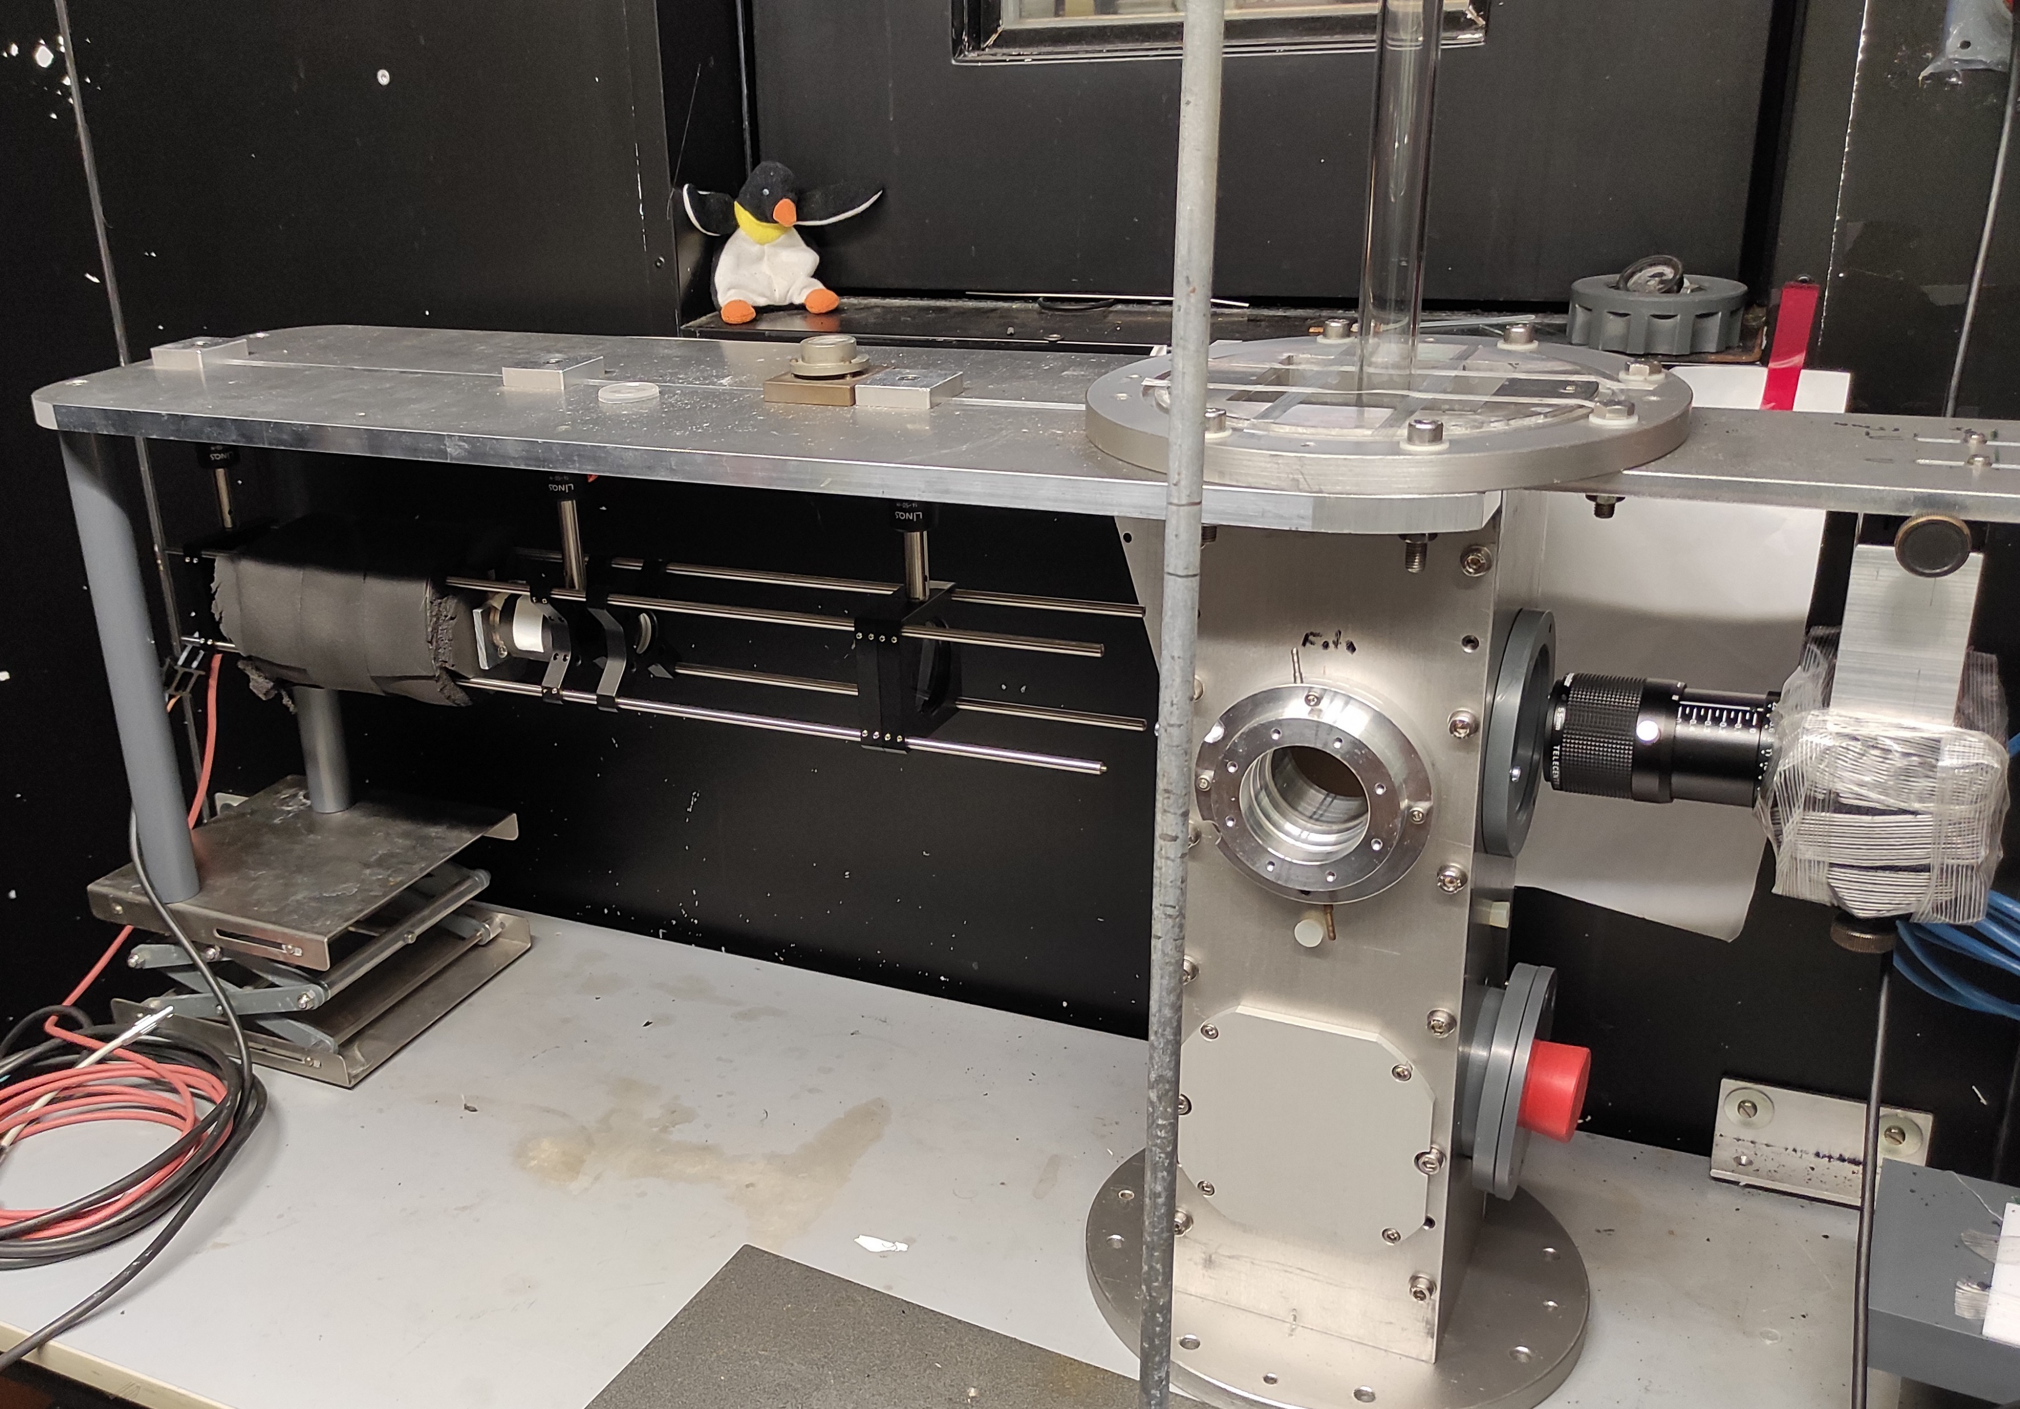
graupel-snowflake collisions
Launch system
Holographic instrument
Snowflake position
Collision tube
Laser
Collision tube
Laser
Beam expander
Reconstructed holographic image
Collision tube
Petri dish
Sampling volume
Camera

