Slide 1


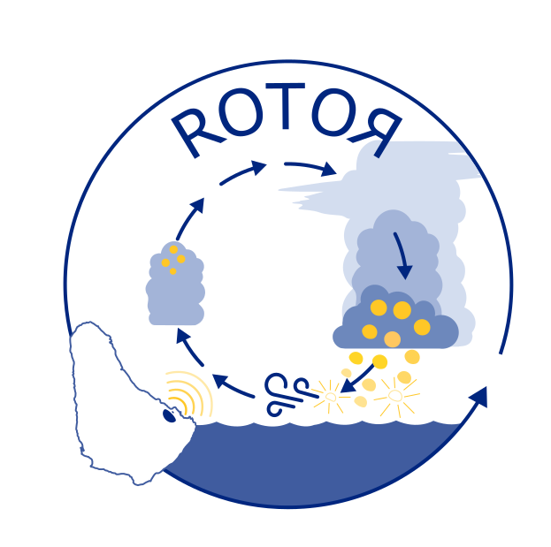

Retrieving rain evaporation rates from Doppler radars at the Barbados Cloud Observatory
Nina Robbins Blanch
Florian Poydenot, Claudia Acquistapace, Sabrina Schnitt, and Raphaela Vogel
PrePEP – 20/03/2025

Slide 2







Bjorn Stevens
Raphaela Vogel

Slide 3
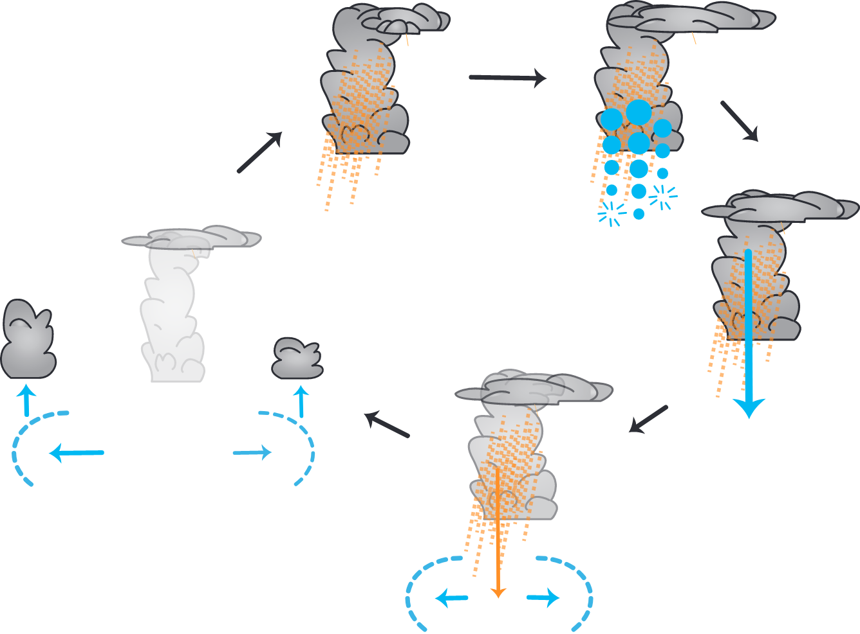
Rain processes strongly modulate cloudiness through cold pools
evaporative cooling
downdraft
cloud hole
cold pool

Slide 4



cold pools and cloud holes
Bjorn Stevens
Jakob Deutloff
Nicolas Rochetin

Slide 5
The role of rain evaporation for determining cloudiness in cold pools and cloud holes is unclear
Condensate evaporation, radiative, convective, and turbulent processes also play a role
Main reasons for this knowledge gap:
Lack of long-term rain evaporation measurements.
Uncertain model skill.
Raphaela Vogel

Slide 6

Steps towards understanding rain evaporation in the trades
BCO
Compare rain evaporation retrieval methods and assess their robustness.
Obtain a >10 year-long dataset of rain evaporation at the Barbados Cloud Observatory.
Characterize the vertical structure of evaporation, its link to downdrafts and cold pools, and its impact on atmospheric stability and thus cloud formation.
Raphaela Vogel

Slide 7
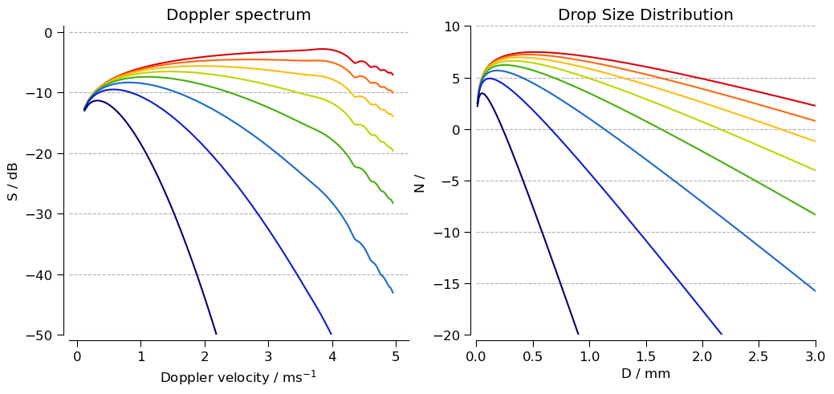
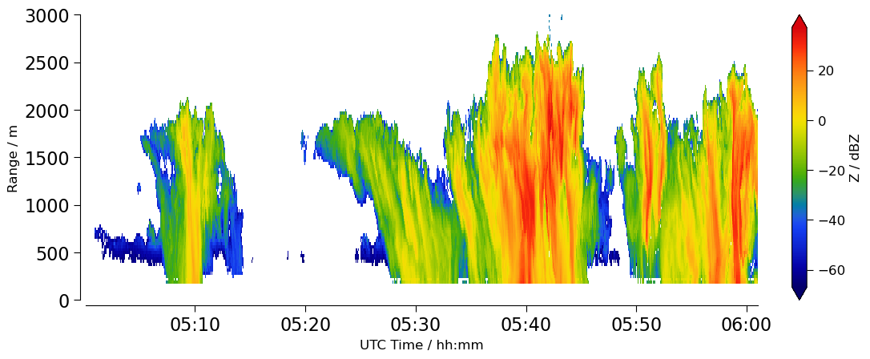
How can we retrieve rain evaporation from Doppler radar data?
S
N
Small drops evaporate faster
Large drops evaporate slower
What we observe
Doppler velocity can be translated to drop size (small drops fall slower, large drops fall faster).
Evaporation leads to a shrinkage of raindrops as they fall.
We can track changes in rain mass flux between atmospheric layers following Tridon et al. (2017).

Slide 8
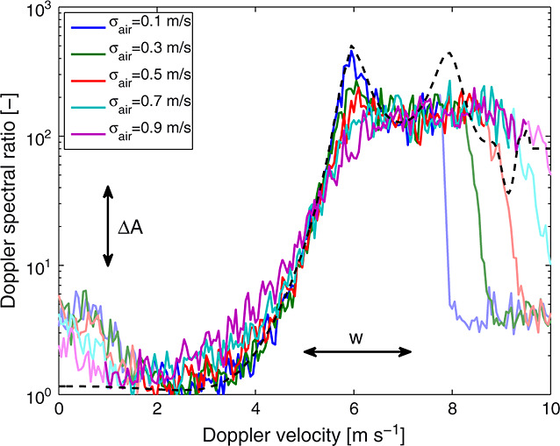

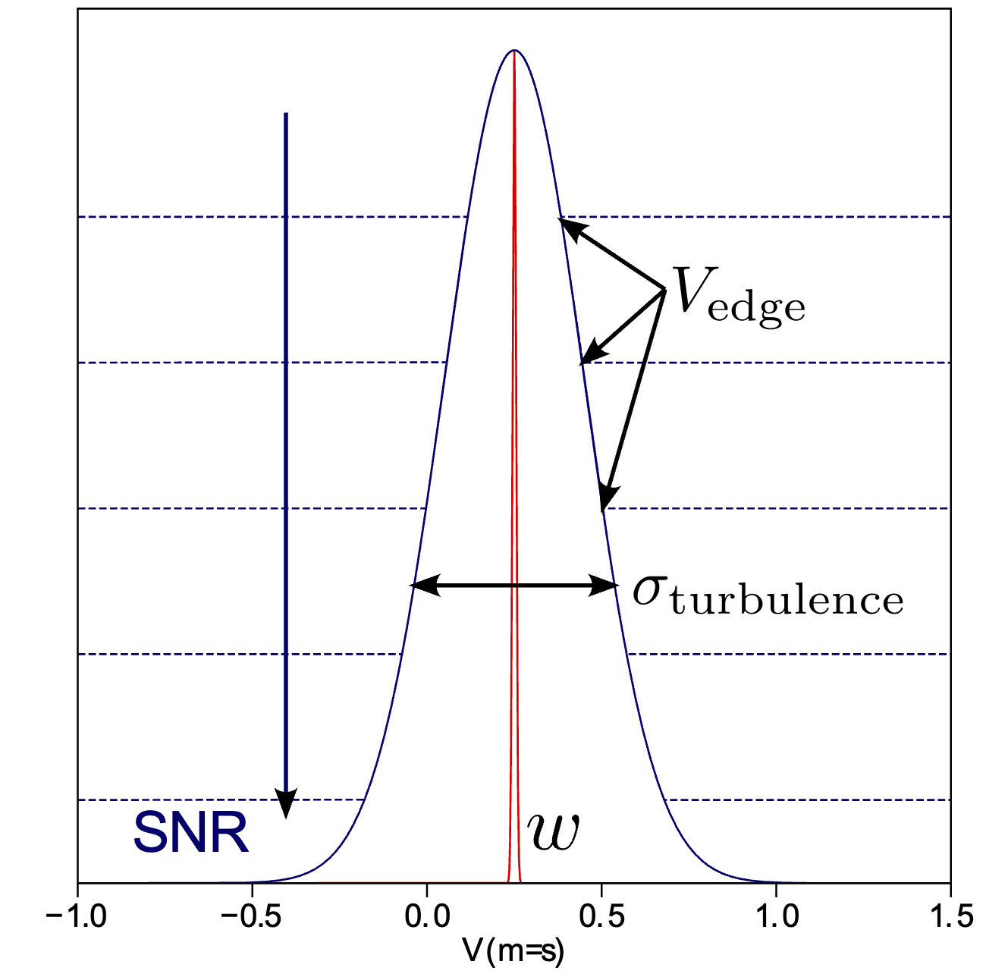
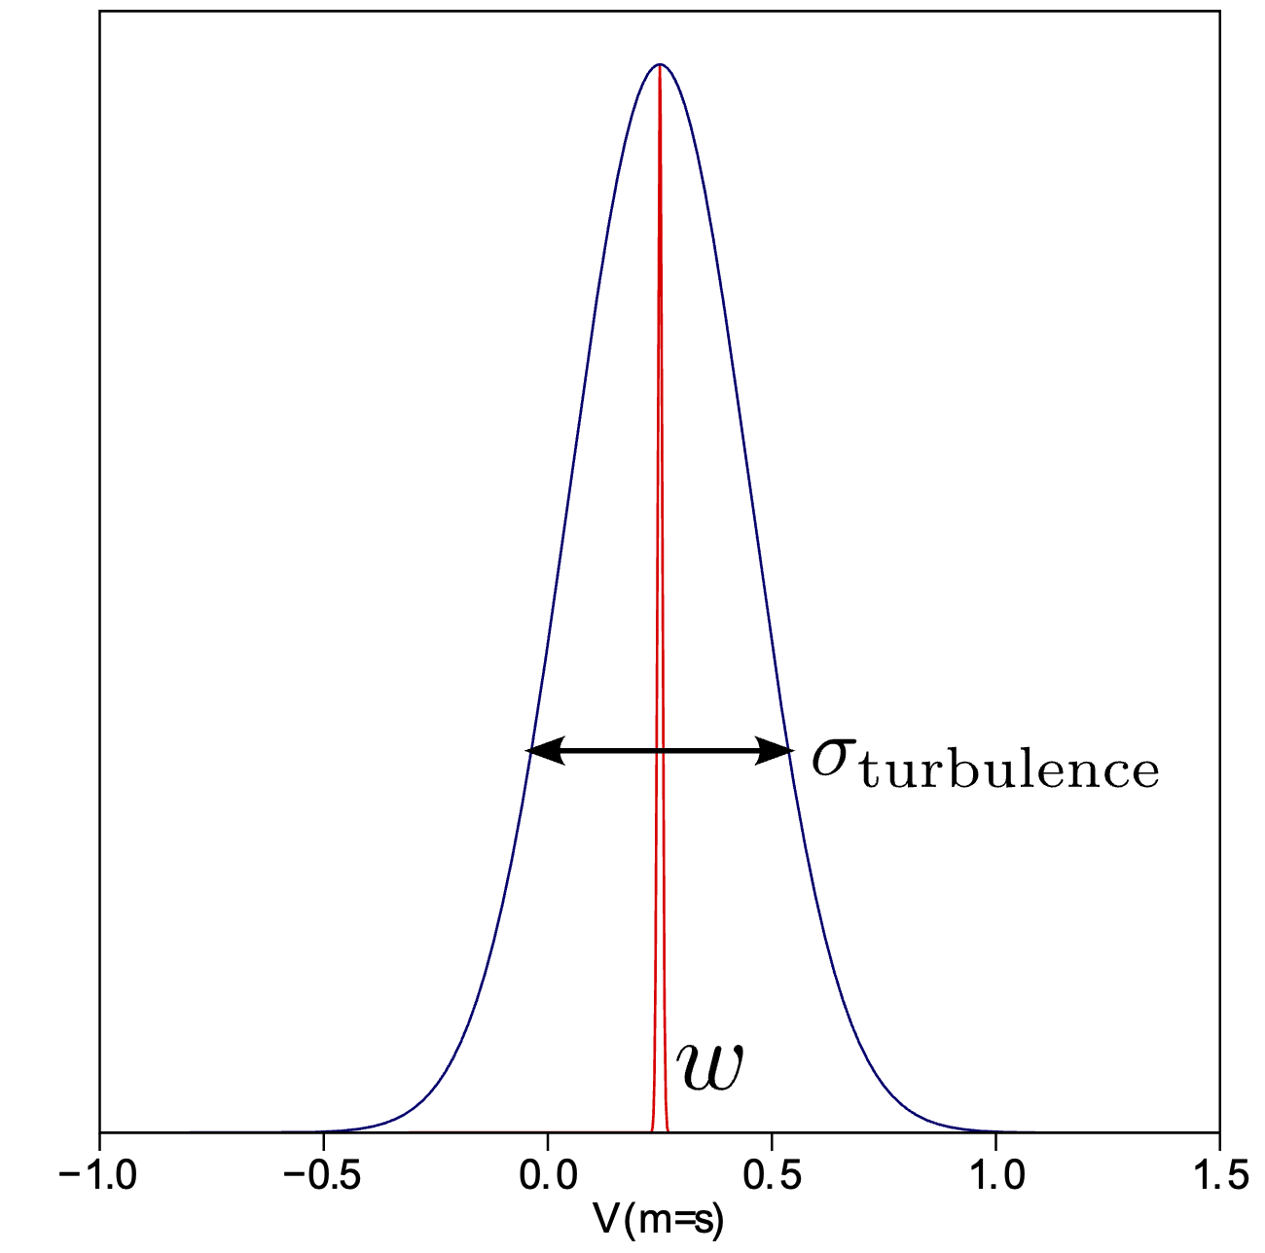
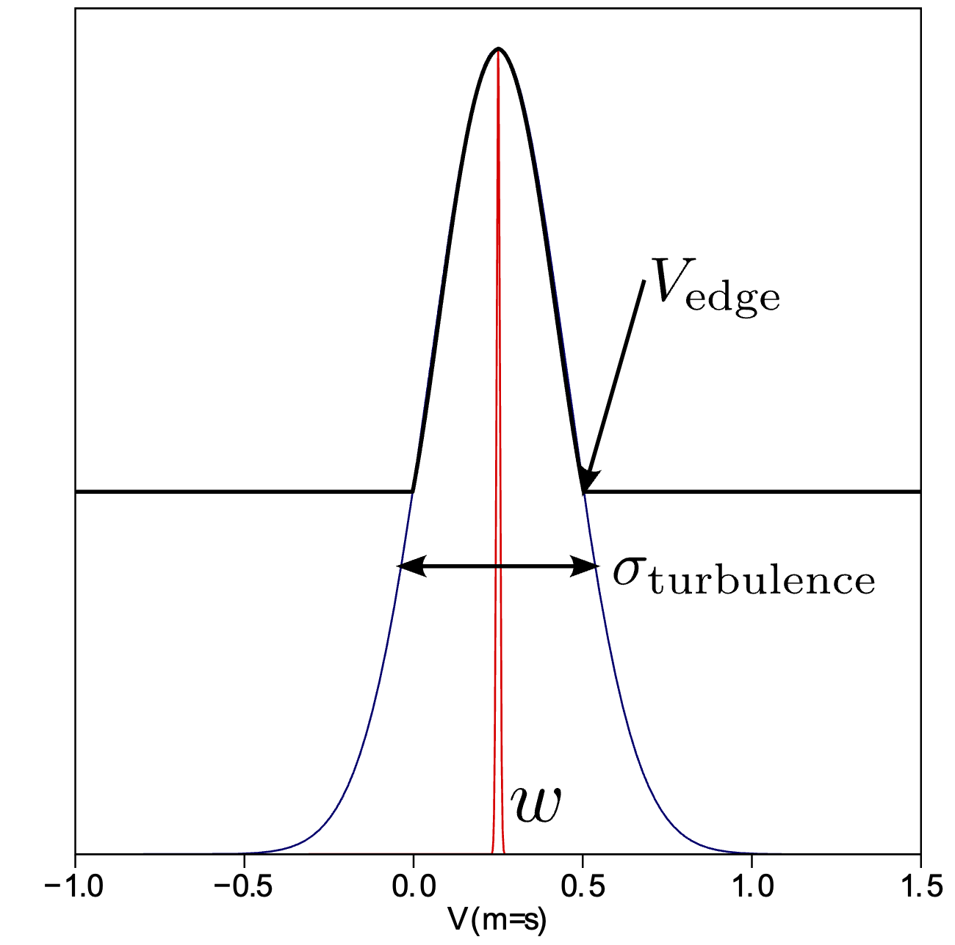
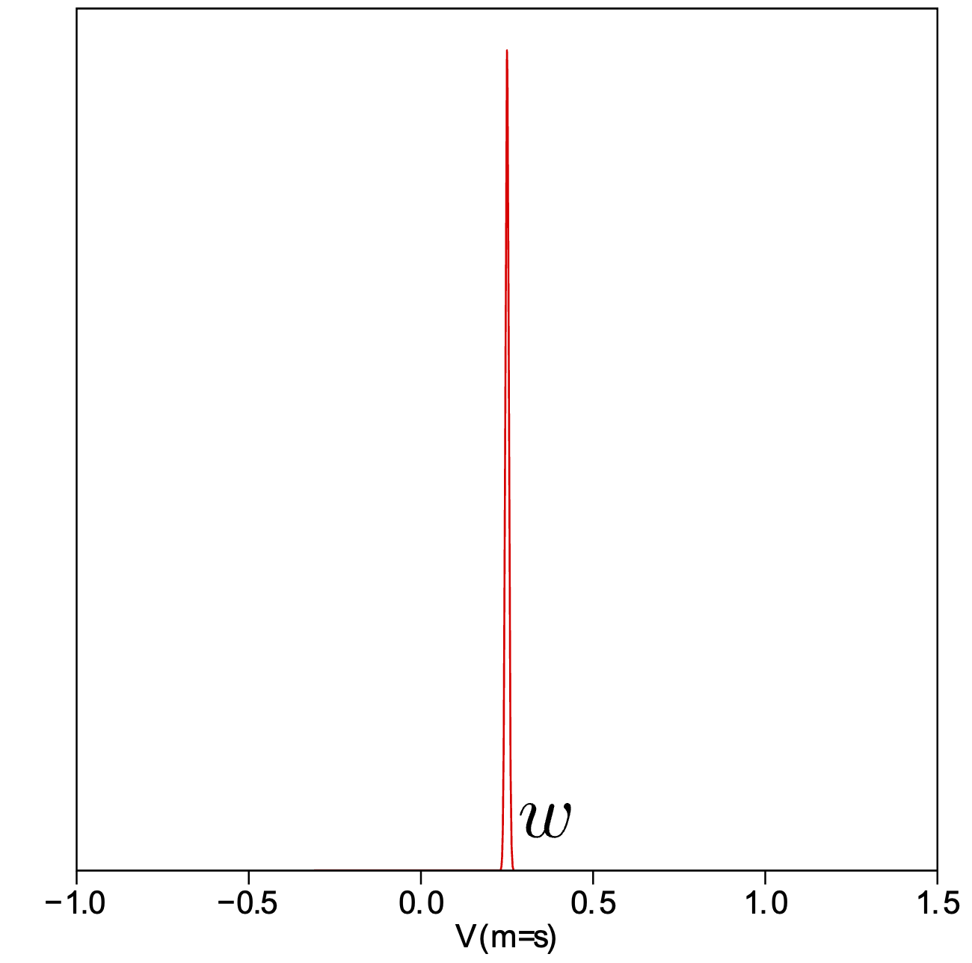

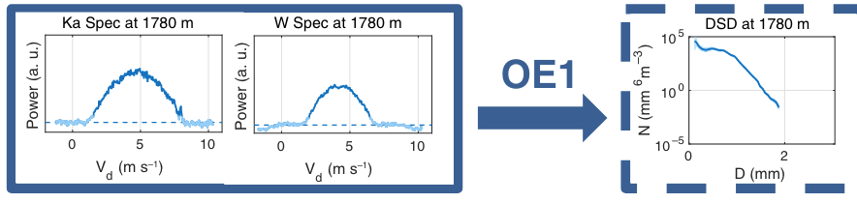

Observed Doppler spectra need to be corrected for vertical wind and turbulence broadening
Single-frequency edge velocity retrieval
Dual-frequency retrieval leveraging Doppler spectral ratio (DSR)
Zhu et al. (2020) & Poydenot et al. (in prep.)
Suited for in-cloud and drizzle
Tridon et al. (2013, 2015, 2017) & Robbins-Blanch et al. (in prep.)
Suited for moderate to heavy rain below cloud base
DSR
$$∆A$$
(a-priori)
v

Slide 9
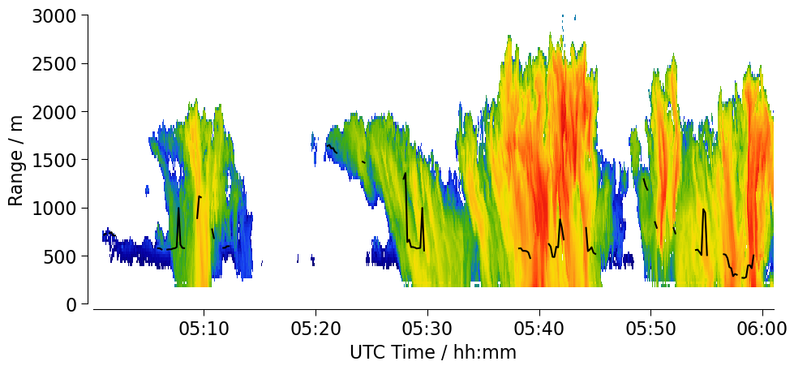
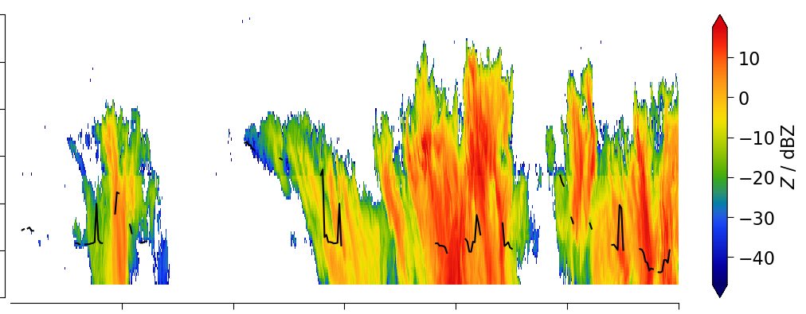
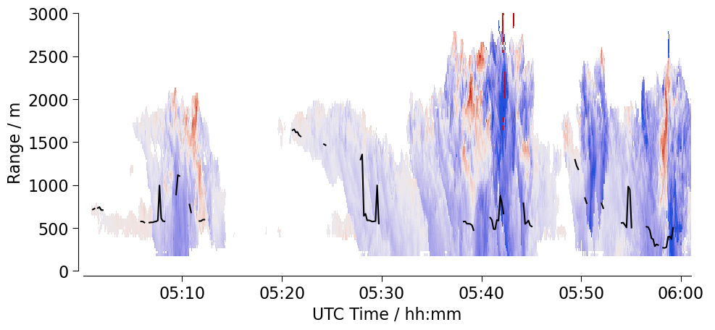
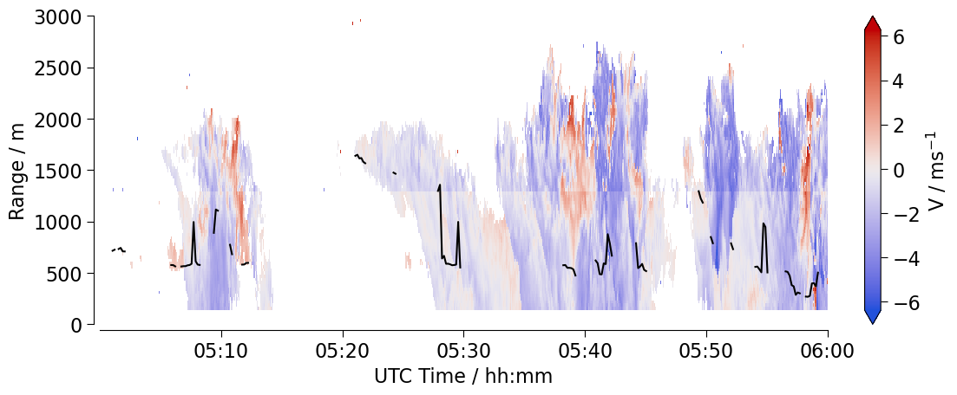
Case study: a moderate rain case in July 2024
Ka-band radar
W-band radar
CBH from ceilometer

Slide 10
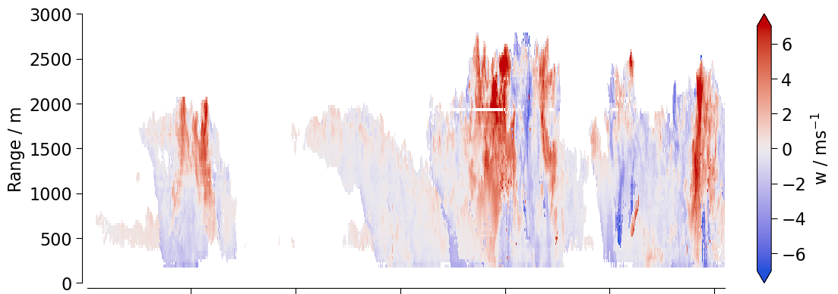
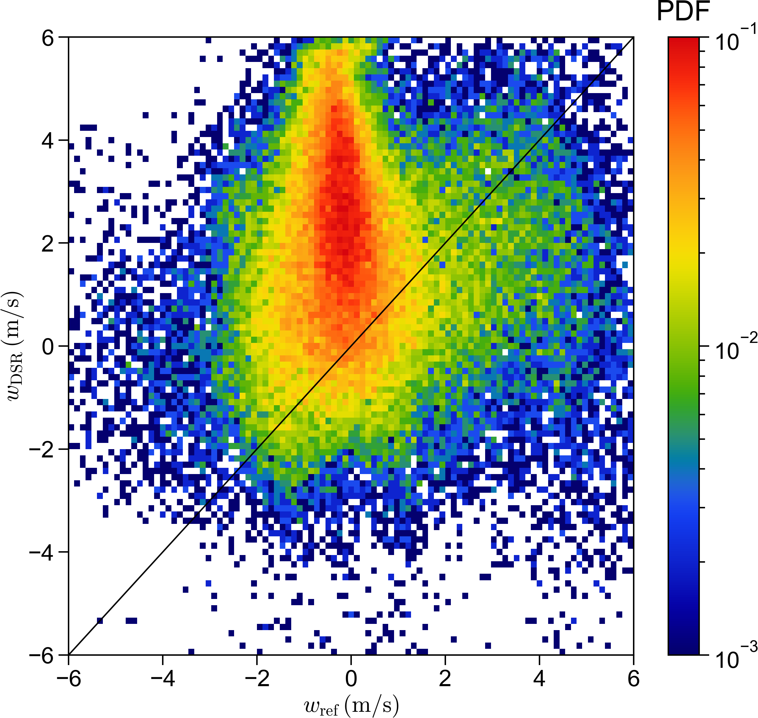
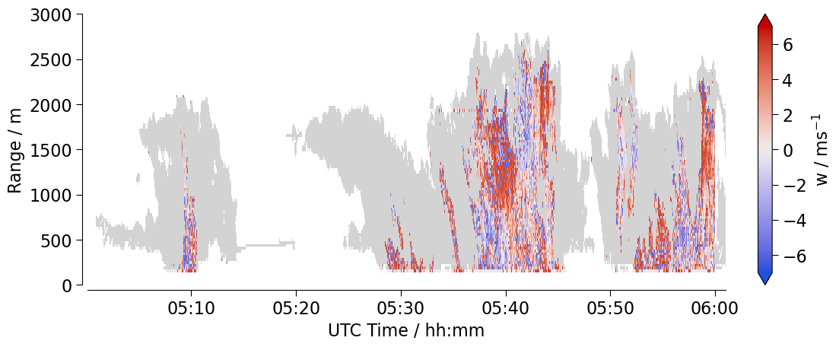


Single frequency retrieval is smoother, and dual-frequency retrieval matches at high SNR
Single frequency retrieval
CBH
$w_{DF}$ / $ms^{−1}$
Dual frequency retrieval
SNR < 40 dB
$w_{SF}$ / $ms^{−1}$
Caution: preliminary data!

Slide 11
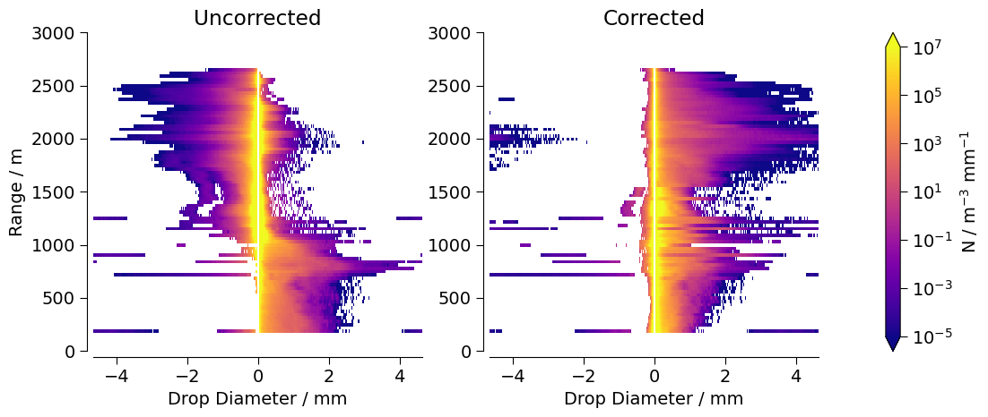
Correcting the DSD by the vertical velocity results in physical drop sizes (>0mm) from true fall velocities
Single frequency retrieval
unphysical

Slide 12
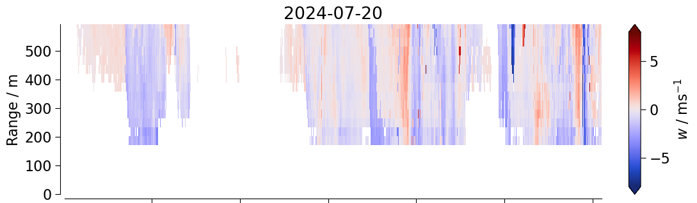
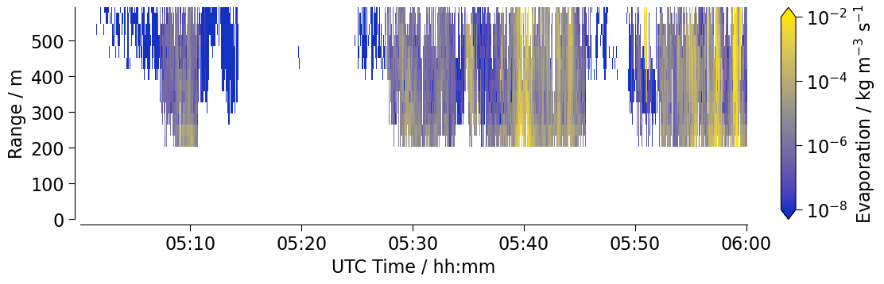
Preliminary evaporation rate retrieval at the subcloud layer
CBH
Stronger evaporation associated with downdrafts.
Order of magnitude is consistent with the literature (Tridon et al., 2017).
More robust evaporation rates expected with dual frequency retrieval.
Single frequency retrieval
Caution: preliminary data!

Slide 13
Different retrievals will have different levels of skill in different regimes
They can be assessed against each other and combined
Single-frequency retrieval
Zhu et al. (2020),
Poydenot et al. (in prep.)
Use for light rain cases, and in combination with the Doppler lidar.
Use to get a first guess of the DSD at cloud base
Dual-frequency retrieval
Tridon et al. (2013, 2015, 2017),
Robbins-Blanch et al. (in prep.)
Use for moderate to heavy rain cases and below cloud base.
Observationally-constrained microphysical model
Sarkar et al. (2025),
Niebaum et al. (in prep.)
Use for the entire BCO period (when dual-frequency measurements are unavailable)

Slide 14
Outlook
How does this data help us understand the role of rain evaporation in determining cloudiness?
What is the vertical structure of rain evaporation? Is it top- or bottom-heavy?
How is rain evaporation influenced by rain intensity and ambient humidity?
How does the vertical distribution of rain evaporation affect boundary layer stability and cloudiness?
Thank you!
Nina Robbins Blanch (nina.robbins.blanch@uni-hamburg.de)

Slide 15
References
Li, Haoran, and Dmitri Moisseev. “Melting Layer Attenuation at Ka- and W-Bands as Derived From Multifrequency Radar Doppler Spectra Observations.” Journal of Geophysical Research: Atmospheres 124, no. 16 (2019): 9520–33. https://doi.org/10.1029/2019JD030316.
Moisseev, Dmitri N., and V. Chandrasekar. “Nonparametric Estimation of Raindrop Size Distributions from Dual-Polarization Radar Spectral Observations.” Journal of Atmospheric and Oceanic Technology 24, no. 6 (June 2007): 1008–18. https://doi.org/10.1175/JTECH2024.1.
Tridon, F., and A. Battaglia. “Dual-Frequency Radar Doppler Spectral Retrieval of Rain Drop Size Distributions and Entangled Dynamics Variables.” Journal of Geophysical Research: Atmospheres 120, no. 11 (2015): 5585–5601. https://doi.org/10.1002/2014JD023023.
Tridon, F., A. Battaglia, E. Luke, and P. Kollias. “Rain Retrieval from Dual-Frequency Radar Doppler Spectra: Validation and Potential for a Midlatitude Precipitating Case-Study.” Quarterly Journal of the Royal Meteorological Society 143, no. 704 (2017): 1364–80. https://doi.org/10.1002/qj.3010.
Tridon, Frédéric, Alessandro Battaglia, and Pavlos Kollias. “Disentangling Mie and Attenuation Effects in Rain Using a Ka-W Dual-Wavelength Doppler Spectral Ratio Technique.” Geophysical Research Letters 40, no. 20 (2013): 5548–52. https://doi.org/10.1002/2013GL057454.
Tridon, Frédéric, Alessandro Battaglia, and Daniel Watters. “Evaporation in Action Sensed by Multiwavelength Doppler Radars.” Journal of Geophysical Research: Atmospheres 122, no. 17 (2017): 9379–90. https://doi.org/10.1002/2016JD025998.
Zhu, Zeen, Pavlos Kollias, Fan Yang, and Edward Luke. “On the Estimation of In-Cloud Vertical Air Motion Using Radar Doppler Spectra.” Geophysical Research Letters 48, no. 1 (2021): e2020GL090682. https://doi.org/10.1029/2020GL090682.

