Slide 1


Relationships between cloud thermodynamic structure and the properties of precipitation from cloud radar and disdrometer observations
Tom Gaudek, Johannes Bühl, Kevin Ohneiser, Martin Radenz, Patric Seifert
PrePEP 2025
20 March 2025

Slide 2
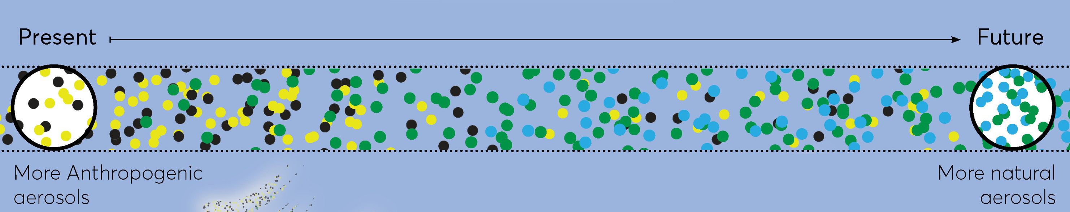
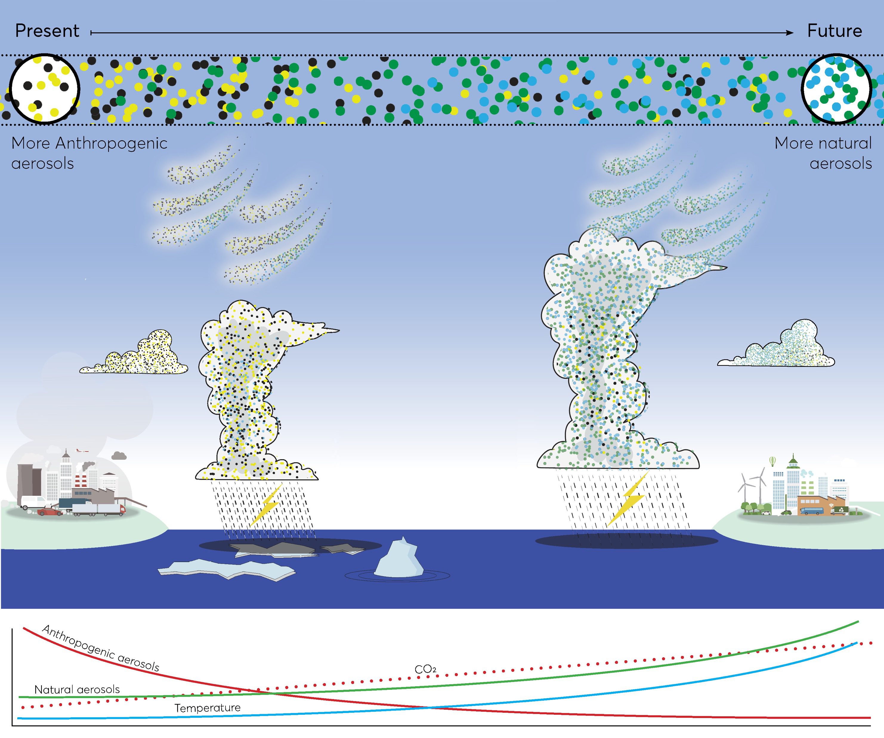
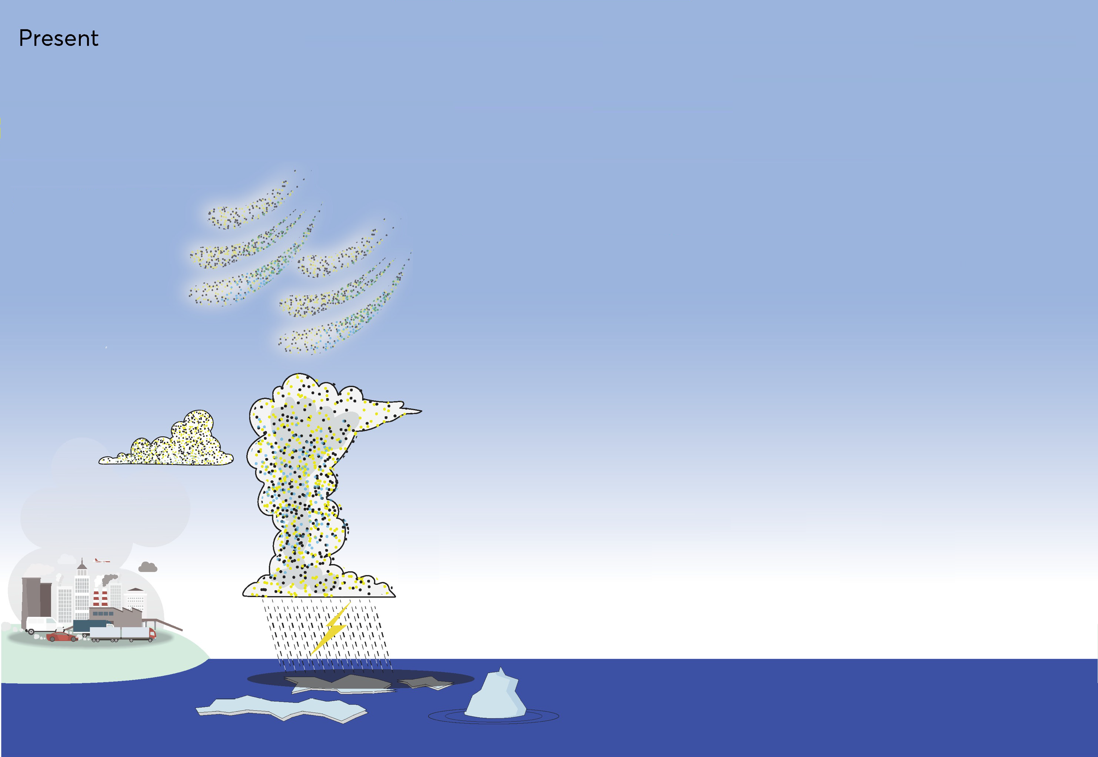
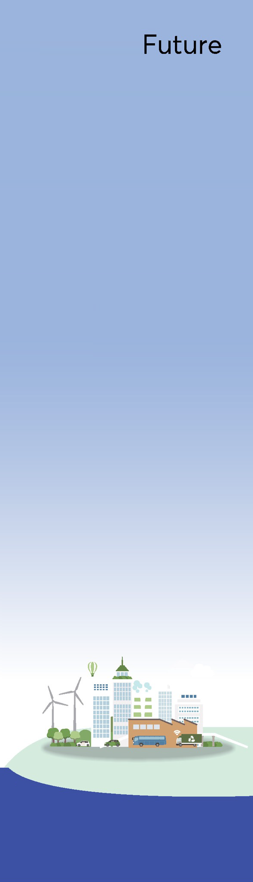
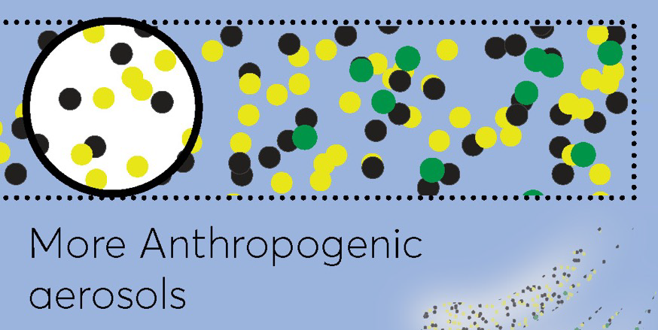
CL
3
Regional to global post
fossil projections
CL
1
Aerosols and
cloud processes
This study:
Relationships between aerosol, temperature, cloud structure, and precipitation for key-sites of climate research
Clouds and climate transitioning to post-fossil aerosol regime
EU project
01/2024 – 12/2027
CL
2
Convective systems and extreme weather
Anthropogenic
aerosols
CO₂
Natural aerosols
Temperature
© https://projects.au.dk/cleancloud/cleancloud-project/work-packages
Notes:
mehr natural: resultiert aus weniger anthropogenic → in jedem fall relativ
one key goal: prepare climate models for the transition of europe from anthropogenic to natural environment
approach: investigate trasition by means of measurements and models
KÜRZER!!!!!!!!!!!!!!!!!!!!!!!

Slide 3
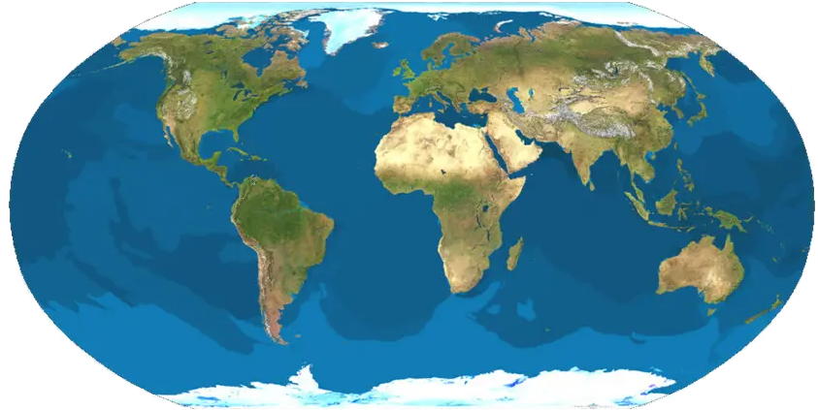
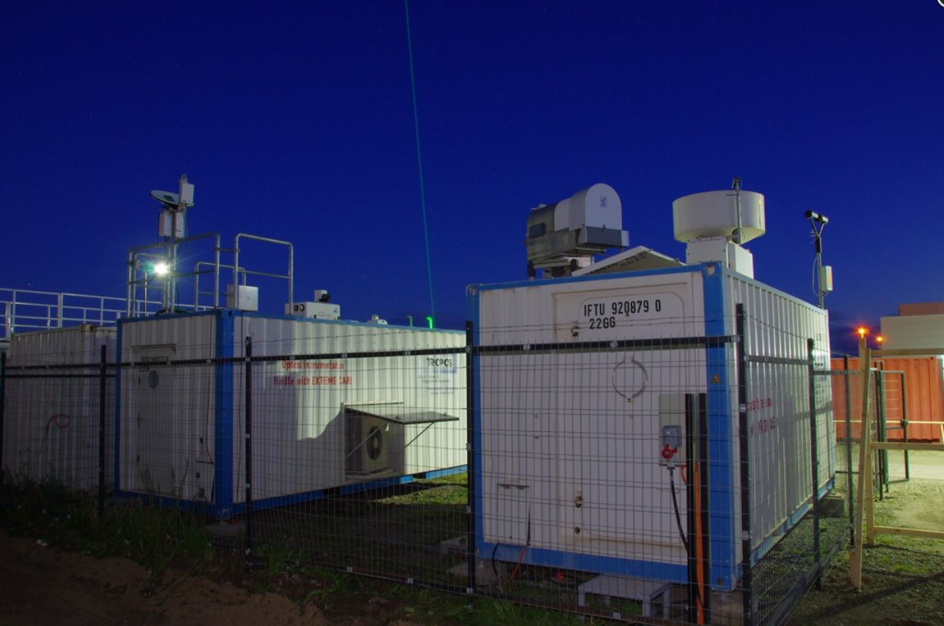

CleanCloud key sites
Leipzig, Germany
Limassol, Cyprus
Campina (ATTO),
Brazil
Invercargill, NZ
Punta Arenas, Chile
Neumayer III
CleanCloud: key regions with different dominating aerosol
LACROS-like stations were operating in most of those key sites
→ longterm Cloudnet datasets available
https://www.tropos.de/

Slide 4
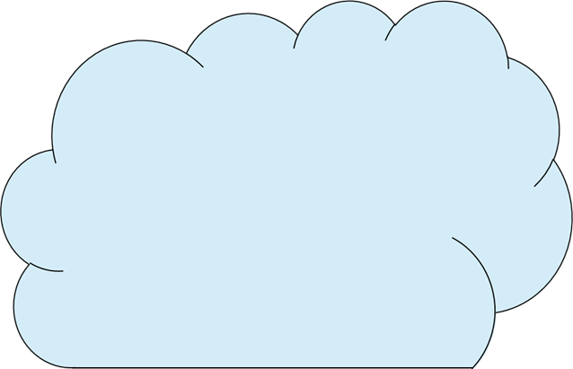
cloud-relevant aerosols
Precipitation formation
cloud condensation nuclei (CCN)
homogeneous ice formation
ice nucleating particles (INP)
heterogeneous ice formation
-37°C
riming
SIP
aggregation
WBF
collision coalescence
liquid water
Primary hydrometeor formation processes are temperature dependent
RH_{i} > 100%
ice particles
SIP – secondary ice production
WBF – Wegener-Bergeron- Findeisen-process
melting
0°C
condensation
RH_{w} > 100%
warm / cold
rain
Notes:
liquid-dependent: immersion, condensation, and contact freezing
! most processes aerosol dependend

Slide 5
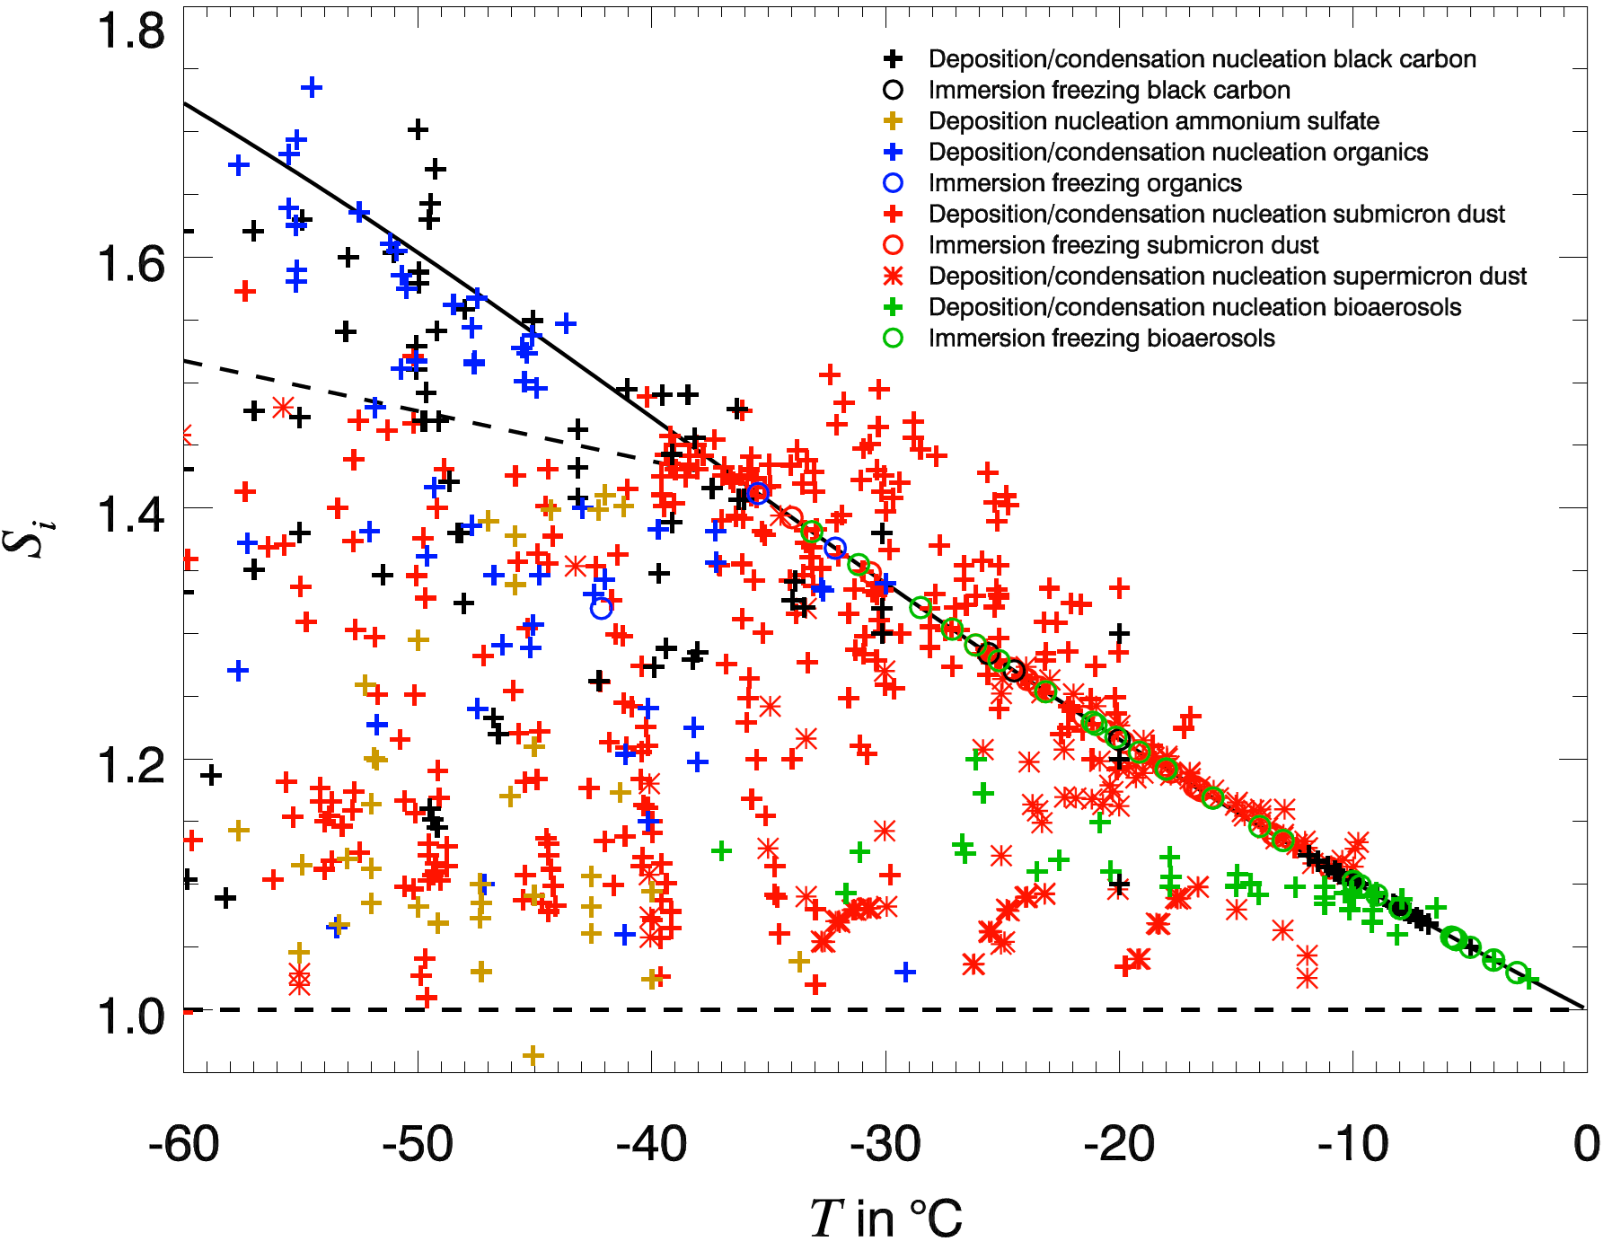
Definition of cloud-top temperature regimes
¹ de Boer et al. (2011, GRL) ³ Westbrook and Illingworth (2011, GRL)
² Ansmann et al. (2009, JGR) ⁴ Koop et al. (2004, ZPC)
Temperature | > 0°C | 0 to -27°C | -27 to -37°C | < -37°C
warm rain
liquid-dependent freezing^{1,2} *
deposition freezing^{1,3}
homogeneous freezing⁴
* liquid-dependent freezing includes immersion, condensation, and contact freezing
ice nucleation onset temperatures and saturation ratios from laboratory experiments
simplified legend:
black carbon
ammonium sulfate
organics
dust
bioaerosols
Freezing processes are temperature-dependent!
In which regions are which processes dominating?
How do models represent the precipitation patterns?
Hoose and Möhler (2012, ACP)
Notes:
boundaries are not super sharp
liquid dependend freezing aerosol dependend → hauptaugenmerk liquid → zu erwarten: Niederschlag ändert sich mit veränderten Aerosoleigenschaften
model evaluation

Slide 6
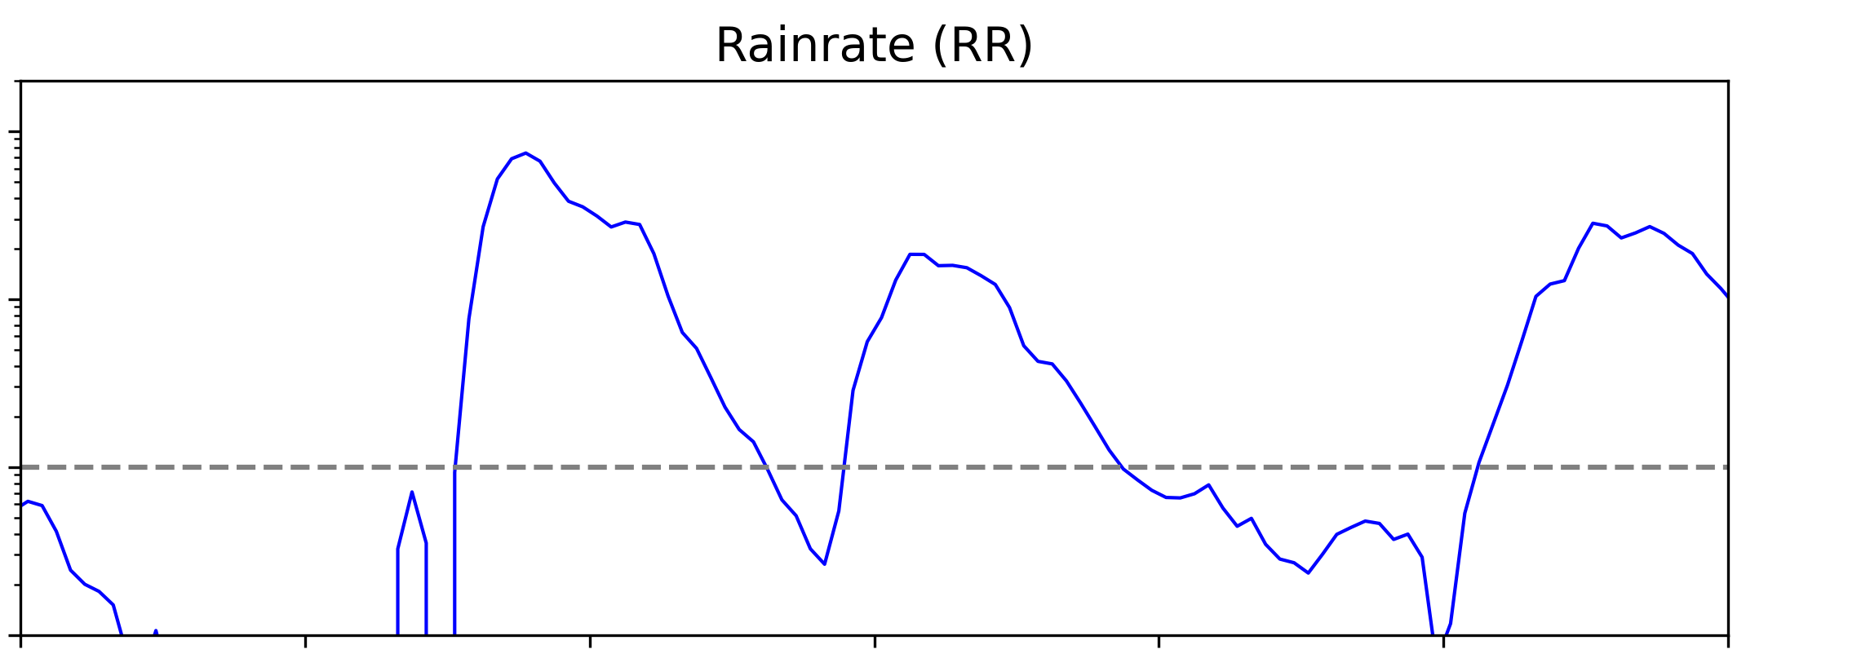

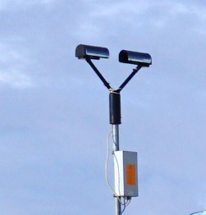

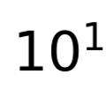



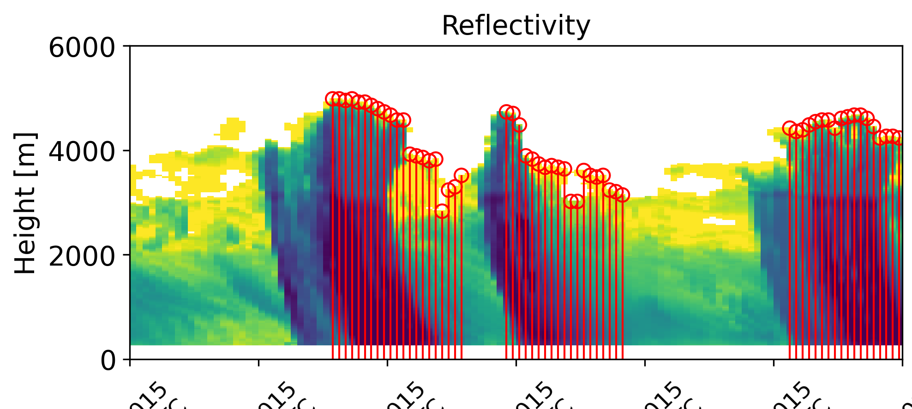
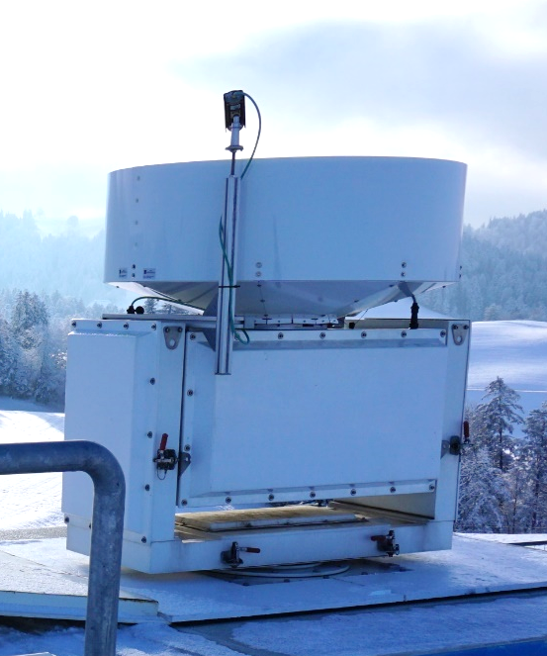
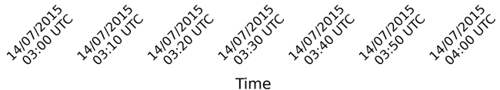
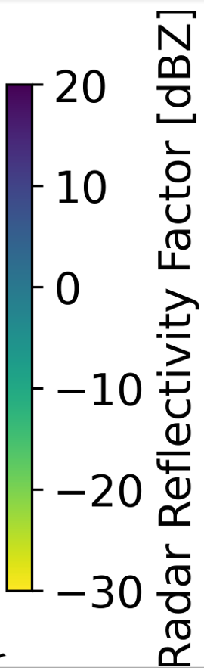
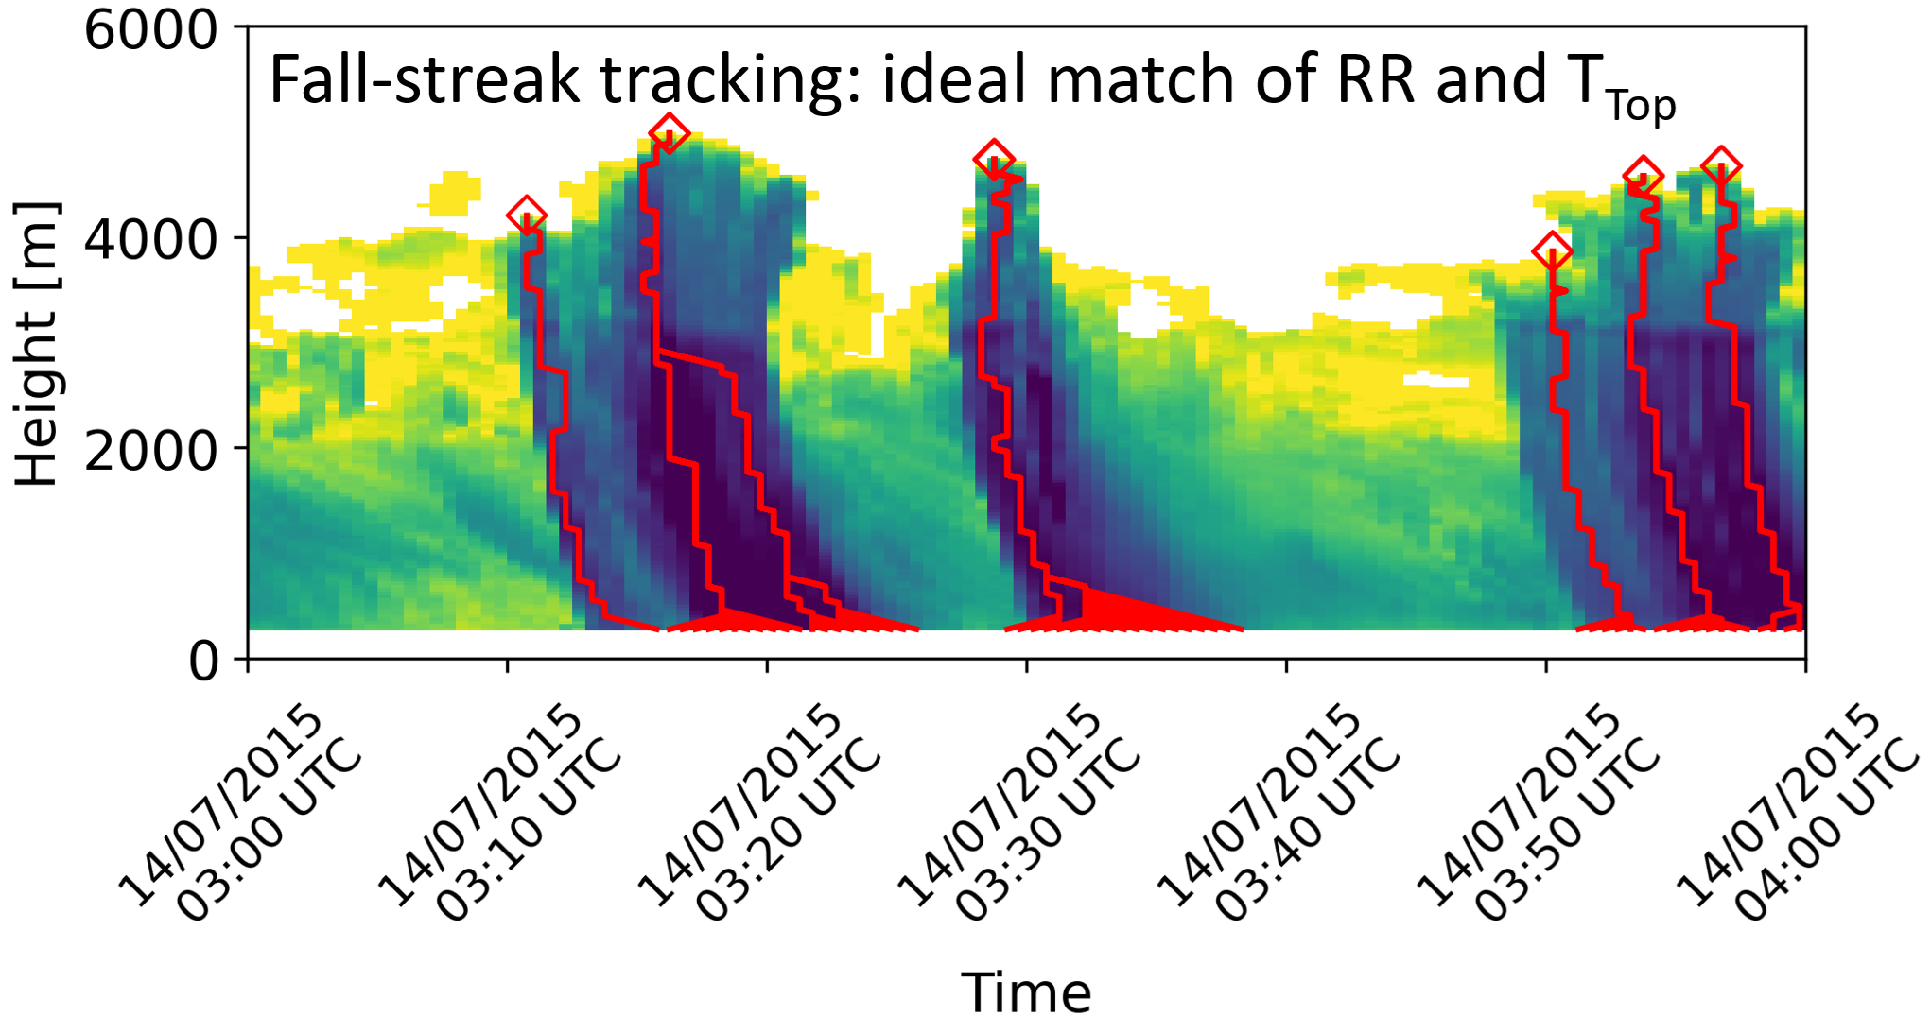
Cloud properties versus precipitation rate (CLOPPER)
The idea of CLOPPER:
idea: different temperature regimes can be assigned to certain hydrometeor formation processes
combination of disdrometer, cloud radar, and ECMWF IFS model is used (combined in CLOUDNET categorize files)
fallstreak algorithm is applied
Profile-based approach: risk of mismatches
PR
Notes:
preip → t

Slide 7
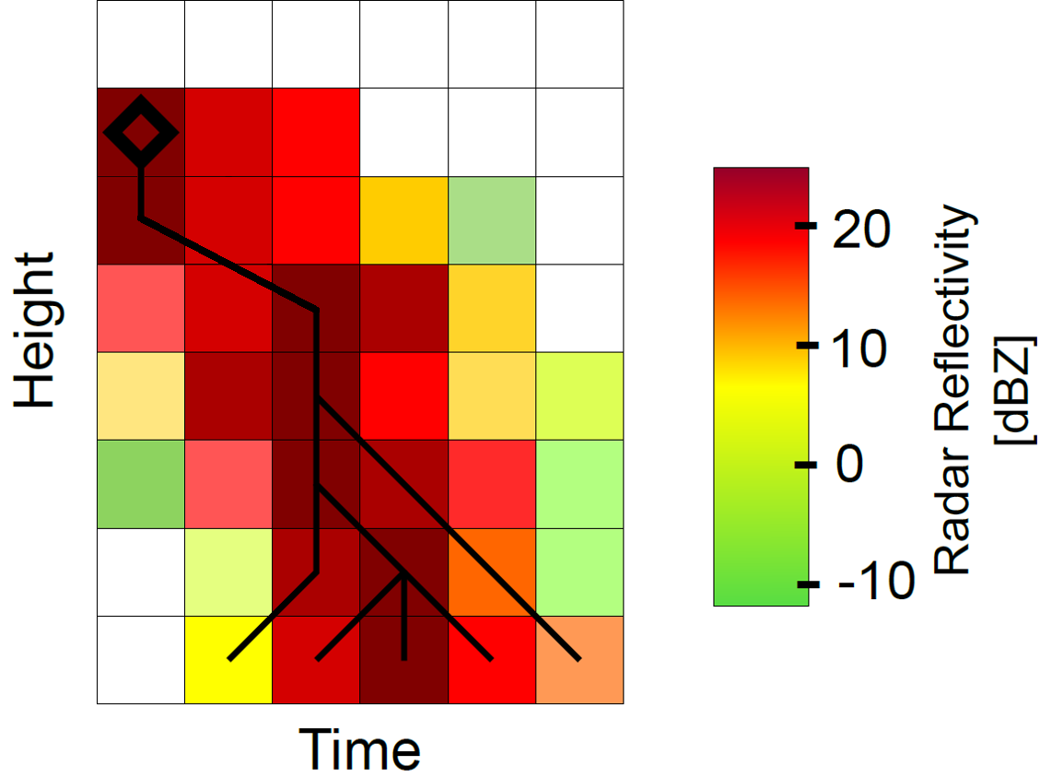
Cloud properties versus precipitation rate (CLOPPER)
The idea of CLOPPER:
idea: different temperature regimes can be assigned to certain hydrometeor formation processes
combination of disdrometer, cloud radar, and ECMWF IFS model is used (combined in CLOUDNET categorize files)
fallstreak algorithm is applied
Profile-based approach: risk of mismatches
schematic fallstreak reconstruction
PR
T < 0°C
±2
T > 0°C
±1
time bin tolerance for next height level
Notes:
Why? → CTT indicates… , freezing process, ….
What for? → for …, model comparison, …
CTT vs PR algorithm
Where is the cloud top? → fallstreak algorithm(s

Slide 8
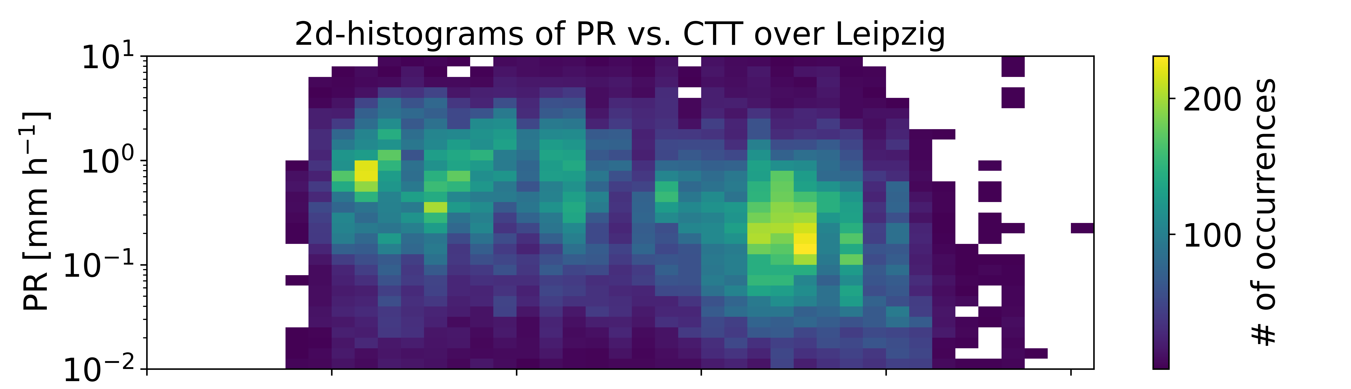
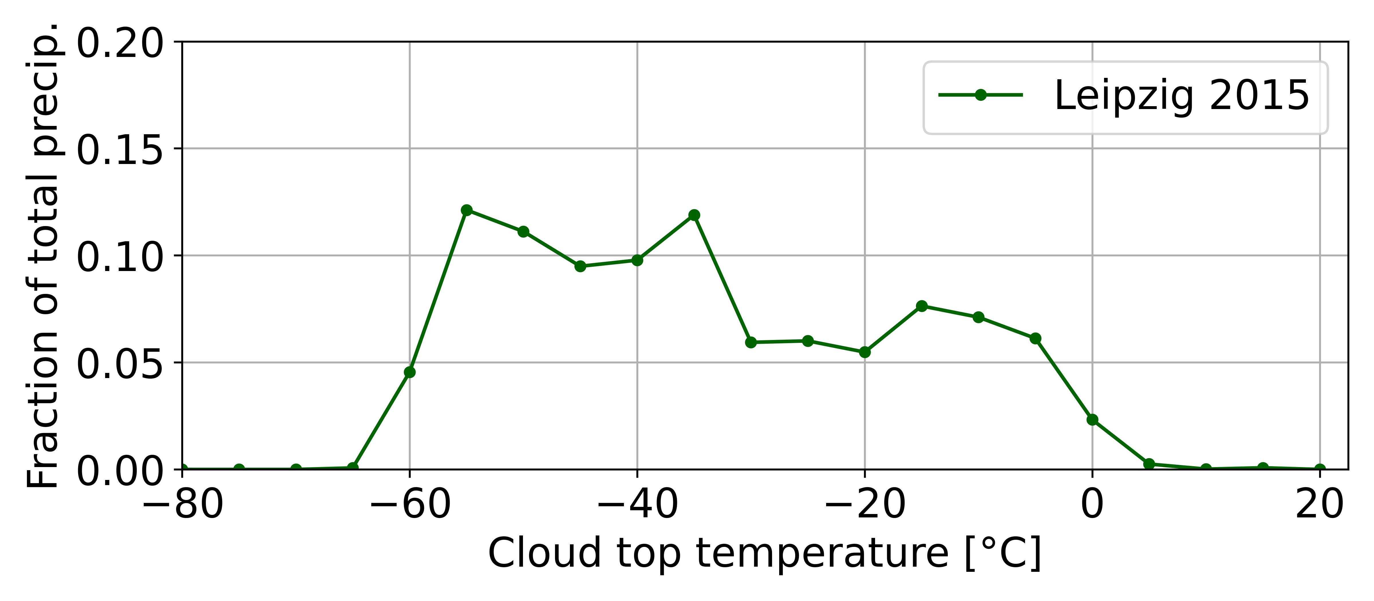
Statistics for Leipzig 2015
Leipzig
01/2015 – 12/2015
homogeneous &| deposition freezing (< -37°C): 49%
liquid-dep. &| deposition freezing (-37°C – -27°C): 16%
liquid-dep. &| warm rain (-27°C – 0°C): 33%
warm rain (> 0°C): 2%
49% 16% 33% 2%
-37 -27 0
-
Notes:
in linke grafik die regime
statistik darunter mit vertikalen linken

Slide 9
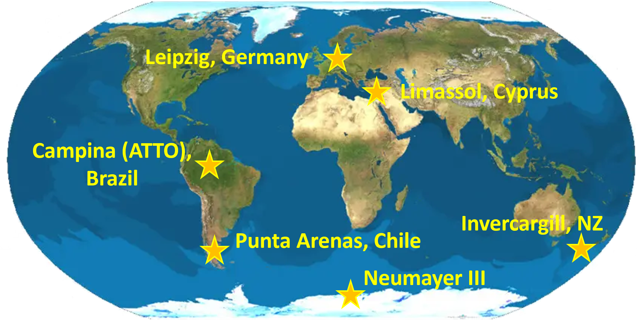
Summary
CLOPPER: assignment of precipitation formation processes to temperature regimes
Temperature | 0°C warm rain | 0 to -27°C liquid-dep. &| warm rain | -27 to -37°C liquid-dep. &| depos. freezing | < -37°C hom. &| depos. freezing
Leipzig | 2% | 33% | 16% | 49%
Outlook
CLOPPER will be applied to different stations
CLOPPER can be extended
  in-cloud vertical velocity
  ambient aerosol properties
  evolution of hydrometeor and habits
combined cloud tracking studies
  analyse the impact of the air mass origin on detected clouds
Notes:
summary über outlook (mit zahlen für jedes regime)
hier sagen, „wie wir in den vorherigen Vorträgen schon gehört haben, gibt es interessante Techniken zur Detektion von Aerosol oder Cloud Dynamik properties…“

Slide 10
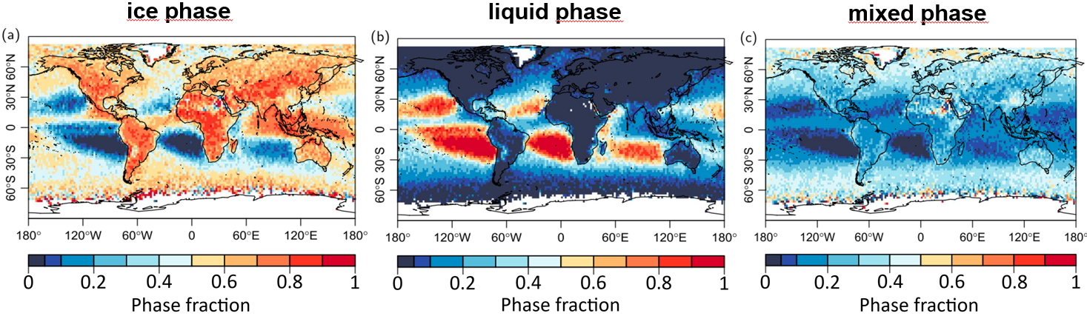
Observation of cloud and precipitation processes
Leipzig, Germany
Limassol, Cyprus
Punta Arenas, Chile
satellite-based observation of cloud phase during rain events⁵
Heymsfield et al. (2020): global cloud phase fractions during precipitation events
→ combined satellite and modelling data
57% cold rain; 15% combination of cold and warm rain; 23% warm rain; 5% precipitating ice⁶
hemispheric contrast studies: average INP concentrations for different stations derived by ground-based lidar measurements⁷
___________________________
⁵ Mülmenstädt et al. (2015, GRL)
⁶ Heymsfield et al. (2020, JAS)
⁷ Radenz et al. (2021, ACP)
Notes:
short selection of what has already been done in this field and what is relevant for my study
Radenz: stationary ground-based observations; multi-year datasets
Heymsfield: can these numbers be refined?

Slide 11
Aerosols, Clouds and Precipitation
heterogeneous (primary) ice formation processes
ice nucleating particle (INP)
immersion freezing
deposition freezing
liquid water
T
ice particle
RH_{w} > 100%
water vapour
contact nucleation
condensation freezing
contact nucleation
+ condensation freezing
+ immersion freezing
→ liquid-dependent freezing processes
RH_{i} > 100%
_________________________
⁸ de Boer et al. (2011, GRL)
¹¹ Ansmann et al. (2009, JGR)
¹² Knopf and Alpert (2023, NRP)
Notes:
immersion freezing: INP is immersed within a supercooled water droplet (INP is enclosed by liquid water)
difference to condensation freezing: Droplet used to be warmer than INP activation temperature

Slide 12
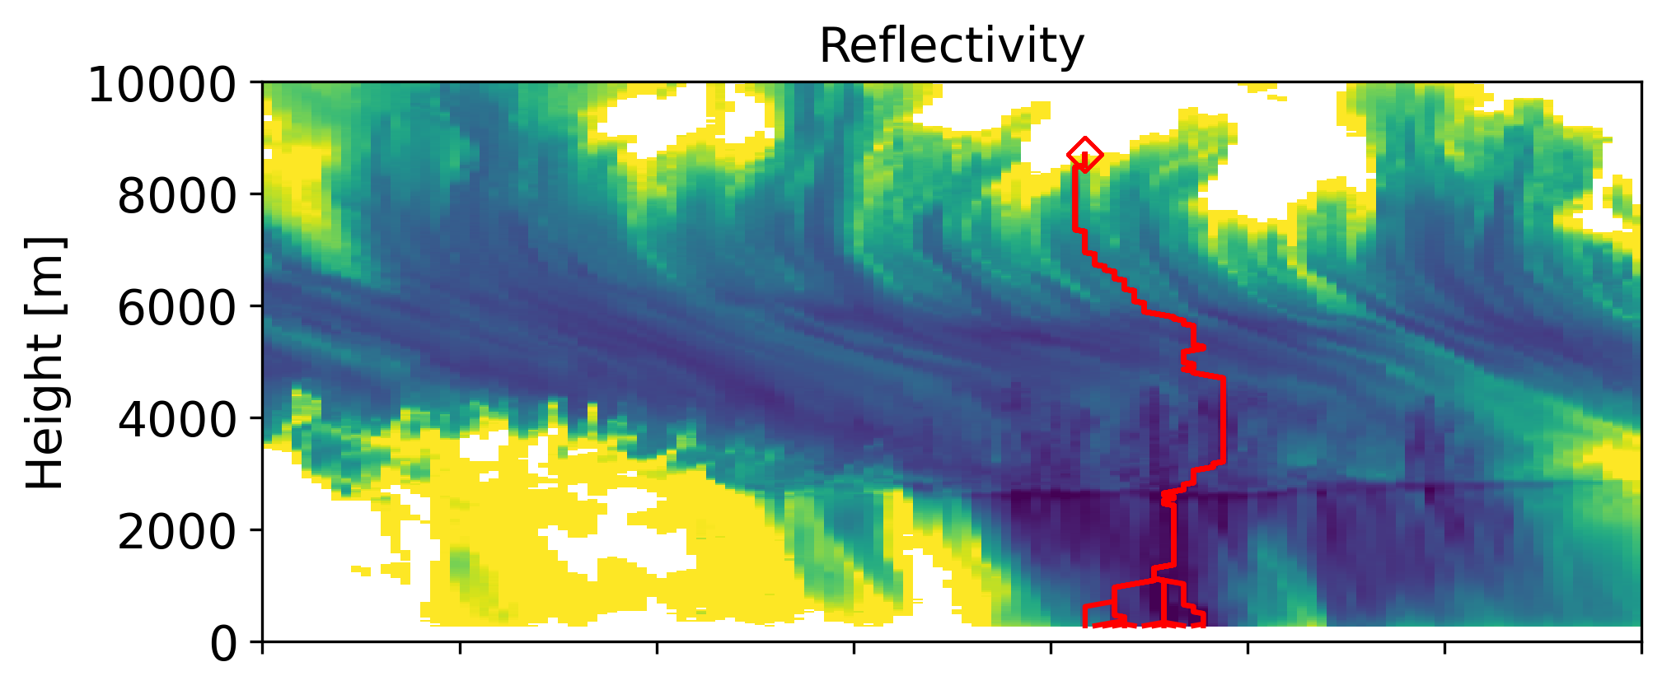





13 Jul 2015
13:50 – 15:00
±5
±1
time bin tolerance for next height level
±2
±2
±1
±3
±3
±1

Slide 13
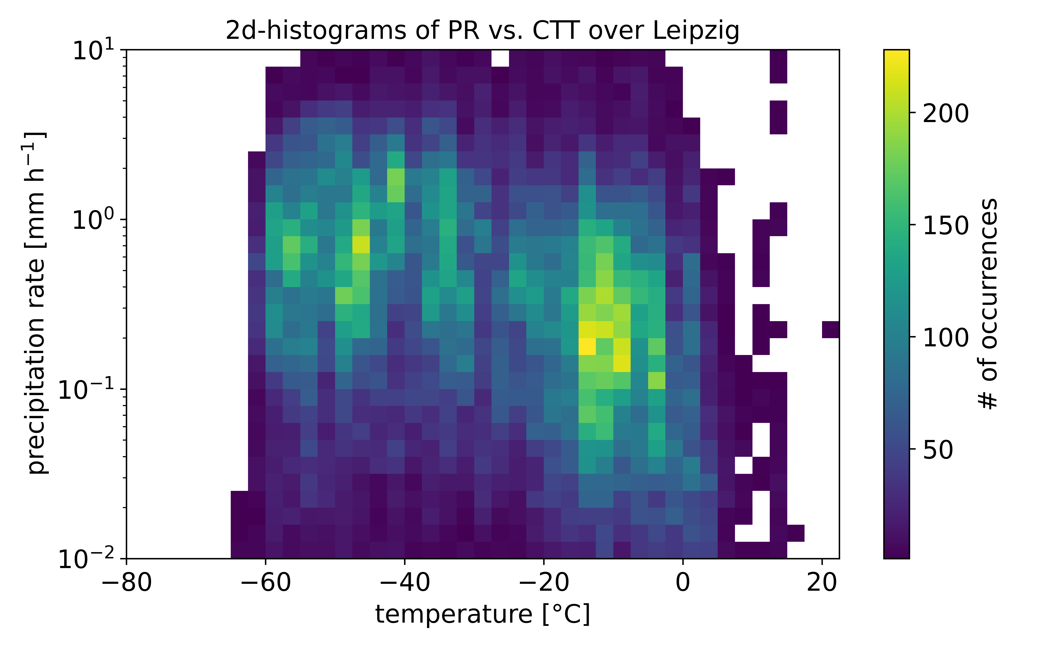
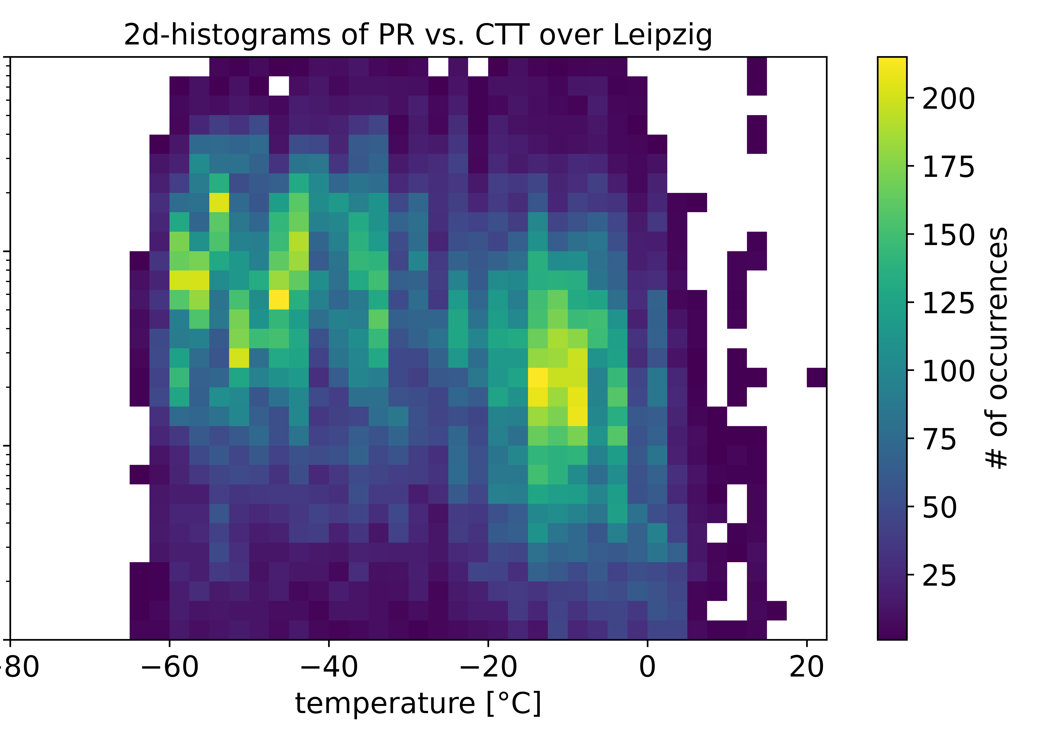
Statistics over Leipzig – V1 vs. V2
±3
T < 0°C
Version 1
±1
all T
Version 2
±1
T > 0°C

