Slide 1



ROTOЯ - Constraining the role of warm rain processes for cloud amount and cloud organization in the trades
Raphaela Vogel, Nils Antary, Clara Bayley, Nils Niebaum, Florian Poydenot, Nina Robbins-Blanch, Jan Kazil, Mampi Sarkar, Zeen Zhu
Trade cumulus clouds during EUREC⁴A field campaign

Slide 2
...the silent majority
major source of uncertainty in global warming (Bony & Dufresne 2005, Zelinka et al. 2020)
Trade cumulus clouds during EUREC⁴A field campaign

Slide 3

...relevance for radiation budget?
evaporation of tiny raindrops critically impacts the mesoscale cloud field
(Credit: ORCESTRA / Stevens)

Slide 4
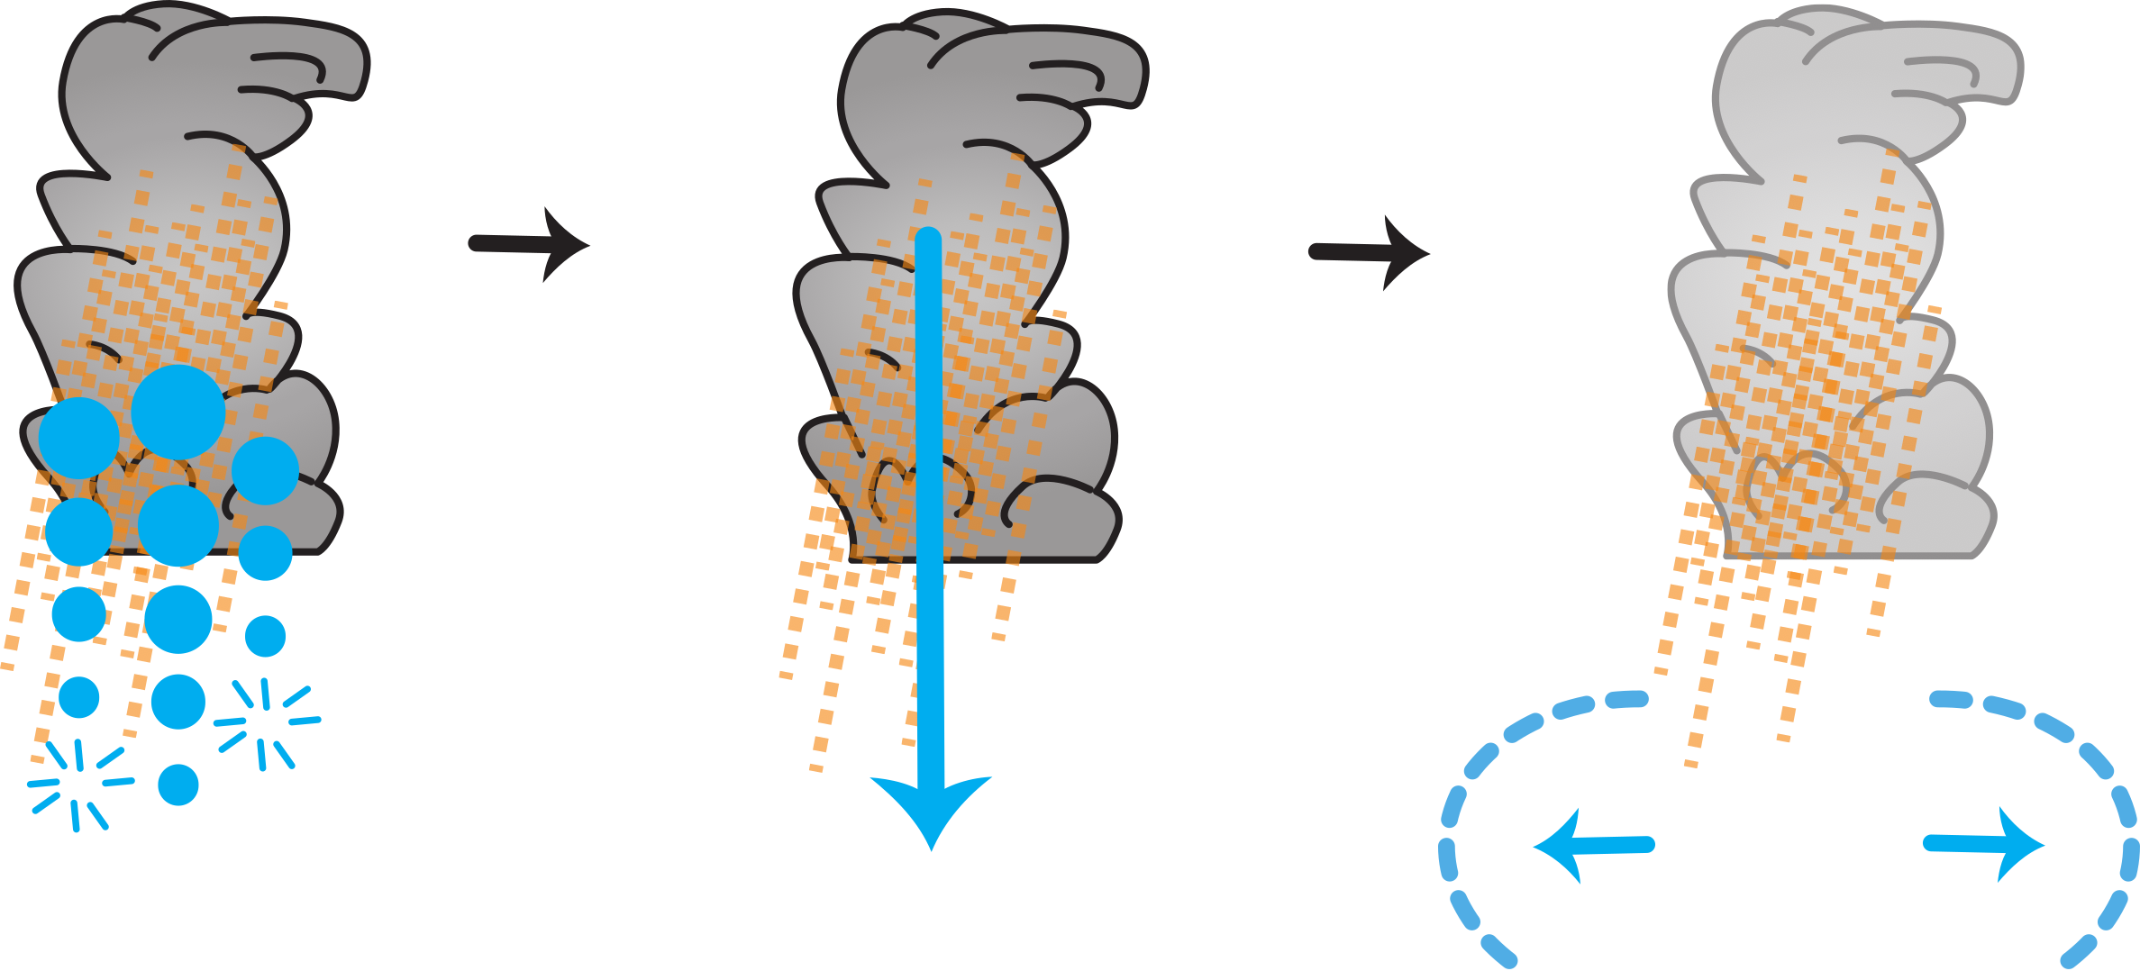
How rain evaporation can influence the mesoscale structure of a cloud field
2.5 km
evaporation
downdrafts
cold pools
initiation of new (deeper) clouds
cloud suppression
Rain drops evaporate in the unsaturated air below clouds
Induces cooling and negative buoyancy, accelerating the air towards the ground → downdraft
Spreads out radially at the surface as a density current → cold pool
Cloudiness suppressed inside cold pool (cloud holes) but enhanced at the gust front (cloud arcs)
especially when cold-pools collide (e.g., Zuidema et al. 2017, Schlemmer & Hohenegger 2014, Torri & Kuang 2016)
Although not deeper than ~2-3 km, about 30% of trade cumuli rain (Nuijens et al. 2017) & cold pools occur about 8% of the time in the winter trades (Vogel et al. 2021, Touzé-Peiffer et al. 2022)

Slide 5

Importance of rain evaporation and cold pools for weather and climate
Ubiquity of cold pools in trades well-documented, but fundamental understanding of their role for mean state, cloud organization & cloud amount missing
Also: potential changes with warming very unclear
Challenges:
Multiscale & Multiphysics
Parameterized / neglected in coarse models
Uncertain skill of high-resolution models
Lack of robust rain process observations
(Credit: ORCESTRA / Stevens)
$$\sim 200 km$$
Radiation, Aerosols & Cloud microphysics
Shallow & deep convection
Turbulence
mesoscale
Planetary waves
Gravity waves
1mm 1m 1km 10km 100km 1000km global
Large-eddy simulation
traditional GCMs
Coupled storm-resolving simulations

Slide 6
ERC starting grant ROTOЯ*
Radiative budget: Do cold pools reduce total cloudiness?
Mesoscale organization: What role do they play in the patterning of clouds?
*Rain and cloud Organization in the Trades using ObseRvations and models

Slide 7
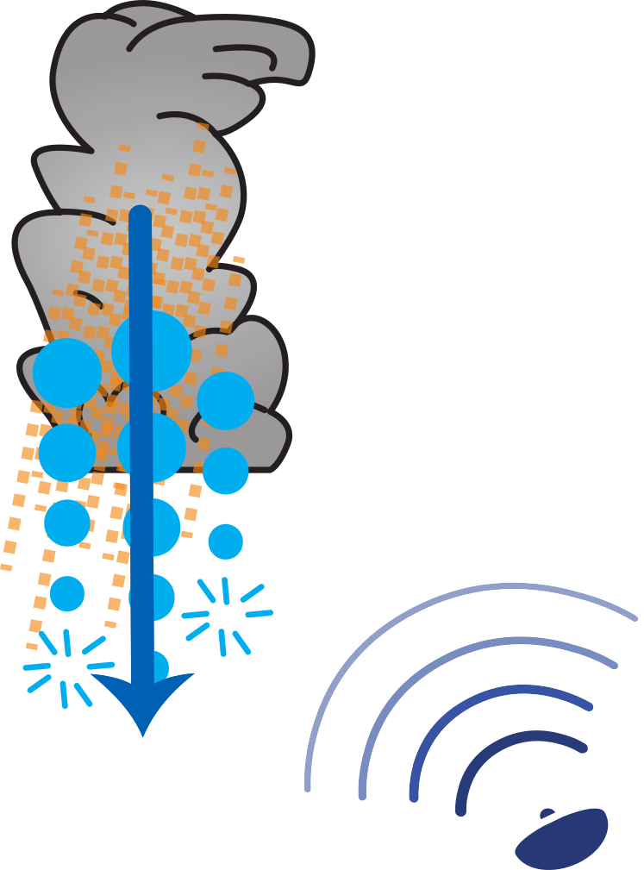
ERC starting grant ROTOЯ*
Radiative budget: Do cold pools reduce total cloudiness?
Mesoscale organization: What role do they play in the patterning of clouds?
Tool 1:
Create a >10-year dataset of rain evaporation & downdraft profiles from radar-lidar synergy & 1D rainshaft models
Apply Doppler & multi-frequency methods (Zhu et al. 2021, Tridon et al. 2017) to BCO & EUREC⁴A data
Assess robustness combining different approaches
→ Nina Robbins-Blanch’s talk earlier today!

Slide 8
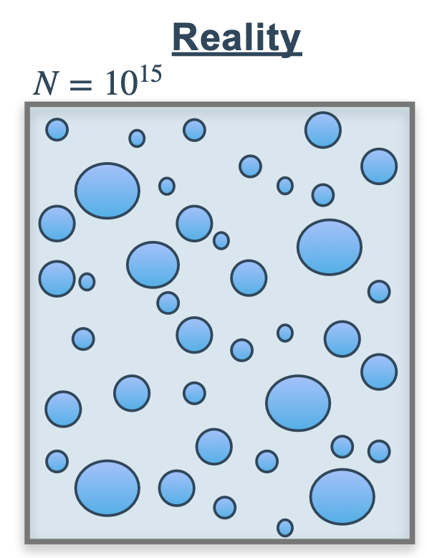
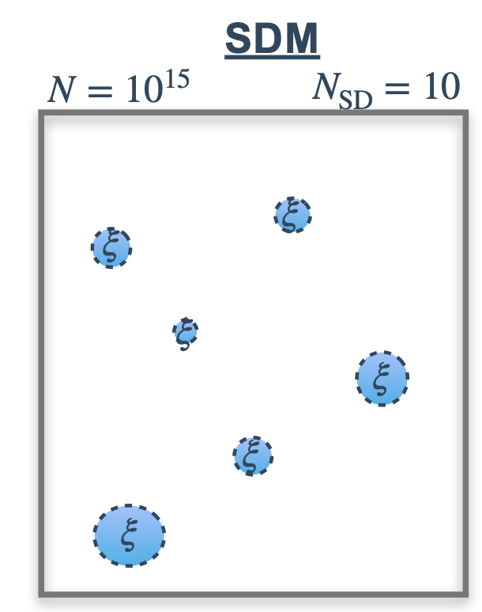
ERC starting grant ROTOЯ*
Radiative budget: Do cold pools reduce total cloudiness?
Mesoscale organization: What role do they play in the patterning of clouds?
Tool 1:
Create a >10-year dataset of rain evaporation & downdraft profiles from radar-lidar synergy & 1D rainshaft models
Tool 2:
Perform high-resolution large domain simulations with Super-droplet microphysics (SDM)
(Clara Bayley, Shima et al. 2009)
Apply Doppler & multi-frequency methods (Zhu et al. 2021, Tridon et al. 2017) to BCO & EUREC⁴A data
Assess robustness combining different approaches
→ Nina Robbins-Blanch’s talk earlier today!
ICON LES with Clara Bayley’s new SDM CLEO
Quantitative model evaluation with new obs
Cold-Pool Model Intercomparison project (with J. Kazil & others)
Benchmark for new global km-scale simulations (e.g., NextGEMS, DestinE) and new satellite data (e.g., EarthCARE, INCUS, WIVERN...)

Slide 9
Early ROTOЯ results
1. Vertical air-motion retrieval of Zhu et al. 2021 developed for stratocumulus applicable to trade cumulus regime (Poydenot, Zhu et al., in prep)
2. Collision-coalescence-breakup processes not relevant for rain evaporation for the light rain rates measured during the EUREC⁴A field campaign (Niebaum, Bayley et al., in prep)
3. Simulated cold pool properties show (some) consistency among large-eddy simulation models for idealized trade-wind case (Antary, Kazil et al., in prep)

Slide 10
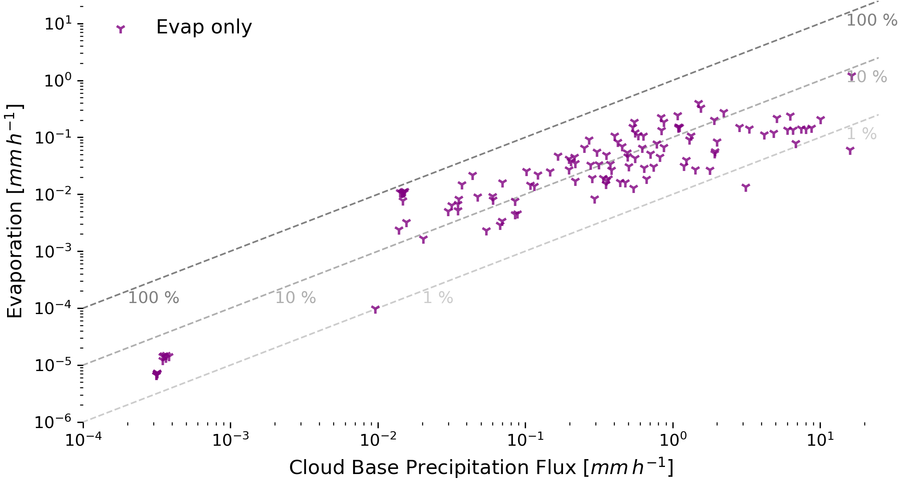
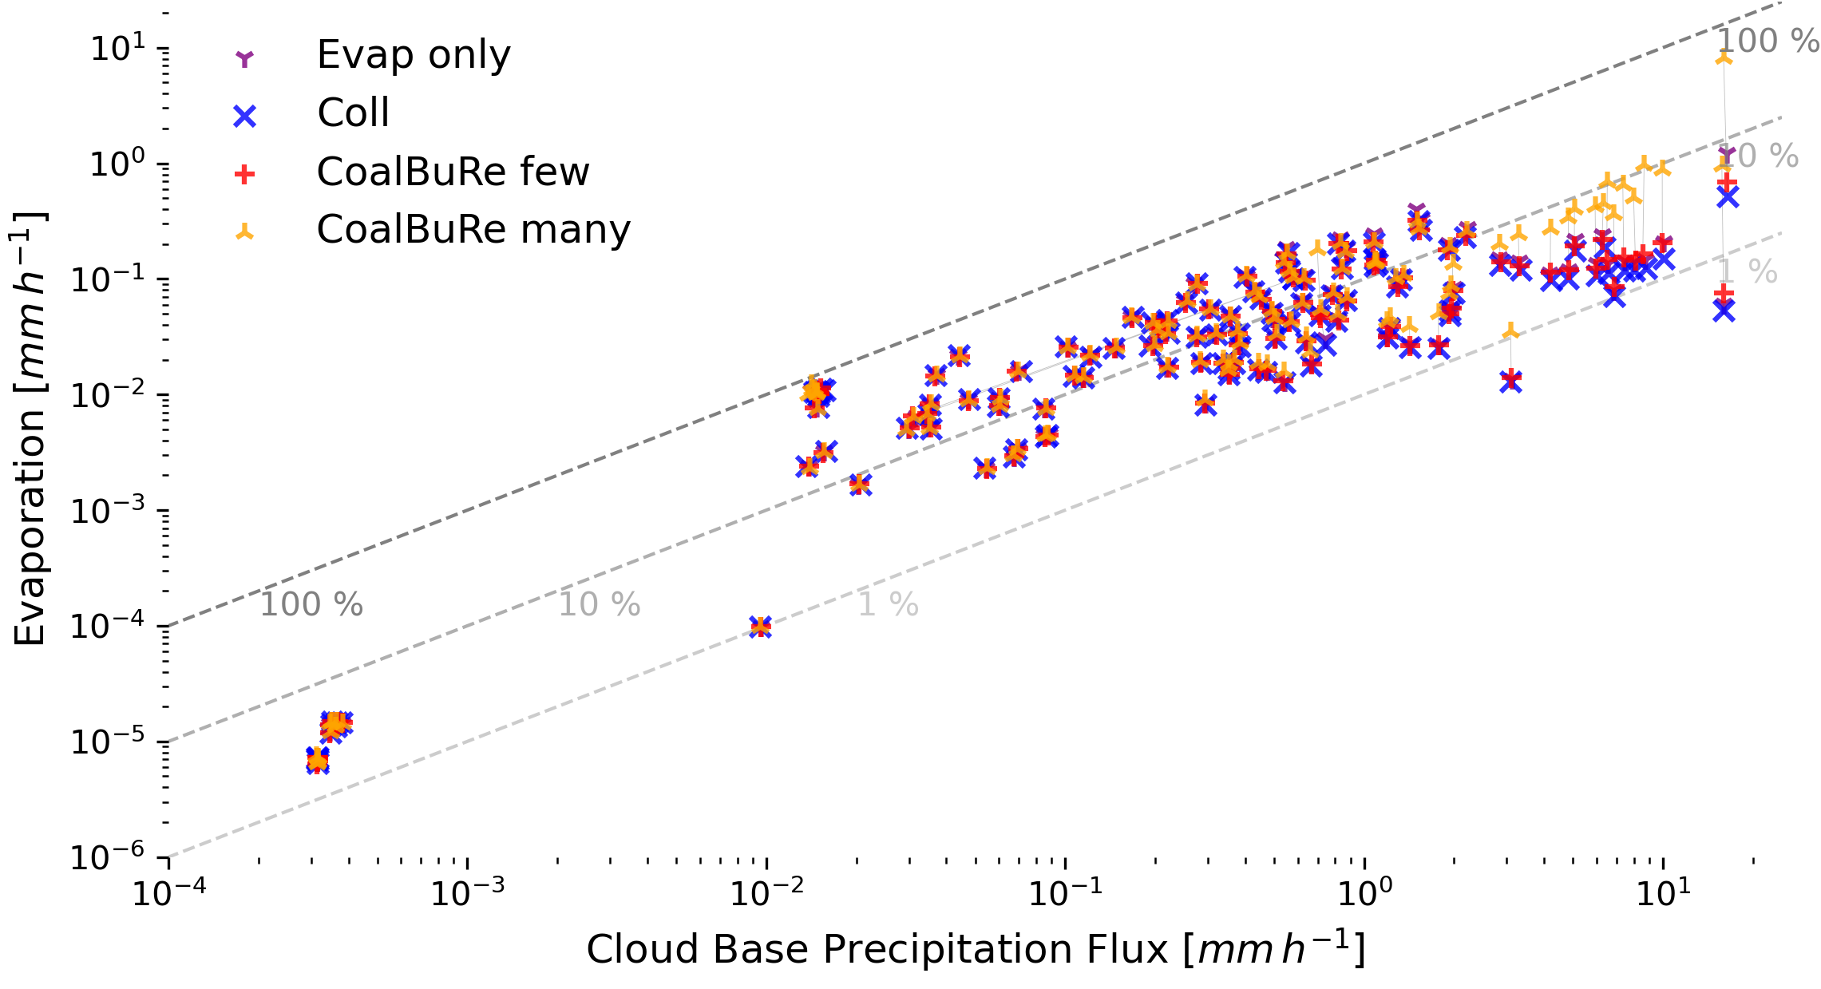
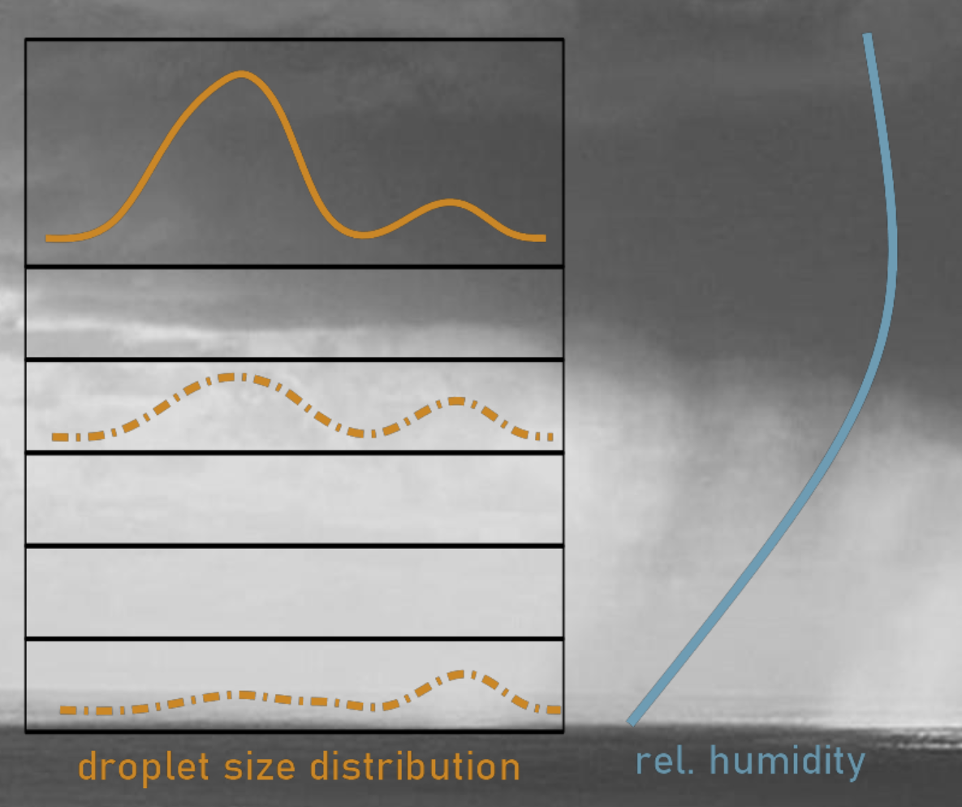
2. (Light) rain evaporation not sensitive to microphysical complexity
Rain evaporation during EUREC⁴A campaign constrained using the Super-droplet model CLEO (Bayley et al., in prep) in a 1D rainshaft setup
Evap only
+ Collision-Coalescence
+ Breakup (few fragments)
+ Breakup (many frag.)
evaporation fraction
sub-cloud layer cloud
Evaporation rate increases but evaporation fraction decreases with increasing rain flux (and mean drop radius)
Collision-coalescence-breakup processes not relevant for light rain rates
Inclusion of ventilation factor important
aircraft in-situ data
dropsonde data
(Niebaum, Bayley et al., in prep)

Slide 11
Early ROTOЯ results
1. Vertical air-motion retrieval of Zhu et al. 2021 developed for stratocumulus applicable to trade cumulus regime (Poydenot, Zhu et al., in prep)
2. Collision-coalescence-breakup processes not relevant for rain evaporation for the light rain rates measured during the EUREC⁴A field campaign (Niebaum, Bayley et al., in prep)
3. Simulated cold pool properties show (some) consistency among large-eddy simulation models for idealized trade-wind case (Antary, Kazil et al., in prep)

Slide 12
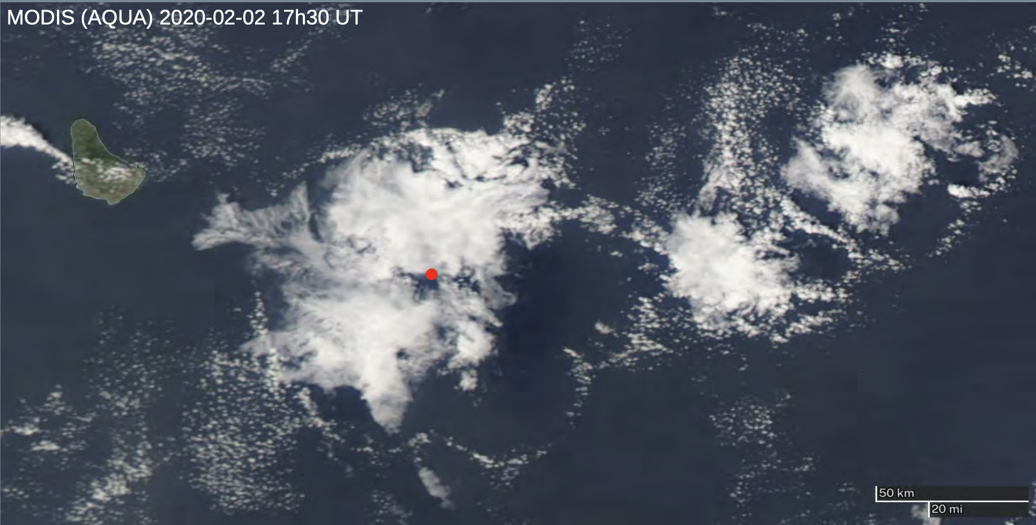
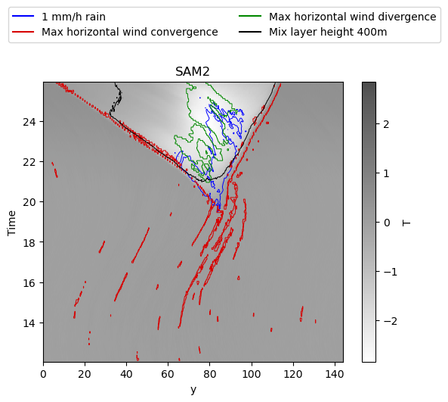
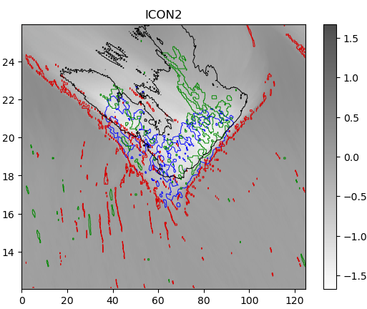
3. Consistency of simulated cold pools among CP-MIP models
EUREC⁴A Cold pool model intercomp.:
144 x 144 x 7 km³ domain, dx=150 m
Periodic boundary conditions
ERA5 forcing along Lagrangian traj.
init. cylindric 1 g/kg water vapor anom
ICON 2-mom bulk
Temp. perturbation / K
Time / h
y / km
(Antary, Kazil et al., in prep)

Slide 13
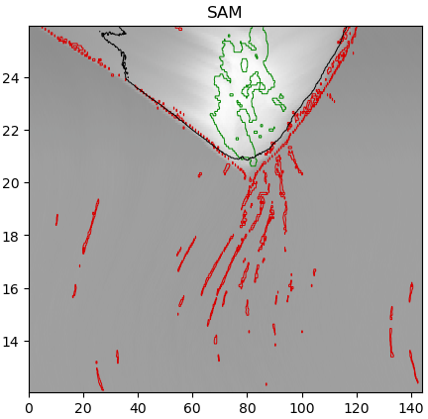
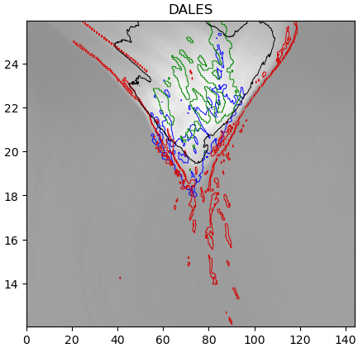
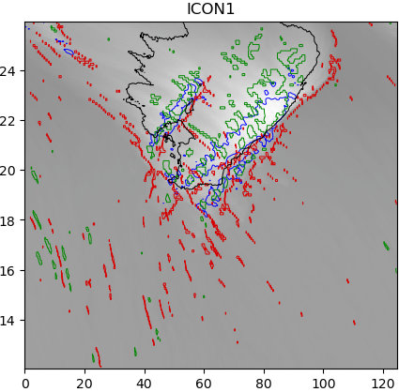
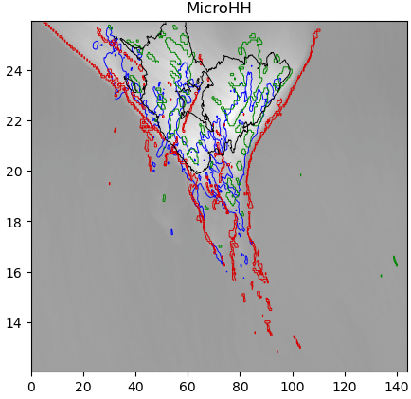
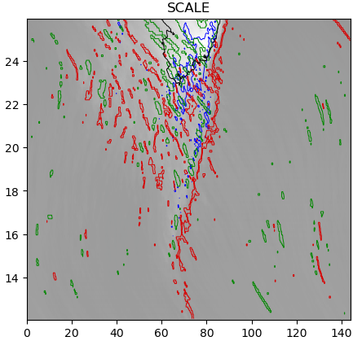
3. Consistency of simulated cold pools among CP-MIP models
EUREC⁴A Cold pool model intercomp.:
144 x 144 x 7 km³ domain, dx=150 m
Periodic boundary conditions
ERA5 forcing along Lagrangian traj.
init. cylindric 1 g/kg water vapor anom
SAM 2-mom bulk
SAM 2-mom bin
DALES 2-mom bulk
ICON 2-mom bulk
ICON 1-mom bulk
MicroHH 2-mom bulk
SCALE 1-mom bulk
Temp. perturbation / K
Time / h
y / km
(Antary, Kazil et al., in prep)

Slide 14
3. Consistency of simulated cold pools among CP-MIP models
First order behavior surprisingly consistent
Surface rain & rain efficiency sensitive to microphysics scheme, but cold pool properties largely unaffected
Outlook: Comparison with observations
(Antary, Kazil et al., in prep)

Slide 15
Take-home messages
1. Vertical air-motion retrieval of Zhu et al. 2021 developed for stratocumulus applicable to trade cumulus regime (Poydenot, Zhu et al., in prep)
2. Collision-coalescence-breakup processes not relevant for rain evaporation for the light rain rates measured during the EUREC⁴A field campaign (Niebaum, Bayley et al., in prep)
3. Simulated cold pool properties show (some) consistency among large-eddy simulation models for idealized trade-wind case (Antary, Kazil et al., in prep)
The new process observations and large-domain Super-droplet simulations will help us elucidate the role of rain evaporation and cold pools for weather and climate

