Slide 1



PrePEP-Conference: Precipitation Processes-Estimation and Prediction
16–21 Mar 2025
University of Bonn
Comprehending Meteorological Drought in the Tons River Basin, India:
A Spatio-Temporal Assessment of Variability and its impact on water resources
Samiul Sk¹, S. Sreekesh²
¹ Ph.D. Scholar (Presenting Author),
² Professor, CSRD, JNU
Centre for the Study of Regional Development (CSRD)
School of Social Science (SSS)
Jawaharlal Nehru University, New Delhi-110067
Indian Council Social Science Research
Ministry of Education, Govt. of India

Slide 2
Introduction:
The recent human-induced warming is expected to increase the frequency and severity of extreme climatic events, like heat waves, extreme rainfall, drought, and cyclones across the earth (Jenkins & Warren, 2015; IPCC, 2023;).
In the 21st century, with changing climate variables, semi-arid regions face frequent drought issues (Li et al., 2010; Mishra & Singh, 2011).
According to the IPCC's Sixth Assessment Report, 2023, severe hazards from dryland water scarcity are anticipated in the near future at 1.5°C global warming. The frequency, duration, and areal extent of drought are affected by it (Wilhite, 1993).
The semi-arid region is highly vulnerable to meteorological drought. Any significant changes in the average temperature and rainfall pattern lead to weather and climate alteration, ultimately resulting in droughts with higher intensity and severity.
Surface water coverage is more adversely affected by meteorological drought in the semi-arid region than in the humid region over space and time.

Slide 3
Database:
Objective
To study the Meteorological drought in the Tons River Basin over space and Time.
To provide insight into the impact of the meteorological drought on the surface water resources of the Tons River Basin.
Furthermore, to study the dynamics of surface water extent, which are the primary sources of freshwater resources in the river basin.
Satellite image-based indices have calculated using following satellite images:
Sl. No. | Name of the Data | Time Period of Data Required
1. | Landsat 5, Landsat 7 ETM+ C2 L2, Landsat 8 OLI/TIRS C2 | From 01.06.1990 to 30.05.2024

Slide 4
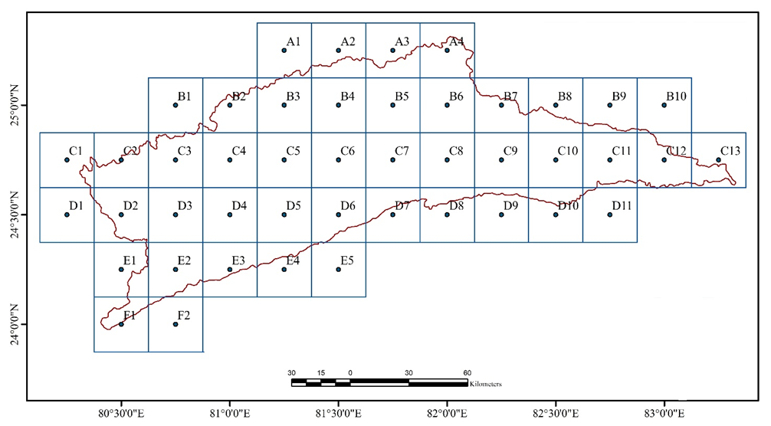
IMD Gridded Rainfall and the grids in the River basin
To analyze meteorological drought the following data have used:
Data | Source | Time Period of Data used | Spatial Resolution | Unit of the Rainfall | Interpolation used for data preparation
0.25° x 0.25° Daily Gridded Rainfall Data (IMD4) | IMD (Data Supply Portal), MoES, Government of India, Pune. (https://www.imdpune.gov.in/cmpg/Griddata/Rainfall_1_NetCDF.html) | 1961 to 2020 | 0.25° x 0.25° | Millimeters (mm) | IDW by Shepard (1968)

Slide 5
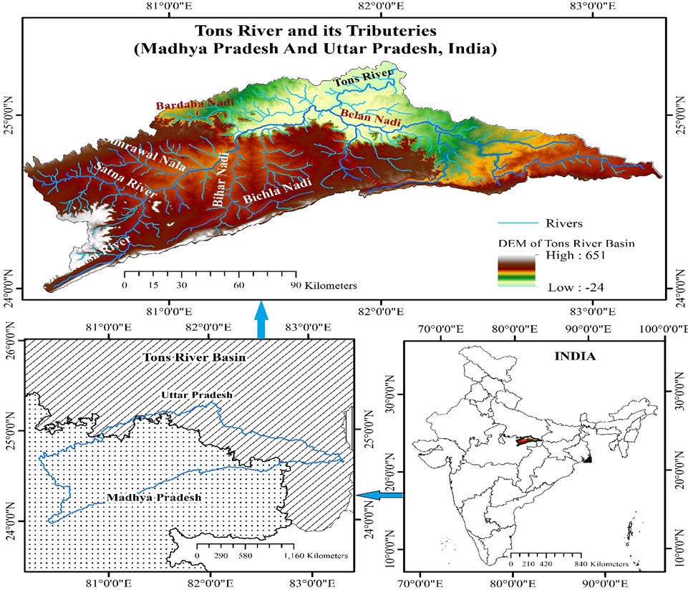
The Study Area:
In the present study, to understand the nature, intensity, and Spatio-temporal pattern of drought with changing climate and how the aridity intensifies meteorological drought, Tons River basin have taken as the study area.
It is one of the important sub-basins of the River Ganga. It is also known as the Tamsa River. It originates from the Kaimur range of the Satna District of Madhya Pradesh.
It covers an area of about 17,000 square km, out of which 11,974 square km lies in Madhya Pradesh, and the rest lie in UP.
It receives 90% of the total annual rainfall during the summer season (Darshana et al., 2013) and depends on monsoonal rainfall.
The maximum temperature in this area is found in the months of April and May, and the temperature ranges from 36° to 41°C, minimum temperature is found in the months of December and January, ranging from 8° to 12°C.

Slide 6
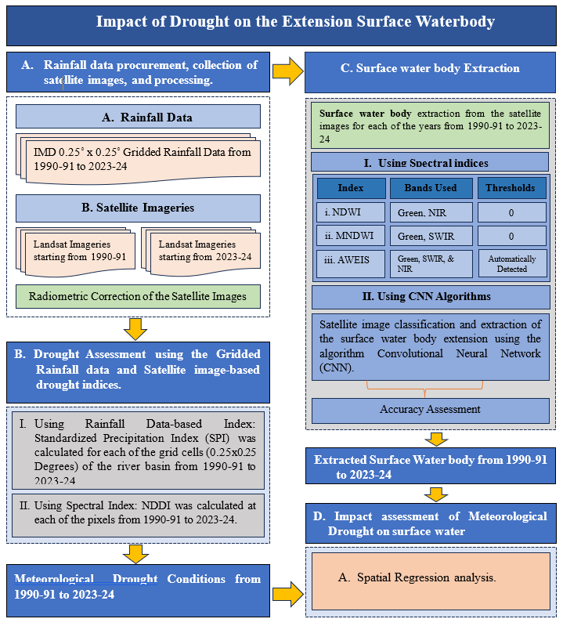
Methods
1. Schematic representation of the methodology.
2. Schematic Representation of the Convolutional Neural Network.

Slide 7
Meteorological Drought Conditions in the TRB (1990-91 to 2023-24)
Results and Discussion
Frequently experiencing meteorological drought every year from 1990-91 to 2023-24 except 2011-12.
From very less to extreme drought in the years 2007-08, 2009-10, 2010-11, 2014-15, 2015-16, 2017-18, 2018-19, and 2023-24.
With higher drought intensity and covering almost the entire river basin has been found in the hydrological year 2007-08.
While some parts of the river basin were under moist to very moist conditions in the years 1994-95, 1999-00, 2003-04, 2011-12,2012-13, and 2013-14.
SPI Values

Slide 8
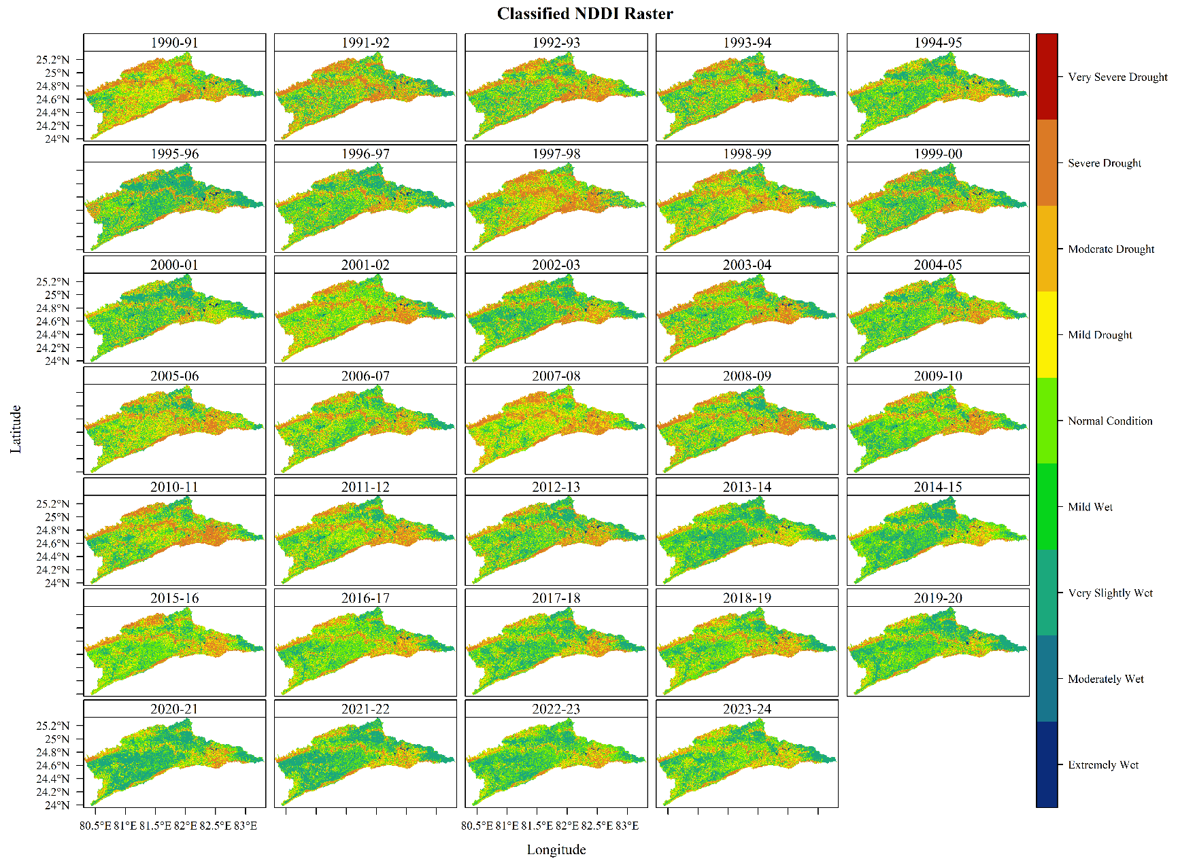
Meteorological Drought Pattern in the Tons River Basin (1990-91 to 2023-24)

Slide 9
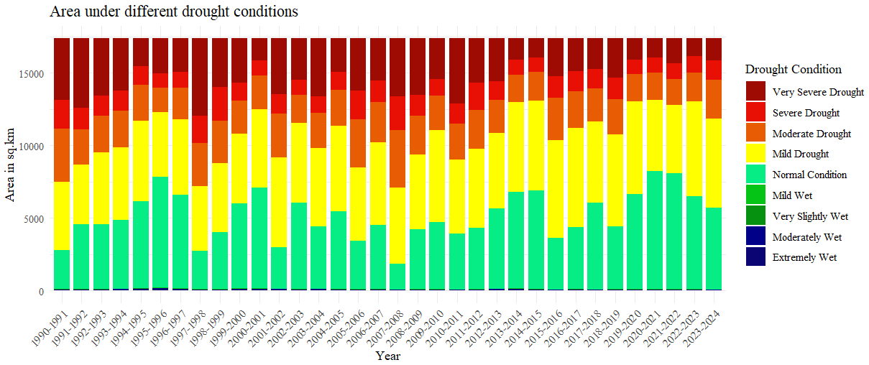
Areas under different drought classes
Descriptive Statistics of the Computed Area under the defined different classes using the NDDI.
Sl. No. | Drought Classes | Mean | Median | Minimum | Maximum | Standard Deviation | CV (%)
 | Extremely Wet | 51.86 | 47.33 | 21.53 | 113.90 | 23.25 | 44.83
2. | Moderately Wet | 13.94 | 14.08 | 5.58 | 19.32 | 3.85 | 27.60
3. | Very Slightly Wet | 16.41 | 15.93 | 11.01 | 27.26 | 3.41 | 20.79
4. | Mild Wet | 20.24 | 20.42 | 11.19 | 31.50 | 4.99 | 24.66
5. | Normal Condition | 5073.10 | 4685.59 | 1765.07 | 8148.55 | 1593.80 | 31.42
6. | Mild Drought | 5483.73 | 5404.41 | 4137.04 | 6843.03 | 710.55 | 12.96
7. | Moderate Drought | 2483.89 | 2459.77 | 1696.53 | 3977.46 | 511.51 | 20.59
8. | Severe Drought | 1388.00 | 1339.50 | 986.05 | 2344.94 | 367.41 | 26.47
9 | Very Severe Drought | 2856.88 | 2852.98 | 1248.83 | 5351.29 | 1106.02 | 38.71
Droughts are Happening every year.
5483.73 sq. km (31.54%) were characterized by mild drought conditions. After the mild drought, 2856.88 sq. km. (16.43%) were found under the very severe meteorological drought, followed by 2483.89 sq. km. (14.29%) under moderate drought and 1388 sq. km. (7.98%) under severe drought

Slide 10
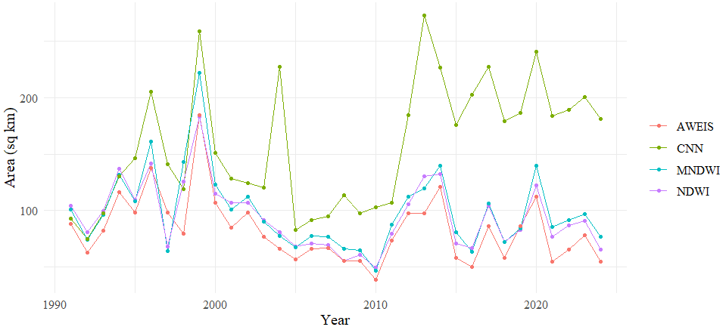
Surface waterbody extension obtained from NDWI, MNDWI, and AWEIS (1990-91 to 2023-24).
The spatiotemporal characteristics of the extension of the total surface water bodies are compiled in the above diagram, which show significant variations in the surface water extension from 1990-91 to 2023-34. The total area of all surface water bodies shows a mean of 157.63 sq. km., a median of 148.95 sq. km., and a maximum of 272.92 sq. km. in the year 2012-13. The variance of 3083.8 sq. km. and standard deviation of 55.53 sq. km. reflect high variability in the combined water area. The coefficient of variation (CV) for the total area is 35.23%, indicating moderate relative variability.

Slide 11
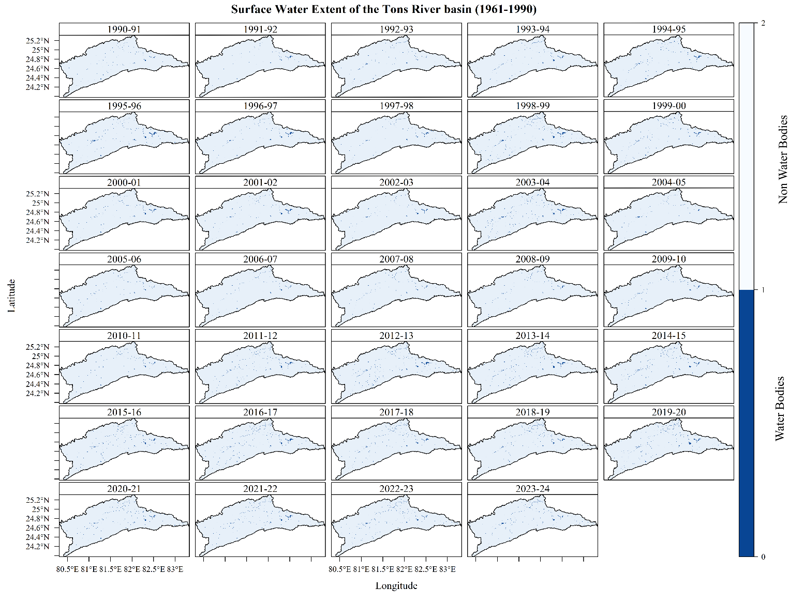
Surface Water Extent of the Tons River Basin from 1990-91 to 2023-24.

Slide 12
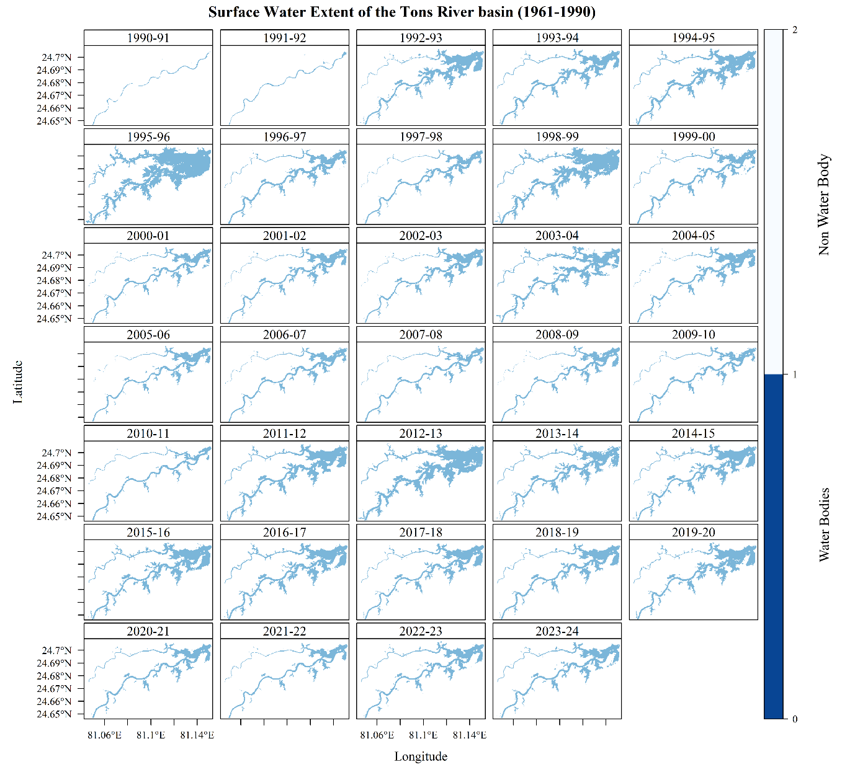
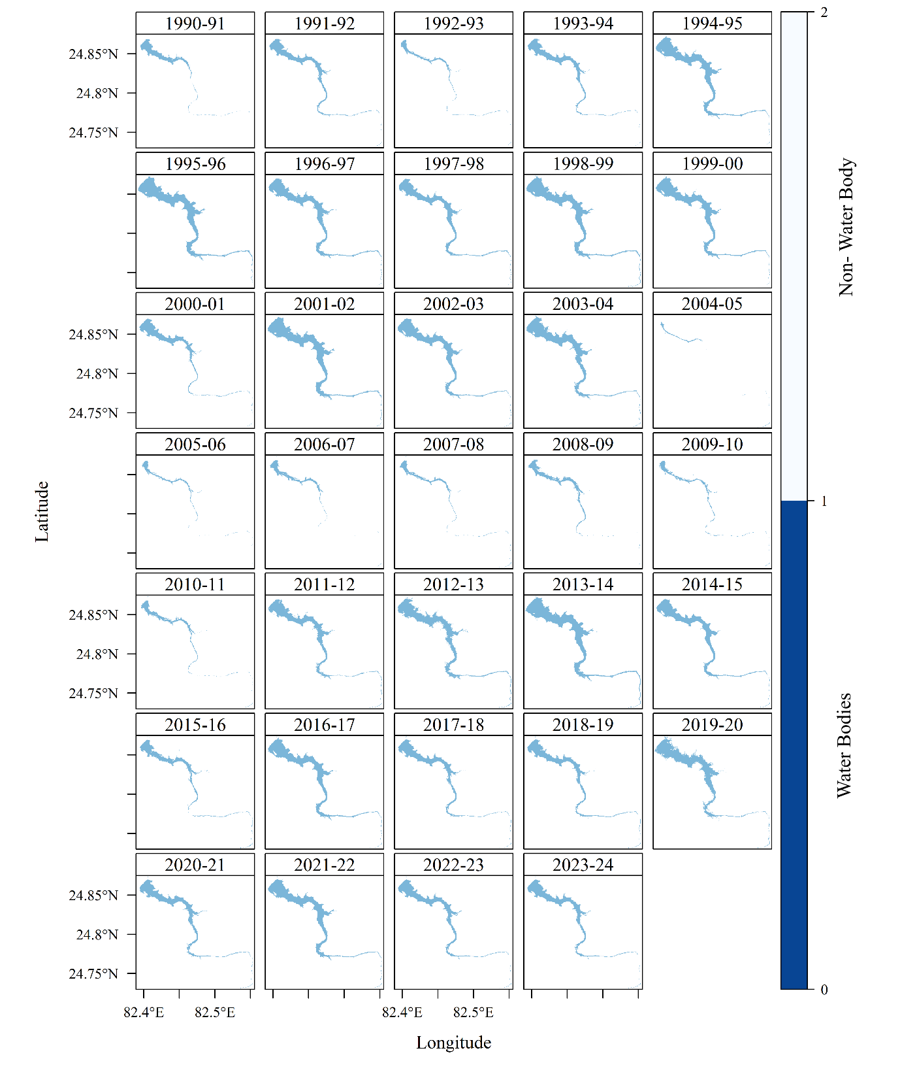
Surface water extent of the Tons River Dam Reservoir from 1990-91 to 2023-24.
Surface water extent of the Pipari Dam Reservoir from 1991 and 2024.

Slide 13
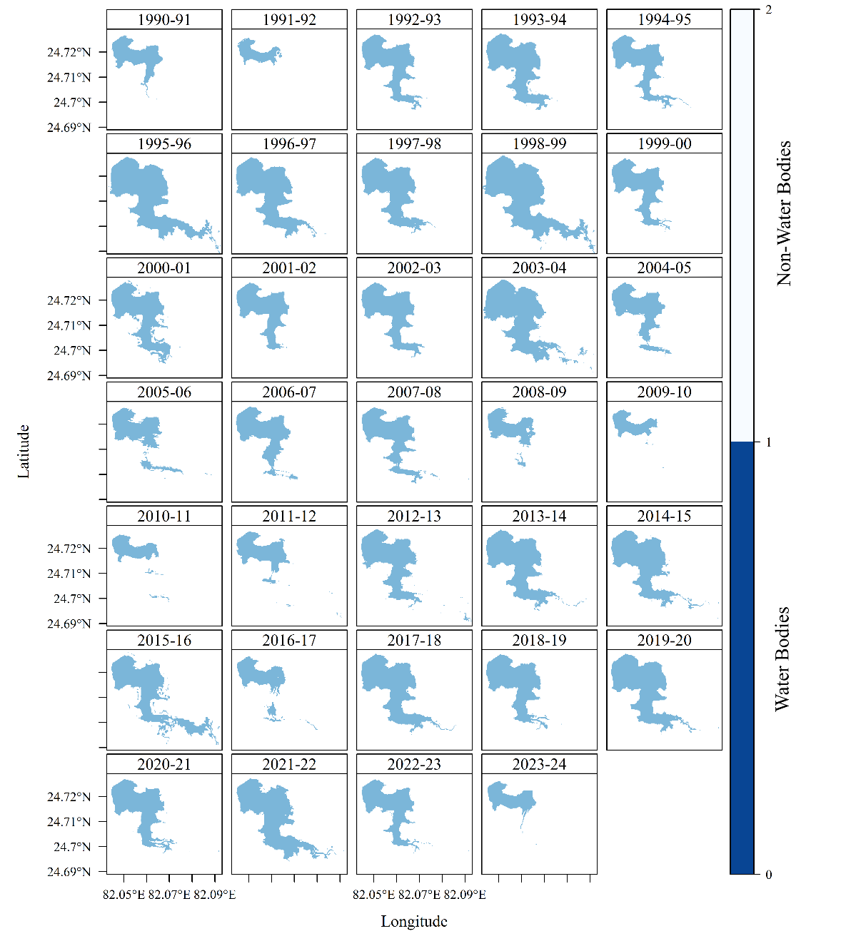
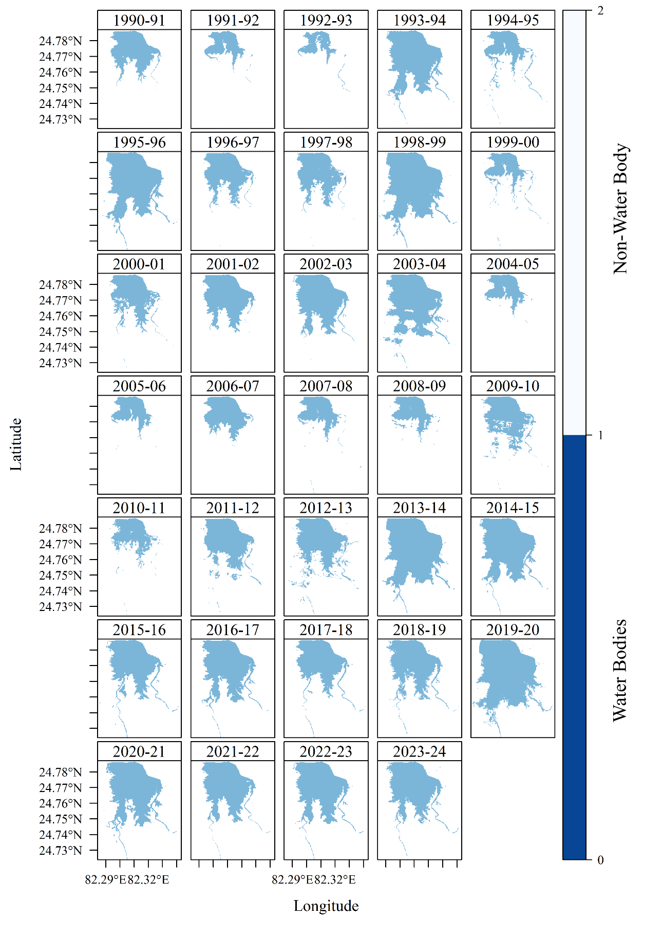
Surface water extent of the Gorma Dam Reservoir from 1990-91 to 2023-24.
Surface water extent of the Adwa Dam Reservoir from 1991 and 2024.

Slide 14
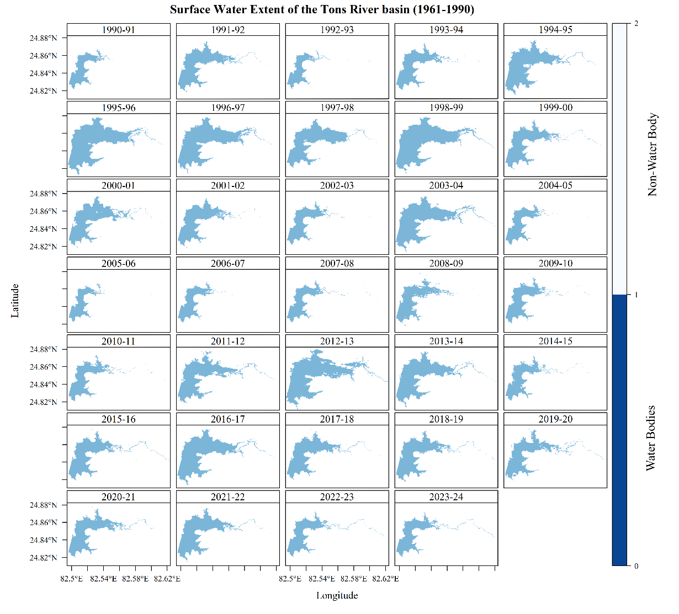
Surface water extent of the Sirsi Dam Reservoir from 1990-91 to 2023-24.
Descriptive Statistics of the Computed Area of the 5 reservoirs classes using the NDDI.
Sl. No. | Reservoir’s Names | Mean | Median | Minimum | Maximum | Standard Deviation | CV (%)
 | Tons River Dam Reservoir | 8.98 | 8.36 | 0.93 | 21.20 | 3.91 | 43.59
2. | Sirsi Dam Reservoir | 16.91 | 16.11 | 7.60 | 30.11 | 6.43 | 38.02
3. | Pipari Dam Reservoir | 14.21 | 14.70 | 1.13 | 25.34 | 6.93 | 48.76
4. | Gorma Dam Reservoir | 4.30 | 4.23 | 1.32 | 8.14 | 1.68 | 39.12
5. | Adwa Dam Reservoir | 10.33 | 10.29 | 3.14 | 19.52 | 4.38 | 42.43
6. | Total Area of the SWB | 157.63 | 148.95 | 74.60 | 272.92 | 55.53 | 35.23

Slide 15
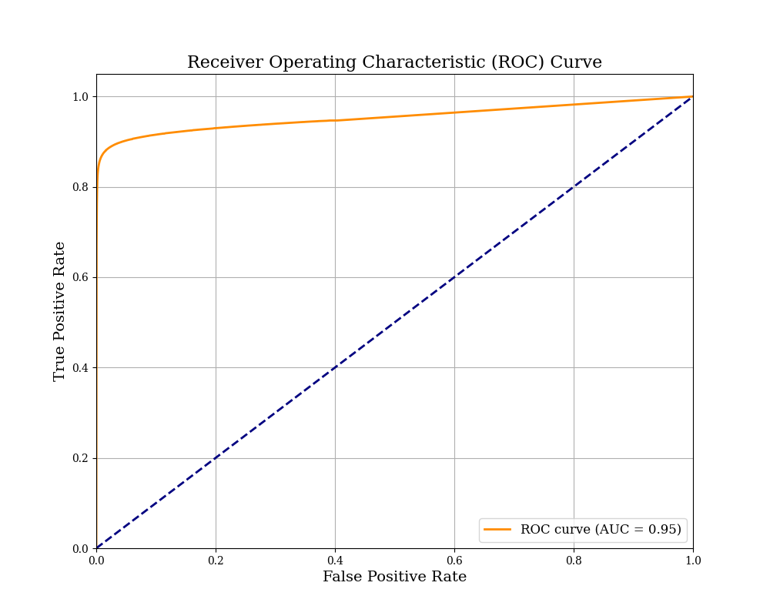
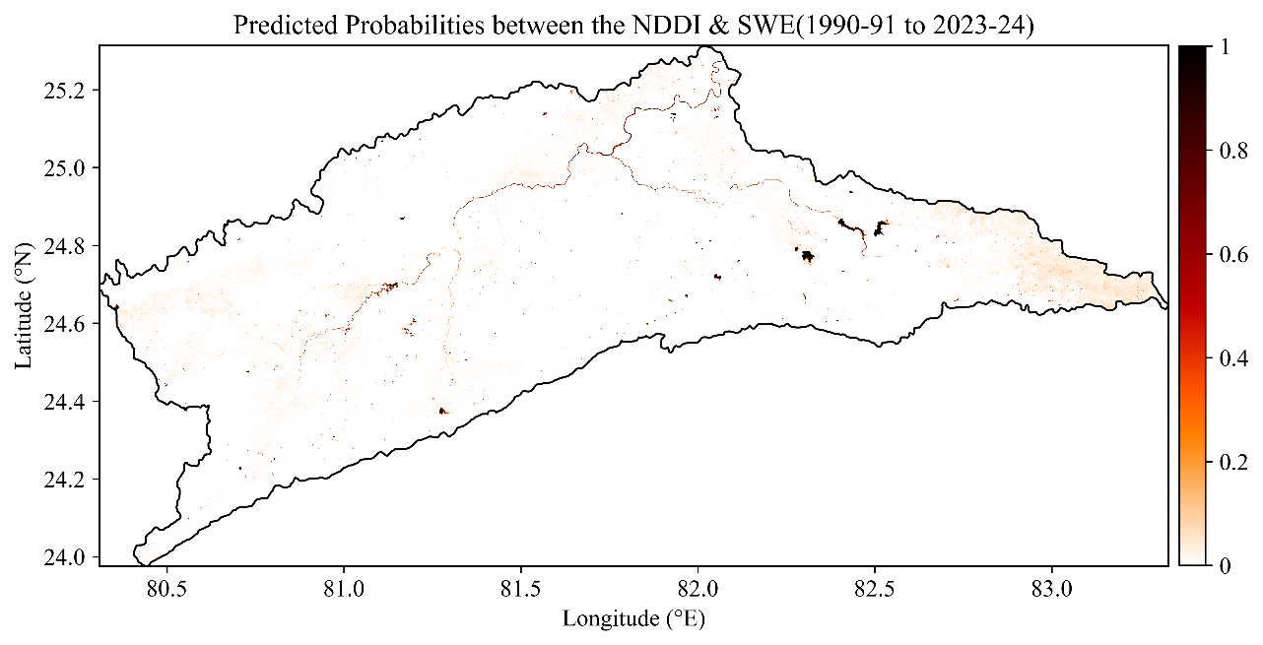
Predicted Probabilities between the NDDI & SWE (1990-91 to 2023-24)

Slide 16
Conclusions
The present study is mainly focused on the impact of the meteorological drought on the extension of the surface water bodies over space and time in the Tons River basin.
It is also found that the river basin is characterized by water bodies of very small numbers and in size.
The extension of the surface water body has been affected by the increasing drought with higher intensity over the last 34 years. The figure shows that the water bodies (ponds, lakes, reservoirs, and rivers) in the Tons River Basin were significantly affected by the meteorological drought, with the values of the predicted probabilities ranging from 0.6 to 1.
The predicted probabilities between NDDI and surface water body extent approached 0 in the areas without surface water bodies. An Area under curve (AUC) of 0.95 highlights a strong relationship between NDDI and the extension of the surface water bodies.

Slide 17
Reference
Jenkins, K., & Warren, R. (2015). Quantifying the impact of climate change on drought regimes using the Standardised Precipitation Index. Theoretical and Applied Climatology, 120(1–2), 41–54. https://doi.org/10.1007/s00704-014-1143-x.
Li, K., Wang, J., Cheng, W., Wang, Y., Zhou, Y., & Altansukh, O. (2022). International Journal of Applied Earth Observations and Geoinformation Deep learning empowers the Google Earth Engine for automated water extraction in the Lake Baikal Basin. International Journal of Applied Earth Observation and Geoinformation, 112(February), 102928. https://doi.org/10.1016/j.jag.2022.102928.
Mishra, A. K., & Singh, V. P. (2011). Drought modeling - A review. Journal of Hydrology, 403(1–2), 157–175. https://doi.org/10.1016/j.jhydrol.2011.03.049
IPCC. (2014). Synthesis Report. Contribution of Working Groups I, II and III to the Fifth Assessment Report of the Intergovernmental Panel on Climate Change [Core Writing Team, R.K. Pachauri and L.A. Meyer (eds.)]. In IPCC, Geneva, Switzerland, 151 pp. https://doi.org/10.1016/S0022-0248(00)00575-3.
Wilhite, D. A. (1993). Drought Assessment, Management, and Planning: Theory and Case Studies. In D. A. Wilhite (Ed.), Kluwer Academic Publishers (1 st). Kluwer Academic Publishers. https://doi.org/DOI 10.1007/978-1-4615-3224-8

Slide 18
Thank you for listening to me
Feel Free to Contact me-
Email ID- samiulsk5@gmail.com
Phone- 8967231355
International Travel Funded by
Indian Council Social Science Research
Ministry of Education, Govt. of India

