Slide 1


Ground-Based Observations of Secondary Ice Production: A Case Study Showing Droplet
Fragmentation during Refreezing Rain
Nils Pfeifer¹, Susan Hartmann², Bernd Mom³, Dmitri Moisseev³, Maximilian Maahn¹
¹Leipzig University, Leipzig Institute of Meteorology (LIM), Germany
²Institute for Atmospheric and Earth System Research/Physics, Faculty of Science, University of Helsinki, Finland
³Leibniz Institute for Tropospheric Research (TROPOS), Germany
^{Bonn, 20.3.2025}
PrePEP 2025

Slide 2
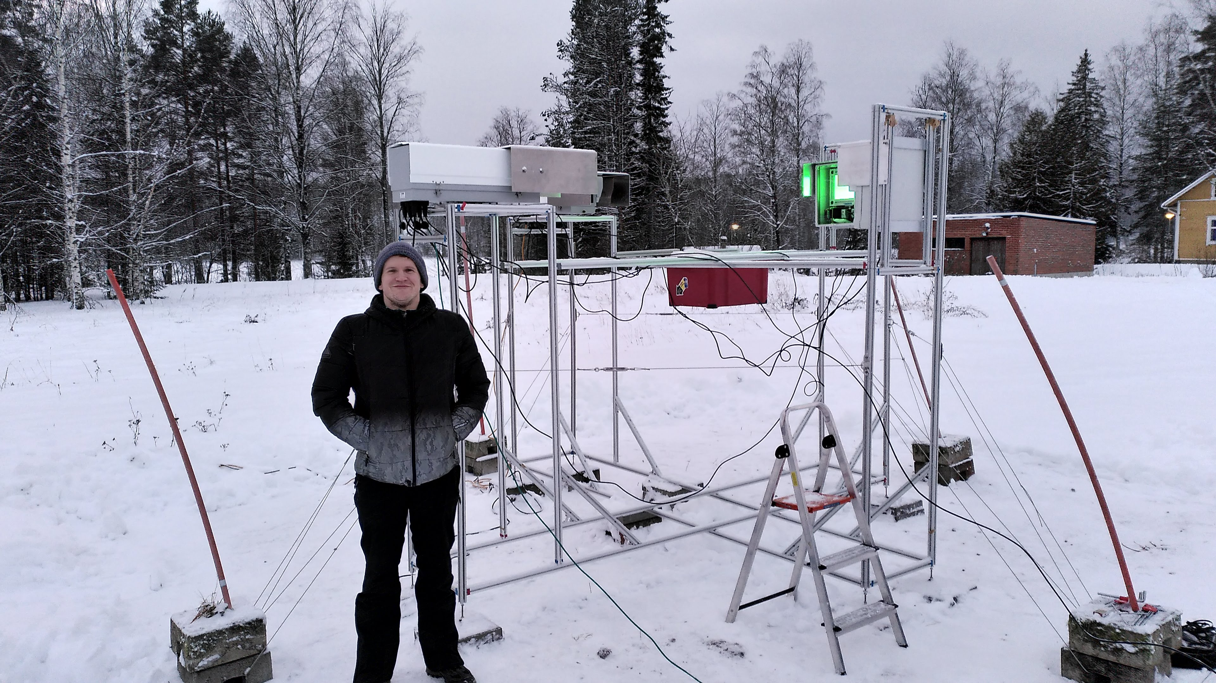
Campaign – Evaluating microphysical pathways of midlatitude snow formation
Purpose: Integrated field work involving in situ measurements, remote sensing, and modeling
5 weeks fieldwork in Hyytiälä, Finland, Jan – March 2024
13 snowfall events
Goal: Quantitative comparison of model outputs and observations
foto © Bernd Mom
Mesaurement Devices:
Video In Situ Snowfall Sensor (VISSS)
94 Ghz vertically pointing cloud radar
GRAW DFM 17 radiosondes

Slide 3
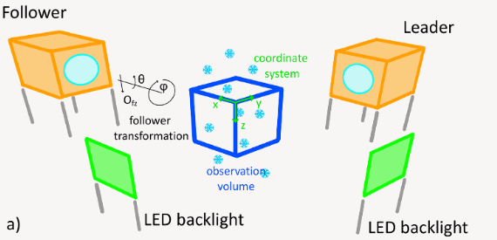
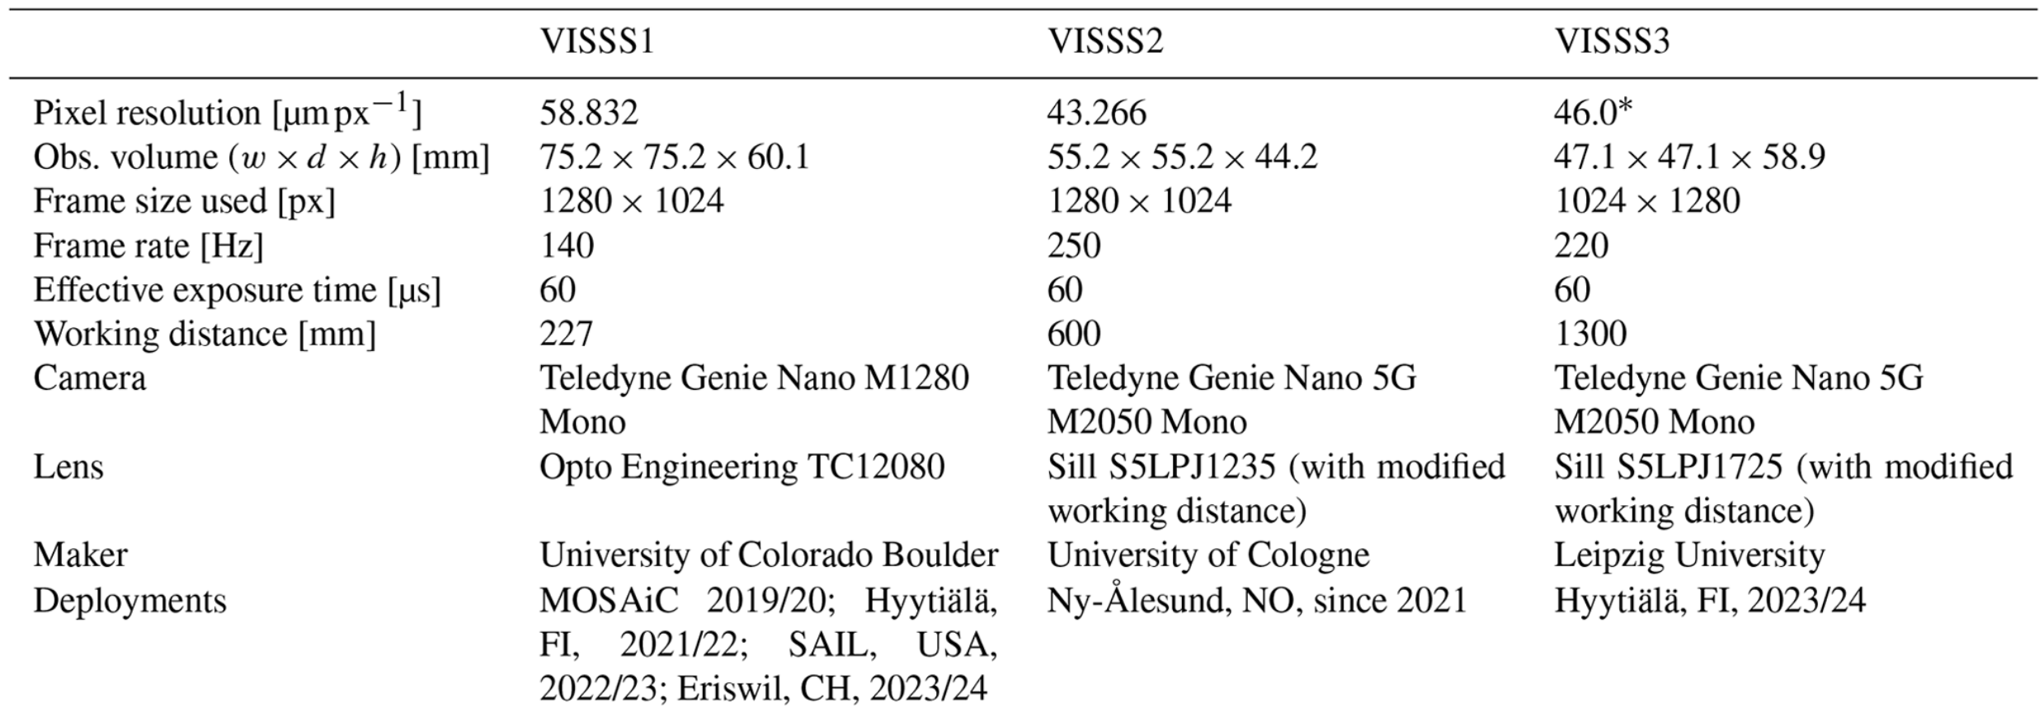
Campaign – Device: VISSS
Maahn et al., 2024, Introducing the Video In Situ Snowfall Sensor (VISSS)
2 high resolution images
Constrained sampling volume
Open-source design
Goal: Retrieving process parameters from VISSS data,
like secondary ice processes

Slide 4
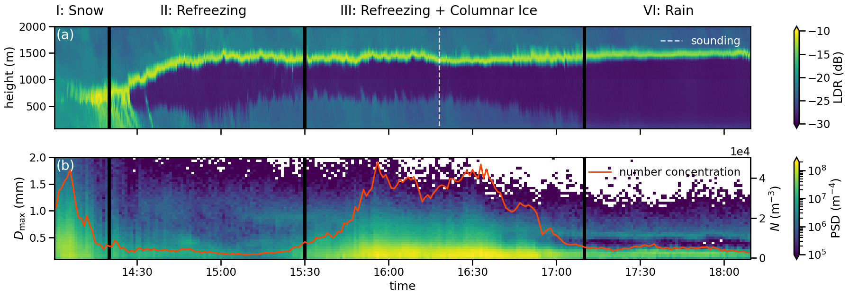
Case Study – Refreezing Event 16.02.2024
94 GhZ vertically pointing cloud radar:
Refreezing signature
VISSS:
Secondary ice production by droplet fragmentation?

Slide 5
Case Study – Deformations
Modes of droplet shattering:
Spicular bubble burst
Breakup
Incomplete breakup

Slide 6
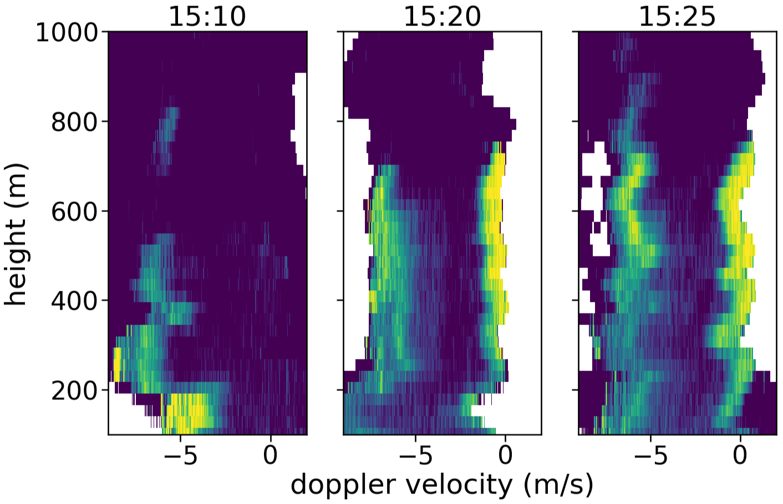
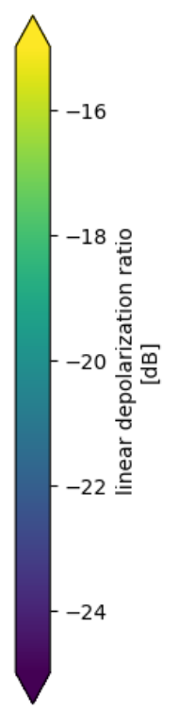
Case Study – Origin of Columnar Ice
Ice pellets (bulged or broken)
Columnar Ice
2nd slow particle mode at 800m
Between 15:10 and 17:00, together with explosion in concetration
Secondary ice production during droplet refreezing

Slide 7
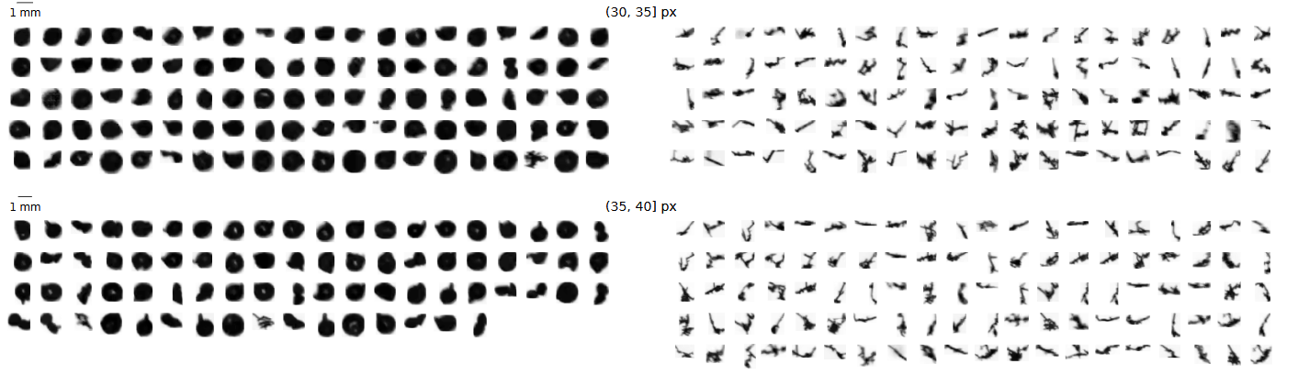
Classification
(Size dependent) Threshold in Complexity : $χ= \frac{Perimeter}{2 \sqrt{πArea}}$
Droplets (liquid or ice)
Columnar Ice (Monomers + Aggregates)
Classification Error < 5% for Hydrometeors > 0.41 mm

Slide 8
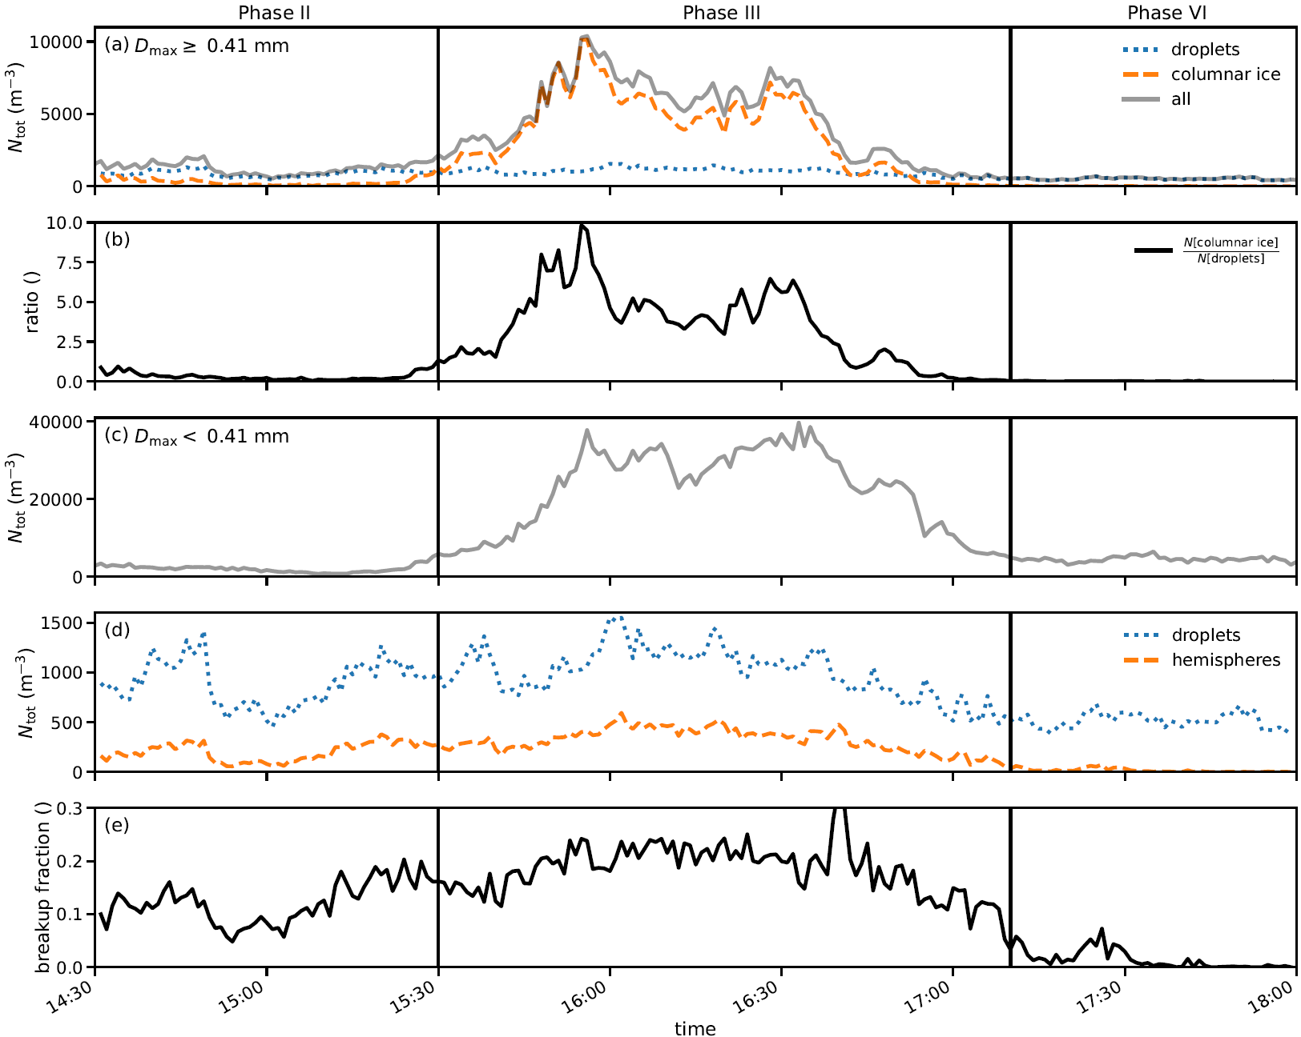
Concentrations
Ratio as proxy for effectiveness
Transient Process
Effectiveness is lower limit due to smaller particles
Mean from 15:30 – 17:00: ~3.8

Slide 9
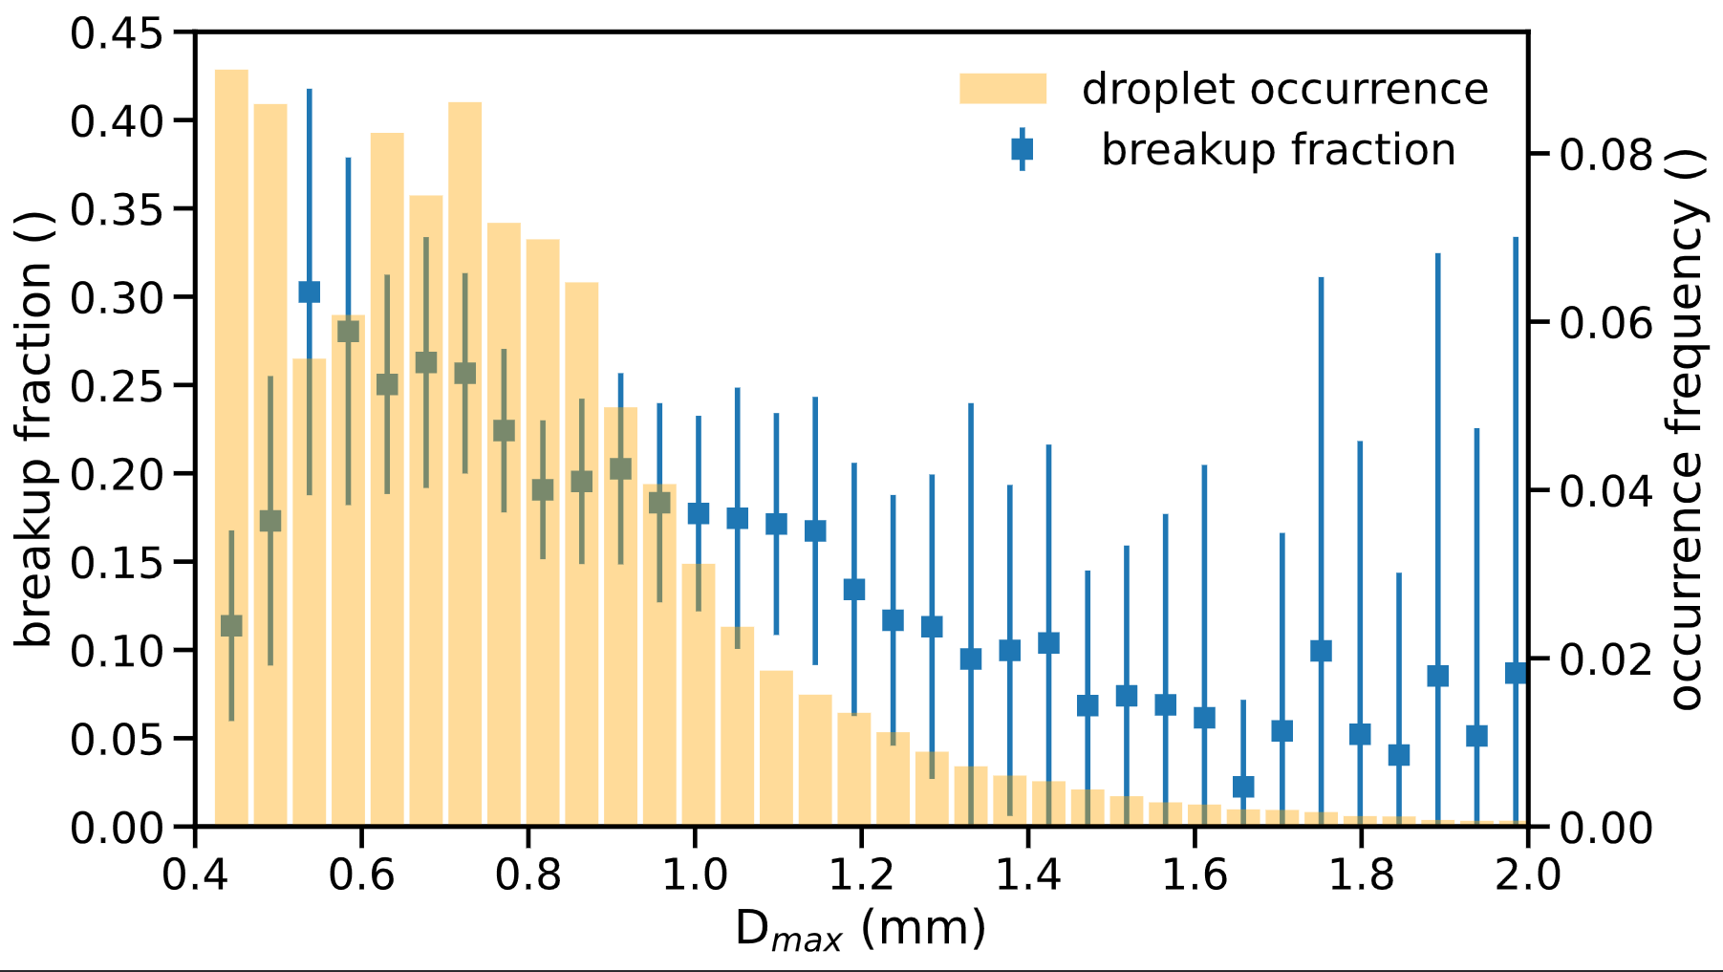


Which Fraction of Droplets is broken?
Threshold in aspect Ratio (AR)
AR $≈$1
AR $≈0.5$
Bimodal droplet distribution
Maximum of Breakup fraction at 0.5 mm
Notes:
+

Slide 10
Summary
Identification of a likely droplet fragmentation event with in-situ + radar
Confirmation of breakup modes from the lab
Constraining the effectiveness by comparing concentrations
Characterized geometry of broken droplets with behavior differing from previous lab studies
Notes:
+

Slide 11
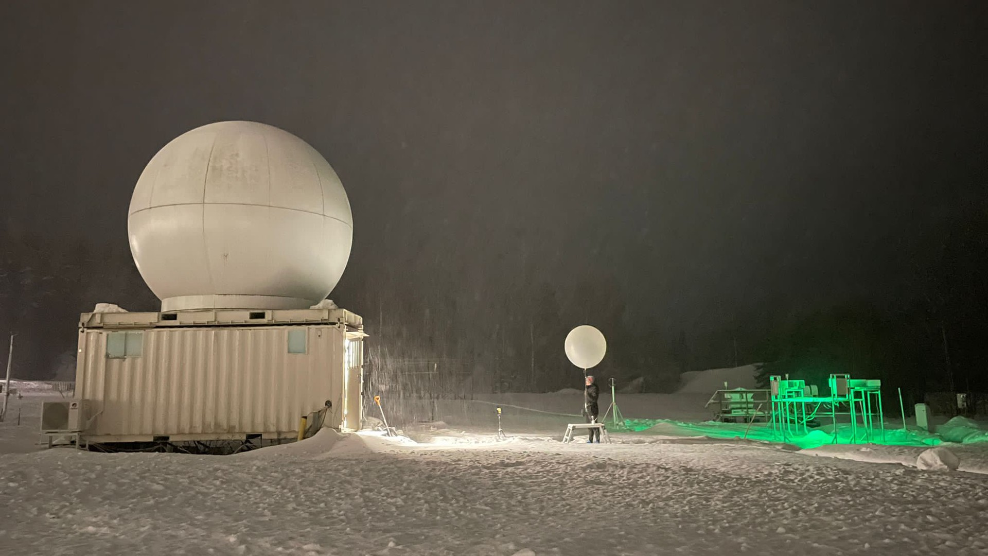
Thank you for your Attention!
^{Nils Pfeifer}
Leipzig Institute for Meteorology
Working Group - Cloud and Precipitation Observations for Process Studies (DrOPS)
^{nils.pfeifer@uni-Leipzig.de}
foto © Agnes Meyer-Brandis

Slide 12
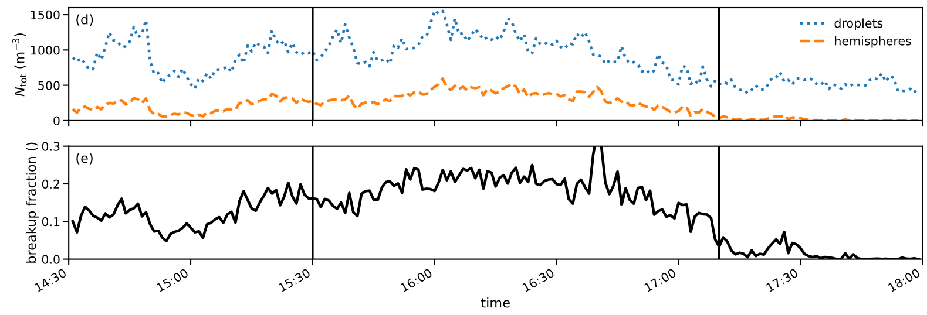
Concentrations Hemispheres

Slide 13
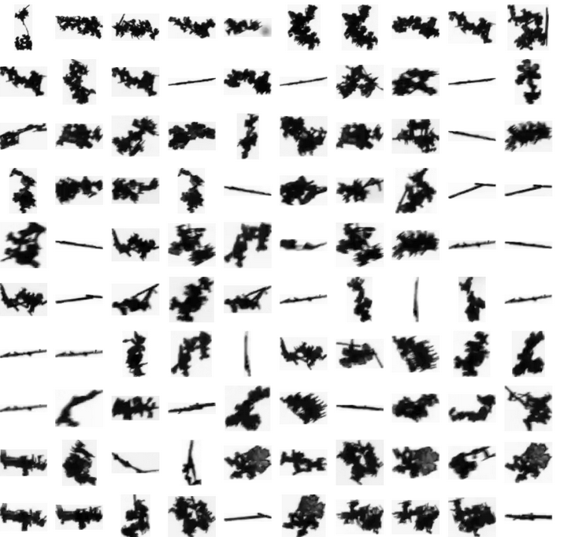
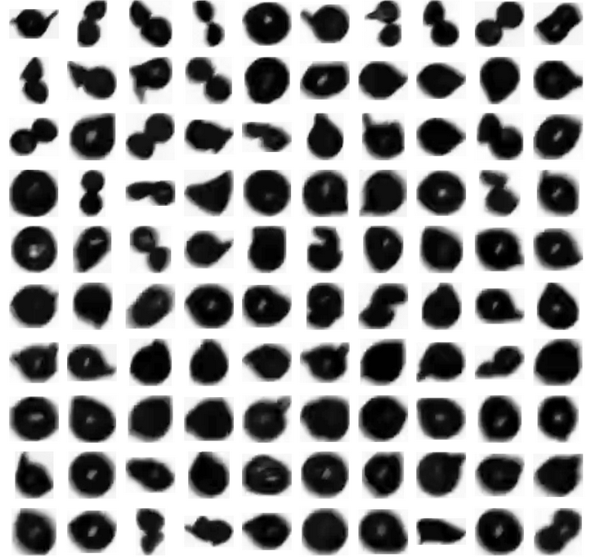
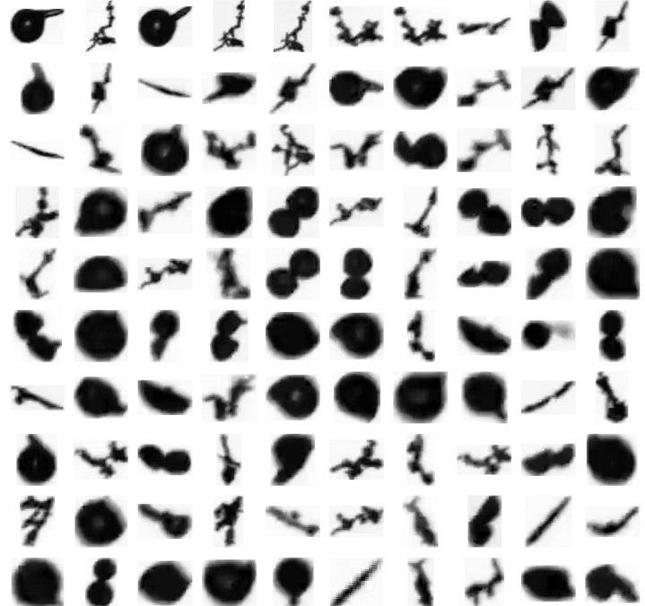
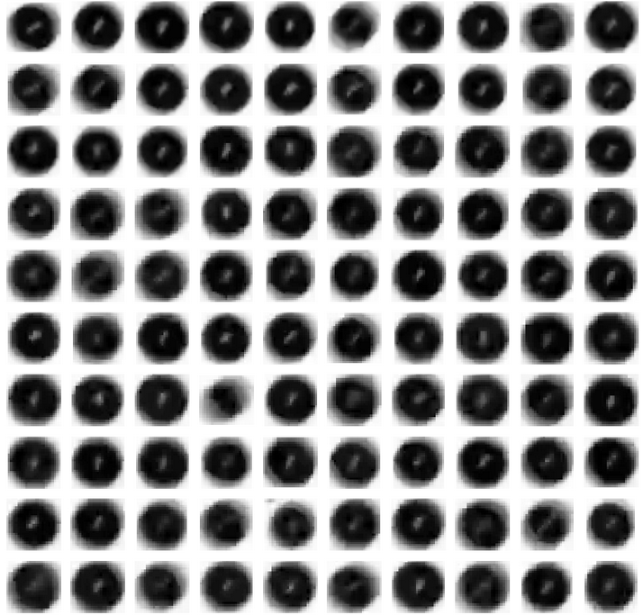

Precipitation Composition Phases
I) Snow II) Broken droplets III) Broken droplets + Columnar ice IV) Rain

