Slide 1
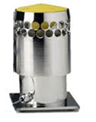
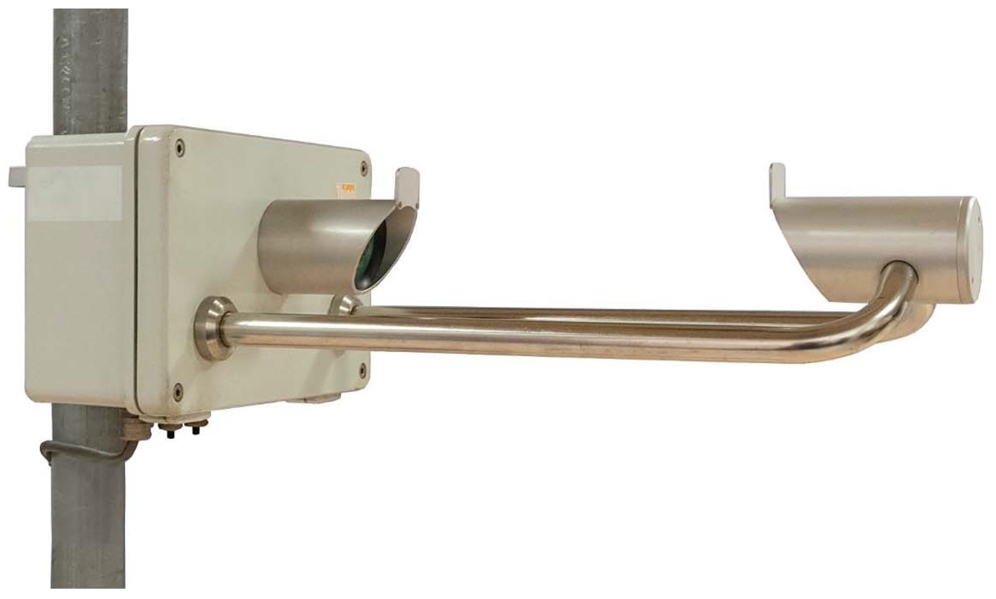
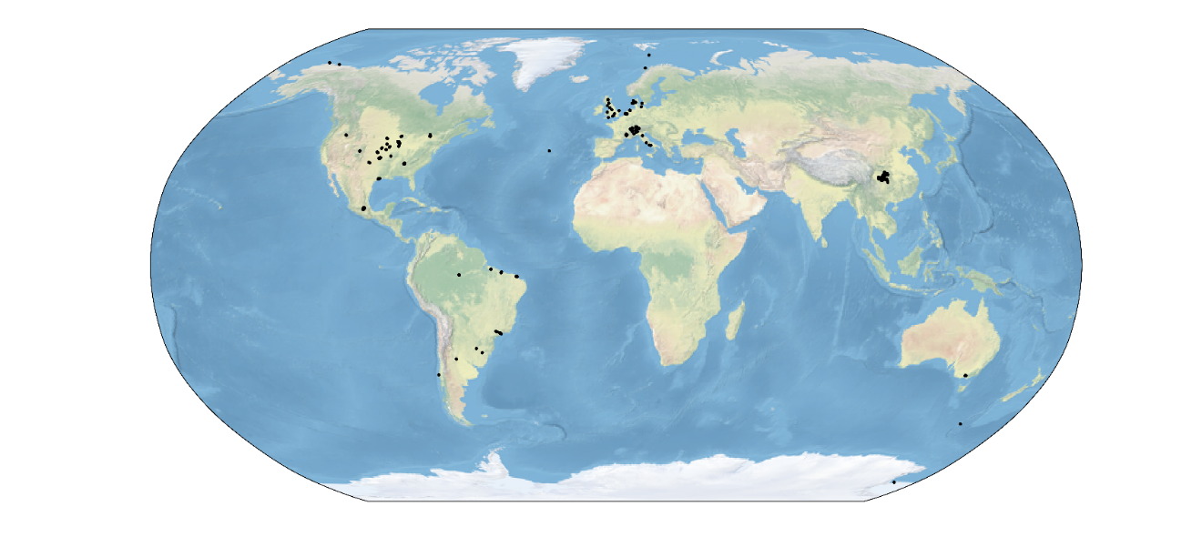
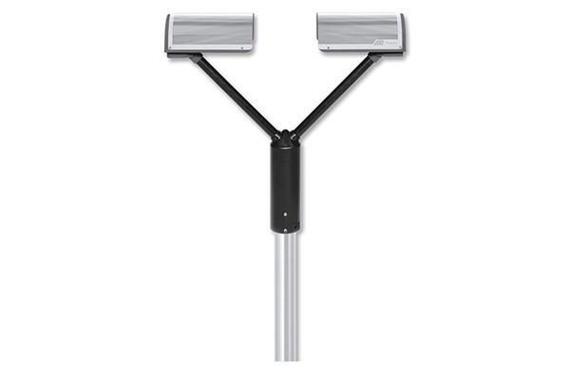
DISDRODB
A global disdrometer archive of raindrop size distribution observations
Gionata Ghiggi¹, Anne Claire Billault-Roux¹, Kim Candolfi¹, Leo Pillac-Mage¹,
Christine Unal³, Marc Schleiss³, Remko Uijlenhoet² , Tim Raupach⁴, Alexis Berne¹
(1) Environmental Remote Sensing Laboratory, EPFL, Lausanne, Switzerland
(2) Department of Water Management, TU Delft, Netherlands
(3) Geoscience & Remote Sensing Department, TU Delft, Netherlands
(4) Institute for Climate Risk and Response, University of New South Wales, Sydney, Australia
Gionata Ghiggi
PrePEP Conference – 20.03.2025

Slide 2
Motivation
Disdrometer data are scattered across institutions
Access to the data is often very difficult
Data documentation is often lacking
Older datasets are at risk of getting lost !
Different sensors
Different data formats

Slide 3
Motivation
Disdrometer data are scattered across institutions
Access to the data is often very difficult
Data documentation is often lacking
Older datasets are at risk of getting lost !
Different sensors
Different data formats
No standards for
Data Exchange
Data Processing
Data Quality Checks (QC)
Limited
Open Source Software
Analysis-Ready-Data (ARD)
Global DSD Studies

Slide 4
Motivation
Disdrometer data are scattered across institutions
Access to the data is often very difficult
Data documentation is often lacking
Older datasets are at risk of getting lost !
Weeks are wasted in searching
and wrangling the data
Different sensors
Different data formats
No standards for
Data Exchange
Data Processing
Data Quality Checks (QC)
Limited
Open Source Software
Analysis-Ready-Data (ARD)
Global DSD Studies

Slide 5
Vision
A global archive of homogenized and quality checked disdrometer data
A public infrastructure for data exchange, sharing and standardization
An open source software for data management, data processing and generation of analysis-ready DSD products
Make very convenient to join the DISDRODB initiative
Establish a research community automatically sharing their data
Promote mobilization and standardization of existing data archives
Goals

Slide 6






DISDRODB Infrastructure
DISDRODB Metadata Archive
DISDRODB Decentralized Raw Data Archive
online
online
disdrodb software
local
DISDRODB Products
L0A L0B L0C L1 L2E L2M
local

Slide 7
DISDRODB Metadata Archive
Keeps track of available disdrometer stations and remote data repositories with raw data
Each station has a file with a standardized set of metadata fields informing about geolocation, authorship, deployment status, issues, … ← Summary of ACTRIS, ARM, DIVEN, OceanRAIN metadata
Hosted on GitHub, enables collaborative and recursive metadata improvements while keeping a transparent and fully reproducible history. Changes can be tracked over time !

Slide 8
DISDRODB Decentralized Raw Data Archive
Remove the cost (IT + staff) associated to maintaining a centralized data archive
Data contributors do not need to wait for “external” actions
Contributors upload directly their raw data on a remote repository (i.e. Zenodo)
Contributors maintain control and ownership of their data !

Slide 9
DISDRODB Data Sharing Mechanism
To share their data through DISDRODB, contributors just need to:
  Upload the station raw data on a remote repository
  Add the station reader (if not already available) to the disdrodb software
  Specify the reader name and the url where the raw data are stored in the metadata
  Upload the station metadata file to the DISDRODB Metadata Archive
Users can download the raw data of stations of interest using the disdrodb software:
> disdrodb_download_archive --data_sources <data_sources> --campaign_names <campaign_names>
DISDRODB Products Generation
Users can generate the DISDRODB products of interest using the disdrodb software
Users can generate the DISDRODB products of interest using the disdrodb software:
> disdrodb_run_l0
> disdrodb_run_l1
> disdrodb_run_l1
> disdrodb_run_l2

Slide 10
DISDRODB Products
DISDRODB L0
Raw data standardized in netCDF format
DISDRODB L1
Quality-checked and homogenized DISDRODB L0 product
DISDRODB L2
Empirical DSD parameters (L2E)
Model-based DSD parameters (L2M)
Polarimetric radar variables at S, C, X, Ku, Ka and W bands.

Slide 11
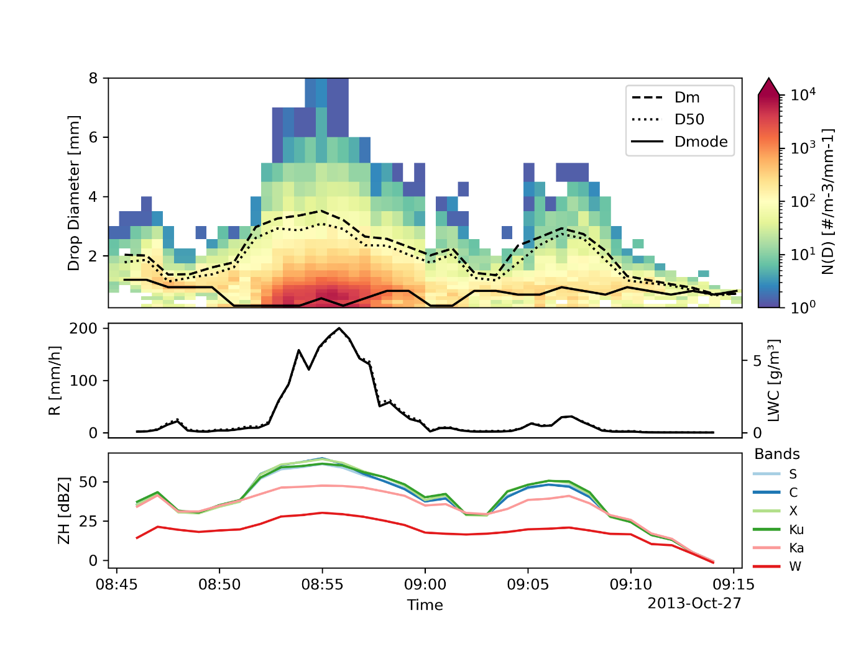
DISDRODB L2 product
Multiple temporal aggregations
→ …, 1MIN, 5MIN, 10MIN, …
Optional resampling using sliding windows (ROLL)
Polarimetric radar variables simulated using T-Matrix
Empirical DSD variables are provided in L2E product
> disdrodb_run_l2e

Slide 12
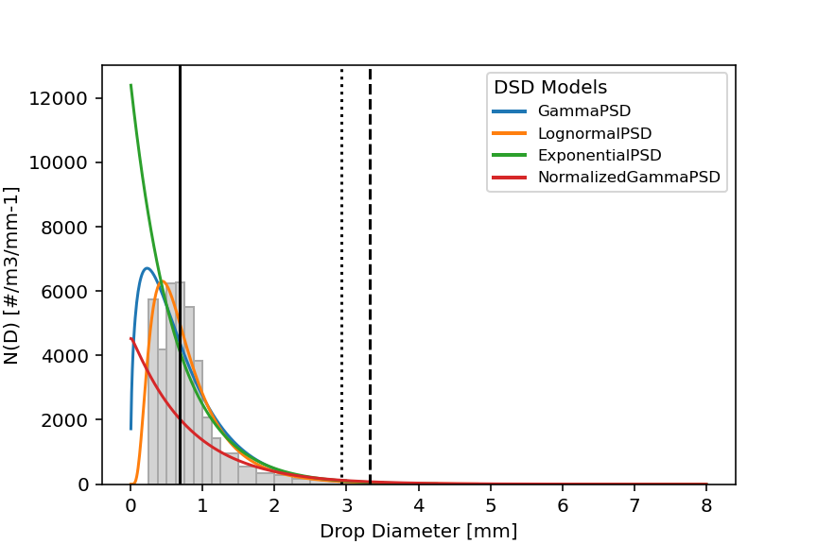

DISDRODB L2 product
Multiple temporal aggregations
→ …, 1MIN, 5MIN, 10MIN, …
Optional resampling using sliding windows (ROLL)
Polarimetric radar variables simulated using T-Matrix
Empirical DSD variables are provided in L2E product
Modelled DSD parameters and variables are provided in L2M product
> disdrodb_run_l2m

Slide 13

DISDRODB Global Archive
We initiated the effort toward the creation of a global DSD archive
Over 400 stations from 12 institutions have already been included
We need your help to grow the database!

Slide 14
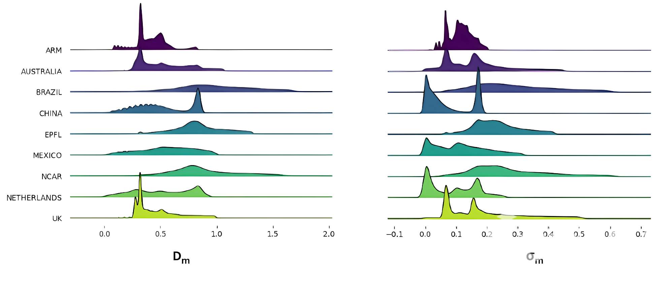
DISDRODB Opportunities
The analysis-ready data format makes exploration straightforward
Lot of DSD patterns to be revealed and analyzed
D_{m}
σ_{m}

Slide 15
Summary
We developed a suite of tools to standardize DSD data management and processing
The DISDRODB metadata archive documents and keeps tracks of the disdrometer stations !
The DISDRODB decentralized data archive allows the exchange of the raw data
Everyone can contribute his data !
The disdrodb software allows to easily download the raw data and produce the DISDRODB products
Modular configuration files allow to customize every step of the DISDRODB processing chain
The DISDRODB products provides standardized scientific analysis-ready data
We initiated the effort by including > 400 stations worldwide (and additional > 300 in the making…)
Potential to open new opportunities for global DSD studies
Further product development and improvements are possible and encouraged !
We look forward for feedbacks, new data and software contributors !

Slide 16
References
Metadata Archive: https://github.com/ltelab/disdrodb-data
Documentation: https://disdrodb.readthedocs.io
Software: https://github.com/ltelab/disdrodb
Installation: conda install disdrodb
Contact: gionata.ghiggi@epfl.ch
Thanks for your attention

Slide 18
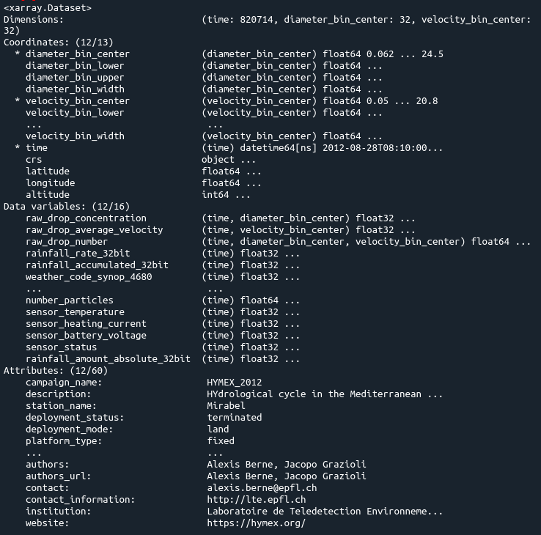

DISDRODB L0 product
Raw data converted and stored into daily standardized CF-compliant netCDF4 files
Standardized names for :
  Dimensions
  Coordinates
  Attributes
  Metadata
Duplicated timesteps are removed
No raw data is discarded or masked
No quality check of the data is performed
> disdrodb_run_l0

Slide 19
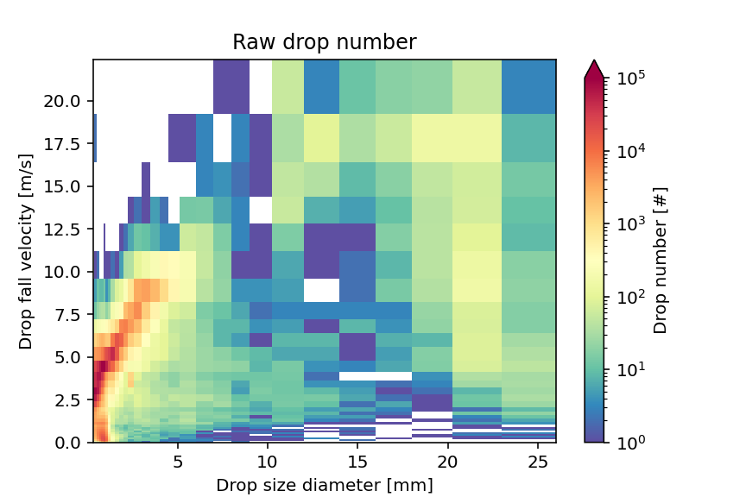
DISDRODB L1 product
Filtered DSD spectrum
A configuration file allows to customize the filtering criteria and the techniques for estimating drop fall velocity
> disdrodb_run_l1

Slide 20
DISDRODB L1 product
Filtered DSD spectrum
A configuration file allows to customize the filtering criteria and the techniques for estimating drop fall velocity
> disdrodb_run_l1

Slide 21
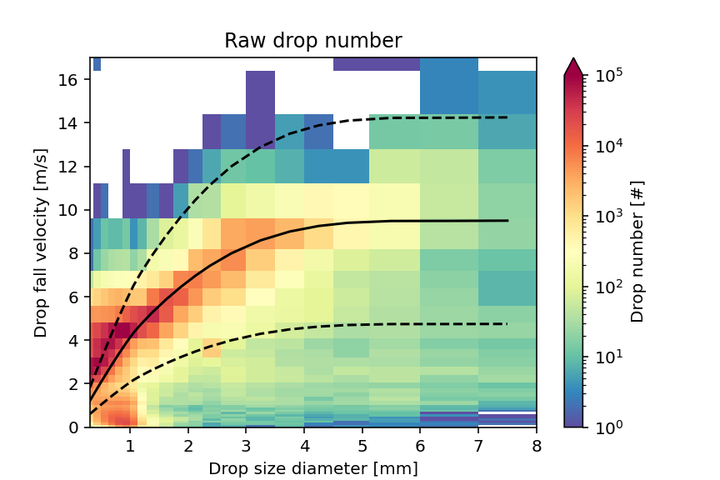
DISDRODB L1 product
Filtered DSD spectrum
A configuration file allows to customize the filtering criteria and the techniques for estimating drop fall velocity
> disdrodb_run_l1

Slide 22
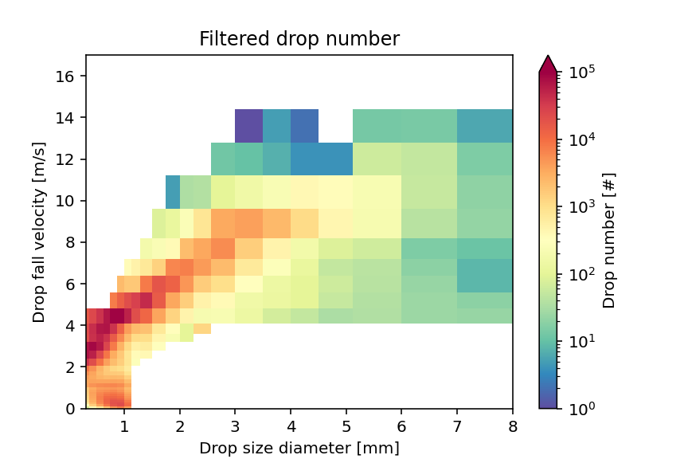
DISDRODB L1 product
Filtered DSD spectrum
A configuration file allows to customize the filtering criteria and the techniques for estimating drop fall velocity
> disdrodb_run_l1

Slide 23
DISDRODB L2 product
Multiple temporal aggregations
→ …, 1MIN, 5MIN, 10MIN, …
Optional resampling using sliding windows (ROLL)
Polarimetric radar variables simulated using T-Matrix
Empirical DSD variables are provided in L2E product
> disdrodb_run_l2e

Slide 24
DISDRODB L2 product
Multiple temporal aggregations
→ …, 1MIN, 5MIN, 10MIN, …
Optional resampling using sliding windows (ROLL)
Polarimetric radar variables simulated using T-Matrix
Empirical DSD variables are provided in L2E product
> disdrodb_run_l2e

Slide 25
DISDRODB L2 product
Multiple temporal aggregations
→ …, 1MIN, 5MIN, 10MIN, …
Optional resampling using sliding windows (ROLL)
Polarimetric radar variables simulated using T-Matrix
Empirical DSD variables are provided in L2E product
Modelled DSD parameters and variables are provided in L2M product
> disdrodb_run_l2m

Slide 26


Slide 27
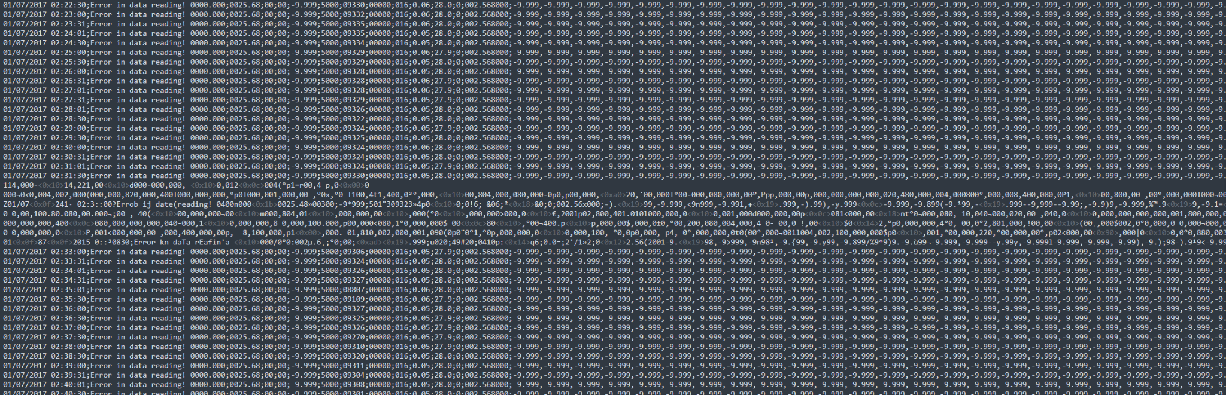
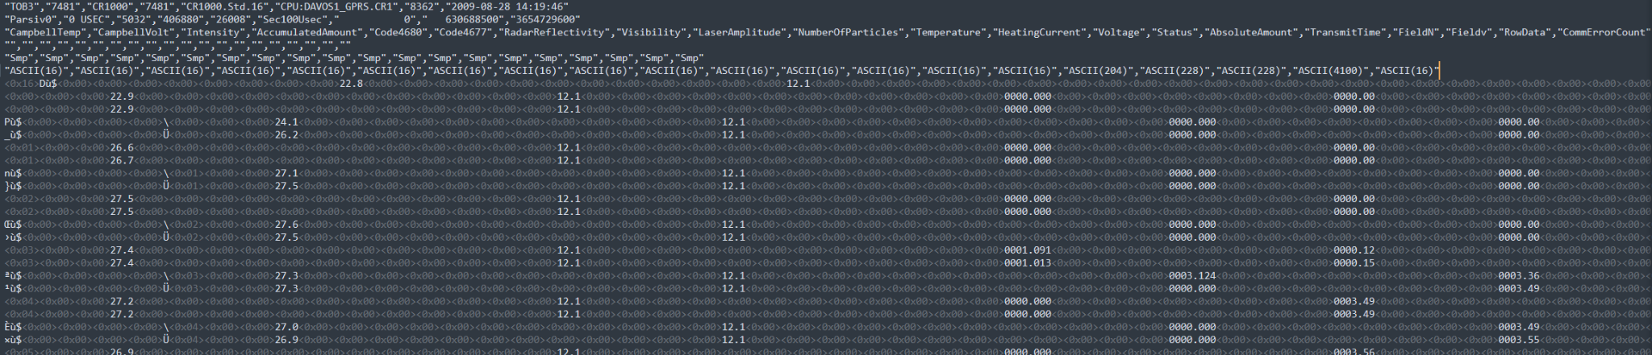

Slide 28
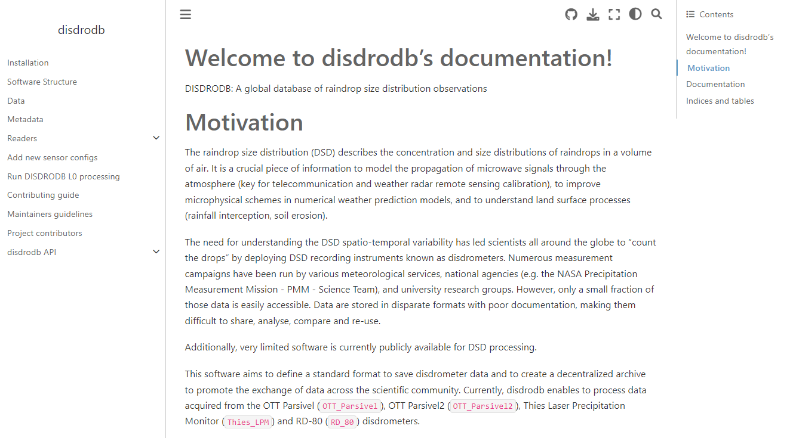
DISDRODB - Documentation
Notes:
The disdrodb software is extensively documented and I would be happy to coach and help the new people willing to taking over project

Slide 29
DISDRODB – Data Contribution System
Add your station information to the DISDRODB Metadata Archive
Design the reader for your data and update the metadata disdrodb_reader field
Ensure that your metadata and reader pass the DISDRODB Quality Screening Check
Upload your data to a remote repository and update the metadata disdrodb_data_url field

Slide 30
DISDRODB L0 products
DISDRODB L0A
Conversion of raw text-format data into Apache Parquet binary format.
Each input file produces one output file.
DISDRODB L0B
Conversion of raw netCDF-format data into DISDRODB L0B netCDF format.
Conversion of DISDRODB L0A files into DISDRODB L0B netCDF format.
Each input file produces one output file.
DISDRODB L0C
Data homogenization products.
DISDRODB L0B files are grouped into daily files.
Duplicate timestamps are removed, and timestamps are adjusted to correct for sensor offsets (e.g., 00:02 becomes 00:00).
A quality indicator is associated with each time step to indicate the availability of neighboring data, time adjustments, etc.
For sensors with variable sampling intervals, a separate file is generated for each interval, ensuring correct resampling for L2 products.

Slide 31
DISDRODB L1 product
DISDRODB L1
Provides the filtered drop size distribution (DSD) spectrum.
For each DISDRODB L0C file, a DISDRODB L1 file is generated.
A configuration file allows customization of filtering criteria and techniques for estimating drop fall velocity.
All calculations are vectorized and parallelized.

Slide 32
DISDRODB L2 products
DISDRODB L2E
Provides empirical DSD parameters and polarimetric radar variables at W, Ka, Ku, X, C, and S simulated using T-Matrix
All calculations and radar simulations are vectorized and parallelized.
A file is generated for each "event."
An event is defined by a start_time and end_time.
Users can choose to define an event as a group of consecutive days, months, or years (or the entire dataset) or, alternatively, based on configurable criteria that identify rain events.
The processing chain allows multiple temporal aggregations (1MIN, 5MIN, etc.) and resampling using sliding windows (e.g., "ROLL1MIN").
DISDRODB L2M
Estimates PSD parameters and subsequently computes integrated DSD variables and polarimetric radar variables.
Various PSD models and parameter estimation methods available.
A L2M file is generated for each L2E file.

Slide 33
DISDRODB – PSD models and parameter estimation
PSD models
ExponentialPSD
GammaPSD
NormalizedGammaPSD
LognormalPSD
Parameter estimation methods
ML (Maximum Likelihood)
Options for likelihood: Poisson vs Multinomial
Options for use of Truncated Likelihood.
Options to use MOM estimates as initial values for ML optimization.
Options for numerical optimization algorithms
MOM (Method of Moments)
Multiple formulations
GS (Grid Search)
Minimizes a user-defined cost function with targets like ND, R, LWC, or Z, using different error metrics (i.e. MAE, MSE, …).
Options to fix parameters (i.e. µ of NormalizedGammaPSD)

