Slide 1
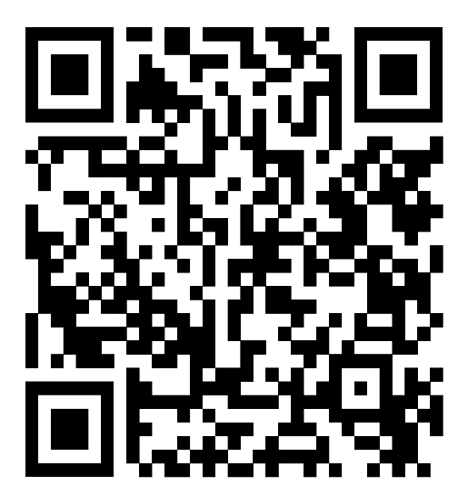
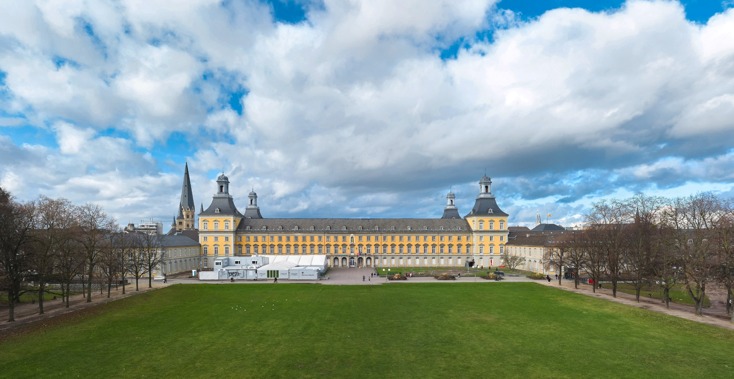
PrePEP 2025
Conference on Precipitation Processes – Estimation and Prediction
17 – 21 March 2025, Bonn, Germany
https://indico.scc.kit.edu/event/prepep/
PrePEP discusses new approaches to improve the monitoring, understanding, nowcasting and prediction of precipitation processes.
Photo: University of Bonn, main building © University of Bonn / Volker Lannert

Slide 2
RealPEP
RealPEP
- Near-Realtime Quantitative Precipitation Estimation and Prediction -
exploit the full observational state evolution information at all stages to improve Flash floods prediction

Slide 3
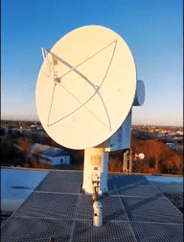
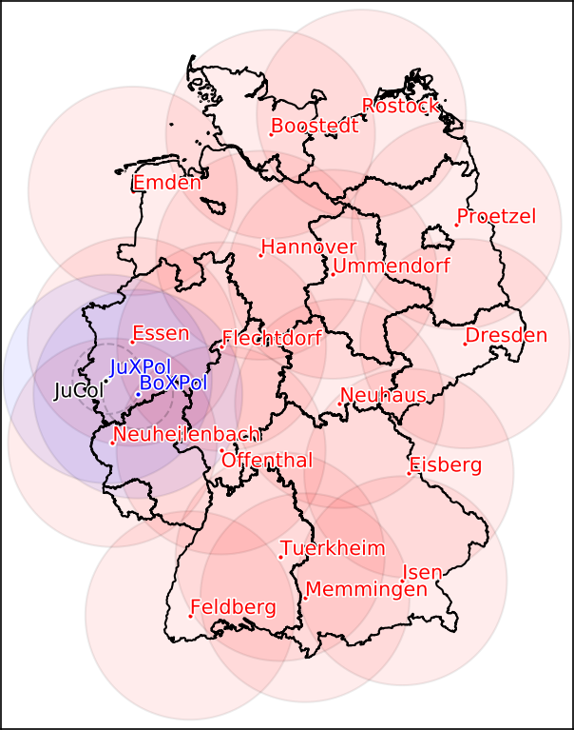
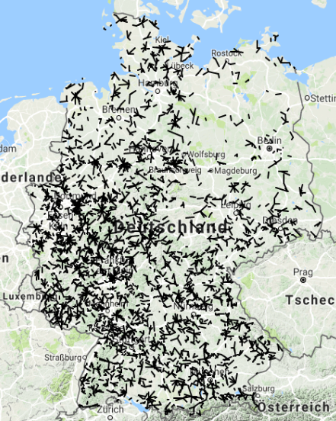
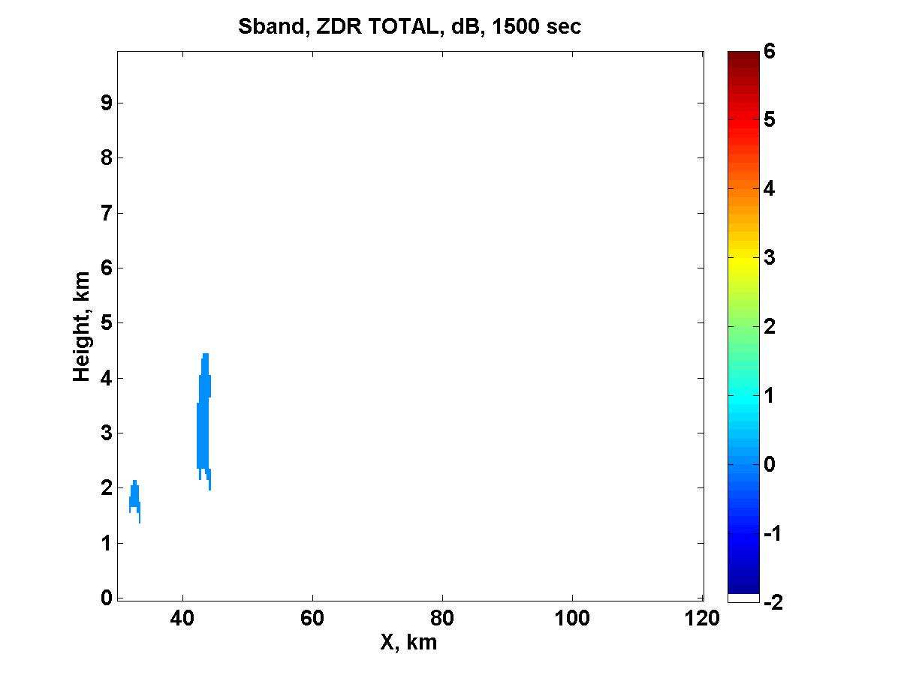
RealPEP
RealPEP
- Near-Realtime Quantitative Precipitation Estimation and Prediction -
exploit the full observational state evolution information at all stages to improve Flash floods prediction
Cosmic-Ray Neutron Sensor
Quantitative Precipitation
Nowcasting (QPN)
Convective Initiation
Quantitative Precipitation Estimation (QPE)
Flash Flood Prediction
(Hydro)
Courtesy of A. Khain

Slide 4
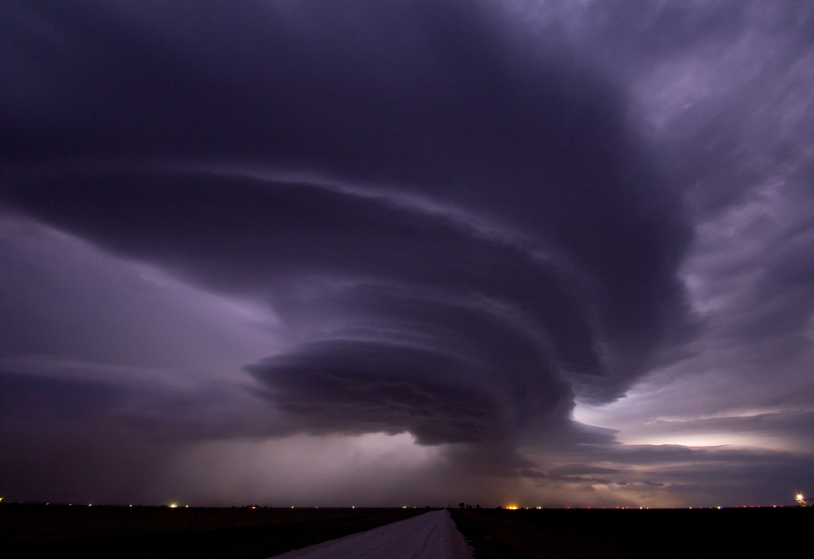
SPP2115: Polarimetric Radar Observations meet Atmospheric Modelling (PROM)
Overall goal: Fusion of Radar Polarimetry and Numerical Atmospheric Modelling Towards an Improved Understanding of Cloud and Precipitation Processes

Slide 5
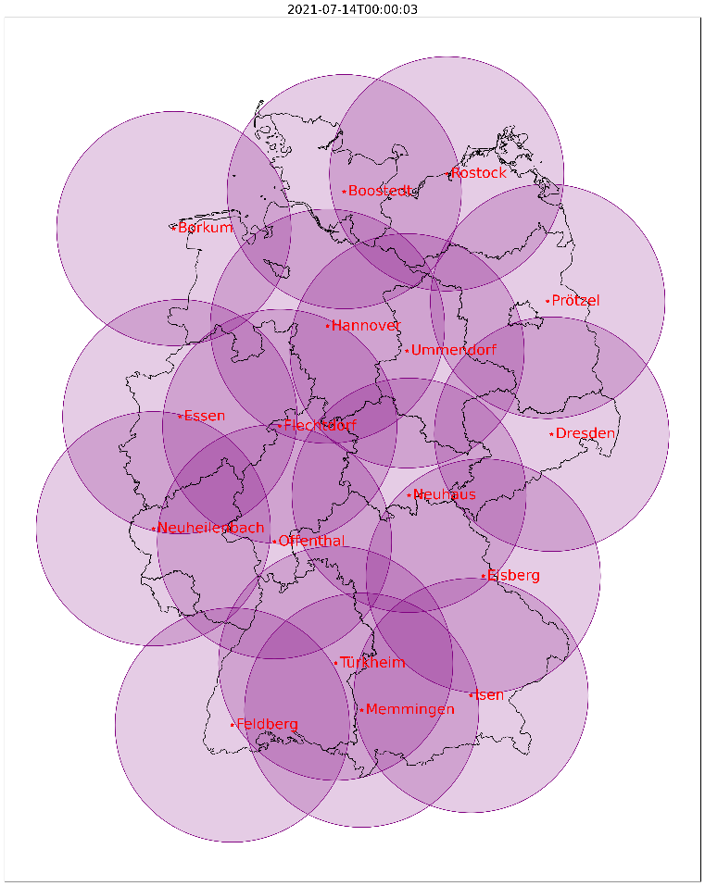
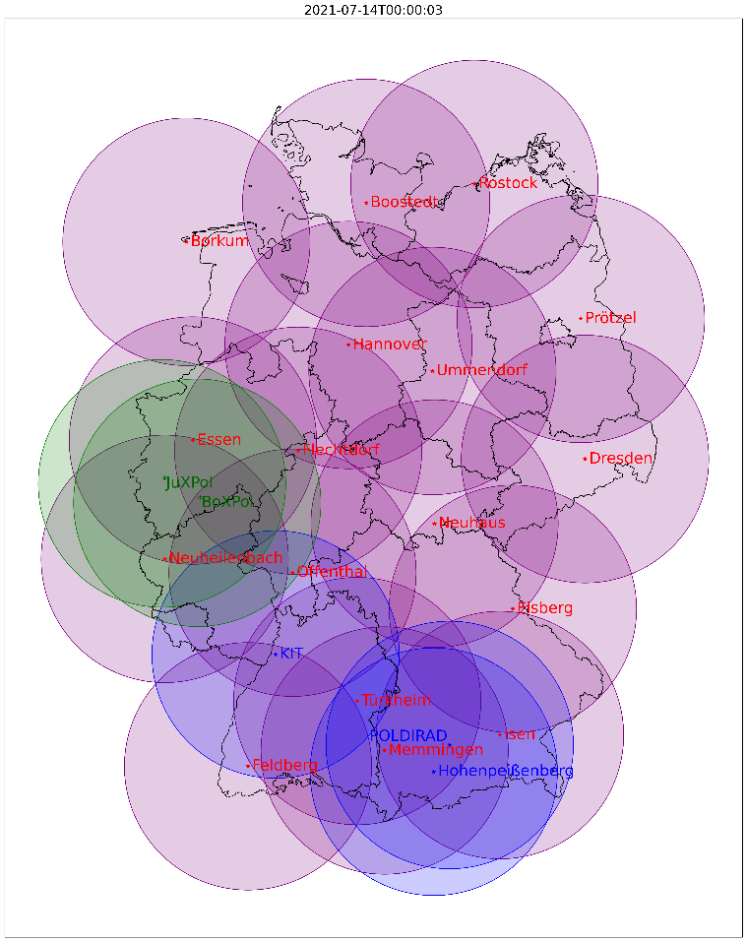
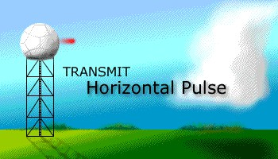
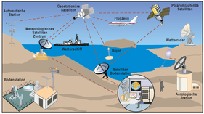
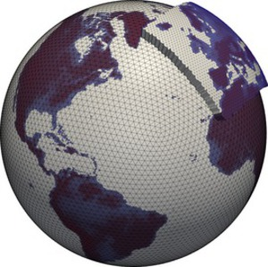
PROM: Motivation & Tools
Cloud and precipitation processes are a main source for uncertainties in weather prediction and climate change projections, which largely result from limited scientific understanding and the missing of sufficiently detailed observations.
New Observations
Model-Observation Fusion
Radar Polarimetry
Data Assimilation
Atmospheric Models

Slide 6
Seamless INtegrated FOrecastiNg sYstem
Talk by the head of SINFONY, U. Blahak in Session 4B on Wednesday at 11:15:
Current status of SINFONY – The combination of nowcasting and numerical weather prediction for forecasting convective events at DWD

Slide 7
Representing Organizing Committee
• PD Dr. Silke Trömel, University of Bonn
• Dr. Ulrich Blahak, Deutscher Wetterdienst Offenbach
• Prof. Dr. Roland Potthast, Deutscher Wetterdienst Offenbach
• Dr. Christian Chwala, Karlsruhe Institute of Technology, Campus Alpin
• Prof. Dr. Clemens Simmer, University of Bonn
• Assistant Prof. Dr. Ricardo Reinoso-Rondinel, KU Leuven-KMI,
• PD Dr. Miklos Szakall, University of Mainz
• Kathrin Michel, University of Bonn
RealPEP

Slide 8
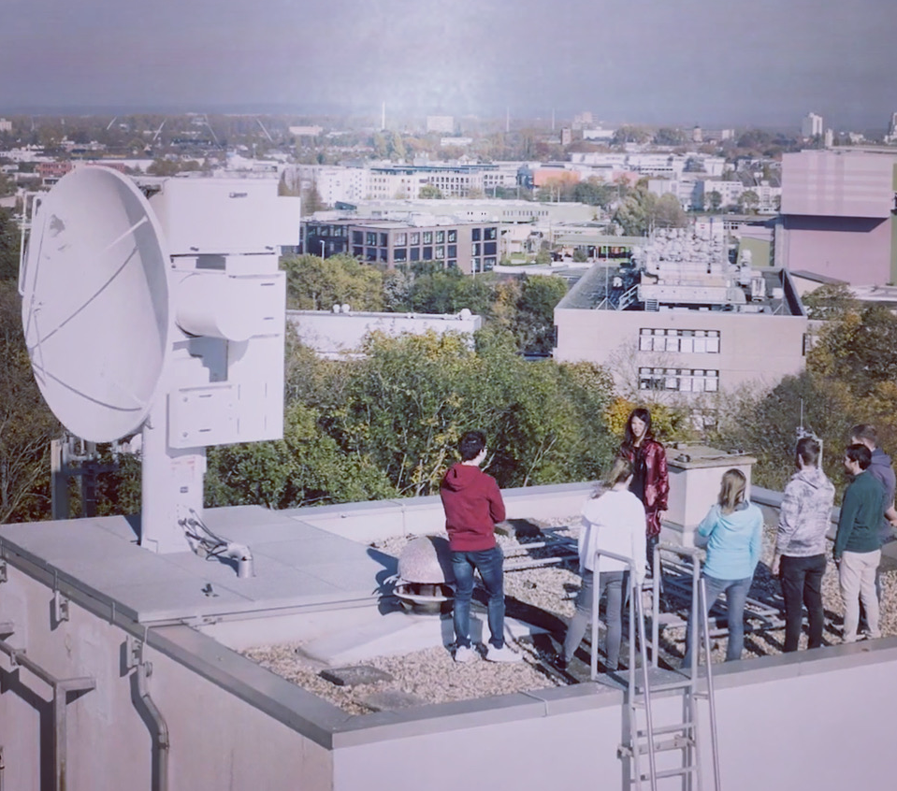
Radar history at University of Bonn
1961 founding of Meteorological Institute by Prof. Dr. Hermann Flohn
1966 installation of the 1st radar at a German university
1997 thorough modernisation
1998 continuous measurements, first every 15, later every 10, nowadays every 5 min
2003 Doppler ability
2008 installation of polarimetric X band radar BoXPol
2023 ✝BoXPol, stop of operations

Slide 9
Organization
Upload your presentations the day before
Stay in time, time slots for talks are 12 min + 3 min discussions
Posters are displayed the whole week, poster session with authors in attendance is scheduled for tomorrow
Your acceptance to make PrePEP presentations publicly available after conference?
Market place has several options for lunch
After Icebreaker, we need to leave at 21:30 latest
Bus for Ahrtal excursion on Wednesday leaves at 14:00, i.e. later than previously scheduled
WLAN access: Keep your password for the entire week and log in again daily

Slide 10
Overview of sessions and their scope
Session 1: From Classical to Integrated Remote Sensing 1.A New observation strategies for clouds and precipitation (multi-frequency, spectral polarimetry, multi-sensor)
1.B New retrieval and estimation techniques (e.g. fusion, Bayesian) Session 2: Enhancing Process Understanding 2.A New observations for modeling and parameterization development
2.B Model parameter estimation Session 3: Prediction Scales and Model Development 3.A Modeling elements in nowcasting
3.B Hectometer scale modeling for precipitation Session 4: Seamless Prediction 4.A Data assimilation integrating nowcasting and new observations
4.B Blending and probabilistic techniques based on nowcasting and NWP ensembles Session 5: Precipitation and Hydrological Models 5.A Extreme precipitation events
5.B Evaluation, verification and interfaces Contact: prepep2025@uni-bonn.de

