Slide 1
From the "bad-looking" raw data to the "handsome" precipitation estimate
vers. 08
The amazing journey through an opportunistic satellite sensing system
Filippo Giannetti
Department of Information Engineering, University of Pisa, Italy
filippo.giannetti@unipi.it
Acknowledgments
COST Action CA20136 OPENSENSE (Opportunistic Precipitation Sensing Network), supported by COST (European Cooperation in Science and Technology).
SCORE (Smart Control of the Climate Resilience in European Coastal Cities), funded by EU’s H2020 research and innovation programme under Grant No. 101003534.
Fabiola Sapienza (University of Pisa).
Attilio Vaccaro (MBI, Pisa) and the whole teams of the NEFOCAST and INSIDERAIN projects.
Roberto Nebuloni (CNR, Milan) and the whole Italian team within Opensense.
Precipitation Processes - Estimation and Prediction (PrePEP), Bonn, Germany, March 16-21, 2025

Slide 2
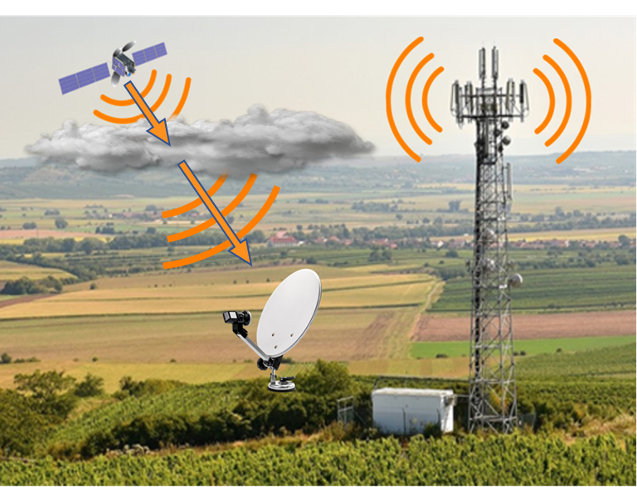
Remote Sensing & Wireless Communications
Integrated Sensing and Communication (ISAC): technological concept that denotes the symbiosis between sensing and communication:
it enables hardware & spectrum reuse ("for free") between sensing & communication functions;
it enhances features such as location awareness and movement detection, and boosts efficiency and capacity;
as such, it has been identified as a novel feature of 6G and next-generation networks.
According to the International Telecommunication Union (ITU) Report ITU-R M.2516-0 "Towards 2030": Communication systems can support sensing services at radio level through the concept of “network as a sensor”.
Pre-existing communication infrastructures, either terrestrial or satellite-based, are sources of microwave (MW) signals that can be exploited for Opportunistic Sensing (OS) of rain.

Slide 3
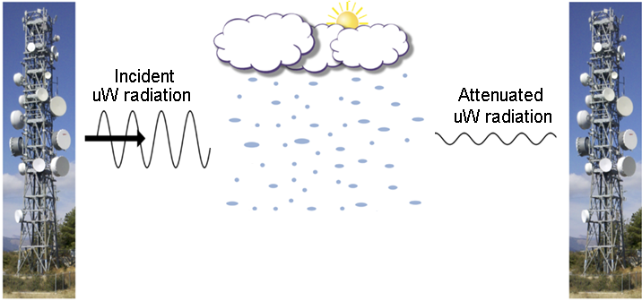
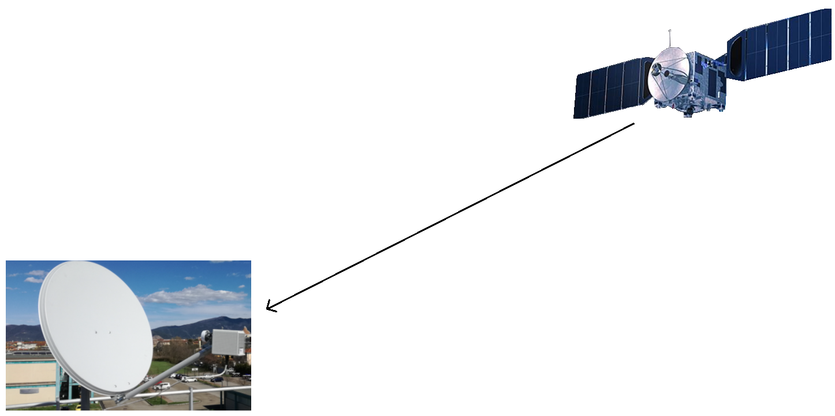
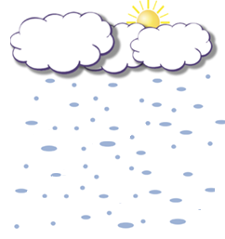
Rain attenuation in MW communication links
Rain introduces additional attenuation on microwave (MW) communication links, due to signal reflection, scattering and absorption caused by raindrops (significant effects for f > 3 GHz).
Both terrestrial and satellite MW communication links are affected by rain:
backhaul connections of commercial cellular networks, via tower-to-tower horizontal paths;
downlink of direct-to-home (DTH) satellite broadcasting, via satellite-to-ground slanted paths.
MW
MW
a) Horizontal terrestrial MW link Commercial MW link (CML)
b) Slanted satellite MW link
Satellite MW link (SML)
Opportunistic estimation of rainfall intensity relies on real-time measurements, made at the receiver site, of an RF signal metric denoted as Received Signal Level (RSL).

Slide 4
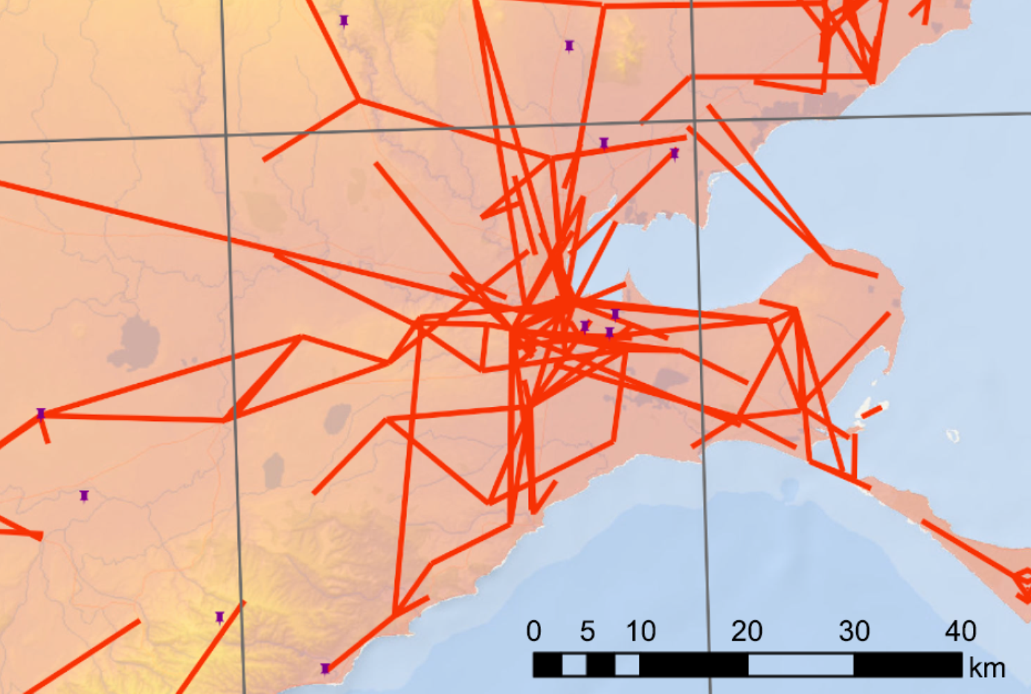
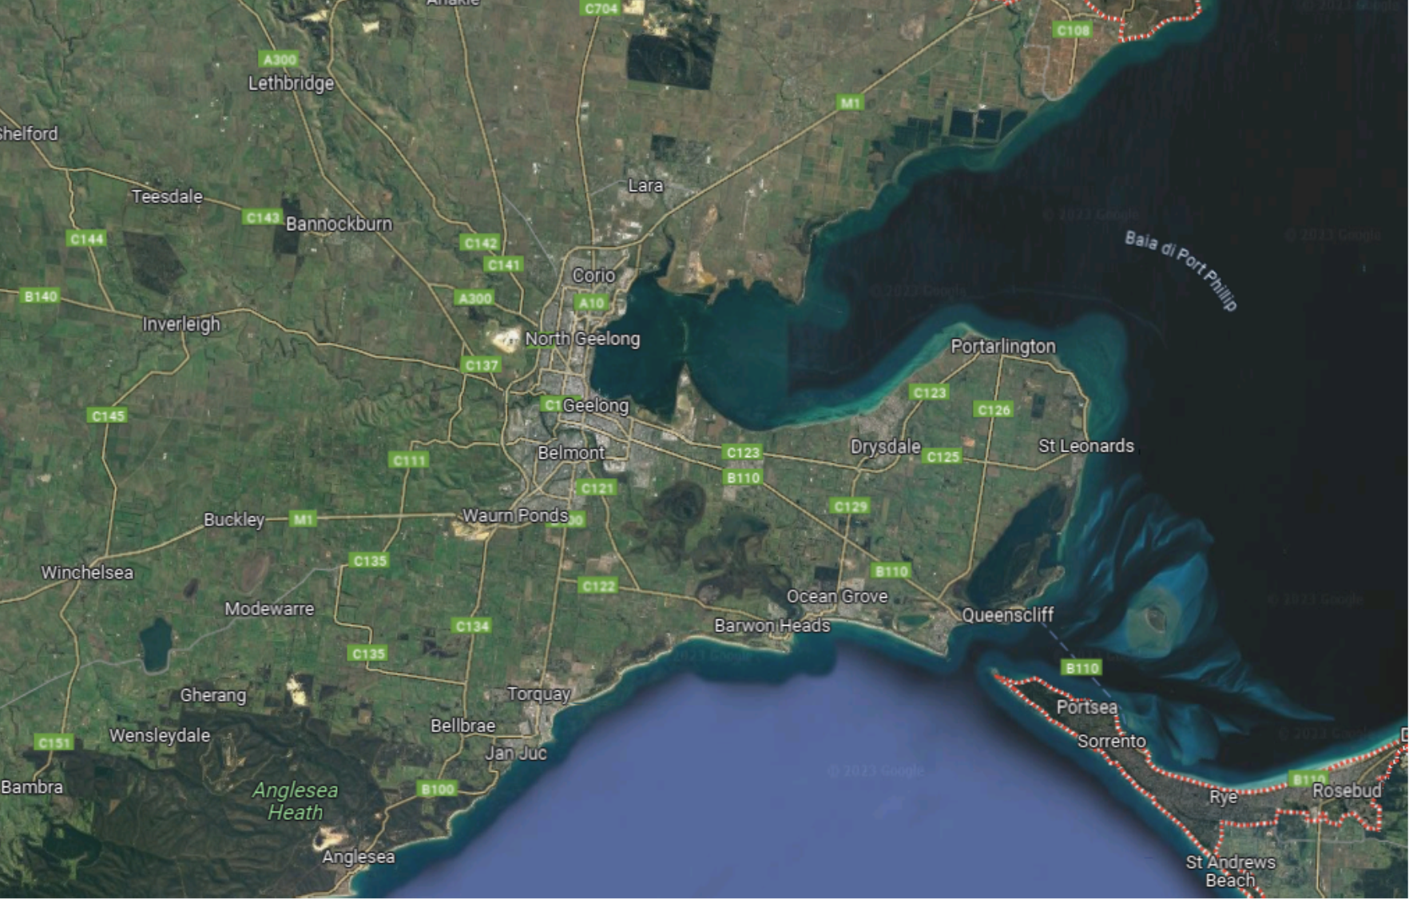
Limitations of CML-based opportunistic rain sensing
For CMLs, however, access to RSL data requires the authorization of the network operator and the payment of a fee.
Also, ground coverage of the CML mesh is non uniform: coverage gaps, especially in rural areas.
It is not possible to add new links to the mesh, wherever necessary.
coverage gaps due to sparse CML in suburban/rural areas
dense CML mesh in urban area
Mesh of CMLs in the area of Melbourne (AUS)

Slide 5
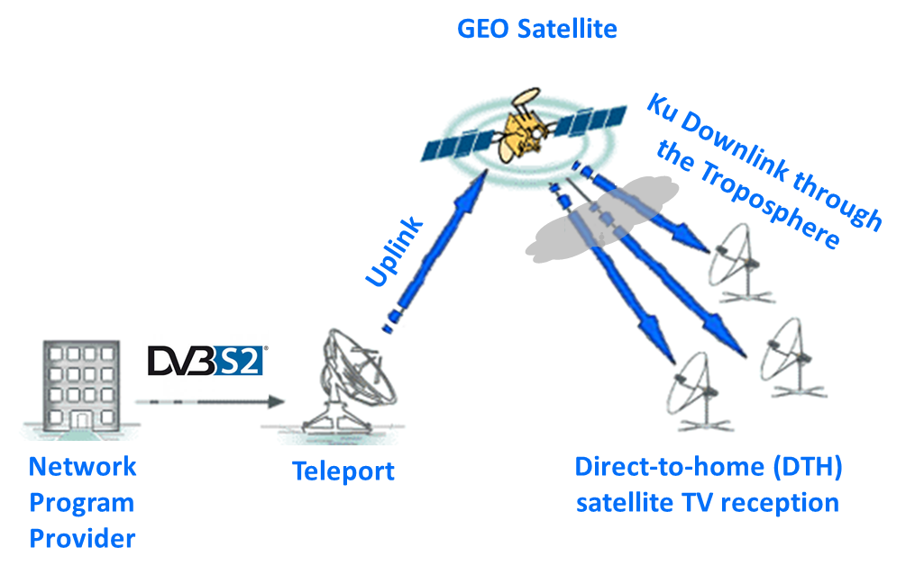
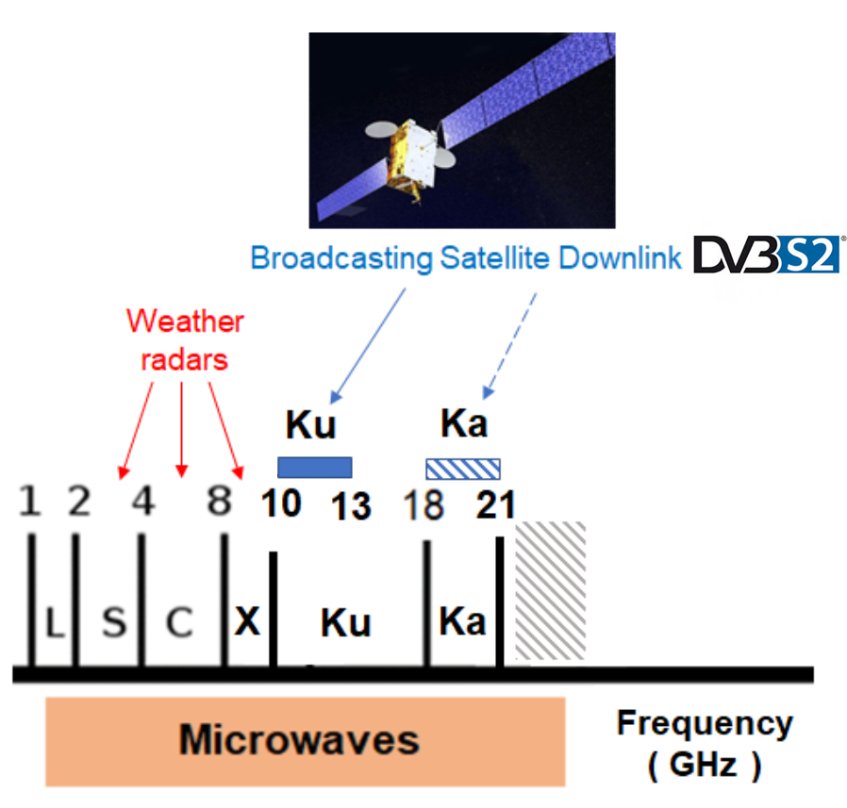
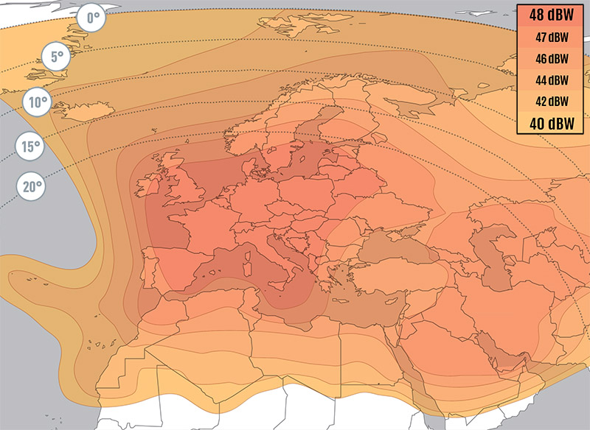
Advantages of SML-based opportunistic rain sensing
Hereafter, we will focus on the use of SML for OS due to the following noteworthy features
Wide-area signal coverage – broadcast satellites provide geographical coverage on continental scale (footprint).
Ease of reception – within the satellite footprint, signals are strong and can be easily received with small sized parabolas (Ø ≤ 80 cm).
Ease of installation – low-size (and cheap) parabolas can be easily put in place and aimed.
Low cost equipment – commercial-grade equipment for satellite TV reception can be used. DVB-S2 in Ku band (10-13 GHz).
Ease of access to signal measurements – measurements of RSL are made by sat. TV receivers with no authorization or fee.
High scalability of spatial-resolution – if necessary, satellite terminals can be quickly and easily deployed to improve spatial density.
High temporal resolution – RSL readings can be taken at 1 sample/minute or even more.
No installation and no maintenance of transmitters – opportunity transmitters are serviced by their owners.
Green functioning – no additional electromagnetic radiation is diffused into the environment for sensing.
Ku footprint of Eutelsat 10A satellite, at 10°E

Slide 6
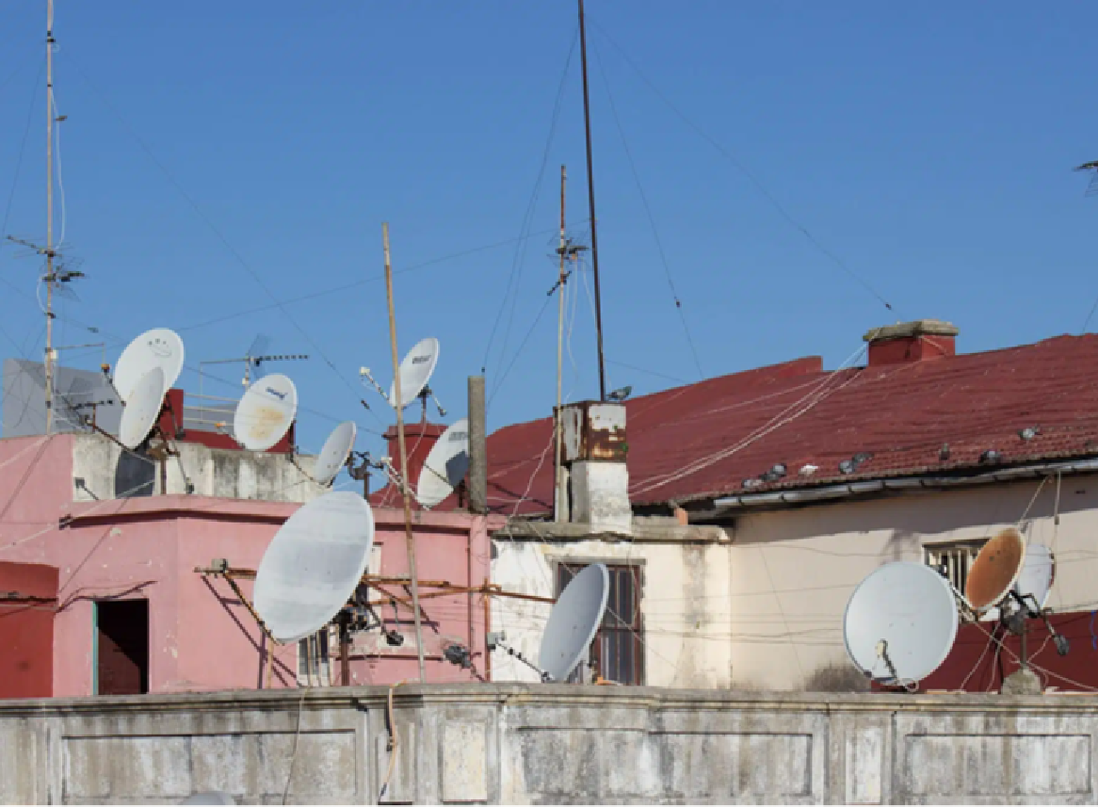
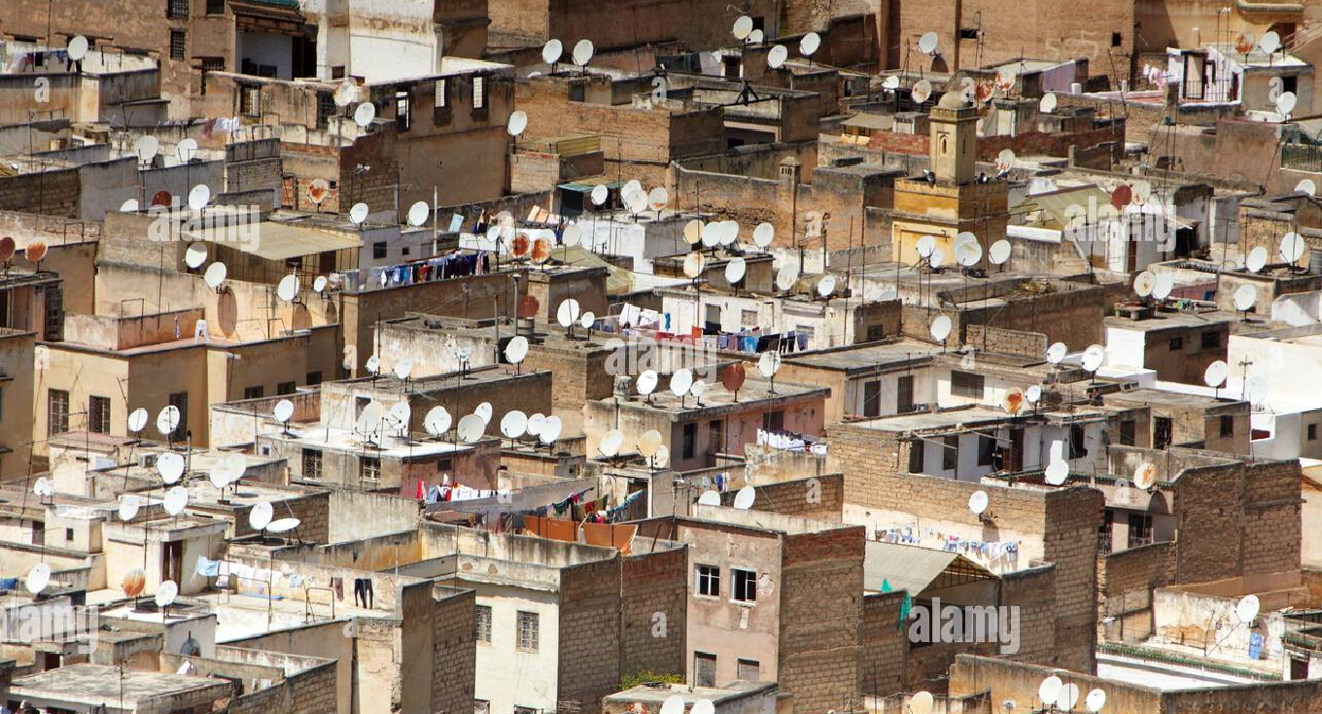
Towards an ubiquitous SML-based OS?
Many cities and regions worldwide exhibit a pervasive diffusion of terminals for direct reception of satellite TV broadcasts.
But, is this a real enabler for the development of an ubiquitous OS network?

Slide 7
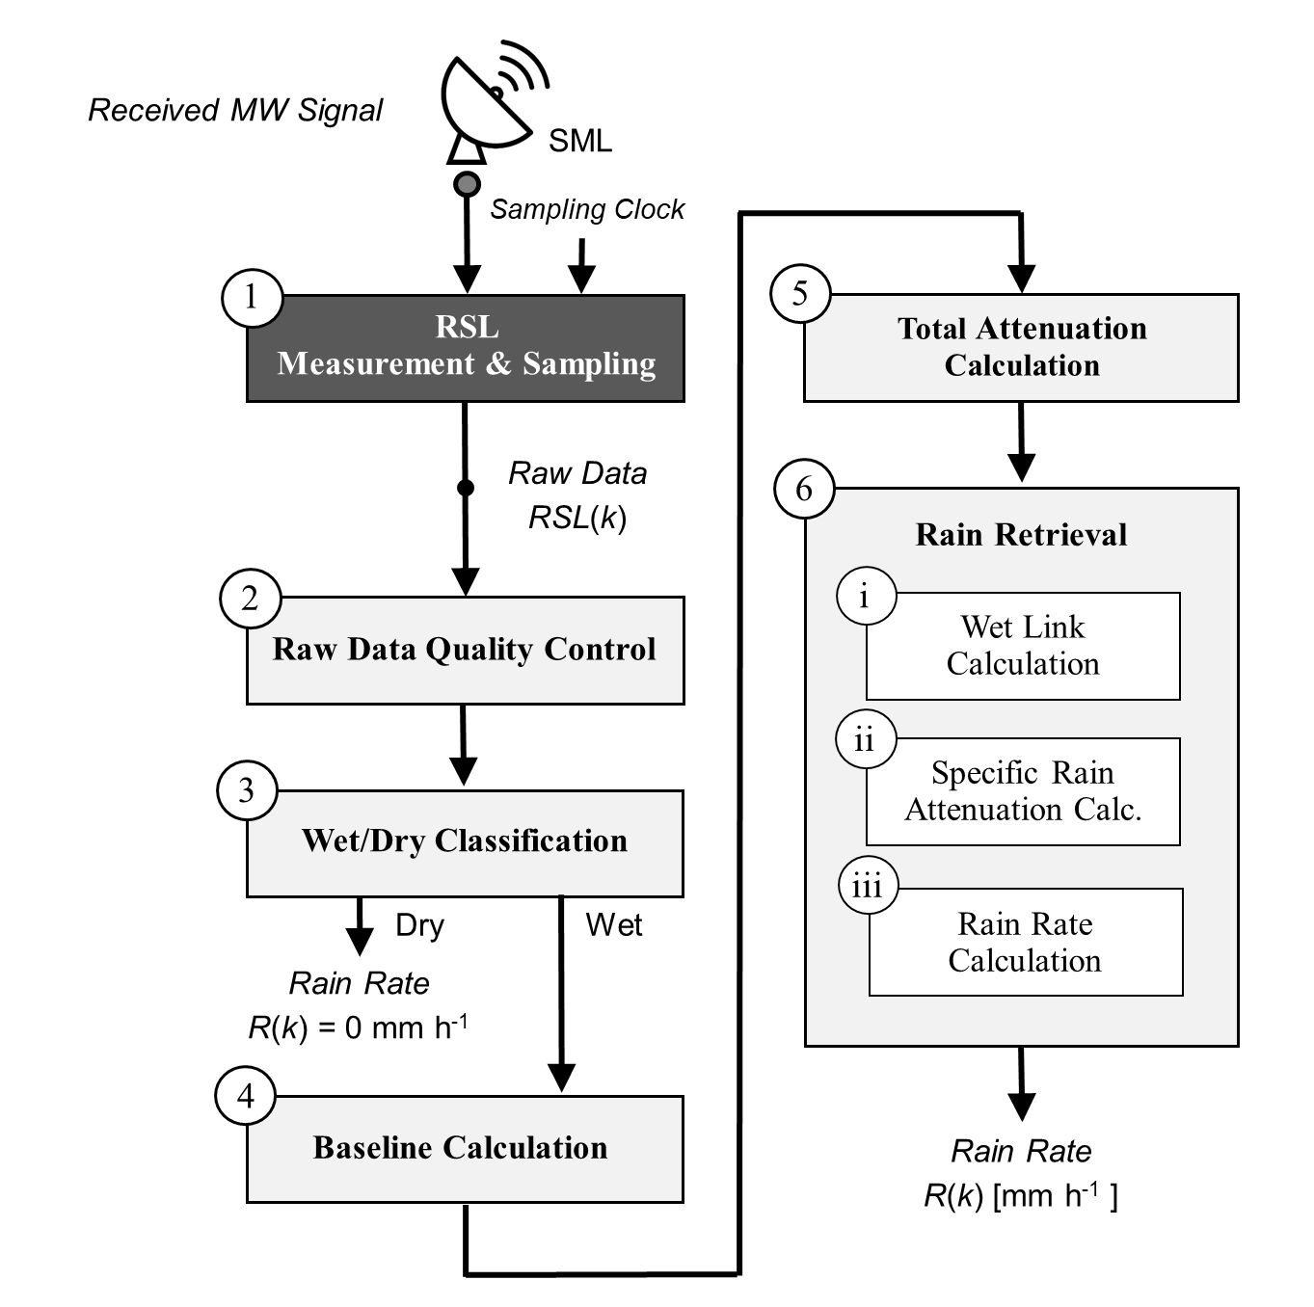
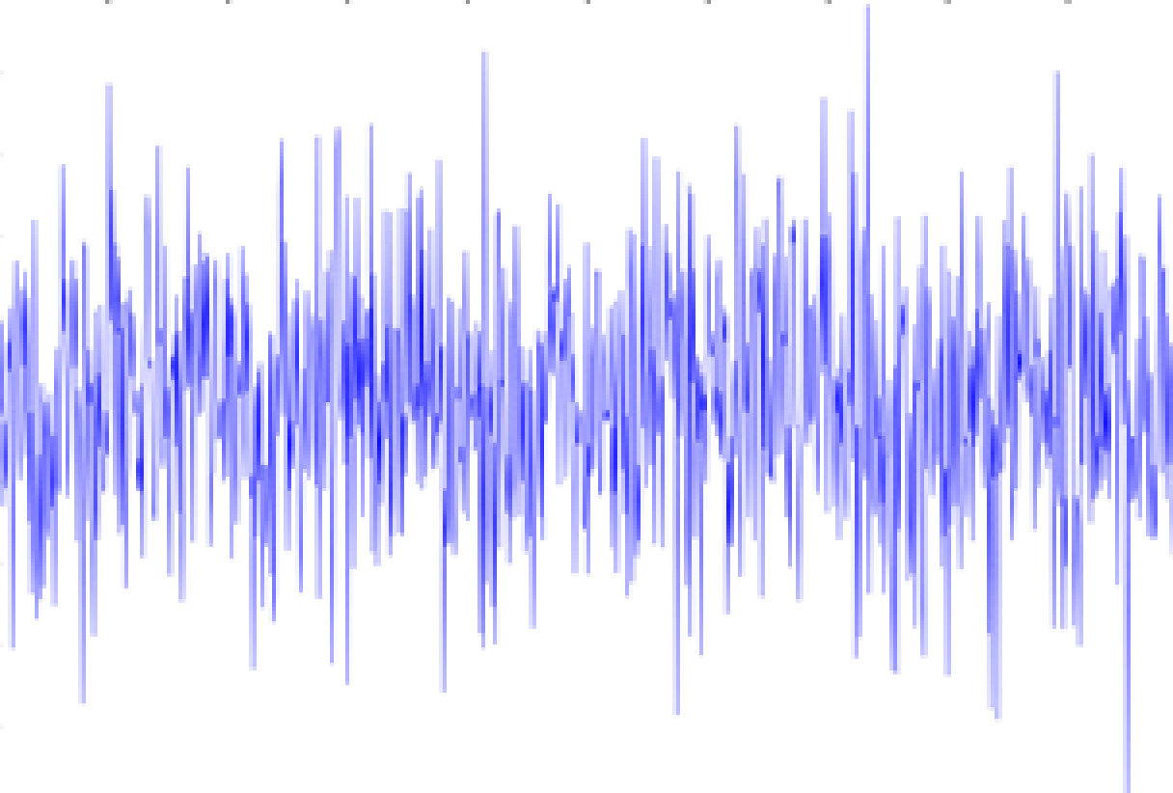
RSL Definition, Measurement and Sampling
Commonly-used RF signal metric for the Received Signal Level (RSL)
1
Signal-to-Noise Ratio
2
Received Power

Slide 8
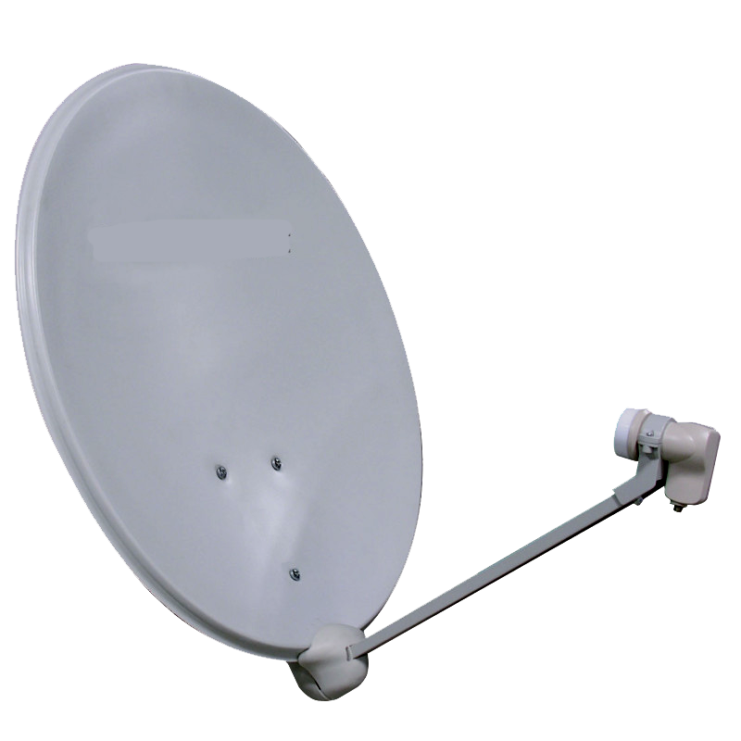
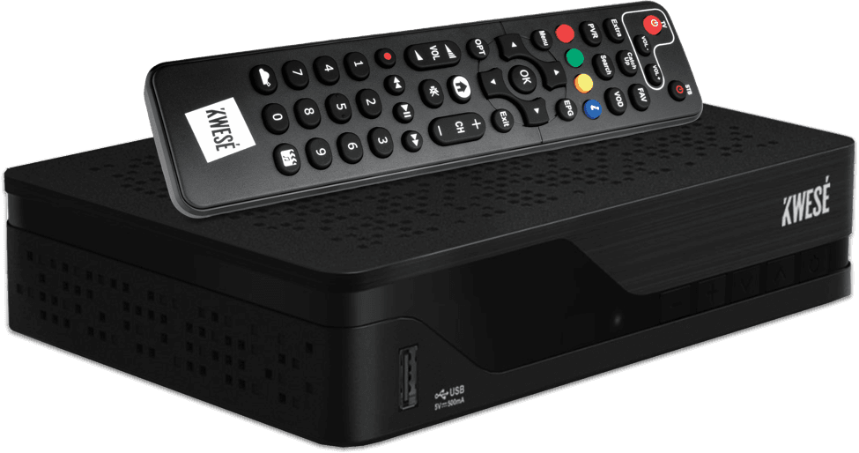
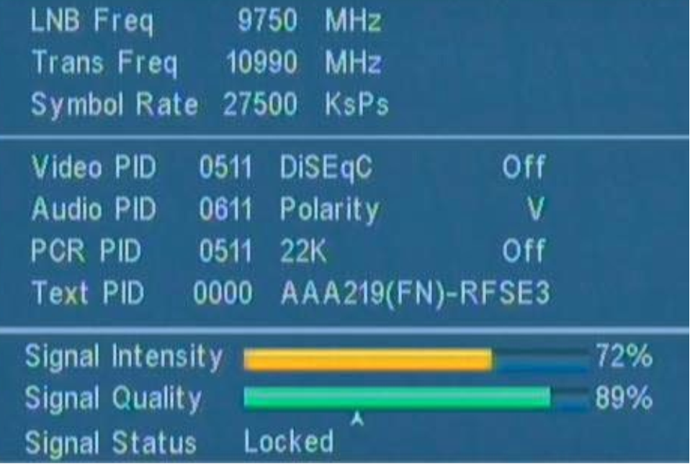
Satellite TV receivers technology: Commercial off-the-shelf decoder for DTH satellite broadcasting
DVB-S2 channels
Ku-Band TV signal downlink from GEO satellite.
LNB (Low Noise Block) converter
DVB-S2 data stream
Dish diameter
70 – 80 cm (typ.)
Coaxial cable
L-Band electrical signal
COTS indoor decoder unit/integrated board
Every COTS decoder implements a RSL measurement.
However, data logging functionalities are not available.
RSL

Slide 9
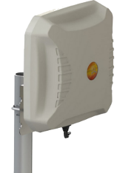
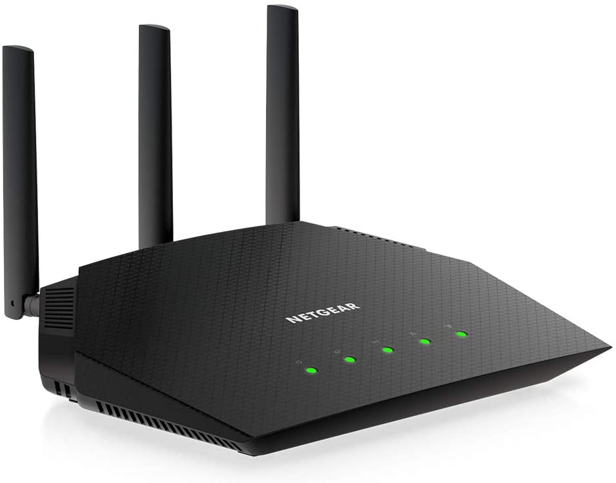
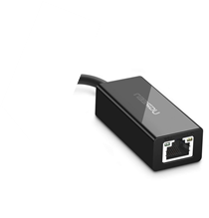
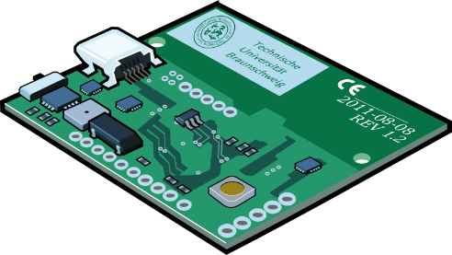
Satellite TV receivers technology: Custom board for RSL acquisition
DVB-S2 channels
Ku-Band TV signal downlink from GEO satellite.
Data-Logging interfaces
4G / 5G modem
LNB (Low Noise Block) converter
RSL
Wi-Fi router
Dish diameter
70 – 80 cm (typ.)
Coaxial cable
L-Band electrical signal
Ethernet socket
Custom board for RSL acquisition and data-logging
Entails electronic design and manufacturing of a dedicated device for RSL acquisition.
Requires the availability of a telecommunication infrastructure.
Commercial-grade components may exhibit poor performance

Slide 10
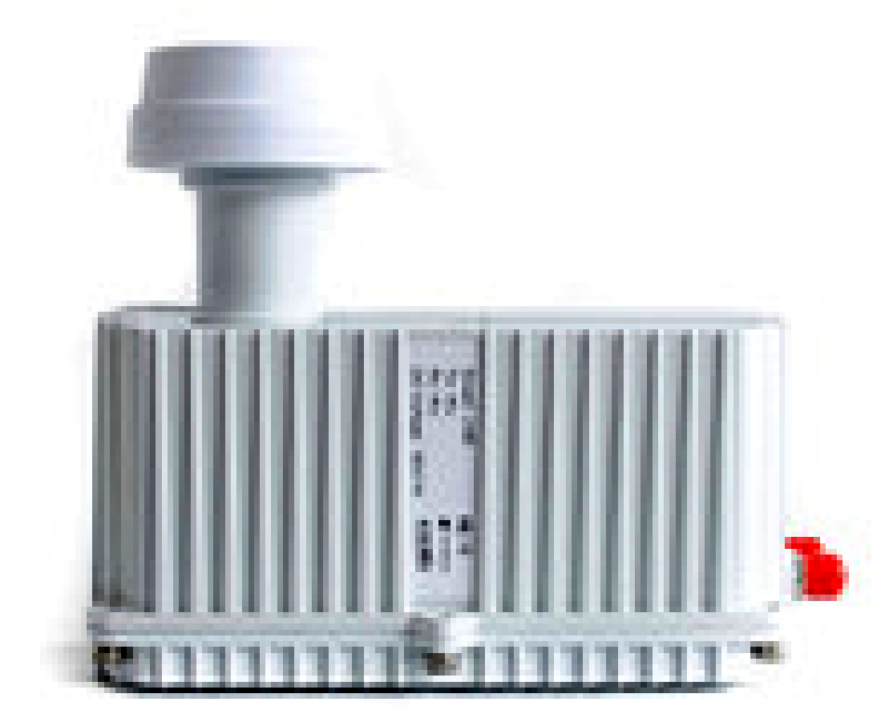
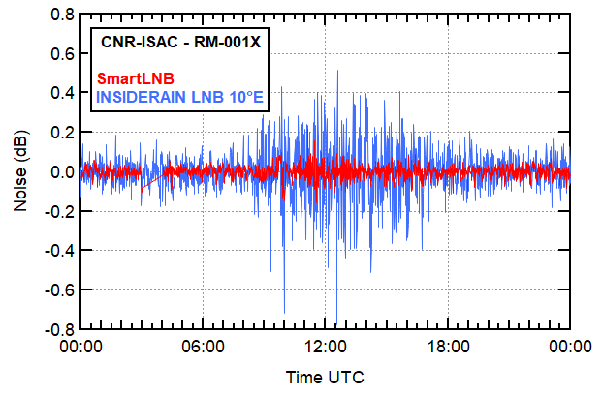
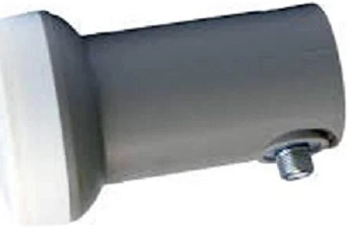
Low-cost LNB performance
GEO satellite Eutelsat 10A, on 11.345 GHz (Ku-Band)
Rome, 29/05/2022 – Temperature: min 15° C – max 26° C – Clear sky
A few hundreds of euro
SmartLNB
LNB
High-end commercial device
30° C
Around 5 euro
25° C
Atmospheric temperature
Cheap and noisy electronics
Poor quality plastic case
Poor thermal shielding
Dubious waterproofness
Possible "wet antenna effect"
20° C
15° C

Slide 11
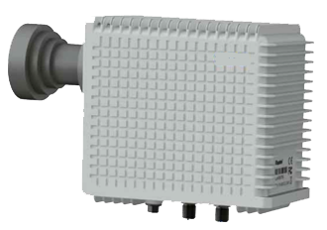
Satellite TV receivers technology: The SmartLNB as a data acquisition and logging decvice for rain OS
DVB-S2 channels
Ku-Band return channel uplink towards GEO satellite carrying
receiver status info and RSL readings (1 or 2 per minute).
RSL
(user data)
TX
SmartLNB
(LNB + Decoder)
RX
Coaxial cable
Indoor unit (IDU)
SmartLNB innovative satellite terminal
Commercial device
Integrated: LNB + decoder unit are combined into the same case
Interactive: two-way device
sensing: receives DVB-S2 channels and measures RSL
data-logging: transmits receiver status (incl. RSL) and user's data (interactive TV, IoT sensors)
Very appealing solution for the practical implementation of opportunistic satellite-based rain-sensing

Slide 12
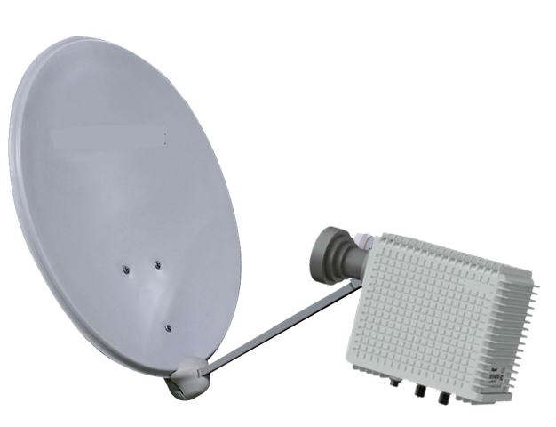
RSL harvesting from SmartLNB sensors via satellite return link
GEO sat EUTELSAT 10A
Satellite platform EUROBIS / HyperCube
Owned and managed by MBI srl, Pisa, Italy
Subscription required for return link access
RSL # 1
RSL # 3
RSL # 2
RSL # 2
SmartLNB Terminal # 1
RSL # 3
RSL # 1
Raw data
Algorithm
Rain rate estimate (mm/h)
SmartLNB Terminal # 2
Satellite footprint
Satellite hub
SmartLNB Terminal # 3
Service Center (data storage and processing, rain retrieval)

Slide 13
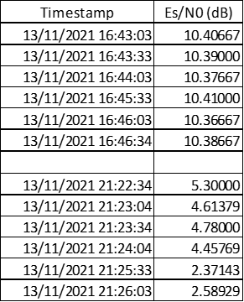
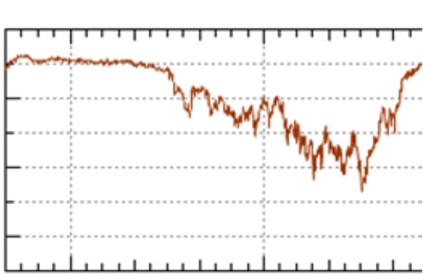
The "bad-looking" raw data from the SmartLNB
1 sample every 30 sec (or 60 sec)
Clear-Sky RSLs
Rain Fading RSLs
Clear-Sky RSL
10.40 dB
Rain Attenuation
4.50 dB
Rain Fading RSL
Es/N0 (dB)
13/11/2021 16:45
13/11/2021 21:25

Slide 14
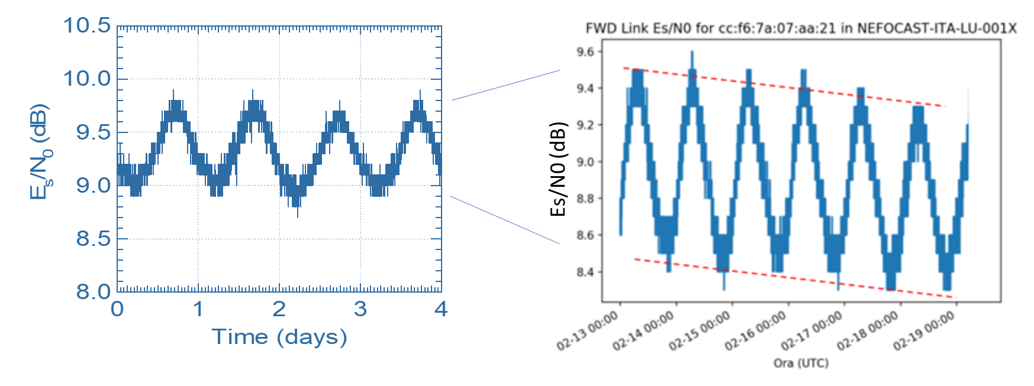
Noise and signal amplitude fluctuations
Tropospheric scintillation noise and other noise contributions
GEO satellite orbit perturbations (inclination, drift)
14

Slide 15
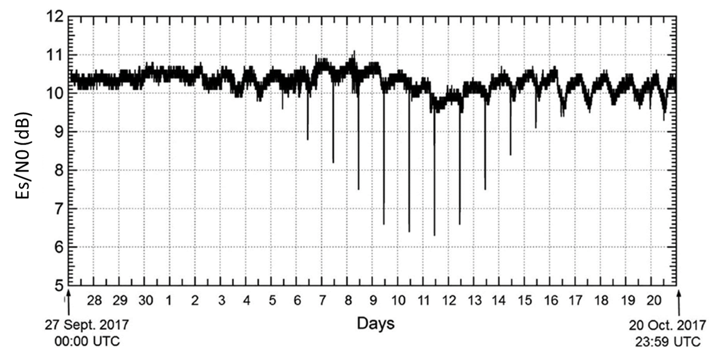
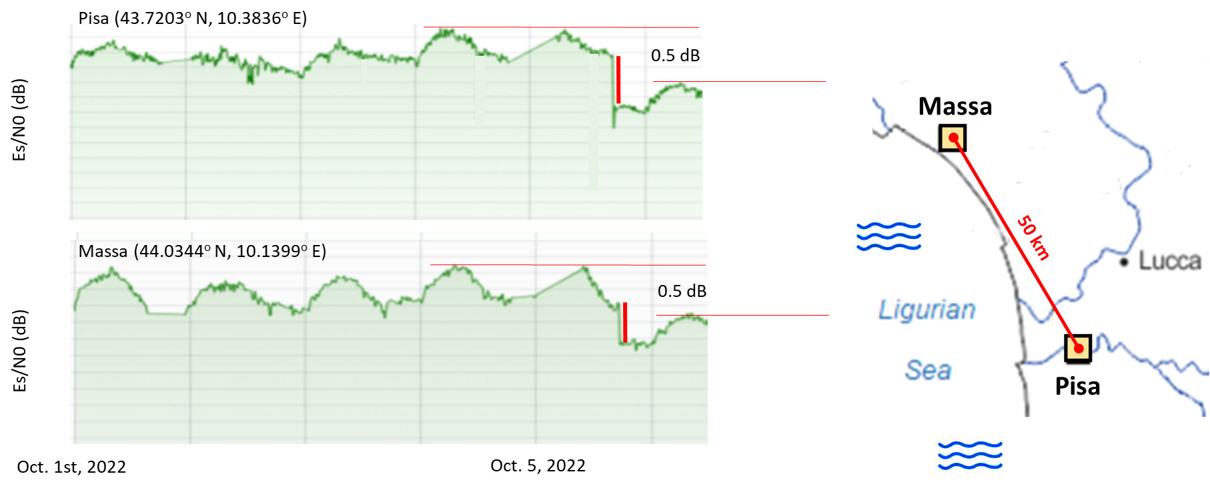
Noise and signal amplitude fluctuations
Sun transit noise
Satellite operator's maneuvers / uplink fading
15

Slide 16
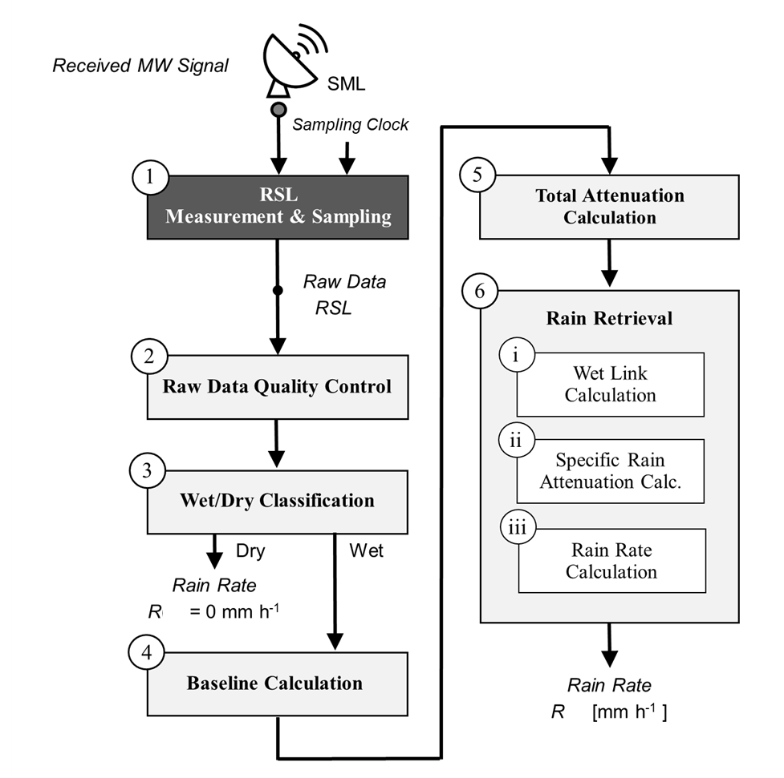
Flowchart of the basic processing steps for rainfall retrieval from OS data collected by a SML
Service Center
SmartLNB
Return Link via Satellite

Slide 17
Flowchart of the basic processing steps for rainfall retrieval from OS data collected by a SML
Service Center
(2) Raw Data Quality Control
Telecom MW link and equipment not designed/optimized for sensing.
SML receivers are commercial-grade products.
Standard tests on raw data:
search for missing data, i.e., gaps in the time series;
identification of outliers, e.g. glitches or step-like variations in signal power;
identification of receiver blinding due to sun transit;
cross-check of data collected by different frequency channels of the same link or by nearby links.
SmartLNB
Return Link via Satellite

Slide 18
Flowchart of the basic processing steps for rainfall retrieval from OS data collected by a SML
(3) Wet/Dry Classification
Labeling the RSL samples as wet or dry :
enables detection of precipitation and measurement of duration;
eases subsequent rain intensity estimation.
Operation:
detects rain event by exploiting the different features of RSL wet samples w.r.t. dry ones;
removes scintillation noise;
tracks RSL fluctuations due to perturbations of GEO.
Techniques:
Kalman filtering;
AI methods for wet/dry classification of SML data
Artificial Neural Network
Support Vector Machine
Random Forest / Extremely Randomized Trees
Logistic Regression / Decision Tree
Service Center
SmartLNB
Return Link via Satellite

Slide 19
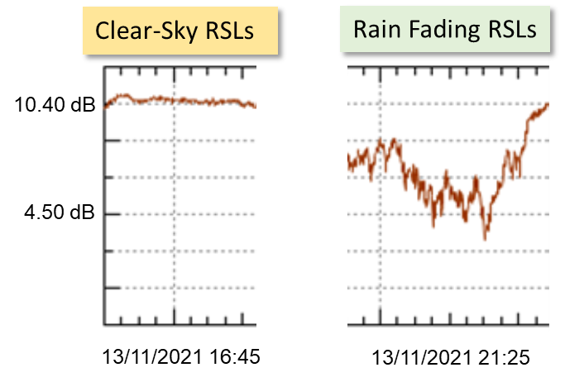
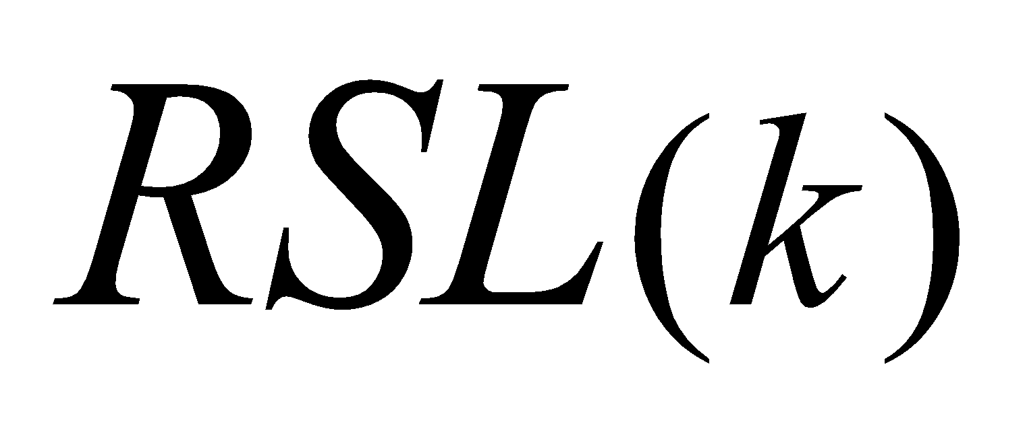
Flowchart of the basic processing steps for rainfall retrieval from OS data collected by a SML
(4) Baseline Calculation
RSL baseline value for dry conditions is necessary for rain attenuation estimation.
Techniques:
It is assumed constant during the entire rain event, as:
the last "dry" RSL reading;
the median RSL value over the preceding 24 dry hours.
It is updated at every sample by dynamic techniques (sliding windows, filters, etc.).
Service Center
SmartLNB
Return Link via Satellite

Slide 20
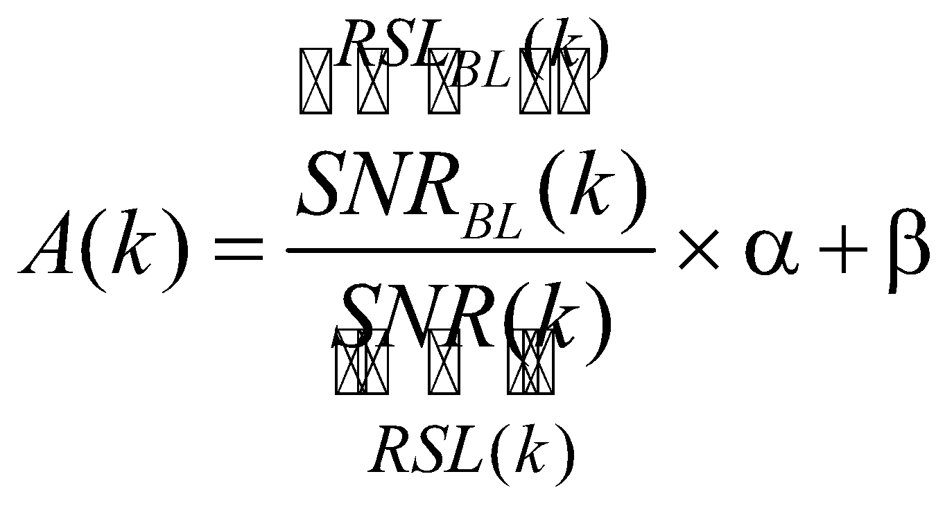
Flowchart of the basic processing steps for rainfall retrieval from OS data collected by a SML
Service Center
(5) Total Attenuation Calculation
SmartLNB
RSL is a power level
Return Link via Satellite
RSL is a Signal-to-Noise Ratio

Slide 21
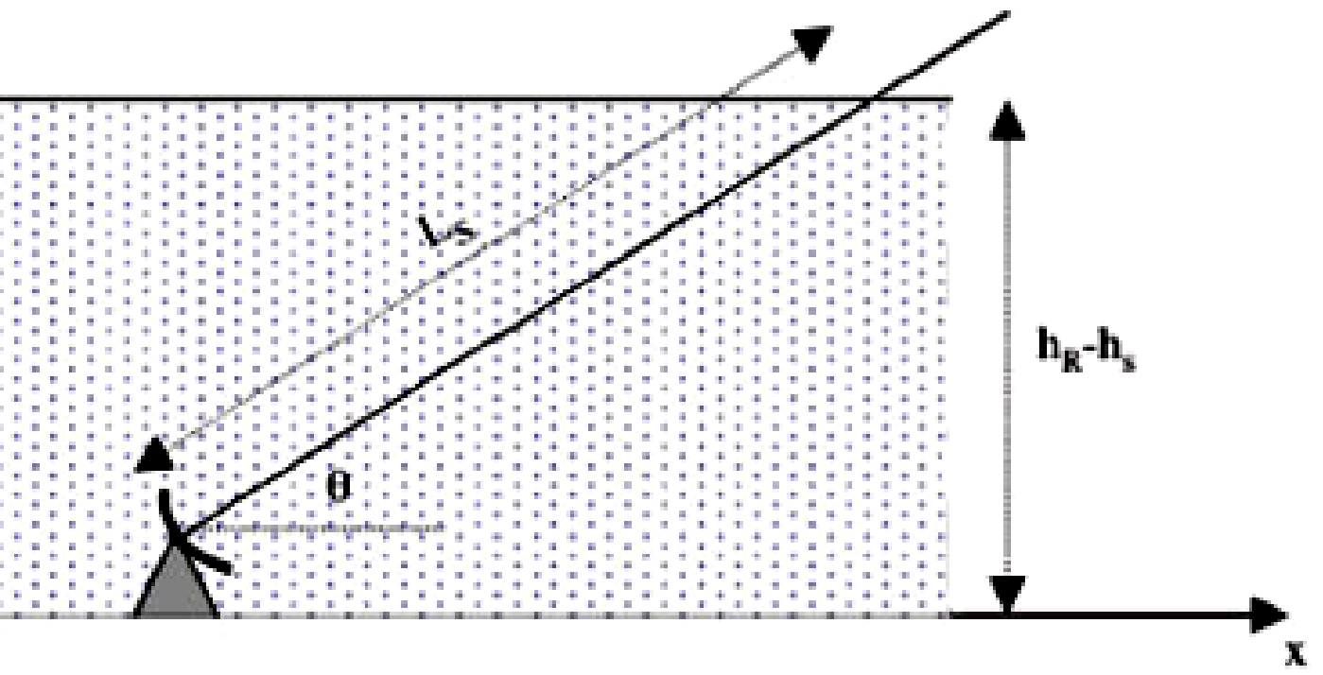
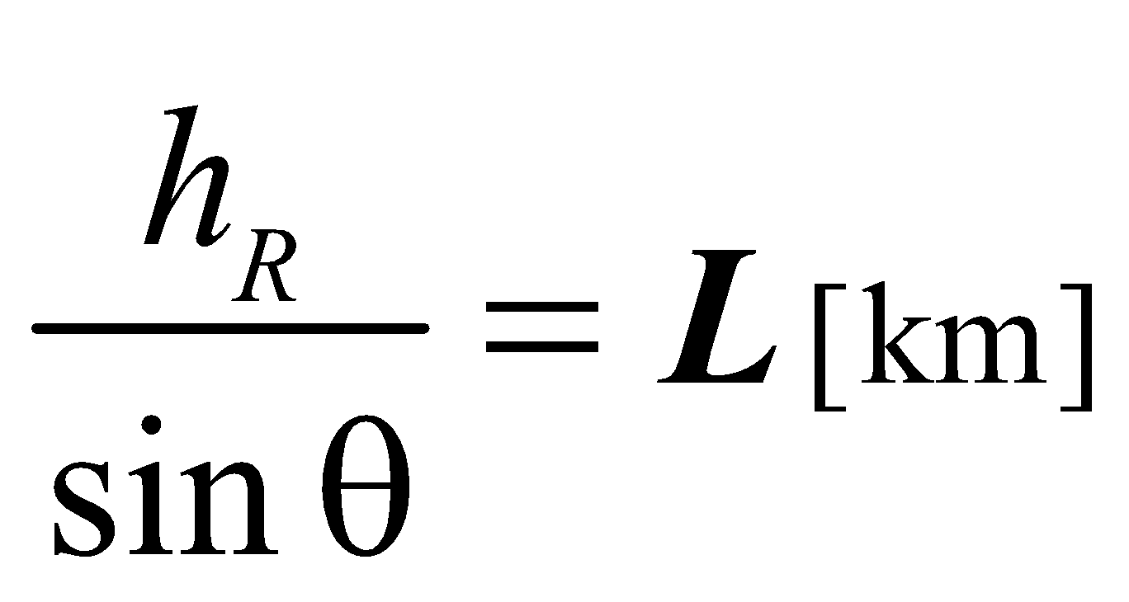
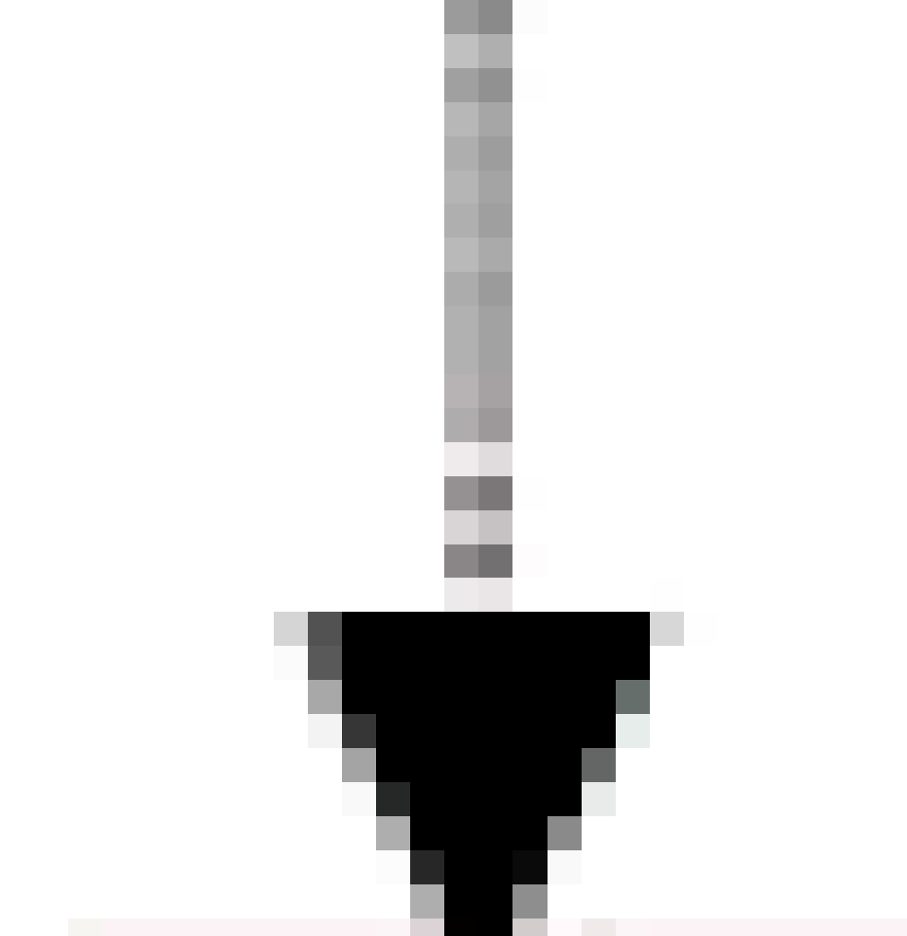
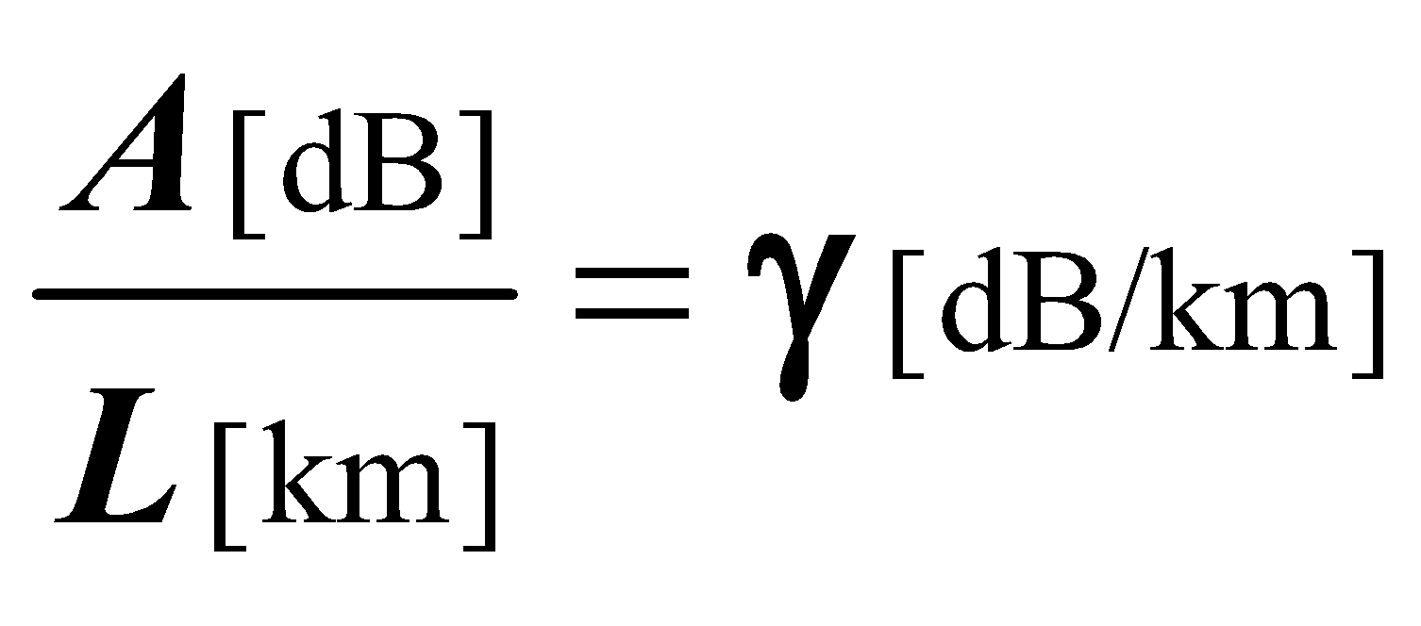
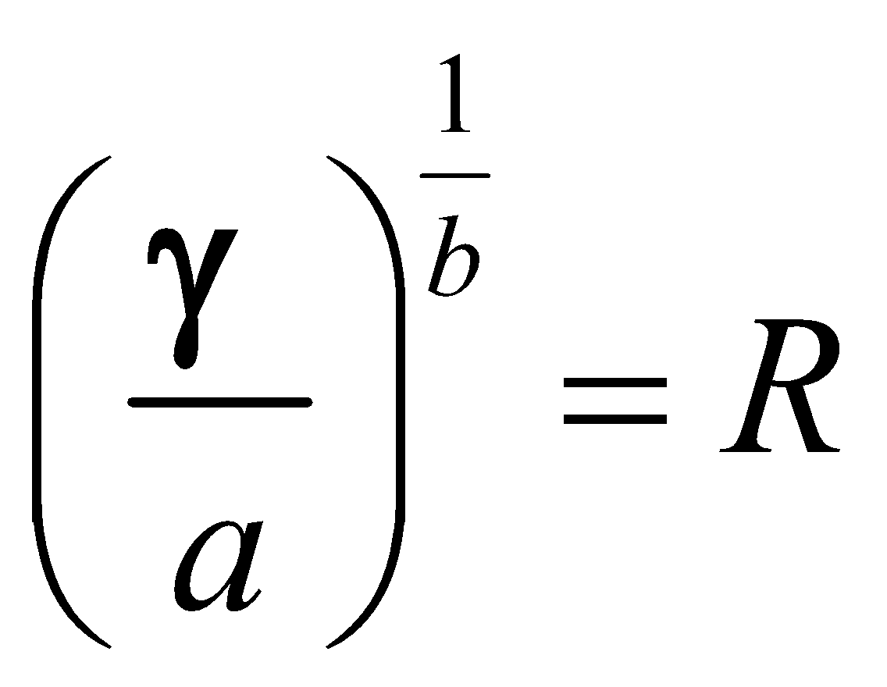
Flowchart of the basic processing steps for rainfall retrieval from OS data collected by a SML
(6) Rain Retrieval
Service Center
2-layer ITU model
i. Wet Link Calculation
ITU-R Rec. P.618
ITU-R Rec. P.839
SmartLNB
Return Link via Satellite
ii. Specific Rain Attenuation Calculation
ITU-R Rec. P.618
In
iii. Rain Rate Calculation
ITU-R Rec. P.618
Out

Slide 22
Flowchart of the basic processing steps for rainfall retrieval from OS data collected by a SML
(6) Rain Retrieval
Service Center
2-layer ITU model (overestimates rain intensity)
In
Out
SmartLNB
Return Link via Satellite
3-layer tropospheric model, which takes into account also for the effects of the melting layer (ML)
In
Out
Ku-band propagation in
Liquid-Layer
Melting-Layer
International patent application No. PCT/IB2021/056594
International filing date 21 July 2021

Slide 23
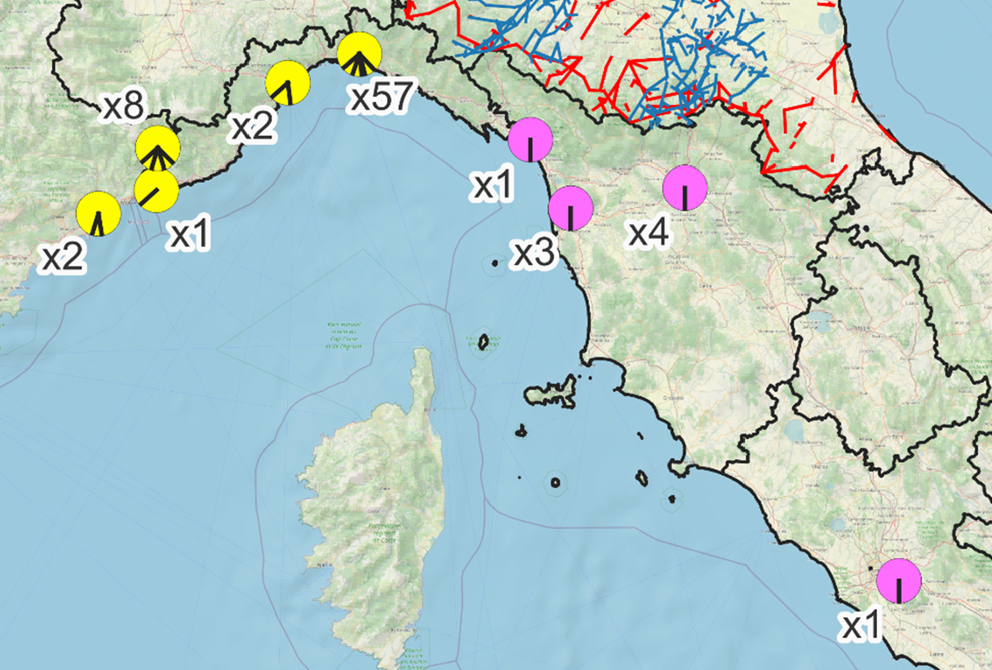
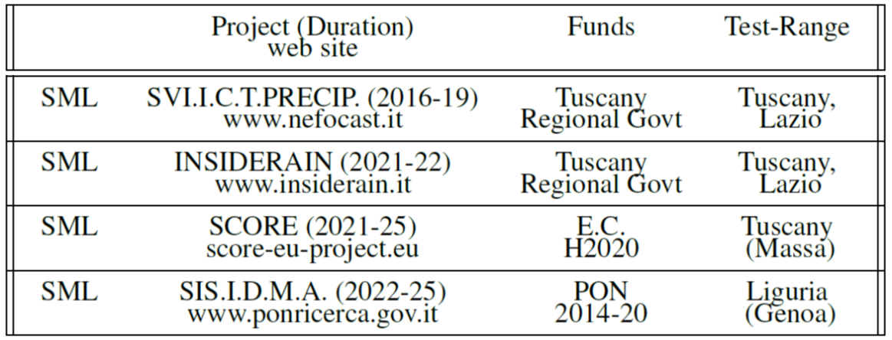
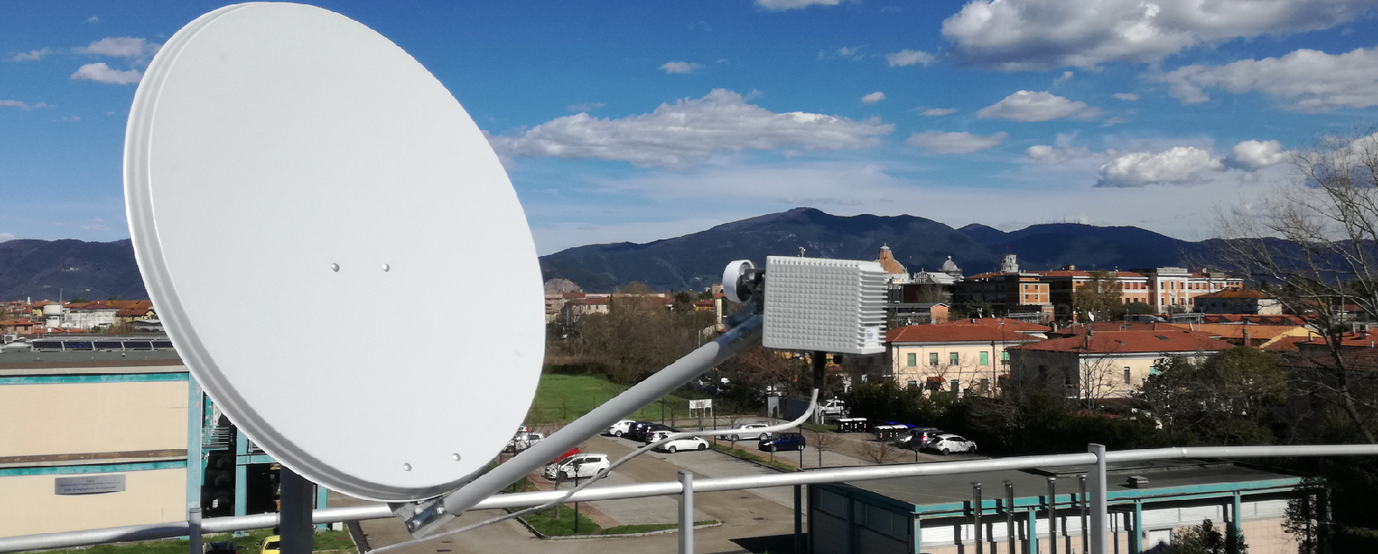
SML-based OS activities in Italy
Test ranges for SML-based OS of rain deployed in Italy
Recent projects carried out in Italy on SML-based OS of rain
L i g u r i a
Genoa
Massa
Pisa
Florence
T u s c a n y
Opportunistic rain sensing terminal featuring a SmartLNB device, installed at the Department of Information Engineering, University of Pisa, Italy (43.7203º N, 10.3836º E), on a Ø 80 cm offset parabola, aimed at Eutelsat 10A satellite (10º E)
L a z i o
Ligurian Team
Tuscan Team
Rome
SML-based OS characteristics
Sensitivity: approx. 1 mm/h
Saturation: 80 mm/h @ h₀ = 4.5 km, 160 mm/h @ h₀ = 1 km
Detection range: 1.2 km @ h₀ = 1 km, 5.6 km @ h₀ = 4.5 km
Time resolution 30" – 60"

Slide 24
Validation Studies
Wet/Dry Classification
Rain Intensity Retrieval
From: R. Nebuloni et al. "A Review of Technical Challenges in Opportunistic Rainfall Estimation Using Satellite and Terrestrial Microwave Links," under review, 2025.

Slide 25
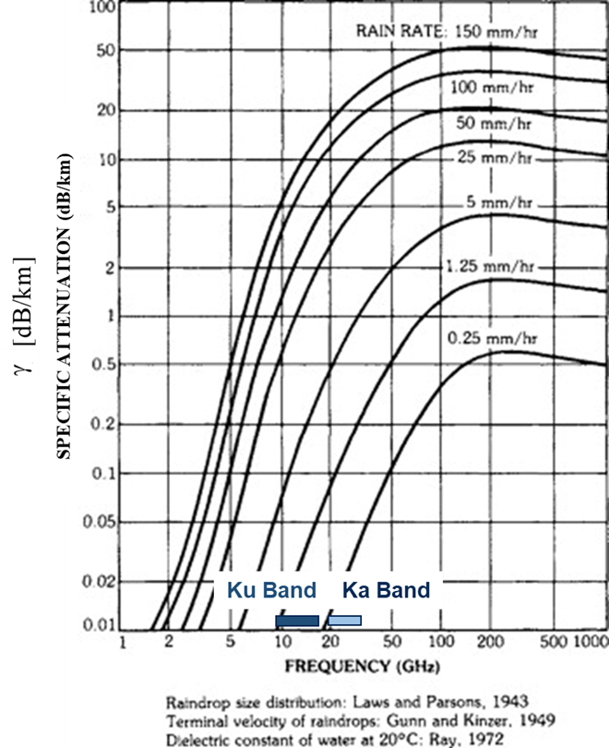
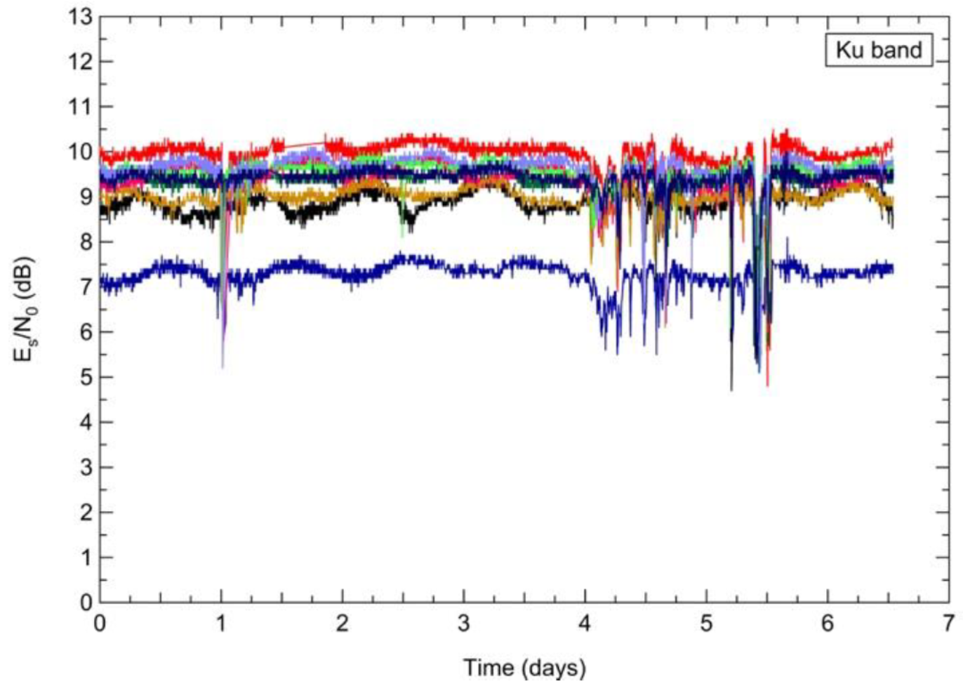
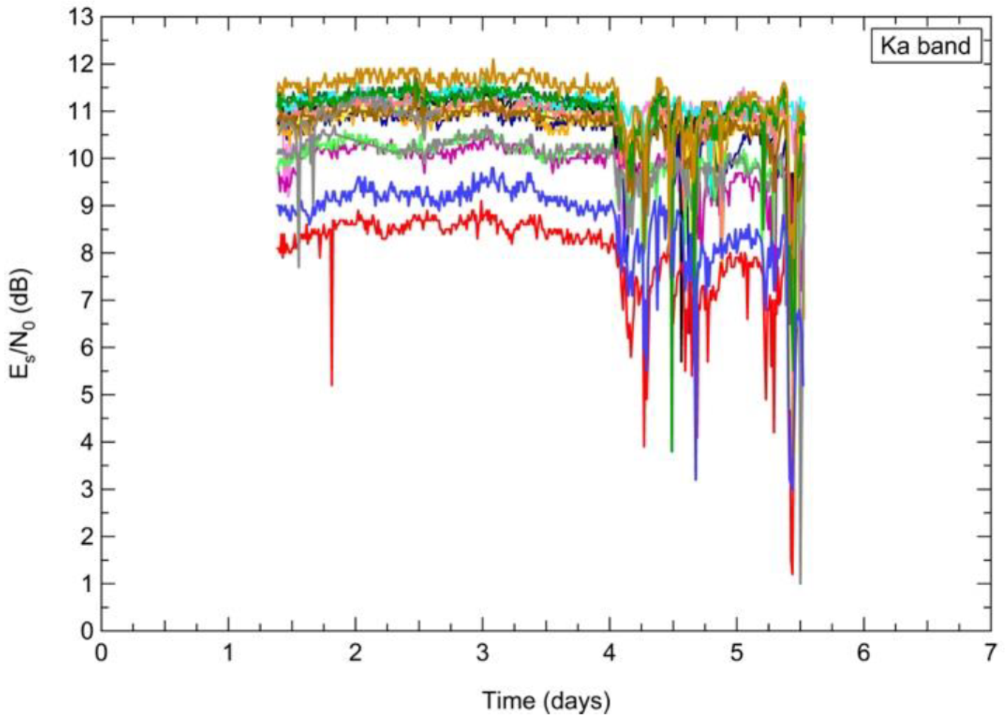
Future developments and trends: migration to higher frequency bands (Ka-Band and above)
Rain fading dynamics @ Ku
Rain fading dynamics @ Ka
Improved sensitivity at low rain rates

Slide 26
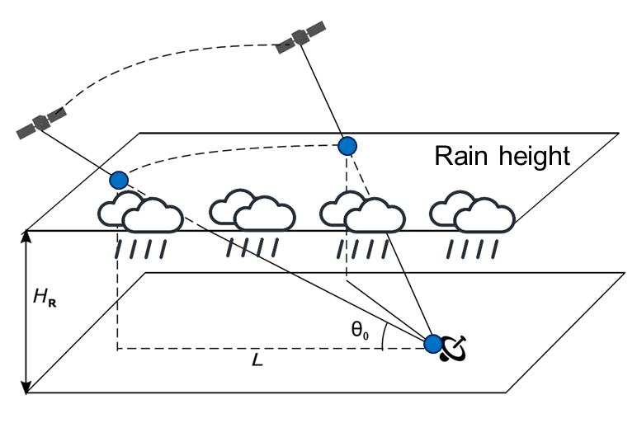
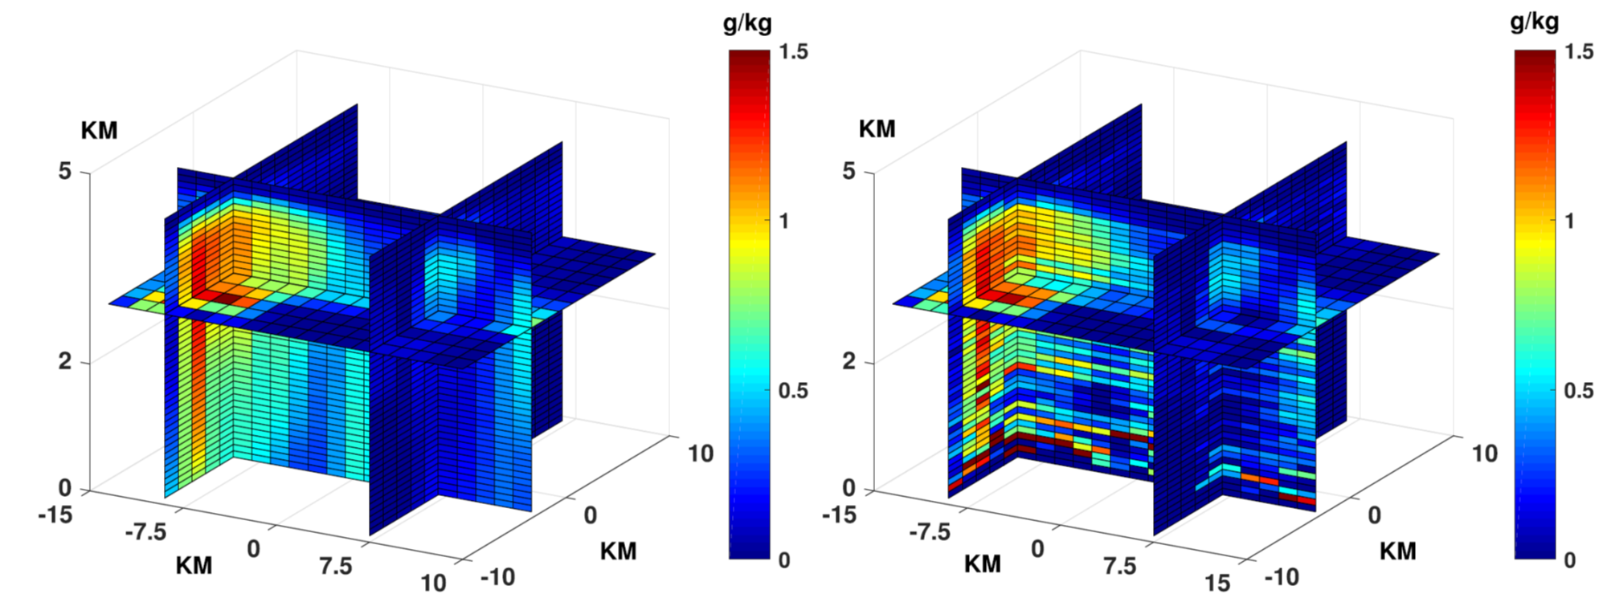
Future developments and trends: LEO Mega-Constellations (Ku- and Ka-Bands)
The moving multiple links of a LEO constellation pass through the Earth atmosphere along many different directions.
LEO satellites linked to their ground terminals can be used to scan the rainfall field in a vertical plane.
Xi Shen et alii, "3-D Tomographic Reconstruction of Rain Field Using Microwave Signals From LEO Satellites: Principle and Simulation Results", IEEE TGRS, Aug. 2019.
3-D view of the original rain field
3-D view of the reconstructed rain field
3D reconstruction of the precipitation

Slide 27
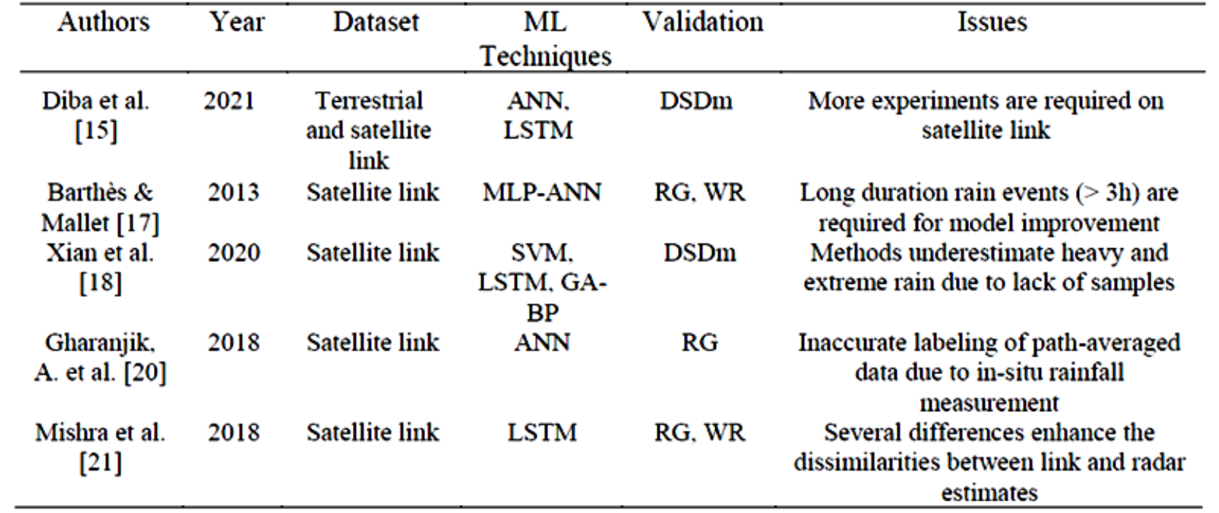
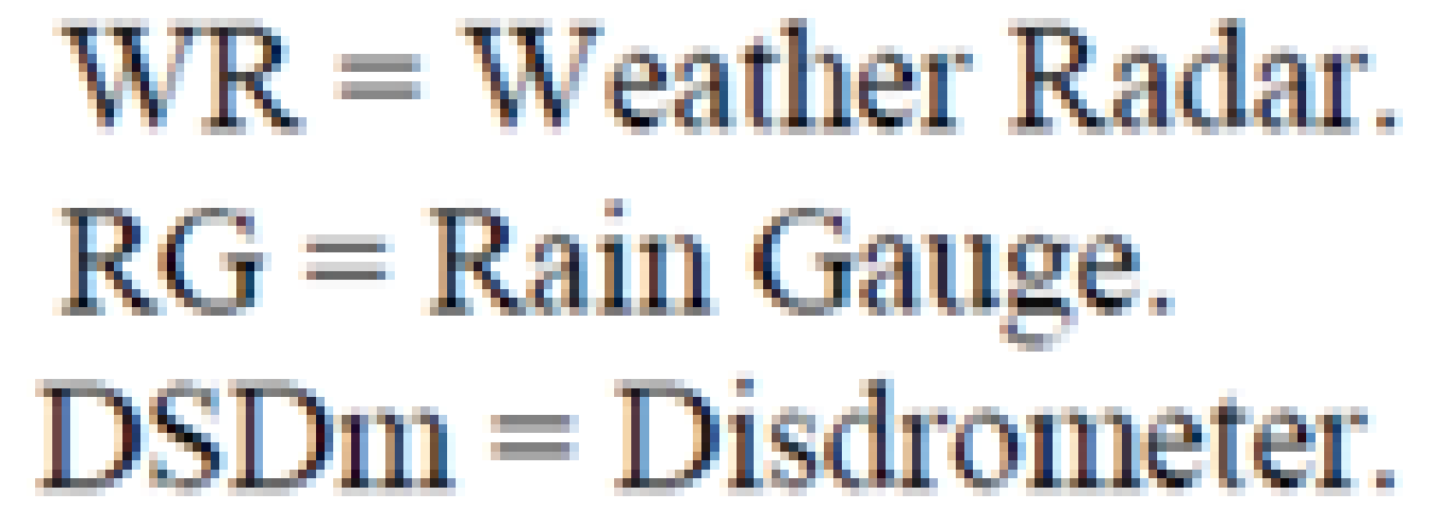
Future developments and trends: Artificial Intelligence
R Y Mardyansyah et al. "Artificial Intelligent for Rainfall Estimation In Tropical Region: A Survey," IOP Conf. Series: Earth Environ. Sci., 1105 012024, 2022. DOI 10.1088/1755-1315/1105/1/012024
Gianoglio, et al. "Rain Discrimination with Machine Learning Classifiers for Opportunistic Rain Detection System Using Satellite Micro-Wave Links," Sensors 2023, 23, 1202. https://doi.org/10.3390/s23031202
Scognamiglio, et al. "Deep Learning for Opportunistic Rain Estimation via Satellite Microwave Links," Sensors 2024, 24, 6944. https://doi.org/10.3390/s24216944
Use of AI/ML for wet/dry classification, rainfall intensity estimation, statistical feature extraction, precipitation maps retrieval etc.

Slide 28
Conclusions, comments and perspectives
Practical example of Integrated Sensing and Communication (ISAC): a symbiosis between sensing and communication and a novel feature of next-generation networks (ITU, 6G).
Terrestrial and satellite MW communication infrastructures are sources of signals for oportunistic sensing (OS).
Opportunistic estimation of rainfall intensity relies on the availability of RSL measurements (Raw Data): difficult for terrestrial CMLs, much easier for SMLs.
However:
low cost commercial satellite receivers are unfit: high quality receivers are needed;
satellite signals are affected by many impairments ("bad-looking" Raw Data): clever processing needed;
propagation medium (troposphere), is complex and time varying in vertical: accurate modeling needed.
Numerical results show accurate rain estimate from SMLs.
Future evolutions:
Higher frequency bands: Ka, mmW;
Mega-constellations of LEO satellites;
Use of AI/ML for wet/dry classification, rainfall intensity estimation, precipitation maps retrieval etc.

Slide 29
References
Giannetti, F.; Reggiannini, R. Opportunistic Rain Rate Estimation from Measurements of Satellite Downlink Attenuation: A Survey. Sensors 2021, 21, 5872. https://doi.org/10.3390/s21175872.
F. Giannetti, M. Moretti, R. Reggiannini and A. Vaccaro, "The NEFOCAST System for Detection and Estimation of Rainfall Fields by the Opportunistic Use of Broadcast Satellite Signals," in IEEE Aerospace and Electronic Systems Magazine, vol. 34, no. 6, pp. 16-27, 1 June 2019, doi: 10.1109/MAES.2019.2916292.
Ortolani, A., F. Caparrini, S. Melani, L. Baldini, and F. Giannetti, 2021: An EnKF-Based Method to Produce Rainfall Maps from Simulated Satellite-to-Ground MW-Link Signal Attenuation. J. Hydrometeor., 22, 1333–1350, https://doi.org/10.1175/JHM-D-20-0128.1.
E. Adirosi, L. Facheris, F. Giannetti, S. Scarfone, G. Bacci, A. Mazza, A. Ortolani, L. Baldini, "Evaluation of Rainfall Estimation Derived From Commercial Interactive DVB Receivers Using Disdrometer, Rain Gauge, and Weather Radar," in IEEE Transactions on Geoscience and Remote Sensing, vol. 59, no. 11, pp. 8978-8991, Nov. 2021, doi: 10.1109/TGRS.2020.3041448.
S. Angeloni et al., "Enhanced Estimation of Rainfall From Opportunistic Microwave Satellite Signals," in IEEE Transactions on Geoscience and Remote Sensing, vol. 62, pp. 1-12, 2024, Art no. 4101312, doi: 10.1109/TGRS.2023.3349100.

Slide 30
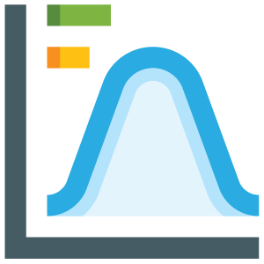
Thanks for Your Attention
Post nubila Phœbus
filippo.giannetti@unipi.it
score-eu-project.eu
Smart control of the climate resilience in European coastal cities
This project has received funding from the European Union's Horizon 2020 research and innovation programme under grant agreement No 101003534.
opensenseaction.eu
Opportunistic precipitation sensing network
The author acknowledges the COST Action CA20136 OPENSENSE, supported by COST (European Cooperation in Science and Technology).

Slide 31
The author greatly acknowledges the following projects
COST Action CA20136 OPENSENSE (Opportunistic Precipitation Sensing Network), supported by COST (European Cooperation in Science and Technology).
SCORE (Smart Control of the Climate Resilience in European Coastal Cities), funded by European Union’s Horizon 2020 research and innovation programme under Grant No. 101003534.
"Nefocast" - SVI.I.C.T.PRECIP. (Sviluppo di piattaforma tecnologica integrata per il controllo e la trasmissione informatica di dati sui campi precipitativi in tempo reale), funded by "Fondo per le Agevolazioni alla Ricerca" and "Fondo Aree Sottoutilizzate" (FAR-FAS) 2014 of the Tuscany Region, Italy, under agreement No. 4421.02102014.072000064.
INSIDERAIN (INStruments for Intelligent Detection and Estimation of Rain for Agricultural INnovation) funded by "Programmi Operativi Regionali - Fondo Europeo di Sviluppo Regionale (POR FESR) 2014-2020 of the Tuscany Region, Italy, under agreement No. 21885, 18 December 2020.
Space It Up, funded by ASI and MUR, Contract no. 2024-5-E.0, CUP no. I53D24000060005).
FoReLab, funded by MUR in the framework of the Departments of Excellence

Slide 32
The author greatly acknowledges the following partners
Industrial partners, for providing technical documentation and support
www..etgsrl.it
www.mbigroup.it
Research partners, for their scientific contribution
www.lamma.rete.toscana.it
www.ibe.cnr.it
www.isac.cnr.it
www.dinfo.unifi.it
Private local weather services, for sharing their data
www.meteoapuane.it
www.meteopisa.it

Slide 33
The author greatly acknowledges the following institutions
Institutions and agricultural land owners that provided sensor installation sites and test-range areas
www.agr.unipi.it
www.acque.net
www.osservatorioadstatuas.it
lacapannaccia.com
International institutions that expressed their interest for these research activities
meteofrance.com
www.eutelsat.com
www.nasa.gov/goddard

Slide 34
SML-based OS rain sensor characteristics
Settings for experimental measurements
Geographical area: North Western Tuscany / Lazio (Italy)
Test sites: Pisa (10.4°E, 43.7°N), Massa (10.1°E, 44.0°N) / Rome (41.8°E , 12.6°N)
Satellite: Eutelsat 10A @ 10°E
Elevation: 39° / 41.7°
Frequency: 11.345 GHz @ Ku band
Downlink signal: DVB-S2
RSL metric: E_{s}/N₀ (dB)
RSL clear sky: approx. 10.5 dB
RSL sensitivity: approx. - 2 dB
RSL resolution: 0.1 dB
RSL sampling rate: 1 – 2 sample/minute

Slide 35
Performance Metrics Definitions

