Slide 1
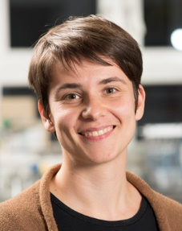


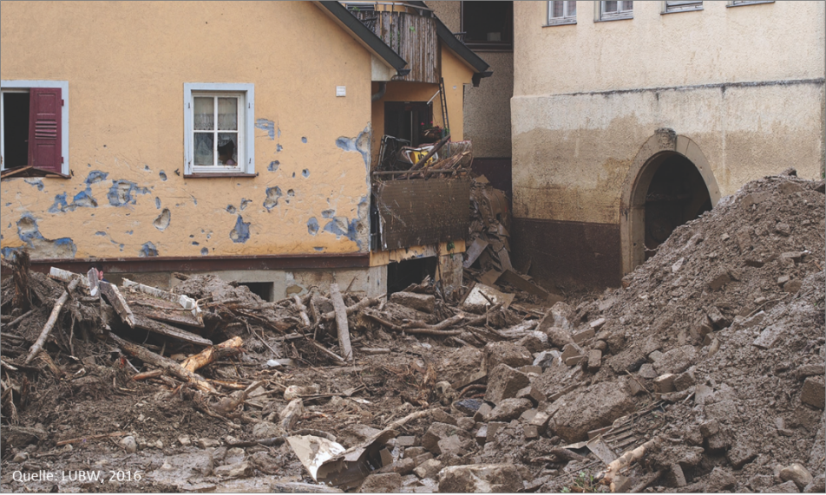
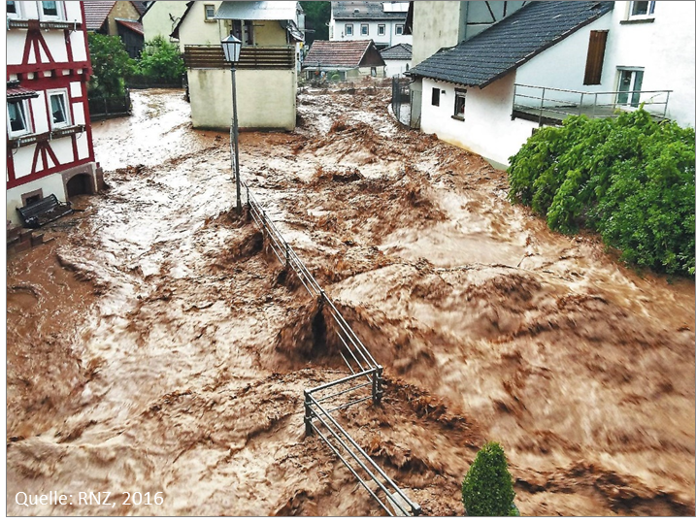

Flash floods predictions and mitigation under change – challenges, models, perspectives
Erwin Zehe¹, Franziska Villinger¹, Ralf Loritz¹, Ashish Manoj¹, Judith Nijzink², Laurent Pfister²
1) Institute of Water and Environment Karlsruhe Institute of Technology, Germany
2) ERIN, Luxembourg Institute of Technology, Luxembourg
Braunsbach, 2016
Neckargerach, 2016

Slide 2
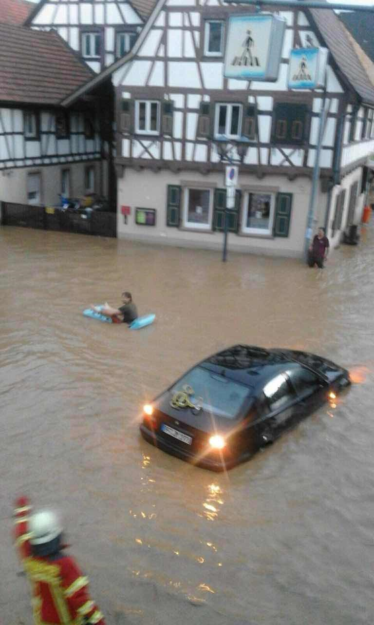
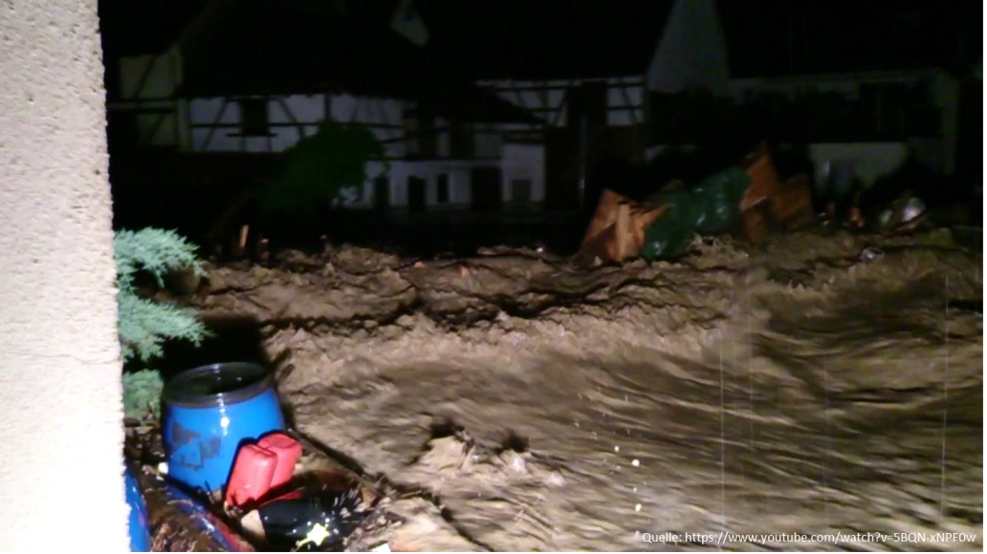
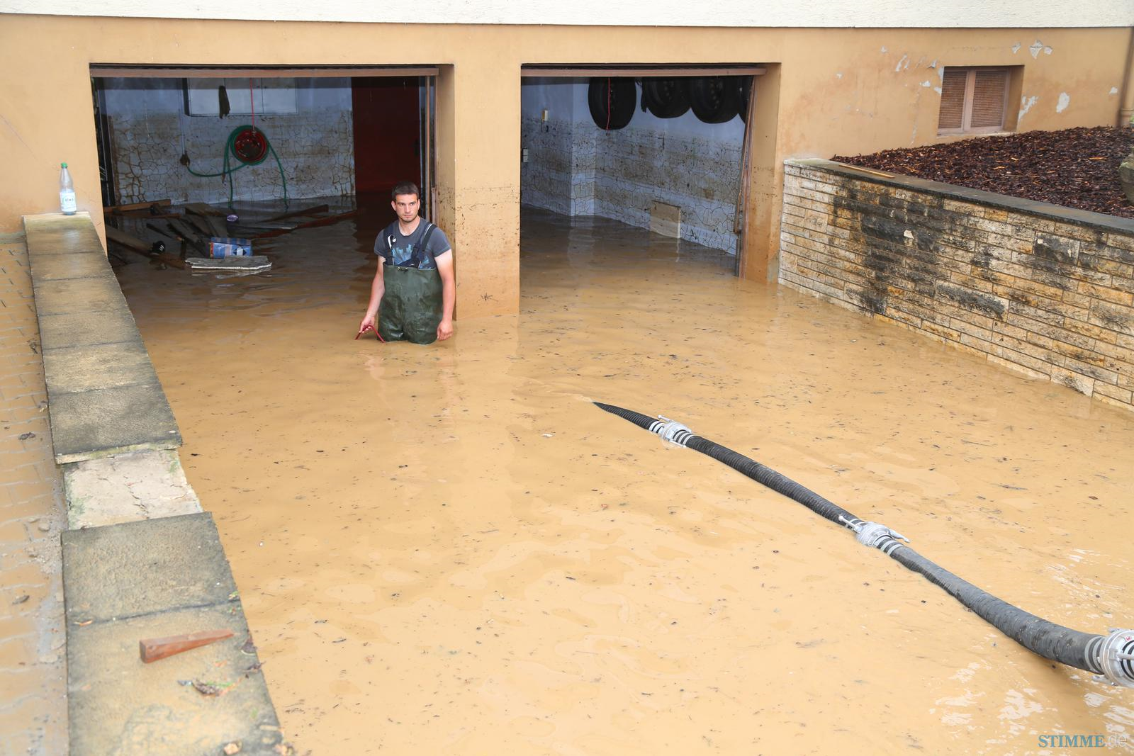
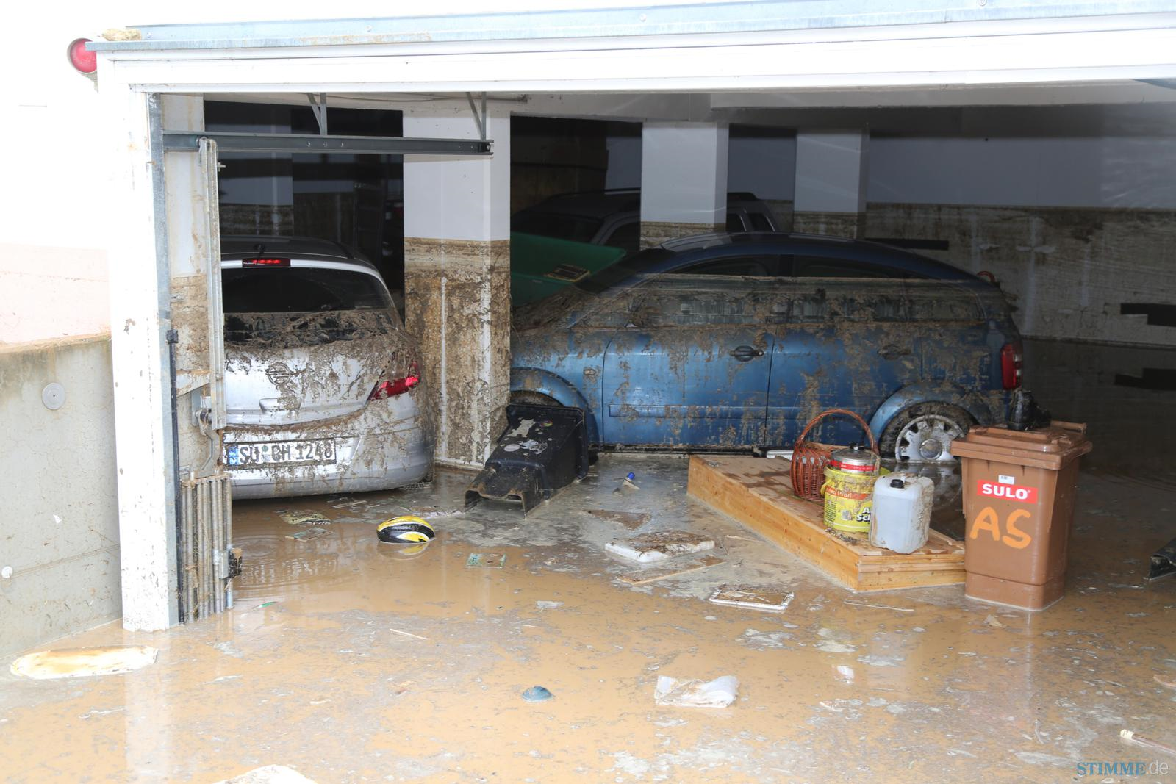
The Flash flood summer 2016 -> 2.5 M€
Stein, 2016
Braunsbach, 2016
Neckargerach, 2016
Alfeld, 2016
Quelle: Gemeinde Stein, 2016
Quelle: LUBW, 2016
Eppingen, 2016
Eppingen, 2016
Quelle: rnz, 2016
Quelle: rnz, 2016
© Hans Göppert

Slide 3
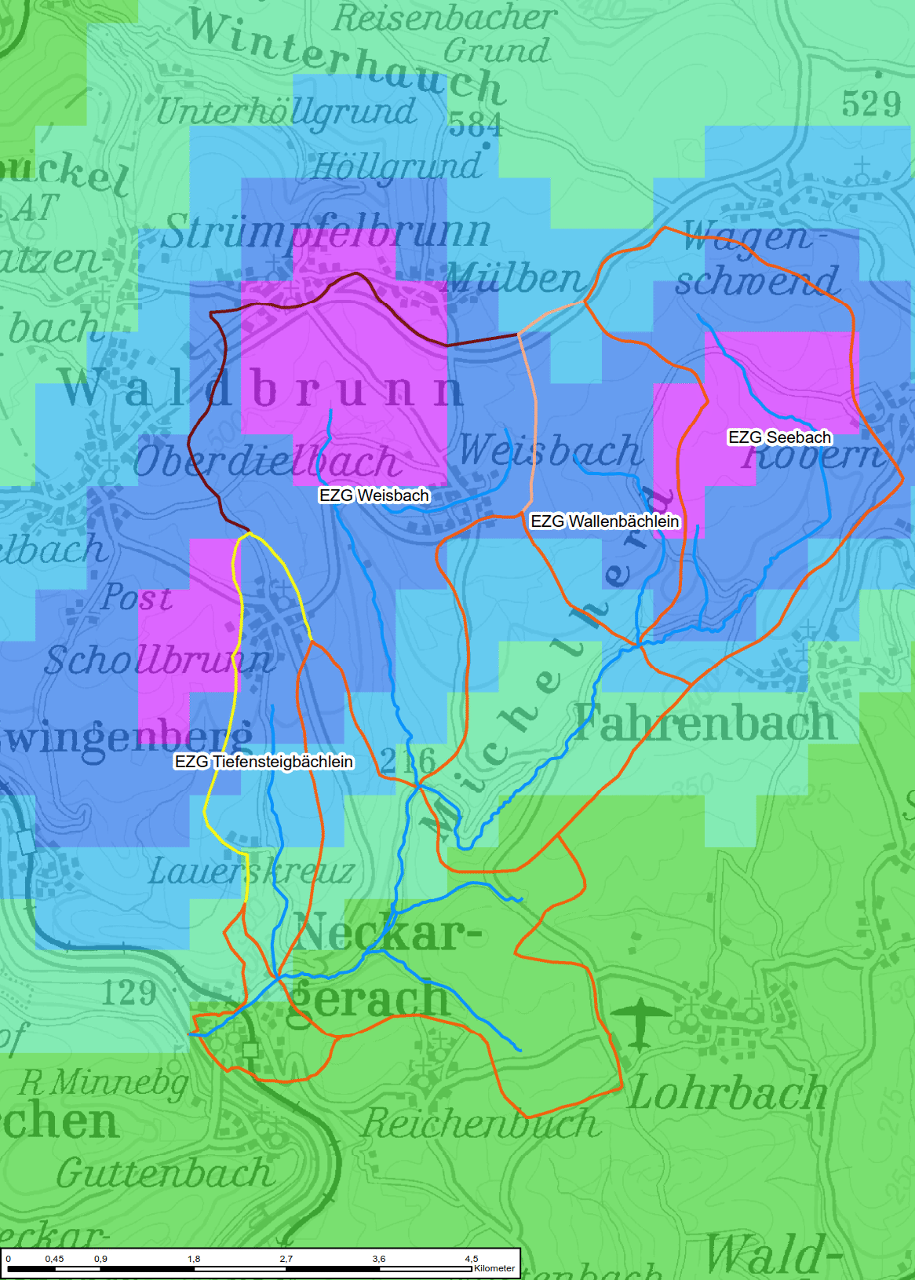
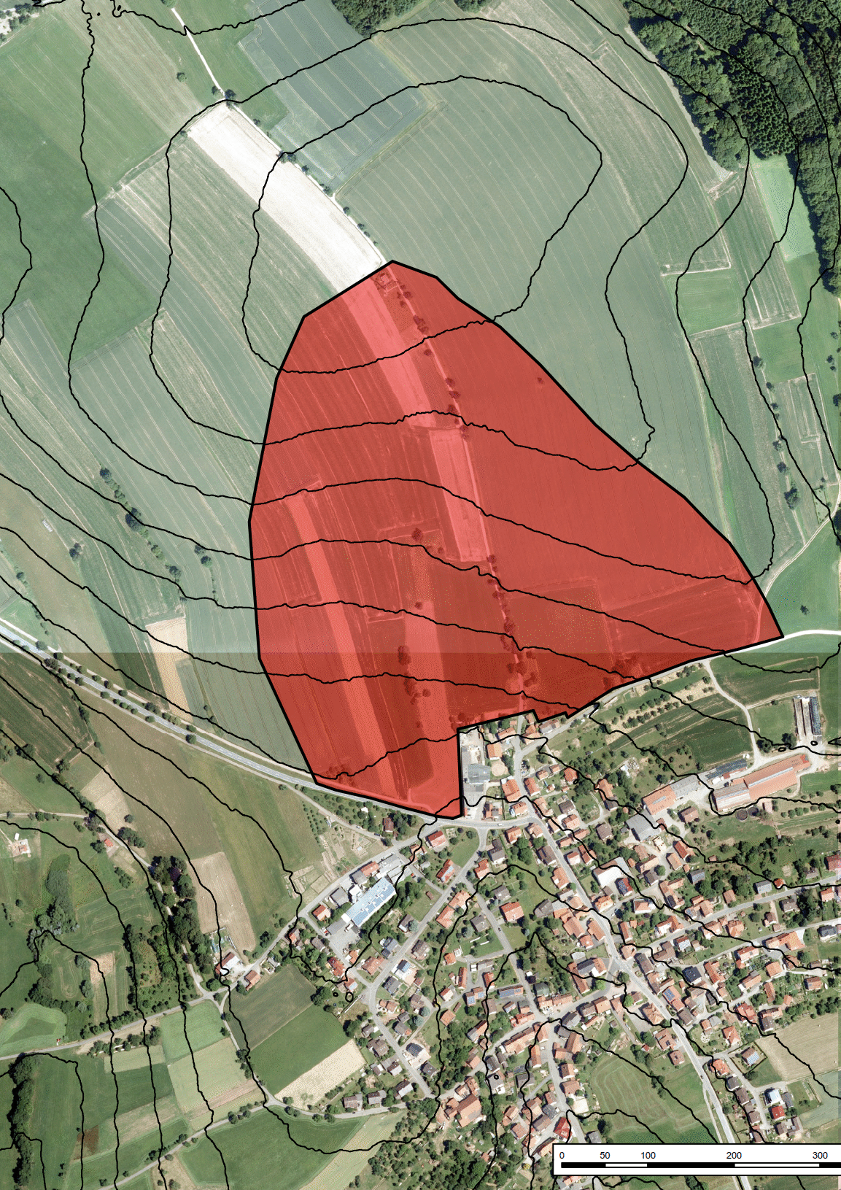
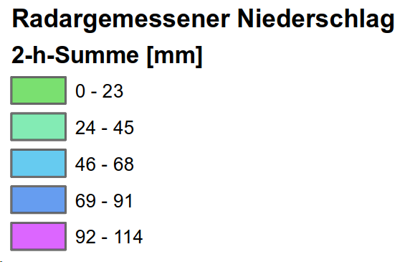
… extreme runoff partly from single hillslopes
A_{Eo}= 23 ha
Schollbrunn
Schollbrunn
© Hans Göppert

Slide 4

Göppert, H., 2018. Auswertung von abgelaufenen Starkregenereignissen über Radarmessungen. WASSERWIRTSCHAFT 108, 44–50. https://doi.org/10.1007/s35147-018-0223-8
… manifested climate change?
© Hans Göppert
10 out of 22 y with floods T > 500 a
Location | Date | Amount [mm] | Duration [h] | Return period T DWD KOSTRA
Steißlingen | 24.03.2005 | 58 | 0,5 | >500a
Stebbach/Kirchardt/Gondelsheim | 05.07.2006 | 100 | 1 | >500a
Reichenbach (Fils) | 09.06.2007 | 91 | 1,5 | >500a
Eubigheim/Buchen | 08.08.2007 | 60 | 2 | 500a
Schutteroberlauf | 01.09.2008 | 80 | 1 | 500a
Ettenheim/Niederschopfh./Kinzigtal | 01.09.2008 |  |  | >500a
Gechingen/Aidlingen | 15.05.2009 | 100 | 2-3 | >500a
Lein / Böllinger Bach | 06.06.2010 | 75 | 1 | >500a
Ditzingen (Glems) | 04.07.2010 | 160 | 2 | >500a
Munzingen | 12.07.2010 | 85 | 0,75 | >500a
Bisingen (Borrenbach) | 23.07.2010 |  |  | >500a
Saalbach, Pfinz, Schmie, … | 01.06.2013 |  |  | >500a
Emmingen | 28.07.2014 | 110 | 3 | >500a
Bretten | 06.06.2015 | 100 | 6 | >500a
Waldbrunn | 28.05.2016 | 105 | 1 | >500a
Dallau | 29.05.2016 | 97 | 8 | >500a
Allfeld (Schefflenz) | 30.05.2016 | 80 | 3 | >500a
Stein | 07.06.2016 | 88 | 0,5 | >500a
Waldkirch | 07.06.2016 | 77 | 2 | 500a
Bad Rappenau /Treschklinge | 08.06.2016 |  |  | >500a
Waldkirch | 13.06.2016 | 91,5 | 8 | >500a
Eppingen | 25.06.2016 | 61 | 0,5 | >500a

Slide 5


Roadmap
  Challenges and processes
  Reflect on design practice and short comings
  Perspectives for integrated design with process models
  and flash flood warnings with process based models

Slide 6
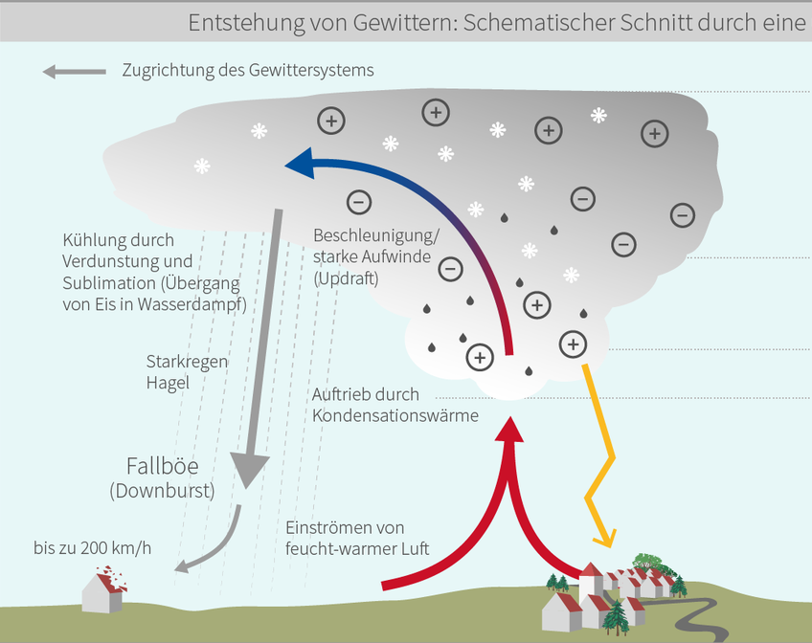
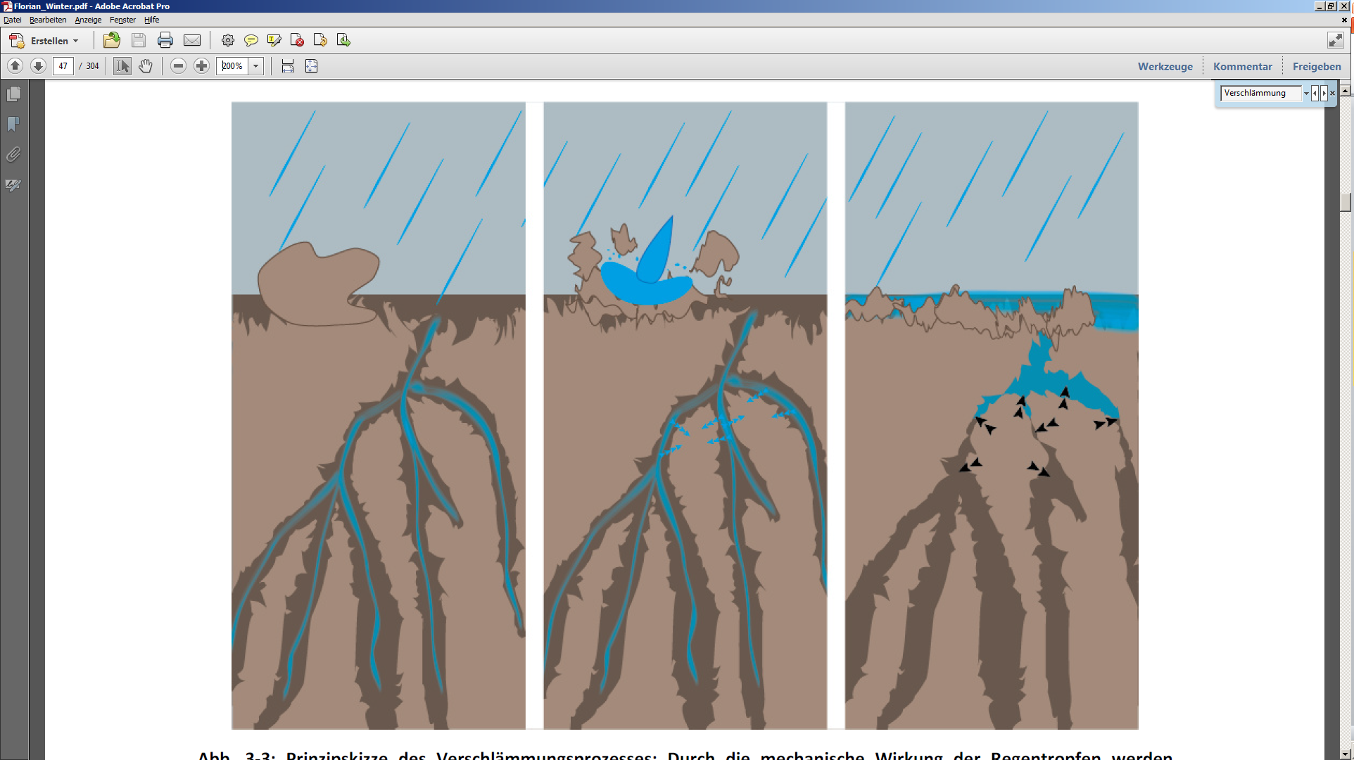
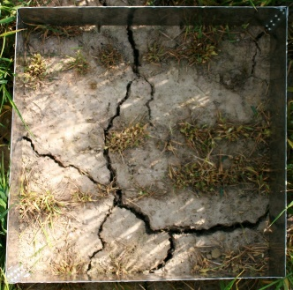
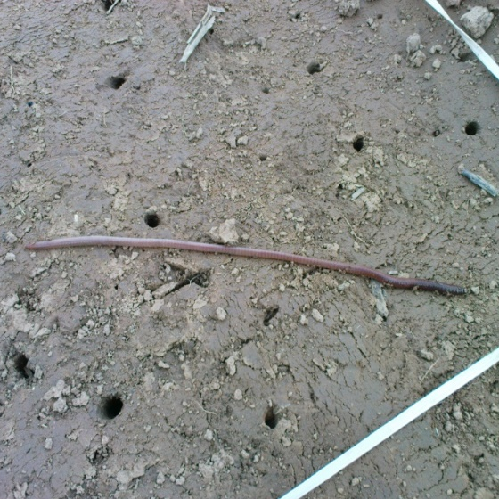
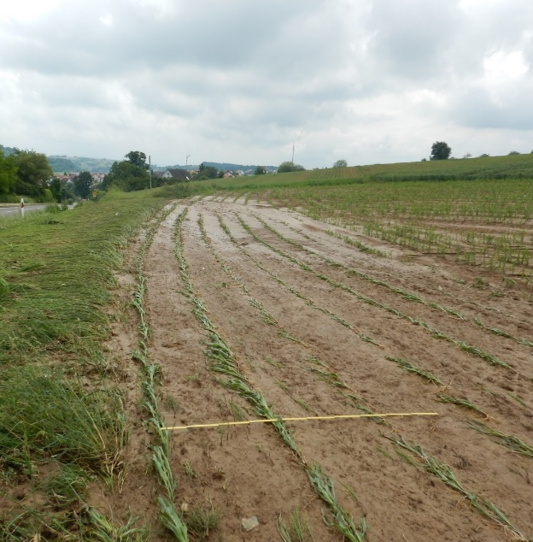
Flash flood ingredients: Convective storms & infiltration excess
© Roth, 1992
Fast and furious
Sediments + X
Transient infiltration properties
  Moisture
  Surface sealing due to splash
  Biopores & cracks

Slide 7
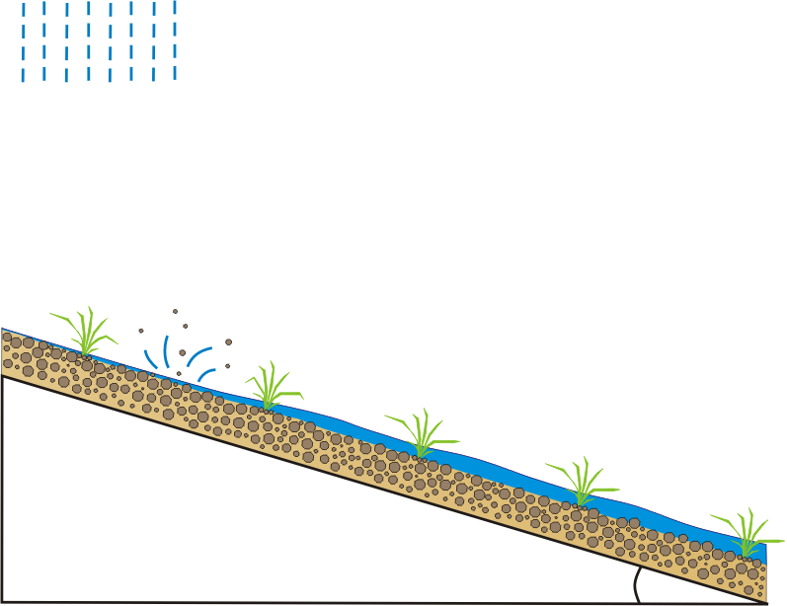

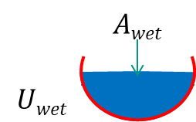

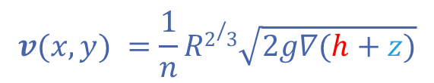
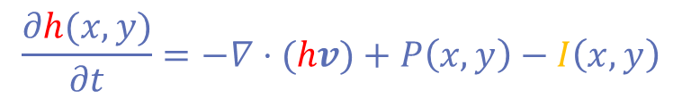
Strong coupling between overland flow “hydrology” & “hydraulics”
Surface runoff flows along unsaturated surface
v reflects balance of friction and gravity
Slower runoff means more time for “re”-infiltration
More infiltration slows down overland flow due to a smaller hydraulic radius
$$\frac{∂h(x,y)}{∂t}=−∇⋅(hv)+P\left(x,y\right)−I\left(x,y\right)$$
$$v(x,y) =\frac{1}{n}R2/3\sqrt{2g∇(h+z)}$$
z
Δz
F_{r}
h
v
F_{g}
L
z
x

Slide 8
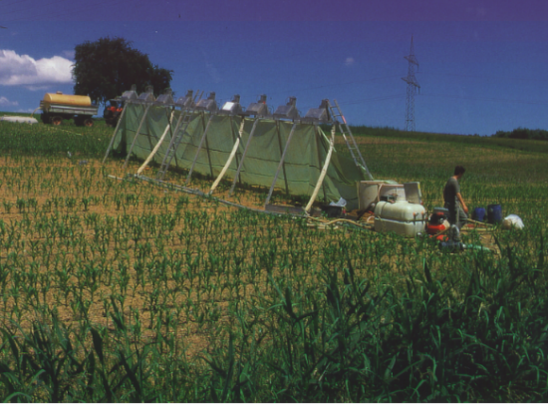
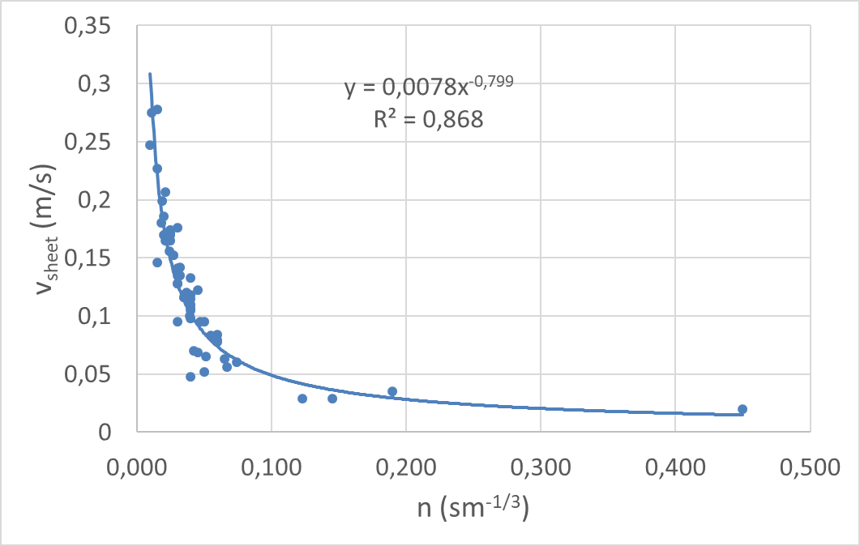
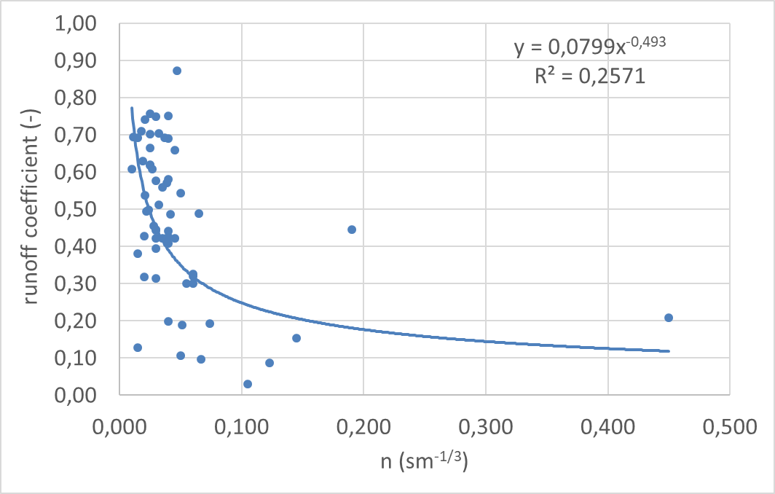
Strong coupling between overland flow “hydrology” & “hydraulics”
Rainfall simulations on 12 long plots, 60 mm in 1h
Roughness is limiting overland flow velocity (not slope)
Runoff coefficient declines with increasing roughness/ n

Slide 9
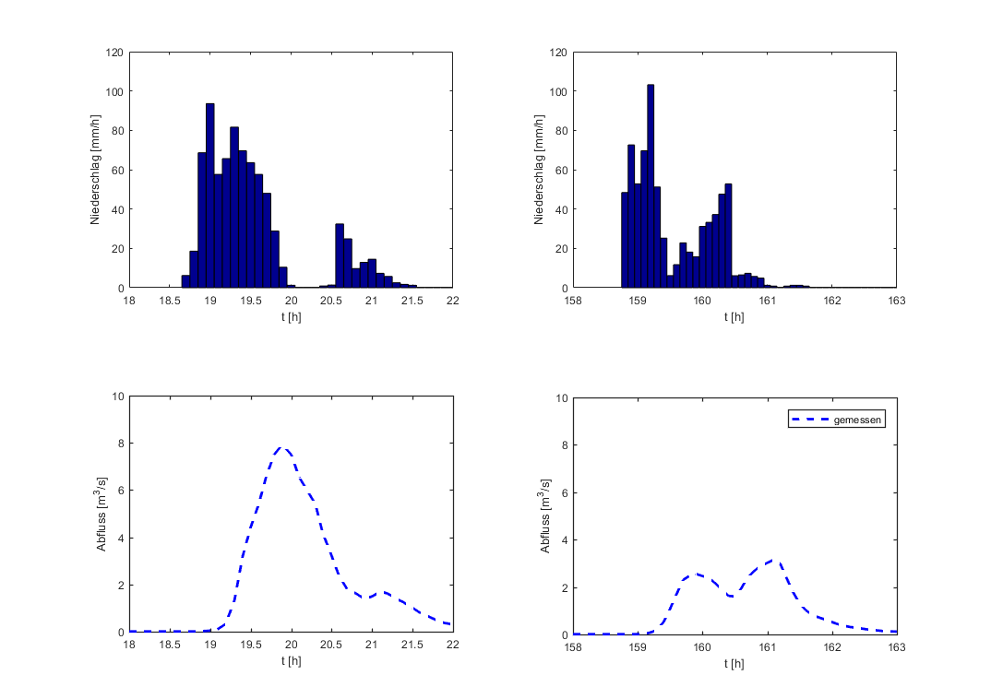
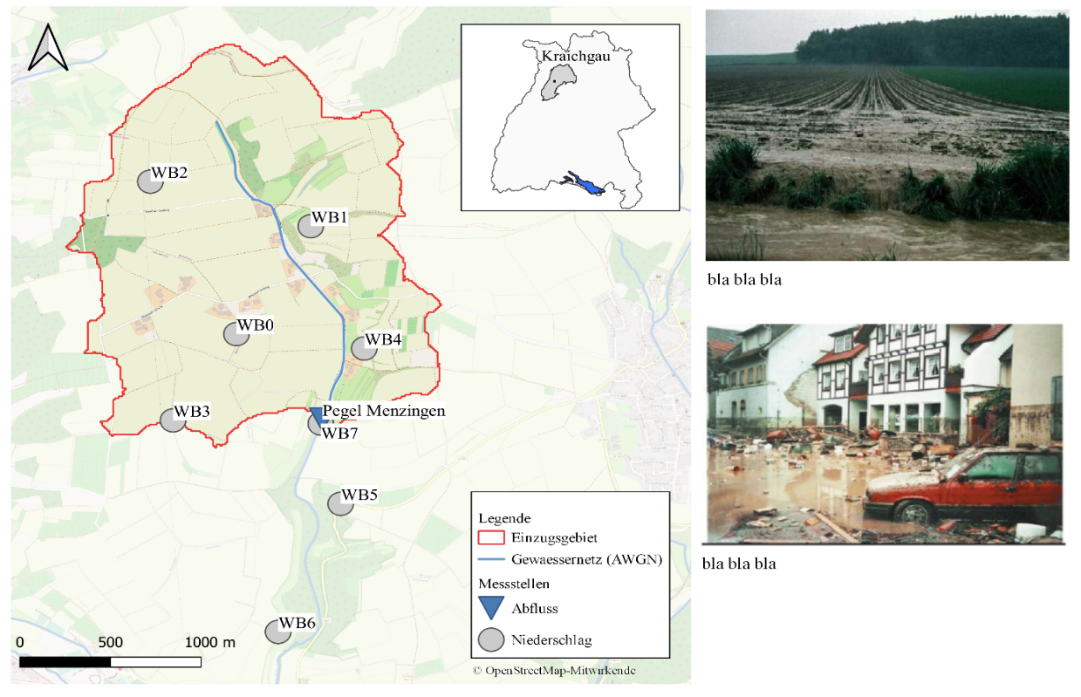
Flash flood „Weiherbach“ June 1994 (3.5 km²)
© Gemeinde Königsbach-Stein, 2016
N = 78 mm in 3h, T = 200y
Q_{max} = 7,8 m³/s = 2 x HQ ₁₀₀₀₀
Sediment load 1800t
RC = 12%

Slide 10
… luckily two 200y - Rainstorms in 2 years
27.06.1994
78 mm
13.08.1995
72 mm
1995 HQ₁₀₀₀₀
Same initial wetness
50% Q_{max}
50% Volume
30 % Sediments
RC = 7%
1994 2 x HQ₁₀₀₀₀
50% less infiltration!
Less macropores?
Sealing due to splash?
???
Notes:
Um das 95-er Ereignis nachrechnen zu können muss die Durchlässigkeit der Böden um rund 50% im Vergleich zu der 94-er Simulation erhöht werden. Ein plausibler Erklärungsansatz die Verschlämmung. Wir gehen davon aus, dass bei dem 94-er Ereignis Flächen verschlämmten aufgrund dem höhren Anteil an unbedeckten Flächen bedingt durch den noch niederigeren Bewuchs der landwirtschafltichen Nutzplanzen im Frühsommer im Vergleich zum Spätsommer.

Slide 11
Resume´
Infiltration excess runoff generation
Non-linear: return period of HQ >> return period of N
Runoff coefficients are small (10-20% VOL) – re-infiltration matters!
Runoff coefficient/ infiltration capacity
Not constraint by initial wetness & precipitation amount
Transient influence due to surface sealing, biopores & cracks
Strong coupling between mass balance and momentum balance
Needs coupled simulation
Landuse as option for reducing flash flood runoff -> work on the cause!

Slide 12
Roadmap
  Challenges and processes
  Reflect on design practice and short comings
  Perspectives for integrated design with process models
  and flash flood warnings with process based models

Slide 13
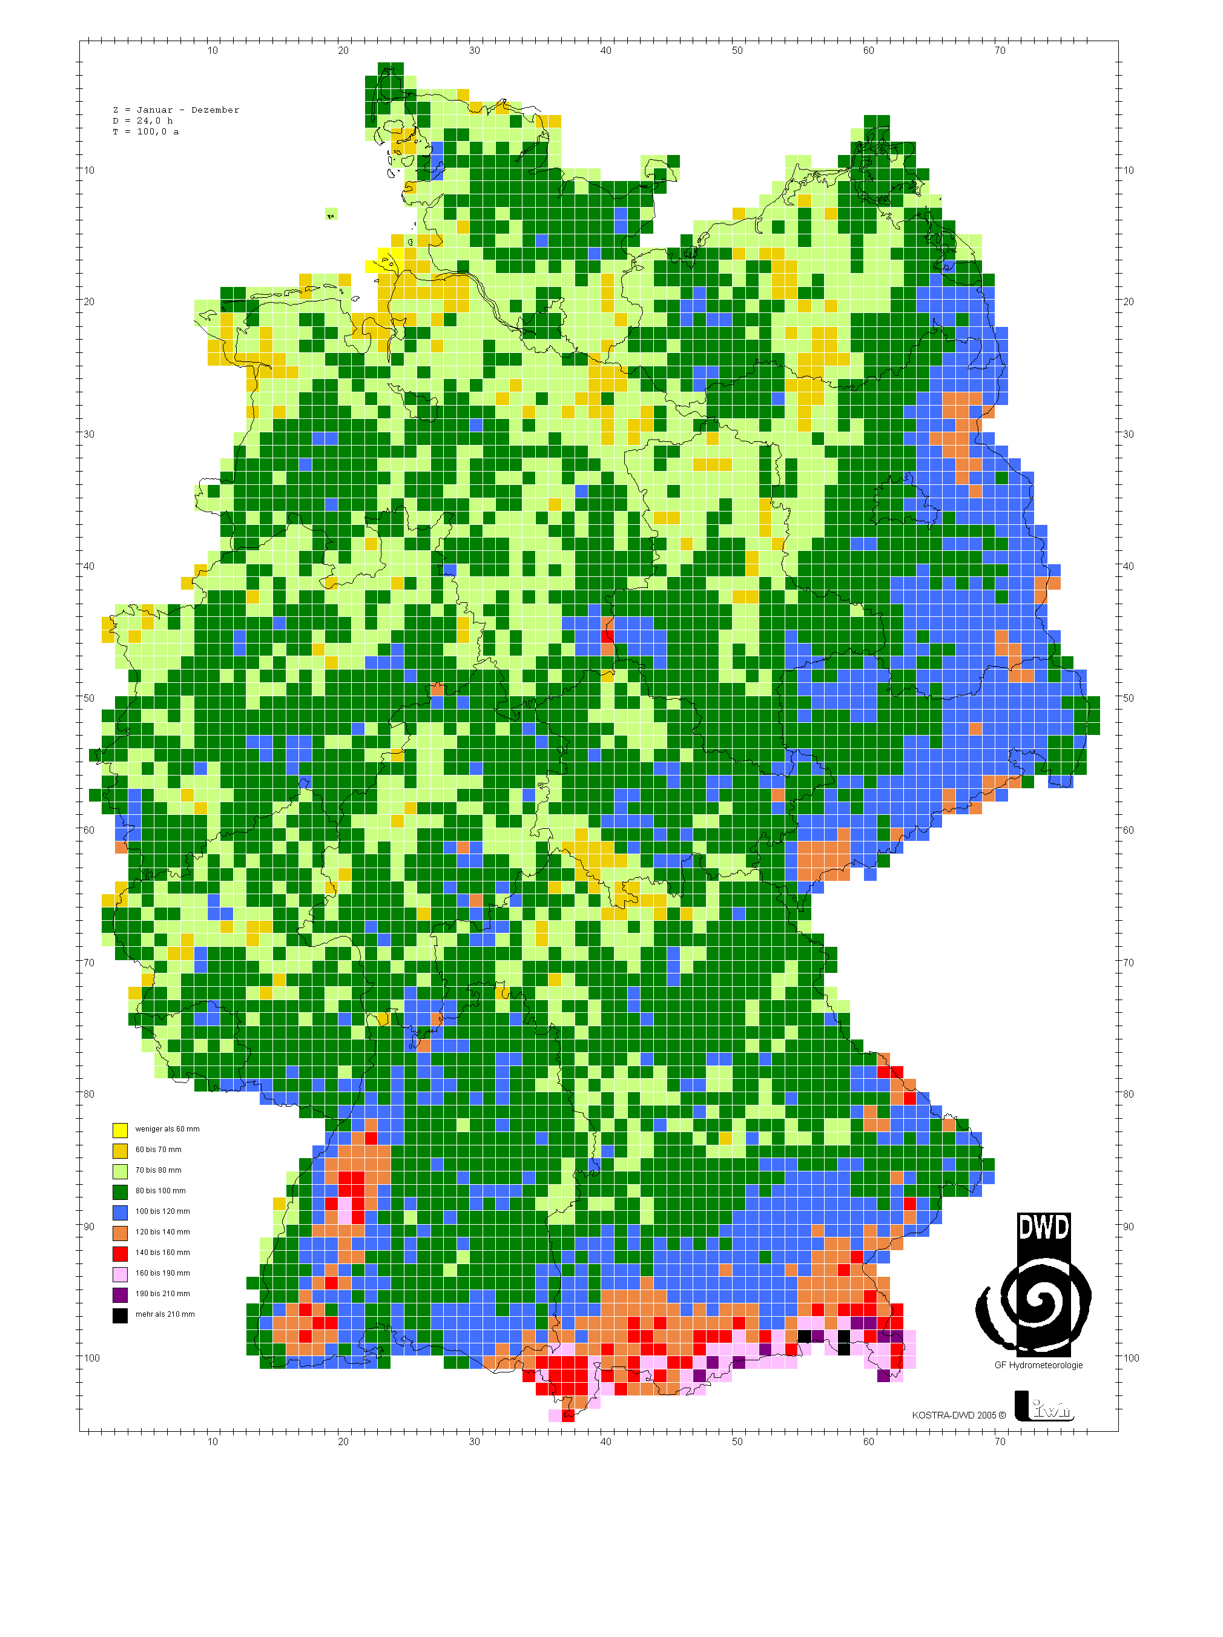
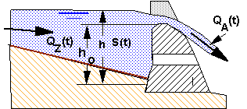
T = 100a
D = 24h
Technical tlood protection and design
More than 850 flood reservoirs in BW
50% in catchments smaller than 5km²
Design aims
Flood volume -> flood safety
Peak -> reservoir/dam safety
Design practice
Kostra + standard rainstorms
Simple event based rainfall runoff models
  Unit hydrograph (Shermann, 1932)
  Runoff coefficients from statistics
Short comings
Linear
Hydrology “feeds” hydraulics
Works on the “effect” only

Slide 14

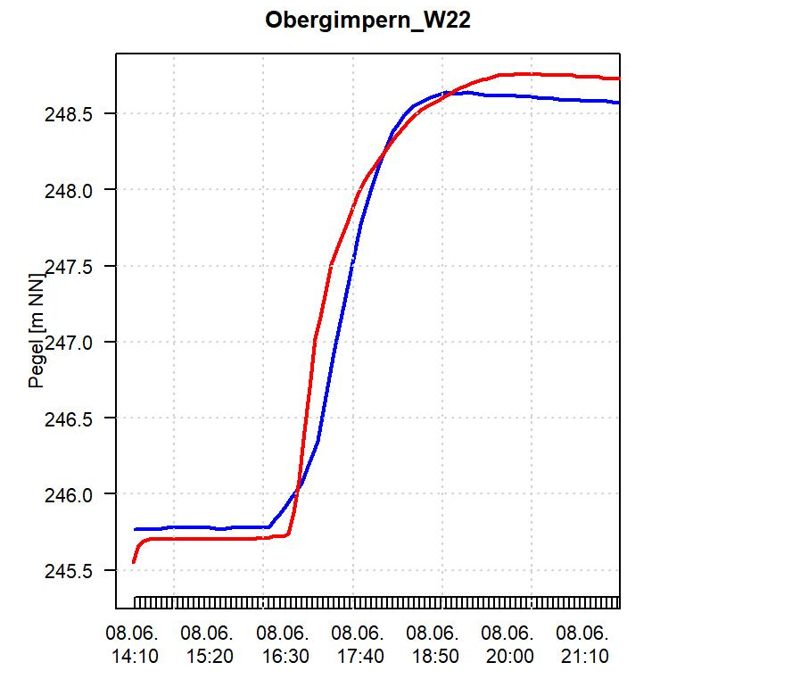
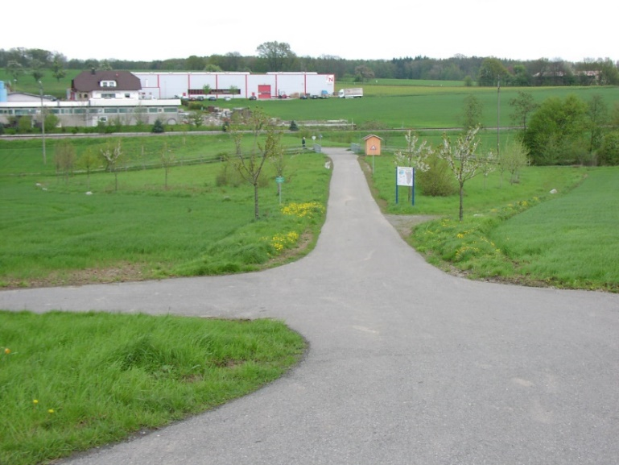
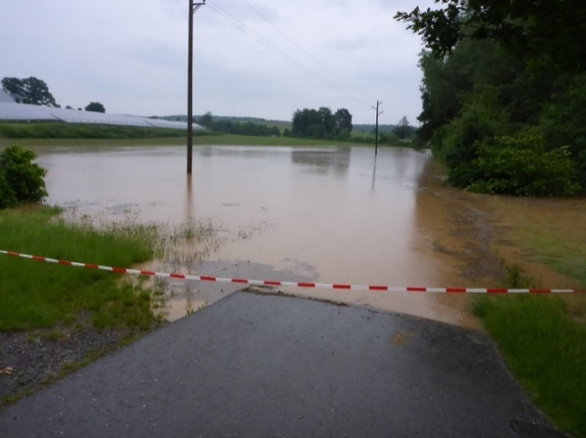
… conceptual models and design at the limit
Flash flood summer 2016
Reservoir over-topped after 10-20 years rainfall (N = 49 mm, 3h), HQ 10000
Successful re-simulation with FGM (used for design)
But when doubling rainfall to 85.4 mm (200-500y)
Runoff coefficient f(q, N, Month): insensitive to rainfall intensity
© Elsenz Schwarzbach Verband

Slide 15
Roadmap
  Challenges and processes
  Reflect on design practice and short comings
  Perspectives for integrated design with process based models
  and flash flood warnings with process based models

Slide 16
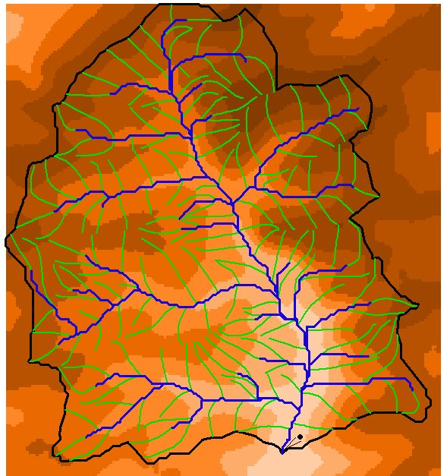
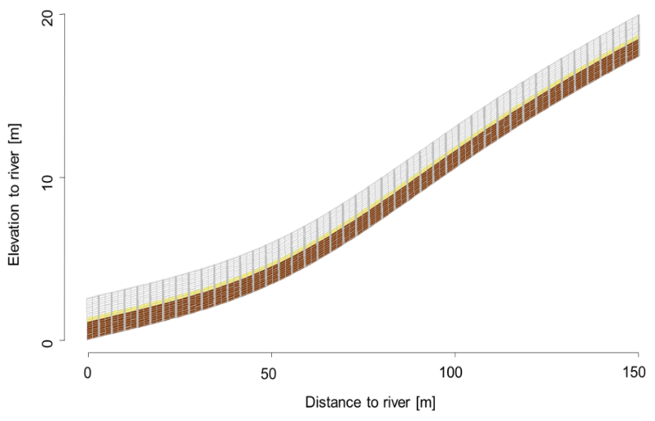
In house model Catflow
Subdivide catchment into
- N 2d hillslopes and interconnected river network
Evapo-Transpiration, Interception
Penman-Monteith-Eq.
Overland, rill- and stream flow
Saint-Venant-Eq., upstream finite volumes
Soil water dynamics
2D Richards-Eq. + macropore flow, implicit Picard iteration
…. and more
Notes:
Structure fingerprint of past work –> needs free energy
Structures acellerate fluxes -> can be expressesd in free energy terms
Vegetation controls
Bottle necks/ limitation expressed in free energy terms (except water limitiation
Express ET in water and energy flux e-> free energy as common current for framing their functioning

Slide 17
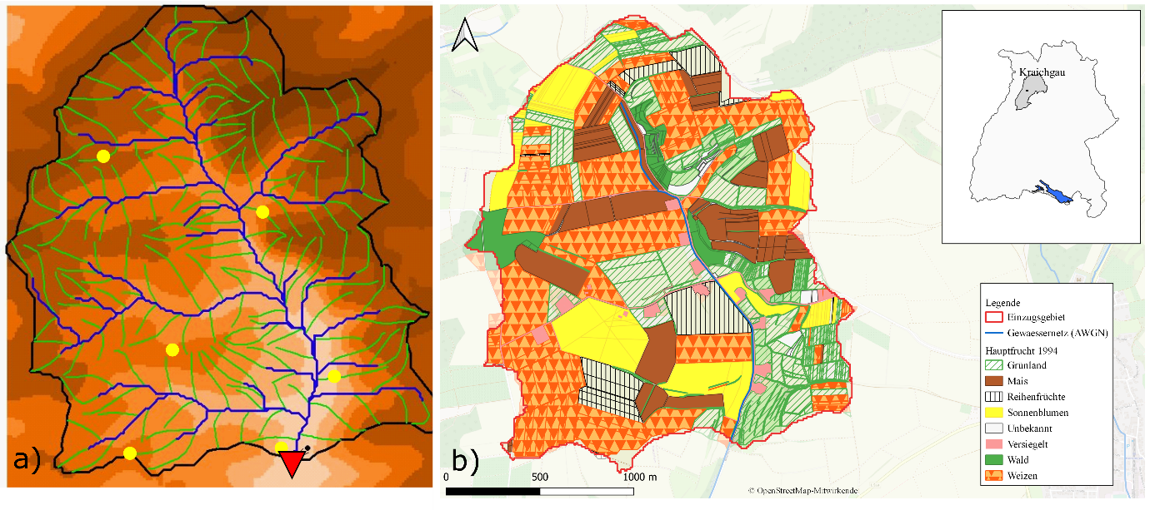
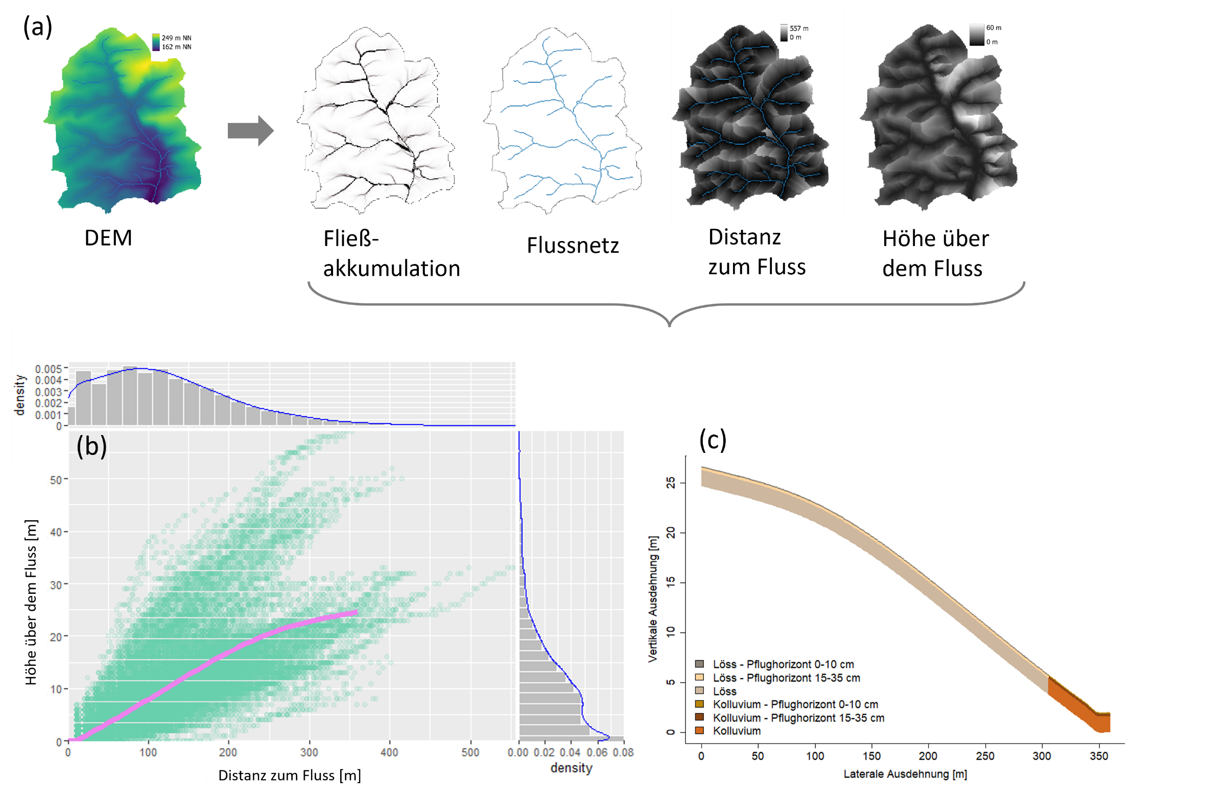
Distributed versus representative hillslope model
Catchment model
169 hillslopes
Typical catena, soil hydraulic properties
River net (prismatic cross sect, Manning’s n)
Landuse parameters (n, ET)
1 year spin-up
7 representative hillslopes
Preserves potential energy along averaged flow path to the river
Typical catena, soil hydraulic properties
7 hillslopes to represent areal share of landuse/crops
1 year spin-up
Zehe, E., Becker, R., Bardossy, A., and Plate, E.: Uncertainty of simulated catchment runoff response in the presence of threshold processes: Role of initial soil moisture and precipitation, Journal of Hydrology, 315, 183-202, 2005.
Villinger, F., Loritz, R. & Zehe, E. Physically based simulation of an occurred flash flood using "representative hillslopes" in a rural catchment. Hydrologie Und Wasserbewirtschaftung 66, 286-297, doi:10.5675/HyWa_2022.6_1 (2022).
Notes:
Gut Gut

Slide 18
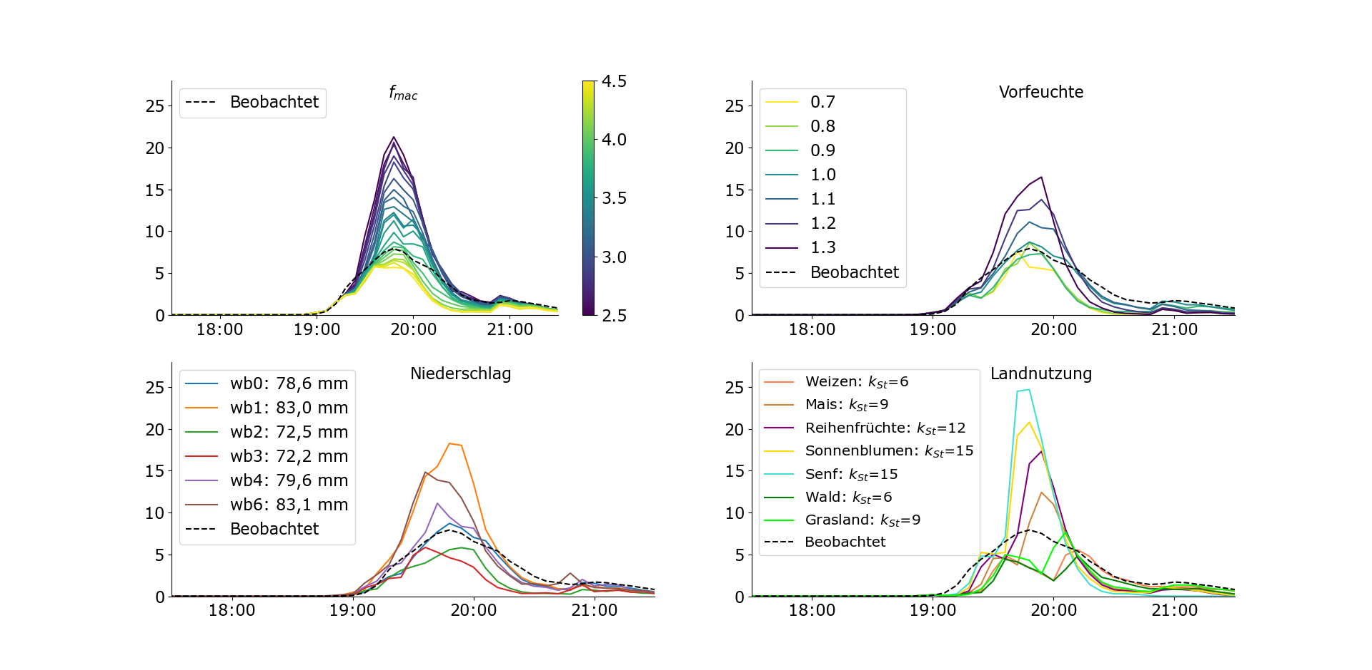
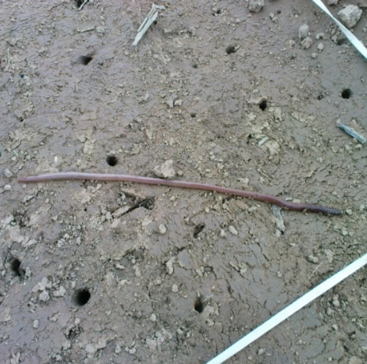
Infiltration excess: infiltration capacity matters
distributed
representative (works, but way faster)
Zehe, E., Becker, R., Bardossy, A., and Plate, E.: Uncertainty of simulated catchment runoff response in the presence of threshold processes: Role of initial soil moisture and precipitation, Journal of Hydrology, 315, 183-202, 2005.
Villinger, F., Loritz, R. & Zehe, E. Physically based simulation of an occurred flash flood using "representative hillslopes" in a rural catchment. Hydrologie Und Wasserbewirtschaftung 66, 286-297, doi:10.5675/HyWa_2022.6_1 (2022).
Notes:
Gut Gut

Slide 19
Infiltration excess: storm intensity pattern matters
Station | N [mm] | T [a]
WB0 | 78.6 | 200-500 a
WB1 | 83.0 | ~500 a
WB2 | 72.5 | 100-200 a
WB3 | 72.2 | 100-200 a
WB4 | 79.5 | 200-500 a
WB6 | 83.1 | ~500a
Villinger, F., Loritz, R. & Zehe, E. Physically based simulation of an occurred flash flood using "representative hillslopes" in a rural catchment. Hydrologie Und Wasserbewirtschaftung 66, 286-297, doi:10.5675/HyWa_2022.6_1 (2022).
Notes:
Gut Gut

Slide 20
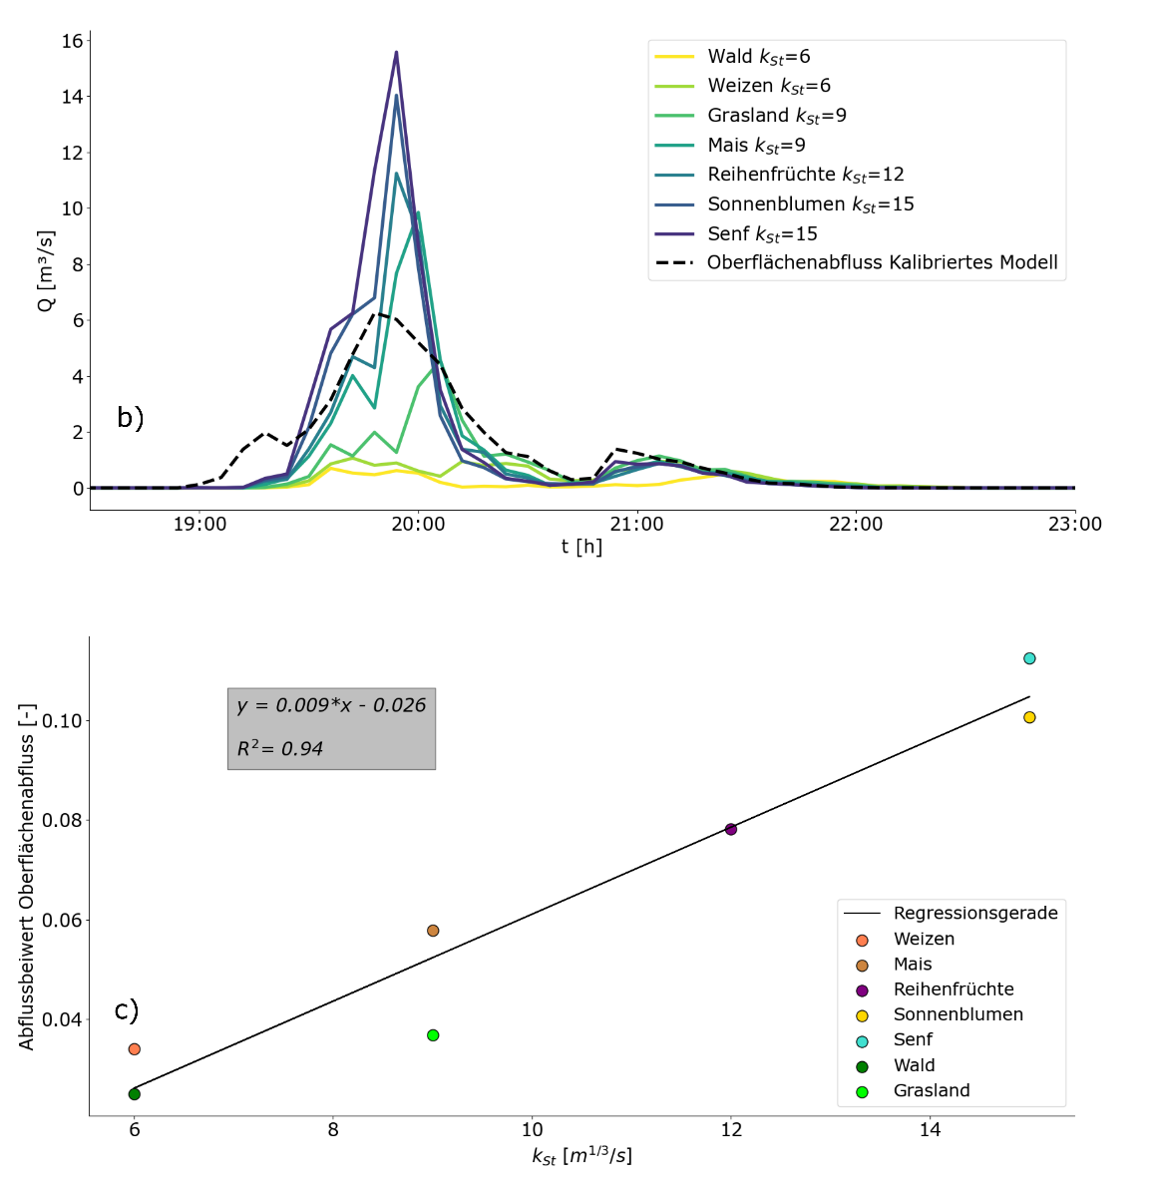
Infiltration excess: land use matters
Best set up, but with uniform landuse
Changes in roughness affect flood peak, timing
and flood volume
Faster runoff means more runoff
Landuse is the key for mitigating flash floods
in small catchments
Villinger, F., Loritz, R. & Zehe, E. Physically based simulation of an occurred flash flood using "representative hillslopes" in a rural catchment. Hydrologie Und Wasserbewirtschaftung 66, 286-297, doi:10.5675/HyWa_2022.6_1 (2022).
Notes:
Gut Gut

Slide 21
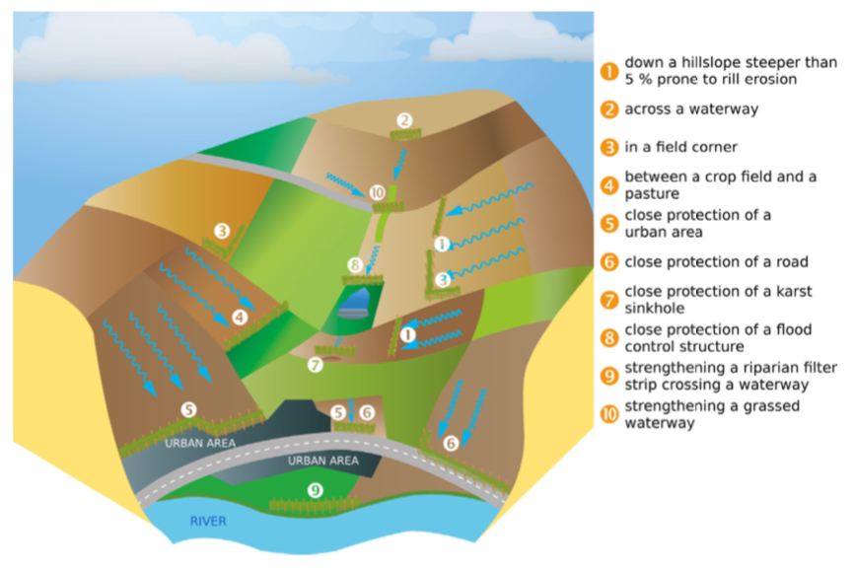
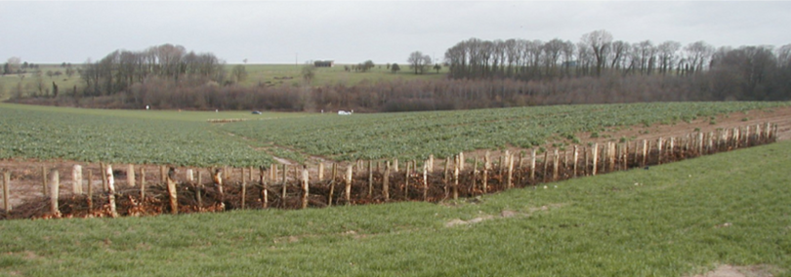
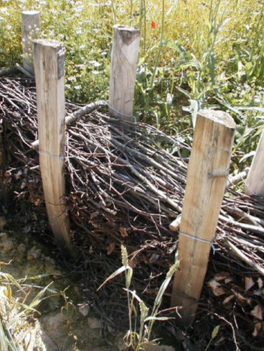
Landuse- a key to mitigate overland flow and erosion risk
Richet et al. (2017): experiments to quantify efficiency of hedges to mitigate flash flooding
Slow down surface runoff: k_{st} 2-3 m^{1/3}/s
Enhance infiltration from 5 to 200 - 550 mm/h
Richet, Jean-Baptiste und J.-F. Ouvry und M. Saunier (2017). „The role of vegetative barriers such as fascines and dense shrub hedges in catchment management to reduce runoff and erosion effects: Experimental evidence of eciency, and conditions of use,“ in: Ecological
Engineering 103, S. 455–469.
Notes:
Fragen:
Warum gibt’s konzeptionelle Hydrologie?
Warum machen wir keine Hochwasservorhersage für kleine Gebiete?
Sagen:
Das ist Inhalt der heutigen Vorlesung

Slide 22
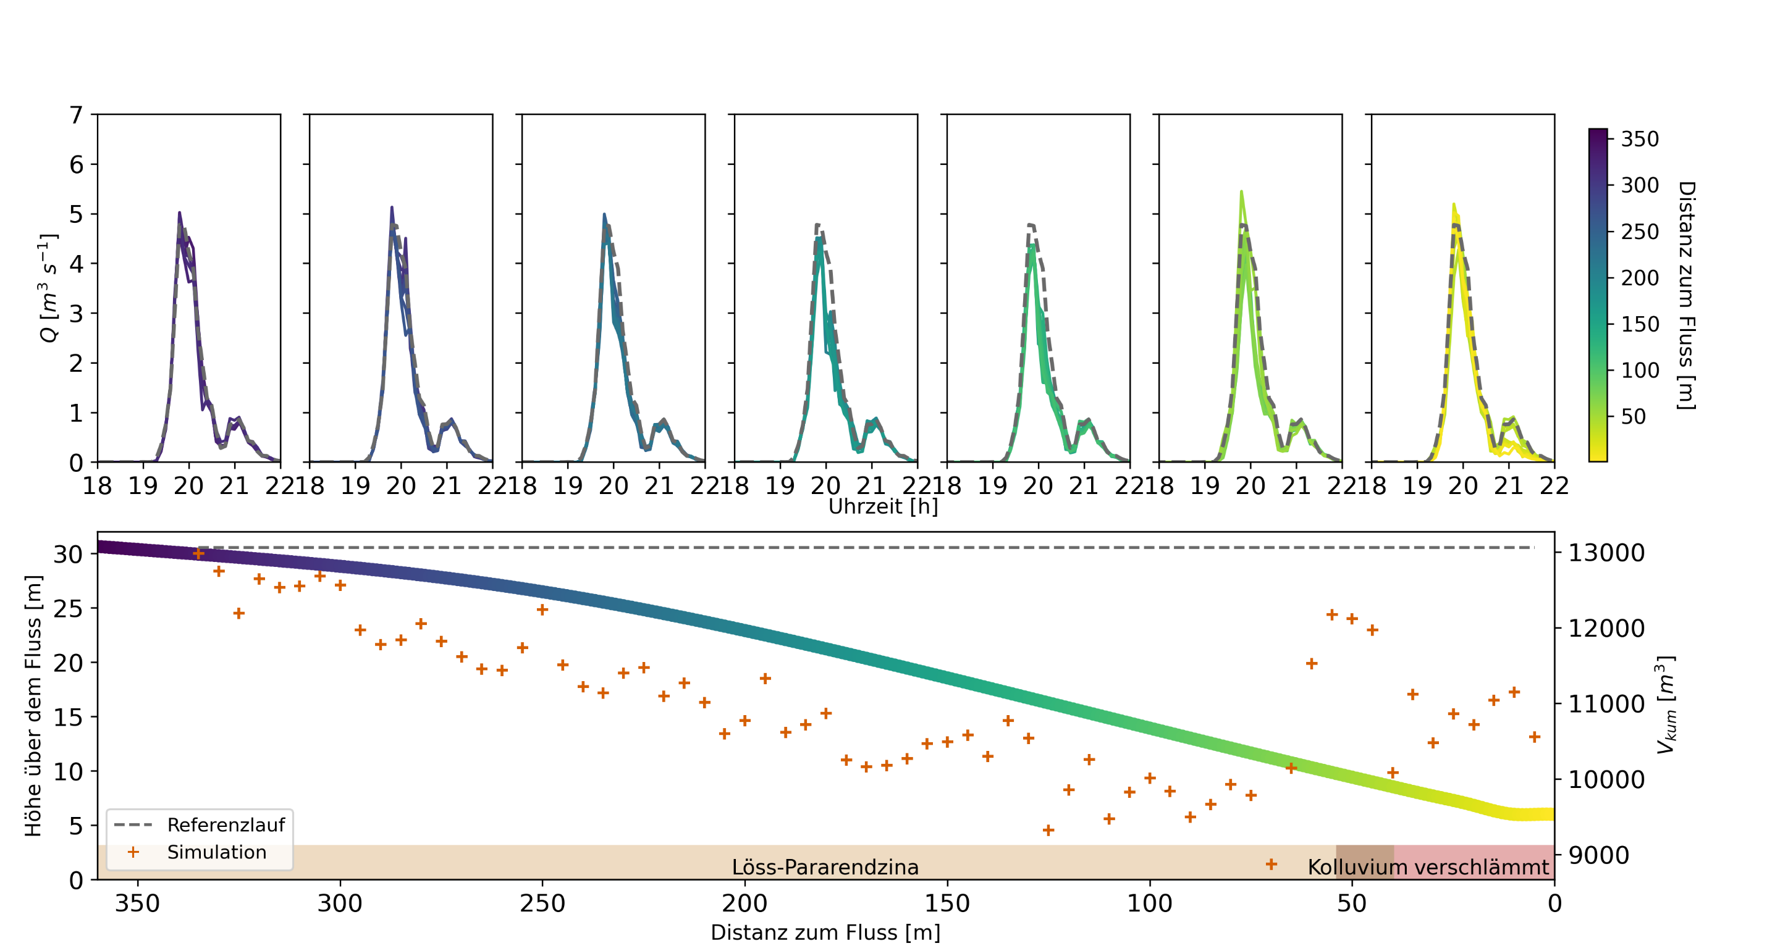
Explore sensitivity to hedges and their positions
Vary location on the hillslopes
Strickler value k_{st}=2 m^{1/3}/s, k_{s} = 1.5 10⁻⁴ m/s

Slide 23
Roadmap
  Challenges and processes
  Reflect on design practice and short comings
  Perspectives for integrated design with process based models
  and flash flood warnings with process based models

Slide 24
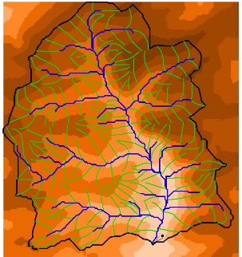
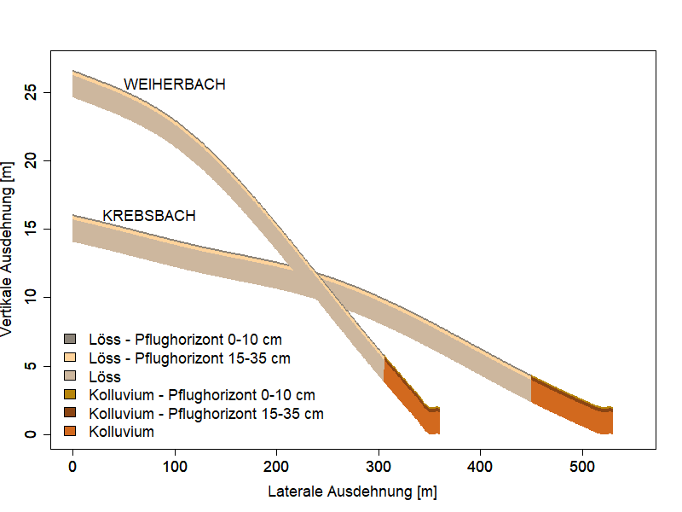
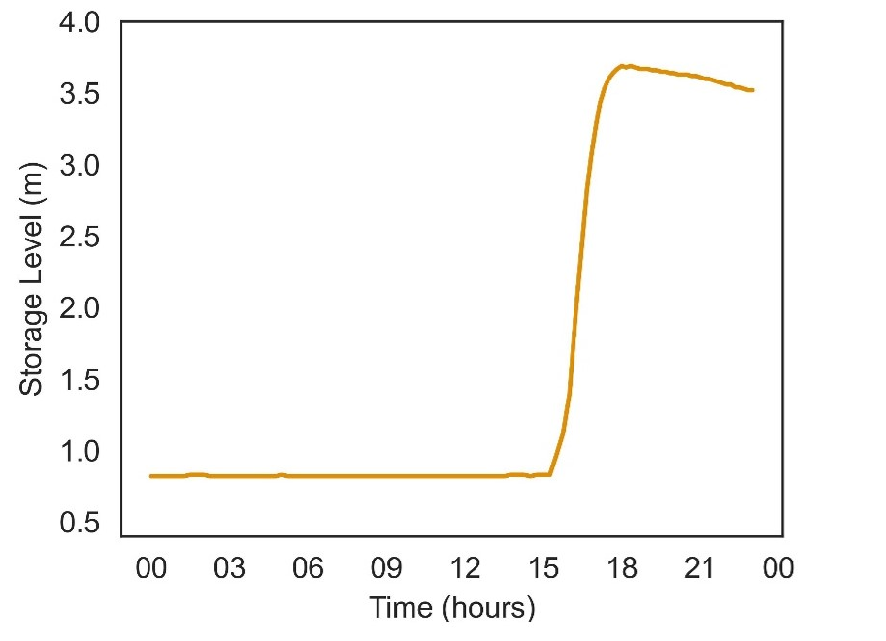


Representative hillslopes for regional flash flood warnings
Weiherbach as „Donor“ for parameter transfer to Schwarzbach catchments
Typical catena, soil hydraulic parameters
Landuse characteristics, Manning’s n
Simulate reservoir overtopping in 2016
Model spin-up: ERA 5 rainfall and potential ET
Rainfall input during event: “Kachelmann” Radar product
Target: reservoir inflow from inverted reservoir mass balance
$$\frac{dS}{dt}=Q_{in}−Qout$$
© Elsenz Schwarzbach Verband
Notes:
Es geht natürlich auch ne Nummer kleiner

Slide 25
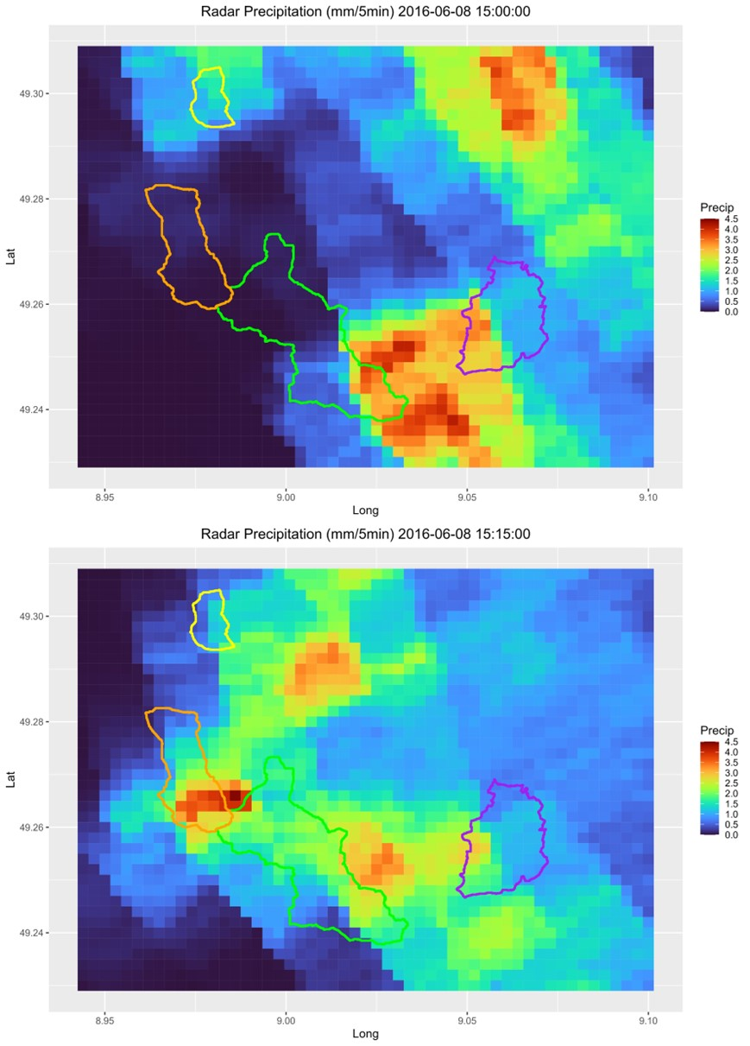
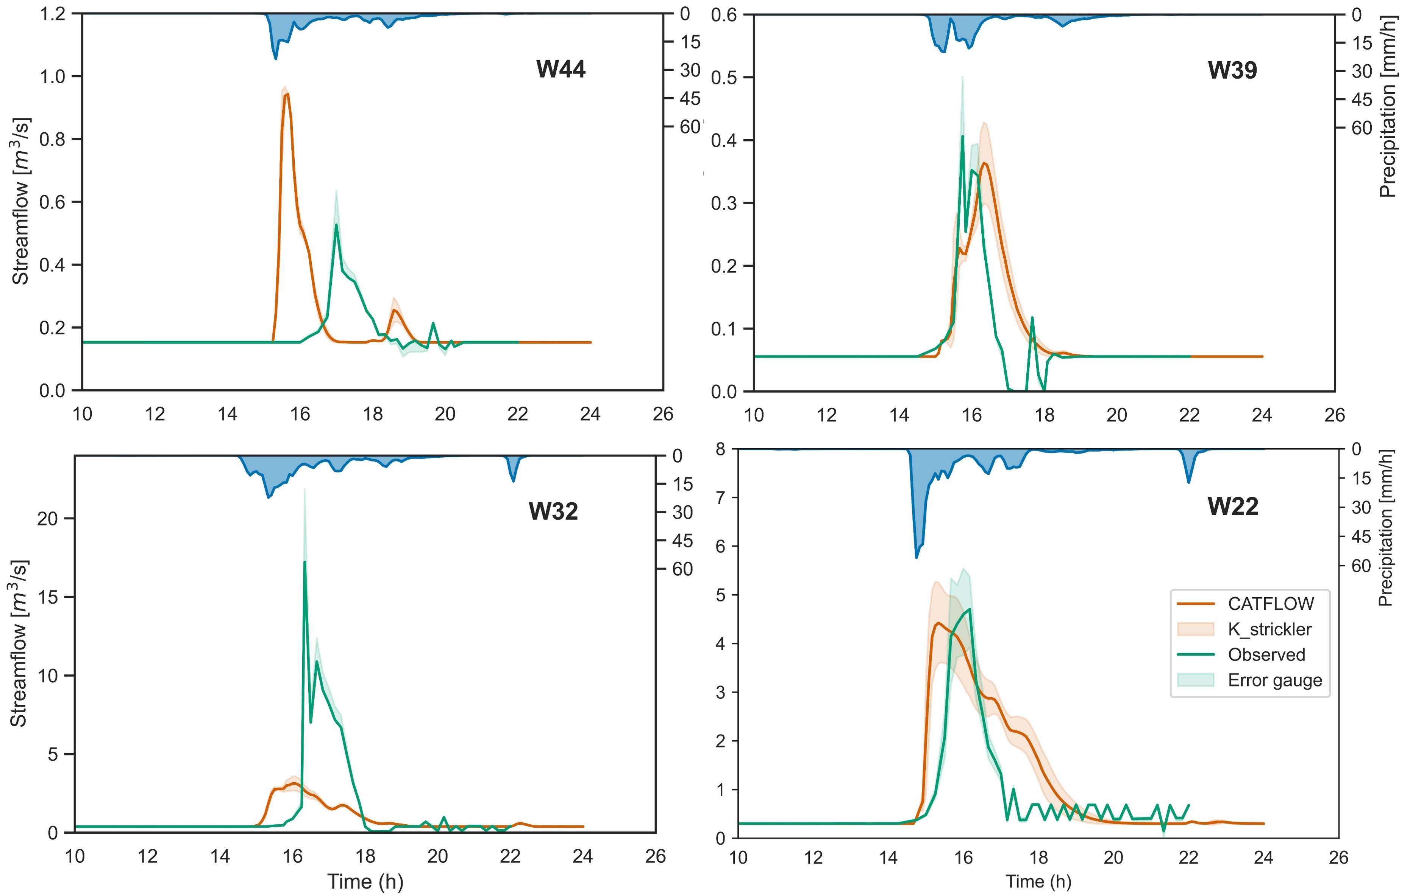
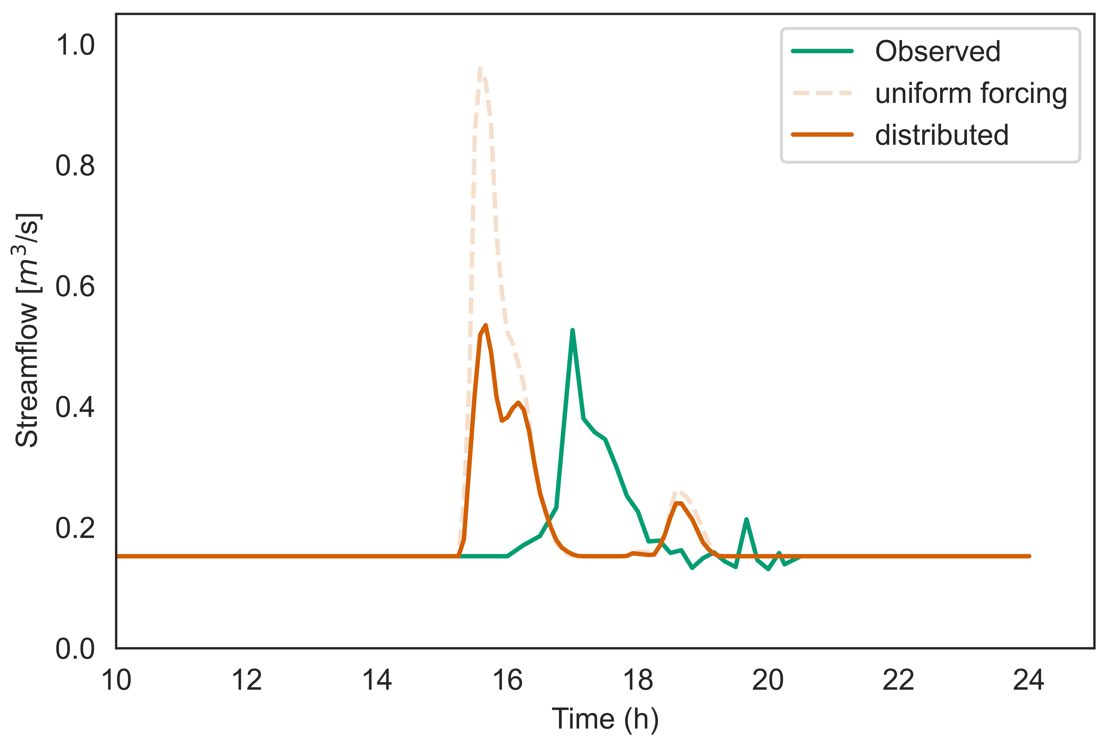
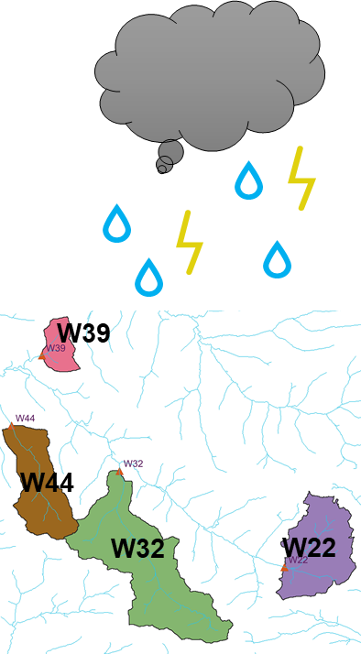
Representative hillslopes for regional flash flood warnings
W44
Notes:
Es geht natürlich auch ne Nummer kleiner

Slide 26
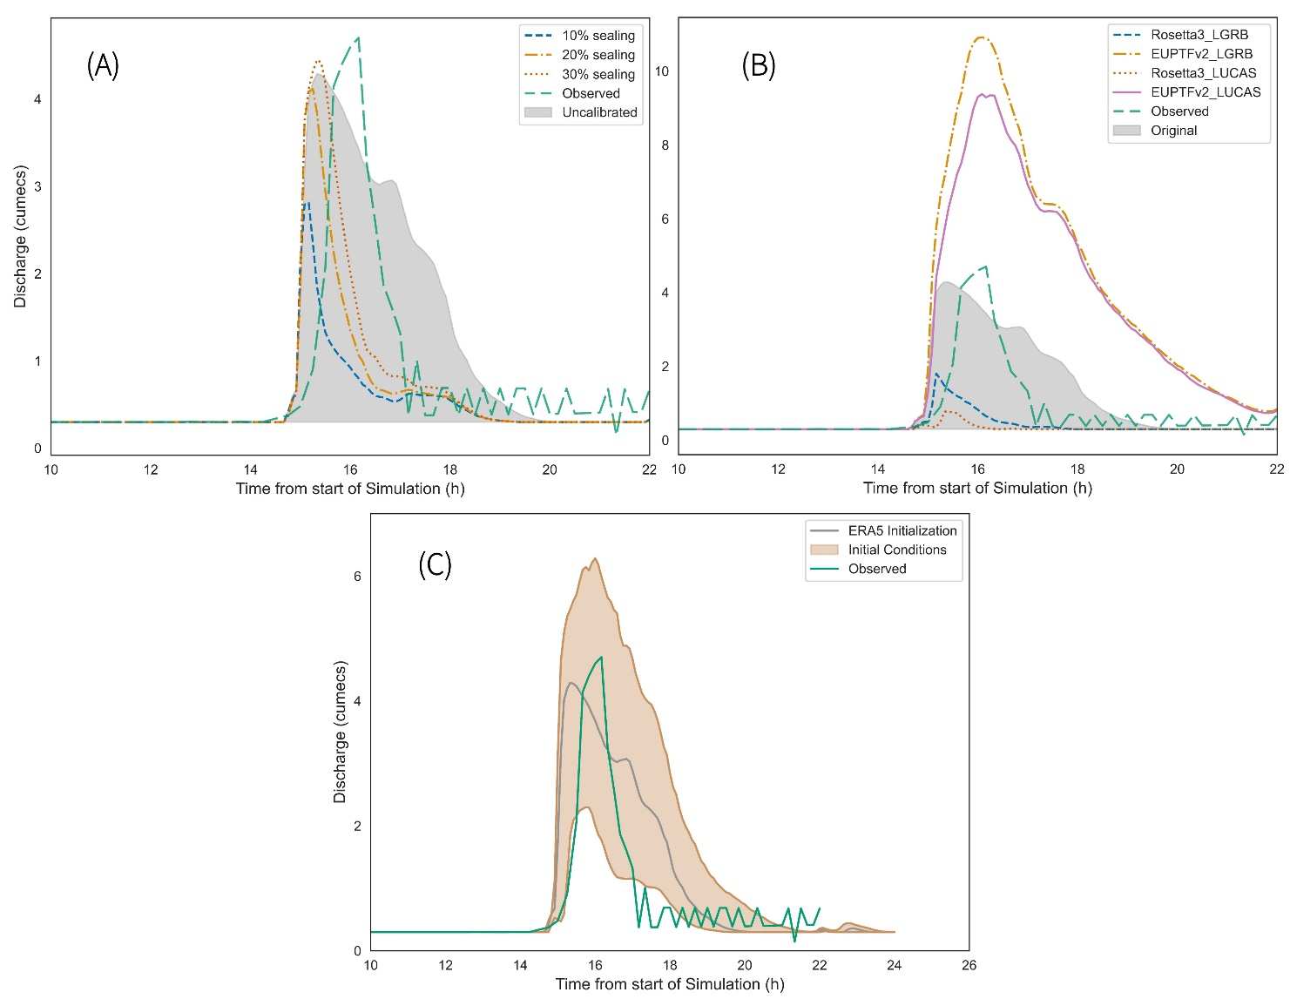
Sensitivity to soil parameters & initial conditions
© Schwarzach Elsenz
Notes:
Es geht natürlich auch ne Nummer kleiner

Slide 27
Resume´
Process based models are feasible for
Integrated design in small catchments flash floods
Strong sensitivity to temporal rainstorm pattern
Quantify combination of distributed green/landuse & technical solutions -> up to 50% less runoff
Representative hillslope models feasible for flash flood warnings
Sufficiently fast
Use re-analysis products for spin-up -> reduces uncertainy
Highly resolved radar products/ Synfony for flood simulation
Soil hydraulic parameters are landscape not catchment specific- > research catchment as donors
Flood retention reservoirs provide a large but largely untapped data treasure for flash modelling and learning

Slide 28

Conclusions
Flash floods pose enormous challenges to flood warning and safety
…… but they can be addressed with the right tools-
……still time for
or better

Slide 29
Infiltration excess: storm intensity pattern matters
Villinger, F., Loritz, R. & Zehe, E. Physically based simulation of an occurred flash flood using "representative hillslopes" in a rural catchment. Hydrologie Und Wasserbewirtschaftung 66, 286-297, doi:10.5675/HyWa_2022.6_1 (2022).
Notes:
Gut Gut

Slide 30
Erosion: Event June 1994
f_{crit} from regression: (N = 43, R²=0.69)
Schroers, S., Scherer, U., and Zehe, E.: Energy efficiency in transient surface runoff and sediment fluxes onhillslopes - a concept to quantify the effectiveness of extreme events, Hydrology and Earth System Sciences, 27, 2535-2557, 10.5194/hess-27-2535-2023, 2023.

Slide 31
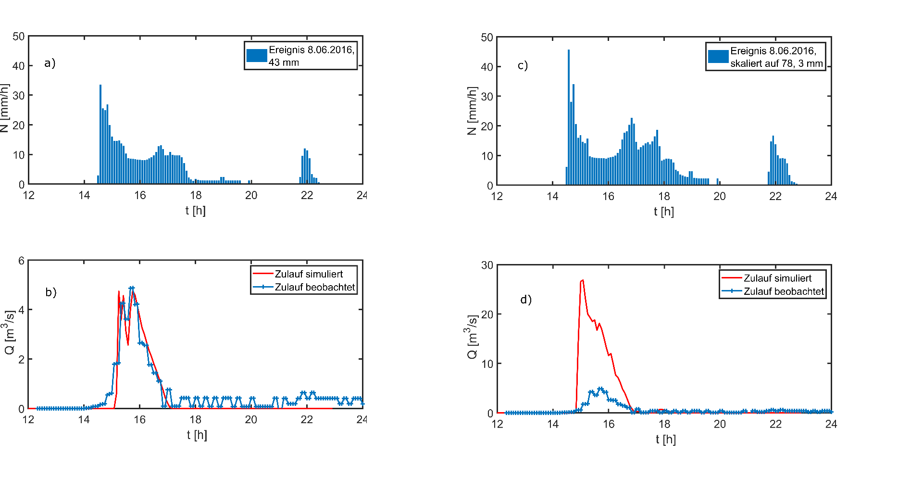


Representative hillslopes for scenarios
Notes:
Es geht natürlich auch ne Nummer kleiner

Slide 32


Perspective for integrated design
Scenario with hedges

Slide 33
The representative hillslope

Slide 34


Model initialisation
KGE | 0.674
r | 0.809
 | SMAP | ERA5 | CATFLOW
SMAP | 1 | - | -
ERA5 | 0.78 | 1 | -
CATFLOW | 0.61 | 0.82 | 1
Notes:
Reanalysis dataset
Hillslope models are run using mean catchment values
Corresponding soil moisture states are saved for the event runs

Slide 35


Standard versus observed rainfall
Notes:
Gut Gut

