Slide 1
Precipitation nowcasting: from Lagrangian models to advanced ML approaches
Ulrich Hamann Ioannis Sideris Loris Foresti
Daniele Nerini
Jussi Leinonen Nathalie Rombeek
Athanasios Ntoumos
Urs Germann

Slide 2
What is nowcasting ?
Definition by Paul Joe, following K Browning (1981) and Conway (1998):
Nowcasting is forecasting with local detail, by any method, over a period from the present to a few hours ahead;
this includes a detailed description of the present weather.
measurements
nowcasting
NWP
now + next few hours
tomorrow
past
in 10 days
now
6h

Slide 3
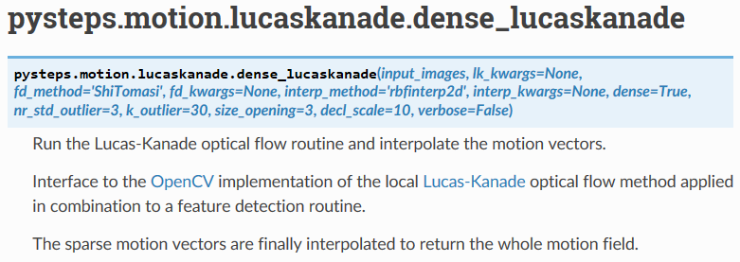
Step 1: Optical flow methods
Spectral method (DARTS)
Local Lucas Kanade (LK)
Global variational echo tracking approach (VET)
Anisotropic diffusion method (Proesmans)
Spectral method DARTS
Local Lucas-Kanade
Pulkkinen, Seppo, et al. "Pysteps: An open-source Python library for probabilistic precipitation nowcasting (v1. 0)." Geoscientific Model Development 12.10 (2019): 4185-4219.
Notes:
Spectral Method (DARTS)
This method utilizes spectral techniques for optical flow computation.
DARTS (Differential and Spectral) combines derivative-based and frequency-domain analysis to capture motion accurately.
Particularly useful for applications with periodic structures or oscillatory motion.
Local Lucas-Kanade (LK)
A classic local method that assumes motion within a small window and estimates flow using a linear system.
Works well for small displacements and smooth motion fields.
Sensitive to brightness variations and large displacements.
Global Variational Echo Tracking (VET)
A global, variational method that formulates optical flow estimation as an optimization problem.
Suitable for complex motion since it introduces smoothing constraints across the entire image.
More robust to noise and significant deformations.
Anisotropic Diffusion Method (Proesmans)
Uses anisotropic diffusion to smooth optical flow fields while preserving motion boundaries.
Prefers smoothing along motion directions to reduce noise effects.
Especially useful for scenes with strong motion discontinuities.
Each method has its strengths and weaknesses, depending on the application and image conditions.

Slide 4
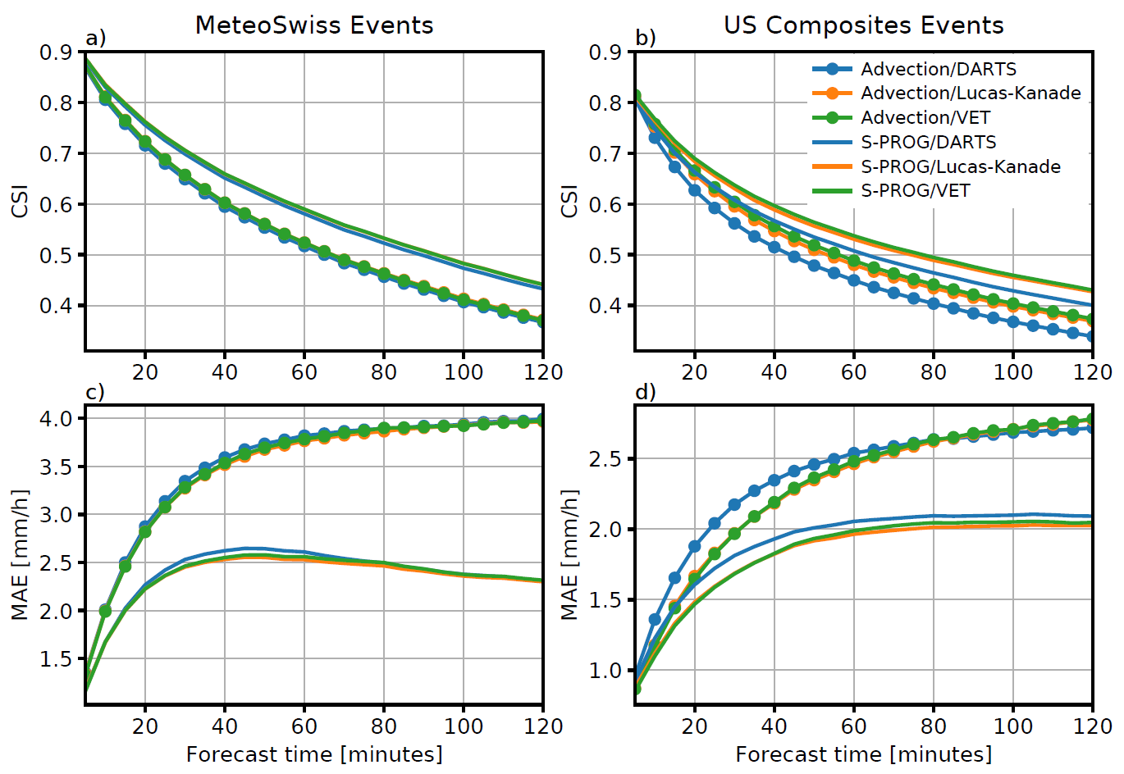
Optical flow (pysteps verification)
The choice of optical flow method is not a first order problem in terms of nowcast quality (differences < 2%)
But, there may be some specific situations requiring more advanced schemes, e.g. in presence of orographic rain and/or multiscale motion

Slide 5
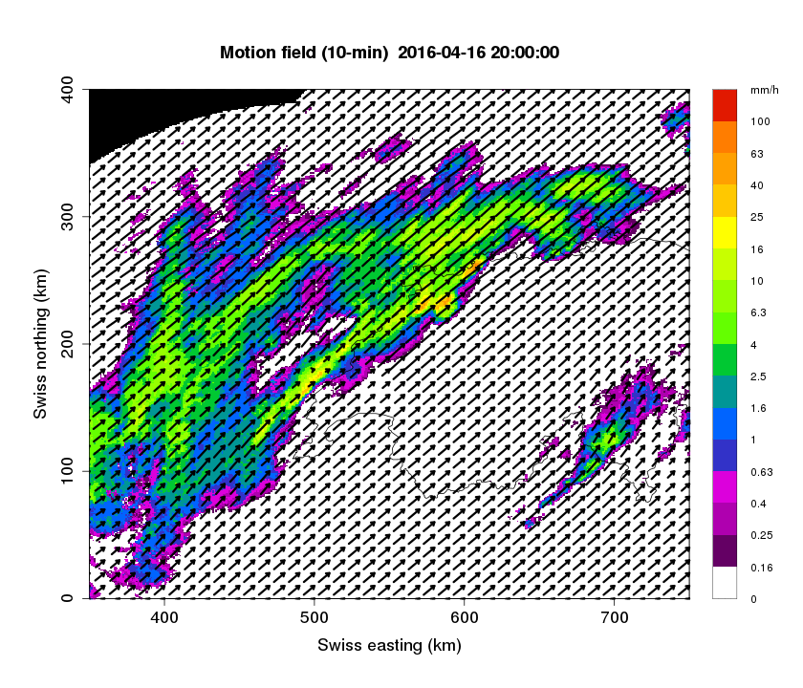
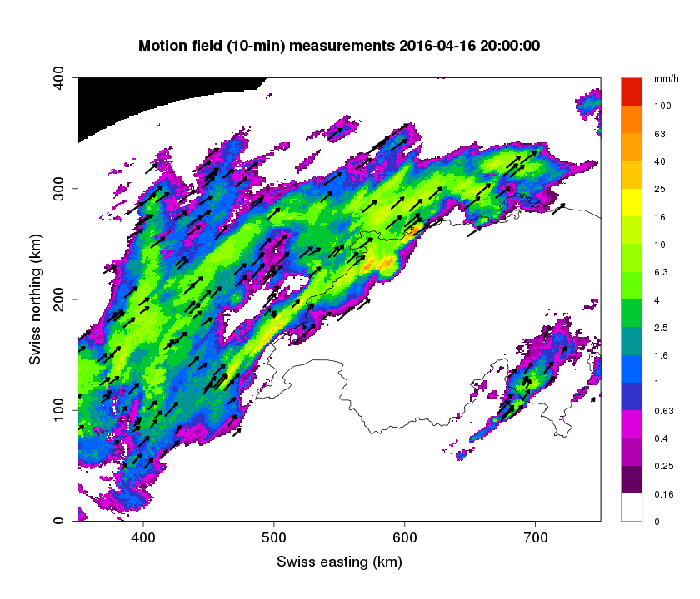
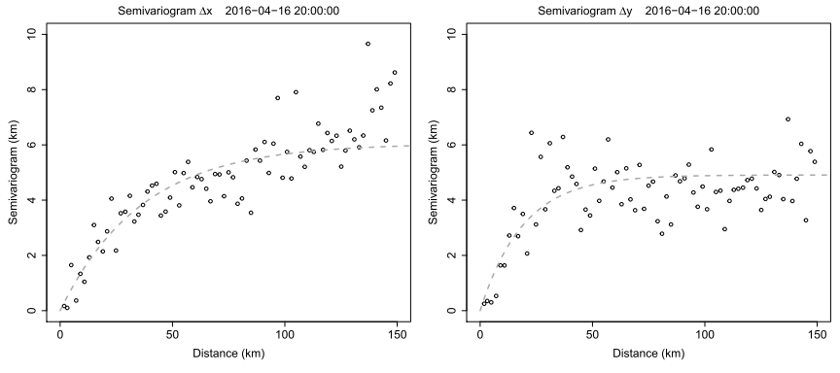
Step 1: Optical flow methods (nowtrack)
The motion field of NowPrecip is based on block optical flow and kriging.
The name of this method is NowTrack
Chooses randomly a small number of points and determines their velocity
Then interpolates this information to each pixel of the raster using kriging.
The current motion field is dynamic radar-NWP-based
Two variograms Δx and Δy are fit automatically to determine the correlation between the velocities of the few random points. Then estimation at each pixel follows.

Slide 6
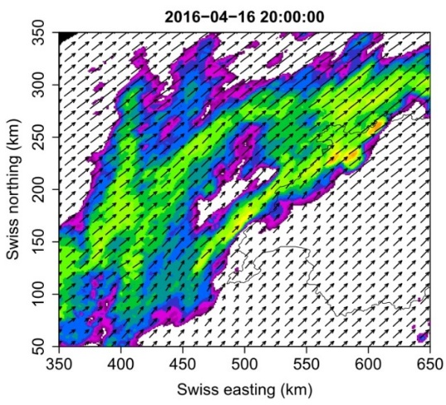
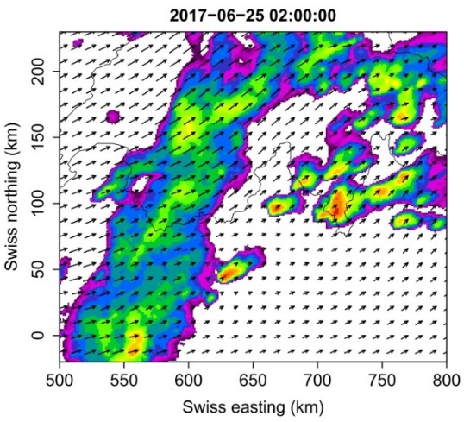
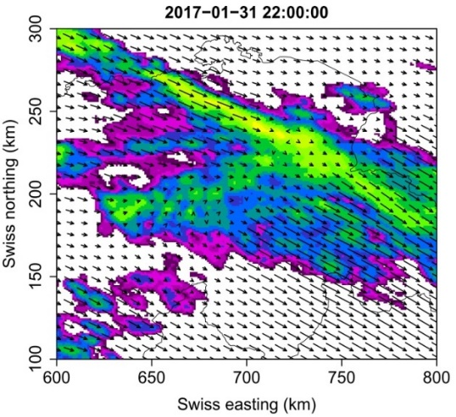
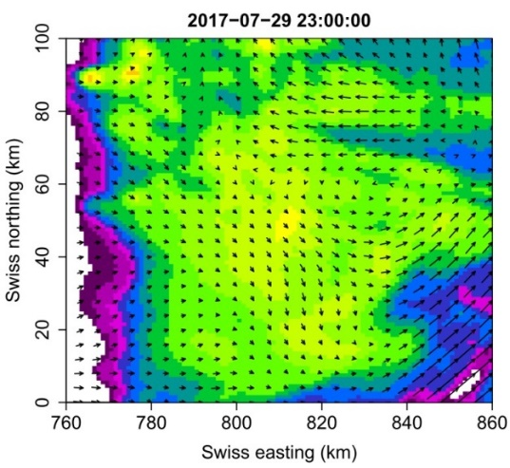
Optical flow methods (nowtrack)
Nowtrack is very flexible in functioniong in all sorts of motion
It seems to excel even on very challenging motions like localized rotations which take place within a few tens of kilometers.
Stratiform
Convection
Orographic
Rotation

Slide 7
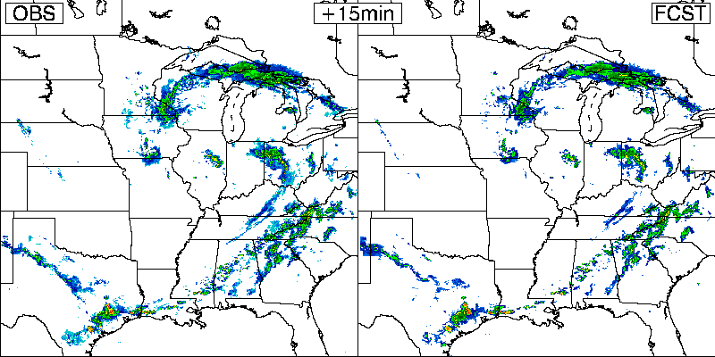
Step 1: Lagrangian models
Method: Move the patterns according to latest motion.
OBS
FCST
25 May 2001, 08:00 UTC, 0 - 6h nowcast
Notes:
Simplest nowcasting model, benchmark
Representation of the apparent motion
No source or decay term: No synopitic forcing No orographic effects like blocking or föhn No lifecycle of convective cells

Slide 8
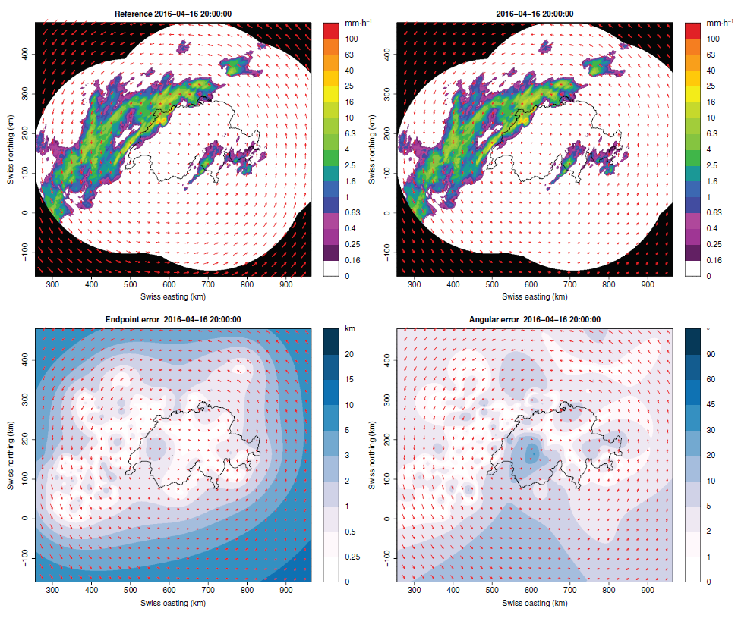
NowPrecip – optical flow
First verification results of NowTrack suggests that the error is very small (usually<1km) where there are data.
Endpoint error:
Angular error:

Slide 9
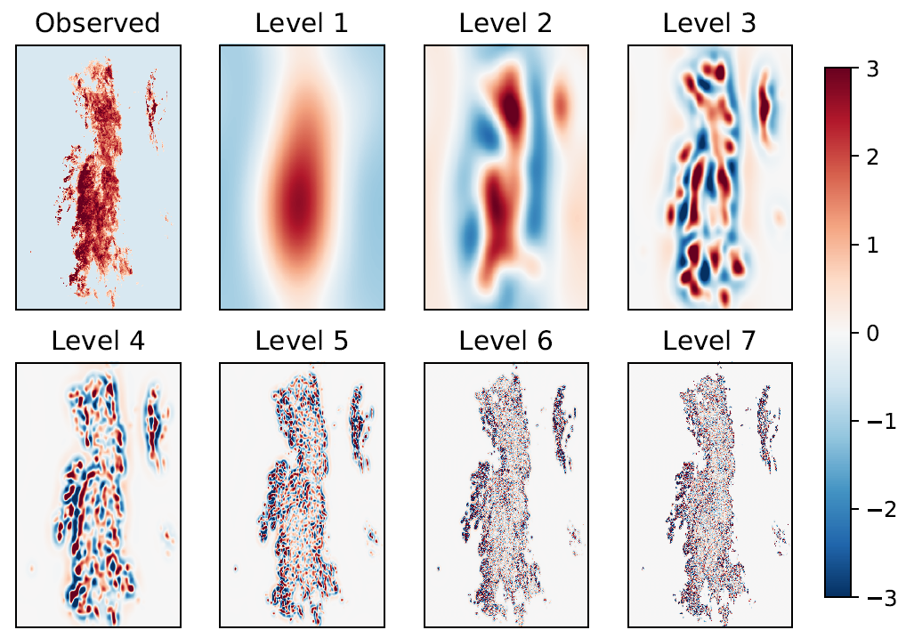
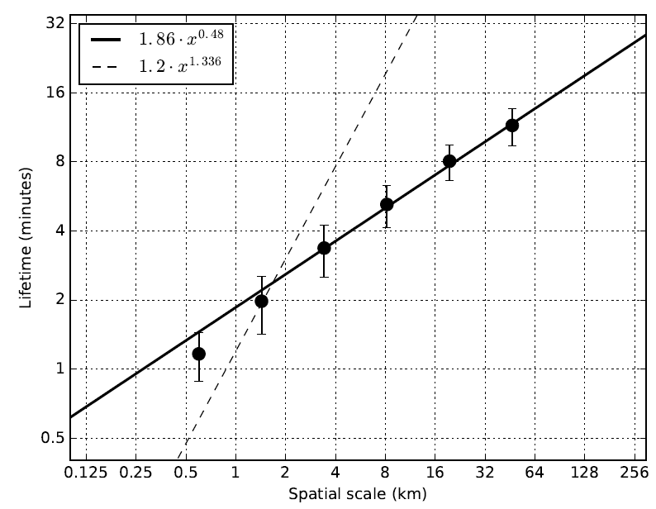
Step 2: Cascade decomposition
Predictability of precipitation
depends on spatial scale!
log(lifetime) ~ k*log(scale)
Lifetime [minutes]
Spatial scale [km]

Slide 10
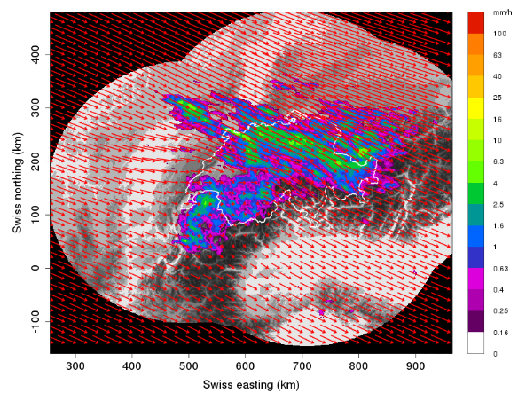
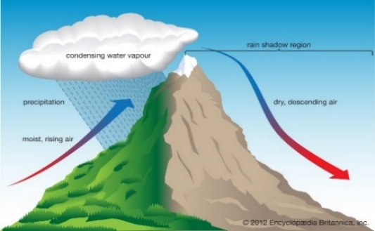
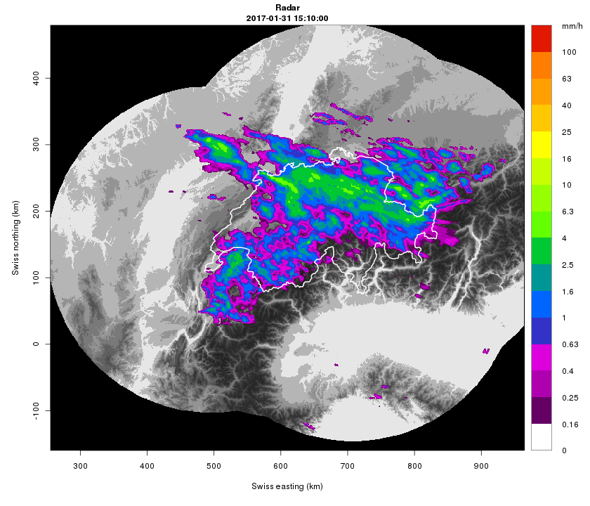
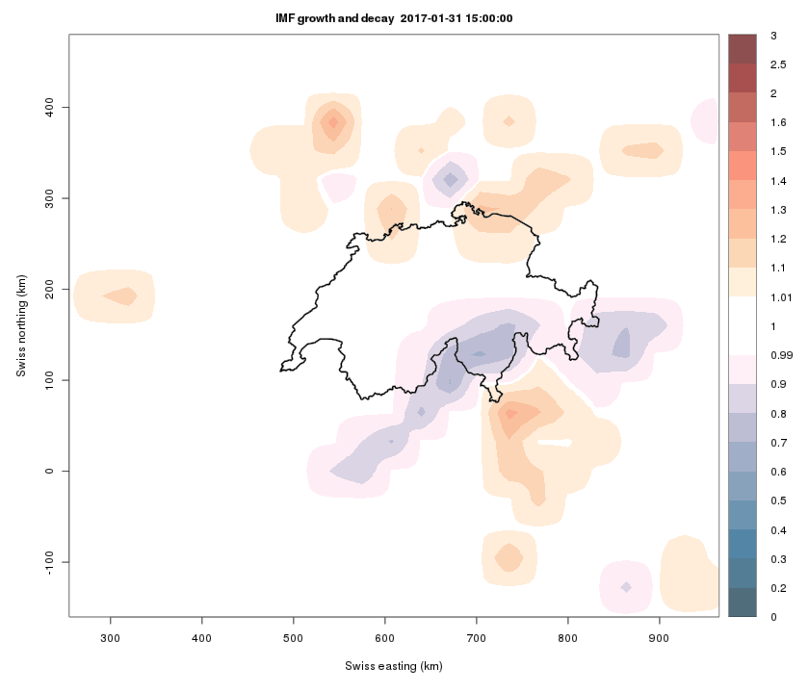
Step 3: Growth and decay
1
Orographic precipitation:
Moist air is lifted as it moves over a mountain range (as the air rises and cools, orographic clouds form and fuel precipitation, most of which falls upwind of the mountain ridge).
On the lee side of the mountain range, rainfall is usually low (rain shadow).
Radar 2017-01-31 15:10:00
Map: Growth - Decay
2
Optical flow slow-down accompanied by decay on the entire rainfall front.
Total change
Growth/decay
Advection

Slide 11
From: Ulrich Blahak, SINFONY - the Combination of Nowcasting and NWP on the Convective Scale at DWD

Slide 12
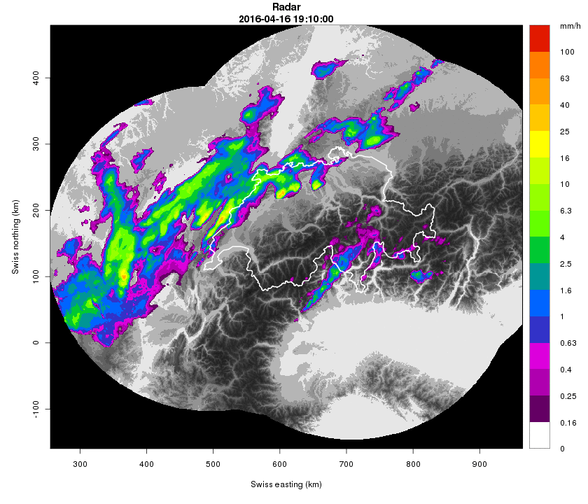
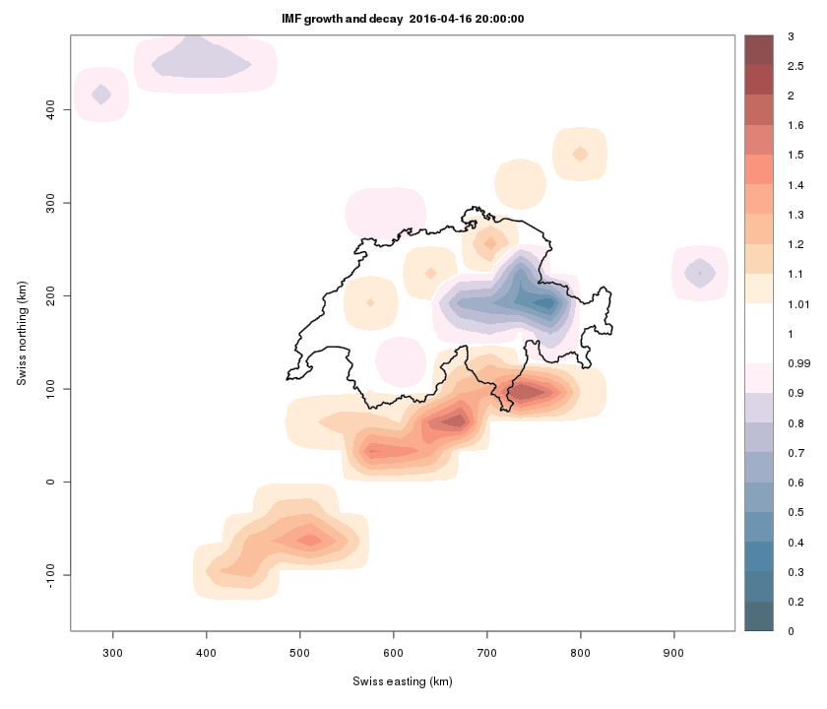
Step 3: Growth and decay
Dynamic growth and decay based on both radar and NWP.
In some regions (orography) this growth/decay is quite systematic.
Important : information from NWP enters the nowcast before merging…
…this conditions nowcast better for the upcoming merging and helps seamlessness

Slide 13
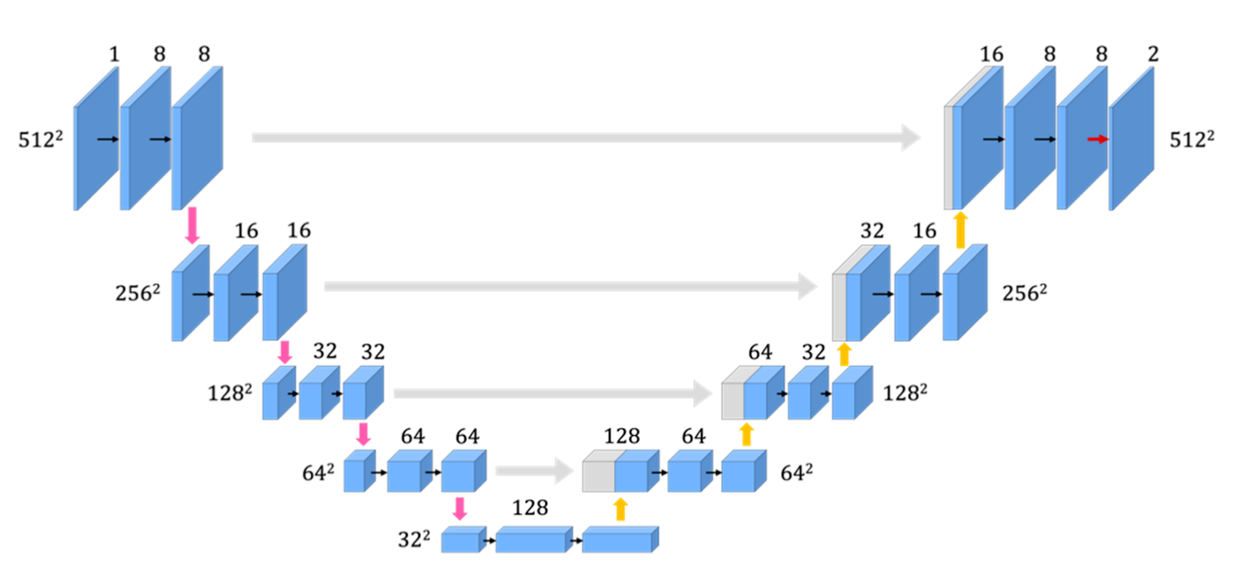
Step 1+2+3: Nowcast with CNNs
Input are 2D images (satellite image, radar image, topography…)
Deep learning applies filters on several spatial scales
Adapted for nowcasting by Leinonen et al. 2022 for the weather4cast competition
Extended with recurrent layers to exploit temporal trends and to predict several lead time steps
Illustration of a U-net architecture
Conv 3x3
Conv 1x1
max pooling downscaling
upscaling
encoder
forecaster
Hirose, Ikumi, et al. "U-Net-Based Segmentation of Microscopic Images of Colorants and Simplification of Labeling in the Learning Process." Journal of Imaging 8.7 (2022): 177.

Slide 14
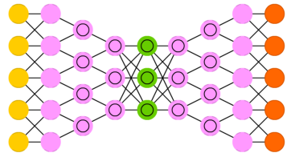
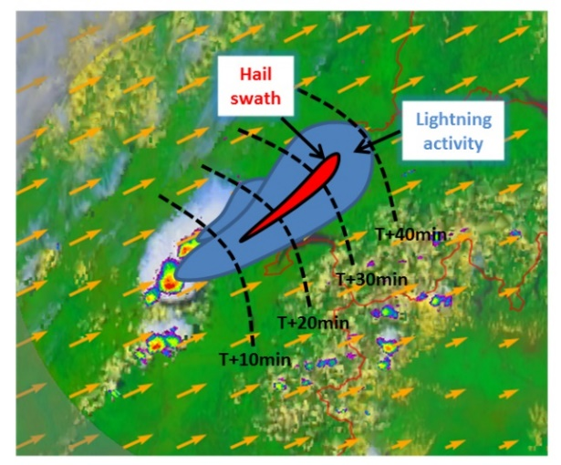
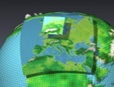
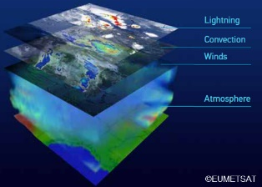
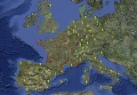
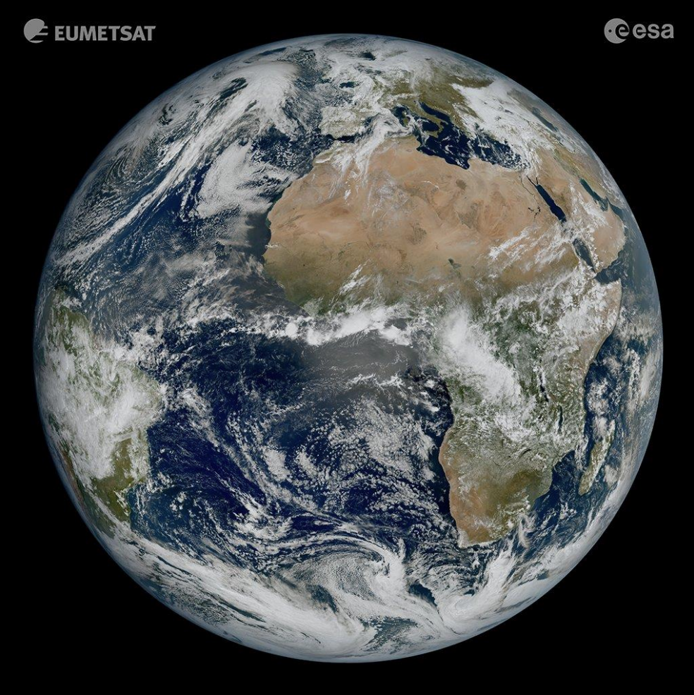
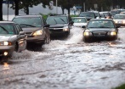
Step 1+2+3: Multi-data fusion with RCNNs
COALITION-4 Hazard specific thunderstorm nowcast based on deep learning Existing products: Heavy precipitation, hail, hail size, and lightning
1. Extensive database
2. Deep Learning Neural Network
3. Thunderstorm Nowcast
Radar
COSMO/ICON-1E
Satellite
Lightning
©EUMETSAT
Rain
Hail
Lightning
Wind

Slide 15
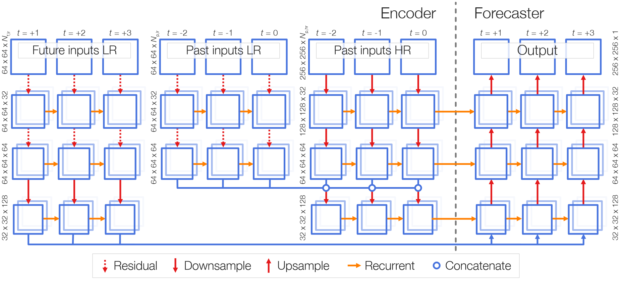
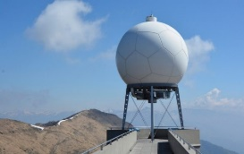
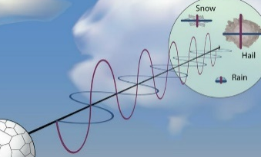
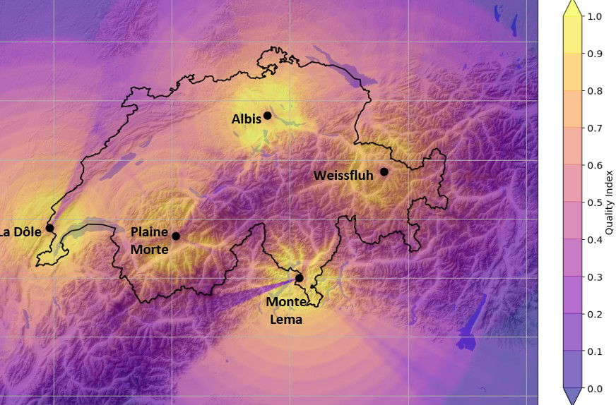
Step 1+2+3: Exploit polarimetric radar obs.
Dataset: Convective season of 2020
Swiss radar data (R)^{1,2,3}:
Rain-rate and vertical structure of radar reflectivity such as echo top height
Swiss radar
Polarimetric variables (P):
co-polar cross correlation (${\text{ρ}}_{hv}$), differential reflectivity ($Z_{DR}$), vertical reflectivity ($Z_{v}$) and specific differential phase $(K_{dp}$)→ aggregated to the ground⁴.
Polarimetric variables
Quality index
Quality index (Q)⁵
Rombeek, Nathalie, Jussi Leinonen, and Ulrich Hamann. "Exploiting radar polarimetry for nowcasting thunderstorm hazards using deep learning." Natural Hazards and Earth System Sciences 24.1 (2024): 133-144.
1. Germann et al. (2022) 2. Leinonen et al. (2022) 3. Leinonen et al. (2022)
4. Wolfensberger et al. (2021) 5. Feldmann et al. (2021)

Slide 16
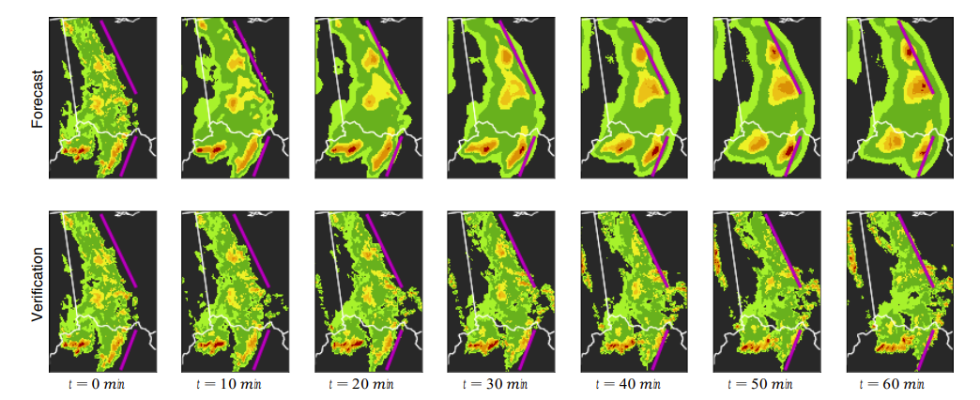
Step 1+2+3: Nowcast with CNNs
Samsi, Siddharth, Christopher J. Mattioli, and Mark S. Veillette. "Distributed deep learning for precipitation nowcasting." 2019 IEEE High Performance Extreme Computing Conference (HPEC). IEEE, 2019.

Slide 17
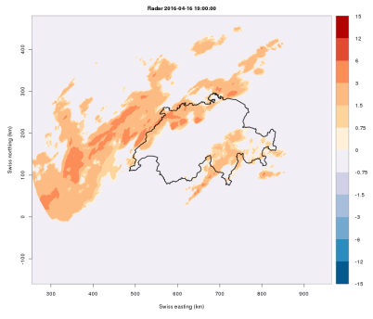
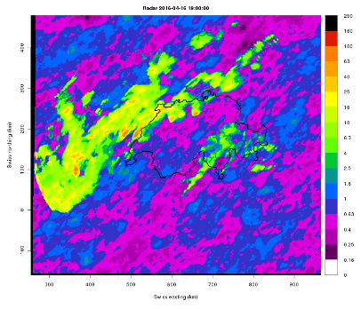
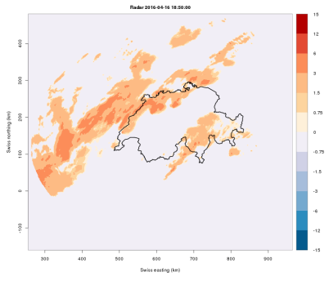
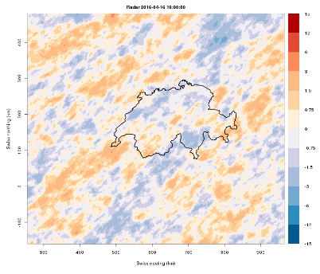
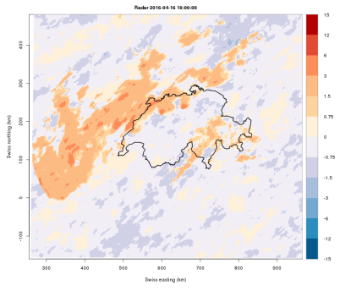
Step 4: Uncertainty and autocorrelation
Autoregressive model plus spatially correlated noise
Spatially correlated noise depends on the observations
This takes place in 1km² scale
$φ_{1}R_{i−1} +{ φ}_{2}R_{i−2} +{ As}_{i} =$ $R_{i}$
Observation₁
Observation₂
Colored Noise
Next Frame
+
+
=
This 1km² operations takes place in a transformed space.

Slide 18
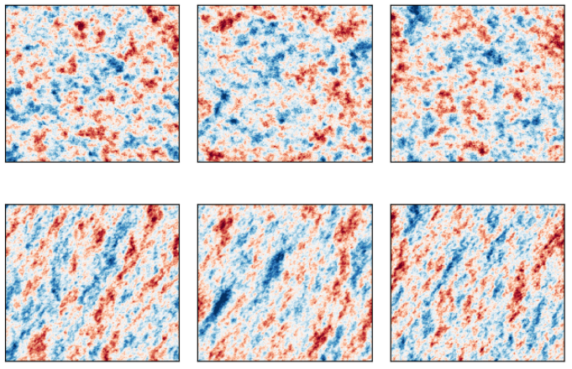
Step 4: Uncertainty estimates

Slide 19
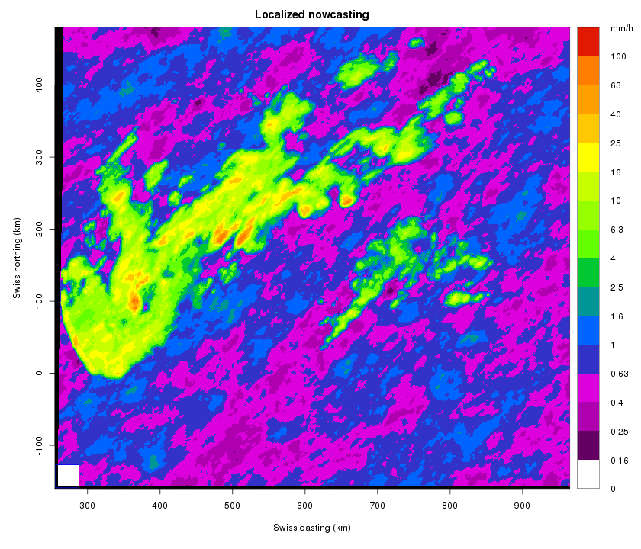
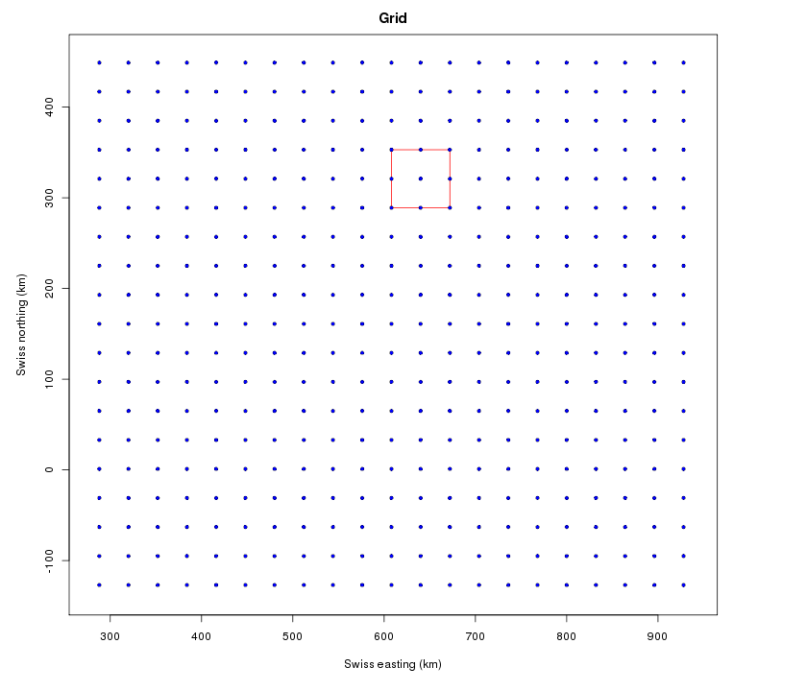
Step 4: Uncertainty and autocorrelation
Localized adjustment on 64x64 km² boxes:
Shift and scale mechanism: two parameters control the appearance of each box:
1. Mean value (IMF)
2. Fraction of wet pixels (WAR)

Slide 20
Step 4: Generative model
LDCast Nowcasting Model, Jussi Leinonen
Condition diffusion model on past frames
Train to generate future frames
Network based on Adaptive Fourier Neural Operator for conditioning
Adapted Stable Diffusion U-Net for denoising
Variational autoencoder (VAE) to reduce dimensions → Diffusion process in latent space reduces computational cost → Latent diffusion model (LDM)
Notes:
A Generative Adversarial Network (GAN) is like a game between two smart artists:
The Generator (The Faker) 🎭
This artist tries to create fake images (or data) that look real.
At first, its drawings are terrible, but it keeps improving by learning from mistakes.
The Discriminator (The Detective) 🕵️‍♂️
This artist's job is to spot fakes.
It looks at both real and fake images and tries to tell them apart.
🔄 How They Compete:
The Faker keeps getting better at fooling the Detective.
The Detective keeps getting better at spotting fakes.
Over time, the Faker gets so good that the fakes look just like real images!
💡 Why is this cool? GANs can create realistic images, art, music, and even deepfake videos! They are used in AI art, game design, and improving blurry photos.

Slide 21
Step 4: What are diffusion models?
Forward process (in theory): Image degraded gradually by noise until indistinguishable from random noise
Train a neural network as an inverse model to denoise the image step by step
Apply this network to a completely noisy image step by step → Will converge to a random sample from the training distribution
Latent diffusion models use an autoencoder to transform data to a latent space before running diffusion
→ More stable models with lower computational requirements

Slide 22
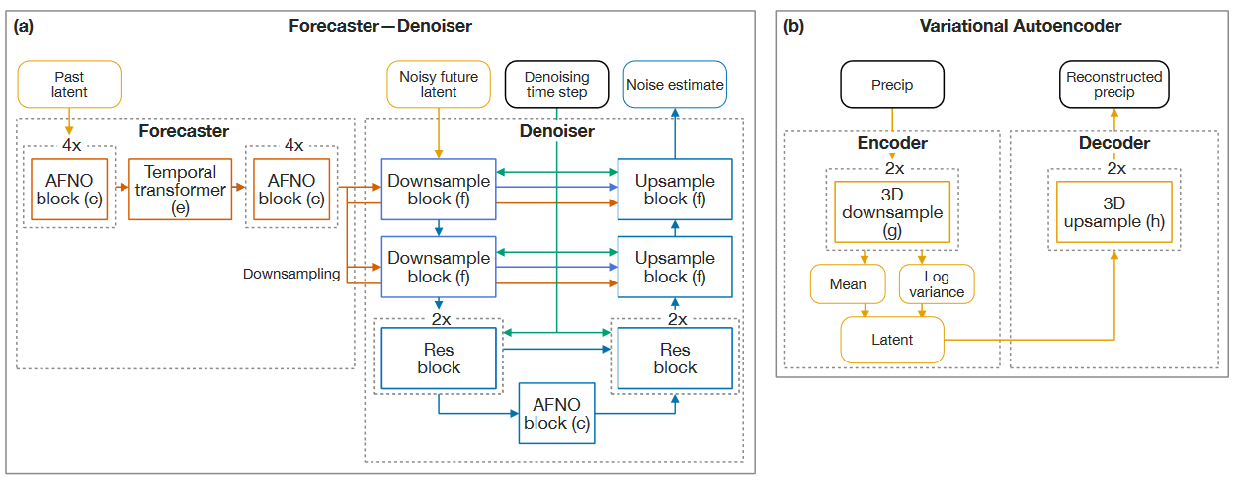
LDCast Nowcasting Model
Condition diffusion model on past frames
Train to generate future frames
Network based on Adaptive Fourier Neural Operator for conditioning
Adapted Stable Diffusion U-Net for denoising
Variational autoencoder (VAE) to reduce dimensions → Diffusion process in latent space reduces computational cost → Latent diffusion model (LDM)

Slide 23
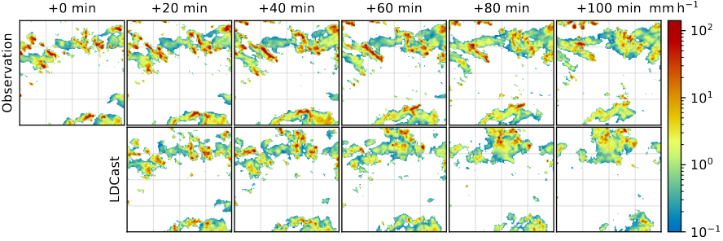
Step 4: Nowcast example
Realistic results that diverge gradually from the observed precipitation

Slide 24
Step 3+4: Sample diversity
LDCast generates more diversity then DeepMind GAN nowcasting model (DGMR):
More variable samples at +90 min

Slide 25
Step 4: Predictions for Switzerland
Works as a fully convolutional network:
Possible to train on one size and apply to another

Slide 26
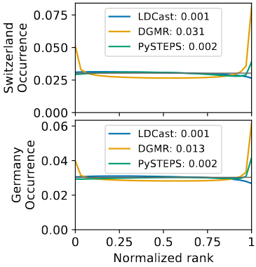
Step 4: Quantitative metrics
Leinonen, Jussi, et al. "Latent diffusion models for generative precipitation nowcasting with accurate uncertainty quantification." arXiv preprint arXiv:2304.12891 (2023).
LDCast outperforms DGMR in CRPS, advantage reduced out-of-domain
LDCast produces much better rank histograms
LDCast sometimes performs worse with predicting heavy precipitation events
Notes:
GAN-based Deep Generative Models of Rainfall

Slide 27
LDCast status & future
Paper in review, preprint: https://arxiv.org/abs/2304.12891
Code, with link to data: https://github.com/MeteoSwiss/ldcast/
Easily applicable pre-trained model available at Github/Zenodo
Can run ensemble predictions on multi-GPU nodes
Future applications:
New source variables:
NWP for seamless nowcast/postprocessing?
New targets: winds etc.
Training:
Training datasets in similar format to COALITION-4, currently uses only radar
Training time on CSCS Tsa with 8xGPU around 50-60 hours total

Slide 28
CRPS

Slide 29
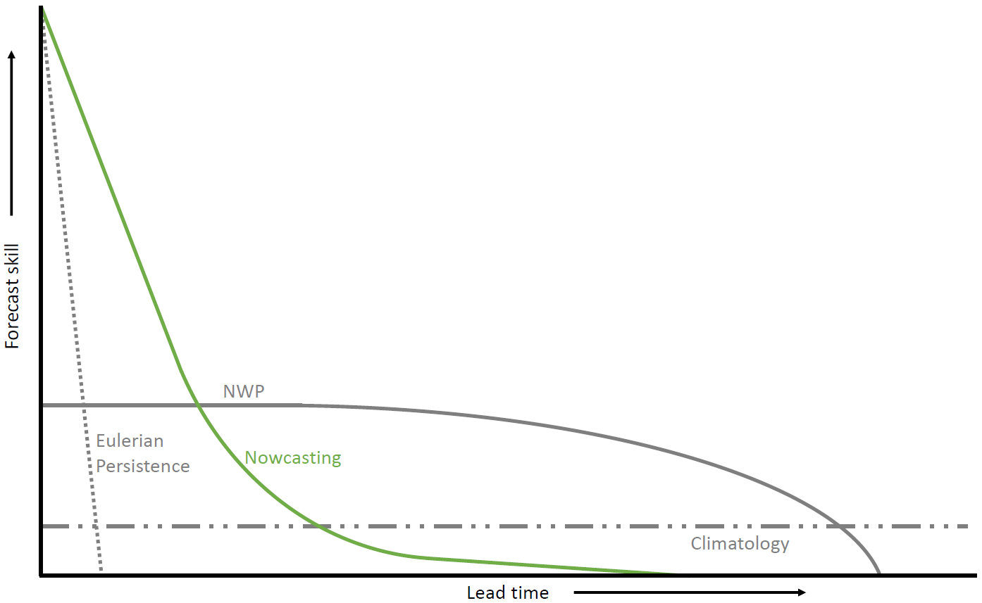
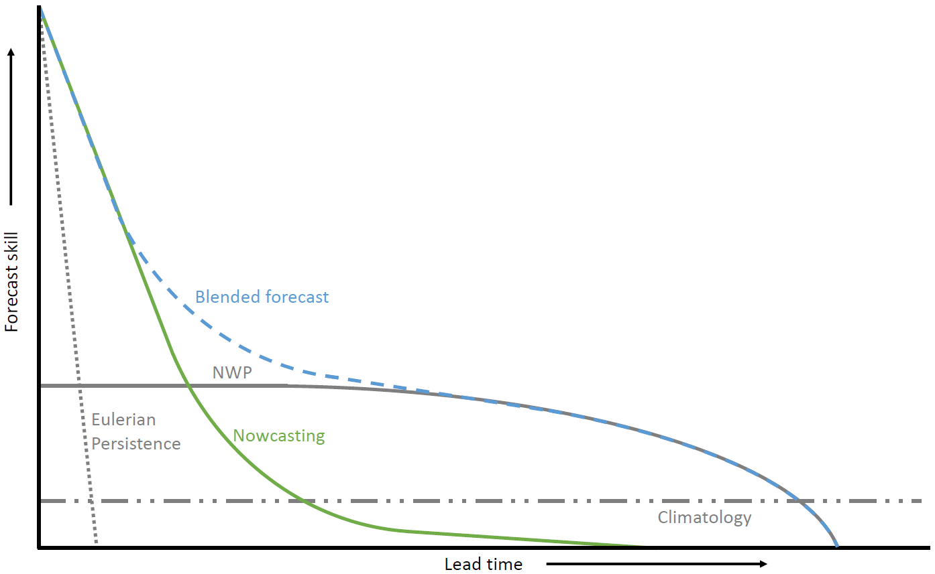
Step 5: Blending with NWP
Can we extend the skillful forecast horizon of nowcasting?
Nowcasting more skillful than NWP up to approx. 2 h. Often not enough for (flood) early warning.
How to improve the rainfall forecast up to 6 h or more ahead?

Slide 30
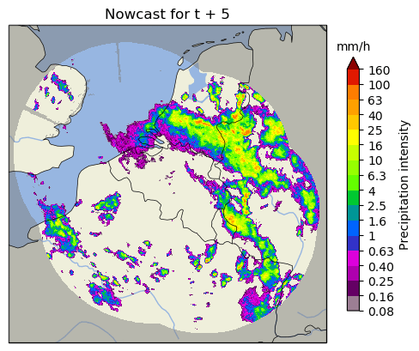
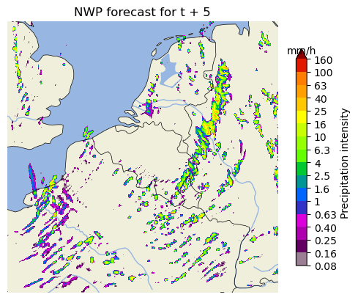
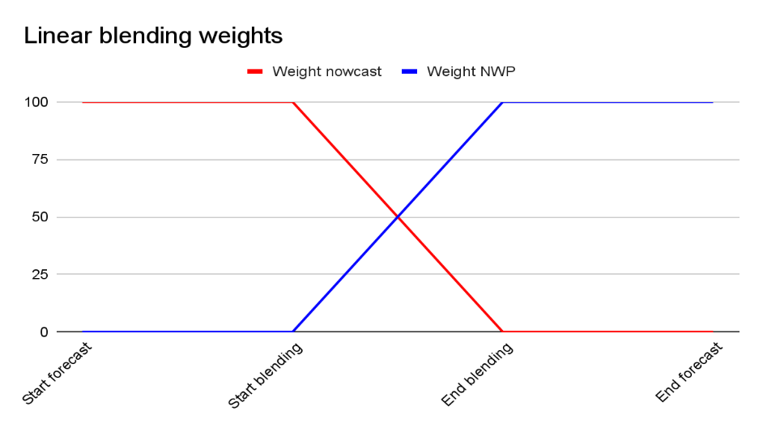
Simple linear blending an option, but..
Implementation of STEPS blending scheme (Bowler et al., 2006; Seed et al., 2013) in pysteps:
Scale-dependent blending
Blending weights depend on skill of forecast components
Ensemble forecasts with stochastic perturbations
How to merge a case like this?

Slide 31
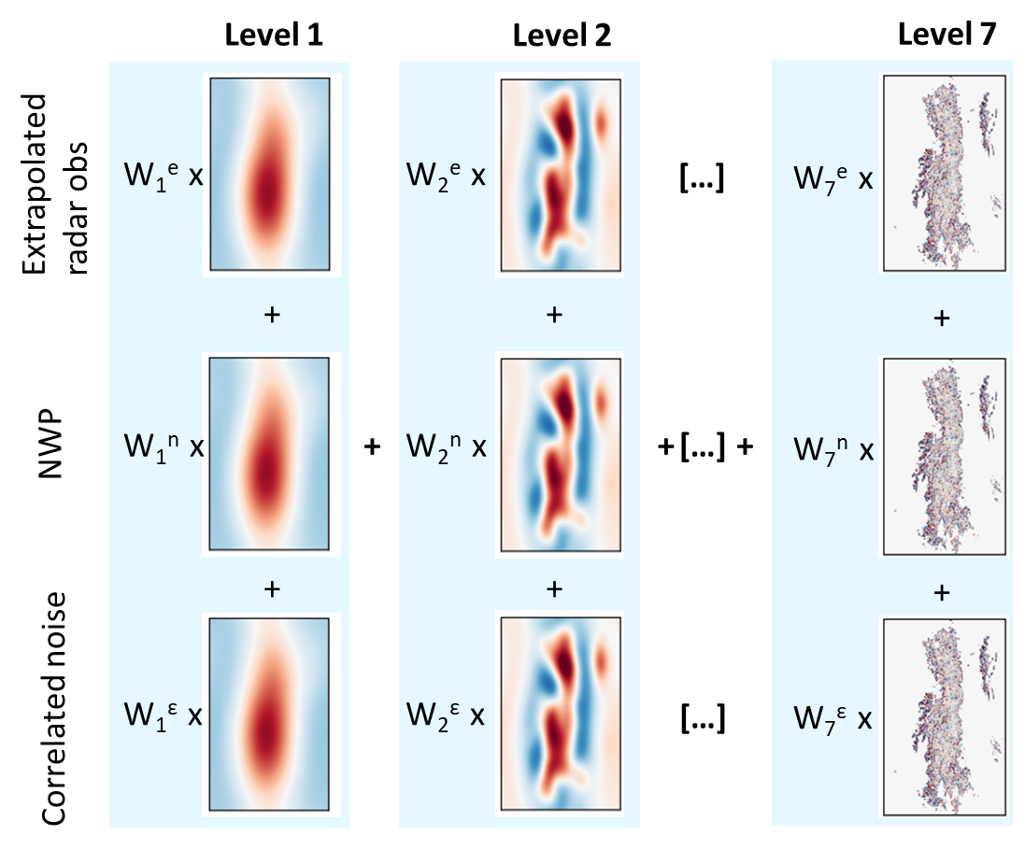
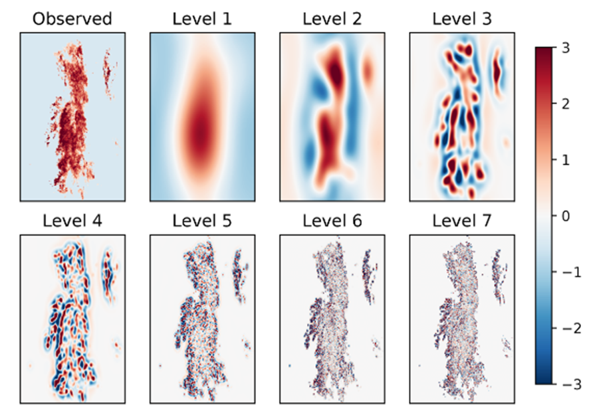
Per ensemble member:
Fast-Fourier transform to different spatial scales
Pulkkinen et al., 2019
Blending weights depend on initial and expected future skill

Slide 32
Functionalities added to original concept:
Skill NWP component regresses to skill of the past days
Multiple weights determination methods
Option to blend multiple NWP ensemble members / models
To constrain rain (dis)appearance in the ensemble to regions around rainy areas:
Lagrangian blended probability matching scheme
Incremental masking strategy

Slide 33
Step 5b: Weighted Blending with NWP
1
Merging of the nowcast with the NWP takes place employing a formula which is based on weights of the two components.
Correlation (single member)
2
How fast the merging will take place depends on the correlation of the NWP with recent observations.
When NWP correlates well with the recent observations the merging takes place faster.
Lead Time

Slide 34
Step 5: Probabilistic Blending with NWP
NowPrecip Ensemble
Designed to use stochastic noise: it can produce an ensemble of possible scenarios
Each nowcasting scenario can merge seamlessly with one of the members of the NWP output
Real time ensemble production will take place in the future
Member 1
Member 2
Member 3
Member 4
Black curves: correlation of NowPrecip nowcasts with time.
Red curves: correlation with time of the COSMO ensemble members. Green and blue curves represent mean values.
Member 5
Observation

Slide 35
NowPrecip – Scores averaged over many different events

Slide 36
NowPrecip – anatomy of the product
1
New, operational nowcasting system of MeteoSwiss (since 2020)
Areal-nowcasting
Spatial resolution: 1km
Temporal resolution: 5 min
Forecasting horizon: 6.5h
Stochastic noise / ensemble capable
Merging with NWP
Growth and decay
2
Areal nowcasting systems have typically two components:
Optical flow to construct the motion field
Extrapolation, to extrapolate the most recent raster into the future

Slide 37
Pysteps functionalities
Laroche & Zawadzki (1995). Retrievals of Horizontal Winds from Single-Doppler Clear-Air Data by Methods of Cross Correlation and Variational Analysis.
Germann & Zawadzki (2002). Scale-Dependence of the Predictability of Precipitation from Continental Radar Images. Part I: Description of the Methodology.
Germann & Zawadzki (2004). Scale-Dependence of the Predictability of Precipitation from Continental Radar Images. Part II: Probability Forecasts.
Seed (2002). A Dynamic and Spatial Scaling Approach to Advection Forecasting.
Bowler et al (2006). STEPS: a probabilistic precipitation forecasting scheme which merges an extrapolation nowcast with downscaled NWP.
Seed et al (2013). Formulation and evaluation of a scale decomposition-based stochastic precipitation nowcast scheme.
Roberts & Lean (2008). Scale-selective verification of rainfall accumulations from high-resolution forecasts of convective events.
Wernli et al (2008). Sal — A novel quality measure for the verification of quantitative precipitation forecasts.

Slide 38
Summary
Nowcasting: Statistical prediction for now to a few hours ahead
Step 1: Optical flow and extrapolation
Step 2: Cascade decomposition
Step 3: Growth and decay
Step 1+2+3: Convolutional Neural Network / U-net, recurrent CNNs
Step 4: Uncertainty estimation and spatio-temporal structures
Step 4: Generative Models GAN or latend diffusion models
Step 5: Blending with NWP

