Slide 1
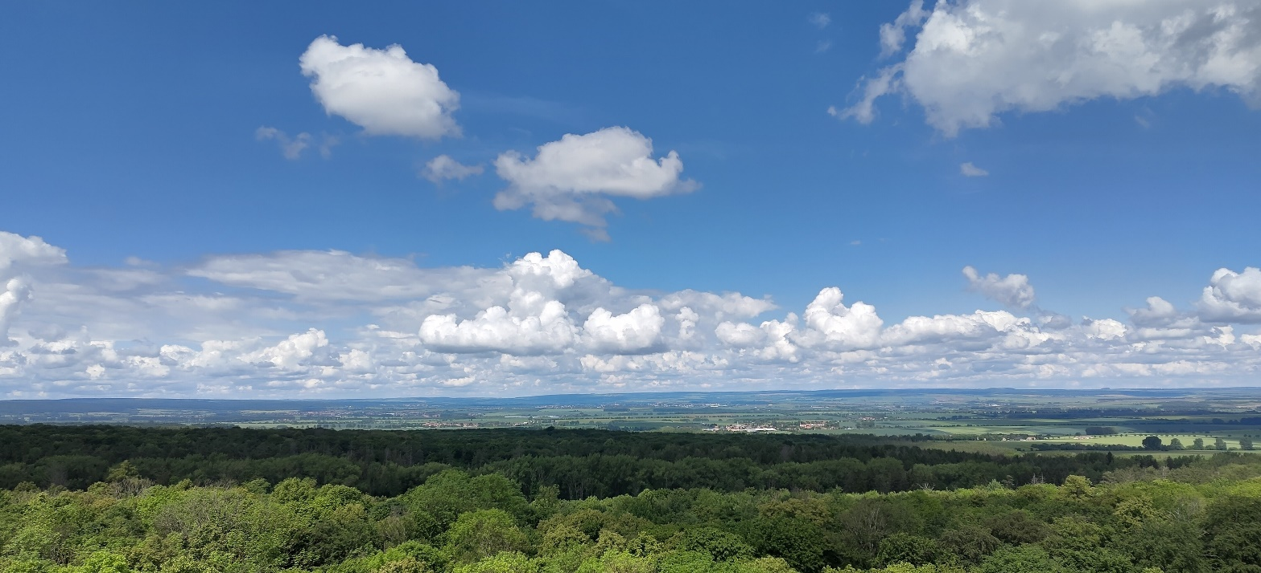
Making use of supplementary observations for the
development of physical parameterizations
Linda Schlemmer, Maike Ahlgrimm , Sophie Löbel, Alberto de Lozar, Daniela Littmann

Slide 2
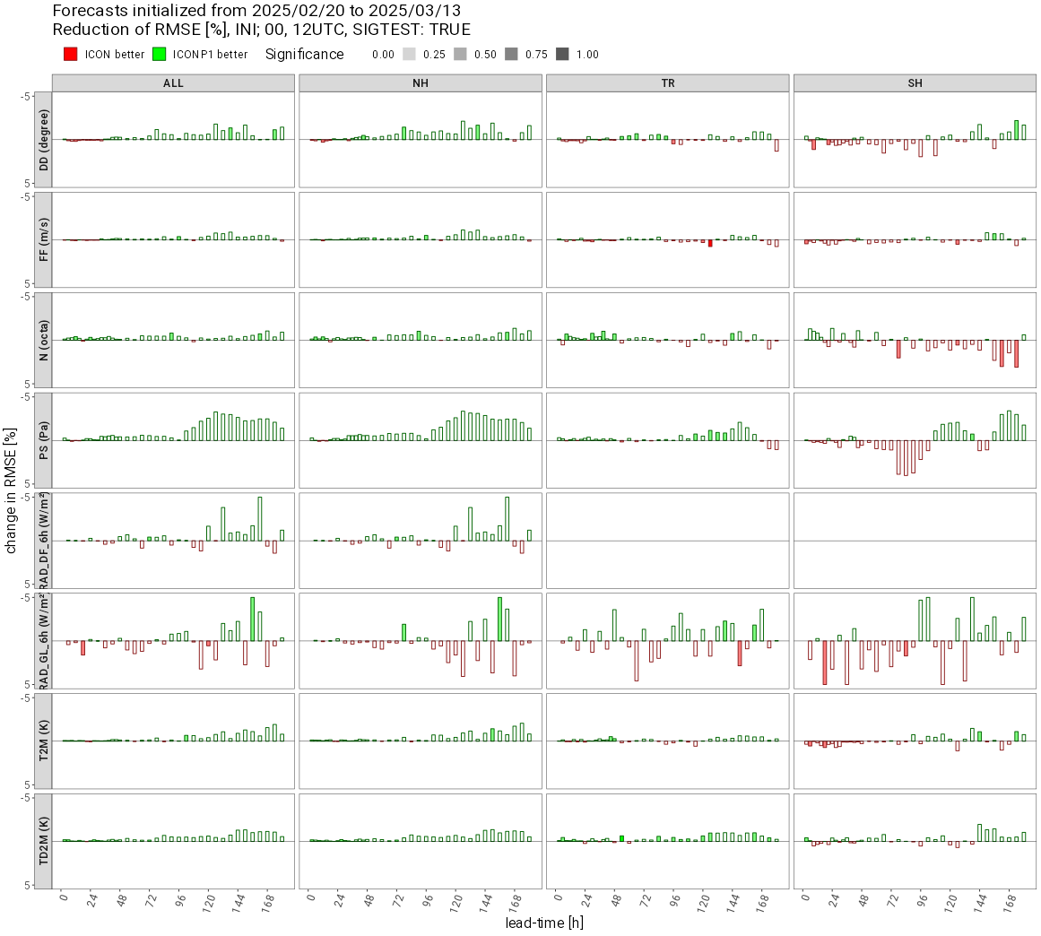
Standard Verification
Verification against observations in standardised way
Very useful and very efficient
Sometimes it can be hard to learn something about individual processes and thus parametrizations
→ Need additional (auxiliary) observations

Slide 3
Outline
Ground-based remote sensing
  FESSTVaL
  TEAMx - PIANO
Crowd-sourced observations
Satellite-based evaluations

Slide 4
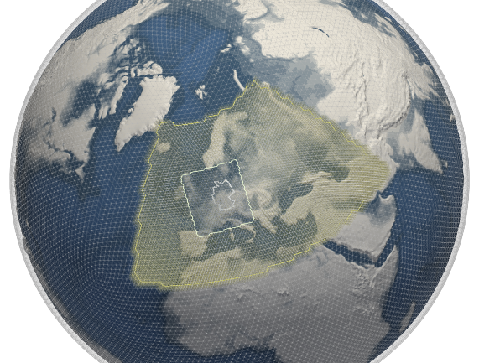





NWP Model-Chain 03/2025 – the ICON family
ICON
(Icosahedral Nonhydrostatic) Model
ICON–D500
ICON–D2
ICON-D2-RUC
ICON EU
ICON global
Florian Prill
Global (coarse) and
regional (high-resolution) applications
Roland Potthast, NWP@DWD

Slide 5
Outline
Ground-based remote sensing
  FESSTVaL
  TEAMx - PIANO
Crowd-sourced observations
Satellite-based evaluations

Slide 6

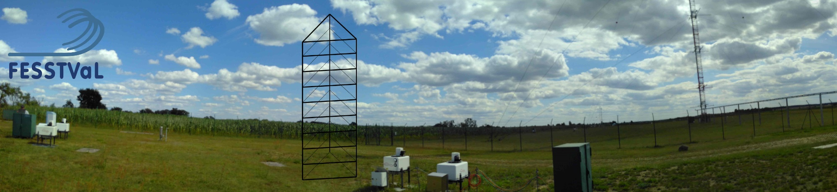
Cathy Hohenegger, Daniel Klocke, Felix Ament, Bastian Kirsch, Sarah Wiesner, Finn Burgemeister, Marco Clemens, Ingo Lange, Ulrich Loehnert, Julian Steinheuer, Tobias Böck, Stephanie Fiedler, Frank.Beyrich, Carola Detring, Ronny Leinweber, Matthieu Masbou, Linda Schlemmer, Volker Lehmann, Igor Kroener, Eileen Paeschke, Christine Knist, Henning Rust, Martin Göber, Mirjana Sakradzija, Noviana Dewani, Ivan Bastak Duran, Jürg Schmidli, Andreas Platis, Jakob Boventer, Jens Bange, Chiel van Heerwaarden, Wouter Mol, Nima Shokri, Hannes Nevermann, Kevin Wolz, Johannes Speidel, vogelmann, Norman Wildmann, Luc Rochette, Dave Turner, …

Slide 7
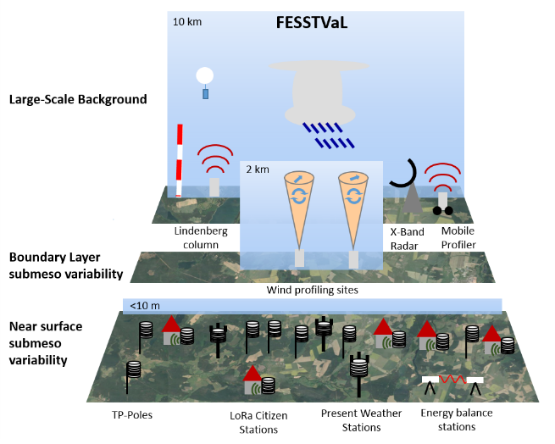
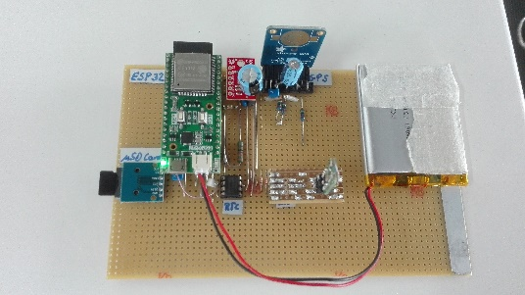
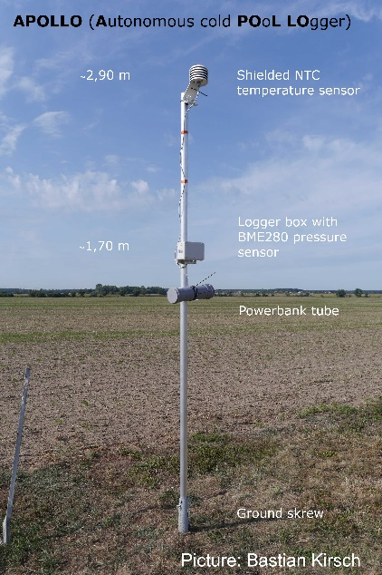
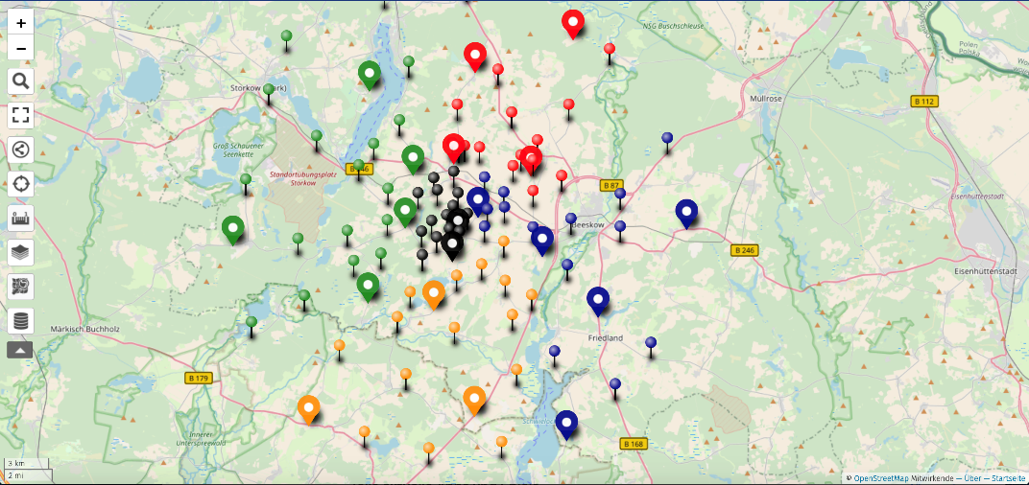
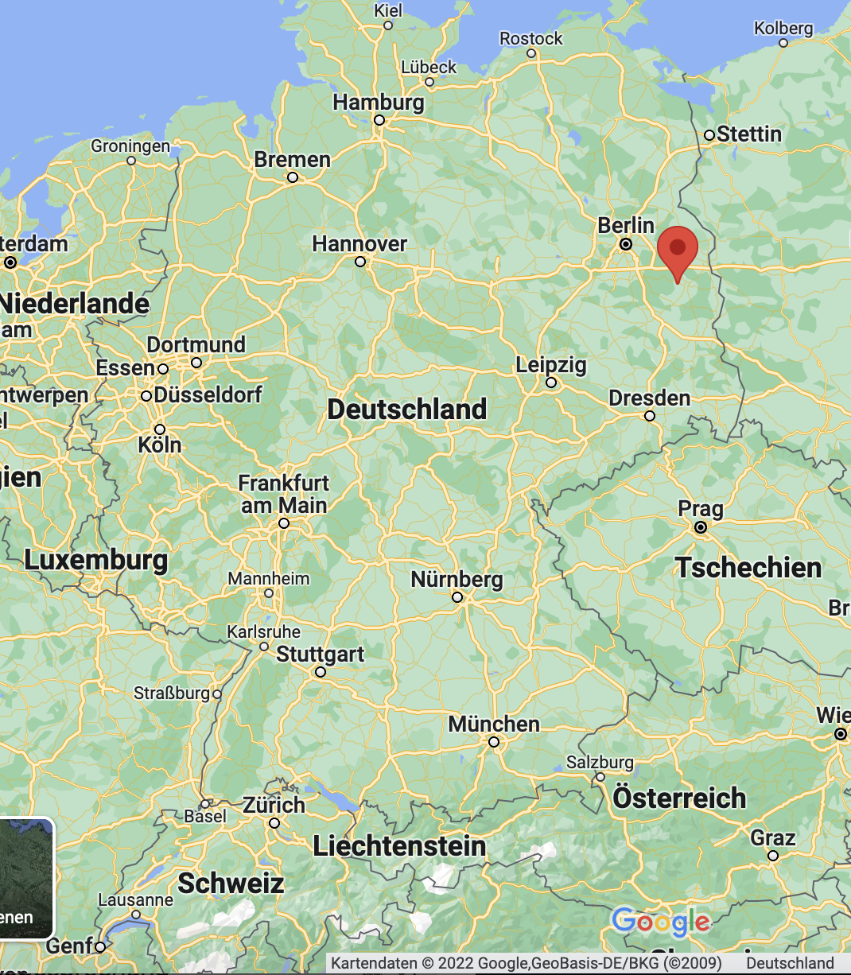
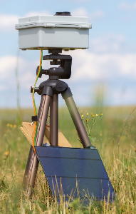
TP-pole: temperature and pressure (University Hamburg)
Measurements distributed in space
+ vertical profiling
+ UAS (unmanned aerial systems), University Tübingen
APOLLO
BME280
GPS
PT1000
Cheap radiation sensors
(University Wageningen)

Slide 8
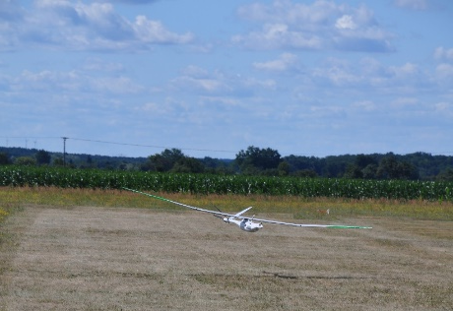
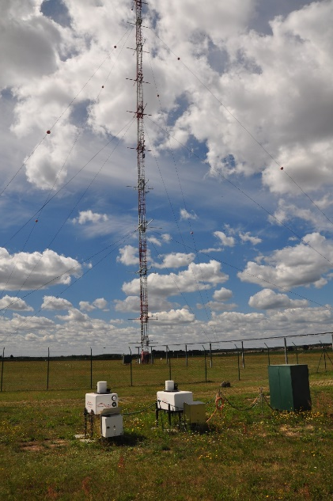
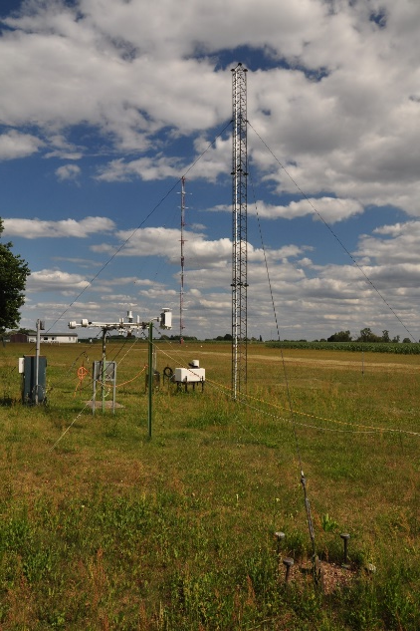
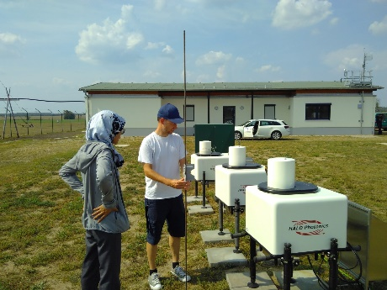
Impressions

Slide 9

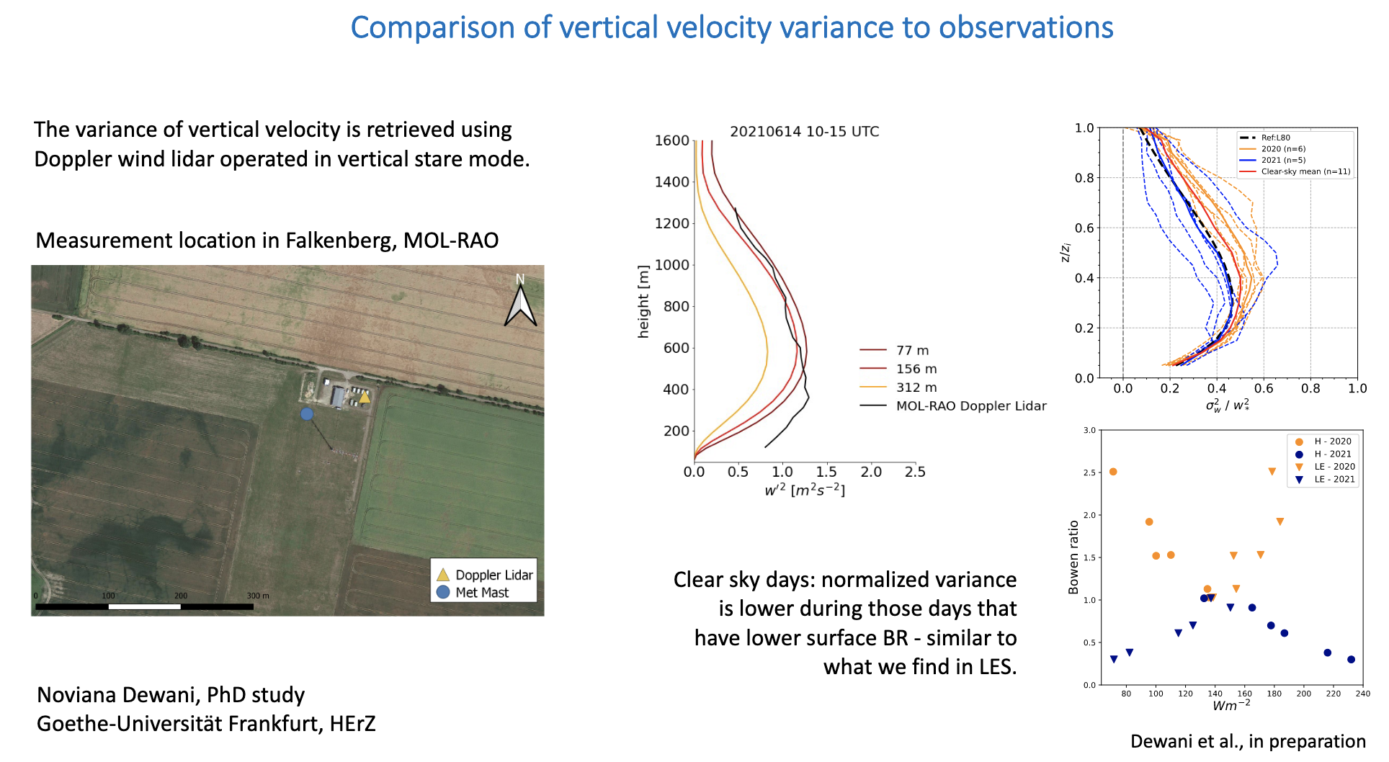
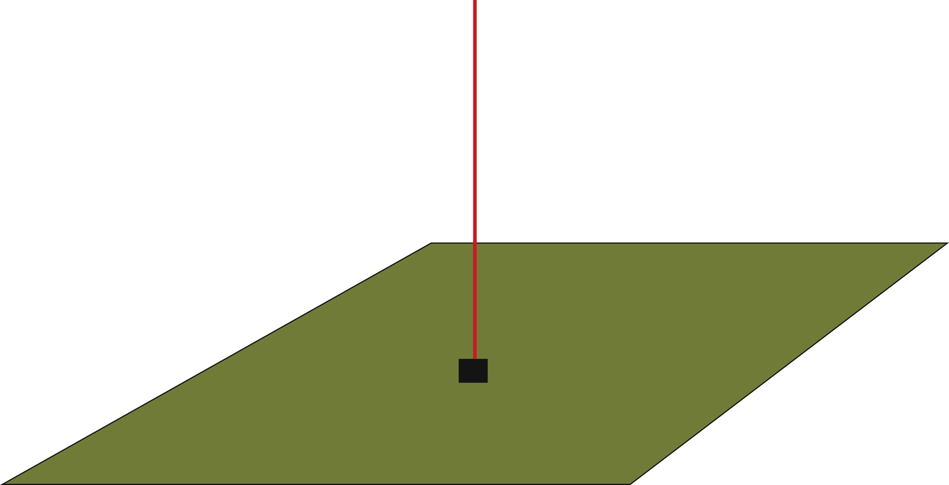
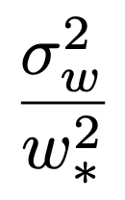
Boundary Layer Turbulence
measure w
derive w’, w’², w’³,…
Measure of turbulence intensity
Dewani et al, 2023
Notes:
\frac{\sigma_w^2}{w_{\ast}^2}
Convective velocity scale

Slide 10
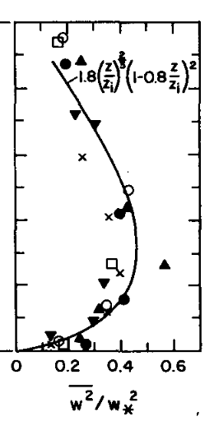
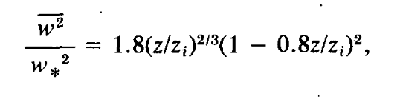
Boundary Layer Turbulence
Lenschow, D. H., Wyngaard, J. C., & Pennell, W. T. (1980).
Dewani et al, 2023

Slide 11
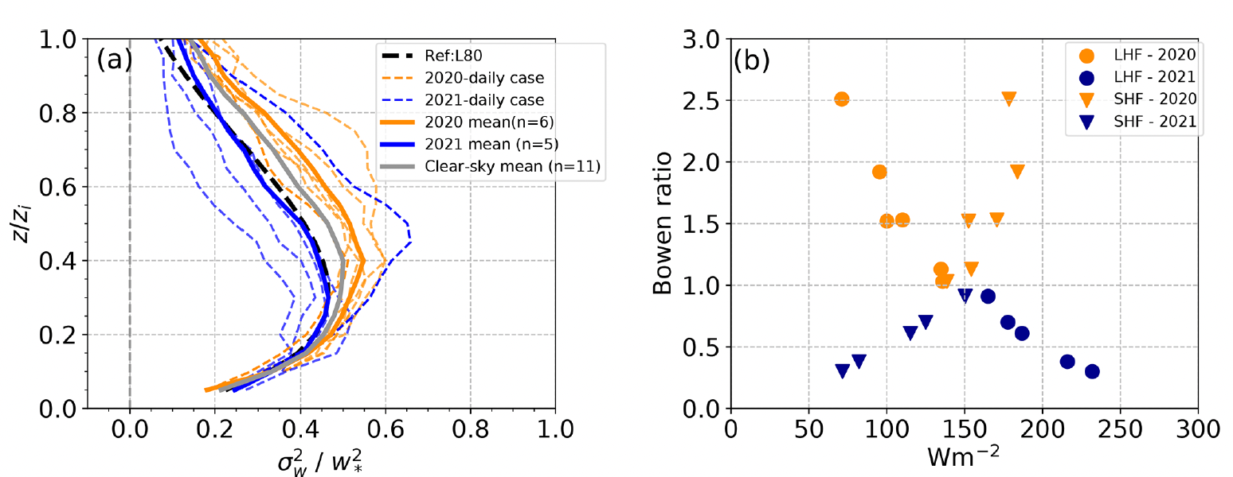
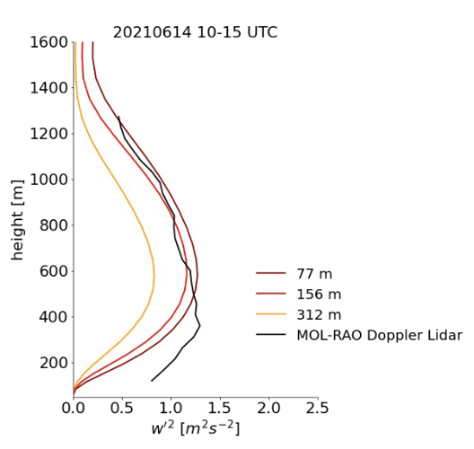
Boundary Layer Turbulence
Clear-sky days
This suggests that moisture content and moisture transport are limiting
factors for the intensity of turbulence in the convective boundary layer
Lenschow, D. H., Wyngaard, J. C., & Pennell, W. T. (1980).
Dewani et al., 2023

Slide 12
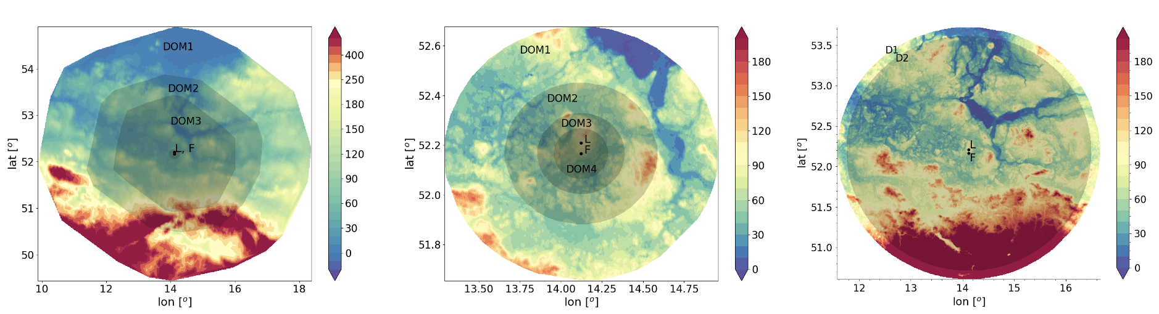
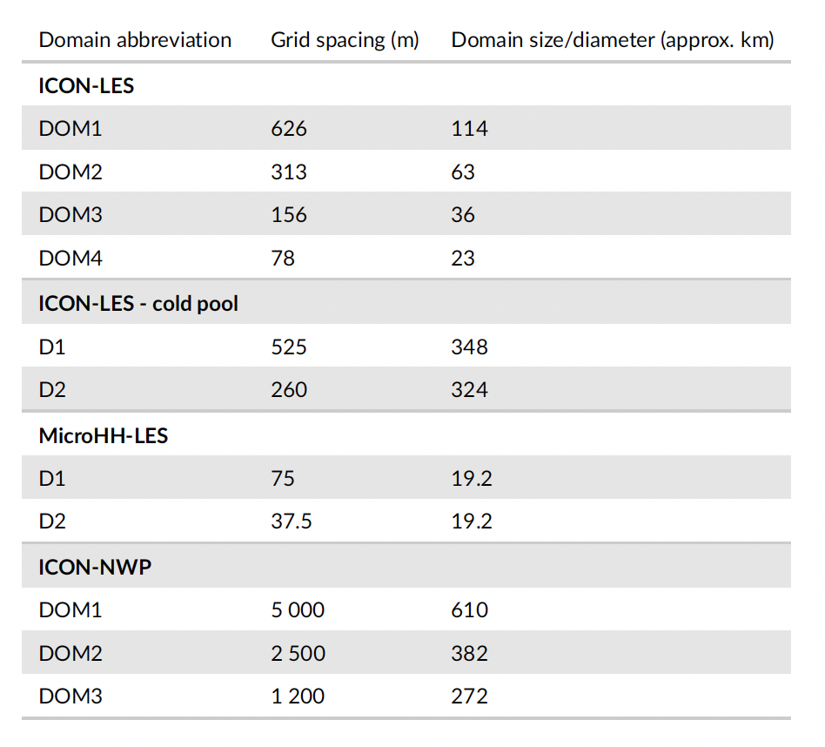
Comparison model ↔︎ observations
ICON-nwp
ICON-LES
Sakradzija et al., 2025, submitted

Slide 13
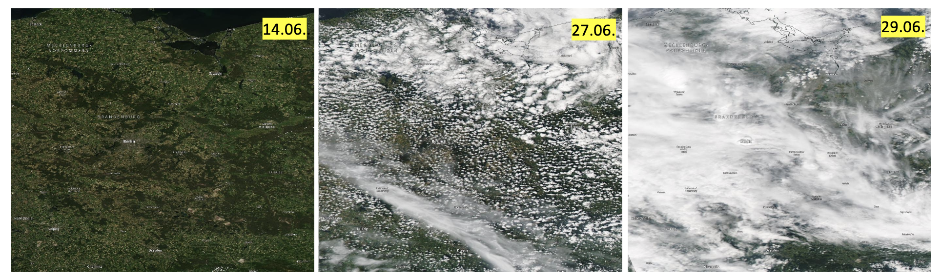
Comparison model ↔︎ observations
clear sky
shallow convection
deep convection

Slide 14
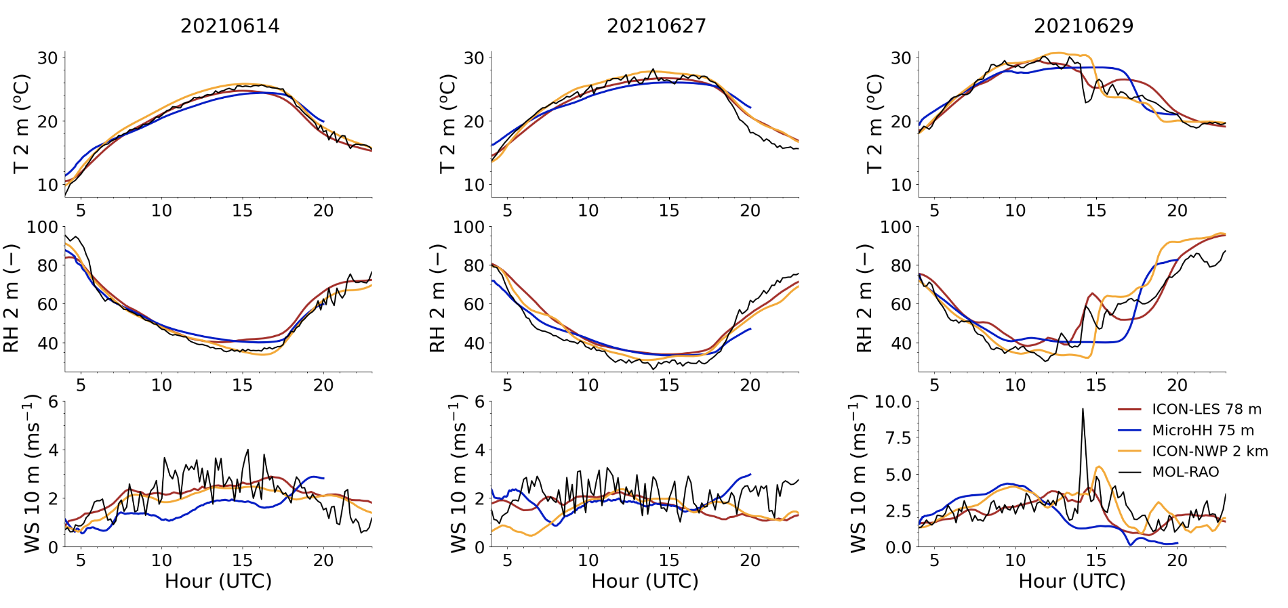
Near-surface quantities fit well with observations
Sakradzija et al., 2025, submitted

Slide 15
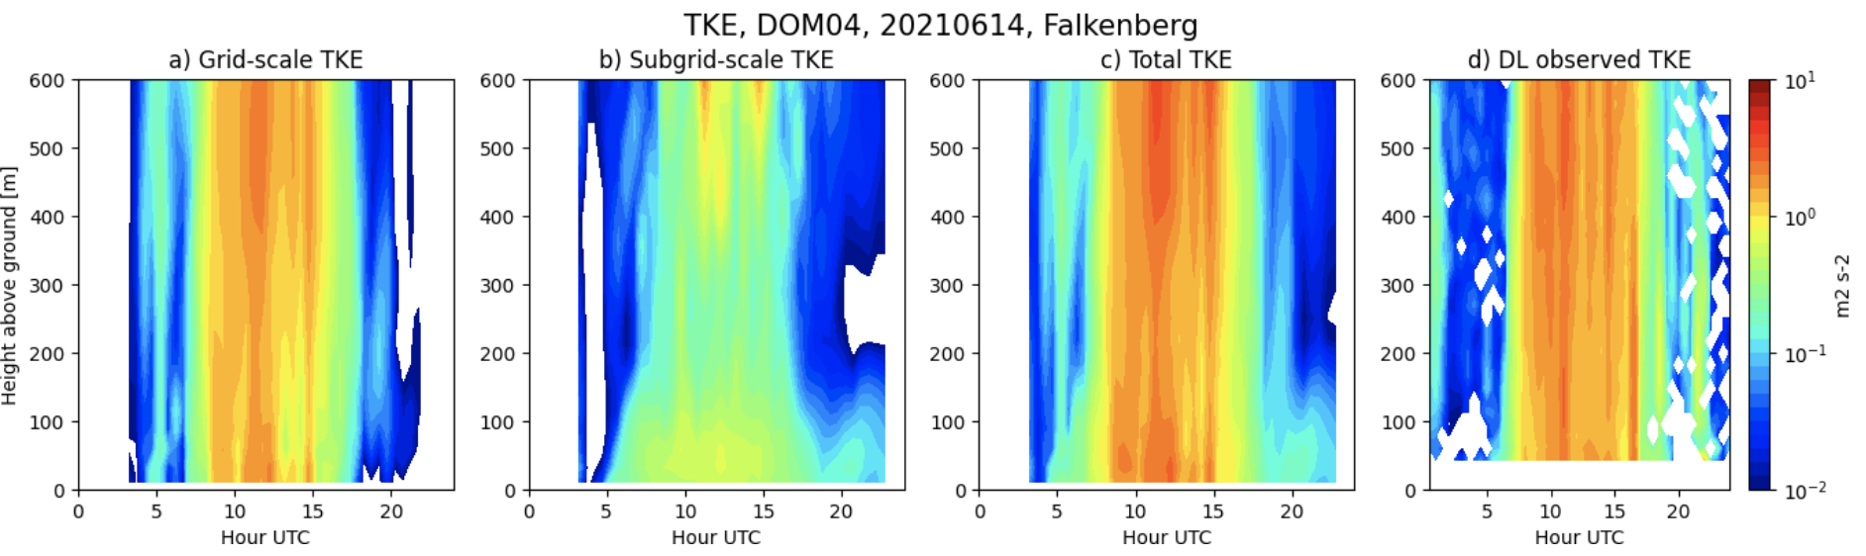
TKE: model ↔︎ observations
(Domain 04 ∆x=78 m )
TKE: turbulent kinetic energy
Sakradzija et al., 2025, submitted
At ∆x=78 m still a lot of TKE at the sub-grid scale
TKE well approximated during the daytime

Slide 16
Outline
Ground-based remote sensing
  FESSTVaL
  TEAMx - PIANO
Crowd-sourced observations
Satellite-based evaluations

Slide 17

2. Experimental Setup around the Measurement Campaign PIANO cold air pool case, October 2017

Slide 18
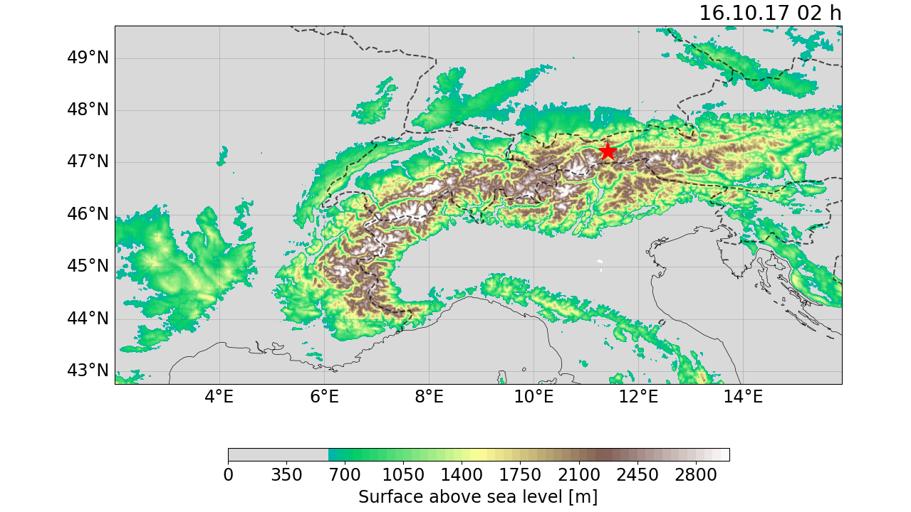
Experimental Setup around the Measurement Campaign PIANO
∆x
2 km
1 km
500 m
250 m
Station site

Slide 19
Model Setup of ICON-LAM*
Physics Configuration
Orography | Orographic gravity wave drag
Mircrophysics | Two-moment
Turbulence | TKE closure (/ Smagorinsky)
Sfc Transfer | TKE-STC (/ Louis)
Convection | Shallow convection
Model top | 22 km
Vertical level | 65 full (66 half)
Hor. grid scale | 2 km, 1 km, 500 m, 250m
1.
2.
3.
4.
LATBC (at start) | Forecast (IFS)
5.
Forecast restart | 0 h
Duration | 36 h
6.
7.
1-way-Nesting
Model version icon-2024.10
Land Surface | TERRA
Lott an Miller (1997)
Seifert and Beheng (2006)
Mellor and Yamada (1982), and Raschendorfer (2001)
Smagorinsky (1963), Lilly (1962), and Dipankhar (2015)
Louis (1979)
Tiedke (1989), and Bechthold et al. (2008)
Schrodin and Heise (2001), and Schulz et al. (2016)
* Limited Area Mode (LAM)
Notes:
RUC: SINFONY heavy convective cases

Slide 20
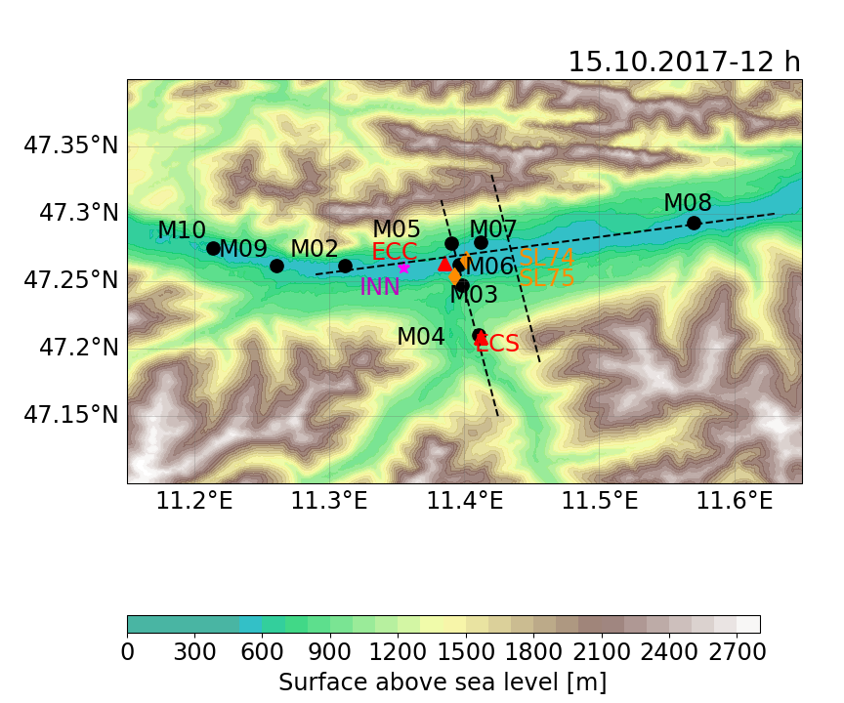
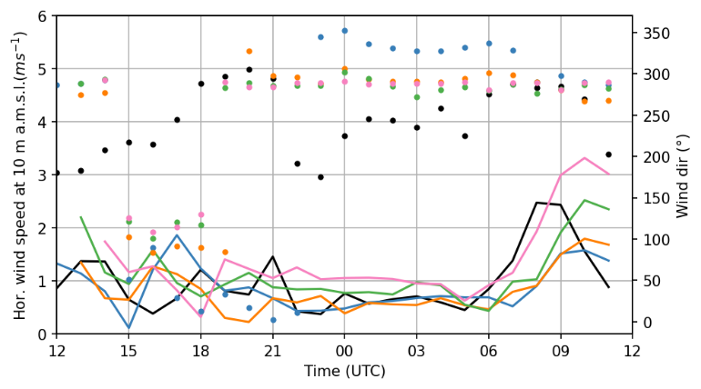
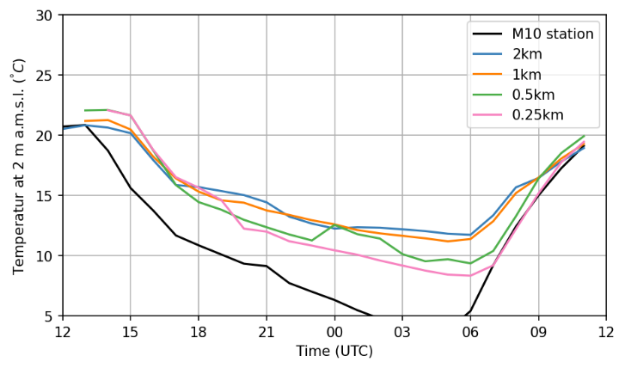
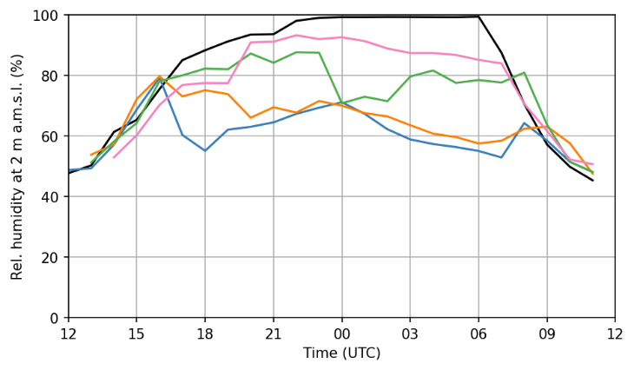
M10 - Westside
Figure: Temporal evolution of 10 m horizontal wind speed (left), 2 m temperature (middle), and 2 m relative humidity (right), averaged over the nearest neighbouring grid cell from simulations with horizontal grid spacings of 2 km (blue), 1 km (yellow), 0.5 km (green), 0.25 km (rosa), and observations from the Weather station M10 (black) for the night between 15.10.2017, 12 h and 16.10.2017, 12 h.
Notes:
Temporal evolution … for M10
right: map of inn valley with highlightes station
Besides the good agreement of wind speed → strong bias in temperature
0.25 m in better agreement with observation

Slide 21
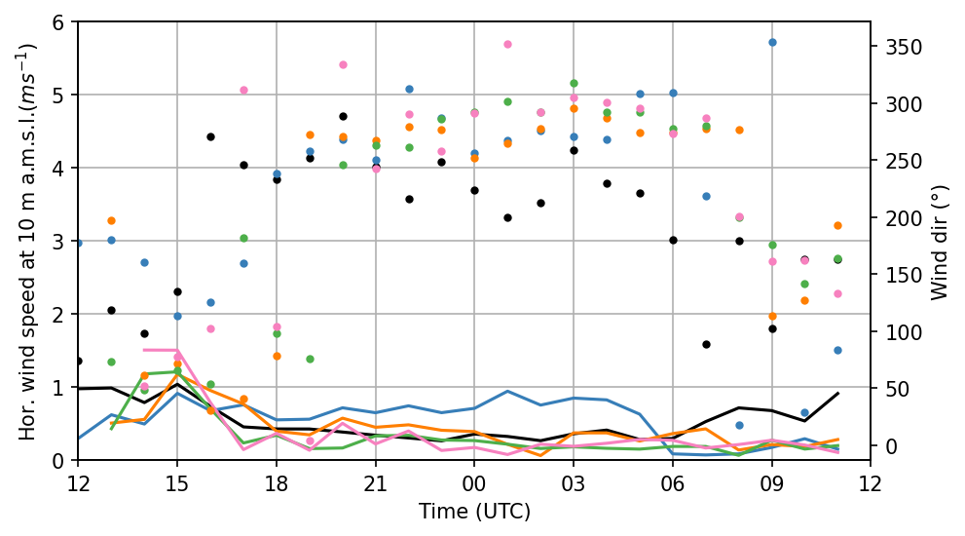
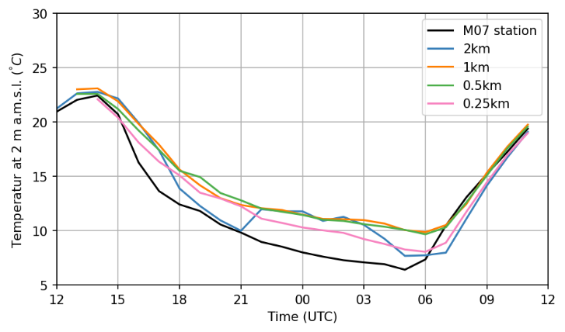
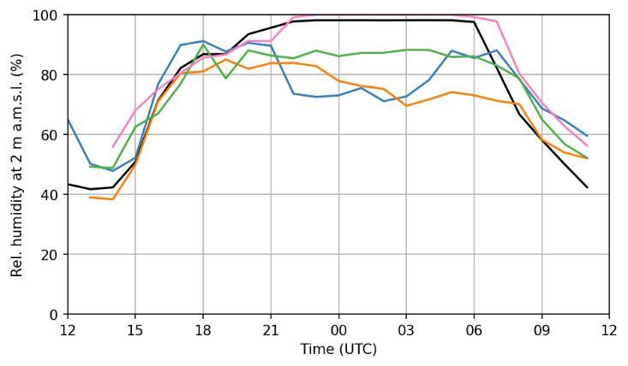
M07- Mid-Section
Wind speed and dir.
T 2m
RH 2m
Figure: Temporal evolution of 10 m horizontal wind speed (left), 2 m temperature (middle), and 2 m relative humidity (right), averaged over the nearest neighbouring grid cell from simulations with horizontal grid spacings of 2 km (blue), 1 km (yellow), 0.5 km (green), 0.25 km (rosa), and observations from the Weather station M07 (black) for the night between 15.10.2017, 12 h and 16.10.2017, 12 h.

Slide 22
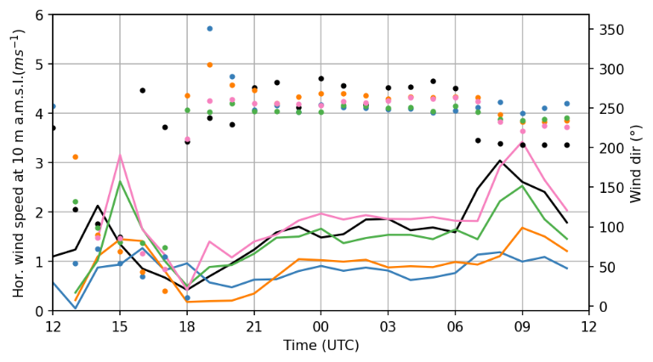
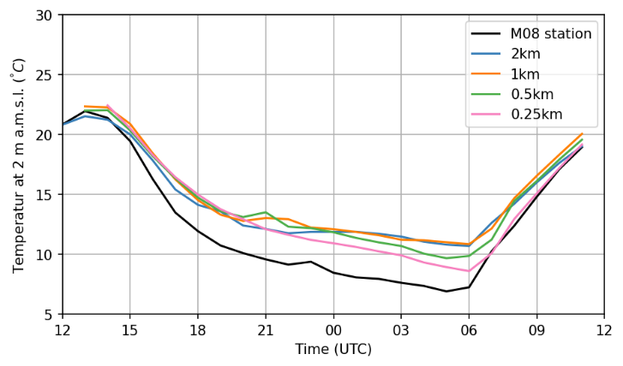
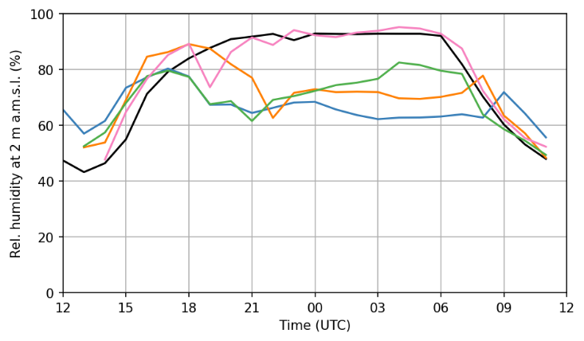
M08 - Eastside
Figure: Temporal evolution of 10 m horizontal wind speed (left), 2 m temperature (middle), and 2 m relative humidity (right), averaged over the nearest neighbouring grid cell from simulations with horizontal grid spacings of 2 km (blue), 1 km (yellow), 0.5 km (green), 0.25 km (rosa), and observations from the Weather station M08 (black) for the night between 15.10.2017, 12 h and 16.10.2017, 12 h.

Slide 23
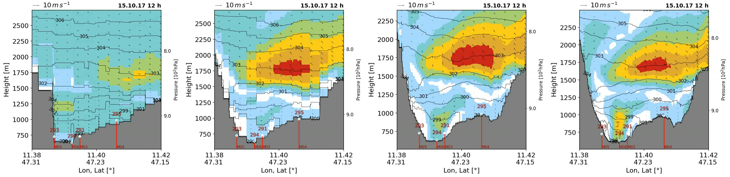

Wind circulation at higher resolution
∆x = 2 km
∆x = 1 km
∆x = 0.5 km
∆x = 0.25 km
Besides having stronger winds in the afternoon, the impact on the temperature at 2 m is low in the simulations
Figures: Vertical cross sections in the Inn Valley for horizontal grid scales of 2 km, 1 km, 500 m, and 250 m (left to right). Contours represent the averaged horizontal wind speed, arrows indicate the wind direction, contour lines show the potential temperature for a cold air pool case during the night of 15.-16. October 2017. Measurements are marked as lines (red). A strong jet is resolved by higher resolutions
Notes:
Highlight here: inflowing southern wind circulation at higher resolution has a rather low impact on the cold-air pool development
location of valley and indicated cross secetion (dashed)
to better understand the model physics perfoming different weather events, but also to compare to others
Cold Air Pool in the fall of 2017: Weak synoptic southwesterly winds

Slide 24
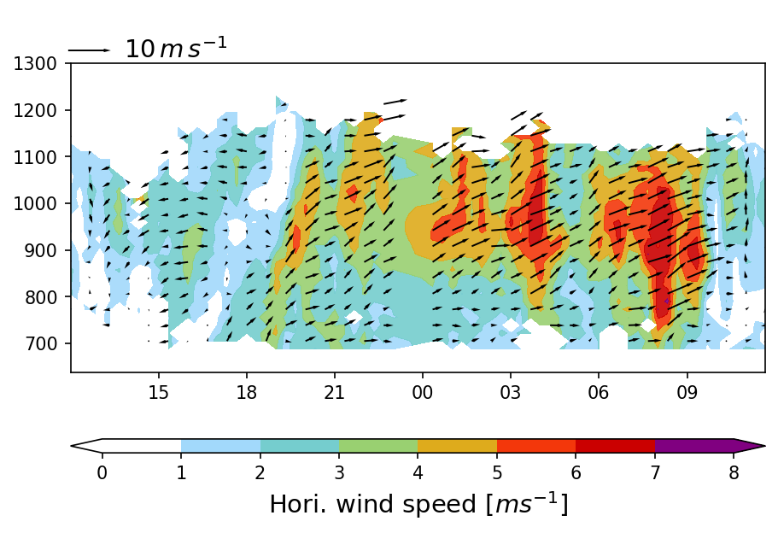
Observed wind speed
Figure: Temporal evolution of horizontal wind speed (contour) and wind direction (arrows) from LIDAR observation.
Notes:
Turning wind speed in the afternoon, flow from east to west
Starting from early night: low wind speed flow from west to east near the surface with stronger circulatins in the upper boundary layer during the early morning
- Caption: Pfeilrichtung

Slide 25
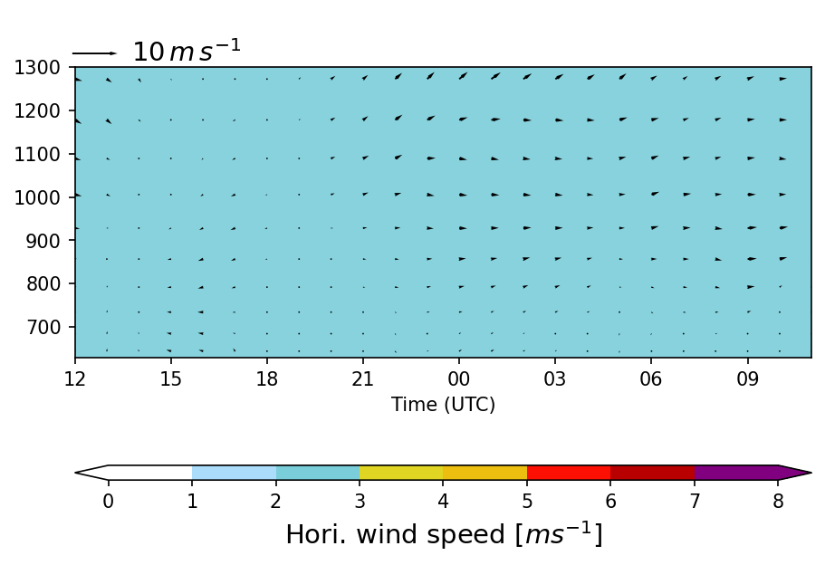

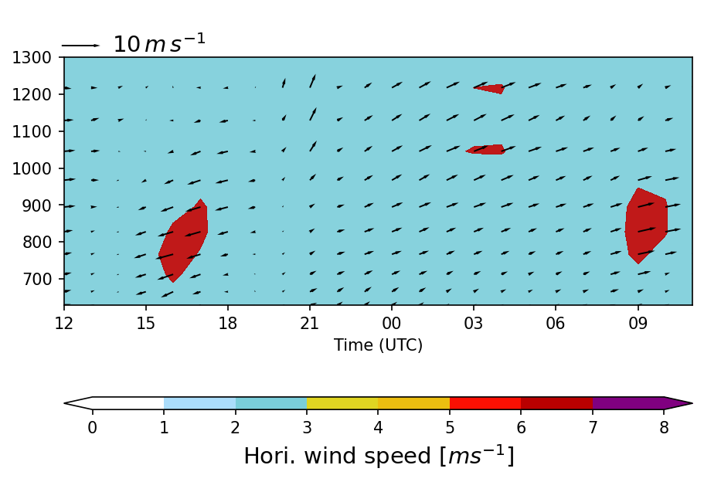
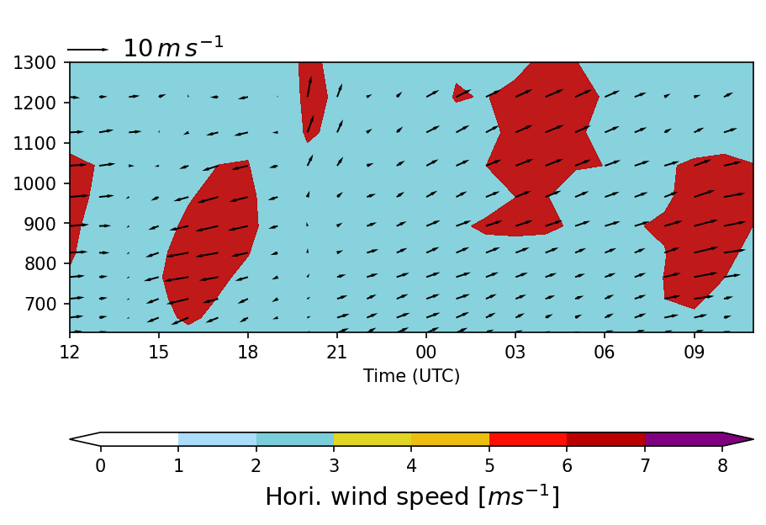
Simulated temporal wind speed
∆x = 2 km
∆x = 1 km
Changing wind direction a bit delated
Observed circulation pattern reproduced at high resolution
∆x = 0.5 km
∆x = 0.25 km
Notes:
All models are capable to reproduce the changing direction of wind speed, even if a bit delated
More circulation with increasing resolution
In high resolution results → circulation overstimated in the afternoon, but in good agreement in the morning

Slide 26
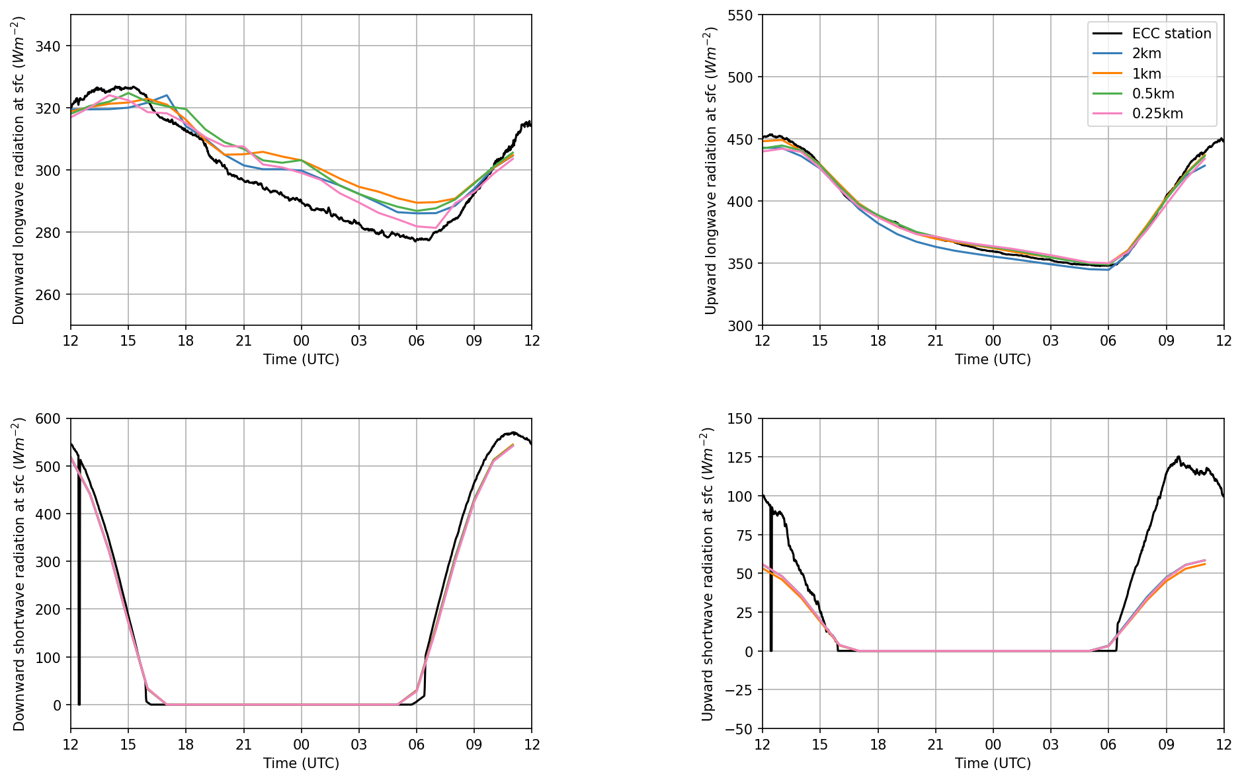
Radiation
Longwave ↓
Longwave ↑
Figure: Temporal evolution of downward longwave radiation (left top), upward longwave radiation (right top), downward shortwave radiation (left bellow), and upward shortwave radiation (right below) from simulations with different horizontal grid scales (colored) and observation (black).
Temperature bias near the surface is
impacted by bias in the radiation
→ entire valley atmosphere too warm
Shortwave ↓
Shortwave ↑

Slide 27
Outline
Ground-based remote sensing
  FESSTVaL
  TEAMx - PIANO
Crowd-sourced observations
Satellite-based evaluations

Slide 28

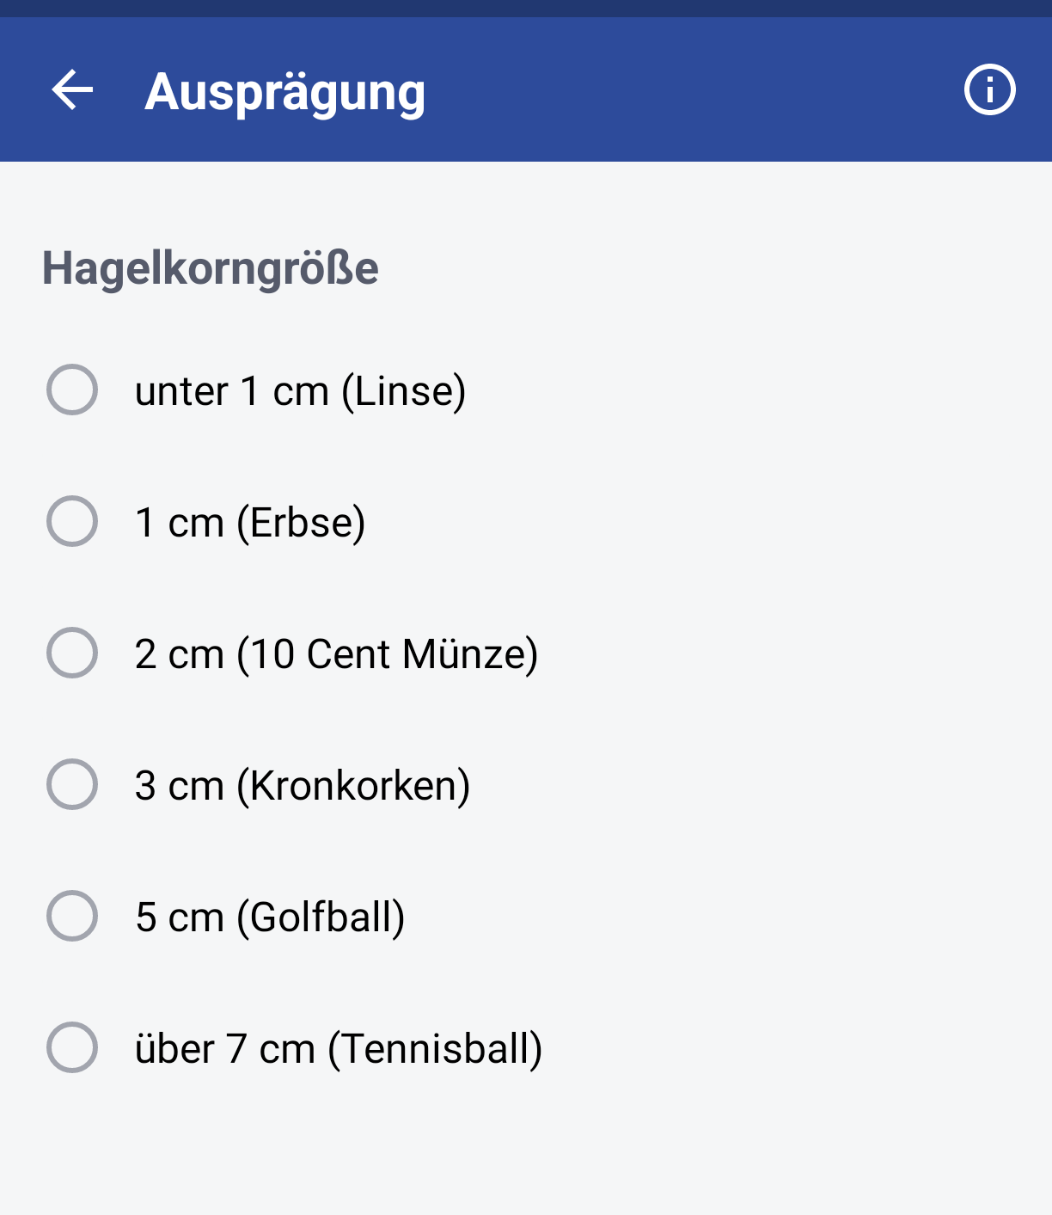
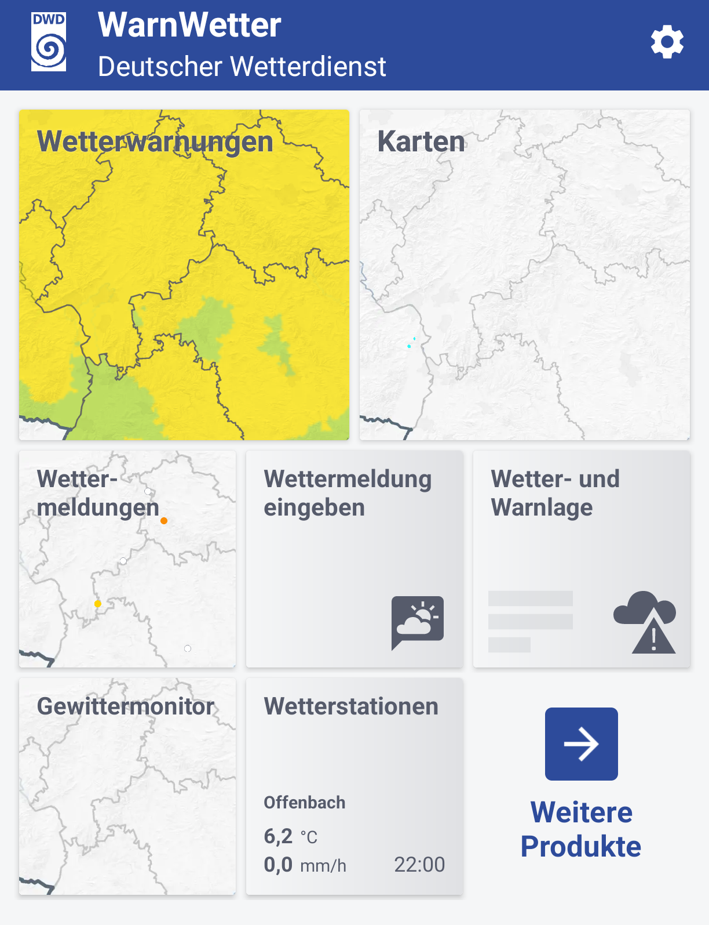
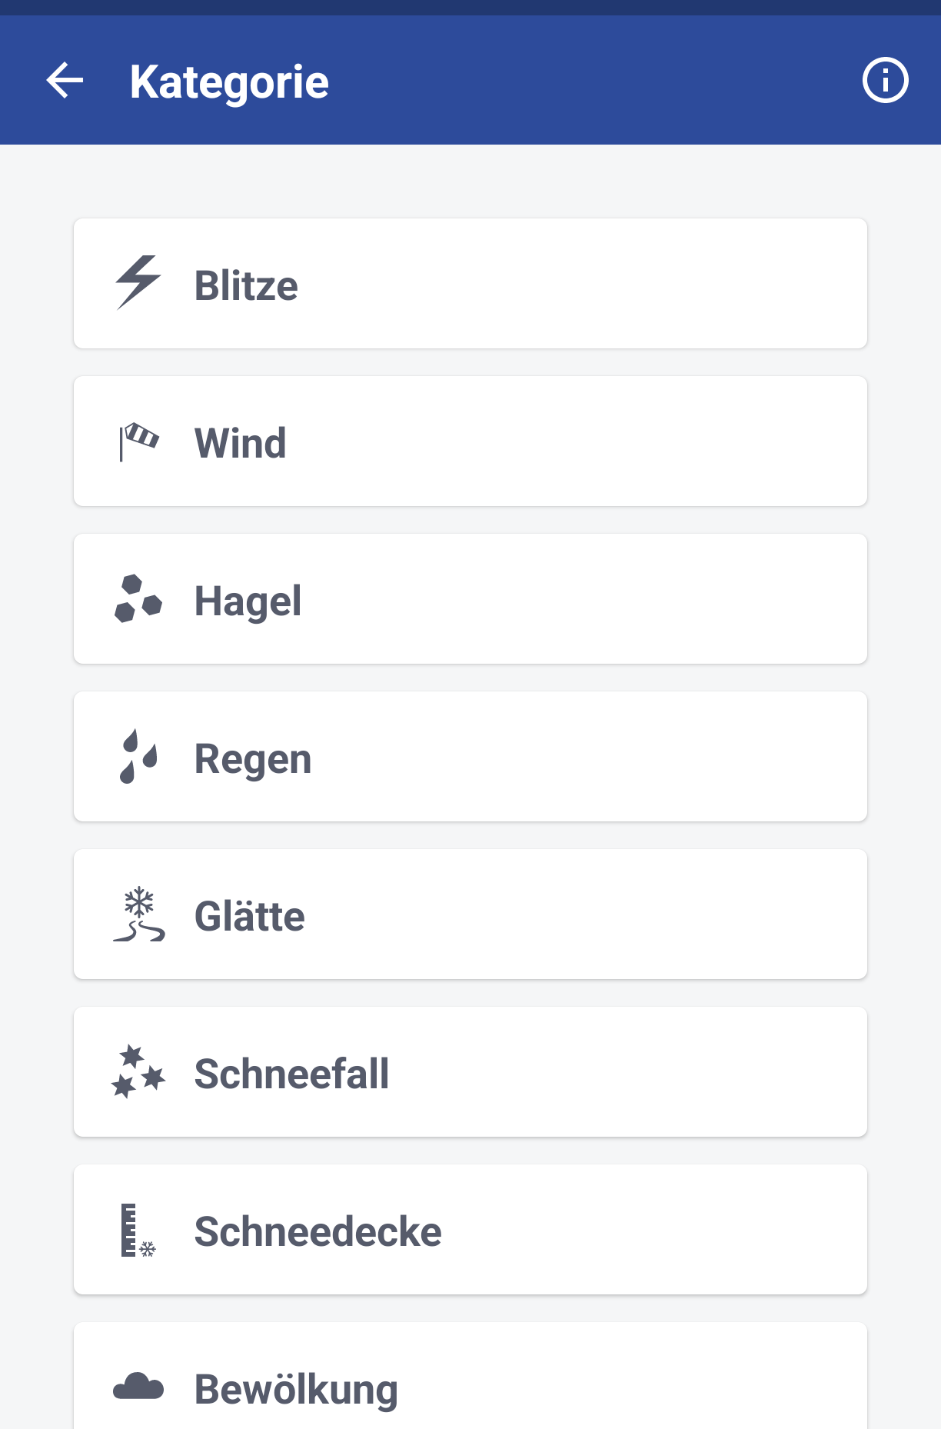
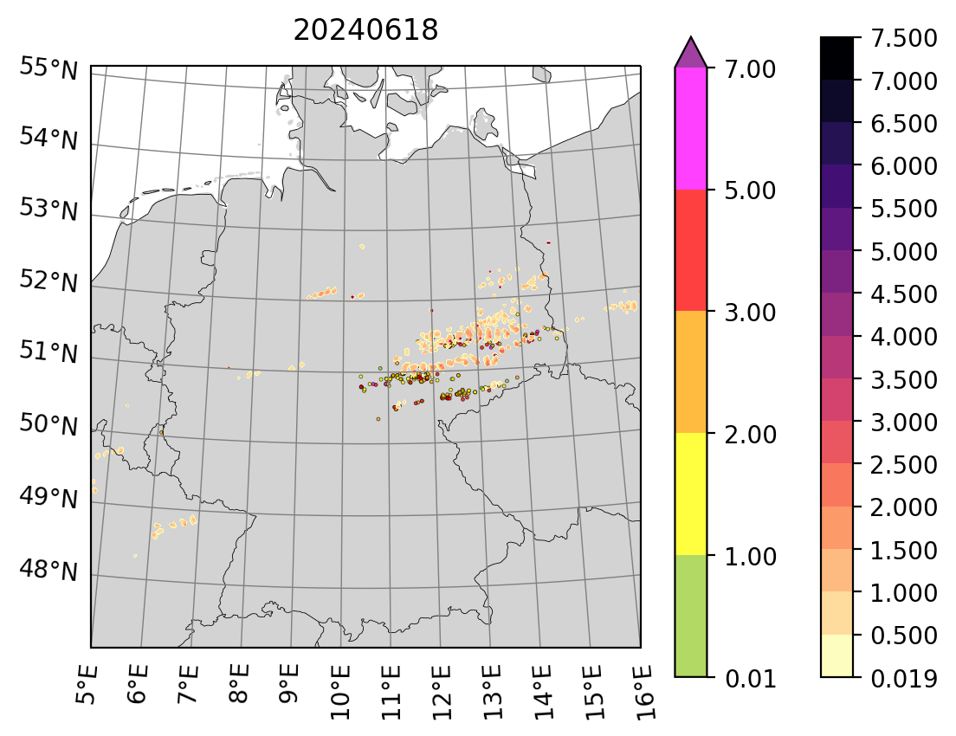
Making use of hail reports - hail size
reported
Model derived
lentil
pea
10 cent coin
bottle cap
golf ball
tennis ball
Sophie Löbel, Alberto de Lozar, Uli Blahak

Slide 29
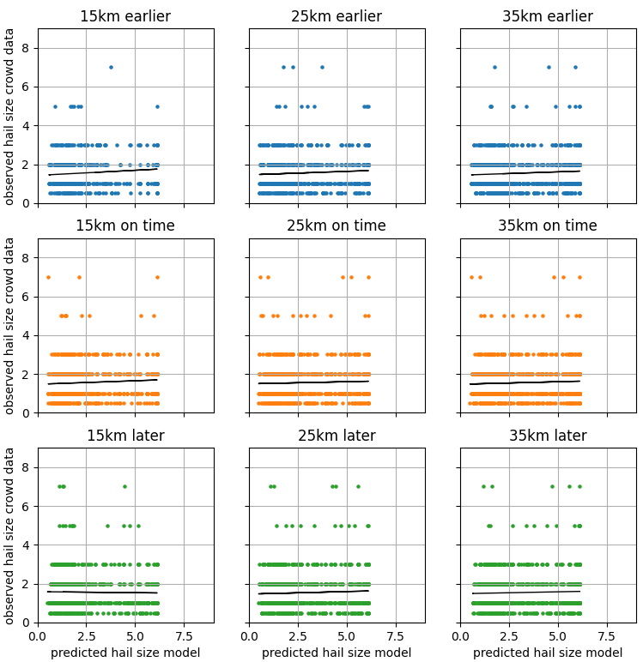
Making use of hail reports - hail size
For the specific case of hail size reports:
The location can be used as a guide to judge if the model produced hail at the right place
The quantitative comparison of reported and predicted hail size is difficult, probably due to a non-standardized reporting procedure
Changed maximum value for median diameter for hail in the parametri-zation as a result
Next step: add information from radar
Sophie Löbel, Alberto de Lozar, Uli Blahak

Slide 30
Outline
Ground-based remote sensing
  FESSTVaL
  TEAMx - PIANO
Crowd-sourced observations
Satellite-based evaluations

Slide 31
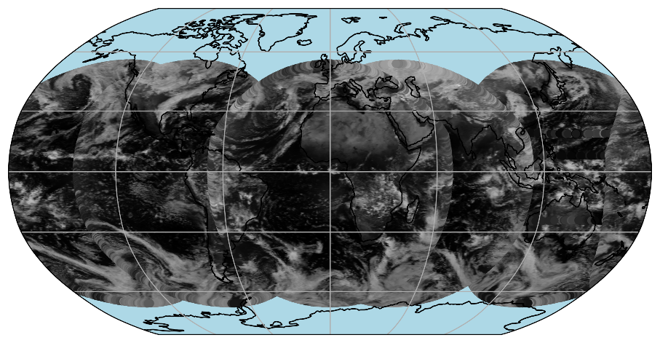
Intercomparison setup - observations
ABI, SEVIRI and AHI 0.6µm reflectances 15 January 2024 (21,18,12,9,3 UTC )
Visible reflectances from 0.6µm channel
  SEVIRI: Met-9 & Met-10 (updated calibration; A. Mousivand, Eumetsat)
  AHI: Him-9
  ABI: Goes-16 & Goes-18
Experimental period
  January 2024
  Time resolution: 3-hourly data at 0, 3, 6, … UTC
Observation data processing
  DWD: Observations averaged onto model grid cells (here at 26km resolution)
  ECMWF: Observation superobbing to ~29km resolution
Christina Stumpf, Christina Köpken-Watts, Axel Seifert

Slide 32
Intercomparison setup – Global NWP models ICON & IFS
Similar resolutions: ICON @ 26km, IFS @ 29km
Sub-grid cloud parameterizations
ICON model physics setups:
  1M: 1-mom. scheme – operational
  2Mi: 2-mom. ice scheme with MODIS CDNC
  2Mi, CLC: 2-mom. ice scheme with MODIS CDNC and ad hoc modification of cloud cover over sea by A. Seifert
Effective cloud particle radii:
  ICON: radiation scheme (1M), microphysics (2Mi & 2Mi, CLC) or RTTOV param. (Martin & Wyser)
  IFS: RTTOV param. (Martin & McFarquhar)
Shallow convection over sea
Christina Stumpf, Christina Köpken-Watts, Axel Seifert

Slide 33
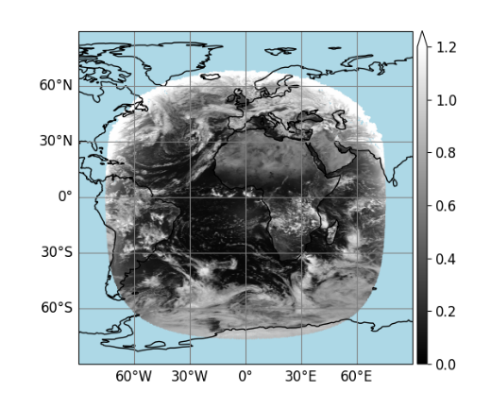

Intercomparison setup – consistent quality control
QC check | Reason for rejection
Sun / sat. zenith angle > 74⁰ | Missing 3D effects in MFASIS-NN Nighttime conditions
Reflectances > 1.63 | Missing 3D effects in MFASIS-NN
Glint angle < 40⁰ | Sun glint sea surfaces
Model orography > 1500m | Misinterpretation of snow as clouds
DWD: BRDF atlas flags 3-6 ECMWF: Snow inconsistency in BRDF & IFS | Bad BRDF quality and snow in BRDF climatology
Sea ice & heterogeneous surfaces | BRDF in RTTOV / MFASIS-NN
Met-10 SEVIRI 0.6µm
(15 Jan. 2024, 12 UTC)
QC
Christina Stumpf, Christina Köpken-Watts, Axel Seifert

Slide 34


RTTOV-DOM used for reference calculations and NN training data generation,
No aerosols but clear-sky Rayleigh scatt. And molecular abs. taken into account
More ‘standard’ channels as 0.6um can live with less input variables (even further simplified vertical profiles), others (0.9um) probably need more input variables (more detailes on wv profiles)
Fast and memory-efficient forward operator for visible satellite image simulation
  suited for data assimilation and model evalutation
  Available in RTTOV since v13.2
  channels with negligible water-vapour sensitivity -> further developments in RTTOV-14.0 and following
Based on relatively small feed-forward neural network
  A few input parameters for describing atmospheric model profile and viewing geometry
Training data set: RTTOV-DOM reflectances of ~ few 10⁷ synthetic profiles (random numbers covering physical range as input variables, normalized)
NN training with open-source Tensorflow package
4000 training epochs with early stopping
Activation functions: CSU (hidden layers), softplus (output layer)
Intercomparison setup – Radiative Transfer
MFASIS-NN in RTTOV-13.2: Fast RT model for visible satellite images
  NN-based approach with limited set of input parameters per atmospheric model column
  Trained on RTTOV-DOM (radiative transfer DISORT, 1 dim.)
RTTOV / MFASIS-NN
Profile simplification
NN inference
8 hidden layers perform well,
Have tested 15, 25, 32 nodes per layer, 15 & 25 nodes seem to work well
NWP model profiles
…
R₀
R(A) =
f(R₀, ΔR_{0.5}, ΔR₁)
ΔR_{0.5}
ΔR₁
Jonkheid et al. 2012 (ACP)
8 hidden layers with 15 or 25 nodes (channel-specific)
Refs.: Scheck 2021 (JQSRT), Baur et al. 2023 (AMT), RTTOV-14 Science and Validation Report
BRDF land atlas: based on Jan. 2024 MODIS collection 6 data (J. Vidot)
Training data do not depend on any NWP model, but have used NWP-SAF profile set (IFS) to derive profile simplification -> do not expect that this affects cloud simulations for other NWP models (sufficient range)
Early stopping: only store weights and biases that improve the NN, stop early if necessary (then have trained less than 4000 epochs)
Christina Stumpf, Christina Köpken-Watts, Axel Seifert
1.6um channel more challenging:
Abs. in ice stronger than in water, larger errors for mixed-phase clouds in previous LUT version
Abs. due to CO2, CH4, wv: Air mass between cloud and satellite has stronger effect on reflectance than in vis channels
Vertical variation of effective particle radii from different cloud layers: uppermost cloud layers contribute mainly with single-scattering events (scattering angle dependence of reflectance), below these layers within the cloud multi-scattering processes dominate (angle-averaged reflectance)
CSU act function: similar to ELU (exponential linear unit) without computationally expensive exp function
Softplus act function guarantees positive output values
First study: Replace LUT by NN
for 0.6µm (no additional inputs)
→ Scheck 2021 (JQSRT)
Second study: Use additional
input variables for 1.6µm NIR
→ Baur et al. 2023 (AMT, published, add ref.),
implemented in RTTOV 13.2 (mostly)
Training data set: RTTOV-DOM reflectances of ~ few 10⁷ synthetic profiles (random numbers covering physical range as input variables, normalized)
NN training with open-source Tensorflow package
4000 training epochs with early stopping
Activation functions: CSU (hidden layers), softplus (output layer)

Slide 35






New plots: Obs vs 1M (SEVIRI, comparison IFS), then add Reff params to plot, then add 2Mi, CLC setup to plots
Next slide: Show ICON results Met-10 and Goes-16
Refl. histograms for SEVIRI: ICON vs. IFS
IFS: Colors misleading, black is simulation
ICON: too much thin clouds over sea in comparison to IFS, this is known issue, but for our current forecast mode over Europe and without coupled ocean-atmosphere not an issue
Future: with coupled ocean-atm. System and global sat. DA (vis, but also other channels) this may be a problem
Cloud cover scheme modifications: from first sensitivity study only, and only over sea; largely improves agreement of refl histograms
Full disk
Land surfaces
Sea surfaces
Overall structure of refl. histograms reproduced in sim.
Main difference: Peak at low reflectances due to too many thin model clouds in ICON (mainly oceans)
ICON
IFS
Christina Stumpf, Christina Köpken-Watts, Axel Seifert

Slide 36



New plots: Obs vs 1M (SEVIRI, comparison IFS), then add Reff params to plot, then add 2Mi, CLC setup to plots
Next slide: Show ICON results Met-10 and Goes-16
Refl. histograms for SEVIRI: ICON vs. IFS
Full disk
Land surfaces
Sea surfaces
Overall structure of refl. histograms reproduced in sim.
Main difference: Peak at low reflectances due to too many thin model clouds in ICON (mainly oceans)
ICON
Little dependence on diff. radius param.s
IFS
Christina Stumpf, Christina Köpken-Watts, Axel Seifert

Slide 37


New plots: Obs vs 1M (SEVIRI, comparison IFS), then add Reff params to plot, then add 2Mi, CLC setup to plots
Next slide: Show ICON results Met-10 and Goes-16
Refl. histograms for SEVIRI: ICON vs. IFS
Full disk
Land surfaces
Sea surfaces
Overall structure of refl. histograms reproduced in sim.
Main difference: Peak at low reflectances due to too many thin model clouds in ICON (mainly oceans)
ICON
Little dependence on diff. radius param.s
Cloud cover scheme modifications largely reduce diff.s at low reflectances (ICON)
IFS
Christina Stumpf, Christina Köpken-Watts, Axel Seifert

Slide 38
Summary
(Novel) observations, in addition to standard verification, can help in the development of parametrizations
  Process understanding
  Fine-tuning, callibration
  Identification of missing processes
Each observational data set is different, need to understand how the measurement was taken and processed
Quick availability of data is an advantage – easier to work on recent episodes

