Slide 1
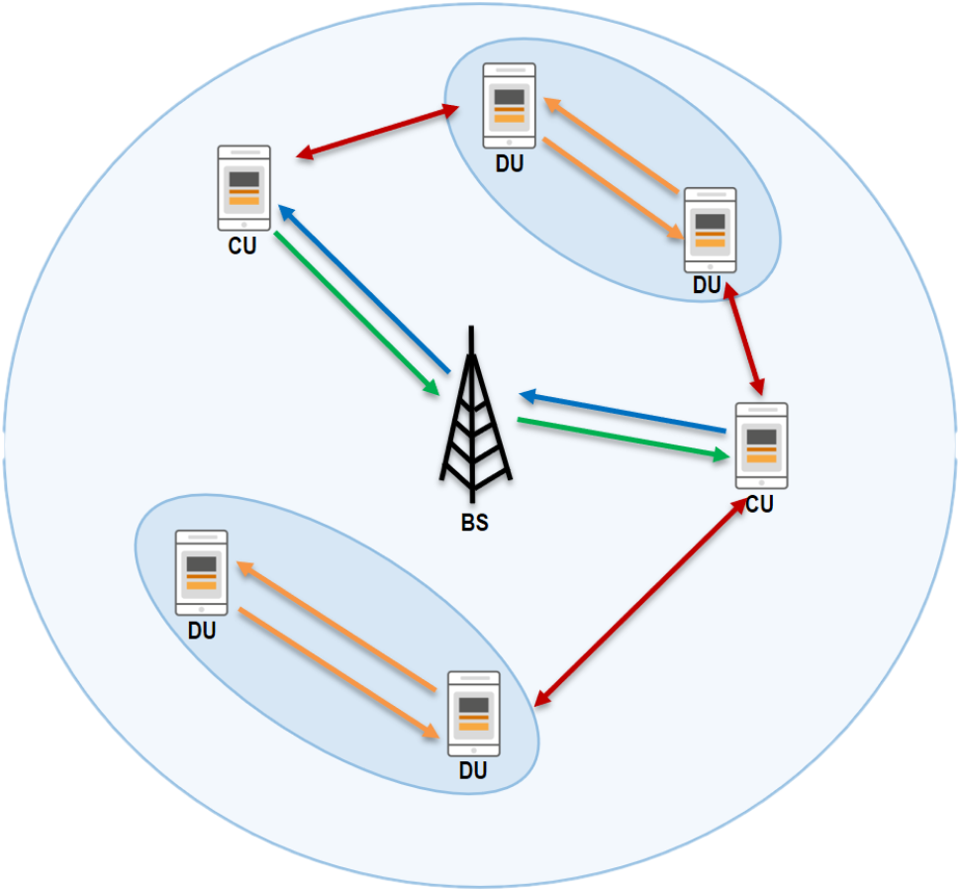
Multi-Agent Reinforcement Learning to achieve reliable wireless communication
Sabrina Pochaba, Peter Dorfinger,
Roland Kwitt, Simon Hirlaender
04/04/2025
RL4AA’25
General Applications of RL

Slide 2

Cellular and D2D communication
DU
Problem:
Reliable Communication without regulation of BS
CU
DU
BS = Base Station
CU = Cellular User
DU = D2D User
Solution:
Multi-Agent Reinforcement Learning
BS
CU
DU
DU
Pochaba et al.

Slide 3


Multi-Agent Reinforcement Learning
  Agent
  Agent
State
  Agent
Action
Reward
  Environment
Pochaba et al.

Slide 4
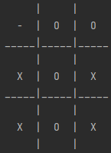
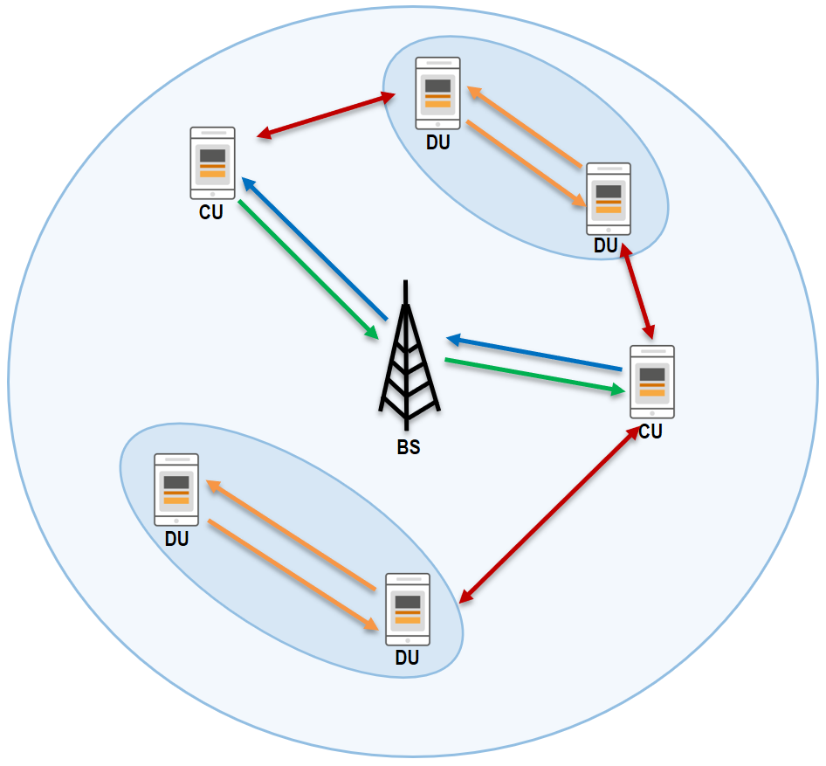
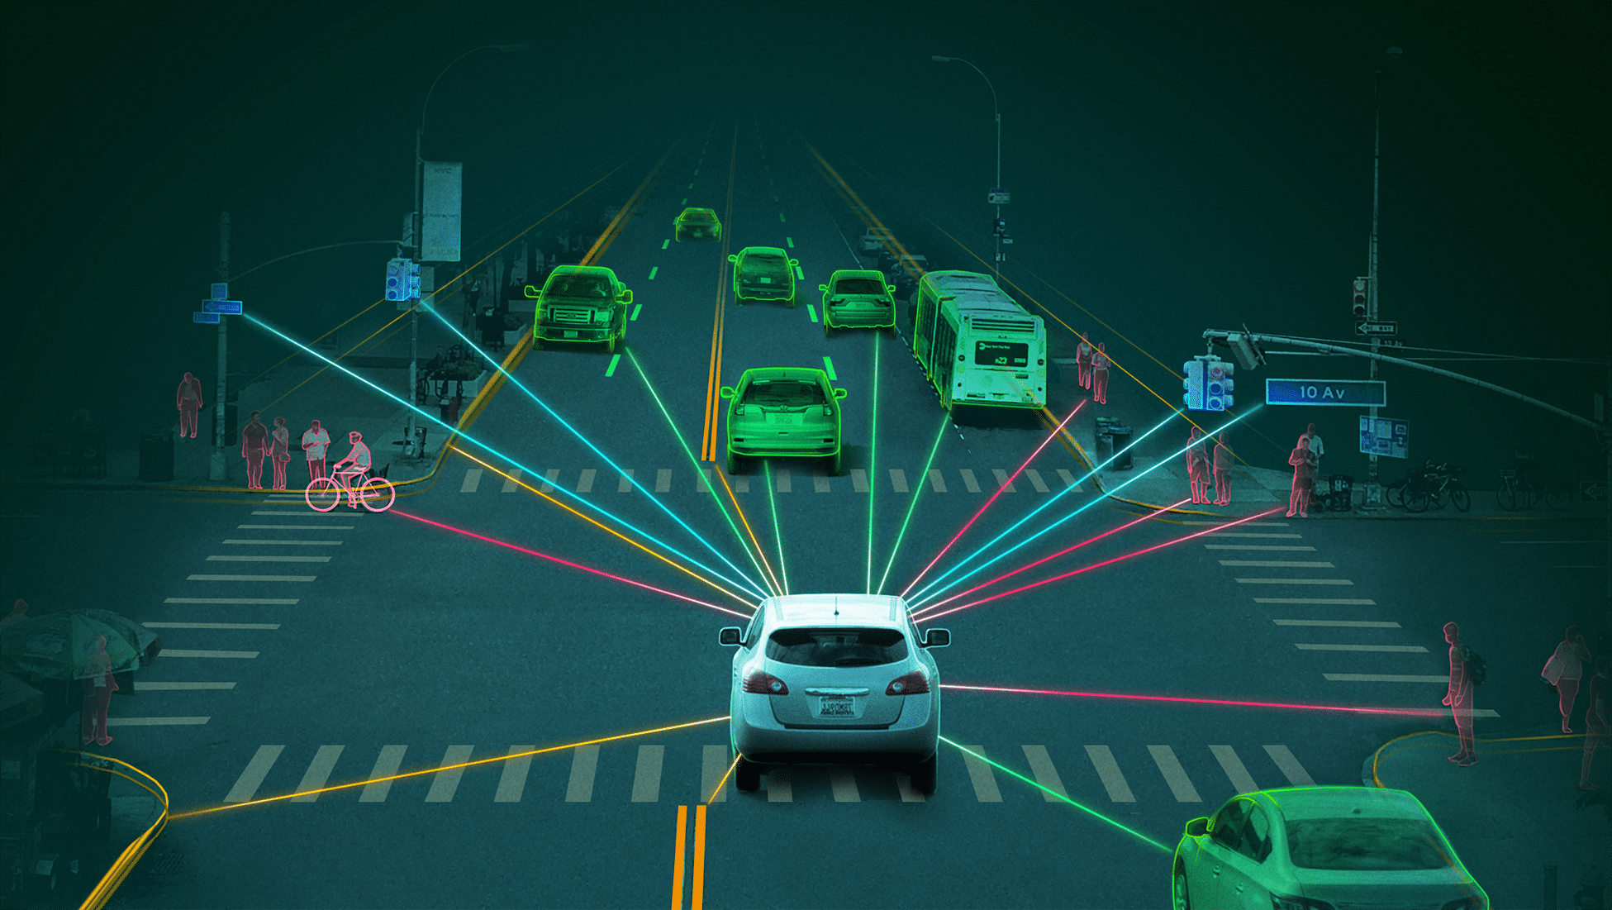

Multi-Agent Reinforcement Learning
Adversarial Games:
Cooperative
Games:
Mixed Games:
https://www.youtube.com/watch?v=kopoLzvh5jY
Pochaba et al.

Slide 5
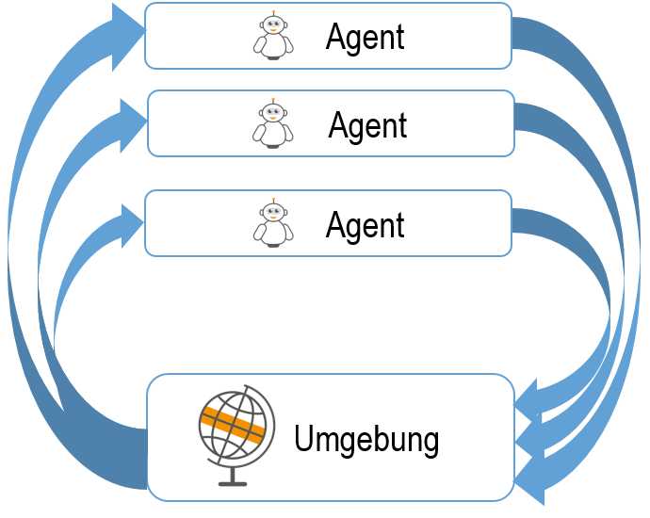


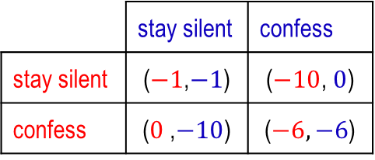
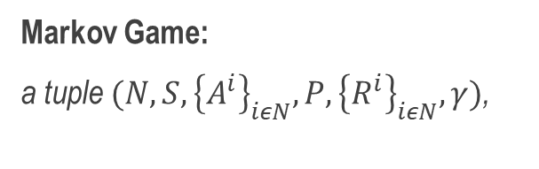
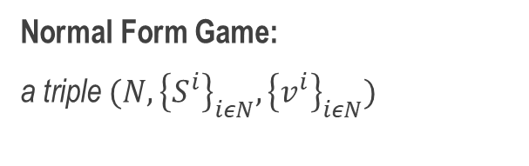
Game Theory
(s,r)
a
Normal Form Game:
a triple $(N, {\left\{S^{i}\right\}}_{iεN}, {\left\{v^{i}\right\}}_{iεN})$
(s,r)
a
(s,r)
a
 | stay silent | confess
stay silent | ($−1$,$−1$) | ($−10$,$0$)
confess | ($0$,$−10$) | ($−6,−6$)
Markov Game:
a tuple $(N, S, {\left\{A^{i}\right\}}_{iεN}, P, {\left\{R^{i}\right\}}_{iεN},γ)$,
Multi-Agent Reinforcement Learning: A Selective Overview of Theories and Algorithms; Kaiqing Zhang, Zhuoran Yang, Tamer Basar; 24.Nov.2019
Pochaba et al.
Notes:
A Markov Game is a tuple $(N, S, {\left\{A^{i}\right\}}_{iεN}, P, {\left\{R^{i}\right\}}_{iεN},γ)$,
$N=\left\{1, …, N\right\}$ set agents,
$S$ state space observed by all agents,
$A^{i}$ action space of agent $i$
$P:S×A→∆(S)$ transition probability from $sεS$ to $s′εS$ for $aεA$
$R^{i}:S×A×S→ℝ$ reward function of agent $i$ for a transition from $(s,a)$ to $s^{′}$
$γε\left[0,1\right]$ discount factor.

Slide 6
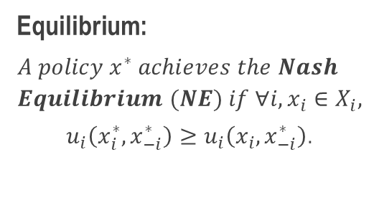
Game Theory
Equilibrium:
$$A policy x^{∗} achieves the Nash \\ Equilibrium (NE) if ∀i, x_{i}∈X_{i},$$
$u_{i}\left(x_{i}^{∗},x_{−i}^{∗}\right)≥u_{i}\left(x_{i},x_{−i}^{∗}\right)$.
Environment
Action?
Action?
Action?
Action?
Action?
Action?
Pochaba et al.
Notes:
Reward: oft nicht möglich Reward von allen Agenten zu maximieren
Suche steady state (bestes Ergebnis für alle Agenten gegeben die Aktionen der Anderen)
Nash Equi
Existieren ein paar MARL algorithmen, aber nicht viele
Forschung in MARL ist in Anfangsstadium
Nash
u_i Gewinn von Agent i
x_i policy von Agent i
Nicht eindeutig-> Koordinations problem
Additional:
Je nach Spiel/ Verhalten der Agenten, können unterschiedliche Equis sinnvoll sein
-> Mixed Nash: Unsicherheit (für Interaktion der Agenten)
-> Stackelberg: Follower/ Leader (for repeated games)
Nash Equi:
->mehr als 1 Nash Equi mit verschiedenem Reward für verschiedene Agenten
->Kein eindeutiges Ergebnis
->Wie wählt man das richtige NE? (Koordinierungsproblem)

Slide 7


Game Theory
Nash Equilibria:
  ($confess$,$confess$)
Normal Form Game:
a triple $(N, {\left\{S^{i}\right\}}_{iεN}, {\left\{v^{i}\right\}}_{iεN})$
 | stay silent | confess
stay silent | ($−1$,$−1$) | ($−10$,$0$)
confess | ($0$,$−10$) | ($−6,−6$)
Pochaba et al.
Notes:
A Markov Game is a tuple $(N, S, {\left\{A^{i}\right\}}_{iεN}, P, {\left\{R^{i}\right\}}_{iεN},γ)$,
$N=\left\{1, …, N\right\}$ set agents,
$S$ state space observed by all agents,
$A^{i}$ action space of agent $i$
$P:S×A→∆(S)$ transition probability from $sεS$ to $s′εS$ for $aεA$
$R^{i}:S×A×S→ℝ$ reward function of agent $i$ for a transition from $(s,a)$ to $s^{′}$
$γε\left[0,1\right]$ discount factor.

Slide 8
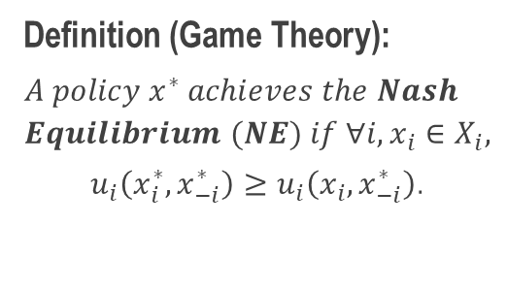
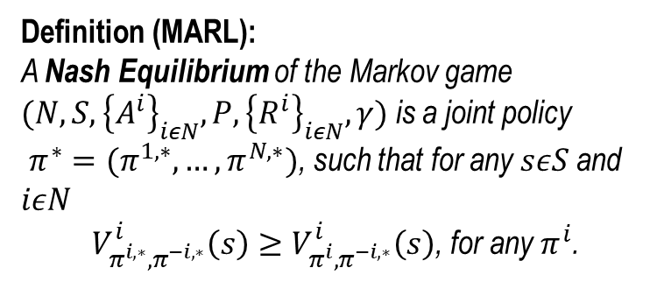
Game Theory
Definition (Game Theory):
$$A policy x^{∗} achieves the Nash \\ Equilibrium (NE) if ∀i, x_{i}∈X_{i},$$
$u_{i}\left(x_{i}^{∗},x_{−i}^{∗}\right)≥u_{i}\left(x_{i},x_{−i}^{∗}\right)$.
Environment
Action?
Action?
Action?
Definition (MARL):
A Nash Equilibrium of the Markov game $(N, S, {\left\{A^{i}\right\}}_{iεN}, P, {\left\{R^{i}\right\}}_{iεN},γ)$ is a joint policy
$π^{∗}=(π^{1,∗}, …,π^{N,∗})$, such that for any $sεS$ and $iεN$
$V_{π^{i,∗},π^{−i,∗}}^{i}\left(s\right)≥V_{π^{i},π^{−i,∗}}^{i}\left(s\right)$, for any $π^{i}$.
Action?
Action?
Action?
Pochaba et al.
Notes:
For any joint policy $π$ and state $sεS$
$V_{π^{i},π^{−i}}^{i}\left(s\right)≔𝔼\left[\sum_{t≥0}{γ^{t}R^{i}(s_{t},a_{t},s_{t+1})}\left|a_{t}^{i}\sim π^{i}(∙\left|s_{t})\right., s_{0}=s\right.\right]$.
Most algorithm converge to such a NE

Slide 9

Algorithms
Agent $i$
Q-Learning
$$Q^{i}\left(s,a\right)←Q^{i}\left(s,a\right)+α(R+γ\max_{a}{Q^{i}\left(s^{′},a\right)}−Q^{i}\left(s,a\right))$$
Q-value
+
Learning rate
(
+
Discount Factor
max
Q-value
-
Q-value
)
Reward
Q-value
+
Learning rate
(
+
Discount Factor
Best response
-
Q-value
)
NashQ
Reward
$$Q^{i} \left(s,a\right)←Q^{i}\left(s,a\right)+α(R+γBR({Q^{i}\left(s^{′},a\right))}−Q^{i}\left(s,a\right))$$
NE assuming Q-tables of all other agents
Pochaba et al.

Slide 10
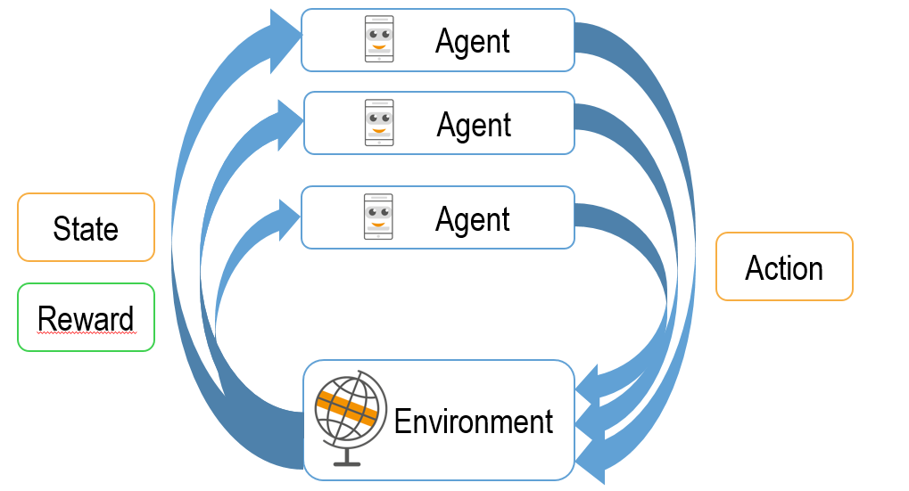
MARL in D2D communication
  Action: Choose RB
  State:
    Own RB selection
    Satisfaction (QoS)
    Neighbors
    RB selection of neighbors
  Reward: Satisfaction (QoS) of all devices
Pochaba et al.

Slide 11
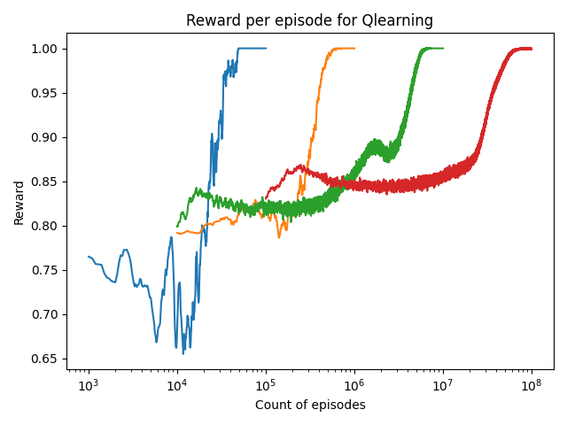
Results
3 Agents
4 Agents
5 Agents
6 Agents
Pochaba et al.
Notes:
Make a testing scenario (50 tests with random states)
Maximum Reward for 2 Agents = 2
Works pretty well (Q-table correct)
Q-Values for one Device
Left hand side Dev 0 chooses Ch0 => Dev 1 chooses Ch1 (orange higher than blue)
Right hand side Dev 0 chooses Ch1 => Dev1 chooses Ch0 (blue higher than orange)

Slide 12

Scenarios
Wrong Channel Scenario
Zero Channel Scenario
Basic Scenario
{1,…n}
Channel 0
Basic Scenario
+ devices are replaced
new devices choose a channel {1,…,n} without knowing their environment
Basic Scenario
+ devices are replaced
new devices choose channel 0 to prevent interference
Action:
Choose a channel {1,…n} to communicate
Pochaba et al.

Slide 13
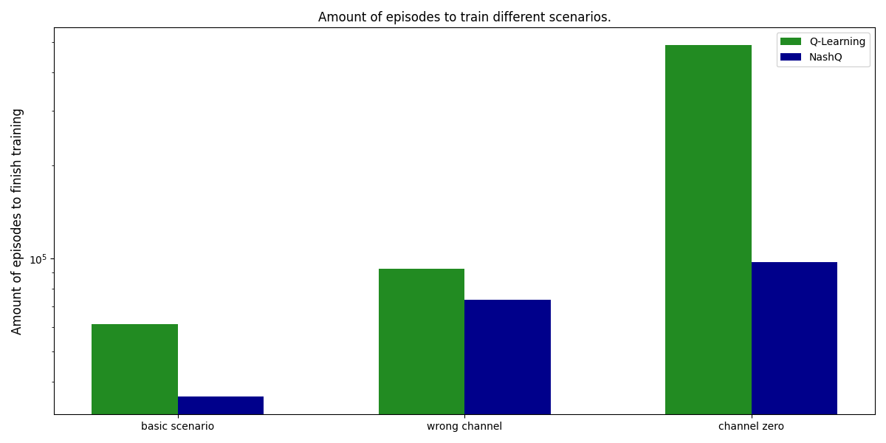
Results
Pochaba et al.
Notes:
Make a testing scenario (50 tests with random states)
Maximum Reward for 2 Agents = 2
Works pretty well (Q-table correct)
Q-Values for one Device
Left hand side Dev 0 chooses Ch0 => Dev 1 chooses Ch1 (orange higher than blue)
Right hand side Dev 0 chooses Ch1 => Dev1 chooses Ch0 (blue higher than orange)

Slide 14
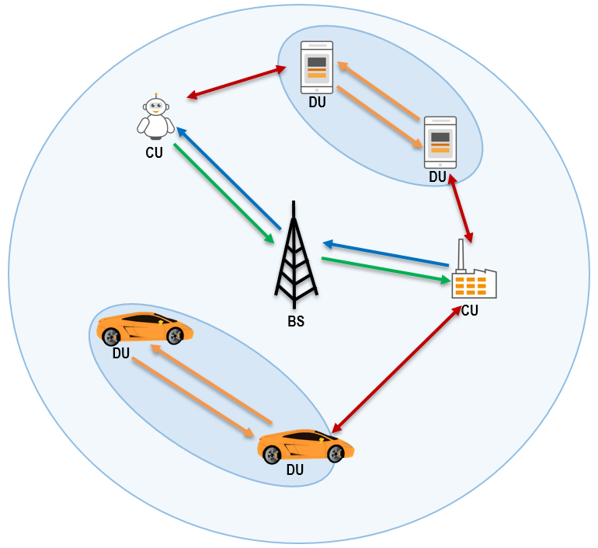
Conclusion
Results for more agents
Movement of Devices
Up- & Downlink
Traffic Priorities
Redundancy
Information of neighbours
Problem:
Reliable Communication without regulation of BS
Aim:
Optimization of Communication with
Multi-Agent Reinforcement Learning Methods
Pochaba et al.

Slide 15


Questions?
Sabrina Pochaba
Salzburg Research Forschungsgesellschaft mbH
Jakob-Haringer-Str. 5/3 | Salzburg, Austria
+43 662 2288-459
sabrina.pochaba@salzburgresearch.at
References
Stefano V. Albrecht, Filippos Christianos, Lukas Schäfer. Multi-Agent Reinforcement Learning: Foundations and Modern Approaches.The MIT Press, 2024
Junling Hu, Michael P.Wellman. Nash Q-Learning for General-Sum Stochastic games. Journal of Mahcine Learning Research 4 (2003)
Arash Asadi, Qing Wang, and Vincenzo Mancuso. A survey on device-to-device communication in cellular networks. IEEE Communications Surveys Tutorials,16(4):1801–1
Khaled B. Letaief, Wei Chen, Yuanming Shi, Jun Zhang, and Ying-Jun Angela Zhang. The roadmap to 6g: Ai em-powered wireless networks. IEEE Communications Magazine, 57(8):84–90, 2019.
Andreas F. Molisch. Wireless Communications. Wiley Publishing, 2nd edition, 2011.
Ann Nowé, Peter Vrancx, and De Hauwere Yann-Micha ̈el. Game Theory and Multi-agent Reinforcement Learning, pages 441–470. Springer-Verlag Berlin Heidelberg, 2012.
Richard S. Sutton and Andrew G. Barto. Reinforcement Learning: An Introduction. The MIT Press, second edition, 2018
Huaqing Zhang and Shanghang Zhang. Multi-Agent Reinforcement Learning, pages 335–346. Springer Singapore, Singapore, 2020.
Kaiqing Zhang, Zhuoran Yang, and Tamer Basar. Multi-agent reinforcement learning: A selective overview of theories and algorithms. CoRR, abs/1911.10635, 2019.
Yuan Zhi, Jie Tian, Xiaofang Deng, Jingping Qiao, and Dianjie Lu. Deep reinforcement learning-based resource allocation for d2d communications in heterogeneous cellular networks. Digital Communications and Networks, 2021.
Pochaba et al.

Slide 16
MARL for D2D communication
2 channel
Nash Equilibrium
Device 2
 | Channel 1 | Channel 2 | No Ch.
Channel 1 | (- 1,- 1) | ( 1, 1) | ( 1, 0)
Channel 2 | ( 1, 1) | (- 1,- 1) | ( 1, 0)
No Ch | ( 0, 1) | ( 0, 1) | ( 0, 0)
Device 1
Pochaba et al.
Notes:
Max(Sum(payoff)) = 2
Max(min(payoff)) = 1

