Slide 1
RL for Spill Optimization of the Mu2e Resonant Extraction:
Compensating Non-Stationarity
Jason St. John
Reinforcement Learning for Autonomous Accelerators 2025
2025.04.02-04
FERMILAB-SLIDES-25-0030-AD-CSAID-LDRD

Slide 2
Outstanding research group
READS collaboration: A. Narayanan, J. Arnold, M. Austin, J. R. Berlioz, P. Hanlet, K. J. Hazelwood, M. A. Ibrahim, V. P. Nagaslaev, D. J. Nicklaus, G. Pradhan, P. S. Prieto, B. A. Schupbach, K. Seiya, A. Saewert, R. M. Thurman-Keup, N. V. Tran, D. Ulusel [FNAL]
and J. Jiang, H. Liu, S. Memik, R. Shi, M. Thieme [Northwestern U]
Additional FAN-C/LDRD Group: A. Whitbeck, A. Narayan, J. St. John, N. Tran, K. J. Hazelwood, M. Khan, B. Hawks, K. Danison-Fieldhouse [FNAL]
and Jingtian Ji, Matt Walter [Toyota Technological Institute at Chicago]
This work was produced by FermiForward Discovery Group, LLC under Contract No. 89243024CSC000002 with the U.S. Department of Energy, Office of Science, Office of High Energy Physics. Publisher acknowledges the U.S. Government license to provide public access under the DOE Public Access Plan.

Slide 3
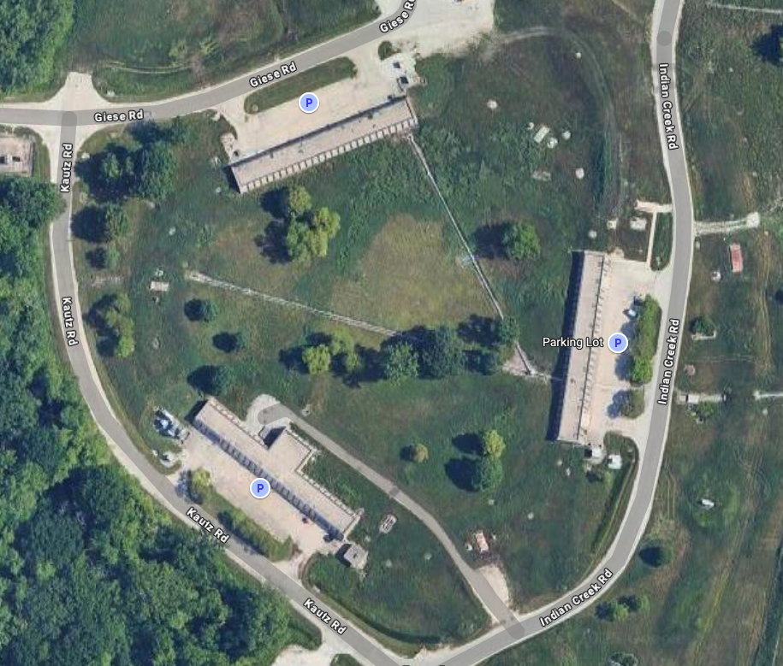
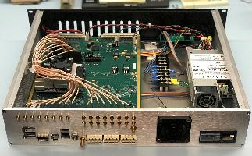
Outline / Zusammenfassung
The accelerator control problem: 3rd Order Resonant Slow Extraction for Mu2e
The control context: Spill Regulation System (SRS)
SRS Fast Regulation:
System Requirements
On the use of surrogate models
Expected advantages
Initial explorations
Plans and goals
The work presented here build on the READS project (under DOE FOA LAB 20-2261) 2021-’23
Esp. see work presented at IPAC 2021, Campinas, SP, Brazil doi:10.18429/JACoW-IPAC2021-THPAB243
↑ The Delivery Ring has a distinctive triangular layout.
← Spill Regulation System will deploy on FPGA.

Slide 4
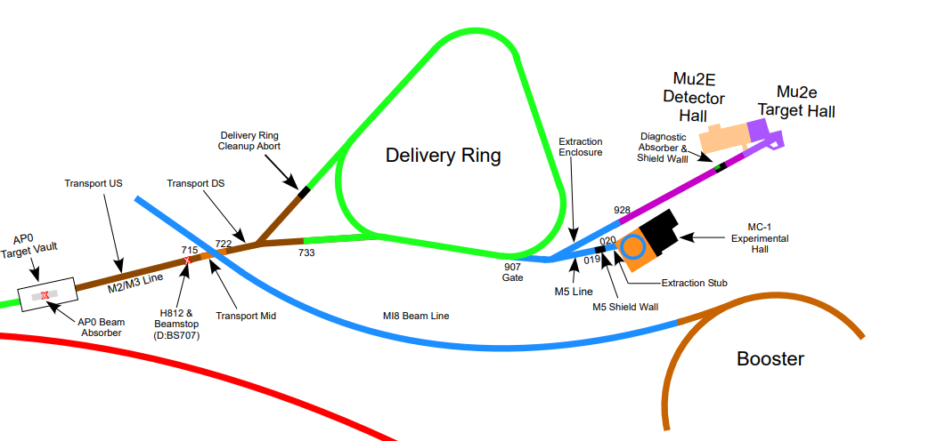
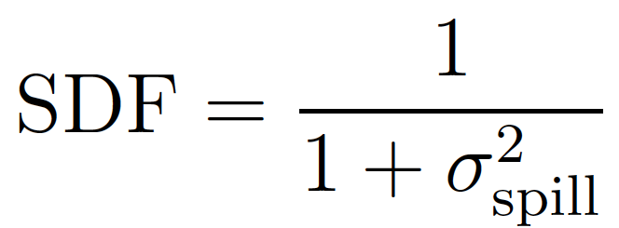
Optimizing 3rd Integer Resonant Extraction for Mu2e
Delivery Ring will store 8 GeV protons from Booster via Recycler Ring, extract to Mu2e
Beam extraction requirements: FERMILAB-CONF-15-166-APC
43 µs spills
250 ns pulses (FW)
1.7 µs inter-pulse separation with <1E-10 extinction fraction
SDF > 0.6
Commissioning to resume Spring 2025
pending repairs & approvals

Slide 5
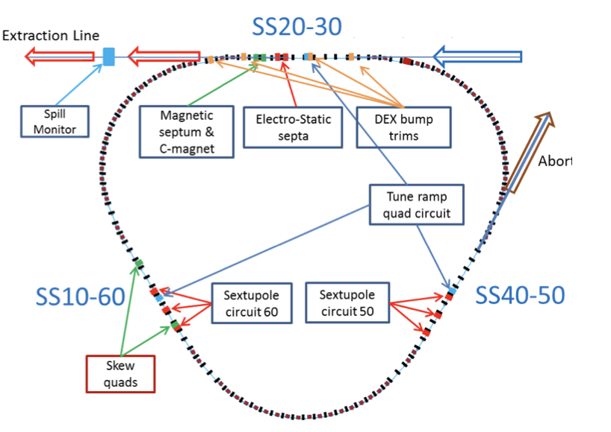
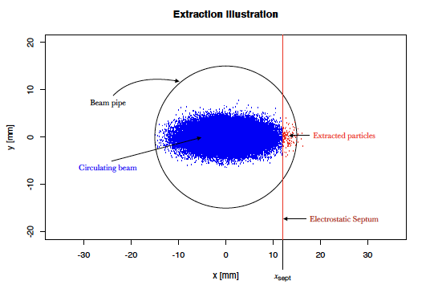
Mu2e Resonant Extraction
Injection Line
8 GeV Protons (in & out)
1E12 protons Total per Spill
505 m Circumference
1.694 µs Orbit Time
590.3 kHz Orbit Frequency
Nominal Operation:
43 ms Spill Duration
< 4E7 protons Spilled per Orbit
Above: Delivery Ring schematic, showing resonant-extraction system components.
Left: Horizontal-plane extraction using electrostatic septa.
credit: Aakash Narayanan (thesis 2022)

Slide 6
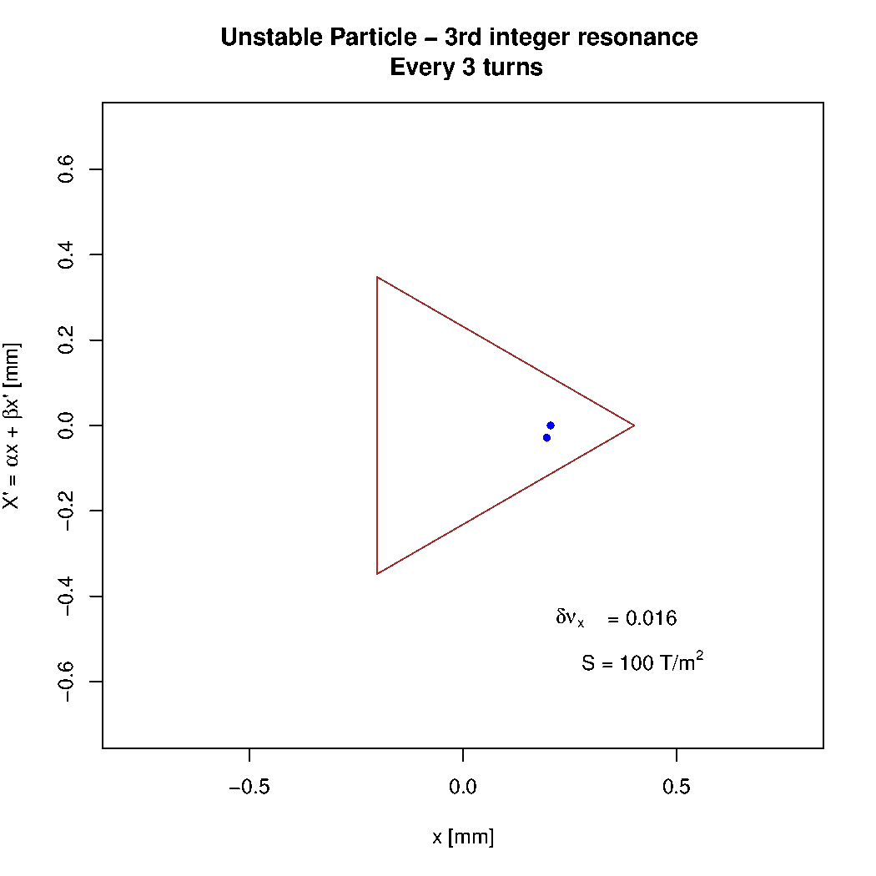
3rd Integer Resonant Extraction
Strong sextupole moments impose triangular stable region in transverse phase space.
This separatrix is closed on the beam by driving the tune toward nearby third-integer resonance.
animation: Aakaash Narayanan

Slide 7
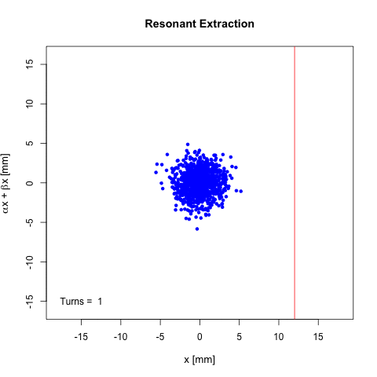
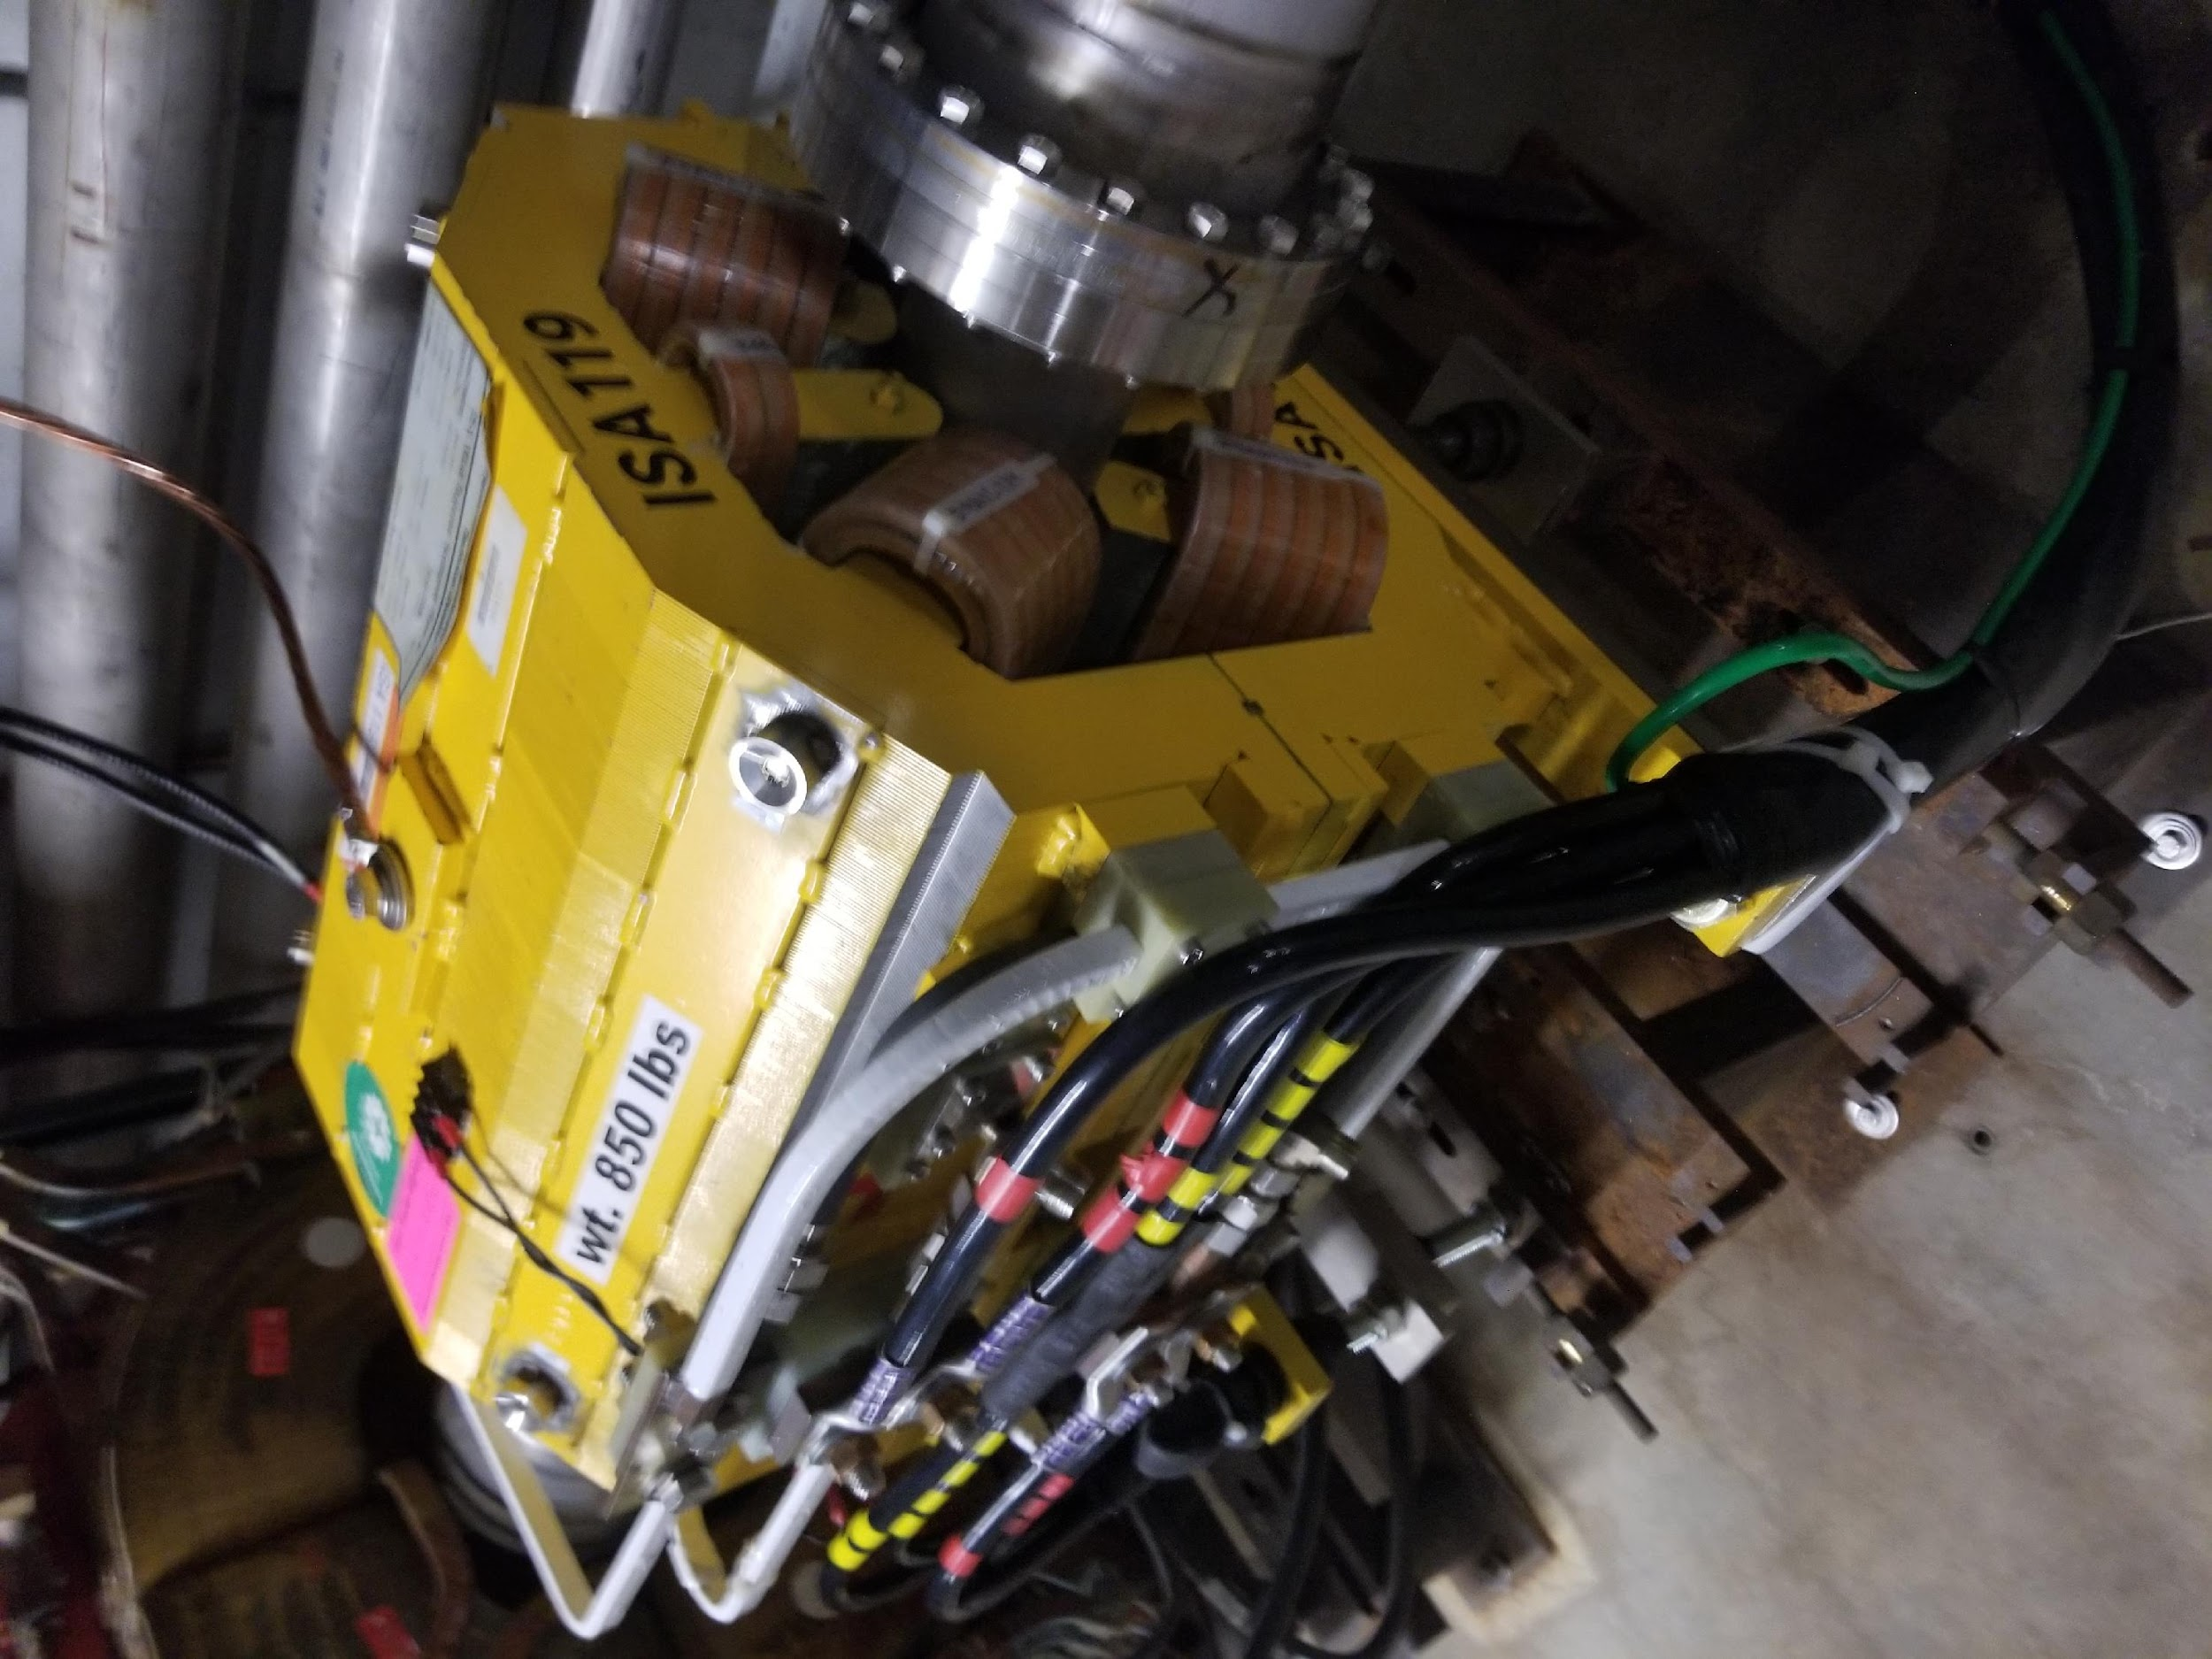
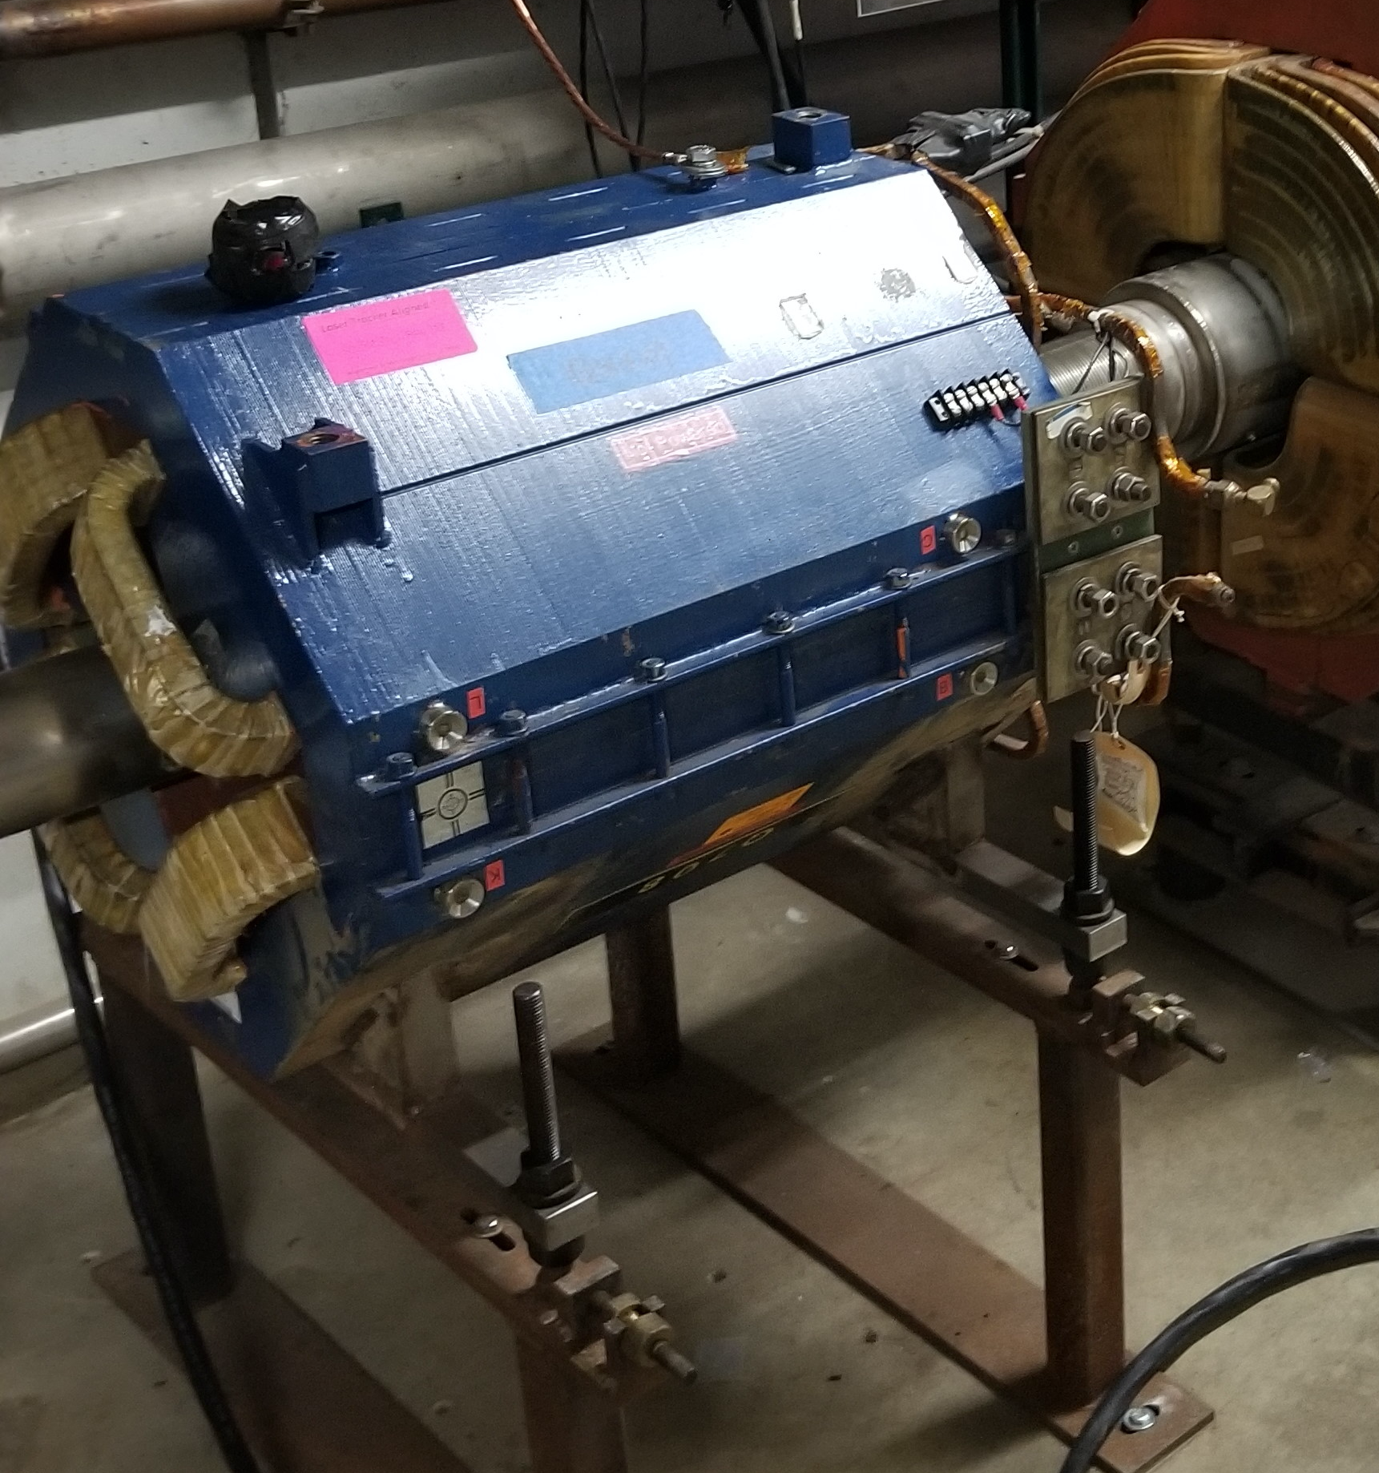
Mu2e Resonant Extraction
Set of 6 sextupoles excites the 3rd integer resonance in the DR.
Q_{h}: 9.650 → 9.666
Dedicated set of 3 fast-ramping, tune-shifting quadrupoles in the DR drive the horizontal tune toward 29/3, shrinking triangular separatrix.
Septum position = 12 mm
animation: Aakaash Narayanan

Slide 8
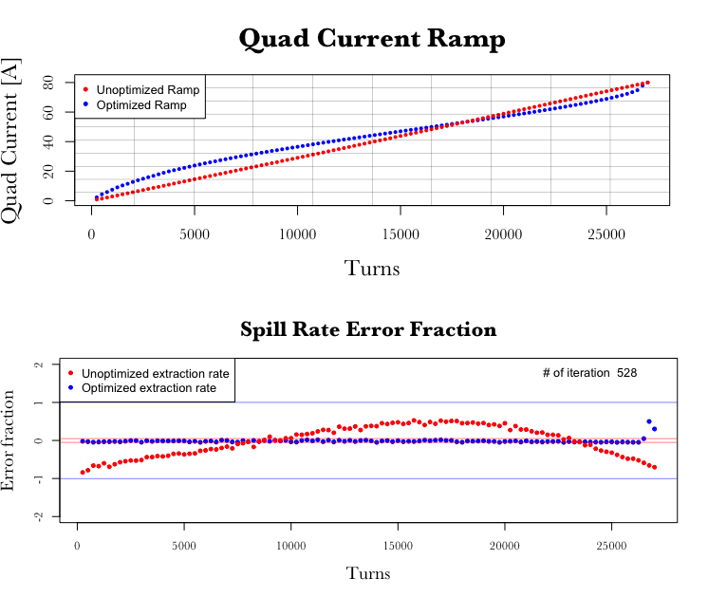
Slow Regulation Loop
For each of the 8 spills planned each SuperCycle (~60 s):
- Batch recent ~few hundred spills
- Take means of circulating beam (DCCT) & extracted beam (RWM) sequences
- Calculate correction & update quad ramp reference.
(See IPAC ‘21, A. Narayan)
- Control sequence is read in at start of each spill.

Slide 9
Slow Regulation Loop
For each of the 8 spills planned each SuperCycle (~60 s):
- Batch recent ~few hundred spills
- Take means of circulating beam (DCCT) & extracted beam (RWM) sequences
- Calculate correction & update quad ramp reference.
(See IPAC ‘21, A. Narayan)
- Control sequence is read in at start of each spill.
But what about 60 Hz harmonic noise and other quickly-changing disturbances?

Slide 10
Fast Regulation Project
To improve SDF beyond Slow Regulation Loop, we want to develop a control agent which:
Executes on dedicated FPGA (guaranteed <100 µs)
Adds/subtracts correctively to the tune-shifting quad ramp control sequence
before ramp begins, or even
during the ramp play-out time.

Slide 11
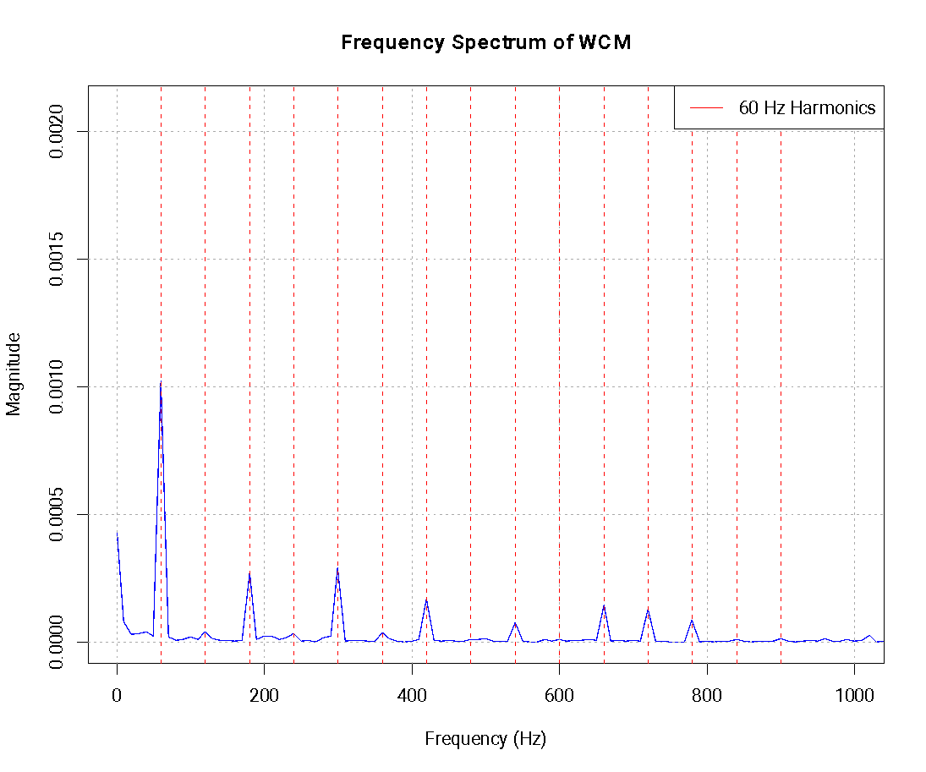
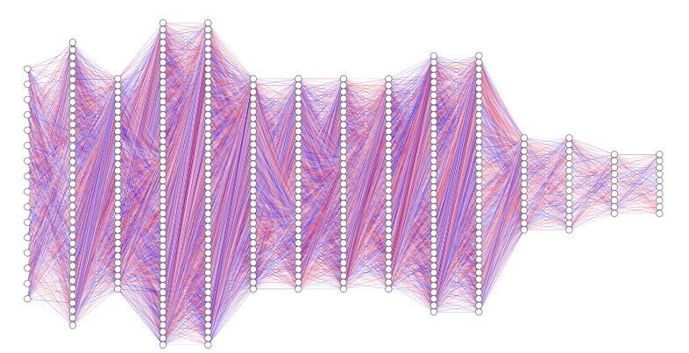
Spill Regulation System - the control context
Slow Regulation Loop
Harmonic Content Tracker
Fast Regulation
Input Averaged previous O(100) spill rates & quad current programs
Output: Smooth ramp-value control signal (100 µs steps)
Execution Timing: Every ~100 spills, between spills
Identifies amplitude & phase of residual n*60 Hz noise content contributed by power supplies.
Adds feedforward corrections to each ramp sequence.
Execution Timing: TBD
Input Current history of spill-rate, total quad ramp control signal, loss monitors,
Output: On-the-fly adjustments to quad ramp control signal
Inference Timing: O(100) inferences during each spill

Slide 12
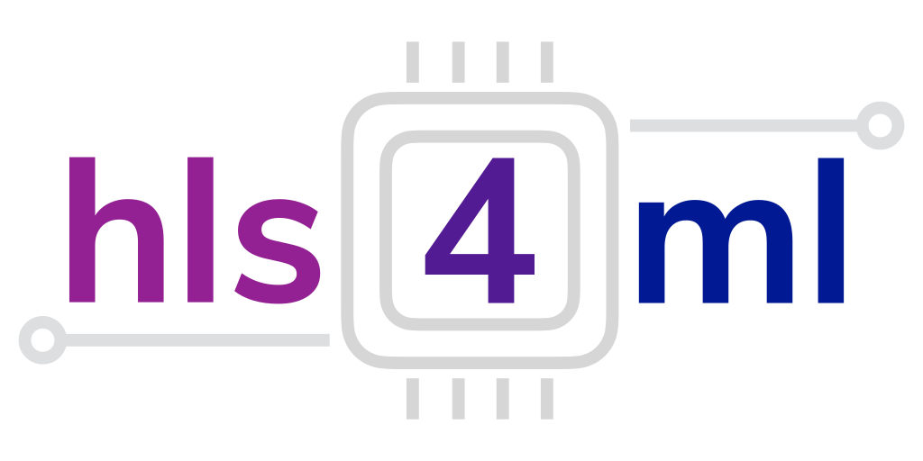
Fast Regulation System
Using information available during each spill, can we improve the SDF?
Integrated with/aware of Harmonic Content Tracker
Must not take on the work of the Slow Regulation Loop
Deploy on Arria10 SoC FPGA + carrier board
Helps ensure inference latency
Available FPGA resources inform choice of neural net architecture, activation functions, bit precision scheme, etc.
Neural Nets → FPGA using hls4ml

Slide 13
Surrogate Models as Training Environments
The case for learning offline / “nearline”
Machine commissioning: unstable agile/exploratory operation mode
Expect ongoing changes to key parameter values: Spill duration, control-event timing, injection parameters, etc
Normal operations also challenging for online learning:
Slow: Maximum 8 spills / supercycle (~60 s)
High-pressure: Priority on beam delivery, not policy exploration

Slide 14
Surrogate Models as Training Environments
The case for learning offline / “nearline”
Machine commissioning: unstable agile/exploratory operation mode
Expect ongoing changes to key parameter values: Spill duration, control-event timing, injection parameters, etc
Normal operations also challenging for online learning:
Slow: Maximum 8 spills / supercycle (~60 s)
High-pressure: Priority on beam delivery, not policy exploration
Can a surrogate model reproduce spill-response dynamics well enough? If so: Take surrogate as RL environment
Fast: Control agent training limited by computing resources, not accelerator program
Safe: Entirely virtual
Reproducible: Happy scientists

Slide 15
Surrogate Models as Training Environments
Dataset: archived live operations data including control actions taken
Resonant Extraction Process
Control Agent at work

Slide 16
Surrogate Models as Training Environments
Dataset: archived live operations data including control actions taken
Train predictive surrogate on this → Reproduces the response dynamics
Spill rate sequence,
other context,
Quad current seq. + new action x_{t}
x_{t}
Resonant Extraction Process
Control Agent at work
y_{t+1}
Predicted spill rate

Slide 17
Surrogate Models as Training Environments
Dataset: live operations data including control actions taken
Train predictive surrogate on this → Reproduces the response dynamics
Live evaluation of predictive accuracy against new data
→ Evaluates “best” model over given time horizon
Insight into patterns of system dynamics re-emergence
X = {actual control actions,
..., other inputs}
X
actual adjustment
surrogate A
y_{A}
X
X
actual
spill rate
surrogate C
surrogate B
y_{C}
y_{B}

Slide 18
Using the Surrogate: Control Agent Training
With current “best” surrogate model
Current
surrogate

Slide 19
Using the Surrogate: Control Agent Training
With current “best” surrogate model as RL environment:
Train new (/transfer-learn previous) control agent to optimize reward
Architecture, activation functions, floating-point precision appropriate to FPGA
X
Control Agent being trained
Current
surrogate
y

Slide 20
Using the Surrogate: Control Agent Training
With current “best” surrogate model as RL environment:
Train new (/transfer-learn previous) control agent to optimize reward
Architecture, activation functions, floating-point precision appropriate to FPGA
Also measure performance of current control agent
X
Control Agent being trained
Storage Ring
Current agent (on FPGA)
Current
surrogate
y
X
Current Control Agent
Current
surrogate
y

Slide 21
Using the Surrogate: Control Agent Training
With current “best” surrogate model as RL environment:
Train new (/transfer-learn previous) control agent to optimize reward
Architecture, activation functions, floating-point precision appropriate to FPGA
Also measure performance of current control agent
Significant performance improvement? Promote to FPGA. New current agent.
X
Control Agent being trained
Storage Ring
Current agent (on FPGA)
Current
surrogate
y
X
Current Control Agent
Current
surrogate
y

Slide 22
Development Work using Non-MC Simulation
Until measured data are available:
Fast, semi-analytical simulation for proof-of-principle & workflow development
Same sampling format as data - switching to real data will be straightforward once available
Captures some of the real physics
Low-cost computation - ideal for development
Assume underlying ramp is great, but Log-norm magnet PS noise perturbs.
Beam pipe shields high-frequency corrections.
Final resulting spill- monitor sequence
Control agent responds @10kHz
Extraction takes µ±σ orbits

Slide 23
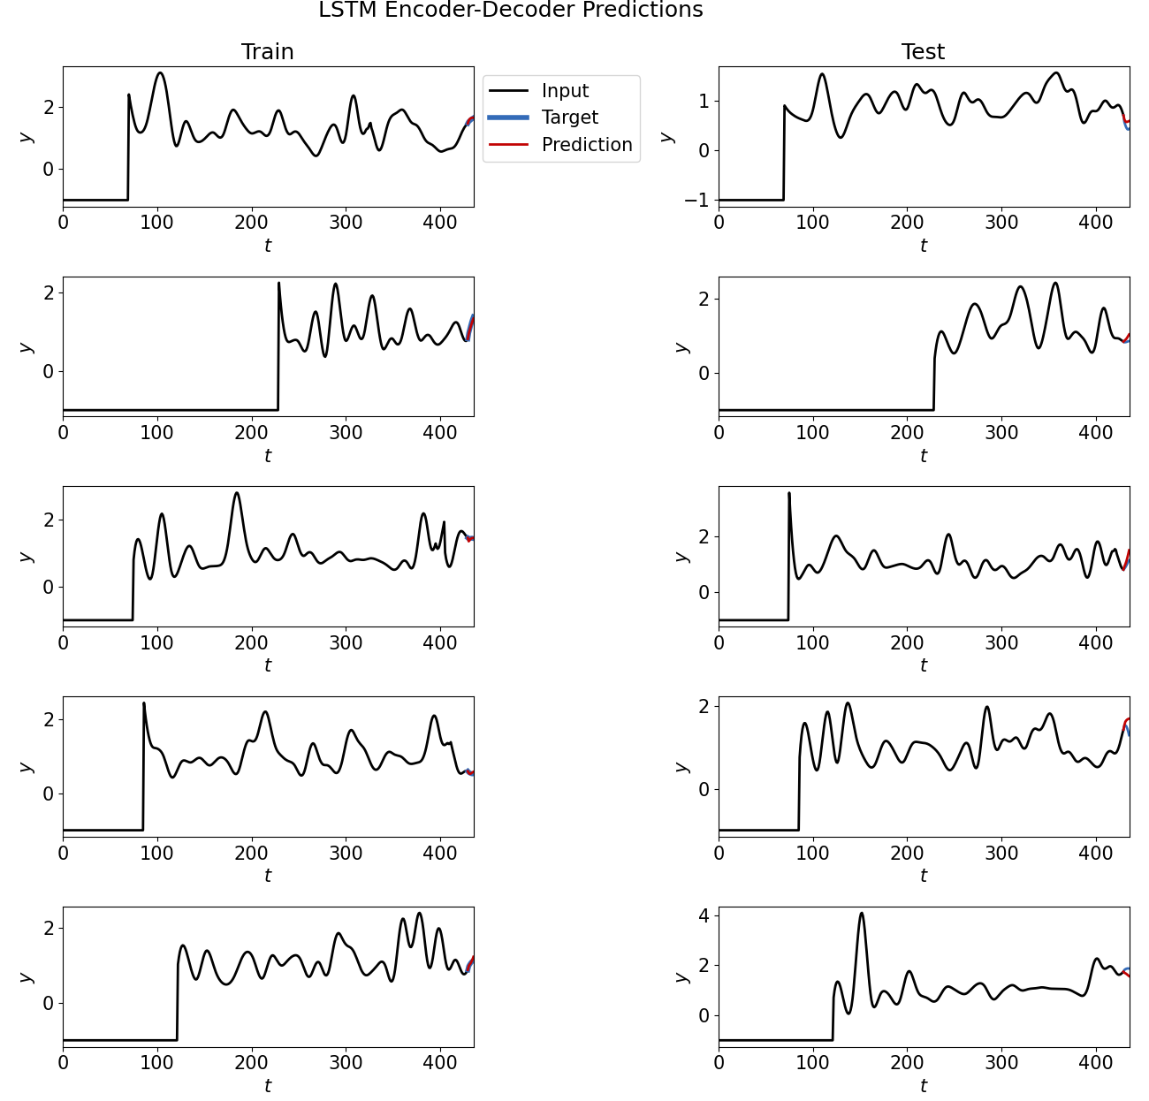
Development Work
Simple LSTM Surrogate
(fixed window size of full spill) using
Analytical simulation w/ PID loop
Input: random-sample point sequences
10 kHz spill rate
10 kHz PID action
10 kHz binary “In-spill” flag
10 KHz in-spill timestep count
Output:
Spill rate for next timestep

Slide 24
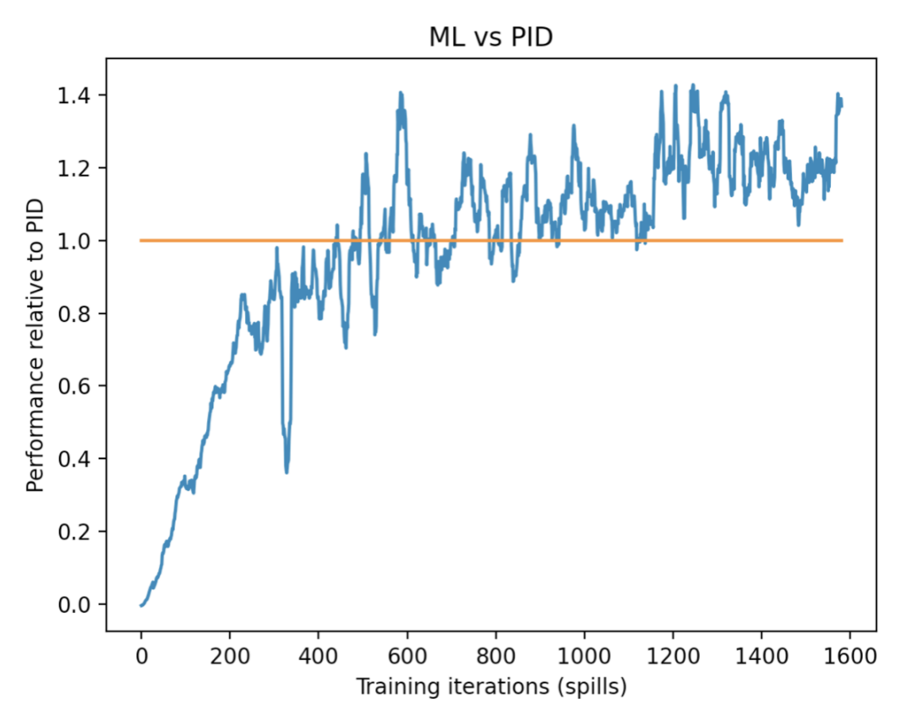
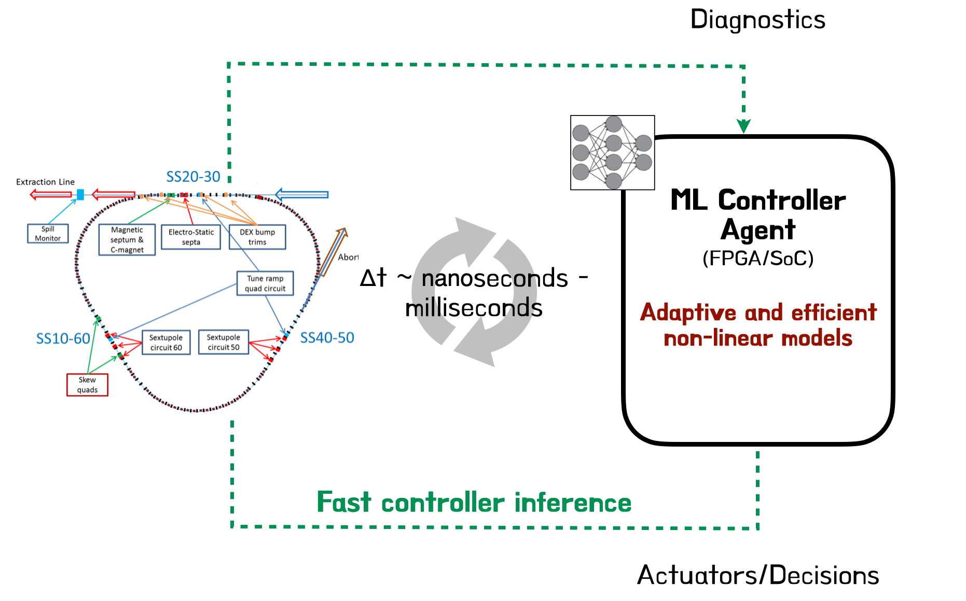
Development Work - Results
We have seen that a FCNN controller can outperform traditional PID controllers in simulation.
The semi-analytic simulation developed likely does not capture all of the dynamics or the variability of the system.
Motivates tools that can
Learn live, directly from systems
Adapt to variability
Above: NAPAC?

Slide 25
Ongoing and Upcoming Work
Simulation-based work:
Refine & refactor analytical sim
Investigate effect of changing drop-in control agent
Given effort available: Numerical sim + controller-in-loop

Slide 26
Ongoing and Upcoming Work
Simulation-based work:
Refine & refactor analytical sim
Investigate effect of changing drop-in control agent
Given effort available: Numerical sim + controller-in-loop
Hardware work:
Which signals available to record & as live inputs?
At 10 kHz and <100 µs latency
At 10 kHz and some higher latency
At some rate and some latency
RWM: Circulating beam current
RWM: Extracted beam current
Beam Position monitors (monitor centroid steering)
Beam Loss monitors - ionized gas ⇒ integration time & high readout latency
In case of loss-limiting conditions

Slide 27
Ongoing and Upcoming Work: Timeline
Commissioning resumes 2025/04
Summer maintenance & upgrade shutdown
Working to control quad ramp in-time w/ simple control agent on FPGA before Shutdown 2025.
When operations resume, full workflow cycle:
Collect live data & train spill surrogate by watching PID loop in action
Use spill surrogate to train neural net & deploy on FPGA
Engineer robustly automated training, evaluating, archiving… (mlflow, etc.)
Lots of (fun!) work ahead!

Slide 28
Want to know more?
ML for Fast Regulator Agent Beyond PID Controllers: PPO with neuralized PID Policy for Proton Beam Intensity Control in Mu2e (NeurIPS ML4Phy Workshop 2023) C. Xu, J. Y.-C. Hu, A. Narayanan, M. Thieme, V. Nagaslaev, M. Austin, J. Arnold, J. Berlioz, P. Hanlet, A. Ibrahim, D. Nicklaus, J. Mitrevski, J. M. St. John, G. Pradhan, A. Saewert, K. Seiya, B. Schupbach, R. Thurman-Keup, N. Tran, R. Shi, S. Ogrenci, A. M. I. Shuping, K. Hazelwood, and H. Liu
FPGA and BLMs ML-Based Real-Time Control at the Edge: An Approach Using hls4ml (2023) R. Shi, S. Ogrenci, J. M. Arnold, J. R. Berlioz, P. Hanlet, K. J. Hazelwood, M. A. Ibrahim, H. Liu, V. P. Nagaslaev, A. N. 1, D. J. Nicklaus, J. Mitrevski, G. Pradhan, A. L. Saewert, B. A. Schupbach, K. Seiya, M. Thieme, R. M. Thurman-Keup, and N. V. Tran
High-rate BLM readout scheme: Disentangling Beam Losses in The Fermilab Main Injector Enclosure Using Real-Time Edge AI (ICALEPCS’23) K. Hazelwood, J. Arnold, M. Austin, J. Berlioz, P. Hanlet, J. Hu, M. Ibrahim, J. Jiang, H. Liu, A. Livaudais-Lewis, S. Memik, J. Mitrevski, V. Nagaslaev, A. Narayanan, D. Nicklaus, G. Pradhan, A. Saewert, B. Schupbach, K. Seiya, R. Shi, A. Shuping, M. Thieme, R. Thurman-Keup, N. Tran, and C. Xu
Background to Work Presented Here Machine Learning for Slow Spill Regulation in the Fermilab Delivery Ring for Mu2e (NAPAC’22)
Und mehr Vorgeschichte Application of Machine Learning for Spill Regulation System in Mu2e (2022) tech report. J. Jiang
Analytical Simulation, etc. Optimizing Mu2e Spill Regulation System Algorithms (IPAC 2021) SRS mainly

Slide 29
Thank you!

Slide 30
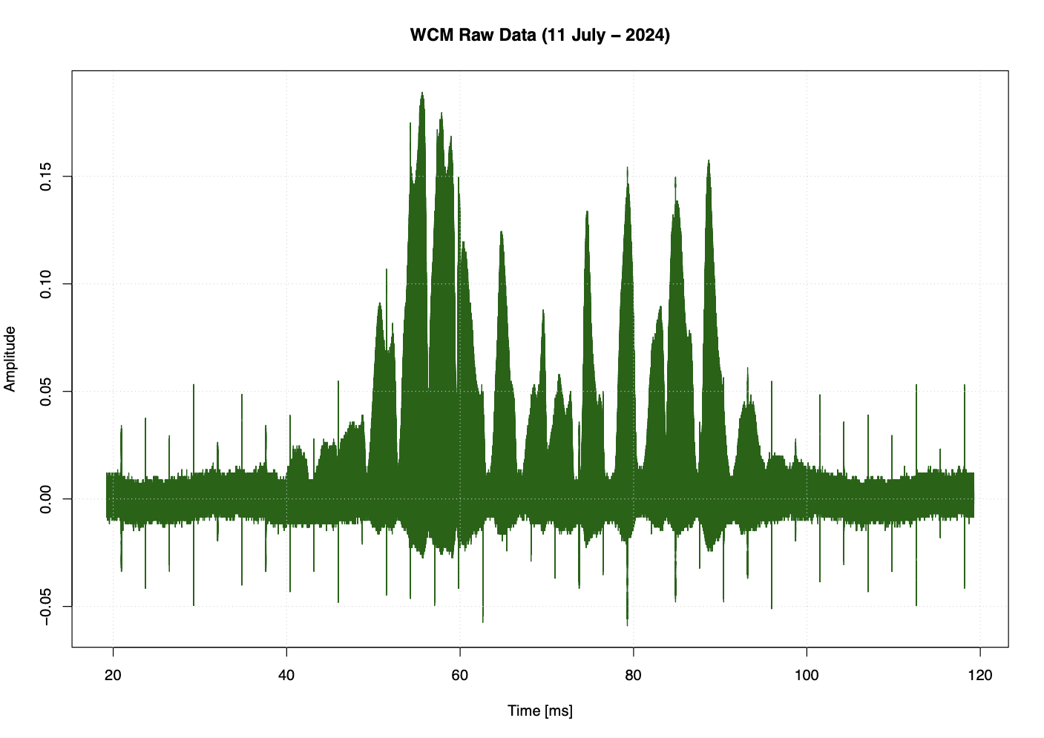
Harmonic Content Tracker
500 MHz Sample rate

Slide 31
Harmonic Content Tracker

Slide 32
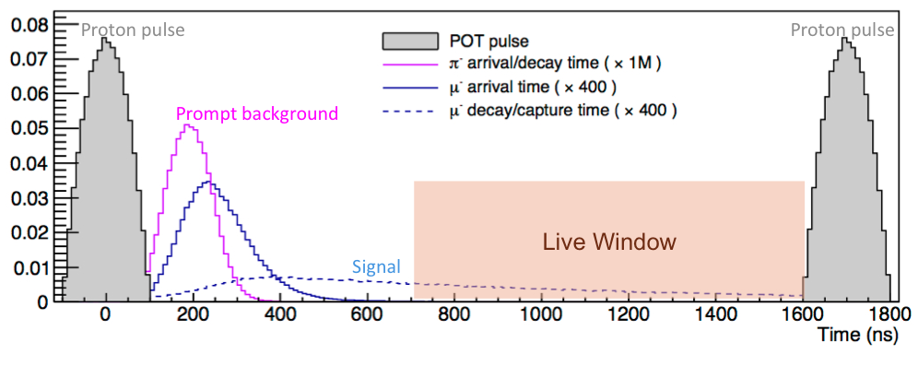
Mu2e Beam Requirements for Pulse Time Structure
Pulsed time structure for the Mu2e experiment, showing delayed signal and background pulses. These physics drive the inter-pulse extinction requirement, and motivate the Spill Duty Factor > 0.6 beam quality goal.
source: Bartoszek, L., & et al. (2015). Mu2e Technical Design Report. Lawrence Berkeley National Laboratory. http://dx.doi.org/10.2172/1172555 Retrieved from https://escholarship.org/uc/item/0fg2p3g5

Slide 33
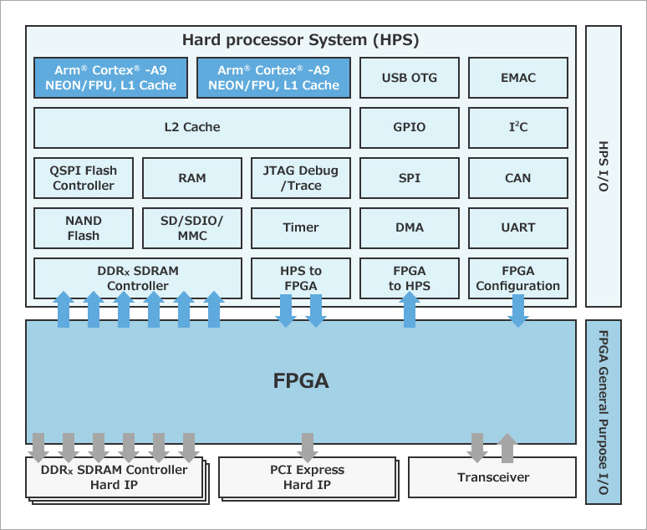
System on a Chip: HPS+FPGA generic diagram

Slide 34
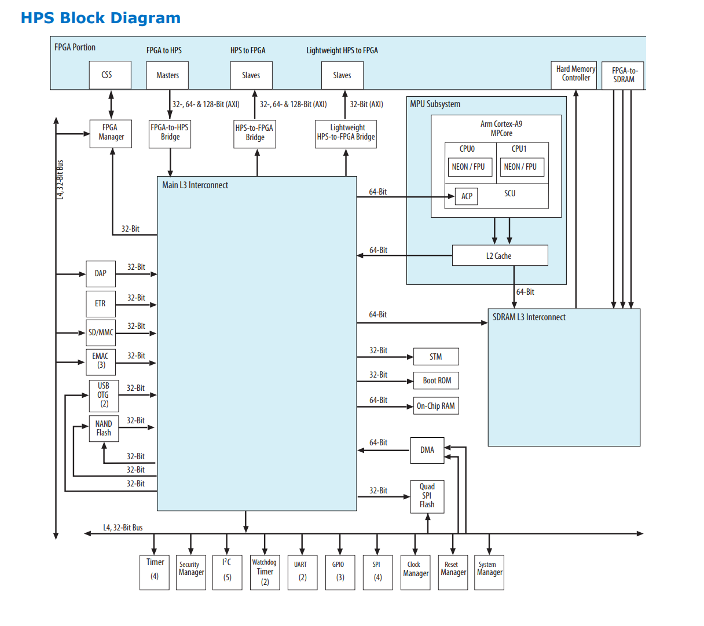
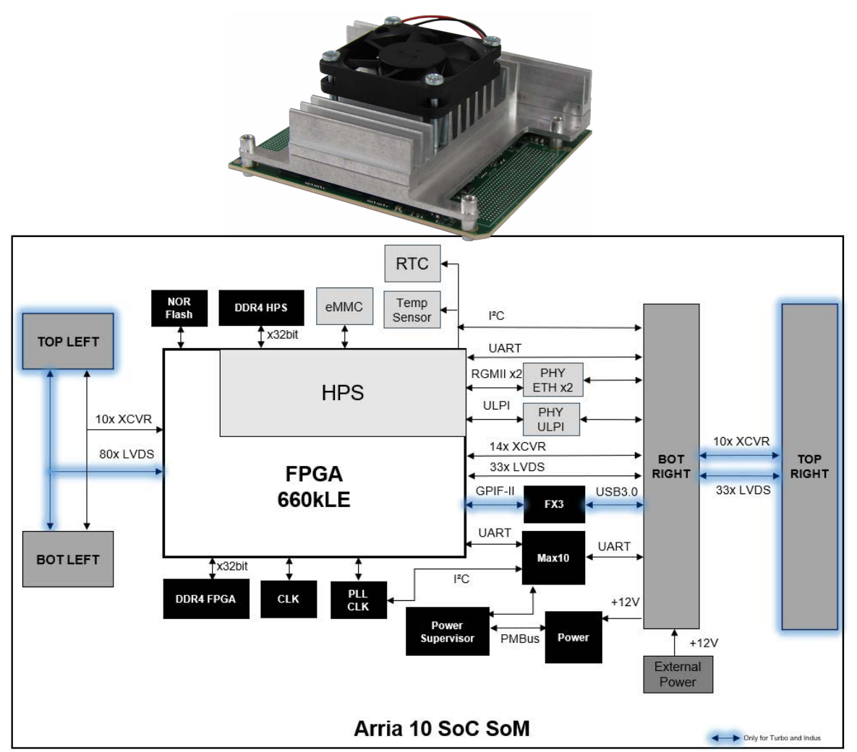
System on a Chip: HPS+FPGA: Arria10 SoC SoM

Slide 35
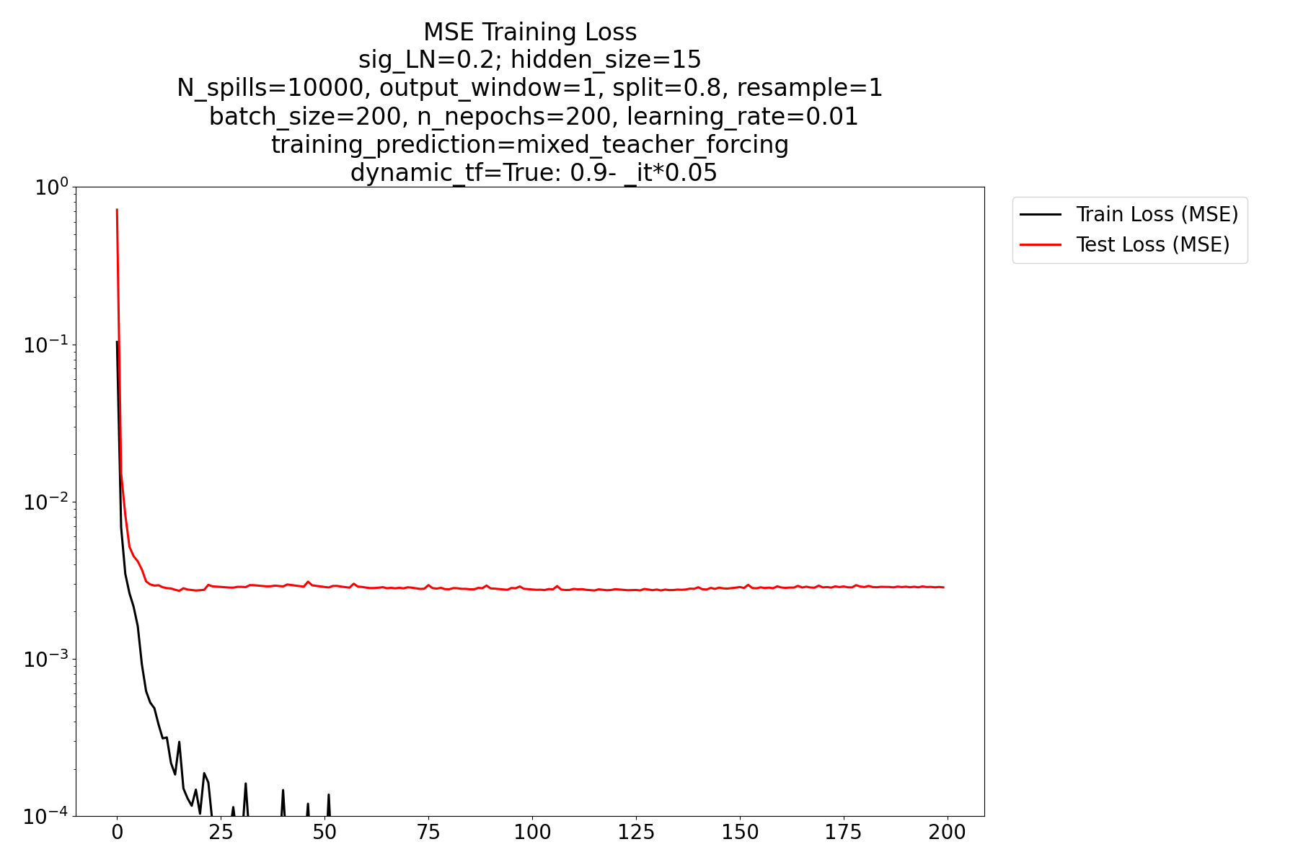
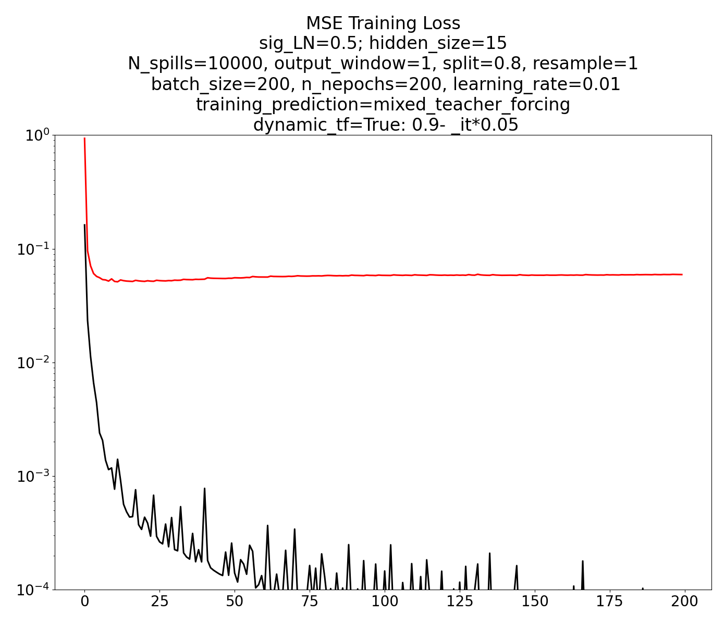
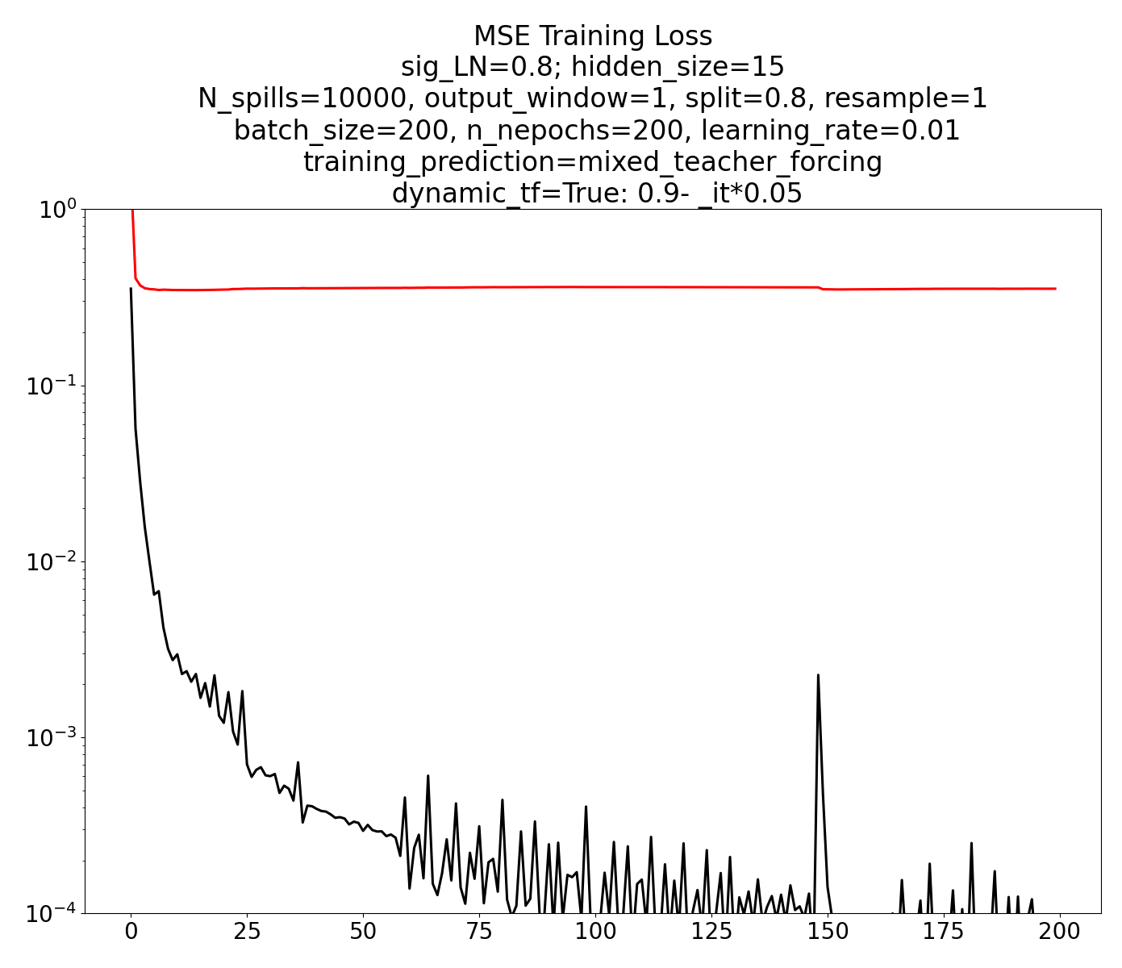
Development Work - Results
LSTM surrogate (layer size, etc) already shows interesting training/testing behavior
Ex: Loss floor depends on assumed noise parameter
σ_{LN}=0.2
σ_{LN}=0.5
σ_{LN}=0.8
(Yes, clearly over-fitting here. But the effect holds.)

