Slide 1
Opportunities for Reinforcement Learning in Accelerator Automation Jonathan Edelen, Joshua Einstein-Curtis, Christopher Hall, Morgan Henderson (RadiaSoft) Auralee Edelen, Finn O’Shea (SLAC) Stuart Calder, Christina Hoffman, Bhargavi Krishna (ORNL)
April 3rd 2025
RL4AA 2025: Hamburg Germany
This material is based upon work supported by the U.S. Department of Energy, Office of Science, Office of Accelerator R&D and Production award number DE-SC0023641
Boulder, Colorado USA | radiasoft.net

Slide 2
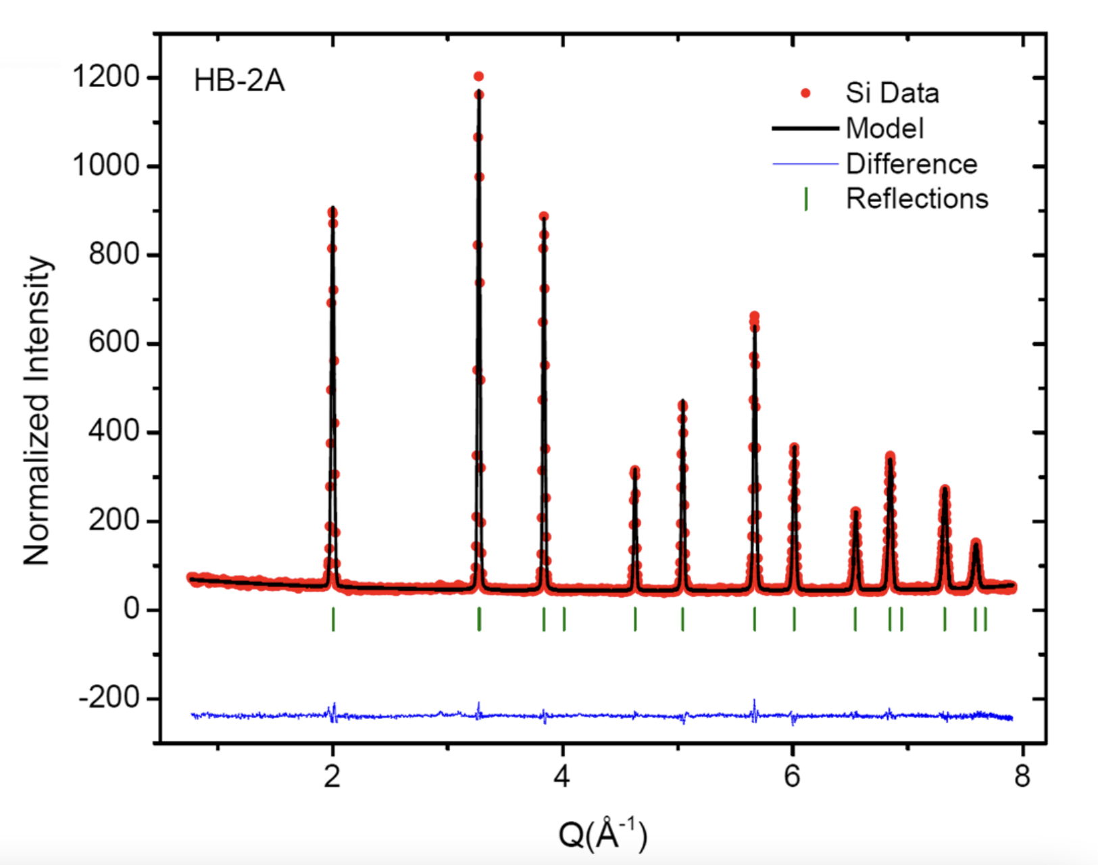
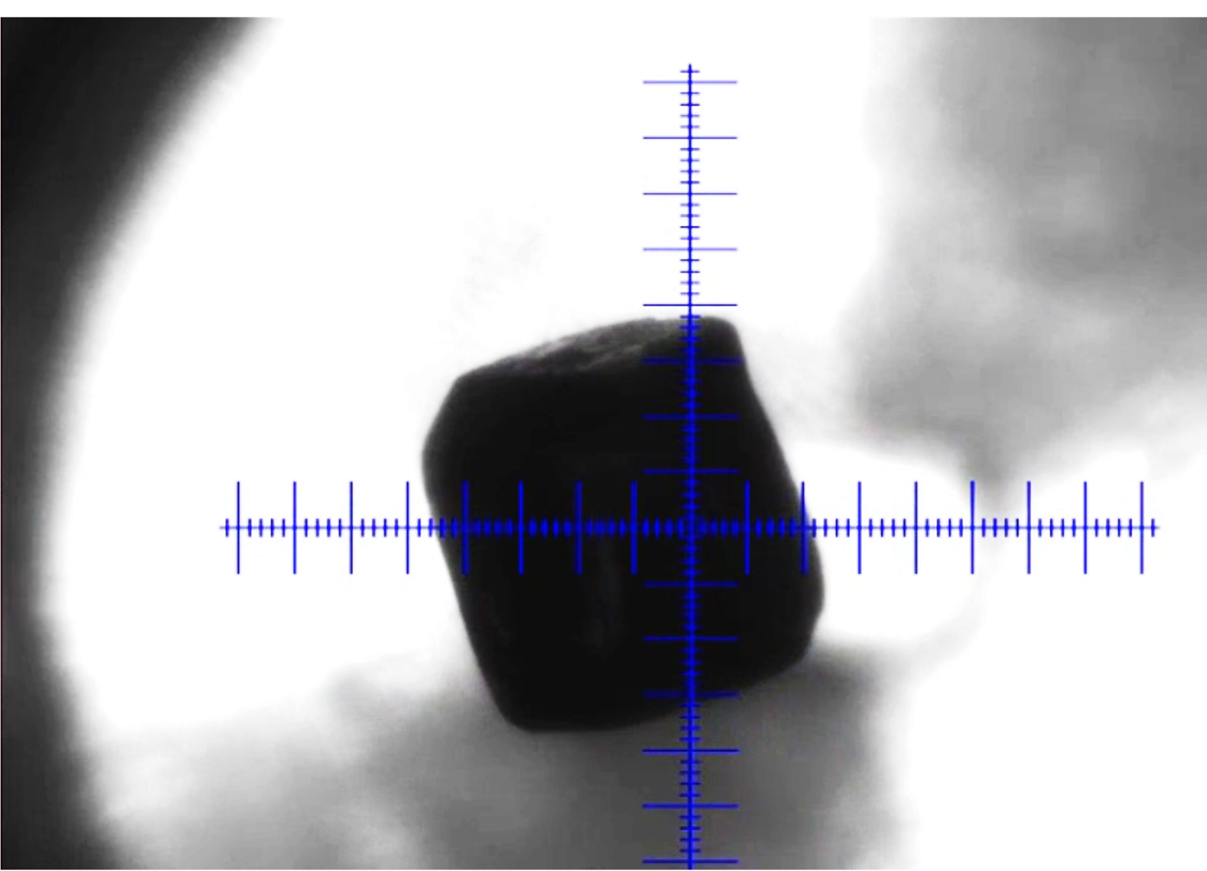
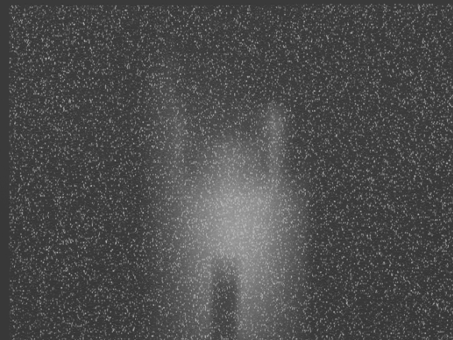
Automation of Sample Alignment in Neutron Beamlines
Optical Cameras
Machine Learning Model
Motor Controller
Center of Mass of sample sent to external motor controllers
Motor control software has pre-determined algorithm to move the sample based on user click
Fiducialized to sample and beam
Machine Learning + Classical Controls
Detector Data
Beam Center Identification
Neutron Camera
Sample Positioning Motors
Provides verification of alignment status
Sample Position Identification
Not Fiducialized to sample and beam

Slide 3
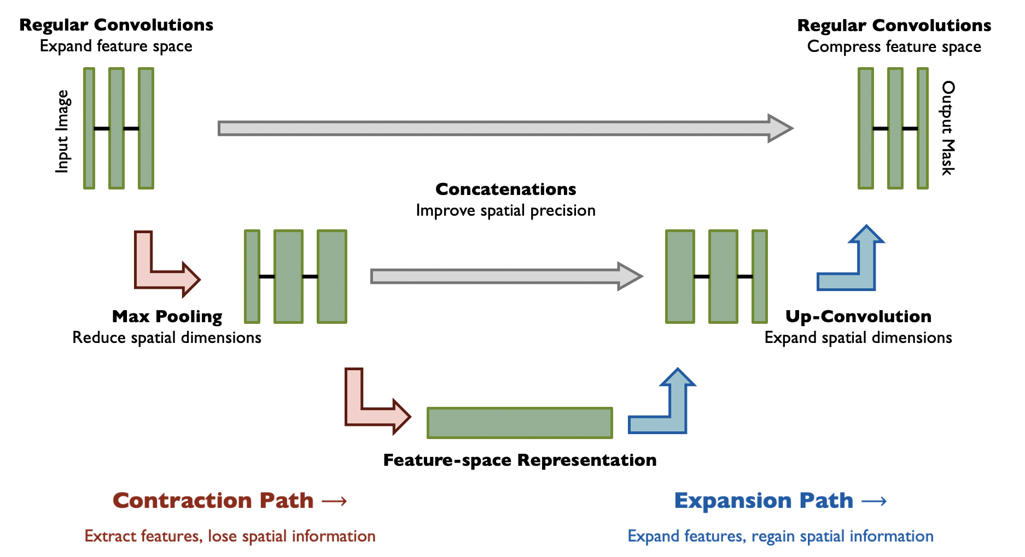
TOPAZ Single Crystal Diffractometer
Automation of sample alignment makes experiments more efficient and compensates for thermal drift during temperature scans
Utilize image contouring to identify sample location in the environment
Contour images using expert feedback
Train Convolutional Neural Network to compute the sample mask
From sample mask compute center of mass
Implementation using Python based EPICS IOC
Optical image or neutron camera image (optical image shown in the top right)
U-Net computes sample center and serves up the mask to EPICS along with the sample offset from the beam
Motor software moves and rotates the sample for optimal alignment in the neutron beam
Image
Mask
Prediction

Slide 4
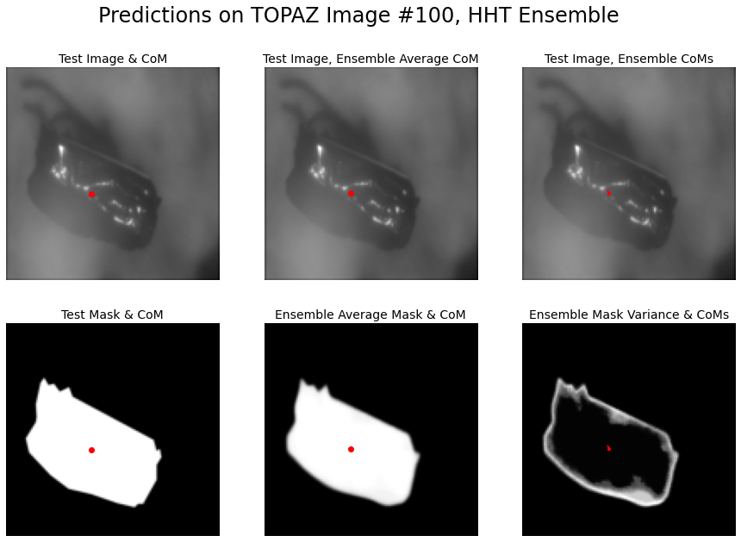
Uncertainty Quantification
During supervised training
Real error compared to human-defined masks
During testing and operations
Ground-truth data not available
Employ statistics from ensemble predictions
Variance between many trained models
Takeaways
Excellent CoM prediction
Negligible ensemble spread with low uncertainty
Mask variance is restricted to edges

Slide 5
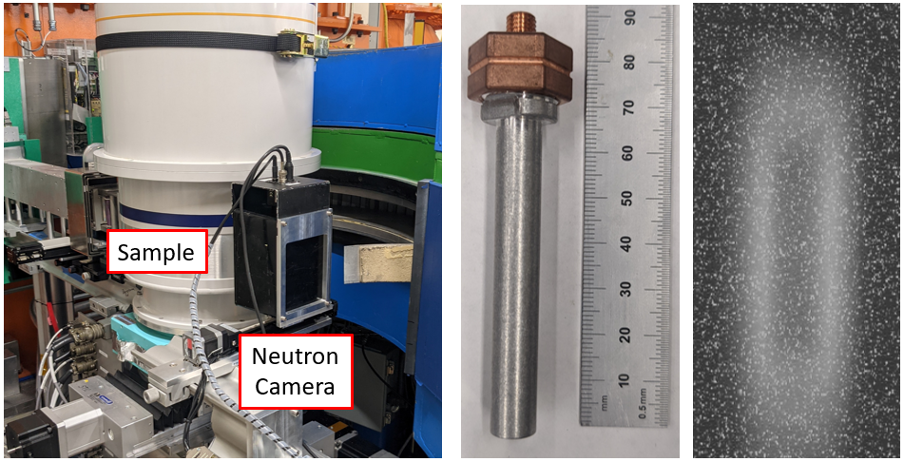
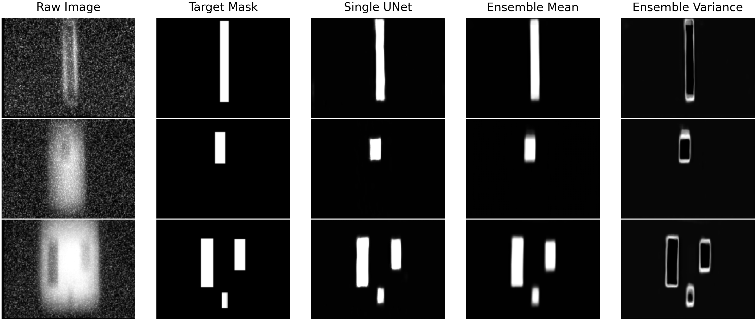
HB-2A Powder Diffractometer
Located at ORNL and receives neutrons from the Spallation Neutron Source
Samples can be measured with high precision for volumetric sampling in reciprocal space (momentum measurements)
Samples are rotated to measure all aspects of the lattice
Temperature control from 5 K - 450 K
Sample alignment
Neutron production time is limited
Some activities require constant realignment, such as temperature scans
User facilities especially face schedule constraints
Machine learning (ML) is a key automation tool
Alignment protocols vary between beamlines
Opportunity to employ & test models
Broad applications for sample alignment

Slide 6
RL for Automation of Sample Alignment
Environment
Neutron Camera
Actor
Sample Positioning Motors
(control actions)
Detector Data
Image Processing Model
Beam Center Identification
Sample Position Identification
Reward function
Sample Positioning Information / Detector Data Evaluation

Slide 7
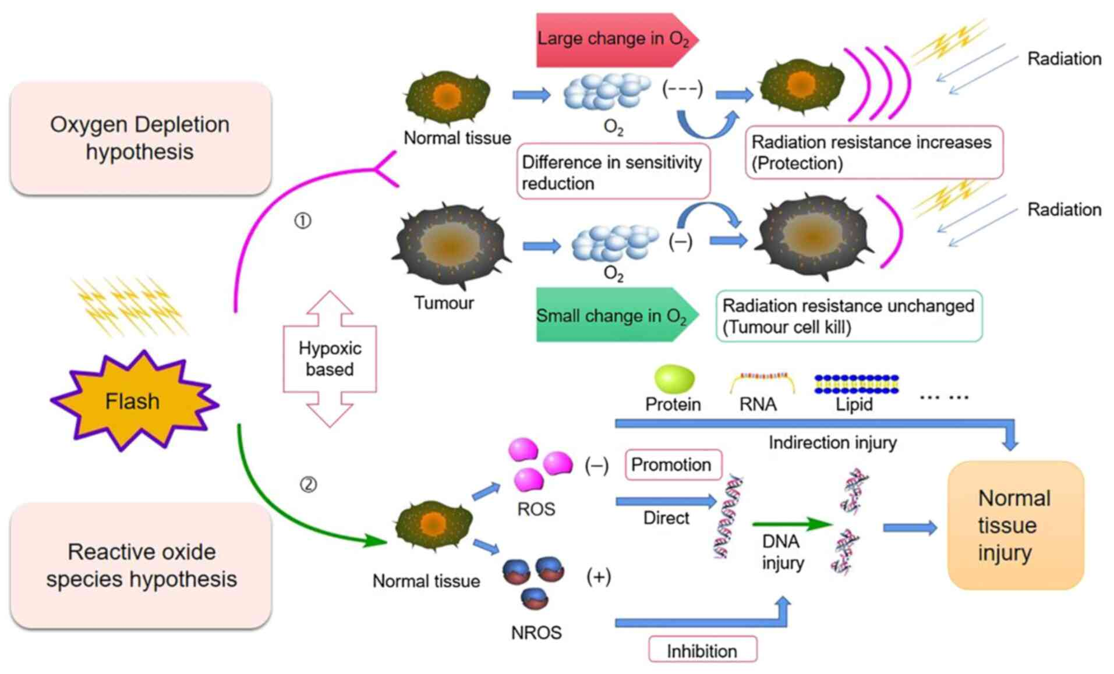
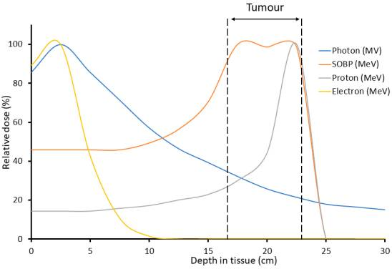
What is FLASH Radiotherapy?
Ultrafast delivery of radiation
dose rates that are several orders of magnitude greater than those used in conventional radiotherapy
40 Gy/s (FLASH) vs 0.5–5 Gy/min (conventional)
Preclinical data suggesting that FLASH could achieve better disease control with fewer side effects
Improved safety and efficacy (confirmed by clinical trials)
Oxygen consumption hypothesis: High-dose transient irradiation reduces the presence of oxygen, and this effect is greater on normal cells, resulting in stronger radiation resistance.
Reactive Oxygen Species (ROS) levels that causes DNA, RNA, protein and lipid injury, and an increase in the protective non-reactive oxygen species (NROS) levels that inhibits DNA injury.
Hughes JR, Parsons JL. FLASH Radiotherapy: Current Knowledge and Future Insights Using Proton-Beam Therapy. Int J Mol Sci. 2020 Sep 5;21(18):6492. doi: 10.3390/ijms21186492. PMID: 32899466; PMCID: PMC7556020.

Slide 8
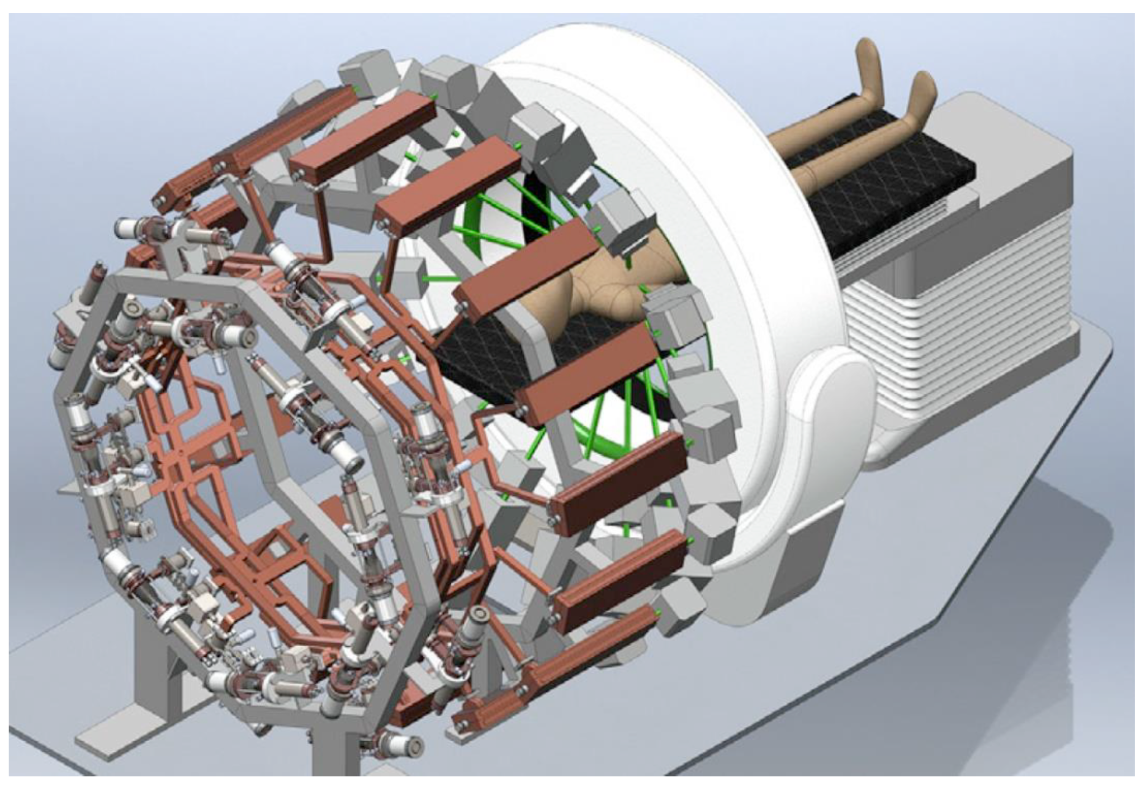
PHASER: A solution for FLASH-RT
PHASER (pluridirectional high-energy agile scanning electronic radiotherapy)
16 klystrinos power combined to drive a given linac with 5.3 MW of peak power
Switching between LINACs occurs at 300ns
Understanding the accelerator
Modeling the power combining is challenging (compensating for phase and amplitude jitter in the klystrinos)
Different LINACs need to operate at different energies
Beam steering using magnets
Patient treatment
Rapid computation of optimal dose
Compensation for breathing

Slide 9
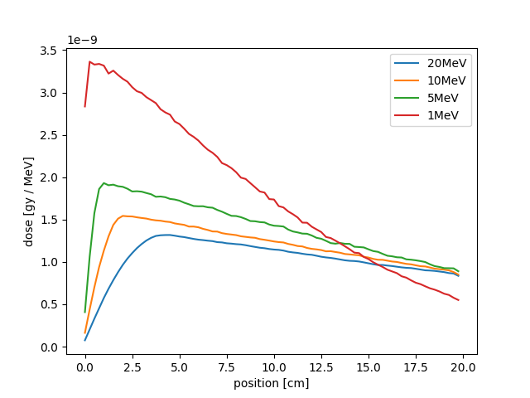
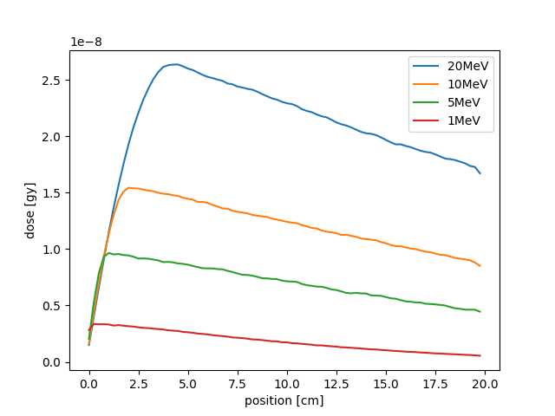
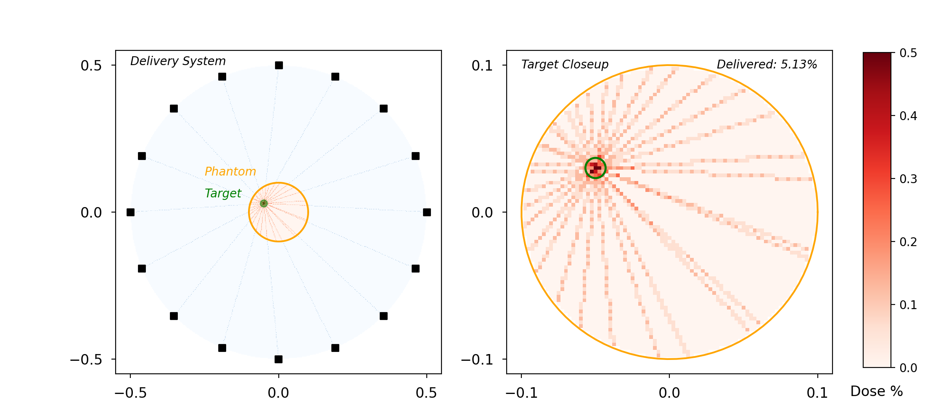
A Toy Model for A PHASER-like system
Water phantom simulated in GEANT-4
Modeling 1-D energy loss / deposition
Sixteen different x-ray sources with the ability to tune energy and steering to optimize the dose delivery profile
Toy model assumes a single target plane (2D)
Energy deposited in a water phantom
Energy range of the x-rays is 1-20 MeV
Can adjust commensurate with PHASER parameters
Compute the energy loss as a function of position inside a water phantom
Scan energy then use interpolating function to generate a continuous control knob for the RL model
Dose computed for 10⁶ x-rays – realistic beams would deliver ~10k times this dose

Slide 10
RL for Dose Optimization
Actor
Environment
Beam energy
Beam steering
Reward function
Dose target evaluation

Slide 11
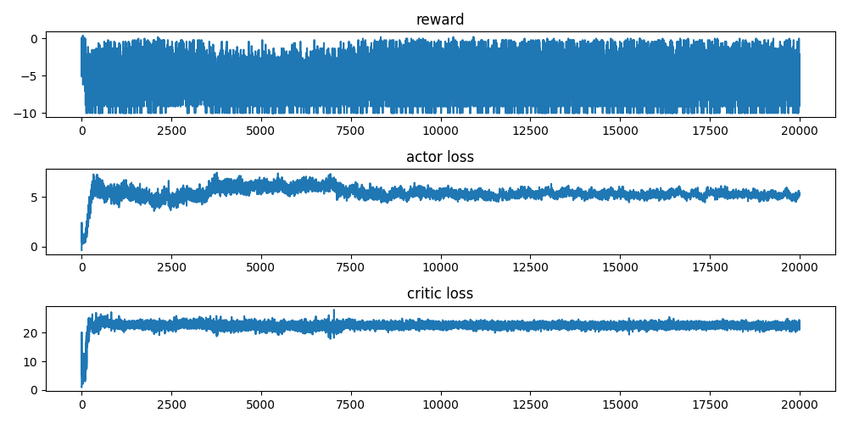
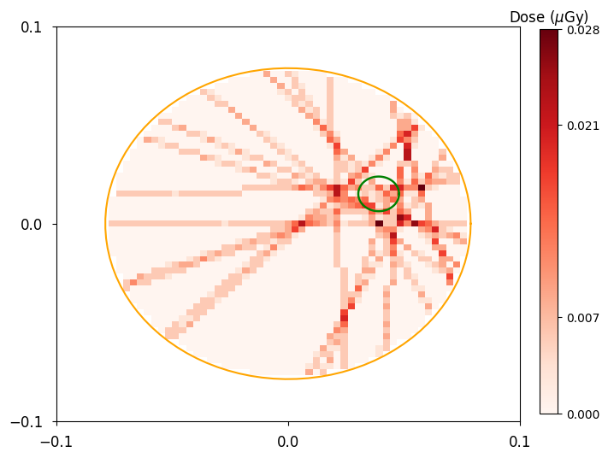
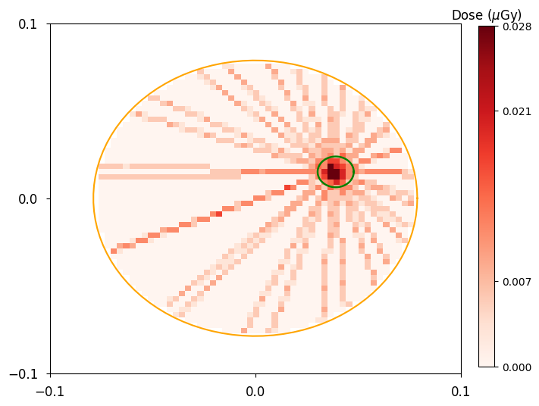
A Toy Model for A PHASER-like system
Target defined as a circular region with a fixed center point
Right – reward function, actor loss, and critic loss as a function of training iteration
Bottom – dose delivery results
Random errors in the steering (left)
Correct beam steering (middle)

Slide 12
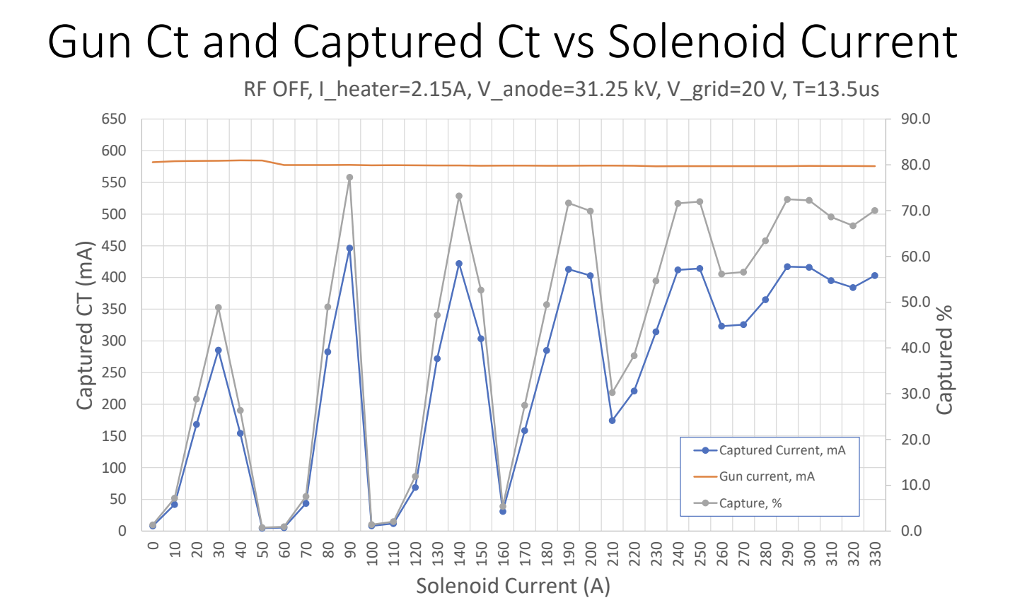
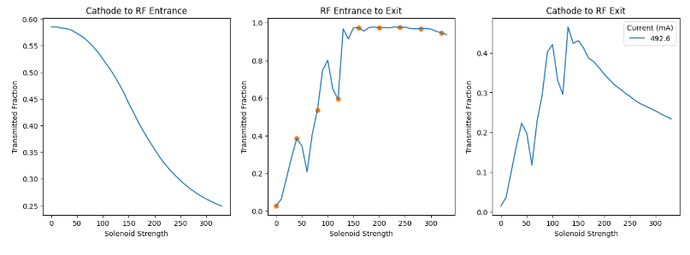
Applying RL to Industrial Accelerators
Objective: Rapidly switch between machine states for different sample imaging requirements
Control parameters: RF power / frequency (energy), electron beam pulse format and current, solenoids
Measurables: beam transmission, beam size/energy
Establish simulation model in SPIFFE that is representative of the system
See poster by Finn O’Shea
Focusing Solenoids (control parameter)
Beam current (measurables)
Gridded thermionic electron source (voltage control)
Sample
Pulse format controller
RF Linear Accelerator
(power, frequency)

Slide 13
Disclaimer
This report was prepared as an account of work sponsored by an agency of the United States Government. Neither the United States Government nor any agency thereof, nor any of their employees, makes any warranty, express or implied, or assumes any legal liability or responsibility for the accuracy, completeness, or usefulness of any information, apparatus, product, or process disclosed, or represents that its use would not infringe privately owned rights. Reference herein to any specific commercial product, process, or service by trade name, trademark, manufacturer, or otherwise does not necessarily constitute or imply its endorsement, recommendation, or favoring by the United States Government or any agency thereof. The views and opinions of authors expressed herein do not necessarily state or reflect those of the United States Government or any agency thereof.

