Slide 1
Autonomous Trajectory Steering of DC Beams at CERN’s SPS Transfer Lines Using Reinforcement Learning
Presenter: Adrián Menor de Oñate Contributors: Verena Kain, Michael Schenk, Niky Bruchon
03-04-2025

Slide 2
Outline
Problem Definition
Algorithm Implementation
Results
  Simulation
  Reality
Next Steps
Conclusion

Slide 3
Problem Definition

Slide 4
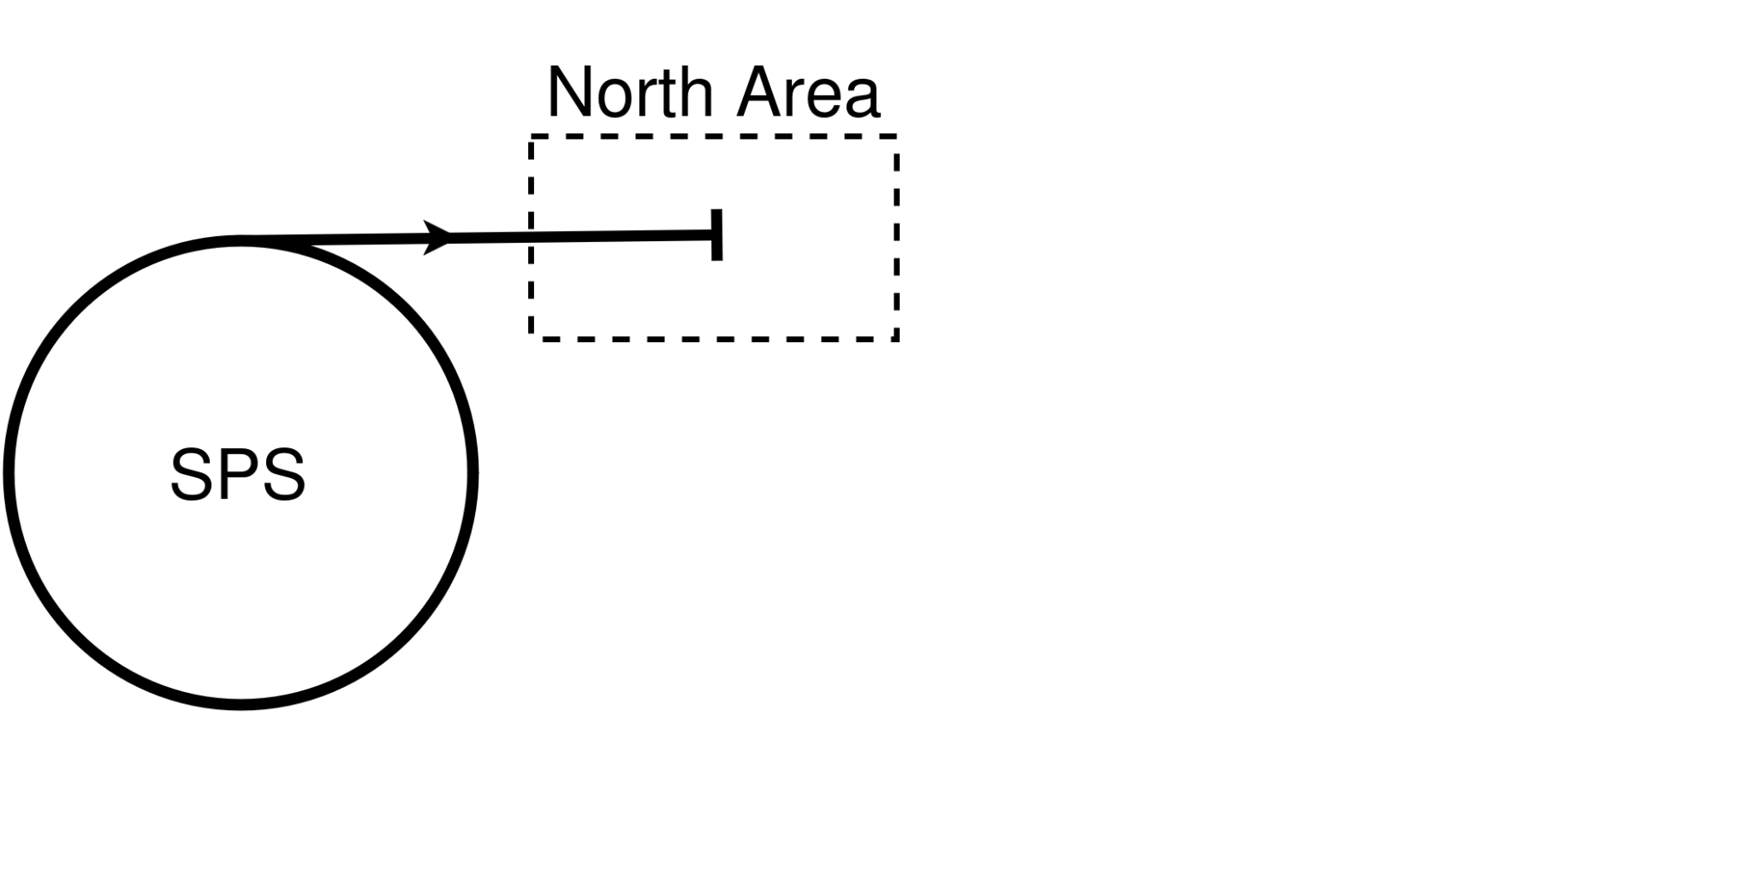
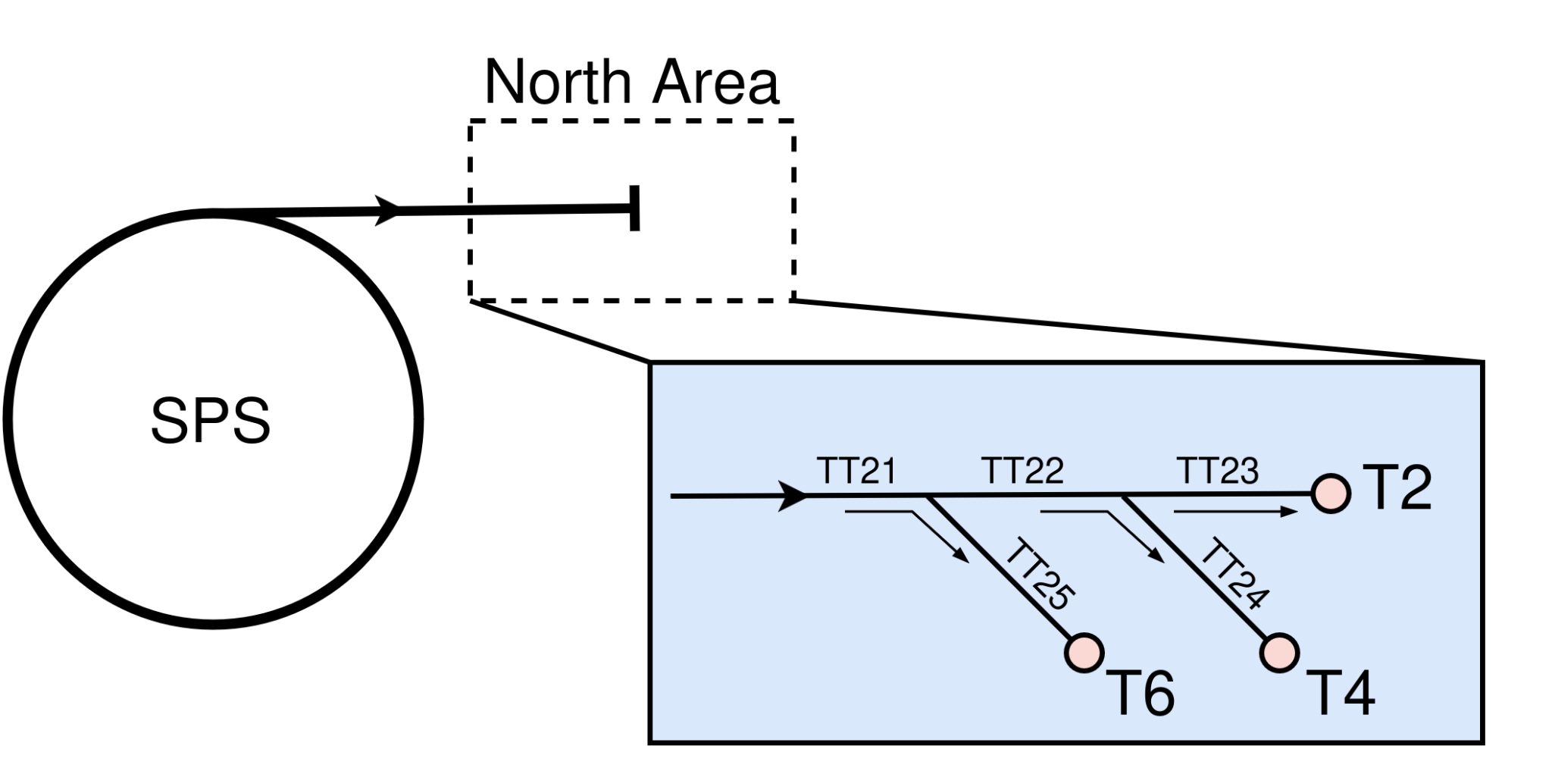
The SPS-North Area Transfer Lines
Goal: Having an aligned beam in the transfer lines
Act via dipole magnets
Observations?

Slide 5
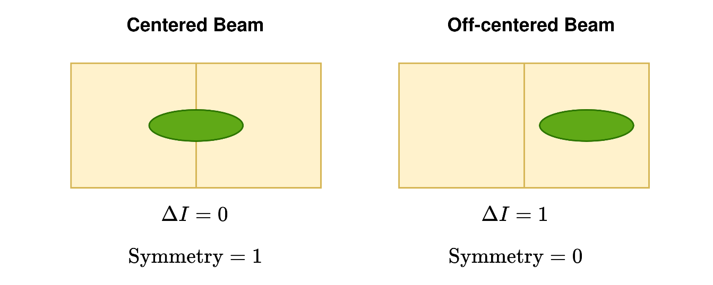
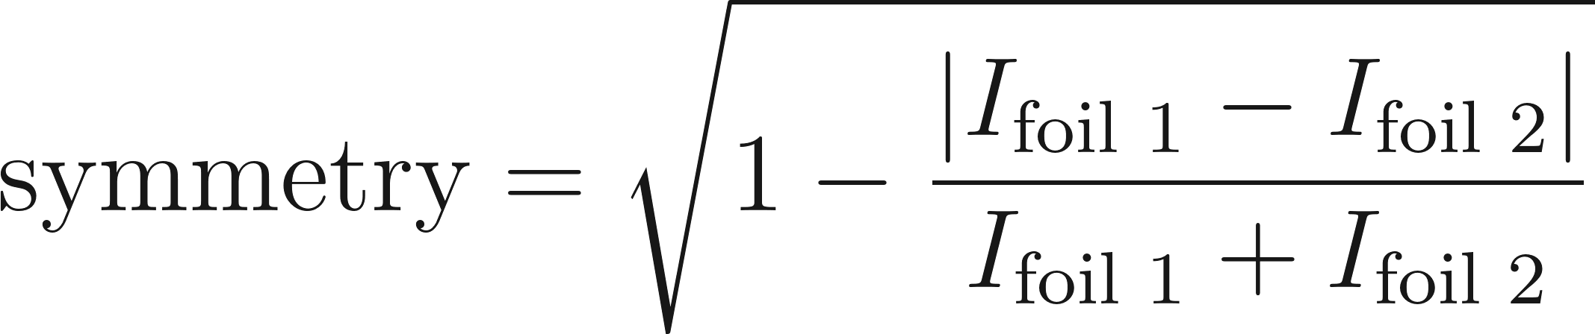
Observation Challenges
There are no beam position monitors available!
Split foils are used instead
Classical control algorithms (currently used) fail when the beam is only on one foil
Need for a flexible control architecture that requires minimal tailor tuning when applied to different transfer lines
Beam
Foil

Slide 6
Algorithm Implementation

Slide 7
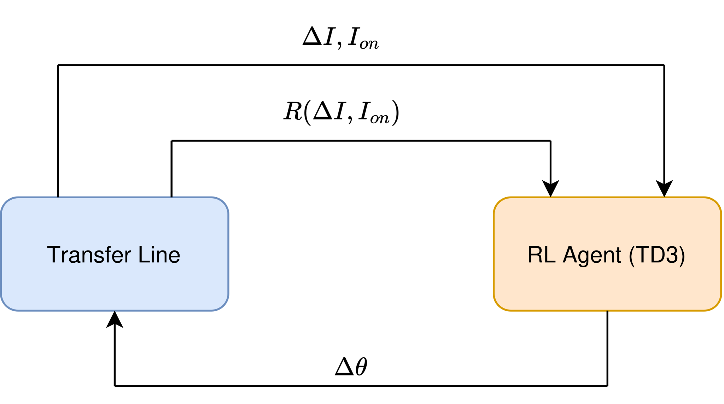
Reinforcement Learning Setup
Offline training, online deployment
Independent controllers for H and V planes
Beam dynamics simulated with MAD-X
Dipoles’ settings

Slide 8
Action Space
Strength of the dipoles [μ rad]
Actions are relative
Actions are kept within a max step size
Dipoles’ settings

Slide 9
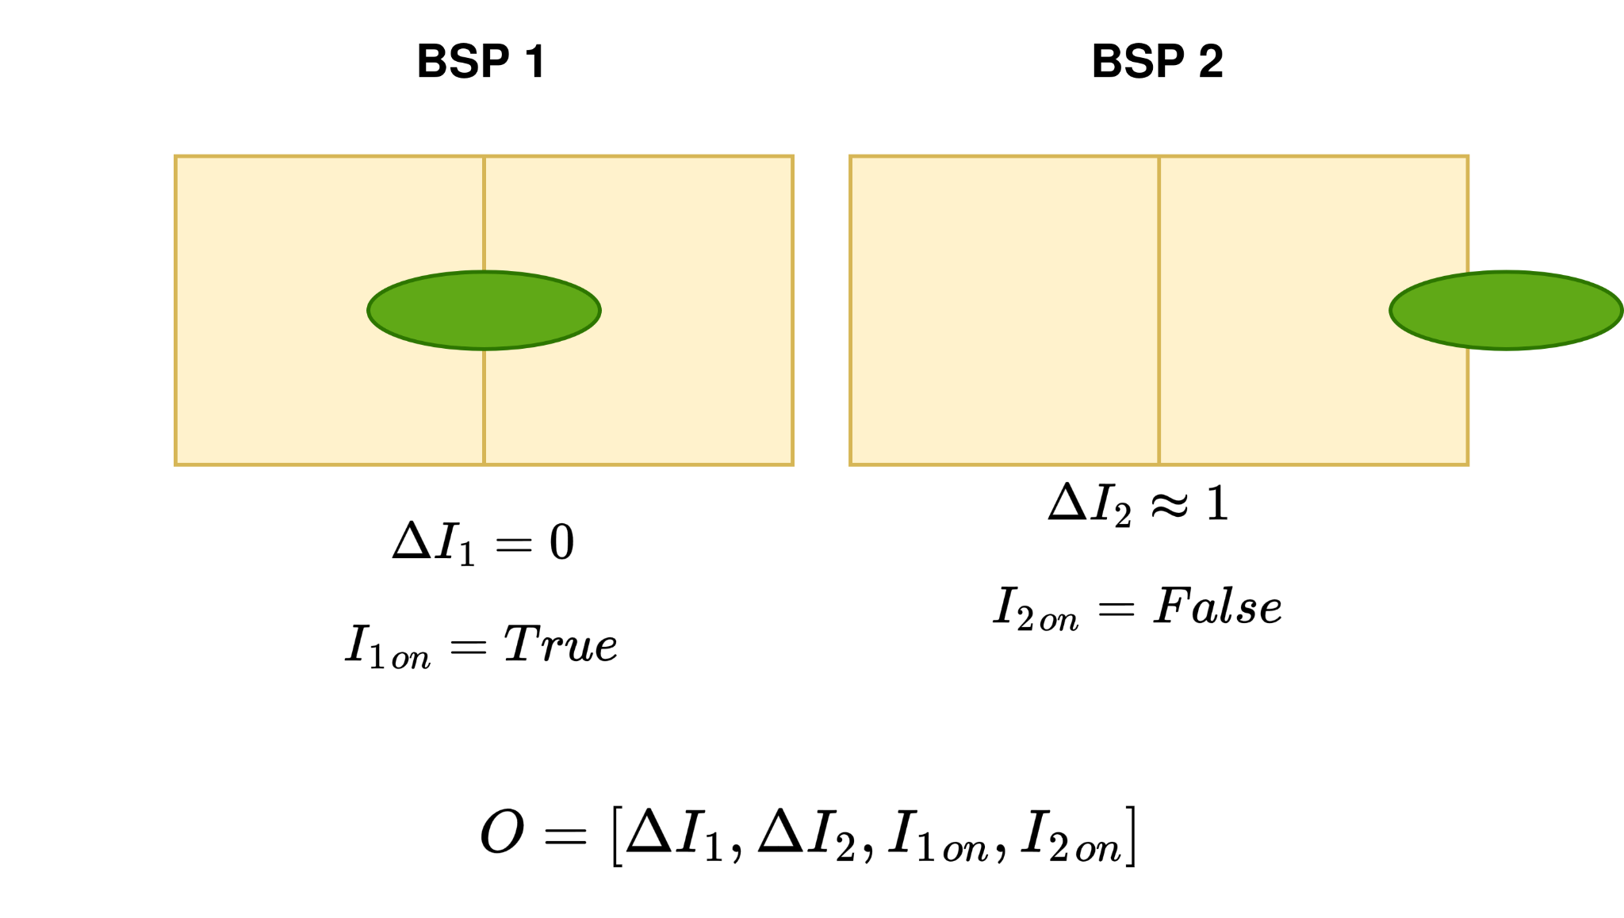
Observation Space
Example
Dipoles’ settings

Slide 10
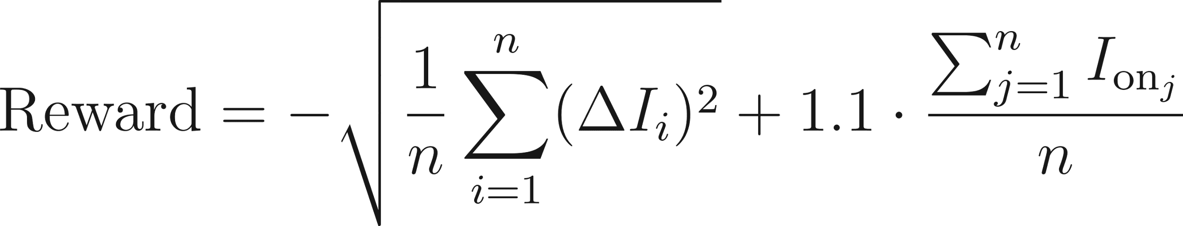
Reward Function
Centered beam
No beam loss

Slide 11
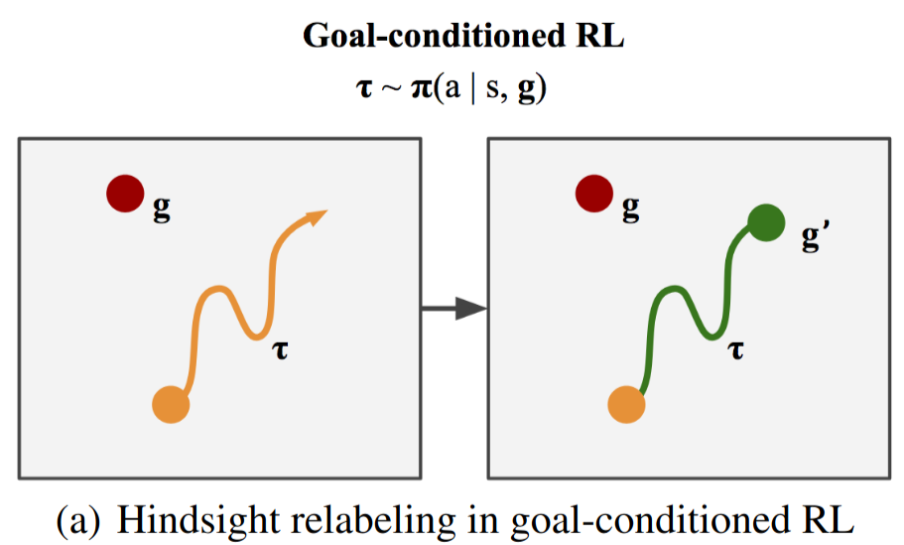
Reinforcement Learning Agent
TD3 algorithm
Hindsight Experience Replay (HER) buffer
  Robust against sparse reward functions
  Implicit curriculum learning
Image: Packer, C., Abbeel, P., & Gonzalez, J. E. (2021). Experience Replay for Sparse Reward Meta-RL. 35th Conference on Neural Information Processing Systems (NeurIPS 2021).

Slide 12
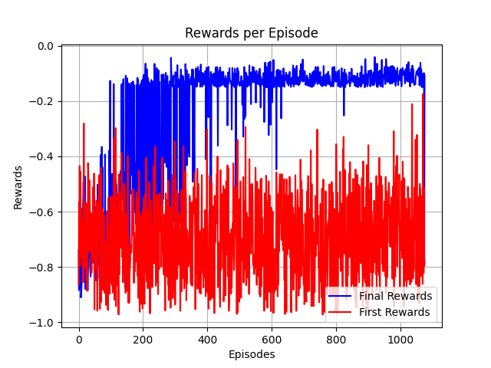
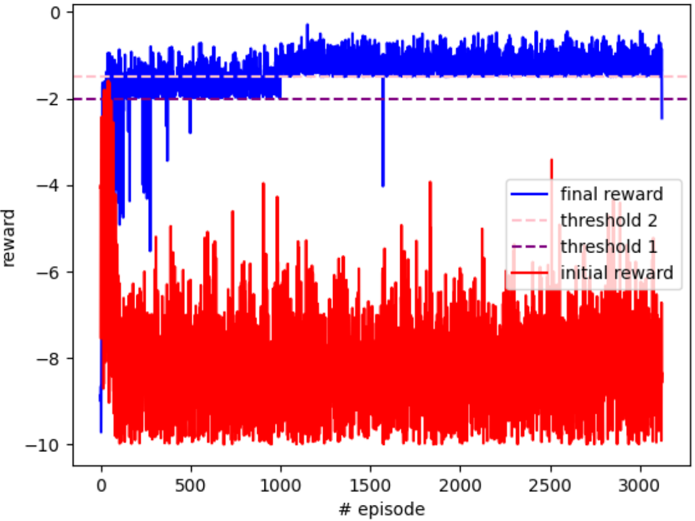
Hindsight Experience Replay (HER)
Train with larger actions and harder stopping criteria
No need for curriculum learning
W/O HER
HER

Slide 13
Results

Slide 14
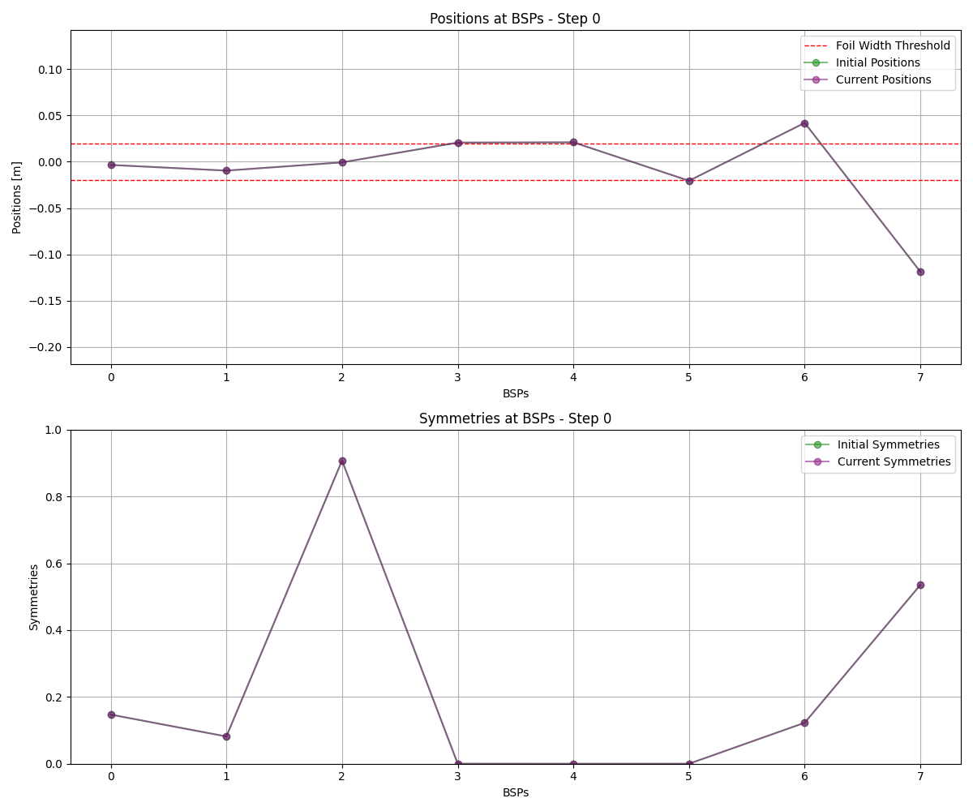
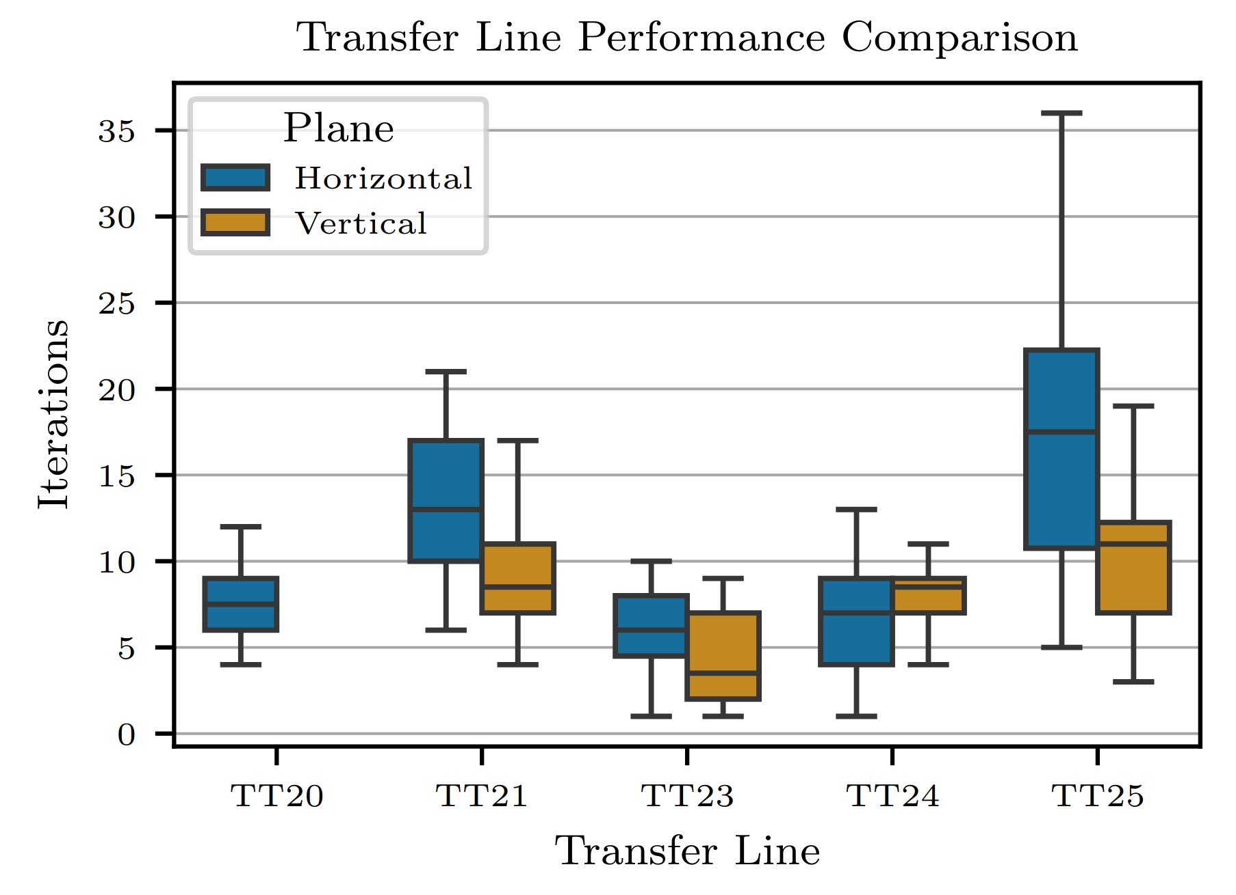
Simulation

Slide 15
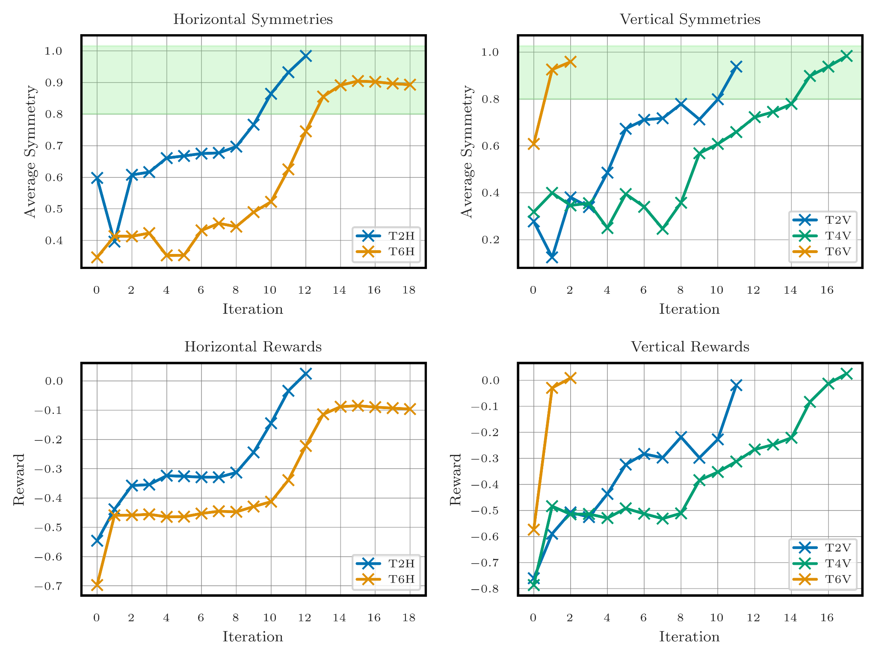
Reality

Slide 16
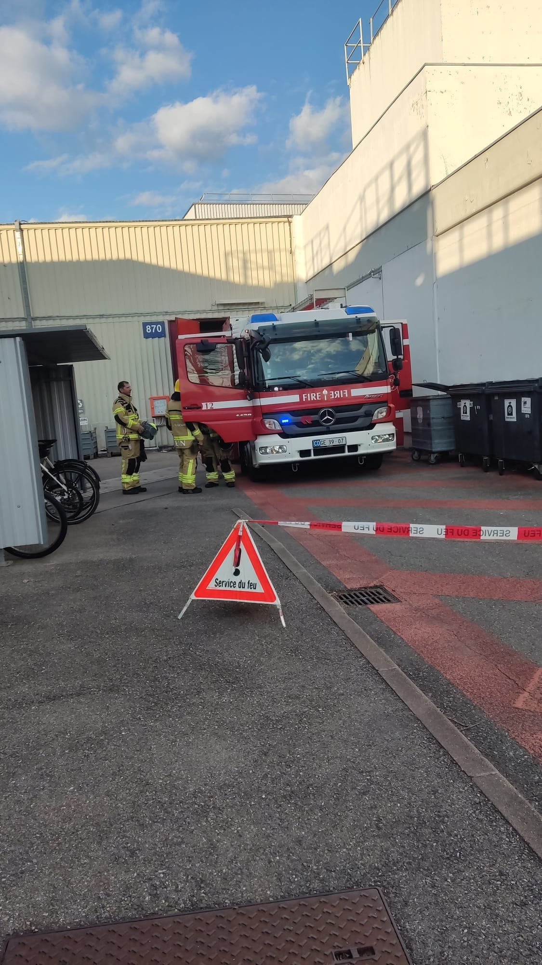
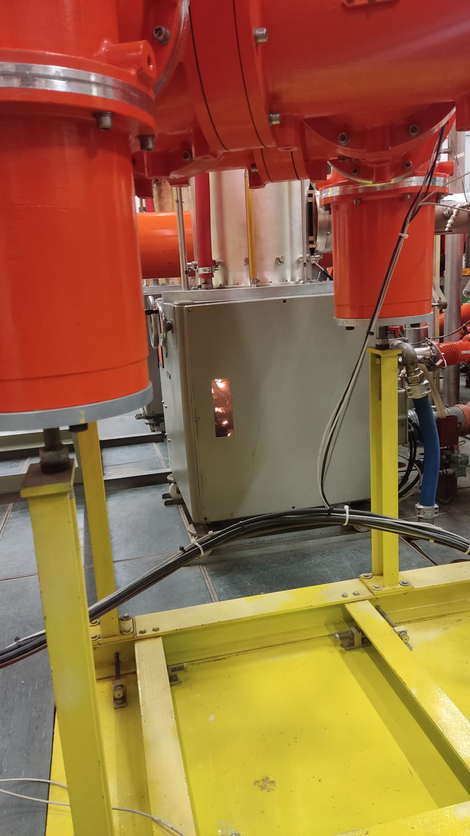
Reality

Slide 17
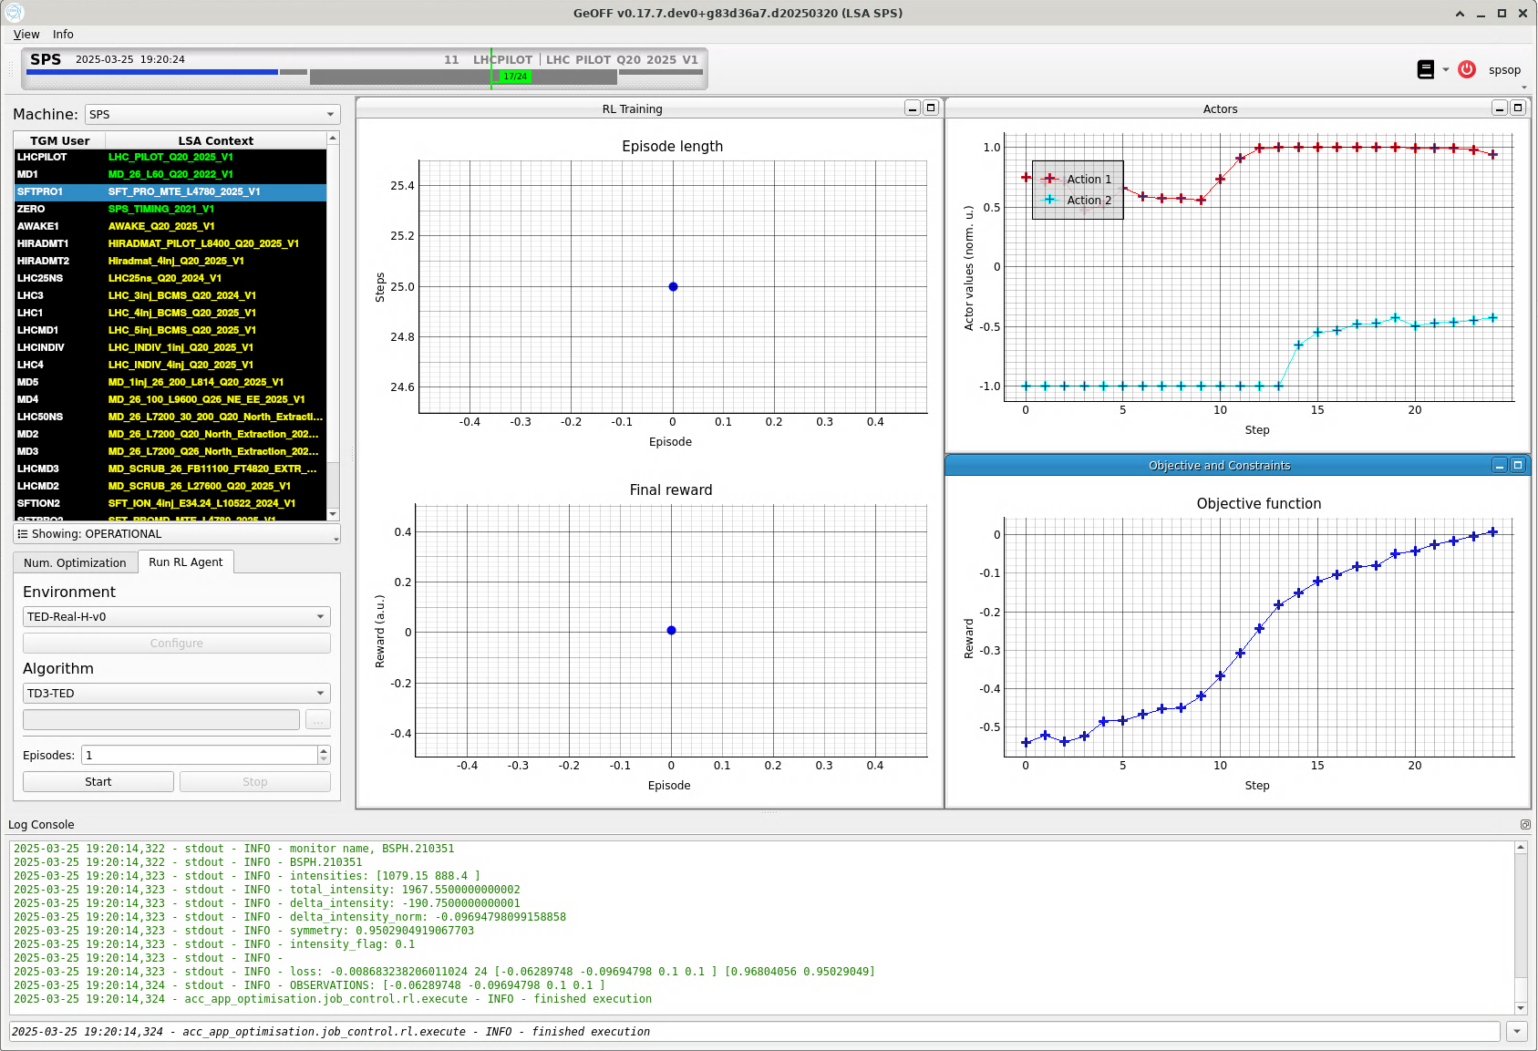
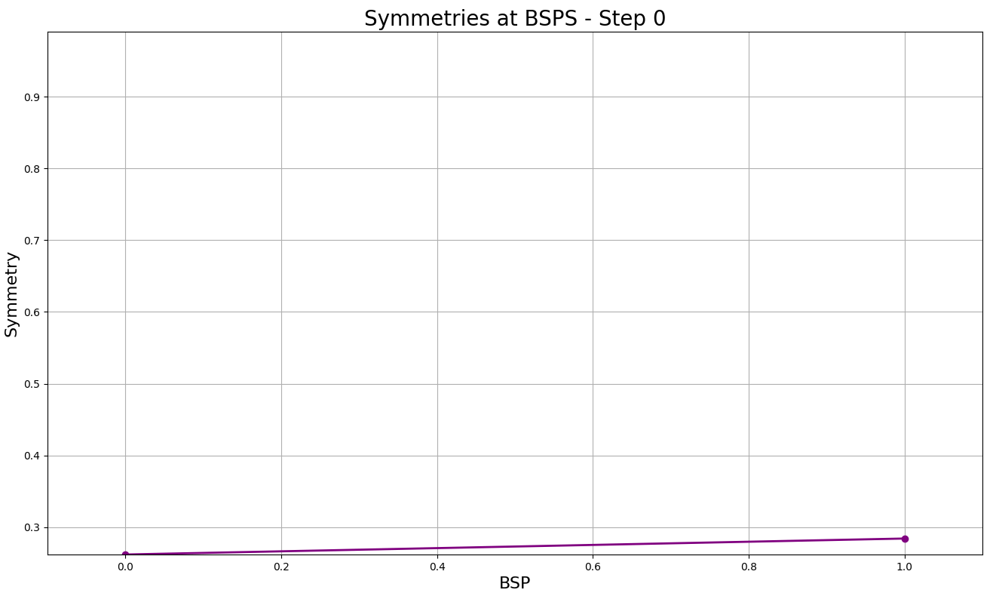
Reality

Slide 18
Next Steps

Slide 19
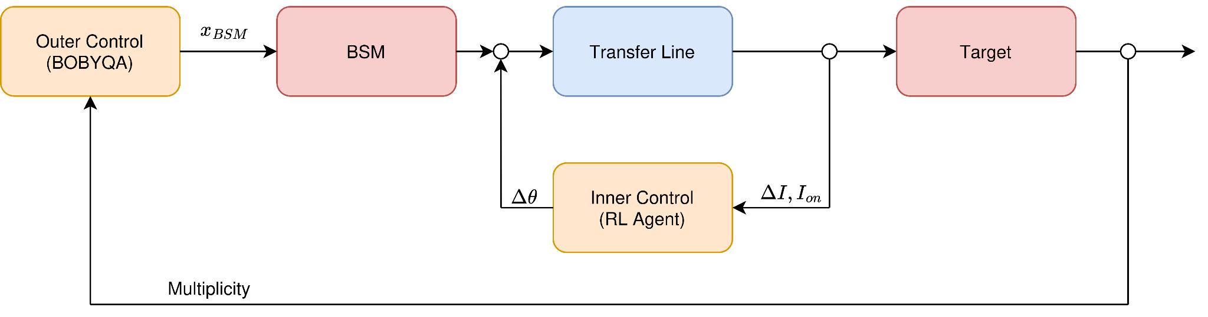
Future Steps: Automating The Target Setup
BSM = movable split monitor
RL Logic

Slide 20
Conclusion
The RL policies successfully transfer to the real world
The beam can be successfully steered in the different tests
The RL pipeline is flexible to adapt to the different transfer lines
Next steps may allow full target setup automation

Slide 22
Backup slides

Slide 23
Reality

Slide 24
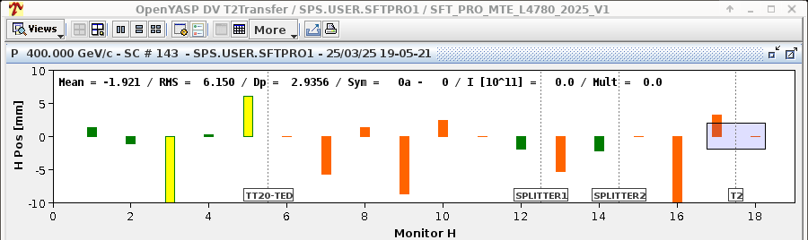
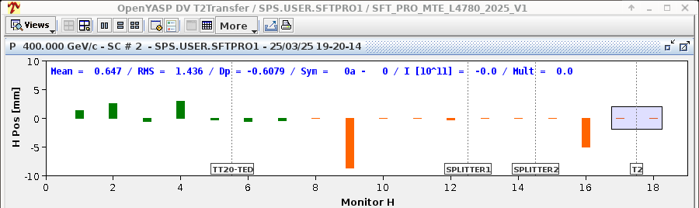
Reality
Before
After

Slide 25
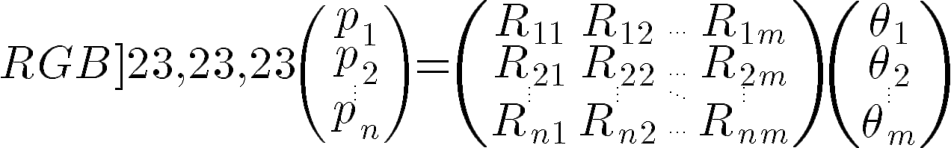
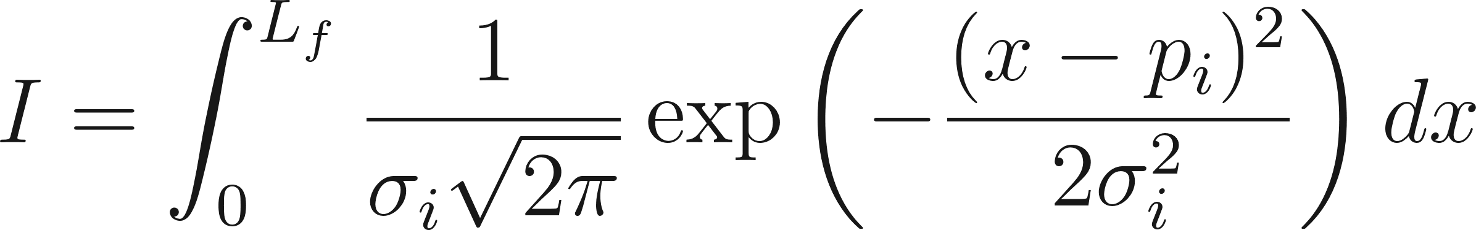
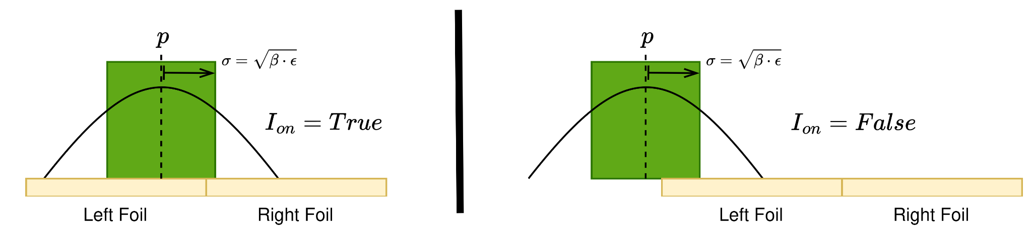
Simulated Environment
Linear Dynamics
Nonlinear Observation

Slide 26
Simulation vs Reality
 | Simulation | Reality
Beam loss flag | Mean beam position | Intensity threshold
Noise | Initial magnet settings | Magnet settings, beam conditions etc

