Slide 1
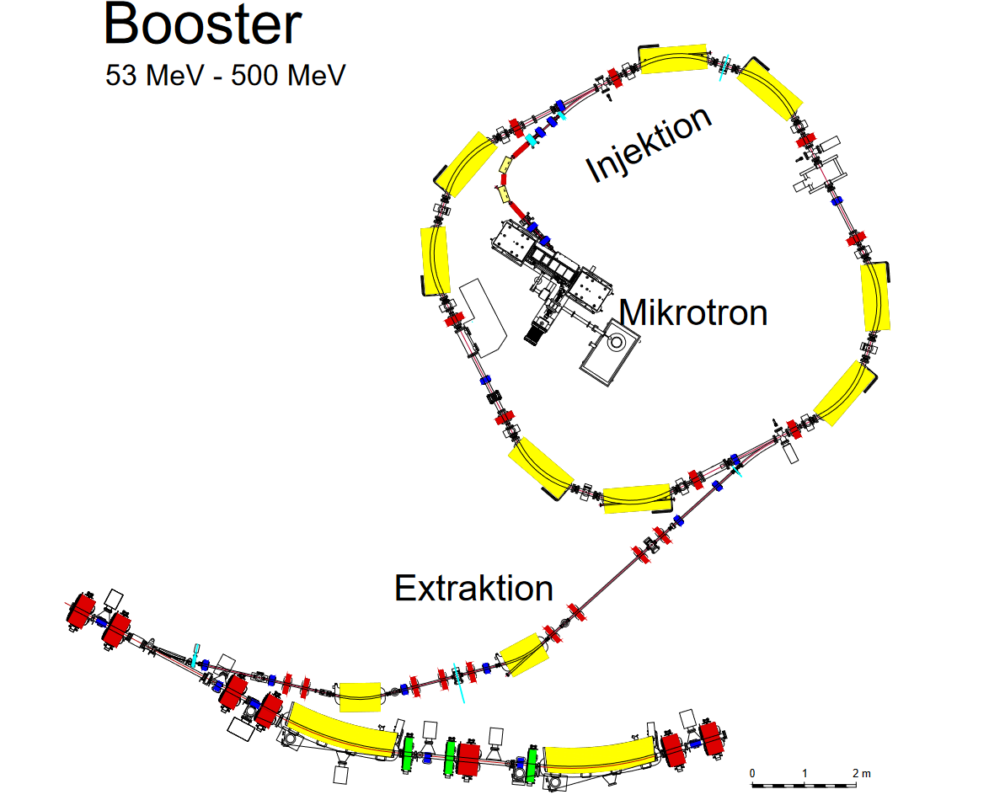
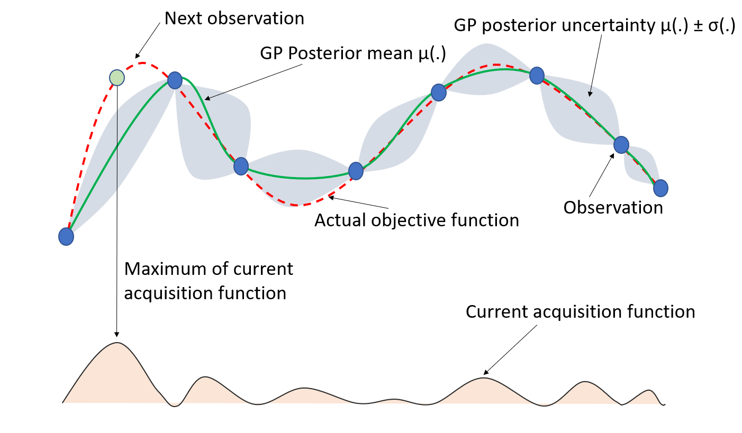
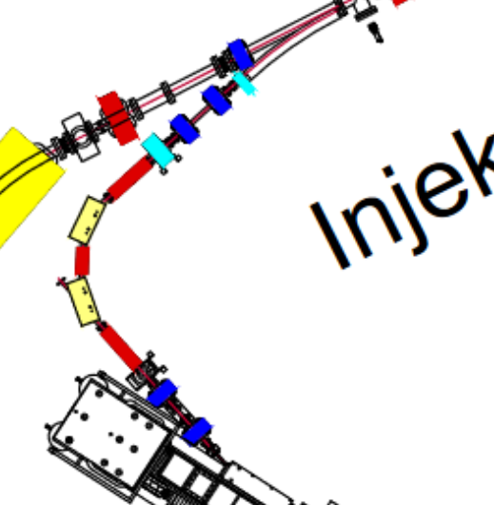
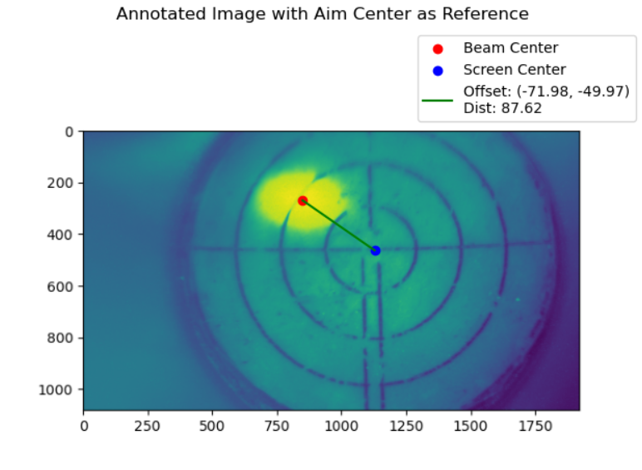
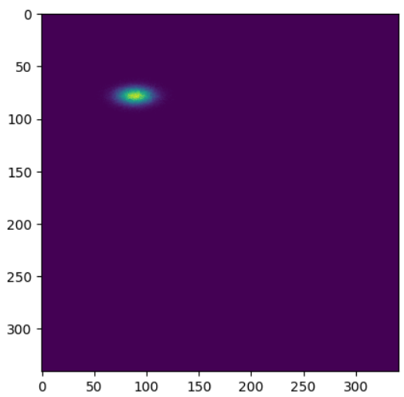
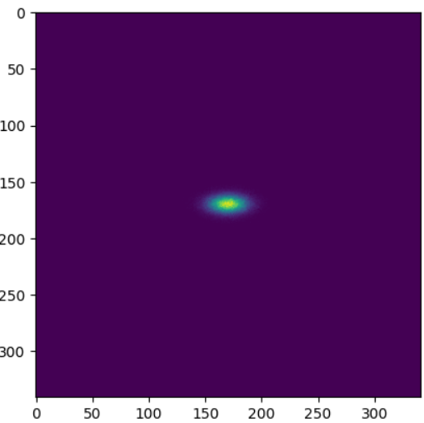
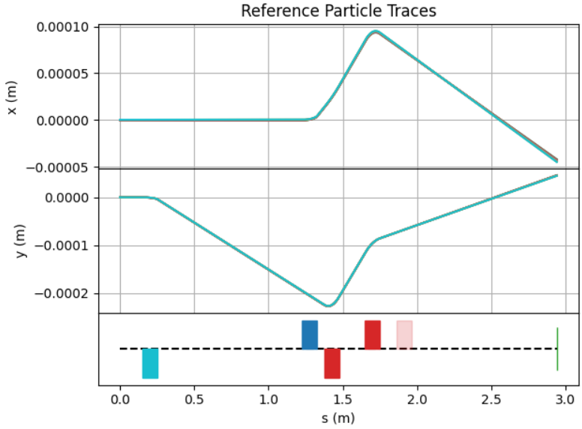
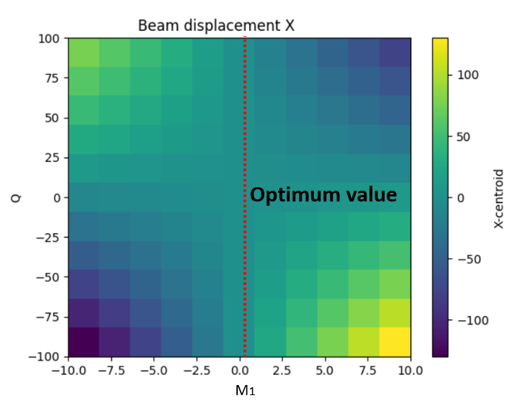
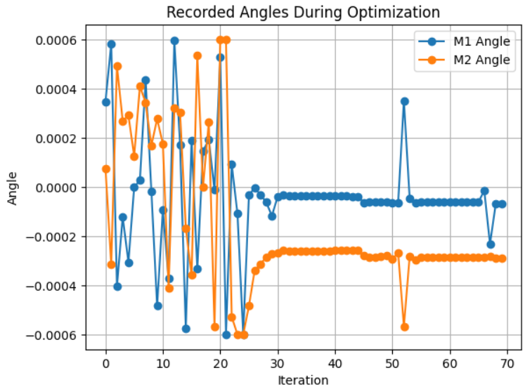
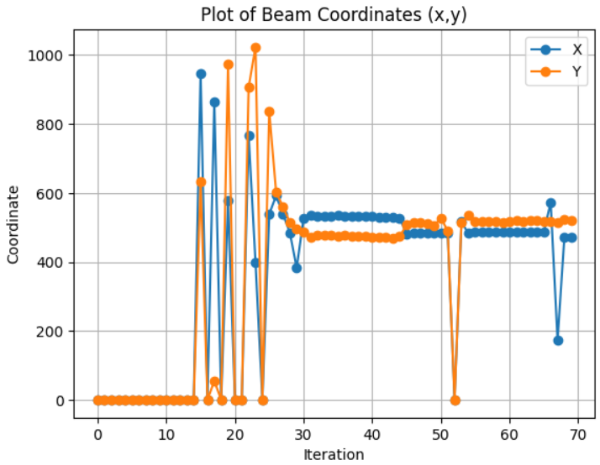
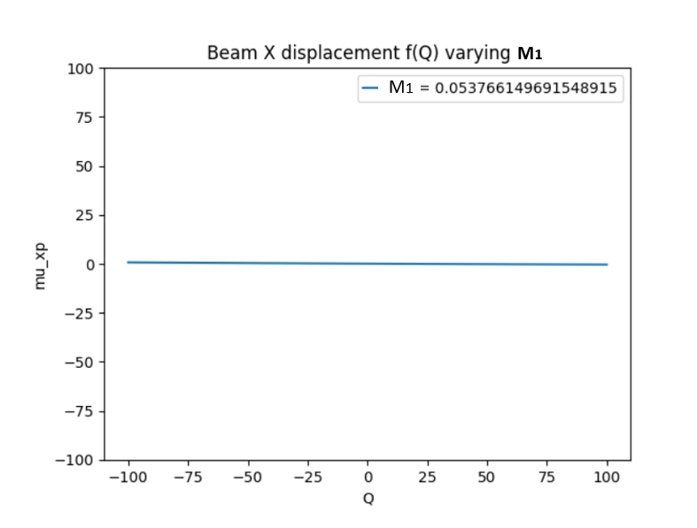
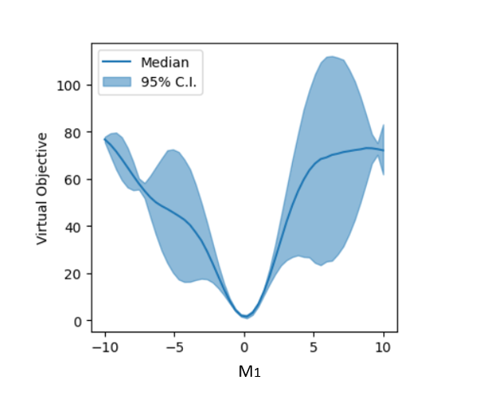
Efficient accelerator operation with artificial intelligence based optimization methods
Evangelos Matzoukas, Anke-Susanne Müller, Chenran Xu, Giovanni De Carne
Introduction
Bayesian Optimization (BO) / BAX / Cheetah code
KARA injection line
Faster tuning
Accurate alignment
Automated optimization
Cheetah
Deflection of the particle beam
Increased energy loss
Reduced beam efficiency and performance
Errors in diagnostics.
Fast simulation toolkit for particle accelerators
Easy-to-use differentiable simulation toolkit
Ease and speed-up the development and deployment of machine learning methods to particle accelerators
Simulations / Results
BAYESIAN ALGORITHM EXECUTION
BO controlling steering magnets (M1, M2)
BAX to align beam through quadrupole centre (M1, Q1)
Before (BO)
After (BO)
Pixels
Pixels
BO achieved the centering of the beam with the control of the steering parameters M1, M2
BAX efficiently finds the ideal steering parameters M1 for transporting through a quadrupole Q1.
Acknowledgment: This work has been supported by the Research Facility 2.0 project that has received funding from the European Union’s Horizon Europe research and innovation program under grant agreement No. 101131850.

