Slide 1
ViCE:
From desktop to cloud or HPC – Virtualized Research Environments
University of Freiburg, eScience dept.
D. v. Suchodoletz
28/08/2018 – GridKa School in Karlsruhe
Notes:
10.12.13
1
Novel Workflows for Abstract ...
1

Slide 2
Structure of the talk
Virtualization – paradigm shift for researchers and university computer centers
Motivation: Virtualized teaching and learning environments for computer pools / desktop virtualization
HPC, bwCloud and hybrid cluster operations
Virtual Research Environments and how to create them
Outlook

Slide 3
Challenges of CC operations
Today‘s challenges of computer centers
Very diverse scientific communities and broad set of software, tool demands
Different, contradicting demands regarding software environments
Short notice demands for hardware to be used at least for five years (but often for much shorter projects)
Personnel to operate all the (small, diverse) hardware servers expensive
Most resources underutilized most of the time; Save on money and hardware resources
Save on rackspace, power and cooling – computer centers generate significant energy bills

Slide 4
eScience and CC operations
History of applied CC operations research by the attached professorship and the eScience dept.
Where it began:
→ Optimize operation of computer pools
Very diverse user base requiring very different software environments for different courses: Lecturers, students
No real common denominator
Windows OS for „standard“ software packages like text processing, spreadsheets or interactive statistics, web publishing, …
Linux OS for software development, many open source packages like R, GIS, ...
Very different ideas on how even a common software base should be configured (modules, examples installed or not, preconfiguration of packages, …)

Slide 5
Pre-Virt: Make everyone unhappy
Lecturers expect the computer center to comply to their expectations on installed software
Should be available in 20 minutes time (when the course starts) on 20+ machines
Works for me, should work in the PC pools too (where is the problem??)
Install some evaluation software which is only valid for 20 days (even a month would be to short for decent planning)
Why didn‘t you install the exhaustive example collection?
Why did you changed/updated the software base; when it was fine in my last course!?
Traditional software deployment doesn‘t work that way
Not all software and versions easily live together in a single installation

Slide 6
Pre-Virt: Make everyone unhappy
Pool admins annoyed by ever changing expectations of different lecturers
Often not available in the right time
PC pools never free during normal working hours or at least not long enough for proper software roll-out and testing
Utilization of computer pools suboptimal
Software environment for the morning course might significantly differ from the one for afternoon and evening again and again for the week to follow
Difficult to schedule courses to pools
Software installation in one pool is completely different to the one in the other (no option to change the room if a particular one not available)

Slide 7
Pre-Virt: Make everyone unhappy
Students are unhappy not to find the software environment of the course they are attending
Might be only available in the pool booked by some other course
Might just got removed because of conflicting demands of some other course
Tight hardware – software coupling introduces inflexibility in time and space
Inflexibility increases operational costs

Slide 8
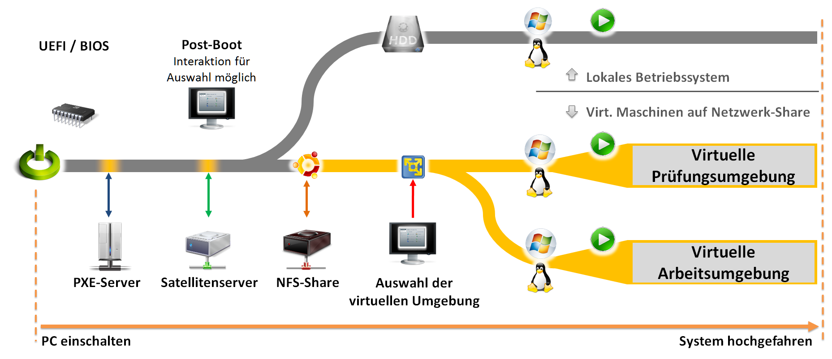
Optimize operation of PC pools
Virtualization comes into play: Break the tight link between software and hardware
Developed a new form of Desktop virtualization
Only PXE boot a Linux system on the PC (without the need of locally installed software at all)
Even allows to maintain local installation

Slide 9
Optimize operation of PC pools
Let the user choose from a wide selection of different environments (which are actually made available as images from a network share)
Then configure a hypervisor (or container) to run selected environment
Linux base system tries to handle all locally relevant stuff
Configuring of hardware including drivers
Authentication of users
Mounting home directory and further shares if desired
Provide printing services
→ Trying to avoid any site dependencies within the virtual teaching and learning environment

Slide 10
Selection of teaching environment
Hypervisor runs locally on the PC with selected virtual environment
Excellent for class rooms
Change rapidly from Programming C in Linux to Desktop Publishing in Windows without „leftovers“

Slide 11
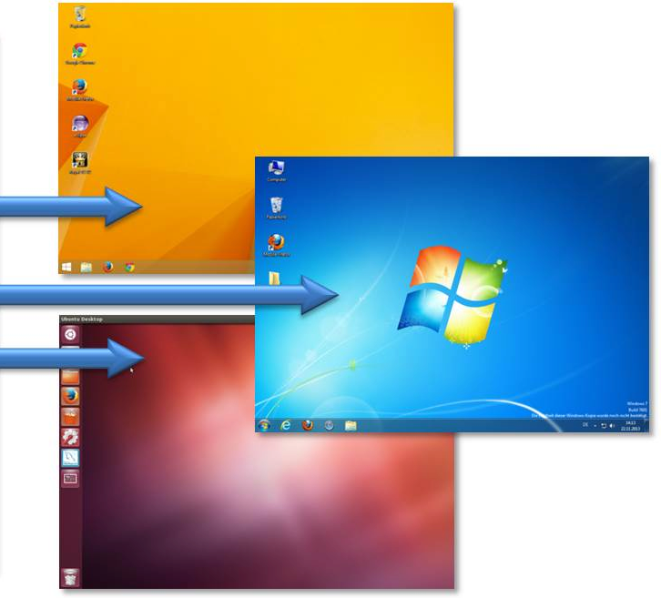
bwLehrpool: Separation of tasks
Administration of hardware is independent of the administration of the netbooted base Linux
Software environment and configuration is absolutely up to the lecturer who wants to teach a certain course
No time and physical dependencies for installations
Lecturer receives just a base image and extends it to his/her needs
All booted systems are exactly the same as using the same image to boot from

Slide 12
New ways of cooperation & application
Courses / images of virtual teaching and learning environments could get exchanged statewide offering cooperation between different entities
Next step: community provided environments e.g. created by students of a certain semester or faculty
Successful model of task separation between users, lecturers and computer centers
Plus: Adding to the drive in resource virtualization
→ Concept established – now widen it‘s application to further domains

Slide 13
Virtual science – how far we got?
Challenge: convince science that virtualization approach is beneficial
If only for convenience and reliability of results
Virtual(ized) research environments (VRE) for various scientific communities
Build virtual machines which suit a whole discipline → at least for their research interest
Bio-informatics: virtual Galaxy workflow engine
Long term usage and reproducibility
Long term archive (create some kind of “electronic lab book” as a side effect)
Right from the outset
CERN already uses „standard virtual machines“
Some disciplines are on the right track

Slide 14
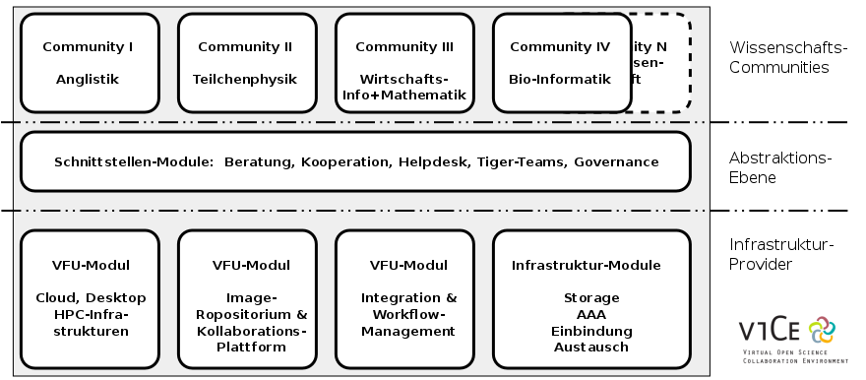
Bridging worlds
ViCE – state sponsored cooperation project of multiple disciplines and computer centers
Separate infrastructure / provider from core scientific tasks

Slide 15
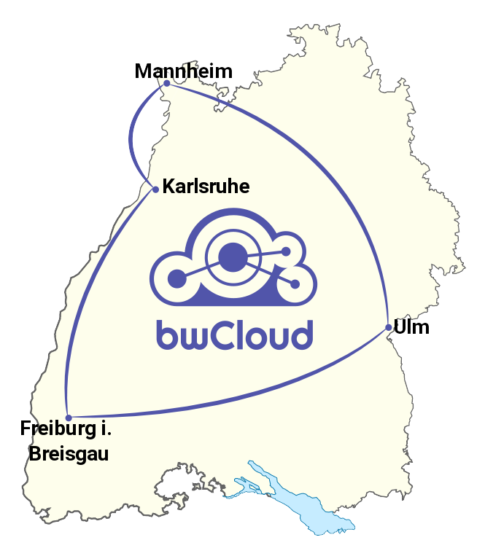
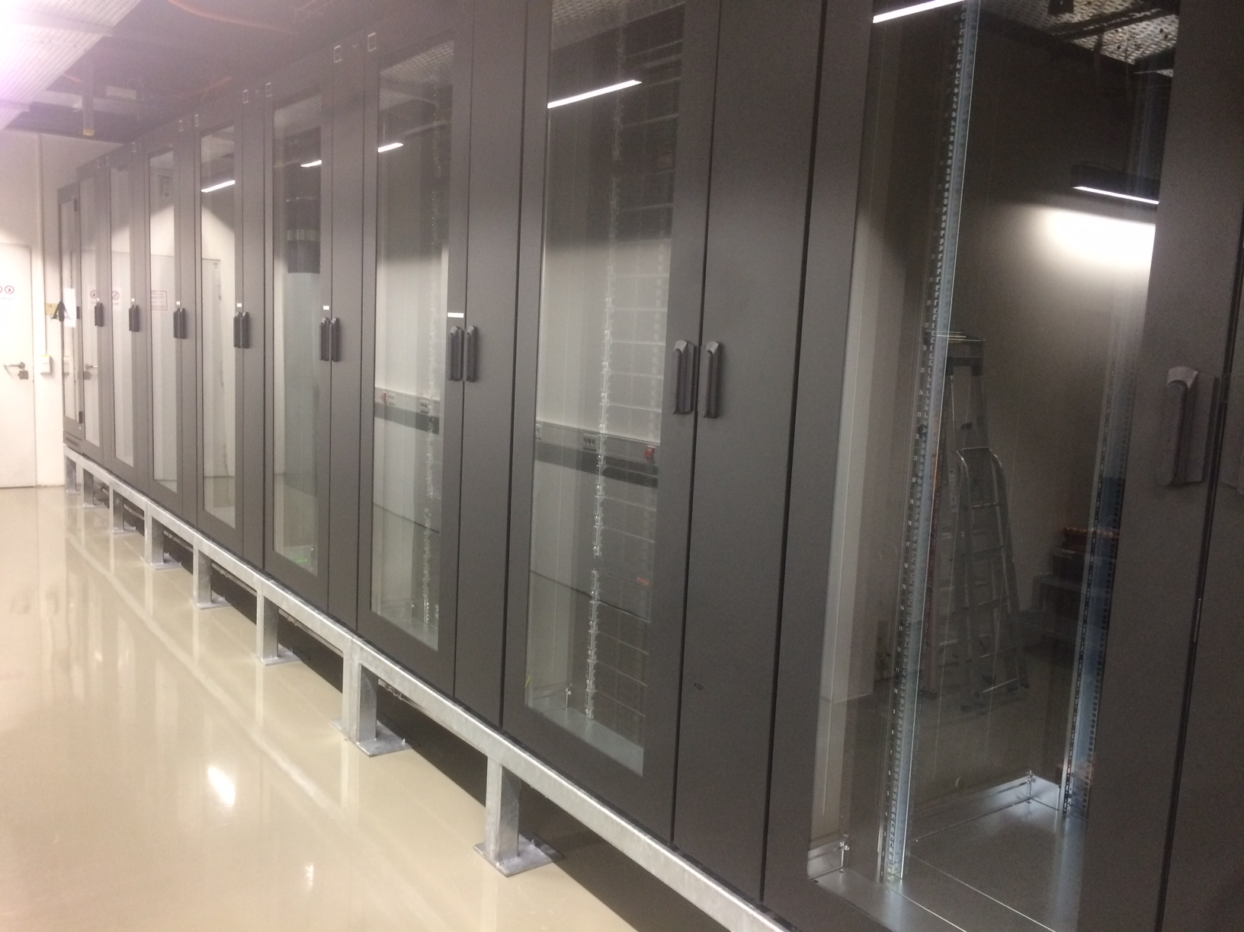
Research infrastructures
bwCloud and NEMO significant compute infrastructures in Freiburg well above 1000 nodes in a flexible boot and deployment environment
Both state wide cooperation of university computer centers in various constellations

Slide 16
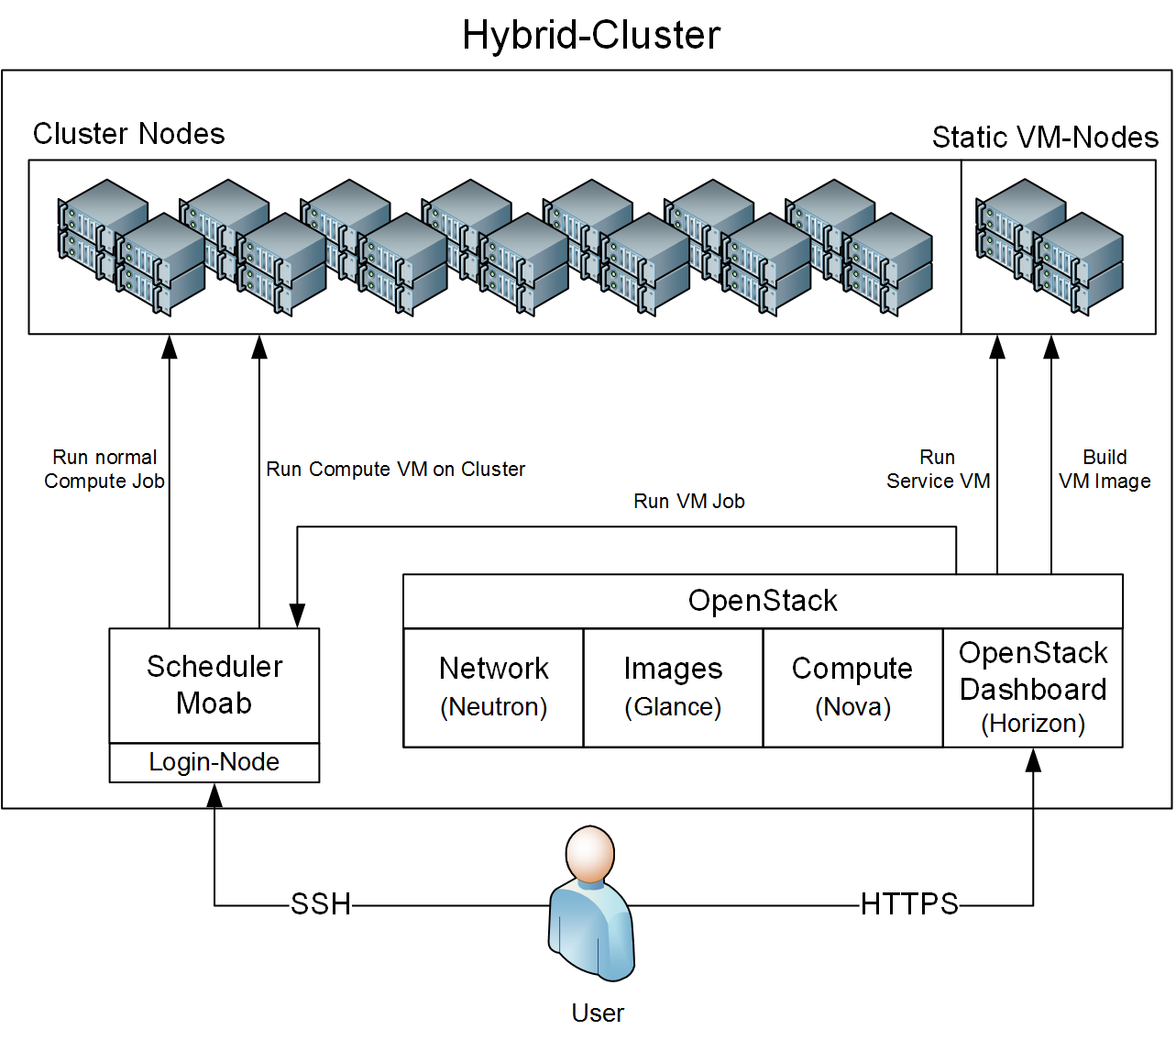
HPC and virtualization and cloud
Same hardware, different usecases: Create flexibility by abstracting hardware and software (again)

Slide 17
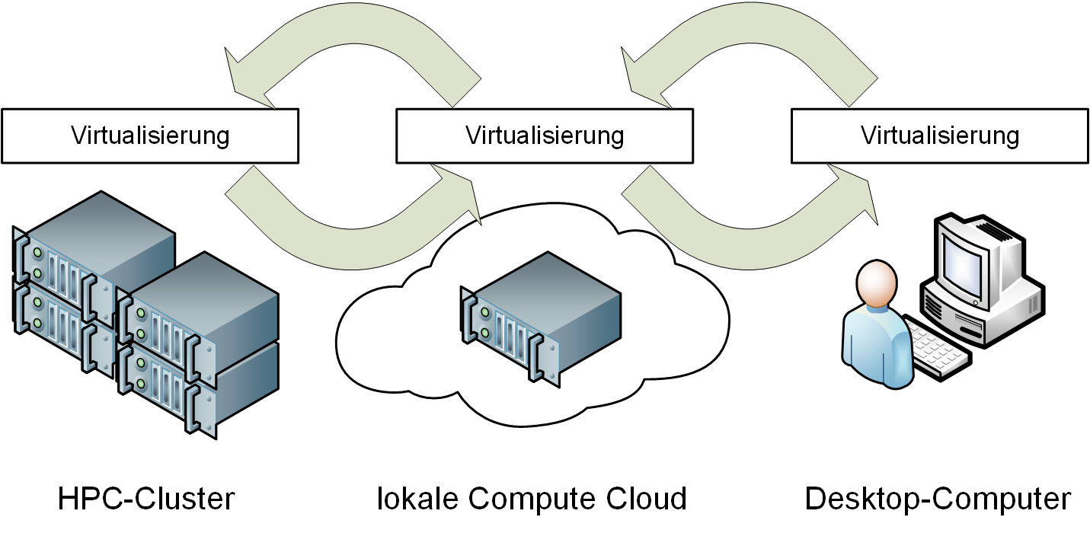
HPC and virtualization
Optimally: Allow flexibility over the different domains
Start to create and test a scientific workflow interactively on your desktop
Move it into the cloud in long running and not dependent on massive resources
Move it to the cluster if larger resources required or massive parallelization possible

Slide 18
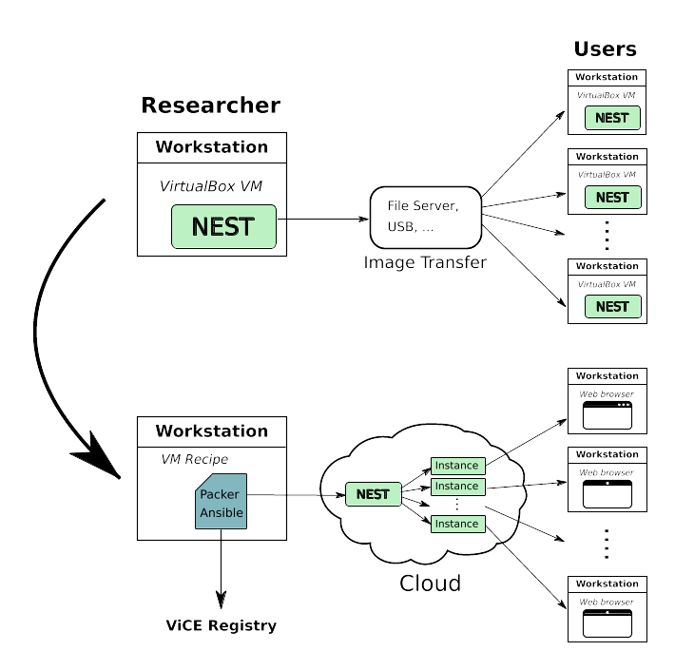
Usecases explored in ViCE
Bioinformatics: Galaxy workflows in VMs and containers
Computer linguistic and English language studies – provide a state-wide common environment for teaching, learning and research
Microsystems technology: Remote visualization to view large data sets (without copying them; ongoing experiments)
Economics: Dealing with large scale data and researching into secure environments
Neuroscience: From fast setup of interactive course environment to non-interactive use in HPC

Slide 19
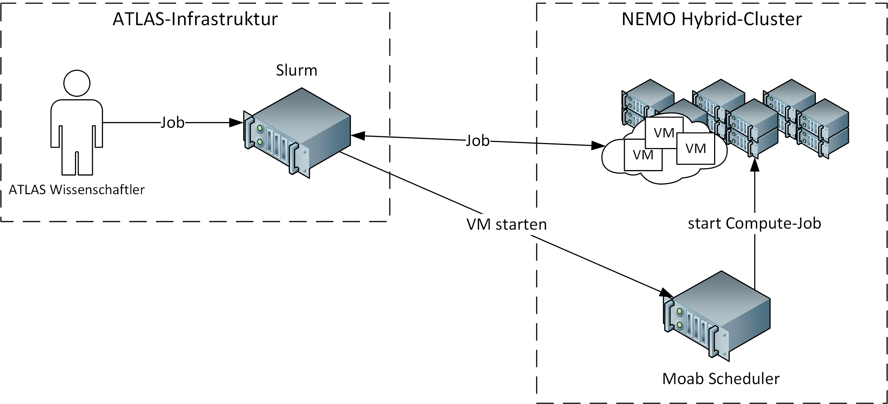
Usecases in Particle Physics
ATLAS/CMS: large scale, world-wide run experiments based on CERN data
Environment has to be exactly the same everywhere in the world
Software updates are slow because of exhaustive regression tests
Phd thesis of K. Meier
Software environment can not easily be reproduced directly on the NEMO cluster

Slide 20
HPC and virtualization
Additional benefits: VREs could get suspended and resumed (to be operationalized though)
Plenty of new options for scheduling / to improve scheduling
Offer long running jobs on a cluster with a standard 4 days walltime
Suspend (expensive, because of long running) jobs before cluster maintanance
Create a „fast lane“ and let certain jobs overtaking long running ones (which otherwise would clog the cluster)

Slide 21
Steps to define VREs
Depends on the scientific application and scaling factor (e.g. desktop interactive vs. massively parallel)
Audience: per scientist, per scientific workgroup or even per scientific field
Options of authentication depend on the actual users to log-on to the machine, if any
Resources for scientific workflows might differ significantly for e.g. grid systems, resource brokers, portals, knowledge systems or (large) data collections
Technical environment: The origin technical platforms may include desktop, cloud or HPC resources

Slide 22
Steps to define & create VREs
External dependencies of filesystems, identity management systems or if required of license servers
How to deal, manage, describe and provide access to large collections of VRE (versions)
Planning of setup and maintenance: Optimally, instances can be created by automatic procedures like Packer, Ansible and alike or cloned from templates
Long running VREs might require updates and older versions need to be stored for reproducibility

Slide 23
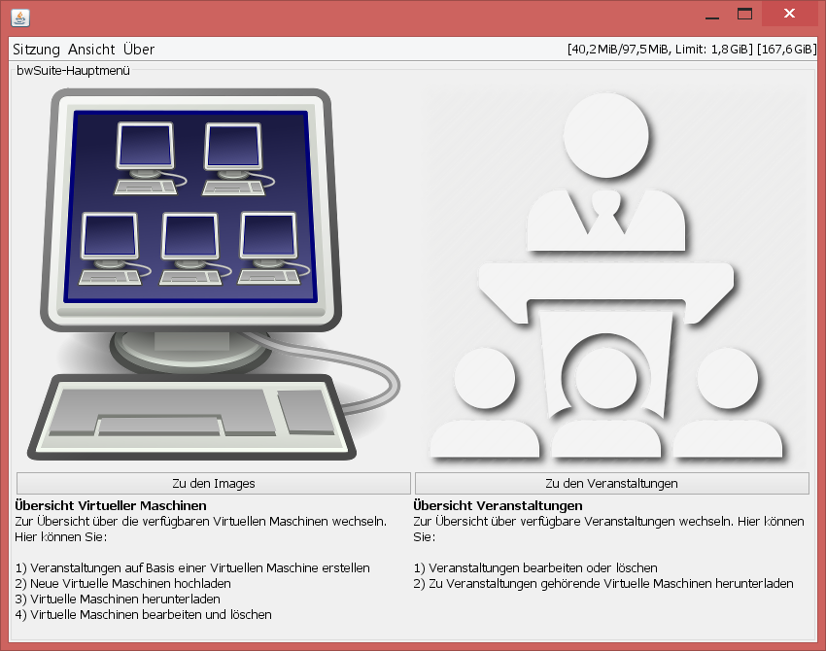
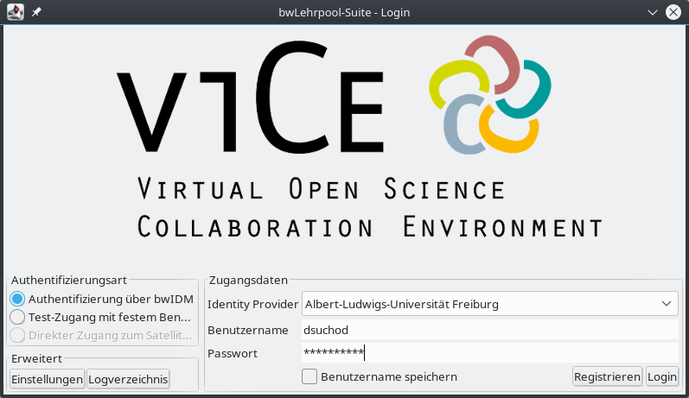
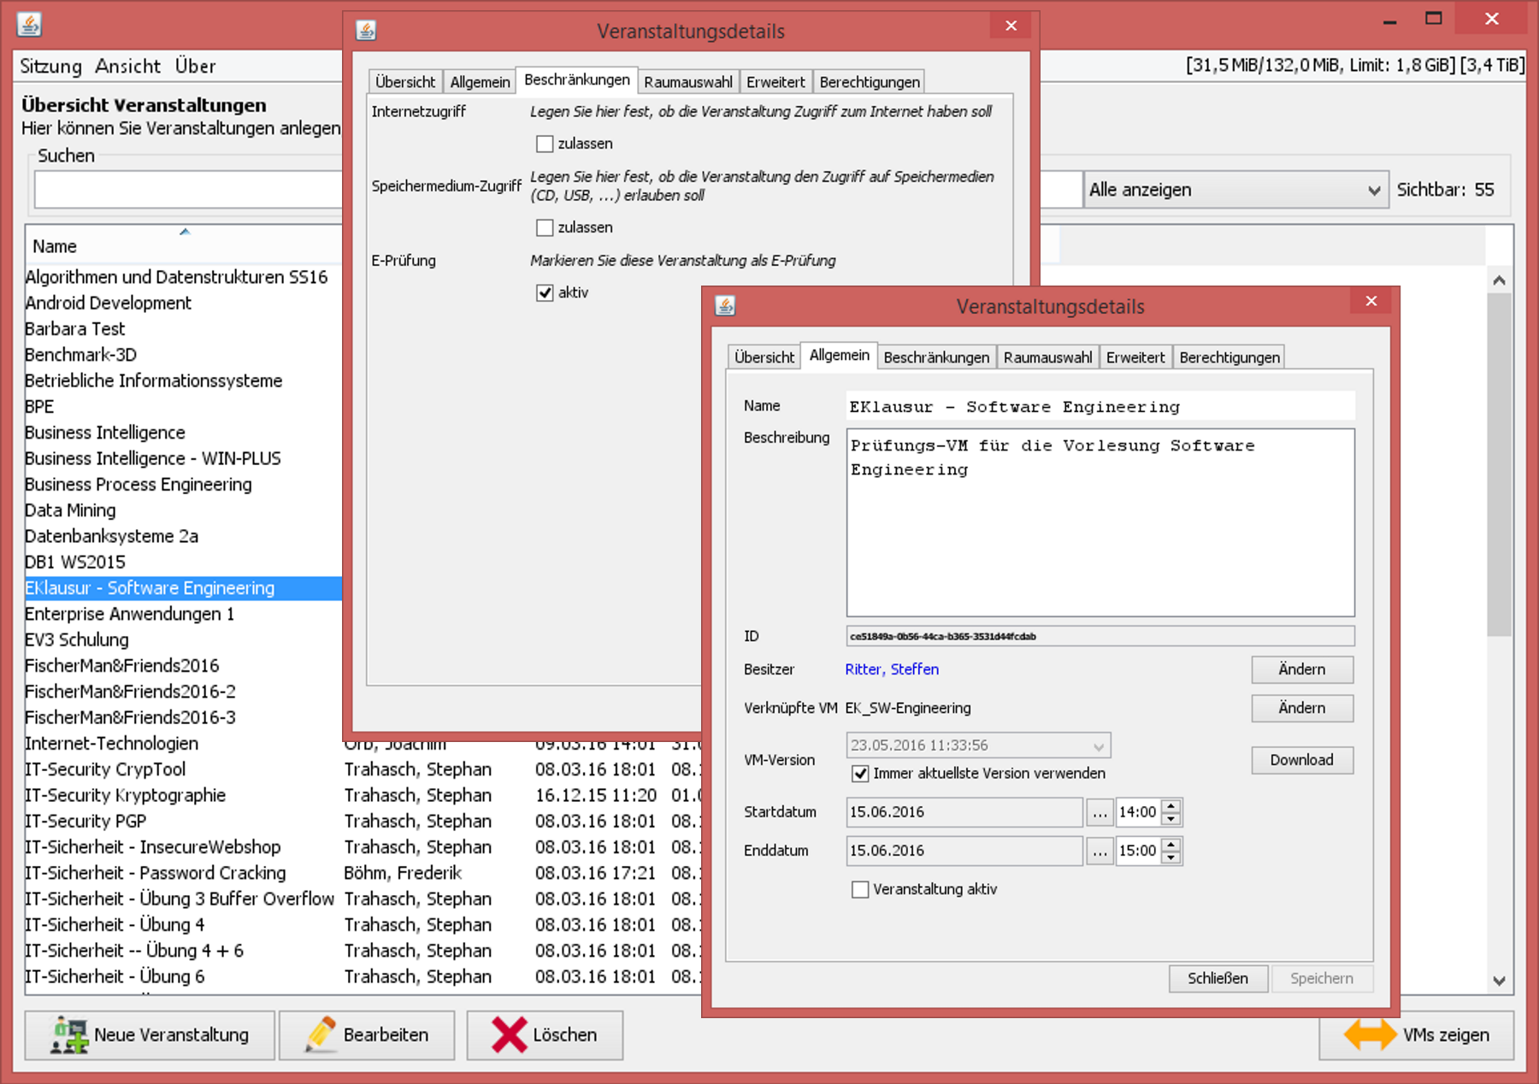
Manage VREs
Primarily: Interactive tool to manage Vms/VREs in bwLehrpool
Additionally: Created a prototypical ViCE registry which can exchange meta data with bwCloud/OpenStack and bwLehrpool

Slide 24
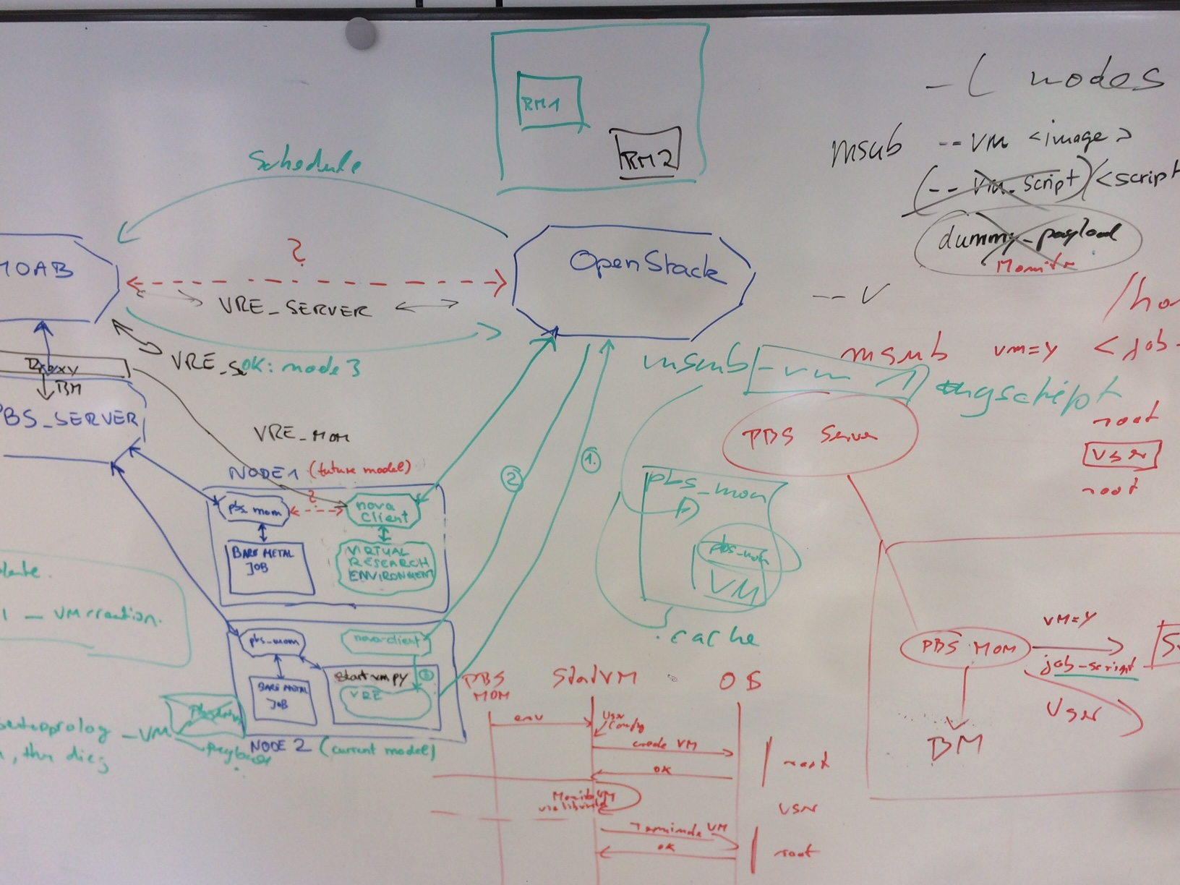
Challenges / Research Questions
How to properly describe scientific software and/or complete VREs?
Which meta data, schema to use?
E.g. suggestion of a very abstract schema definition (dataset), http://schema.org/Dataset or discussion on data publishing: http://blog.wolfram.com/2017/04/20/launching-the-wolfram-data-repository-data-publishing-that-really-works/#the-data-curation-hierarchy
Scheduling challenge
Hybrid clusters generate nice „scheduling nightmares“
Running non-interactive batch jobs for a rather wide selection of different computations and simulations
Batch scheduler tries to allocate appropriate resources and optimally fill the cluster

Slide 25
Consequence: Virtual workflows
180° turn:
Provide a virtual machine to the computer (instead of using it bare metal)
With all necessary drivers, connectors, etc before the environment is used for research
Then it becomes easy to archive the complete environment
Only approved images will be used
Higher reliability in research
Reduced complexity – all computers run the same environment; same artefacts
Coexistence with local environments and environments of other users
Saves time – no need to install software
Talk about science rather than setup + configuration problems

Slide 26
Creating electronic „lab books“
Digital science often a „good“ example for fire & forget principle
Results created/generated by computer program(s) which are heavily dependent on a certain environment
Status Quo in digital science
Data, results become worthless without proper context
„inherit“ the data and worry about how it was produced
Not everything is known, although promised
Some inter-dependencies forgotten
Exact state of the original computer environment is unkown
Updates, modification to the system, twists imposed by manufacturers of research hardware
Malicious modifications of the computing environment?
By accident – or intentionally?
i.e. make the mistake and worry later

Slide 27
Thank you / Questions!?
Further information: ViCE people
ATLAS / physics: F. Bühler, A. Gamel
Bio informatics: B. Grüning, H. Rasche
Computer center FR: J. Bauer, M. Janczyk, B. Wiebelt, O. Zharkow, D. v. Suchodoletz
Project descriptions:
https://www.alwr-bw.de/kooperationen/vice
http://www.bwlehrpool.de
https://www.bw-cloud.org/en

