Slide 1
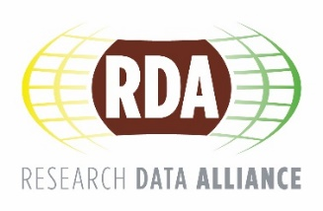
Building global bridges and connections: The Research Data Alliance
HILARY HANAHOE
secretary General
Research Data Alliance
Hilary.Hanahoe@gmail.com
CC BY-SA 4.0

Slide 2
Once upon a time …
there was a data management office (DMO)
Specifically …
The Biological and Chemical Oceanography (BCO) DMO
CC BY-SA 4.0

Slide 3
The Challenge
Curating research data for over a decade and currently operating on a 5-year grant. With data management best practices changes within a funding cycle, it is hard to make major systemic changes to workflows and infrastructure.
CC BY-SA 4.0

Slide 4
existing system allowed researchers to cite data and subsets of the data, but did not have a mechanism for managing those citations as new versions of the dataset became available
CC BY-SA 4.0

Slide 5
The Solution(s)
Cite data subject to change
Applied a common core data model
Classified their data sets in standard data types
Defined standard core PID information types
CC BY-SA 4.0

Slide 6
“Without these solutions it would not be possible for citations to be made that didn’t specify the version of the data being cited.”
CC BY-SA 4.0

Slide 7
The Solution(s)
Cite data subject to change -> Dynamic Data Citation
Applied a common core data model -> Data Foundation & Terminology
Classified their data sets in standard data types -> Data Type Registries
Defined standard core PID information types -> PID Information Types
CC BY-SA 4.0

Slide 8
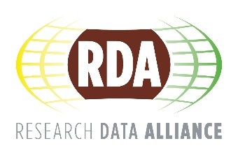
4 RDA recommendations Dynamic Data Citation Data Foundation & Terminology Data Type Registries PID Information Types
CC BY-SA 4.0

Slide 9
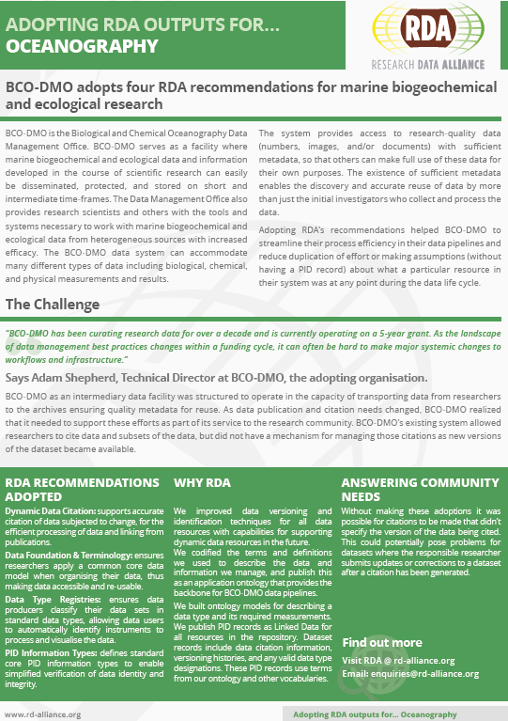
Read the full story … at https://tinyurl.com/y9uhvmzc
CC BY-SA 4.0

Slide 10
The Research Data Alliance vision is researchers and innovators openly sharing data across technologies, disciplines, and countries to address the grand challenges of society
CC BY-SA 4.0

Slide 11
… to build the social and technical bridges that enable open sharing and re-use of data.
CC BY-SA 4.0

Slide 12
What is RDA?
Members come together, from across the world, through self-formed, volunteer, focussed Working Groups, exploratory Interest Groups to exchange knowledge, share discoveries, discuss barriers and potential solutions, explore and define policies and test as well as harmonise standards to enhance and facilitate global data sharing & re-use.
rd-alliance.org/about-rda
CC BY-SA 4.0

Slide 13
6 GUIDING PRINCIPLES BALANCE HARMONISATION CONSENSUS OPENNESS NON-PROFIT COMMUNITY DRIVEN
CC BY-SA 4.0

Slide 14
CC BY-SA 4.0

Slide 15
Individual Membership
Any individual, regardless of profession or discipline, with an interest in reducing the barriers to data sharing and re-use and who agrees to RDA’s guiding principles can become an RDA community member
Benefits
Contribute to acceleration of data infrastructure development
Work and share experiences with collaborators throughout the world
Access to extraordinary network of colleagues with various levels of experience, perspectives and practices
Gain greater expertise in data science regardless of whether one is a student, early or seasoned career professional
Enhance the quality and effectiveness of personal work and activities
Improve one’s competitive advantage professionally and positioning oneself for leadership within the broader research community
Individual RDA Members 7,180
rd-alliance.org/get-involved/individual-membership.html
CC BY-SA 4.0

Slide 16
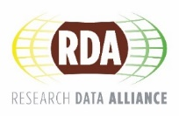
Who is RDA
The Research Data Alliance was launched in March 2013
rd-alliance.org/about-rda
CC BY-SA 4.0

Slide 17
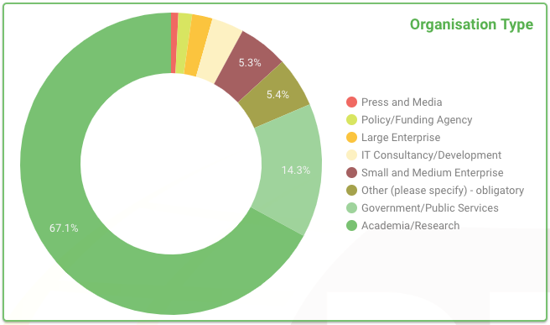
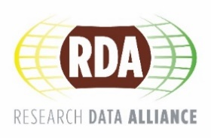
Who is RDA
rd-alliance.org/about-rda
CC BY-SA 4.0

Slide 18
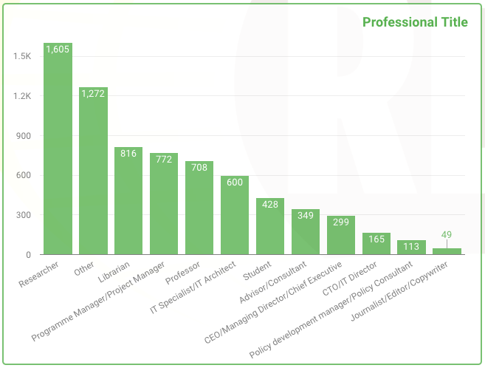
Who is RDA
CC BY-SA 4.0

Slide 19
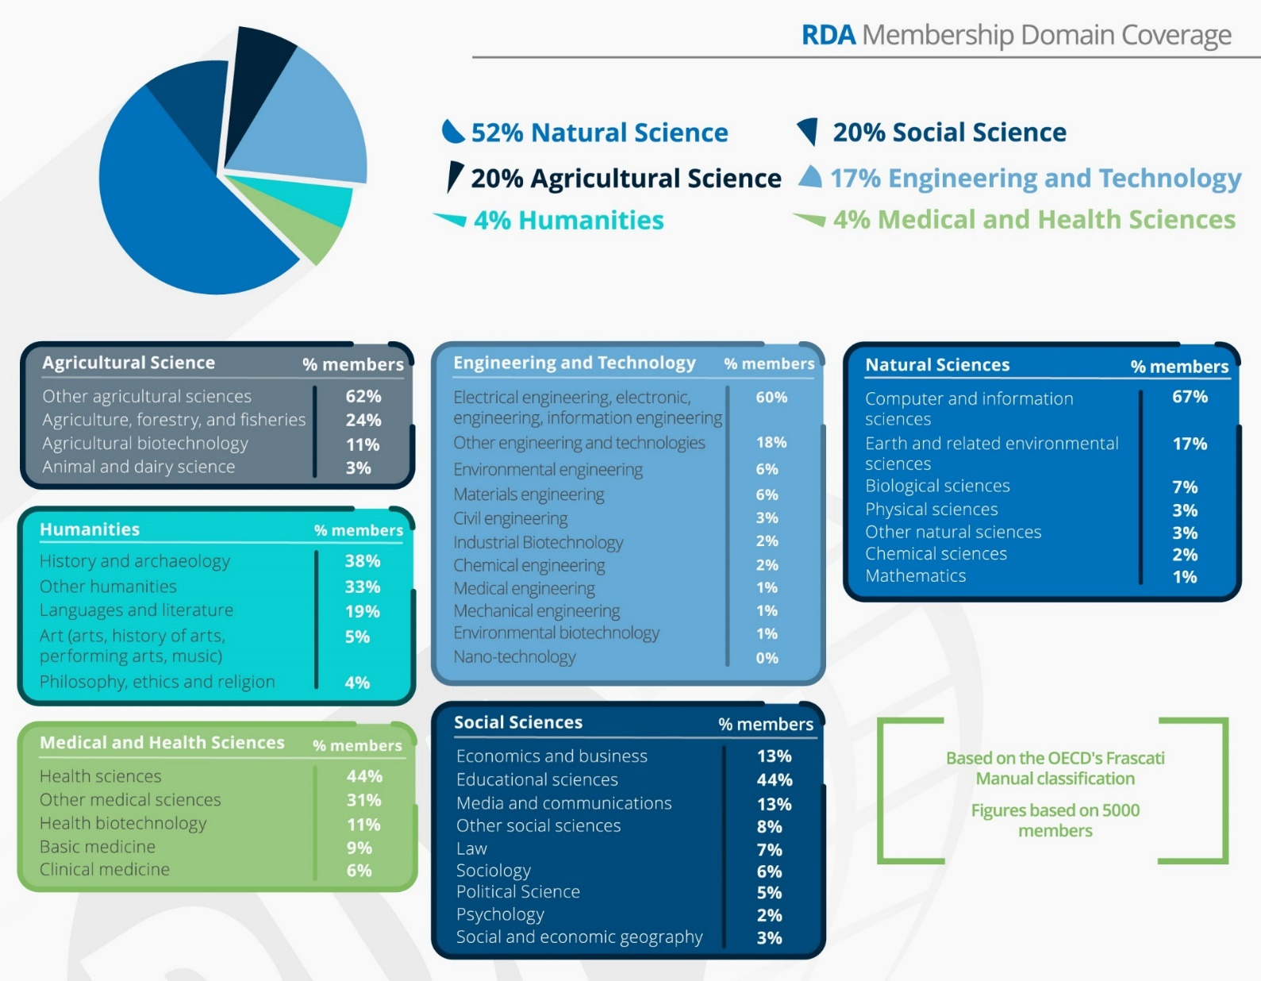
Membership breakdown based on 6 macro & 42 sub domains of Science & Technology classification (OECD Frascati)
Disclaimer: 5,000 member manual classification
CC BY-SA 4.0

Slide 20
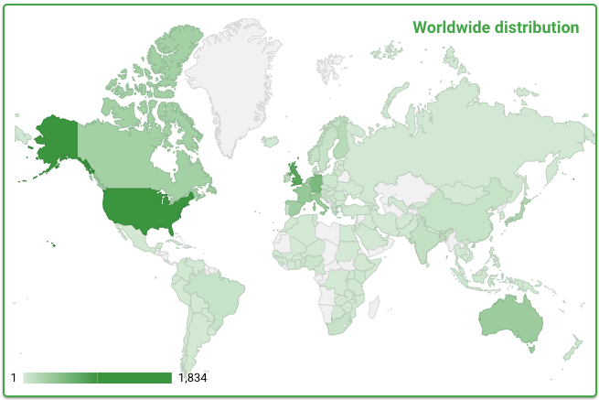
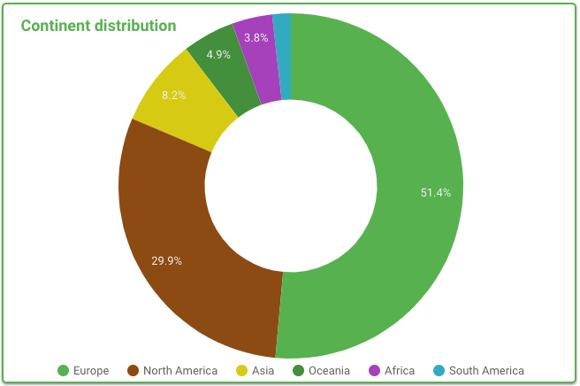
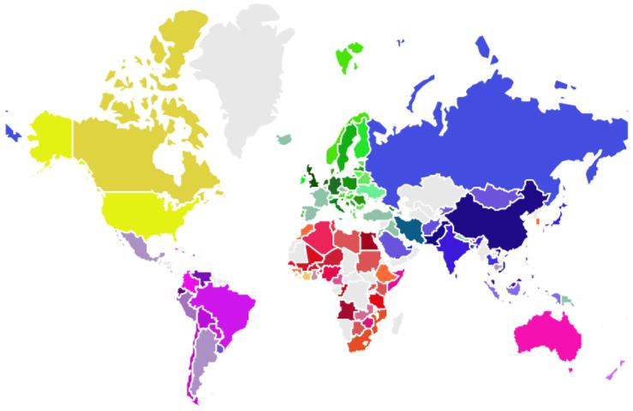
RDA Geographical Distribution
RDA members come from 137 different countries
rd-alliance.org/about-rda
CC BY-SA 4.0

Slide 21
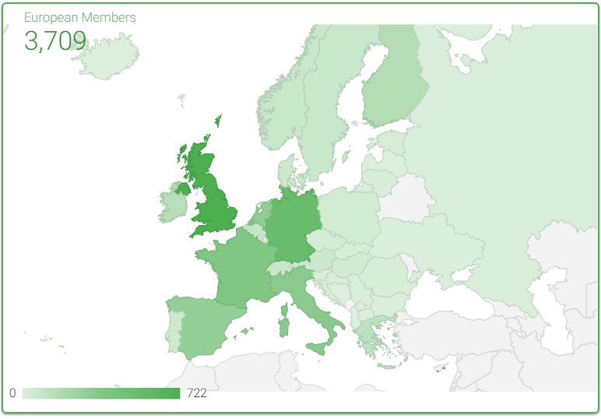
RDA in Europe
RDA members from Europe make up +50% community
rd-alliance.org/about-rda
CC BY-SA 4.0

Slide 22
RDA Working & Interest Groups
Working Groups
develop and implement data infrastructure, e.g. tools, policy, practices & products that are adopted and used by projects, organizations, and communities
TIMING: 12-18 MONTHS
TOTAL: 32 Working Groups
Interest Groups
focus on solving a specific data sharing problem and identifying what kind of infrastructure needs to be built.
TIMING: as long as group is active
TOTAL: 61 Interest Groups
RECOMMENDATIONS: Concrete deliverables - “Running code”, tools, standards, etc.
OUTPUT: Possibly case statements for new WGs, guidelines, communication
https://www.rd-alliance.org/groups
www.rd-alliance.org
@resdatall
CC BY-SA 4.0

Slide 23
RDA active Interest (IG) & Working Groups (WG) by Focus (1)
Total 93 groups:
32 Working Groups & 61 Interest Groups
Domain Science - focused
Agrisemantics WG
BioSharing Registry WG
Blockchain Applications in Health WG
Capacity Development for Agriculture Data WG
Fisheries Data Interoperability WG
On-Farm Data Sharing (OFDS) WG
Rice Data Interoperability WG
Wheat Data Interoperability WG
Agricultural Data IG (IGAD)
Biodiversity Data Integration IG
Chemistry Research Data IG
Digital Practices in History and Ethnography IG
ESIP/RDA Earth, Space, and Environmental Sciences IG
Geospatial IG
Global Water Information IG
Health Data IG
Linguistics Data Interest Group
Mapping the Landscape IG
Marine Data Harmonization IG
Quality of Urban Life IG
RDA/CODATA Materials Data, Infrastructure & Interoperability IG
Research data needs of the Photon and Neutron Science community IG
Small Unmanned Aircraft Systems’ Data IG
Structural Biology IG
Weather, Climate and air quality IG
From Observational Data to Information IG
Partnership Groups
RDA / TDWG Metadata Standards for attribution of physical and digital collections stewardship WG
RDA/WDS Scholarly Link Exchange Working Group
ELIXIR Bridging Force IG
RDA/NISO Privacy Implications of Research Data Sets IG
RDA/WDS Publishing Data IG
rd-alliance.org/groups
CC BY-SA 4.0

Slide 24
RDA active Interest (IG) & Working Groups (WG) by Focus (2)
Total 93 groups:
32 Working Groups & 61 Interest Groups
Reference and Sharing - focused
Data Citation WG
Data Description Registry Interoperability WG
Data Security and Trust WG
Empirical Humanities Metadata WG
International Materials Resource Registries WG
Provenance Patterns WG
Storage Service Definitions WG
Research Data Collections WG
Research Data Repository Interoperability WG
Data Usage Metrics WG
Data Discovery Paradigms IG
National Data Services IG
RDA/CODATA Legal Interoperability IG
Reproducibility IG
Sharing Rewards and Credit (SHARC) IG
Community Needs - focused
RDA/CODATA Summer Schools in Data Science and Cloud Computing in the Developing World WG
Public Health Graph WG
CODATA/RDA Research Data Science Schools for Low and Middle Income Countries
Archives & Records Professionals for Research Data IG Data for Development IG
Development of Cloud Computing Capacity and Education in Developing World Research IG
Early Career and Engagement IG
Education and Training on handling of research data IG
Ethics and Social Aspects of Data IG
International Indigenous Data Sovereignty IG
Open Questionnaire for Research Data Sharing Survey IG
Data for Development IG
rd-alliance.org/groups
CC BY-SA 4.0

Slide 25
RDA active Interest (IG) & Working Groups (WG) by Focus (3)
Total 93 groups:
32 Working Groups & 61 Interest Groups
Data Stewardship and Services – focused
Brokering Framework WG
DMP Common Standards WG
Exposing Data Management Plans WG
WDS/RDA Assessment of Data Fitness for Use WG
Data Versioning WG
Active Data Management Plans IG
Data in Context IG
Data Rescue IG
Domain Repositories IG
Virtual Research Environments IG
Libraries for Research Data IG
Long tail of research data IG
Physical Samples and Collections in the Research Data Ecosystem IG
Preservation e-Infrastructure IG
Preservation Tools, Techniques, and Policies IG
RDA/WDS Certification of Digital Repositories IG
RDA/WDS Publishing Data Cost Recovery for Data Centres IG
Repository Platforms for Research Data IG
Research Data Architectures in Research Institutions IG
Research Data Provenance IG
Data policy standardisation and implementation IG
Base Infrastructure – focused
Array Database Assessment WG
Data Type Registries WG
Metadata Standards Catalog WG
PID Kernel Information WG
Persistent Identification of Instruments WG
Data Fabric IG
Data Foundations and Terminology IG
Disciplinary Interoperability Framework IG
Big Data IG
Brokering IG
Metadata IG
PID IG
Software Source Code IG
Vocabulary Services IG
Federated Identity Management IG
rd-alliance.org/groups
CC BY-SA 4.0

Slide 26
RDA Recommendations that make data work
“Create - Adopt - Use”
Adopted code, policy, specifications, standards, or practices that enable data sharing
“Harvestable” efforts for which 12-18 months of work can eliminate a roadblock
Efforts that have substantive applicability to groups within the data community but may not apply to all
Efforts that can start today
25 flagship recommendations & outputs with over 75 cases of adoption in different domains, organisations and countries
rd-alliance.org/recommendations-outputs
CC BY-SA 4.0

Slide 27
RDA Recommendations & Outputs
Recommendations: are the flagship outputs of RDA. They are RDA’s equivalent of the “specifications” or “standards” that other organisations create and endorse.
Supporting Outputs: are the outputs of RDA WGs and IGs that are fruit of RDA work, but are not necessarily adoptable bridges.
Other Outputs: include workshop reports, published articles, survey results, etc. Anything a WG or IG wants to register and report.
25 RECOMMENDATIONS & OUTPUTS
75+ ADOPTION CASES
rd-alliance.org/recommendations-and-outputs/all-recommendations-and-outputs
CC BY-SA 4.0

Slide 28
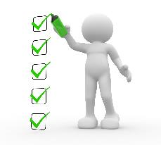
RDA Community Plenary Meetings
organised around the world every 6 months
bringing together a unique community of data science professionals, from multiple disciplines and domains;
move the community forward in creating tangible deliverables that improve data sharing across disciplines, technologies, and countries;
working meetings of RDA Working & Interest groups and new potential groups through Birds of a Feather meetings
presentation of new Outputs and Adoption cases
rd-alliance.org/plenaries
CC BY-SA 4.0

Slide 29
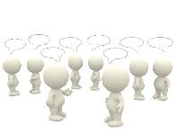
RDA Plenary Meetings: benefits of attending
Exchange knowledge, share discoveries, discuss barriers and potential solutions
Learn about new trends, strategies, research developments, directions and policies
Expand your network and meet new committed and passionate data science professionals, working in multiple disciplines
Contribute to acceleration of data infrastructure development
rd-alliance.org/plenaries
CC BY-SA 4.0

Slide 30
Digital Frontiers of Global Science
To find out more visit:
https://www.rd-alliance.org/plenaries/rda-twelfth-plenary-meeting-part-international-data-week-2018-gaborone-botswana
rd-alliance.org/plenaries
CC BY-SA 4.0

Slide 31
RDA EU Expert & Early Career OPEN CALLS for grants to support EUROPEAN participation to 12th Plenary meeting
Students and early career professionals
Apply for one of 7 grants of maximum €1750
https://grants.rd-alliance.org/OpenCalls/call-early-careers
Mid-career or senior data professional or scientist
Apply for one of 5 grants of maximum €1800
https://grants.rd-alliance.org/OpenCalls/call-experts
Digital Frontiers of Global Science
Deadline 30 august 2018, 17:00 CEST
CC BY-SA 4.0

Slide 32
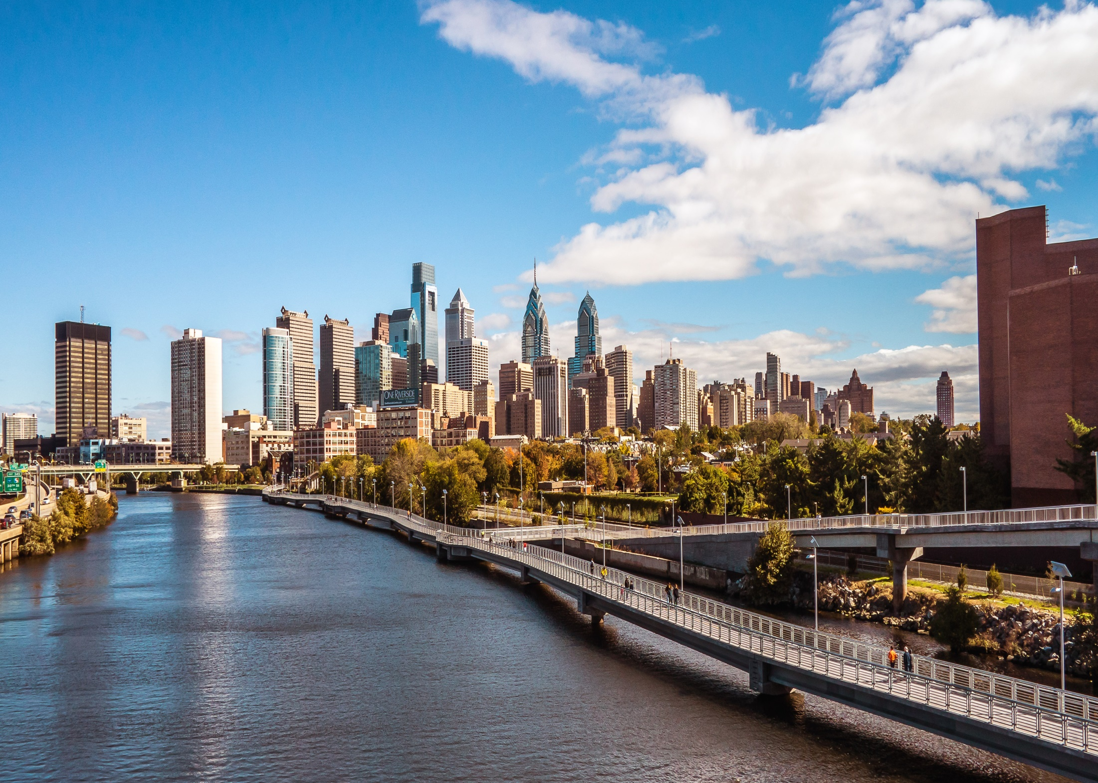
RDA’s 13th Plenary Meeting
Philadelphia, Pennsylvania
2- 4 April 2019
https://rd-alliance.org/plenaries/rda-thirteenth-plenary-meeting-philadelphia-us
rd-alliance.org/plenaries
CC BY-SA 4.0

Slide 33
Call to Action
Sign up as an RDA Community Member
Join Working & Interest Groups
Join National Group – RDA in …..
Attend an RDA Plenary Meeting
Set up an Interest / Working group
Adopt an RDA Recommendation or Output
rd-alliance.org/plenaries
CC BY-SA 4.0

Slide 34
The Research Data Alliance is … an enabling organisation offering a global, open, neutral, experienced and independent forum to interact and build state-of-the-art data solutions with data professionals, scientists, ICT experts and academics from around the world.
CC BY-SA 4.0

Slide 35
The Research Data Alliance is building global bridges and connections. The Research Data Alliance is YOU
CC BY-SA 4.0

Slide 36
RDA @ GridKA School 2018 29 August 2018 Karlsruhe, Germany www.rd-alliance.org/ @resdatall
RDA Global
Email - enquiries@rd-alliance.org
Web - www.rd-alliance.org
Twitter - @resdatall
LinkedIn - www.linkedin.com/in/ResearchDataAlliance
Slideshare - http://www.slideshare.net/ResearchDataAlliance
Hilary Hanahoe, Secretary General
Email – hilary.hanahoe@gmail.com
Twitter - @hilaryhanahoe

